Slide 1
NumPy 2
Thomas Schwarz, SJ

Slide 2
Free ebook
https://riptutorial.com/ebook/numpy

Slide 3
NumPy Operations
Numpy allows fast operations on array elements
We can simply add, subtract, multiply or divide by a scalar
>>> vector = np.arange(20).reshape(4,5)
>>> vector
array([[ 0, 1, 2, 3, 4],
[ 5, 6, 7, 8, 9],
[10, 11, 12, 13, 14],
[15, 16, 17, 18, 19]])
>>> vector += 1
>>> vector
array([[ 1, 2, 3, 4, 5],
[ 6, 7, 8, 9, 10],
[11, 12, 13, 14, 15],
[16, 17, 18, 19, 20]])

Slide 4
NumPy Operations
Numpy also allows operations between arrays
>>> mat = np.random.normal(0,1,(4,5))
>>> mat
array([[ 0.04646031, -1.32970787, 1.16764921, -0.48342653, 0.42295389],
[ 0.70547825, 1.51980589, 1.46902433, -0.46742839, 1.42472386],
[ 0.78756679, -0.39975927, 1.24411043, -0.67336526, -0.92416835],
[ 0.4708628 , -0.29419976, -0.58634161, 0.29038393, -0.78814955]])
>>> vector + mat
array([[ 1.04646031, 0.67029213, 4.16764921, 3.51657347, 5.42295389],
[ 6.70547825, 8.51980589, 9.46902433, 8.53257161, 11.42472386],
[11.78756679, 11.60024073, 14.24411043, 13.32663474, 14.07583165],
[16.4708628 , 16.70580024, 17.41365839, 19.29038393, 19.21185045]])

Slide 5
NumPy Operations
What happens if there is an error?
Python would throw an exception, but not so NumPy
Example: Create two vectors, one with a zero
If we divide, we get a warning
But the result exists, with an inf value for infinity
>>> vector = np.arange(5)
>>> vector2 = np.arange(2,7)
>>> vec = vector2/vector
Warning (from warnings module):
File "<pyshell#11>", line 1
RuntimeWarning: divide by zero encountered in true_divide
>>> vec
array([ inf, 3. , 2. , 1.66666667, 1.5 ])

Slide 6
NumPy Operations
If we divide 0 by 0, we get an nan -- not a value
>>> vec=np.arange(4)
>>> vec
array([0, 1, 2, 3])
>>> vec/vec
Warning (from warnings module):
File "<pyshell#15>", line 1
RuntimeWarning: invalid value encountered in true_divide
array([nan, 1., 1., 1.])

Slide 7
NumPy Operations
There are rules for how to define operations with nan and inf, that make intuitive sense
IEEE Standard for Binary Floating-Point Arithmetic (IEEE 754)
We can create inf directly by saying np.inf
Example: Infinity divided by infinity is not defined
>>> np.inf/np.inf
nan

Slide 8
Operations between Vectors and Matrices
Adding two vectors:
>>> v1 = np.array([1,2,3])
>>> v2 = np.array([5,4,3])
>>> v1 + v2
array([6, 6, 6])

Slide 9
Operations between Vectors and Matrices
Adding two matrices
>>> m1 = np.array([[1,2,3],[4,5,6],[9,10,0]])
>>> m1
array([[ 1, 2, 3],
[ 4, 5, 6],
[ 9, 10, 0]])
>>> m2 = np.array([[4,2,0],[7,3,1],[5,1,2]])
>>> m2
array([[4, 2, 0],
[7, 3, 1],
[5, 1, 2]])
>>> m1+m2
array([[ 5, 4, 3],
[11, 8, 7],
[14, 11, 2]])

Slide 10
Operations between Vectors and Matrices
Scalar multiplication
>>> v = np.array([5,3,-2,4])
>>> 5*v
array([ 25, 15, -10, 20])

Slide 11
Operations between Vectors and Matrices
Scalar multiplication
>>> m1
array([[ 1, 2, 3],
[ 4, 5, 6],
[ 9, 10, 0]])
>>> 3*m1
array([[ 3, 6, 9],
[12, 15, 18],
[27, 30, 0]])

Slide 12
Operations between Vectors and Matrices
Element-wise multiplication is not matrix multiplication
>>> m1
array([[ 1, 2, 3],
[ 4, 5, 6],
[ 9, 10, 0]])
>>> m2
array([[4, 2, 0],
[7, 3, 1],
[5, 1, 2]])
>>> m1*m2
array([[ 4, 4, 0],
[28, 15, 6],
[45, 10, 0]])

Slide 13
Operations between Vectors and Matrices
Matrix multiplication uses the (new) @ operator
Python 3.5 and later
>>> m1
array([[ 1, 2, 3],
[ 4, 5, 6],
[ 9, 10, 0]])
>>> m2
array([[4, 2, 0],
[7, 3, 1],
[5, 1, 2]])
>>> m1@m2
array([[ 33, 11, 8],
[ 81, 29, 17],
[106, 48, 10]])

Slide 14
Operations between Vectors and Matrices
Can be used to multiply matrix and vector
Notice that the vector is in row form
$$\left(\begin{matrix}2 & 3 \\ 1 & -1\end{matrix}\right)⋅\left(\begin{matrix}1, & 2\end{matrix}\right)=\left(\begin{matrix}8, & -1\end{matrix}\right)$$
Follows usage of matlab and Mathematica
>>> m = np.array([[2,3],[1,-1]])
>>> v = np.array([1,2])
>>> m@v
array([ 8, -1])

Slide 15
Operations between Vectors and Matrices
Transpose with np.transpose or the .T operator
>>> m
array([[ 2, 3],
[ 1, -1]])
>>> m.T
array([[ 2, 1],
[ 3, -1]])

Slide 16
Operations between Vectors and Matrices
Thus, could have used
>>> m@ v.T
array([ 8, -1])

Slide 17
Operations between Vectors and Matrices
We can use this to make a linear transform of a data set
def transform(matrix, dataset):
return (matrix@ dataset.T).T
mat = np.array([[.1, .2, .3, .4],
[.2, .2, .3, .4],
[.1, -.1, .2, 3],
[3, 2, 1, -2]
])
print(transform(mat, iris))

Slide 18
Operations between Vectors and Matrices
Dot-product of two vectors:
v = np.array([1, 2, 3, 4, 5])
>>> v@v.T
55
>>> np.vdot(v,v)55

Slide 19
Operations between Vectors and Matrices
Can use linear algebra package in numpy
numpy.linalg
$${\left(\begin{matrix}1 & 2 \\ 1 & -1\end{matrix}\right)}^{10}=\left(\begin{matrix}243 & 0 \\ 0 & 243\end{matrix}\right)$$
np.linalg.matrix_power(np.array([[1,2],[1,-1]]),10)
array([[243, 0],
[ 0, 243]])

Slide 20
Operations between Vectors and Matrices
Can calculate matrix inverses
Throws LinAlgError if singular
>>> np.linalg.inv( np.array([1,-2],[-2,4]) )
Traceback (most recent call last):
…
numpy.linalg.LinAlgError: Singular matrix

Slide 21
Operations between Vectors and Matrices
Can directly solve linear equations
Solving $x+2y=2,x-y=3$
With solution $x=8/9,y=-1/3$
Gives an error if matrix is not square or singular
>>> np.linalg.solve( np.array([[1,2],[1,-1]]) ,
np.array([2,3]) )
array([ 2.66666667, -0.33333333])

Slide 22
NumPy:
Universal Array Functions
There is a plethora of functions that can be applied to a numpy array.
These are much faster than the corresponding Python functions
You can find a list in the numpy u-function manual
https://docs.scipy.org/doc/numpy/reference/ufuncs.html

Slide 23
NumPy:
Universal Array Functions
There are universal functions around which the operations are wrapped
np.add, np.subtract, np.negative, np.multiply, np.divide, np.floor_divide, np.power, np.mod
The absolute function is
abs
np.absolute

Slide 24
NumPy:
Universal Array Functions
Trigonometric functions
np.sin, np.cos, np.tan, np.arcsin, np.arccos, np.arctan
Exponents and logarithms
np.log, np.log2 (base 2), np.log10 (base 10)
np.expm1 (more exact for small arguments)
np.log1p (more exact for small arguments)

Slide 25
NumPy:
Universal Array Functions
Special u-functions:
In addition, the submodule scipy.special contains many more specialized functions

Slide 26
NumPy:
Universal Array Functions
Avoid creating temporary arrays
If they are large, too much time spent on moving data
Specify the array using the 'out' parameter
>>> y = np.empty(10)
>>> x = np.arange(1,11)
>>> np.exp(x, out = y)
array([2.71828183e+00, 7.38905610e+00, 2.00855369e+01, 5.45981500e+01,
1.48413159e+02, 4.03428793e+02, 1.09663316e+03, 2.98095799e+03,
8.10308393e+03, 2.20264658e+04])
>>> y
array([2.71828183e+00, 7.38905610e+00, 2.00855369e+01, 5.45981500e+01,
1.48413159e+02, 4.03428793e+02, 1.09663316e+03, 2.98095799e+03,
8.10308393e+03, 2.20264658e+04])

Slide 27
NumPy:
Universal Array Functions
Can use np.min, np.max, sum
Use np.argmin, np.argmax to find the index of the maximum / minimum element
Can use np.mean, np.std, np.var, np.median, mp.percentile to get statistics
Not the only way, see the scipy module

Slide 28
NumPy: Broadcasting
Operations can be also made between arrays of different sizes
Example 1: adding a scalar (zero-dimensional) to a vector
>>> x = np.full(5,1)
>>> x+1
array([2, 2, 2, 2, 2])

Slide 29
NumPy: Broadcasting
Adding a vector to a matrix:
Create a matrix
Create a vector
Add them together: The vector has been broadcast to a 2 by 5 matrix by doubling the single row
>>> matrix = np.arange(1,11).reshape((2,5))
>>> matrix
array([[ 1, 2, 3, 4, 5],
[ 6, 7, 8, 9, 10]])
>>> x = np.arange(1,6)
>>> x
array([1, 2, 3, 4, 5])
>>> matrix+x
array([[ 2, 4, 6, 8, 10],
[ 7, 9, 11, 13, 15]])

Slide 30
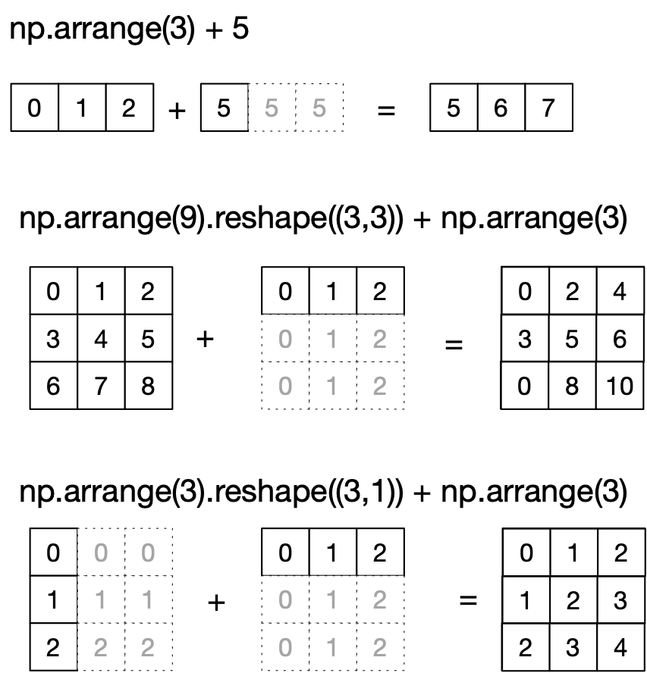
NumPy: Broadcasting
The broadcast rules: Expand a single coordinate in a dimension in one operand to the value in the other

Slide 31
NumPy: Broadcasting
Rule 1: If the two arrays differ in their number of dimensions, the shape of the one with fewer dimensions is padded with ones on its leading site
Rule 2: If the shape of two arrays does not match in any dimension, the array with shape equal to 1 in that dimension is stretched to match the other shape
Rule 3: If in any dimensions the sizes disagree and neither is equal to 1, an error is raised

Slide 32
Neat Example
We combine broadcasting with mathplotlib
Using IDLE, we need to call the show function at the end.

Slide 33
NumPy: Broadcasting
Create a row and a column vector x and y
Then use broadcasting to combine them for something two-dimensional
This will get displayed
import matplotlib.pyplot as plt
def prob7():
x = np.linspace(0,5,51)
y = np.linspace(0,5,51).reshape(51,1)
z = np.sin(x)**5+np.cos(10+x*y)
plt.imshow(z, origin='lower', extent=[0, 5, 0, 5],
cmap='viridis')
plt.colorbar()
plt.show()

Slide 34
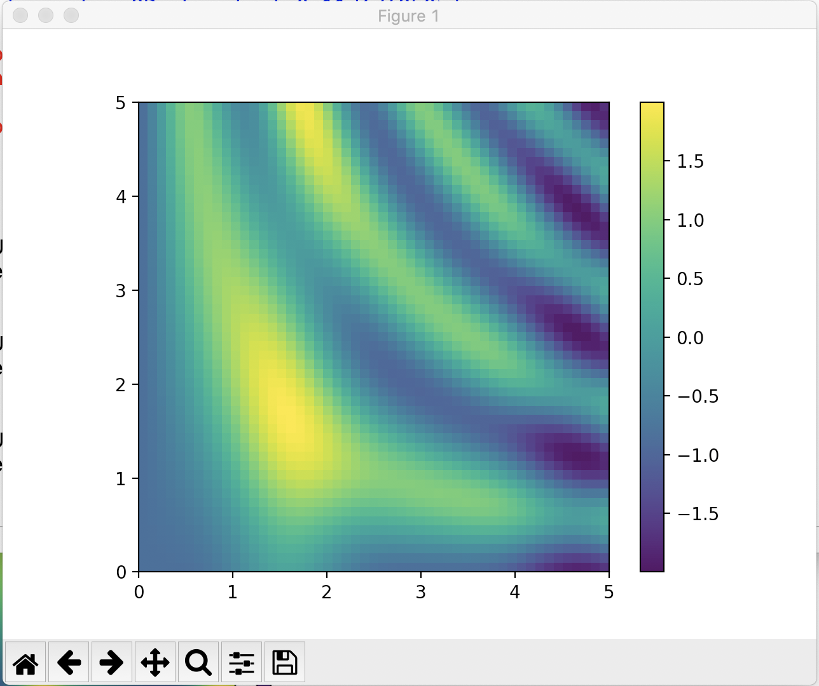
NumPy: Broadcasting

Slide 35
NumPy: Fancy Indexing
Fancy indexing:
Use an array of indices in order to access a number of array elements at once

Slide 36
NumPy: Fancy Indexing
Example:
Create matrix
Fancy Indexing:
>>> mat = np.random.randint(0,10,(3,5))
>>> mat
array([[3, 2, 3, 3, 0],
[9, 5, 8, 3, 4],
[7, 5, 2, 4, 6]])
>>> mat[(1,2),(2,3)]
array([8, 4])

Slide 37
NumPy: Fancy Indexing
Application:
Creating a sample of a number of points
Create a large random array representing data points
Select the x and y coordinates by slicing
>>> mat = np.random.normal(100,20, (200,2))
>>> x=mat[:,0]
>>> y=mat[:,1]

Slide 38
NumPy: Fancy Indexing
Create a matplotlib figure with a plot inside it
>>> fig = plt.figure()
>>> ax = fig.add_subplot(1,1,1)
>>> ax.scatter(x,y)
>>> plt.show()

Slide 39
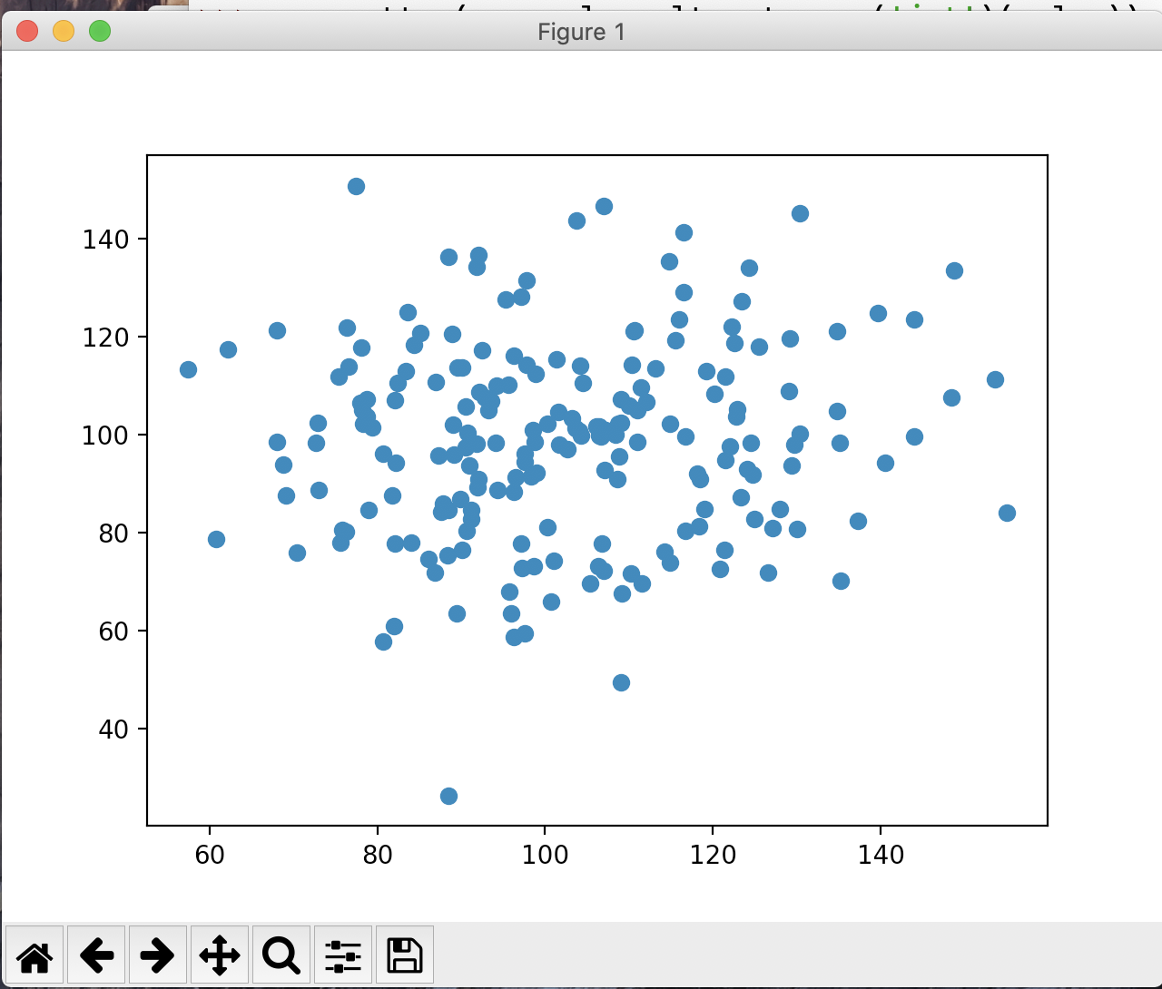
NumPy: Fancy Indexing

Slide 40
NumPy: Fancy Indexing
Create a list of potential indices
Use fancy indexing to create the subset of points
>>> indices = np.random.choice(np.arange(0,200,1),10)
>>> indices
array([ 32, 93, 172, 134, 90, 66, 109, 158, 188, 30])
>>> subset = mat[indices]

Slide 41
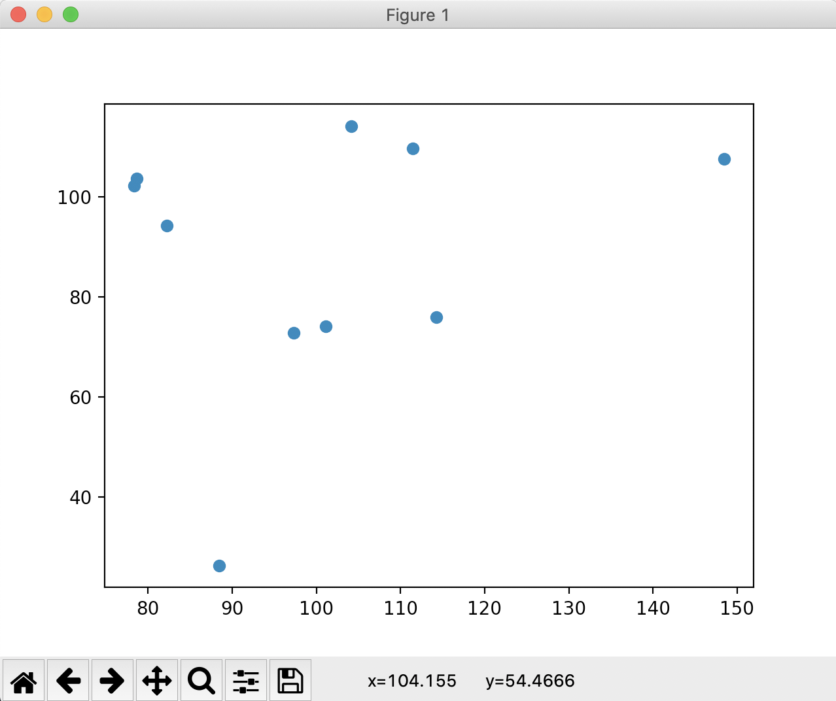
NumPy: Fancy Indexing

Slide 42
Simple Stats
Recall iris data set
After normalization
>>> iris
array([[0.22222222, 0.625 , 0.06779661, 0.04166667],
[0.16666667, 0.41666667, 0.06779661, 0.04166667],
[0.11111111, 0.5 , 0.05084746, 0.04166667],
[0.08333333, 0.45833333, 0.08474576, 0.04166667],
[0.19444444, 0.66666667, 0.06779661, 0.04166667],
[0.30555556, 0.79166667, 0.11864407, 0.125 ],
[0.08333333, 0.58333333, 0.06779661, 0.08333333],
[0.19444444, 0.58333333, 0.08474576, 0.04166667],
[0.02777778, 0.375 , 0.06779661, 0.04166667],

Slide 43
Simple Stats
Calculate average along of all values
Much more important: calculate average along an axis
>>> np.mean(iris)
0.4483046924042686
>>> np.mean(iris, axis=0)
array([0.4287037 , 0.43916667, 0.46757062, 0.45777778])

Slide 44
Simple Stats
Simularly: np.min, np.max, np.median
With version in case nan (not a value) is present
Example: Normalizing the iris data set
def normalize(array):
maxs = np.max(array, axis = 0)
mins = np.min(array, axis = 0)
return (array-mins)/(maxs-mins)

Slide 45
Simple Stats
Or normalize to have mean 0 and standard deviation 1
def normalizeS(array):
means = np.mean(array, axis = 0)
stdevs = np.std(array, axis = 0)
return (array - means)/stdevs

Slide 46
Simple Stats
Can determine percentiles and quantiles
>>> iris[:5,:]
array([[5.1, 3.5, 1.4, 0.2],
[4.9, 3. , 1.4, 0.2],
[4.7, 3.2, 1.3, 0.2],
[4.6, 3.1, 1.5, 0.2],
[5. , 3.6, 1.4, 0.2]])
])
>>> np.percentile(iris, 5, axis=0)
array([4.6 , 2.345, 1.3 , 0.2 ])
np.percentile(iris, 95, axis=0)
array([7.255, 3.8 , 6.1 , 2.3 ])

Slide 47
Broadcast Application
Getting the difference matrix of a vector$\left(\begin{matrix}v_{0}, & v_{1}, & ,…, & v_{n-1}\end{matrix}\right)$
$$\left(\begin{matrix}v_{0}-v_{0} & v_{0}-v_{1} & … & v_{0}-v_{n-1} \\ v_{1}-v_{0} & v_{1}-v_{1} & … & v_{1}-v_{n-1} \\ ⋮ & ⋮ & ⋱ & ⋮ \\ v_{n-1}-v_{0} & v_{n-1}-v_{1} & … & v_{n-1}-v_{n-1}\end{matrix}\right)$$

Slide 48
Broadcast Application
Because of broadcast rules, this will not work
>>> v = np.array([1,2,3,4,5,6,7])
>>> v - v.T
array([0, 0, 0, 0, 0, 0, 0])

Slide 49
Broadcast Application
But we can embed the vector into a two-dimensional vector in two different ways
>>> v[None,:]
array([[1, 2, 3, 4, 5, 6, 7]])
>>> v[:,None]
array([[1],
[2],
[3],
[4],
[5],
[6],
[7]])

Slide 50
Broadcast Application
Now we can use broadcasting
>>> v[:,None]-v[None,:]
array([[ 0, -1, -2, -3, -4, -5, -6],
[ 1, 0, -1, -2, -3, -4, -5],
[ 2, 1, 0, -1, -2, -3, -4],
[ 3, 2, 1, 0, -1, -2, -3],
[ 4, 3, 2, 1, 0, -1, -2],
[ 5, 4, 3, 2, 1, 0, -1],
[ 6, 5, 4, 3, 2, 1, 0]])

Slide 51
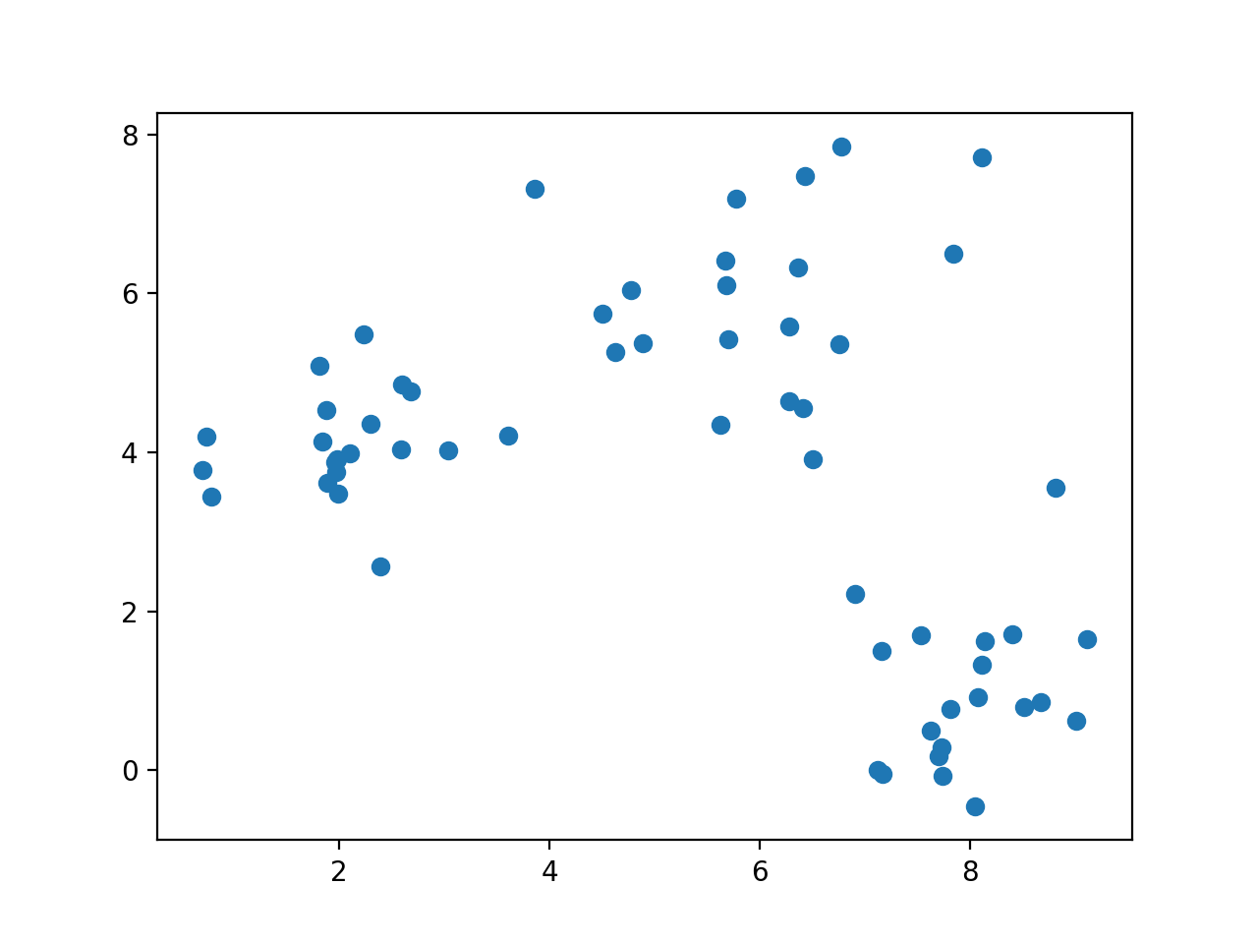
k-means clustering
Given a set of data, can we cluster it even if we do not know its structure?

Slide 52
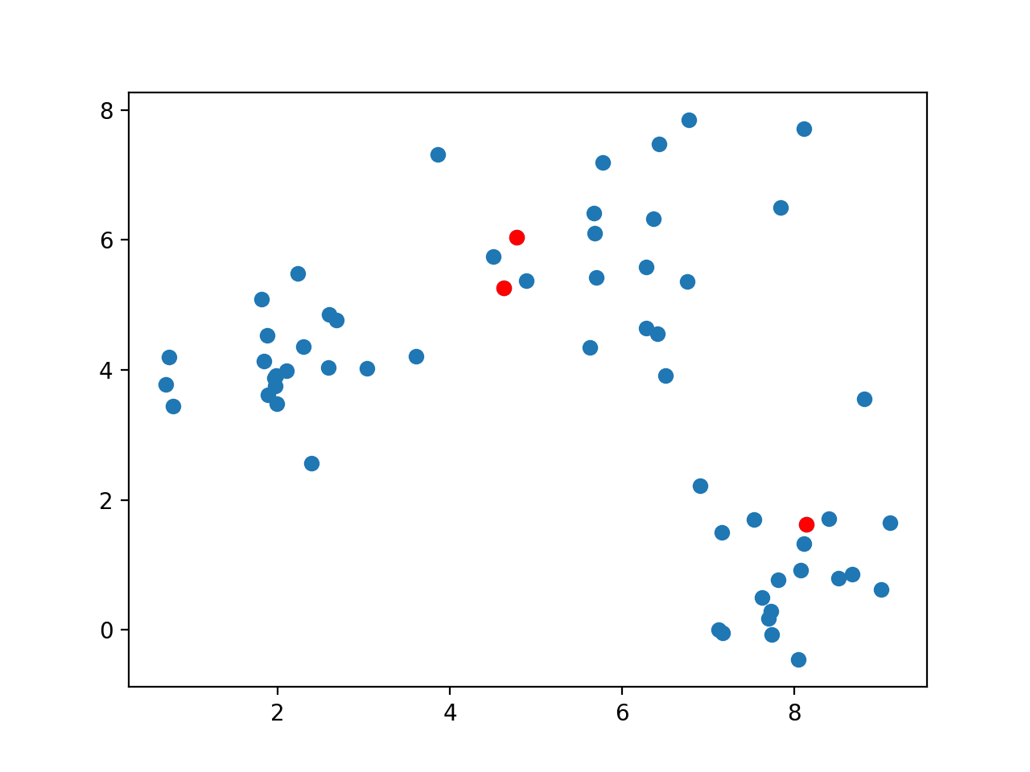
k-means clustering
Guess a number of clusters and pick k arbitrary points

Slide 53
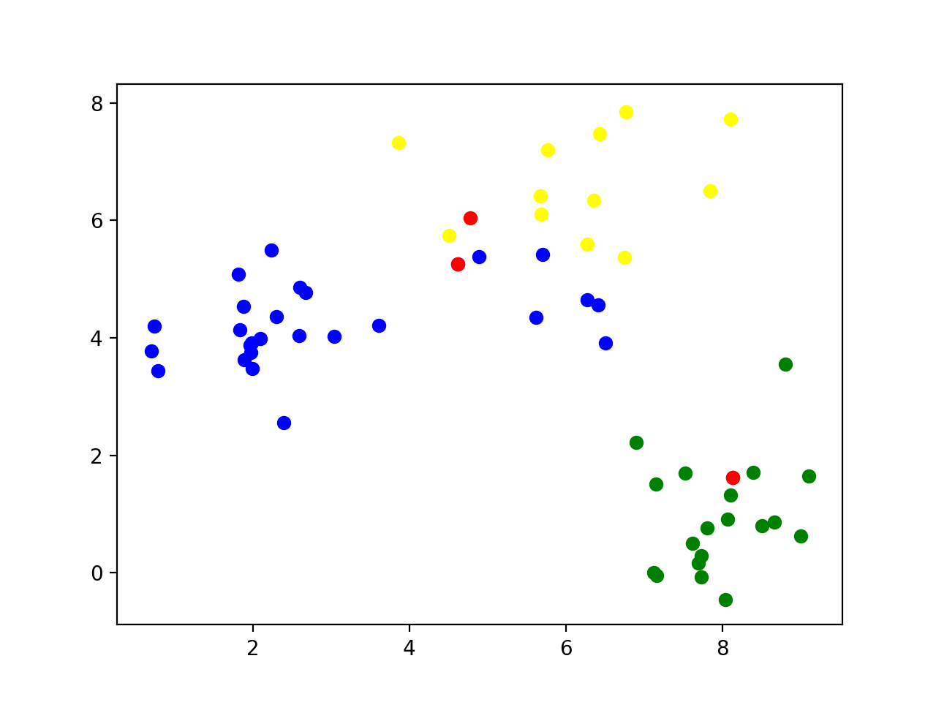
k-means clustering
Classify all points according to which of the points they are closest

Slide 54
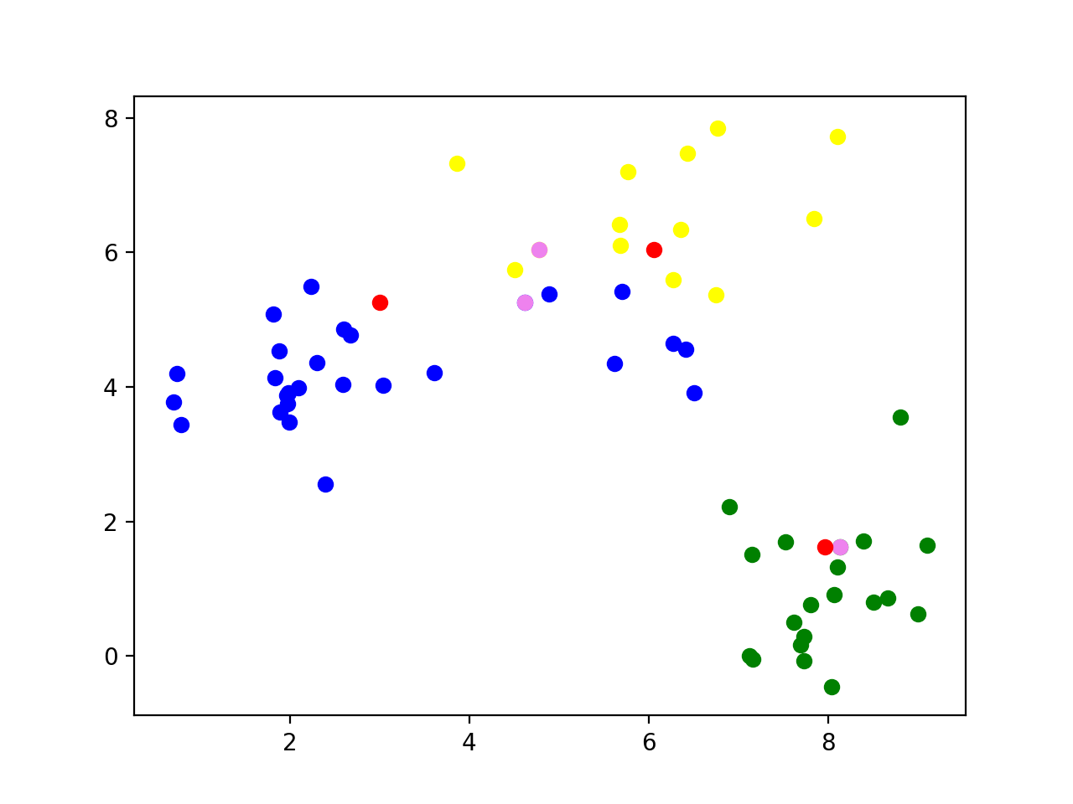
k-means clustering
Calculate the mean of all the data points and set it as the new center

Slide 55
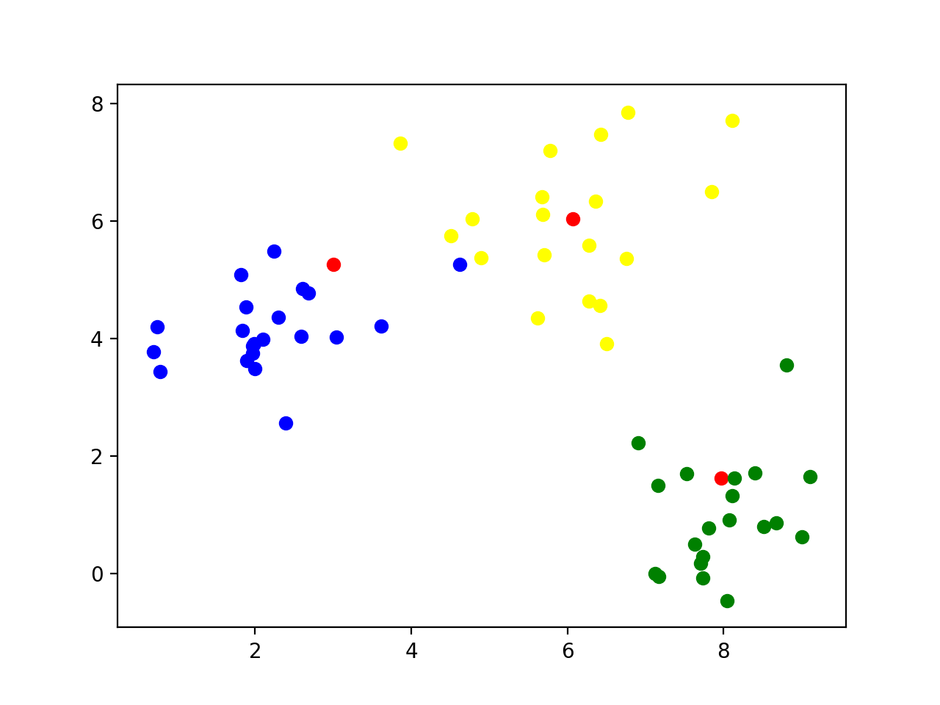
k-means clustering
Reclassify all the points according to their closeness to the new centers

Slide 56
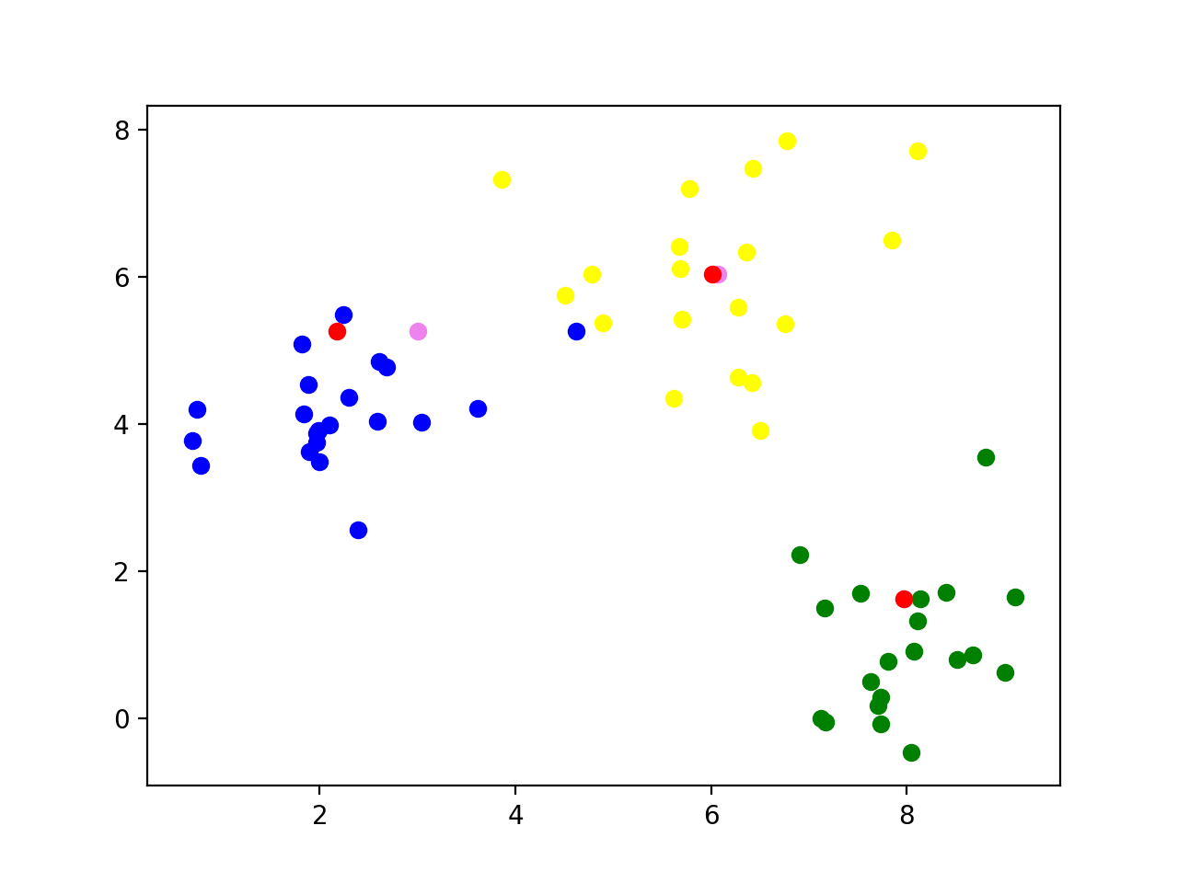
k-means clustering
Now calculate the new centers of the groups

Slide 57
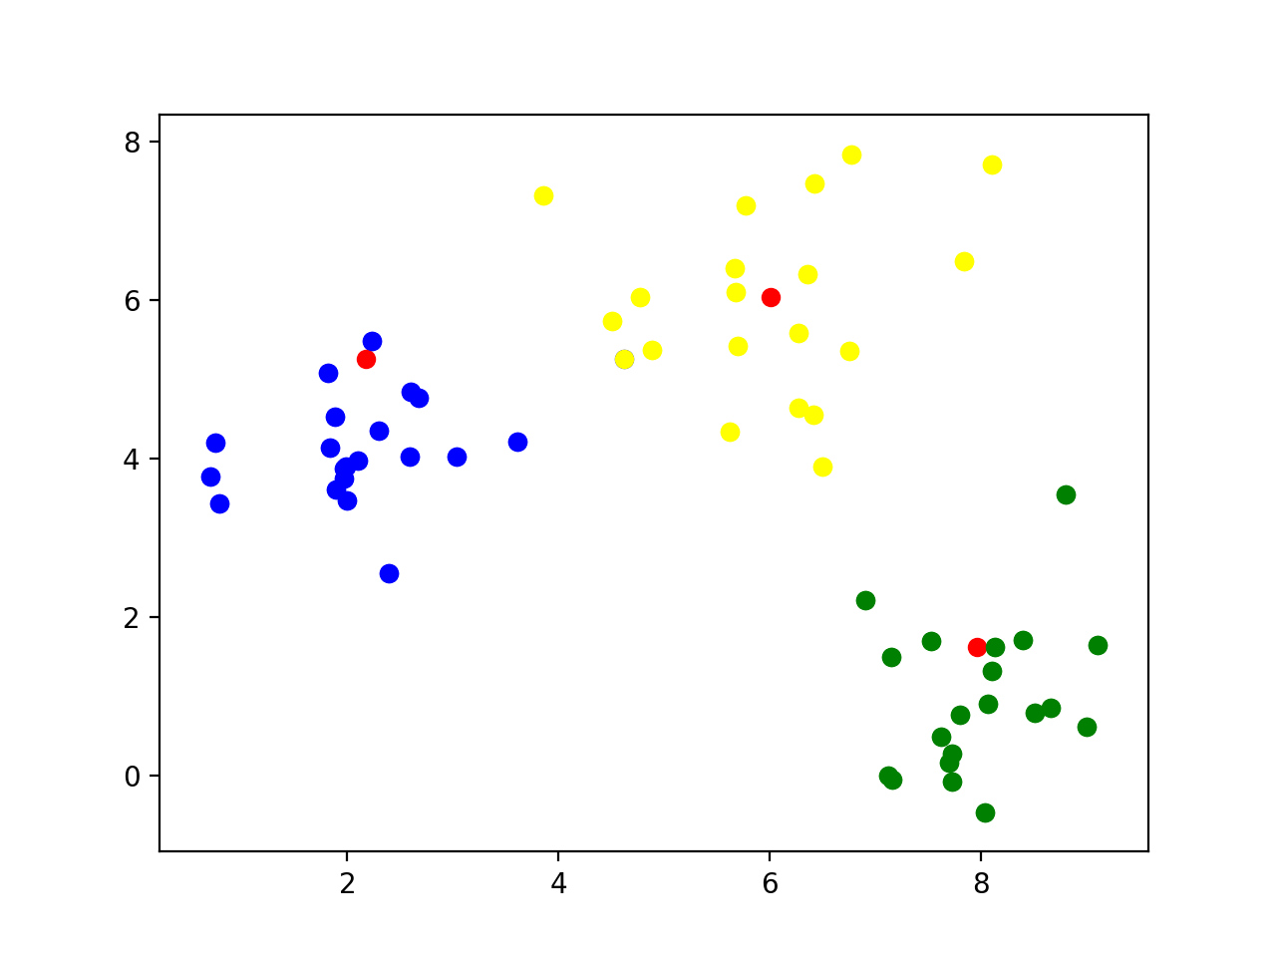
k-means clustering
Repeat: Classify according to closeness to the new centers

Slide 58
k-means clustering
Continue
The centers no longer move when points are no longer moved between different categories

Slide 59
k-means clustering
Implementation
Find starting points by random selection
def cluster(data, k, limit):
centers = data[ np.random.choice(np.arange(data.shape[0]), k, replace=False),: ]
for _ in range(limit):
distances = ((data[:,:,None] - centers.T[None, :, :])**2).sum(axis=1)
classification = np.argmin( distances, axis=1)
new_centers = np.array([data[classification==j,:].mean(axis=0) for j in range(k)])
if np.max(np.abs(new_centers - centers)) < 0.01:
break
else:
centers = new_centers
else: #loop did not end
print('No convergence')
return centers

Slide 60
k-means clustering
Enter a limited loop:
def cluster(data, k, limit):
centers = data[ np.random.choice(np.arange(data.shape[0]), k, replace=False),: ]
for _ in range(limit):
distances = ((data[:,:,None] - centers.T[None, :, :])**2).sum(axis=1)
classification = np.argmin( distances, axis=1)
new_centers = np.array([data[classification==j,:].mean(axis=0) for j in range(k)])
if np.max(np.abs(new_centers - centers)) < 0.01:
break
else:
centers = new_centers
else: #loop did not end
print('No convergence')
return centers

Slide 61
Use the previous trick to calculate the difference between all points and the centers
def cluster(data, k, limit):
centers = data[ np.random.choice(np.arange(data.shape[0]), k, replace=False),: ]
for _ in range(limit):
distances = ((data[:,:,None] - centers.T[None, :, :])**2).sum(axis=1)
classification = np.argmin( distances, axis=1)
new_centers = np.array([data[classification==j,:].mean(axis=0) for j in range(k)])
if np.max(np.abs(new_centers - centers)) < 0.01:
break
else:
centers = new_centers
else: #loop did not end
print('No convergence')
return centers

Slide 62
For each point, find the closest distance
def cluster(data, k, limit):
centers = data[ np.random.choice(np.arange(data.shape[0]), k, replace=False),: ]
for _ in range(limit):
distances = ((data[:,:,None] - centers.T[None, :, :])**2).sum(axis=1)
classification = np.argmin( distances, axis=1)
new_centers = np.array([data[classification==j,:].mean(axis=0) for j in range(k)])
if np.max(np.abs(new_centers - centers)) < 0.01:
break
else:
centers = new_centers
else: #loop did not end
print('No convergence')
return centers

Slide 63
The new centers are obtained by taking the mean of the points with a given classification
def cluster(data, k, limit):
centers = data[ np.random.choice(np.arange(data.shape[0]), k, replace=False),: ]
for _ in range(limit):
distances = ((data[:,:,None] - centers.T[None, :, :])**2).sum(axis=1)
classification = np.argmin( distances, axis=1)
new_centers = np.array([data[classification==j,:].mean(axis=0) for j in range(k)])
if np.max(np.abs(new_centers - centers)) < 0.01:
break
else:
centers = new_centers
else: #loop did not end
print('No convergence')
return centers

Slide 64
If the centers do not move, we are done
def cluster(data, k, limit):
centers = data[ np.random.choice(np.arange(data.shape[0]), k, replace=False),: ]
for _ in range(limit):
distances = ((data[:,:,None] - centers.T[None, :, :])**2).sum(axis=1)
classification = np.argmin( distances, axis=1)
new_centers = np.array([data[classification==j,:].mean(axis=0) for j in range(k)])
if np.max(np.abs(new_centers - centers)) < 0.01:
break
else:
centers = new_centers
else: #loop did not end
print('No convergence')
return centers

Slide 65
Possible to not have convergence
For production quality code: consider raising an exception
def cluster(data, k, limit):
centers = data[ np.random.choice(np.arange(data.shape[0]), k, replace=False),: ]
for _ in range(limit):
distances = ((data[:,:,None] - centers.T[None, :, :])**2).sum(axis=1)
classification = np.argmin( distances, axis=1)
new_centers = np.array([data[classification==j,:].mean(axis=0) for j in range(k)])
if np.max(np.abs(new_centers - centers)) < 0.01:
break
else:
centers = new_centers
else: #loop did not end
print('No convergence')
return centers

Slide 66
The loop stabilized, we are done
def cluster(data, k, limit):
centers = data[ np.random.choice(np.arange(data.shape[0]), k, replace=False),: ]
for _ in range(limit):
distances = ((data[:,:,None] - centers.T[None, :, :])**2).sum(axis=1)
classification = np.argmin( distances, axis=1)
new_centers = np.array([data[classification==j,:].mean(axis=0) for j in range(k)])
if np.max(np.abs(new_centers - centers)) < 0.01:
break
else:
centers = new_centers
else: #loop did not end
print('No convergence')
return centers

Slide 67
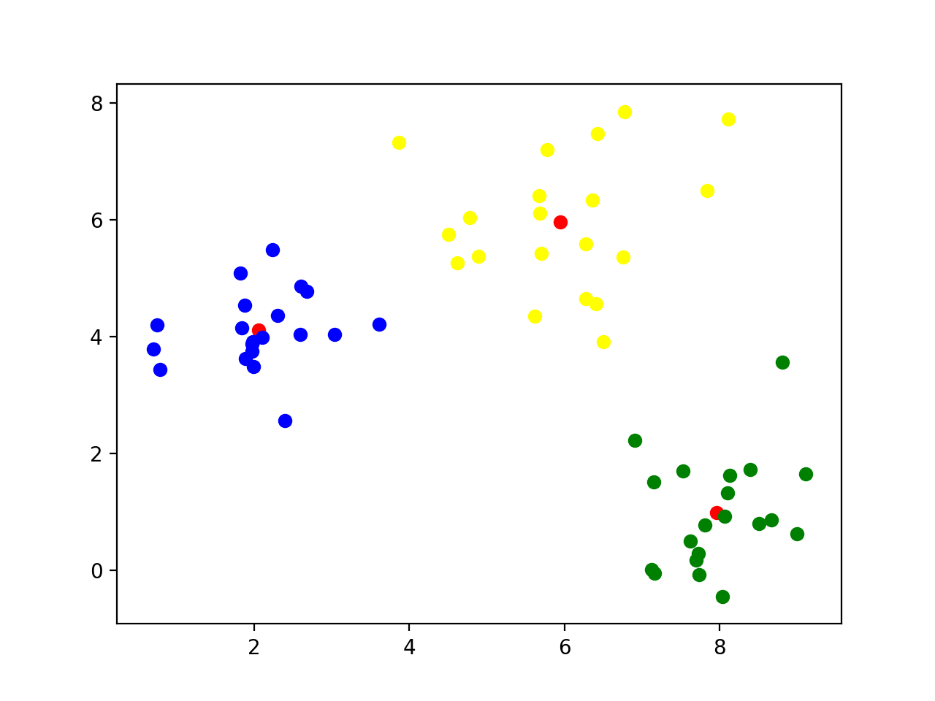
k-means clustering
Final result

Slide 68
k-means clustering
This worked because I used normalvariate to generate points around (2,4), (8,1), and (6,6)

Slide 69
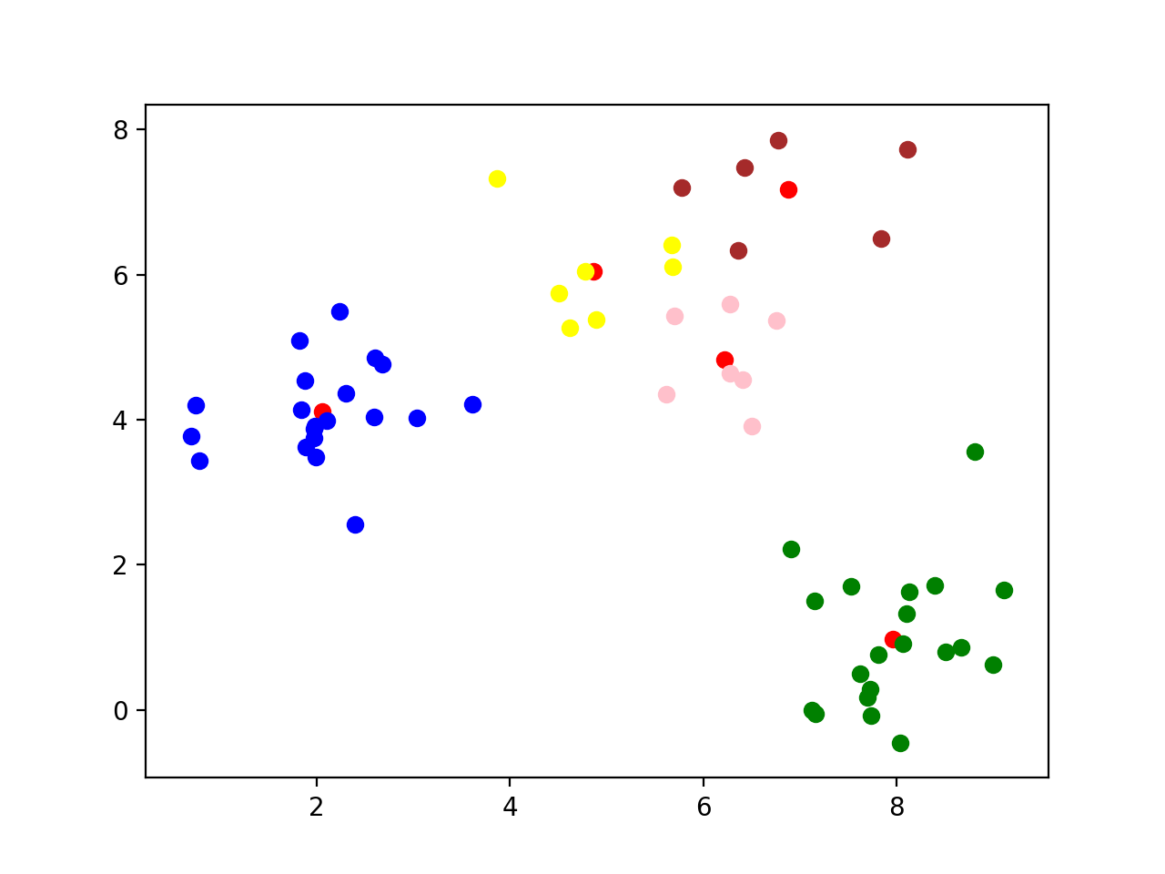
k-means clustering
What happens if we use a different k?
k=5: A cluster gets arbitrarily split

Slide 70
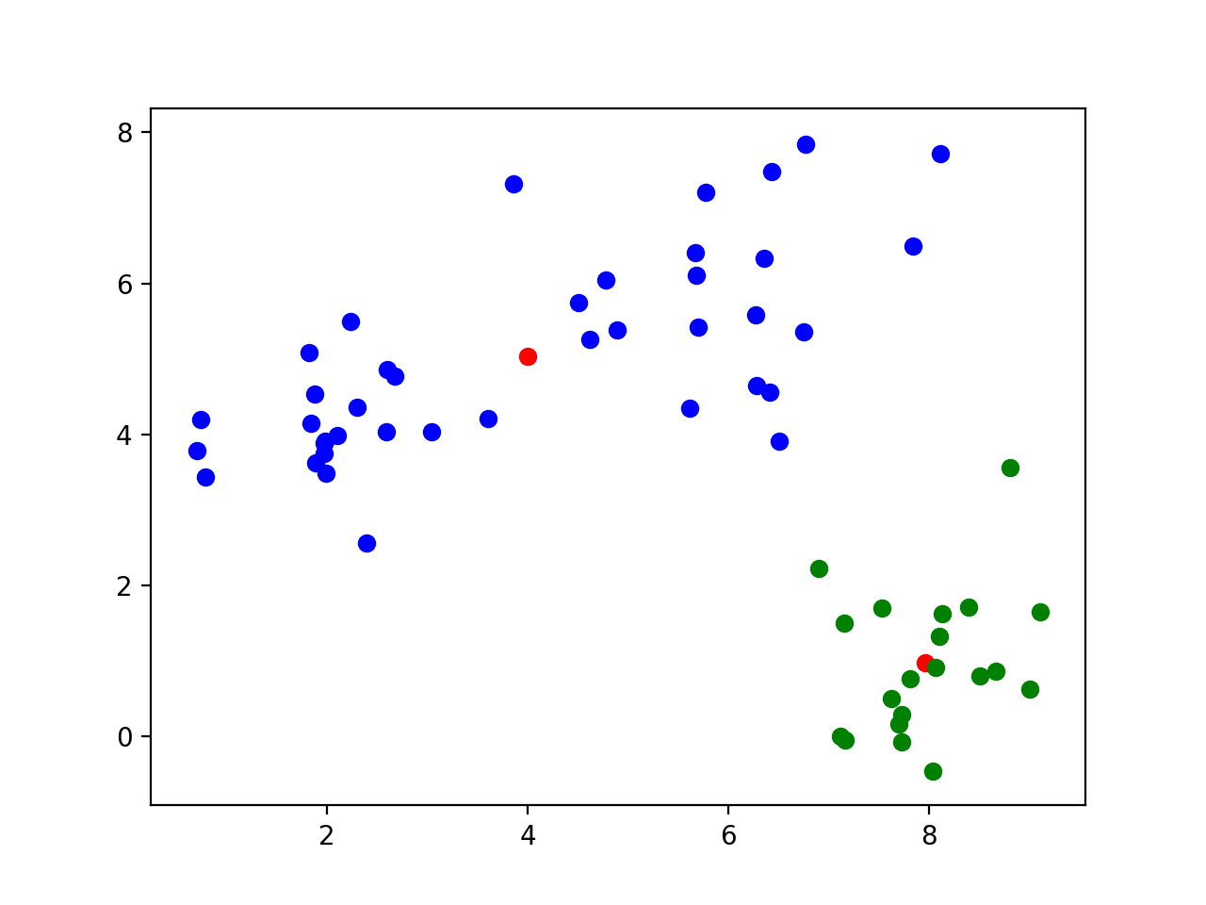
k-means clustering
k=2 Two clusters get merged

Slide 71
k-means clustering
Let's try this out on the Iris data set
We only keep the measurements
We can normalize data using the min-max method
def normalize(array):
maxs = np.max(array, axis = 0)
mins = np.min(array, axis = 0)
return (array-mins)/(maxs-mins)

Slide 72
k-means clustering
Now we try clustering without normalizing
The first 50 are 'Setosa', the next 50 are 'Virginica', then 'Variegata'
Sample with k = 5:
Recognizes 'Setosa' cluster, but not the other two
[1 1 1 1 1 1 1 1 1 1 1 1 1 1 1 1 1 1 1 1 1 1 1 1 1 1 1 1 1 1 1 1 1 1 1 1 1
1 1 1 1 1 1 1 1 1 1 1 1 1 0 0 0 4 0 4 0 2 0 4 2 4 4 0 4 0 4 4 0 4 0 4 0 0
0 0 0 0 0 4 4 4 4 0 4 0 0 0 4 4 4 0 4 2 4 4 4 0 2 4 3 0 3 3 3 3 4 3 3 3 0
0 3 0 0 3 3 3 3 0 3 0 3 0 3 3 0 0 3 3 3 3 3 0 0 3 3 3 0 3 3 3 0 3 3 3 0 0
3 0]

Slide 73
k-means clustering
With k = 3: looks a bit better, but still cannot recognize Virginia and Variegata
[2 2 2 2 2 2 2 2 2 2 2 2 2 2 2 2 2 2 2 2 2 2 2 2 2 2 2 2 2 2 2 2 2 2 2 2 2
2 2 2 2 2 2 2 2 2 2 2 2 2 1 0 1 0 0 0 0 0 0 0 0 0 0 0 0 0 0 0 0 0 0 0 0 0
0 0 0 1 0 0 0 0 0 0 0 0 0 0 0 0 0 0 0 0 0 0 0 0 0 0 1 0 1 1 1 1 0 1 1 1 1
1 1 0 0 1 1 1 1 0 1 0 1 0 1 1 0 0 1 1 1 1 1 0 1 1 1 1 0 1 1 1 0 1 1 1 0 1
1 0]

Slide 74
k-means clustering
Best results with k = 2:
[1 1 1 1 1 1 1 1 1 1 1 1 1 1 1 1 1 1 1 1 1 1 1 1 1 1 1 1 1 1 1 1 1 1 1 1 1
1 1 1 1 1 1 1 1 1 1 1 1 1 0 0 0 0 0 0 0 1 0 0 0 0 0 0 0 0 0 0 0 0 0 0 0 0
0 0 0 0 0 0 0 0 0 0 0 0 0 0 0 0 0 0 0 1 0 0 0 0 1 0 0 0 0 0 0 0 0 0 0 0 0
0 0 0 0 0 0 0 0 0 0 0 0 0 0 0 0 0 0 0 0 0 0 0 0 0 0 0 0 0 0 0 0 0 0 0 0 0
0 0]

Slide 75
k-means clustering
With mean-std normalization, results are more encouraging, but still not satisfactory
[2 2 2 2 2 2 2 2 2 2 2 2 2 2 2 2 2 2 2 2 2 2 2 2 2 2 2 2 2 2 2 2 2 2 2 2 2
2 2 2 2 0 2 2 2 2 2 2 2 2 1 1 1 0 1 0 1 0 1 0 0 0 0 0 0 1 0 0 0 0 1 0 0 0
0 1 1 1 0 0 0 0 0 0 0 1 1 0 0 0 0 0 0 0 0 0 0 0 0 0 1 0 1 1 1 1 0 1 1 1 1
1 1 0 1 1 1 1 1 0 1 0 1 1 1 1 1 1 1 1 1 1 1 1 0 1 1 1 1 1 1 1 0 1 1 1 0 1
1 1]
[1 1 1 1 1 1 1 1 1 1 1 1 1 1 1 1 1 1 1 1 1 1 1 1 1 1 1 1 1 1 1 1 1 1 1 1 1
1 1 1 1 1 1 1 1 1 1 1 1 1 2 2 2 0 0 0 2 0 0 0 0 0 0 0 0 2 0 0 0 0 2 0 0 0
0 2 2 2 0 0 0 0 0 0 0 2 2 0 0 0 0 0 0 0 0 0 0 0 0 0 2 0 2 2 2 2 0 2 0 2 2
0 2 0 0 2 2 2 2 0 2 0 2 0 2 2 0 0 2 2 2 2 2 0 0 2 2 2 0 2 2 2 0 2 2 2 0 2
2 0]
[1 2 2 2 1 1 2 2 2 2 1 2 2 2 1 1 1 1 1 1 2 1 2 2 2 2 2 1 2 2 2 2 1 1 2 2 1
2 2 2 2 2 2 2 1 2 1 2 1 2 0 0 0 0 0 0 0 0 0 0 0 0 0 0 0 0 0 0 0 0 0 0 0 0
0 0 0 0 0 0 0 0 0 0 0 0 0 0 0 0 0 0 0 0 0 0 0 0 0 0 0 0 0 0 0 0 0 0 0 0 0
0 0 0 0 0 0 0 0 0 0 0 0 0 0 0 0 0 0 0 0 0 0 0 0 0 0 0 0 0 0 0 0 0 0 0 0 0
0 0]

Slide 76
k-means clustering
With k = 2, we cluster into Setosa and not-Setosa
[1 1 1 1 1 1 1 1 1 1 1 1 1 1 1 1 1 1 1 1 1 1 1 1 1 1 1 1 1 1 1 1 1 1 1 1 1
1 1 1 1 1 1 1 1 1 1 1 1 1 0 0 0 0 0 0 0 0 0 0 0 0 0 0 0 0 0 0 0 0 0 0 0 0
0 0 0 0 0 0 0 0 0 0 0 0 0 0 0 0 0 0 0 0 0 0 0 0 0 0 0 0 0 0 0 0 0 0 0 0 0
0 0 0 0 0 0 0 0 0 0 0 0 0 0 0 0 0 0 0 0 0 0 0 0 0 0 0 0 0 0 0 0 0 0 0 0 0
0 0]
[1 1 1 1 1 1 1 1 1 1 1 1 1 1 1 1 1 1 1 1 1 1 1 1 1 1 1 1 1 1 1 1 1 1 1 1 1
1 1 1 1 1 1 1 1 1 1 1 1 1 0 0 0 0 0 0 0 0 0 0 0 0 0 0 0 0 0 0 0 0 0 0 0 0
0 0 0 0 0 0 0 0 0 0 0 0 0 0 0 0 0 0 0 0 0 0 0 0 0 0 0 0 0 0 0 0 0 0 0 0 0
0 0 0 0 0 0 0 0 0 0 0 0 0 0 0 0 0 0 0 0 0 0 0 0 0 0 0 0 0 0 0 0 0 0 0 0 0
0 0]
[0 0 0 0 0 0 0 0 0 0 0 0 0 0 0 0 0 0 0 0 0 0 0 0 0 0 0 0 0 0 0 0 0 0 0 0 0
0 0 0 0 0 0 0 0 0 0 0 0 0 1 1 1 1 1 1 1 1 1 1 1 1 1 1 1 1 1 1 1 1 1 1 1 1
1 1 1 1 1 1 1 1 1 1 1 1 1 1 1 1 1 1 1 1 1 1 1 1 1 1 1 1 1 1 1 1 1 1 1 1 1
1 1 1 1 1 1 1 1 1 1 1 1 1 1 1 1 1 1 1 1 1 1 1 1 1 1 1 1 1 1 1 1 1 1 1 1 1
1 1]

Slide 77
k-means clustering
With k=4: still no separation
[0 3 3 3 0 0 3 0 3 3 0 3 3 3 0 0 0 0 0 0 0 0 0 3 3 3 0 0 0 3 3 0 0 0 3 3 0
3 3 0 0 3 3 0 0 3 0 3 0 3 2 2 2 1 1 1 2 1 1 1 1 1 1 1 1 2 1 1 1 1 2 1 1 1
1 2 2 2 1 1 1 1 1 1 1 2 2 1 1 1 1 1 1 1 1 1 1 1 1 1 2 1 2 2 2 2 1 2 2 2 2
2 2 1 1 2 2 2 2 1 2 1 2 1 2 2 1 2 2 2 2 2 2 1 1 2 2 2 1 2 2 2 1 2 2 2 1 2
2 1]
[2 2 2 2 2 2 2 2 2 2 2 2 2 2 2 2 2 2 2 2 2 2 2 2 2 2 2 2 2 2 2 2 2 2 2 2 2
2 2 2 2 2 2 2 2 2 2 2 2 2 0 0 0 1 0 1 0 1 0 1 1 1 1 0 1 0 1 1 1 1 0 1 1 1
0 0 0 0 1 1 1 1 1 1 1 0 0 1 1 1 1 0 1 1 1 1 1 1 1 1 0 1 3 0 0 3 1 3 0 3 0
0 0 1 0 0 0 3 3 1 3 1 3 0 0 3 0 0 0 3 3 3 0 0 1 3 0 0 0 0 0 0 1 3 3 0 1 0
0 0]
[2 1 1 1 2 3 2 2 1 1 2 2 1 1 3 3 3 2 3 2 2 2 2 2 2 1 2 2 2 1 1 2 3 3 1 2 2
1 1 2 2 1 1 2 2 1 2 1 2 2 0 0 0 0 0 0 0 1 0 0 1 0 0 0 0 0 0 0 0 0 0 0 0 0
0 0 0 0 0 0 0 0 0 0 0 0 0 0 0 0 0 0 0 1 0 0 0 0 1 0 0 0 0 0 0 0 0 0 0 0 0
0 0 0 0 0 0 0 0 0 0 0 0 0 0 0 0 0 0 0 0 0 0 0 0 0 0 0 0 0 0 0 0 0 0 0 0 0
0 0]

Slide 78
k-means clustering
Morale:
With k-means clustering
Definitely need to normalize data set
Need to repeat method many times
Pick the one with the lowest sum of Euclidean distances

