Slide 1
Dimensionality Reduction
Thomas Schwarz, SJ

Slide 2
Introduction
Feature selection
Data sets contain often large numbers of features
Some of the features depend on each other
Selecting features
makes current classification fast
can generalize better from training to general data
This even works with Neural Networks

Slide 3
Introduction
Feature Combination:
Generate artificial features by combining features
Then do away with (some of the) old features

Slide 4
Introduction
Clustering:
Automatic clustering
Groups similar data points
Often allows fewer features to be used

Slide 5
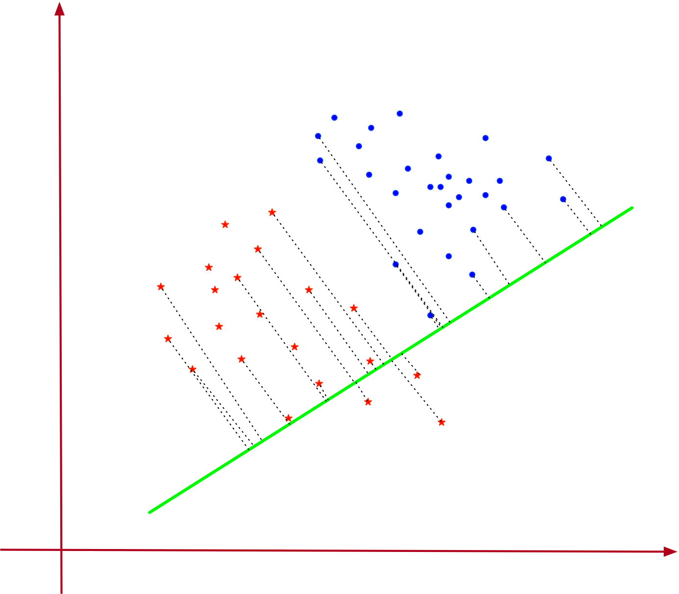
Introduction
Automatic dimensionality reduction:
Project 2-dimensional data set on a single line
Projections separates the two data sets
Can use a single, combined feature for classification
Linear Discriminant Analysis

Slide 6
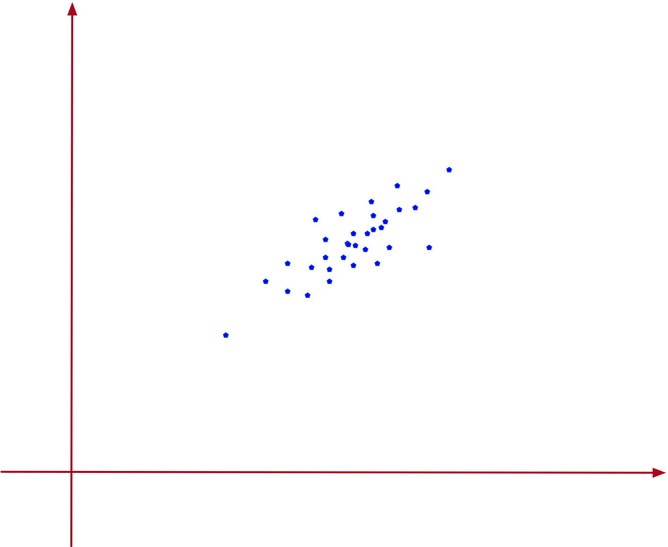
Introduction
Two-dimensional data set
Spread around one dimension
Combine the two features (x, y) into one that has almost all the variance
Principal component analysis

Slide 7
Principal Component Analysis
Goal:
Find the one direction in which the data sets varies most

Slide 8
Principal Component Analysis
Given a set of $U$ of data points with $d$ numerical attributes
Write as an $n×d$ matrix
$D=\left(\begin{matrix}x_{1,1} & x_{1,2} & … & x_{1,d} \\ x_{2,1} & x_{2,2} & … & x_{2,d} \\ x_{3,1} & x_{3,2} & … & x_{3,d} \\ & … & & \\ x_{n,1} & x_{n,2} & … & x_{n,d}\end{matrix}\right)$

Slide 9
Principal Component Analysis
Each data point is a linear combination of standard basis
$x_{i}=\overset{d}{\underset{j=1}{∑}}x_{i,j}e_{j}$
Dimensionality reduction:
Replace standard basis with another orthogonal matrix
Weight of data should be concentrated in a few dimensions

Slide 10
Principal Component Analysis
Assume $(u_{i}|i∈\{1,…,d\})$ is such a basis
Then $u_{i}⋅u_{j}=δ_{i,j}$
Actually, any $d$ vectors of length one with this property are a basis
Proof: If $\overset{d}{\underset{i=1}{∑}}α_{i}u_{i}=0$, then
$0=u_{j}⋅\overset{d}{\underset{i=1}{∑}}α_{i}u_{i}=α_{j}$

Slide 11
Principal Component Analysis
Write the vectors in an orthonormal basis as column vectors of a matrix
$U=\left(\begin{matrix}| & | & … & | \\ u_{1} & u_{2} & … & u_{d} \\ | & | & … & |\end{matrix}\right)$
Then: $u_{i}^{t}u_{j}=δ_{i,j}$ implies:
$U^{T}U=1_{d}$

Slide 12
Principal Component Analysis
A feature vector $x$ is a linear combination $x=\overset{d}{\underset{i=1}{∑}}α_{i}u_{i}$ .
Write: $a=(α_{1},α_{2},…,α_{n})$
Then $x=a⋅U^{t}$ or equivalently $x^{t}=U⋅a^{t}$

Slide 13
Principal Component Analysis
$U=(\frac{1}{\sqrt{2}},0,\frac{-1}{\sqrt{2}}),(\frac{1}{\sqrt{6}},\frac{\sqrt{2}}{\sqrt{3}},\frac{1}{\sqrt{6}}),(\frac{1}{\sqrt{3}},\frac{-1}{\sqrt{3}},\frac{1}{\sqrt{3}})$ is an orthonormal basis of $R^{3}$
Matrix is $U=\left(\begin{matrix}\frac{1}{\sqrt{2}} & \frac{1}{\sqrt{6}} & \frac{1}{\sqrt{3}} \\ 0 & \frac{\sqrt{2}}{\sqrt{3}} & \frac{-1}{\sqrt{3}} \\ \frac{-1}{\sqrt{2}} & \frac{1}{\sqrt{6}} & \frac{1}{\sqrt{3}}\end{matrix}\right)$

Slide 14
Principal Component Analysis
Column vector $(2,1,3)^{t}$ is a linear combination of the column vectors of $U$ .
Use $\left(\begin{aligned}2 \\ 1 \\ 3\end{aligned}\right)=U⋅a^{t}$
Multiply with $U^{t}$
$\left(\begin{matrix}\frac{1}{\sqrt{2}} & 0 & \frac{-1}{\sqrt{2}} \\ \frac{1}{\sqrt{6}} & \frac{\sqrt{2}}{\sqrt{3}} & \frac{1}{\sqrt{6}} \\ \frac{1}{\sqrt{3}} & \frac{-1}{\sqrt{3}} & \frac{1}{\sqrt{3}}\end{matrix}\right)⋅\left(\begin{aligned}2 \\ 1 \\ 3\end{aligned}\right)=U^{t}⋅U⋅a=a^{t}$
Obtain: $(-\frac{3}{\sqrt{2}}+\sqrt{2},2\sqrt{\frac{2}{3}}+\sqrt{\frac{3}{2}},\frac{1}{\sqrt{3}}+\sqrt{3})=a$

Slide 15
Principal Component Analysis: Projection on Subspace
Write a data point as $x=\overset{d}{\underset{i=1}{∑}}α_{i}u_{i}.$
Assume that we have ordered the basis by importance
We select only the first $r$ components:
Write: $U_{r}=\left(\begin{matrix}| & | & … & | \\ u_{1} & u_{2} & … & u_{r} \\ | & | & … & |\end{matrix}\right)$
Then set $π_{r}(x)=\overset{r}{\underset{i=1}{∑}}α_{i}u_{i}=U_{r}⋅(α_{1},α_{2},…,α_{r})^{t}$

Slide 16
Principal Component Analysis: Projection on Subspace
Since $a^{t}=U^{t}⋅x$, it follows $π_{r}(a^{t})=U_{r}^{t}x^{t}$ and
$π_{r}(x^{t})=U_{r}π_{r}(a^{t})=U_{r}U_{r}^{t}x^{t}$
$Π_{r}=U_{r}U_{r}^{t}$ is called the projection matrix since
(a) $Π_{r}⋅Π_{r}=U_{r}U_{r}^{t}U_{r}U_{r}^{t}=U_{r}U_{r}^{t}$
(b) $Π_{r}^{t}=(U_{r}U_{r}^{t})^{t}={U_{r}^{t}}^{t}U^{t}=U_{r}U_{r}^{t}Π_{r}=U_{r}U_{r}^{t}$

Slide 17
Principal Component Analysis: Projection on Subspace
Example (continued): Project on the first two coordinates with respect to $U$
$U_{r}=\left(\begin{matrix}\frac{1}{\sqrt{2}} & \frac{1}{\sqrt{6}} \\ 0 & \frac{\sqrt{2}}{\sqrt{3}} \\ -\frac{1}{\sqrt{2}} & \frac{1}{\sqrt{6}}\end{matrix}\right)$

Slide 18
Principal Component Analysis: Projection on Subspace
Then we calculate the projection matrix
$$Π_{2}=U_{2}U_{2}^{t}=\left(\begin{matrix}\frac{2}{3} & \frac{1}{3} & \frac{-1}{3} \\ \frac{1}{3} & \frac{2}{3} & \frac{1}{3} \\ \frac{-1}{3} & \frac{1}{3} & \frac{2}{3}\end{matrix}\right)$$

Slide 19
Principal Component Analysis: Projection on Subspace
Projection of $x^{t}=(2,1,3)$ is
$Π_{2}(\left(\begin{aligned}2 \\ 1 \\ 3\end{aligned}\right))=\left(\begin{aligned}\frac{2}{3} \\ \frac{7}{3} \\ \frac{5}{3}\end{aligned}\right)$

Slide 20
Principal Component Analysis: Projection on Subspace
Now we know how to project
Need to find the best orthonormal matrix for the projection

Slide 21
Single Principal Component Analysis
There are infinitely many choices of orthonormal bases
Start out with reduction to a single dimension
First step: Center the data set
By subtracting the mean of the data set
Therefore: The mean of the data set is zero

Slide 22
Single Principal Component Analysis
If we reduce to a single dimension, than the partial basis is given by a single vector $u$.
Optimality criterion: Projection maximizes the variance

Slide 23
Single Principal Component Analysis
$$\text{var}(\{u^{t}x_{i}|i∈\{1,…,n\}\})=\frac{1}{n}\overset{n}{\underset{i=1}{∑}}(u^{t}x_{i}-u^{t}(\overline{x}))^{2}$$
$=\frac{1}{n}\overset{n}{\underset{i=1}{∑}}(u^{t}x_{i})^{2}\text{(Average is zero)}$
$=\frac{1}{n}\overset{n}{\underset{i=1}{∑}}(u^{t}x_{i})(u^{t}x_{i})^{t}$
$=\frac{1}{n}\overset{n}{\underset{i=1}{∑}}u^{t}x_{i}x_{i}^{t}u$
$=u^{t}\left(\overset{n}{\underset{i=1}{∑}}x_{i}x_{i}^{t}\right)u=u^{t}Σu$

Slide 24
Single Principal Component Analysis
Therefore: $u^{t}Σu⟶max$ subject to $u^{t}u=1$
Use Lagrange multiplier $λ$ and now maximize
$J(u):=u^{t}Σu-λ(u^{t}u-1)$
So, we differentiate:
$\frac{δ}{δu}J(u)=2Σu-2λ$

Slide 25
Single Principal Component Analysis
Result: Maximum obtained if $Σu=λu$
With other words: $u$ has to be an eigenvector of $Σ$ with eigenvalue $λ$.
And to maximize, we want the eigenvector with the largest eigenvalue

Slide 26
Single Principal Component Analysis
Turns out that finding the maximum eigenvector and eigenvalue is quite simple:
Write any non-zero vector as a combination of eigen-vectors
Then repeatedly apply the matrix, but always normalize the product
The coefficient corresponding to the largest eigenvalue gets more and more magnified
And in the limit, the product will be the eigenvector corresponding to the largest eigenvalue

Slide 27
Single Principal Component Analysis
Another goodness criterion:
Minimize the sum of squares of the differences between projected values and original values of the feature vector
Error is
$||x-Π_{1}(x)||^{2}=(x-Π_{1}(x))^{t}(x-Π_{1}(x))$

Slide 28
Single Principal Component Analysis
$\overset{n}{\underset{i=1}{∑}}||x_{i}-Π_{1}(x-i)||^{2}$
$$=\overset{n}{\underset{i=1}{∑}}(x_{i}-Π_{1}(x_{i})^{t}(x_{i}-Π_{1}(x_{i}))$$
$$=\overset{n}{\underset{i=1}{∑}}(||x_{i}||^{2}-2x_{i}^{t}Π_{1}(x_{i})+Π_{1}(x)^{t}Π_{1}(x))$$
$$=\overset{n}{\underset{i=1}{∑}}(||x_{i}||^{2}-2(u^{t}x_{i})(x_{i}^{t}u)+(u^{t}x_{i})(u^{t}x_{i})u^{t}u)$$

Slide 29
$$=\overset{n}{\underset{i=1}{∑}}(||x_{i}||^{2}-2(u^{t}x_{i})(x_{i}^{t}u)+(u^{t}x_{i})(u^{t}x_{i}))$$
$$=\overset{n}{\underset{i=1}{∑}}(||x_{i}||^{2}-(u^{t}x_{i})(x_{i}^{t}u))$$
$=\overset{n}{\underset{i=1}{∑}}(||x_{i}||^{2})-\overset{n}{\underset{i=1}{∑}}(u^{t}x_{i}x_{i}^{t}u)$ $=\overset{n}{\underset{i=1}{∑}}(||x_{i}||^{2})-u^{t}(\overset{n}{\underset{i=1}{∑}}x_{i}x_{i}^{t})u$
$$=\overset{n}{\underset{i=1}{∑}}(||x_{i}||^{2})-u^{t}(\overset{n}{\underset{i=1}{∑}}x_{i}x_{i}^{t})u$$
$$=\overset{n}{\underset{i=1}{∑}}(||x_{i}||^{2})-nu^{t}Σu$$

Slide 30
Single Principal Component Analysis
This means:
In order to minimize the sum of squared errors,
Need to minimize the projected variance
Our two criteria are the same

Slide 31
Dual Principal Component Analysis
We can redo our calculation for two dimensions
Calculate just as before the minimum variance
Obtain: minimum variance is the sum of the two largest eigenvalues
Need to pick the two eigenvectors with the two largest eigenvalues

Slide 32
PCA in Python
Part of sklearn.decomposition
Import bunch of modules
Create random, but skewed data set
import numpy as np
import matplotlib.pyplot as plt
import seaborn as sns
from sklearn.decomposition import PCA
,
rng = np.random.RandomState(2020716)
X = np.dot(rng.rand(2, 2), rng.randn(2, 200)).T

Slide 33
PCA in Python
Here is some code to draw a vector
def draw_vector(v0, v1, ax=None):
ax = ax or plt.gca()
arrowprops=dict(arrowstyle='->',
linewidth=1,
shrinkA=0, shrinkB=0)
ax.annotate('', v1, v0, arrowprops=arrowprops)

Slide 34
PCA in Python
Calculate the PCA (with two components)
pca = PCA(n_components=2)
pca.fit(X)
print(pca.components_)
print(pca.explained_variance_)

Slide 35
PCA in Python
First component has almost all the variance:
[[-0.99638832 -0.08491358]
[-0.08491358 0.99638832]]
[0.89143208 0.01057402]

Slide 36
PCA in Python
Draw everything:
plt.scatter(X[:, 0], X[:, 1], s=2, c='blue')
for length, vector in zip(pca.explained_variance_, pca.components_):
v = vector * 2.3 * np.sqrt(length)
draw_vector(pca.mean_, pca.mean_ + v)
plt.axis('equal')
plt.show()

Slide 37
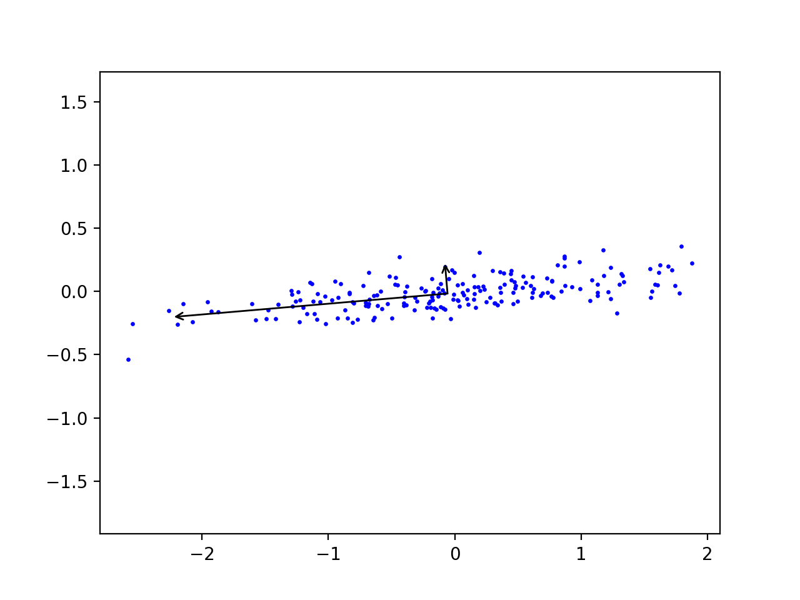
PCA in Python

Slide 38
PCA in Python
Can express data points in the new coordinates:
pca = PCA(n_components=2, whiten=True)
pca.fit(X)
X_pca = pca.transform(X)

Slide 39
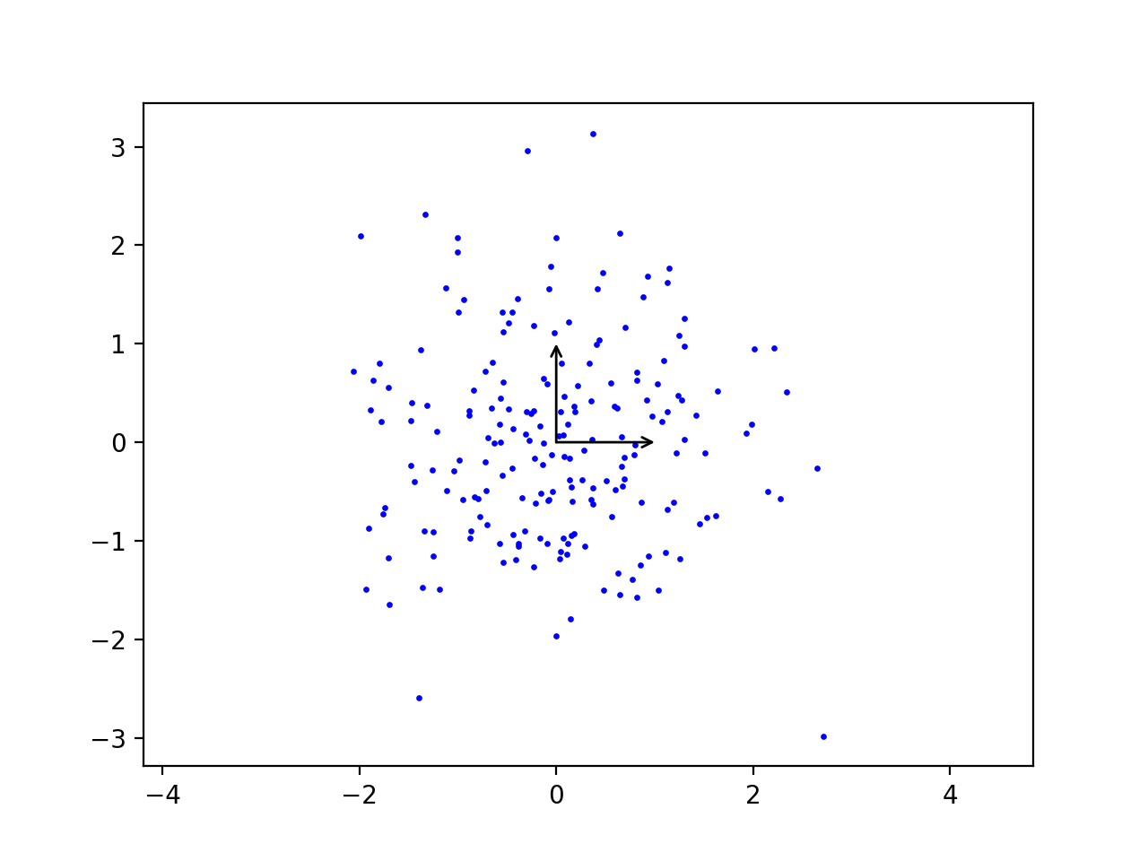
PCA in Python

Slide 40
PCA in Python
Sklearn has the digit data-set
Used for learning how to recognize digits for post-office automation, etc

Slide 41
PCA in Python
Images have 64 pixels with gray values
from sklearn.datasets import load_digits
digits = load_digits()
>>> digits.data.shape
(1797, 64)

Slide 42
PCA in Python
Can use PCA to lower dimension to two
pca = PCA(2)
projected = pca.fit_transform(digits.data)

Slide 43
PCA in Python
And display with the Spectral colormap
plt.scatter(projected[:, 0],
projected[:, 1],
s=5,
c=digits.target,
edgecolor='none',
alpha=0.7,
cmap=plt.cm.get_cmap('Spectral', 10))
plt.xlabel('component 1')
plt.ylabel('component 2')
plt.colorbar();
plt.show()

Slide 44
PCA in Python
Result shows that two features already give a decent classification:

Slide 45
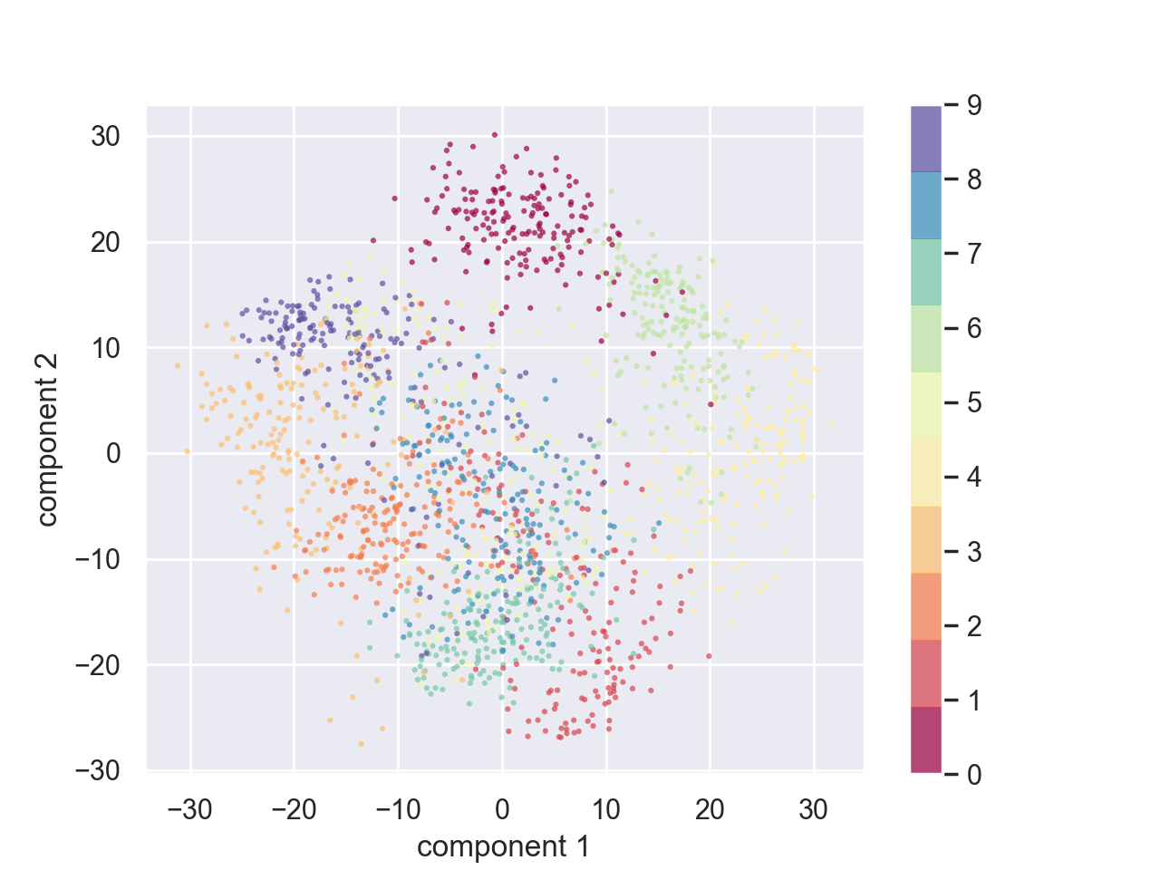
PCA in Python

Slide 46
PCA in Python
We can calculate the complete orthonormal base
And decide how many features we might need by looking at the total explained variance
pca = PCA().fit(digits.data)
plt.plot(np.cumsum(pca.explained_variance_ratio_))
plt.xlabel('number of components')
plt.ylabel('cumulative explained variance')
plt.show()

Slide 47
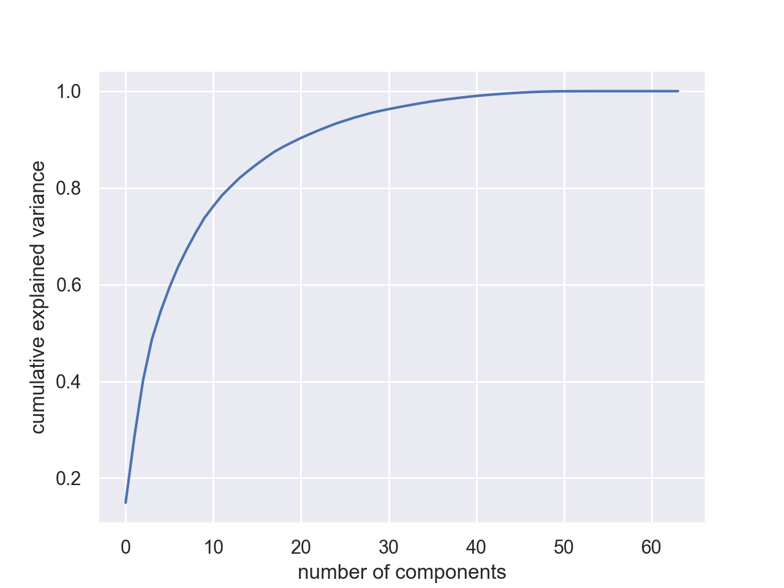

Slide 48
PCA in Python
Can also use this to filter noise:
Data will live primarily in the most important components

Slide 49
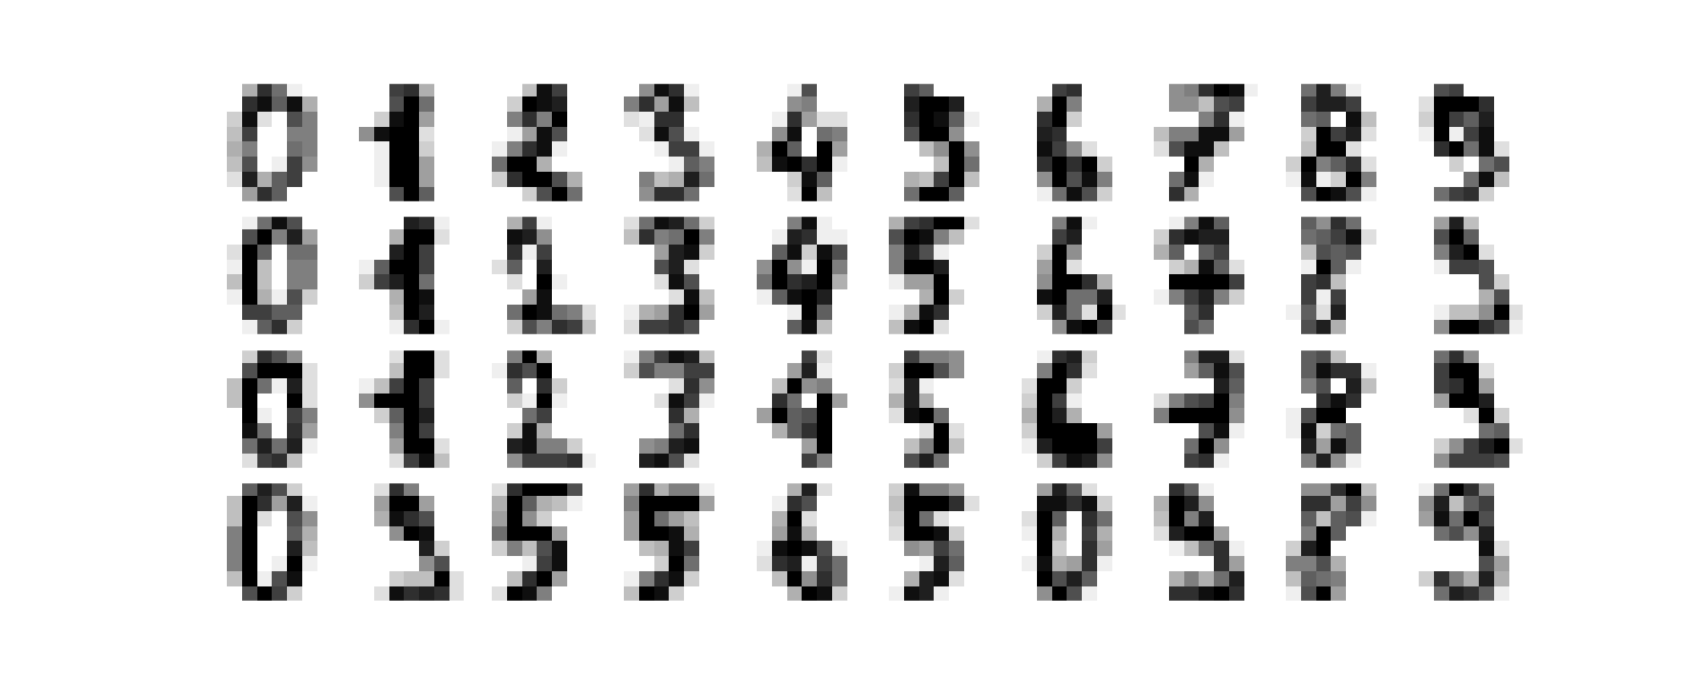
PCA in Python
Example:
Use some digits from the data set

Slide 50
PCA in Python
Now add some noise
np.random.seed(42)
noisy = np.random.normal(digits.data, 4)
plot_digits(noisy)

Slide 51
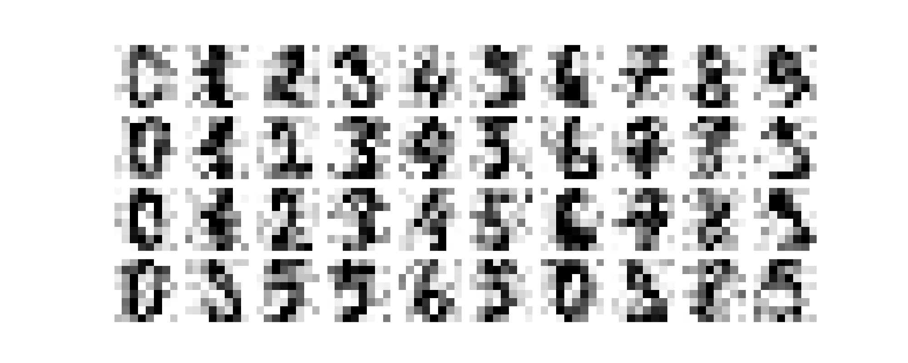
PCA in Python

Slide 52
PCA in Python
Take the noisy set
Use enough components to obtain 50% explained variance
Need 12 components in this case
pca = PCA(0.50).fit(noisy)
print(pca.n_components_)

Slide 53
PCA in Python
Then display the data of only the highest 12 components
components = pca.transform(noisy)
filtered = pca.inverse_transform(components)
plot_digits(filtered)
plt.show()

Slide 54
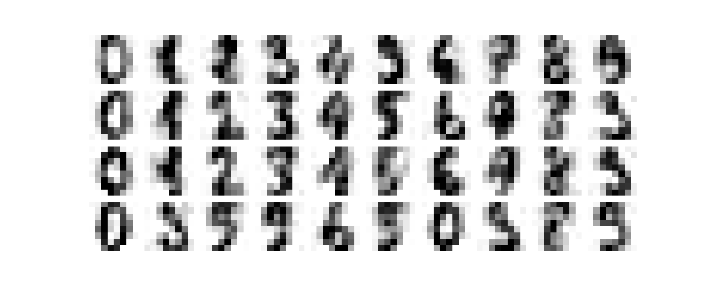

Slide 55
PCA : Eigenfaces
There is a set of faces of important people in sklearn
from sklearn.datasets import fetch_lfw_people
sns.set()
faces = fetch_lfw_people(min_faces_per_person=60)
print(faces.target_names)
print(faces.images.shape)
['Ariel Sharon' 'Colin Powell' 'Donald Rumsfeld' 'George W Bush'
'Gerhard Schroeder' 'Hugo Chavez' 'Junichiro Koizumi' 'Tony Blair']
(1348, 62, 47)

Slide 56
PCA : Eigenfaces
There is a randomized version of PCA that approximates
This is necessary because of the size of the data set
pca = PCA(n_components=150,
svd_solver = 'randomized',
whiten=True
)
pca.fit(faces.data)

Slide 57
pca = PCA(n_components=150, svd_solver = 'randomized', whiten=True)
pca.fit(faces.data)
components = pca.transform(faces.data)
projected = pca.inverse_transform(components)
fig, ax = plt.subplots(2, 10, figsize=(10, 2.5),
subplot_kw={'xticks':[], 'yticks':[]},
gridspec_kw=dict(hspace=0.1, wspace=0.1))
for i in range(10):
ax[0, i].imshow(faces.data[i].reshape(62, 47), cmap='binary_r')
ax[1, i].imshow(projected[i].reshape(62, 47), cmap='binary_r')
ax[0, 0].set_ylabel('full-dim\ninput')
ax[1, 0].set_ylabel('150-dim\nreconstruction');
plt.show()

Slide 58
PCA : Eigenfaces
With about 150 components, the features of the faces are retained

Slide 59
Linear Discriminant Analysis
Idea:
Estimate mean and variance for each category
Assumes same covariances
Calculates (like PCA) an affine transformation

Slide 60
Linear Discriminant Analysis
Import LDA:
Read data & divide
from sklearn.discriminant_analysis import LinearDiscriminantAnalysis as LDA
iris = pd.read_csv('Iris.csv', index_col=0).drop(columns='Species')
X_train, X_test, y_train, y_test = train_test_split(
iris,
50*[0]+50*[1]+50*[2],
test_size=0.2,
random_state=0)

Slide 61
Linear Discriminant Analysis
Reset
Train with two dimensions:
sc = StandardScaler()
X_train = sc.fit_transform(X_train)
X_test = sc.transform(X_test)
lda = LDA(n_components=2)
lda.fit(X_train, y_train)
for i in range(len(X_test)):
print(lda.predict([X_test[i]])[0], y_test[i])

Slide 62
Linear Discriminant Analysis
Results is 100%

Slide 63
Linear Discriminant Analysis
Show transformation for LDA:
transX = lda.fit_transform(iris, 50*[0]+50*[1]+50*[2])
cmap = colors.ListedColormap(['b','r','g'])
plt.scatter(transX[:, 0], transX[:, 1], s=3,
c=50*[0]+50*[1]+50*[2], cmap = cmap )
plt.show()

Slide 64
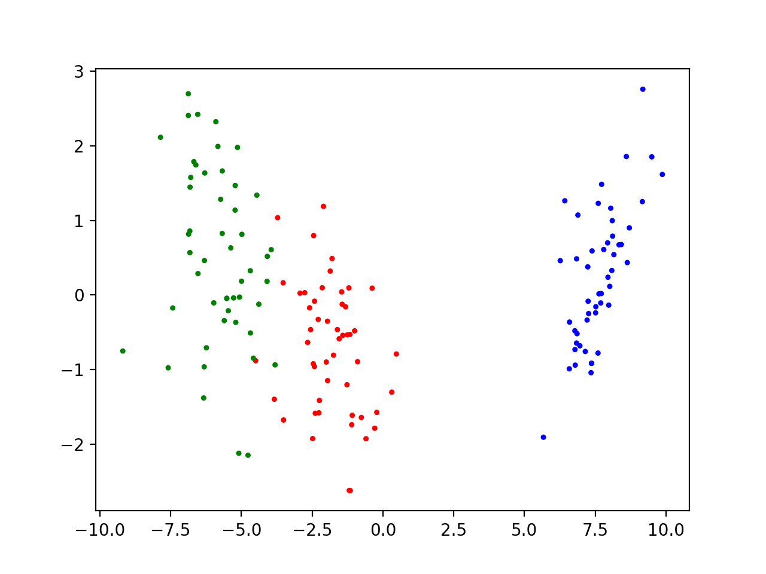
Linear Discriminant Analysis

