Slide 1
Pandas
Thomas Schwarz, SJ

Slide 2
Basics
Tool for data sets:
Analysis
Aggregation
Cleaning
Merging
Pivoting

Slide 3
Basics
Where to get Pandas
Install via pip or homebrew
Use a distribution like Anaconda
Comes with Jupyter (aka iPython) Notebooks which are popular among data scientists

Slide 4
Pandas Overview
Build on top of NumPy
Uses DataFrame (and Series) as fundamental data structure
Supports
attaching labels to data
working with missing data
grouping
pivoting

Slide 5
Pandas Overview
Usually imported as pd

Slide 6
Pandas Series
A one-dimensional array
Can hold data of any type
Axis labels are called index
Works a bit like a dictionary

Slide 7
Pandas Series
Can create using a scalar that is going to be repeated.
An index needs to be explicitly provided
pd.Series(5,['a', 'b', 'c'])
a 5
b 5
c 5
dtype: int64

Slide 8
Pandas Series
Default Index is np.arange(n), i.e. the numbers from 0, ...,
Example:
creates a Pandas Series
import pandas as pd
lit_it_isl = pd.Series(['elba', 'ischia', 'capri'])
0 elba
1 ischia
2 capri
dtype: object

Slide 9
Pandas Series
dtype is the type of the Series
In this case, it is object because the data consists of strings

Slide 10
Pandas Series
We can create an explicit index
When we print out the result, we now see the index
labels = ['nice', 'nicer', 'nicest']
data = ['elba', 'ischia', 'capri']
lit_it_isl = pd.Series(data = data, index = labels)
nice elba
nicer ischia
nicest capri
dtype: object

Slide 11
Pandas Series
There are a number of data sources
Can create using a Python list
Can create using a dictionary
Can create using a numpy array
isl_dic={'nice':'elba', 'nicer':'ischia', 'nicest':'capri'}
>>> lit_it_isl = pd.Series(isl_dict)
pd.Series(np.random.uniform(0,1,5))
0 0.644686
1 0.812248
2 0.496581
3 0.876687
4 0.280538
dtype: float64

Slide 12
Pandas Series
There is no limit imposed on the objects that can be stored
For example, we can store functions
pd.Series([random.uniform, print, len, "".join])
0 <bound method Random.uniform of <random.Random...
1 <built-in function print>
2 <built-in function len>
3 <built-in method join of str object at 0x104c3...
dtype: object

Slide 13
Pandas Series
To retrieve a data value, we give it the index
lit_it_isl['nicer']
'ischia'

Slide 14
Pandas Series
The slice operation works differently
ex = pd.Series(['capri', 'ischia', 'elba',
'giglia', 'giannutri'],
index=list('abcde'))
a capri
b ischia
c elba
d giglia
e giannutri
dtype: object

Slide 15
Pandas Series
Both the beginning and the end are included
ex['b':'d']
b ischia
c elba
d giglia
dtype: object

Slide 16
Pandas Series
Slices:
Like in NumPy, a slice only creates a reference
If you change a slice, you change the original
Example: Create a series
Create a slice
ex = pd.Series(['capri', 'ischia', 'elba', 'giglia', 'giannutri'], index=list('abcde'))
my_slice = ex['b':'d']

Slide 17
Pandas Series
Slices are references (cont.)
Change the slice
The original (as well as the slice) have changed
my_slice = ex['b':'d']
ex
a capri
b ischia
c zanone
d giglia
e giannutri
dtype: object

Slide 18
Pandas Series
If an index is not in the series, a KeyError is raised
ex['h']
Traceback (most recent call last):
...
KeyError: 'h'
>>>

Slide 19
Pandas Series
As we have seen, we can use indexing to update a value

Slide 20
Pandas Series
Use head( ) and tail( ) to access beginning and end of a series
df = pd.Series(['bonn', 'koeln', 'duesseldorf',
'essen', 'aachen','dortmund'])
>>> df.head(2)
0 bonn
1 koeln
dtype: object
>>> df.tail(2)
4 aachen
5 dortmund
dtype: object

Slide 21
Pandas Series
In addition to explicit indexing with the [ ] operator
Can use subsets referring explicit indices (offsets)
with the .loc operator
with the .iloc

Slide 22
Pandas Series
Example:
Define a series based on the Olympic ice-hockey tournament 2018
icehockey2018 = pd.Series({'russia': 1, 'germany': 2, 'canada': 3, 'czech': 4, 'sweden':5})
>>> icehockey2018
russia 1
germany 2
canada 3
czech 4
sweden 5
dtype: int64

Slide 23
Pandas Series
Example
Using .loc with a list of labels
icehockey2018.loc[['russia', 'sweden']]
russia 1
sweden 5
dtype: int64

Slide 24
Pandas Series
Example
Accessing a sub-series with iloc by numerical index
icehockey2018.iloc[1:3]
germany 2
canada 3
dtype: int64

Slide 25
Pandas Series
Example
Using a series of integer indices with .iloc
icehockey2018.iloc[[1,2,3,4]]
germany 2
canada 3
czech 4
sweden 5
dtype: int64

Slide 26
Pandas Series
Just as for numpy arrays, we can use operations between series
These are dependent on labels

Slide 27
Pandas Series
Example: Olympic Ice-hockey results
icehockey2018 = pd.Series({'russia': 1, 'germany': 2, 'canada': 3, 'czech': 4, 'sweden':5})
>>> icehockey2018
russia 1
germany 2
canada 3
czech 4
sweden 5
dtype: int64

Slide 28
Pandas Series
icehockey2014= pd.Series({'canada':1, 'sweden':2, 'finland':3, 'usa': 4, 'czech':5})

Slide 29
Pandas Series
Calculate the average, and we get lot's of Not a Number (NaN)
(icehockey2018+icehockey2014)/2
canada 2.0
czech NaN
finland NaN
germany NaN
russia 3.0
sweden 3.5
usa NaN
dtype: float64

Slide 30
Pandas Dataframe
A two-dimensional table
example = pd.DataFrame(np.random.randn(5,4), ['a','b','c','d','e'],['w','x','y','z'])
>>> example
w x y z
a 0.968015 -0.292712 -0.456712 0.478160
b -0.182741 0.801120 1.466134 0.883498
c 0.497248 -0.170697 -0.487031 3.018604
d 0.948902 -0.878197 0.796428 -0.479922
e -1.420614 0.200272 1.111076 -0.283730

Slide 31
Pandas Dataframe
Access to data uses the bracket [ ] operation
Example (continued):
example['w']
a 0.968015
b -0.182741
c 0.497248
d 0.948902
e -1.420614
Name: w, dtype: float64

Slide 32
Pandas Dataframe
Example (continued)
example[['w','z']]
w z
a 0.968015 0.478160
b -0.182741 0.883498
c 0.497248 3.018604
d 0.948902 -0.479922
e -1.420614 -0.283730

Slide 33
Pandas Dataframe
The rows are given by an "index"
Columns can be added
example['summa']=example['w']+example['x']+
example['y']+example['z']
w x y z summa
a 0.968015 -0.292712 -0.456712 0.478160 0.696751
b -0.182741 0.801120 1.466134 0.883498 2.968011
c 0.497248 -0.170697 -0.487031 3.018604 2.858124
d 0.948902 -0.878197 0.796428 -0.479922 0.387211
e -1.420614 0.200272 1.111076 -0.283730 -0.392997

Slide 34
Pandas Dataframe
Columns can also be deleted
Use drop
drop has a parameter axis
Axis 0: drop an index
Axis 1: drop a column

Slide 35
Pandas Dataframe
Example:
Drop the first column with label 'w'
example.drop('w',axis=1)
x y z summa
a -0.292712 -0.456712 0.478160 0.696751
b 0.801120 1.466134 0.883498 2.968011
c -0.170697 -0.487031 3.018604 2.858124
d -0.878197 0.796428 -0.479922 0.387211
e 0.200272 1.111076 -0.283730 -0.392997

Slide 36
Pandas Dataframe
Example (continued)
But this does not change the original dataframe
example
w x y z summa
a 0.968015 -0.292712 -0.456712 0.478160 0.696751
b -0.182741 0.801120 1.466134 0.883498 2.968011
c 0.497248 -0.170697 -0.487031 3.018604 2.858124
d 0.948902 -0.878197 0.796428 -0.479922 0.387211
e -1.420614 0.200272 1.111076 -0.283730 -0.392997

Slide 37
Pandas Dataframe
To make the change to the original, need to specify that the inplace parameter is True
Otherwise, we are just making a copy
This is really a bit of a headache
Need to lookup manual to figure out whether an operation makes a copy or changes the original

Slide 38
Pandas Dataframe
Example: With inplace being True, we change the dataframe itself
example.drop('w',axis=1, inplace=True)
example
x y z summa
a -0.292712 -0.456712 0.478160 0.696751
b 0.801120 1.466134 0.883498 2.968011
c -0.170697 -0.487031 3.018604 2.858124
d -0.878197 0.796428 -0.479922 0.387211
e 0.200272 1.111076 -0.283730 -0.392997

Slide 39
Pandas Dataframe
Selftest
Drop a row from an example dataframe

Slide 40
Pandas Dataframe
Self-test Solution
Just use axis = 0
example.drop('e', axis=0, inplace = True)
x y z summa
a -0.292712 -0.456712 0.478160 0.696751
b 0.801120 1.466134 0.883498 2.968011
c -0.170697 -0.487031 3.018604 2.858124
d -0.878197 0.796428 -0.479922 0.387211

Slide 41
Pandas Dataframe
How to select rows
Use the .loc operation
Use the .iloc operation
example.loc[['a','c']]
x y z summa
a -0.292712 -0.456712 0.478160 0.696751
c -0.170697 -0.487031 3.018604 2.858124

Slide 42
Pandas Dataframe
Just as for numpy arrays, can use multi-indices
example.loc[['a','c'],['x','y']]
x y
a -0.292712 -0.456712
c -0.170697 -0.487031

Slide 43
Pandas Dataframe
Just as in numpy, we can create boolean selections
boolex = example > 1
x y z summa
a False False False False
b False True False True
c False False True True
d False False False False

Slide 44
Pandas Dataframe
And use the boolean selection to select values from the frame
Behavior differs from numpy
example[boolex]
x y z summa
a NaN NaN NaN NaN
b NaN 1.466134 NaN 2.968011
c NaN NaN 3.018604 2.858124
d NaN NaN NaN NaN

Slide 45
Pandas Dataframe
Or do so in a single step
Notice that the numbers not fitting are NaNs
example[example>1]
x y z summa
a NaN NaN NaN NaN
b NaN 1.466134 NaN 2.968011
c NaN NaN 3.018604 2.858124
d NaN NaN NaN NaN

Slide 46
Pandas Dataframe
A more typical selection uses a column
Example: The example dataframe
Select the rows where the 'z' value is positive:
x y z summa
a -0.292712 -0.456712 0.478160 0.696751
b 0.801120 1.466134 0.883498 2.968011
c -0.170697 -0.487031 3.018604 2.858124
d -0.878197 0.796428 -0.479922 0.387211
example[example['z']>0]
x y z summa
a -0.292712 -0.456712 0.478160 0.696751
b 0.801120 1.466134 0.883498 2.968011
c -0.170697 -0.487031 3.018604 2.858124

Slide 47
Pandas Dataframe
Compound Conditions
We can combine conditions for selection
Unlike classical Python, we cannot use and / or
Need to use single ampersand or vertical bar & | for and, or

Slide 48
Pandas Dataframe
Example:
Create a random frame
example = pd.DataFrame(np.random.randn(4,3), ['a','b','c','d'],['x','y','z'])
print(example)
x y z
a 1.411543 2.160431 -1.891248
b -1.062715 -0.831573 0.440250
c -1.157673 -0.963104 1.817167
d -0.162145 0.140711 -0.016717

Slide 49
Pandas Dataframe
Select the rows where 'x' is negative and 'z' is positive
These are rows b and c
x y z
a 1.411543 2.160431 -1.891248
b -1.062715 -0.831573 0.440250
c -1.157673 -0.963104 1.817167
d -0.162145 0.140711 -0.016717

Slide 50
Pandas Dataframe
Use the ampersand
Parentheses are necessary
new_frame = example[(example['x']<0) & (example['z']>0)]
print(new_frame)
x y z
b -1.062715 -0.831573 0.440250
c -1.157673 -0.963104 1.817167

Slide 51
Pandas Dataframe
We can make our own Boolean conditions
We do so by using the dataframe .apply method that applies a function along an axis of the data frame
axis=0: index
Applies function to each column
default
axis=1: columns
Applies function to each row

Slide 52
Pandas Dataframe
Example:
Find all entries that have US somewhere in the 'company_name' of a dataframe df
Here the function returns a Boolean value
return df[df[company_name].apply(
lambda x: 'US' in x)]

Slide 53
Pandas Dataframe
We can change the index
Example: Import the following .csv file
First Name, Last Name, Position, Year
Salmon, Chase, CJUS, 1865
Salmon, Chase, CJUS, 1866
Salmon, Chase, CJUS, 1867
Salmon, Chase, CJUS, 1868
Salmon, Chase, CJUS, 1869
Ulysses, Grant, PotUS, 1869
Ulysses, Grant, GUSA, 1866
Ulysses, Grant, GUSA, 1867
Ulysses, Grant, GUSA, 1868
Andrew, Johnson, PotUS, 1865
Andrew, Johnson, PotUS, 1866
Andrew, Johnson, PotUS, 1867
Andrew, Johnson, PotUS, 1868
Andrew, Johnson, PotUS, 1869
William, Sherman, GUSA, 1869

Slide 54
Pandas Dataframe
Import using read_csv
ex = pd.read_csv('example.csv')
First Name Last Name Position Year
0 Salmon Chase CJUS 1865
1 Salmon Chase CJUS 1866
2 Salmon Chase CJUS 1867

Slide 55
Pandas Dataframe
Create a new column
Needs to have the same number of elements as there are data rows:
ex['entry']=['a','b','c','d','e','f','g','h','i',
'j','k','l','m','n','o']
First Name Last Name Position Year entry
0 Salmon Chase CJUS 1865 a
1 Salmon Chase CJUS 1866 b
2 Salmon Chase CJUS 1867 c
3 Salmon Chase CJUS 1868 d

Slide 56
Pandas Dataframe
Now set the index to this new column
add parameter inplace = True if these changes are intended to be permanent
ex.set_index('entry')
First Name Last Name Position Year
entry
a Salmon Chase CJUS 1865
b Salmon Chase CJUS 1866
c Salmon Chase CJUS 1867
d Salmon Chase CJUS 1868

Slide 57
Example:
Salaries in San Francisco

Slide 58
Example
Use Salaries.csv with salary data from municipal employees in San Francisco
San Francisco is one of the most expensive cities in the country

Slide 59
Example
Look at the raw file first:
def get_head():
with open('Salaries.csv') as infile:
line_nr = 0
for line in infile:
print(line)
line_nr+=1
if line_nr > 5:
break

Slide 60
Example
Result: Column header
Id,EmployeeName,JobTitle,BasePay,OvertimePay,OtherPay,Benefits,TotalPay,TotalPayBenefits,Year,Notes,Agency,Status
1,NATHANIEL FORD,GENERAL MANAGER-METROPOLITAN TRANSIT AUTHORITY,167411.18,0.0,400184.25,,567595.43,567595.43,2011,,San Francisco,
2,GARY JIMENEZ,CAPTAIN III (POLICE DEPARTMENT),155966.02,245131.88,137811.38,,538909.28,538909.28,2011,,San Francisco,
3,ALBERT PARDINI,CAPTAIN III (POLICE DEPARTMENT),212739.13,106088.18,16452.6,,335279.91,335279.91,2011,,San Francisco,
4,CHRISTOPHER CHONG,WIRE ROPE CABLE MAINTENANCE MECHANIC,77916.0,56120.71,198306.9,,332343.61,332343.61,2011,,San Francisco,
5,PATRICK GARDNER,"DEPUTY CHIEF OF DEPARTMENT,(FIRE DEPARTMENT)",134401.6,9737.0,182234.59,,326373.19,326373.19,2011,,San Francisco,

Slide 61
Example
Pandas has functions to read csv files
Remove the limit on columns to be displayed
Read first line of data
sal = pd.read_csv('Salaries.csv', low_memory = False)
pd.set_option('display.max_columns', None)
>>> sal.iloc[[0],[0,1,2,3,4,5]]
Id EmployeeName JobTitle \
0 1 NATHANIEL FORD GENERAL MANAGER-METROPOLITAN TRANSIT AUTHORITY
BasePay OvertimePay OtherPay
0 167411.18 0.0 400184.25

Slide 62
Example
Sometimes, we will need converters in order to read data
Let's write a converter that converts to float or NaN
def my_converter(x):
try:
converted_value = float(x)
except ValueError:
converted_value = np.NaN
return converted_value

Slide 63
Example
Then adorn read_csv with converters for each column that has strings in them
def get_data():
return pd.read_csv('Salaries.csv',
converters = {'BasePay': my_converter,
'OvertimePay': my_converter,
'OtherPay': my_converter,
'Benefits': my_converter,
'TotalPay': my_converter,
'TotalPayBenefits': my_converter,
'Status' : my_converter}
)

Slide 64
Example
Now we got the salary database as a Pandas datasheet
sal = get_data()

Slide 65
Example
Who is getting paid a lot?
def high_paid():
sal = get_data()
return sal[sal['BasePay']>300000][['EmployeeName','BasePay', 'TotalPayBenefits', 'JobTitle','Year']]

Slide 66
Example
What is the mean salary?
>>> sal = get_data()
>>> return sal[TotalPay'].mean()
74768.32197169267

Slide 67
Example
Who is getting paid the most?
For this we need to look up the argmin function and find it is deprecated.
The new function is idxmax( )
We first find the index of the person with the biggest 'TotalPay'
And then use iloc to print it out
sal.iloc[sal['TotalPay'].idxmax()]

Slide 68
Example
And who is getting paid least?
sal.iloc[sal['TotalPay'].idxmin()]
Id 148654
EmployeeName Joe Lopez
JobTitle Counselor, Log Cabin Ranch
BasePay 0
OvertimePay 0
OtherPay -618.13
Benefits 0
TotalPay -618.13
TotalPayBenefits -618.13
Year 2014
Notes NaN
Agency San Francisco
Status NaN

Slide 69
Example
And who is getting paid least?
>>> sal.iloc[sal['BasePay'].idxmin()]
Id 72833
EmployeeName Irwin Sidharta
JobTitle Junior Clerk
BasePay -166.01
OvertimePay 249.02
OtherPay 0
Benefits 6.56
TotalPay 83.01
TotalPayBenefits 89.57
Year 2012
Notes NaN
Agency San Francisco
Status NaN
Name: 72832, dtype: object

Slide 70
Example
Find all captains.
This is a boolean condition, which we can implement easiest by applying a function on the 'JobTitle' column
>>> sal[sal['JobTitle'].apply(lambda x: 'captain' in x.lower())]['BasePay']
1 155966.02
2 212739.13
11 99722.00
17 140546.87
22 140546.88
...
116604 73355.21
120867 7660.00
122361 0.00
126588 68491.89
132232 61039.43
Name: BasePay, Length: 552, dtype: float64

Slide 71
Example
And this is how much they make on average
>>> sal[sal['JobTitle'].apply(lambda x: 'captain' in x.lower())]['BasePay'].mean()
152090.02520871142

Slide 72
Aggregation
For analysis, need to aggregate information
Typical aggregation functions:
mean, standard deviation, max, min and other descriptive statistics

Slide 73
Aggregation
Typical:
Split a data frame
Using a label or list of labels
Using a mapping / function
Done by the groupby method
Which returns a qu
Combine the results in each split using an aggregation function

Slide 74
Aggregation
Example:
Download the file '30_Auto_theft.csv'
Load it into a data frame
import pandas as pd
import numpy as np
def get_data():
return pd.read_csv('30_Auto_theft.csv')

Slide 75
Aggregation
Example (continued)
This creates a group-by object
Can aggregate on the group-by object
Returns the mean for each 'Area_Name'
auto = get_data()
auto.groupby('Area_Name').mean()
[['Auto_Theft_Stolen']]

Slide 76
Combining Data Frames
Can combine through
Concatenation
Merging
Joining

Slide 77
Repetition
Pandas Series:
A one-dimensional array with an index
Can use the default index or create the index yourself
>>> import pandas as pd
>>> obj = pd.Series([4,3,8,7])
>>> obj
0 4
1 3
2 8
3 7
dtype: int64

Slide 78
Repetition
The values of the Pandas series are in property values.
The index in property index
>>> obj.values
array([4, 3, 8, 7])
>>> obj.index
RangeIndex(start=0, stop=4, step=1)

Slide 79
Repetition
Creating a series with explicit index
>>> obj = pd.Series([4,3,8,7], index = ['green',
'red', 'blue', 'yellow'])
>>> obj
green 4
red 3
blue 8
yellow 7
dtype: int64

Slide 80
Repetition
Access to elements
Like NumPy, can use conditions
obj['green']
>>> obj[obj > 5]
blue 8
yellow 7
dtype: int64

Slide 81
Repetition
Can treat a pandas series as a dictionary
Vice versa, can use a dictionary to create a pandas series
>>> pd.Series(dicti)
Ahmedabad 5
Mumbai 18
Delhi 16
Kolkatta 14
Chennai 9
Bangalore 9
Hyderabad 8
Pune 5
dtype: int64

Slide 82
Repetition
In this case, the series has the key:value pairs in the same order as they are in the dictionary
We can control this by giving the indices explicitly
Surat is not in the dictionary, therefore the NaN
>>> popu = pd.Series(dicti, index =
['Mumbai', 'Delhi', 'Kolkatta', 'Surat'])
>>> popu
Mumbai 18.0
Delhi 16.0
Kolkatta 14.0
Surat NaN

Slide 83
Repetition
We can check for null values with pd.isnull
Provided we imported pandas as pd
>>> pd.isnull(popu)
Mumbai False
Delhi False
Kolkatta False
Surat True

Slide 84
Repetition
DataFrames are rectangular tables
Often created from a dictionary of arrays of equal size
populationdict = {
'city': ['Kolkata', 'Kolkata','Kolkata','Mumbai',
'Mumbai', 'Mumbai', 'Chennai', 'Chennai',
'Chennai'],
'years': [1901, 1951, 2001, 1901, 1951, 2001, 1901, 1951, 2001],
'population': [1.5, 4.7, 13.3, 1.0, 3.2, 16.4,
.6, 1.5, 6.7]}

Slide 85
Repetition
Without a specific index, all rows get a default index.
>>> frame = pd.DataFrame(populationdict)
>>> frame
city years population
0 Kolkata 1901 1.5
1 Kolkata 1951 4.7
2 Kolkata 2001 13.3
3 Mumbai 1901 1.0
4 Mumbai 1951 3.2
5 Mumbai 2001 16.4
6 Chennai 1901 0.6
7 Chennai 1951 1.5
8 Chennai 2001 6.7

Slide 86
Repetition
Can use either dictionary-like notation or the name of the columns in order to select a series
>>> frame['population']
0 1.5
1 4.7
2 13.3
3 1.0
4 3.2
5 16.4
6 0.6
7 1.5
8 6.7
>>> frame.population
0 1.5
1 4.7
2 13.3
3 1.0
4 3.2
5 16.4
6 0.6
7 1.5
8 6.7

Slide 87
Repetition
We can add a column through assignment
>>> frame['debt'] = 0.0
>>> frame
city years population debt
0 Kolkata 1901 1.5 0.0
1 Kolkata 1951 4.7 0.0
2 Kolkata 2001 13.3 0.0
3 Mumbai 1901 1.0 0.0
4 Mumbai 1951 3.2 0.0
5 Mumbai 2001 16.4 0.0
6 Chennai 1901 0.6 0.0
7 Chennai 1951 1.5 0.0
8 Chennai 2001 6.7 0.0

Slide 88
Repetition
We can change the index by simply assigning an array
>>> frame.index = ['a1', 'a2', 'a3', 'b1', 'b2', 'b3', 'c1', 'c2', 'c3']
>>> frame
city years population debt
a1 Kolkata 1901 1.5 0.0
a2 Kolkata 1951 4.7 0.0
a3 Kolkata 2001 13.3 0.0
b1 Mumbai 1901 1.0 0.0
b2 Mumbai 1951 3.2 0.0
b3 Mumbai 2001 16.4 0.0
c1 Chennai 1901 0.6 0.0
c2 Chennai 1951 1.5 0.0
c3 Chennai 2001 6.7 0.0

Slide 89
Repetition
Dataframes and Series work together
Can assign a series to a dataframe column
Holes are filled with NaN
frame.debt = pd.Series({'a1':0.0, 'a2':10.0, 'a3': 140.0, 'b1': 0, 'b2': 12, 'c1': 0})
>>> frame
city years population debt
a1 Kolkata 1901 1.5 0.0
a2 Kolkata 1951 4.7 10.0
a3 Kolkata 2001 13.3 140.0
b1 Mumbai 1901 1.0 0.0
b2 Mumbai 1951 3.2 12.0
b3 Mumbai 2001 16.4 NaN
c1 Chennai 1901 0.6 0.0
c2 Chennai 1951 1.5 NaN
c3 Chennai 2001 6.7 NaN

Slide 90
Repetition
We can also use a a nested dict of dicts
outer dictionary keys are columns
inner dictionary keys are rows
>>> population={'Kolkata':{1901: 1.5, 1951: 4.7, 2001: 13.3},
'Mumbai':{1901:1.0, 1951: 3.2, 2001:16.4},
'Chennai':{1901: 0.6, 1951: 1.5, 2001: 6.7}}
>>> popframe = pd.DataFrame(population)
>>> popframe
Kolkata Mumbai Chennai
1901 1.5 1.0 0.6
1951 4.7 3.2 1.5
2001 13.3 16.4 6.7

Slide 91
Repetition
Just like numpy, we can transpose
(switch rows and columns)
>>> popframe.T
1901 1951 2001
Kolkata 1.5 4.7 13.3
Mumbai 1.0 3.2 16.4
Chennai 0.6 1.5 6.7

Slide 92
Repetition
Index objects
Hold the name of the axis labels and other metadata
Indices are immutable
Can also contain multiple values
>>> popframe.index
Int64Index([1901, 1951, 2001], dtype='int64')

Slide 93
Reindex
Reindex: Create a new object with the data conformed to the new index
Create a series
>>> allIndia = pd.Series([238, 316, 1071, 1380],index=[1901, 1951, 2001, 2020])
>>> allIndia
1901 238
1951 316
2001 1071
2020 1380
dtype: int64

Slide 94
Reindex
Now re-index
>>> allIndia2 = allIndia.reindex([2020, 2001, 1976, 1951, 1926, 1901])
>>> allIndia2
2020 1380.0
2001 1071.0
1976 NaN
1951 316.0
1926 NaN
1901 238.0
dtype: float64

Slide 95
Reindex
This is particularly important for time series
We want to replace missing values using some interpolation
One possibility: forward fill: ffill
Or set a fillvalue
>>> allIndia2 = allIndia.reindex([1901, 1926, 1951, 1976, 2001, 2020], method = 'ffill')
>>> allIndia2
1901 238
1926 238
1951 316
1976 316
2001 1071
2020 1380
dtype: int64

Slide 96
Reindex
Use interpolate to fill in missing values in a dataframe
>>> allIndia2 = allIndia.reindex([1901, 1926, 1951, 1976, 2001, 2020])
>>> allIndia2.interpolate()
1901 238.0
1926 277.0
1951 316.0
1976 693.5
2001 1071.0
2020 1380.0
dtype: float64

Slide 97
Dropping
Remove rows with drop
Can remove columns if we use axis=1 or axis = 'columns'
>>> allIndia2 = allIndia2.drop([1926, 1976])
>>> allIndia2
1901 238.0
1951 316.0
2001 1071.0
2020 1380.0
dtype: float64

Slide 98
Indexing, Selection, Filtering
Use bracket notation to find elements
Can use slicing
But endpoints are included (in contrast to Python)

Slide 99
Indexing, Selection, Filtering
Access methods are loc (using names) and iloc (using integer indices)
>>> popframe
Kolkata Mumbai Chennai
1901 1.5 1.0 0.6
1951 4.7 3.2 1.5
2001 13.3 16.4 6.7
>>> popframe.iloc[1]
Kolkata 4.7
Mumbai 3.2
Chennai 1.5
Name: 1951, dtype: float64

Slide 100
Indexing, Selection, Filtering
Access methods are loc (using names) and iloc (using integer indices)
>>> popframe
Kolkata Mumbai Chennai
1901 1.5 1.0 0.6
1951 4.7 3.2 1.5
2001 13.3 16.4 6.7
popframe.loc[1901:1951]
Kolkata Mumbai Chennai
1901 1.5 1.0 0.6
1951 4.7 3.2 1.5

Slide 101
Indexing, Selection, Filtering
Access methods are loc (using names) and iloc (using integer indices
Can get columns
>>> popframe
Kolkata Mumbai Chennai
1901 1.5 1.0 0.6
1951 4.7 3.2 1.5
2001 13.3 16.4 6.7
popframe.loc[:,'Chennai']
1901 0.6
1951 1.5
2001 6.7
Name: Chennai, dtype: float64

Slide 102
Indexing, Selection, Filtering
df[val] Select single column or sequence from dataframe
df.loc[val] Select row(s)
df.loc[:,val] Select column(s)
df.iloc[where] Select row by position
df.iloc[:,where] Select row by position
df.iloc[rwhere, cwhere] Select row and column by position
df.at[label1, label2] Select single scalar value

Slide 103
Operations
General principle:
Only operate on values with the same labels
Other values are filled with NaN

Slide 104
Operations
Example:
Create two dataframes with different dimensions
>>> df1 = pd.DataFrame(np.arange(12).reshape((3,4)), columns = list('abcd'))
>>> df2 = pd.DataFrame(np.arange(20).reshape((4,5)), columns = list('abcde'))
>>> df1
a b c d
0 0 1 2 3
1 4 5 6 7
2 8 9 10 11
>>> df2
a b c d e
0 0 1 2 3 4
1 5 6 7 8 9
2 10 11 12 13 14
3 15 16 17 18 19

Slide 105
Operations
Example: Missing values lead to NaN
>>> df1 + df2
a b c d e
0 0.0 2.0 4.0 6.0 NaN
1 9.0 11.0 13.0 15.0 NaN
2 18.0 20.0 22.0 24.0 NaN
3 NaN NaN NaN NaN NaN

Slide 106
Operations
We can avoid the NaN by giving a fill value in the add method
>>> df2.add(df1, fill_value = 2.5)
a b c d e
0 0.0 2.0 4.0 6.0 6.5
1 9.0 11.0 13.0 15.0 11.5
2 18.0 20.0 22.0 24.0 16.5
3 17.5 18.5 19.5 20.5 21.5

Slide 107
Operations
Numpy allows operations between arrays of different dimensions
Pandas similarly allows operations between Series and Dataframes
Using the same broadcasting rules
By default on the columns
df2.add(pd.Series([1.1,2.2, 3.3], index=list('abc')))
a b c d e
0 1.1 3.2 5.3 NaN NaN
1 6.1 8.2 10.3 NaN NaN
2 11.1 13.2 15.3 NaN NaN
3 16.1 18.2 20.3 NaN NaN

Slide 108
ufuncs
Can apply functions to all elements in a frame
Example: create a frame
>>> frame = pd.DataFrame(np.random.randn(4,3), columns=['b','c','d'], index = ['Ar', 'Ca',
'Wi','Mi'])
>>> frame
b c d
Ar -0.112323 0.522181 1.238267
Ca 2.157295 0.004614 0.183871
Wi -0.154632 1.233146 0.098956
Mi 1.491147 -0.036329 0.788408

Slide 109
ufuncs
Apply np.abs to the elements in the frame
This does not change the frame unless we specify explicitly
>>> np.abs(frame)
b c d
Ar 0.112323 0.522181 1.238267
Ca 2.157295 0.004614 0.183871
Wi 0.154632 1.233146 0.098956
Mi 1.491147 0.036329 0.788408

Slide 110
Example
Get Google stock price data in google.csv
Comma separated
Need to write converters for date and volume
Date,Open,High,Low,Close,Volume
1/3/2012,325.25,332.83,324.97,663.59,"7,380,500"
1/4/2012,331.27,333.87,329.08,666.45,"5,749,400"
1/5/2012,329.83,330.75,326.89,657.21,"6,590,300"
1/6/2012,328.34,328.77,323.68,648.24,"5,405,900"
1/9/2012,322.04,322.29,309.46,620.76,"11,688,800"

Slide 111
Example
First column has a date, but in standard form
Volume has a comma in it
Easiest to write custom converter
def convert_volume(x):
temp=[]
for letter in x:
if letter in '0123456789':
temp.append(letter)
x = ''.join(temp)
try:
return int(x)
except ValueError:
return np.NaN

Slide 112
Example
'Close' also needs a converter because of a bad value
def my_converter(x):
try:
return float(x)
except ValueError:
return np.NaN

Slide 113
Example
Now we can get the google data
my_df = pd.read_csv('google.csv',
parse_dates=[0],
index_col=0,
converters={
'Close': my_converter,
'Volume': convert_volume}
)

Slide 114
Example
To make sure it works, we print out the info on the data frame
>>> google.info()
<class 'pandas.core.frame.DataFrame'>
DatetimeIndex: 1258 entries, 2012-01-03 to 2016-12-30
Data columns (total 5 columns):
Open 1258 non-null float64
High 1258 non-null float64
Low 1258 non-null float64
Close 1149 non-null float64
Volume 1258 non-null int64
dtypes: float64(4), int64(1)
memory usage: 59.0 KB

Slide 115
Example
Pandas allows direct plotting
>>> google.Open.plot()
<matplotlib.axes._subplots.AxesSubplot object at 0x7faeeb4c3ee0>
>>> google.Close.plot()
<matplotlib.axes._subplots.AxesSubplot object at 0x7faeeb4c3ee0>
>>> google.High.plot()
<matplotlib.axes._subplots.AxesSubplot object at 0x7faeeb4c3ee0>
>>> plt.show
<function show at 0x7faeeb476f70>
>>> plt.show()

Slide 116
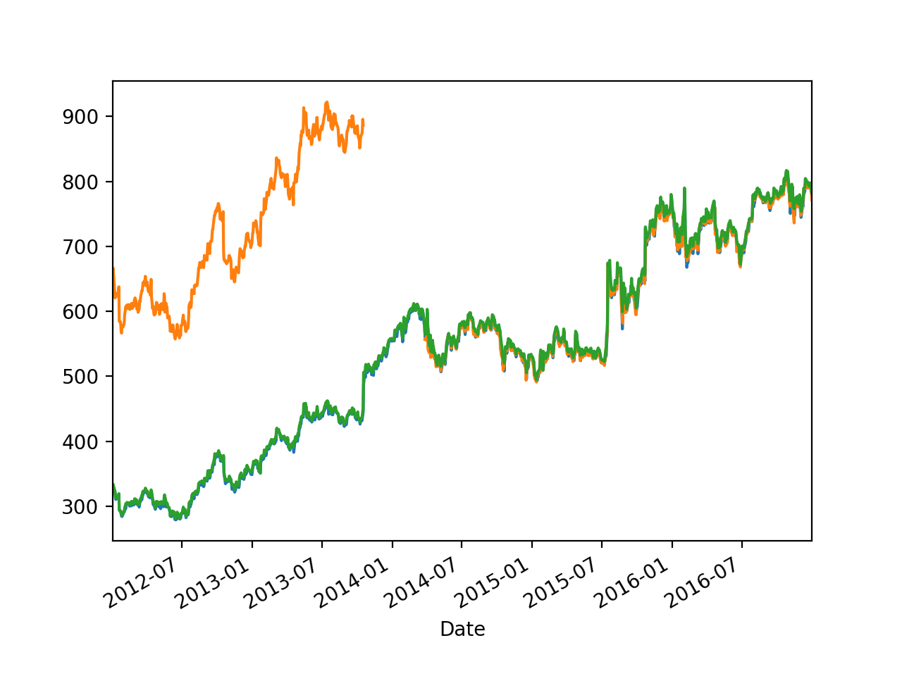
Example

Slide 117
Example
We can also get the data from Apple
>>> apple = pd.read_csv('AAPL.csv', parse_dates=[0], index_col=0)
>>> apple.info()
<class 'pandas.core.frame.DataFrame'>
DatetimeIndex: 9848 entries, 1980-12-12 to 2020-01-02
Data columns (total 6 columns):
Open 9847 non-null float64
High 9847 non-null float64
Low 9847 non-null float64
Close 9847 non-null float64
Adj Close 9847 non-null float64
Volume 9847 non-null float64
dtypes: float64(6)
memory usage: 538.6 KB

Slide 118
Example
We now rename the Close columns
>>> google.rename(columns={'Close':'GOOG'},
inplace = True)
>>> apple.rename(columns={'Close':'AAPL'},
inplace = True)

Slide 119
Example
Now we concatenate parts of the two data frames
axis = 1 means we want to concatenate columns
>>> my_df = pd.concat([google['GOOG'], apple['AAPL']], axis = 1)
>>> my_df.info()
<class 'pandas.core.frame.DataFrame'>
DatetimeIndex: 9848 entries, 1980-12-12 to 2020-01-02
Data columns (total 2 columns):
GOOG 1149 non-null float64
AAPL 9847 non-null float64
dtypes: float64(2)
memory usage: 230.8 KB

Slide 120
Example
Let's see what we got:
>>> my_df.plot()
<matplotlib.axes._subplots.AxesSubplot object at 0x7fd35892b7f0>
>>> plt.show()

Slide 121
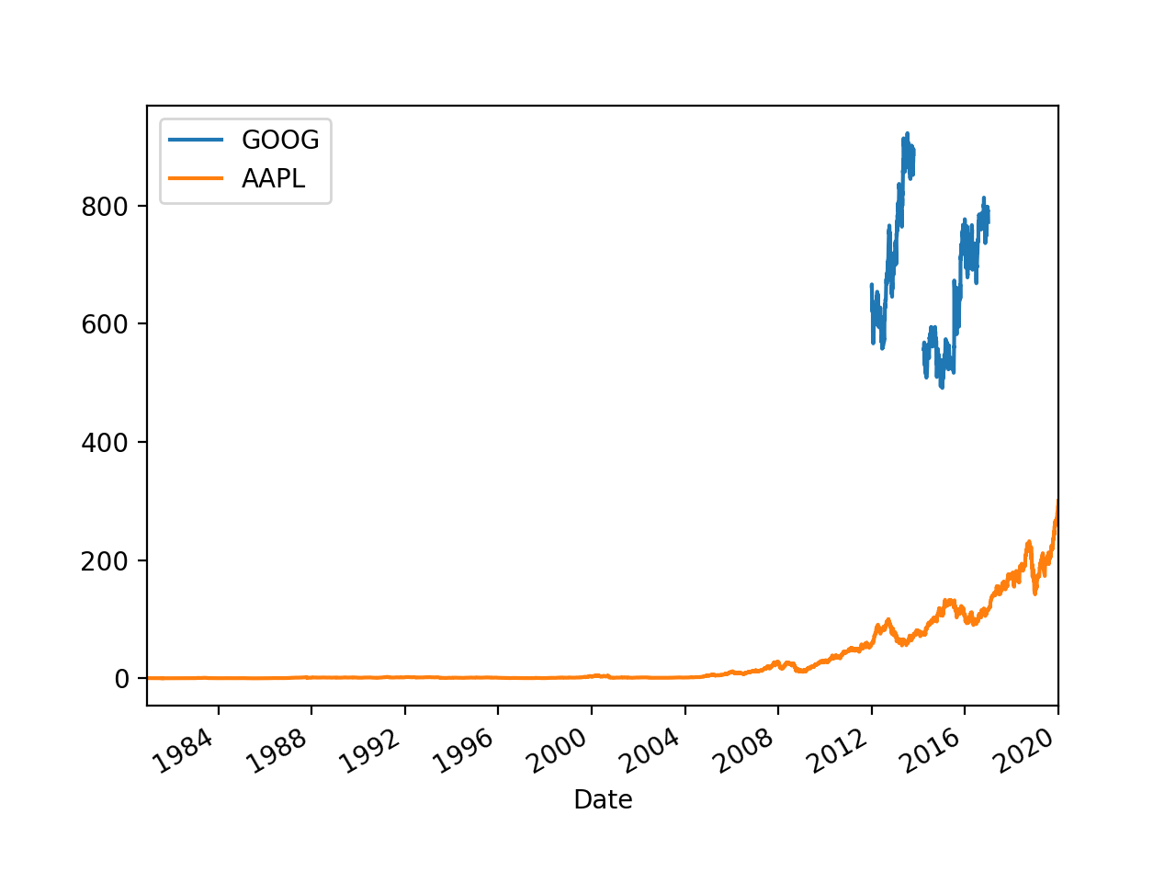
Example

Slide 122
Example
That does not tell us too much (other than that Google had a stock split, as did Apple)
First, we drop rows with NaN
>>> my_df.dropna(inplace = True)
>>> my_df.head()
GOOG AAPL
Date
2012-01-03 663.59 58.747143
2012-01-04 666.45 59.062859
2012-01-05 657.21 59.718571
2012-01-06 648.24 60.342857
2012-01-09 620.76 60.247143

Slide 123
Example
Now we normalize by setting the beginning value to 100
>>> normalized = my_df/my_df.iloc[0]*100
>>> normalized.head()
GOOG AAPL
Date
2012-01-03 100.000000 100.000000
2012-01-04 100.430989 100.537415
2012-01-05 99.038563 101.653575
2012-01-06 97.686825 102.716241
2012-01-09 93.545713 102.553316

Slide 124
Example
>>> normalized.plot()
<matplotlib.axes._subplots.AxesSubplot object at 0x7fd352b00460>
>>> plt.show()

Slide 125
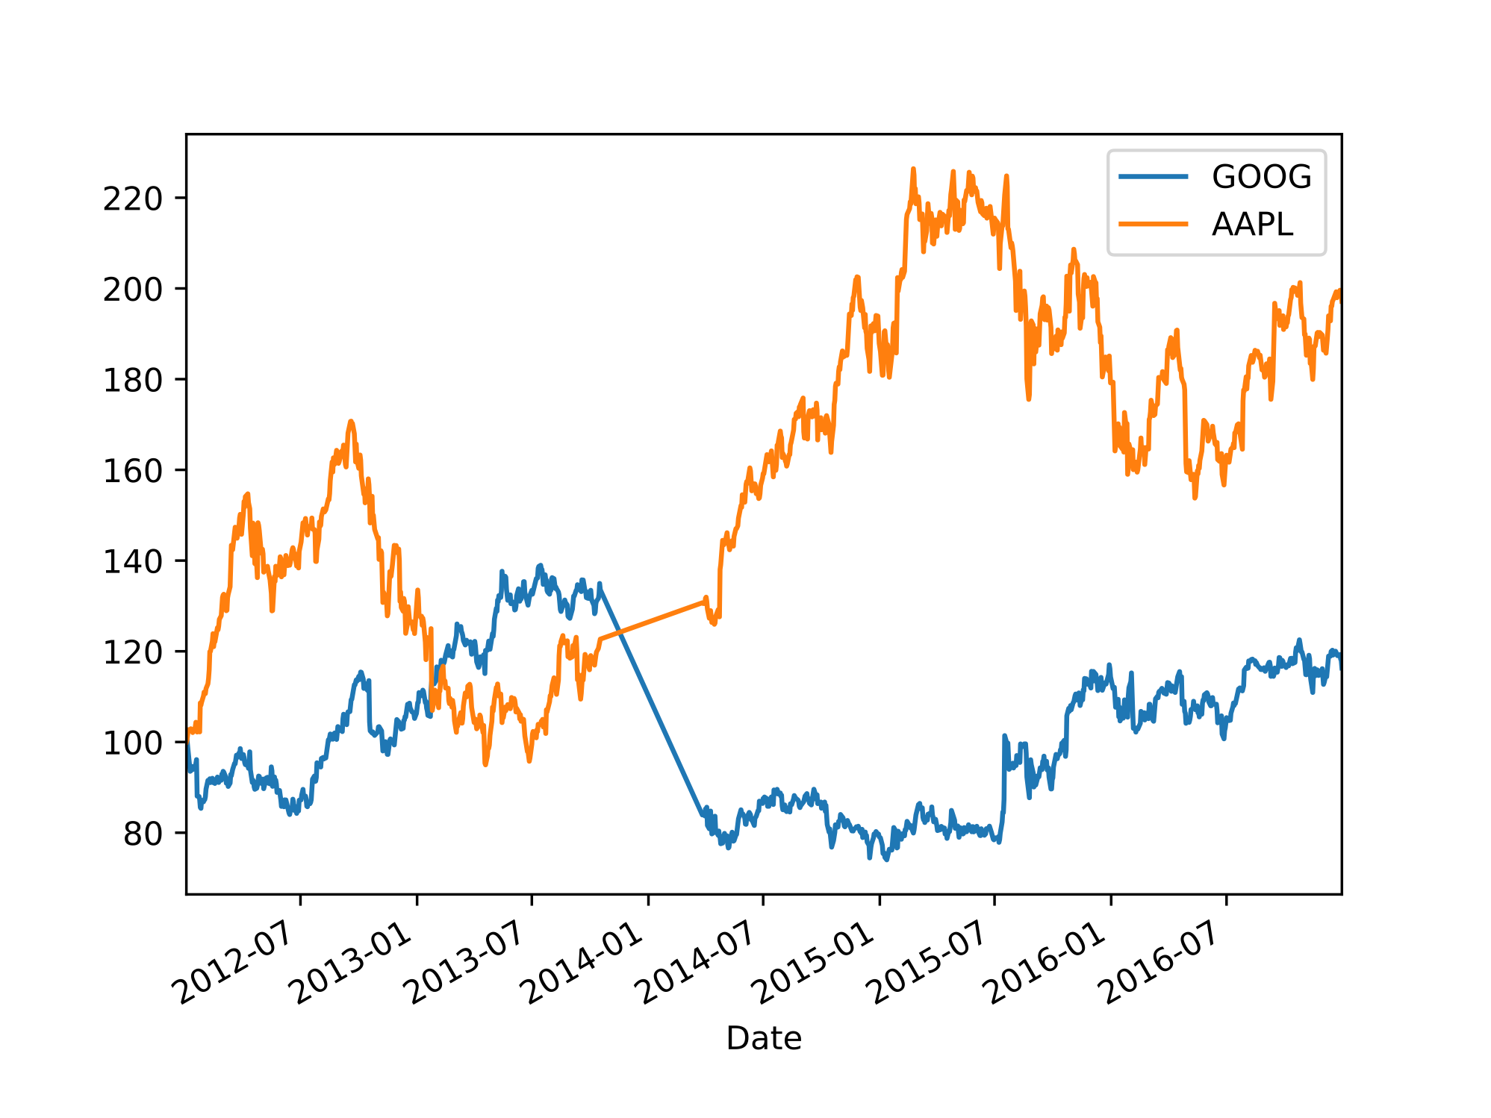
Example

Slide 126
Example

Slide 127
Example

