Slide 1
Support Vector Machines
Thomas Schwarz

Slide 2
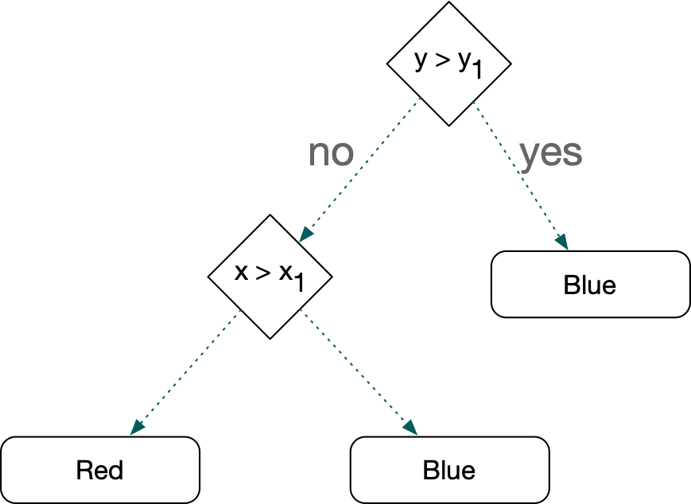
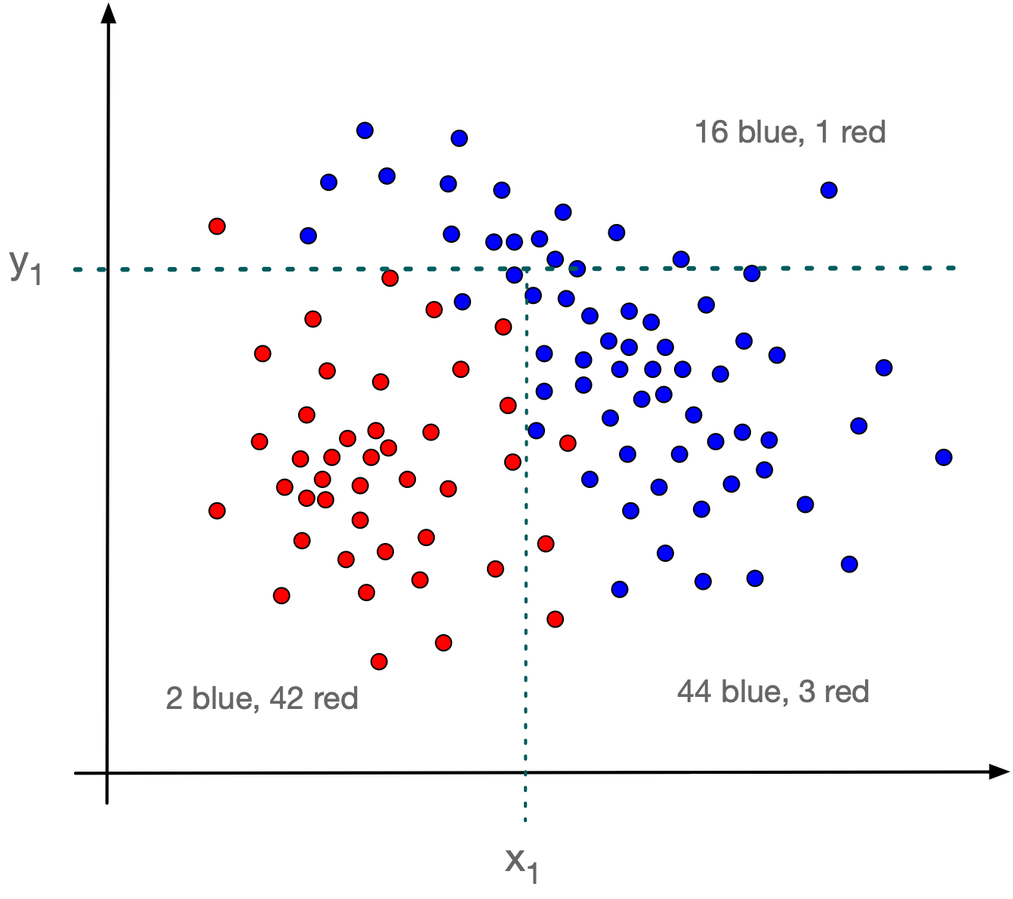
Introduction
Recall Decision Trees
Use the features in order to make recursively decisions
End up with a classification

Slide 3
Introduction
Decision trees are a type of supervised learning
Limited by using only a single feature

Slide 4
Introduction
KNN — k nearest neighbors
Supervised learning
to classify a feature point:
we look at all elements in the training set
Drawback: Not scalable if training set is large

Slide 5
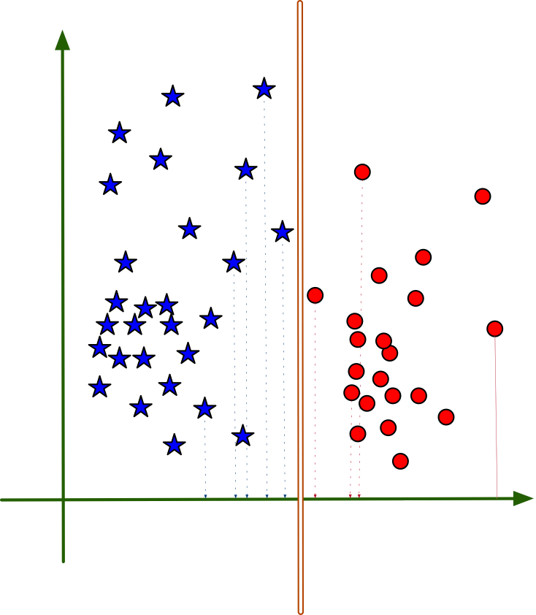
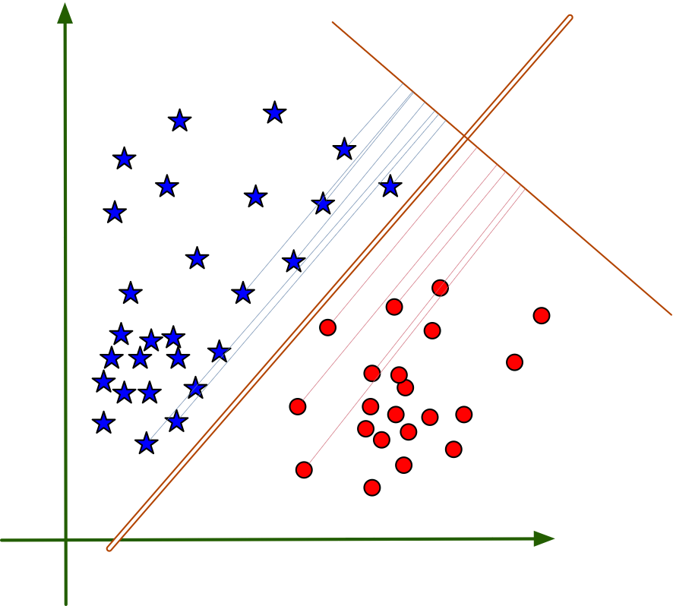
Introduction
SVM:
Uses any hyperplane to separate sets
Decision tree boundaries are
parallel to axes
SVM boundaries can be
any hyper-planes

Slide 6
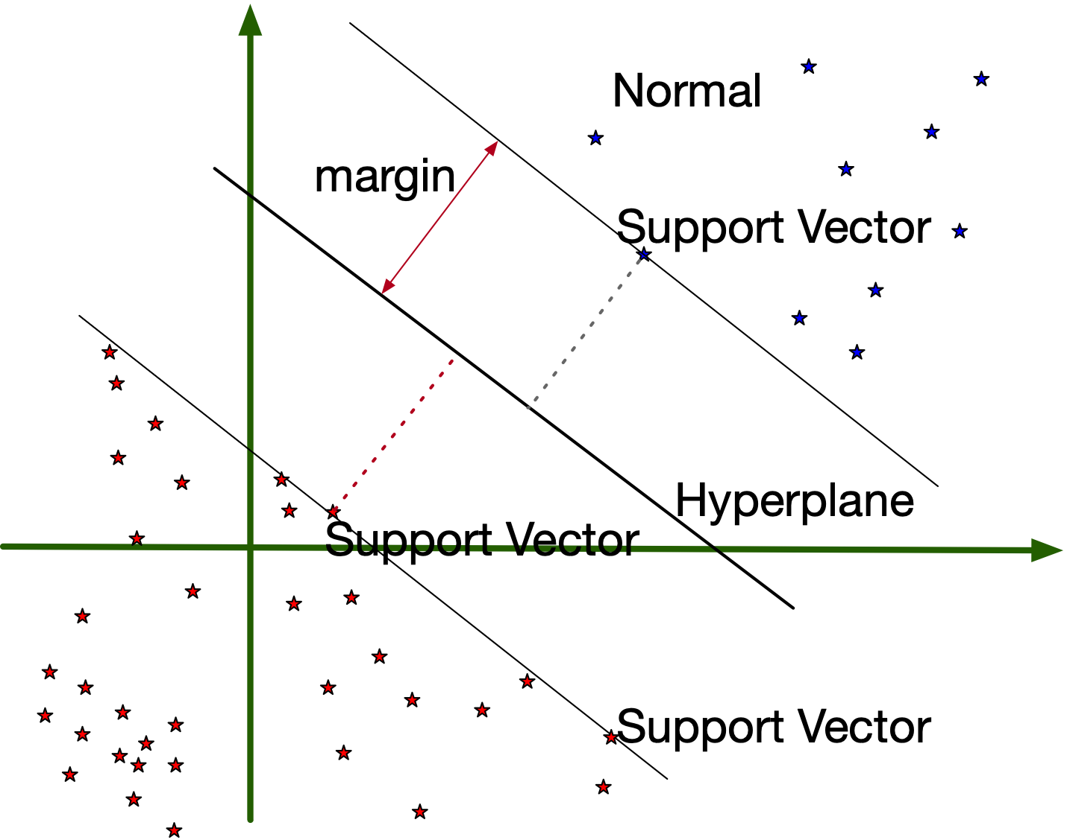
Introduction
SVM:
Can encode the hyper-plane using a few data points:
The support vectors

Slide 7
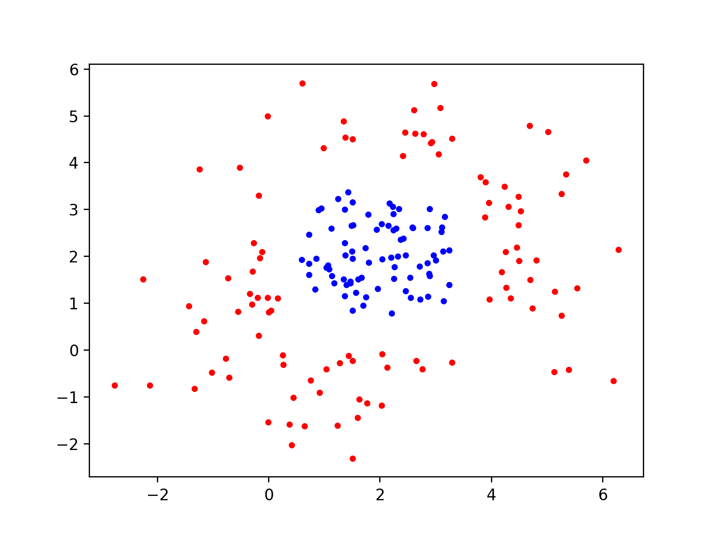
Introduction
SVM:
Can solve classification even if the data set is not linearly separable

Slide 8
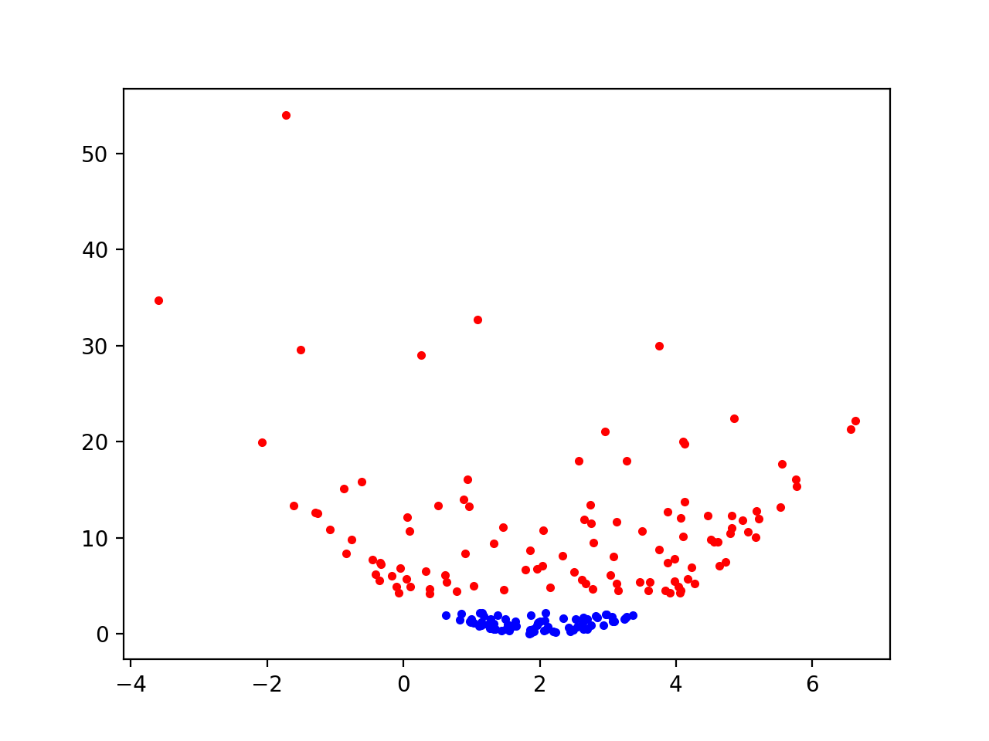
Introduction
Use a (non-linear transform of the data)
Kernel function: $(x,y)↦(x,(x-2)^{2}+(y-2)^{2})$

Slide 9
Mathematics of SVM
Hyper-plane through the origin is an $n-1$ -dimensional subspace of $R^{n}$
$$H=\{x∈R^{n}|c⋅x=0\}$$
$c$ is a "normal" vector, usually of length 1
Dot is the dot product
Can also use the matrix product
$$H=\{x∈R^{n}|c^{t}⋅x\}$$

Slide 10
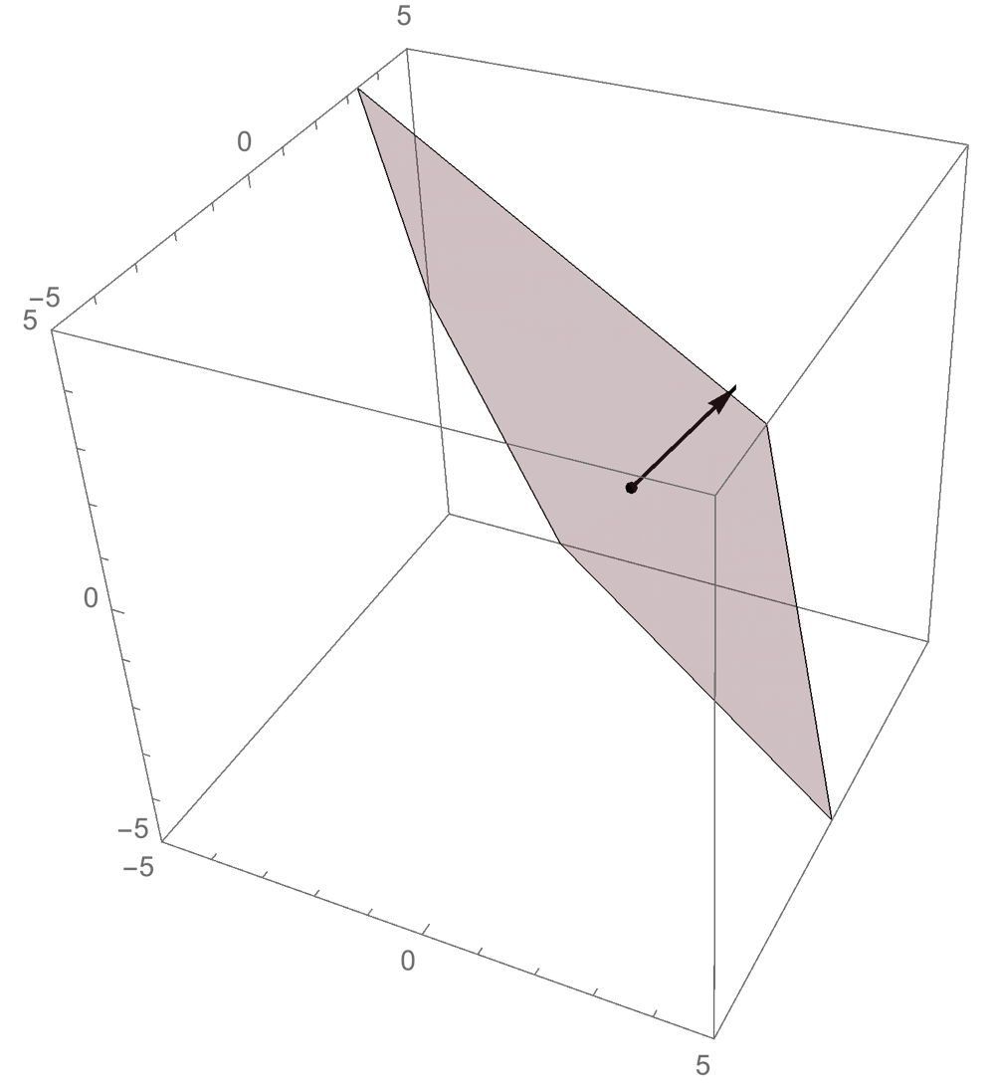
Mathematics
$$H=\{x∈R^{n}|c⋅x=0\}$$
Hyperplane defined
by normal vector (2,3,1)
through the point (1,1,0).

Slide 11
Mathematics
Task: Find $H_{c,p}$
Orthogonal to vector $c$
Passing through a point $p$

Slide 12
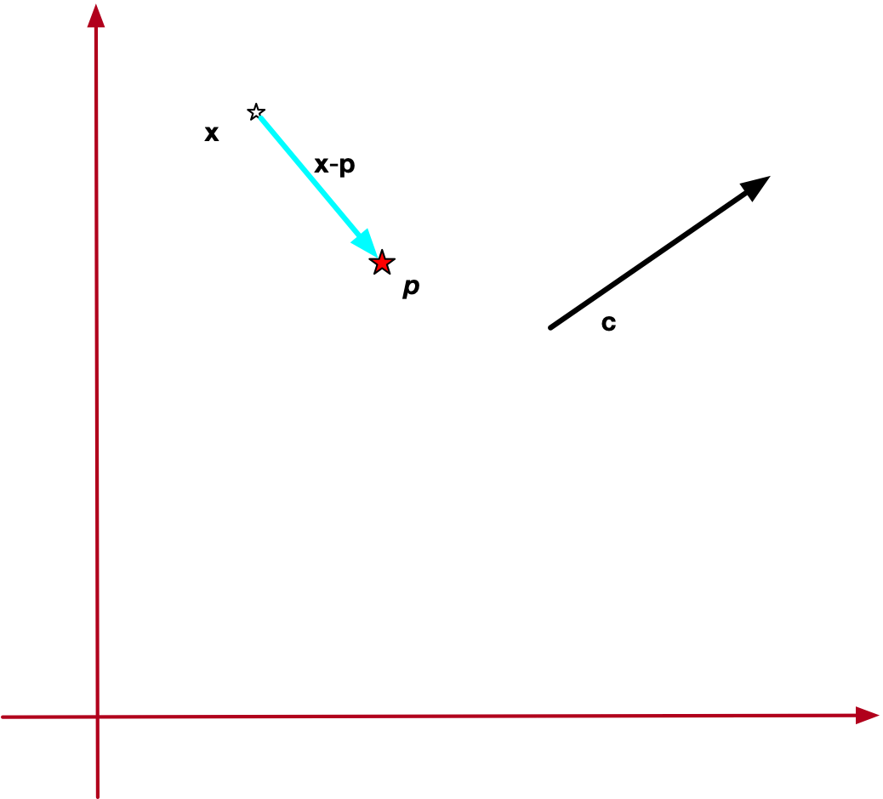
Mathematics
$x∈H_{c,p}$
if and only if $(x-p)$ is orthogonal to $c$
$$(x-p)⋅c=0$$

Slide 13
Mathematics
Hyperplane given by
$H_{c,p}=\{x∈R^{n}|x⋅c-c⋅p=0\}$
$=\{x∈R^{n}|x⋅c+b=0\}$
Defined by a linear functional $λ:R^{n}⟶R$
$$H_{c,p}=\{(x∈R^{n}|λ(x)=b\}$$

Slide 14
Mathematics
Hyperplane separates space into two halves:
$$H_{c,p}^{-}=\{(x∈R^{n}|λ(x)+b<0\}$$
$$H_{c,p}^{+}=\{(x∈R^{n}|λ(x)+b>0\}$$

Slide 15
Mathematics
Learning task:
Find a hyperplane such that
All feature vectors of one category are in $H_{c,p}^{-}$
All feature vectors of the other category are in $H_{c,p}^{+}$
The best hyperplane
(and most likely to achieve good results)
Maximizes distance of feature vectors from the plane

Slide 16
Mathematics
How do we determine the distance of a point from the hyper-plane?
Distance is length of a line between point and closest point on the hyperplane
This line needs to be orthogonal to the hyperplane
(Otherwise can find something closer

Slide 17
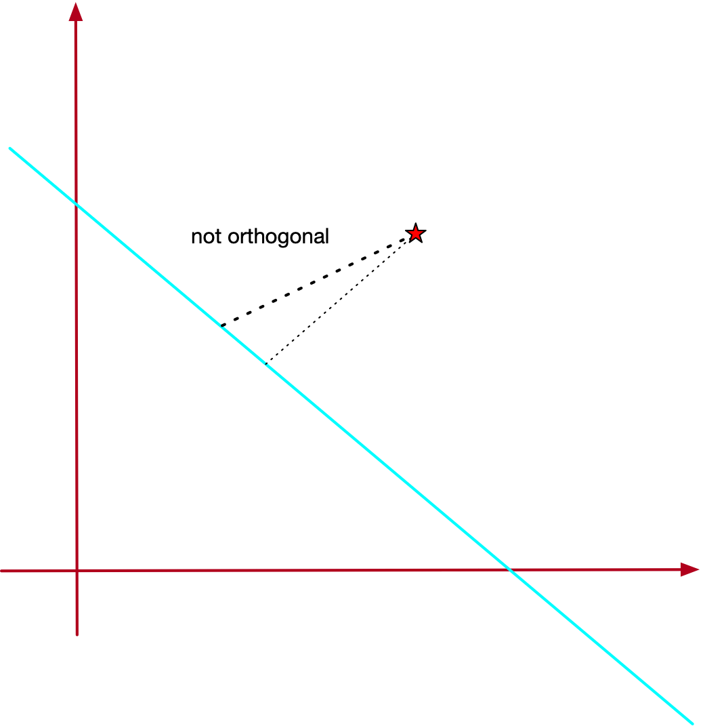
Mathematics

Slide 18
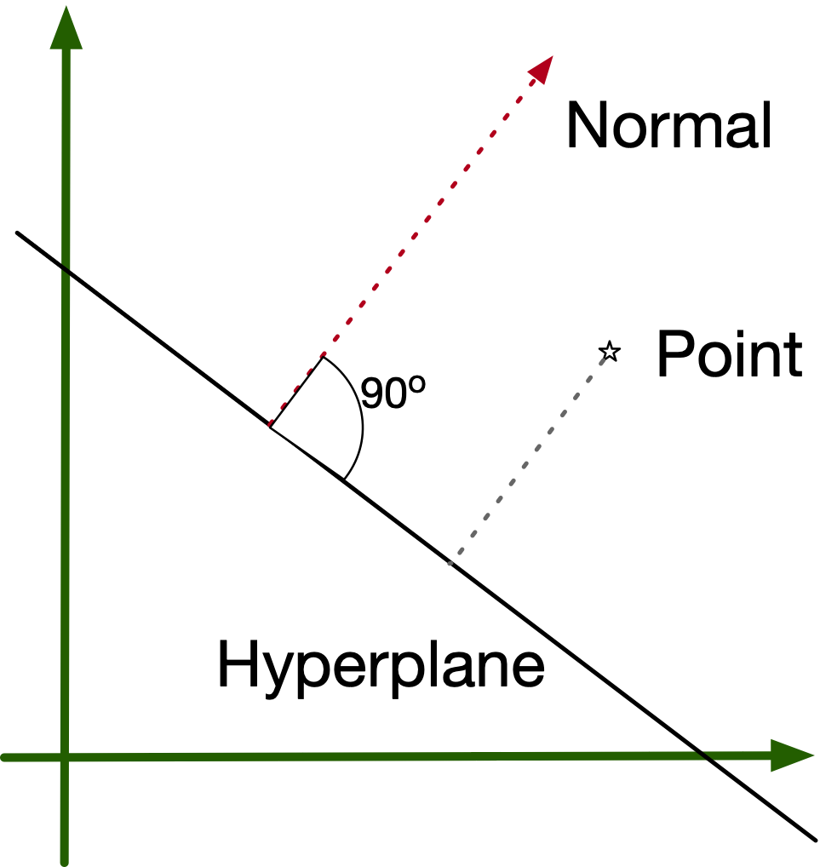
Mathematics
Distance of a point from a
hyperplane is the length of
a normal of the hyperplane
through the point.

Slide 19
Mathematics
Let $x$ be a point on the hyperplane
Hyperplane defined by $H_{w,b}=\{(x∈R^{n}|w⋅x+b=0\}$
Write
$x-p=αw+βv$, with $w⋅v=0$
Multiply with $w$
$w⋅(x-p)=αw⋅w+βw⋅v=α$ since $w⋅w=|w|^{2}=1$

Slide 20
Mathematics
Therefore
Projection of $x-p$ on normal $w$ is $w⋅(x-p).$
This is the distance between $p$ and the hyperplane:
$$\text{dist}(p,H_{w,b)}=|α|=|w⋅(x-p)|$$
$$=|w⋅x-w⋅p|=|-b-w⋅p|=|b+w⋅p|$$

Slide 21
Mathematics
Summary:
Want all the feature vectors of first category in
$$H_{w,b}^{-}=\{(x∈R^{n}|w⋅x+b<0\}$$
Want all the feature vectors of the second category in
$$H_{w,b}^{+}=\{(x∈R^{n}|w⋅x+b>0\}$$

Slide 22
Mathematics
First category gets label -1 , second category gets label +1
Condition becomes:
$$\text{label}(x_{i})(w⋅x_{i}+b)>0$$
In addition:
$$\min_{i∈I}\{\text{label}(x_{i})(w⋅x_{i}+b)\}→\text{max}$$
where we maximize over all normals $w$ of length 1 and all scalars $b$
All data points $\{x_{i}|i∈I\}$ contribute to the optimization

Slide 23
Mathematics
Allow normals to have length other than 1
Replace $b$ with $|w|b$
Optimization becomes
$\min_{i∈I}\{\text{label}(x_{i})(w⋅x_{i}+b)/|w|\}→\text{max}$
The points $x_{i}$ where the minima are attained are called the support vectors.

Slide 24
Mathematics

Slide 25
Mathematics
This even works if the two categories are not linearly separable

Slide 26
Mathematics
Problem: $\min_{i∈I}\{\frac{\text{label}(x_{i})(w⋅x_{i}+b)}{|w|}\}→\text{max}$
Support vectors: $\text{label}(x)(w⋅x+b)/|w|$ is minimum
Can multiply $w$ and $b$ with a scalar
Set scalar to $s=(\text{label}(x)(w⋅x+b))^{-1}$
Then:
$$(\text{label}(x)(w⋅x+b))=1$$
Distance of $x$ to hyperplane is $1/|w|$
All other feature vectors: $\text{label}(x)\left(w⋅x+b\right)≥1$

Slide 27
Mathematics
Can now reformulate optimization problem
$$\min_{w,b}\{\frac{|w|^{2}}{2}\}→min$$
subject to
$$∀i∈I:\text{label}(x_{i})(wx_{i}+b)≥1$$

Slide 28
Mathematics
Solve with Lagrange multiplier, traditionally called $α$
Solve subject to constraints
$∀i∈I:α_{i}(\text{label}(x_{i})(wx_{i}+b)-1)=0$ , $α_{i}≥0.$
$$L=\frac{|w|^{2}}{2}-\underset{i∈I}{∑}α_{i}(\text{label}(x_{i})(wx_{i}+b)-1)→min$$

Slide 29
Mathematics
Take partial derivatives with respect to $w$ and $b$
Since $\frac{δ}{δw_{i}}\left(\frac{1}{2}\overset{n}{\underset{i=1}{∑}}w_{i}^{2}\right)=w_{i}$
We obtain
$$\frac{δ}{δw}L=w-\overset{n}{\underset{i=1}{∑}}α_{i}\text{label}(x_{i})x_{i}$$
$$\frac{δ}{δb}L=\overset{n}{\underset{i=1}{∑}}α_{i}\text{label}(x_{i})$$

Slide 30
Mathematics
Setting them to zero for the minimum, we get
$w=\overset{n}{\underset{i=1}{∑}}α_{i}\text{label}(x_{i})x_{i}$
and therefore
$w=\overset{n}{\underset{i=1}{∑}}α_{i}\text{label}(x_{i})x_{i}$

Slide 31
Mathematics
$w=\overset{n}{\underset{i=1}{∑}}α_{i}\text{label}(x_{i})x_{i}$ implies
$w$ is a linear combination of features

Slide 32
Mathematics
Use $\frac{|w|^{2}}{2}=\frac{w⋅w}{2}$ in our optimization problem
$$L=\frac{|w|^{2}}{2}-\underset{i∈I}{∑}α_{i}(\text{label}(x_{i})(wx_{i}+b)-1)→min$$
Use
$-\underset{i∈I}{∑}α_{i}(\text{label}(x_{i})(wx_{i}+b)-1)$
$$=-w⋅(\overset{n}{\underset{i=1}{∑}}α_{i}\text{label}(x_{i}))-\overset{n}{\underset{i=1}{∑}}α_{i}\text{label}(x_{i})b+\overset{n}{\underset{i=1}{∑}}α_{i}$$
$$=-w⋅w+\overset{n}{\underset{i=1}{∑}}α_{i}$$

Slide 33
Mathematics
Function $L$ is now simplified:
$$L=-\frac{1}{2}w⋅w+\overset{n}{\underset{i=1}{∑}}α_{i}$$

Slide 34
Mathematics
Plugging in again
$$w=\overset{n}{\underset{i=1}{∑}}α_{i}\text{label}(x_{i})x_{i}$$
we obtain
$$L=\overset{n}{\underset{i=1}{∑}}α_{i}-\frac{1}{2}\overset{n}{\underset{i=1}{∑}}\overset{n}{\underset{j=1}{∑}}α_{i}α_{j}\text{label}(x_{i})\text{label}(x_{j})x_{i}⋅x_{j}$$
which we want to maximize subject to constraints
$∀i∈I:α_{i}≥0$ and $\sum_{i=1}^{n}{α_{i}}\text{label}(x_{i})=0$

Slide 35
Mathematics
This is the "dual" optimization problem, but it is quadratic in the alphas.
This means that it can be solved using Kuhn Tucker

Slide 36
Mathematics: Soft Margin SVM
The preceding works if the data set is linearly separable
If not, we introduce slack variables
$$\text{label}(x_{i})(w⋅x_{i}+b)≥1-ξ_{i}$$
They measure the violation of the separation condition
If zero: separation condition is fulfilled and the point lies $≥\frac{1}{|w|}$ away from the hyperplane
If $0<ξ_{i}<1$: point lies inside the margin, but point is classified
If $ξ_{i}≥1$, point is mis-classified

Slide 37
Mathematics
Choosing an optimization function is no longer straight-forward
Do we want a hyperplane with a few violations or do we want to minimize the total amount of violations

Slide 38
Mathematics
One possibility:
$$\min_{w,b,ξ_{i}}\left(\frac{|w|^{2}}{2}+C\overset{n}{\underset{i=1}{∑}}ξ_{i}^{k}\right)$$
subject to
$$∀i∈I:\text{label}(x_{i})\left(\text{w}⋅x_{i}+b\right)≥1-ξ_{i}$$
$$∀i∈I:ξ_{i}≥0$$

Slide 39
Mathematics
The power k in
$\min_{w,b,ξ_{i}}\left(\frac{|w|^{2}}{2}+C\overset{n}{\underset{i=1}{∑}}ξ_{i}^{k}\right)$
describes our policy:
k=1: Hinge loss
k=2: Quadratic losss
C describes the trade-off between large margins and loss minimization

Slide 40
Mathematics
Much research has been spent on optimizing for each case
Luckily, we do not have to use them

Slide 41
SVM with Scikit-Learn
Has a whole module svm
from sklearn import svm

Slide 42
SVM with Scikit-Learn
Generate data
d_a = np.random.multivariate_normal(
mean = [1,3],
cov = [ [.1,.02], [.02,.1]],
size=100)
d_b = np.random.multivariate_normal(
mean = [3,4],
cov = [ [.2,.005], [.005,.2]],
size=100)

Slide 43
SVM with Scikit-Learn
Data are the feature, target are the labels
Now fit the whole data set
data = np.concatenate((d_a, d_b), axis=0)
target = np.concatenate((np.zeros(100), np.ones(100)))
clf = svm.SVC(kernel='linear', C=3)
clf.fit(data, target)

Slide 44
SVM with Scikit-Learn
Now print stuff:
To see the coefficient, we needed to use the linear kernel
print(clf.support_vectors_)
w = clf.coef_[0]
a = -w[0] / w[1]
xx = np.linspace(1.5, 2.25)
yy = a * xx - (clf.intercept_[0]) / w[1]
print('w',w)
print(a)

Slide 45
SVM with Scikit-Learn
Support vectors
Normal and intercept:
[[1.83311697 3.13576805]
[1.49922547 3.41011599]
[1.80136907 3.32299734]
[2.10066171 3.82740692]
[2.16113553 3.35389843]
[2.48658474 2.79743539]]
w [2.63976203 0.98909858]
-2.6688563564106373

Slide 46
SVM with Scikit-Learn
Draw the data and the hyperplane
plt.figure(1)
plt.plot(d_a[:,0], d_a[:,1], 'b.')
plt.plot(d_b[:,0], d_b[:,1], 'r.')
plt.plot(xx, yy, 'k:')
plt.show()

Slide 47
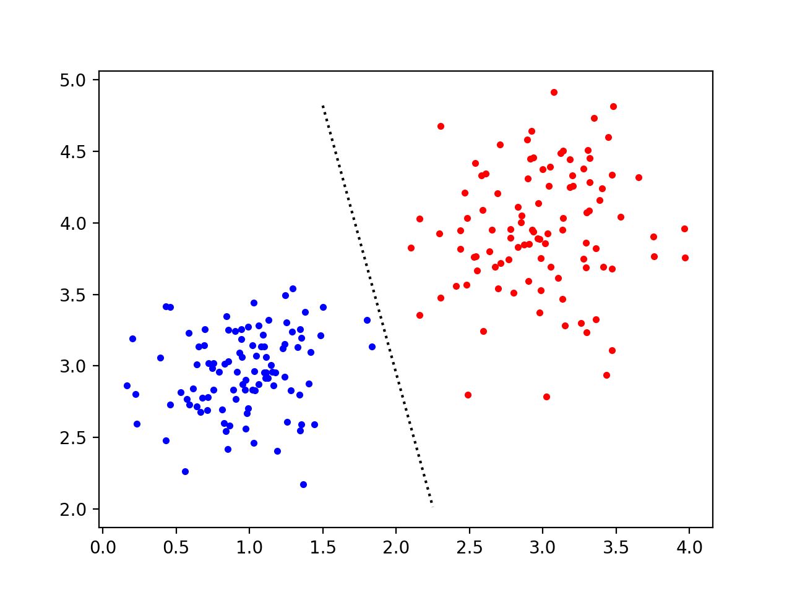
SVM with Scikit-Learn

Slide 48
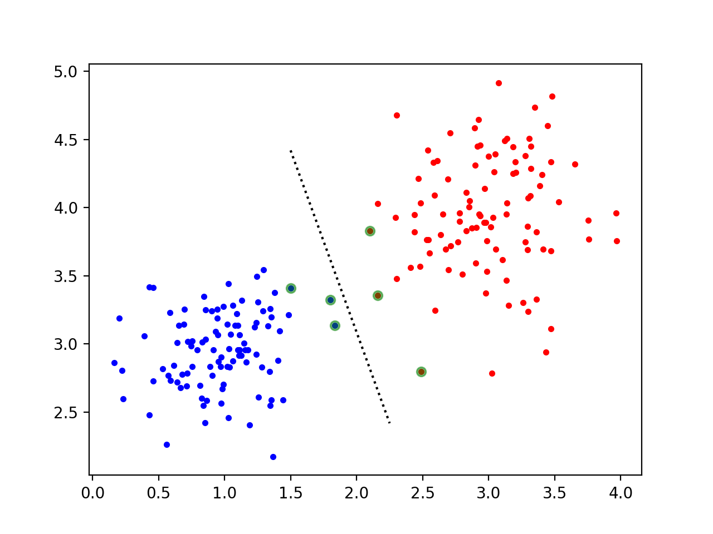
SVM with Scikit-Learn

Slide 49
SVM with Scikit-Learn
New points are evaluated only using the support vectors
This makes SVM more efficient

Slide 50
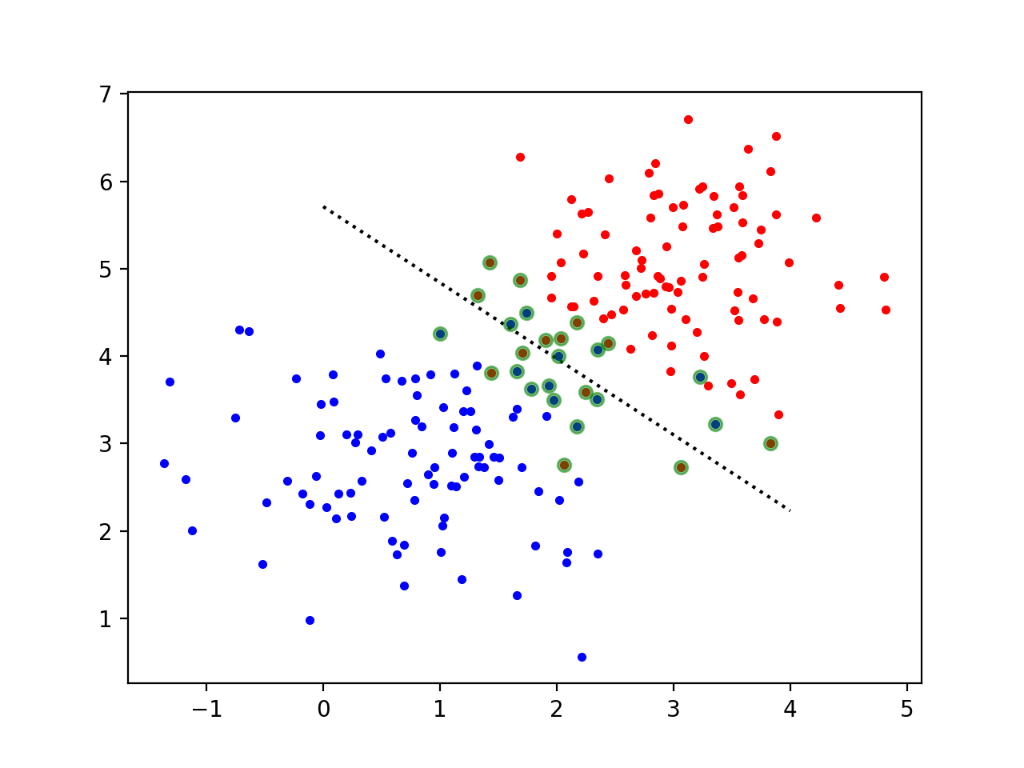
SVM with Scikit-Learn
Example with non-separable data sets

Slide 51
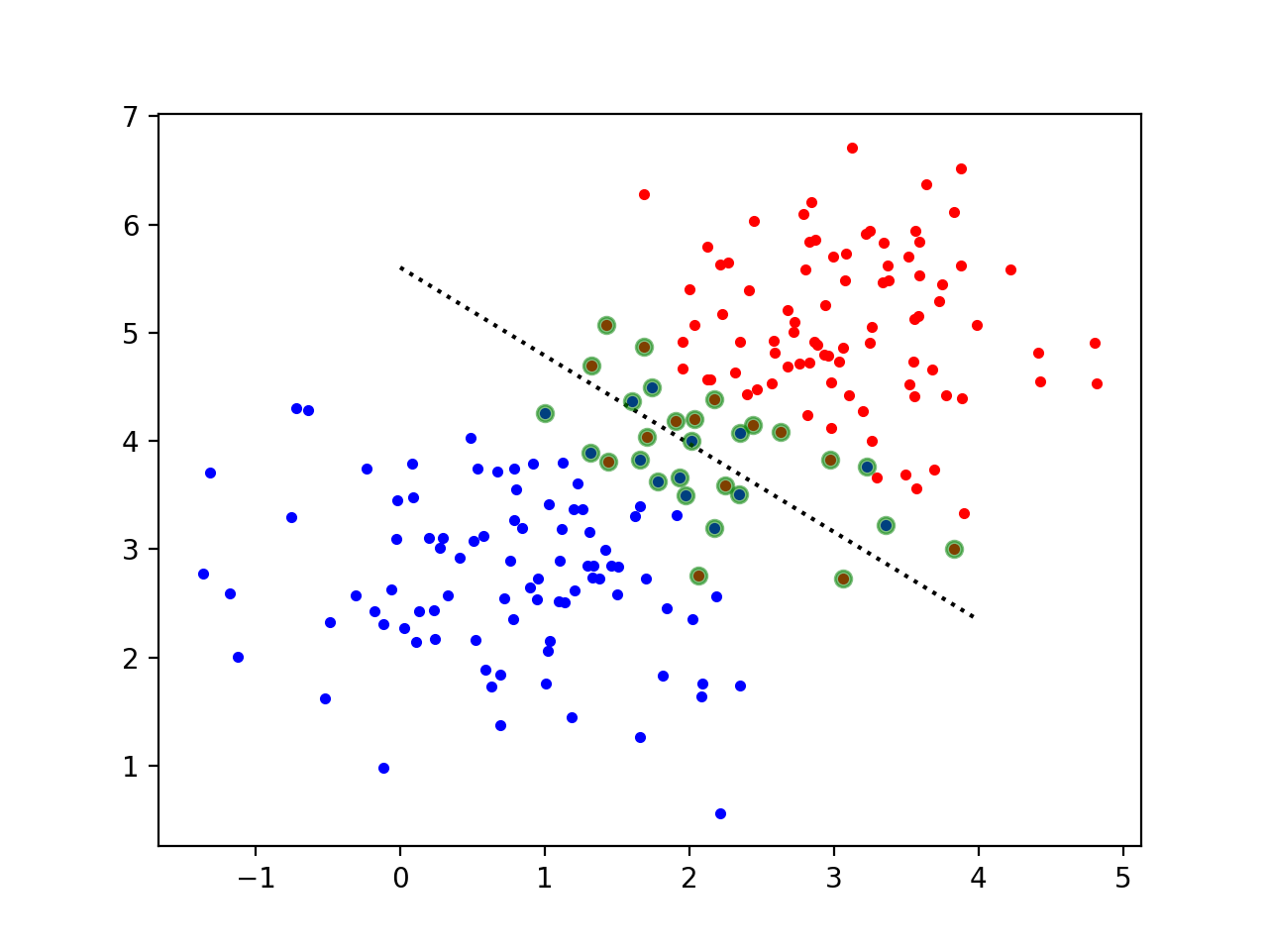
SVM with Scikit-Learn
In this case, the C-value does not change much
C=3
C=0.5

Slide 52
SVM with Scikit-Learn
This is a very difficult set to classify without transformation

Slide 53
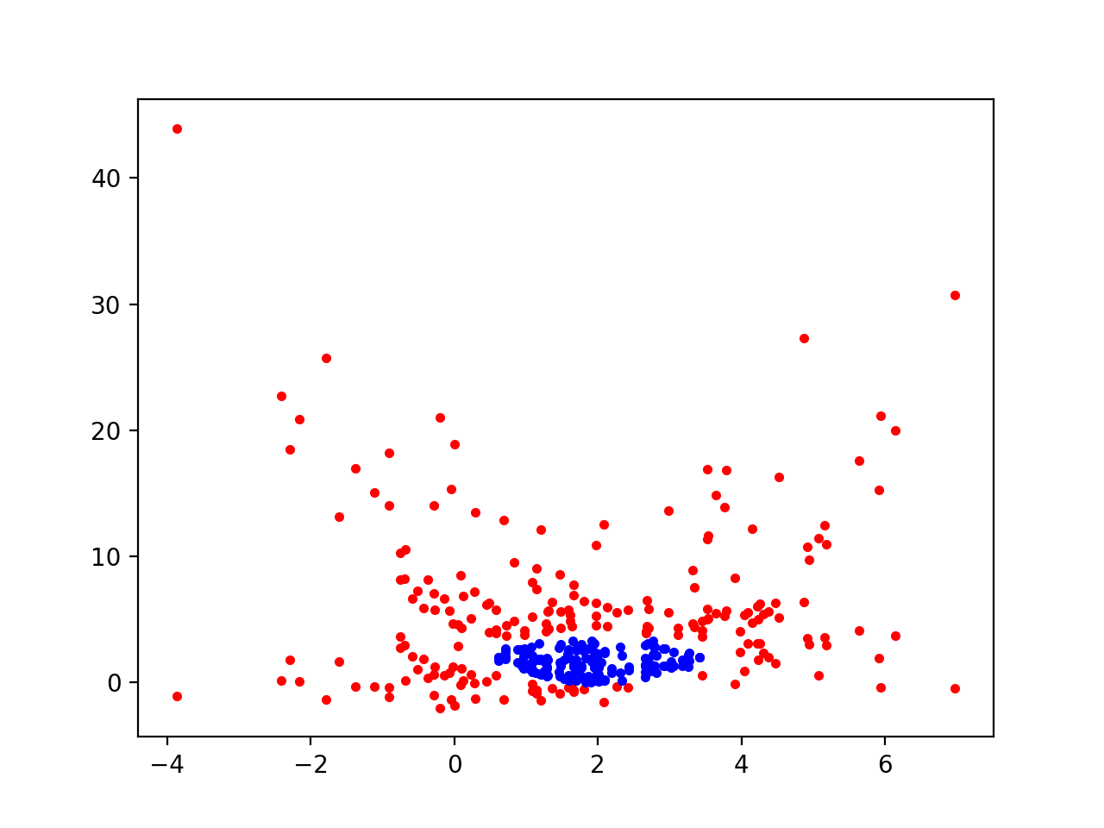
SVM with Scikit-Learn

Slide 54
SVM with Scikit-Learn
If we try with several kernels, results are not so good
Import some stuff
import numpy as np
import matplotlib.pyplot as plt
from sklearn import svm
from sklearn import metrics
from sklearn.model_selection import train_test_split
np.random.seed(12)

Slide 55
SVM with Scikit-Learn
Generate data set
d_a = np.random.multivariate_normal(
mean = [2,2],
cov = [ [.2,.15], [.15,.2]],
size=150)
d_b = np.random.multivariate_normal(
mean = [2,2],
cov = [ [3,1], [1,3]],
size=220)
one = np.array( [x for x in d_b if
np.linalg.norm(x-[2,2])<1.5])
two = np.array( [x for x in d_b if
np.linalg.norm(x-[2,2])>2])

Slide 56
SVM with Scikit-Learn
Split dataset into training and test set (70% training)
X_train, X_test, y_train, y_test =
train_test_split(
data,
target,
test_size=0.3)

Slide 57
SVM with Scikit-Learn
Train
clf = svm.SVC(kernel = 'sigmoid')
clf.fit(X_train, y_train)

Slide 58
SVM with Scikit-Learn
Predict and get accuracy:
y_pred = clf.predict(X_test)
print("Accuracy:",
metrics.accuracy_score(y_test, y_pred))

Slide 59
SVM with Scikit-Learn
Accuracy: linear 0.62
Accuracy: poly 0.7666666666666667
Accuracy: rbf 1.0
Accuracy: sigmoid 0.34

Slide 60
SVM with Scikit-Learn
Could use a custom kernel
def my_kernel(X, Y):
return np.dot((X-[2,2])**2,((Y-[2,2])**2).T)
clf = svm.SVC(kernel = my_kernel)
clf.fit(X_train, y_train)

Slide 61
SVM with Scikit-Learn
Not surprisingly, this works completely
Accuracy: 1.0

Slide 62
SVM with Scikit-Learn
Radial basis function kernel
$$K(x,y)=exp\left(-\frac{||x-y||^{2}}{2σ^{2}}\right)$$

