Slide 1
Probability & Statistics
Thomas Schwarz, SJ

Slide 2
Overview
Statistics is the lifeblood of data science
  You need to learn how to use statistics
  But the calculations are implemented in two powerful Python modules
    scipy.stats
    statsmodels

Slide 3
Probability
We concentrate on categorical data
  Categorical data is discrete: e.g. "not infected", "infected, but no symptoms", "sick", "recovered", "dead"
  Categorical data can be ordinal :
    number of cases in Milwaukee County
  Categorical data can be nominal :
    Republican, Democrat, Other, Non-affiliated

Slide 4
Probability Distributions for Categorical Data
Binomial distribution:
  Given a binary characteristic (yes/no) and a sample / population of $n$ what is the probability that $i$ have the characteristics
  If we assume that the presence of the characteristic in one individual is independent of the characteristic of another individual
  $p_{binom}(y,n,π)=\frac{n!}{y!(n-y)!}π^{y}π^{(n-y)}$

Slide 5
In Python
Let's run an experiment:
  Select an element of a population with probability p
  Count how often a population member is selected
  Then normalize
def run_trials(runs, pop_size, p):
results = np.zeros((pop_size+1))
for _ in range(runs):
seen = len([x for x in np.random.rand(pop_size) if x < p])
results[seen]+=1
return results/runs

Slide 6
In Python
Then compare with the binomial probability
  binom.pmf is the probability mass function $\left({n \atop k}\right)p^{k}(1-p)^{n-k}$
from scipy.stats import binom
results = run_trials(runs, pop_size, p)
xvalues = np.arange(0, len(results))
binom.pmf(xvalues,pop_size, p)

Slide 7
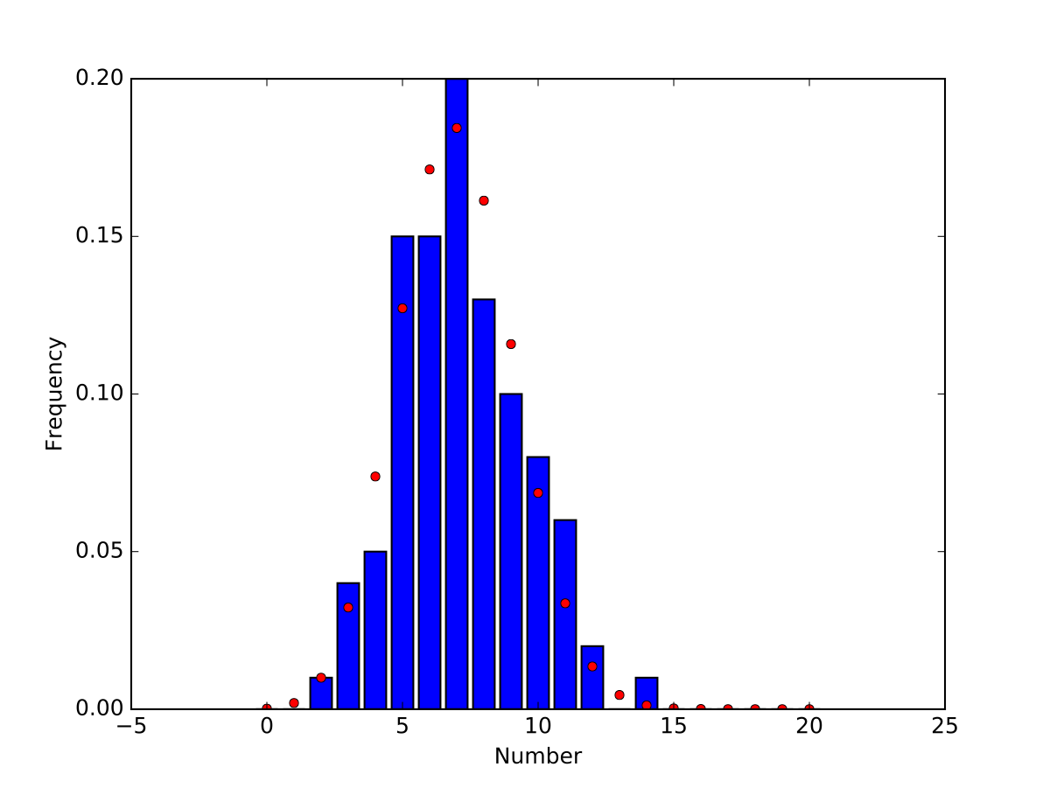
In Python
100 runs : Prediction and experimental results differ

Slide 8
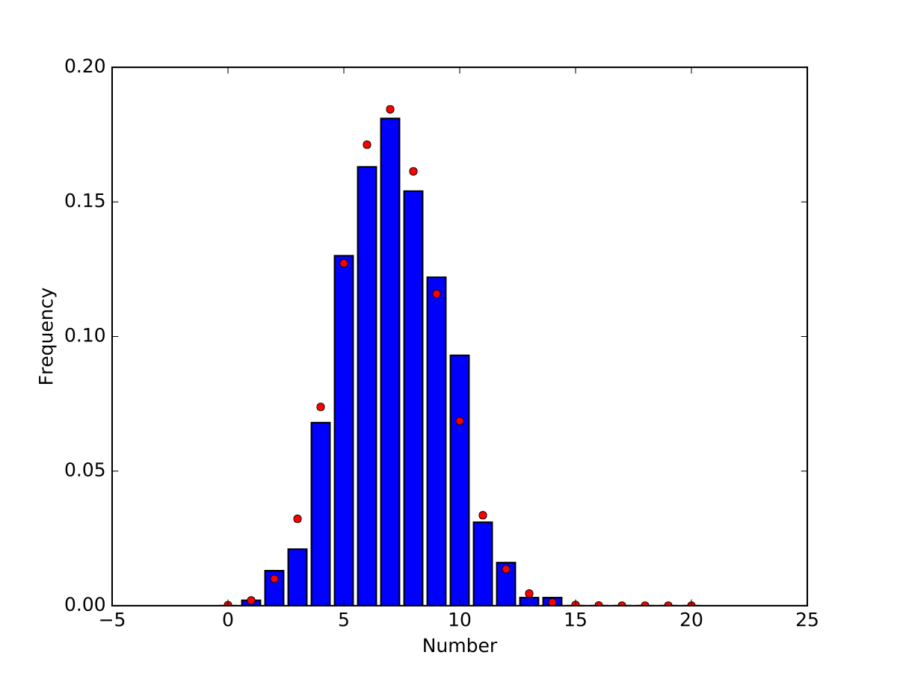
In Python
1000 runs: getting better

Slide 9
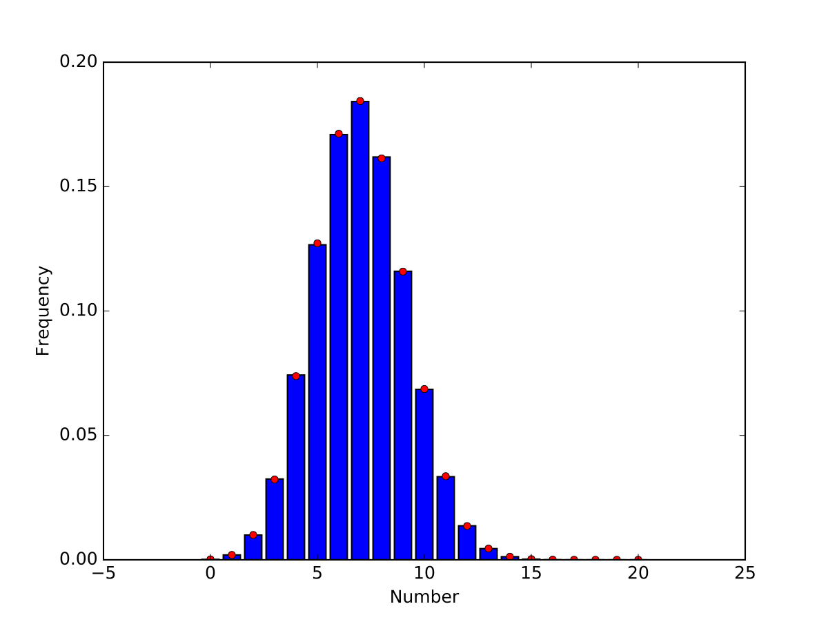
In Python
1,000,000 runs

Slide 10
Likelihood Estimation
Problem: Given data, can we say something about the underlying probability distribution
  Thought experiment: Throw a fair coin 10 times
    H H H H H H H H H H is equally likely than H H T T H T T H H T
    Why do we think the first one is fishy and the second one not?
    We use a statistics (number of heads) and assume that coin is fair
    Observing 10 heads has probability $2^{-10}=0.0009765625$
      Observing 5 heads and 5 tails has probability $\left({10 \atop 5}\right)(\frac{1}{2})^{5}(\frac{1}{2})^{5}=0.24609375$

Slide 11
Likelihood Estimation
Reversely
  Given a sample and a putative probability $π$
  Likelihood:
    What is the probability given $π$ to observe a statistics on the sample

Slide 12
Likelihood Estimation
Assume a binominally distributed random variable
  How do we estimate $π$ from a sample?
    Likelihood: Given $π$, what is the chance to observe what we have seen
    Observed: $x$ out of $n$
    Probability that this happens is $L(x:p)=\frac{x!(n-x)!}{n!}π^{x}(1-π)^{(n-x)}$

Slide 13
In Python
Example: observed 30 out of 100
def likelihood(x, pop_size):
prob = np.linspace(0,1,1000)
likelihood = binom.pmf(x, pop_size, prob)
fig = plt.figure()
ax = plt.axes()
ax.set_xlabel("Probability")
ax.set_ylabel("Frequency")
ax.plot(prob, likelihood)
fig.savefig("{}{}.pdf".format(x,pop_size))

Slide 14
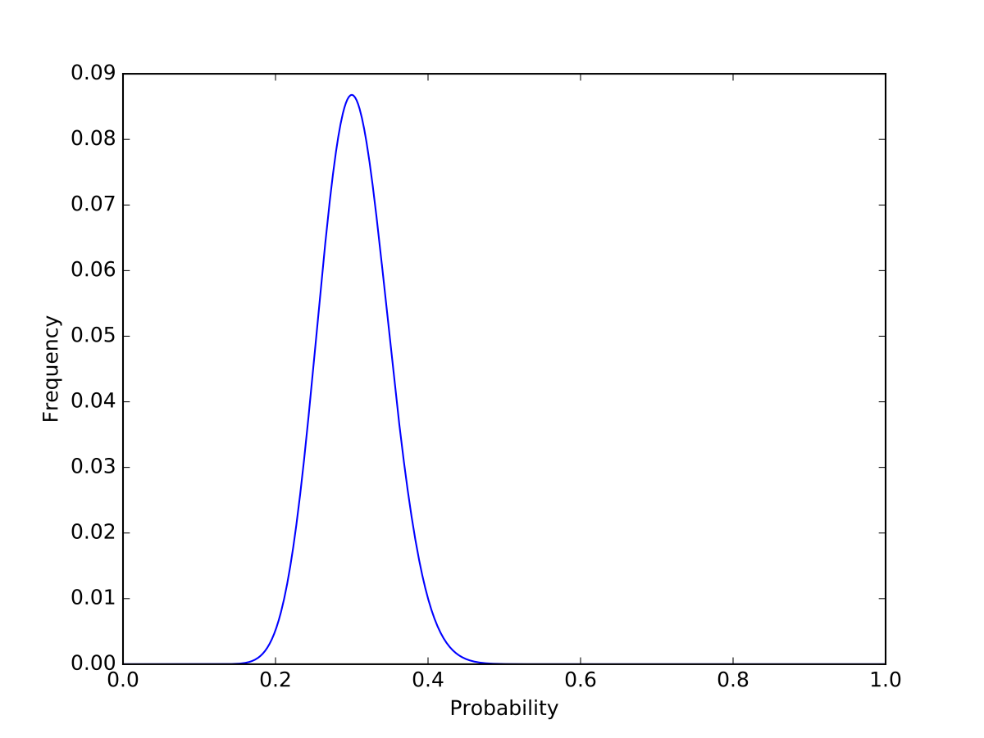
In Python
Example: observed 30 out of 100

Slide 15
Binomial Distribution
Likelihood is maximized for $π=30/100$
Formally:
    $$L(x:p)→max$$
    $$\text{const}⋅p^{x}(1-p)^{(n-x)}→max$$
  which implies by differentiation that
    $$xp^{x-1}(1-p)^{n-x}-(n-x)p^{x}(1-p)^{n-x-1}=0$$
    $$x(1-p)=(n-x)p$$
    $$p=\frac{x}{n}$$

Slide 16
Binomial Distribution
Therefore: Maximum Likelihood estimator for $π$ given $x$ out of $n$ observations is
  $$\frac{x}{n}$$

Slide 17
Getting Statistics

Slide 18
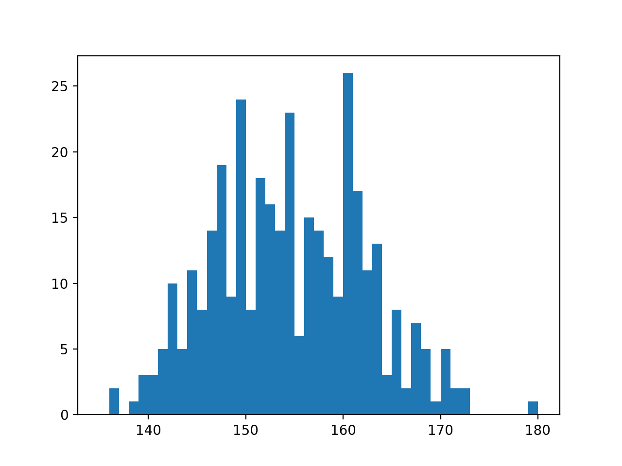
First Step : Visualize
Example: Heights

Slide 19
Second Step: Get Stats
Statistic: any type of measure taken on a sample
Implemented in scipy.stats
Random number generation in np.random

Slide 20
Sample Generation
Use np.random
  Returns samples for many different distributions
    E.g.
      np.random.normal(mean, std, size=1000)
      np.random.gamma(shape, scale, size=1000)
  Can use numpy.random.seed(12345)to insure same behavior

Slide 21
Getting Statistical Measures
Use scipy.stats
Has many different distributions
  scipy.stats.norm is a distribution object
    Has a pdf, a cdf, …

Slide 22
Getting Statistic Measures
def stats():
np.random.seed(6072001)
sample1 = create_beta(alpha = 1.5, beta = 2)
fig = plt.figure()
ax = plt.axes()
ax.set_xlabel("Values")
ax.set_ylabel("Frequency")
ax.hist(sample1, bins = 20)
fig.savefig('beta15_2')
print(f'mean is {np.mean(sample1)}')
print(f'median is {np.median(sample1)}')
print(f'25% quantile is {scipy.stats.scoreatpercentile(sample1,25)}')
print(f'75% quantile is {scipy.stats.scoreatpercentile(sample1,75)}')
print(f'st. dev. is {np.std(sample1)}')
print(f'skew is {scipy.stats.skew(sample1)}')
print(f'kurtosis is {scipy.stats.kurtosis(sample1)}')

Slide 23
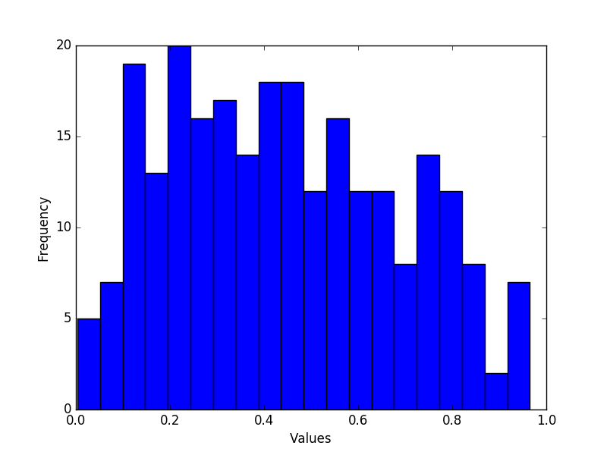
Getting Statistic Measures

Slide 24
Getting Statistic Measures
Many statistical descriptors are available:
mean is 0.44398507464612896
median is 0.42091200120073147
25% quantile is 0.2421793406556383
75% quantile is 0.6277333146506446
st. dev. is 0.24067438845525105
skew is 0.24637036296183917
kurtosis is -0.933113268968349

Slide 25
Getting Statistical Measures
Can also fit to distributions
  Example: Height data
    Use norm.fit
from scipy.stats import norm
pop1 = np.array([151.765, 156.845, 163.83, 168.91,
165.1, 151.13, 163.195, 157.48, 161.29, 146.4,
147.955, 161.925, 160.655, 151.765, 162.8648,
171.45, 154.305, 146.7, …
loc, std = norm.fit(pop1)

Slide 26
Getting Statistical Measures
To display the data:
  Create bins for a histogram
  We need the centers later on
  Numpy has a function that calculates a histogram
bins = np.linspace(135, 180, 46)
binscenter = np.array([(bins[i]+bins[i+1])/2
for i in range(len(bins)-1)])
dt = np.histogram(pop1, bins)[0]

Slide 27
Getting Statistical Measures
dt contains the number of elements in a bin
[ 0 2 0 1 3 3 5 10 5 11 8 14 19 9 24 8
18 16 14 23 6 15 14 12 9 26 17 11 13 3 8 2
7 5 1 5 2 2 0 0 0 0 0 0 1]

Slide 28
Getting Statistical Measures
We now determine mean and standard deviation using the fit function
We could do the same using np.mean and np.std
loc, std = norm.fit(pop1)
print(loc, std)

Slide 29
Getting Statistical Measures
We now create a normal distribution object with this mean and this standard deviation
pdf = norm(loc, std).pdf

Slide 30
Getting Statistical Measures
Now, we draw both the histogram and the pdf
  The pdf has an integral of 1, so we multiply with the number of elements in the population
plt.figure()
plt.bar(binscenter, dt, width = bins[1]-bins[0])
plt.plot(binscenter, len(pop1)*pdf(binscenter),'red')
plt.show()

Slide 31
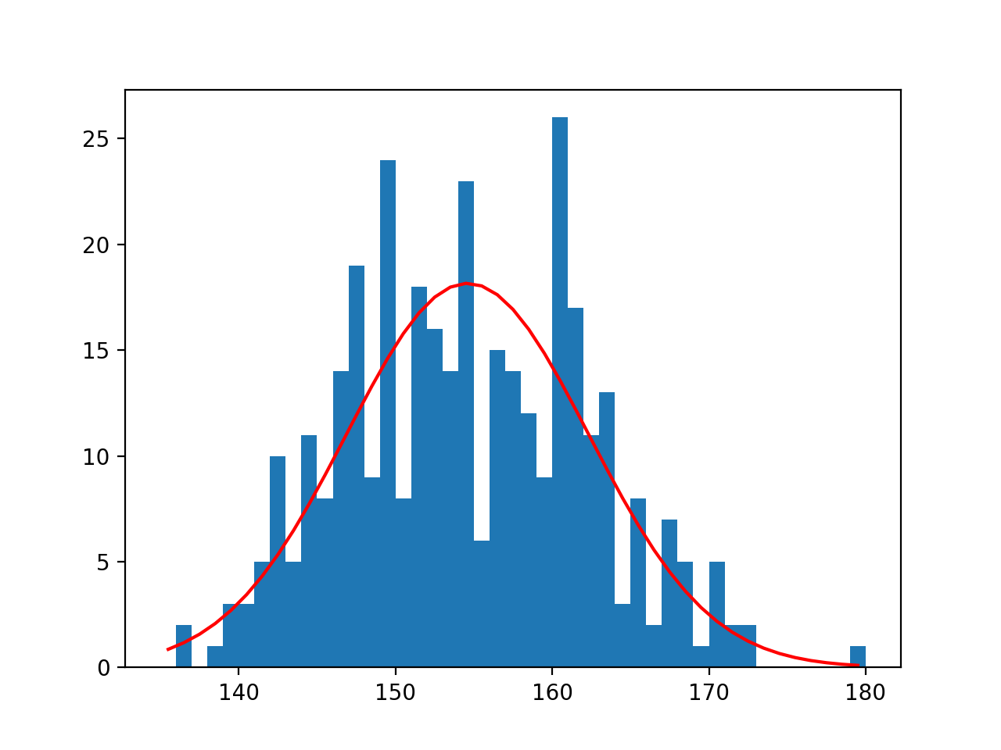
Getting Statistical Measures

Slide 32
Statistical Tests

Slide 33
Statistical Tests
Statistical test calculates a value — the test statistics — from a sample in order to refute or confirm a hypothesis
  Formulate a null hypothesis
    This is usually the boring stuff: two samples from the same distribution, mean is where it is expected to be, …
  Calculate the probability that the observed statistics or a more significant result has occurred given the null hypothesis
  If the probability is small: reject the null hypothesis

Slide 34
Statistical Tests
Alpha — measures the confidence as $α=1-\text{confidence}$
  Typical are $α=0.05,α=0.01$
Critical value — point at which we start rejecting the null hypothesis
P-value — probability of the observed outcome (or something more significant) under the null hypothesis
We reject if the p-value is below $α$
WARNING: while used, this is somewhat controversial among statisticians

Slide 35
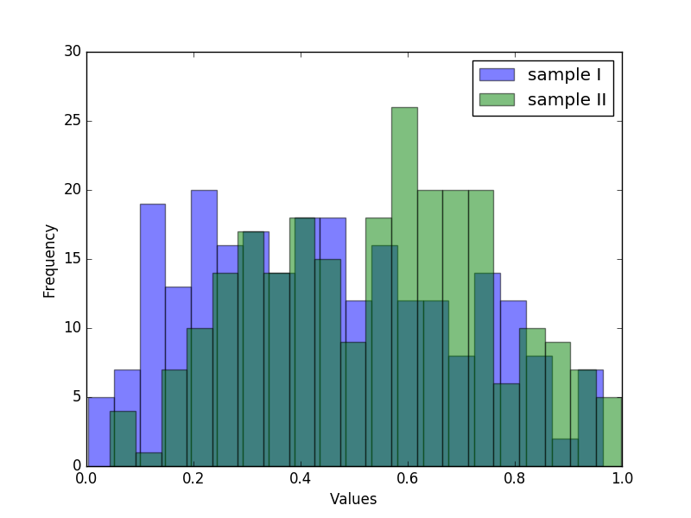
Statistical Tests
Create two samples,
  Beta distributed with $α=1.5$ and $β=2$
  Normally distributed with $μ=0.5$ and $σ=0.25$

Slide 36
Statistical Tests
To test whether two means are equal:
  z-test: Assumes two normally / Gaussian distributions with same standard deviation
  Zero Hypothesis: The means are equal
  z-score is $z=\frac{x-μ}{σ/{\sqrt{n}}}$
  Use statsmodels
WARNING: population should be at least 30

Slide 37
Statistical Tests
Example:
Result:
    Again, reject zero hypothesis
print('z-score\n', statsmodels.stats.weightstats.ztest(sample1, x2=None, value = 0.5))
z-score
(-3.672599393379993, 0.00024009571884724942)

Slide 38
Statistical Tests
Compare the two samples
statsmodels.stats.weightstats.ztest(
sample1,
sample2,
value = 0,
alternative='two-sided'
)
z-score
(-4.611040794712781, 4.0065789390516926e-06)

Slide 39
Statistical Tests
Student t-test:
  Assumes Gaussian distribution
  Works for different variances
  Can use for smaller samples

Slide 40
Statistical Tests
Example: One sample t-test
Two sample t-test
print(scipy.stats.ttest_1samp(sample1, 0.5))
Ttest_1sampResult(statistic=-3.672599393379993, pvalue=0.0002938619482386932)
print(scipy.stats.ttest_ind(sample1, sample2))
Ttest_indResult(statistic=-4.611040794712781, pvalue=5.0995747086364474e-06)

Slide 41
Statistical Tests
This is just a sample of important tests

Slide 42
Contingency Tables

Slide 43
Contingency tables
Experiments to measure effects of causes on outcomes
Example:
  Test two machine learning algorithm on ten data sets
    Can we say that classifier 2 is better or could this be chance?
 | Correct | Incorrect | Totals
Classifier 1 | 6 | 4 | 10
Classifier 2 | 5 | 5 | 10
Totals | 11 | 9

Slide 44
Contingency Tables
Other example: treatment versus control
  Does Aspirin help against cardiovascular disease (1988)
 | myocardial infarction | none | total
Placebo | 189 | 10845 | 11034
Aspirin | 104 | 10933 | 11037
Total | 293 | 21778

Slide 45
Contingency Tables
Usually have
  explanatory variables (Aspirin)
  response variables (Disease)

Slide 46
Contingency Tables
Type I error:
  We report an effect when there is none
Type II error:
  We do not report an effect even though there is one

Slide 47
Contingency Tables
There are many possible statistics
  More, if the number of observations is high

Slide 48
Contingency Tables
Number of different statistical tests
Built into statsmodels
 | myocardial infarction | none | total
Placebo | 189 | 10845 | 11034
Aspirin | 104 | 10933 | 11037
Total | 293 | 21778
Estimate SE LCB UCB p-value
-------------------------------------------------
Odds ratio 1.832 1.440 2.331 0.000
Log odds ratio 0.605 0.123 0.365 0.846 0.000
Risk ratio 1.818 1.433 2.306 0.000
Log risk ratio 0.598 0.121 0.360 0.835 0.000
-------------------------------------------------

Slide 49
Contingency Tables
 | myocardial infarction | none | total
Placebo | 189 | 10845 | 11034
Aspirin | 104 | 10933 | 11037
Total | 293 | 21778
Odds:
  If we take a placebo, odds are $\frac{189}{10845}$
  If we do not take a placebo, odds are $\frac{104}{10933}$
  The statistic looks at the ratio of the odds: $θ=\frac{189⋅10933}{104⋅10845}=1.832$
  If there would be no influence, then we expect $θ=1$.

Slide 50
Contingency Tables
Log odds
  The statistics for odds are heavily skewed
  Easier to use $log(θ)$ which can be approximated with a normal distribution

Slide 51
Contingency Tables
Relative risk
  $π_{1}$ probability of success for group one
  $π_{2}$ probability of success for group two
  Relative risk is $\frac{π_{1}}{π_{2}}$
  Depends on how we define success because in general$\frac{π_{1}}{π_{2}}≠\frac{1-π}{1-π_{2}}$

Slide 52
Contingency Tables
 | myocardial infarction | none | total
Placebo | 189 | 10845 | 11034
Aspirin | 104 | 10933 | 11037
Total | 293 | 21778
Example:
  Estimate relative risk from observations
  $$τ=\frac{{189}/{11034}}{{104}/{11037}}=1.817802$$

Slide 53
Contingency Tables
Again, log of risk is easier to approximate

Slide 54
Contingency Tables
statsmodels.Table2x2 gives all four values together with a p-value
The risk and log risk ratio statistics are not symmetric, so by transposing, you get different values

Slide 55
Contingency Tables
For small samples, we should use Fisher's exact test
  If there is no influence of the explanatory variables, then the numbers in the cells are distributed according to a hyper-geometric distribution
  With Python, we can apply this even to larger samples
Use fisher_exact in scipy.stats

Slide 56
Contingency Tables
Calling Fisher's exact method
Output is value of the statistics and the p-value
Again, we conclude that the difference between Aspirin and Placebo are unlikely to have happened by chance
scipy.stats.fisher_exact(table))
(1.8320539419087136, 5.032835599791868e-07)

Slide 57
Testing for Normality

Slide 58
Normality Tests
A large number of models assume that data is or close to normally distributed
  If data comes from normal distribution:
    Lots of statistical tricks available
  If data comes from another distribution:
    Maybe use "non-parametic" methods
Use tests to determine whether a given set of data is likely to come from a normal distribution
Step 1:
  Use a histogram or scatter-plot of the data

Slide 59
Normality Tests
I created two arrays of length 250
  With my birth date as the seed for reproducability
First, I create histograms (with default settings)
def show(array, name):
fig = plt.figure()
ax = plt.axes()
ax.set_xlabel("Values")
ax.set_ylabel("Frequency")
ax.hist(array)
fig.savefig(name)

Slide 60
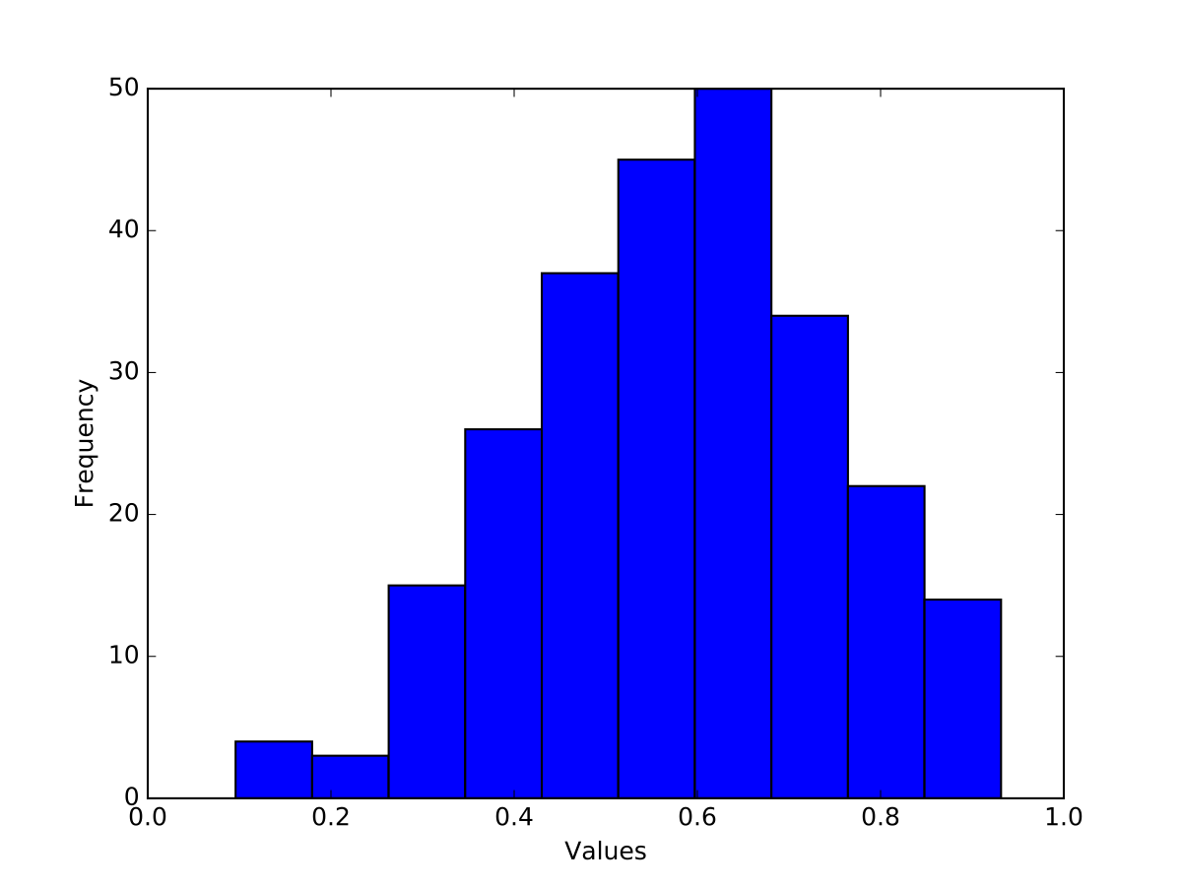
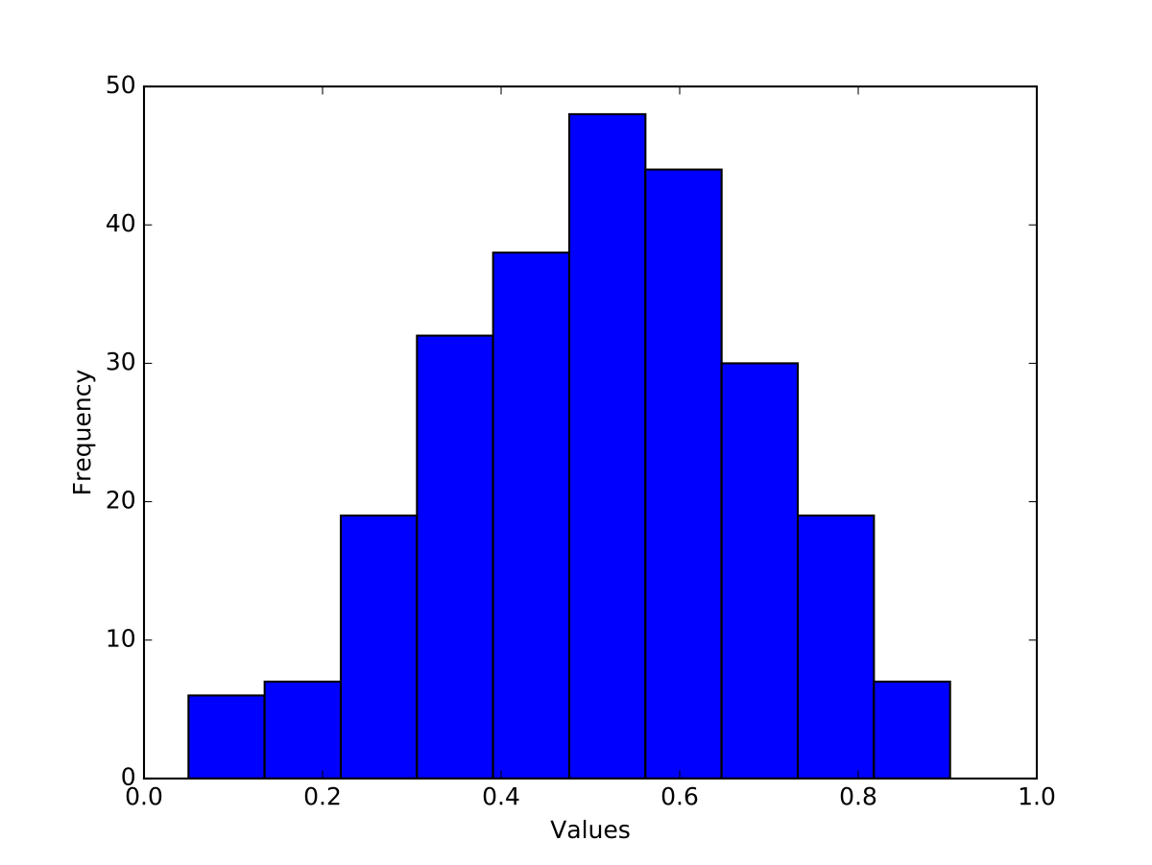
Normality Tests
Results are:
Left: not symmetric (skew is positive)
Right: shape does not look quite right (kurtosis)

Slide 61
Normality Tests
Quantile-Quantile Plot
  Quantile q: Proportion q of the data set fall below the point
  Example: 30% or 0.3 quantile: 30% of the points are below, 70% of the points are above
Plot two data-sets to compare whether they come from the same distribution
Plot one data-set. If linear: suggests normal distribution

Slide 62
Normality Tests
QQ-Plot part of statsmodels package
  Used with numpy, scipy, or pandas and pyplot
    line will draw a 45° line to compare with normal distribution
import statsmodels.api as sm
def showqq(array, name):
fig = sm.qqplot(np.array(array), line='s')
fig.savefig(name)

Slide 63
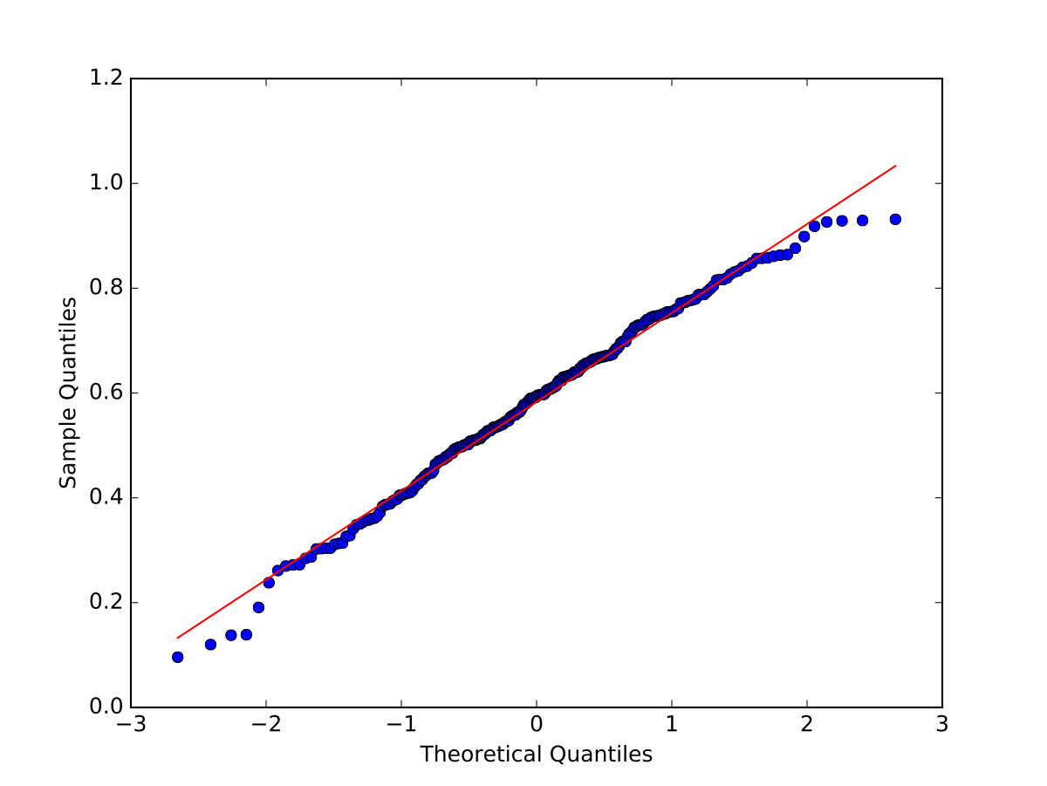
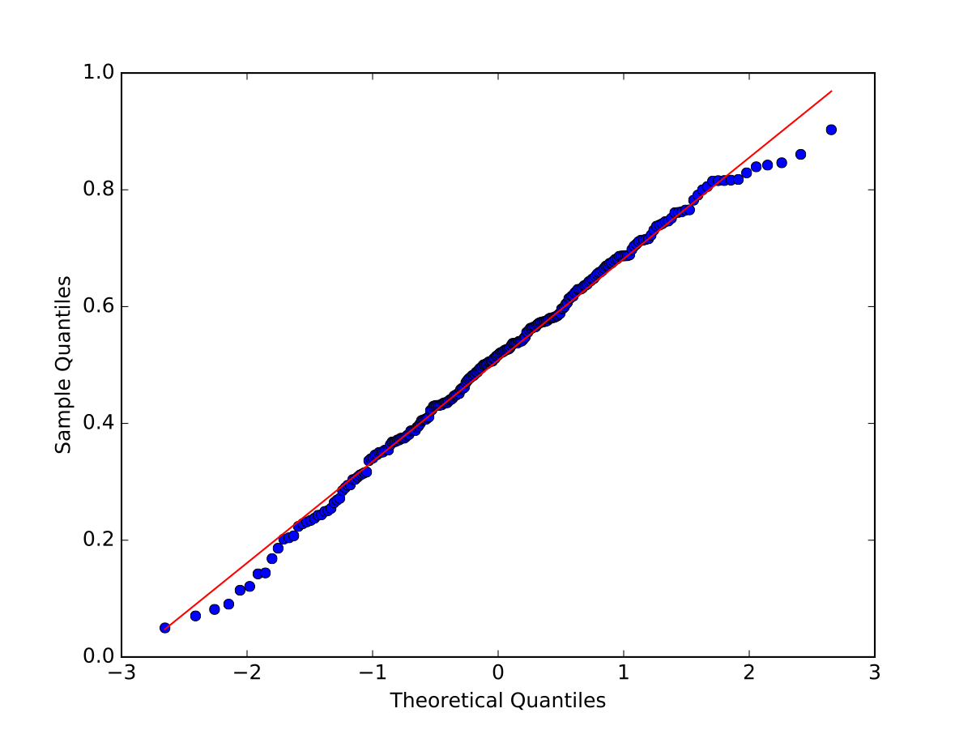
Normality Tests
Results:
  Some outliers are normal

Slide 64
Normality Tests
Statistical tests:
  Takes data and calculates a test statistics
    Calculates the probability of the test value assuming that a null hypothesis is true
    If the probability is too small, concludes that the null hypothesis is false
  In Scipy:
    Null hypothesis: "Distribution is normal"
    Returns a p-value
    If p-value is smaller than $α$ : reject the Null Hypothesis, otherwise see it supported by data

Slide 65
Normality Tests
Shapiro Wilk Test:
      Calculates a test statistics $W=\frac{(∑_{i=1}^{n}a_{i}x_{i})^{2}}{∑_{i=1}^{n}(x_{i}-\overline{x})^{2}}$
      where $x_{i}$ ordered sample values
      $a_{i}$ constants from covariance, variance, mean of sample
For small samples, not so good
W-distribution is calculated via Monte-Carlo simulation

Slide 66
Normality Tests
Use scipy.stats.shapiro
  Input is the data
  Output is the W-value and the p-value
import scipy.stats
def getshapiro(array):
return scipy.stats.shapiro(array)

Slide 67
Normality Tests
Results:
Looks valid, normalcy cannot be rejected at the 0.05 level
(0.9899240732192993, 0.08035389333963394)
(0.9923275709152222, 0.22104869782924652)

Slide 68
Normality Tests
D'Agostino's $k^{2}$ test:
  Looks at skew and curtosis of the normal distribution
  Implemented in scipy.stats as normaltest
  Results:
    Null hypothesis cannot be rejected
def get_dagostino(array):
return scipy.stats.normaltest(array)
statistic=3.7394424212691764, pvalue=0.15416663584307644
statistic=2.821146323808743, pvalue=0.24400338961897727)

Slide 69
Normality Tests
Anderson Darling
  Comes from the Kolmogorov Smirnov test
    KS tests for the distance between the cumulative probability of two samples or one sample with a reference distribution

Slide 70
Normality Tests
Anderson-Darling lives in scipy.stats
Prints out statistics with different significance levels
  Sample 2: the two statistics are smaller than the critical values and the null hypothesis cannot be rejected
print('Anderson Darling: {}'.format(
scipy.stats.anderson(sample1)))
print('Anderson Darling: {}'.format(
scipy.stats.anderson(sample2)))
Anderson Darling: AndersonResult(statistic=1.998061561955467, critical_values=array([0.567, 0.646, 0.775, 0.904, 1.075]), significance_level=array([15. , 10. , 5. , 2.5, 1. ]))
Anderson Darling: AndersonResult(statistic=1.0717930773325293, critical_values=array([0.567, 0.646, 0.775, 0.904, 1.075]), significance_level=array([15. , 10. , 5. , 2.5, 1. ]))

Slide 71
Normality Tests
Sample 1 was however not normally distributed
Sample 2 was generated with a cut-off normal distribution that prevented samples below 0 and above 1
This is typical, there was insufficient information to reject the thesis of normality

Slide 72
Limitations

Slide 73
Limitations
With a p value of 0.05, one in twenty tests is likely to give us a false positive
Rate of false negatives is also around that

Slide 74
Limitations
Not being able to reject the zero hypothesis does not mean that the hypothesis is wrong

Slide 75
Example
Height data

Slide 76
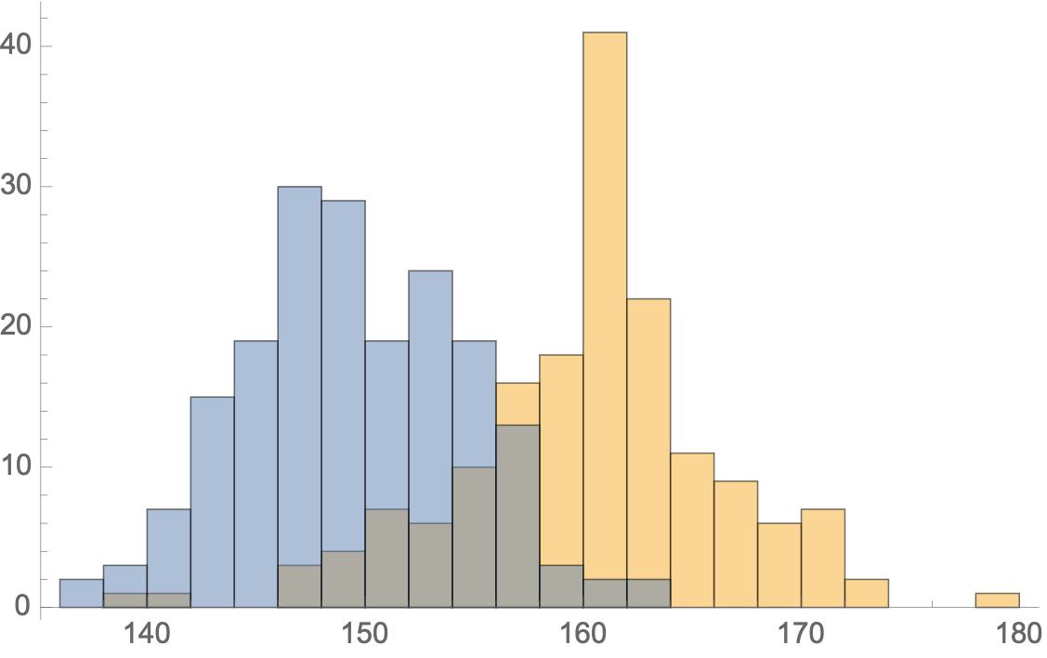
Example
Gender is an important factor for height
If we know the heights, the distribution looks more normal

Slide 77
Example
When we apply normality tests:
  Female is normally distributed
  Male is not normally distributed according to Anderson
  Complete population is normally distributed

Slide 78
Example
Can we recover the two distributions?
  Let's try to fit a combination of two normal distributions to the binned data
def func(t, a, b, m1, s1, m2, s2):
return a*norm(m1, s1).pdf(t) + b*norm(m2, s2).pdf(t)
bins = np.linspace(135, 180, 46)
dt = np.histogram(pop1, bins)[0]
binscenter = np.array([(bins[i]+bins[i+1])/2 for i in
range(len(bins)-1)])
params, pcov = curve_fit(func,
xdata = binscenter,
ydata = dt,
p0=[1,1,145,15,160,15]
)

Slide 79
Example
plt.figure()
plt.bar(binscenter, dt, width = bins[1]-bins[0])
plt.plot(binscenter,func(binscenter, *params),'red')
#plt.plot(binscenter, len(pop1)*pdf(binscenter),'red')
plt.show()

Slide 80

Example
Spectacular failure

Slide 81
Conclusions
Numpy has a very broad selection of random number generators
Scipy.stats has a very good set of implementations for many standard statistical tests
  Which cannot overcome limitations in the data

Slide 82
Readings
Scipy Lecture notes p.195ff

