Slide 1
Time Series 2
Thomas Schwarz SJ

Slide 2
Time Series
General Model of a time series:
Trend + seasonal(s) + remainder
Trend $×$ seasonal(s) $×$ remainders
Remainder can be modeled as a random walk

Slide 3
Trends
Example: Disposable Personal Income Massachusetts and Missouri
from Federal Reserve Bank of St. Louis
Need to check the raw data: Use separator
df_ma = pd.read_csv('MAPCPI.csv',
sep = ',',
)
df_ma.set_index('DATE', inplace = True)

Slide 4
Trends
Example continued:
We have two different files that we want to combine
Pandas has a merge function
Which needs to have a common column
Actually, merge implements an SQL-like join
df = pd.merge(df_ma, df_mo, on='DATE')

Slide 5
Trends
We can now use linear recursion
from statsmodels.formula.api import ols
…
model = ols("df.MOPCPI ~ df.MAPCPI", df).fit()
inter, coef = model.params
print(inter, coef)
print(model.summary())
900.173966439816 0.6894112036215065

Slide 6
Trends
OLS Regression Results
==============================================================================
Dep. Variable: df.MOPCPI R-squared: 0.995
Model: OLS Adj. R-squared: 0.995
Method: Least Squares F-statistic: 1.710e+04
Date: Fri, 03 Jul 2020 Prob (F-statistic): 1.60e-103
Time: 16:40:01 Log-Likelihood: -762.99
No. Observations: 91 AIC: 1530.
Df Residuals: 89 BIC: 1535.
Df Model: 1
Covariance Type: nonrobust
==============================================================================
coef std err t P>|t| [0.025 0.975]
------------------------------------------------------------------------------
Intercept 900.1740 147.748 6.093 0.000 606.601 1193.747
df.MAPCPI 0.6894 0.005 130.771 0.000 0.679 0.700
==============================================================================
Omnibus: 0.064 Durbin-Watson: 0.066
Prob(Omnibus): 0.969 Jarque-Bera (JB): 0.069
Skew: 0.051 Prob(JB): 0.966
Kurtosis: 2.911 Cond. No. 3.69e+04
==============================================================================

Slide 7
Trends
We then plot the result:
plt.plot(df.MAPCPI, df.MOPCPI, '.', alpha=0.3)
plt.plot(np.linspace(0,75000), inter + coef*np.linspace(0,75000), 'r-')
plt.xlabel('MA')
plt.ylabel('MO')
plt.show()

Slide 8
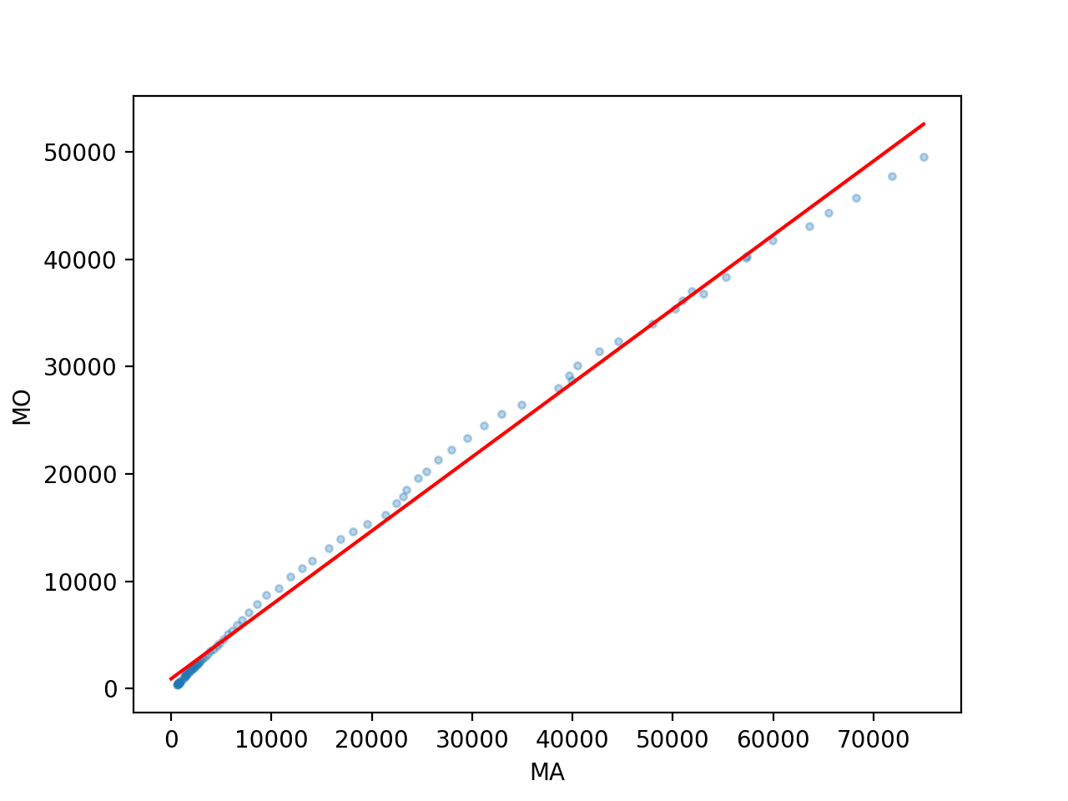
Trends

Slide 9
Trends
We now look at the residual
We define it as an additional column
df['residual'] = df.MOPCPI - inter-coef*df.MAPCPI

Slide 10
Trends
Showing the residual:
Use xticks to make the x-axis readable
And use fill to make the result clearer
plt.plot(df.residual, 'k-')
plt.xticks(['1930-01-01', '1950-01-01', '1970-01-01', '1990-01-01', '2010-01-01'])
plt.fill_between(df.index, 0, df.residual)
plt.show()

Slide 11
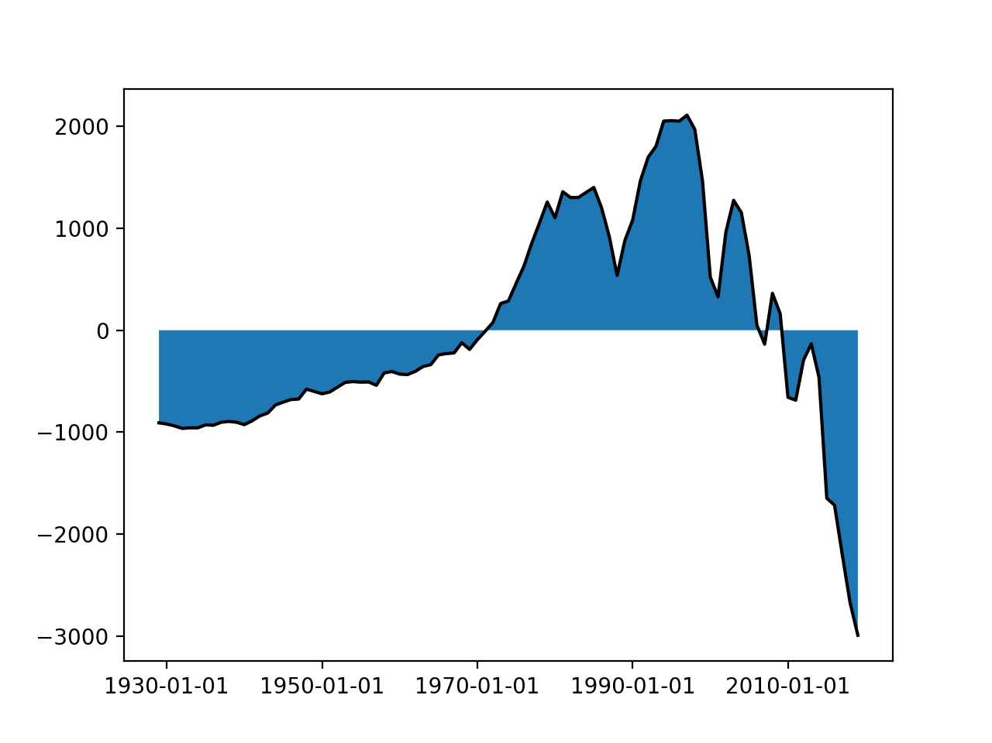
Trends

Slide 12
Trends
This would be a bad regression for prediction!

Slide 13
Seasonal Dummy Variables
Suppose you want to use linear regression
Need to account for the effect of week-days
Introduce dummy variables
 | t13 | t2 | t3 | t4 | t5 | t6 | t7
Mon | 1 | 0 | 0 | 0 | 0 | 0 | 0
Tue | 0 | 1 | 0 | 0 | 0 | 0 | 0
Wed | 0 | 0 | 1 | 0 | 0 | 0 | 0
Thu | 0 | 0 | 0 | 1 | 0 | 0 | 0
Fri | 0 | 0 | 0 | 0 | 1 | 0 | 0
Sat | 0 | 0 | 0 | 0 | 0 | 1 | 0
Sun | 0 | 0 | 0 | 0 | 0 | 0 | 1

Slide 14
Seasonal Dummy Variables
Use linear regression including the dummy variables
$$y=β_{0}+β_{1}x_{1}+…β_{n}x_{n}+γ_{1}t_{1}+γ_{2}t_{2}+γ_{3}t_{3}+…+γ_{7}t_{7}$$

Slide 15
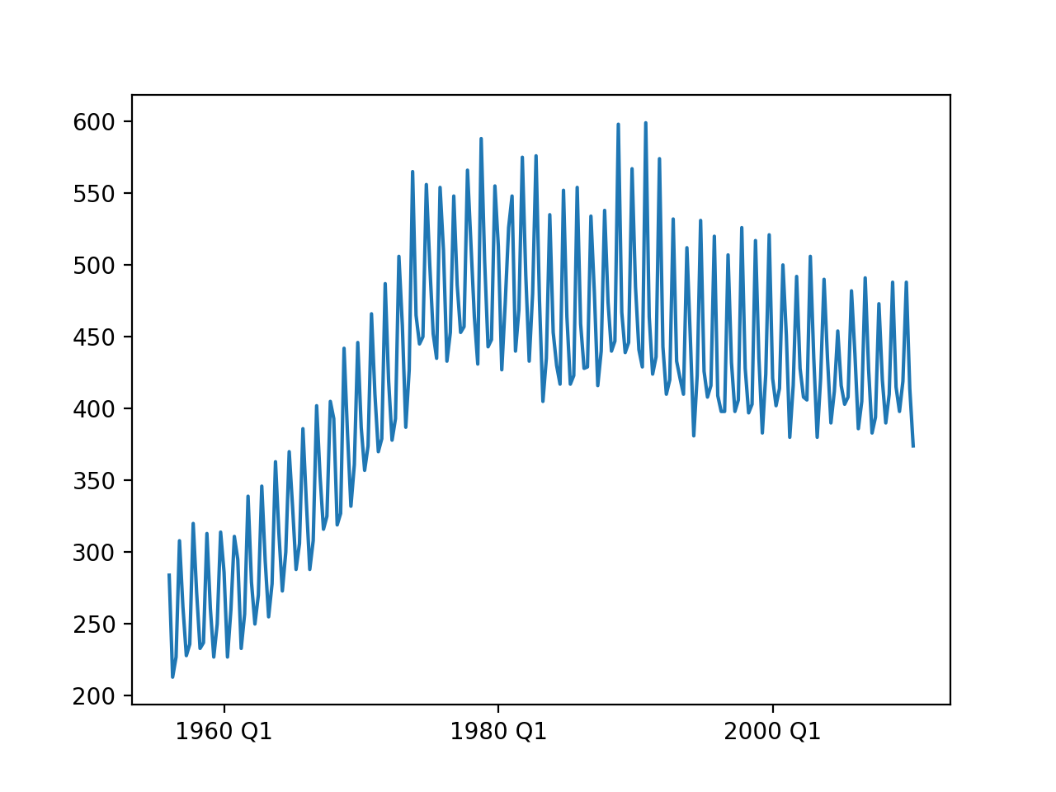
Seasonal Dummy Variables
Example:
Australian beer production (quarterly)

Slide 16
Seasonal Dummy Variables
Obviously, two different trends, 1955 - 1975 and 1975 -

Slide 17
Seasonal Dummy Variables
Look at the original data:
Need to parse time stamps from two different columns
Luckily, parse data is up to it
Time,Year,Quarter,Beer.Production
1,1956,Q1,284
2,1956,Q2,213
3,1956,Q3,227
4,1956,Q4,308
5,1957,Q1,262
6,1957,Q2,228
7,1957,Q3,236
8,1957,Q4,320
9,1958,Q1,272
10,1958,Q2,233
11,1958,Q3,237
12,1958,Q4,313
13,1959,Q1,261
14,1959,Q2,227
15,1959,Q3,250
16,1959,Q4,314
17,1960,Q1,286
def get_data():
df_ab = pd.read_csv('AusBeer.csv',
sep = ',',
parse_dates={'period':['Year', 'Quarter']}
)
df_ab = df_ab.set_index('period')
return df_ab

Slide 18
Seasonal Dummy Variables
Aside:
When we draw the graph, need to select x-ticks
def show(df_ab):
plt.plot(df_ab['Beer.Production'])
plt.plot(df_ab['pred'])
plt.xticks(['1960 Q1', '1980 Q1', '2000 Q1'])
plt.show()

Slide 19
Seasonal Dummy Variables
First, linear regression just on beer production
without accounting for the influence of the quarters
df_ab = get_data()
df = df_ab.loc['1979 Q1':]
y = df['Beer.Production']
x = df['Time']
model = ols("y~ x",df).fit()
print(model.summary())

Slide 20
Seasonal Dummy Variables
This gives so-so values (as should be expected)
OLS Regression Results
==============================================================================
Dep. Variable: y R-squared: 0.169
Model: OLS Adj. R-squared: 0.163
Method: Least Squares F-statistic: 25.26
Date: Fri, 03 Jul 2020 Prob (F-statistic): 1.71e-06
Time: 23:43:30 Log-Likelihood: -667.55
No. Observations: 126 AIC: 1339.
Df Residuals: 124 BIC: 1345.
Df Model: 1
Covariance Type: nonrobust
==============================================================================
coef std err t P>|t| [0.025 0.975]
------------------------------------------------------------------------------
Intercept 545.7075 19.076 28.606 0.000 507.950 583.465
x -0.6003 0.119 -5.026 0.000 -0.837 -0.364
==============================================================================
Omnibus: 13.659 Durbin-Watson: 2.182
Prob(Omnibus): 0.001 Jarque-Bera (JB): 15.806
Skew: 0.858 Prob(JB): 0.000370
Kurtosis: 2.740 Cond. No. 701.
==============================================================================

Slide 21
Seasonal Dummy Variables
But already some nice trend
Get the model parameters and add a new column with predicted values
Then display
a, b = model.params
df_ab['pred'] = a + b*df.Time
df_ab.dropna(inplace=True)
plt.plot(df_ab['Beer.Production'])
plt.plot(df_ab['pred'])
plt.xticks(['1980 Q1', '1985 Q1','1990 Q1',
'1995 Q1', '2000 Q1', '2005 Q1', '2010 Q1'],
['80', '85', '90', '95', '00', '05', '10'])

Slide 22
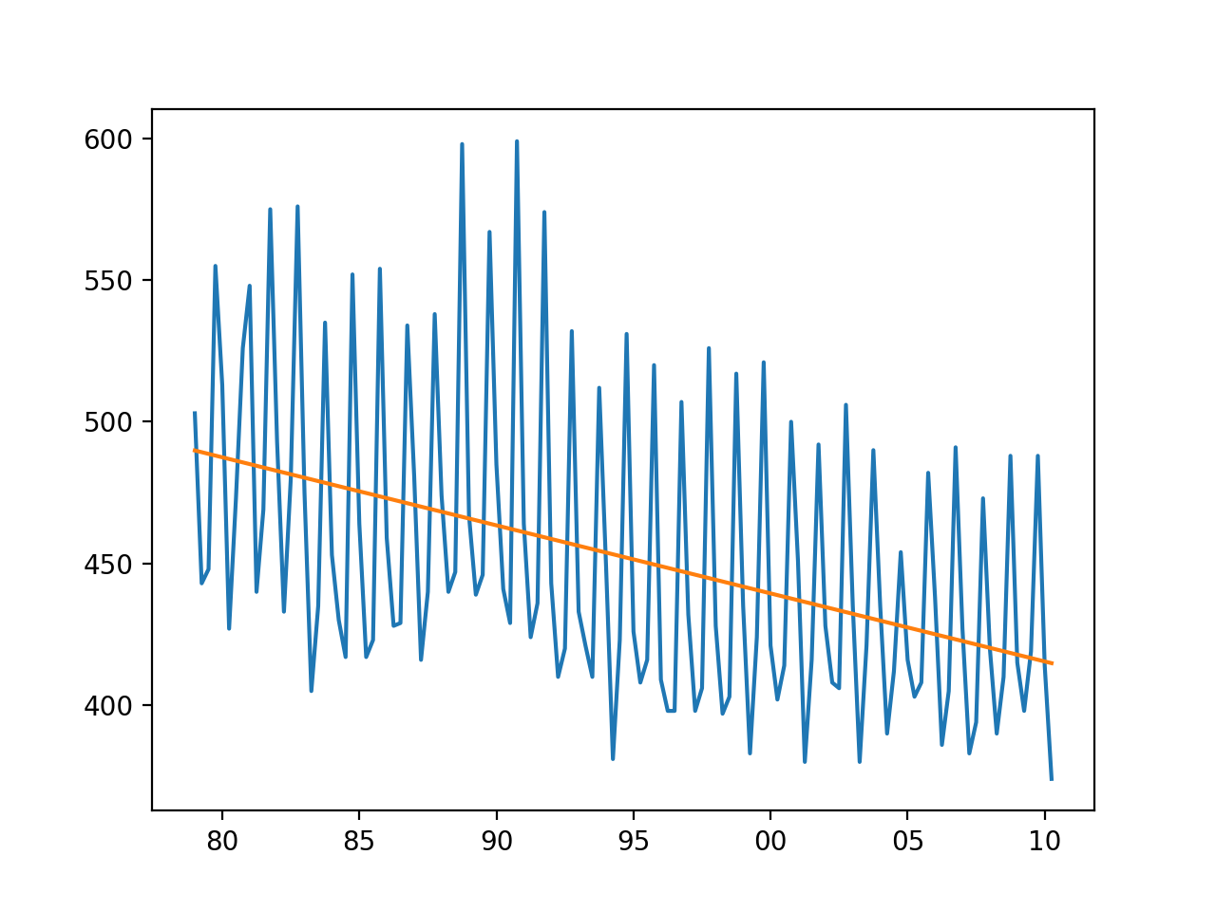
Seasonal Dummy Variables

Slide 23
Seasonal Dummy Variables
Now, let's try using seasonal dummy variables
Create four new columns
def transform(df_ab):
df_ab['s1'] = [ 1 if 'Q1' in df_ab.index[i]
else 0 for i in range(len(df_ab.index))]
df_ab['s2'] = [ 1 if 'Q2' in df_ab.index[i]
else 0 for i in range(len(df_ab.index))]
df_ab['s3'] = [ 1 if 'Q3' in df_ab.index[i]
else 0 for i in range(len(df_ab.index))]
df_ab['s4'] = [ 1 if 'Q4' in df_ab.index[i]
else 0 for i in range(len(df_ab.index))]

Slide 24
Seasonal Dummy Variables
Create a slice since 1979
df_ab = get_data()
transform(df_ab)
df = df_ab.loc['1979 Q1':]

Slide 25
Seasonal Dummy Variables
Set up the model including the seasonal parameters
y = df['Beer.Production']
x = df['Time']
x1 = df['s1']
x2 = df['s2']
x3 = df['s3']
x4 = df['s4']
model = ols("y~ x",df).fit()
print(model.summary())
a, b, b1, b2, b3, b4 = model.params
print(a, b, b1, b2, b3, b4)

Slide 26
Seasonal Dummy Variables
OLS Regression Results
==============================================================================
Dep. Variable: y R-squared: 0.887
Model: OLS Adj. R-squared: 0.883
Method: Least Squares F-statistic: 237.6
Date: Fri, 03 Jul 2020 Prob (F-statistic): 2.70e-56
Time: 23:56:27 Log-Likelihood: -541.83
No. Observations: 126 AIC: 1094.
Df Residuals: 121 BIC: 1108.
Df Model: 4
Covariance Type: nonrobust
==============================================================================
coef std err t P>|t| [0.025 0.975]
------------------------------------------------------------------------------
Intercept 437.5337 5.696 76.809 0.000 426.256 448.811
x -0.6058 0.045 -13.586 0.000 -0.694 -0.517
x1 107.4220 3.124 34.390 0.000 101.238 113.606
x2 65.4965 3.143 20.837 0.000 59.273 71.720
x3 81.4240 3.156 25.804 0.000 75.177 87.671
x4 183.1911 3.175 57.697 0.000 176.905 189.477
==============================================================================
Omnibus: 20.235 Durbin-Watson: 1.948
Prob(Omnibus): 0.000 Jarque-Bera (JB): 34.949
Skew: 0.731 Prob(JB): 2.58e-08
Kurtosis: 5.126 Cond. No. 4.40e+17
==============================================================================

Slide 27
Seasonal Dummy Variables
Add a new column for the prediction
And plot raw data and prediction values
df_ab['pred'] = a + b*df.Time +b1*df.s1+b2*df.s2+b3*df.s3+b4*df.s4
df_ab.dropna(inplace=True)
plt.plot(df_ab['Beer.Production'])
plt.plot(df_ab['pred'], alpha = 0.5)
plt.xticks(['1980 Q1', '1985 Q1','1990 Q1',
'1995 Q1', '2000 Q1', '2005 Q1', '2010 Q1'],
['80', '85', '90', '95', '00', '05', '10'])
plt.show()

Slide 28
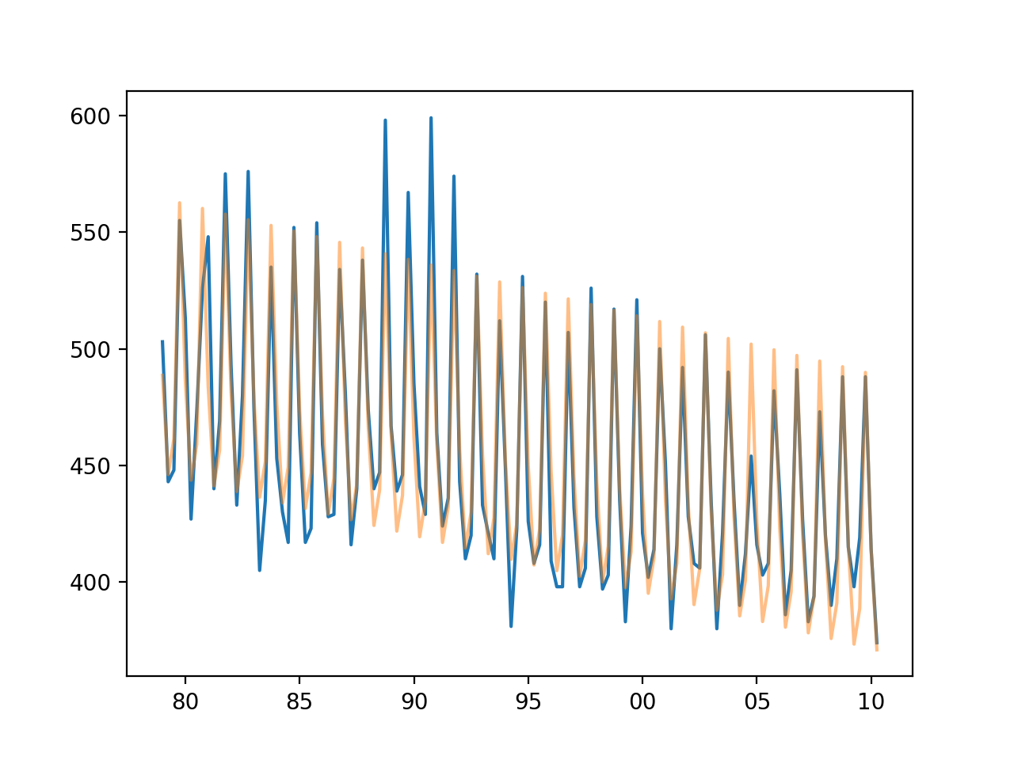
Seasonal Dummy Variables

Slide 29
Seasonal Dummy Variables
Why are we not doing better?
We only have time and season as explanatory variables
Temperature and economy could also explain beer consumption
And maybe exports?

Slide 30
Seasonal Dummy Variables
Let's look at the average error of the prediction
Add one more column to the data frame
And display
df_ab['res'] = (df_ab['Beer.Production']-df_ab['pred'])/df_ab['Beer.Production']

Slide 31
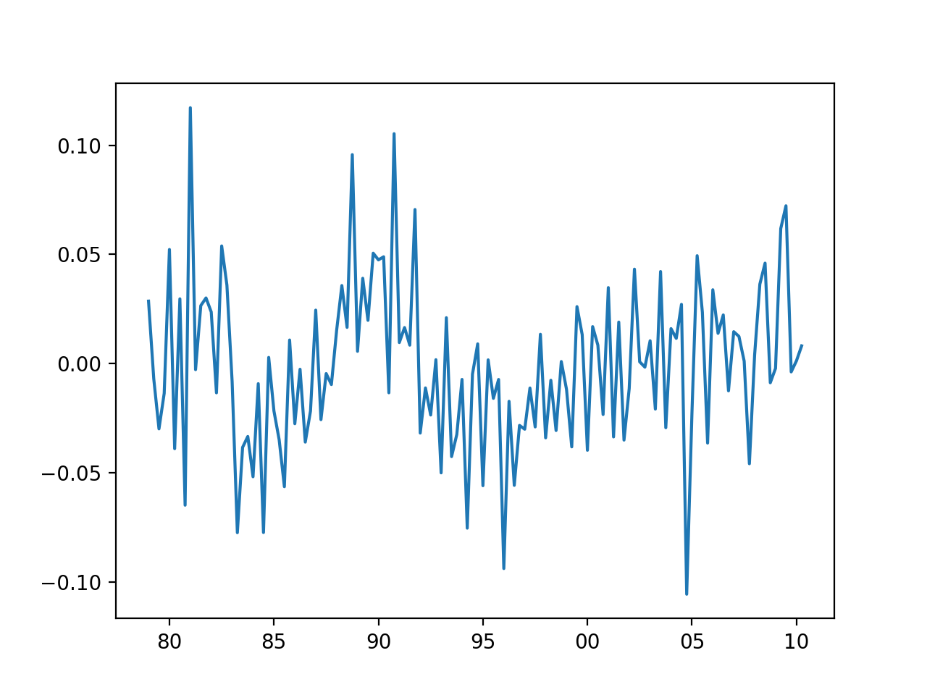
Seasonal Dummy Variables
Shows that we are historically with 10% of the linear regression calculated value

Slide 32
Seasonal Dummy Variables
We can also look at how well the prediction works
plt.scatter(df_ab['Beer.Production'][df_ab['s1']==1],
df_ab['pred'][df_ab['s1']==1],
alpha = 0.5, c = 'red', label='Q1')
plt.scatter(df_ab['Beer.Production'][df_ab['s2']==1],
df_ab['pred'][df_ab['s2']==1],
alpha = 0.5, c = 'green', label='Q2')
plt.scatter(df_ab['Beer.Production'][df_ab['s3']==1],
df_ab['pred'][df_ab['s3']==1],
alpha = 0.5, c = 'blue', label='Q3')
plt.scatter(df_ab['Beer.Production'][df_ab['s4']==1],
df_ab['pred'][df_ab['s4']==1],
alpha = 0.5, c = 'cyan', label='Q4')
plt.legend()
plt.show()

Slide 33
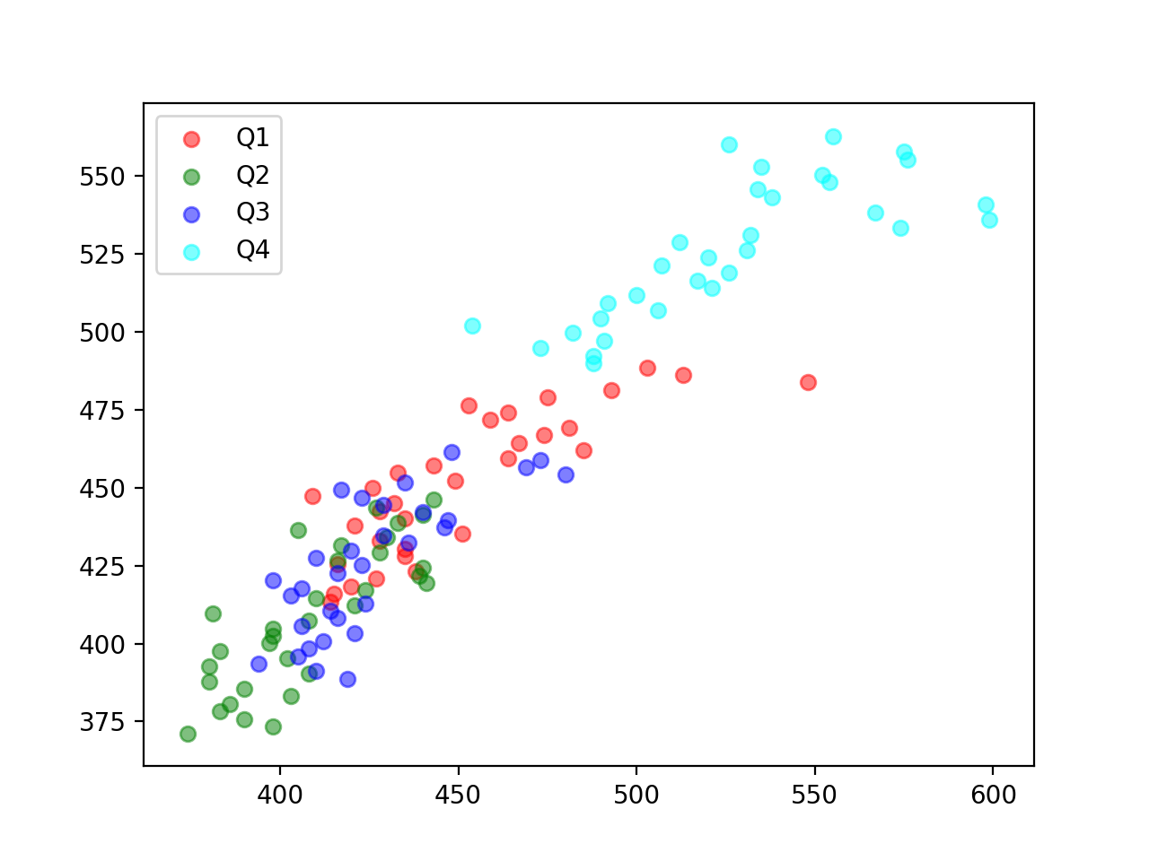
Seasonal Dummy Variables

Slide 34
Classical Decomposition
Simple method with periods of m on $y$
quarters: m=4, business weeks: m=5, years: m = 365
Additive decomposition: $y=T+S+R$
Use moving average of size 2m (or m) to estimate $T$
Calculate the "detrended" series $d_{t}=y_{t}-T_{t}$
Seasonal component is the average over all values for that period $S_{t}=\text{Average}\left(\{…,d_{t-2m},d_{t-m},d_{t},d_{t+m},d_{t+2m},…\}\right)$
Residual is what is left

Slide 35
Classical Decomposition
Problems with classical decomposition:
Trend cycle not available for the first or last times without extrapolation
Rapid rises and falls are smoothed out too much
Assumes seasonal components repeat
Counter-example:
Used to be that electricity consumption peaked in the winter (heating)
Now peaks in the summer (air-conditioning)
Really difficult to deal with extra-ordinary events (strikes, weather, catastrophes, …)

Slide 36
Classical Decomposition
Implemented in statsmodels
Needs a time series x
Needs a model: "additive" (default), "multiplicative
Can give filtering weights
Period (if x not Pandas with frequency)
two-sided: method used for filtering
extrapolate_trend: non-zero value or 'freq' to extrapolate
Otherwise, NaN values
from statsmodels.tsa.seasonal import seasonal_decompose

Slide 37
Classical Decomposition
Example: Australian beer production (again)
def get_data():
df_ab = pd.read_csv('AusBeer.csv',
sep = ',',
parse_dates={'period':['Year', 'Quarter']}
)
df_ab = df_ab.set_index('period')
return df_ab

Slide 38
Classical Decomposition
Limit to values after 1975
Call decomposition
result has components trend, seasonal, resid
df = get_data()['1975 Q1': ]
result = seasonal_decompose(
df['Beer.Production'],
model = 'additive',
period = 4,
extrapolate_trend = 3)

Slide 39
Classical Decomposition
Show results:
def show(result):
fig, axs = plt.subplots(3, sharex=True, figsize=(5,10))
axs[0].plot(result.trend, 'k-')
axs[1].plot(result.seasonal, 'r:')
axs[2].plot(result.resid, 'b-.')
axs[0].set_title('trend')
axs[1].set_title('seasonal')
axs[2].set_title('residual')
axs[2].set_xticks(['1980 Q1', '1990 Q1', '2000 Q1', '2010 Q1'])
axs[2].set_xticklabels(['80', '90', '00', '10'])
plt.show()

Slide 40
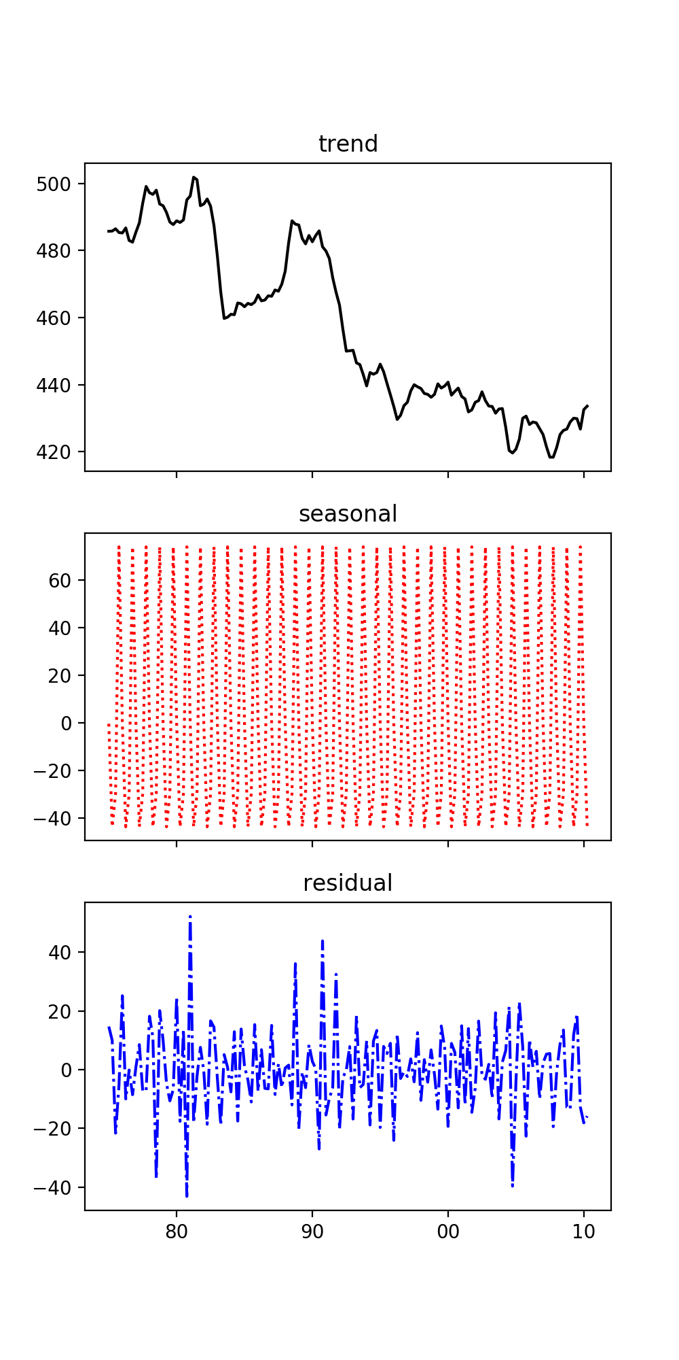
Can extrapolate the trend
Add seasonal
Use residual as a measure of uncertainty

Slide 41
Classical Decomposition
airline passengers
result = seasonal_decompose(df.Passengers,
model = 'additive',
period = 14,
extrapolate_trend = 'freq'
)

Slide 42
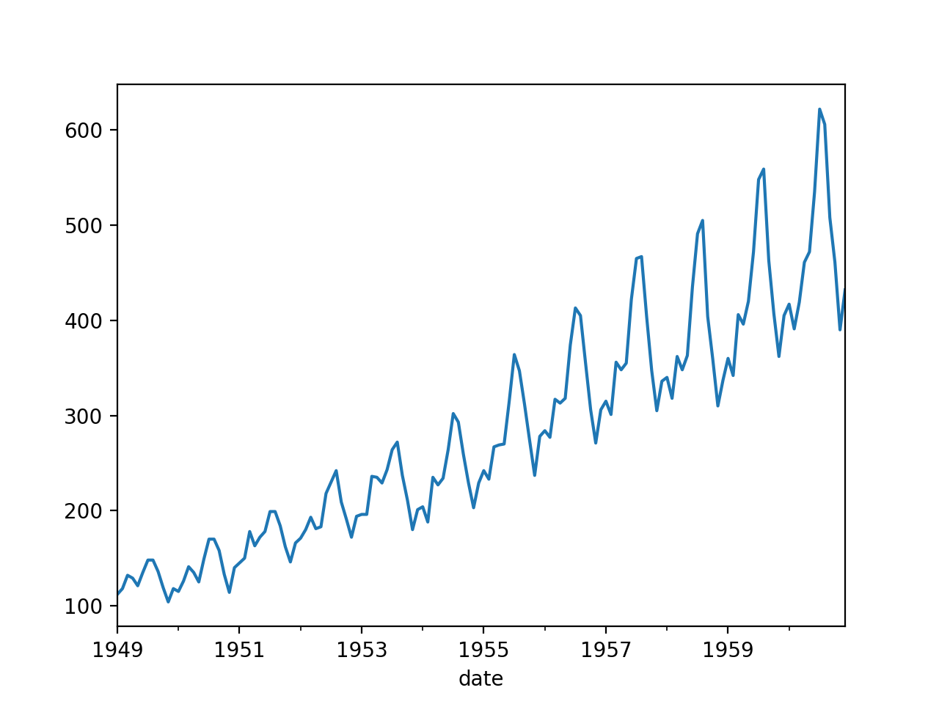

Slide 43
Better Decompositions
Decomposition has had a 100 year history
Better decompositions allow seasonal values to vary
Seasonal Decomposition using LOESS (STL)
LOESS is based on estimating the trend with a range of functions within a certain window

Slide 44
Better Decompositions
STL is implemented in statsmodels
Uses the assumed cyclicity as input (periods)
from statsmodels.tsa.seasonal import STL

Slide 45
Better Decompositions
Example: Australian Beer:
Result is a triple of trend, seasonal, and resid
df = get_data()['1975 Q1': ]
stl = STL(df['Beer.Production'],
period=4,
robust=False)
result = stl.fit()

Slide 46
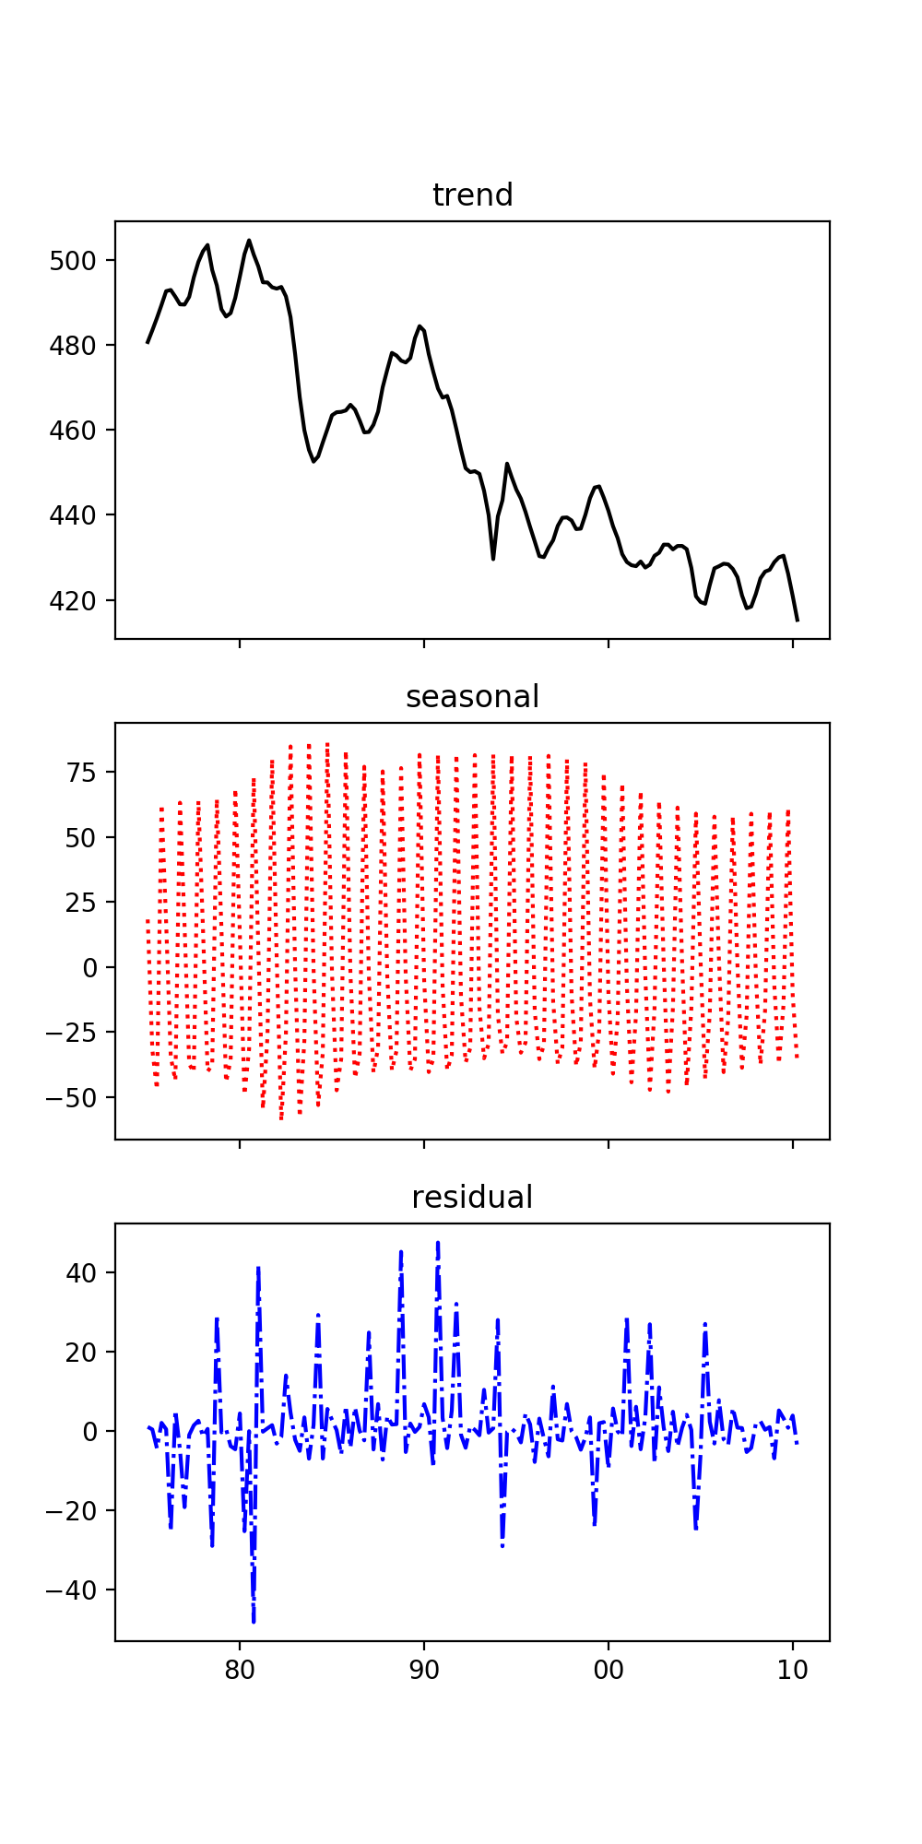
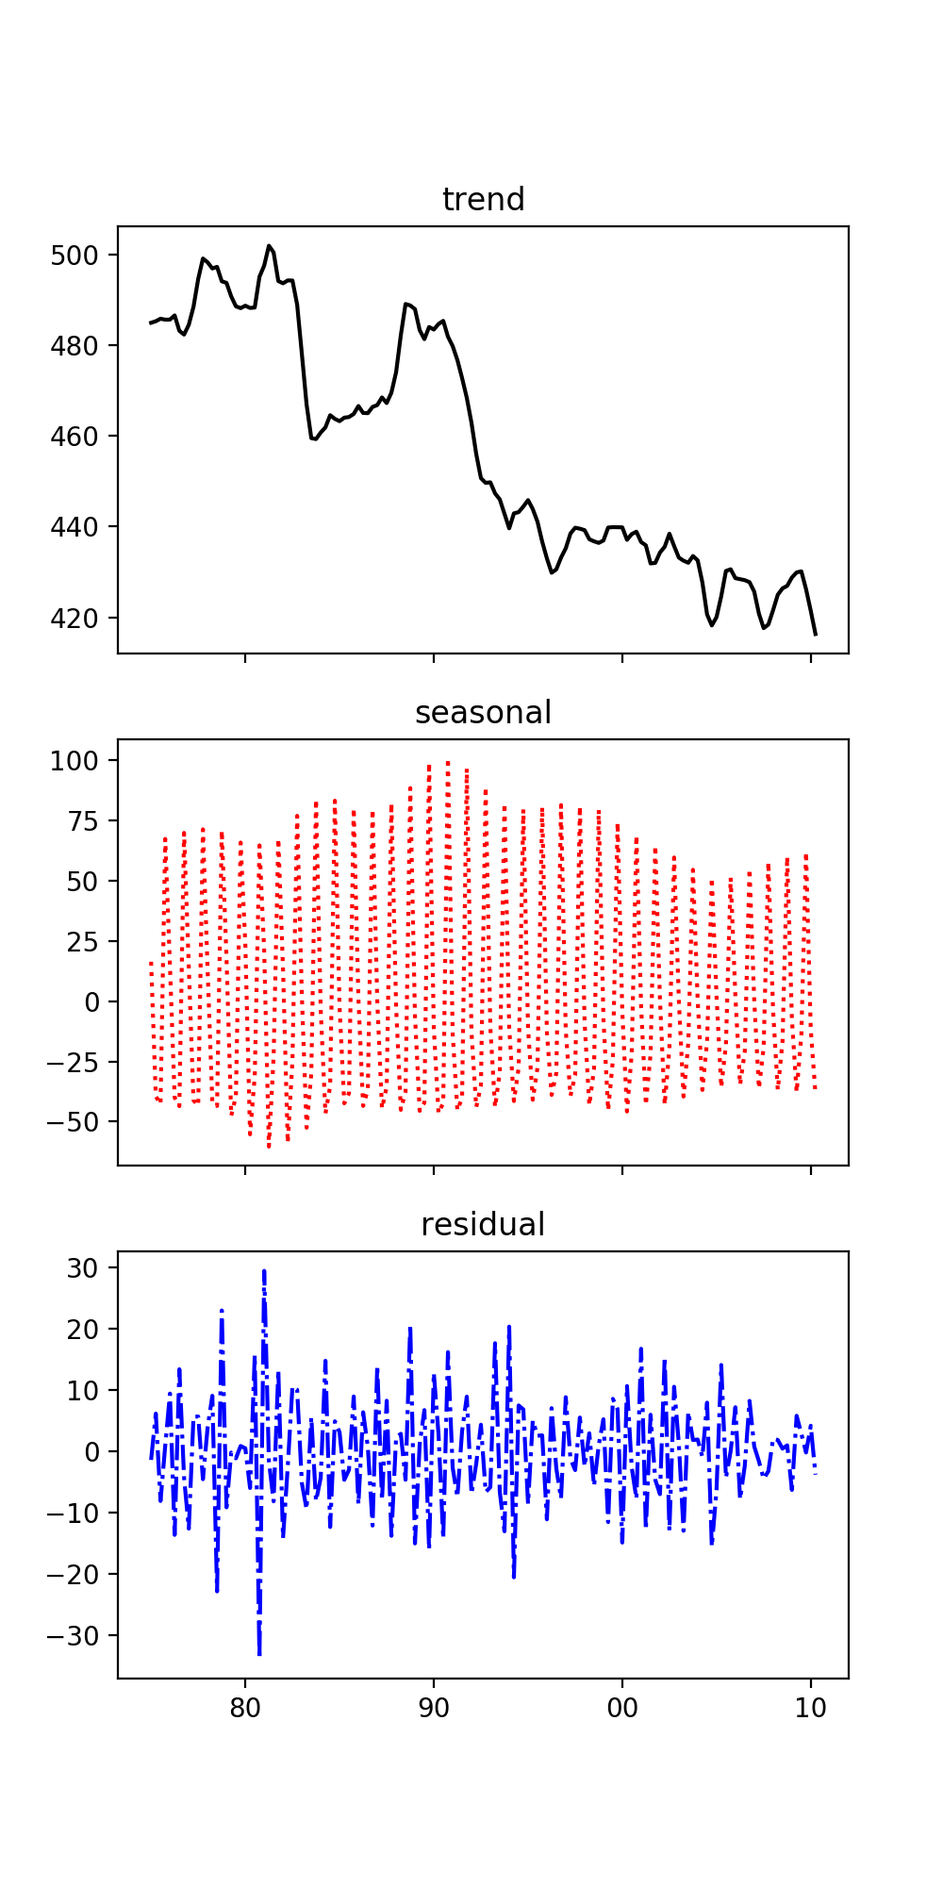
Better Decompositions
robust
not
robust

Slide 47
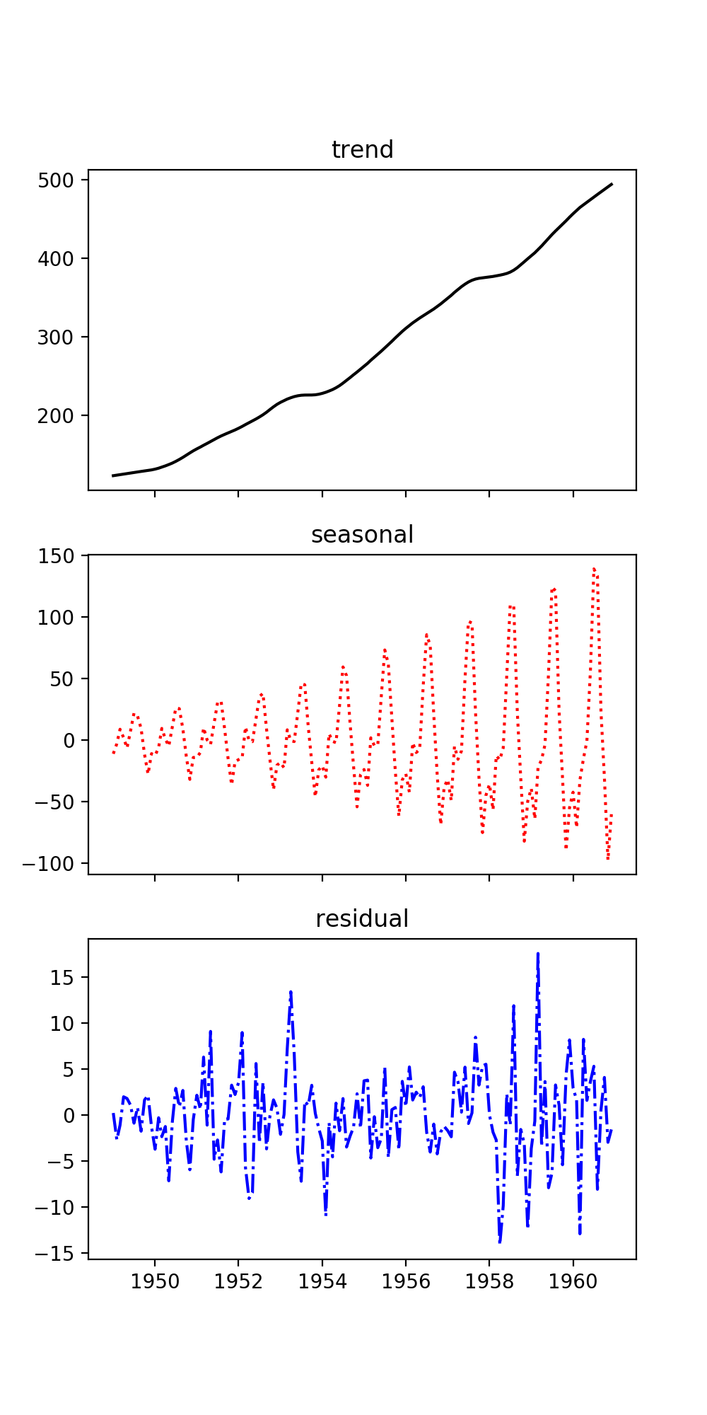
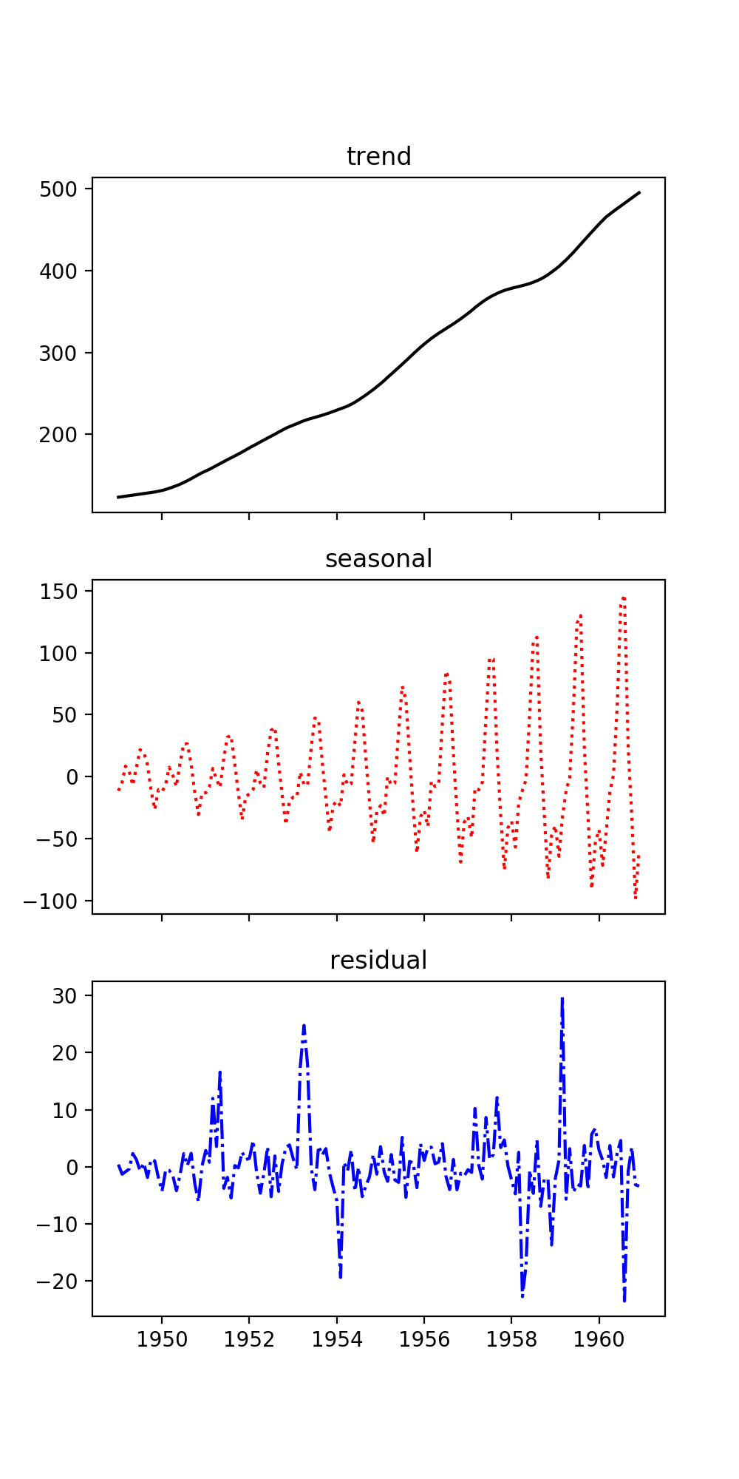
Better Decompositions
airline
passengers
not
robust
robust

Slide 48
Better Decompositions
Holt's linear trend method:
Simple exponential smoothing for data with trend
Estimates series at time t using estimates of the slope obtained as a weighted average
Holt-Winter's Seasonal Method
Adds a seasonal component

Slide 49
Better Decompositions
Implemented in statsmodels
Produces a fitted value (fit) and allows predictions
from statsmodels.tsa.holtwinters import ExponentialSmoothing as esm
df = get_data()
esm = esm(df['Passengers'],
seasonal='mul',
seasonal_periods=12
)
result = esm.fit()

Slide 50
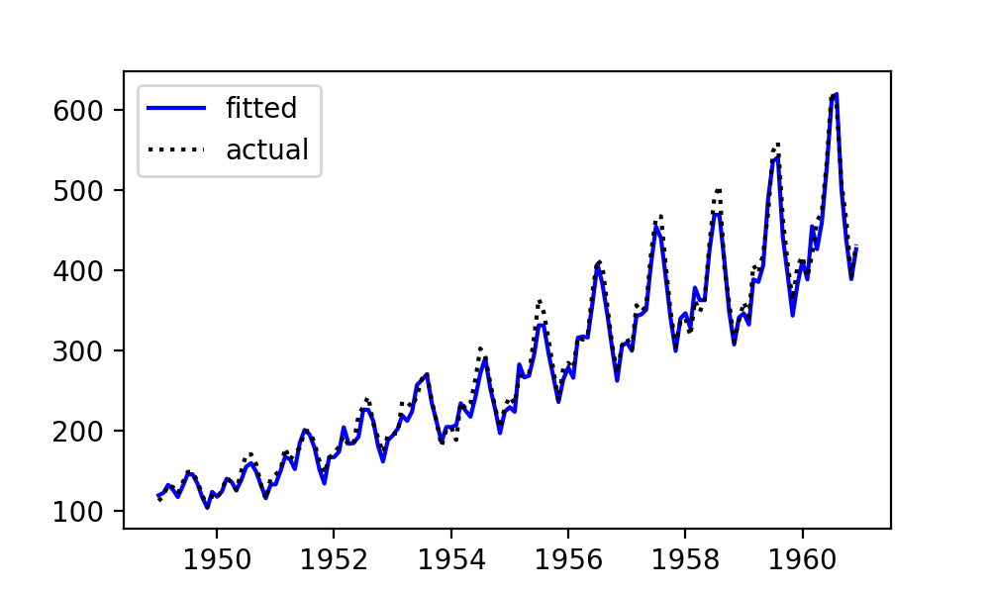
Better Decompositions
Airline Example (multiplicative fit)

Slide 51
Better Decompositions
Airline Example additive seasonality

Slide 52
Stationary Time Series
Properties do not depend on the time at which the series is observed
No trend, no seasonality
But could be cyclic if cycles have no fixed length

Slide 53
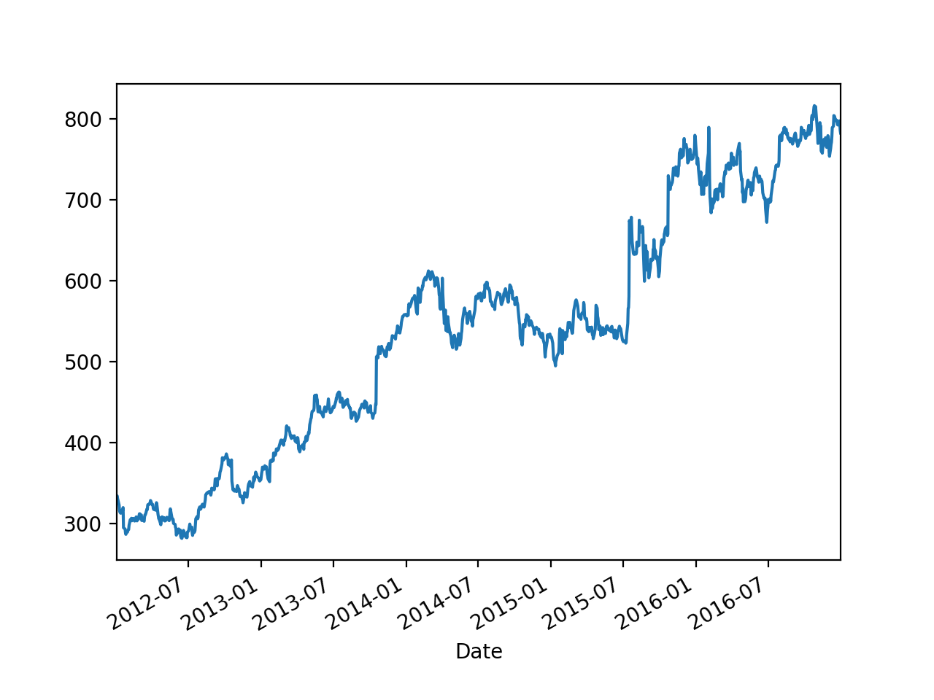
Stationary Time Series
Example:
Google High stock value is not stationary

Slide 54
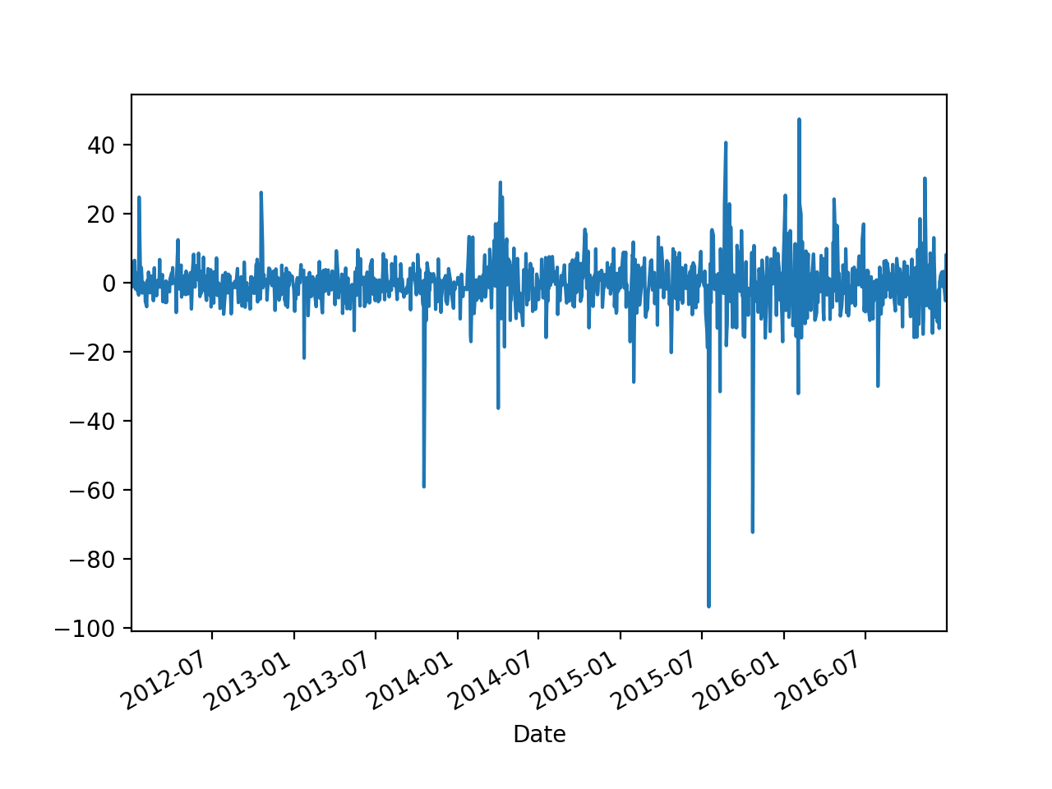
Stationary Time Series
But it's daily change is

Slide 55
Stationary Time Series
Use shift in order to obtain the differences
def get_google_data():
my_df = pd.read_csv('../Pandas/google.csv',
parse_dates=[0],
index_col=0,
converters={
'Close': my_converter,
'Volume': convert_volume}
)
print(my_df.info())
#my_df.High.plot()
(my_df.shift(1).High - my_df.High).plot()
plt.show()
return my_df

Slide 56
Stationary Time Series
This is typical
Differencing
Make a non-stationary time series stationary
Might have to be repeated several times

Slide 57
Stationary Time Series
Can look at the Auto-Correlation Function
How does the value of a time series relate to the values shifted by m periods
Implemented in Pandas as autocorr(lag = m)

Slide 58
Stationary Time Series
Example: google change
my_df = get_google_data()
for i in range(20):
print(i,
(my_df.shift(1).High - my_df.High).autocorr(lag=i))
0 0.9999999999999999
1 0.12080309541084427
2 -0.035334997385017435
3 -0.048524948019570004
4 -0.05560693878878337
5 -0.0064797046657102605
6 0.011124537759089287
7 -0.03901650231472603
8 -0.012520771888603816

Slide 59
Stationary Time Series
One version in statsmodels
Calculates ACF as a numpy array
from statsmodels.tsa.stattools import acf, pacf
my_df = get_google_data()
google = (my_df.shift(1) - my_df).dropna(axis=0)
my_acf = acf(google.High, fft = False)
fig, ax = plt.subplots(1)
ax.plot(my_acf)

Slide 60
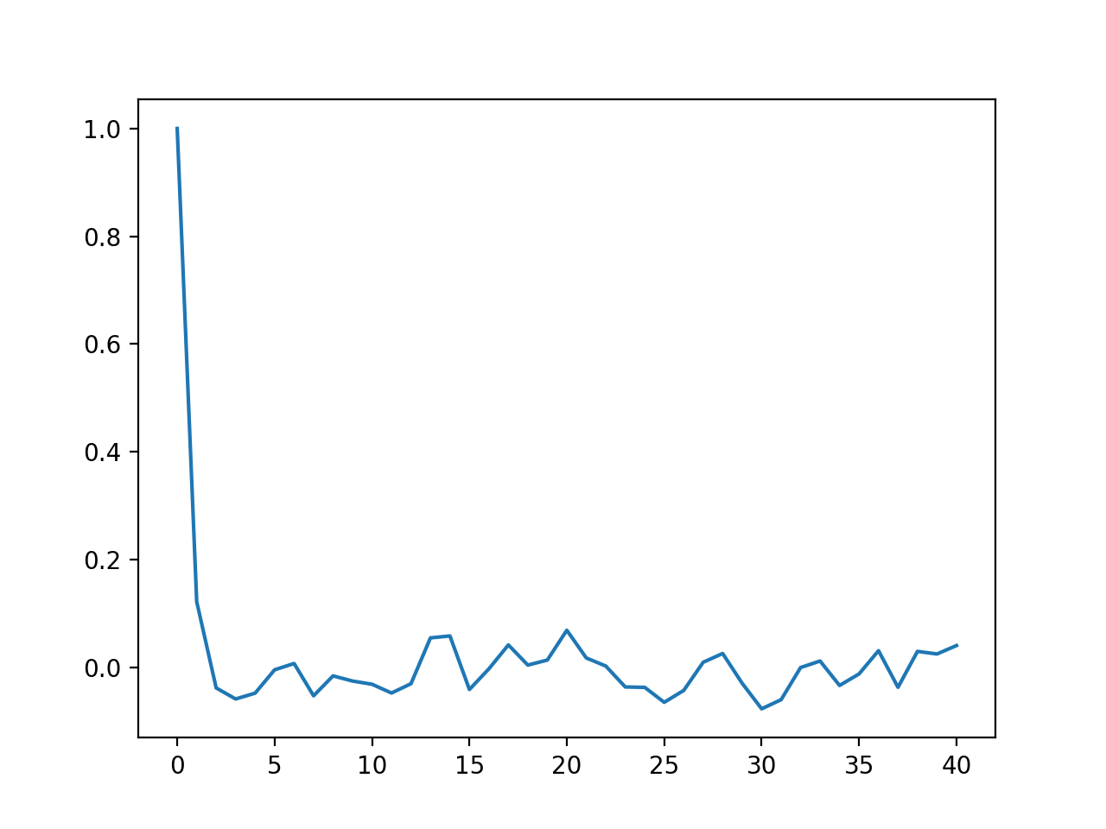
Stationary Time Series

Slide 61
Stationary Time Series
A graphical version is also available:
import statsmodels.graphics.tsaplots as sgt
sgt.plot_acf(google.High, unbiased = True,
zero=False, lags = 40)

Slide 62
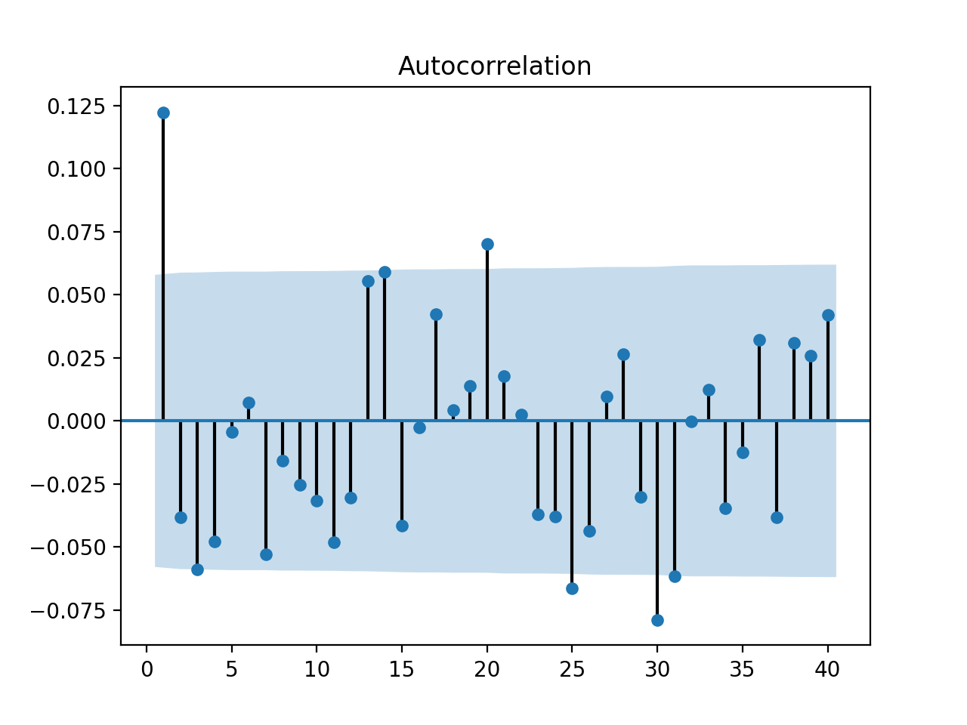
Stationary Time Series

Slide 63
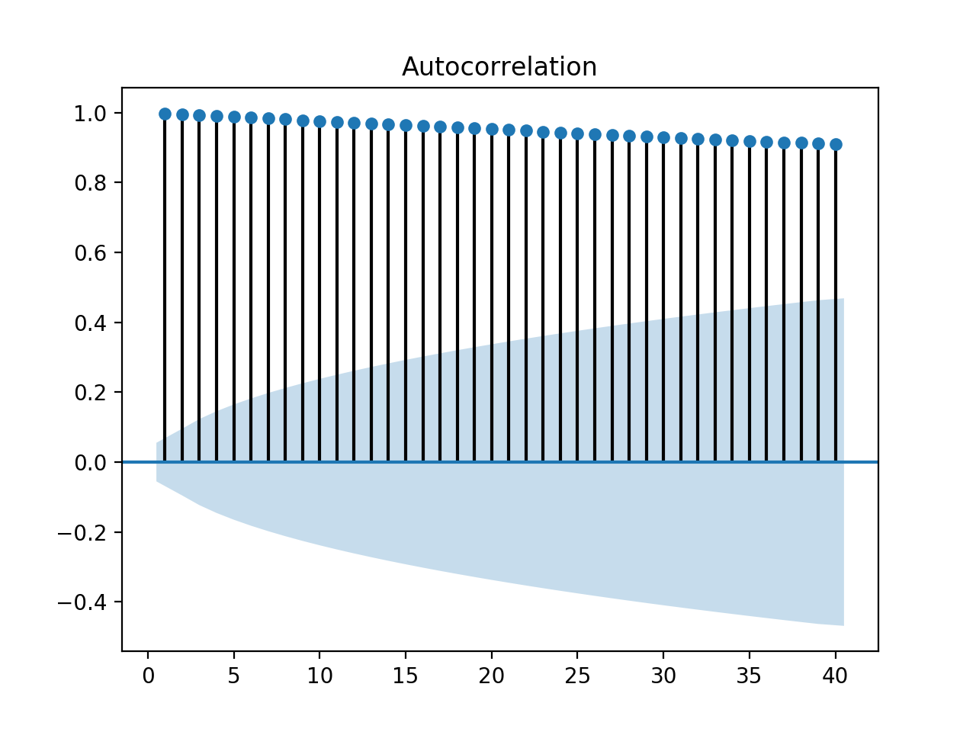
Stationary Time Series
If we apply the same methodology to the original data
Much more autocorrelation

Slide 64
Stationary Time Series
For lag = 2, the value is mostly because of the correlation between lag = 1
Use pacm instead
Calculates only the auto-correlation not explained by auto-correlation for smaller lags
sgt.plot_pacf(my_df.High, lags = 40)

Slide 65
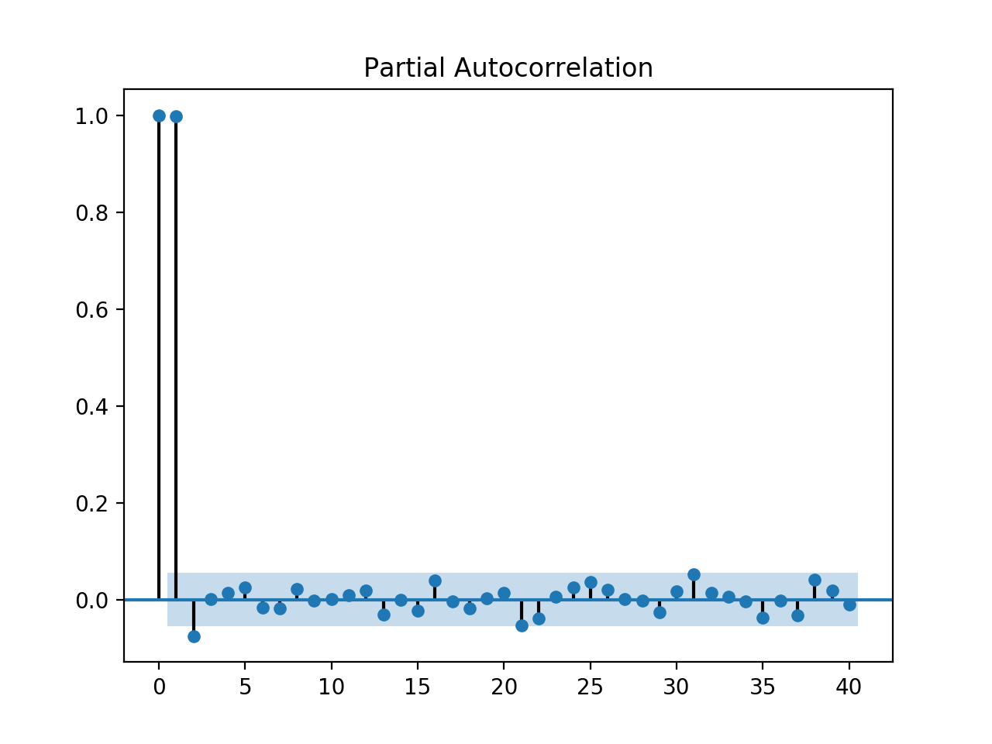
Stationary Time Series

Slide 66
Stationary Time Series
Autoregression Models
Forecast variable of interest using linear combination of past values of the variable
$$y_{t}=c+ϕ_{1}y_{t-1}+ϕ_{2}y_{t-2}+…+ϕ_{m}y_{t-m}+ϵ_{t}$$
With "white error" $ϵ_{t}$
Autoregressive Model of order $m$

Slide 67
Stationary Time Series
Moving average models
Uses past forecast errors
$$y_{t}=c+ϵ_{t}+θ_{1}ϵ_{t-1}+…+θ_{q}ϵ_{t-q}$$
with white noise $ϵ_{t},ϵ_{t-1},…,ϵ_{t-q}$

Slide 68
Stationary Time Series
ARIMA models
AutoRegressive Integrated Moving Average
$$y_{t}^{′}=c+ϕ_{1}y_{t-1}^{′}+…+ϕ_{p}y_{t-p}^{′}+θ_{1}ϵ_{t-1}+…+θ_{m}ϵ_{t-q}+ϵ_{t}$$
Differenced value at t is
autoregressive part of order p
d times differenciated
moving average of order q
ARIMA(p,d,q)

Slide 69
Stationary Time Series
Can use statsmodels
Specify degree of ARIMA model and print out its parameters
Display residual
from statsmodels.tsa.arima_model import ARIMA
model = ARIMA(my_df.High, order=(1,1,0))
model_fit = model.fit(disp=0)
print(model_fit.summary())
residuals = pd.DataFrame(model_fit.resid)
residuals.plot(label='residual')
plt.show()

Slide 70
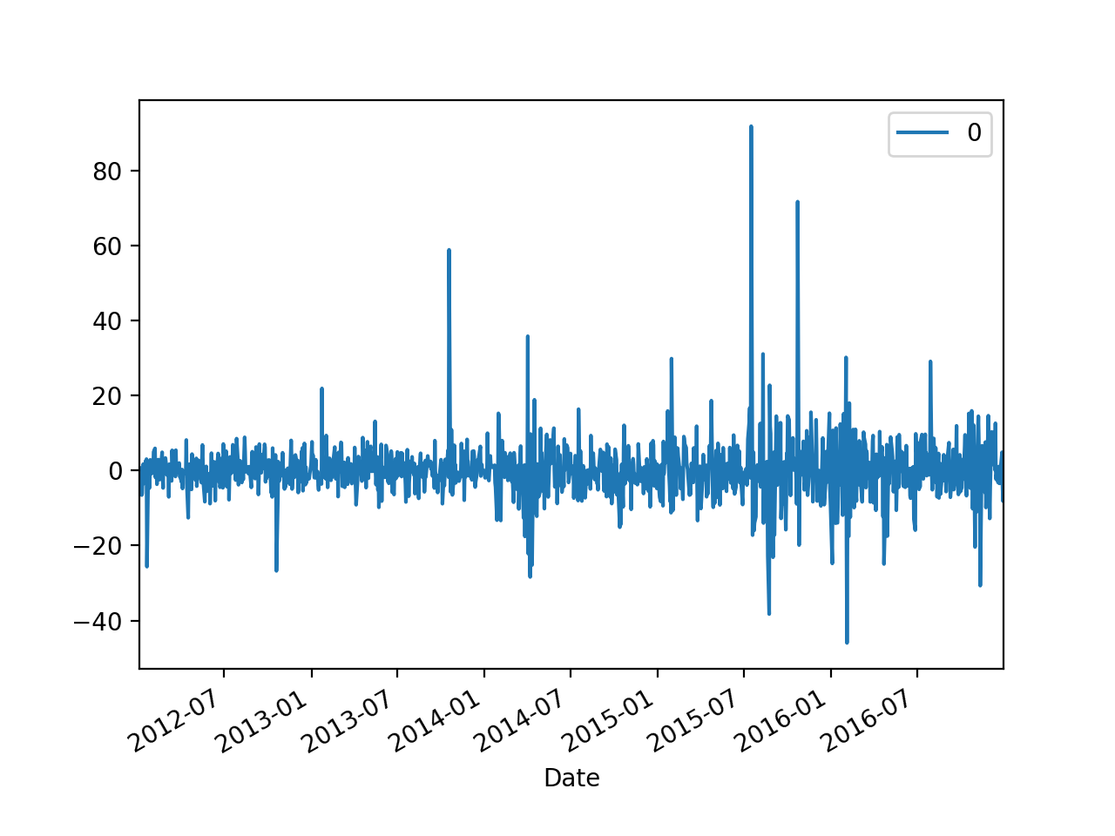
Stationary Time Series

Slide 71
Seasonal Time Series
It is possible to extend ARIMA to include a seasonal component
In which case we could even put in a trend
from statsmodels.tsa.statespace.sarimax import SARIMAX
df = get_data()
my_order = (1,1,1)
my_seasonal_order=(1,1,1,12)
model = SARIMAX(endog = df.Passengers,
order = my_order,
seasonal_order = my_seasonal_order)
results = model.fit()
print(results.summary())
results.resid.plot()
plt.show()

Slide 72
Stationary Time Series

Slide 73
Stationary Time Series

