Slide 1
Visualization
Thomas Schwarz, SJ

Slide 2
Data Visualization
We use Matplotlib
  Import with standard names
  Can set style
import numpy as np
import matplotlib as mpl
import matplotlib.pyplot as plt
plt.style.use('classic')

Slide 3
Matplotlib
Display your results from a script
  Use plt.show( )
    Starts an event loop
    Looks at all figure objects and opens interactive windows
import matplotlib.pyplot as plt
import numpy as np
import math
x = np.linspace(0, 4*math.pi, 200)
plt.plot(x, np.sin(x))
plt.plot(x, np.cos(x))
plt.show()

Slide 4
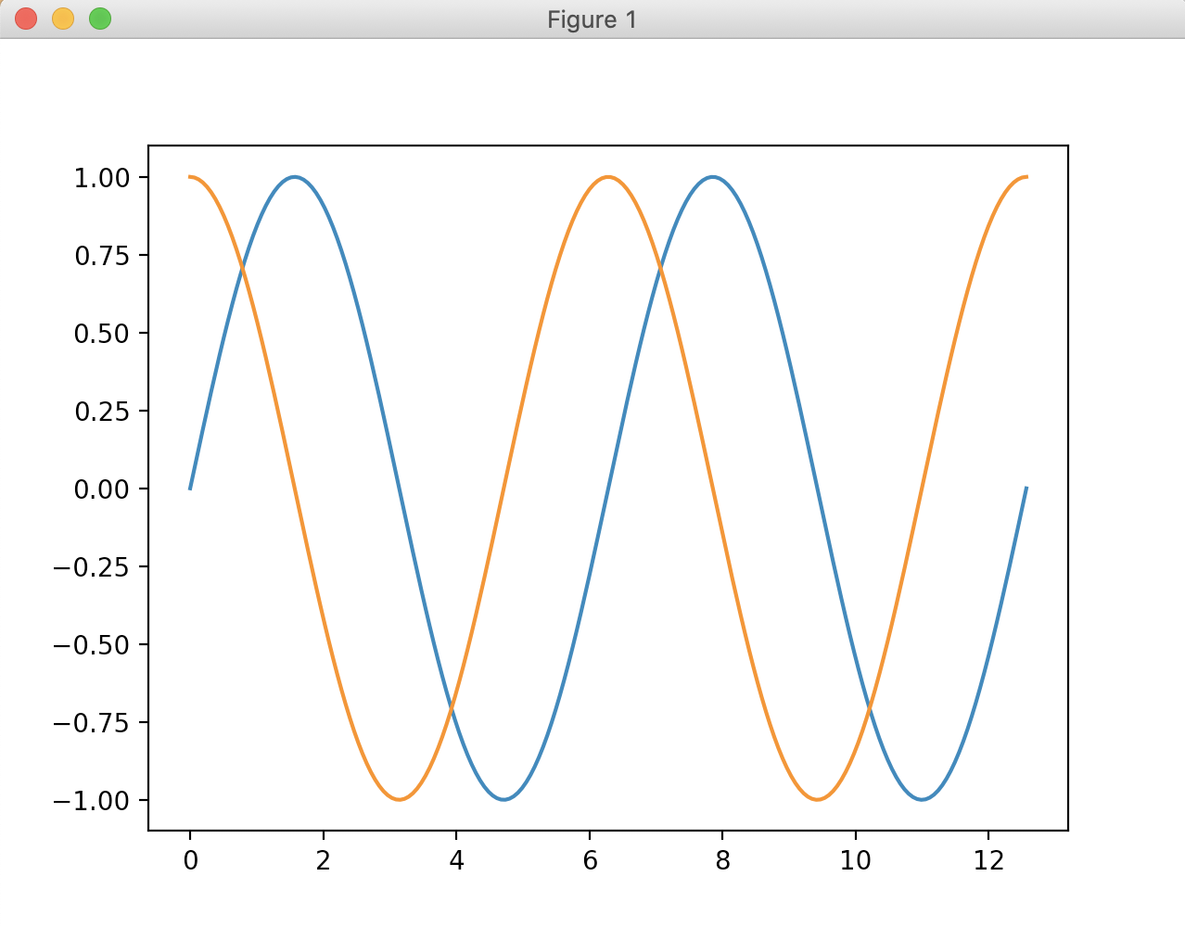
Matplotlib

Slide 5
Matplotlib
Plotting from iPython
  Need to specify matplotlib mode
    In [1]: %matplotlib
    In [2]: import matplotlib.pyplot as plt
  Specify %matplotlib notebook
    Interactive plots embedded in notebook
  Specify %matplotlib interactive
    static images of our plots

Slide 6
Matplotlib
Can save figures with the savefig('myfigure.png') command
  File format inferred from the extension

Slide 7
Histograms
Let's use the iris data set
  A pre-processed version is in sklearn.datasets
    Which means importing it
    We better look at it first:
iris = load_iris()
features = iris.data.T
>>> features[:,:10]
array([[5.1, 4.9, 4.7, 4.6, 5. , 5.4, 4.6, 5. , 4.4, 4.9],
[3.5, 3. , 3.2, 3.1, 3.6, 3.9, 3.4, 3.4, 2.9, 3.1],
[1.4, 1.4, 1.3, 1.5, 1.4, 1.7, 1.4, 1.5, 1.4, 1.5],
[0.2, 0.2, 0.2, 0.2, 0.2, 0.4, 0.3, 0.2, 0.2, 0.1]])

Slide 8
Histograms
Let's create histograms for all four properties of an Iris set
  We can define a simple figure with four different panels
  We then load the axes elements
fig, axs = plt.subplots(2,2, squeeze = True)
axs[0][0]
axs[0][1]
axs[1][0]
axs[1][1]

Slide 9
Histograms
For a histogram, we use the hist method of an axes
  Needs a np.array and a number of bins
axs[0][0].hist(features[0,50:150], bins = 10)
axs[0][1].hist(features[1,50:150], bins = 10)
axs[1][0].hist(features[2,50:150], bins = 10)
axs[1][1].hist(features[3,50:150], bins = 10)

Slide 10
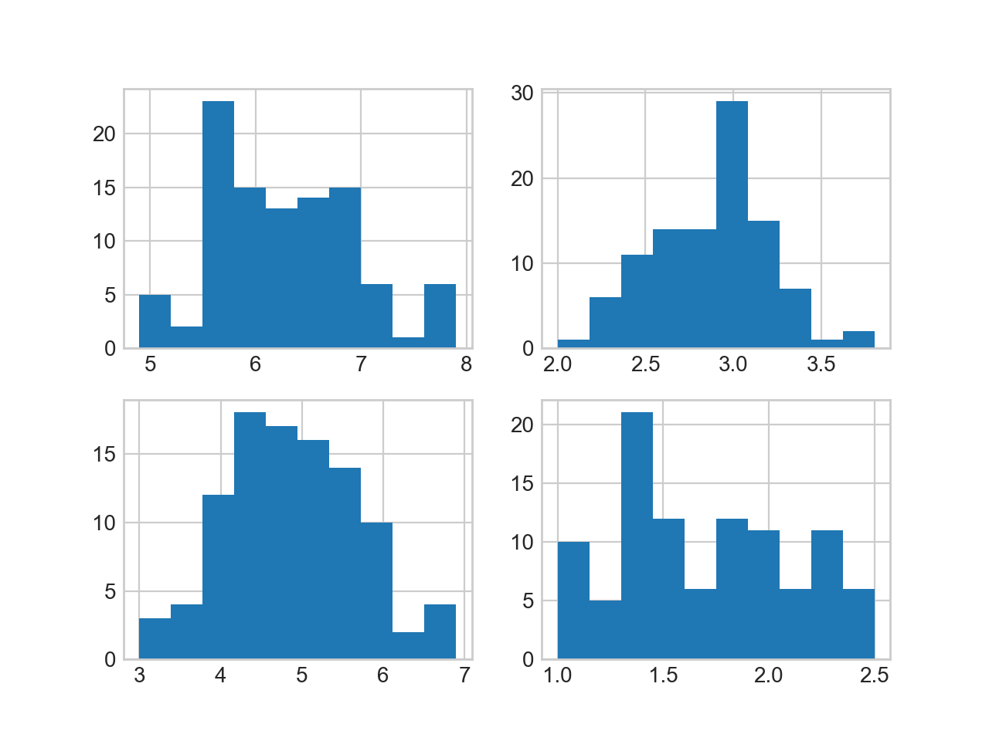
Histograms
Result so far:

Slide 11
Histograms
The axs objects are actually a tuple
  N, bins, patches
    with N the count in each bin
    bins the number in each bin
    patches gives us access to the properties drawn

Slide 12
Histograms
Here is how we get at them
And we can see what is in them
  N00, bins00
N00,bins00,patches00 = axs[0][0].hist(features[0,50:150], bins=10)
N01,bins01,patches01 = axs[0][1].hist(features[1,50:150], bins=10)
N10,bins10,patches10 = axs[1][0].hist(features[2,50:150], bins=10)
N11,bins11,patches11 = axs[1][1].hist(features[3,50:150], bins=10)
array([ 5., 2., 23., 15., 13., 14., 15., 6., 1., 6.])
array([4.9, 5.2, 5.5, 5.8, 6.1, 6.4, 6.7, 7. , 7.3, 7.6, 7.9])

Slide 13
Histograms
The patches is a list of patch objects, one for each bin rectangle
We can for example update the color
  Use patch.set_facecolor(color)
    Where color is a number between 0 and 256
    Which we can select according to colormaps

Slide 14
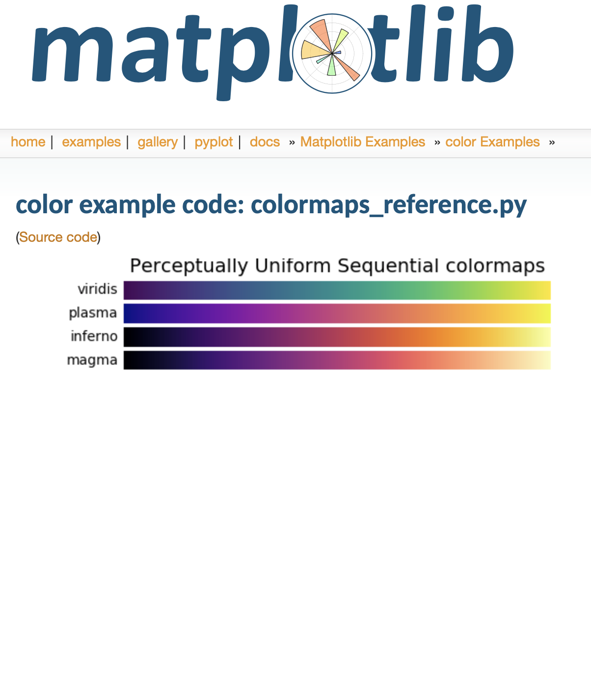
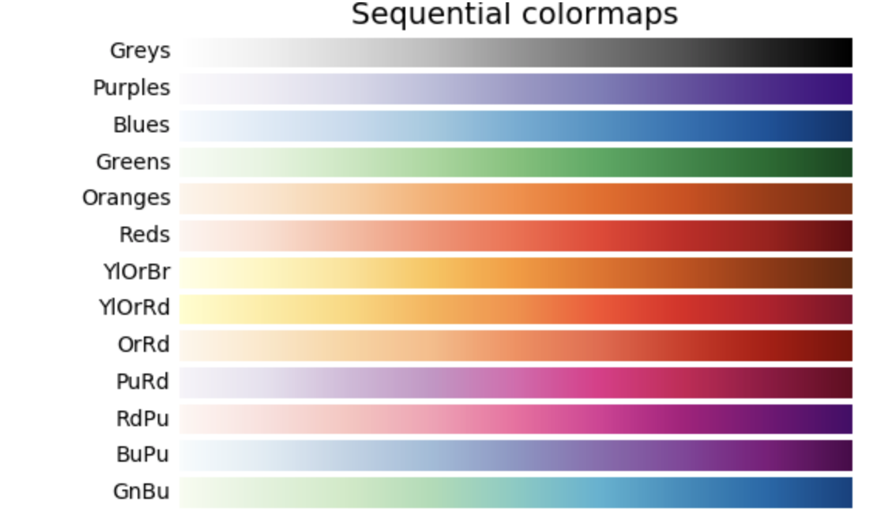
Colormaps

Slide 15
Histograms
For each of the four histograms, we can use a different color map
  We pick the number uniformly through 1 … 256
for i, patch in enumerate(patches00):
color = plt.cm.viridis(i*256//9)
patch.set_facecolor(color)
for i, patch in enumerate(patches01):
color = plt.cm.magma(i*256//9)
patch.set_facecolor(color)

Slide 16
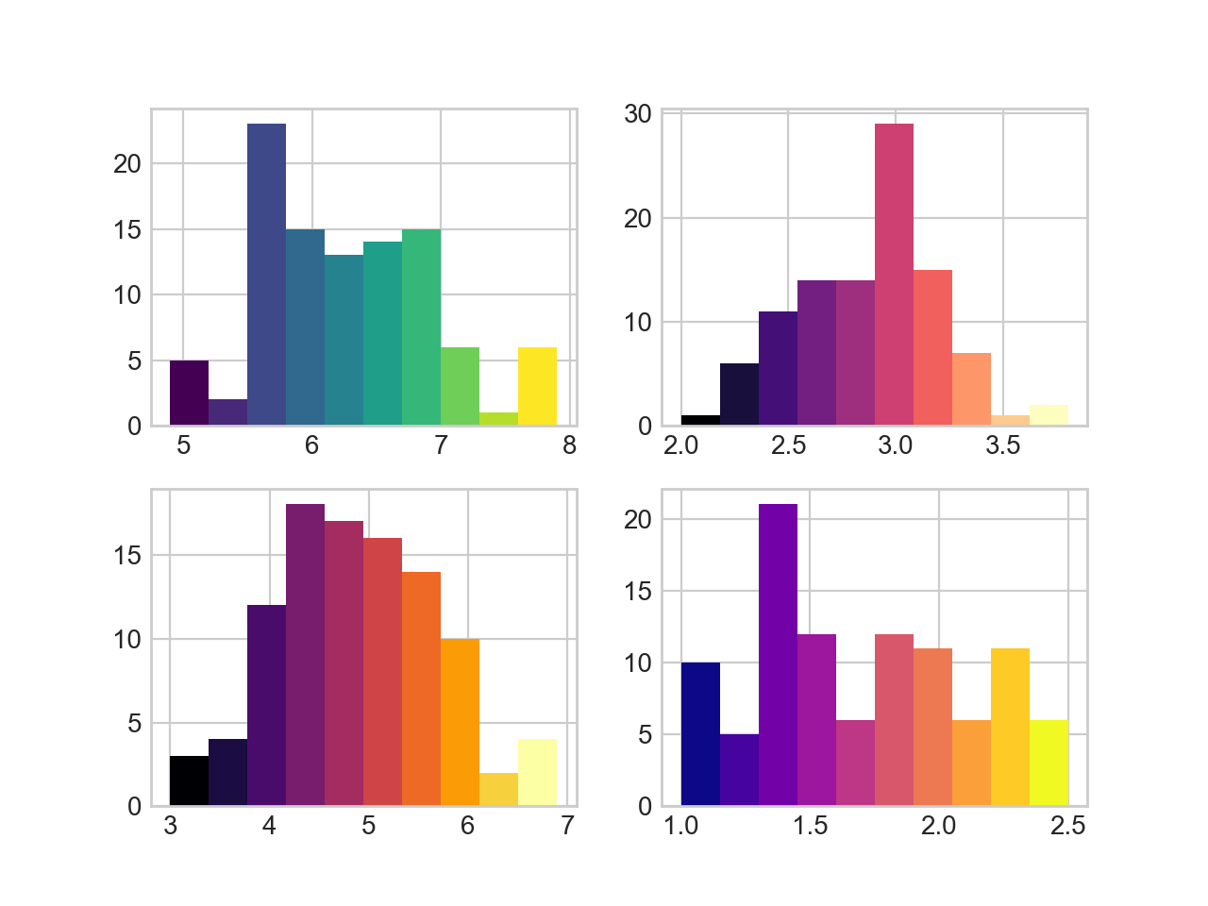
Histograms

Slide 17
Python enumerate
Remember that Python has some great list tools
  enumerate(a_list_or_sequence)
  will generate tuples of index and element

Slide 18
Histograms
We should describe what we are displaying
  First, let's add labels for the axes
    Turns out that the rows are too close together
      Search the web: can be adjusted with tight_layout
for ax in axs:
for a in ax:
a.set_xlabel('mm')
a.set_ylabel('nr')
fig.tight_layout(pad=1.0)

Slide 19
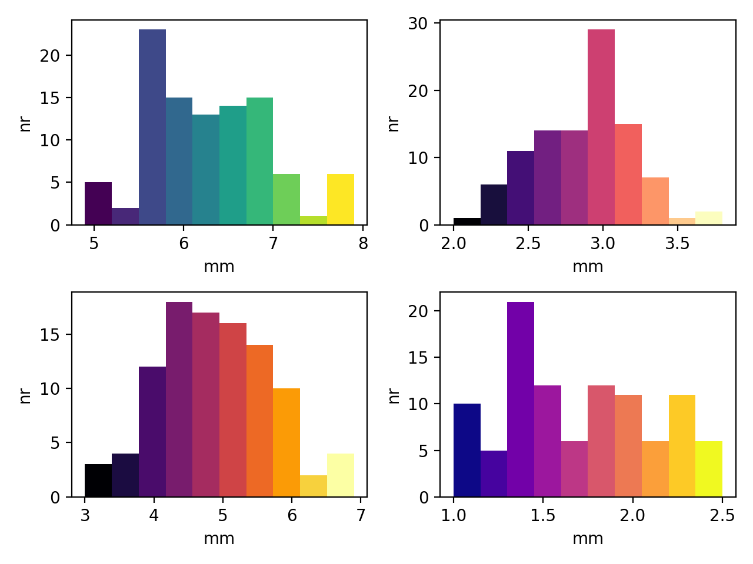
Histograms

Slide 20
Histograms
for ax in axs:
for a in ax:
a.set_xlabel('mm')
a.set_ylabel('nr')
axs[0][0].set_title('Sepal Length')
axs[0][1].set_title('Sepal Width')
axs[1][0].set_title('Petal Length')
axs[1][1].set_title('Petal Width')
fig.tight_layout(pad=1.0)

Slide 21
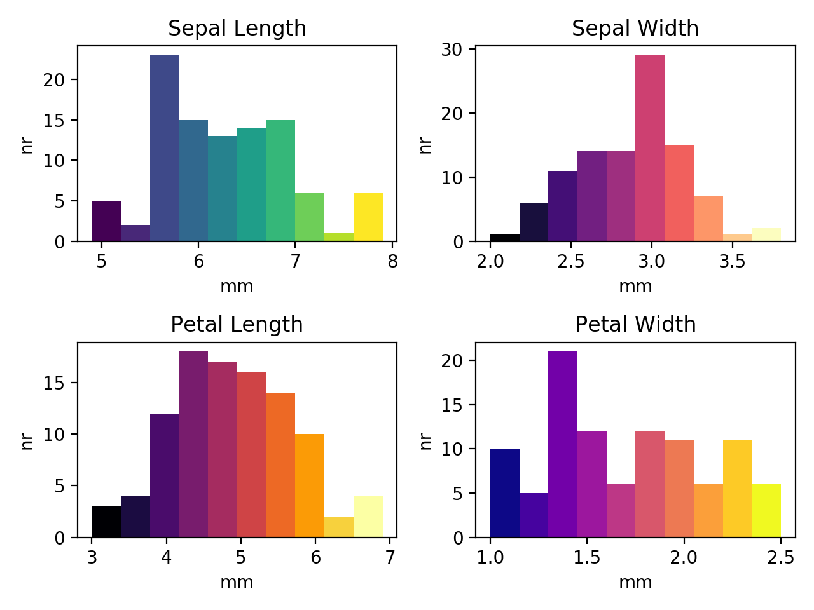
Histograms

Slide 22
2D-Histograms
Two-dimensional histograms use color to show the numbers into a two dimensional bin
import numpy as np
import matplotlib.pyplot as plt
from sklearn.datasets import load_iris
iris = load_iris()
features = iris.data.T
fig, axs = plt.subplots(1,2)
axs[0].hist2d(features[0,50:150],features[1,50:150])
axs[1].hist2d(features[2,50:150],features[3,50:150])
plt.show()

Slide 23
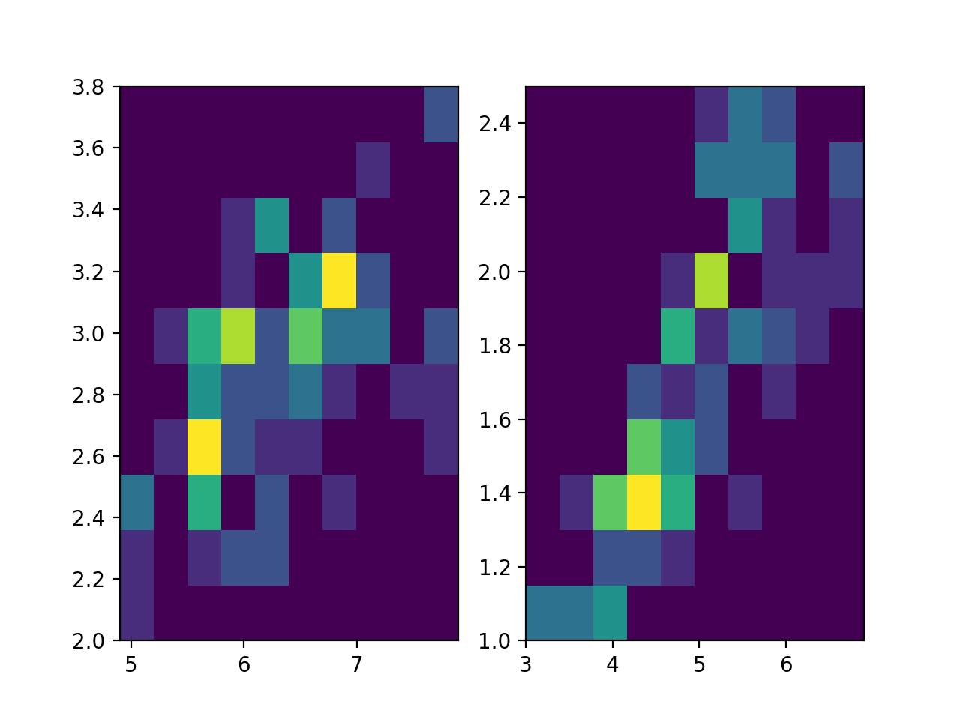
2D-Histograms
The result is harder to read:

Slide 24
2D-Histograms
We can adjust the number of bins on each side
And adjust the color scheme
  set color map to something easily interpretable
from matplotlib import colors

Slide 25
2D-Histograms
fig, axs = plt.subplots(1,2)
axs[0].hist2d(features[0,50:150],
features[1,50:150],
bins=7,
norm=colors.LogNorm(),
cmap = 'Blues')
axs[1].hist2d(features[2,50:150],
features[3,50:150],
bins=7,
norm=colors.LogNorm(),
cmap = 'Blues')

Slide 26
2D-Histograms
Then add labels and titles
for i in range(2):
axs[i].set_xlabel('mm')
axs[i].set_ylabel('mm')
axs[0].set_title('Sepal')
axs[1].set_title('Petal')

Slide 27
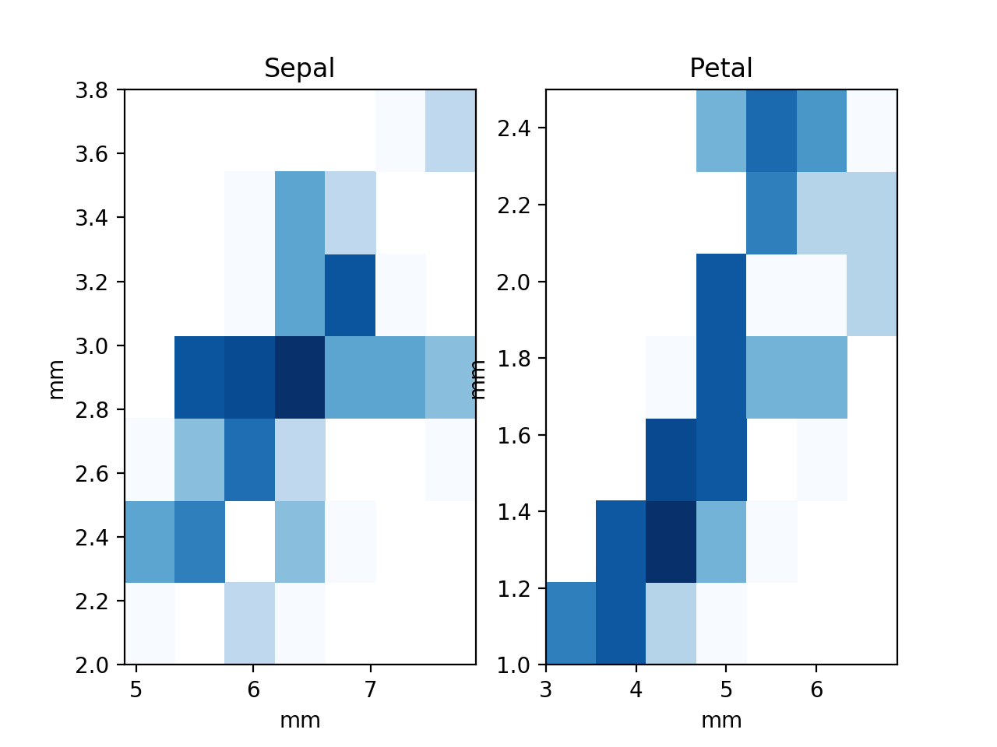
2D-Histograms

Slide 28
2D-Histograms
Need to adjust padding
for a in axs:
a.set_xlabel('mm')
a.set_ylabel('mm')
axs[0].set_title('Sepal')
axs[1].set_title('Petal')
fig.tight_layout(pad=1.0)

Slide 29
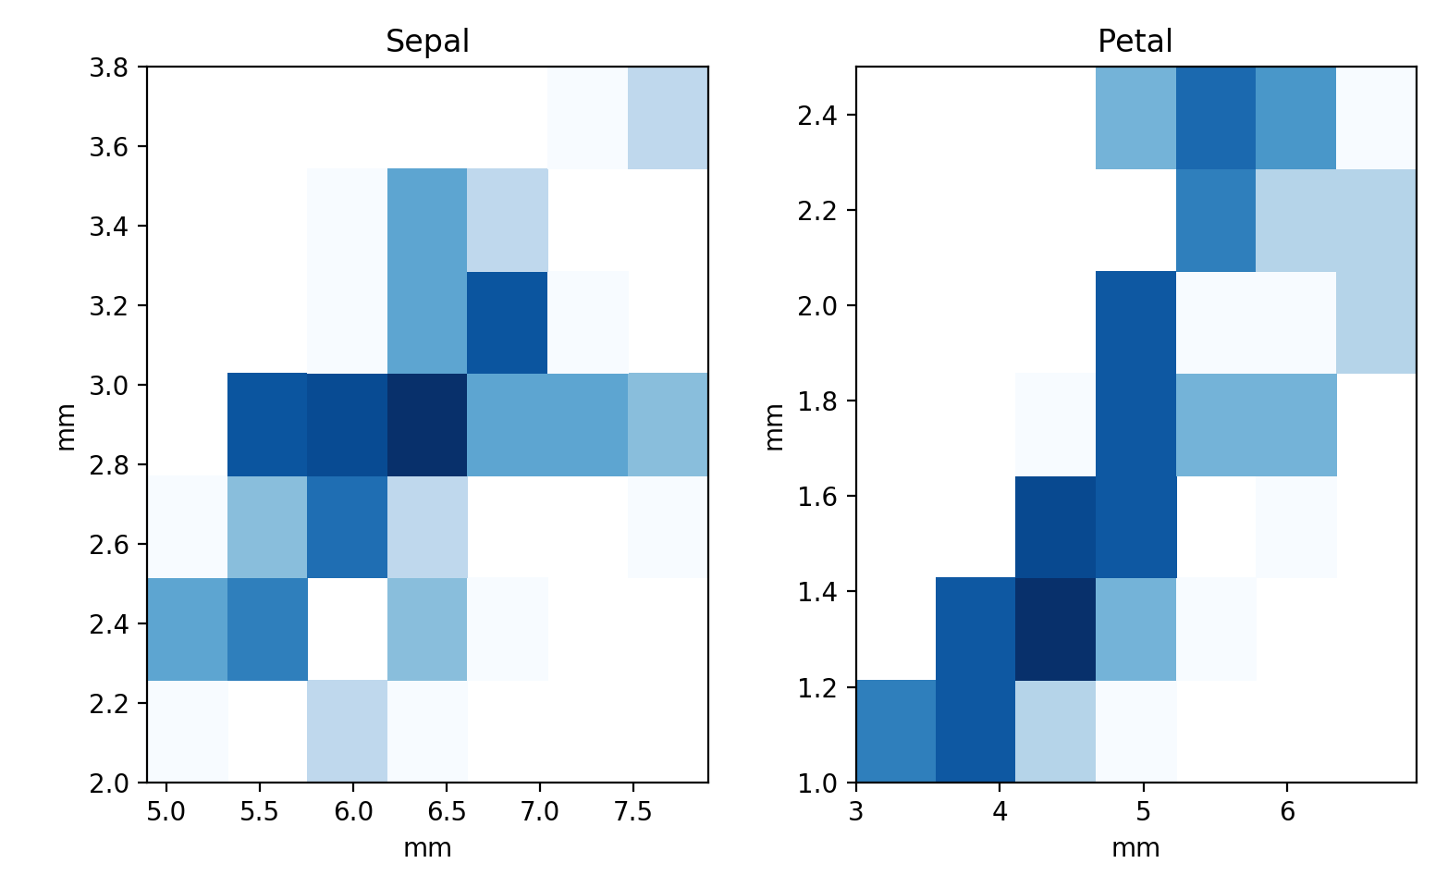
2D-Histograms

Slide 30
Plot Legends
Let's create a simple plot: compare arctan and the logistic functions
Provide a simple legend
  Give a label to the plot
  call legend and the axes object

Slide 31
Plot Legends
import numpy as np
import matplotlib.pyplot as plt
import scipy
import math
plt.style.use('classic')
x = np.linspace(-10,10,1001)
fig, ax = plt.subplots()
ax.plot(x, 2*np.arctan(x)/math.pi, 'b-', label='arctan')
ax.plot(x, 2/(np.exp(-x)+1)-1, 'r--', label='logistic 1')
ax.plot(x, 2/(np.exp(-x/2)+1)-1, 'g:', label='logistic 1/2')
ax.legend()
plt.show()

Slide 32
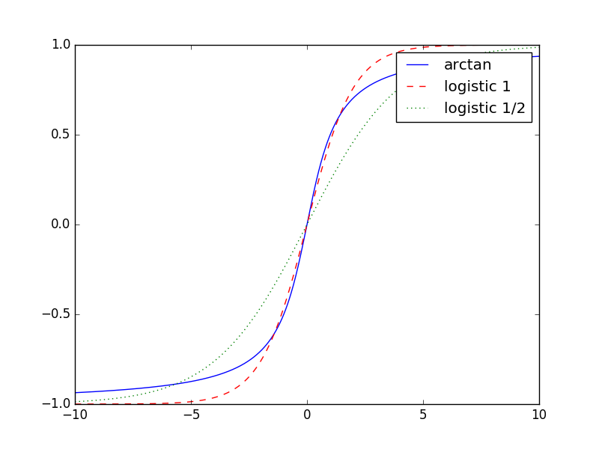
Plot Legends

Slide 33
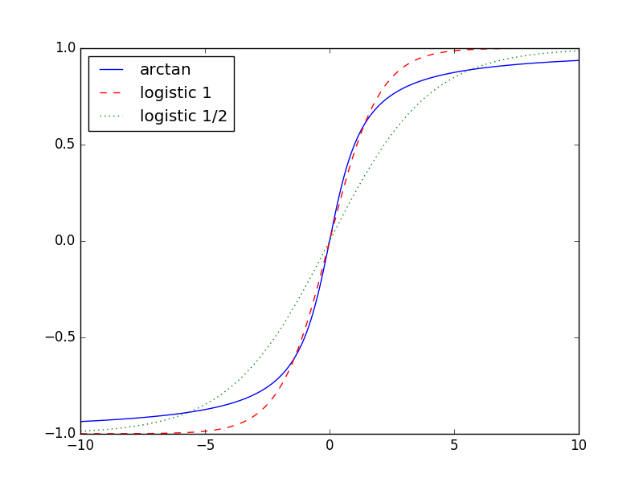
Plot Legends
Can specify placement of the legend
ax.legend(loc='upper left')

Slide 34
Plot Legends
Can specify the number of columns in the legend
x = np.linspace(-10,10,1001)
fig, ax = plt.subplots()
ax.plot(x, 2*np.arctan(x)/math.pi, 'b-', label='arctan')
ax.plot(x, 2*np.arctan(x/2)/math.pi, 'b-.', label='arctan 1/2')
ax.plot(x, 2/(np.exp(-x)+1)-1, 'r--', label='logistic 1')
ax.plot(x, 2/(np.exp(-x/2)+1)-1, 'g:', label='logistic 1/2')
ax.legend(loc='upper left', ncol = 2)
plt.show()

Slide 35
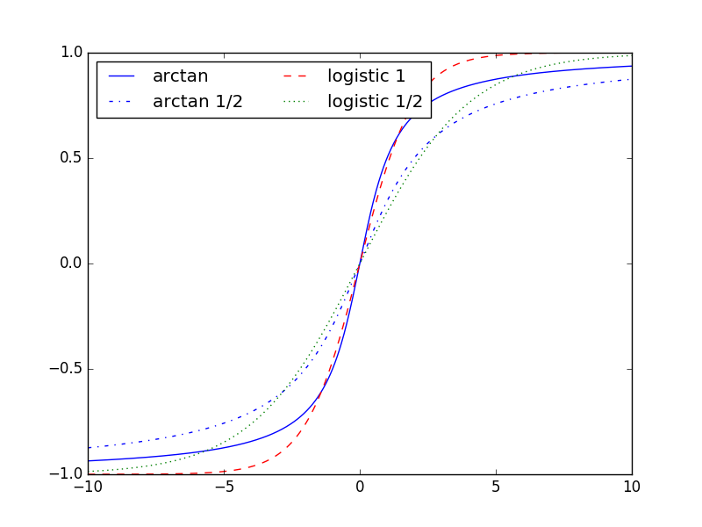
Plot Legends

Slide 36
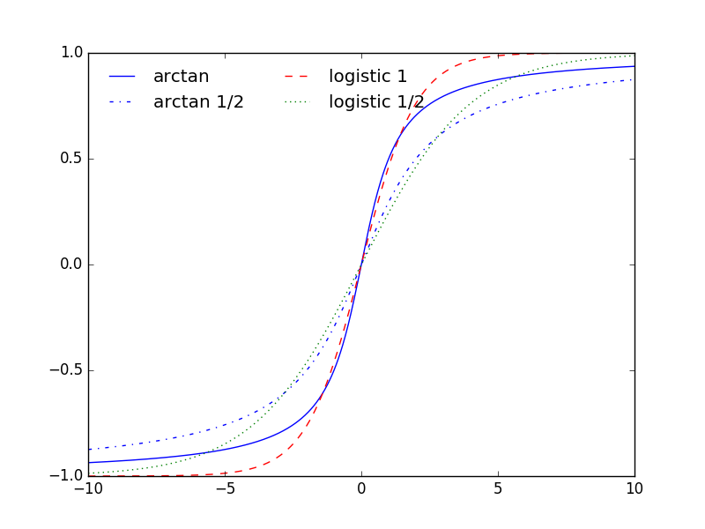
Plot Legends
Turn off the frame
ax.legend(loc='upper left',
ncol = 2,
frameon=False)

Slide 37
Plot Legends
If we do not provide a label in a plot, then it will be ignored

Slide 38
Plot Legends
Can use labels to provide additional information
  Open california_cities.csv
  Create a scatter plot based on latitude and longitude
  Set the color to the population (decadic logarithm)
  Set the size to the area of the city
  Deploy a colorbar with a label (in LaTeX)

Slide 39
Plot Legends
cities = pd.read_csv('california_cities.csv')
lat, lon = cities['latd'], cities['longd']
population, area = cities['population_total'], cities['area_total_km2']
plt.scatter(lon, lat, label=None,
c = np.log10(population), cmap='Blues',
s = area, linewidth = 0, alpha = 0.5)
plt.axis(aspect='equal')
plt.xlabel('longitude')
plt.ylabel('latitude')
plt.colorbar(label='$\log_{10}$(population)')
plt.clim(3,7) #color scaling

Slide 40
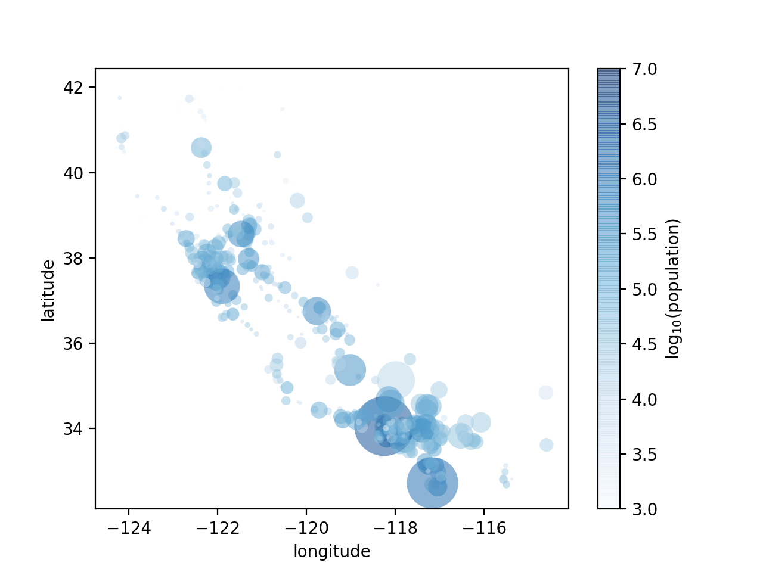
Plot Legends

Slide 41
Plot Legends
This lacks an explanation of the areas of the cities
  In order to create a legend, we need to plot comparison cities with 'label'
  But these cities do not have to exist
for area in [100, 250, 500]:
plt.scatter([],[], c='r',
alpha = 0.3, s=area,
label = str(area)+'km$^2$')
plt.legend(frameon = False, title='City Area')

Slide 42
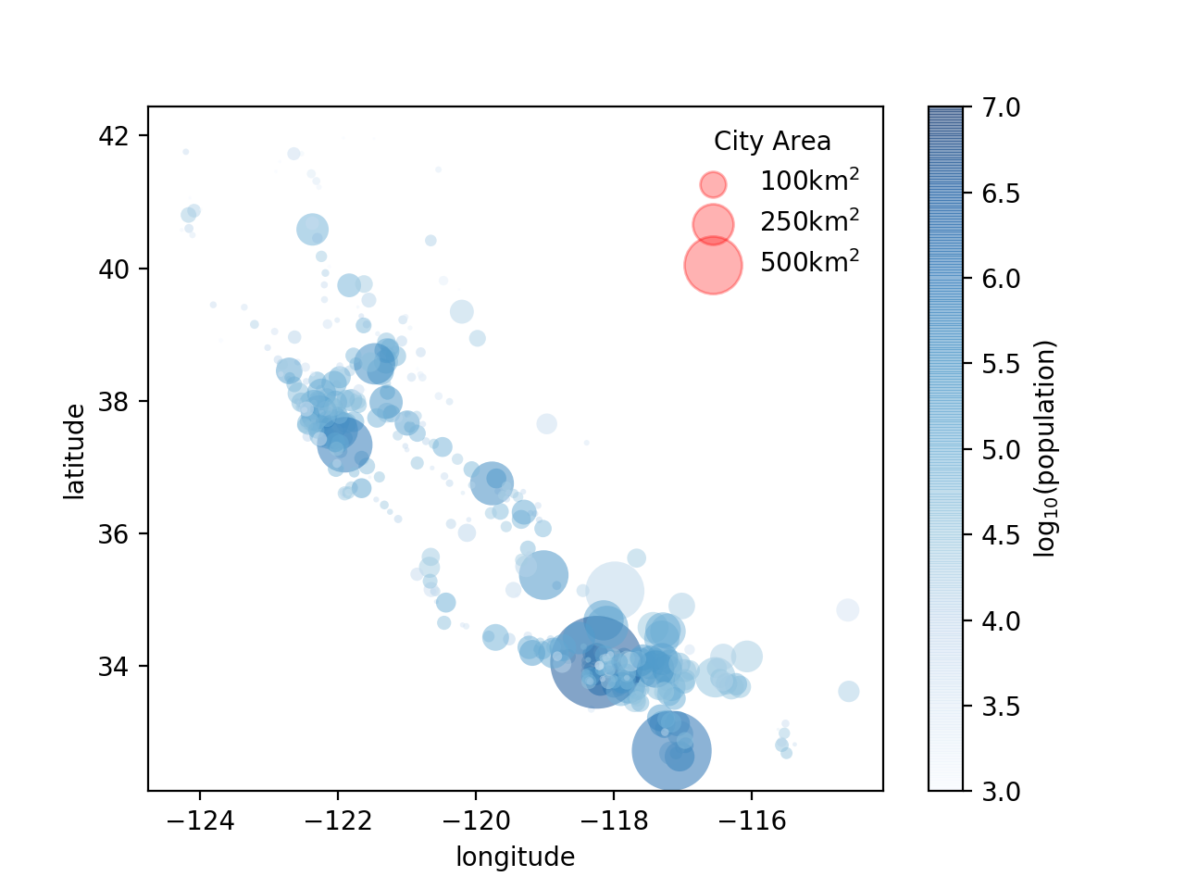
Plot Legends
The label isn't so great

Slide 43
Plot Legends
Use labelspacing to avoid overlap
plt.legend(frameon = False,
title='City Area',
labelspacing=1)

Slide 44
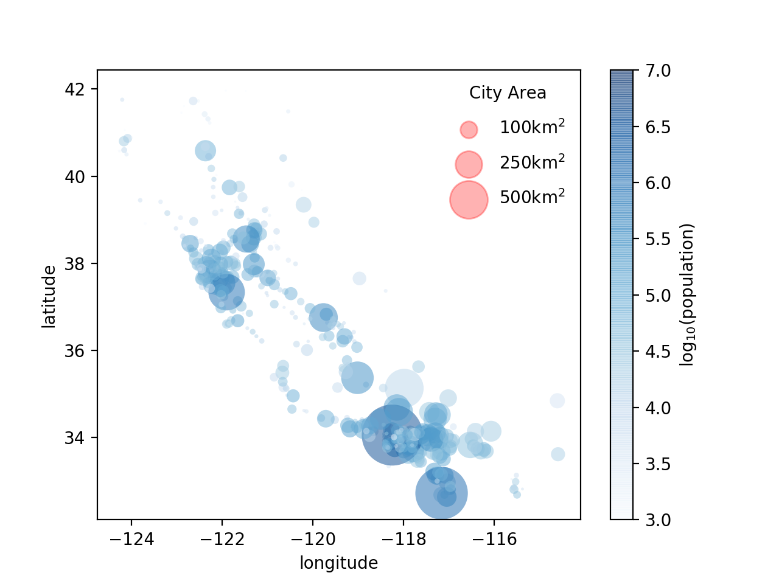
Plot Legends

Slide 45
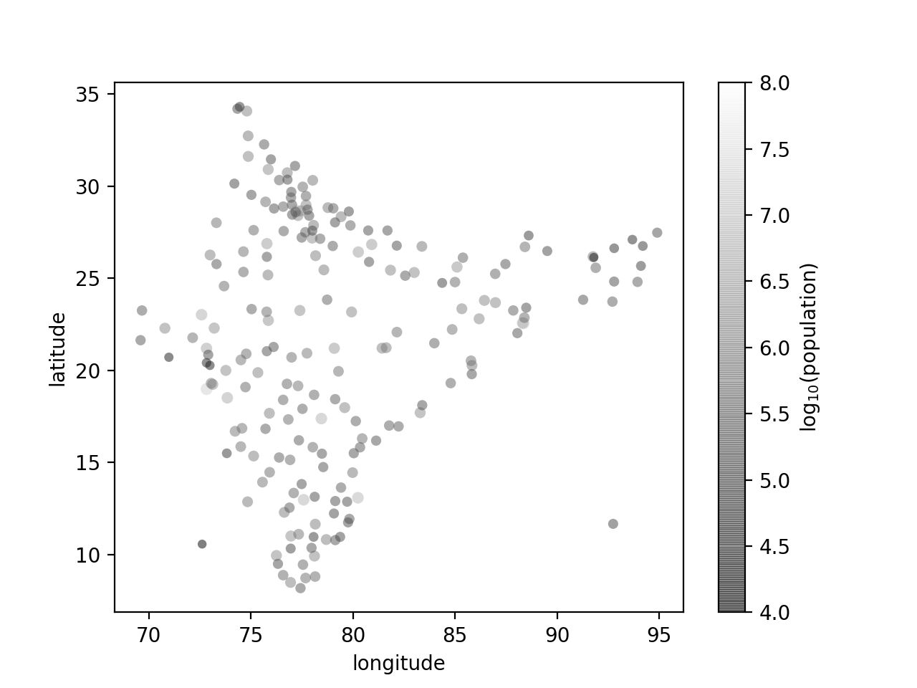
Homework
Use the in.csv map to create a map of India's cities

Slide 46
Homework
Restrict the map to cities of more than 2 million population
Use a better color-scheme

Slide 47
Text and Annotation
We download a database on births per day in the US
import pandas as pd
import numpy as np
import matplotlib.pyplot as plt
births = pd.read_csv('births.csv')
>>> births.head()
year month day gender births
0 1969 1 1.0 F 4046
1 1969 1 1.0 M 4440
2 1969 1 2.0 F 4454
3 1969 1 2.0 M 4548
4 1969 1 3.0 F 4548

Slide 48
Aggregation & Grouping
Pandas has a number of aggregation functions, such as means, sum, count, …
Use grouby to group by 'gender' and calculate the total number in the file
>>> births.groupby('gender')[['births']].sum()
births
gender
F 74035823
M 77738555

Slide 49
Aggregation & Grouping
Or subdivide by year
>>> births.groupby(['gender', 'year'])[['births']].sum()
births
gender year
F 1969 1753634
1970 1819164
1971 1736774
1972 1592347
1973 1533102
... ...
M 2004 2108197
2005 2122727
2006 2188268
2007 2212118
2008 2177227
[80 rows x 1 columns]

Slide 50
Aggregation & Grouping
pivot_table is much simpler to use:
>>> births.pivot_table('births',
index='year',
columns = 'gender',
aggfunc='sum')
gender F M
year
1969 1753634 1846572
1970 1819164 1918636
1971 1736774 1826774
1972 1592347 1673888
1973 1533102 1613023
1974 1543005 1627626
1975 1535546 1618010
1976 1547613 1628863
1977 1623363 1708796

Slide 51
Aggregation & Grouping
Here is the data per year
import pandas as pd
import numpy as np
import matplotlib.pyplot as plt
births = pd.read_csv('births.csv')
births.pivot_table('births',
index='year',
columns='gender',
aggfunc='sum').plot()
plt.ylabel('total births per year');
plt.show()

Slide 52
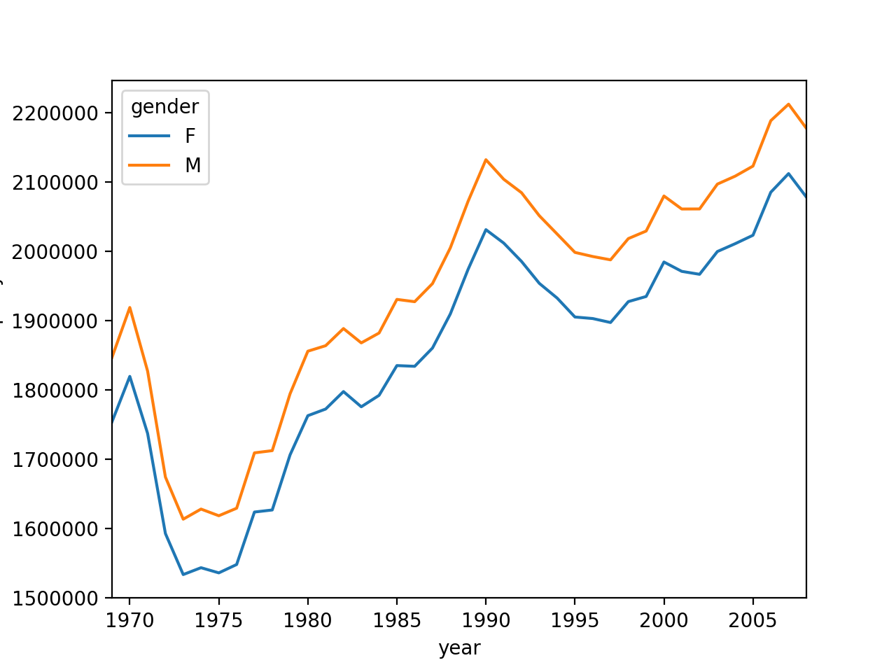
Aggregation & Grouping

Slide 53
Aggregation & Grouping
The data set has some problems:
  Missing values or typos (June 31)
  One possibility is to programmatically find outliers
  First, we estimate the standard deviation of the values
births = pd.read_csv('births.csv')
quartiles = np.percentile(births['births'],
[25, 50, 75])
mu = quartiles[1]
sigma = 0.74*(quartiles[2]-quartiles[0])
print(mu, sigma)

Slide 54
Aggregation & Grouping
Now we want to filter out all values that are more than $5σ$ away from $μ$
This can be done in pandas using the query function
Alternatively, write a Python script to clean the csv file
births = births.query('(births > @mu - 5*@sigma) & (births < @mu + 5*@sigma)')

Slide 55
Aggregation & Grouping
To get the mean number of births per day,
    need to set the day column to integers
      there are some 'null' values
      this works because we already got rid of bad data
births['day'] = births['day'].astype(int)

Slide 56
Aggregation & Grouping
Pandas has its own datetime converter
  trick:
    day, month, year are integers
    calculate an integer in form YYYYMMDD
    it is then interpreted as a string
births.index = pd.to_datetime(
10000*births.year+100*births.month+births.day,
format='%Y%m%d'
)

Slide 57
Aggregation & Grouping
Result is success:
>>> births.head()
year month day gender births
1969-01-01 1969 1 1 F 4046
1969-01-01 1969 1 1 M 4440
1969-01-02 1969 1 2 F 4454
1969-01-02 1969 1 2 M 4548
1969-01-03 1969 1 3 F 4548

Slide 58
Aggregation & Grouping
Create an additional column 'decade'
  Divide year as integer by 10, then multiply by 10
    1974 -> 197 -> 1970
  Then group by decades and calculate mean of births
>>> births.pivot_table('births',
index='decade', columns = 'gender',
aggfunc='mean').head()
gender F M
decade
1960 4802.290411 5056.827397
1970 4452.450164 4687.509584
1980 4968.524027 5222.411800

Slide 59
Aggregation & Grouping
Can also pivot according to day of the week
births['dayofweek'] = births.index.dayofweek
>>> births.pivot_table('births', index='dayofweek', columns = ['gender', 'decade'], aggfunc='mean')
gender F ... M
decade 1960 1970 ... 1970 1980
dayofweek ...
0 4919.500000 4566.764368 ... 4811.431034 5406.437100
1 5153.692308 4752.195777 ... 5018.309021 5649.948936
2 4915.660377 4627.401152 ... 4873.351248 5505.321277
3 4871.230769 4576.057471 ... 4817.789272 5467.665957
4 4975.769231 4659.810345 ... 4904.381226 5530.895745
5 4535.884615 4103.703065 ... 4311.865900 4592.244681
6 4242.115385 3882.128352 ... 4076.429119 4403.017058

Slide 60
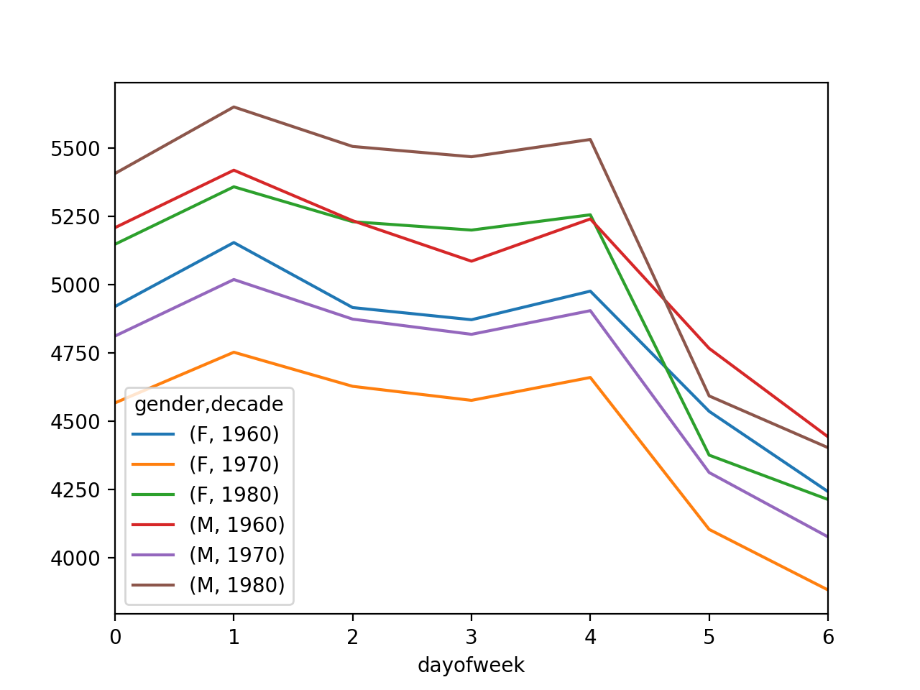
Text and Annotation
We can separate genders:
births.pivot_table('births',
index='dayofweek',
columns = ['gender', 'decade'],
aggfunc='mean').plot()

Slide 61
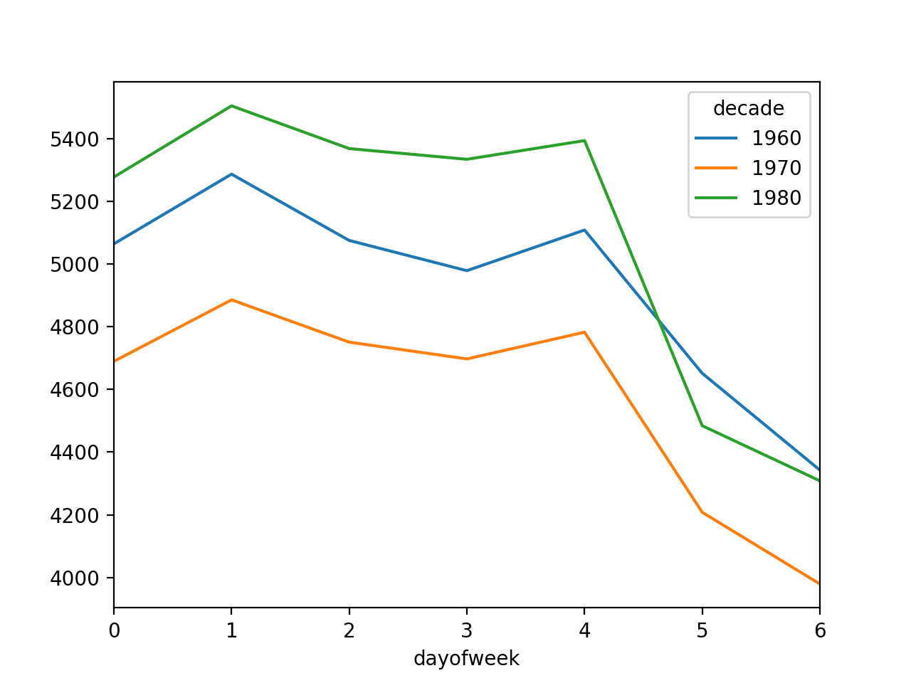
Text and Annotation
Or not
births.pivot_table('births',
index='dayofweek',
columns = ['gender', 'decade'],
aggfunc='mean').plot()

Slide 62
Text and Annotation
This is not so great: The day of the week is a number
  We can actually access labels, but this is in the inside of matplotlib itself
    Use gca to set ticks
plt.gca().set_xticklabels(['M', 'T',
'W', 'R', 'F', 'Sa', 'Su'])
plt.ylabel('mean birth per day')
plt.xlabel('week day')

Slide 63
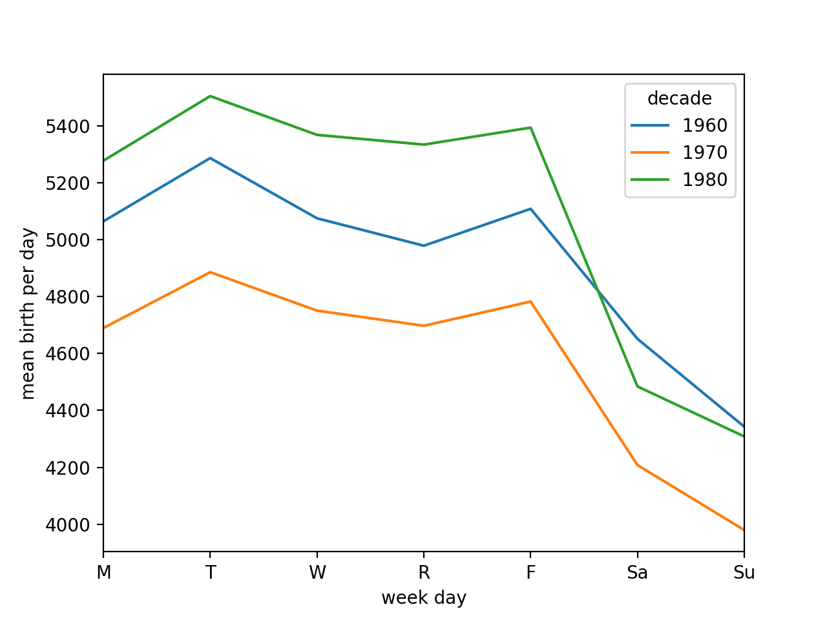
Text and Annotation

Slide 64
Text and Annotation
Apparently, birth dates are controlled by the day of the week

Slide 65
Text and Annotation
What about the effects of holidays
  Create a table with a new index corresponding to the days in 2000 (which was a leap year)
births_by_date = births.pivot_table('births',
[births.index.month, births.index.day])
births_by_date.index = [pd.datetime(2000, month, day)
for (month, day) in births_by_date.index]

Slide 66
Text and Annotation
Then plot them
fig, ax = plt.subplots(figsize=(20,5))
births_by_date.plot(ax=ax)

Slide 67
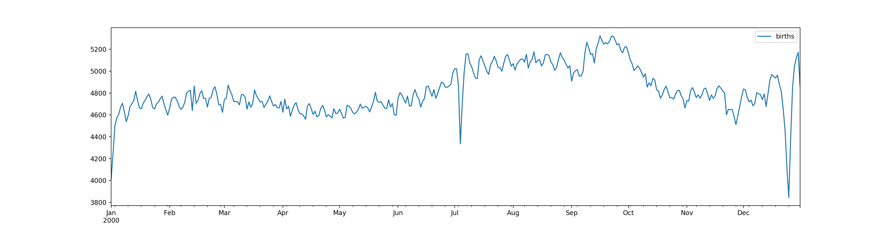
Text and Annotation

Slide 68
Text and Annotation
Can observe:
  Couples procreate more in January
  Three big dips: July 4 and December 24/25, and January 1
  Effect of Thanksgiving and Memorial day are not as visible

Slide 69
Text and Annotation
Can use plt.text or ax.text to place a text at a certain coordinate
my_style = dict(size=10, color='black')
ax.text('2000-7-4', 4200,
'Independence Day',
ha='center',
**my_style)

Slide 70
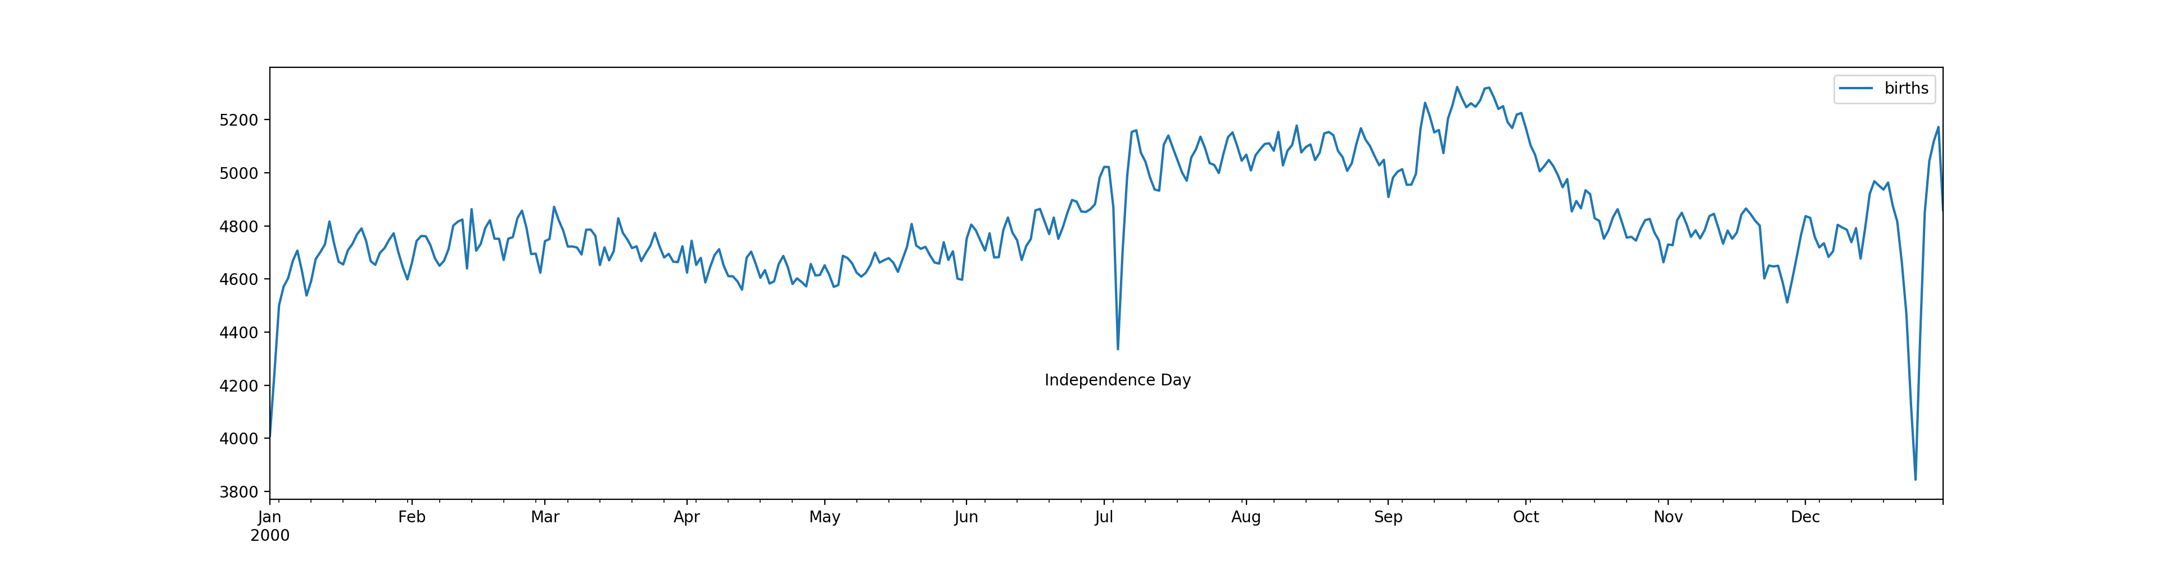
Text and Annotation

Slide 71
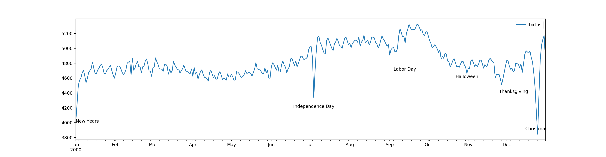
Text and Annotation
my_style = dict(size=10, color='black')
ax.text('2000-7-4', 4200, 'Independence Day', ha='center', **my_style)
ax.text('2000-10-31', 4600, 'Halloween', ha='center', **my_style)
ax.text('2000-12-24', 3900, 'Christmas', ha='center', **my_style)
ax.text('2000-1-1', 4000, 'New Years', ha='left', **my_style)
ax.text('2000-9-4', 4700, 'Labor Day', ha='left', **my_style)
ax.text('2000-11-25', 4400, 'Thanksgiving', ha='left', **my_style)

Slide 72
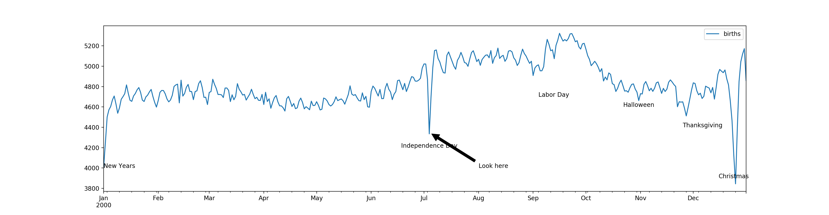
Text and Annotation
Can also use ax.annotate
ax.annotate('Look here', xy = ('2000-7-4',4350), xytext=('2000-8-1',
4000),
arrowprops = dict(facecolor='black', shrink = 0.05))

