Slide 1
Naive Bayes
and
Gaussian Bayesian Inference
Thomas Schwarz

Slide 2
Conditional Probability
Given two events $A$ and $B$, we define the conditional probability as
$$P(A|B)=\frac{P(A∩B)}{P(B)}$$
"probability of A given B"
Write also as:
$$P(A∩B)=P(A|B)P(B)$$

Slide 3
Conditional Probability
Bayes' Theorem: An observation of extreme importance
Giving rise to a new way of statistics
Theorem: $P(A|B)=\frac{P(B|A)⋅P(A)}{P(B)}$
Expresses a probability conditioned on B in one conditioned on A
Proof: $P(A|B)P(B)=P(A∩B)=P(B∩A)=P(B|A)P(A)$
Now solve for $P(A|B)$

Slide 4
Conditional Probability
We can express a probability for one event in terms of another event happening or not
$$P(A)=P(A∩B)+P(A∩\overline{B})$$
$=P(A|B)P(B)+P(A|\overline{B})P(\overline{B})$
A
$$A∩\overline{B}$$
$$A∩B$$
B

Slide 5
Conditional Probability
We can expand Bayes by calculating $P(B)$ as probabilities conditioned on $A$
$P(A|B)=\frac{P(B|A)⋅P(A)}{P(B)}$
$$=\frac{P(B|A)⋅P(A)}{P(B∩A)+P(B∩\overline{A})}$$
$$=\frac{P(B|A)⋅P(A)}{P(B|A)P(A)+P(B|\overline{A})P(\overline{A})}$$

Slide 6
Conditional Probability
Example: Medical Tests
An HIV test is positive. What is the probability that you have HIV?
Need some data: The quality of the test
Type 1 error: Test is negative, but there is illness
Type 2 error: Test is positive, but there is no illness

Slide 7
Conditional Probability
Abbreviate probabilities
T : Test is positive
H : Person infected with HIV
Interested in $P(H|T)$. The quality of the test is expressed in terms of the opposite conditional probability.
Type I error probability: $P(\overline{T}|H)$
Type II error probability: $P(T|\overline{H})$

Slide 8
Conditional Probability
We calculate
$$P(H|T)=\frac{P(T|H)P(H)}{P(T|H)P(H)+P(T|\overline{H})P(\overline{H})}$$
Assume test has 5% type I (false positive) error probability and 1% type II (false negative) error probability:
$$P(T|\overline{H})=0.95$$
$$P(\overline{T}|H)=0.99$$
The probability still depends on the prevalence of HIV in the population

Slide 9
Conditional Probability
$$P(H|T)=\frac{0.99P(H)}{0.99P(H)+0.95(1-P(H))}$$
Example: HIV rate in general population in the US is 13.3/100000 = 0.000,133
After a positive test:
0.000138599 (Almost no change!)
Example 2: HIV in a high risk group in the US is 1,753.1/100000 = 0.017531
After a positive test:
0.0182557

Slide 10
Conditional Probability
With these type I and type II error rates
the test is almost unusable at low incidence rates

Slide 11
Classification with Bayes
Bayes' theorem inverts conditional probabilities
Can use this for classification based on observations
Idea: Assume we have observations $\overset{⃗}{x}$
We have calculated the probabilities of seeing these observations given a certain classification
I.e.: for each category, we know $P(\overset{⃗}{x},c_{i})$
Probability to observe $\overset{⃗}{x}$ assuming that point lies in $c_{i}$
We use Bayes formula in order to calculate $P(c_{i},\overset{⃗}{x})$
And then select the category with highest probability

Slide 12
Classification with Bayes
Document classification:
Spam detection:
Is email spam or ham?
Sentiment analysis:
Is a review good or bad

Slide 13
Classification with Bayes
Bag of words method:
Model a document by only counting words
Restrict ourselves to non-structure = non-common words
"I love this movie! It's sweet, but with satirical humor. The dialogs are great and the adventure scenes are fun. It manages to be romantic and whimsical while laughing at the conventions of the fairy tale genre. I would recommend it to just about anyone. I have seen it several times and I'm always happy to see it again"
fun 1
great 2
happy 1
humor 1
love 1
recommend 1
satirical 1
sweet 1

Slide 14
Classification with Bayes
There is a whole theory about recognizing key-words automatically
Easy out:
Use all words that are not common

Slide 15
Classification with Bayes
Recognizing words
Actual documents have misspelling and grammatical forms
Grammatical forms less common in English but typical in other languages
Lemmatization: Recognize the form of the word
Usually difficult to automatize
जाओ, जाओगे, … —> जाना
went, goes —> to go

Slide 16
Classification with Bayes
Recognizing words
Stemming
Several methods to automatically extract the stem
English: Porter stemmer (1980)
Other languages: Can use similar ideas
https://www.emerald.com/insight/content/doi/10.1108/00330330610681295/full/pdf?title=the-porter-stemming-algorithm-then-and-now

Slide 17
Classification with Bayes
Need to calculate the probability to observe a set of keywords given a classification
This is too specific:
There are too many sets of keywords
First reduction:
Only use existence of words.

Slide 18
Classification with Bayes
Want: $P(w_{1},w_{2},w_{3},…,w_{n}|c_{i})$
The probability to find a certain word in documents of a certain category depends on the existence of other words.
E.g.: "Malicious Compliance"
We make now a big assumptions:
The probabilities of a keyword showing up are independent of each other
That's why this method is called "Naïve Bayes"

Slide 19
Classification with Naïve Bayes
Want:
$$P(w_{1},w_{2},w_{3},…,w_{n}|c_{i})=P(w_{1}|c_{i})×P(w_{2}|c_{i})×P(w_{3}|c_{i})×…P(w_{n}|c_{i})$$
Can estimate this from a training set:
E.g. a set of movie reviews classified with the sentiment
Algorithm:
for document in set:
sentiment = document.sentiment
for word in document:
count[word]+=1
if sentiment=='positive':
countPos[word]+=1
else:
countNeg[word]+=1
return countPos/count, countNeg/count

Slide 20
Classification with Naïve Bayes
This algorithm has a problem:
It can return a probability as zero
Because we use multiplication in our estimator:
$$P(w_{1},w_{2},w_{3},…,w_{n}|c_{i})=P(w_{1}|c_{i})×P(w_{2}|c_{i})×P(w_{3}|c_{i})×…P(w_{n}|c_{i})$$
Would create zero probabilities
Solution: start all counts at 1
No more zero probabilities

Slide 21
Classification with Naïve Bayes
Result: Simple classifier
Example: Two categories I and II
Use the data set to determine $P(\text{feature}|C_{I})$ and $P(\text{feature}|C_{II})$
Calculate
$$P(C_{I}|\text{feature})=\frac{P(\text{feature}|C_{I})P(C_{I})}{P(\text{feature}|C_{I})P(C_{I})+P(\text{feature}|\overline{C_{I}})P(\overline{C_{I})}}$$
$$P(C_{II}|\text{feature})=\frac{P(\text{feature}|C_{II})P(C_{II})}{P(\text{feature}|C_{II})P(C_{II})+P(\text{feature}|\overline{C_{II}})P(\overline{C_{II})}}$$
Select the larger one as the classification
As the denominators are the same, just compare $P(\text{feature}|C_{I})P(C_{I})$ and $P(\text{feature}|C_{II})P(C_{II})$

Slide 22
Classification with Naïve Bayes
Example: Use NLTK, a natural language processor
NLTK has several corpus (which you might have to download separately)
import nltk
from nltk.corpus import movie_reviews
import random

Slide 23
Classification with Naïve Bayes
First step: Get the documents
documents = [(list(movie_reviews.words(fileid)), category)
for category in movie_reviews.categories()
for fileid in movie_reviews.fileids(category)]
random.shuffle(documents)
train_set, test_set = featuresets[500:], featuresets[:500]

Slide 24
Classification with Naïve Bayes
Second step: Get all "features" (important words)
Strategy: Get a list of all words, then order it, then select the frequent ones with exception of the most frequent ones.
Here is all_words:
FreqDist({',': 77717, 'the': 76529, '.': 65876, 'a': 38106, 'and': 35576, 'of': 34123, 'to': 31937, "'": 30585, 'is': 25195, 'in': 21822, …})
Therefore, just drop the first ones.
all_words = nltk.FreqDist(w.lower() for w in movie_reviews.words())
word_features = list(all_words)[200:2000]

Slide 25
Classification with Naïve Bayes
Create a bag of words for each document
def document_features(document):
document_words = set(document)
features = {}
for word in word_features:
features['contains({})'.format(word)] = (word in document_words)
return features
featuresets = [(document_features(d), c) for (d,c) in documents]
train_set, test_set = featuresets[500:], featuresets[:500]

Slide 26
Classification with Naïve Bayes
Use NLTK Naive Bayes Classifier
classifier = nltk.NaiveBayesClassifier.train(train_set)
print(nltk.classify.accuracy(classifier, test_set))

Slide 27
Classification with Naïve Bayes
Results: 80.2% sentiments classified correctly
Can see how the classifier works
>>> classifier.show_most_informative_features(5)
Most Informative Features
contains(segal) = True neg : pos = 11.3 : 1.0
contains(outstanding) = True pos : neg = 8.6 : 1.0
contains(wasted) = True neg : pos = 7.3 : 1.0
contains(mulan) = True pos : neg = 7.2 : 1.0
contains(wonderfully) = True pos : neg = 6.3 : 1.0

Slide 28
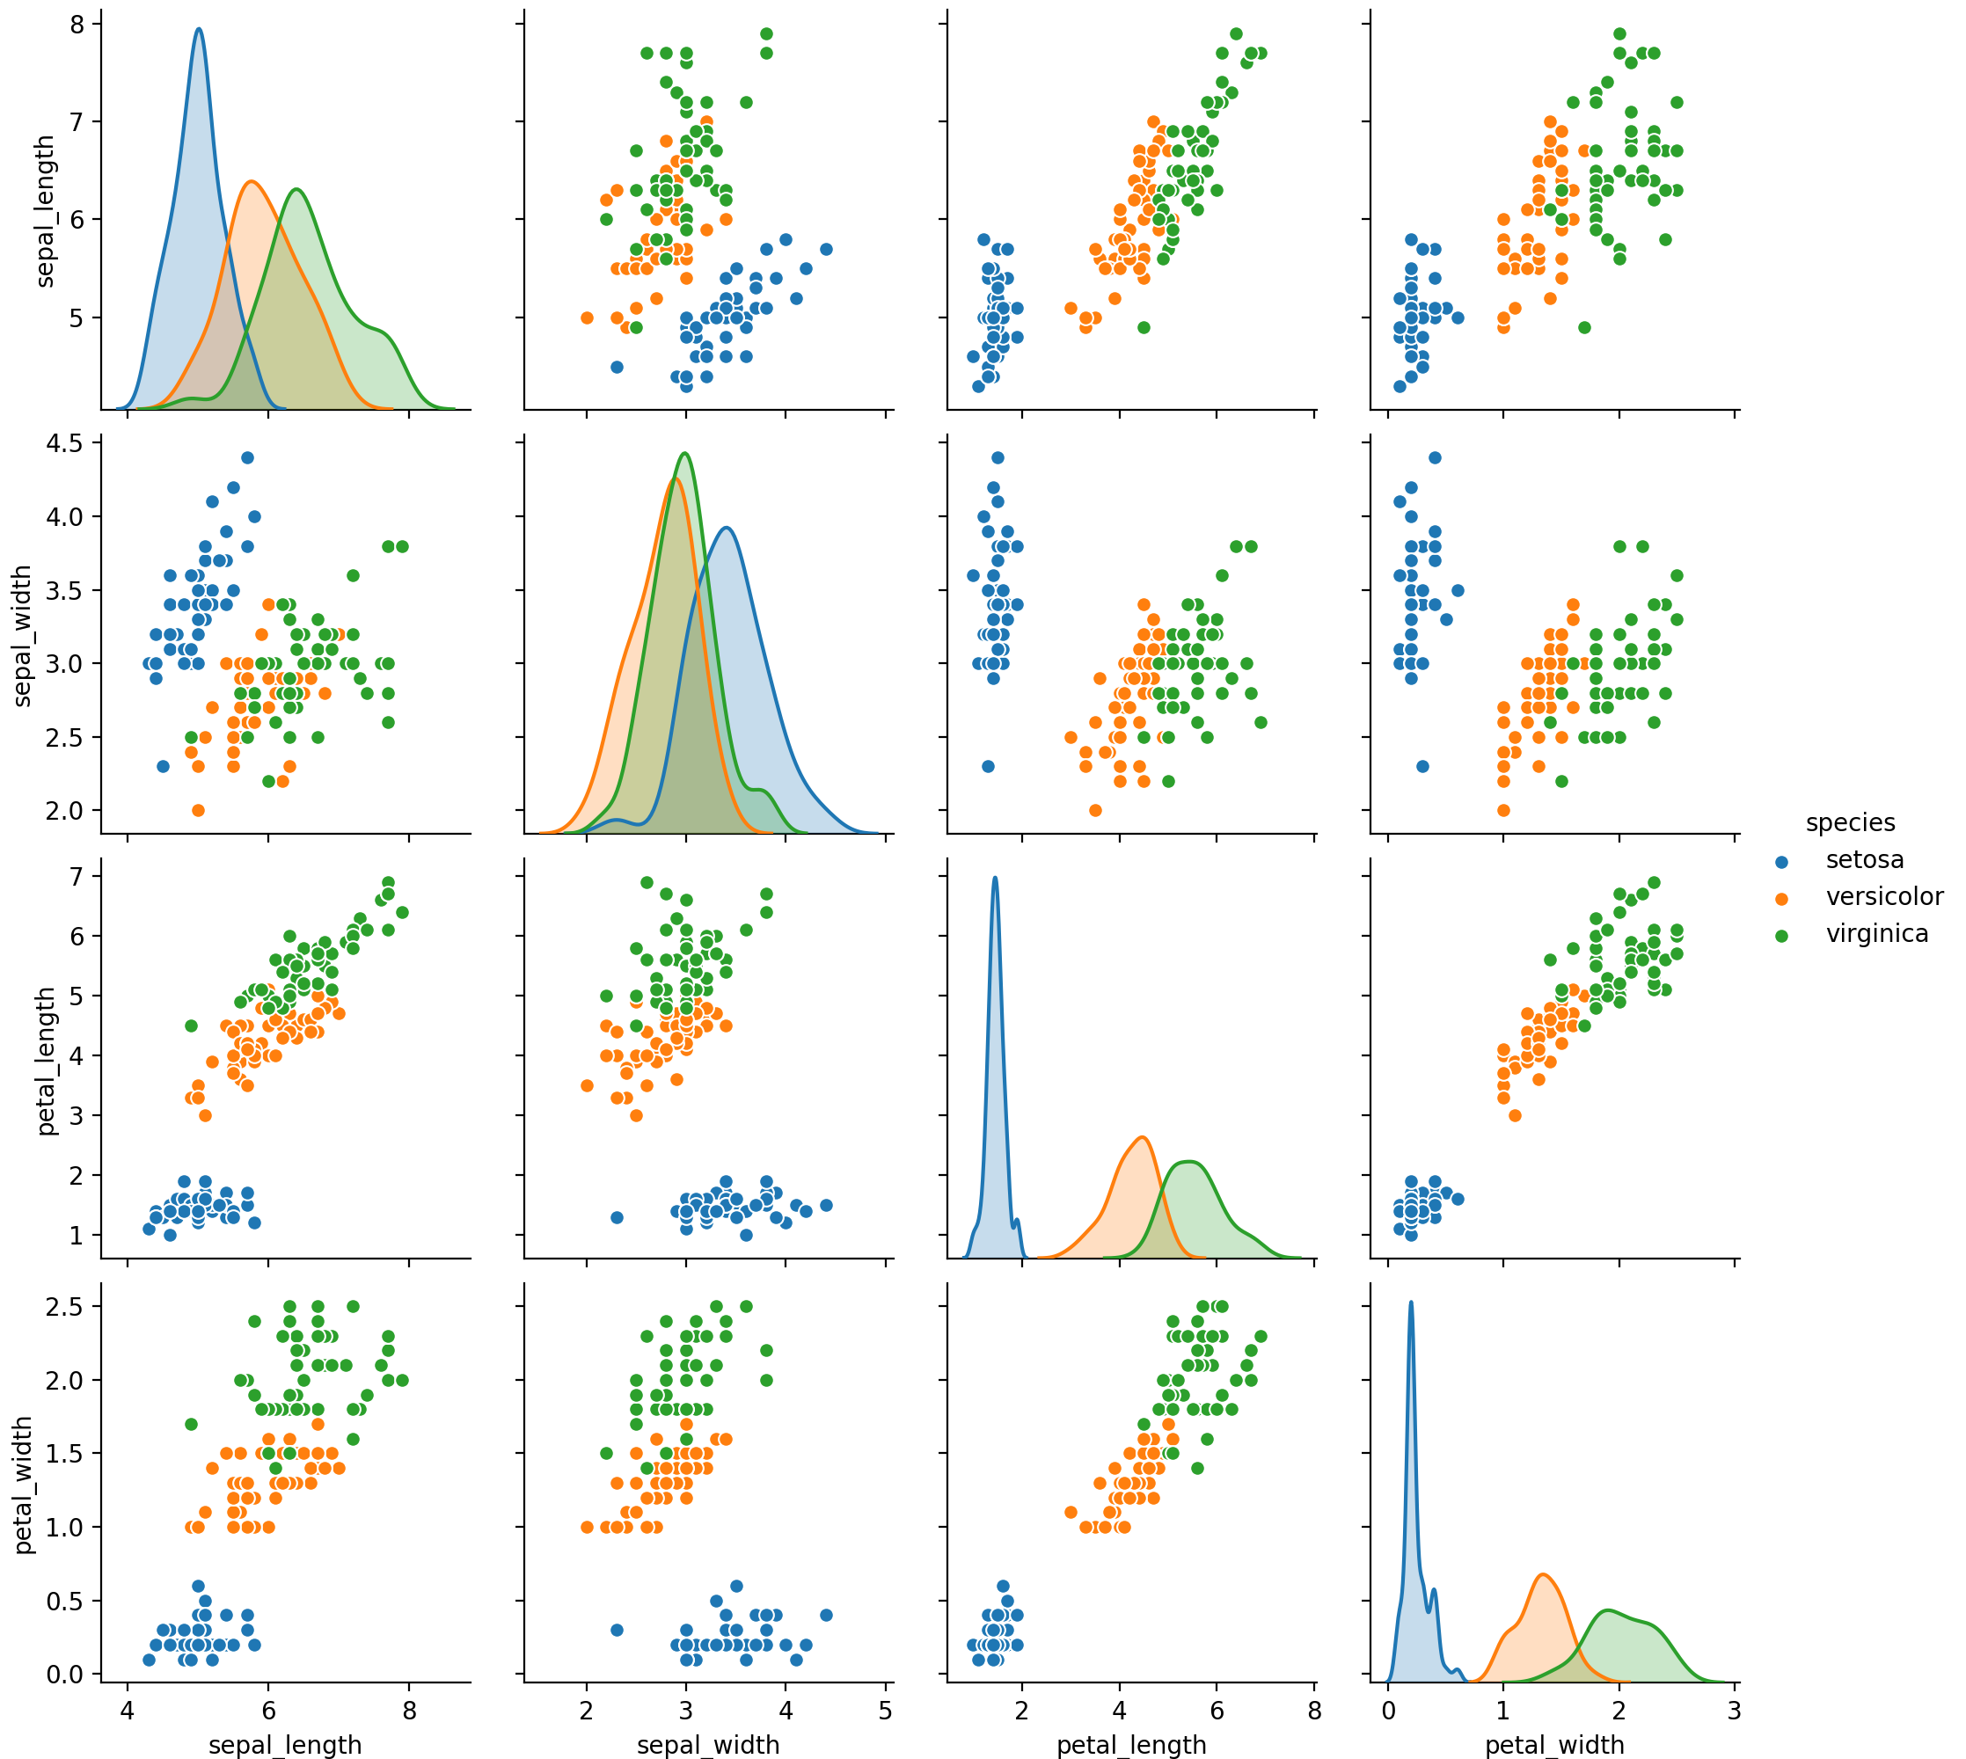
Classification with Gaussian Bayes
Continuous features
Assumption: Features are distributed normally
Example: Look again at Iris set
All features look normally distributed

Slide 29
Classification with Gaussian Naïve Bayes
Possibility one: Disregard correlation —> Naïve
For each feature:
Calculate sample mean $μ$ and sample standard deviation $σ$
Use these as estimators of the population mean and deviation
For a given feature value x, calculate the probability density assuming that $x$ is in a category $c$
$$P(x|c)∼N(μ_{c},σ_{c})$$

Slide 30
Classification with Gaussian Naïve Bayes
Estimate the probability for observation $(x_{1},x_{2},…,x_{n})$ as the product of the densities
$$P((x_{1},…,x_{n})|c_{j})∼N(x_{1},σ_{1,c_{j}},μ_{1,c_{j}})⋅…⋅N(x_{n},σ_{n,c_{j}},μ_{1,c_{j}})$$
Then use Bayes formula to invert the conditional probabilities
This means estimating the prevalence of the categories
$$P(c_{j}|(x_{1},…,x_{n}))=\frac{P((x_{1},…,x_{n})|c_{j})P(c_{j})}{P((x_{1},…,x_{n}))}$$

Slide 31
Classification with Gaussian Naïve Bayes
The denominator does not depend on the category $c_{j}$
So, we just leave it out:
$$P(c_{j}|(x_{1},…,x_{n}))∼P((x_{1},…,x_{n})|c_{j})P(c_{j})$$
We calculate $P((x_{1},…,x_{n})|c_{j})P(c_{j})$
And select the highest value

Slide 32
Classification with Gaussian Naïve Bayes
Implemented in sklearn.naive_bayes
Example with Iris data-set
from sklearn import datasets
from sklearn.naive_bayes import GaussianNB
iris = datasets.load_iris()
model = GaussianNB()
model.fit(iris.data, iris.target)
print('means', model.theta_)
print('stds', model.sigma_)
for x,t, p in zip(iris.data, iris.target, model.predict(iris.data)):
print(x, t, p)

Slide 33
Classification with Gaussian Naïve Bayes
means [[5.006 3.428 1.462 0.246]
[5.936 2.77 4.26 1.326]
[6.588 2.974 5.552 2.026]]
stds [[0.121764 0.140816 0.029556 0.010884]
[0.261104 0.0965 0.2164 0.038324]
[0.396256 0.101924 0.298496 0.073924]]
[5.1 3.5 1.4 0.2] 0
[4.9 3. 1.4 0.2] 0
[4.7 3.2 1.3 0.2] 0
[4.6 3.1 1.5 0.2] 0
[5. 3.6 1.4 0.2] 0
[5.4 3.9 1.7 0.4] 0

Slide 34
Classification with Gaussian Naïve Bayes
There are a few errors:
Caution: We did not divide the data set into a training and verification set.
[6.9 3.1 4.9 1.5] 1 2
[5.9 3.2 4.8 1.8] 1 2
[6.7 3. 5. 1.7] 1 2
[4.9 2.5 4.5 1.7] 2 1
[6. 2.2 5. 1.5] 2 1
[6.3 2.8 5.1 1.5] 2 1

Slide 35
Classification with
Not-So-Naïve Gaussian Bayes
We did not use correlation between features
If we do, use the multi-variate probability density
Need to estimate correlation coefficients:
Then use the multi-variate normal probability density ${\text{norm}}_{μ,Σ}(x)=\frac{1}{(\sqrt{2π})^{d}\sqrt{|Σ|}}exp\left(-\frac{(x-μ)^{\text{T}}Σ^{-1}(x-μ)}{2}\right)$
$$σ_{k,l}=\frac{1}{|C_{j}|}\underset{x∈C_{j}}{∑}(x_{k}-μ_{k})(x_{l}-μ_{l})$$

Slide 36
Classification with
Not-So-Naïve Gaussian Bayes
Luckily, implemented in scipy.stats
Estimate means and correlations
Similarly to before, estimate category by looking at the multi-variate normal density for each category and updating
from scipy.stats import multivariate_normal
def diagnose(tupla):
return np.argmax(
[multivariate_normal.pdf(tupla,mean=Gl.mu_setosa, cov=Gl.sigma_setosa),
multivariate_normal.pdf(tupla,mean=Gl.mu_ver, cov=Gl.sigma_ver),
multivariate_normal.pdf(tupla,mean=Gl.mu_vgc, cov=Gl.sigma_vgc)])

Slide 37
Classification with
Not-So-Naïve Gaussian Bayes
This works slightly better: three mis-classifications
Example:
Virginica features:
Versicolor and virginica probs are similar
>>> get_probs((6.3, 2.8, 5.1, 1.5))
setosa 6.551299963143457e-116
versicolor 0.3895029363227387
virginica 0.25720254045708846

Slide 38
Classification with
Not-So-Naïve Gaussian Bayes
This works slightly better: three mis-classifications
Example:
Versicolor features:
Versicolor and virginica probs are somewhat similar
>>> get_probs((6.0, 2.7, 5.1, 1.6))
setosa 3.4601607892612445e-119
versicolor 0.09776449471242309
virginica 0.56568607797792

Slide 39
Scipy.learn
A more modern set of tools in scipy
Running example:
How to predict the newsgroup from the contents
Data set:
from sklearn.datasets import fetch_20newsgroups

Slide 40
Scipy.learn
A set of 18846 newsgroup contributions from way back
Split 2/3 : 1/3 into a training set (before a certain date) and a test set (after a certain date)
data = fetch_20newsgroups()
print(data.target_names)
['alt.atheism', 'comp.graphics', 'comp.os.ms-windows.misc', 'comp.sys.ibm.pc.hardware', 'comp.sys.mac.hardware', 'comp.windows.x', 'misc.forsale', 'rec.autos', 'rec.motorcycles', 'rec.sport.baseball', 'rec.sport.hockey', 'sci.crypt', 'sci.electronics', 'sci.med', 'sci.space', 'soc.religion.christian', 'talk.politics.guns', 'talk.politics.mideast', 'talk.politics.misc', 'talk.religion.misc']

Slide 41
Scipy.learn
We do not want all of them:
Split into training and test sets
categories = [‘talk.religion.misc',
'soc.religion.christian','alt.atheism',
'sci.space', 'comp.graphics']
train = fetch_20newsgroups(subset='train', categories = categories)
test = fetch_20newsgroups(subset='test', categories = categories)

Slide 42
Scipy.learn
Bag Of Words uses CountVectorizer
We extract the Bag of Words
To display, we make the result into a Pandas Dataframe
from sklearn.feature_extraction.text import CountVectorizer
vec = CountVectorizer()
X = vec.fit_transform(train.data)
df = pd.DataFrame(X.toarray(), columns=vec.get_feature_names())

Slide 43
Scipy.learn
The result is a matrix
Columns by words that appear
Rows by document number
>>> df.iloc[0:15, 10300:10330]
comm command commanded ... commercialization commercialized commercially
0 0 0 0 ... 0 0 0
1 0 0 0 ... 0 0 0
2 0 0 0 ... 0 0 0
3 0 0 0 ... 0 0 0
4 0 0 0 ... 0 0 0
5 0 0 0 ... 0 0 0
6 0 0 0 ... 0 0 0
7 0 0 0 ... 0 0 0
8 0 0 0 ... 0 0 0
9 0 0 0 ... 0 0 0
10 0 0 0 ... 0 0 0
11 0 0 0 ... 0 0 0
12 0 0 0 ... 0 0 0
13 0 0 0 ... 0 0 0
14 0 0 0 ... 0 0 0
[15 rows x 30 columns]

Slide 44
Scipy.learn
Get better result by dividing the words by their frequency
vec = TfidfVectorizer()
X = vec.fit_transform(train.data)
df = pd.DataFrame(X.toarray(), columns=vec.get_feature_names())

Slide 45
Scipy.learn
Term Frequency
Take raw count and divide by the number of words in the document
Inverse Document Frequency
— Logarithm of (Number of Documents w. word) / (Number of Documents)
Term-Frequency — Inverse Document Frequency (TfIDF)
Product of these two

Slide 46
Scipy.learn
Let’s make the difference clearer
from sklearn.feature_extraction.text import CountVectorizer, TfidfVectorizer
import pandas as pd
sample = ['in the beginning of time', 'at dawn we slept',
'this is the story’, 'beginning and end', 'frequent beginning’,
'beginning python']
vec = CountVectorizer()
X = vec.fit_transform(sample)
df = pd.DataFrame(X.toarray(), columns=vec.get_feature_names())
print(df)
vec = TfidfVectorizer()
X1 = vec.fit_transform(sample)
df1 = pd.DataFrame(X1.toarray(), columns=vec.get_feature_names())
print(df1)

Slide 47
Scipy.learn
CountVectorizer
and at beginning dawn end frequent ... slept story the this time we
0 0 0 1 0 0 0 ... 0 0 1 0 1 0
1 0 1 0 1 0 0 ... 1 0 0 0 0 1
2 0 0 0 0 0 0 ... 0 1 1 1 0 0
3 1 0 1 0 1 0 ... 0 0 0 0 0 0
4 0 0 1 0 0 1 ... 0 0 0 0 0 0
5 0 0 1 0 0 0 ... 0 0 0 0 0 0
[6 rows x 16 columns]

Slide 48
Scipy.learn
TfIdfVectorizer
and at beginning dawn ... the this time we
0 0.000000 0.0 0.295730 0.0 ... 0.408763 0.000000 0.498483 0.0
1 0.000000 0.5 0.000000 0.5 ... 0.000000 0.000000 0.000000 0.5
2 0.000000 0.0 0.000000 0.0 ... 0.427903 0.521823 0.000000 0.0
3 0.652057 0.0 0.386839 0.0 ... 0.000000 0.000000 0.000000 0.0
4 0.000000 0.0 0.510227 0.0 ... 0.000000 0.000000 0.000000 0.0
5 0.000000 0.0 0.510227 0.0 ... 0.000000 0.000000 0.000000 0.0
[6 rows x 16 columns]

Slide 49
Scipy.learn
CountVectorizer and TfidfVectorizer generate sparse matrices
Storage is compressed

Slide 50
Scipy.learn
Multinomial Bayes is in sklearn
sklearn has a pipeline constructor
Combines feature extraction with training multinomial NB
from sklearn.naive_bayes import MultinomialNB
from sklearn.pipeline import make_pipeline
model = make_pipeline(TfidfVectorizer(), MultinomialNB())
model.fit(train.data, train.target)
labels = model.predict(test.data)

Slide 51
Scipy.learn
To measure success:
Use a confusion matrix
For the test set: Show how often group elements are predicted to belong to another group
Fictitious example: Can a NN distinguish cats and dogs
 |  | actual
 |  | dog | cat
predicted | dog | 1023 | 245
predicted | cat | 134 | 1183

Slide 52
Scipy.learn
Can find confusion matrix
Import pyplot and seaborn
from sklearn.metrics import confusion_matrix
import seaborn as sns
import matplotlib.pyplot as plt
mat = confusion_matrix(test.target, labels)
sns.heatmap(mat.T, square=True, annot=True, fmt='d', cbar=False,
xticklabels=train.target_names,
yticklabels=train.target_names)
plt.xlabel('true label')
plt.ylabel('predicted label')
plt.show()

Slide 53
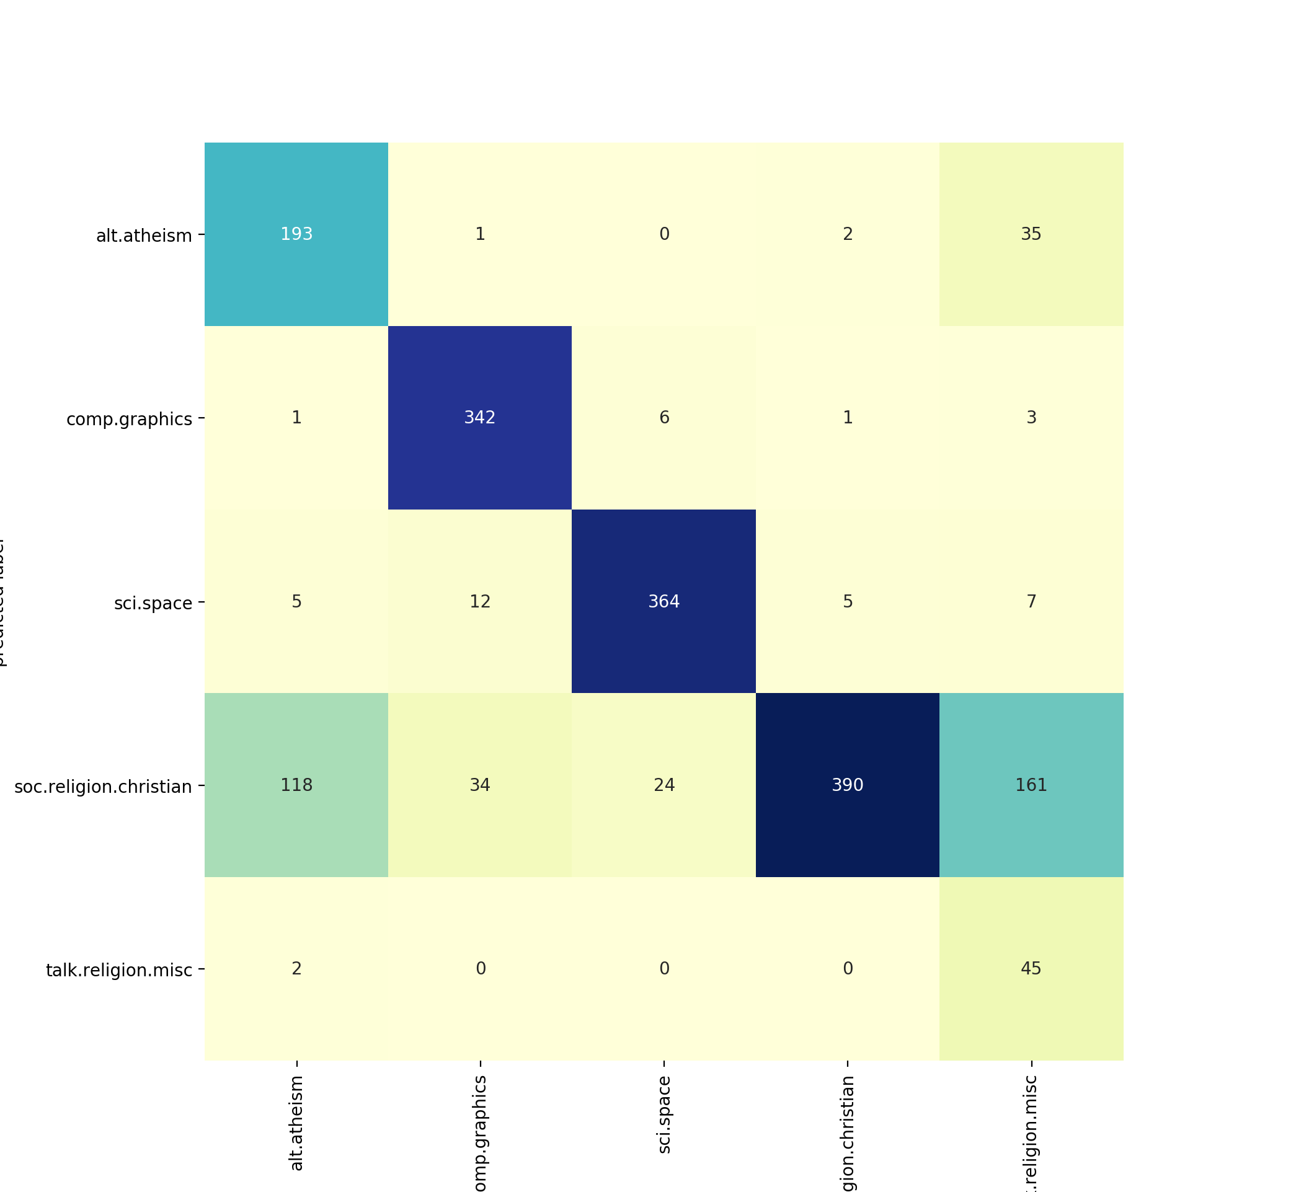
Scipy.learn

Slide 54
Dimensionality Reduction
Thomas Schwarz, SJ

Slide 55
Introduction
Real life problems need to learn from many features
This can cause problem
Excursion
Why our intuition is wrong about high dimensional data

Slide 56
High-Dimensional Data
As we increase the number of (numerical) dimensions:
Our intuition is faulty
Look at this using random numbers

Slide 57
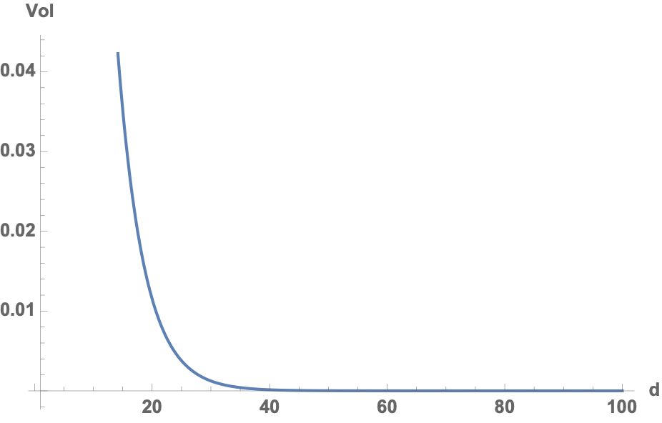
High Dimensional Data
Intuition 1: Random points tend to be close to the center
Hypercube volumes
Volume of a hypercube that stays 0.1 away from the edge
$${0.8}^{d}$$

Slide 58
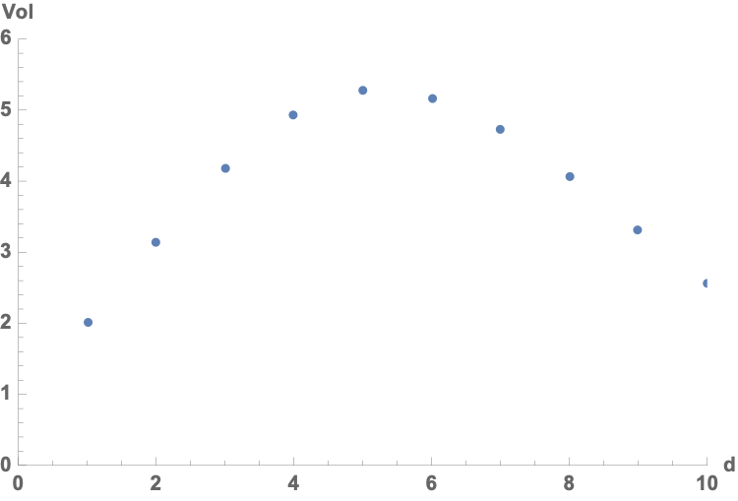
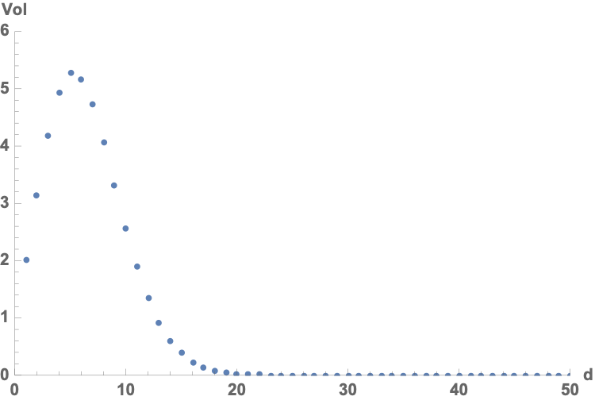
High-Dimensional Data
Hyper-ball of radius r
Volume is
Maximum volume for dimension 5
$$r^{d}(\frac{π^{\frac{d}{2}}}{Γ(\frac{d}{2}+1)})$$

Slide 59
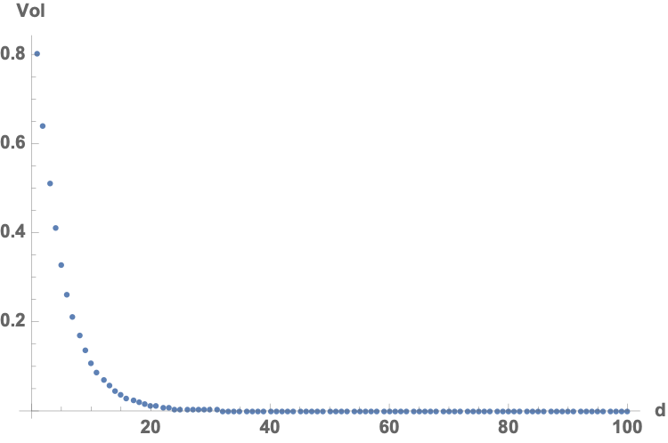
High-Dimensional Data
Proportion of points in a unit hyper-ball that are 0.1 away from the edge is
$$\frac{{0.4}^{d}}{{0.5}^{d}}$$

Slide 60
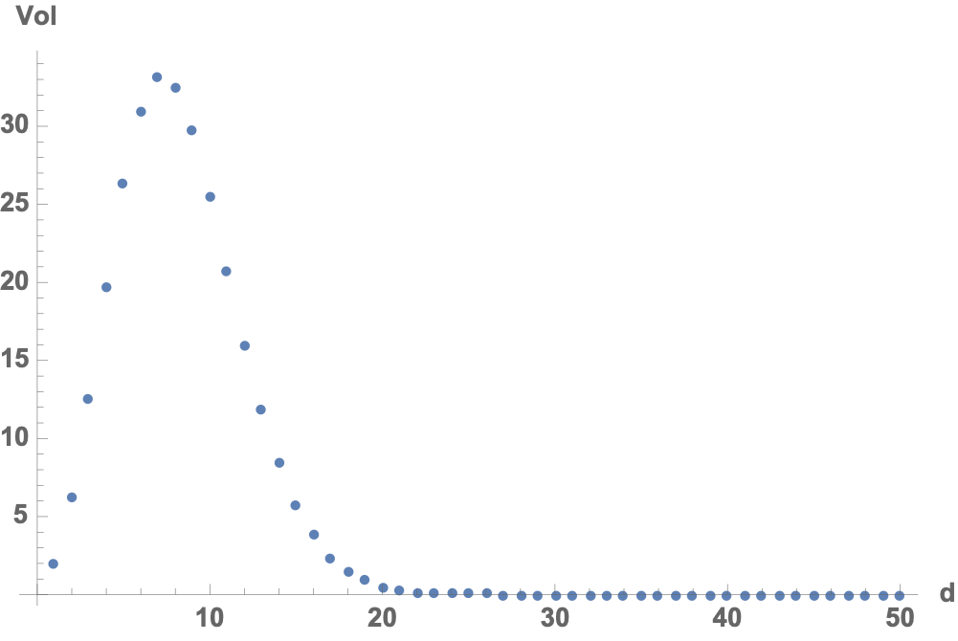
High-Dimensional Data
Surface Area of the hypersphere in dimension d
$$r^{d-1}(\frac{2π^{\frac{d}{2}}}{Γ(\frac{d}{2})})$$

Slide 61
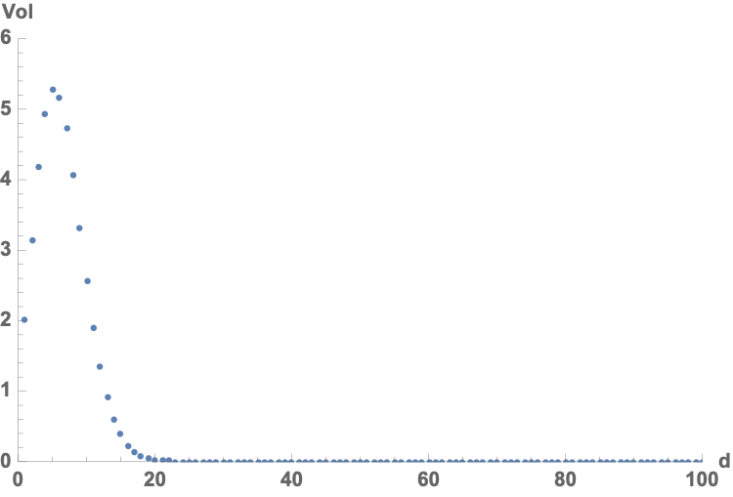
High-Dimensional Data
Hypersphere inscribed a hypercube
Ratio of volume of hypersphere over volume of hypercube goes quickly to zero

Slide 62
High-Dimensional Data
Volume of a thin shell of width ε is
with
$$1-(1-\frac{ϵ}{r})^{d}$$
$$\lim_{d→∞}(1-(1-\frac{ϵ}{r})^{d}=1$$

Slide 63
High-dimensional Data
Assume a multi-variate normal distribution centered around the origin and without covariances
Probability density is given by
Peak density is
$$f(\overset{→}{x})=\frac{1}{{\sqrt{2π}}^{d}}exp(-\frac{{\overset{→}{x}}^{T}\overset{→}{x}}{2})$$
$$f(\overset{→}{0})=\frac{1}{{\sqrt{2π}}^{d}}$$

Slide 64
High-dimensional Data
Set of points with α of the peak density is given by
Since follows a χ² distribution, we can calculate the probability of a random point being within α of the peak density to be
$$\frac{f(\overset{→}{x})}{f(\overset{→}{0})}≥α⇔exp(-\frac{{\overset{→}{x}}^{T}\overset{→}{x}}{2})≥α⇔\frac{{\overset{→}{x}}^{T}\overset{→}{x}}{2}≤-\log_{e}(α)$$
$${\overset{→}{x}}^{T}\overset{→}{x}$$
$$F_{χ_{d}^{2}}(-2lnα)$$

Slide 65
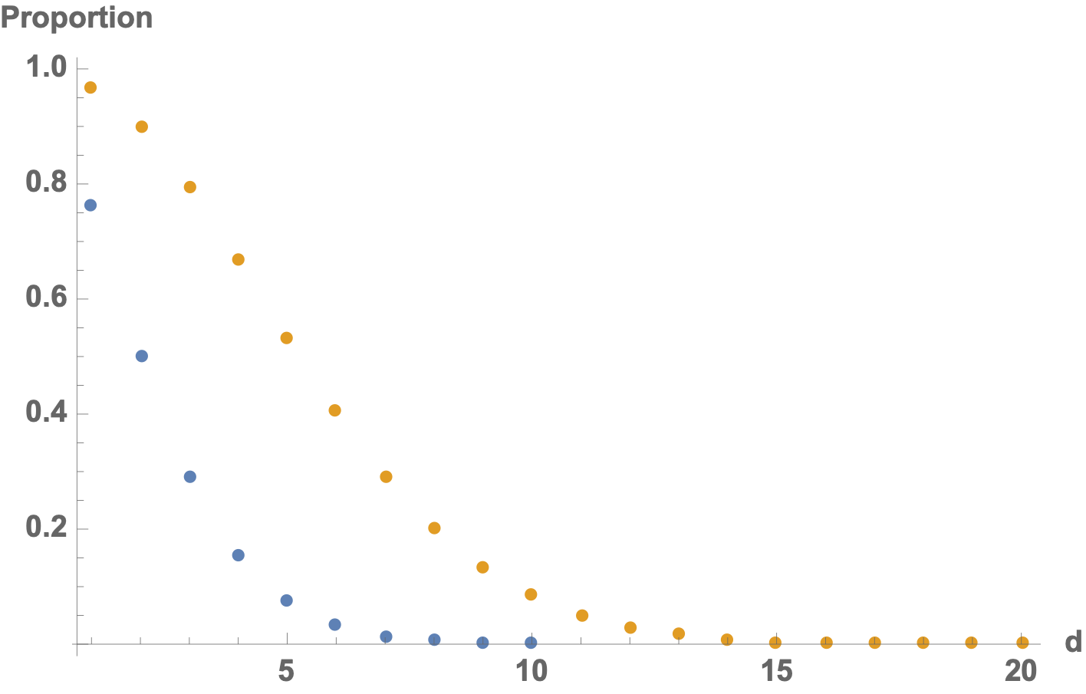
High Dimensional Data
This proportion goes quickly to zero. Mass of the probability distribution migrates to the tail region
α = 0.1
α = 0.5

Slide 66
Consequences
Almost all of the data is close to a boundary
Almost all of the data is in a corner, whereas the center is empty
I.e. there are no more "typical" data points by looking at typical values in a random world

Slide 67
Consequences
K-means algorithm
Determine the category of a new data point by choosing the closest k points to the new data point
Assign the majority of the categories of these k points to the new point
Very simple but quite effective at learning categories
But in high dimensions, all data points tend to be wide apart.

Slide 68
Consequences
Naive or not naive Bayes
Estimate the distribution of points in a category with a multi-variate normal distribution (with or without correlations)
Categorize a new point according to the probabilities according these distributions
The category for which the probability of the point is the highest
Tends to be quite good until all probabilities are low
High dimensionality: expect many more close decisions (that have a higher failure quota)

Slide 69
Consequences
Luckily, real world data does not look like random data
But we still need to reduce dimensionality

Slide 70
Introduction
Feature selection
Data sets contain often large numbers of features
Some of the features depend on each other
Selecting features
makes current classification fast
can generalize better from training to general data
This even works with Neural Networks

Slide 71
Introduction
Feature Combination:
Generate artificial features by combining features
Then do away with (some of the) old features

Slide 72
Introduction
Clustering:
Automatic clustering
Groups similar data points
Often allows fewer features to be used

Slide 73
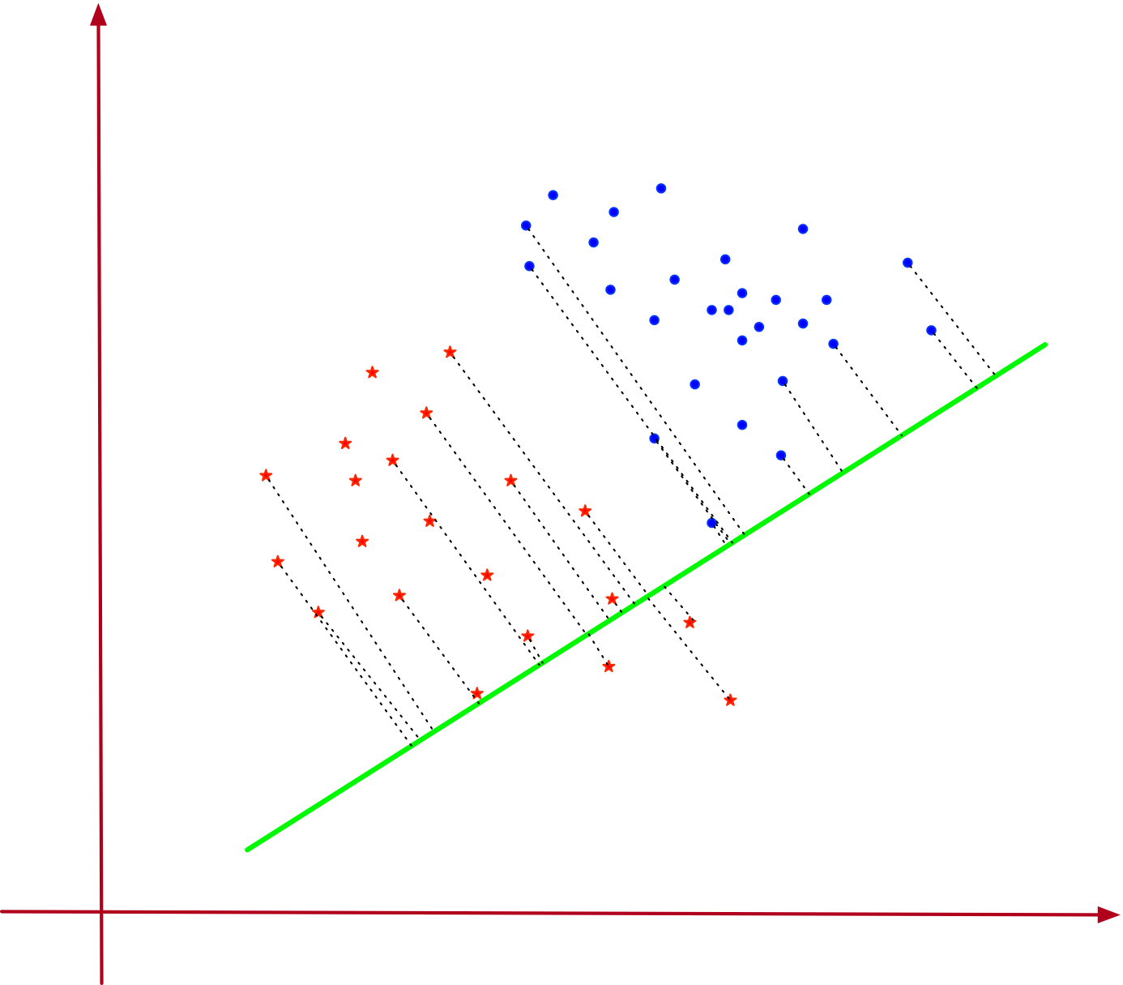
Introduction
Automatic dimensionality reduction:
Project 2-dimensional data set on a single line
Projections separates the two data sets
Can use a single, combined feature for classification
Linear Discriminant Analysis

Slide 74
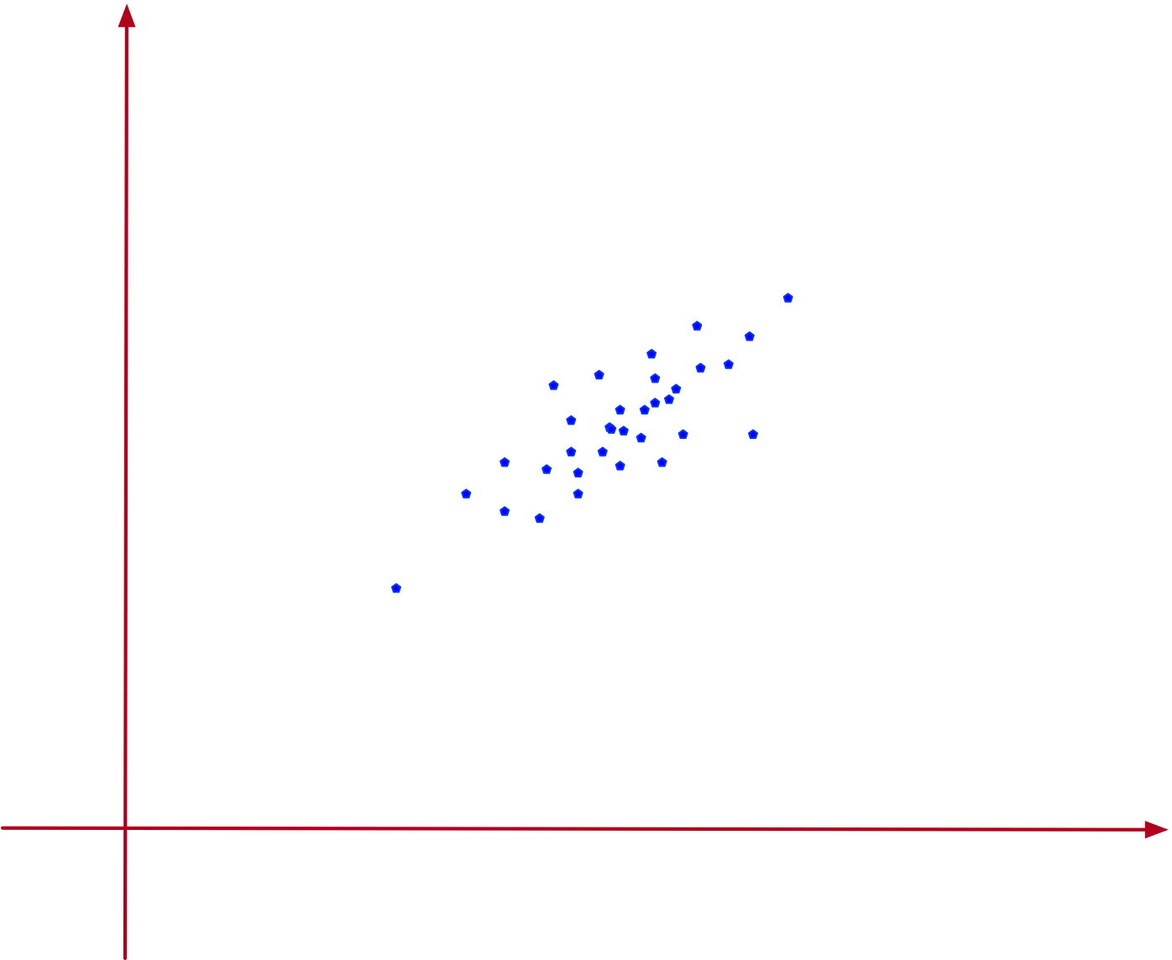
Introduction
Two-dimensional data set
Spread around one dimension
Combine the two features (x, y) into one that has almost all the variance
Principal component analysis

Slide 75
Principal Component Analysis
Goal:
Find the one direction in which the data sets varies most

Slide 76
Principal Component Analysis
Given a set of $U$ of data points with $d$ numerical attributes
Write as an $n×d$ matrix
$D=\left(\begin{matrix}x_{1,1} & x_{1,2} & … & x_{1,d} \\ x_{2,1} & x_{2,2} & … & x_{2,d} \\ x_{3,1} & x_{3,2} & … & x_{3,d} \\ & … & & \\ x_{n,1} & x_{n,2} & … & x_{n,d}\end{matrix}\right)$

Slide 77
Principal Component Analysis
Each data point is a linear combination of standard basis
$x_{i}=\overset{d}{\underset{j=1}{∑}}x_{i,j}e_{j}$
Dimensionality reduction:
Replace standard basis with another orthogonal matrix
Weight of data should be concentrated in a few dimensions

Slide 78
Principal Component Analysis
Assume $(u_{i}|i∈\{1,…,d\})$ is such a basis
Then $u_{i}⋅u_{j}=δ_{i,j}$
Actually, any $d$ vectors of length one with this property are a basis
Proof: If $\overset{d}{\underset{i=1}{∑}}α_{i}u_{i}=0$, then
$0=u_{j}⋅\overset{d}{\underset{i=1}{∑}}α_{i}u_{i}=α_{j}$

Slide 79
Principal Component Analysis
Write the vectors in an orthonormal basis as column vectors of a matrix
$U=\left(\begin{matrix}| & | & … & | \\ u_{1} & u_{2} & … & u_{d} \\ | & | & … & |\end{matrix}\right)$
Then: $u_{i}^{t}u_{j}=δ_{i,j}$ implies:
$U^{T}U=1_{d}$

Slide 80
Principal Component Analysis
A feature vector $x$ is a linear combination $x=\overset{d}{\underset{i=1}{∑}}α_{i}u_{i}$ .
Write: $a=(α_{1},α_{2},…,α_{n})$
Then $x=a⋅U^{t}$ or equivalently $x^{t}=U⋅a^{t}$

Slide 81
Principal Component Analysis
$U=(\frac{1}{\sqrt{2}},0,\frac{-1}{\sqrt{2}}),(\frac{1}{\sqrt{6}},\frac{\sqrt{2}}{\sqrt{3}},\frac{1}{\sqrt{6}}),(\frac{1}{\sqrt{3}},\frac{-1}{\sqrt{3}},\frac{1}{\sqrt{3}})$ is an orthonormal basis of $R^{3}$
Matrix is $U=\left(\begin{matrix}\frac{1}{\sqrt{2}} & \frac{1}{\sqrt{6}} & \frac{1}{\sqrt{3}} \\ 0 & \frac{\sqrt{2}}{\sqrt{3}} & \frac{-1}{\sqrt{3}} \\ \frac{-1}{\sqrt{2}} & \frac{1}{\sqrt{6}} & \frac{1}{\sqrt{3}}\end{matrix}\right)$

Slide 82
Principal Component Analysis
Column vector $(2,1,3)^{t}$ is a linear combination of the column vectors of $U$ .
Use $\left(\begin{aligned}2 \\ 1 \\ 3\end{aligned}\right)=U⋅a^{t}$
Multiply with $U^{t}$
$\left(\begin{matrix}\frac{1}{\sqrt{2}} & 0 & \frac{-1}{\sqrt{2}} \\ \frac{1}{\sqrt{6}} & \frac{\sqrt{2}}{\sqrt{3}} & \frac{1}{\sqrt{6}} \\ \frac{1}{\sqrt{3}} & \frac{-1}{\sqrt{3}} & \frac{1}{\sqrt{3}}\end{matrix}\right)⋅\left(\begin{aligned}2 \\ 1 \\ 3\end{aligned}\right)=U^{t}⋅U⋅a=a^{t}$
Obtain: $(-\frac{3}{\sqrt{2}}+\sqrt{2},2\sqrt{\frac{2}{3}}+\sqrt{\frac{3}{2}},\frac{1}{\sqrt{3}}+\sqrt{3})=a$

Slide 83
Principal Component Analysis: Projection on Subspace
Write a data point as $x=\overset{d}{\underset{i=1}{∑}}α_{i}u_{i}.$
Assume that we have ordered the basis by importance
We select only the first $r$ components:
Write: $U_{r}=\left(\begin{matrix}| & | & … & | \\ u_{1} & u_{2} & … & u_{r} \\ | & | & … & |\end{matrix}\right)$
Then set $π_{r}(x)=\overset{r}{\underset{i=1}{∑}}α_{i}u_{i}=U_{r}⋅(α_{1},α_{2},…,α_{r})^{t}$

Slide 84
Principal Component Analysis: Projection on Subspace
Since $a^{t}=U^{t}⋅x$, it follows $π_{r}(a^{t})=U_{r}^{t}x^{t}$ and
$π_{r}(x^{t})=U_{r}π_{r}(a^{t})=U_{r}U_{r}^{t}x^{t}$
$Π_{r}=U_{r}U_{r}^{t}$ is called the projection matrix since
(a) $Π_{r}⋅Π_{r}=U_{r}U_{r}^{t}U_{r}U_{r}^{t}=U_{r}U_{r}^{t}$
(b) $Π_{r}^{t}=(U_{r}U_{r}^{t})^{t}={U_{r}^{t}}^{t}U^{t}=U_{r}U_{r}^{t}Π_{r}=U_{r}U_{r}^{t}$

Slide 85
Principal Component Analysis: Projection on Subspace
Example (continued): Project on the first two coordinates with respect to $U$
$U_{r}=\left(\begin{matrix}\frac{1}{\sqrt{2}} & \frac{1}{\sqrt{6}} \\ 0 & \frac{\sqrt{2}}{\sqrt{3}} \\ -\frac{1}{\sqrt{2}} & \frac{1}{\sqrt{6}}\end{matrix}\right)$

Slide 86
Principal Component Analysis: Projection on Subspace
Then we calculate the projection matrix
$$Π_{2}=U_{2}U_{2}^{t}=\left(\begin{matrix}\frac{2}{3} & \frac{1}{3} & \frac{-1}{3} \\ \frac{1}{3} & \frac{2}{3} & \frac{1}{3} \\ \frac{-1}{3} & \frac{1}{3} & \frac{2}{3}\end{matrix}\right)$$

Slide 87
Principal Component Analysis: Projection on Subspace
Projection of $x^{t}=(2,1,3)$ is
$Π_{2}(\left(\begin{aligned}2 \\ 1 \\ 3\end{aligned}\right))=\left(\begin{aligned}\frac{2}{3} \\ \frac{7}{3} \\ \frac{5}{3}\end{aligned}\right)$

Slide 88
Principal Component Analysis: Projection on Subspace
Now we know how to project
Need to find the best orthonormal matrix for the projection

Slide 89
Single Principal Component Analysis
There are infinitely many choices of orthonormal bases
Start out with reduction to a single dimension
First step: Center the data set
By subtracting the mean of the data set
Therefore: The mean of the data set is now zero

Slide 90
Single Principal Component Analysis
If we reduce to a single dimension, than the partial basis is given by a single vector $u$.
Optimality criterion: Projection maximizes the variance

Slide 91
Single Principal Component Analysis
$$\text{var}(\{u^{t}x_{i}|i∈\{1,…,n\}\})=\frac{1}{n}\overset{n}{\underset{i=1}{∑}}(u^{t}x_{i}-u^{t}(\overline{x}))^{2}$$
$=\frac{1}{n}\overset{n}{\underset{i=1}{∑}}(u^{t}x_{i})^{2}\text{(Average is zero)}$
$=\frac{1}{n}\overset{n}{\underset{i=1}{∑}}(u^{t}x_{i})(u^{t}x_{i})^{t}$
$=\frac{1}{n}\overset{n}{\underset{i=1}{∑}}u^{t}x_{i}x_{i}^{t}u$
$=u^{t}\left(\overset{n}{\underset{i=1}{∑}}x_{i}x_{i}^{t}\right)u=u^{t}Σu$

Slide 92
Single Principal Component Analysis
Therefore: $u^{t}Σu⟶max$ subject to $u^{t}u=1$
Use Lagrange multiplier $λ$ and now maximize
$J(u):=u^{t}Σu-λ(u^{t}u-1)$
So, we differentiate:
$\frac{δ}{δu}J(u)=2Σu-2λ$

Slide 93
Single Principal Component Analysis
Result: Maximum obtained if $Σu=λu$
With other words: $u$ has to be an eigenvector of $Σ$ with eigenvalue $λ$.
And to maximize, we want the eigenvector with the largest eigenvalue

Slide 94
Single Principal Component Analysis
Turns out that finding the maximum eigenvector and eigenvalue is quite simple:
Write any non-zero vector as a combination of eigen-vectors
Then repeatedly apply the matrix, but always normalize the product
The coefficient corresponding to the largest eigenvalue gets more and more magnified
And in the limit, the product will be the eigenvector corresponding to the largest eigenvalue

Slide 95
Single Principal Component Analysis
Another goodness criterion:
Minimize the sum of squares of the differences between projected values and original values of the feature vector
Error is
$||x-Π_{1}(x)||^{2}=(x-Π_{1}(x))^{t}(x-Π_{1}(x))$

Slide 96
Single Principal Component Analysis
$\overset{n}{\underset{i=1}{∑}}||x_{i}-Π_{1}(x-i)||^{2}$
$$=\overset{n}{\underset{i=1}{∑}}(x_{i}-Π_{1}(x_{i})^{t}(x_{i}-Π_{1}(x_{i}))$$
$$=\overset{n}{\underset{i=1}{∑}}(||x_{i}||^{2}-2x_{i}^{t}Π_{1}(x_{i})+Π_{1}(x)^{t}Π_{1}(x))$$
$$=\overset{n}{\underset{i=1}{∑}}(||x_{i}||^{2}-2(u^{t}x_{i})(x_{i}^{t}u)+(u^{t}x_{i})(u^{t}x_{i})u^{t}u)$$

Slide 97
$$=\overset{n}{\underset{i=1}{∑}}(||x_{i}||^{2}-2(u^{t}x_{i})(x_{i}^{t}u)+(u^{t}x_{i})(u^{t}x_{i}))$$
$$=\overset{n}{\underset{i=1}{∑}}(||x_{i}||^{2}-(u^{t}x_{i})(x_{i}^{t}u))$$
$=\overset{n}{\underset{i=1}{∑}}(||x_{i}||^{2})-\overset{n}{\underset{i=1}{∑}}(u^{t}x_{i}x_{i}^{t}u)$ $=\overset{n}{\underset{i=1}{∑}}(||x_{i}||^{2})-u^{t}(\overset{n}{\underset{i=1}{∑}}x_{i}x_{i}^{t})u$
$$=\overset{n}{\underset{i=1}{∑}}(||x_{i}||^{2})-u^{t}(\overset{n}{\underset{i=1}{∑}}x_{i}x_{i}^{t})u$$
$$=\overset{n}{\underset{i=1}{∑}}(||x_{i}||^{2})-nu^{t}Σu$$

Slide 98
Single Principal Component Analysis
This means:
In order to minimize the sum of squared errors,
Need to minimize the projected variance
Our two criteria are the same

Slide 99
Dual Principal Component Analysis
We can redo our calculation for two dimensions
Calculate just as before the minimum variance
Obtain: minimum variance is the sum of the two largest eigenvalues
Need to pick the two eigenvectors with the two largest eigenvalues

Slide 100
PCA in Python
Part of sklearn.decomposition
Import bunch of modules
Create random, but skewed data set
import numpy as np
import matplotlib.pyplot as plt
import seaborn as sns
from sklearn.decomposition import PCA
rng = np.random.RandomState(2020716)
X = np.dot(rng.rand(2, 2), rng.randn(2, 200)).T

Slide 101
PCA in Python
Here is some code to draw a vector
def draw_vector(v0, v1, ax=None):
ax = ax or plt.gca()
arrowprops=dict(arrowstyle='->',
linewidth=1,
shrinkA=0, shrinkB=0)
ax.annotate('', v1, v0, arrowprops=arrowprops)

Slide 102
PCA in Python
Calculate the PCA (with two components)
pca = PCA(n_components=2)
pca.fit(X)
print(pca.components_)
print(pca.explained_variance_)

Slide 103
PCA in Python
First component has almost all the variance:
[[-0.99638832 -0.08491358]
[-0.08491358 0.99638832]]
[0.89143208 0.01057402]

Slide 104
PCA in Python
Draw everything:
plt.scatter(X[:, 0], X[:, 1], s=2, c='blue')
for length, vector in zip(pca.explained_variance_, pca.components_):
v = vector * 2.3 * np.sqrt(length)
draw_vector(pca.mean_, pca.mean_ + v)
plt.axis('equal')
plt.show()

Slide 105
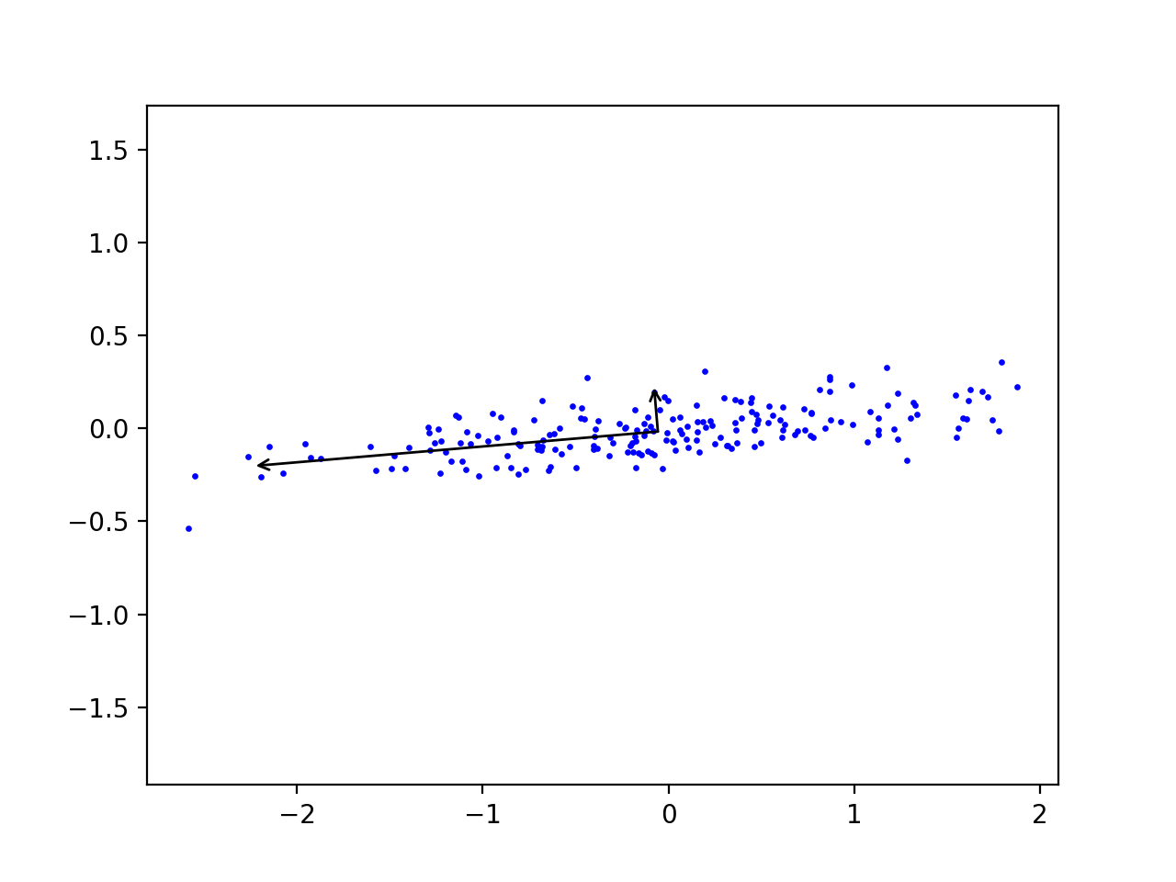
PCA in Python

Slide 106
PCA in Python
Can express data points in the new coordinates:
pca = PCA(n_components=2, whiten=True)
pca.fit(X)
X_pca = pca.transform(X)

Slide 107
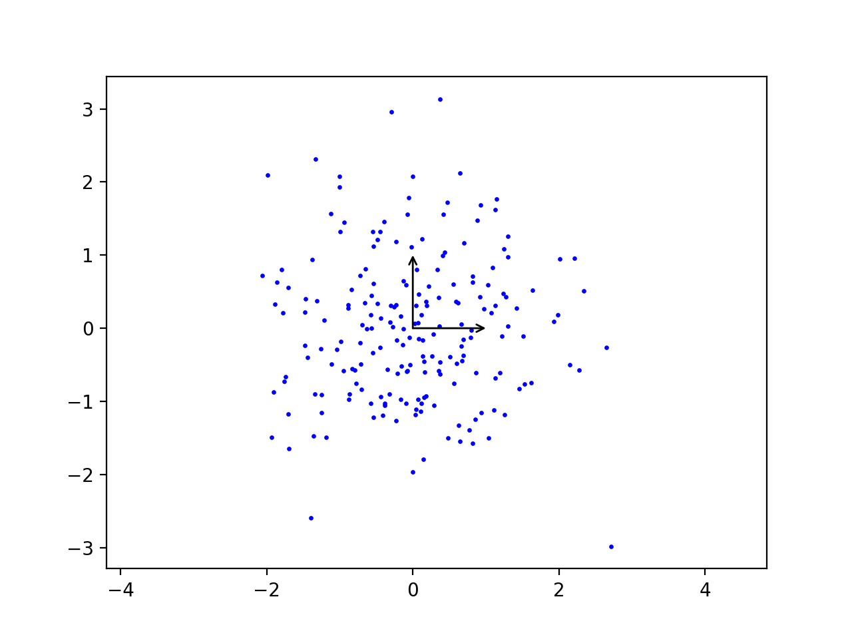
PCA in Python

Slide 108
PCA in Python
Sklearn has the digit data-set
Used for learning how to recognize digits for post-office automation, etc

Slide 109
PCA in Python
Images have 64 pixels with gray values
from sklearn.datasets import load_digits
digits = load_digits()
>>> digits.data.shape
(1797, 64)

Slide 110
PCA in Python
Can use PCA to lower dimension to two
pca = PCA(2)
projected = pca.fit_transform(digits.data)

Slide 111
PCA in Python
And display with the Spectral colormap
plt.scatter(projected[:, 0],
projected[:, 1],
s=5,
c=digits.target,
edgecolor='none',
alpha=0.7,
cmap=plt.cm.get_cmap('Spectral', 10))
plt.xlabel('component 1')
plt.ylabel('component 2')
plt.colorbar();
plt.show()

Slide 112
PCA in Python
Result shows that two features already give a decent classification:

Slide 113
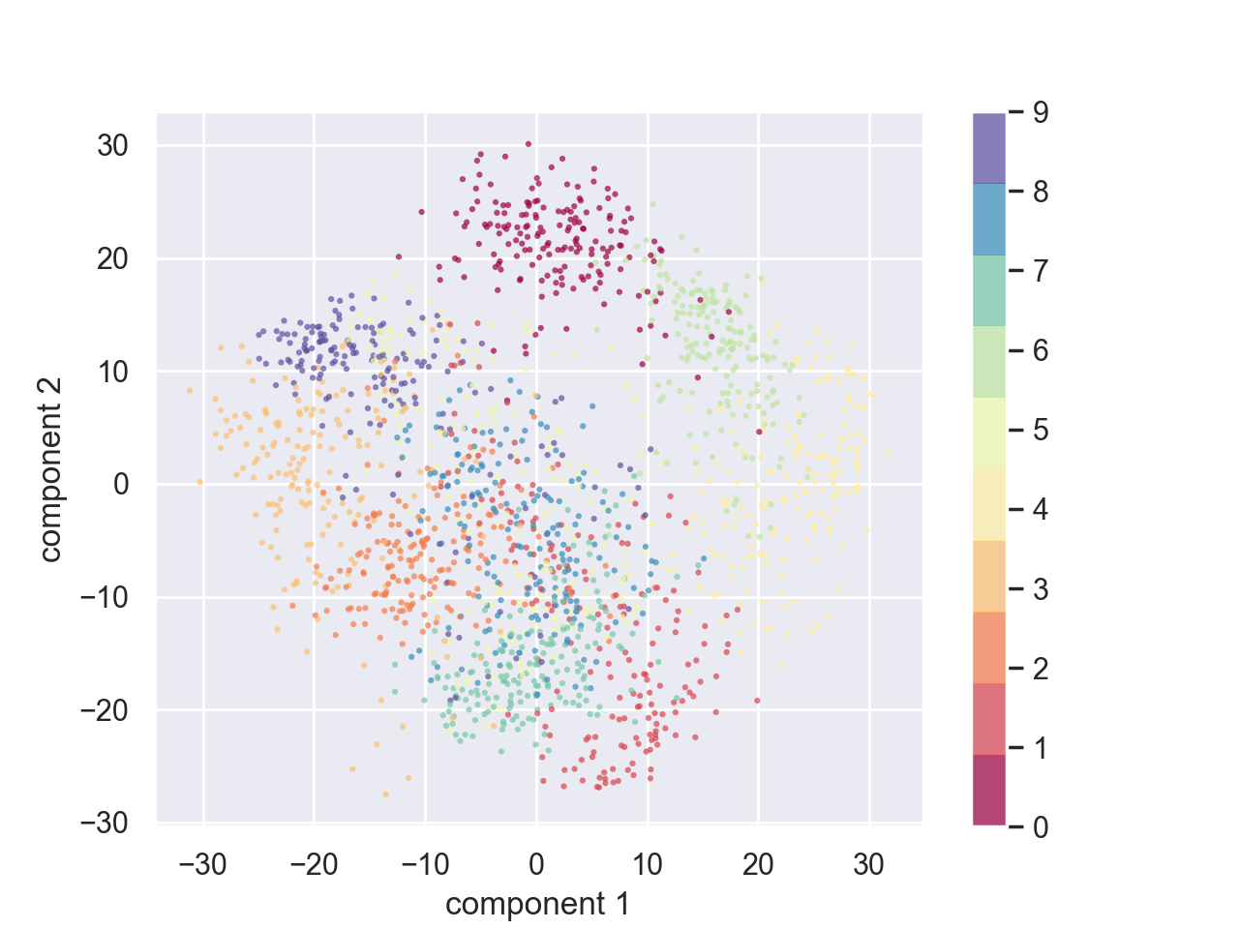
PCA in Python

Slide 114
PCA in Python
We can calculate the complete orthonormal base
And decide how many features we might need by looking at the total explained variance
pca = PCA().fit(digits.data)
plt.plot(np.cumsum(pca.explained_variance_ratio_))
plt.xlabel('number of components')
plt.ylabel('cumulative explained variance')
plt.show()

Slide 115
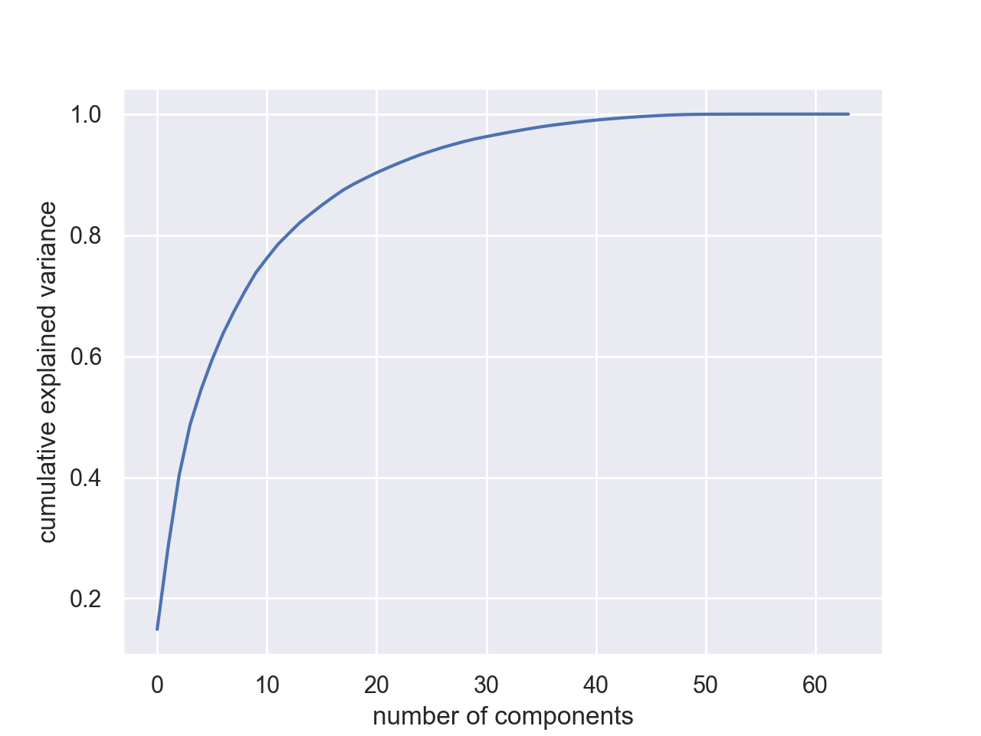

Slide 116
PCA in Python
Can also use this to filter noise:
Data will live primarily in the most important components

Slide 117
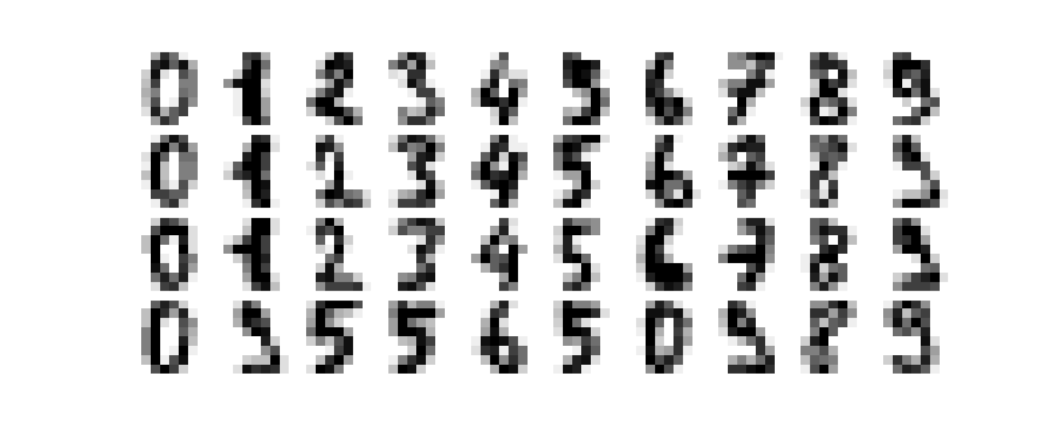
PCA in Python
Example:
Use some digits from the data set

Slide 118
PCA in Python
Now add some noise
np.random.seed(42)
noisy = np.random.normal(digits.data, 4)
plot_digits(noisy)

Slide 119
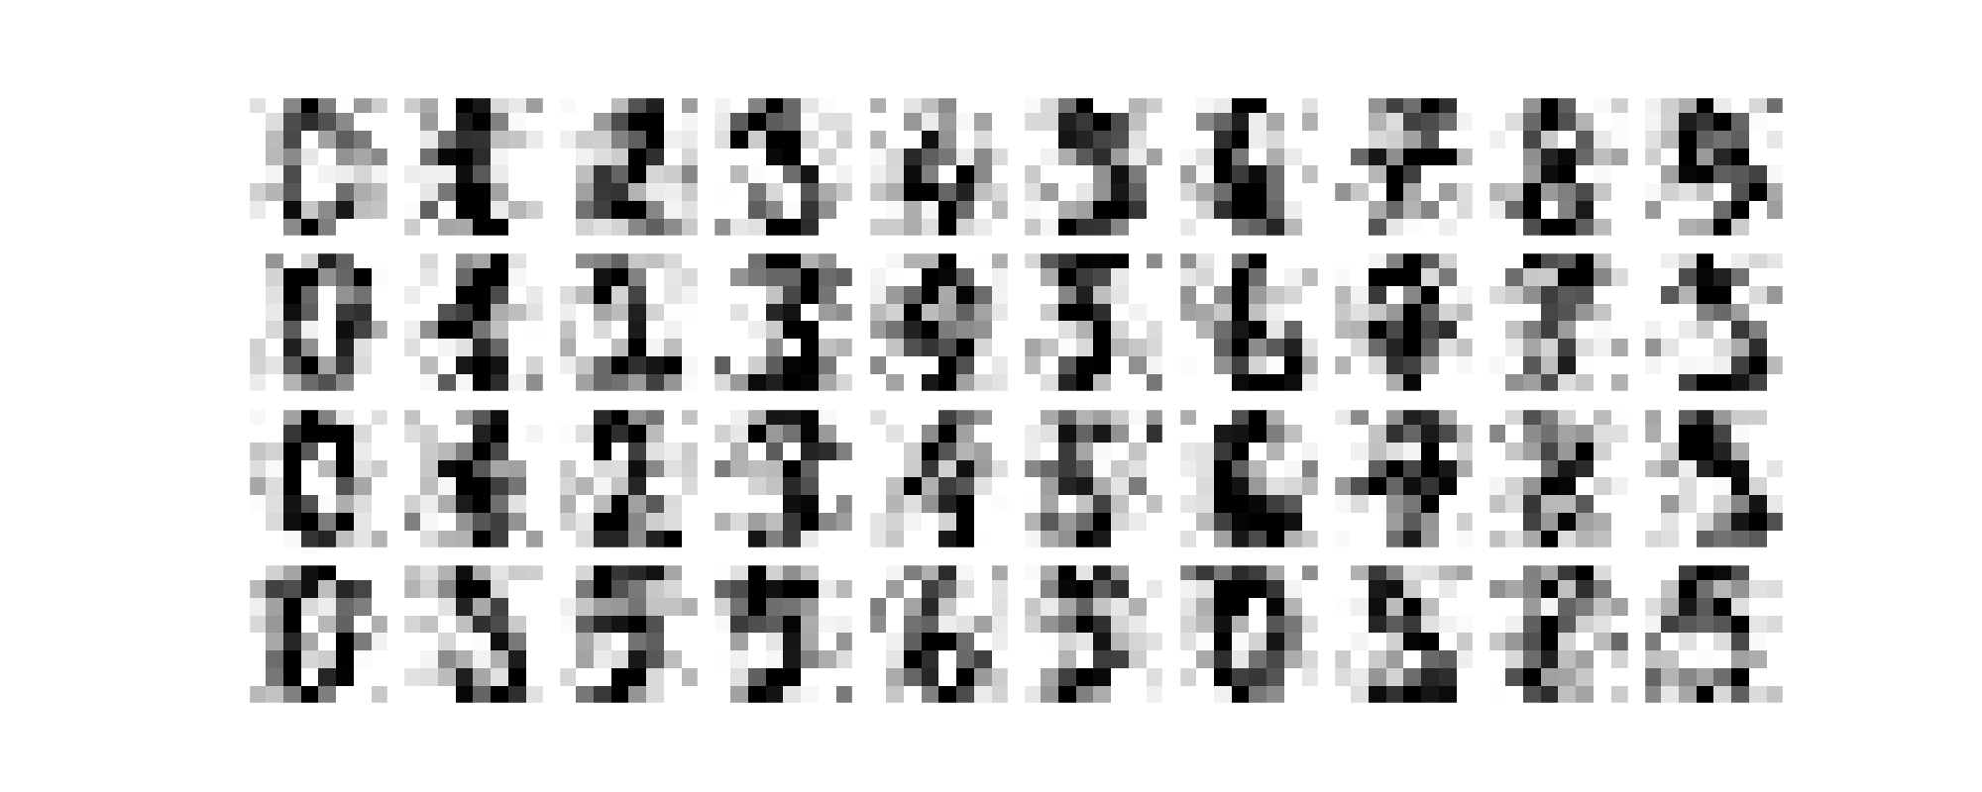
PCA in Python

Slide 120
PCA in Python
Take the noisy set
Use enough components to obtain 50% explained variance
Need 12 components in this case
pca = PCA(0.50).fit(noisy)
print(pca.n_components_)

Slide 121
PCA in Python
Then display the data of only the highest 12 components
components = pca.transform(noisy)
filtered = pca.inverse_transform(components)
plot_digits(filtered)
plt.show()

Slide 122
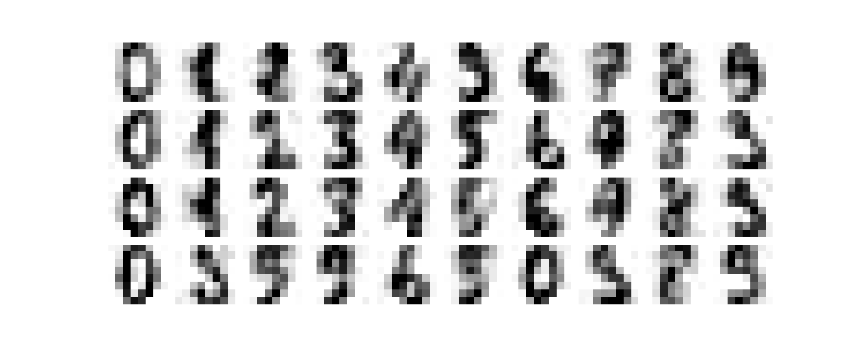

Slide 123
PCA : Eigenfaces
There is a set of faces of important people in sklearn
from sklearn.datasets import fetch_lfw_people
sns.set()
faces = fetch_lfw_people(min_faces_per_person=60)
print(faces.target_names)
print(faces.images.shape)
['Ariel Sharon' 'Colin Powell' 'Donald Rumsfeld'
'George W Bush' 'Gerhard Schroeder' 'Hugo Chavez'
'Junichiro Koizumi' 'Tony Blair']
(1348, 62, 47)

Slide 124
PCA : Eigenfaces
There is a randomized version of PCA that approximates
This is necessary because of the size of the data set
pca = PCA(n_components=150,
svd_solver = 'randomized',
whiten=True
)
pca.fit(faces.data)

Slide 125
pca = PCA(n_components=150, svd_solver = 'randomized', whiten=True)
pca.fit(faces.data)
components = pca.transform(faces.data)
projected = pca.inverse_transform(components)
fig, ax = plt.subplots(2, 10, figsize=(10, 2.5),
subplot_kw={'xticks':[], 'yticks':[]},
gridspec_kw=dict(hspace=0.1, wspace=0.1))
for i in range(10):
ax[0, i].imshow(faces.data[i].reshape(62, 47), cmap='binary_r')
ax[1, i].imshow(projected[i].reshape(62, 47), cmap='binary_r')
ax[0, 0].set_ylabel('full-dim\ninput')
ax[1, 0].set_ylabel('150-dim\nreconstruction');
plt.show()

Slide 126
PCA : Eigenfaces
With about 150 components, the features of the faces are retained

Slide 127
Linear Discriminant Analysis
Idea:
Estimate mean and variance for each category
Assumes same covariances
Calculates (like PCA) an affine transformation

Slide 128
Linear Discriminant Analysis
Import LDA:
Read data & divide
from sklearn.discriminant_analysis import LinearDiscriminantAnalysis as LDA
iris = pd.read_csv('Iris.csv', index_col=0).drop(columns='Species')
X_train, X_test, y_train, y_test = train_test_split(
iris,
50*[0]+50*[1]+50*[2],
test_size=0.2,
random_state=0)

Slide 129
Linear Discriminant Analysis
Reset
Train with two dimensions:
sc = StandardScaler()
X_train = sc.fit_transform(X_train)
X_test = sc.transform(X_test)
lda = LDA(n_components=2)
lda.fit(X_train, y_train)
for i in range(len(X_test)):
print(lda.predict([X_test[i]])[0], y_test[i])

Slide 130
Linear Discriminant Analysis
Results is 100%

Slide 131
Linear Discriminant Analysis
Show transformation for LDA:
transX = lda.fit_transform(iris, 50*[0]+50*[1]+50*[2])
cmap = colors.ListedColormap(['b','r','g'])
plt.scatter(transX[:, 0], transX[:, 1], s=3,
c=50*[0]+50*[1]+50*[2], cmap = cmap )
plt.show()

Slide 132
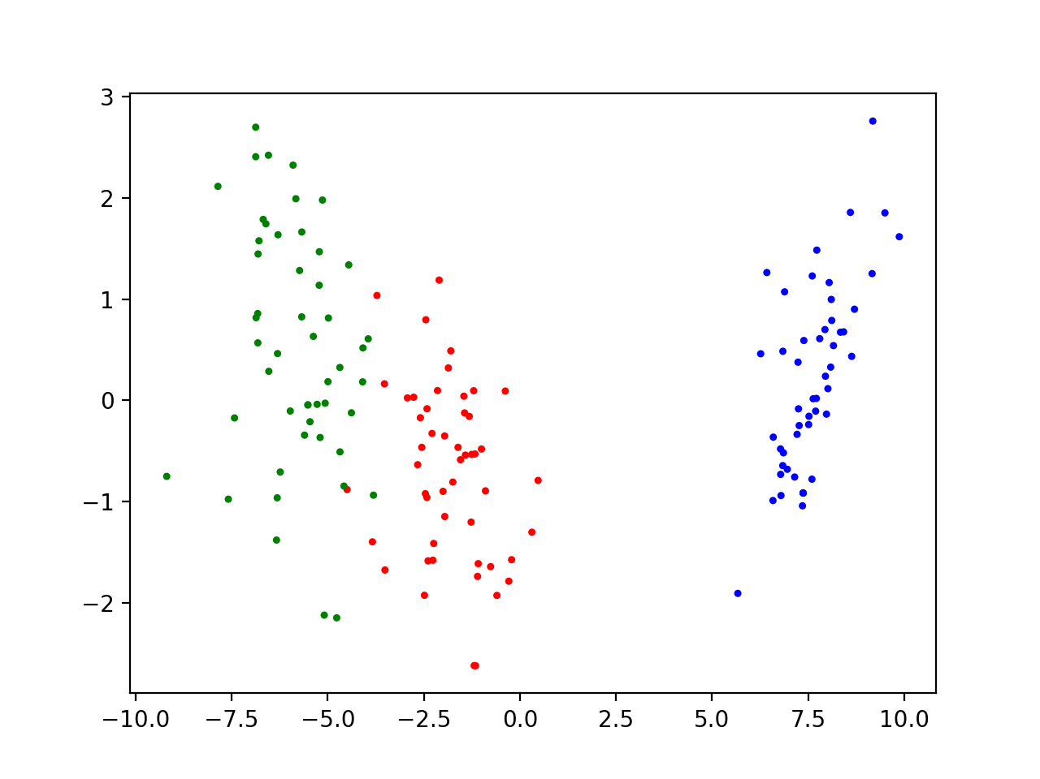
Linear Discriminant Analysis

Slide 133
Final Example
Kaggle has a penguins data set on three types of penguins on three islands in the antarctic ocean
After downloading
Read data into a Pandas Dataframe
Need to get rid of NA columns
penguins_df = pd.read_csv('../SVM/penguins.csv')
penguins_df.dropna(axis=0, how='any',inplace=True)

Slide 134
Final Example
Let's prepare the data for SVM
Take 'Adelie' and 'Chinstrap' as the target categories
Restrict to only those data
Get the labels from the species column
Restrict to numerical columns
penguins_df = penguins_df.loc[
penguins_df['species'].isin(['Adelie','Chinstrap'])]
labels = np.array(penguins_df['species'])
penguins_df=penguins_df[['bill_length_mm', 'bill_depth_mm', 'flipper_length_mm', 'body_mass_g']].astype(float)

Slide 135
Final Example
Make the labels numerical
And make the features into a numpy array
labels[labels=='Adelie']=0
labels[labels=='Chinstrap']=1
labels = labels.astype(int)
features=np.array(penguins_df)

Slide 136
Final Example
Create training and test data (70% / 30% split)
from sklearn.model_selection import train_test_split
X_train, X_test, y_train, y_test = train_test_split(
features, labels, test_size=0.3)

Slide 137
Final Example
Use SVM (better vary C)
Determine accuracy
clf = svm.SVC(kernel='linear', C=0.5)
clf.fit(X_train, y_train)
from sklearn import metrics
y_pred = clf.predict(X_test)
print("Accuracy:", metrics.accuracy_score(y_test, y_pred))
print(clf.coef_)

Slide 138
Final Example
Result varies between 95% and 100% accuracy based on values for C
C=0.5 gives the best results

Slide 139
Final Example
Principal component analysis
PCA only affects the features
Vary the dimensions
from sklearn.decomposition import PCA
pca = PCA(n_components=4)
pca.fit(features)

Slide 140
Final Example
Now print out the results
pca_df = pd.DataFrame(pca.components_,
columns=list(penguins_df.columns))
print(pca.components_)
print(pca.explained_variance_)
print(pca_df)

Slide 141
Final Example
The data frame results (for N=4):
These results show that PCA selects basically the coordinates
And body_mass followed by flipper-length are the most important components
bill_length_mm bill_depth_mm flipper_length_mm body_mass_g
0 0.004003 -0.001154 0.015195 0.999876
1 -0.319278 0.086848 -0.943542 0.015717
2 0.941265 0.144495 -0.305190 0.001036
3 -0.109847 0.985686 0.127891 -0.000366

Slide 142
Final Example
Linear Discriminant Analysis
Train
sc = StandardScaler()
X_train = sc.fit_transform(X_train)
X_test = sc.transform(X_test)
lda = LDA(n_components=2)
lda.fit(X_train, y_train)

Slide 143
Final Example
Display
transX = lda.fit_transform(features, labels)
cmap = colors.ListedColormap(['b','r','g'])
plt.scatter(transX[:, 0], transX[:, 1], s=5,
c=labels, cmap = cmap )
plt.show()

Slide 144
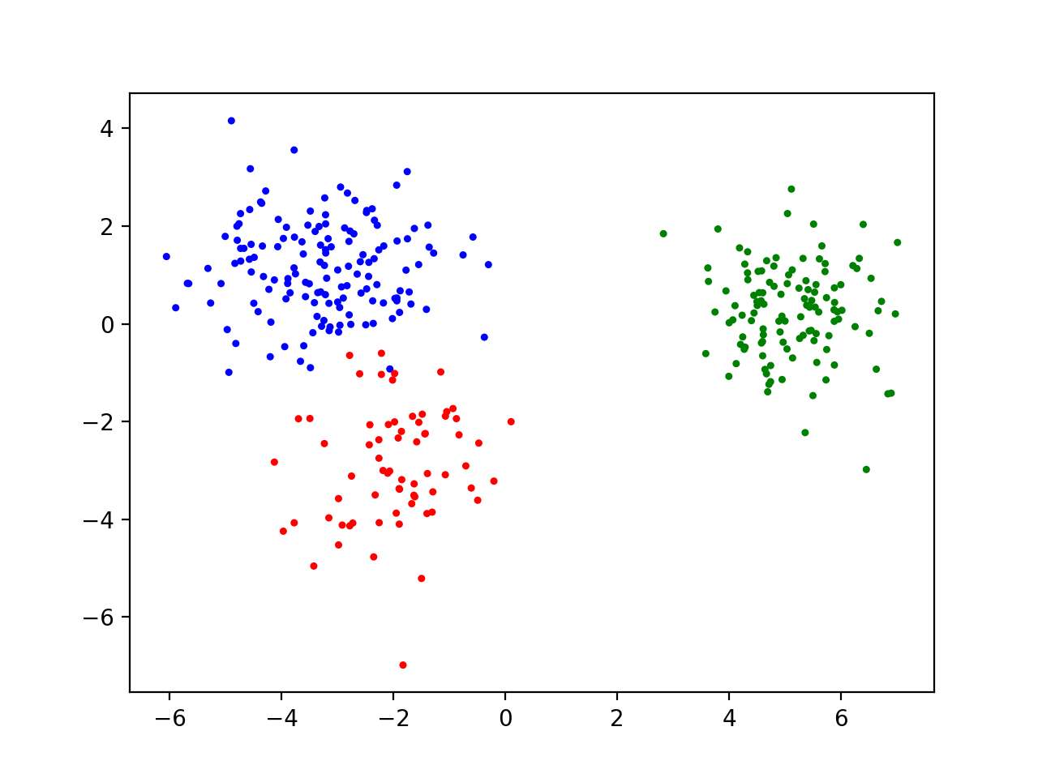
Final Example

