Slide 1
Repetition

Slide 2
Loops
The foo-bang problem
  Print a list of all numbers between 1 and 100
    Whenever the number is divisible by 3, print "foo" afterwards
    Whenever the number is divisible by 5, print "bang"
    If both conditions are set, print "foo-bang"
This is a version of a well-known easy programming interview question

Slide 3
Loops
def foo_bang(n):
for i in range(1, n+1):
if i%3 == 0 and i%5 == 0:
print(i, 'foobang')
elif i%3 == 0 and i%5 != 0:
print(i, 'foo')
elif i%3 != 0 and i%5 == 0:
print(i, 'bang')
elif i%3 != 0 and i%5 != 0:
print(i)
else:
print(f'With {i}: Logic error in program')

Slide 4
Loops
A use case for continue
  Find all numbers $x$ between 1 and 10000 that satisfy the following conditions simultaneously:
    $x$ is not a square
    $x^{3}+2$ is divisible by 4
    $(x-1)(x+1)$ is not divisible by 7
    $(x+2)(x+3)$ is divisible by 5

Slide 5
Loops
Find the smallest number $n$ such that $\overset{n}{\underset{i=1}{∑}}\frac{1}{i^{2}}>\sqrt{2}+\frac{1}{10}$

Slide 6
Loops
Each letter stands for a different digit.
  Solve:
SEND
+MORE
—————
MONEY

Slide 7
Loops
Each letter stands for a different digit
  Solve
six
+ six
+ six
=
nine
+nine

Slide 8
Loops
Solve:
nine
+seven
+seven
+seven
———————
thirty

Slide 9
Classes and Object 1
Thomas Schwarz, SJ
Marquette University

Slide 10
Classes and Objects
Imperative programming manipulates the state of memory
  Breaks up tasks through procedures and functions
Object Oriented Programming
  Creates objects that interact with each other
  Objects are defined with a user-defined data type

Slide 11
Classes and Objects
Each object maintains its own state
  Objects manipulate themselves and other objects through methods

Slide 12
Classes and Objects
Running Example:
  Complex Numbers
  Complex numbers live in the complex plane
    Two canonical way of representing them:
    Via coordinates (the real and the imaginary part)
    Via length and angle to x-axis

Slide 13
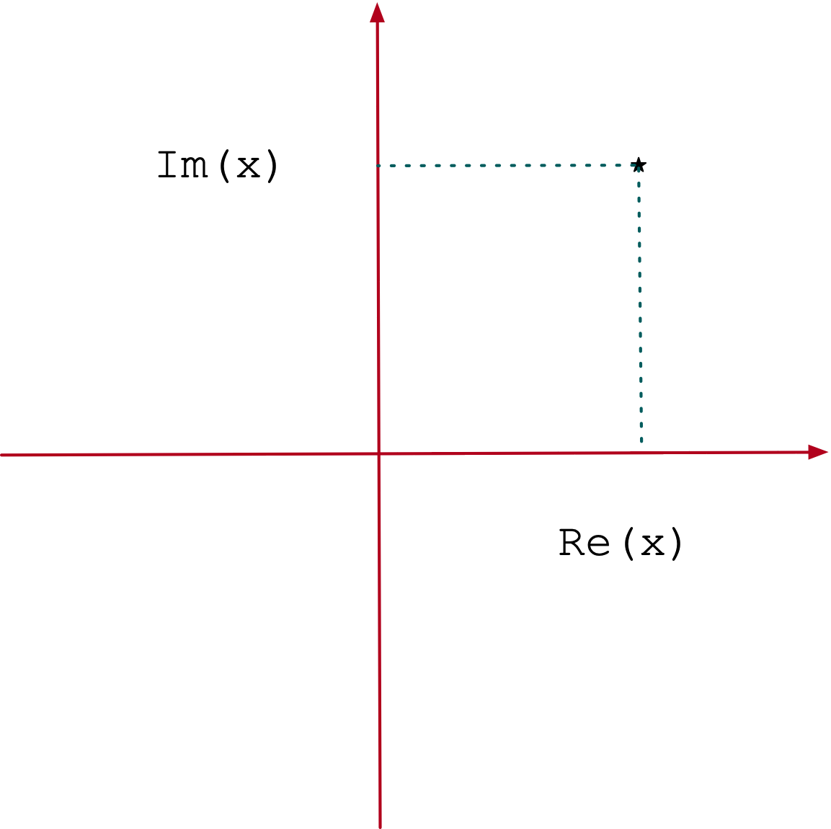
Complex Numbers
Complex numbers are points in the Gaussian plane
Can be represented as pairs (a,b)
  a is called the real part, b is called the imaginary part
  Written as a+ib, the “algebraic notation”

Slide 14
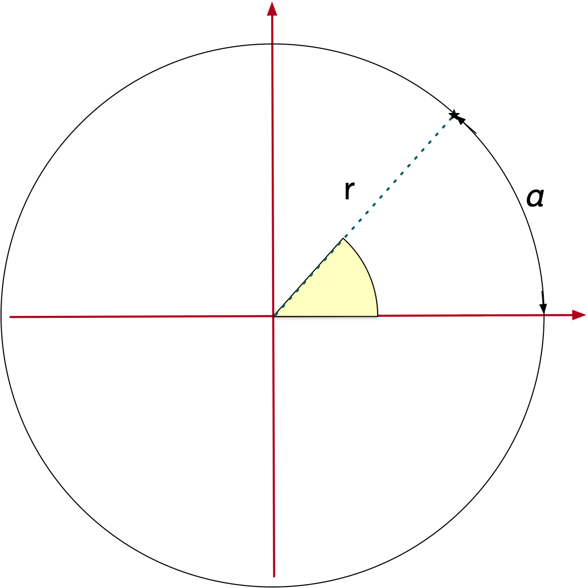
Complex Numbers
r is the length
α is the phase in radians
Polar form
  Given by angle with x-axis and a length
  Written as
$$α$$
$$r$$
$$r⋅e^{iα}$$

Slide 15
Complex Numbers
Complex numbers allow various operations such as addition, multiplication, exponentiation,
The have a length, a real part, and imaginary part, and a phase
They have a transpose
And so much more

Slide 16
OOP in Python
We define the type of an object as a class
  Objects have fields and methods
    Fields are like variables
    Methods are like functions
A complex number has two fields: the real and the imaginary part
A method would be the calculation of the length
Another standard method would be a string describing the number

Slide 17
OOP in Python
There are two types of fields and methods:
  Those that belong to the class:
    Class variables (aka Class fields), Class methods
  And those that belong to an object
    Object variables, Object methods

Slide 18
OOP in Python
To create an object of type class, “instantiation”: we define and use an initializer called __init__()
The initializer can have arguments.
If we create object variables and methods, we use the (quasi-)keyword self to refer to the object.

Slide 19
OOP in Python
The double underscore before and after make this a reserved method name.
class Complex():
def __init__(self, real, imaginary):
self.re = real
self.im = imaginary
def __str__(self):
return "{}+i{}".format(self.re, self.im)
if __name__ == "__main__":
a = Complex(-2, 3)
b = Complex(1, 2)
print(a, b)
They are called dunder methods.

Slide 20
OOP in Python
The “self” is required. It renders this is an instance method
class Complex():
def __init__(self, real, imaginary):
self.re = real
self.im = imaginary
def __str__(self):
return "{}+i{}".format(self.re, self.im)
if __name__ == "__main__":
a = Complex(-2, 3)
b = Complex(1, 2)
print(a, b)

Slide 21
OOP in Python
The real and imaginary are parameters
class Complex():
def __init__(self, real, imaginary):
self.re = real
self.im = imaginary
def __str__(self):
return "{}+i{}".format(self.re, self.im)
if __name__ == "__main__":
a = Complex(-2, 3)
b = Complex(1, 2)
print(a, b)

Slide 22
OOP in Python
class Complex():
def __init__(self, real, imaginary):
self.re = real
self.im = imaginary
def __str__(self):
return "{}+i{}".format(self.re, self.im)
if __name__ == "__main__":
a = Complex(-2, 3)
b = Complex(1, 2)
print(a, b)
This is the creation of an instance of the class. “self” is hidden, -2 is real and 3 is imaginary

Slide 23
OOP in Python
This defines an instance field called “re”
class Complex():
def __init__(self, real, imaginary):
self.re = real
self.im = imaginary
def __str__(self):
return "{}+i{}".format(self.re, self.im)
if __name__ == "__main__":
a = Complex(-2, 3)
b = Complex(1, 2)
print(a, b)

Slide 24
OOP in Python
This defines an instance field called “im”
class Complex():
def __init__(self, real, imaginary):
self.re = real
self.im = imaginary
def __str__(self):
return "{}+i{}".format(self.re, self.im)
if __name__ == "__main__":
a = Complex(-2, 3)
b = Complex(1, 2)
print(a, b)

Slide 25
OOP in Python
Assigning self.whatever anywhere in the definition of the class will create an instance object
class Complex():
def __init__(self, real, imaginary):
self.re = real
self.im = imaginary
def __str__(self):
return "{}+i{}".format(self.re, self.im)
if __name__ == "__main__":
a = Complex(-2, 3)
b = Complex(1, 2)
print(a, b)

Slide 26
OOP in Python
The two underscores before and after denotes __str__ as a reserved name.
class Complex():
def __init__(self, real, imaginary):
self.re = real
self.im = imaginary
def __str__(self):
return "{}+i{}".format(self.re, self.im)
if __name__ == "__main__":
a = Complex(-2, 3)
b = Complex(1, 2)
print(a, b)

Slide 27
OOP in Python
__str__ takes the instance and creates a string. The string should reflect the contents of the object.
class Complex():
def __init__(self, real, imaginary):
self.re = real
self.im = imaginary
def __str__(self):
return "{}+i{}".format(self.re, self.im)
if __name__ == "__main__":
a = Complex(-2, 3)
b = Complex(1, 2)
print(a, b)

Slide 28
OOP in Python
When print is called on objects of type complex, then Python looks first for a __str__ method and then for a __repr__ method. The __repr__ method is supposed to give more details for debugging.
class Complex():
def __init__(self, real, imaginary):
self.re = real
self.im = imaginary
def __str__(self):
return "{}+i{}".format(self.re, self.im)
if __name__ == "__main__":
a = Complex(-2, 3)
b = Complex(1, 2)
print(a, b)

Slide 29
OOP in Python
Adding Methods
  Every complex number has a length:
    To create a method calculating the length:
      We need one argument: the object (the complex number) itself
      This argument is called self
$$|a+bi|=\sqrt{a^{2}+b^{2}}$$

Slide 30
class Complex():
def __init__(self, real, imaginary):
self.re = real
self.im = imaginary
def __str__(self):
if self.re==0 and self.im==0:
return "0"
if self.re==0 and self.im>0:
return "i{}".format(self.im)
if self.re==0 and self.im<0:
return "-i{}".format(-self.im)
if self.im<0:
return "{}-i{}".format(self.re, -self.im)
if self.im>0:
return "{}+i{}".format(self.re, self.im)
return str(self.re)
def length(self):
return math.sqrt(self.re*self.re+self.im*self.im)
if __name__ == "__main__":
a = Complex(-2, 3)
print(a.length())
The one argument is self

Slide 31
class Complex():
def __init__(self, real, imaginary):
self.re = real
self.im = imaginary
def __str__(self):
if self.re==0 and self.im==0:
return "0"
if self.re==0 and self.im>0:
return "i{}".format(self.im)
if self.re==0 and self.im<0:
return "-i{}".format(-self.im)
if self.im<0:
return "{}-i{}".format(self.re, -self.im)
if self.im>0:
return "{}+i{}".format(self.re, self.im)
return str(self.re)
def length(self):
return math.sqrt(self.re*self.re+self.im*self.im)
if __name__ == "__main__":
a = Complex(-2, 3)
print(a.length())
Here is how this function is called: The object is followed by a period

Slide 32
class Complex():
def __init__(self, real, imaginary):
self.re = real
self.im = imaginary
def __str__(self):
if self.re==0 and self.im==0:
return "0"
if self.re==0 and self.im>0:
return "i{}".format(self.im)
if self.re==0 and self.im<0:
return "-i{}".format(-self.im)
if self.im<0:
return "{}-i{}".format(self.re, -self.im)
if self.im>0:
return "{}+i{}".format(self.re, self.im)
return str(self.re)
def length(self):
return math.sqrt(self.re*self.re+self.im*self.im)
if __name__ == "__main__":
a = Complex(-2, 3)
print(a.length())
So, this method is really a function of one argument, even if it does not look like it.

Slide 33
class Complex():
def __init__(self, real, imaginary):
self.re = real
self.im = imaginary
def __str__(self):
if self.re==0 and self.im==0:
return "0"
if self.re==0 and self.im>0:
return "i{}".format(self.im)
if self.re==0 and self.im<0:
return "-i{}".format(-self.im)
if self.im<0:
return "{}-i{}".format(self.re, -self.im)
if self.im>0:
return "{}+i{}".format(self.re, self.im)
return str(self.re)
def length(self):
return math.sqrt(self.re*self.re+self.im*self.im)
if __name__ == "__main__":
a = Complex(-2, 3)
print(a.length())
Here we are referring to an instance field.

Slide 34
Self Test:
Stop the presentation and fire up IDLE
The phase of a complex number is defined by
Raise a ValueError in the last case, the arctan in the math library is called atan.
$$\text{arg}(a+bi)=\{\begin{matrix}arctan(\frac{b}{a}) & \text{if}a>0 \\ arctan(\frac{b}{a})+π & \text{if}a<0\text{and}b≥0 \\ arctan(\frac{b}{a})-π & \text{if}a<0\text{and}b<0 \\ \frac{π}{2} & \text{if}a=0\text{and}b>0 \\ -\frac{π}{2} & \text{if}a=0\text{and}b<0 \\ \text{undefined} & \text{if}x=0\text{and}b=0\end{matrix}$$

Slide 35
class Complex():
def arg(self):
if self.re == 0 and self.im == 0:
raise ValueError
if self.re > 0:
return math.atan(self.im/self.re)
if self.re < 0 and self.im >= 0:
return math.atan(self.im/self.re)+math.pi
if self.re < 0 and self.im < 0:
return math.atan(self.im/self.re) - math.pi
if self.re == 0 and self.im > 0:
return math.pi/2
if self.re == 0 and self.im < 0:
return -math.pi/2
if __name__ == "__main__":
a = Complex(0, 0)
print(a.arg())

Slide 36
OOP in Python
Methods can of course return other objects
  The conjugate of a complex number is obtained by reflecting around the y-axis
$$\overline{a+bi}=a-bi$$

Slide 37
OOP in Python
class Complex():
def conjugate(self):
return Complex(self.re, -self.im)
if __name__ == "__main__":
a = Complex(2, 3)
print(a.conjugate())

Slide 38
OOP
Python knows “operator overloading”
  Instead of adding two complex numbers by saying something like c=add(a,b)
  We can say c=a+b
Python knows a number of such overloads and associates them by reserving function names

Slide 39
class Complex():
def __add__(self, other):
return Complex(self.re+other.re, self.im+other.im)
if __name__ == "__main__":
a = Complex(2, 3)
b = Complex(3, -5)
print(a+b)
We need to return a complex number
Here we are adding two complex numbers.

Slide 40
Self Test
Overload the subtraction
  The reserved method name is __sub__
    (Two underscores before and after)

Slide 41
Solution
class Complex():
def __sub__(self, other):
return Complex(self.re-other.re, self.im-other.im)
if __name__ == "__main__":
a = Complex(2, 3)
b = Complex(3, -5)
suma = a+b
dif = a-b
print(a, b, suma, dif)

Slide 42
OOP in Python
We can define comparisons via overloading
  For equality, the reserved method name is __eq__

Slide 43
OOP in Python
Resolving operators
  Operator overloading does not have to happen between objects of the same type
  If there is an expression a==b
    Python first looks into the class definition of a for an __eq__ method that has second parameter the type of b
    If that fails, Python then looks into the class definition of b for an __eq__method

Slide 44
OOP
In fact, there is a default comparison between two objects
  It is based on IDENTITY NOT EQUALITY
  Identity: Two objects are stored at the same location
  Equality: Two objects have the same fields

Slide 45
class Complex():
def __eq__(self, other):
if isinstance(other, Complex):
return self.re==other.re and self.im==other.im
return NotImplemented
def __ne__(self, other):
if isinstance(other,Complex):
return self.re!=other.re or self.im!=other.im
return NotImplemented
if __name__ == "__main__":
a = Complex(2, 3)
b = Complex(3, -5)
print(a==b, a!=b)
print(a==Complex(2,3), a!=Complex(2,3))
We only want to compare two complex numbers

Slide 46
class Complex():
def __eq__(self, other):
if isinstance(other, Complex):
return self.re==other.re and self.im==other.im
return NotImplemented
def __ne__(self, other):
if isinstance(other,Complex):
return self.re!=other.re or self.im!=other.im
return NotImplemented
if __name__ == "__main__":
a = Complex(2, 3)
b = Complex(3, -5)
print(a==b, a!=b)
print(a==Complex(2,3), a!=Complex(2,3))
Two complex numbers are equal if they have the same real and imaginary parts

Slide 47
class Complex():
def __eq__(self, other):
if isinstance(other, Complex):
return self.re==other.re and self.im==other.im
return NotImplemented
def __ne__(self, other):
if isinstance(other,Complex):
return self.re!=other.re or self.im!=other.im
return NotImplemented
if __name__ == "__main__":
a = Complex(2, 3)
b = Complex(3, -5)
print(a==b, a!=b)
print(a==Complex(2,3), a!=Complex(2,3))
If we compare a complex number with a non-complex number then we want to return the constant NotImplemented

Slide 48
Classes and Objects
Classes usually define objects, but they can also used in isolation
  Assume that you want to use a number of global variables
    This is dangerous, since you might be reusing the same name
  Solution: Use a class that contains all these variables

Slide 49
A Globals Class
We call the class Gl — short for global
Store constants as class variables
Easy to identify in program
class Gl:
gr2gr = 0.06479891
dr2gr = 1.7718451953125
oz2gr = 28.349523125
lb2gr = 453.59237
st2gr = 6350.29318
def translate(number, measure):
if measure == "gr":
return "{0:.3f} {1}".format(number*Gl.gr2gr, "gram")
if measure == "dr":
return "{0:.3f} {1}".format(number*Gl.dr2gr, "gram")
if measure == "oz":
return "{0:.3f} {1}".format(number*Gl.oz2gr, "gram")
if measure == "lb":
return "{0:.3f} {1}".format(number*Gl.lb2gr, "gram")
if measure == "st":
return "{0:.3f} {1}".format(number*Gl.st2gr/1000, "kg")
raise ValueError

Slide 50
Class and Instance Variables
Class variable
  belong to the class
  shared by all objects
  defined without prefix in the class
Instance variable
  belong to the instance
  not shared by objects
  defined by using an object or self prefix

Slide 51
Self Test
Identify the type of the bold-faced variables in the following code
import math
class Example:
exists = False
def __init__(self, x, y):
self.radius = math.sqrt(x*x+y+y)
self.x = x
self.y = y
Example.exists = True
print(Example.exists)
e = Example(2, 3)
print(e.x)
print(Example.exists)
print(e.radius)

Slide 52
Answer
import math
class Example:
exists = False
def __init__(self, x, y):
self.radius = math.sqrt(x*x+y+y)
self.x = x
self.y = y
Example.exists = True
print(Example.exists)
e = Example(2, 3)
print(e.x)
print(Example.exists)
print(e.radius)
It happens to be defined in __init__. However, it is defined with the self prefix.
This is an instance variable. It belongs to the (one and only) object of type Example.

Slide 53
Answer
import math
class Example:
exists = False
def __init__(self, x, y):
self.radius = math.sqrt(x*x+y+y)
self.x = x
self.y = y
Example.exists = True
print(Example.exists)
e = Example(2, 3)
print(e.x)
print(Example.exists)
print(e.radius)
It is defined without a prefix within the class.
This is a class variable. It is specified by using the class name “Example.”

Slide 54
Answer
import math
class Example:
exists = False
def __init__(self, x, y):
self.radius = math.sqrt(x*x+y+y)
self.x = x
self.y = y
Example.exists = True
print(Example.exists)
e = Example(2, 3)
print(e.x)
print(Example.exists)
print(e.radius)
It is used by referring to an object e.
This is an instance variable. It is defined with the prefix self.

Slide 55
Class and Instance Methods
The same distinction can be made for methods
  Methods are functions related to an object
A class method depends only on the class.
  It is defined in the class, but has no argument self
  It is called by giving the class-name
An instance method depends on an instance
  It is defined in the class with first argument self
  It is called by prefacing it with an instance.
    The instance is called the implicit argument

Slide 56
Class and Instance Methods
A method definition without argument self:
Class Method
class Example:
def foo():
print("foo")
def __init__(self):
pass
def bar(self):
print("bar")
Example.foo()
e = Example()
e.bar()
It is called using the class-name to call it

Slide 57
Class and Instance Methods
A method definition with argument self:
Instance Method
class Example:
def foo():
print("foo")
def __init__(self):
pass
def bar(self):
print("bar")
Example.foo()
e = Example()
e.bar()
It is called using the Instance.
Without an object e, we cannot call it.

Slide 58
Self Test
Identify the type of methods in the following code
import math
class Vector3D:
def __init__(self, x, y, z):
self.x = x
self.y = y
self.z = z
def zeroes():
return Vector3D(0,0,0)
def ones():
return Vector3D(1,1,1)
def __add__(self, other):
return Vector3D(self.x+other.x,
self.y+other.y,
self.z+other.z)
def __str__(self):
return "({}, {}, {})".format(self.x, self.y, self.z)
def length(self):
return math.sqrt(self.x**2+self.y**2+self.z**2)

Slide 59
Answers
Dunder (double under) method:
Hard to tell
import math
class Vector3D:
def __init__(self, x, y, z):
self.x = x
self.y = y
self.z = z
def zeroes():
return Vector3D(0,0,0)
def ones():
return Vector3D(1,1,1)
def __add__(self, other):
return Vector3D(self.x+other.x,
self.y+other.y,
self.z+other.z)
def __str__(self):
return "({}, {}, {})".format(self.x, self.y, self.z)
def length(self):
return math.sqrt(self.x**2+self.y**2+self.z**2)

Slide 60
Answers
import math
class Vector3D:
def __init__(self, x, y, z):
self.x = x
self.y = y
self.z = z
def zeroes():
return Vector3D(0,0,0)
def ones():
return Vector3D(1,1,1)
def __add__(self, other):
return Vector3D(self.x+other.x,
self.y+other.y,
self.z+other.z)
def __str__(self):
return "({}, {}, {})".format(self.x, self.y, self.z)
def length(self):
return math.sqrt(self.x**2+self.y**2+self.z**2)
Class Method, even though it generates an object

Slide 61
Answers
import math
class Vector3D:
def __init__(self, x, y, z):
self.x = x
self.y = y
self.z = z
def zeroes():
return Vector3D(0,0,0)
def ones():
return Vector3D(1,1,1)
def __add__(self, other):
return Vector3D(self.x+other.x,
self.y+other.y,
self.z+other.z)
def __str__(self):
return "({}, {}, {})".format(self.x, self.y, self.z)
def length(self):
return math.sqrt(self.x**2+self.y**2+self.z**2)
Class Method, even though it generates an object

Slide 62
Answers
import math
class Vector3D:
def __init__(self, x, y, z):
self.x = x
self.y = y
self.z = z
def zeroes():
return Vector3D(0,0,0)
def ones():
return Vector3D(1,1,1)
def __add__(self, other):
return Vector3D(self.x+other.x,
self.y+other.y,
self.z+other.z)
def __str__(self):
return "({}, {}, {})".format(self.x, self.y, self.z)
def length(self):
return math.sqrt(self.x**2+self.y**2+self.z**2)
Instance method

Slide 63
Answers
import math
class Vector3D:
def __init__(self, x, y, z):
self.x = x
self.y = y
self.z = z
def zeroes():
return Vector3D(0,0,0)
def ones():
return Vector3D(1,1,1)
def __add__(self, other):
return Vector3D(self.x+other.x,
self.y+other.y,
self.z+other.z)
def __str__(self):
return "({}, {}, {})".format(self.x, self.y, self.z)
def length(self):
return math.sqrt(self.x**2+self.y**2+self.z**2)
Dunder instance method

Slide 64
Answers
import math
class Vector3D:
def __init__(self, x, y, z):
self.x = x
self.y = y
self.z = z
def zeroes():
return Vector3D(0,0,0)
def ones():
return Vector3D(1,1,1)
def __add__(self, other):
return Vector3D(self.x+other.x,
self.y+other.y,
self.z+other.z)
def __str__(self):
return "({}, {}, {})".format(self.x, self.y, self.z)
def length(self):
return math.sqrt(self.x**2+self.y**2+self.z**2)
Instance method

Slide 65
Dunder Methods
Python reserves special names for functions that allows the programmer to emulate the behavior of built-in types
  For example, we can create number like objects that allow for operations such as addition and multiplication
  These methods have special names that start out with two underscores and end with two underscores
Aside: If you preface a variable / function / class with a single underscore, you indicate that it should be treated as reserved and not used outside of the module / class

Slide 66
Dunder Method
A class for playing cards:
  A card has a suit and a rank
    We define this in the constructor __init__
class Card:
def __init__(self, suit, rank):
self.suit = suit
self.rank = rank

Slide 67
Dunder Method
We want to print it
  Python likes to have two methods:
    __repr__ for more information, e.g. errors
    __str__ for the print-function
    Both return a string
class Card:
def __str__(self):
return self.suit[0:2]+self.rank[0:2]
def __repr__(self):
return "{}-{}".format(self.suit, self.rank)

Slide 68

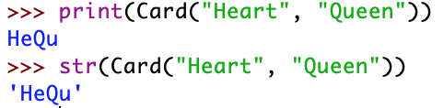
Dunder Method
__repr__ is used when we create an object in the terminal
__str__ is used within print or when we say str(card)

Slide 69
Dunder Method
We now create a carddeck class
  Consists of a set of cards
  Constructor uses a list of ranks and a list of suits
class Deck:
def __init__(self, los, lov):
self.cards = [Card(suit, rank) for suit in los
for rank in lov]

Slide 70
Dunder Method
We create the string method. Remember that it needs to return a string.
class Deck:
def __init__(self, los, lov):
self.cards = [Card(suit, rank) for suit in los
for rank in lov]
def __str__(self):
result = []
for card in self.cards:
result.append(str(card))
return " ".join(result)

Slide 71
Dunder Method
In order to allow python to check whether a deck exists, we want to have a length class. Besides, it is useful in itself.
  if deck: works by checking len(deck)
class Deck:
def __len__(self):
return len(self.cards)

Slide 72
Dunder Method
Given a deck, we want to be able to access the i-th element.
We do so by defining __getitem
class Deck:
def __getitem__(self, position):
return self.cards[position]

Slide 73

Dunder Method
This turns out to be very powerful:
  We can print out the i-th element of the deck
  But we can also slice the deck
french_deck = Deck(['Spade', 'Diamonds', 'Hearts', 'Clubs'],
['Ace', 'King', 'Queen', 'Jack', '10', '9',
'8', '7', '6', '5', '4', '3', '2'])

Slide 74

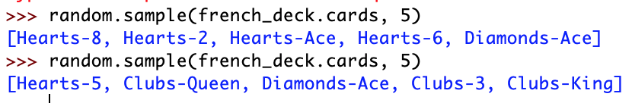
Dunder Method
We can use random.choice() to select a card
Only for random.sample do we need to go to the underlying instance field
  But this is ugly and we better write a class method for it.

