Slide 1
Classes
Thomas Schwarz, SJ

Slide 2
Address Class
How to generate addresses
Each country has its own way of generating addresses
An address consists of
an optional modifier (apartment, floor, neighborhood)
a street
a street number
a city
a state (in most of the Americas)
a country

Slide 3
Address Class
To deal with optional arguments:
Use a default argument of none
def __init__(self, country, city, street, number,
postal, state, apartment = None):

Slide 4
Aside: How to deal with long lines in Python
Python statements ideally fit in a single line
In fact, if you want to write poorly readable code, you can put more than one statement in a line and separate with a semi-colon ( ; )
Python still allows to use a single forward slash as a continuation marker
But this is not very readable
Put expressions into parentheses (unless they already come with parentheses)
Python interpreter will interpret correctly

Slide 5
The purpose of str and repr
The dunder methods __str__ and __repr__ seem to do the same thing,
But:
__str__ is called by print with priority over __repr__
This is how you want your output be displayed
__repr__ should represent the internal structure of your class instances

Slide 6
Addresses
We can use __repr__ to just give us the internal makeup of an Address instance
def __repr__(self):
return "apartment: {0}\nstreet: {1}\nnumber: {2}\ncity: {3}\npostal: {4}\nstate: {5}, \ncountry: {6}".format(
self.apartment, self.street, self.number, self.city, self.postal, self.state, self.country)

Slide 7
Addresses
But for __str__, we will let the country code determine what to do.
The code is ugly, but that is the price for internationalization
And we have not even discussed how to be able to use non-English keyboard letters in Python

Slide 8
Self Test
Open up the file address.py
Edit the __str__ dunder method to allow for Indian addresses

Slide 9
Addresses
When we use str(my_address) on an Address object, we get the result of __str__
When we use repr(my_address), we get the result of __repr__

Slide 10
Instances can be fields of classes
When we model processes (such as business processes), we will build up our entities from simpler entities
We can have a has-a relationship
For example, each person has an address
(With many sad exceptions: some have none, some have more than one)

Slide 11
Modular programming
Remember modules:
They are just py-files
They are imported using import statements
The form of the import statements determines how the names are being resolved
import address
imports the module, names are prefixed with “address.”
from address import *
Not recommended, just use names without prefix
from address import Address
Just as before, but only imports the class Address

Slide 12
Client Example
Clients have a name and an address
import address
class Client:
def __init__(self, name, address):
self.name = name
self.address = address
def __str__(self):
return "{}\n{}".format(self.name, str(self.address))
def __repr__(self):
return "Name: {}\n {}".format(self.name, repr(self.address))
if __name__=="__main__":
address4 = address.Address("Canada", "Ottawa", "Wellington Street",
80, "ON K1A 0A2", "Ontario",
"Office of the Prime Minister")
trudy = Client("The Honorable Justin Trudeau", address4)
print(trudy)

Slide 13
Doc Strings
Classes are reusable
No need to reinvent a working name class
But need to provide documentation
In Python:
This is done primarily with the so-called doc string
Right after the definition of a class or function
Included between triple quotes

Slide 14
Doc Strings
The contents are made available to the help function

Slide 15
Example
A simple checking account class
class Checking_Account:
"""A class that models a checking account.
Attributes: a name -- string in this implementation
Balance: a balance in cents
"""
def __init__(self, name, balance):
"""Constructor. name is a string. balance is a floating point or integer."""
self.name = name
self.balance = round(balance*100)
def __str__(self):
"""Returns balance as dollars and cents"""
return "Account for {} with balance US${:d}.{:02d}".format(
self.name,
self.balance//100,
self.balance%100)
def transfer(act1, act2, amount):
"""transfers amount (floating pt) in dollars from act1 to act2"""
amount = round(amount*100)
act1.balance -= amount
act2.balance += amount

Slide 16
Example
if __name__ == "__main__":
a1 = Checking_Account("Thomas Schwarz", 1543.285)
a2 = Checking_Account("Joseph Cuelho", 1009)
print(a1)
print(a2)
print("Transferring")
Checking_Account.transfer(a1, a2, 500.01)
print(a1)
print(a2)

Slide 17
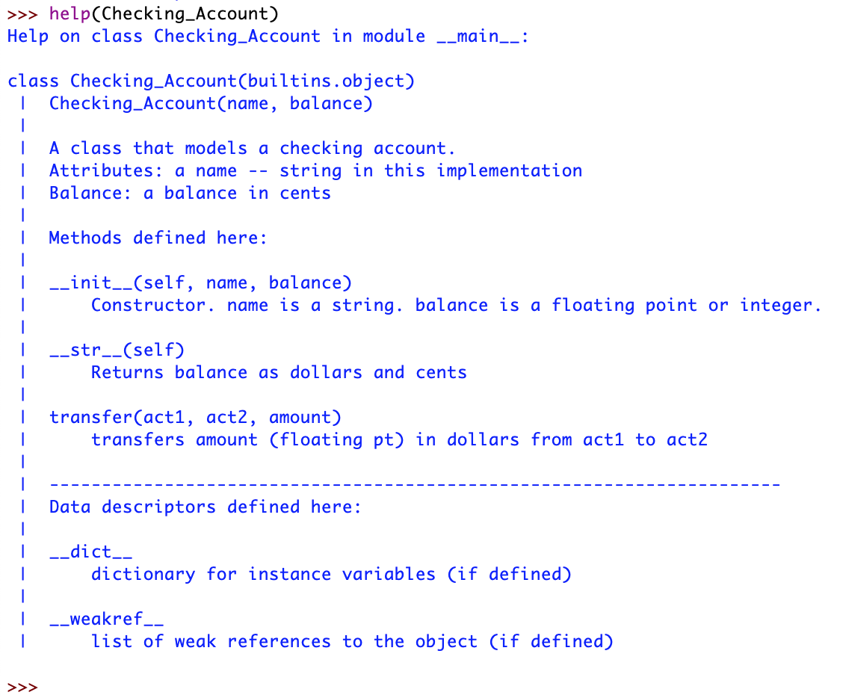
Example
This is the result of typing help(Checking_Account)

Slide 18
Example
As you can see, Python has automatically created a help file from the information you provided.

Slide 19
Tricks with Currency Amounts
Currency is usually a decimal number with exactly two digits precision.
Could use the decimal - class
Could use third party classes
We build our own
Idea: Present currency as multiples of cents.

Slide 20
class Checking_Account:
"""A class that models a checking account.
Attributes: a name -- string in this implementation
Balance: a balance in cents
"""
def __init__(self, name, balance):
"""Constructor. name is a string. balance is a
floating point or integer.
“""
self.name = name
self.balance = round(balance*100)

Slide 21
Tricks with Currency Accounts
To print out currencies, we break the cents apart into the dollars (displayed normally) and the cents amount proper.
The format mini-language allow us to print out amounts with leading 0.
Just stick a 0 in front of the width field
def __str__(self):
"""Returns balance as dollars and cents"""
return "Account for {} with balance US${:d}.{:02d}".format(
self.name,
self.balance//100,
self.balance%100)
Specify leading zero in the format mini-language

Slide 22
Self Test
Modify the __str__ function so that a negative amount is written in the form
-US$103.05

Slide 23
Solution
Just make a case distinction, but make sure that you do not change the field
def __str__(self):
"""Returns balance as dollars and cents"""
if self.balance >= 0:
return "Account for {} with balance US${:d}.{:02d}".format(
self.name,
self.balance//100,
self.balance%100)
else:
balance = -self.balance
return "Account for {} with balance -US${:d}.{:02d}".format(
self.name,
balance//100,
balance%100)

Slide 24
K Nearest Neighbor
A simple classification system
Classify an unknown category by looking at the k nearest neighbors

Slide 25
K Nearest Neighbor
How do we define near-ness
One possibility: Euclidean distance
Data points with numerical values $x_{1},x_{2},…,x_{n}$ and $y_{1},y_{2},…,y_{n}$: $\sqrt{(x_{1}-y_{1})^{2}+(x_{2}-y_{2})^{2}+…+(x_{n}-y_{n})^{2}}$

Slide 26
k Nearest Neighbor
Usually need to normalize values
Otherwise dimension will matter
(100000, 1) and (1000010, 5) are almost equally distant from (0,6)
Normalize: $x↦\frac{x-min}{max-min}$
Now all coordinates are between 0 and 1

Slide 27
k Nearest Neighbor
Other distances are possible
Angle between the two points $arccos(\frac{x⋅y}{|x||y|})$
Weighted euclidean distance
Manhattan distance
…

Slide 28
k Nearest Neighbor
Parameter k has an influence on accuracy:
Choose odd k to deal with ties when we have only two categories

Slide 29
knn Implementation
Want to do something more generic
Assume a csv file:
First column might be an index
Then observable values
Finally category
Want to normalize:
Need to find maximum and minimum for each coordinate
This goes into class variables

Slide 30
knn Implementation
Create a class for data: Cat_Data
class Cat_Data():
nr_cols = 0
mins = []
maxs = []

Slide 31
knn Implementation
Whenever an object is created, we update the three class variables
def __init__(self, data, cat):
self.values = data
self.cat = cat
if len(self.values) > Cat_Data.nr_cols:
Cat_Data.mins.extend(data[Cat_Data.nr_cols: ])
Cat_Data.maxs.extend(data[Cat_Data.nr_cols: ])
Cat_Data.nr_cols = len(self.values)
for i, val in enumerate(self.values):
if val < Cat_Data.mins[i]:
Cat_Data.mins[i] = val
if val > Cat_Data.maxs[i]:
Cat_Data.maxs[i] = val

Slide 32
knn Implementation
Need to create string dunder
def __str__(self):
retVal = []
for val in self.values:
retVal.append(str(val))
retVal.append('cat: ' + str(self.cat))
return ', '.join(retVal)

Slide 33
knn Implementation
The repr dunder is mainly the same
def __repr__(self):
retVal = ['Cat_Data']
for val in self.values:
retVal.append(str(val))
retVal.append('cat: ' + str(self.cat))
return ', '.join(retVal)

Slide 34
knn Implementation
Create a class method 'load'
Takes file name and as optional parameter, whether the first column is an index column
def load(file_name, index = True):
lista = []
with open(file_name) as infile:
infile.readline() # remove first line
for line in infile:
contents = line.strip().split(',')
data = []
if index:
contents = contents[1:]
for val in contents[:-1]:
data.append(float(val))
cat = contents[-1]
lista.append(Cat_Data(data, cat))
return lista

Slide 35
knn Implementation
To normalize, need to know the value and the coordinate
def normalize(val, i):
return (val-Cat_Data.mins[i])/(Cat_Data.maxs[i]-Cat_Data.mins[i])

Slide 36
knn Implementation
Distance between points is the Euclidean distance between normalized data points
def distance(self, other):
yog = 0
for i in range(min(len(self.values), len(other.values))):
yog += (Cat_Data.normalize(self.values[i], i)- Cat_Data.normalize(other.values[i], i))**2
return math.sqrt(yog)

Slide 37
knn Implementation
Now can write a classifier
Needs to find the nearest k elements
We can speed this up by limiting the number of elements that we need to look at
E.g. using a kd-tree
But here, we just order all data points by their distance
Use Counter and sort with a key function

Slide 38
knn Implementation
def classify(element, lista, k=5):
distances = [ (el, element.distance(el)) for el in lista ]
distances.sort(key = lambda x: x[1])
votes = Counter( [ x[0].cat for x in distances[:k]] )
return votes.most_common(1)[0][0]

