Slide 1
Comprehension
Thomas Schwarz, SJ

Slide 2
Contents
The random module
Some repetition and new stuff about loops
List and dictionary comprehension

Slide 3
The random module
Python
Marquette University

Slide 4

A Monte Carlo Method for
Area calculation
Calculate the area of a circle of radius 1
  Can be done analytically:
  Can be done with Monte Carlo Method
    Use pseudo-random numbers in order to determine values probabilistically
    Named after Stanislav Ulam
      Used for work on the thermo-nuclear device

Slide 5

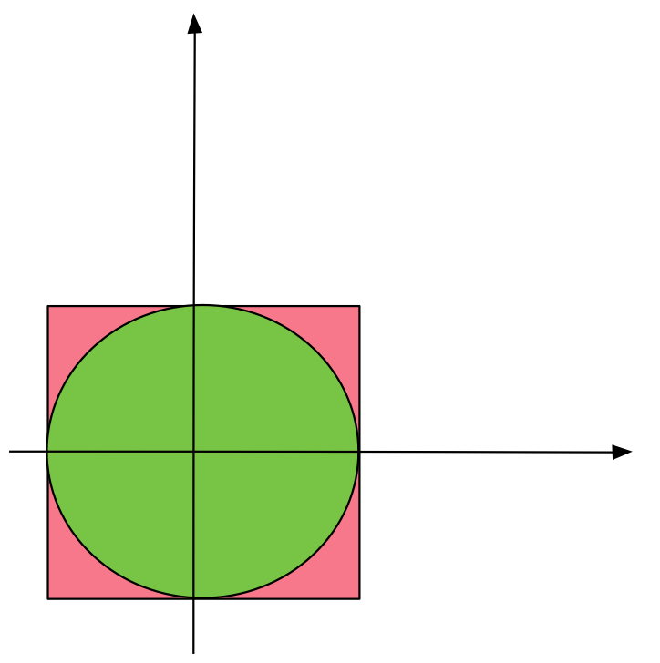
A Monte Carlo Method for
Area calculation
Inscribe Circle with a square
Circle:
Square:

Slide 6
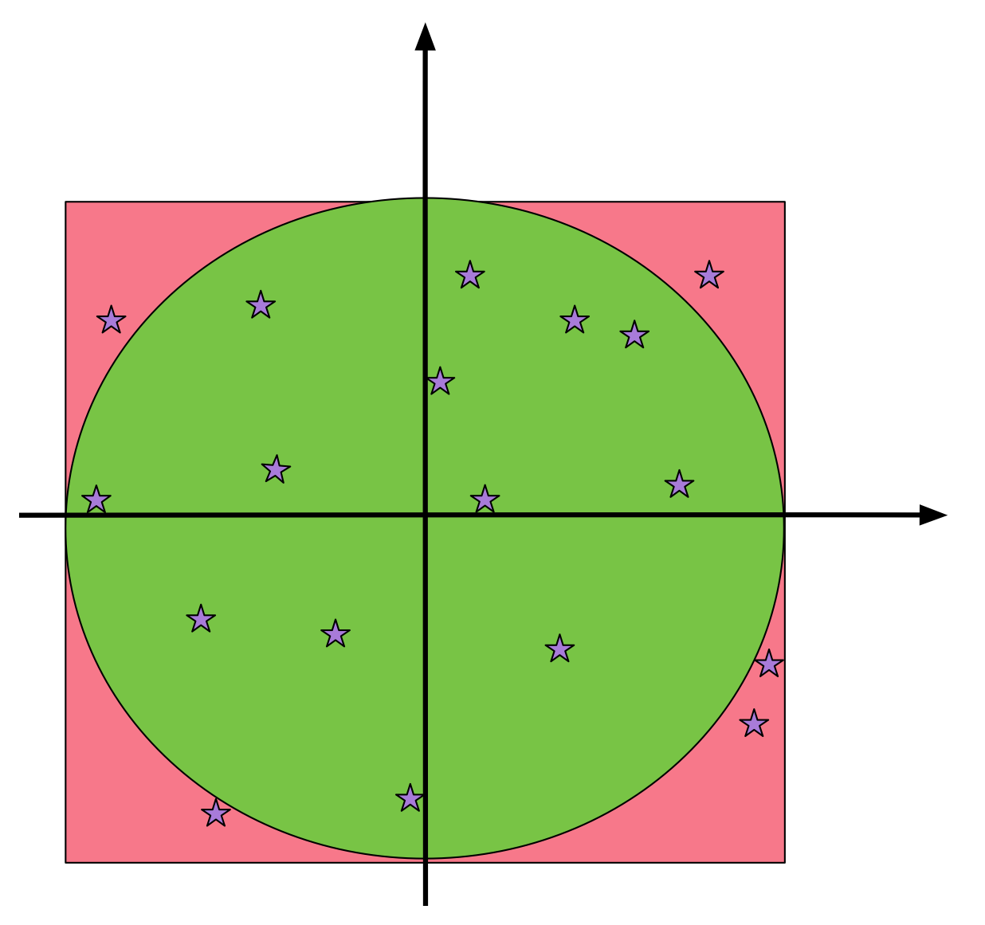
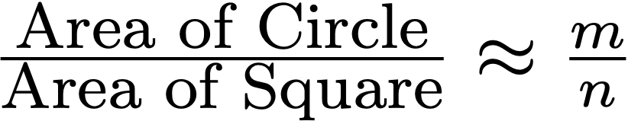
A Monte Carlo Method for
Area calculation
Method:
  Choose n random points in the square
  m points inside circe

Slide 7
Random Number Generation
Computers are deterministic (one hopes) and using a deterministic device to generate randomness is not possible
  Modern systems can use physical phenomena
    Geiger counters for radioactive materials
    Atmospheric radio noise
  But for large sets of seemingly random numbers, use pseudo-random number generators
    Create deterministically based on a seemingly random seed output that passes statistical tests for randomness

Slide 8
Random Number Generation in Python
Sophisticated methods to generate seemingly random sequences of numbers
Part of a module called random

Slide 9
Interlude:
Python Modules
Anyone can create a python module
  Just a file with extension .py
  In a directory in the Python path, which is set for the OS
  Or just in the same directory as files that use the module
A module contains definitions of variables and functions
  Any python script that imports the module can use them

Slide 10
Interlude: Python Modules
Predefined modules
  Python defines many modules
    We already have seen math and os
To use such a module, say
  import random
    in order to use the functions within random

Slide 11
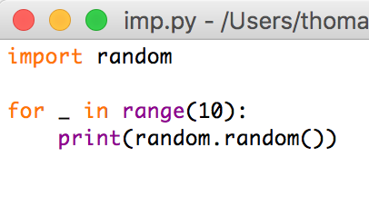
Interlude: Python Modules
If I just import the module random, then I can use its functions by prefixing “random.”
Using the function random inside the module random

Slide 12
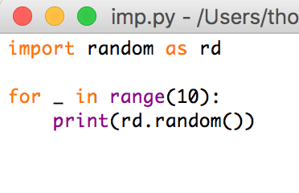
Interlude: Python Modules
If I want to avoid writing the module name I can use an “as” clause that redefines the name of the module within the script
Using the same function in the same module,
but now after internally renaming the module

Slide 13
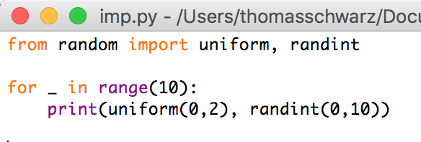
Interlude: Python Modules
By using the “from — import” clause, I can use variables and functions without repeating the module name
Importing the two functions uniform and randint from
the random module.

Slide 14
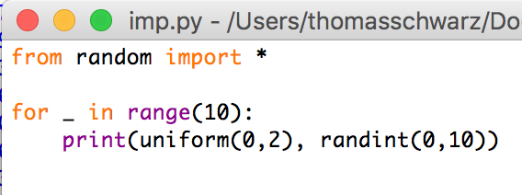
Interlude: Python Modules
I could even import everything from a module
  But this can create havoc if I defined a function with the same name as a function in the module
A dangerous practice: Importing all
functions from a module

Slide 15
Random Module
Important functions in the random module
  random.randint(a, b) Selects a random integer between a and b (boundaries included)
  random.uniform(a, b) Selects a random float between a and b
  random.random( ) Selects a random number between 0 and 1

Slide 16
A Monte Carlo Method for
Area calculation
Method:
  Choose n random points in the square
  m points inside circe

Slide 17
A Monte Carlo Method for
Area calculation
Use random module
  random.uniform(-1,1) generates random number between -1 and 1
  Generating 20 random numbers:
import random
for i in range(20):
x = random.uniform(-1,1)
y = random.uniform(-1,1)
print("({:6.3f},{:6.3f})".format(x,y))

Slide 18
A Monte Carlo Method for
Area calculation
import random
def approx(N):
count = 0
for i in range(N):
x = random.uniform(-1,1)
y = random.uniform(-1,1)
if x*x+y*y<1:
count += 1
return (4*count/N)
We then only count those that are inside the circle

Slide 19
A Monte Carlo Method for Area Calculations
Since and the area of the box is 4
we return
$$\frac{\text{count}}{N}≈\frac{\text{Area Circle}}{\text{Area Box}}$$
import random
def approx(N):
count = 0
for i in range(N):
x = random.uniform(-1,1)
y = random.uniform(-1,1)
if x*x+y*y<1:
count += 1
return (4*count/N)
$$\frac{4\text{count}}{N}$$

Slide 20
A Monte Carlo Method for
Area calculation
Need few random point to get a general idea
Need lots to get any good accuracy
Method of choice used to determine 6-dimensional integrals for simulation of quantum decay where accuracy is not as important as speed

Slide 21
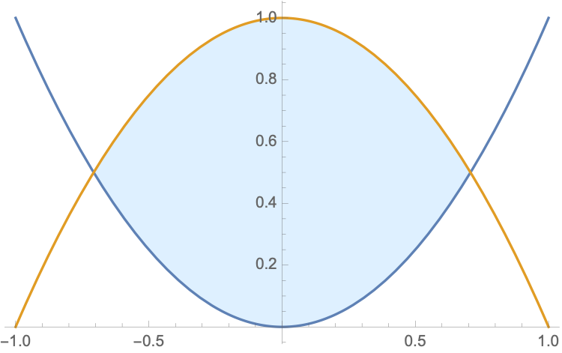



A Monte Carlo Method for
Area calculation
Your task:
  Determine the area between the curves
  Hint: We draw points in the rectangle [-1,1] x [0,1]
  (x,y) lies in the area if

Slide 22
A Monte Carlo Method for
Area calculation
Select random points in the box [-1,1] x [0,1]
Count the number of times that the point falls in
the area
Multiply the ratio count / #pts by the area of the
box, which is 2
import random
N = int(input("Give the number of random points: "))
count = 0
for _ in range(N):
x = random.uniform(-1,1)
y = random.uniform(0,1)
if x*x < y < 1-x*x:
count += 1
print("The area is approximately", count*2/N)

Slide 23
Monte-Carlo Volume Calculation
Sometimes, Monte-Carlo is the method of choice
  When there is no need for super-precision
  When the volume is not easily evaluated using analytic methods.

Slide 24
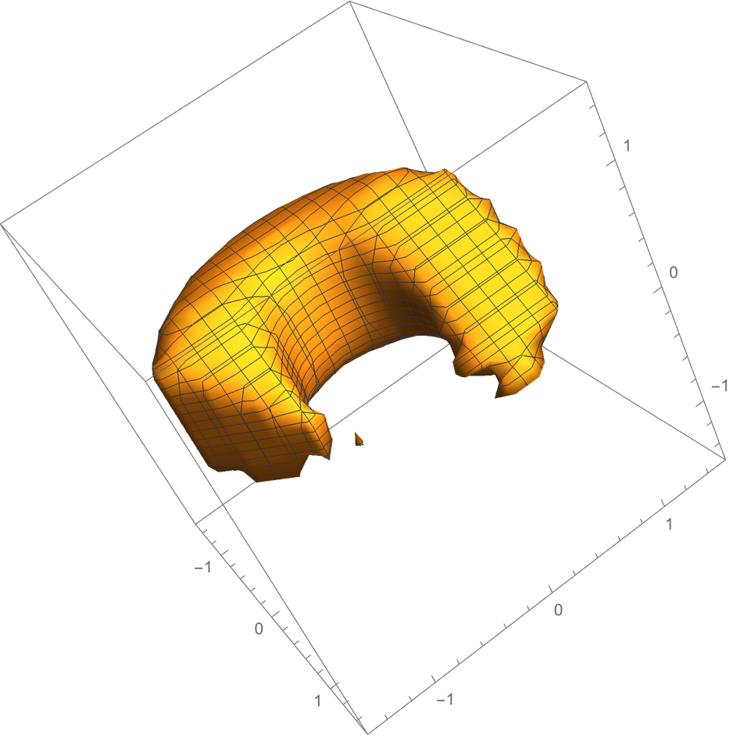
Volume Calculation
A partially eaten donut
$${\left(1-\sqrt{x^{2}+y^{2}}\right)}^{2}+z^{4}<0.2\text{and}x-y<.9\text{and}x+z<0.1\text{and}x+y<1.8$$

Slide 25
Volume Calculation
Monte Carlo:
  Select random points in the box -1.5<x<1.5, -1.5<y<1.5, -1.5<z<1.5.
  Check whether they are inside the donut
  Count over total number is approximately area of donut over area of box (which is 9).

Slide 26
Volume Calculation
A partially eaten donut
$${\left(1-\sqrt{x^{2}+y^{2}}\right)}^{2}+z^{4}<0.2\text{and}x-y<.9\text{and}x+z<0.1\text{and}x+y<1.8$$
import random
import math
N = int(input("Give the number of random points: "))
count = 0
for _ in range(N):
x = random.uniform(-1.5,1.5)
y = random.uniform(-1.5,1.5)
z = random.uniform(-1.5,1.5)
if (1-math.sqrt(x**2+y**2))**2+z**4<0.2 and x-y<0.9 and x+z<0.1 and x+y<1.8:
count += 1
print("The area is approximately", count*27/N)

Slide 27
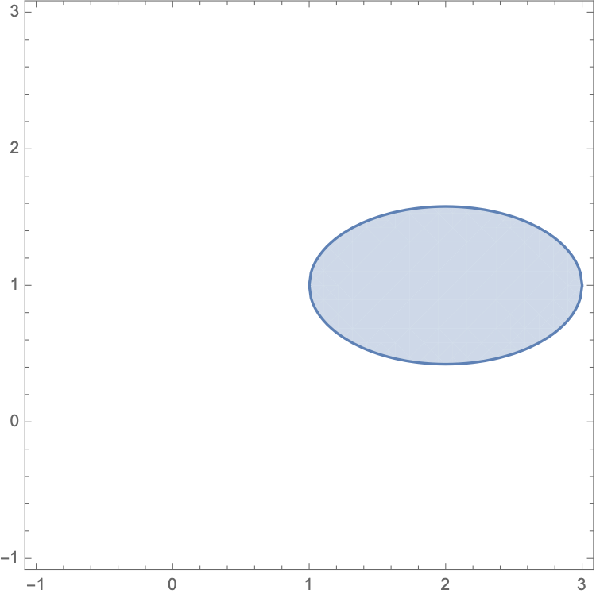
Additional Exercises
Find the area of
      Hint: First determine maximum and minimum values for x and y

Slide 28
Loops

Slide 29
Loops
Python does not use indices in for loops
animals = ['bird', 'dog', 'cat']
for animal in animals:
print(f'I have a {animal})

Slide 30
Loops
If we need indices in Python, we can use enumerate
enumerate returns an enumerate object which is an iterator that allows us to use a for loop
You can even change the "index"
colors = ['blue', 'yellow', 'red', 'green']
for i, color in enumerate(colors):
print(i, color)
for i, color in enumerate(colors, start = 1):

Slide 31
Loops
Dictionaries:
  The for loop takes the keys
animals = {'dog' : 3, 'cat' : 5, 'bird' : 1, 'hamster': 2}
for animal in animals:
print(f'I have {animals[animal]} {animal}(s)')

Slide 32
Loops
Dictionaries:
  We can avoid the bracket notation using items
  items returns an items object, but that is not important to us
animals = {'dog' : 3, 'cat' : 5, 'bird' : 1, 'hamster': 2}
for animal, count in animals.items():
print(f'I have {count} {animal}(s)')

Slide 33
Comprehension
Thomas Schwarz, SJ
Marquette University

Slide 34
Programming Styles
Styles of Programming
  Imperative Programming:
    Describe in detail how computation proceeds
    Basically, change states of variables
    This is what we practiced up till now

Slide 35
Programming Styles
Functional Programming
  Define functions
    Specify program behavior by executing nested functions
    Pure functional programming: No variables that capture a state
  Advantage: Easier to prove programming correctness

Slide 36
Programming Styles
Declarative Programming
  Specify what a program should do
    System figures out how to do it.
    Example 1: Prolog (Classic AI programming language)
      Specify rules in Prolog:
        animal(X) :- cat(X) means every cat is an animal
        ?- cat(tom). means that tom is a cat
      You can ask about the world defined by these rules
        ?- animal(X). asks for what things are animals
      Prolog consists of rules and base facts, then on its own finds out other facts.

Slide 37
Programming Styles
Declarative Programming:
  Example 2: SQL — Database Language
    Database consists of relations stored in various tables
    Example:
Marquette_ID | First_Name | Family_Name | Address
123123007 | David | Roy | 1984 31st Street, Milwaukee, WI 54321
97007007 | Thomas | Schwarz | 4821 Wisconsin Ave, Milwaukee, WI 54213
14309873 | Joseph | Cuelho | 9821 12th Avenue, Milwaukee, WI 54321
90874132 | Donald | Drumpf | 321 Pennsylvania Ave, Madison, WI 32451

Slide 38
Programming Styles
Declarative Programming:
  Example SQL:
    SQL statement describes all combinations of record pieces
    SELECT first_name, family_name FROM addresses, classes
    WHERE classes.name = “COSC1010” and classes.role = “instructor” and classes.id = addresses.id

Slide 39
Programming Styles
Declarative Programming:
  Example SQL:
    SQL statement describes all combinations of record pieces
    How the database engine performs the query is not specified
    In fact, for complicated queries, the database will try out several ways before selecting the actual algorithms

Slide 40
Programming Styles
Object-Oriented Programming
  Program defined various objects
    Objects have data and methods
      E.g. Marquette Persons have IDs, names, addresses, …
      Classes have lists of participants
  We will learn Object-Oriented (OO) programming in this class

Slide 41
Comprehension
List comprehension is used in functional programming but it becomes handy
  We define a list with a for clause within the brackets that define the list.
  Here are two ways to construct a list consisting of squares
lista = []
for i in range(100):
  lista.append(i**2)
lista = [i**2 for i in range(100)]

Slide 42
Comprehension
output expression
generator
expression
variable
list
(or list-like expression)

Slide 43
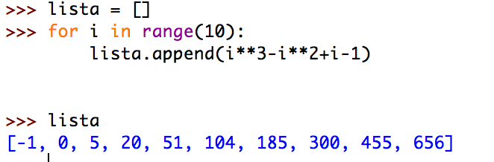
Self Test
The following code fragment defines a list of elements
Use list comprehension in order to generate the same list
    Use the interactive window in IDLE

Slide 44
Self Test
Pause the presentation until you have solved the problem

Slide 45
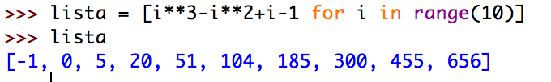
Self Test Solution

Slide 46
Comprehension
List comprehension can add an if-condition
  Result is now all even squares.

Slide 47

Comprehension
List comprehension can be quite involved
  Remember that we can check for types of variables
  We use the built-in function isinstance( )
  Example: is True
  Application to list comprehension: Squaring the elements of a list (a_list) that are integers
isinstance(345, int)

Slide 48
Comprehension
We can nest comprehensions
A list of all composite numbers between 2 and 100.
  A composite number is a product of two integers i and j that are larger than 1.
  However, the result contains many repeated numbers
[i*j for i in range(2,51) for j in range(2,101) if i*j < 100]
[4, 6, 8, 10, 12, 14, 16, 18, 20, 22, 24, 26, 28, 30, 32, 34, 36, 38, 40, 42, 44, 46, 48, 50, 52, 54, 56, 58, 60, 62, 64, 66, 68, 70, 72, 74, 76, 78, 80, 82, 84, 86, 88, 90, 92, 94, 96, 98, 6, 9, 12, 15, 18, 21, 24, 27, 30, 33, 36, 39, 42, 45, 48, 51, 54, 57, 60, 63, 66, 69, 72, 75, 78, 81, 84, 87, 90, 93, 96, 99, 8, 12, 16, 20, 24, 28, 32, 36, 40, 44, 48, 52, 56, 60, 64, 68, 72, 76, 80, 84, 88, 92, 96, 10, 15, 20, 25, 30, 35, 40, 45, 50, 55, 60, 65, 70, 75, 80, 85, 90, 95, 12, 18, 24, 30, 36, 42, 48, 54, 60, 66, 72, 78, 84, 90, 96, 14, 21, 28, 35, 42, 49, 56, 63, 70, 77, 84, 91, 98, 16, 24, 32, 40, 48, 56, 64, 72, 80, 88, 96, 18, 27, 36, 45, 54, 63, 72, 81, 90, 99, 20, 30, 40, 50, 60, 70, 80, 90, 22, 33, 44, 55, 66, 77, 88, 99, 24, 36, 48, 60, 72, 84, 96, 26, 39, 52, 65, 78, 91, 28, 42, 56, 70, 84, 98, 30, 45, 60, 75, 90, 32, 48, 64, 80, 96, 34, 51, 68, 85, 36, 54, 72, 90, 38, 57, 76, 95, 40, 60, 80, 42, 63, 84, 44, 66, 88, 46, 69, 92, 48, 72, 96, 50, 75, 52, 78, 54, 81, 56, 84, 58, 87, 60, 90, 62, 93, 64, 96, 66, 99, 68, 70, 72, 74, 76, 78, 80, 82, 84, 86, 88, 90, 92, 94, 96, 98]

Slide 49
Comprehensions
Luckily, we can use a set instead:
The difference is just curly brackets instead of rectangular brackets
The result is now simpler:
{i*j for i in range(2,51) for j in range(2,51) if i*j < 100}
{4, 6, 8, 9, 10, 12, 14, 15, 16, 18, 20, 21, 22, 24, 25, 26, 27, 28, 30, 32, 33, 34, 35, 36, 38, 39, 40, 42, 44, 45, 46, 48, 49, 50, 51, 52, 54, 55, 56, 57, 58, 60, 62, 63, 64, 65, 66, 68, 69, 70, 72, 74, 75, 76, 77, 78, 80, 81, 82, 84, 85, 86, 87, 88, 90, 91, 92, 93, 94, 95, 96, 98, 99}

Slide 50
Comprehensions
We can now get all of the prime numbers between 2 and 100 by using this set, using comprehension on top of comprehension
This is cool but will not win any price for clarity
You can make it more comprehensible if you define a set of composite numbers before using it
{i for i in range(2,100) if i not in
{i*j for i in range(2,51) for j in range(2,51) if i*j < 100}}

Slide 51
Self Test
Use the previous example to generate a set of all numbers between 1 and 100 (included) that are not squares

Slide 52
Self Test Solution
seta = {i for i in range(1,101) if i not in {i*i for i in range(10)}}

Slide 53
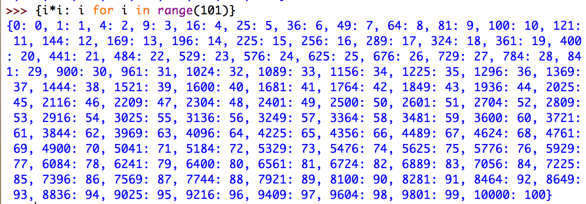
Comprehensions
You can also use comprehension on dictionaries
Here is how you create a dictionary that associates integers up to 100*100 to their square root
  {i*i: i for i in range(101)}

Slide 54


Comprehensions
And here is how you can try to “invert” a dictionary where the roles of keys and values are swapped
This one works well, because the values are different for different keys
And this one inverts with some arbitrariness
drev = {d[key]:key for key in d}

Slide 55
Self Test
You are given a function func that takes one integer argument
You want to create a memoization dictionary that associates i for i in range(100) with func(i)

Slide 56
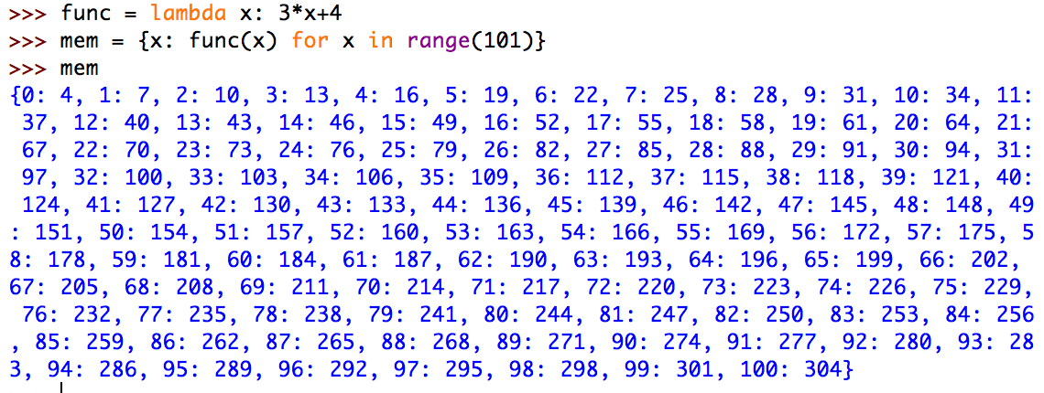
Self Test Answer
mem_func = {i: func(i) for i in range(101)}
func = lambda x: 3*x+4
gives

Slide 57
Map, Filter

Slide 58

Map
Map allows you to apply a function to all elements of a list
Example:
Why the list? map returns an iterator (so that it does not waste memory on values that are not used)
func = lambda x: x+3
list(map(func, [2,3,4])

Slide 59
Filter
You filter a list by applying a condition
The result is the list formed by all elements that satisfy the condition
  You need to have a boolean function, i.e. a function that returns True or False
  Here is an example of such a function:
    Returns True if x is divisible by 2
    Returns False otherwise
    x%2 is zero if and only if x is even
lambda x: x%2==0

Slide 60
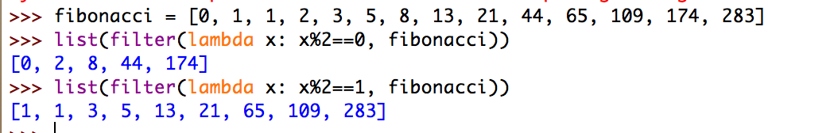
Filter
The function filter(function, sequence) return an iterable of all elements in the sequence t that render the function True.

Slide 61
Comprehension in Action
Python

Slide 62
Getting the listing of a directory
Task: Generate a listing of all files in a directory that end in “.py”
  Tool: import the os module and use listdir
[filename for filename in os.listdir(directoryname)
if filename.endswith(".py")]

Slide 63
Creating sub-directories
Task: We want to create a sub-dictionary of a dictionary where the keys are restricted by a condition
  Use dictionary comprehension
def evenkeys(dictionary):
return { i:dictionary[i] for i in dictionary if i%2==0}

Slide 64
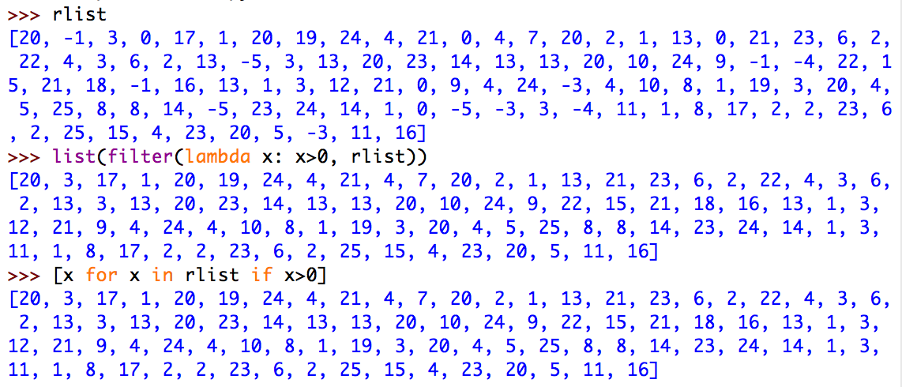
Filtering a list
We want to filter a list using a criterion
  We can use the filter function
  We can use list comprehension, which is often simpler
  Example: Only display the positive elements of this large list

Slide 65
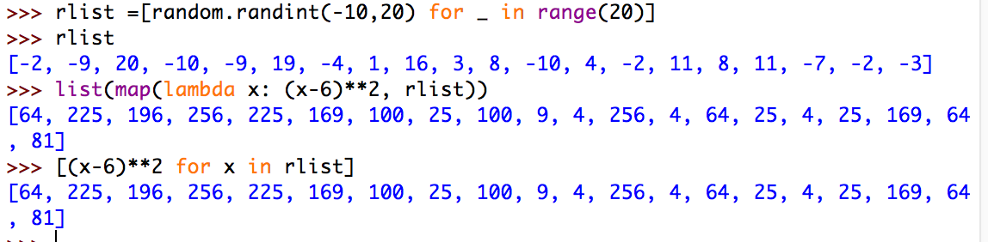
Mapping a list
We want to apply a function to all elements in a list

Slide 66
Zip

Slide 67
Zip
Often we have related data in a number of lists
  Example: list of student names, list of grades, list of high school
    [“Frankieboy”, “Violet”, “Kumar”, “Dshenghis”]
    [“D”, “A”, “B”, “C”]
    [“MPS1”, “MH”, “MH”, “MPS59”]
  Zipping will create a zip object that generates the tuples (“Frankieboy”, “D”, “MPS1”), (“Violet”,“A”,”MH”), (“Kumar”, “B”, “MH”), (“Dshenghis”,”C”, “MPS59”)

Slide 68
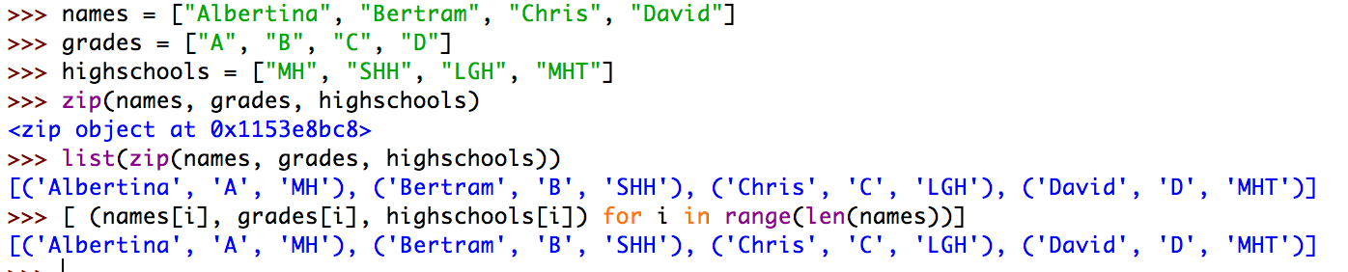
Zip
We can reach the same effect with list comprehension, but since we cannot enumerate in parallel through several iterables, we need to use indices.

Slide 69
Zip
What happens if you give zip iterables of different length
  E.g. a list of 5, a list of 4 and a list of 3 elements?
  The result is a zip object of length the minimum of the lengths.

Slide 70
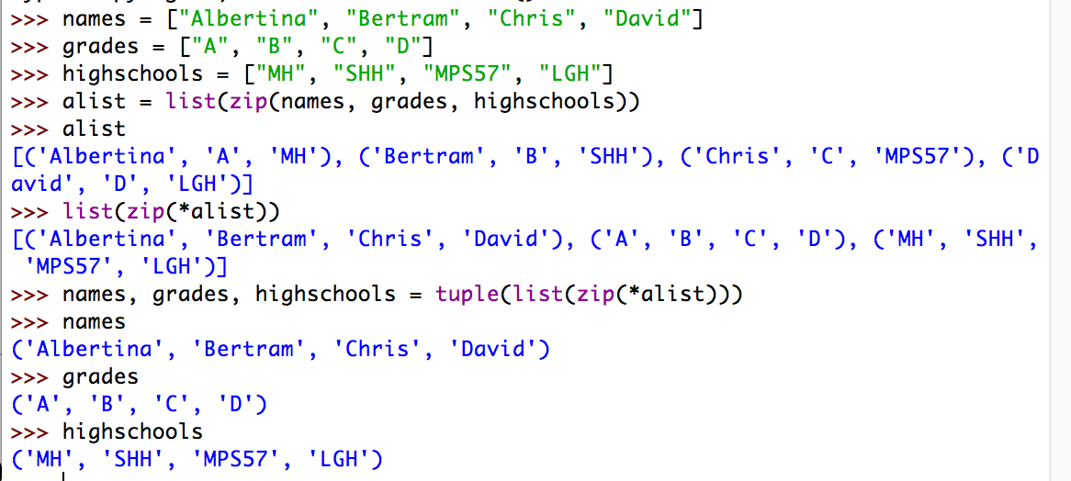
Zip
Undoing a zip:
  If you make a list alist out of a zip object, you can break it apart with the zip(*alist) command

Slide 71
Exercises

Slide 72
Exercise
Use list comprehension:
  Flatten a matrix
    Example: [ [1, 2, 3], [4, 5, 6], [7, 8, 9]] —> [1,2,3,4,5,6,7,8,9]

Slide 73
Solution
Loop Solution:
  Using extend
  But this cannot be translated
def flatten1(matrix):
result = []
for row in matrix:
result.extend(row)
return result

Slide 74
Solution
A loop solution that can be translated
This is not english, but Python: for row in matrix for item in row
def flatten2(matrix):
result = []
for row in matrix:
for item in row:
result.append(item)
return result

Slide 75
Solution
Now we can do comprehension with the same order of for loops
def flatten3(matrix):
return [ item for row in matrix for item in row]

Slide 76
Exercise
Given a list, subtract its reverse from itself
  [10, 7, 5, 4, 2, 1] —> [10-1, 7-2, 5-4, 4-5, 2-7, 1-10]

Slide 77
Solution
Loop version:
  Use a slice to get the reverse of the list
def clw(lista):
result = []
for first, second in zip(lista, lista[::-1]):
result.append(first-second)
return result

Slide 78
Solution
Translated into comprehension
def clwc(lista):
return [first - sec for first, sec in zip(lista, lista[::-1])]

Slide 79
Exercise
Given a matrix, calculate its negative
[ [1,2,4],
[2,5,8],
[3,3,3],
[5,4,2]
]

Slide 80
Solution
A double loop
def neg1(matrix):
result = []
for row in matrix:
new_row = [ ]
for item in row:
new_row.append(-item)
result.append(new_row)
return result

Slide 81
Solution
A single loop with one interior comprehension
def neg2(matrix):
result = []
for row in matrix:
result.append([-item for item in row])
return result

Slide 82
Solution
A double comprehension (which shows that you might not want to overdo comprehension)
def neg3(matrix):
return [ [-item for item in row] for row in matrix]

Slide 83
Generator Comprehension
We can use comprehension on generators
Called generator expressions
  Generators are defined with round parentheses
squares = (n**2 for n in range(1, 100))
>>> next(squares)
1
>>> next(squares)
4
>>> next(squares)
9
>>> next(squares)
16
>>> next(squares)
Traceback (most recent call last):
File "<pyshell#36>", line 1, in <module>
next(squares)
StopIteration

Slide 84
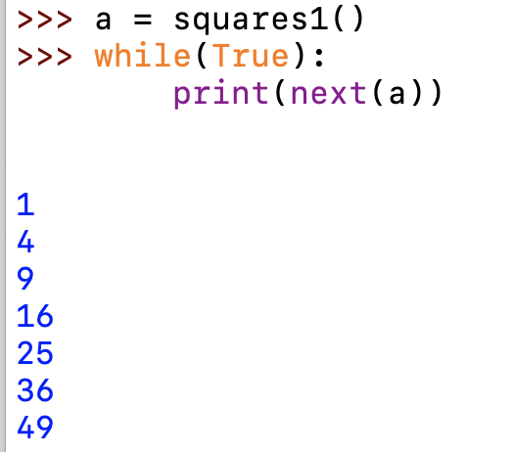
Generator Comprehension
The generator expression can be called with next( )
  However, what if we want an infinite generator?
    Could define a generator the old fashioned way
def squares1():
n=0
while True:
n+=1
yield(n**2)

Slide 85
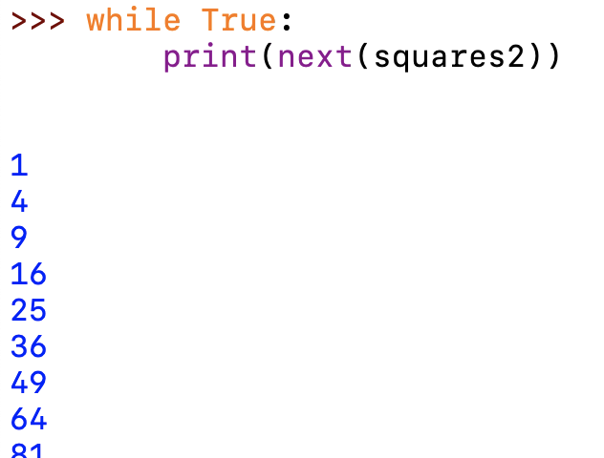
Generator Comprehension
Or use generators defined in itertools
import itertools
squares2 = (n**2 for n in itertools.count(1,1))

Slide 86
Generator Comprehension
WHY?
  Assume you want to process a huge set of data
  You need to create intermediate results
  If you use lists, they eat up memory
  If you use generators, they don't

Slide 87
And now for something completely different

Slide 88
Copying Data Structures
Copying and assignment are two different things

Slide 89
Copying Data Structures
Copying and assignment are two different things
  We have an object a
  We assign a to b
  But the two objects are still linked:
a = set(1, 2, “one”)

Slide 90
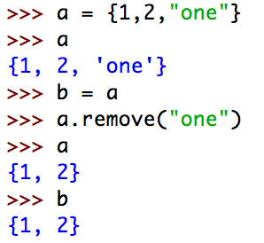
Copying Data Structures
Copying and assignment are two different things
a = set([1, 2, "one"])
print(a)
b = a
print(b)
# Now we change set a
a.remove("one")
# Which also changes set b
print(b)

Slide 91


Copying Data Structures
Copying and assignment are two different things
  Here is what happens
    In Python, names point to objects
    Assigning adds a name to the same object
a
{1, 2, “one”}
a
{1, 2, “one”}
b

Slide 92
Copying Data Structures
Copying and assignment are two different things
  Since there is only one object, I can manipulate the object through either name
a
{1, 2, “one”}
b

Slide 93
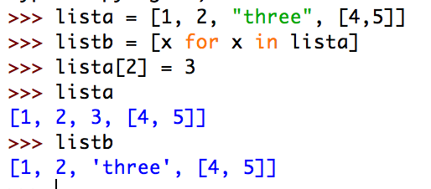
Copying Data Structures
Copying and assignment are two different things
  If I want to copy, I need to do so explicitly
Now changes to one do not change the other!
lista = [1, 2, "three", [4,5]]
listb = [x for x in lista]
lista[2] = 3
print(lista)
print(listb)

Slide 94
Copying Data Structures
Copying and assignment are two different things
  One can use slices to copy lists
listb = lista[0:4]

Slide 95
Copying Data Structures
Copying becomes difficult if we have compound objects
    E.g.: A list which contains lists, sets, …
  Shallow copy:
    Resulting copies have shared elements

Slide 96
Copying Data Structures
Example: A matrix as a list of rows
  Create zero row by multiplying list with an integer
One might think it creates a structure like
  which is not entirely false
matrix = 3*[ 4*[0]]
[ [0, 0, 0, 0],
[0, 0, 0, 0],
[0, 0, 0, 0]]

Slide 97
Copying Data Structures
We can get the elements as we should
And we can set elements
But now we see that we got three times the same row
matrix = 3*[ 4*[0]]
print(matrix[3][2])
matrix = 3*[ 4*[0]]
matrix[3][2] = 5

Slide 98

Copying Data Structures
matrix = 3*[ 4*[0] ]
print(matrix)
matrix[2][3] = 5
print(matrix)
RESTART: /Users/tjschwarzsj/Google Drive/AATeaching/Python/Programs/copying.py
[[0, 0, 0, 0], [0, 0, 0, 0], [0, 0, 0, 0]]
[[0, 0, 0, 5], [0, 0, 0, 5], [0, 0, 0, 5]]

Slide 99
Copying Data Structures
How can we do this:
  Need to construct the zero rows independently
    Use e.g. list comprehension
matrix = [ [0 for _ in range(4)] for i in range(3)]

Slide 100
Copying Data Structures
Shallow copy: Assume we have
We create a shallow copy by
But here is what is happening
lista = [1, 2, [3,4,5]]
lista = [1, 2, [3, 4, 5]]
listb = lista[:]

Slide 101

lista
[1,2, ? ]
listb
[1,2, ? ]
{1, 2, “one”}
lista = [1, 2, [3, 4, 5]]
listb = lista[:]
The two lists still share a component. We can change this
component in one list and change it in the other one as well.

Slide 102
Copying Data Structures
We have two copies of the list, but the third element are two different names for the same object
lista
[1,2, ? ]
listb
[1,2, ? ]
{1, 2, “one”}
lista = [1, 2, [3, 4, 5]]
listb = lista[:]

Slide 103

Copying Data Structures
In consequence, I can alter the same element in the list which is element number 2
  prints out
lista = [1, 2, [3, 4, 5]]
listb = lista[:]
lista[2][0] = 6
print(lista)
print(listb)
[1, 2, [6, 4, 5]]
[1, 2, [6, 4, 5]]

Slide 104
Copying Data Structures
I need to use a deep copy
  Easiest:
    Use the module copy
      Use copy.deepcopy(object) for deep copying
      Use copy.copy(object) for shallow copying

Slide 105
Copying Data Structures
This is a famous Python gotcha
    Behavior is not intuitive.

