Slide 1
Minimization and Curve Fitting with SciPy
Thomas Schwarz, SJ

Slide 2
Why is this important
Mathematical optimization underlies many machine learning algorithms
Need to know how to do deal with exceptionally circumstances
Provides techniques for data exploration

Slide 3
Curve Fitting
Want to construct a curve (mathematical function) that best fits a series of data points
First, need to select a model: what type of curve?
Then, need to determine how we measure fit
Examples:
y-values: $L(y,\overset{̂}{y})=\overset{n}{\underset{ν=1}{∑}}(y_{i}-\overset{̂}{y}(i))^{2}→min$
orthogonal least squares

Slide 4
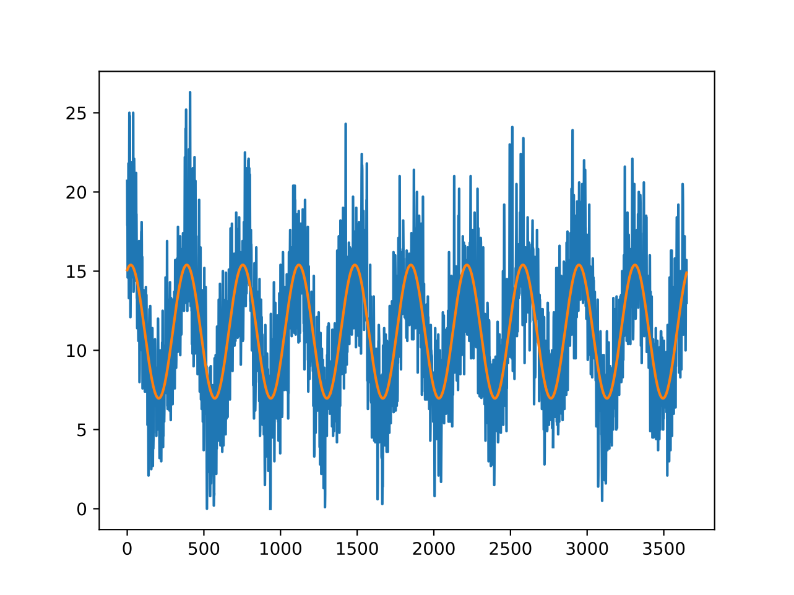
Curve Fitting
Example: Fit a sine curve to meteorological data
Minimum daily temperatures in Melbourne
$$f_{α,β,γ,δ}(t)=α+βsin(γt+δ)$$

Slide 5
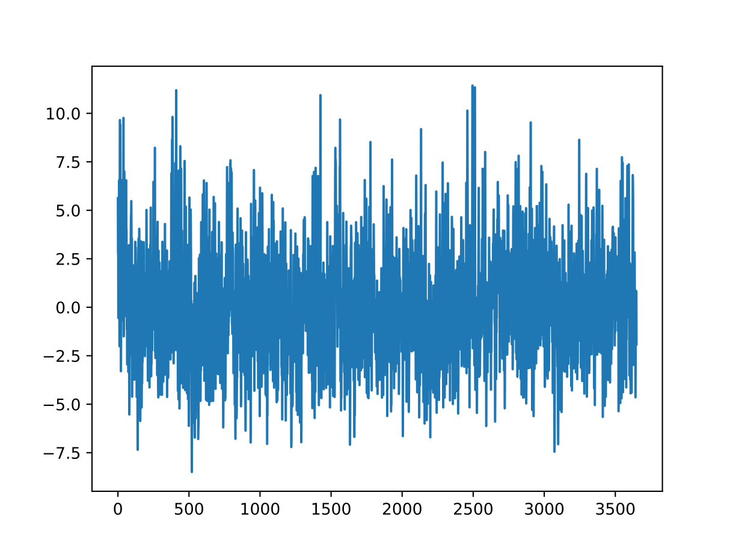
Curve Fitting
The data after removing the sine curve shows a seemingly random time series with just a little bit of seasonality

Slide 6
Curve Fitting
We can do better by including a cos (which is just a second sine)
$$f_{α,β,γ,δ,ϵ}(t)=α+βsin(γt+δ)+ϵcos(γt+δ)$$

Slide 7
Curve Fitting
Residual:
Looks slightly better?

Slide 8
Curve Fitting
Find the parameters that minimize the squared difference between function and model
This is a minimization problem
Too general a model:
Optimization can be very difficult and lengthy
Overfit: The result matches the test set, but not the future
Not general a model
Fit is not good, therefore no strong predictions either

Slide 9
Program
Need to learn about minimization
One dimensional methods: Minimization along a line
Gradient Descent Methods
Minimization for Sums of Squares
Curve-fitting

Slide 10
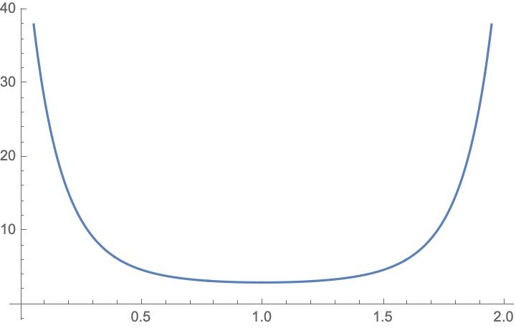
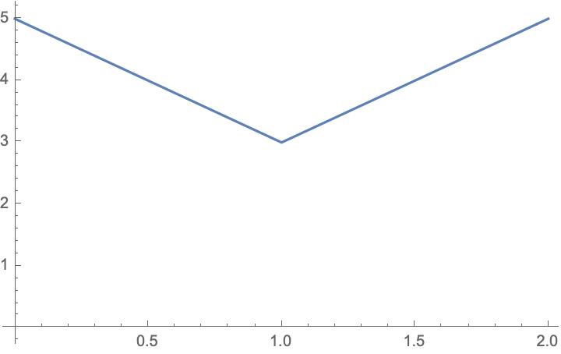
Minimization
Functions can be smooth and non-smooth

Slide 11
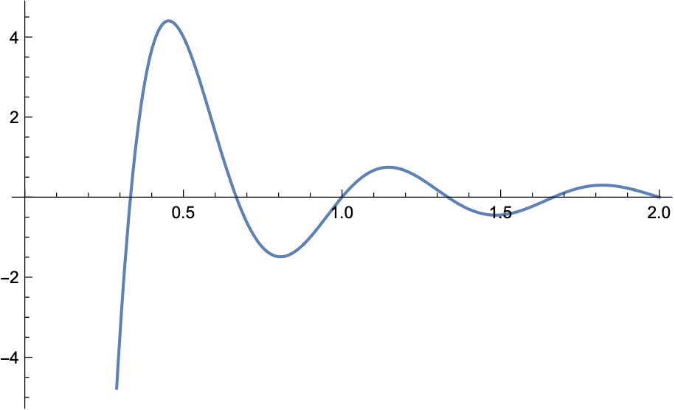
Minimization
Given a function $R^{n}→R$
Find a minimum
Potential problems:
Minimum might not exist
Minimum might be local

Slide 12
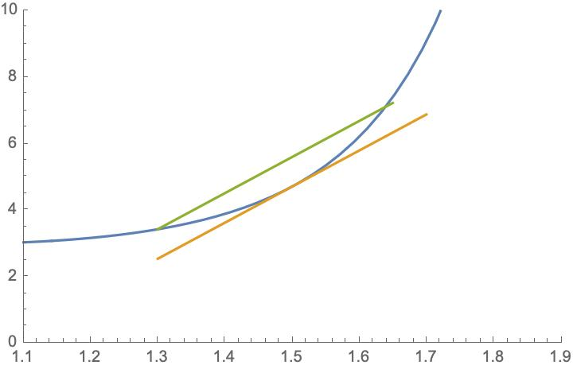
Minimization
Convex functions: For $t∈[0,1]:$
$f(\overset{⃗}{a}+t(\overset{⃗}{b}-\overset{⃗}{a}))≤f(\overset{⃗}{a})+t(f(\overset{⃗}{b})-f(\overset{⃗}{a})$
Tends to be easy
Relative minimum is unique

Slide 13
Scalar Minimization
Minimum implies derivatives vanish
Can use the derivatives to guide us to the minimum
Can be done by using bisection:
Find two points $a,b$ such that $f(a)$ and $f(b)$ have different signs
Then there is a zero between $a,b$
Can evaluate function at $\frac{a+b}{2}$
Can be done using the secant method
Find two points $a,b$ such that $f(a)≠f(b)$, but both values have the same sign
Use the slope in order to guess a zero
Brent's method combines both with quadratic interpolation

Slide 14
Scalar Minimization
Brent's method is the default for scipy:
Optimizing a curvy function
from scipy import optimize
import numpy as np
from matplotlib import pyplot as plt
def f2(x):
return -np.exp(-(x-.9)**2+0.1*x+np.cos(10*x))

Slide 15
Scalar Minimization
Show:
def show(f):
x = np.linspace(0,2,251)
y = f(x)
plt.plot(x,y)
plt.show()

Slide 16
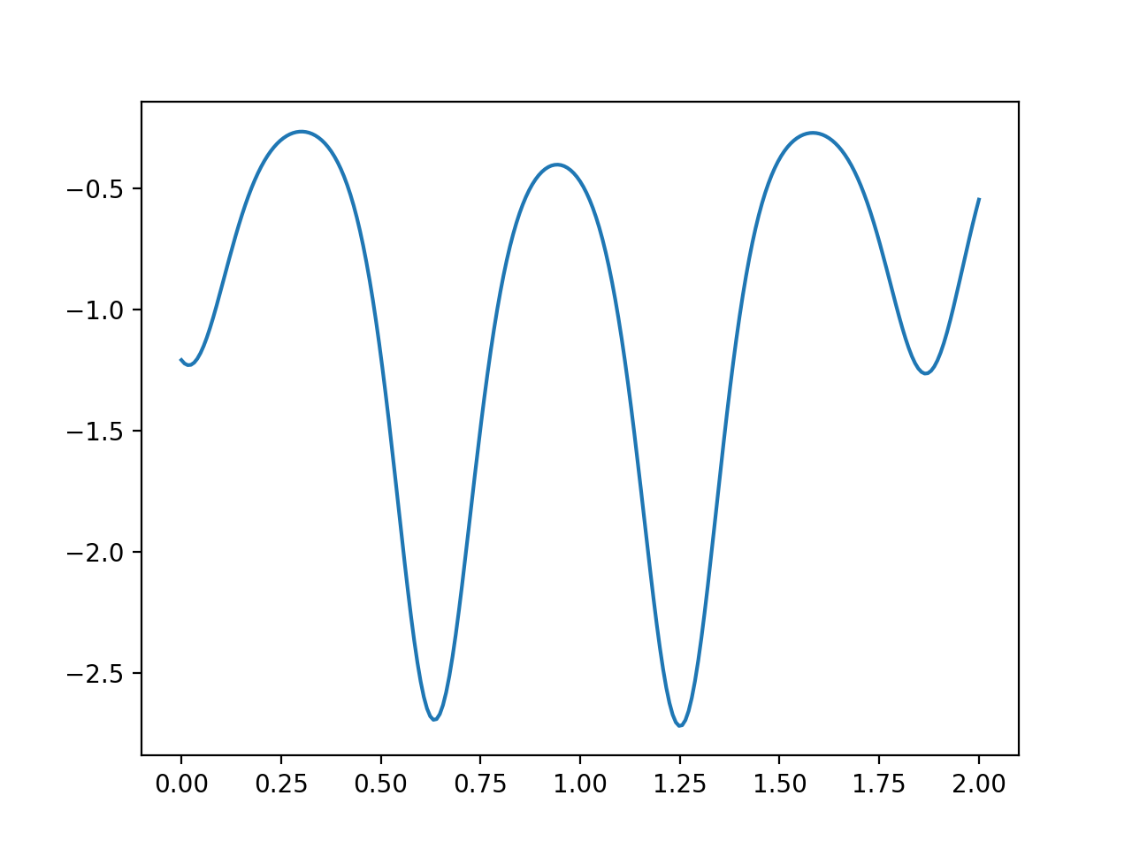
Scalar Minimization

Slide 17
Scalar Minimization
Brent’s method is the default
from scipy import optimize
result = optimize.minimize_scalar(f2)
>>> result>>> result
fun: -2.7191461357325406
message: 'Solution found.'
nfev: 12
status: 0
success: True
x: 1.2506211193351628

Slide 18
Scalar Minimization
Bounded Brent method
result = optimize.minimize_scalar(f2, bounds=(0,2), method='bounded')
>>> result
fun: -2.7191461357325406
message: 'Solution found.'
nfev: 12
status: 0
success: True
x: 1.2506211193351628

Slide 19
Minimization
Smooth functions are (usually) easier than non-smooth functions
Exception: Linear systems with constraints —> Linear Programming

Slide 20
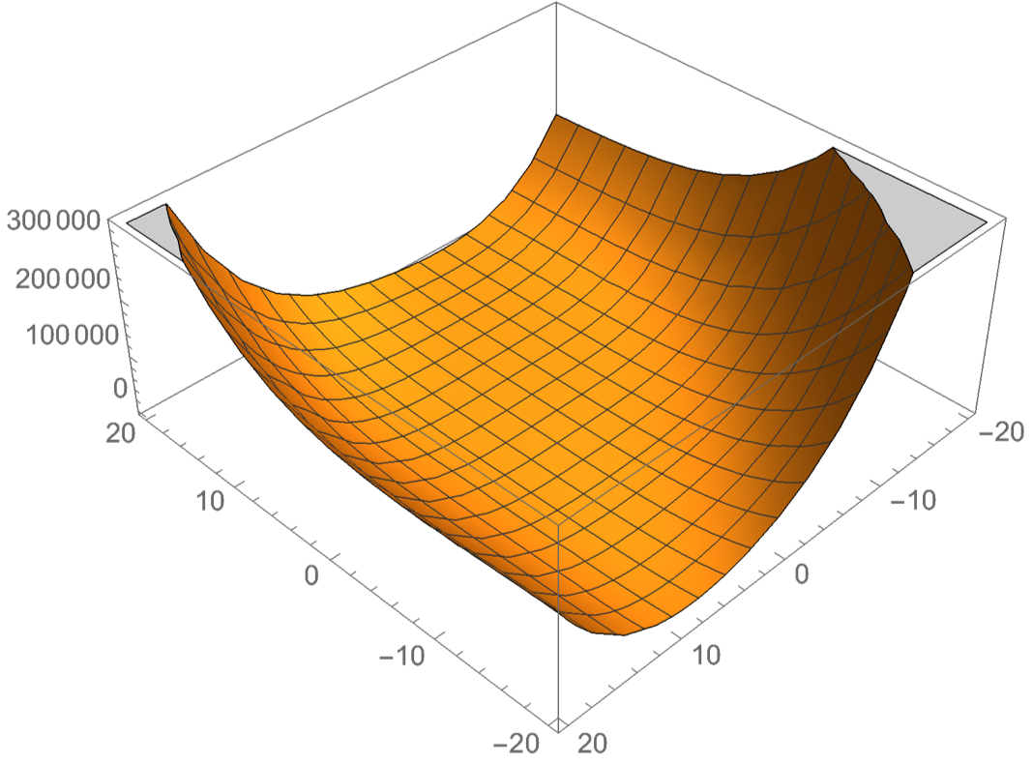
Minimization
Minimization is easier for convex functions
Take a line segment $[a,b]$
Values are higher on the end points
Than on points in between

Slide 21
Minimization
Gradient $∇f=(\frac{df}{dx_{1}},\frac{df}{dx_{2}},\frac{df}{dx_{3}},…,\frac{df}{dx_{n}})$ is always in the direction of greatest increase of a function

Slide 22
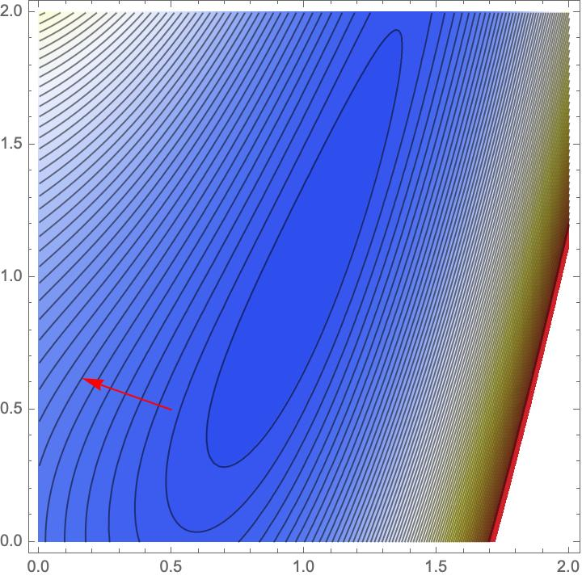
Minimization
Example: Rosenbrock Function
$$f(x,y)=1.2(y-x^{2})^{2}+1.1(1-x)^{2}$$
Gradient is $(-2.2(1-x)-4.8x(-x^{2}+y),2.4(-x^{2}+y)$
Contour graph is

Slide 23
Minimization
Descent Methods:
Choose a starting point $x_{0}∈R^{n}$
If $∥∇f(x_{k})∥<ϵ$ declare victory and return $x_{k}$
Pick a search direction $d_{k}∈R^{n}$ s.t. $∇f(x_{k})⋅d_{k}<0$
Choose a step size $α_{k}>0$ s.t. $f(x_{k}+α_{k}d_{k})<f(x_{k})$
Set $x_{k+1}=x_{k}+α_{k}d_{k}$. Go to 2

Slide 24
Minimization
This algorithm leaves two things open:
Selecting the step length $α_{k}$
Selecting the search direction $d_{k}$

Slide 25
Minimization
Finding minimum along line:
Finding minimum of function $t↦f(x_{k}+td_{k})$
Use derivative is usually dangerous:
Often function too flat
Better bracketing

Slide 26
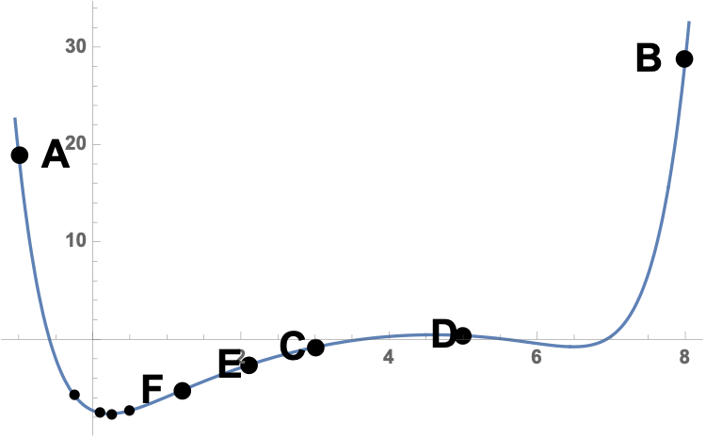
Minimization
Can use bracketing
Three points A < C < B such that $f(A)>f(C)<f(B)$
Thus, minimum guaranteed to exist
Now find another point D between A and C or C and B
Get a new bracket

Slide 27
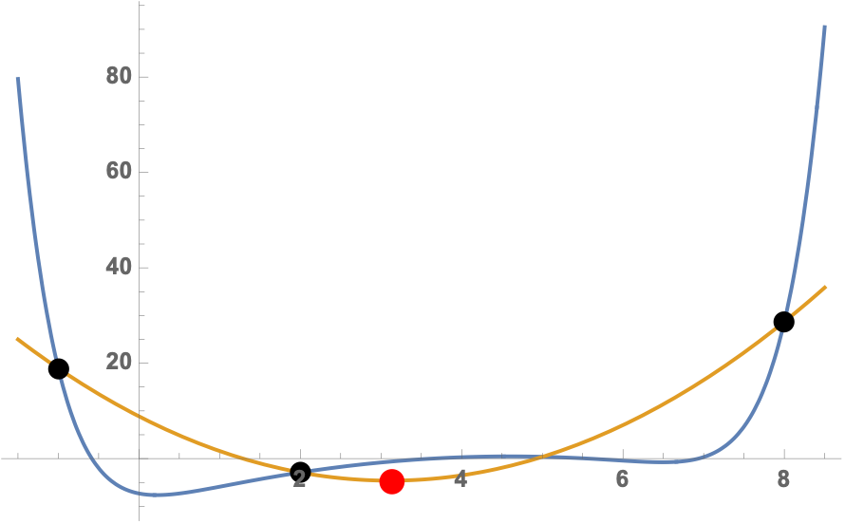
Minimization
One possibility: golden ratio: $\frac{|A-C|}{|A-B|}=\frac{|B-C|}{|A-C|}$
Other possibility: parabolic approximation
Or a combination of both

Slide 28
Minimization
Determining direction:
Can use coordinates

Slide 29
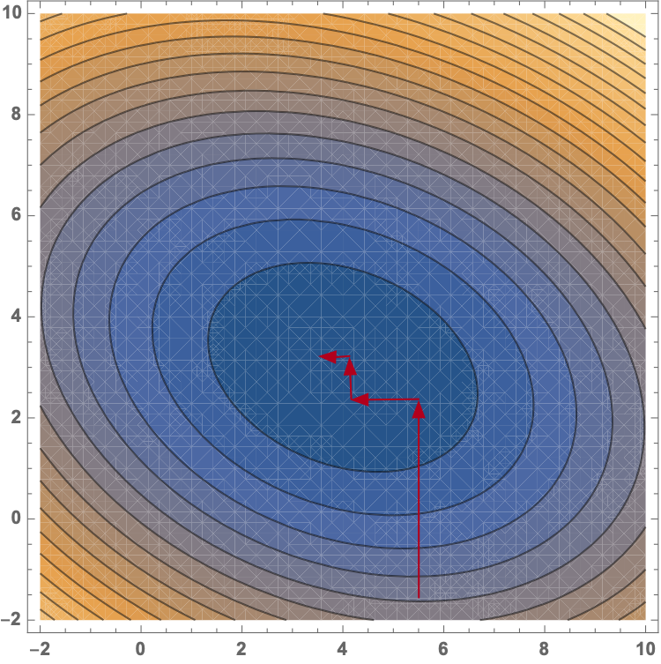
Minimization

Slide 30
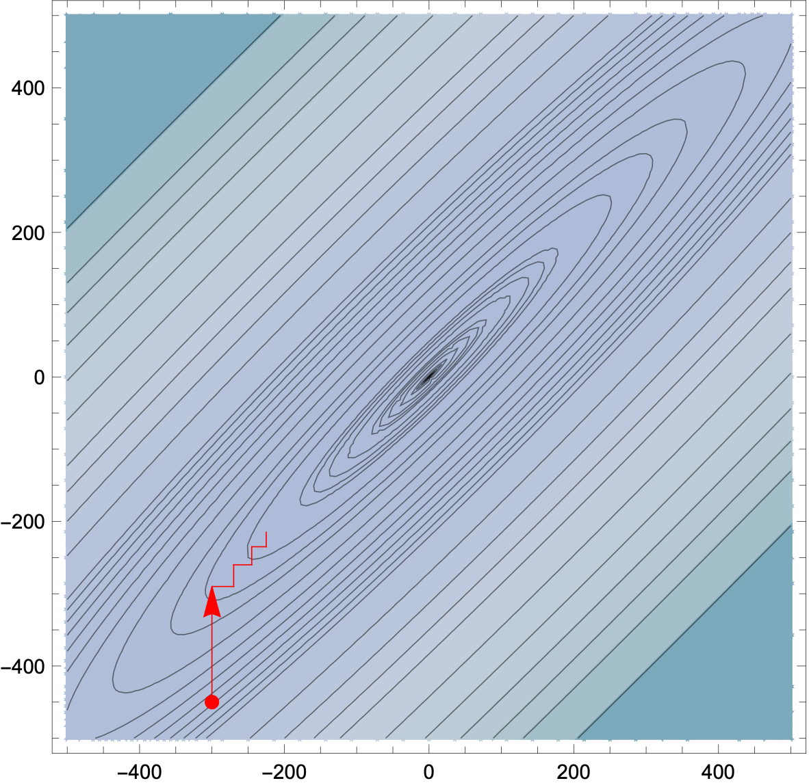
Minimization
Using coordinates
Make little progress per iteration

Slide 31
Minimization
Better use orthogonal directions:
otherwise we partially undo the previous steps
Possibilities
Canonical Directions
Steepest Descent (Cauchy)
badly affected by round-off errors and subject to zigzagging
Powell: Change set of directions every so often

Slide 32
Minimization
Selecting the step length
Finding the best step length is laborious
Often do better by guessing
Many machine learning algorithms use a steadily declining $α$
Trying out several guesses

Slide 33
Minimization
Newton Methods:
Repeatedly replace condition$∇f(x)=0$ by a sequence of linear problems
Newton-Raphson:
apply exact Newton steps
possibly does not converge
works best for convex functions
Use linear-search descent, then switch to Newton

Slide 34
Minimization
Numerical minimization of a cost function of the parameters
Various minimization methods
Line methods
Minimize along a particular line

Slide 35
Minimization
Instead of line searches: Trust Region Methods
Idea: for each iteration: replace $f$ with a quadratic model function
Quadratic model function approximates $f$ in the "trust region"
And quadratic model functions are easy to minimize!
The proposed solution can or cannot have a smaller value for $f$
Many different ways of defining the model

Slide 36
Minimization with SciPy
Can use a number of method for finding a local minimum
Some need the Jacobian and some need in addition the Hessian
Can be calculated numerically but results are better with exact functions
Jacobian $J(f)=\frac{df}{dx}=(\frac{δf}{δx_{1}},\frac{δf}{δx_{2}},…,\frac{δf}{δx_{n}})$
Hessian $H(f)={\left(\begin{aligned}\frac{δ^{2}f}{δx_{i}δx_{j}}\end{aligned}\right)}_{i,j}$

Slide 37
Minimization with SciPy
Use scipy.optimize.minimize
Needs a function that is a one-dimensional np.array
Specify a starting point, options, and method

Slide 38
Minimization with SciPy
Importing the optimizer:
import numpy as np
from scipy.optimize import minimize

Slide 39
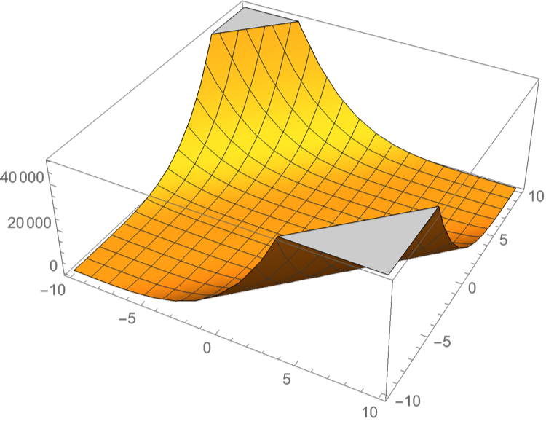
Minimization with SciPy
Defining a function to be minimized
Needs to be in "standard form", i.e. numpy array of one dimension
def func(x):
return np.sin(x[0]*x[1])+(x[0]+x[1]-1)**2+(x[0]-x[1]+1)**4

Slide 40
Minimization with SciPy
Sometimes need to give Jacobian
def jacob(x):
return np.array(
(4*(1+x[0]-x[1])**3 +
2*(x[0]+x[1]-1)+
x[1]*np.cos(x[0]*x[1]),
-4*(1+x[0]-x[1])**3 +
2*(x[0]+x[1]-1)+
x[0]*np.cos(x[0]*x[1])) )

Slide 41
Minimization with SciPy
We pick (5,5) as the starting point
res = minimize(func,
[5,5],
method = 'nelder-mead',
options = {'xatol': 1e-9, 'disp':True}
)
print(res.x)

Slide 42
Minimization with SciPy
Success: (but with lots of function evaluations)
Optimization terminated successfully.
Current function value: -0.295490
Iterations: 84
Function evaluations: 164
[-0.37249737 1.18821832]

Slide 43
Minimization with SciPy
res = minimize(func,
[5,5],
method = 'Newton-CG',
jac = jacob,
options = {'disp':True}
)
print(res.x)

Slide 44
Minimization with SciPy
Optimization terminated successfully.
Current function value: -0.295490
Iterations: 10
Function evaluations: 12
Gradient evaluations: 47
Hessian evaluations: 0
[-0.37249737 1.18821832]

Slide 45
Minimization with SciPy
res = minimize(func,
[5,5],
method = 'Powell',
options = {'disp':True}
)
print(res.x)

Slide 46
Minimization with SciPy
Optimization terminated successfully.
Current function value: -0.295490
Iterations: 5
Function evaluations: 139
[-0.37249969 1.18821518]

Slide 47
Minimization with SciPy
res = minimize(func,
[5,5],
method = 'BFGS',
options = {'disp':True}
)
print(res.x)

Slide 48
Minimization with SciPy
Optimization terminated successfully.
Current function value: -0.295490
Iterations: 15
Function evaluations: 84
Gradient evaluations: 21
[-0.37249848 1.18821848]

Slide 49
Least Square Optimization
For curve fitting, we want to optimize polynomials of degree 2 in several variables
Allows using special methods

Slide 50
Least Square Optimization
Want to minimize a sum of squares
$$f:R^{n}→R^{m}$$
$f(\overset{⃗}{x})=\frac{1}{2}\overset{m}{\underset{j=1}{∑}}r_{j}^{2}(\overset{⃗}{x})$
(Factor of 1/2 to make derivatives look nicer)

Slide 51
Least Square Optimization
With this special form, we can calculate the Jacobian of $(r_{1}(\overset{⃗}{x}),r_{2}(\overset{⃗}{x}),…,r_{m}(\overset{⃗}{x}))^{T}$ more easily
$J^{T}=\left(\begin{matrix}\frac{δr_{1}}{δx_{1}} & \frac{δr_{2}}{δx_{1}} & … & \frac{δr_{m}}{δx_{1}} \\ \frac{δr_{1}}{δx_{2}} & \frac{δr_{2}}{δx_{2}} & … & \frac{δr_{m}}{δx_{2}} \\ ⋮ & ⋮ & ⋱ & ⋮ \\ \frac{δr_{1}}{δx_{n}} & \frac{δr_{2}}{δx_{n}} & … & \frac{δr_{m}}{δx_{n}}\end{matrix}\right)=\left(\begin{aligned}\frac{δr_{j}}{δx_{i}}\end{aligned}\right)$

Slide 52
Least Square Optimization
Then
$$∇f(\overset{⃗}{x})=J(\overset{⃗}{x})^{T}r(x)$$
$$∇^{2}f(\overset{⃗}{x})=J(\overset{⃗}{x})^{T}J(\overset{⃗}{x})+\overset{m}{\underset{j=1}{∑}}r_{j}(\overset{⃗}{x})∇^{2}r_{j}(\overset{⃗}{x})$$

Slide 53
Least Square Optimization
Now we assume that $||r(\overset{⃗}{x})||$ is linear
Then $J$ is a constant
$$∇^{2}(r_{j})(\overset{⃗}{x})=0$$
Taylor expansion is
$$f(\overset{⃗}{x})=f(x_{0})+J(f(x))|_{{\overset{⃗}{x}}_{0}}(\overset{⃗}{x}-{\overset{⃗}{x}}_{0})+\frac{1}{2}(\overset{⃗}{x}-{\overset{⃗}{x}}_{0})^{T}H(f(\overset{⃗}{x})|_{{\overset{⃗}{x}}_{0}}(\overset{⃗}{x}-{\overset{⃗}{x}}_{0})+…$$
Taking derivatives gives
$$∇f(\overset{⃗}{x})=J^{T}(J\overset{⃗}{x}+\overset{⃗}{r})=0$$
at a minimum

Slide 54
Least Square Optimization
This means we can solve for the minimum since then$J^{T}J\overset{⃗}{x}=-J^{T}r(\overset{⃗}{x})$
and so we could solve $\overset{⃗}{x}=(J^{T}J)^{-1}J^{T}r$

Slide 55
Least Square Optimization
However, calculating the inverse is
computationally expensive
numerically unstable

Slide 56
Least Square Optimization
Can use
Cholesky factorization
QR factorisation
Singular value decomposition of
$$J^{T}J$$
which are all implemented in np.linalg

Slide 57
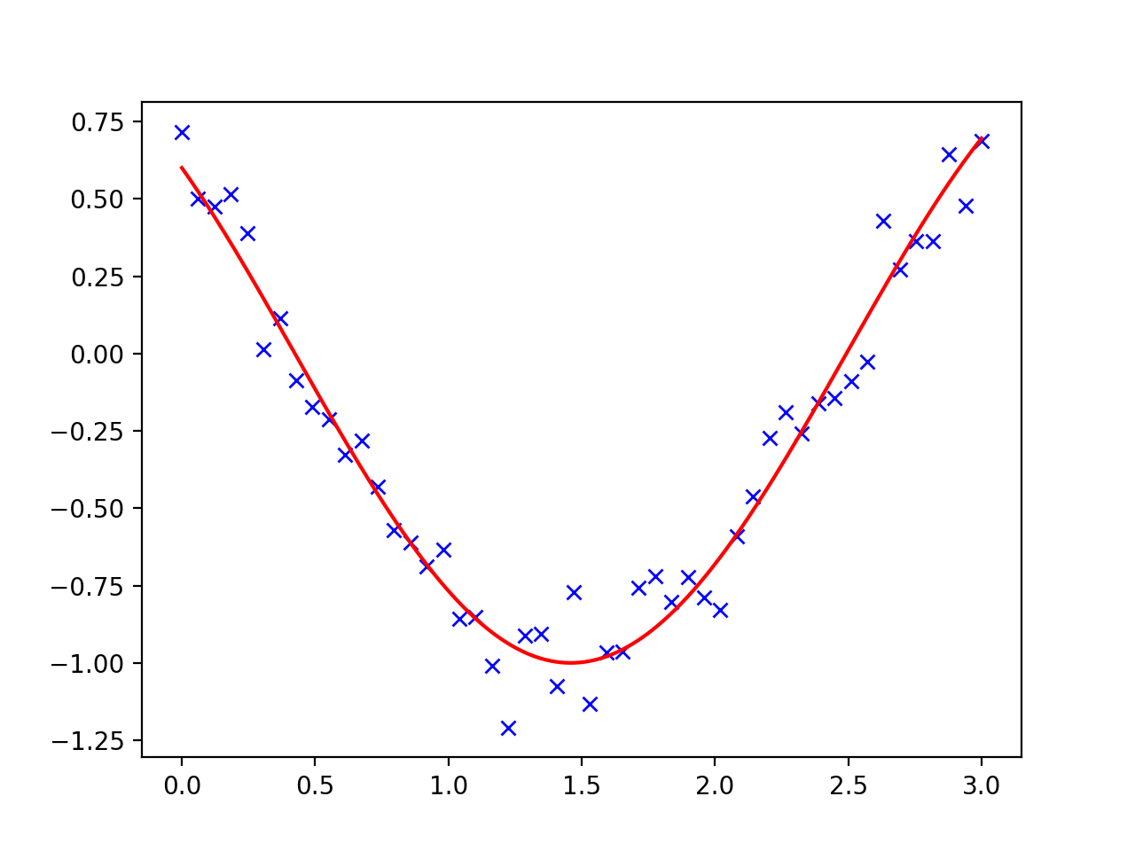
Curve Fitting
Number of numerical methods for minimization problems
Curve fitting:
Given a number of points, find a smooth curve going through it

Slide 58
Curve Fitting
Use a cosine as the test function
def f(t, omega, phi):
return np.cos(omega * t + phi)

Slide 59
Fitting with scipy
Create sample data
x = np.linspace(0, 3, 50)
y = f(x, 1.5, 1) + .1*np.random.normal(size=50)

Slide 60
Fitting with scipy
Now fit using scipy.optimize
params, params_cov = optimize.curve_fit(f, x, y)
print(params)

Slide 61
Fitting with scipy
Can almost recover parameters
y = f(x, 1.5, 1) + .1*np.random.normal(size=50)
[1.51854577 0.92665541]

Slide 62
Fitting with scipy

Slide 63
Fitting with scipy
Could also fit with a quadratic
def g(t, a, b, c):
return a*t**2+b*t+c
params, params_cov = optimize.curve_fit(g, x, y)

Slide 64
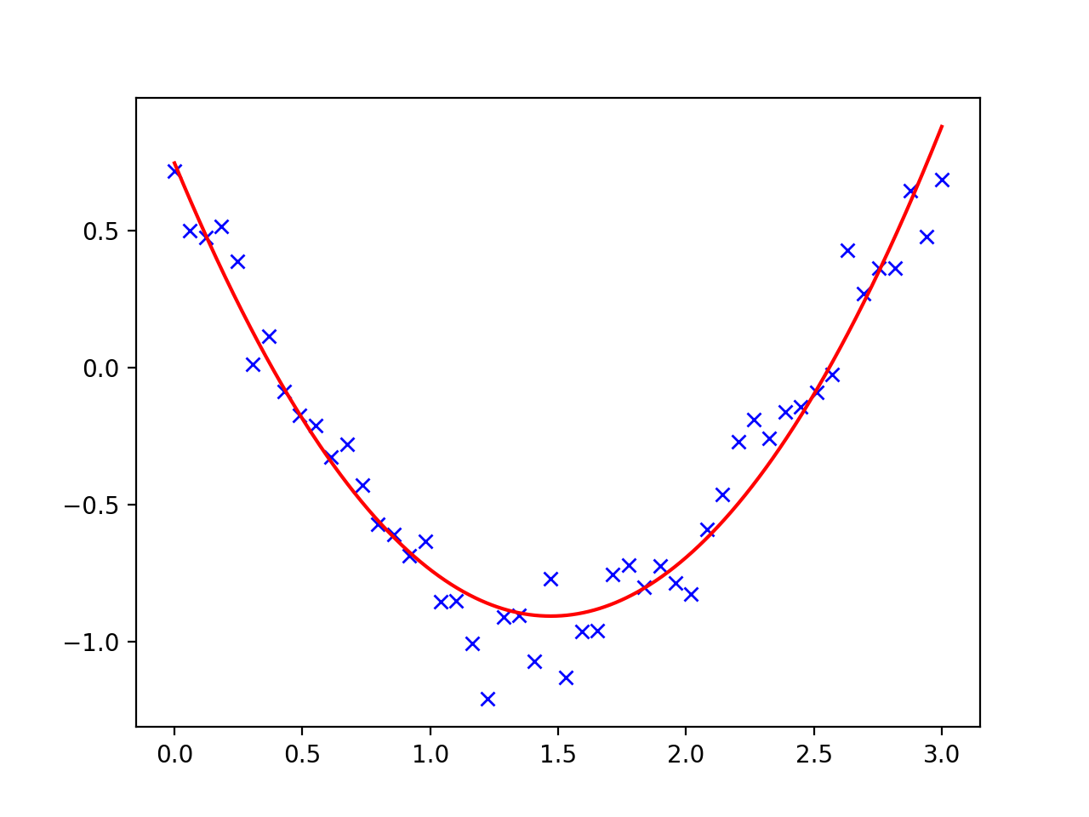
Fitting with scipy

Slide 65
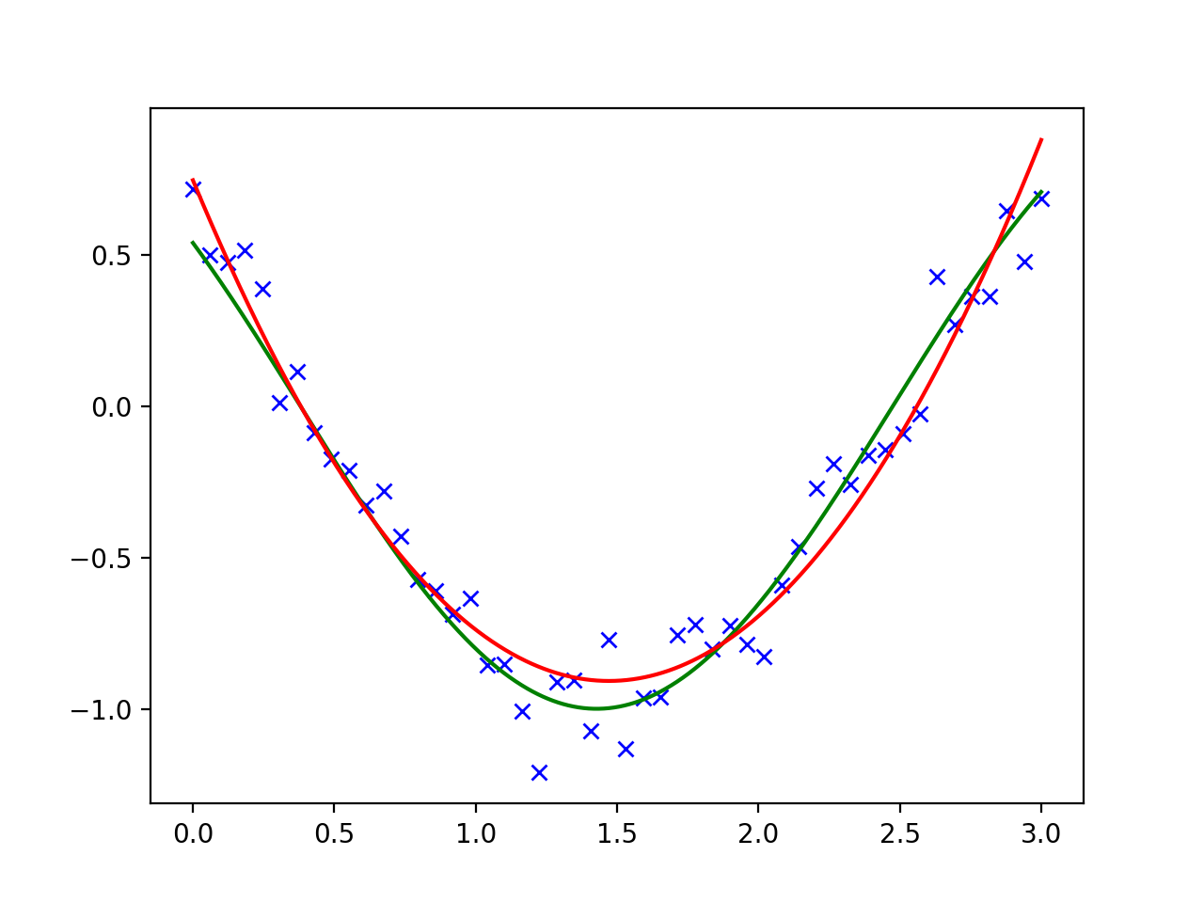
Fitting with scipy

Slide 66
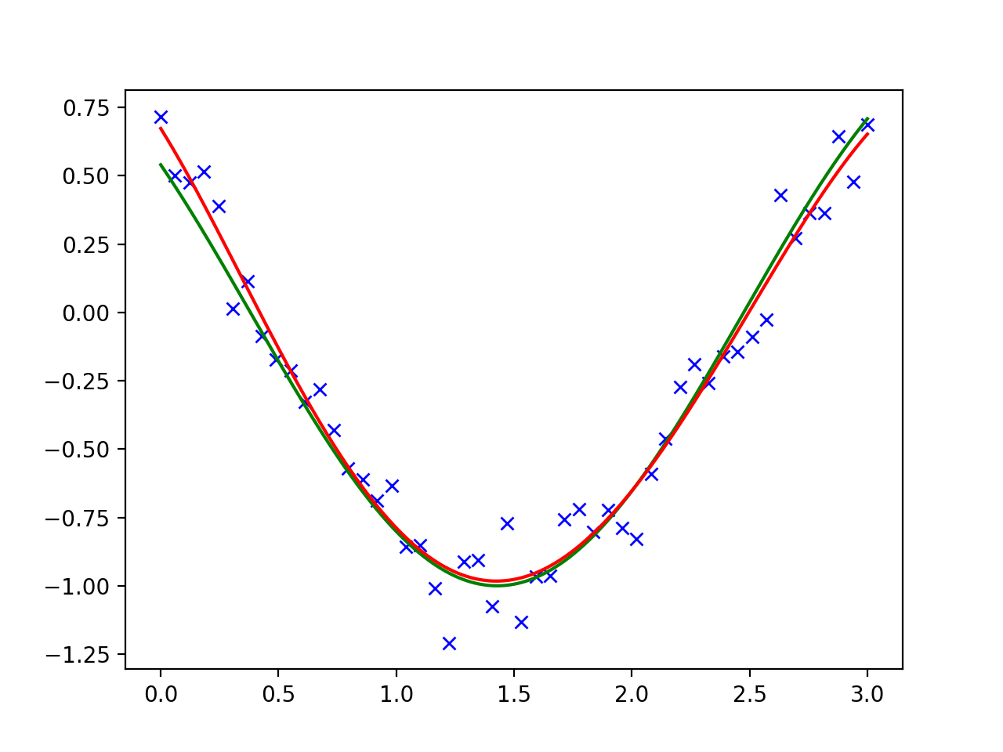
Fitting with scipy
Could also try a higher level polynomial

Slide 67
Fitting with scipy
And if we try with a polynomial with as many degrees as there are points, we would get perfect fit
And absolutely no insights!

Slide 68
Example
Macro-economic data from Longley
Can download from jbrownlee's github site
GNP.deflator: GNP implicit price deflator (1954=100)
GNP: Gross National Product.
Unemployed: number of unemployed.
Armed.Forces: number of people in the armed forces.
Population: ‘noninstitutionalized’ population ≥ 14 years of age.
Year: the year (time).
Employed: number of people employed.

Slide 69
Example
import scipy.optimize as opt
import numpy as np
import pandas as pd
import matplotlib.pyplot as plt
url = 'https://raw.githubusercontent.com/jbrownlee/Datasets/master/longley.csv'
dataframe = pd.read_csv(url, header = None)
data = dataframe.values

Slide 70
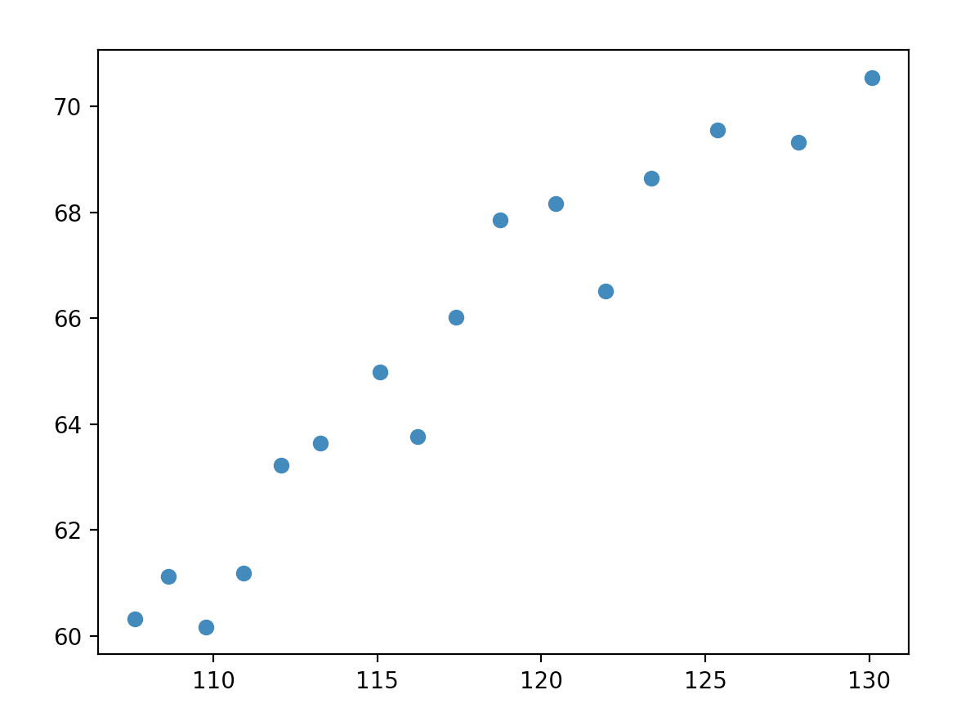
Example
Employment dependent on population
x, y = data[:,4], data[ :,-1]
plt.scatter(x,y)
plt.show()

Slide 71
Example
Define a model function
What is the proposed dependence:
Linear Regression:
$$\text{emp}=α⋅\text{pop}+β$$
def model(x, alpha, beta):
return alpha*x+beta

Slide 72
Example
Now we can use curve-fitting
scipy.optimize.curve_fit(model, xvals, yvals) returns
popt: optimal parameters
pcov: covariance matrix

Slide 73
Example
popt, pcov = opt.curve_fit(model, x, y)
print(popt)
a, b = popt
plt.scatter(x,y)
xrange = np.linspace(np.min(x), np.max(x), 3)
plt.plot(xrange, model(xrange, a, b))
plt.show()
[0.48487809 8.38067476]

Slide 74
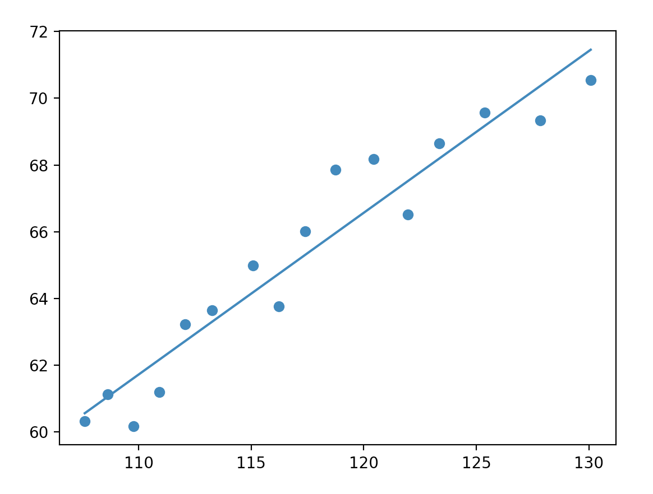
Example

Slide 75
Example
Change the model by adding a quadratic component
def model(x, alpha, beta, gamma):
return alpha*x**2+beta*x+gamma
popt, pcov = opt.curve_fit(model, x, y)
print(popt)
a, b, c = popt
plt.scatter(x,y)
xrange = np.linspace(np.min(x), np.max(x), 101)
plt.plot(xrange, model(xrange, a, b, c))
plt.show()

Slide 76
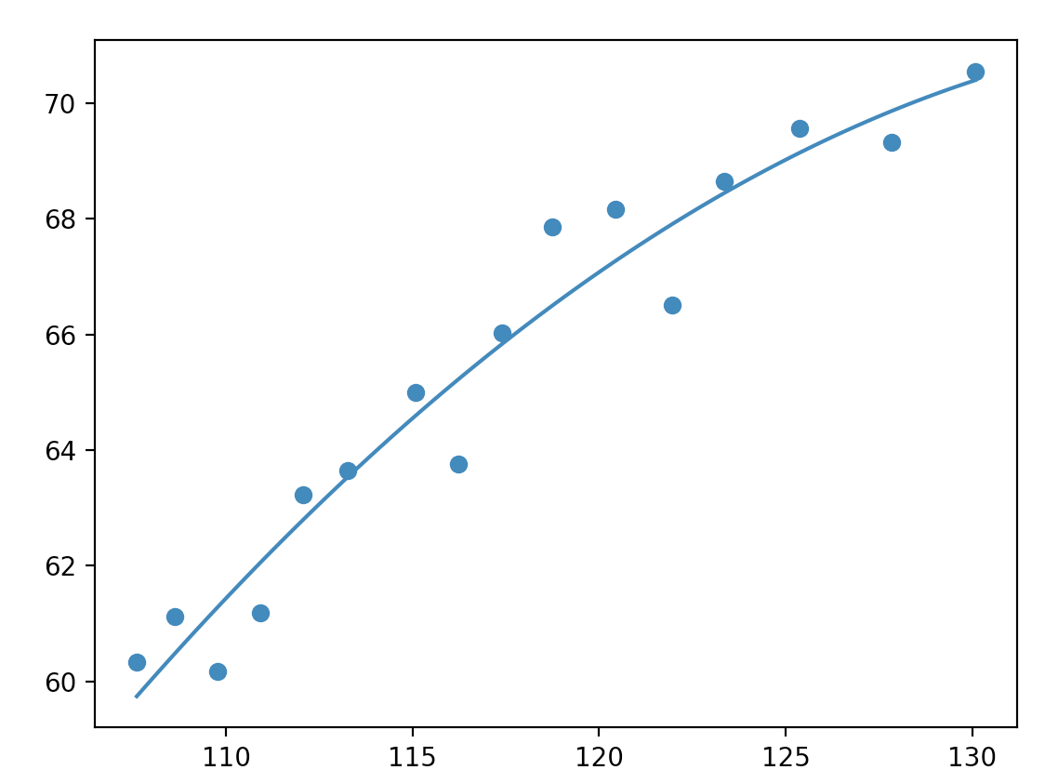
Example

Slide 77
Optimization
Global optimizers:
Grid search: Start out at a large number of starting positions
Try out several methods
If possible, calculate the gradient and the Hessian yourself
Can use scipy.optimize.check_grad( ) to see whether you calculated correctly

Slide 78
Curve Fitting
Need to have a good model:
Avoids under- and over-fitting
Find a way to measure success
E.g. time series: You want to remove trends and have white noise left over

Slide 79
Constraints
Often need to optimize under constraints
Easiest constraints are for box bounds:
Variables need to be within a certain range

Slide 80
Constraints
Function:
def f(x):
return np.sqrt((x[0]-3)**2 + (x[1]-2)**2)

Slide 81
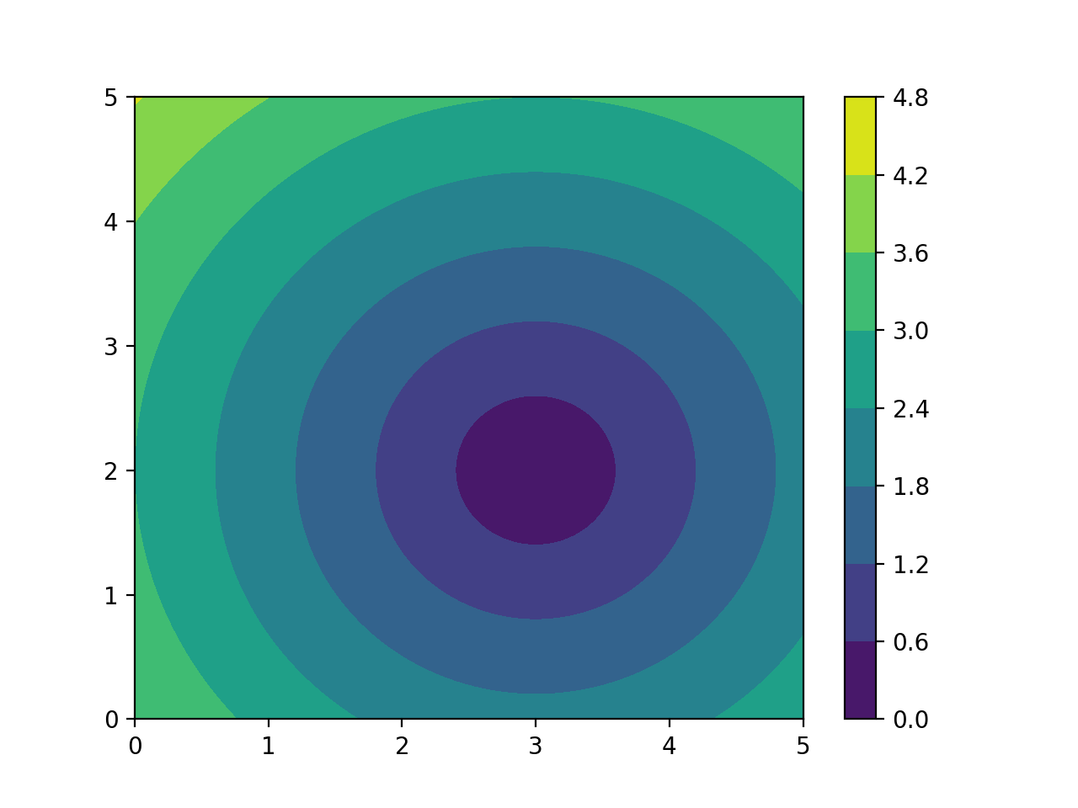
Constraints

Slide 82
Constraints
Optimization:
result = optimize.minimize(f, np.array([0, 0]), bounds=((-1.5, 1.5), (-1.5, 1.5)))

Slide 83
Constraints
Result:
>>> result
fun: 1.5811388300841898
hess_inv: <2x2 LbfgsInvHessProduct with dtype=float64>
jac: array([-0.94868331, -0.31622778])
message: b'CONVERGENCE: NORM_OF_PROJECTED_GRADIENT_<=_PGTOL'
nfev: 9
nit: 2
status: 0
success: True
x: array([1.5, 1.5])

Slide 84
Constraints
We can use minimize with a tuple of constraints
Assume we want to optimize a sum of Gaussian functions
By looking at the function, we know that the optimum of -3 is reached at x[0]=1, x[1]=0.3, x[2]=2.1
def f(x):
return -(np.exp(-(x[0]+1)**2/(2.1**2))+
np.exp(-(x[1]-0.3)**2/(0.8**2))+
np.exp(-(x[2]-2.1)**2/(1.7**2)))

Slide 85
Constraints
result = opt.minimize(f,
x0=np.array([0,0,0]),
method='SLSQP',
#constraints = my_constraints,
options={'maxiter':1000})
print(result)

Slide 86
Constraints
With result
fun: -2.9999996182639146
jac: array([-8.09729099e-05, -2.40176916e-04, 7.11053610e-04])
message: 'Optimization terminated successfully'
nfev: 34
nit: 8
njev: 8
status: 0
success: True
x: array([-1.00017856, 0.29992313, 2.10102744])

Slide 87
Constraints
SLSQP allows constraints
Define constraints as functions
Put them into a dictionary, and make a tuple of them
Read: $x_{0}^{2}+2⋅x_{1}^{2}+3⋅x_{2}^{2}<1$
def constraint(x):
return 1-(x[0]**2+2*x[1]**2+3*x[2]**2)
my_constraints = ({'type': 'ineq','fun': constraint})

Slide 88
Constraints
def constraint(x):
return 1-(x[0]**2+2*x[1]**2+3*x[2]**2)
my_constraints = ({'type': 'ineq','fun': constraint})
result = opt.minimize(f,
x0=np.array([0,0,0]),
method='SLSQP',
constraints = my_constraints,
options={'maxiter':1000})
print(result)

Slide 89
Constraints
Result:
fun: -2.3352953005679837
jac: array([ 0.19044936, -0.16718537, -0.44114104])
message: 'Optimization terminated successfully'
nfev: 33
nit: 8
njev: 8
status: 0
success: True
x: array([-0.56132919, 0.2462587 , 0.43344502])

Slide 90
HELP!!!!
Get Scipy Lecture notes (for free)
www.scipy-lectures.org

