Slide 1
Numpy Arrays

Slide 2
NumPy: Fancy Indexing
Fancy indexing:
Use an array of indices in order to access a number of array elements at once

Slide 3
NumPy: Fancy Indexing
Example:
Create matrix
Fancy Indexing:
>>> mat = np.random.randint(0,10,(3,5))
>>> mat
array([[3, 2, 3, 3, 0],
[9, 5, 8, 3, 4],
[7, 5, 2, 4, 6]])
>>> mat[(1,2),(2,3)]
array([8, 4])

Slide 4
NumPy: Fancy Indexing
Application:
Creating a sample of a number of points
Create a large random array representing data points
Select the x and y coordinates by slicing
>>> mat = np.random.normal(100,20, (200,2))
>>> x=mat[:,0]
>>> y=mat[:,1]

Slide 5
NumPy: Fancy Indexing
Create a matplotlib figure with a plot inside it
>>> fig = plt.figure()
>>> ax = fig.add_subplot(1,1,1)
>>> ax.scatter(x,y)
>>> plt.show()

Slide 6
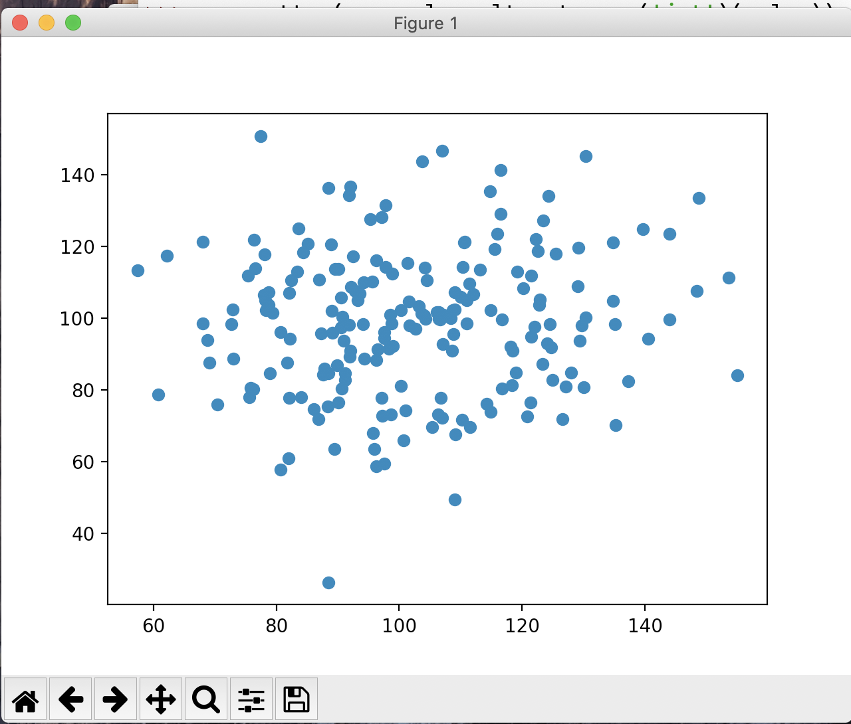
NumPy: Fancy Indexing

Slide 7
NumPy: Fancy Indexing
Create a list of potential indices
Use fancy indexing to create the subset of points
>>> indices = np.random.choice(np.arange(0,200,1),10)
>>> indices
array([ 32, 93, 172, 134, 90, 66, 109, 158, 188, 30])
>>> subset = mat[indices]

Slide 8
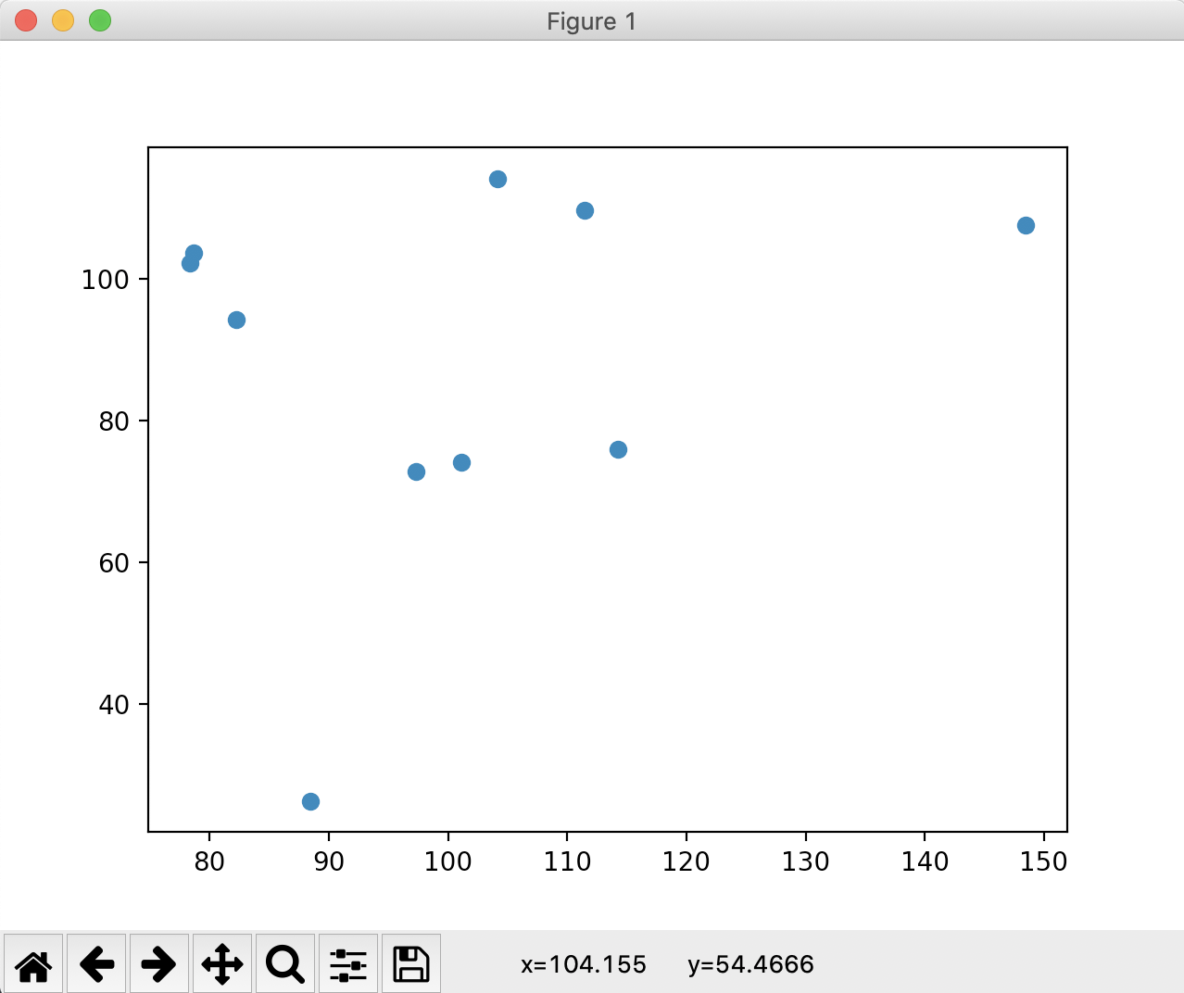
NumPy: Fancy Indexing

Slide 9
Simple Stats
Recall iris data set
After normalization
>>> iris
array([[0.22222222, 0.625 , 0.06779661, 0.04166667],
[0.16666667, 0.41666667, 0.06779661, 0.04166667],
[0.11111111, 0.5 , 0.05084746, 0.04166667],
[0.08333333, 0.45833333, 0.08474576, 0.04166667],
[0.19444444, 0.66666667, 0.06779661, 0.04166667],
[0.30555556, 0.79166667, 0.11864407, 0.125 ],
[0.08333333, 0.58333333, 0.06779661, 0.08333333],
[0.19444444, 0.58333333, 0.08474576, 0.04166667],
[0.02777778, 0.375 , 0.06779661, 0.04166667],

Slide 10
Simple Stats
Calculate average along of all values
Much more important: calculate average along an axis
>>> np.mean(iris)
0.4483046924042686
>>> np.mean(iris, axis=0)
array([0.4287037 , 0.43916667, 0.46757062, 0.45777778])

Slide 11
Simple Stats
Simularly: np.min, np.max, np.median
With version in case nan (not a value) is present
Example: Normalizing the iris data set
def normalize(array):
maxs = np.max(array, axis = 0)
mins = np.min(array, axis = 0)
return (array-mins)/(maxs-mins)

Slide 12
Simple Stats
Or normalize to have mean 0 and standard deviation 1
def normalizeS(array):
means = np.mean(array, axis = 0)
stdevs = np.std(array, axis = 0)
return (array - means)/stdevs

Slide 13
Simple Stats
Can determine percentiles and quantiles
>>> iris[:5,:]
array([[5.1, 3.5, 1.4, 0.2],
[4.9, 3. , 1.4, 0.2],
[4.7, 3.2, 1.3, 0.2],
[4.6, 3.1, 1.5, 0.2],
[5. , 3.6, 1.4, 0.2]])
])
>>> np.percentile(iris, 5, axis=0)
array([4.6 , 2.345, 1.3 , 0.2 ])
np.percentile(iris, 95, axis=0)
array([7.255, 3.8 , 6.1 , 2.3 ])

Slide 14
Broadcast Application
Getting the difference matrix of a vector$\left(\begin{matrix}v_{0}, & v_{1}, & ,…, & v_{n-1}\end{matrix}\right)$
$$\left(\begin{matrix}v_{0}-v_{0} & v_{0}-v_{1} & … & v_{0}-v_{n-1} \\ v_{1}-v_{0} & v_{1}-v_{1} & … & v_{1}-v_{n-1} \\ ⋮ & ⋮ & ⋱ & ⋮ \\ v_{n-1}-v_{0} & v_{n-1}-v_{1} & … & v_{n-1}-v_{n-1}\end{matrix}\right)$$

Slide 15
Broadcast Application
Because of broadcast rules, this will not work
>>> v = np.array([1,2,3,4,5,6,7])
>>> v - v.T
array([0, 0, 0, 0, 0, 0, 0])

Slide 16
Broadcast Application
But we can embed the vector into a two-dimensional vector in two different ways
>>> v[None,:]
array([[1, 2, 3, 4, 5, 6, 7]])
>>> v[:,None]
array([[1],
[2],
[3],
[4],
[5],
[6],
[7]])

Slide 17
Broadcast Application
Now we can use broadcasting
>>> v[:,None]-v[None,:]
array([[ 0, -1, -2, -3, -4, -5, -6],
[ 1, 0, -1, -2, -3, -4, -5],
[ 2, 1, 0, -1, -2, -3, -4],
[ 3, 2, 1, 0, -1, -2, -3],
[ 4, 3, 2, 1, 0, -1, -2],
[ 5, 4, 3, 2, 1, 0, -1],
[ 6, 5, 4, 3, 2, 1, 0]])

Slide 18
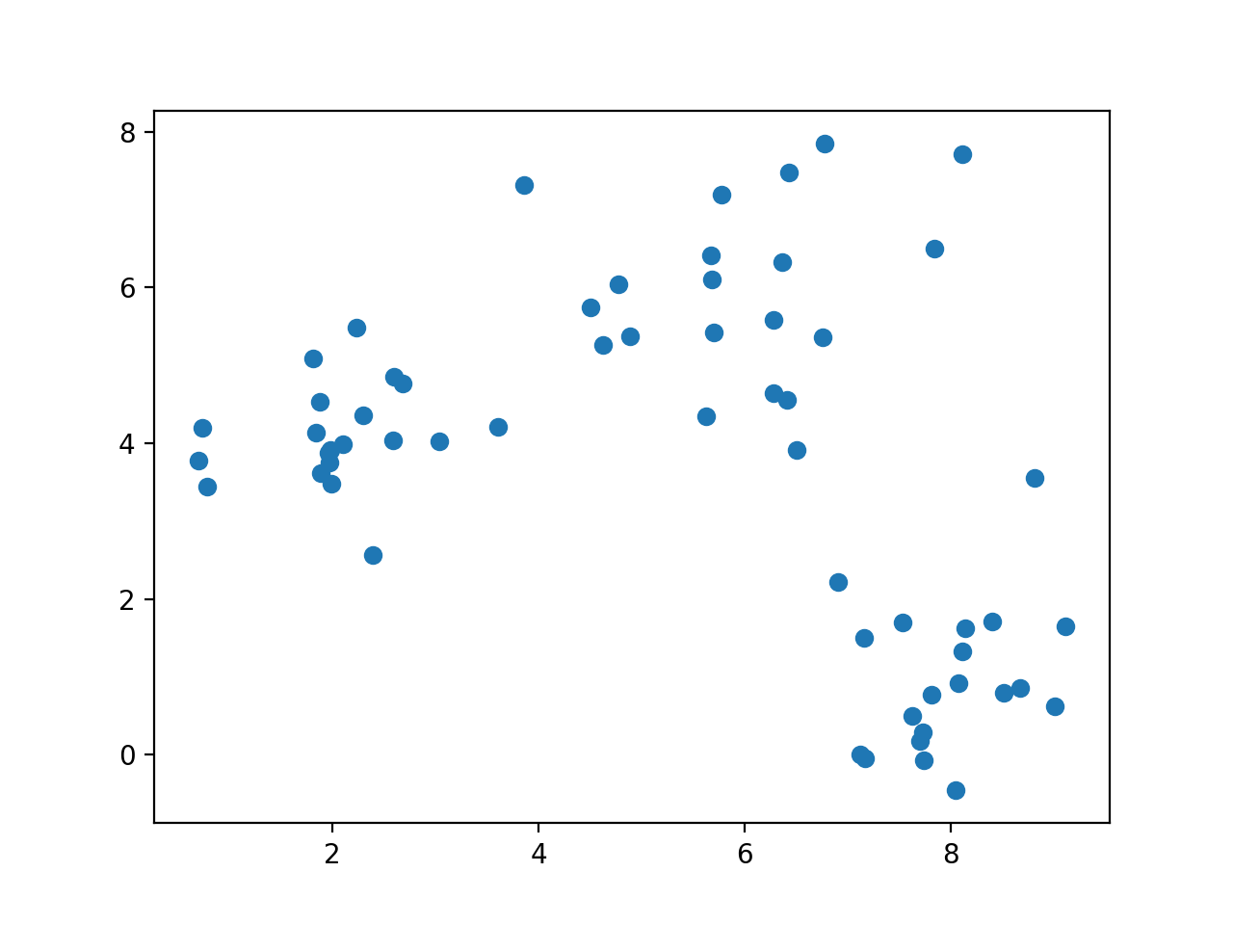
k-means clustering
Given a set of data, can we cluster it even if we do not know its structure?

Slide 19
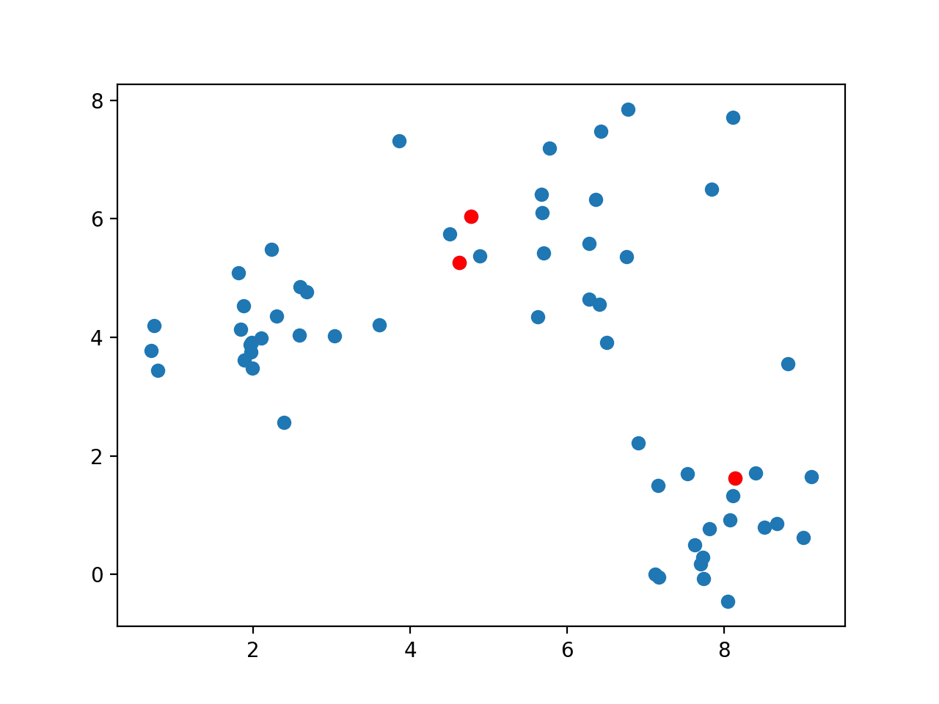
k-means clustering
Guess a number of clusters and pick k arbitrary points

Slide 20
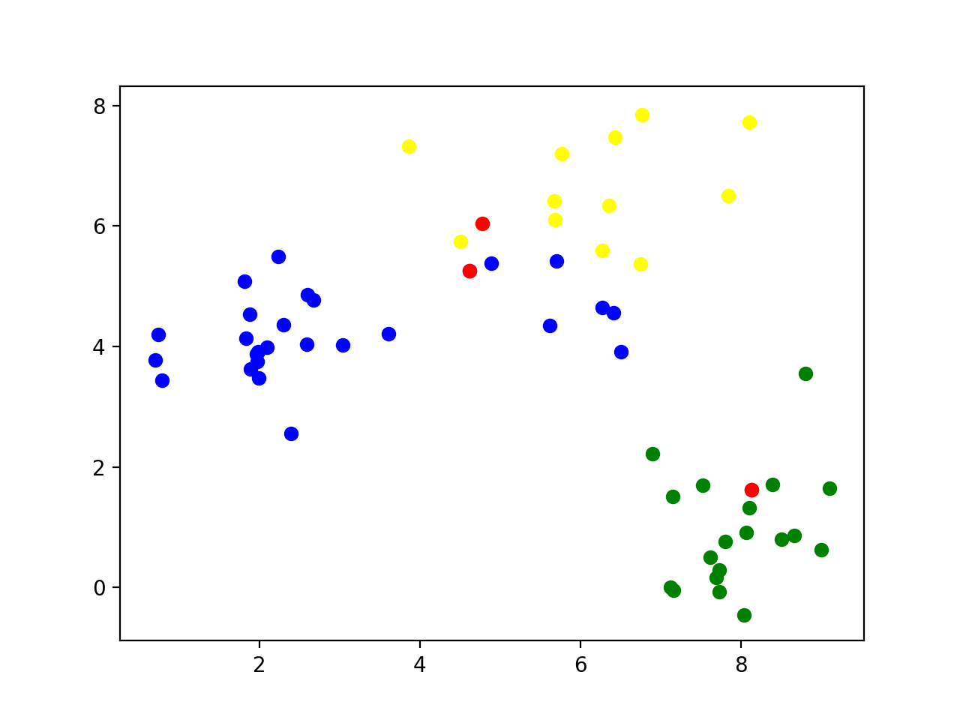
k-means clustering
Classify all points according to which of the points they are closest

Slide 21
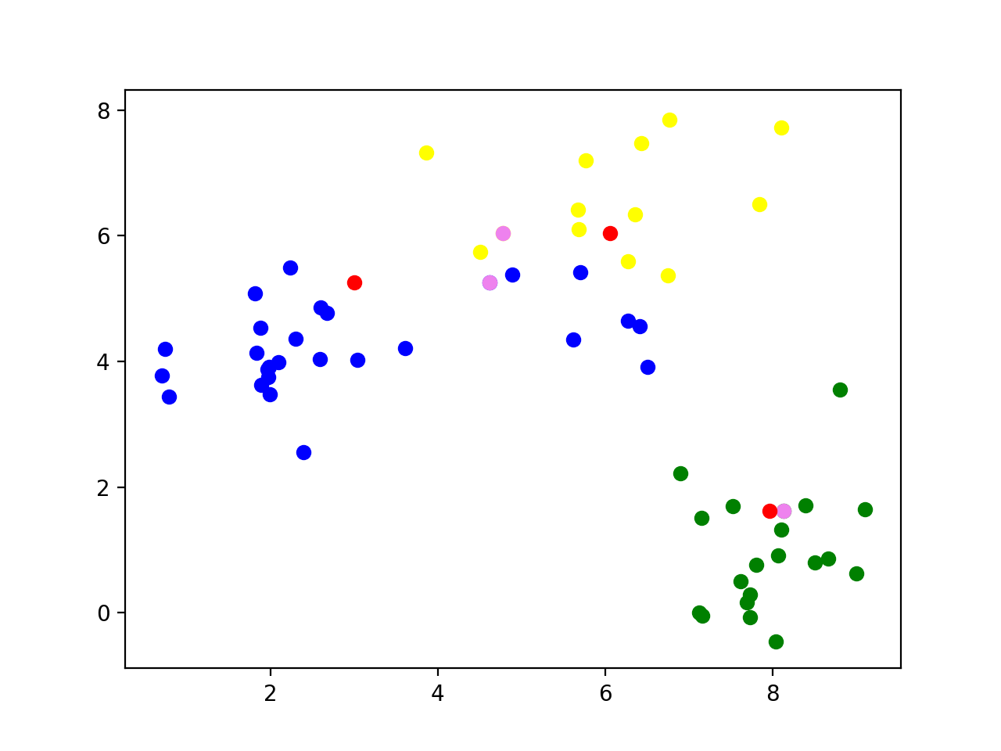
k-means clustering
Calculate the mean of all the data points and set it as the new center

Slide 22
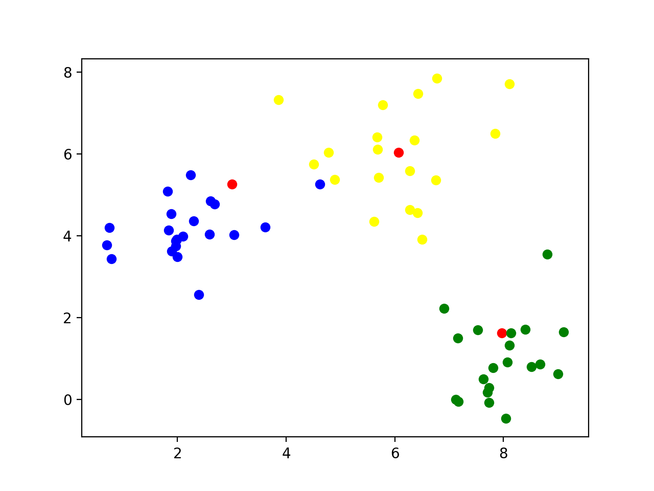
k-means clustering
Reclassify all the points according to their closeness to the new centers

Slide 23
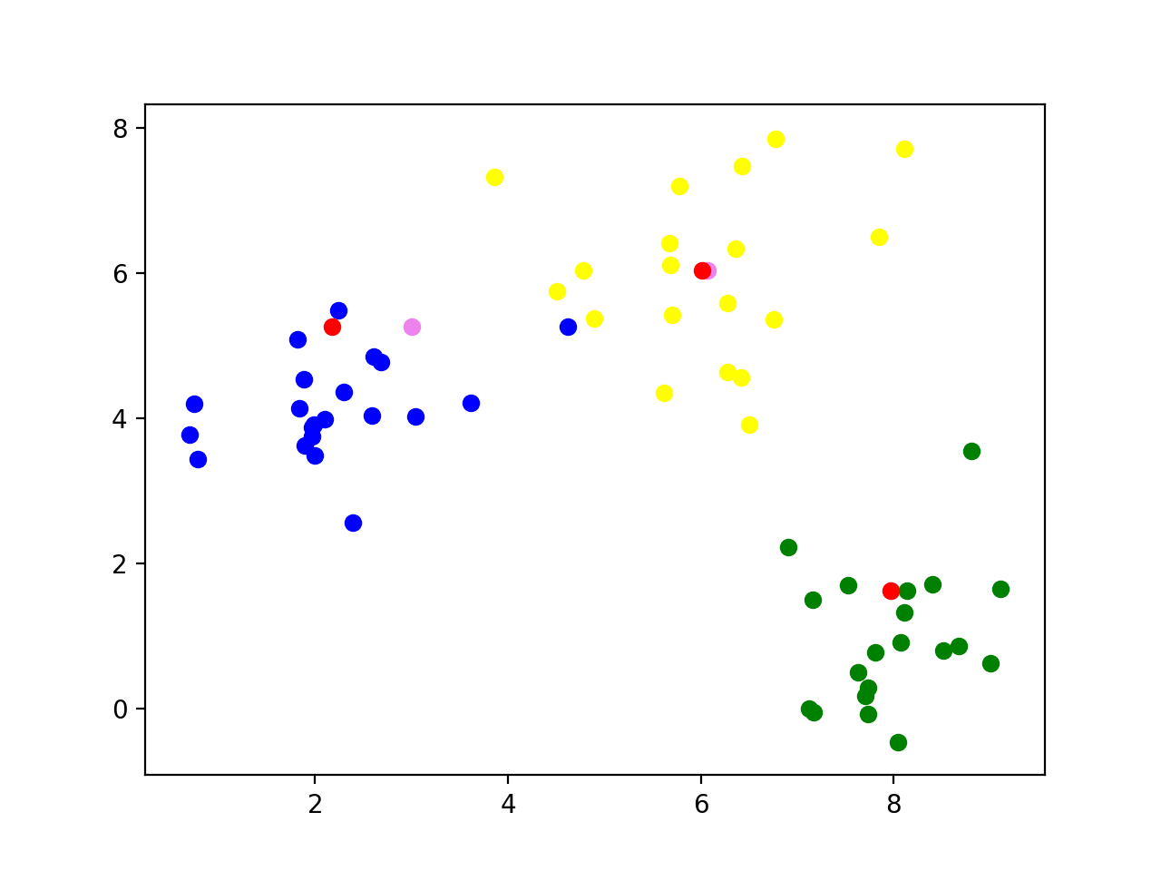
k-means clustering
Now calculate the new centers of the groups

Slide 24
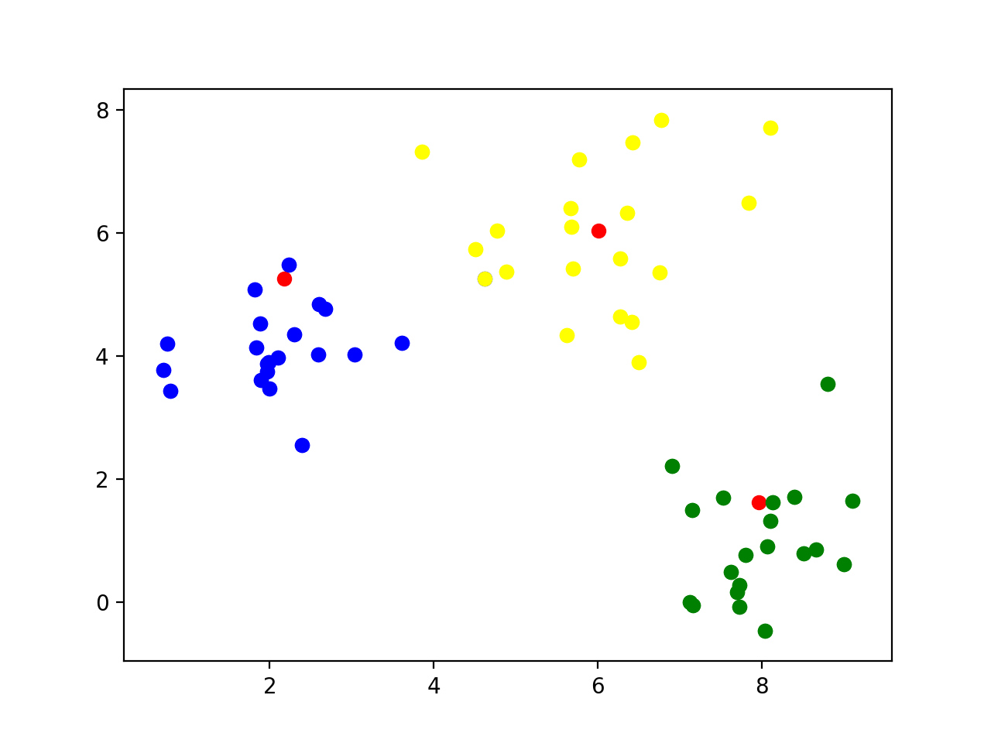
k-means clustering
Repeat: Classify according to closeness to the new centers

Slide 25
k-means clustering
Continue
The centers no longer move when points are no longer moved between different categories

Slide 26
k-means clustering
Implementation
Find starting points by random selection
def cluster(data, k, limit):
centers = data[ np.random.choice(np.arange(data.shape[0]), k, replace=False),: ]
for _ in range(limit):
distances = ((data[:,:,None] - centers.T[None, :, :])**2).sum(axis=1)
classification = np.argmin( distances, axis=1)
new_centers = np.array([data[classification==j,:].mean(axis=0) for j in range(k)])
if np.max(np.abs(new_centers - centers)) < 0.01:
break
else:
centers = new_centers
else: #loop did not end
print('No convergence')
return centers

Slide 27
k-means clustering
Enter a limited loop:
def cluster(data, k, limit):
centers = data[ np.random.choice(np.arange(data.shape[0]), k, replace=False),: ]
for _ in range(limit):
distances = ((data[:,:,None] - centers.T[None, :, :])**2).sum(axis=1)
classification = np.argmin( distances, axis=1)
new_centers = np.array([data[classification==j,:].mean(axis=0) for j in range(k)])
if np.max(np.abs(new_centers - centers)) < 0.01:
break
else:
centers = new_centers
else: #loop did not end
print('No convergence')
return centers

Slide 28
Use the previous trick to calculate the difference between all points and the centers
def cluster(data, k, limit):
centers = data[ np.random.choice(np.arange(data.shape[0]), k, replace=False),: ]
for _ in range(limit):
distances = ((data[:,:,None] - centers.T[None, :, :])**2).sum(axis=1)
classification = np.argmin( distances, axis=1)
new_centers = np.array([data[classification==j,:].mean(axis=0) for j in range(k)])
if np.max(np.abs(new_centers - centers)) < 0.01:
break
else:
centers = new_centers
else: #loop did not end
print('No convergence')
return centers

Slide 29
For each point, find the closest distance
def cluster(data, k, limit):
centers = data[ np.random.choice(np.arange(data.shape[0]), k, replace=False),: ]
for _ in range(limit):
distances = ((data[:,:,None] - centers.T[None, :, :])**2).sum(axis=1)
classification = np.argmin( distances, axis=1)
new_centers = np.array([data[classification==j,:].mean(axis=0) for j in range(k)])
if np.max(np.abs(new_centers - centers)) < 0.01:
break
else:
centers = new_centers
else: #loop did not end
print('No convergence')
return centers

Slide 30
The new centers are obtained by taking the mean of the points with a given classification
def cluster(data, k, limit):
centers = data[ np.random.choice(np.arange(data.shape[0]), k, replace=False),: ]
for _ in range(limit):
distances = ((data[:,:,None] - centers.T[None, :, :])**2).sum(axis=1)
classification = np.argmin( distances, axis=1)
new_centers = np.array([data[classification==j,:].mean(axis=0) for j in range(k)])
if np.max(np.abs(new_centers - centers)) < 0.01:
break
else:
centers = new_centers
else: #loop did not end
print('No convergence')
return centers

Slide 31
If the centers do not move, we are done
def cluster(data, k, limit):
centers = data[ np.random.choice(np.arange(data.shape[0]), k, replace=False),: ]
for _ in range(limit):
distances = ((data[:,:,None] - centers.T[None, :, :])**2).sum(axis=1)
classification = np.argmin( distances, axis=1)
new_centers = np.array([data[classification==j,:].mean(axis=0) for j in range(k)])
if np.max(np.abs(new_centers - centers)) < 0.01:
break
else:
centers = new_centers
else: #loop did not end
print('No convergence')
return centers

Slide 32
Possible to not have convergence
For production quality code: consider raising an exception
def cluster(data, k, limit):
centers = data[ np.random.choice(np.arange(data.shape[0]), k, replace=False),: ]
for _ in range(limit):
distances = ((data[:,:,None] - centers.T[None, :, :])**2).sum(axis=1)
classification = np.argmin( distances, axis=1)
new_centers = np.array([data[classification==j,:].mean(axis=0) for j in range(k)])
if np.max(np.abs(new_centers - centers)) < 0.01:
break
else:
centers = new_centers
else: #loop did not end
print('No convergence')
return centers

Slide 33
The loop stabilized, we are done
def cluster(data, k, limit):
centers = data[ np.random.choice(np.arange(data.shape[0]), k, replace=False),: ]
for _ in range(limit):
distances = ((data[:,:,None] - centers.T[None, :, :])**2).sum(axis=1)
classification = np.argmin( distances, axis=1)
new_centers = np.array([data[classification==j,:].mean(axis=0) for j in range(k)])
if np.max(np.abs(new_centers - centers)) < 0.01:
break
else:
centers = new_centers
else: #loop did not end
print('No convergence')
return centers

Slide 34
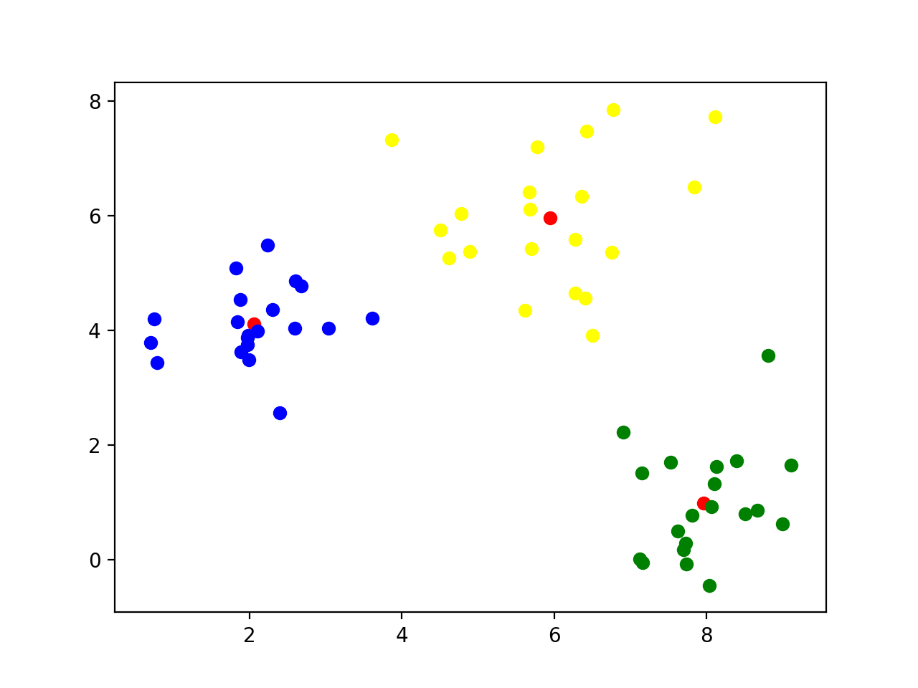
k-means clustering
Final result

Slide 35
k-means clustering
This worked because I used normalvariate to generate points around (2,4), (8,1), and (6,6)

Slide 36
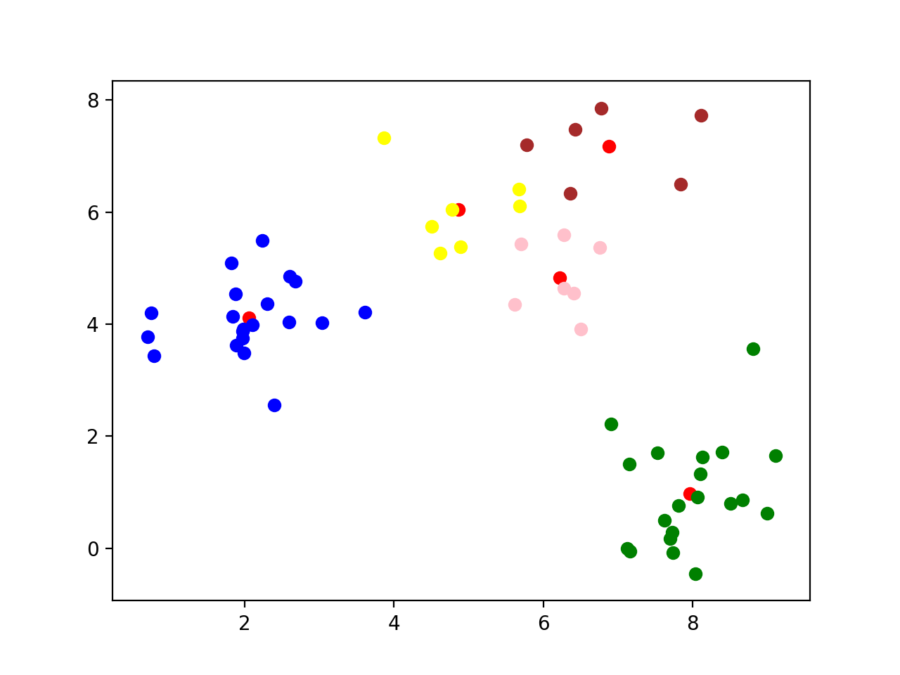
k-means clustering
What happens if we use a different k?
k=5: A cluster gets arbitrarily split

Slide 37
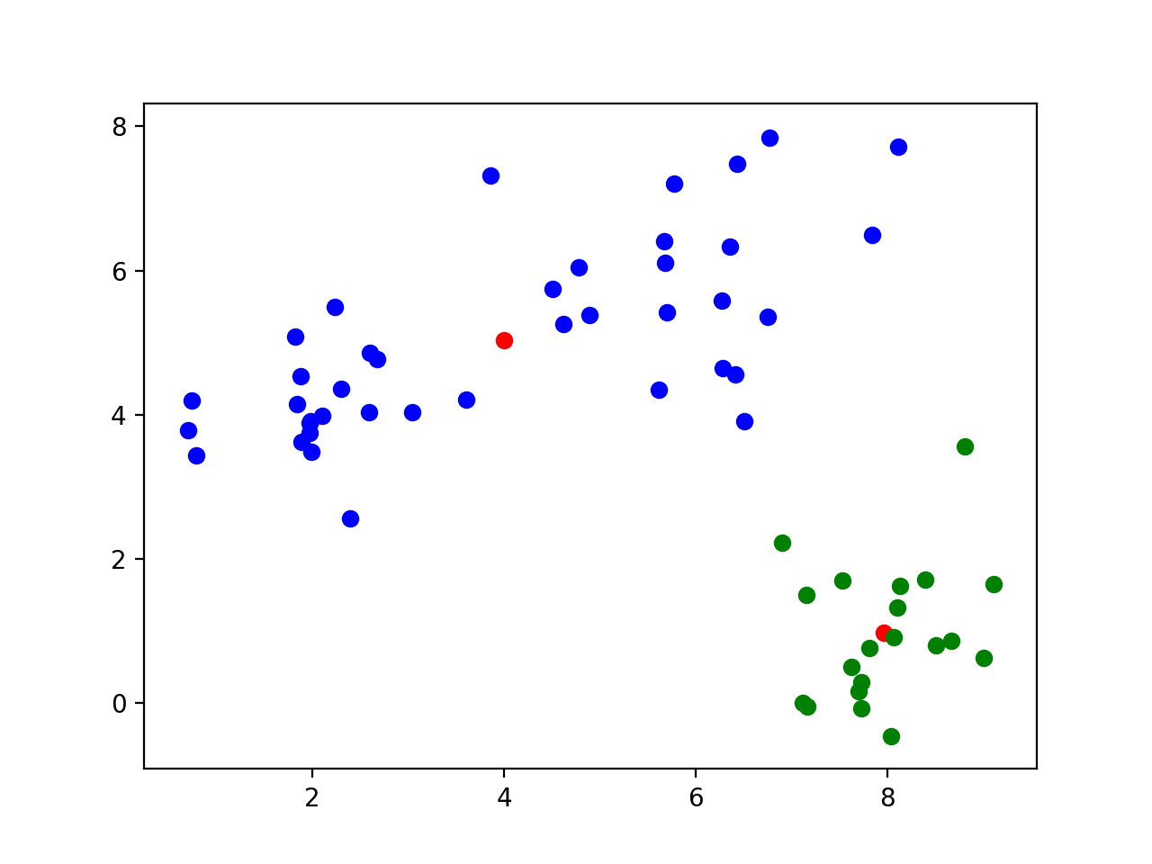
k-means clustering
k=2 Two clusters get merged

Slide 38
k-means clustering
Let's try this out on the Iris data set
We only keep the measurements
We can normalize data using the min-max method
def normalize(array):
maxs = np.max(array, axis = 0)
mins = np.min(array, axis = 0)
return (array-mins)/(maxs-mins)

Slide 39
k-means clustering
Now we try clustering without normalizing
The first 50 are 'Setosa', the next 50 are 'Virginica', then 'Variegata'
Sample with k = 5:
Recognizes 'Setosa' cluster, but not the other two
[1 1 1 1 1 1 1 1 1 1 1 1 1 1 1 1 1 1 1 1 1 1 1 1 1 1 1 1 1 1 1 1 1 1 1 1 1
1 1 1 1 1 1 1 1 1 1 1 1 1 0 0 0 4 0 4 0 2 0 4 2 4 4 0 4 0 4 4 0 4 0 4 0 0
0 0 0 0 0 4 4 4 4 0 4 0 0 0 4 4 4 0 4 2 4 4 4 0 2 4 3 0 3 3 3 3 4 3 3 3 0
0 3 0 0 3 3 3 3 0 3 0 3 0 3 3 0 0 3 3 3 3 3 0 0 3 3 3 0 3 3 3 0 3 3 3 0 0
3 0]

Slide 40
k-means clustering
With k = 3: looks a bit better, but still cannot recognize Virginia and Variegata
[2 2 2 2 2 2 2 2 2 2 2 2 2 2 2 2 2 2 2 2 2 2 2 2 2 2 2 2 2 2 2 2 2 2 2 2 2
2 2 2 2 2 2 2 2 2 2 2 2 2 1 0 1 0 0 0 0 0 0 0 0 0 0 0 0 0 0 0 0 0 0 0 0 0
0 0 0 1 0 0 0 0 0 0 0 0 0 0 0 0 0 0 0 0 0 0 0 0 0 0 1 0 1 1 1 1 0 1 1 1 1
1 1 0 0 1 1 1 1 0 1 0 1 0 1 1 0 0 1 1 1 1 1 0 1 1 1 1 0 1 1 1 0 1 1 1 0 1
1 0]

Slide 41
k-means clustering
Best results with k = 2:
[1 1 1 1 1 1 1 1 1 1 1 1 1 1 1 1 1 1 1 1 1 1 1 1 1 1 1 1 1 1 1 1 1 1 1 1 1
1 1 1 1 1 1 1 1 1 1 1 1 1 0 0 0 0 0 0 0 1 0 0 0 0 0 0 0 0 0 0 0 0 0 0 0 0
0 0 0 0 0 0 0 0 0 0 0 0 0 0 0 0 0 0 0 1 0 0 0 0 1 0 0 0 0 0 0 0 0 0 0 0 0
0 0 0 0 0 0 0 0 0 0 0 0 0 0 0 0 0 0 0 0 0 0 0 0 0 0 0 0 0 0 0 0 0 0 0 0 0
0 0]

Slide 42
k-means clustering
With mean-std normalization, results are more encouraging, but still not satisfactory
[2 2 2 2 2 2 2 2 2 2 2 2 2 2 2 2 2 2 2 2 2 2 2 2 2 2 2 2 2 2 2 2 2 2 2 2 2
2 2 2 2 0 2 2 2 2 2 2 2 2 1 1 1 0 1 0 1 0 1 0 0 0 0 0 0 1 0 0 0 0 1 0 0 0
0 1 1 1 0 0 0 0 0 0 0 1 1 0 0 0 0 0 0 0 0 0 0 0 0 0 1 0 1 1 1 1 0 1 1 1 1
1 1 0 1 1 1 1 1 0 1 0 1 1 1 1 1 1 1 1 1 1 1 1 0 1 1 1 1 1 1 1 0 1 1 1 0 1
1 1]
[1 1 1 1 1 1 1 1 1 1 1 1 1 1 1 1 1 1 1 1 1 1 1 1 1 1 1 1 1 1 1 1 1 1 1 1 1
1 1 1 1 1 1 1 1 1 1 1 1 1 2 2 2 0 0 0 2 0 0 0 0 0 0 0 0 2 0 0 0 0 2 0 0 0
0 2 2 2 0 0 0 0 0 0 0 2 2 0 0 0 0 0 0 0 0 0 0 0 0 0 2 0 2 2 2 2 0 2 0 2 2
0 2 0 0 2 2 2 2 0 2 0 2 0 2 2 0 0 2 2 2 2 2 0 0 2 2 2 0 2 2 2 0 2 2 2 0 2
2 0]
[1 2 2 2 1 1 2 2 2 2 1 2 2 2 1 1 1 1 1 1 2 1 2 2 2 2 2 1 2 2 2 2 1 1 2 2 1
2 2 2 2 2 2 2 1 2 1 2 1 2 0 0 0 0 0 0 0 0 0 0 0 0 0 0 0 0 0 0 0 0 0 0 0 0
0 0 0 0 0 0 0 0 0 0 0 0 0 0 0 0 0 0 0 0 0 0 0 0 0 0 0 0 0 0 0 0 0 0 0 0 0
0 0 0 0 0 0 0 0 0 0 0 0 0 0 0 0 0 0 0 0 0 0 0 0 0 0 0 0 0 0 0 0 0 0 0 0 0
0 0]

Slide 43
k-means clustering
With k = 2, we cluster into Setosa and not-Setosa
[1 1 1 1 1 1 1 1 1 1 1 1 1 1 1 1 1 1 1 1 1 1 1 1 1 1 1 1 1 1 1 1 1 1 1 1 1
1 1 1 1 1 1 1 1 1 1 1 1 1 0 0 0 0 0 0 0 0 0 0 0 0 0 0 0 0 0 0 0 0 0 0 0 0
0 0 0 0 0 0 0 0 0 0 0 0 0 0 0 0 0 0 0 0 0 0 0 0 0 0 0 0 0 0 0 0 0 0 0 0 0
0 0 0 0 0 0 0 0 0 0 0 0 0 0 0 0 0 0 0 0 0 0 0 0 0 0 0 0 0 0 0 0 0 0 0 0 0
0 0]
[1 1 1 1 1 1 1 1 1 1 1 1 1 1 1 1 1 1 1 1 1 1 1 1 1 1 1 1 1 1 1 1 1 1 1 1 1
1 1 1 1 1 1 1 1 1 1 1 1 1 0 0 0 0 0 0 0 0 0 0 0 0 0 0 0 0 0 0 0 0 0 0 0 0
0 0 0 0 0 0 0 0 0 0 0 0 0 0 0 0 0 0 0 0 0 0 0 0 0 0 0 0 0 0 0 0 0 0 0 0 0
0 0 0 0 0 0 0 0 0 0 0 0 0 0 0 0 0 0 0 0 0 0 0 0 0 0 0 0 0 0 0 0 0 0 0 0 0
0 0]
[0 0 0 0 0 0 0 0 0 0 0 0 0 0 0 0 0 0 0 0 0 0 0 0 0 0 0 0 0 0 0 0 0 0 0 0 0
0 0 0 0 0 0 0 0 0 0 0 0 0 1 1 1 1 1 1 1 1 1 1 1 1 1 1 1 1 1 1 1 1 1 1 1 1
1 1 1 1 1 1 1 1 1 1 1 1 1 1 1 1 1 1 1 1 1 1 1 1 1 1 1 1 1 1 1 1 1 1 1 1 1
1 1 1 1 1 1 1 1 1 1 1 1 1 1 1 1 1 1 1 1 1 1 1 1 1 1 1 1 1 1 1 1 1 1 1 1 1
1 1]

Slide 44
k-means clustering
With k=4: still no separation
[0 3 3 3 0 0 3 0 3 3 0 3 3 3 0 0 0 0 0 0 0 0 0 3 3 3 0 0 0 3 3 0 0 0 3 3 0
3 3 0 0 3 3 0 0 3 0 3 0 3 2 2 2 1 1 1 2 1 1 1 1 1 1 1 1 2 1 1 1 1 2 1 1 1
1 2 2 2 1 1 1 1 1 1 1 2 2 1 1 1 1 1 1 1 1 1 1 1 1 1 2 1 2 2 2 2 1 2 2 2 2
2 2 1 1 2 2 2 2 1 2 1 2 1 2 2 1 2 2 2 2 2 2 1 1 2 2 2 1 2 2 2 1 2 2 2 1 2
2 1]
[2 2 2 2 2 2 2 2 2 2 2 2 2 2 2 2 2 2 2 2 2 2 2 2 2 2 2 2 2 2 2 2 2 2 2 2 2
2 2 2 2 2 2 2 2 2 2 2 2 2 0 0 0 1 0 1 0 1 0 1 1 1 1 0 1 0 1 1 1 1 0 1 1 1
0 0 0 0 1 1 1 1 1 1 1 0 0 1 1 1 1 0 1 1 1 1 1 1 1 1 0 1 3 0 0 3 1 3 0 3 0
0 0 1 0 0 0 3 3 1 3 1 3 0 0 3 0 0 0 3 3 3 0 0 1 3 0 0 0 0 0 0 1 3 3 0 1 0
0 0]
[2 1 1 1 2 3 2 2 1 1 2 2 1 1 3 3 3 2 3 2 2 2 2 2 2 1 2 2 2 1 1 2 3 3 1 2 2
1 1 2 2 1 1 2 2 1 2 1 2 2 0 0 0 0 0 0 0 1 0 0 1 0 0 0 0 0 0 0 0 0 0 0 0 0
0 0 0 0 0 0 0 0 0 0 0 0 0 0 0 0 0 0 0 1 0 0 0 0 1 0 0 0 0 0 0 0 0 0 0 0 0
0 0 0 0 0 0 0 0 0 0 0 0 0 0 0 0 0 0 0 0 0 0 0 0 0 0 0 0 0 0 0 0 0 0 0 0 0
0 0]

Slide 45
k-means clustering
Morale:
With k-means clustering
Definitely need to normalize data set
Need to repeat method many times
Pick the one with the lowest sum of Euclidean distances

Slide 46
Decision Trees
Thomas Schwarz, SJ

Slide 47
Decision Trees
One of many machine learning methods
Used to learn categories
Example:
The Iris Data Set
Four measurements of flowers
Learn how to predict species from measurement

Slide 48
Iris Data Set
Iris Setosa
Iris Virginica
Iris Versicolor

Slide 49
Iris Data Set
Data in a .csv file
Collected by Fisher
One of the most famous datasets
Look it up on Kaggle or at UC Irvine Machine Learning Repository

Slide 50
Measuring Purity
Entropy
$n$ categories with proportions $p_{i}$ = (nr in Cat $i$)/(total nr)
$$\text{Entropy}(p_{1},p_{2},…,p_{n})=-\overset{n}{\underset{i=1}{∑}}\log_{2}(p_{i})p_{i}$$
Unless one of the proportions is zero, in which case the entropy is zero.
High entropy means low purity, low entropy means high purity

Slide 51
Measuring Purity
Gini index
$$\text{Gini}(p_{1},p_{2},…,p_{n})=\overset{n}{\underset{k=1}{∑}}p_{i}(1-p_{i})$$
Best calculated as
$$\overset{n}{\underset{k=1}{∑}}p_{i}(1-p_{i})=\overset{n}{\underset{k=1}{∑}}p_{i}-\overset{n}{\underset{k=1}{∑}}p_{i}^{2}=1-\overset{n}{\underset{k=1}{∑}}p_{i}^{2}$$

Slide 52
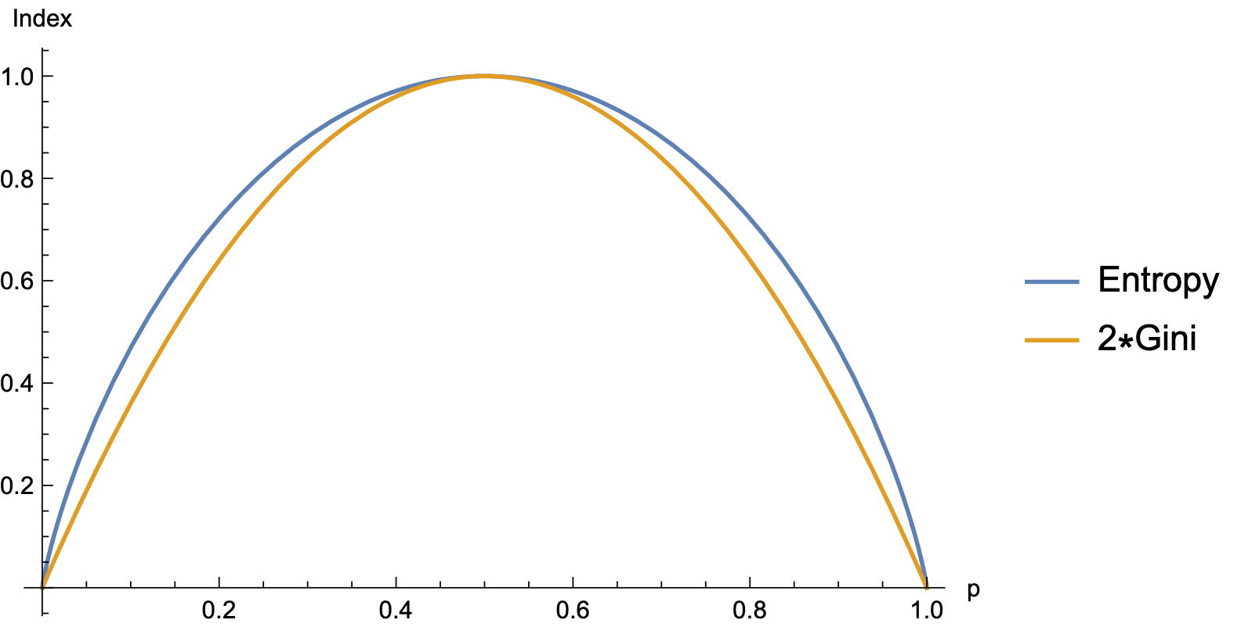
Measuring Purity
Assume two categories with proportions $p$ and $q$

Slide 53
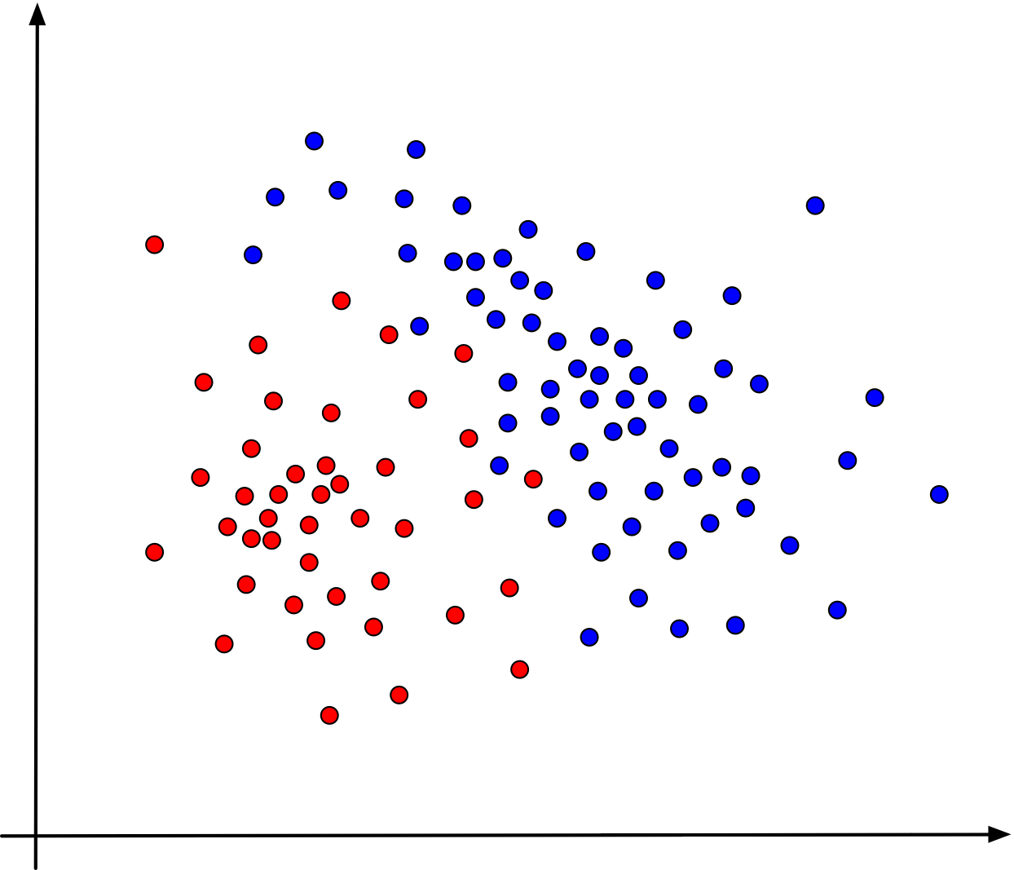
Building a Decision Tree
A decision tree
Can we predict the category (red vs blue) of the data from its coordinates?

Slide 54
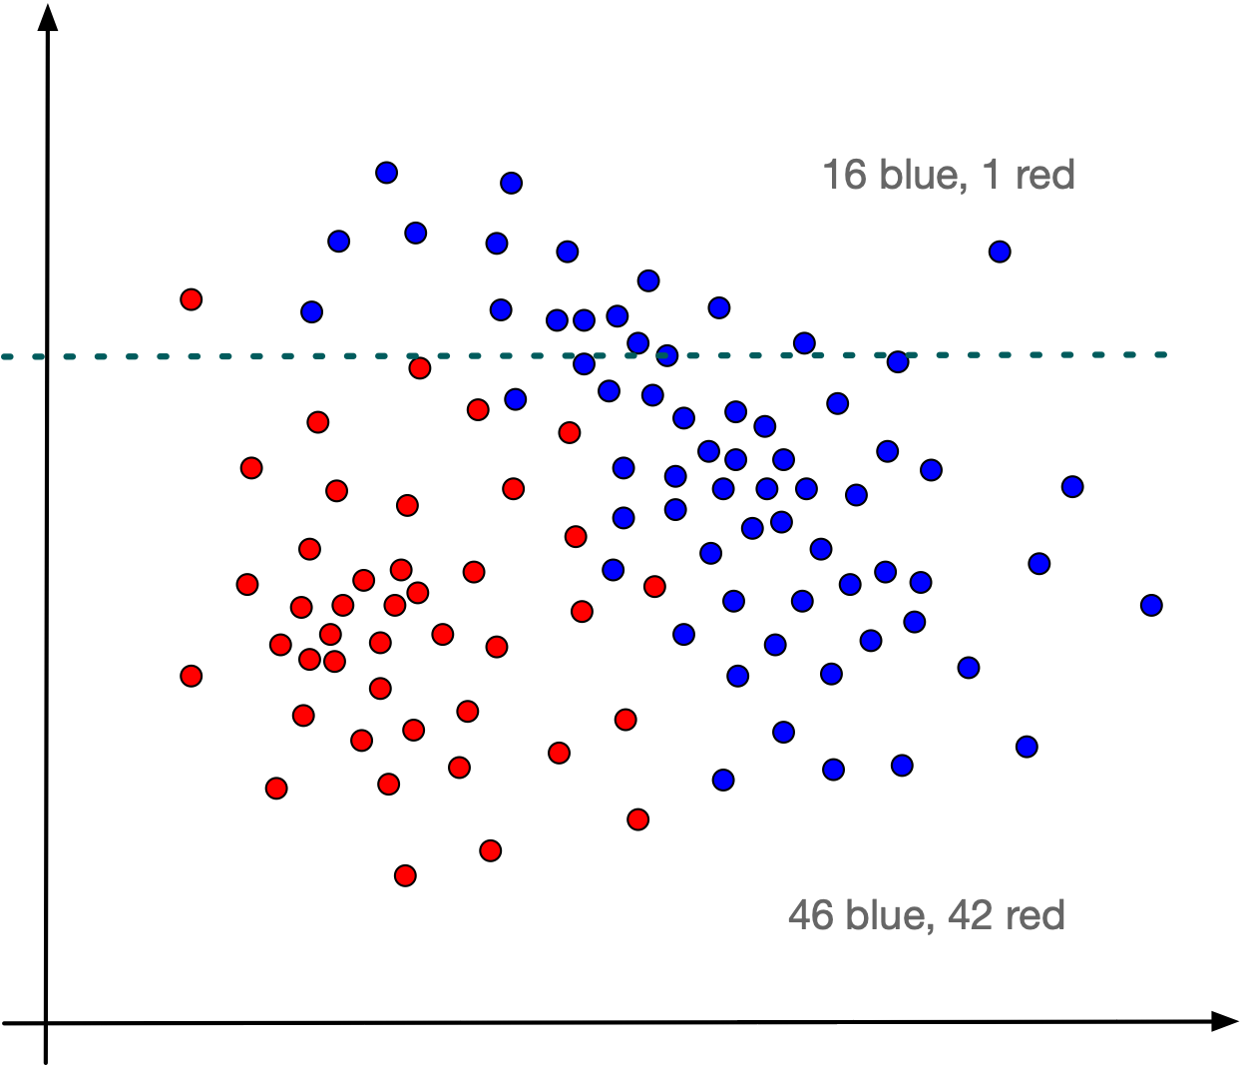
Building a Decision Tree
Introduce a single boundary
Almost all points above the line are blue

Slide 55
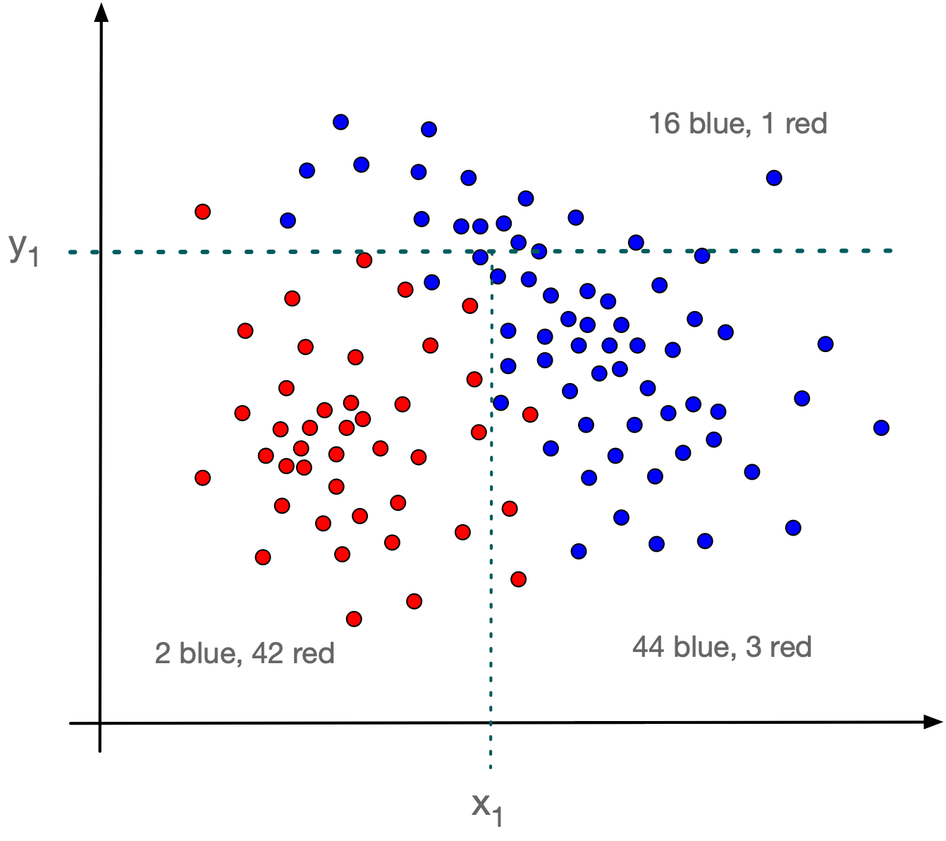
Building a Decision Tree
Subdivide the area below the line
Defines three almost homogeneous regions

Slide 56
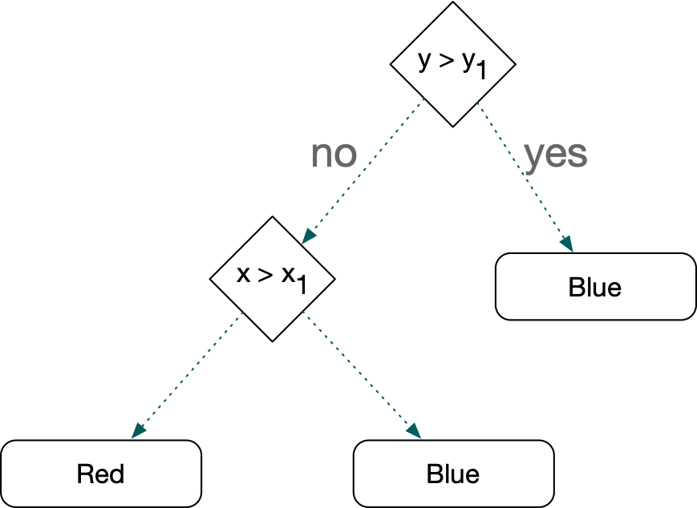
Building a Decision Tree
Express as a decision tree

Slide 57
Building a Decision Tree
Decision trees are easy to explain
Might more closely mirror human decision making
Can be displayed graphically and are easily interpreted by a non-expert
Can easily extend to non-numeric variables
Tend do not be as accurate as other simple methods
Non-robust: Small changes in data sets give rise to completely different final trees

Slide 58
Building a Decision Tree
If a new point with coordinates (x, y) is considered
Use the decision tree to predict the color of the point
Decision tree is not always correct even on the points used to develop it
But it is mostly right
If new points behave like the old ones
Expect the rules to be mostly correct

Slide 59
Building a Decision Tree
How do we build decision trees
Many algorithms were tried out and compared
First rule: Decisions should be simple, involving only one coordinate
Second rule: If decision rules are complex they are likely to not generalize
E.g.: the lone red point in the upper region is probably an outlier and not indicative of general behavior

Slide 60
Building a Decision Tree
How do we build decision trees
Third rule:
Don't get carried away
Prune trees to avoid overfitting

Slide 61
Building a Decision Tree
Algorithm for decision trees:
Find a simple rule:
Maximizes the information gain
Continue sub-diving the regions
Stop when a region is homogeneous or almost homogeneous
Stop when a region becomes too small

Slide 62
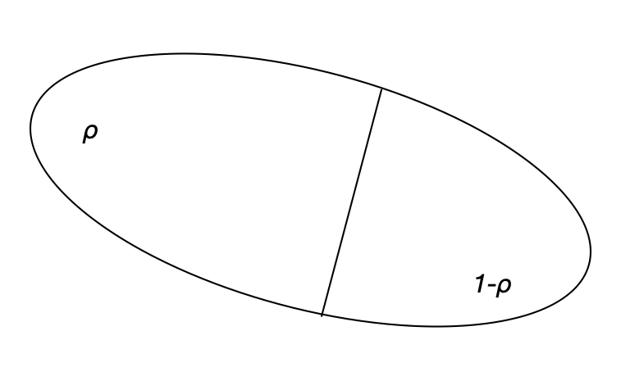
Building a Decision Tree
Information Gain from a split:
$μ$ information measure before
$μ_{1},μ_{2}$ information measures in the split parts
$$\text{Information gain}=μ-(ρμ_{1}+(1-ρ)μ_{2})$$

Slide 63
Processing Iris
We need to read in iris.csv
The last component is a string, which now needs an encoding (but we can pick the encoding to be None for the default)
We cannot use the default float type for the components

Slide 64
Processing Iris
Using genfromtxt
np.genfromtxt('../Classes2/Iris.csv',
usecols=(1,2,3,4,5),
dtype = None,
encoding = None,
delimiter = ',',
converters = converters,
skip_header=1)
Skip first column

Slide 65
Processing Iris
Using genfromtxt
np.genfromtxt('../Classes2/Iris.csv',
usecols=(1,2,3,4,5),
dtype = None,
encoding = None,
delimiter = ',',
converters = converters,
skip_header=1)
We allow all data-types

Slide 66
Processing Iris
Using genfromtxt
np.genfromtxt('../Classes2/Iris.csv',
usecols=(1,2,3,4,5),
dtype = None,
encoding = None,
delimiter = ',',
converters = converters,
skip_header=1)
We use the default encoding

Slide 67
Processing Iris
Using genfromtxt
np.genfromtxt('../Classes2/Iris.csv',
usecols=(1,2,3,4,5),
dtype = None,
encoding = None,
delimiter = ',',
converters = converters,
skip_header=1)
It is comma separated

Slide 68
Processing Iris
Using genfromtxt
np.genfromtxt('../Classes2/Iris.csv',
usecols=(1,2,3,4,5),
dtype = None,
encoding = None,
delimiter = ',',
converters = converters,
skip_header=1)
The first line is the header and we skip it

Slide 69
Processing Iris
Using genfromtxt
np.genfromtxt('../Classes2/Iris.csv',
usecols=(1,2,3,4,5),
dtype = None,
encoding = None,
delimiter = ',',
converters = converters,
skip_header=1)
Here we can process the data per column
Column 5 gets encoded
converters={5: lambda astring:
(0 if astring == 'Iris-setosa'
else 1 if astring == 'Iris-versicolor'
else 2)}

Slide 70
Processing Iris
The result of genfromtxt is a "structured array"
Superseded by Pandas, so we do not look at it
After websearch, find a function that converts a structured array into a normal np.array
from numpy.lib.recfunctions import structured_to_unstructured
iris = structured_to_unstructured(
np.genfromtxt('../Classes2/Iris.csv',
usecols=(1,2,3,4,5),
dtype = None,
encoding = None,
delimiter = ',',
converters = converters,
skip_header=1))

Slide 71
Processing Iris
Here is the result
array([[5.1, 3.5, 1.4, 0.2, 0. ],
[4.9, 3. , 1.4, 0.2, 0. ],
[4.7, 3.2, 1.3, 0.2, 0. ],
[4.6, 3.1, 1.5, 0.2, 0. ],
[5. , 3.6, 1.4, 0.2, 0. ],
…
[6.7, 3.3, 5.7, 2.5, 2. ],
[6.7, 3. , 5.2, 2.3, 2. ],
[6.3, 2.5, 5. , 1.9, 2. ],
[6.5, 3. , 5.2, 2. , 2. ],
[6.2, 3.4, 5.4, 2.3, 2. ],
[5.9, 3. , 5.1, 1.8, 2. ]])

Slide 72
Processing Iris
For any slice of Iris, we need to count the types of Iris represented
As can be expected, there is a np.function that does it for us
def counts(iris):
return np.array(
[np.count_nonzero(iris[:,-1]==0.0),
np.count_nonzero(iris[:,-1]==1.0),
np.count_nonzero(iris[:,-1]==2.0)])

Slide 73
Processing Iris
Given a count, we need to calculate the Gini and the Entropy values
def gini(array):
cts = counts(array)/array.shape[0]
return 1-np.sum(cts**2)
def entropy(array):
cts = counts(array)/array.shape[0]
entropy = 0
for ct in cts:
if ct != 0:
entropy -= ct*log(ct,2)
return entropy

Slide 74
Processing Iris
Example:
Gini and Entropy for the iris data set and for the subset without 'Iris-setosa'
>>> gini(iris)
0.6666666666666667
>>> entropy(iris)
1.584962500721156
>>> gini(iris[iris[:,-1]!=0])
0.5
>>> entropy(iris[iris[:,-1]!=0])
1.0

Slide 75
Processing Iris
Now we need to find the candidates for the cuts
np has a function that generates an array of unique, ordered values
We generate this array for each column
And then calculates the midpoints by hand
def candidates(array, column):
values = np.unique(array[:,column])
return [(values[i]+values[i+1])/2 for i in
range(values.size-1)]

Slide 76
Processing Iris
Example:
>>> np.unique(iris[:,1])
array([2. , 2.2, 2.3, 2.4, 2.5, 2.6, 2.7, 2.8,
2.9, 3. , 3.1, 3.2, 3.3, 3.4, 3.5, 3.6,
3.7, 3.8, 3.9, 4. , 4.1, 4.2, 4.4])
>>> candidates(iris,1)
[2.1, 2.25, 2.3499999999999996, 2.45, 2.55, 2.6500000000000004, 2.75, 2.8499999999999996,
2.95, 3.05, 3.1500000000000004, 3.25,
3.3499999999999996, 3.45, 3.55, 3.6500000000000004,
3.75, 3.8499999999999996, 3.95, 4.05, 4.15, 4.300000000000001]

Slide 77
Processing Iris
Remember how to split?
>>> iris[iris[:,1]<2.45]
array([[4.5, 2.3, 1.3, 0.3, 0. ],
[5.5, 2.3, 4. , 1.3, 1. ],
[4.9, 2.4, 3.3, 1. , 1. ],
[5. , 2. , 3.5, 1. , 1. ],
[6. , 2.2, 4. , 1. , 1. ],
[6.2, 2.2, 4.5, 1.5, 1. ],
[5.5, 2.4, 3.8, 1.1, 1. ],
[5.5, 2.4, 3.7, 1. , 1. ],
[6.3, 2.3, 4.4, 1.3, 1. ],
[5. , 2.3, 3.3, 1. , 1. ],
[6. , 2.2, 5. , 1.5, 2. ]])

Slide 78
Processing Iris
And how to count rows?
>>> iris[iris[:,1]<2.45].shape
(11, 5)

Slide 79
Processing Iris
Now we want to figure out the values for a split
We introduce a threshold so that we do not create splits that are too small
def evaluate(array, column, split_value, thrd=3):
left = array[array[:,column] < split_value]
right = array[array[:,column] > split_value]
if left.shape[0] < thrd or right.shape[0] < thrd:
return 0
return gini(array)-
left.shape[0]/array.shape[0]*gini(left)
- right.shape[0]/array.shape[0]*gini(right)

Slide 80
Processing Iris
Evaluate for each column and each candidate split point
>>> for x in candidates(iris, 2):
print(x, evaluate(iris, 2, x))
1.05 0
1.15 0
1.25 0.0182648401826484
1.35 0.052757793764988126
1.45 0.12073490813648302
1.55 0.2182890855457228
1.65 0.2767295597484277
1.7999999999999998 0.3137254901960784
2.45 0.3333333333333334
3.15 0.3236284412755001
3.4 0.3059067626272451
3.6500000000000004 0.2831813576494428

Slide 81
Processing Iris
To find the best value, use np.argmax / np.argmin
Returns the index of the largest / smallest element
def best(array, column):
mps = candidates(array, column)
best_index = np.argmax(
[evaluate(array, column, x) for x in mps])
return (mps[best_index],
evaluate(array, column, mps[best_index]))

Slide 82
Processing Iris
To find the best split, we need to find the best one for all four columns
def overall_best(array):
values = [best(array, column)[1] for column in range(4)]
col = np.argmax(values)
return col, best(array,col)[0], best(array,col)[1]

Slide 83
Processing Iris
Now that we have found good split points, we need to actually do the split
Here, we are using slices, so we do not create new np.arrays
def split(array, column, value):
return array[array[:,column] < value],
array[array[:,column] > value]

Slide 84
Processing Iris
At this point, we can interactively use our function
Best split point:
We split:
And have achieved partial purity
Because everything in l is setosa
>>> overall_best(iris)
(2, 2.45, 0.3333333333333334)
>>> l, r = split(iris, 2, 2.45)
>>> gini(l)
0.0
>>> gini(r)
0.5

Slide 85
Processing Iris
Now we try to split r
Which gives somewhat impure components
>>> overall_best(r)
(3, 1.75, 0.3896940418679548)
>>> rl, rr = split(r, 3, 1.75)
>>> gini(rl)
0.16803840877914955
>>> gini(rr)
0.04253308128544431
>>> rl.shape
(54, 5)
>>> rr.shape
(46, 5)

Slide 86
Processing Iris
We split rl:
We inspect and see that there is not much hope for further division
>>> overall_best(rl)
(2, 4.95, 0.08239026063100136)
>>> rll, rlr = split(rl, 2, 4.95)

Slide 87
Processing Iris
We look at rr and find it almost pure so we stop

Slide 88
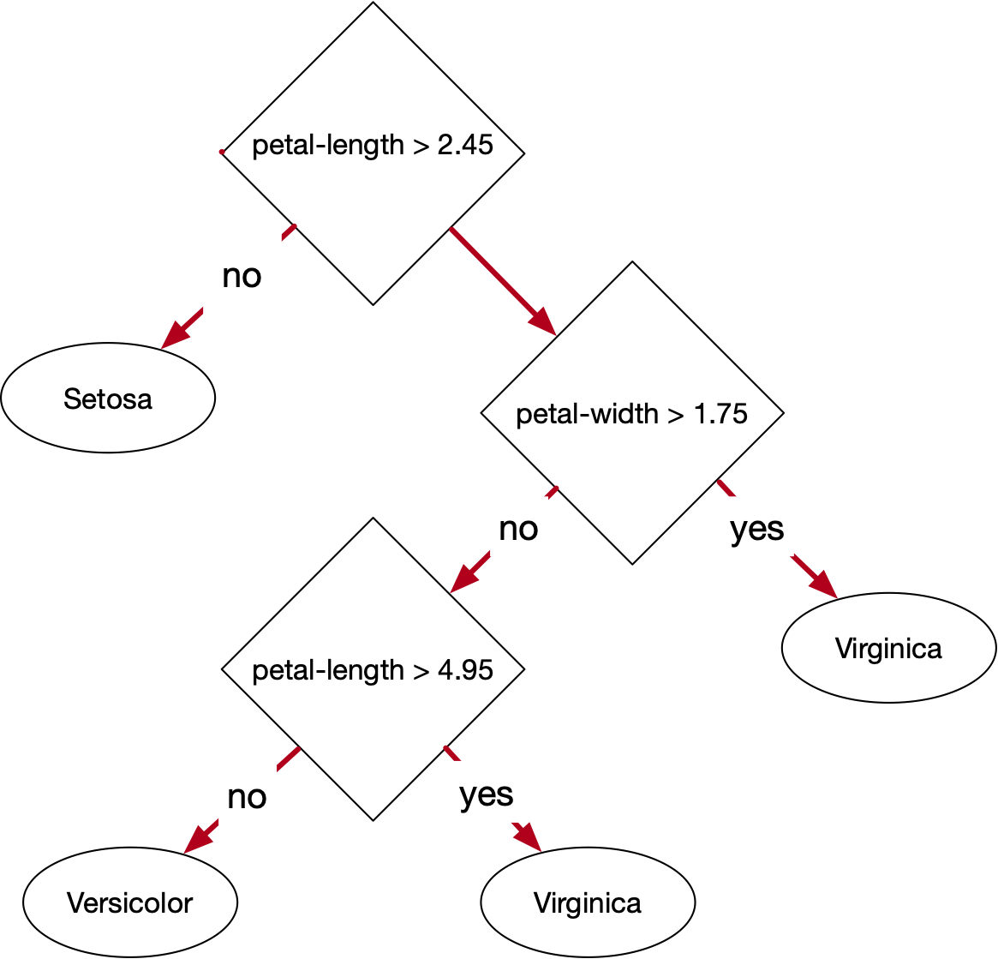
Processing Iris

Slide 89
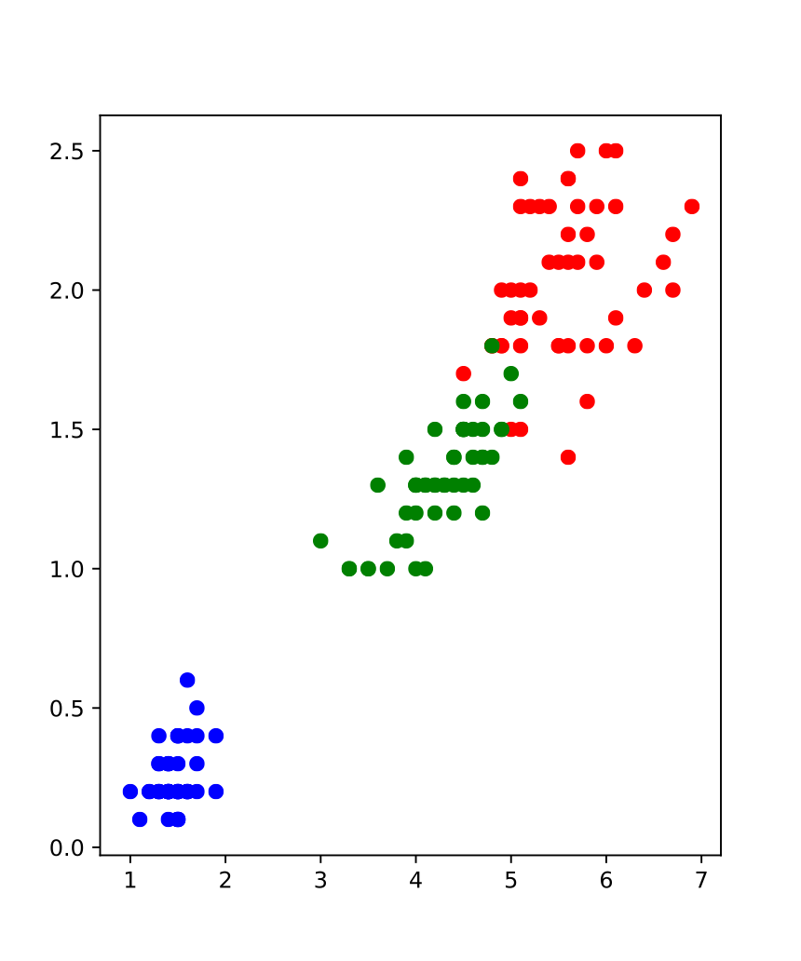
Result
Petal length and width are best at separating types
from matplotlib import pyplot as plt
plt.figure(figsize = (5,6))
plt.scatter( [el[2] for el in Iris if el[-1]==0],
[el[3] for el in Iris if el[-1]==0],
c='red' )
plt.scatter( [el[2] for el in Iris if el[-1]==1],
[el[3] for el in Iris if el[-1]==1],
c='blue' )
plt.scatter( [el[2] for el in Iris if el[-1]==2],
[el[3] for el in Iris if el[-1]==2],
c='green' )
plt.show()

Slide 90
Testing
Let's implement the decision tree:
def predict(element):
if element[2] < 2.45:
return 1
else:
if element[3] < 1.75:
if element[2] < 4.95:
return 2
else:
return 0
else:
return 0

Slide 91
Testing
And see how it works on the test data, taken randomly from the set
One confused element or 1/36 error rate
Total:
Four confused elements out of 150

