Slide 1
Dealing with Files
Thomas Schwarz, SJ

Slide 2
Files
Files
  Basic container of data in modern computing system
  Organized into a hierarchy of directories

Slide 3
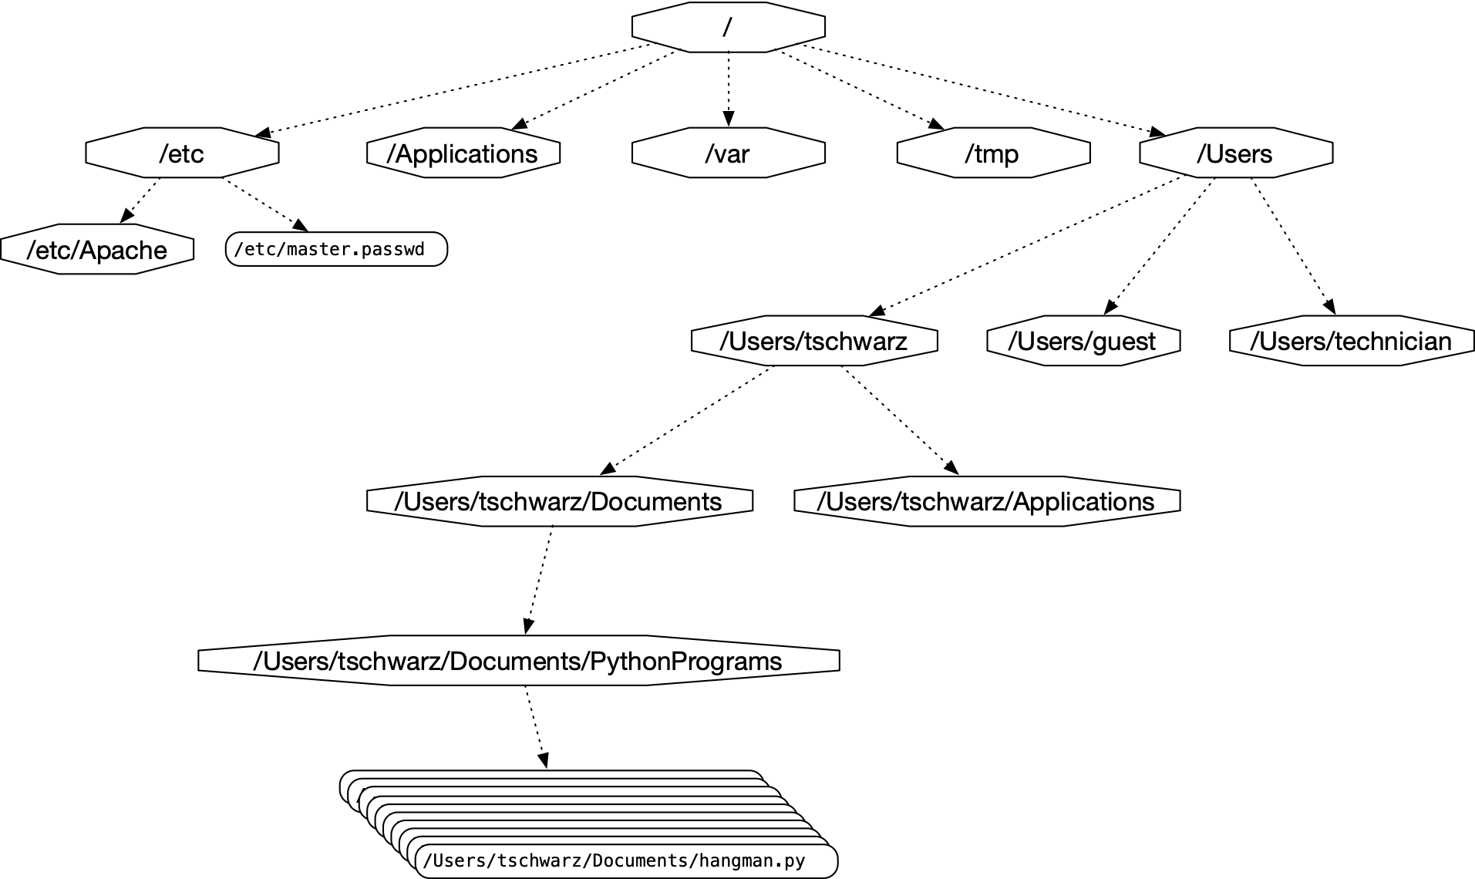
Files
A small subset of directories and files on a system

Slide 4
Files in Python
Files accessed in
  text mode
    Contents interpreted according to encoding
  binary mode
    Contents not interpreted

Slide 5
Files in Python
Python interacts by files through
  reading
  writing / appending
  both

Slide 6
Files in Python
Files need to be opened
  File given by name
    Relative path: Navigation from directory of the file
    Absolute path: Navigation from the root of the file system

Slide 7
Files in Python
  File Name Examples:
    Absolute path on a Mac / Unix
    /Users/tjschwarzsj/Google Drive/AATeaching/Python/Programs/pr.py
    Relate path on a Mac / Unix
      “../“ means move up on directory
    pr.py
    ../Slides/week7.key

Slide 8
Files in Python
Windows uses backward slashes to separate directories in a file name
  Sometimes need to be escaped: \\
  Absolute paths need to include drive name:
    c:\\users\\tschwarz\\My Documents\\Teaching\\temp.py
We will typically read and create files in the same directory as the python program is located

Slide 9
Files in Python
Before files are used, program needs to open them
After they are being used, program should close them
  Will automatically closed when program terminates
  Long-running programs could hog resources

Slide 10
Opening Files in Python
File objects have normal variable names
inFile = open(“data.txt”,”w”)
opens a file “data.txt” in write mode
open takes :
  file name — absolute / relative path
  mode — r (read), w (write), a (appending)
  mode — b (binary), “” or t (text mode)

Slide 11
Closing Files in Python
We close file by invoking close
  inFile.close()

Slide 12
Why we need to close files
Files are automatically closed when the program terminates
When one application has opened a file for writing it acquires a write lock on the file and no other application can access the file.
When one application has opened a file for reading, it acquires a read lock on the file and no other application can write to it.
If you write programs that last more than a few seconds, you do not want to hog files when you do not need them.

Slide 13
With-clauses
Python 3 allows us to open and close files in a single block (context)
with open("twoft8.11.txt") as inFile, open("twoftres8.11.txt", "w") as outFile:
            #Here you work with the file

Slide 14
Processing Files in Python
We write strings to the file
with open(‘somefile.txt’,’wt’) as f:
      f.write(str(500)+”\n")
Redirect print
with open(‘somefile.txt’,’wt’) as f:
      print(500, file = f)

Slide 15
Processing Files in Python
Reading files
  The read-instruction
        string = inFile.read(10)
        reads ten bytes of the file
  Read the entire file
        with open('somefile.txt', 'rt') as f:
                data = f.read()

Slide 16
Processing Files in Python
Reading files
  Read line by line
      with open('somefile.txt', 'rt') as f:
  for line in f:
    #process line

Slide 17
More String Processing
To process read lines:
  strip() and its variants lstrip(), rstrip()
    Remove white spaces (default) or list of characters from the beginning & end of the string
  split() creates a list of words separated by white space (default)
      "This is a sentence with many words in it.".split()
      ['This', 'is', 'a', 'sentence', 'with', 'many', 'words', 'in', 'it.']

Slide 18
Examples
Finding all words over 13 letters long in “Alice in Wonderland”
  Download from Project Gutenberg
import string
with open("alice.txt", "rt", encoding = "utf-8") as f:
for line in f:
for word in line.split():
if len(word) > 13:
print(word)

Slide 19
Examples
Count the number of words and of lines in “Alice in Wonderland”
  Read the file line by line
    The number of words in a line is the length of line.split.
import string
line_counter = 0
word_counter = 0
with open("alice.txt", "rt", encoding = "utf-8") as f:
for line in f:
line_counter += 1
word_counter += len(line.split())
print(line_counter, word_counter)

Slide 20
Problems with Line Endings
ASCII code was developed when computers wrote to teleprinters.
  A new line consisted of a carriage return followed or preceded by a line-feed.
UNIX and windows choose to different encodings
  Unix has just the newline character “\n”
  Windows has the carriage return: “\r\n”
By default, Python operates in “universal newline mode”
  All common newline combinations are understood
  Python writes new lines with the system default
You could disable this mechanism by opening a file with the universal newline mode disabled by saying:
  open(“filename.txt”, newline='')

Slide 21
Encodings
Information technology has developed a large number of ways of storing particular data
  Here is some background
Using a forensics tool (Winhex) in order
to reveal the bytes actually stored

Slide 22
Encodings
Teleprinters
    Used to send printed messages
      Can be done through a single line
      Use timing to synchronize up and down values

Slide 23
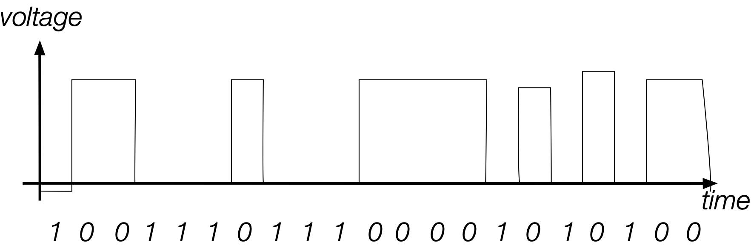
Encodings
Serial connection:
  Voltage level during an interval indicates a bit
  Digital means that changes in voltage level can be tolerated without information loss

Slide 24
Encodings
Parallel Connection
  Can send more than one bit at a time
  Sometimes, one line sends a timing signal

Slide 25
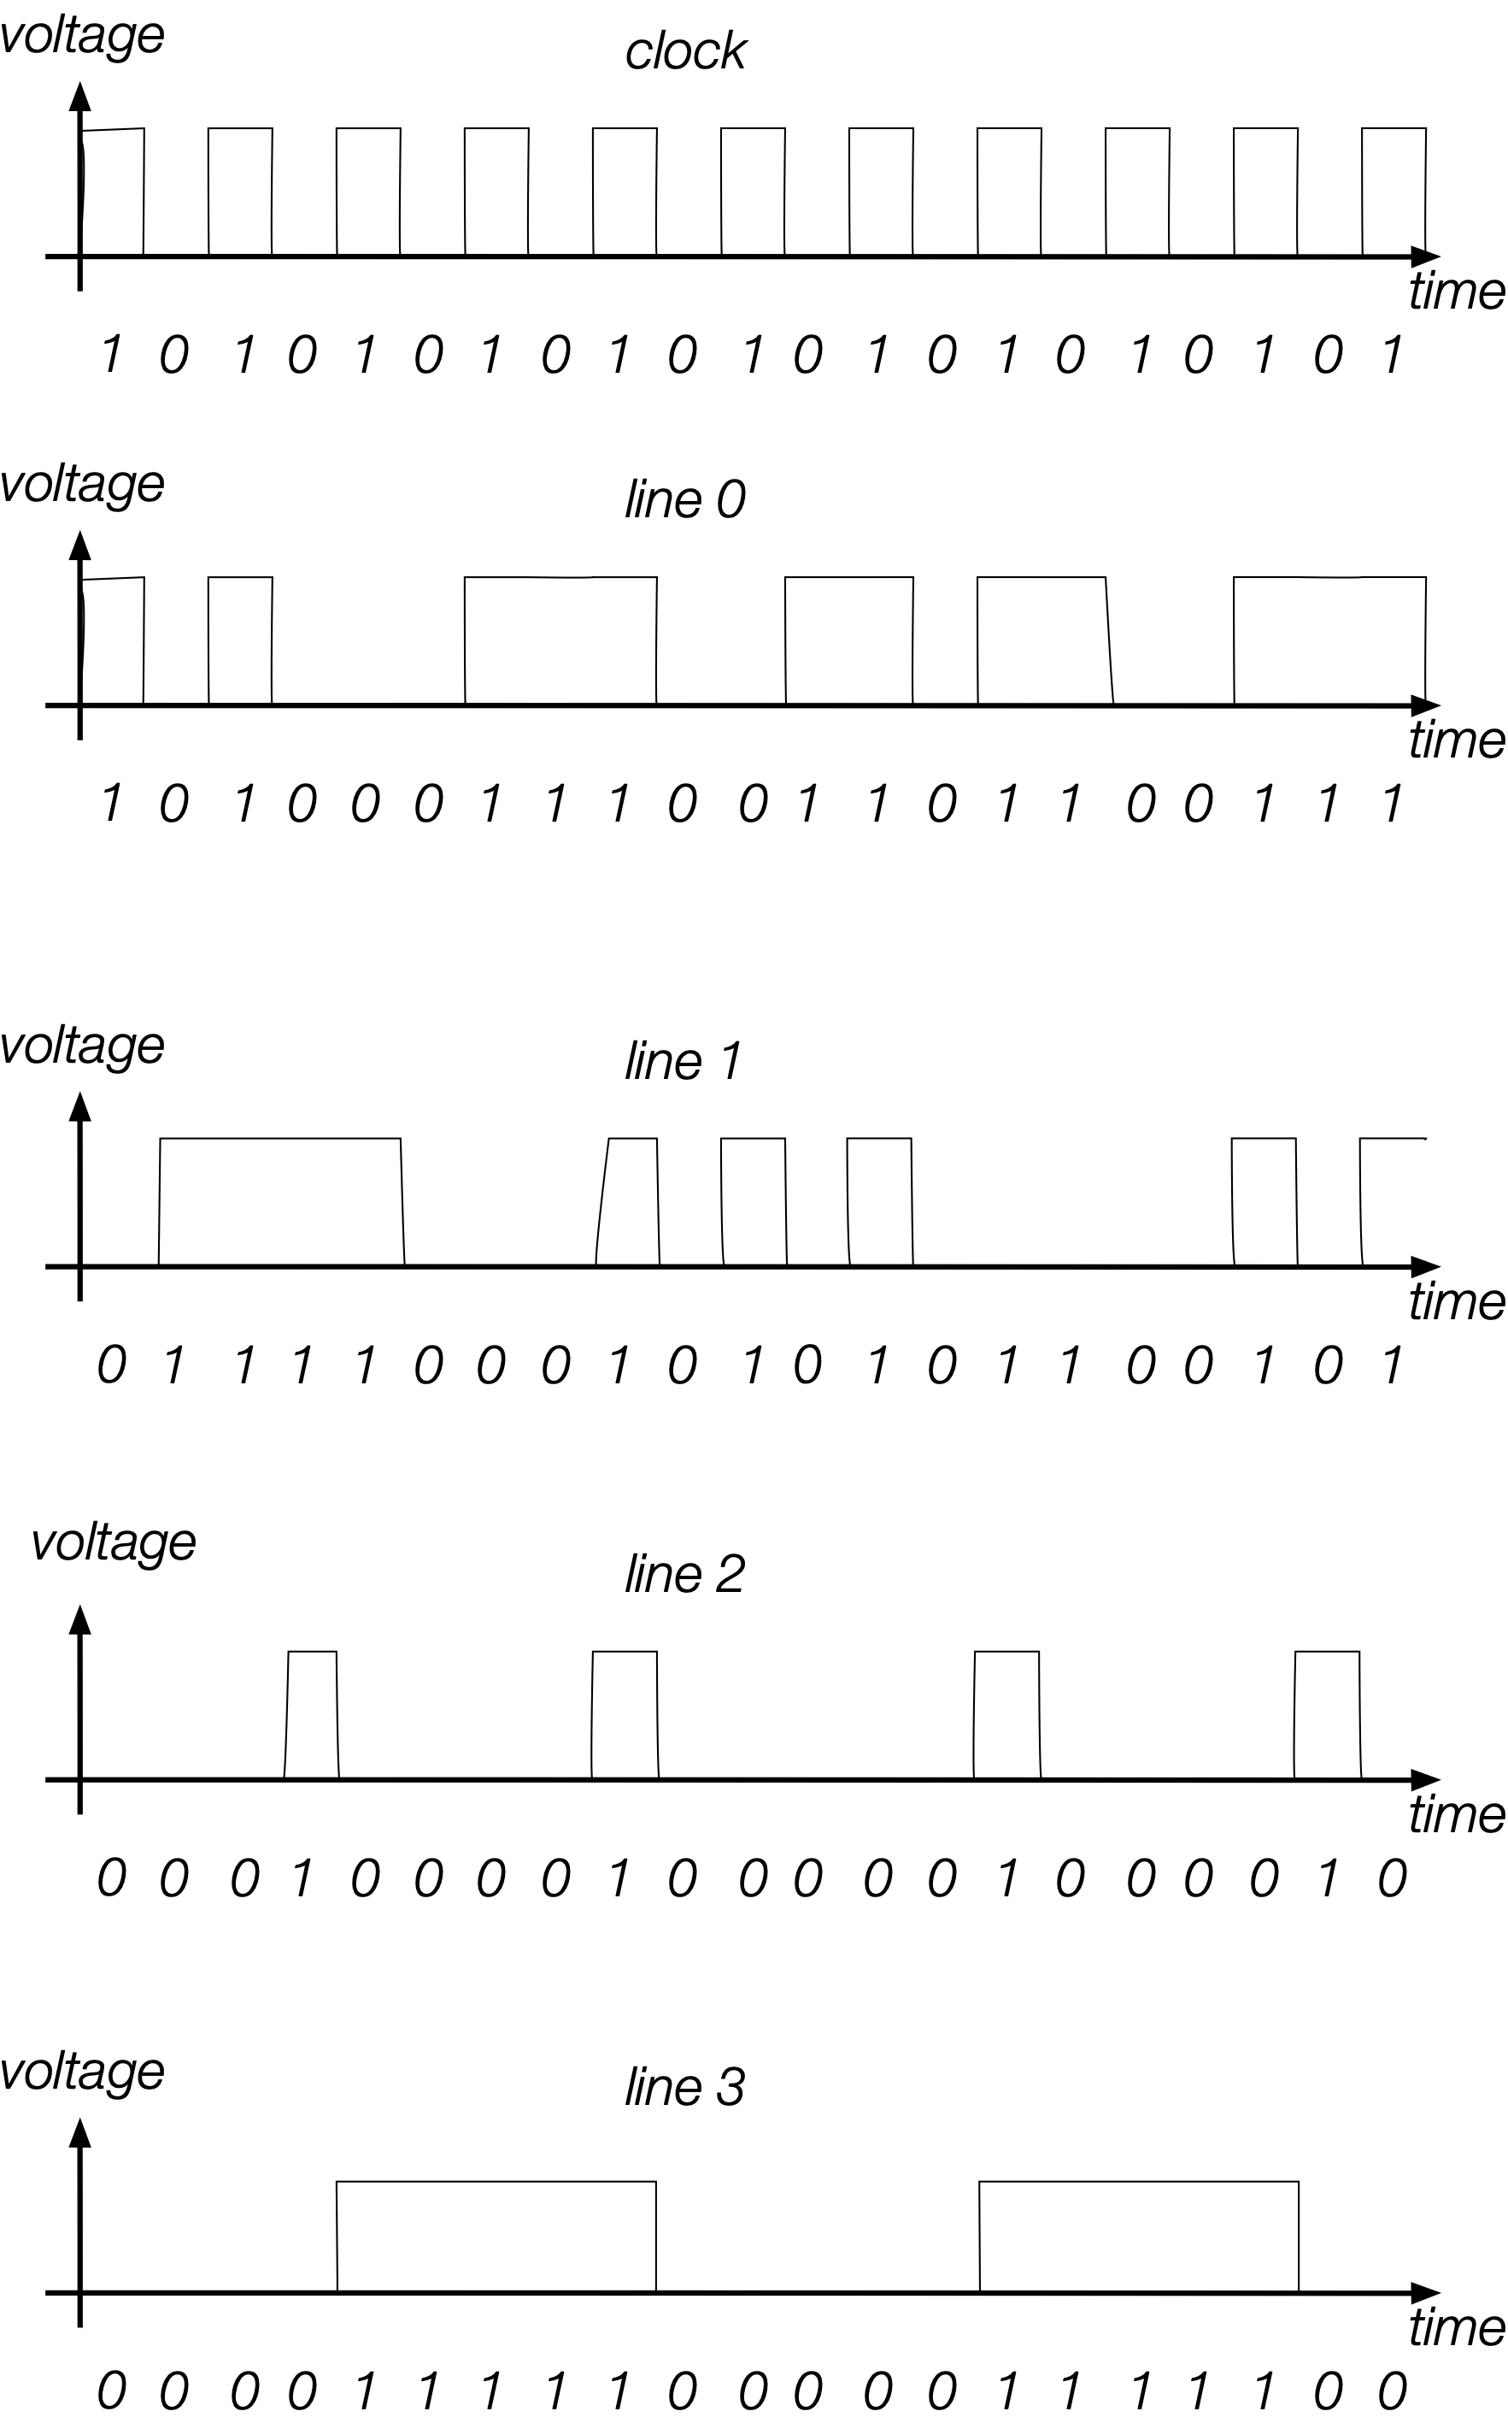
Encodings
Sending
  1000
  0100
  1100
  0100
  …
Small errors in timing and voltage are repaired automatically

Slide 26
Encodings
Need a code to transmit letters and control signals
Émile Baudot’s code 1870
  5 bit code
    Machine had 5 keys, two for the left and three for the right hand
    Encodes capital letters plus NULL and DEL
    Operators had to keep a rhythm to be understood on the other side

Slide 27
Encodings
Many successors to Baudot’s code
  Murray’s code (1901) for keyboard
    Introduced control characters such as Carriage Return (CR) and Line Feed (LF)
    Used by Western Union until 1950

Slide 28
Encodings
Computers and punch cards
  Needed an encoding for strings
    EBCDIC — 1963 for punch cards by IBM
    8b code

Slide 29
Encodings
ASCII — American Standard Code for Information Interchange — 1963
  8b code
    Developed by American Standard Association, which became American National Standards Institute (ANSI)
    32 control characters
    91 alphanumerical and symbol characters
    Used only 7b to encode them to allow local variants
  Extended ASCII
    Uses full 8b
      Chooses letters for Western languages

Slide 30
Encodings
Unicode - 1991
  “Universal code” capable of implementing text in all relevant languages
  32b-code
  For compression, uses “language planes”

Slide 31
Encodings
UTF-7 — 1998
  7b-code
    Invented to send email more efficiently
    Compatible with basic ASCII
    Not used because of awkwardness in translating 7b pieces in 8b computer architecture

Slide 32
Encodings
UTF-8 — Unicode
  Code that uses
    8b for the first 128 characters (basically ASCII)
    16b for the next 1920 characters
      Latin alphabets, Cyrillic, Coptic, Armenian, Hebrew, Arabic, Syriac, Thaana, N’Ko
    24b for
      Chinese, Japanese, Koreans
    32b for
      Everything else

Slide 33
Encodings
Numbers
  There is a variety of ways of storing numbers (integers)
    All based on the binary format
  For floating point numbers, the exact format has a large influence on the accuracy of calculations
    All computers use the IEEE standard

Slide 34
Python and Encodings
Python “understands” several hundred encodings
  Most important
    ascii (corresponds to the 7-bit ASCII standard)
    utf-8 (usually your best bet for data from the Web)
    latin-1
      straight-forward interpretation of the 8-bit extended ASCII
      never throws a “cannot decode” error
      no guarantee that it read things the right way

Slide 35
Python and Encodings
If Python tries to read a file and cannot decode, it throws a decoding exception and terminates execution
We will learn about exceptions and how to handle them soon.
For the time being: Write code that tells you where the problem is (e.g. by using line-numbers) and then fix the input.
Usually, the presence of decoding errors means that you read the file in the wrong encoding

Slide 36
Using the os-module
With the os-module, you can obtain greater access to the file system
  Here is code to get the files in a directory
import os
def list_files(dir_name):
files = os.listdir(dir_name)
for my_file in files:
print(my_file, os.path.getsize(dir_name+"/"+my_file))
list_files(“Example")

Slide 37
Using the os-module
Get a list of file names in the directory
import os
def list_files(dir_name):
files = os.listdir(dir_name)
for my_file in files:
print(my_file, os.path.getsize(dir_name+"/"+my_file))
list_files(“Example")

Slide 38
Use the os-module
import os
def list_files(dir_name):
files = os.listdir(dir_name)
for my_file in files:
print(my_file, os.path.getsize(dir_name+"/"+my_file))
list_files(“Example")
Creating the path name to the file

Slide 39
Use the os-module
import os
def list_files(dir_name):
files = os.listdir(dir_name)
for my_file in files:
print(my_file, os.path.getsize(dir_name+"/"+my_file))
list_files(“Example")
Gives the size of the file in bytes

Slide 40
Use the os-module
import os
def list_files(dir_name):
files = os.listdir(dir_name)
for my_file in files:
print(my_file, os.path.getsize(dir_name+"/"+my_file))
list_files(“Example")
List and

Slide 41
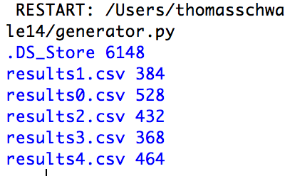
Use the os-module
Output:
  Note the Mac-trash file

Slide 42
Use the os-module
Using the listing capability of the os-module, we can process all files in a directory
  To avoid surprises, we best check the extension
  Assume a function process_a_file
    Our function opens a comma-separated (.csv) file
    Calculates the average of the ratios of the second over the first entries

Slide 43
Use the os-module
1.290, 12.495
2.295, 11.706
3.063, 9.083
4.058, 4.112
4.891, 34.675
5.737, 26.422
7.137, 13.041
7.832, 22.620
9.103, 27.732
9.885, 45.692
11.411, 59.964
11.895, 43.350
12.867, 57.141
13.633, 77.273
14.560, 85.039
16.369, 86.708
16.902,109.293
18.466,114.118
19.454,117.050
19.918,130.860
21.390,139.678
22.411,159.317
23.418,174.622
24.417,181.855
The process_a_file takes the file-name
  Calculates the average ratio
1.147, 1.093
1.997, 8.833
2.781, 10.032
4.225, 9.733
5.455, 15.820
6.151, 20.939
6.573, 26.547
8.058, 33.335
9.132, 37.546
10.474, 47.130
11.207, 50.559
12.413, 62.268
12.525, 68.175
13.826, 76.877
15.327, 84.574
15.664, 93.389
17.446,103.726
18.347,111.623
18.655,119.797
19.581,130.094
21.190,143.306
21.979,154.047
23.250,169.502
24.406,178.782
24.650,190.953
25.846,199.131
27.373,214.514
28.126,232.827
28.580,245.687
30.360,256.452
31.337,270.849
31.583,288.109
33.288,303.786
0.929, 9.373
1.858, 14.439
3.022, 21.861
3.751, 19.097
4.775, 10.838
6.253, 0.280
6.776, 37.029
8.395, 37.459
9.252, 27.295
9.602, 34.994
10.997, 37.458
11.696, 66.393
13.323, 62.255
14.480, 84.116
14.622, 87.145
16.397, 74.933
16.619,125.048
17.838,110.667
19.352,109.947
19.587,118.509
21.312,152.398
21.628,145.806
23.242,176.448
24.191,155.716
24.818,182.198
26.495,197.358
26.831,214.137
1.147, 1.093
1.997, 8.833
2.781, 10.032
4.225, 9.733
5.455, 15.820
6.151, 20.939
6.573, 26.547
8.058, 33.335
9.132, 37.546
10.474, 47.130
11.207, 50.559
12.413, 62.268
12.525, 68.175
13.826, 76.877
15.327, 84.574
15.664, 93.389
17.446,103.726
18.347,111.623
18.655,119.797
19.581,130.094
21.190,143.306
21.979,154.047
23.250,169.502
24.406,178.782
24.650,190.953
25.846,199.131
27.373,214.514
28.126,232.827
28.580,245.687
30.360,256.452
31.337,270.849
31.583,288.109
33.288,303.786
def process_a_file(file_name):
with open(file_name, "r") as infile:
suma = 0
nr_lines = 0
for line in infile:
nr_lines+=1
array = line.split(',')
suma+= float(array[1])/float(array[0])
return suma/nr_lines

Slide 44
Use the os-module
To process the directory
  Get the file names using os
  For each file name:
    Check whether the file name ends with .csv
    Call the process_a_file function
    Print out the result

Slide 45
Use of the os-module
def process_files(dir_name):
files = os.listdir(dir_name)
for my_file in files:
if my_file.endswith('.csv'):
print(my_file, process_a_file(
                “Example/{}”.format(my_file)))
Using format to create the file name

Slide 46
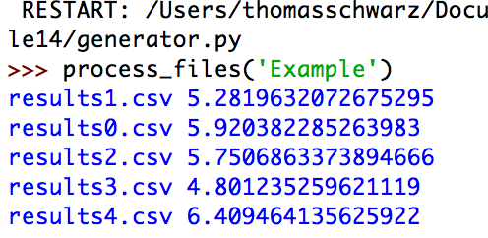
Use of the os-module

Slide 47
Encodings
Whenever you see strings:
  Think about encoding and decoding
    Example: the ë
      'ë'.encode('utf-8').decode('latin-1')
    gives
      'Ã«'
Mixing encodings often creates chaos

Slide 48
Encodings
Python is very good at guessing encodings
  Do not guess encodings
    E.g.: Processing html: read the http header:
      Content-Type: text/html; charset=utf-8
  If you need to guess, there is a module for it:
    chardet.detect(some_bytes)

Slide 49
Encodings
Thinking about encoding and decoding string allows easy internationalization

Slide 50
Bytearrays
On (rare) occasions, you might want to work with bytes directly
  Read the file in binary mode
  Bytearray allows you to manipulate directly binary data
    bytes have range 0-255
  content = bytearray(infile.read())

Slide 51
Exceptions

Slide 52
Exceptions
There are two approaches to living life as a religious:
  Before you do anything, you ask for permission
    Strengthens humility and denial of self
  Do something and then ask for pardon
    Strengthens your Ego too much, but makes it easier on the superior
Similarly: There are two approaches to the risks of live:
  Make sure you are prepared for anything
  Just live your life and deal with the consequences of your errors.
In programming, Python tends to fall squarely into the second category
  But it makes more sense than in real life

Slide 53
Exceptions
RAISING AN EXCEPTION interrupts the flow of the program
HANDLING AN EXCEPTION puts the program flow back on track or deals with an error situation
  Such as out of memory, file cannot be found, CPU illegal instruction error, division by zero, overflow, …

Slide 54
Python Philosophy
Philosopher’s Football
Handle the common case.
  And deal with the exceptions.

Slide 55
C, Java, C++ Philosophy
C: check before you assume
Java, C++: Use exceptions to handle bad situations
Python: Use exceptions for the not so ordinary

Slide 56
Python
If an instruction or block of instruction can cause an error, put it in a try block.
try:
  int(string)
Converts the string into an integer
Notice that we are not using the result of the conversion,
we just attempt the conversion

Slide 57
Python Exceptions
Then afterwards, handle the exception.
  You should, but are not required to specify the possible offending exception
try:
  int(string)
  except ValueError:
    print(“Conversion error”)
If the conversion fails, a ValueError is thrown
This block handles the exception

Slide 58
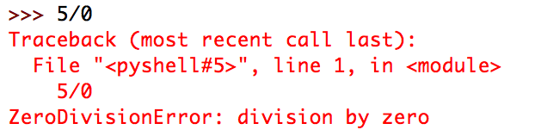
Python Exceptions
How do you find which error is thrown:
  You can cause the error and see what type of error it is
  You can look it up
Division by zero creates a ZeroDivisionError

Slide 59
Python Exceptions
Putting things together: Testing whether a string represents an integer
def is_int(string):
try:
int(string)
return True
except:
return False
Try out the conversion

Slide 60
Python Exceptions
Putting things together: Testing whether a string represents an integer
def is_int(string):
try:
int(string)
return True
except:
return False
Try out the conversion
It worked:
We return True

Slide 61
Python Exceptions
Putting things together: Testing whether a string represents an integer
def is_int(string):
try:
int(string)
return True
except:
return False
Try out the conversion
It did NOT work:
An exception is thrown
We return FALSE

Slide 62
Python Exceptions
As you can see from this example, the moment an exception is thrown, we jump to the exception handler.

Slide 63
Python Exceptions
When to use exceptions and when to use if
  Recall: Using if is defensive programming
  Recall: Using exceptions amounts to the same degree of safety, but is offensive
Rule of thumb:
  If exceptions are raised infrequently, then use them

Slide 64
Python Exceptions
Let’s make some timing experiments
  Define two functions that square all elements in a list, if the elements are integers.
def square_list(lista):
result = []
for element in lista:
if element.isdigit():
result.append(int(element)**2)
def square_list2(lista):
result = []
for element in lista:
try:
result.append(int(element)**2)
except:
pass

Slide 65
Python Exceptions
The pass instruction:
  When Python expects a statement, but we don’t have one:
    Just use pass
      The No-Operation instruction

Slide 66
Python Exceptions
Recall how to use the time-module to obtain the CPU (wall-clock) time
We use this to measure execution time
  First a list that only contains integers
def timeit(function, trials):
lista = [str(i) for i in range(1000000)]
count = 0
for _ in range(trials):
start = time.time()
lista2 = function(lista)
count += time.time()-start
return count/trials

Slide 67
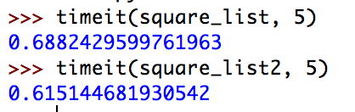
Python Exceptions
Result: Exceptions are somewhat faster

Slide 68
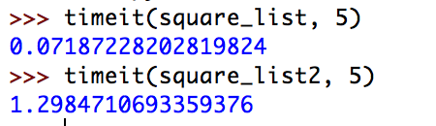
Python Exceptions
What if none of the list elements are integers:
def timeit(function, trials):
lista = ["a"+str(i) for i in range(1000000)]
count = 0
for _ in range(trials):
start = time.time()
lista2 = function(lista)
count += time.time()-start
return count/trials
Exceptions are much slower

Slide 69
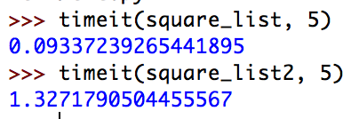
Python Exceptions
What about if the letter is at the end
def timeit(function, trials):
lista = [str(i)+"a" for i in range(1000000)]
count = 0
for _ in range(trials):
start = time.time()
lista2 = function(lista)
count += time.time()-start
return count/trials
Exceptions are still much slower

Slide 70
Self Test
Define a function that calculates the geometric mean of two numbers.
Use an exception to deal with a ValueError, arisen by taking the square-root of a negative number
  Here is the if-version. We return None if there is no mean.
def geo(x, y):
if x*y > 0:
return math.sqrt(x*y)
return None

Slide 71
Self Test Solution
def geoe(x,y):
try:
return math.sqrt(x*y)
except ValueError:
return None

Slide 72
Multiple Exceptions
We can write an exception handler that handles all the exceptions
  This is discouraged since there are just too many exceptions that can occur
    such as out-of-memory, system-error, keyboard-interrupt …
  In this case, the except clause specifies no exception
try:
accum += 1/n
except:
      print(“something bad happened”)
No exception specified
Handler handles everything

Slide 73
Multiple Exceptions
Normally, you want to specify which exceptions you are handling
You can specify several exception handles by repeating the exception clause
Or you can handle a list of exceptions
The parentheses are necessary
def test():
try:
f = open("none.txt")
block = f.read(256)
except IOError:
print("something happened when reading the file")
except EOFError:
print("ran out of file")
except (KeyboardInterrupt, ValueError):
print("something strange happened")

Slide 74
Cleaning Up
Sometimes you need to make sure that failure-prone code cleans up
Use the finally clause
  Guaranteed to be executed
    Even with return statements
    Even when exceptions are raised

Slide 75
Example for finally clause
If we open a file without the if-clause, we are morally obliged to close it
  Let’s say, if you have a long-running process that only needs a file for a little time, you should not hog the file and prevent others from accessing it.

Slide 76
Example for finally clause
def harmonic(filename):
"""
Assumes that the elements in the file are numbers.
We return the harmonic mean of the numbers.
"""
count = 0
accumulator = 0
try:
infile = open(filename, encoding="utf-8")
for line in infile:
for words in line.split():
accumulator += 1/int(words)
count += 1
return count/accumulator
except ZeroDivisionError:
print("saw a zero")
return 1000000000
except ValueError:
print("saw a non-integer")
return 0
finally:
print("I am done and closing the file")
infile.close()
Return in the try block
Return in the handler
But finally is guaranteed to run before any of the returns

Slide 77
Raising exceptions
You can also raise your own exception
  You can even define your own exceptions when you have understood classes
  Just say: raise ValueError
  or whatever the exception is that you want to raise.

Slide 78
Self Test
Recall that the finally clause is always executed.
What is the output of the following code
def raising():
try:
raise ValueError
except ValueError:
return 0
finally:
return 1

Slide 79
Answer
The functions returns 1
  The exception is raised and control passes to the exception handler
  Before the exception handler can return, the finally clause is executed
  And that one returns 1

Slide 80
Multiple Exceptions
It is common that Python code throws multiple exceptions
  Can list different exceptions using a tuple and handle them all
  Or write different exception handlers
try:
client_obj.get_url(url)
except (URLError, ValueError, SocketTimeout):
client_obj.remove_url(url)
try:
client_obj.get_url(url)
except (URLError, ValueError):
client_obj.remove_url(url)
except SocketTimeout:
client_obj.handle_url_timeout(url)

Slide 81
Handles to Exceptions
Exceptions are classes that have methods
To gain access use the as keyword
try:
f = open(filename)
except OSError as e:
if e.errno == errno.ENOENT:
print('file not found')
elif e.errno == errno.EACCES:
print('permission denied')
else:
print('unexpected error')

Slide 82
Multiple Exceptions
More than one exception can be triggered
  The first matching exception handler will handle, even if a more specific exception handler is available
    prints out 'it failed'
try:
f = open(a_missing_file)
except OSError:
print('it failed')
except FileNotFoundError:
print('File not found')

Slide 83
Multiple Exceptions
Exceptions are in a hierarchy
    catches all exceptions except SystemExit, KeyboardInterrupt, GeneratorExit
    If you want to catch those, change Exception to BaseException
try:
…
except Exception as e:
…
print(e)

Slide 84
Creating Custom Exceptions
To create a new exception, just define a class that derives from Exception
class NetworkError(Exception):
pass
class TimeoutError(NetworkError):
pass

Slide 85
Creating Custom Exceptions
If your custom exception overrides the constructor
  Make sure you call the exception class constructor
  Parts of Python and libraries except all exceptions to have an .args attribute, that will be provided by calling the super
class CustomError(Exception):
def __init__(self, message, status):
self.message = message
self.status = status

Slide 86
Chaining Exceptions
Raise an exception in response to catching a different exception, but include information about both exceptions in the traceback
def example():
try:
int('N/A')
except ValueError as e:
raise RuntimeError('A parsing error occured') from e

Slide 87
Assertions
To prevent error conditions, can use assertions
  E.g.: your code only runs on a linux machine
  If the condition is violated, throws an AssertionError
  But the assert statements are optimized away when
import sys
assert ('linux' in sys.platform),
'this code runs on linus only')

Slide 88
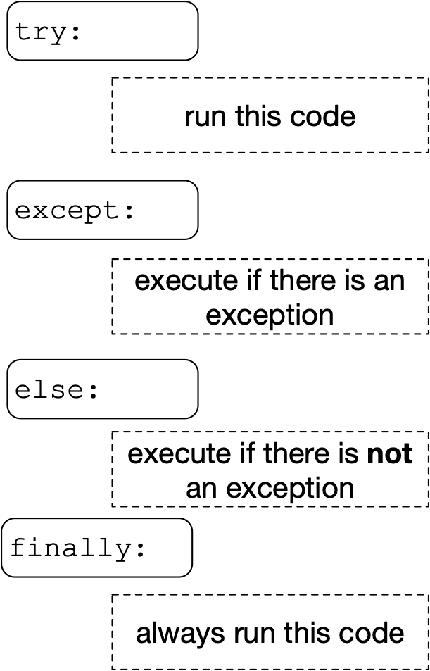
Else Statement
Else block after a try block is executed only if no exception was raised

Slide 89
Else Statement
Exceptions in the else block would not be caught by the current try block
for arg in sys.argv[1:]:
try:
f = open(arg, 'r')
except OSError:
print('cannot open', arg)
else:
print(arg, 'has', len(f.readlines()), 'lines')
f.close()

Slide 90
Exercises
The following code is potentially buggy.
info = [{'score': 3, 'confidence': 2},
{'score': -1, 'confidence': 4},
{'score': 1, 'confidence': 4},
{'confidence': 0}]
def get_total_score(info):
total = 0
for item in info:
  total += item['score']
  return total
get_total_score(info)

Slide 91
Solutions
def get_total_score(info):
total = 0
number_of_items = 0
for item in info:
try:
total += item['score']
except KeyError:
pass
else:
number_of_items += 1
return total/number_of_items
print(get_total_score(info))

Slide 92
Exercises
The following code is potentially buggy.
import os
def check(directory):
for file_name in os.listdir(directory):
with open(file_name) as infile:
nr = len(infile.readlines())
print(file_name, nr)

Slide 93
Solutions
import os
def check(directory):
for file_name in os.listdir(directory):
try:
with open(file_name) as infile:
nr = len(infile.readlines())
print(file_name, nr)
except UnicodeDecodeError:
print('unicode decode error in', file_name)
except IsADirectoryError:
print(f'{file_name} is a directory')

Slide 94
Use Case

Slide 95
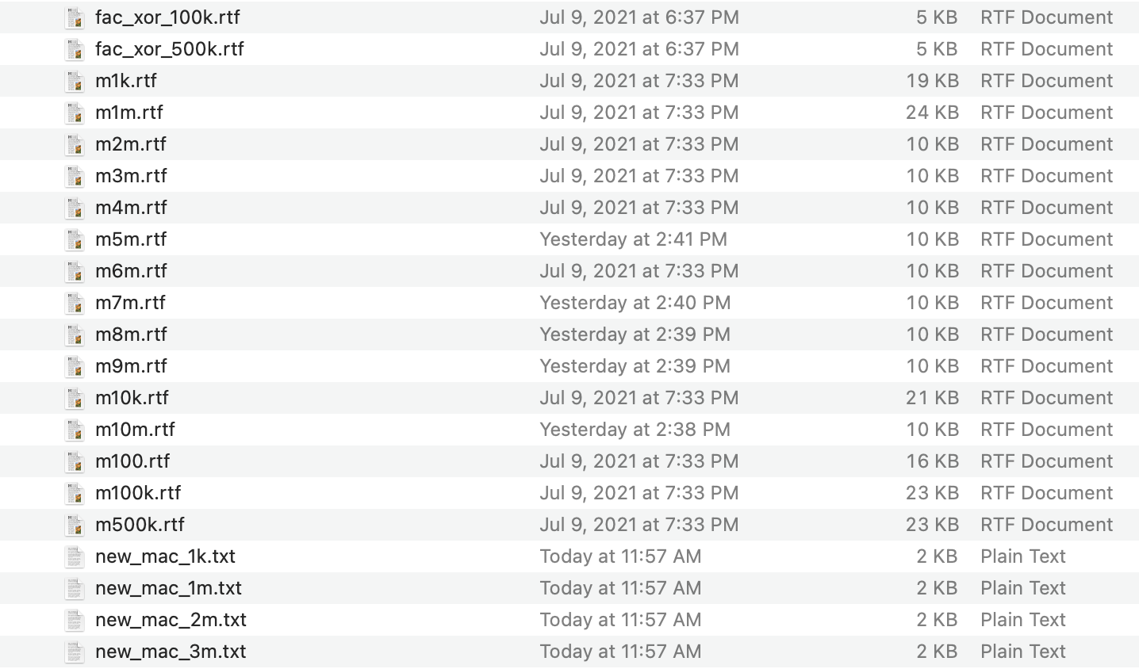
Use Case
Given experimental data in several files, generate statistics: mean, median, standard deviation, min, max
First, need to read and understand the files

Slide 96
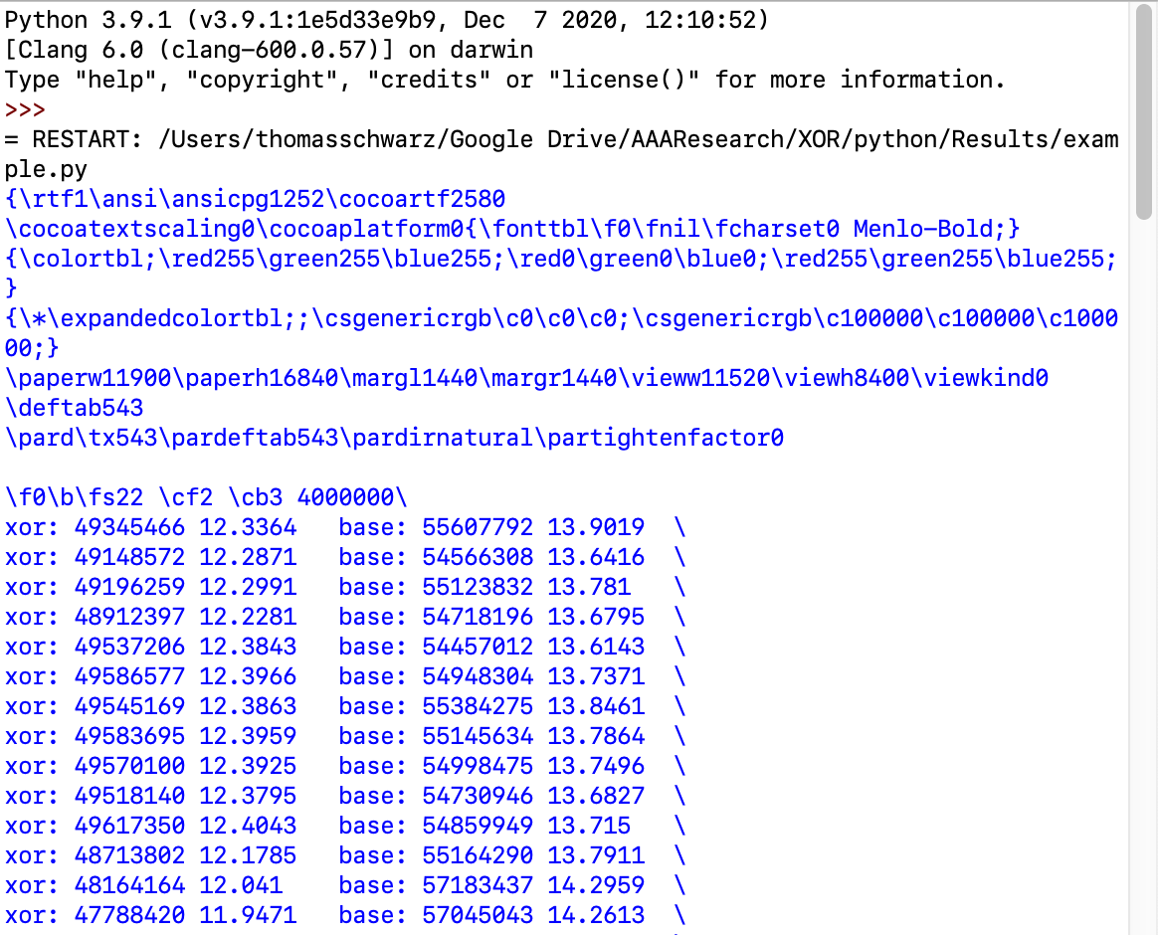
Understanding the File
We want to extract data from the rtf files
  Which is a special format with some metadata
  So, we open up a file and read its contents:
with open('m4m.rtf') as infile:
for line in infile:
print(line.strip())

Slide 97
Understanding the File
First thing: 'rtf' is good because we do not need to struggle with encoding
Second: We want to extract the data from the second and fifth column and get statistics about them
Third: The data is organized into files and the file name gives the parameter. The parameter also appear in the nineth line.
with open('m4m.rtf') as infile:
for _ in range(9):
line = infile.readline()
if '4000000' in line:
print(line)

Slide 98
Checking the File
To open up all the files, we use a for loop
  This gives us more control then using the os-interface because files might be added to the directory
  Trick: Just put the part of the filename into a list that changes

Slide 99
Checking the File
We also want to ensure that the file name and the putative parameter are the same.
  Write the parameters and the filenames into a list
  Then in a for, loop over the zip of the two lists

Slide 100
Checking the File
numbers = [100, 1000, 10000, 100000, 500000, 10**6, 2*10**6, 3*10**6, 4*10**6,
5*10**6, 6*10**6, 7*10**6, 8*10**6, 9*10**6, 10*10**6]
for filename, number in zip(['100','1k', '10k',
'100k', '500k', '1m', '2m', '3m', '4m', '5m',
'6m', '7m', '8m', '9m', '10m'],numbers):
filename = 'm'+filename+'.rtf'
with open(filename) as infile:
for _ in range(9):
line = infile.readline()
if str(number) in line:
print(f'Processing {filename}.')
else:
print(f'Error in {filename}')

Slide 101
Extracting the Data
After the next line, there is data
Extract the second and the fifth column
This uses split
xor: 49345466 12.3364 base: 55607792 13.9019 \
xor: 49148572 12.2871 base: 54566308 13.6416 \
xor: 49196259 12.2991 base: 55123832 13.781 \
xor: 48912397 12.2281 base: 54718196 13.6795 \
xor: 49537206 12.3843 base: 54457012 13.6143 \
xor: 49586577 12.3966 base: 54948304 13.7371 \
for line in infile:
contents = line.strip().split()

Slide 102
Extracting the Data
The result is an array with substrings:
You might notice the escaped back-slash at the end
['xor:', '721', '7.21', 'base:', '1188', '11.88', '\\']
['xor:', '761', '7.61', 'base:', '1192', '11.92', '\\']
['xor:', '754', '7.54', 'base:', '1192', '11.92', '\\']
['xor:', '705', '7.05', 'base:', '1008', '10.08', '\\']
['xor:', '640', '6.4', 'base:', '1047', '10.47', '\\']
['xor:', '608', '6.08', 'base:', '1049', '10.49', '\\']
['xor:', '658', '6.58', 'base:', '1049', '10.49', '\\']
['xor:', '679', '6.79', 'base:', '1049', '10.49', '\\']

Slide 103
Extracting the Data
We convert the substrings to ints and store them in an array each
xor, base = [], []
for line in infile:
contents = line.strip().split()
                try:
                xor.append(int(contents[1]))
                base.append(int(contents[4]))
                except:
                print(line, 'is causing a problem')

Slide 104
Processing the Data
Now we process these numbers
  We are given an array
  We want to obtain min, max, mean, median, standard deviation
  Some of this are built in functions

Slide 105
Processing the Data
Can also use sum on an array
Standard Deviation is the average square of the difference between value and mean
def process(numbers):
mymin = min(numbers)
mymax = max(numbers)
mean = sum(numbers)/len(numbers)
stddev = sum([(x-mean)**2 for x in numbers])/len(numbers)

Slide 106
Processing the Data
Median is the middle value if the number of elements is odd
  and the mean of the two middle numbers if the number of elements is even
  Recall: // is integer (or floor) division
if len(numbers)%2: #odd number of elements
median = numbers[len(numbers)//2]
else: #even number of elements
median = 0.5*(numbers[len(numbers)//2-1]+numbers[len(numbers)//2])

Slide 107
Processing the Data
We use a tuple to return all these values
return mymin, mymax, mean, stddev, median

Slide 108
Output the Results
Now we need to write the results into a file
  Let's open and close it manually
outfile = open('results.csv', 'w')
…
outfile.close()

Slide 109
Output the Results
We write the results into a csv file
We can just use print, though sometimes formatting is more appropriate
  Outside the loop
  Inside the loop
print('number', 'xmymin', 'xmymax', 'xmean', 'xstdev', 'xmedian',
'bmymin', 'bmymax', 'bmean', 'bstdev', 'bmedian',
sep=',', file=outfile)
print(number, xmymin/number, xmymax/number, xmean/number, xstdev/number, xmedian/number,
bmymin/number, bmymax/number, bmean/number, bstdev/number, bmedian/number,
sep=',', file=outfile)

Slide 110
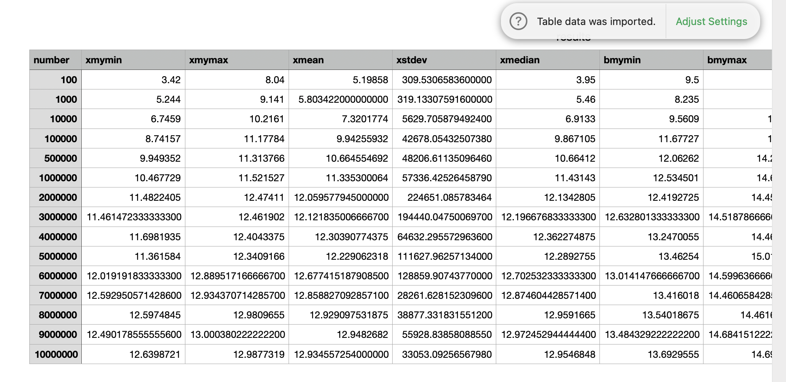
Output the Results
The result can be opened up with a default csv reader

Slide 111
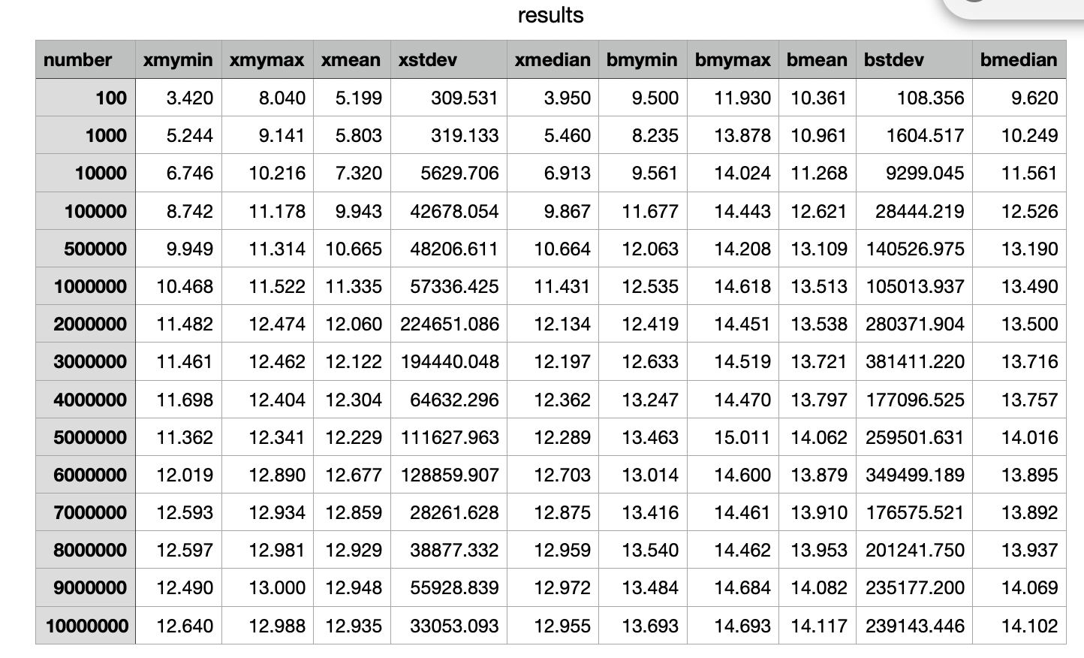
Output the Results
Clearly, a format string is appropriate.

Slide 112
Checking the Results
Which of these columns does not make sense?
Where is the error?

