Slide 1
Functions in Python

Slide 2
Python Functions
Functions defined by keyword def
Can return value with keyword return

Slide 3
Python Functions
Example: A Heron square-root function
def square(S, precision):
""" This is a square root function that uses Heron's Method
"""
x = 1
while not -precision < S-x**2 < precision:
x = 0.5*(x+S/x)
return x

Slide 4
Python Functions
Without return:
Function returns when code is exhausted
Peculiarities:
Neither argument nor return types are specified

Slide 5
Python Functions
This is weird, but legal
Returns a None value for x = 4
Returns int for x=1, string for x=2, float for x=3
def example(x):
if x == 1:
return 1
if x == 2:
return "two"
if x == 3:
return 3.0

Slide 6
Simple Examples
A “fruitless” function that does not return a value:
Printing the first n square numbers
def first_squares(n):
for i in range(1, n+1):
print(i**2)

Slide 7
Simple Examples
A function that returns a power of 2
def power_of_two(x):
return 2**x

Slide 8
Simple Example
A function that calculates the $n$th harmonic number
def har(n):
accu = 0
for i in range(1, n+1):
accu += 1/i
return accu

Slide 9
Simple Example
The harmonic numbers are known to diverge:
They go to infinity
Though numeric inaccuracies make it hard to show this
Create a function that for $x∈R_{>0}$ returns
$$min(\{n:H_{n}>x\})$$

Slide 10
Simple Examples
To determine the smallest number such that $H_{n}$ is larger than $x$:
Use a while loop
Keep adding until harmonic number is larger
The while condition is that the accumulator is smaller than $x$

Slide 11
Simple Example
while-solution
def min_har(x):
accu = 0
i = 0
while accu < x:
i+= 1
accu += 1/i
return i

Slide 12
Functions of Functions
Functions are full-fledged objects in Python
This means you can pass functions as parameters
Example: Calculate the average of the values of a function at -n, -n+1, -n+2, …, -2, -1, 0, 1, 2, … , n-2, n-1, n
The function needs to be a function of one integer variable
Example:
n = 2, function is squaring
Return value is
$$((-2)^{2}+(-1)^{2}+0^{2}+1^{2}+2^{2})/5=2$$

Slide 13
Functions of Functions
We first define the averaging function with two arguments
The number n
The function over which we average, called func
def averaging(n, func):

Slide 14
Functions of Functions
Inside the function, we create an accumulator and a loop index, running from -n to n.
def averaging(n, func):
accu = 0
for i in range(-n, n+1):

Slide 15
Functions of Functions
Inside the loop, we modify the accumulator accu by adding the value of the function at the loop variable.
def averaging(n, func):
accu = 0
for i in range(-n, n+1):
accu += func(i)

Slide 16
Functions of Functions
There are 2n+1 points at which we evaluate the function.
We then return the average as the accumulator over the number of points
def averaging(n, func):
accu = 0
for i in range(-n, n+1):
accu += func(i)
return accu/(2*n+1)

Slide 17
Functions of Functions
In order to try this out, we need to use a function
We can just define one in order to try out our averaging function
def square(number):
return number*number
def averaging(n, func):
accu = 0
for i in range(-n, n+1):
accu += func(i)
return accu/(2*n+1)
print(averaging(2, square))

Slide 18
Local Functions
Can have a function definition inside a function
Not many use cases
def factorial(number):
if not isinstance(number, int):
raise TypeError("sorry", number, "must be an integer")
if not number >= 0:
raise ValueError("sorry", number, "must be positive")
def inner_factorial(number):
if number <= 1:
return 1
return number * inner_factorial(number-1)
return inner_factorial(number)

Slide 19
Local and Global Variables
A Python function is an independent part of a program
It has its own set of variables
Called local variables
It can also access variables of the environment in which the function is called.
These are global variables
The space where variables live is called their scope
We will revisit this issue in the future

Slide 20
Examples
a=3
b=2
def foo(x):
return a+x
def bar(x):
b=1
return b+x
print(foo(3), bar(3))
a and b are two global variables
In function foo:
a is global, its value remains 3
In function bar:
b is local, since it is redefined to be 1

Slide 21
The global keyword
In the previous example, we generated a local variable b by just assigning a value to it.
There are now two variables with name b
In bar, the global variable is hidden
If we want to assign to the global variable, then we can use the keyword global to make b refer to the global variable. An assignment then does not create a new local variable, but rather changes the value of the old one.

Slide 22
Example
In foo:
A local variable b
A global variable a
The value of a changes by executing foo( )
a = 1
b = 2
def foo():
global a
a = 2
b = 3
print("In foo:" , "a=", a, " b=", b)
print("Outside foo: " ,"a=", a, " b=", b)
foo()
print("Outside foo: " ,"a=", a, " b=", b)
##Outside foo: a= 1 b= 2
##In foo: a= 2 b= 3
##Outside foo: a= 2 b= 2

Slide 23
Scoping
Global scope:
Names that we define are visible to all our code
Local scope:
Names that we define are only visible to the current function

Slide 24
Scoping
LEGB — rule to resolve names
Local
Enclosed (e.g. enclosing function)
Global
Built-in

Slide 25
Functions with Default Arguments
We have created functions that have positional arguments
Example:
When we invoke this function, the first argument (2) gets plugged into variable foo and the second argument (3) get plugged into variable bar
def fun(foo, bar):
print(2*foo+bar)
fun(2, 3)

Slide 26
Keyword (Named) Arguments
We can also use the names of the variables in the function definition.
Example: (we soon learn how to deal better with errors)
def quadratic(a, b, c):
if b**2-4*a*c >= 0:
return -b/(2*a) + math.sqrt(b**2-4*a*c)/(2*a)
else:
print("Error: no solution")
print(quadratic(1, -4, 4)) #CALL BY POSITION
print(quadratic(c=4, a=1, b=-4) #CALL BY KEYWORD

Slide 27
Keyword (Named) Arguments
Keyword arguments have advantages
If you have a function with many positional arguments, then you need to carefully match them up
At least, you can use the help function in order to figure out what each argument does, if you named them well in the function definition

Slide 28
Keyword (Named) Arguments
You can force the user of a function to use keywords by introducing an asterisk into the definition of the function:
All arguments after the asterisk need to be passed by keyword
The arguments before the asterisk can be positional
def fun(a, b, *, c):
…
print(fun(2, 3, c=5)

Slide 29
Pythonic Tip
If you want to write understandable code:
Use keyword arguments
Use reasonable default values
Write a documentation
Three quotation marks followed by remarks followed by three quotation marks

Slide 30
Default arguments
You have already interacted with built-in functions that use default arguments
Print:
end: How the string is terminated (default is new-line character)
sep: What comes between different outputs (default is space)
file: Location of output (default is “standard output”)

Slide 31
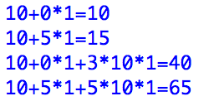
Default Arguments
Defining default arguments is easy
Just use the arguments with default arguments last and assign default values in the function definition

Slide 32
Default Arguments
How to write readable code:
Named arguments and default arguments with well-chosen names make code more readable
Most effort in software engineering goes towards maintaining code

Slide 33
Example
A slightly better square root
def square(S, precision=10**-9):
""" This is a square root function that uses Heron's Method
"""
x = 1
while not -precision < S-x**2 < precision:
x = 0.5*(x+S/x)
return x
>>> square(3)
1.7320508075688772
>>>

Slide 34
Example: Numerical Differentiation
Numerical Differentiation Formula
$$\frac{df}{dx}|_{x=x_{0}}=\lim_{δ→0}\frac{f(x+δ)-f(x-δ)}{2δ}$$
Write a function with a small default value for $δ$

Slide 35
Example: Numerical Differentiation
We want a function that takes a function as an argument and returns a function
This is easy in Python
Inside the function, define a new function and return it

Slide 36
Example: Numerical Differentiation
First things first:
How do we define the derivative function?

Slide 37
Example: Numerical Differentiation
We find f and delta in the scope
Now we have to define the “exterior” function
def fprime(x):
return (f(x+delta) - f(x-delta))/(2*delta)

Slide 38
Example: Numerical Differentiation
Here is the exterior function
def diff(f, delta):
def fprime(x):
return (f(x+delta) - f(x-delta))/(2*delta)
return fprime

Slide 39
Example: Numerical Differentiation
Final step:
Use a default value for delta
def diff(f, delta=10**-7):
def fprime(x):
return (f(x+delta) - f(x-delta))/(2*delta)
return fprime

Slide 40
Preview: Numerical Differentiation
This simple differentiation method is actually quite good
Let’s draw some graphs, as we will learn in the second half
We import two modules that need to be installed with pip (or pip3 if you also have python2)

Slide 41
Preview: Numerical Differentiation
Importing modules
Creating an array of X-values
And three different versions of the derivative of sine
import matplotlib.pyplot as plt
import numpy as np
X=np.linspace(0, 2*np.pi, 1001)
df = diff(np.sin, delta=0.1)
df2 = diff(np.sin, delta=0.01)
df3 = diff(np.sin, delta=0.001)

Slide 42
Preview: Numerical Differentiation
Then we plot the graphs
Need an array of X-values and an array of Y-values
Labels are added for a legend
Then we create the legend and call show
plt.plot(X, np.sin(X), label='sine')
plt.plot(X, df(X), label='der')
plt.plot(X, np.cos(X), label='cos')
plt.legend()
plt.show()

Slide 43
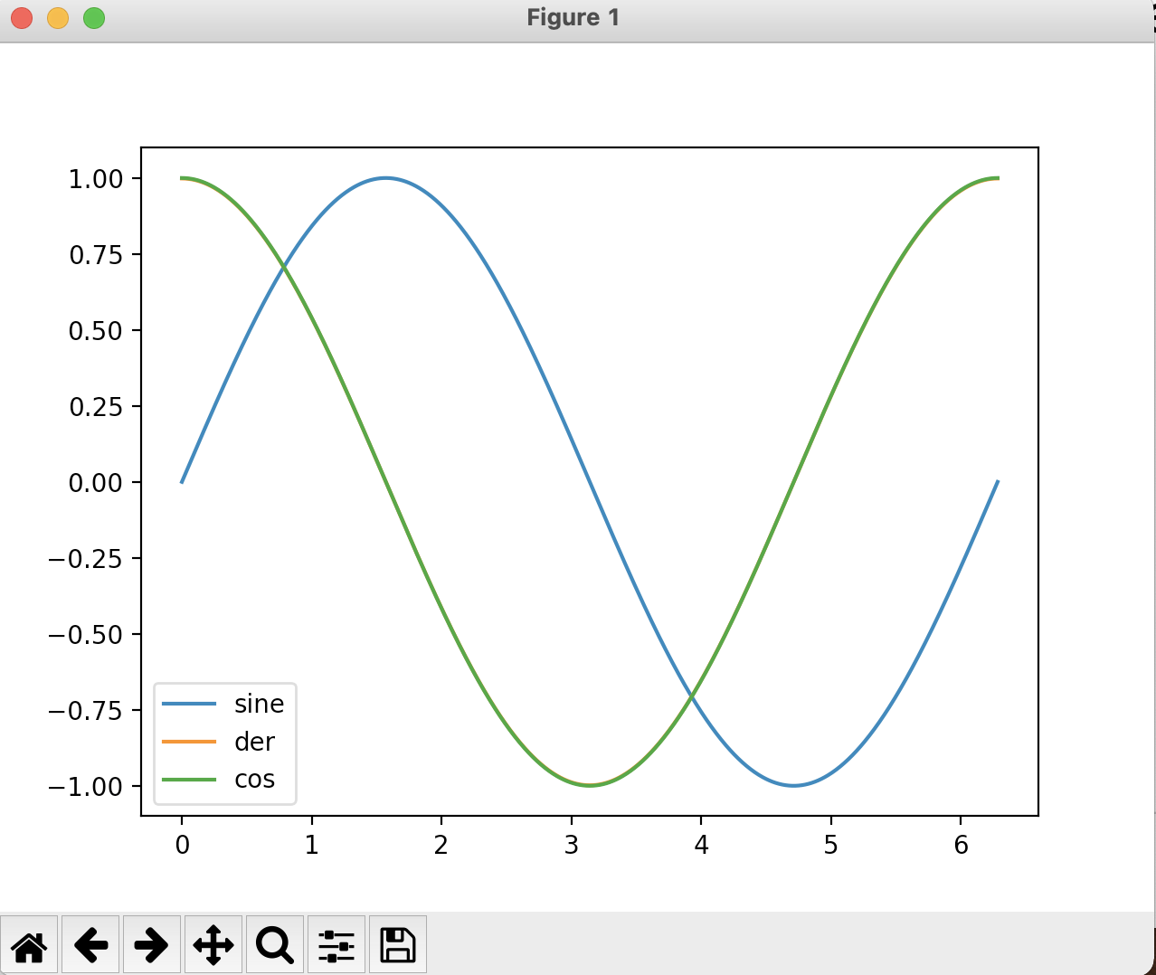
Preview: Numerical Differentiation
When we run this, we get
Result is so good that we cannot see the difference between the numerical derivative and the cosine function

Slide 44
Anonymous Functions
Up till now, we used the def-construct in order to define functions
Sometimes it is necessary to pass functions to another function, but not necessary to define the argument for future uses

Slide 45
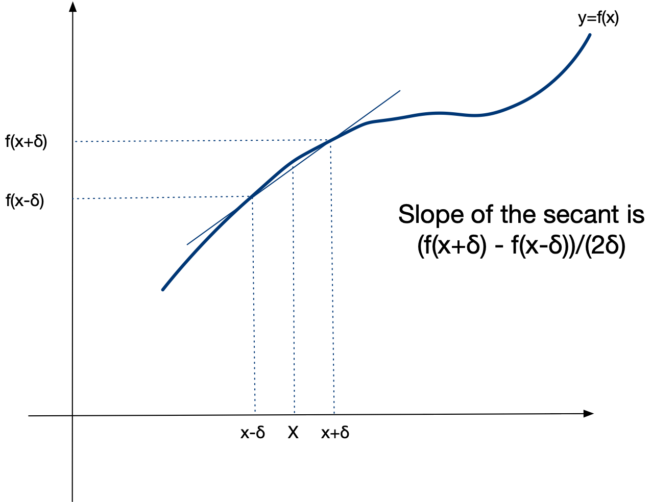
Anonymous Function
Example:
Numerical Differentiation
Derivative of a function f at a point is the slope of the tangent
Approximated by a secant

Slide 46
Anonymous Functions
The slope of the secant is the difference of values over the difference of arguments:
If δ is small, then this is a good approximation of the derivative
$$\frac{f(x+δ)-f(x-δ)}{x+δ-(x-δ)}=\frac{f(x+δ)-f(x-δ)}{2δ}$$

Slide 47
Anonymous Functions
A simple method for derivation uses a fixed, but small value for δ.
To test this, we try it out with sine, whose derivative is cosine
def derivative(function, x):
delta = 0.000001
return (function(x+delta)-function(x-delta))/(2*delta)
for i in range(20):
x = i/20
print(x, math.cos(x), derivative(math.sin, x))

Slide 48
Anonymous Functions
It turns out that the numerical derivative is quite close in this test
0.0 1.0 0.9999999999998334
0.05 0.9987502603949663 0.9987502603940601
0.1 0.9950041652780257 0.9950041652759256
0.15 0.9887710779360422 0.9887710779310499
0.2 0.9800665778412416 0.9800665778519901
0.25 0.9689124217106447 0.9689124216977207
0.3 0.955336489125606 0.9553364891112803
0.35 0.9393727128473789 0.9393727128381713
0.4 0.9210609940028851 0.9210609939747094
0.45 0.9004471023526769 0.9004471023255078
0.5 0.8775825618903728 0.8775825618978494
0.55 0.8525245220595057 0.8525245220880606
0.6 0.8253356149096783 0.8253356149623414
0.65 0.7960837985490559 0.7960837985487856
0.7 0.7648421872844885 0.7648421873063249
0.75 0.7316888688738209 0.7316888688824186
0.8 0.6967067093471655 0.6967067094354462
0.85 0.6599831458849822 0.6599831459119798
0.9 0.6216099682706645 0.6216099682765375
0.95 0.5816830894638836 0.5816830894733727

Slide 49
Anonymous Functions
Notice that in the test, we specified math.sin and not math.sin(x),
The former is a function (which we want)
The latter is a value (which we do not want)
for i in range(20):
x = i/20
print(x, math.cos(x), derivative(math.sin, x))

Slide 50
Anonymous Functions
To specify a function argument, I can use a lambda-expression
Lambda-expressions were used in Mathematical Logic to investigate the potential of formal calculations
Lambda expression consists of a keyword lambda
followed by one or more variables
followed by a colon
followed by an expression for the function
This example implements the function
$$x→5x^{2}-4x+3$$

Slide 51
Anonymous Functions
To test our numerical differentiation function, we pass it the function , which has derivative
$$x→x^{2}$$
$$2x$$
for i in range(20):
x = i/20
print("{:5.3f} {:5.3f} {:5.3f}”.format(
x,
derivative(lambda x: x*x, x),
2*x))

Slide 52
Anonymous Functions
Since we are rounding to only three digits after the decimal point, we get perfect results
0.000 0.000 0.000
0.050 0.100 0.100
0.100 0.200 0.200
0.150 0.300 0.300
0.200 0.400 0.400
0.250 0.500 0.500
0.300 0.600 0.600
0.350 0.700 0.700
0.400 0.800 0.800
0.450 0.900 0.900
0.500 1.000 1.000
0.550 1.100 1.100
0.600 1.200 1.200
0.650 1.300 1.300
0.700 1.400 1.400
0.750 1.500 1.500
0.800 1.600 1.600
0.850 1.700 1.700
0.900 1.800 1.800
0.950 1.900 1.900

Slide 53
Anonymous Functions
I can even use lambda expressions as an alternative way of defining functions:
Since there are two variables, norm is a function of two arguments:
norm = lambda x, y: math.sqrt(x*x+y*y)
print(norm(2.3, 1.7))

Slide 54
Annotations
Completely optional way to make function definitions easier to read
Uses swift language convention
for arguments: name colon type
where type is either a Python type or a string
for return value: use ->
def quadratic(a: 'number', b: 'number', c: 'number') -> float :
disc = (b**2-4*a*c)**0.5
return (-b+disc)/(2*a)

Slide 55
Decorators
Functions are also return values
One way to use this are decorators (for the future)
A decorator is put on top of a function
The decorator then takes the function and replaces it with another function

Slide 56
Decorators
This is an example of a function factory!
We can automatically apply the decorator
def my_decorator(func):
def wrapper():
print("Something is happening before the function is called.")
func()
print("Something is happening after the function is called.")
return wrapper
def say_namaste():
print("Namaste!")
say_when = my_decorator(say_whee)
@my_decorator
def say_namaste():
print("Namaste!")

Slide 57
Decorators
Some decorators are provided in modules
lru_cache in functools
stores the result of functions in an lru cache

Slide 58
Future topics on functions
Memoization
Decorators

Slide 59
In Class Exercises
From the easy to the hard
Write a function of no arguments that prints out an empty line, followed by "Namaste" or "Viva la revolución" or "Laudate Dominum"*, followed by an empty line
* According to your preference

Slide 60
Solution
Python 3 allows the use of unicode characters
def one():
print()
print('नमस्ते ')
print()
def one():
print()
print('Namaste')
print()
def one():
print()
print('¡Viva la revolución!')
print()
def one():
print()
print('LAUDATEDOMINUM ')
print()

Slide 61
In Class Exercises
Write a function that calculates the median of three numbers
E.g. median(2,3,4) return 3, median(1,0,10) returns 1

Slide 62
In Class Exercises
def median(a, b, c):
if a<=b<=c or c<=b<=a:
return b
elif a<=c<=b or b<=c<=a:
return c
else:
return a

Slide 63
In Class Exercises
Define a function $x→x^{2}+\frac{1}{x^{2}+1}$ using a lambda expression

Slide 64
In Class Exercises
func = lambda x: x**2+1/(1+x**2)

Slide 65
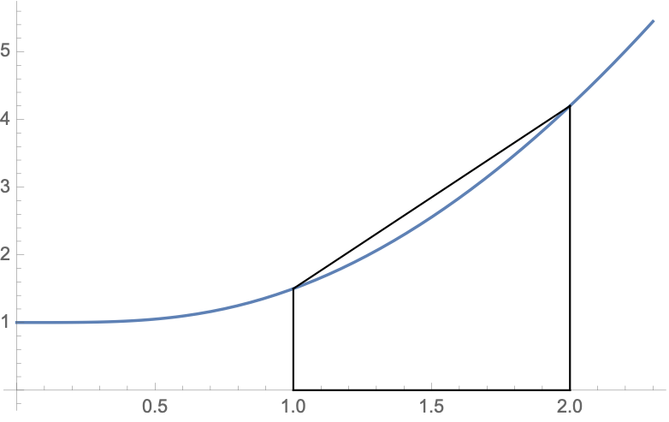
In Class Exercises
Write a function of a function $f$ and arguments a and b that calculates $\frac{1}{2}(f(a)+f(b))(b-a)$
This is the trapezoid formula that approximates $∫_{a}^{b}f(x)dx$

Slide 66
In Class Exercises
def trap(f, a, b):
return 0.5*(f(a)+f(b))*(b-a)
>>> trap(lambda x: x**2+1/(1+x**2), 1, 2)
2.85

Slide 67
In Class Exercises
Write a function that prints out a checker board of n by n fields
>>> checker(8)
*** *** *** ***
*** *** *** ***
*** *** *** ***
*** *** *** ***
*** *** *** ***
*** *** *** ***
*** *** *** ***
*** *** *** ***
*** *** *** ***
*** *** *** ***
*** *** *** ***
*** *** *** ***
*** *** *** ***
*** *** *** ***
*** *** *** ***
*** *** *** ***
>>> checker(4)
*** ***
*** ***
*** ***
*** ***
*** ***
*** ***
*** ***
*** ***

Slide 68
In Class Exercises
def checker(n):
fields = n//2
for _ in range(fields):
for i in range(2):
print(fields*(3*'*'+3*' '))
for i in range(2):
print(fields*(3*' '+3*'*'))

Slide 69
Strings in Python
Thomas Schwarz, SJ

Slide 70
Strings
Basic data type in Python
Strings are immutable, meaning they cannot be changed
Why?
It’s complicated, but string literals are very frequent. If strings cannot be changed, then multiple occurrences of the same string in a program can be placed in a single memory location.
More importantly, strings can serve keys in key-value pairs.

Slide 71
String Literals
String literals are defined by using quotation marks
Example:
To create strings that span newlines, use the triple quotation mark

Slide 72
Escapes
Python is very good at detecting your intentions when processing string literals
E.g.: "It's mine"
Still sometimes need to use the escape character
\t, \n, \", \', \\, \r
\xhh —> character with hex value 0xhh
Python 3 uses machine conventions for endings
Python 3 uses utf-8 natively
greetings = ("शुभ प्रभात", "સુપ્રભાત", "शुभ प्रभात")

Slide 73
Docstrings
Doc strings
String literals that appear as the first line of a module, function, class, method definition
All these items should have a docstring
The docstring replaces the help string in Idle and IPython/Jupyter
Indent them under the indentation of the object they describe

Slide 74
Docstrings
Always use triple quotation marks
Even for one-liners

Slide 75
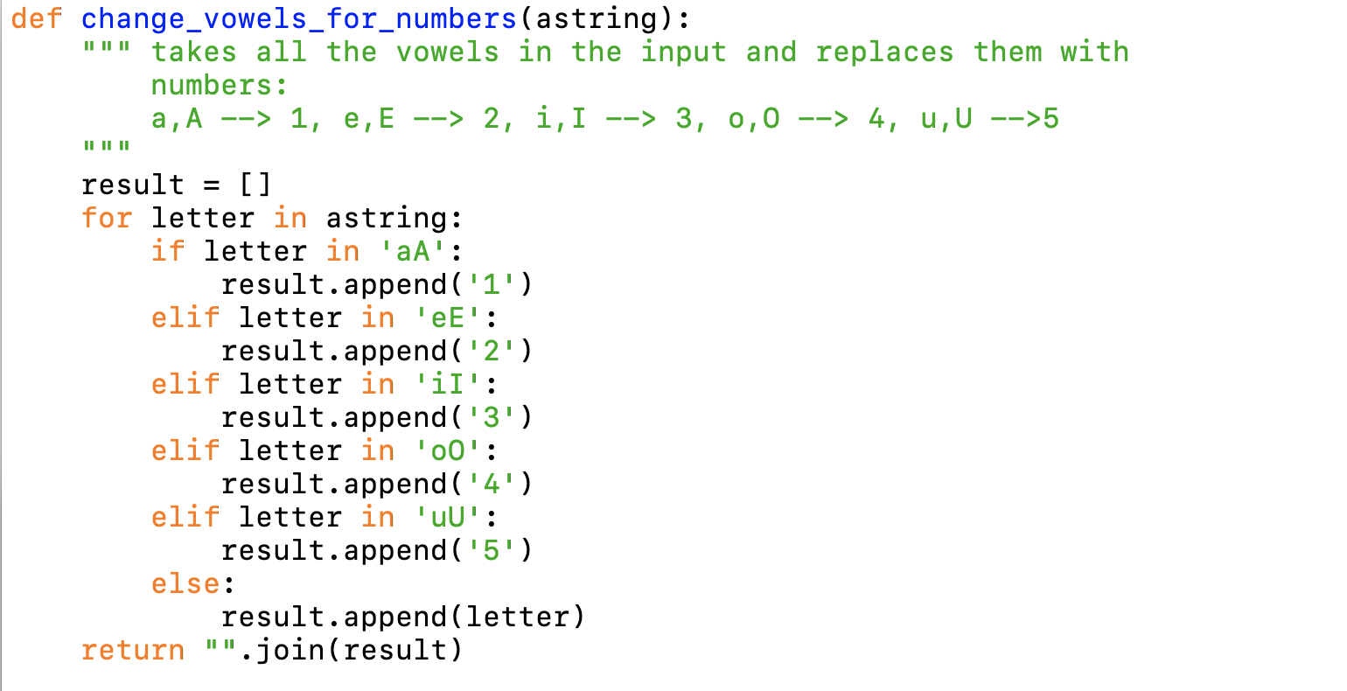
Docstrings
Example

Slide 76
String Methods
Strings are classes and have many built in methods
s.lower(), s.upper() : returns the lowercase or uppercase version of the string
s.strip(): returns a string with whitespace removed from the start and end
s.isalpha() / s.isdigit() / s.isspace() tests if all the string chars are in the various character classes
s.startswith('other'), s.endswith('other') tests if the string starts or ends with the given other string

Slide 77
String Methods
There are a number of methods for strings. Most of them are self-explaining
s.find('other') : searches for the given other string (not a regular expression) within s, and returns the first index where it begins or -1 if not found
s.replace('old', ‘new'): returns a string where all occurrences of 'old' have been replaced by 'new'
len(s) returns the length of a string

Slide 78
Strings and Characters
Python does not have a special type for characters
Characters are just strings of length 1.

Slide 79
Accessing Elements of Strings
We use the bracket notation to gain access to the characters in a string
a_string[3] is character number 3, i.e. the fourth character in the string

Slide 80
String Processing
Since strings are immutable, we process strings by turning them into lists, then processing the list, then making the list into a string.
String to list: Just use the list-command

Slide 81
String Processing
Turn lists into strings with the join-method
The join-method has weird syntax
a_string = "".join(a_list)
The method is called on the empty string ""
The sole parameter is a list of characters or strings
You can use another string on which to call join
This string then becomes the glue

Slide 82
String Processing
Examples

Slide 83
String Processing
Procedure:
Take a string and convert to a list
Change the list or create a new list
Use join to recreate a new string
Alternative Procedure:
Build a string one by one, using concatenation ( + -operator)
Creates lots of temporary strings cluttering up memory
Which is bad if you are dealing with large strings.

