Slide 1

Python for Data Science
Overview of Python
Why Python
Installing Python
Installing Python Modules

Slide 2
Overview of the course
Assumptions:
  We are here to learn some new skills
  We learn new skills by doing
  We work better with others
  Python is important
    It is a glue language
      Need minimal python skills to use
    It is interesting on its own
      It's a modern language with interesting features
      It's useful where-ever modules don't exist

Slide 3
Python
Python is an interpreted (scripting) language
  Source code is compiled into a bytecode representation
  Executed by Python virtual machine (usually implemented in C or Java)
  If performance is needed:
    Can call C-code from Python
    Use PyPy with Just-In-Time compilation (JIT)

Slide 4
Python
Why Python:
  Cool language
  Extensible through modules
    Statistics
    Machine learning
    Graphics

Slide 5
Python
Getting Python
  Can use bundles (anaconda)
  For the first half: get native Python from Python.org
    Python 2.7 stable solution (built into MacOS)
    Python 3.9.1 the version I am using
    Important : Allow automatic path adjustments on windows
      This are the defaults

Slide 6
Python
Using Python:
  We are going to use IDLE
    Can create and safe scripts
    Can interact directly in the IDE

Slide 7
Python 3 Modules
Python comes with many pre-installed modules
We need later to install some modules
  Use Pip
    MacOS / Linus
      In a shell:
    Windows:
      In a command window
thomasschwarz@Peter-Canisius Module1 % python3.9 -m pip install matplotlib
py -3.9 -m pip install matplotlib

Slide 8
Why Python
Universal, accessible language
  Clear and simple syntax
    Python philosophy: The frequent should be easy
    Made for reading
    Used for fast prototyping
Excellent support community
  Help for beginners and experts is easily available

Slide 9
Why Python
Universal Language
  Serves many different constituencies
    Examples:
      Gaming: AI engine is usually in Python
      String processing: Basis for digital humanities and data wrangling
      Many extension modules
        With scypy or numpy, fast programs for scientific programming
        Use pyplot for good quality graphics
        …
      Notebooks based on Python (Jupyter) integrate presentation, data, and programs

Slide 10
Why Python
Python in Data Science

Slide 11
Why Python
https://youtu.be/pKPaHH7hnv8

Slide 12
Python Modules

Slide 13
Why Python
Example:
  Time series data: closing prices of four stock indices
    given as a cvs file
  Use Pandas in order to deal with two dimensional data
  Use matplotlib for graphics

Slide 14
Why Python? Time Series Example
Import the modules
Import the cvs file as a pandas dataframe
The first column should be the index, read as a date
import pandas as pd
import numpy as np
import matplotlib.pyplot as plt
raw_data = pd.read_csv('Index2018.csv')
values = raw_data.copy()
values.date = pd.to_datetime(values.date, dayfirst=True)
values.set_index("date", inplace = True)
print(values.describe())
print(values.head())

Slide 15
Why Python? Time Series Example
Fill in missing values and normalize to start at 100
Now display the US Standard & Poor and the German DAX
Now annotate the plot and show it
values.spx = values.spx.fillna(method = 'ffill')/values.spx['1994-01-07']*100.0
values.dax = values.dax.fillna(method = 'ffill')/values.dax['1994-01-07']*100.0
values.spx.plot(label='S&P')
values.dax.plot(label='DAX')
plt.title('S&P v DAX')
plt.xlabel('date')
plt.ylabel('Price')
plt.legend()
plt.show()

Slide 16
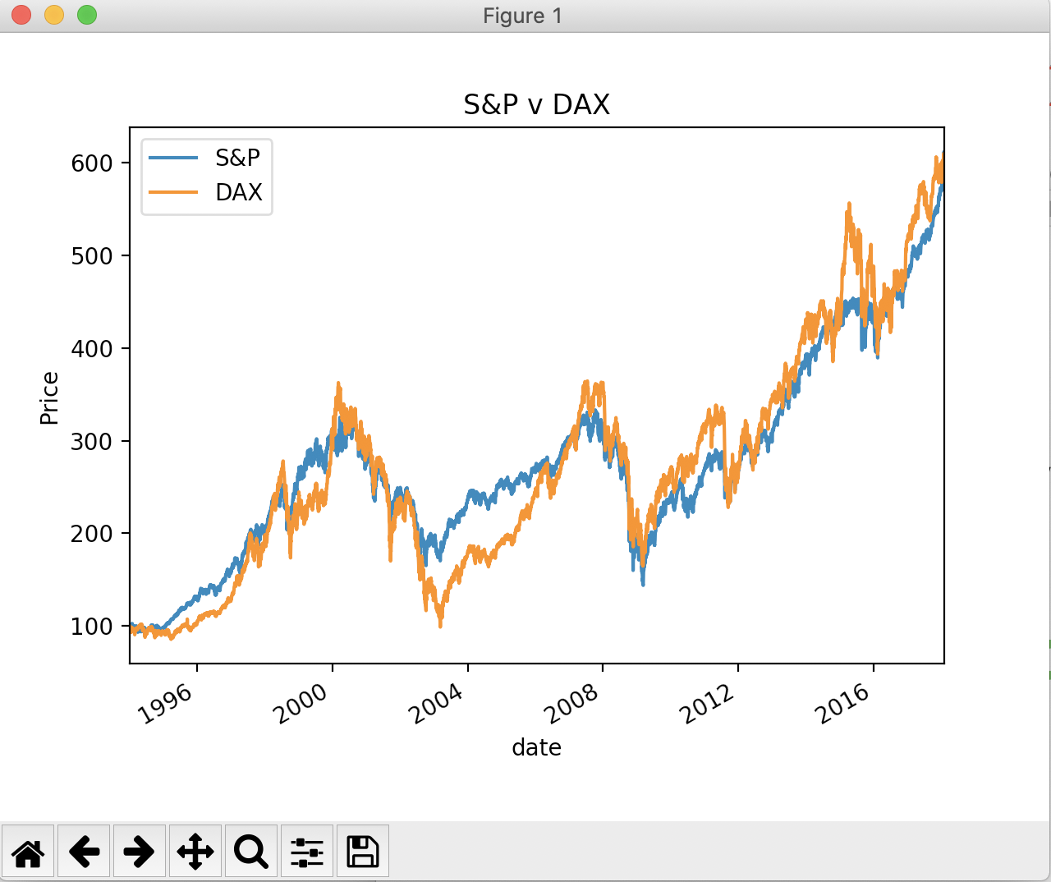
Why Python? Time Series Example
Result:

Slide 17
Why Python
Most of the programming was done for us
Needed to invoke powerful method
Majority of the code giving to small tweaks

Slide 18
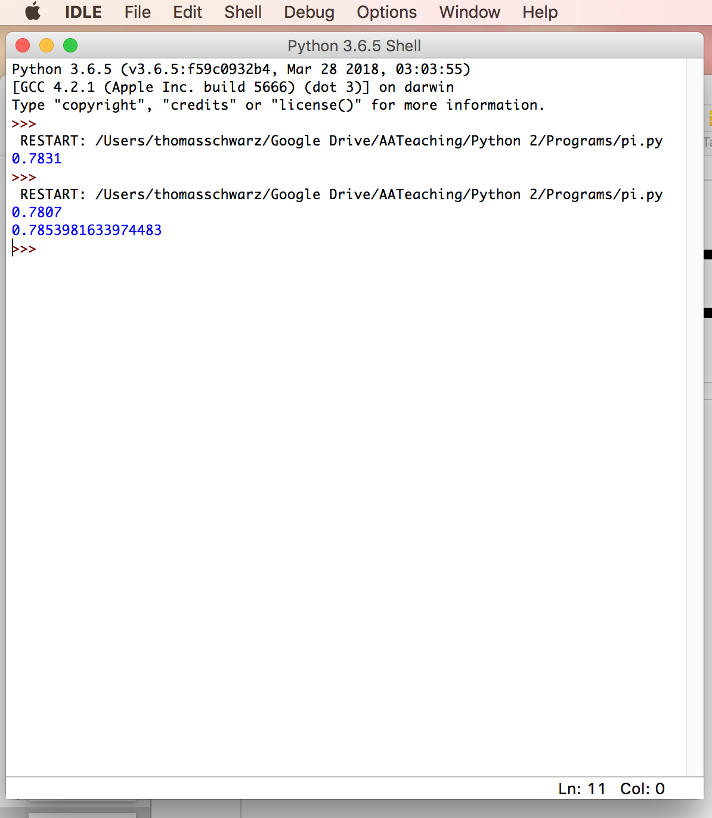
IDLE
IDLE is an interactive Python interpreter
  Can be used as a desk calculator
  Allows you to create new files

Slide 19
Python Syntax

Slide 20
Variables and Types
All program languages specify how data in memory locations is modified
Python: A variable is a handle to a storage location
  The storage location can store data of many types
    Integers
    Floating point numbers
    Booleans
    Strings

Slide 21
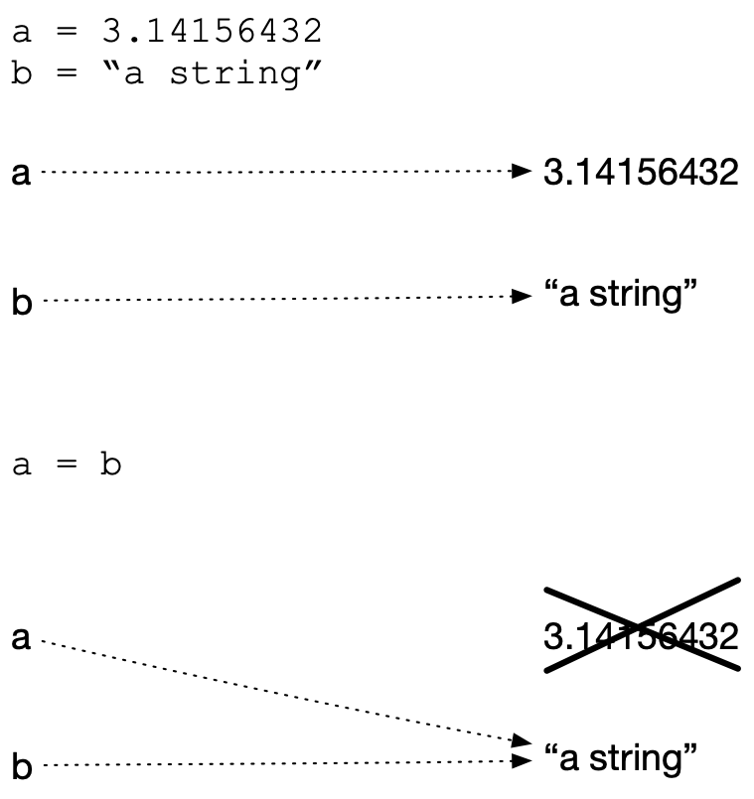
Variables and Types
Assignment operator = makes a variable name refer to a memory location
Variable names are not declared and can refer to any legitimate type
Create two variables and assign values to them
Variable a is of type floating point and variable b is of type string
After reassigning, both variable names refer to the same value
The floating point number is garbage collected

Slide 22
Expressions
Python builds expression from smaller components just as any other programming language
  The type of operation expressed by the same symbol depends on the type of operands
Python follows the usual rules of precedence
  and uses parentheses in order to express or clarify orders of precedence.

Slide 23
Expressions
Arithmetic Operations between integers / floating point numbers:
  Negation (-), Addition (+), Subtraction (-), Multiplication (*), Division (/), Exponentiation (**)
  Integer Division //
  Remainder (modulo operator) (%)

Slide 24
Expressions
IF we use / between two integers, then we always get a floating point number
If we use // between two integers, then we always get an integer
  a//b is the integer equal or just below a/b

Slide 25
Expressions
Strings are marked by using the single or double quotation marks
You can use the other quotation mark within the string
Some symbols are given as a combination of a forward slash with another symbol
  Examples: \t for tab, \n for new line, \’ for apostrophe, \“ for double quotation mark, \\ for backward slash
  We’ll get to know many more, but this is not the topic of today

Slide 26
Expressions
Strings can be concatenated with the +
They can be replicated by using an integer and the * sign
Examples:
  “abc"+"def" —> 'abcdef'
  ‘abc\"'+'fg' —> 'abc"fg'
  3*”Hi'" —> “Hi'Hi'Hi'"

Slide 27
Change of Type
Python allows you to convert the contents of a variable or expression to an expression with a different type but equivalent value
  Be careful, type conversation does not always work
To change to an integer, use int( )
To change to a floating point, use float()
To change to a string, use str( )

Slide 28
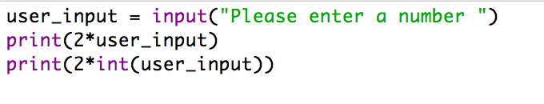
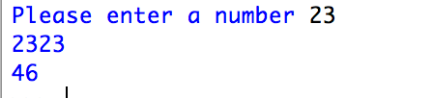
Example
Input is done in Python by using the function input
  Input has one variable, the prompt, which is a string
  The result is a string, which might need to get processed by using a type conversion (aka cast)
  The following prints out the double of the input (provided the user provided input is interpretable as an integer), first as a string and then as a number

Slide 29
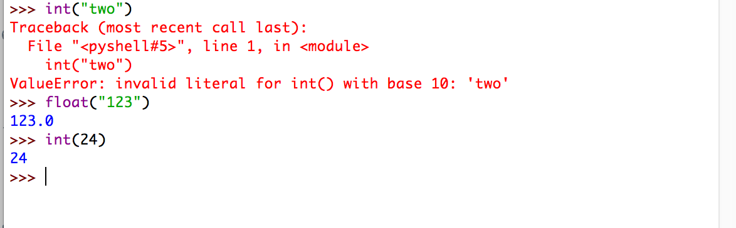
Example
Python does not understand English (or Hindi) so giving it a number in other than symbolic form does not help
It can easily understand “123”
It does not complain about the expression having the same type.

Slide 30
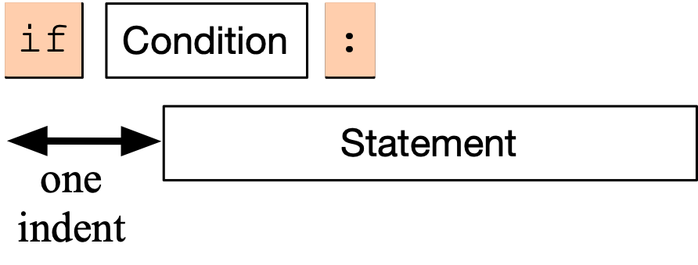
Conditional Statements
Sometimes a statement (or a block of statements) should only be executed if a condition is true.
Conditional execution is implemented with the if-statement
Form of the if-statement:

Slide 31
Conditional Statements
if — is a keyword
Condition: a Boolean, something that is either True or False
Statement: a single or block of statements, all indented
  Indents are tricky, you can use white spaces or tabs, but not both. Many editors convert tabs to white spaces
  The number of positions for the indent is between 3 and 8, depending on the style that you are using. Most important, keep it consistent.

Slide 32
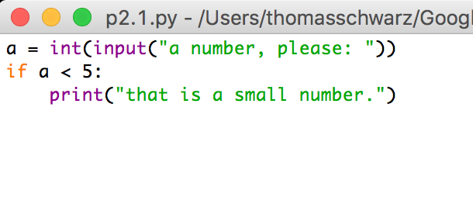
Example
First line asks user for integer input.
Second line checks whether user input is smaller than 5.
In this case only, the program comments on the number.

Slide 33
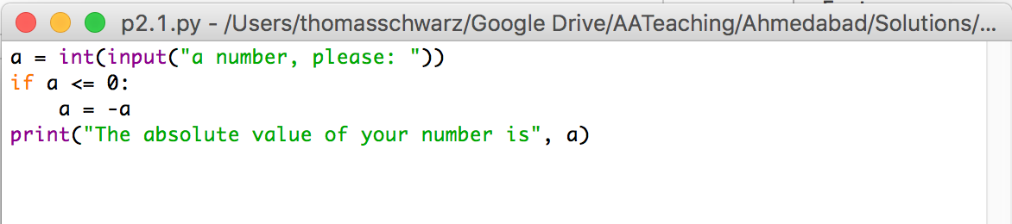
Example
Here we calculate the absolute value of the input.
The third line is indented.
The fourth line is not, it is always executed.

Slide 34
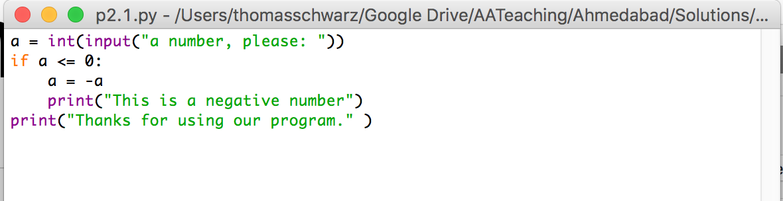
Example
Here, lines 3 and 4 are indented and are executed if the input is a negative integer.
The last line, line 5, is always executed since it is not part of the if-statement

Slide 35
Alternative statements
Very often, we use a condition to decide which one of several branches of execution to pursue.
The else-statement after the indented block of an if-statement creates an alternative route through the program.

Slide 36
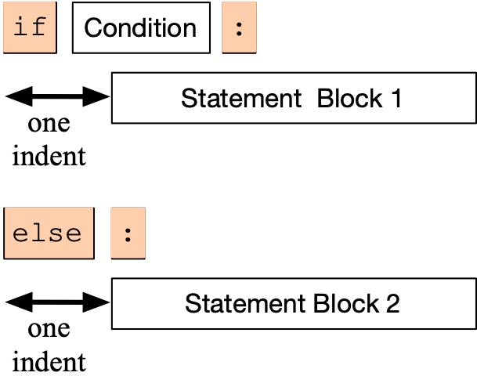
Alternative Statements
The if-else statement has the following form:
  We add the keyword else, followed by a colon
  Then add a second set of statements, indented once
  If the condition is true, then Block 1 is executed, otherwise, Block 2.

Slide 37
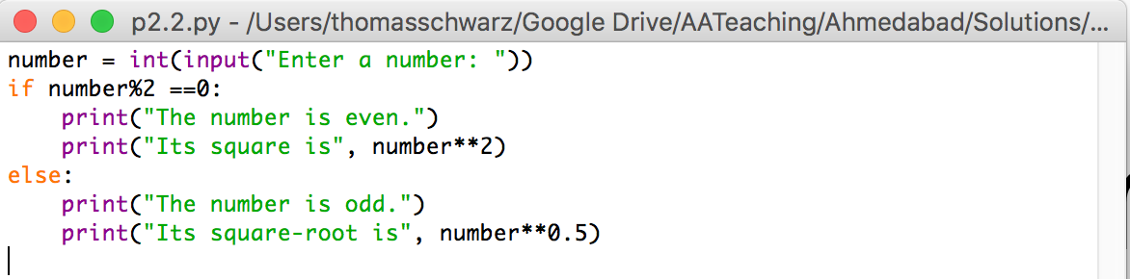
Examples
I can test equality by using the double = sign.
To check whether a number n is even, I take the remainder modulo 2 and then compare with 0.

Slide 38
Alternative Statements
Often, we have more than two alternative streams of execution.
Instead of nesting if expressions, we can just use the keyword “elif”, a contraction of else if.

Slide 39
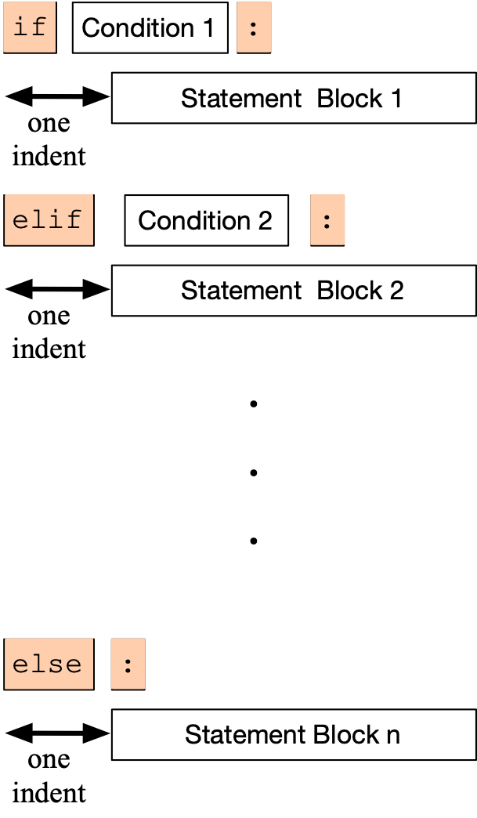
Alternative Statements
One of the statement blocks is going to be executed
The else block contains the default action, if none of the conditions are true

Slide 40
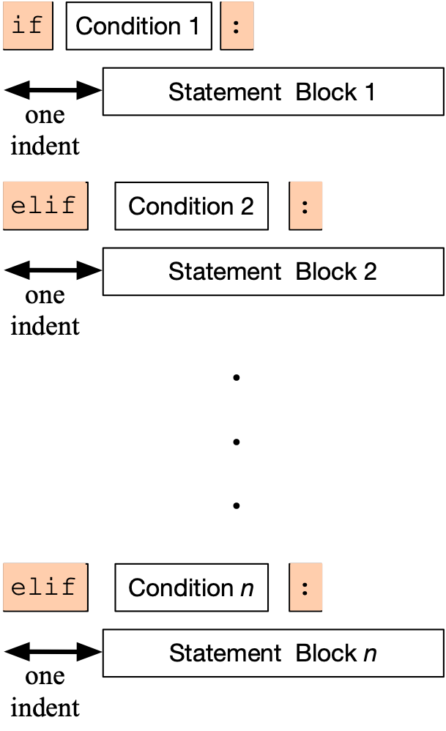
Alternative Statements
Here, there is no else statement, so it is possible that none of the blocks is executed.

Slide 41
Examples
Categorization of temperatures
if temperature < -25.0:
feeling = "arctic"
elif temperature < -10.0:
feeling = "Wisconsin in winter"
elif temperature < 0.0:
feeling = "freezing"
elif temperature < 15.0:
feeling = "cold"
elif temperature < 25.0:
feeling = "comfortable"
elif temperature < 35.0:
feeling = "hot"
elif temperature < 45.0:
feeling = "Ahmedabad in the summer"
else:
feeling = "hot as in hell"

Slide 42
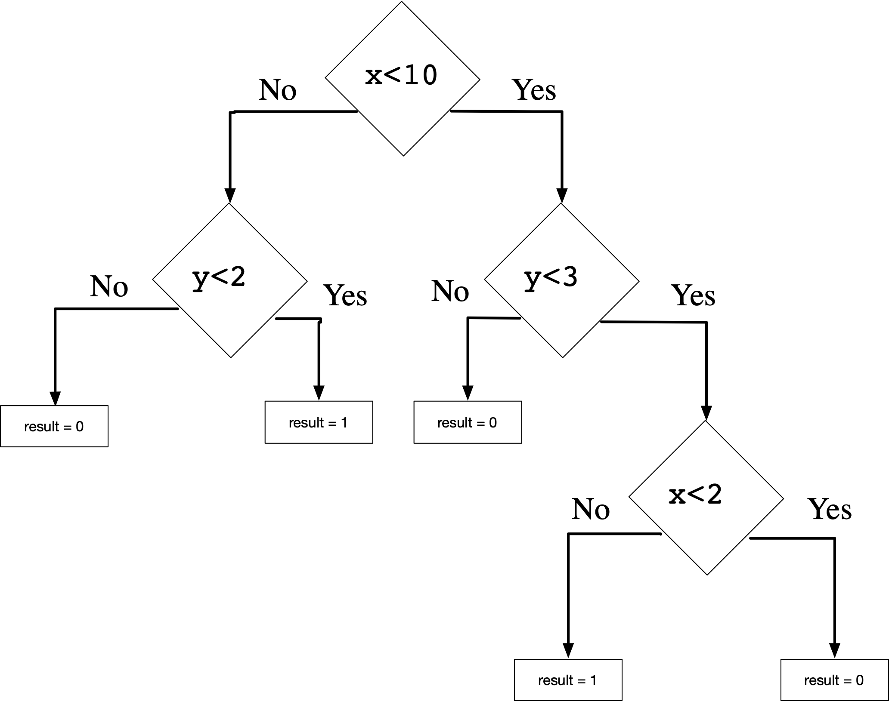
Boolean Expressions
Nested loops to implement decision tree:
if x<10:
if y<3:
if x<2:
result=0
else:
result=1
else:
result=0
else:
if y<2:
result=1
else result=0

Slide 43
Exercises
Use IDLE to calculate the following expressions:
  $$\frac{2+19}{5-2}\left(=7\right)$$
  What is the remainder of $2^{20}$ when dividing by 5?

Slide 44
Exercises
What is the result of
and why?
cat = '12356'
2*cat

Slide 45
Exercises
Write a program that asks the user for an amount in Euros and converts the result to Indian Rupees.
  As of the writing, one Euro corresponds to 87.92489314 Indian Rupees

Slide 46
Solution
Open Idle and select File->New File
  This opens up a new window
Write your code in this window and save the file
Then execute the Python script by using the F5 short-cut or by selecting Run->Run Module

Slide 47
Solution
user_input = input('Enter an amount in Euros: ')
euros = float(user_input)
print('The amount in Indian Rupees is ', euros*87.92489314)

Slide 48
Loops
Thomas Schwarz, SJ

Slide 49
Conditions
A condition is an expression that evaluates to True or False
This type is called Boolean

Slide 50
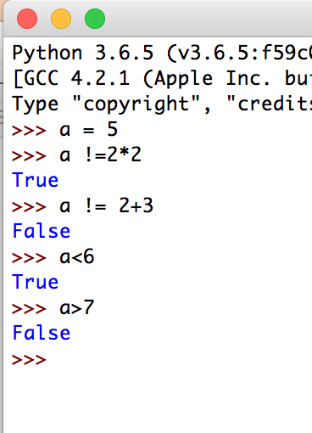
Boolean Expressions
The simplest Boolean expressions are True and False
The next simplest class are numerical comparators
  < smaller
  > greater
  == equals (Two! equal symbols)
  != not equals
  <= smaller or equal
  >= larger or equal

Slide 51
Boolean Expressions
We can combine Boolean expressions using the logical operands
  and
  or
  not
If necessary, we can add parentheses in order to specify precedence

Slide 52
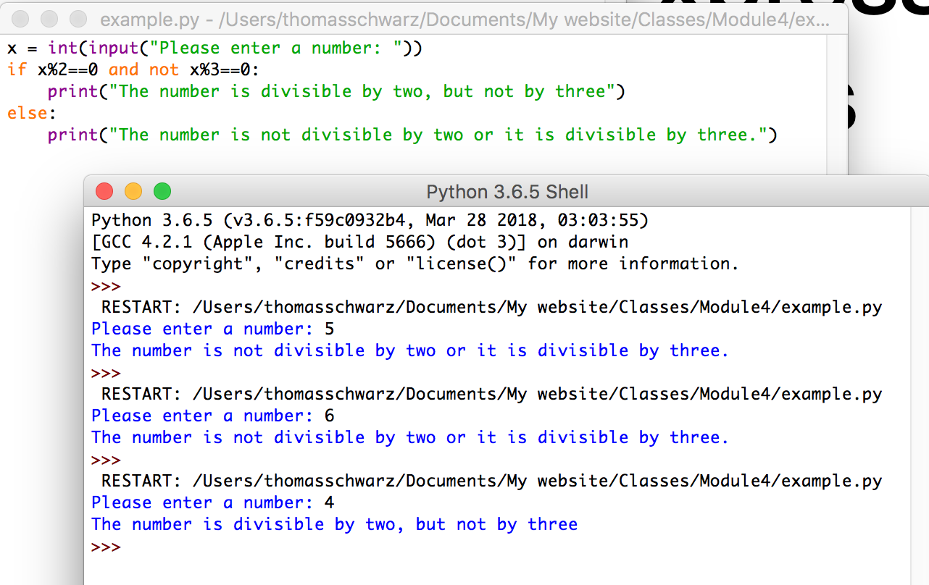
Boolean Expression Examples
A program that decides whether user input is divisible by 2, but not by 3.

Slide 53
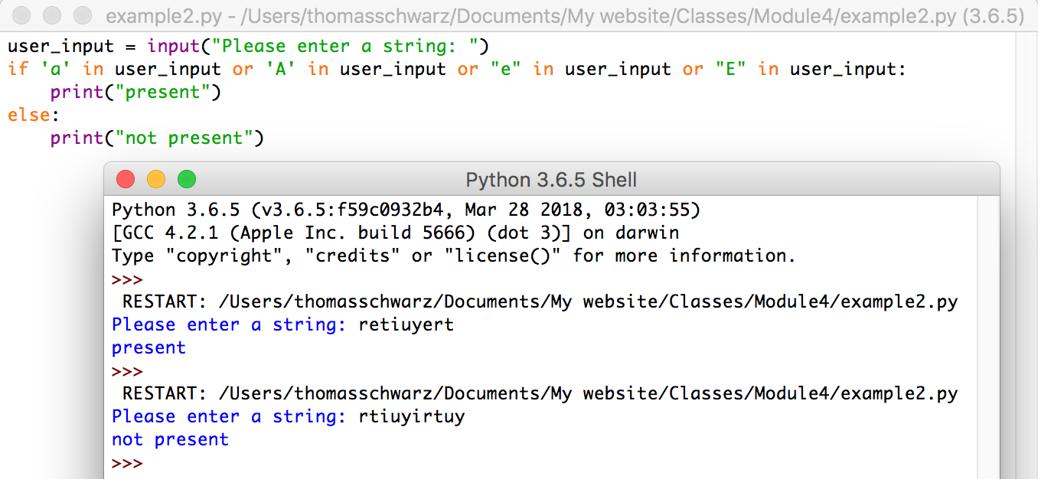
Boolean Expression Example
A program that checks whether the letter “a”, “A”, “e” or “E” is part of user input.
Python allows the keyword “in” to check for the presence of letters in strings.

Slide 54
Short-Circuit Operators
The value of an “or”- or “and” expression is evaluated from the left to the right
  If the first operand of an “or” is True, then the second operand is not evaluated and True is returned.
    This is because the value of the expression is already known
  Similarly, if the first operand of an “and” expression is False, then the second operand is not evaluated and the value of the expression is False.

Slide 55
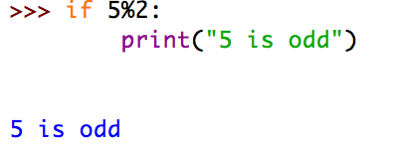
Conversion of other expressions
Any object can be tested for a truth value.
The truth value of a non-zero number is True, otherwise False.
  Example:
  Since 5%2 evaluates to 1, it’s truth value is True and the conditional statement (print(…)) is executed
This behavior extends to other type of objects such as strings
  The empty string “” has truth value 0, every other string has truth value 1.

Slide 56
Loops
In CS: two types of for-loops
  Using an index as in C, C++, Java
  Using lists as in Lisp
Python for loops iterate through an 'iterator'
for(int i = 0; i < 10; i++)
* (loop for x in '(a b c d e)
do (print x) )

Slide 57
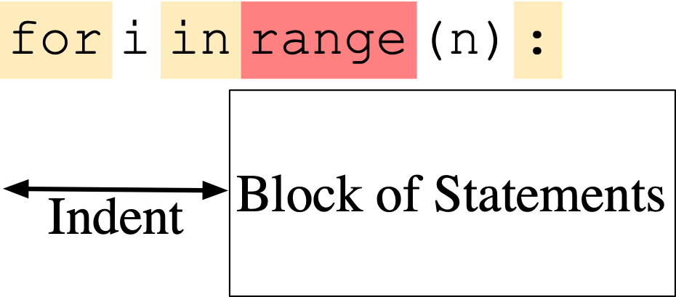
Loops
To repeat a block of statements, use

Slide 58
Loops
Range used to generate a list, but is now a generator
  Like a list, but values are generated only on demand
range with a single variable: variable is the stop value
range allows a start value:
range allows a stride:
range(5)
[0,1,2,3,4]
range(2,5)
[2,3,4]
range(2,10,3)
[2,5,8]
range(10,1,-3)
[10,7,4]

Slide 59
Loops
Examples:
  Calculate $\overset{100}{\underset{i=1}{∑}}i^{2}=1^{2}+2^{2}+…+{99}^{2}+{100}^{2}$
  Use an accumulator to get the sum
def sum_of_squares(limit : int) -> int:
accu = 0
for i in range(1, limit+1):
accu += i*i
return accu
Notice that the sum includes 100

Slide 60
Loops
Example: Count-down
for i in range(10, -1, -1):
print(i)
10
9
8
7
6
5
4
3
2
1
0

Slide 61
Loops
Calculating the factorial $n!=\overset{n}{\underset{i=1}{∏}}i=1⋅2⋅3⋅…⋅(n-1)⋅n$
  accu = 1
for i in range(1, n+1):
accu *= i
return accu

Slide 62
Calculating Sums
For loops are handy to calculate mathematical sums
  Geometric series:
  Calculate
    Determine iterator needs to run from 0 to 10 (inclusive)
      for i in range(11):
    Need to accumulate fractions in a sum
      Just don’t call it “sum”, because “sum” has another meaning
$$\frac{1}{2^{0}}+\frac{1}{2^{1}}+\frac{1}{2^{2}}+\frac{1}{2^{3}}+\frac{1}{2^{4}}+…+\frac{1}{2^{10}}$$

Slide 63

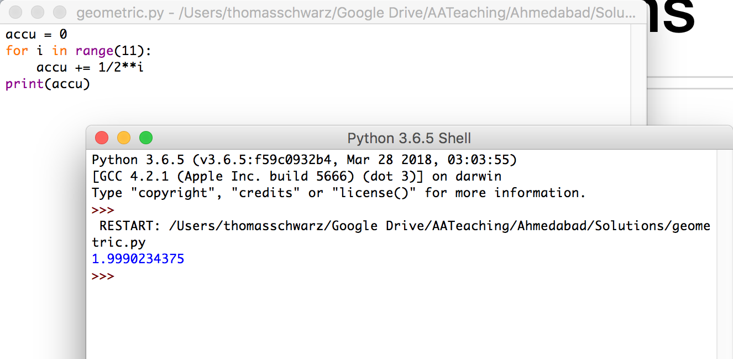
Calculating Sums

Slide 64
Calculating Sums
Admittedly, we could have used Mathematics instead
  The sum is 1.1111111111 in binary.
  Add 1/2**10 or 0.0000000001 in binary and we get 2.
  Thus, the sum is 2 - 1/2**10

Slide 65
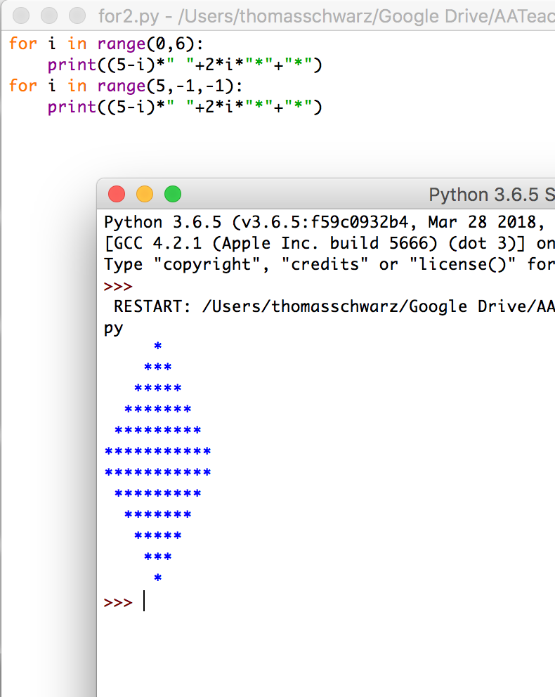
Drawing Pictures
We can use the index in a for loop in order to draw contours
  The trick is to use string repetition instead of drawing each line separately.

Slide 66
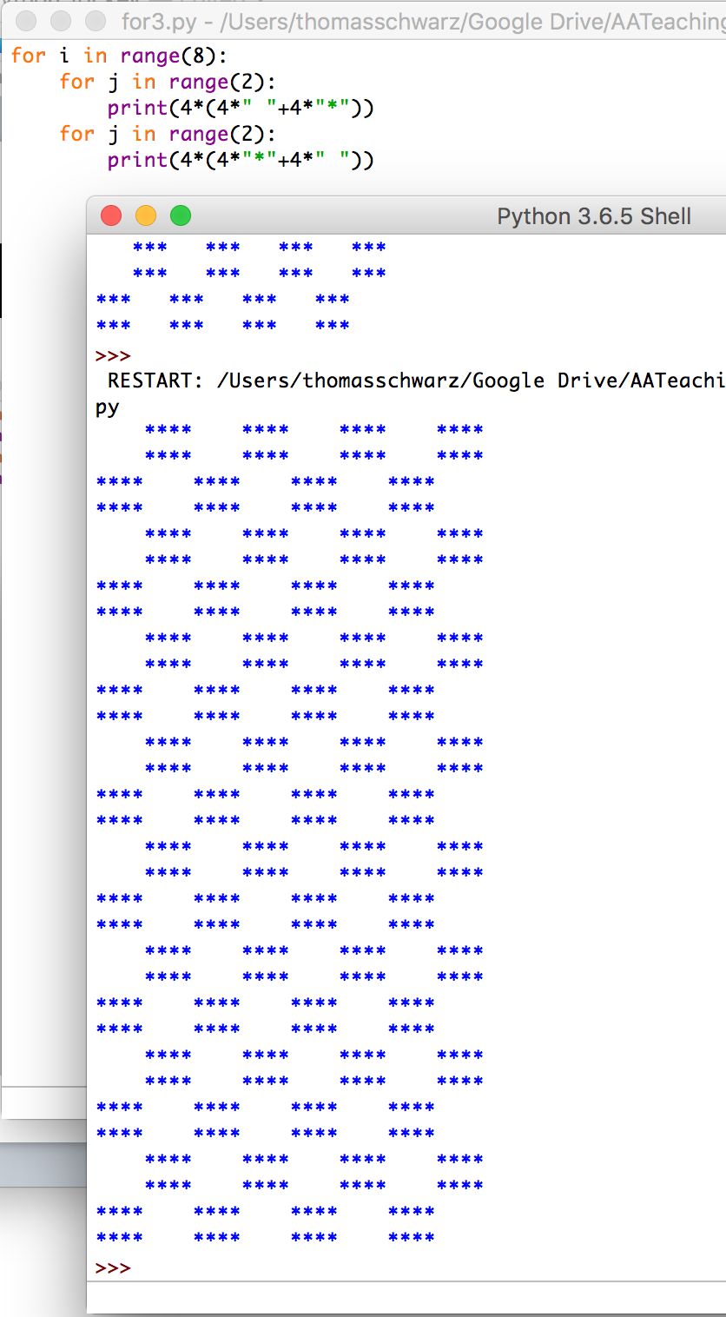
Drawing Pictures

Slide 67
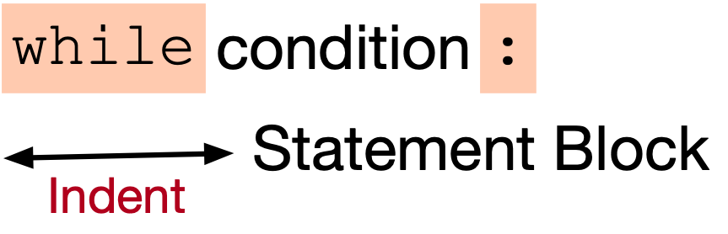
While Loops
Form of the while loop:
  Keyword is while
  Condition needs to evaluate to either True or False
    Condition is a boolean

Slide 68

While Loop Conditions
Statement block is executed as long as condition is valid.
  Allows the possibility of infinite loops
Apple Inc.
One Infinite Loop
Cupertino, CA 95014
(408) 606-5775

Slide 69
An Infinite Loop
while True:
  print(“Hello World”)
If this happens to you, you might have to kill Idle process.

Slide 70
While Loops can emulate for loops
Find an equivalent while loop for the following for-loop
  (which calculates )
$$\sum_{ν=1}^{n}{\frac{1}{ν}}$$
n = int(input("Enter n: "))
suma = 0
for i in range(1,n+1):
suma += 1/i
print("The", n, "th harmonic number is", sum)

Slide 71
While loops can emulate for loops
Solution: the loop-variable i has to start out as 1 and then needs to be incremented for every loop iteration
We stop the loop when i reaches n+1, i.e. we continue as long as i <= n.
n = int(input("Enter n: "))
sum = 0
i = 1
while i<= n:
sum += 1/i
i += 1
print("The", n, "th harmonic number is", sum)

Slide 72
Harmonic Numbers
$$h_{n}=\overset{n}{\underset{ν=1}{∑}}\frac{1}{ν}$$
The nth harmonic number is
  It is known that this series diverges.
Given a positive number x, we want to determine n such that the nth harmonic number is just above x
Solution: add while you have not reached x
$$min(\{n|h_{n}>x\})$$
$$\frac{1}{ν}$$

Slide 73
Harmonic Numbers
x = float(input("Enter x: "))
nu = 1
sum = 0
while sum <= x:
sum += 1/nu
nu += 1
print("The number you are looking for is ", nu-1,
"and incidentally, h_n =“, sum)
When we stop, we need to undo the last increment of nu, but not for sum.

Slide 74
Breaking out of a while loop
You break out of a while loop, if the condition in the while loop is False
Or by using a statement
  break breaks out of the current loop
  Can be used in for loops as well
A related statement is the continue statement
  continue breaks out of the current iteration of the loop and goes to the next
We’ll learn them in the course of the classes.

Slide 75
Example
Find a number that fulfills the following congruences
  This is Sun-Tsu’s problem and the Chinese Remaindering Theorem in Mathematics helps with solving these problems.
$$x≡2(mod3)$$
$$x≡3(mod5)$$
$$x≡2(mod7)$$

Slide 76
Example
We try out all numbers between 1 and
  We check each number whether they fulfill the congruences
  If we find one, we print it out and break out of the while loop.
$$3×5×7$$
x = 1
while x < 3*5*7:
if x%3==2 and x%5==3 and x%7==2:
print(x)
break
x += 1

Slide 77
While Loops
break: stop the execution of the loop
continue: stop the execution of the current iteration and go back to the evaluation of the loop condition
(Stupid) Example: Print out all even numbers from 1 to 100
for i in range(1, 101):
if i%2==1:
continue
print(i)

Slide 78
While Loops
A frequent pattern:
  Have an infinite while loop
  Break out if a certain condition is true

Slide 79
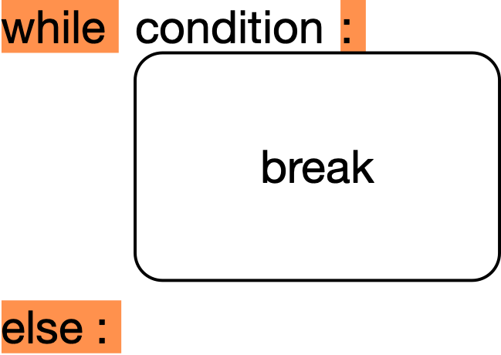
While Loops
Else clause (an example that Python is not perfect)
  Executed if a break is not taken

Slide 80
While Loops
Else clause example:
Notice: 'else' belongs to the inner for, not the if statement
for n in [2,3,4,5,6,7,8,20,21,22,23,24]:
for p in range(2, n):
if p*(n//p) == n: # p devides n
print(n,'=', p, '*', n//p)
break
else:
print(n, 'is prime')

Slide 81
Exercises
Use finer and finer sums in order to calculate $∫_{0}^{1}x^{3}dx=\frac{1}{4}$

Slide 82
Solution
We divide the interval [0,1] into N subintervals of size 1/N
The minimum of the function in the subinterval $\left[\frac{i}{N},\frac{i+1}{N}\right]$ is $\frac{i^{3}}{N^{3}}$
We multiply this with the length of the subinterval $\frac{1}{N}$ and add up to get
  $$\overset{N-1}{\underset{i=0}{∑}}\frac{i^{3}}{N^{3}}\frac{1}{N}$$
as a lower estimate for the integral.

Slide 83
Solution
N = 10000000
suma = 0
for i in range(N):
suma += i**3/N**4
print(suma)

