Slide 1
Numpy Arrays
Thomas Schwarz, SJ

Slide 2
NumPy Fundamentals
Numpy is a module for faster vector processing with numerous other routines
Scipy is a more extensive module that also includes many other functionalities such as machine learning and statistics

Slide 3
NumPy Fundamentals
Why Numpy?
Remember that Python does not limit lists to just elements of a single class
If we have a large list $[a_{1},a_{2},a_{3},…,a_{n}]$ and we want to add a number to all of the elements, then Python will asks for each element:
What is the type of the element
Does the type support the + operation
Look up the code for the + and execute
This is slow

Slide 4
NumPy Fundamentals
Why Numpy?
Primary feature of Numpy are arrays:
List like structure where all the elements have the same type
Usually a floating point type
Can calculate with arrays much faster than with list
Implemented in C / Java for Cython or Jython

Slide 5
Numpy Fundamentals
Python is an interpreted language
The Python engine is usually written in C: Cython
Compiled C-code is about as fast as you can get
The degree to which Python uses C-code directly often determines its speed

Slide 6
Numpy Fundamentals
Example:
Calculating the sum 1+2+3+…+ (number-1)
For which there is of course a mathematical formula
First possibility: using a while loop
def using_while(number):
result = 0
index = 0
while(index<number):
result += index
index += 1
return result

Slide 7
Numpy Fundamentals
Since we want to time it (and not using the awkward timeit) we write our own version for functions with a single argument
Import Python module time
Use time.perf_counter() to get the time
def my_time_it(function, arg):
start = time.perf_counter()
function(arg)
stop = time.perf_counter()
return stop-start

Slide 8
Numpy Fundamentals
If you want to extend this to arbitrary list of arguments:
def my_time_it(function, arg):
start = time.perf_counter()
function(arg)
stop = time.perf_counter()
return stop-start
def my_time_it(function, arg):
start = time.perf_counter()
function(*arg)
stop = time.perf_counter()
return stop-start
print('while', my_time_it(using_while, [number]))
print('while', my_time_it(using_while, number))

Slide 9
Numpy Fundamentals
The for-loop is closer to the C-for loop and therefore faster
def using_for(number):
result = 0
for index in range(number):
result += index
return result

Slide 10
Numpy Fundamentals
Built-ins are even faster
We can use sum on an iterable
def using_sum(number):
return sum(range(number))

Slide 11
Numpy Fundamentals
Now we can check the numbers:
def main():
number = 10**8
print('while', my_time_it(using_while, number))
print('for', my_time_it(using_for, number))
print('sum', my_time_it(using_sum, number))
print('np', my_time_it(using_np, number))

Slide 12
Numpy Fundamentals
While is the slowest because it has the most translation overhead
Built-ins are the best pure vanilla method
In general: Prefer comprehension and built-ins
But numpy is built to provide almost-C performance
number is 10**8
A pure C version takes time 0.23081 sec
while 7.869634077000001
for 5.293767602000001
sum 2.095567817000001
np 0.4438418519999985

Slide 13
Numpy Resources
Jake VanderPlas: Python Data Science Handbook: Essential Tools for Working with Data
https://jakevdp.github.io
Wes McKinney: Python for Data Analysis
https://github.com/wesm/pydata-book

Slide 14
NumPy Arrays
NumPy Arrays are containers for numerical values
Numpy arrays have dimensions
Vectors: one-dimensional
Matrices: two-dimensional
Tensors: more dimensions, but much more rarely used
Nota bene: A matrix can have a single row and a single column, but has still two dimensions

Slide 15
NumPy Arrays
After installing, try out import numpy as np
Making arrays:
Can use lists, though they better be of the same type
import numpy as np
my_list = [1,5,4,2]
my_vec = np.array(my_list)
my_list = [[1,2],[4,3]]
my_mat = np.array(my_list)

Slide 16
Array Creation
Numpy can generate arrays:
From disks or the net,
using various libraries
using loadtxt and similar functions
From lists and similar data structures
Generate them natively

Slide 17
Array Creation
Numpy has a number of ways to create an array
Import numpy as np
np.zeroes((2,3))
array([[ 0., 0., 0.], [ 0., 0., 0.]])
np.ones(5)
array([1., 1., 1., 1. , 1.])
np.eye(3) generates the identity matrix
array([[1., 0., 0.], [0., 1., 0.],[0., 0., 1.]])])

Slide 18
Array Creation
Numpy has a number of ways to create arrays
np.linspace(1., 4., 6) creates an array of 6 elements between 1.0 and 4.0 evenly spaced out
array([ 1. , 1.6, 2.2, 2.8, 3.4, 4. ])
np.arange(2, 3, 0.1) a more generalized version of Python's range function (with float step)
array([ 2. , 2.1, 2.2, 2.3, 2.4, 2.5, 2.6, 2.7, 2.8, 2.9])
np.arange(2,5)
array([2, 3, 4])

Slide 19
Array Creation
Can generate using lists, tuples, etc. even with a mix of types
np.array([[1,2,3], (1,0,0.5)])
array([[1. , 2. , 3. ], [1. , 0. , 0.5]])

Slide 20
Array Creation
Creating arrays:
np.full to fill in with a given value
np.full(5, 3.141)
array([3.141, 3.141, 3.141, 3.141, 3.141])

Slide 21
Array Creation
Can also create arrays with random values:
Example: Uniform distribution between 0 and 1
>>> np.random.random((3,2))
array([[0.39211415, 0.50264835],
[0.95824337, 0.58949256],
[0.59318281, 0.05752833]])

Slide 22
Array Creation
Example: random integers
>>> np.random.randint(0,20,(2,4))
array([[ 5, 7, 2, 10],
[19, 7, 1, 10]])

Slide 23
Array Creation
Ex.: normal distribution with mean 2 and standard deviation 0.5
>>> np.random.normal(2,0.5, (2,3))
array([[1.34857621, 1.34419178, 1.977698 ],
[1.31054068, 2.35126538, 3.25903903]])

Slide 24
Array Creation
fromfunction
>>> x = np.fromfunction(lambda i,j: (i**2+j**2)//2, (4,5) )
>>> x.astype(int)
array([[ 0, 0, 2, 4, 8],
[ 0, 1, 2, 5, 8],
[ 2, 2, 4, 6, 10],
[ 4, 5, 6, 9, 12]])
>>> x.shape
(4,5)

Slide 25
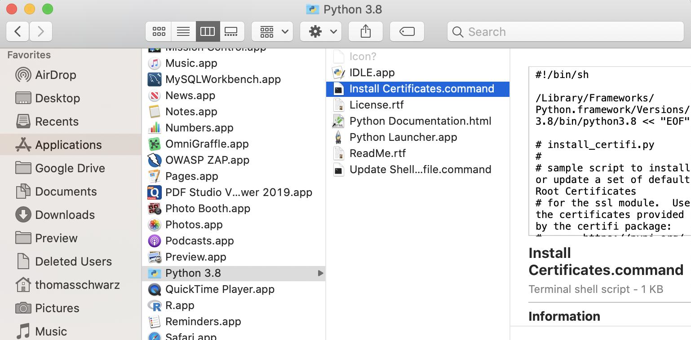
Array Creation
Creating from download / file
We use urllib.request module
If you are on Mac, you need to have Python certificates installed
Go to your Python installation in Applications and click on "Install Certificates command"

Slide 26
Array Creation
Use urllib.request.urlretrieve with website and file name
Remember: A file will be created, but the directory needs to exist
This is a text file, with one numerical value per line
Then create the numpy array using
import urllib.request
urllib.request.urlretrieve(
url = "https://ndownloader.figshare.com/files/12565616",
filename = "avg-monthly-precip.txt"
)
avgmp = np.loadtxt(fname = 'avg-monthly-precip.txt')
print(avgmp)

Slide 27
Array Creation
Example: Get an account at openweathermap.org/appid
Install requests and import json
Use the openweathermap.org api to request data on a certain town
Result is send as a JSON dictionary

Slide 28
Array Creation
import numpy as np
import requests
import json
mumbai=json.loads(requests.get('http://api.openweathermap.org/data/2.5/weather?q=mumbai,india&APPID=4561e0cd15ec2ee307bdcfe19ec22ab9').text)
vasai = json.loads(requests.get('http://api.openweathermap.org/data/2.5/weather?q=vasai,india&APPID=4561e0cd15ec2ee307bdcfe19ec22ab9').text)
navi_mumbai = json.loads(requests.get('http://api.openweathermap.org/data/2.5/weather?q=navi%20mumbai,india&APPID=4561e0cd15ec2ee307bdcfe19ec22ab9').text)
chalco = json.loads(requests.get('http://api.openweathermap.org/data/2.5/weather?q=Chalco,MX&APPID=4561e0cd15ec2ee307bdcfe19ec22ab9').text)
milwaukee = json.loads(requests.get('http://api.openweathermap.org/data/2.5/weather?q=Milwaukee,USA&APPID=4561e0cd15ec2ee307bdcfe19ec22ab9').text)

Slide 29
Array Creation
Can use np.genfromtext
Very powerful and complicated function with many different options

Slide 30
Array Creation
Example
Need a source (the iris file)
Can specify the columns we need
Give the dtype U20-unicode string, S20-byte string
Delimiter
Skipheader, skipfooter
converters to deal with encoding
converters = {5: lambda x: int(0 if 'Iris-setosa'
else 1 if 'Iris-virginica' else 2) }
my_array = np.genfromtxt('../Classes2/Iris.csv',
usecols=(1,2,3,4,5),
dtype =[float, float, float, float, float],
delimiter = ',',
converters = converters,
skip_header=1)

Slide 31
Array Creation
This is an array of 150 tuples
Use comprehension to convert to a two-dimensional array
m = np.array( [ [row[0], row[1], row[2], row[3], row[4]]
for row in my_array ])

Slide 32
Numpy Array Generation
Synthesis
In practice:
We will use Pandas data frames when getting data from the web
We will numpy arrays in order to speed up calculations
So, we concentrate on what we need for the latter task

Slide 33
NumPy Array Attributes
The number of dimensions: ndim
The values of the dimensions as a tuple: shape
The size (number of elements)
>>> tensor
array([[[2.11208424, 2.01510638, 2.03126777, 1.89670846],
[1.94359036, 2.02299445, 2.08515919, 2.05402626],
[1.8853457 , 2.01236192, 2.07019962, 1.93713157]],
[[1.84275427, 1.99537922, 1.96060154, 1.90020305],
[2.00270166, 2.11286224, 2.03144254, 2.06924855],
[1.95375653, 2.0612986 , 1.82571628, 1.86067971]]])
>>> tensor.ndim
3
>>> tensor.shape
(2, 3, 4)
>>> tensor.size
24

Slide 34
NumPy Array Attributes
The data type: dtype
can be bool, int, int64, uint, uint64, float, float64, complex …
Easier to use than its sounds
This is why Numpy can be so fast
The size of a single element in bytes: itemsize
The size of the total array: nbytes

Slide 35
NumPy Array Indexing
How to access / modify elements:
Single elements
Use the bracket notation [ ]
Single array: Same as in standard python
>>> vector = np.random.normal(10,1,(5))
>>> print(vector)
[10.25056641 11.37079651 10.44719557 10.54447875 10.43634562]
>>> vector[4]
10.436345621654919
>>> vector[-2]
10.544478746079845

Slide 36
NumPy Arrays Indexing
Matrix and tensor elements:
Shortcut: a single bracket and a comma separated tuple
>>> tensor
array([[[2.11208424, 2.01510638, 2.03126777, 1.89670846],
[1.94359036, 2.02299445, 2.08515919, 2.05402626],
[1.8853457 , 2.01236192, 2.07019962, 1.93713157]],
[[1.84275427, 1.99537922, 1.96060154, 1.90020305],
[2.00270166, 2.11286224, 2.03144254, 2.06924855],
[1.95375653, 2.0612986 , 1.82571628, 1.86067971]]])
>>> tensor[0,0,1]
2.015106376191313

Slide 37
NumPy Arrays Indexing
Multiple bracket notation
We can also use the Python indexing of multi-dimensional lists using several brackets
It is more writing and more error prone than the single bracket version
>>> tensor[0][1][2]
2.085159191502853

Slide 38
NumPy Arrays Indexing
We can also define slices
>>> vector = np.random.normal(10,1,(3))
>>> vector
array([10.61948855, 7.99635252, 9.05538706])
>>> vector[1:3]
array([7.99635252, 9.05538706])

Slide 39
NumPy Arrays Indexing
In Python, slices are new lists
In NumPy, slices are not copies
Changing a slice changes the original
Based on usage pattern
Avoiding unnecessary copies makes Numpy fast.

Slide 40
NumPy Arrays Indexing
Example:
Create an array
Define a slice
>>> vector = np.random.normal(10,1,(3))
>>> vector
array([10.61948855, 7.99635252, 9.05538706])
>>> x = vector[1:3]

Slide 41
NumPy Arrays Indexing
Example (cont.)
Change the first element in the slice
Verify that the change has happened
But the original has also changed:
>>> x[0] = 5.0
>>> x
array([5. , 9.05538706])
>>> vector
array([10.61948855, 5. , 9.05538706])

Slide 42
NumPy Arrays Indexing
Slicing does not makes copies
This is done in order to be efficient
Numerical calculations with a large amount of data get slowed down by unnecessary copies

Slide 43
NumPy Arrays Indexing
If we want a copy, we need to make one with the copy method
Example:
Make an array
Make a copy of the array
>>> vector = np.random.randint(0,10,5)
>>> vector
array([0, 9, 5, 7, 8])
>>> my_vector_copy = vector.copy()

Slide 44
NumPy Arrays Indexing
Example (continued)
Change the middle elements in the copy
Check the change
Check the original
No change!
>>> my_vector_copy[1:-2]=100
>>> my_vector_copy
array([ 0, 100, 100, 7, 8])
>>> vector
array([0, 9, 5, 7, 8])

Slide 45
NumPy Arrays Indexing
Multi-dimensional slicing
Combines the slicing operation for each dimension
>>> slice = tensor[1:, :2, :1]
>>> slice
array([[[1.84275427],
[2.00270166]]])

Slide 46
NumPy Arrays Indexing
Multi-dimensional slicing
Use : in the dimensions where you do not want to slice
A = np.random.normal(10, 1, (3,4,5))
A[:,2:4, 1:2]
array([[[ 9.30306142],
[10.84579805]],
[[ 8.54188872],
[10.78481198]],
[[ 9.62540173],
[10.70995867]]])

Slide 47
NumPy Arrays
Conditional Selection
We can create an array of Boolean values using comparisons on the array
>>> array = np.random.randint(0,10,8)
>>> array
array([2, 4, 4, 0, 0, 4, 8, 4])
>>> bool_array = array > 5
>>> bool_array
array([False, False, False, False, False,
False, True, False])

Slide 48
NumPy Arrays
Conditional Selection
We can then use the Boolean array to create a selection from the original array
The new array only has one element!
>>> selection=array[bool_array]
>>> selection
array([8])

Slide 49
Selftest
Can you do this in one step?
Create a random array of 10 elements between 0 and 10
Then select the ones larger than 5

Slide 50
Selftest Solution
Solution:
Looks a bit cryptic
First, we create an array
Then we select in a single step
>>> arr = np.random.randint(0,10,10)
>>> arr
array([3, 2, 7, 8, 7, 2, 1, 0, 4, 8])
>>> sel = arr[arr>5]
>>> sel
array([7, 8, 7, 8])

Slide 51
NumPy Arrays
Conditional Selection
Let's try this out with a matrix
We create a vector, then use reshape to make the array into a vector
Recall: the number of elements needs to be the same
>>> mat = np.arange(1,13).reshape(3,4)
>>> mat
array([[ 1, 2, 3, 4],
[ 5, 6, 7, 8],
[ 9, 10, 11, 12]])

Slide 52
NumPy Arrays
Conditional Selection
Now let's select:
This is no longer a matrix, which makes sense:
We remove elements, so we would have a matrix with holes
>>> mat1 = mat[mat>6]
>>> mat1
array([ 7, 8, 9, 10, 11, 12])

Slide 53
Slicing
Photo Manipulation
Need to install imageio and matplotlib
Get a photo as a 3-dimensional array
import imageio
import matplotlib.pyplot as plt
import matplotlib.image as mpimg
im = mpimg.imread('earth.jpg')
print(im.shape)

Slide 54
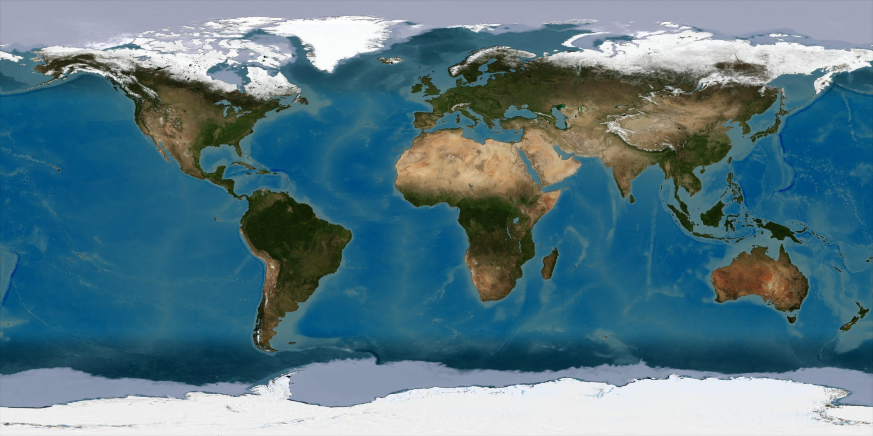
Slicing
Display the photo
plt.imshow(im)
plt.show()

Slide 55
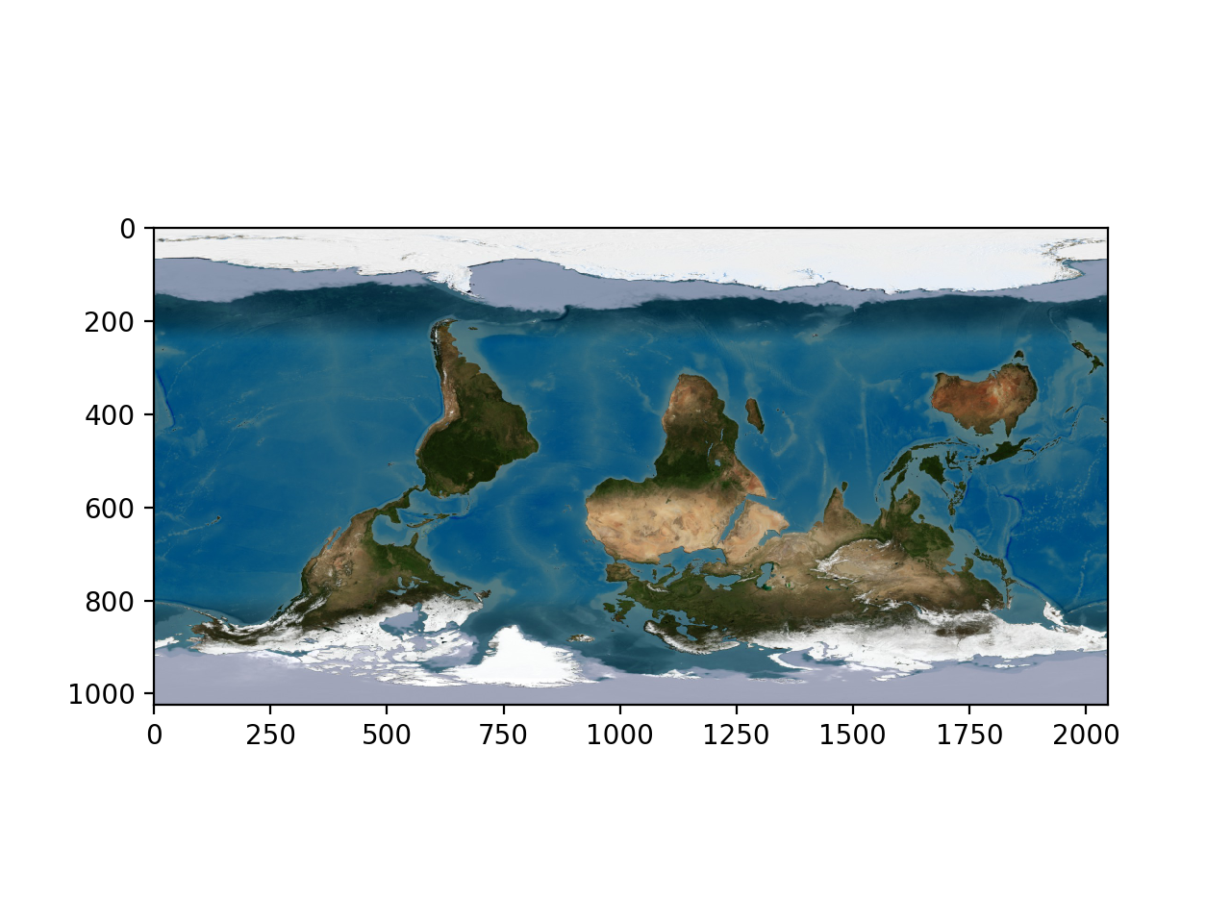
Slicing
Swap first coordinate
plt.imshow(im[::-1,])
plt.show()

Slide 56
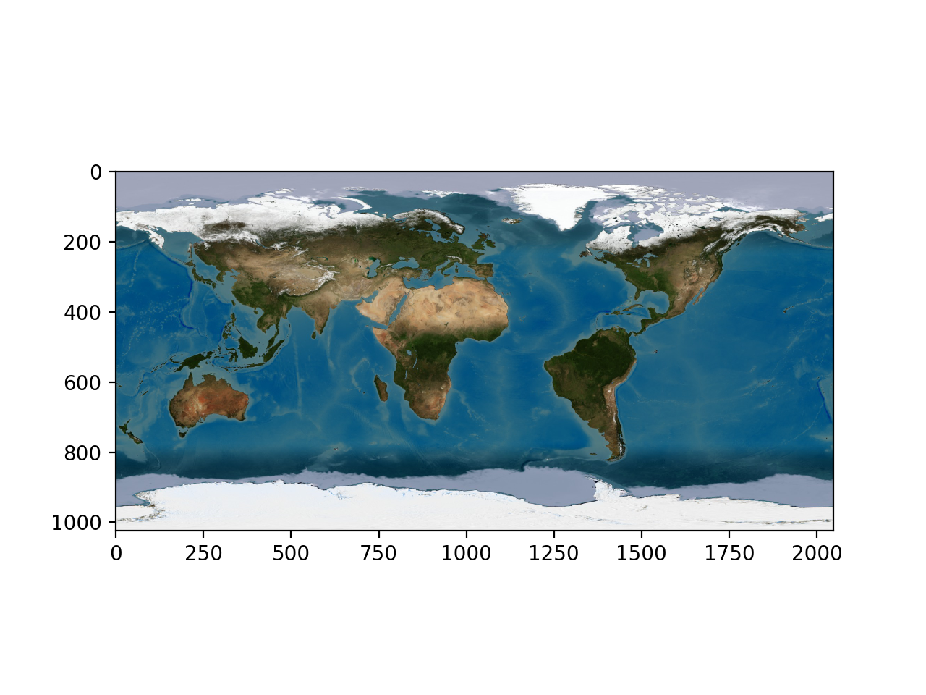
Slicing
Swap second coordinate
plt.imshow(im[:,::-1,])
plt.show()

Slide 57
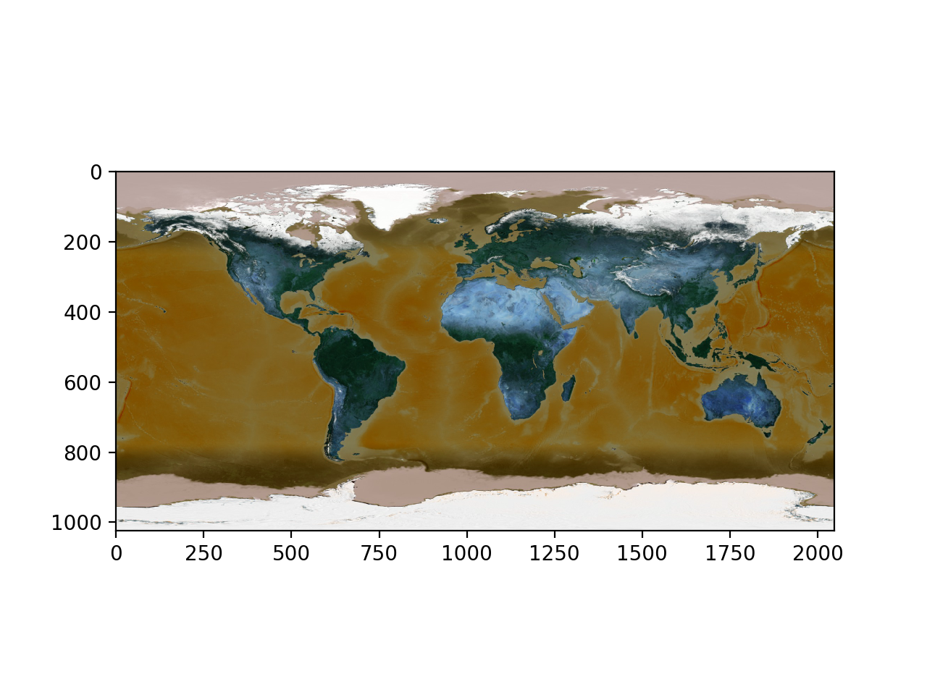
Slicing
Swap third coordinate (color coordinate)
plt.imshow(im[:,:,::-1])
plt.show()

Slide 58
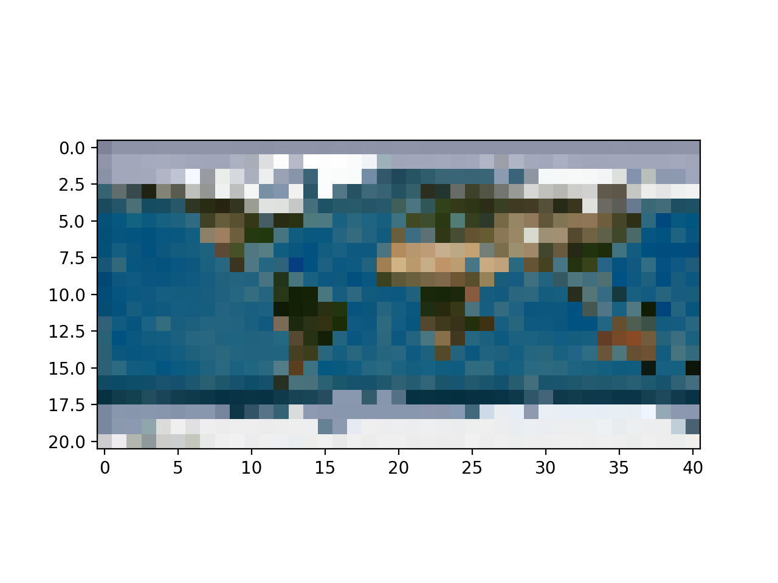
Slicing
Take every 50th line and column
plt.imshow(im[::50, ::50,])
plt.show()

Slide 59
Slicing
We can also apply functions
np.where allows us to replace values
Where-ever the value of the image is less than 100, replace it with 0
Otherwise, replace it with 255
image = np.where(im>100, 255, 0)

Slide 60
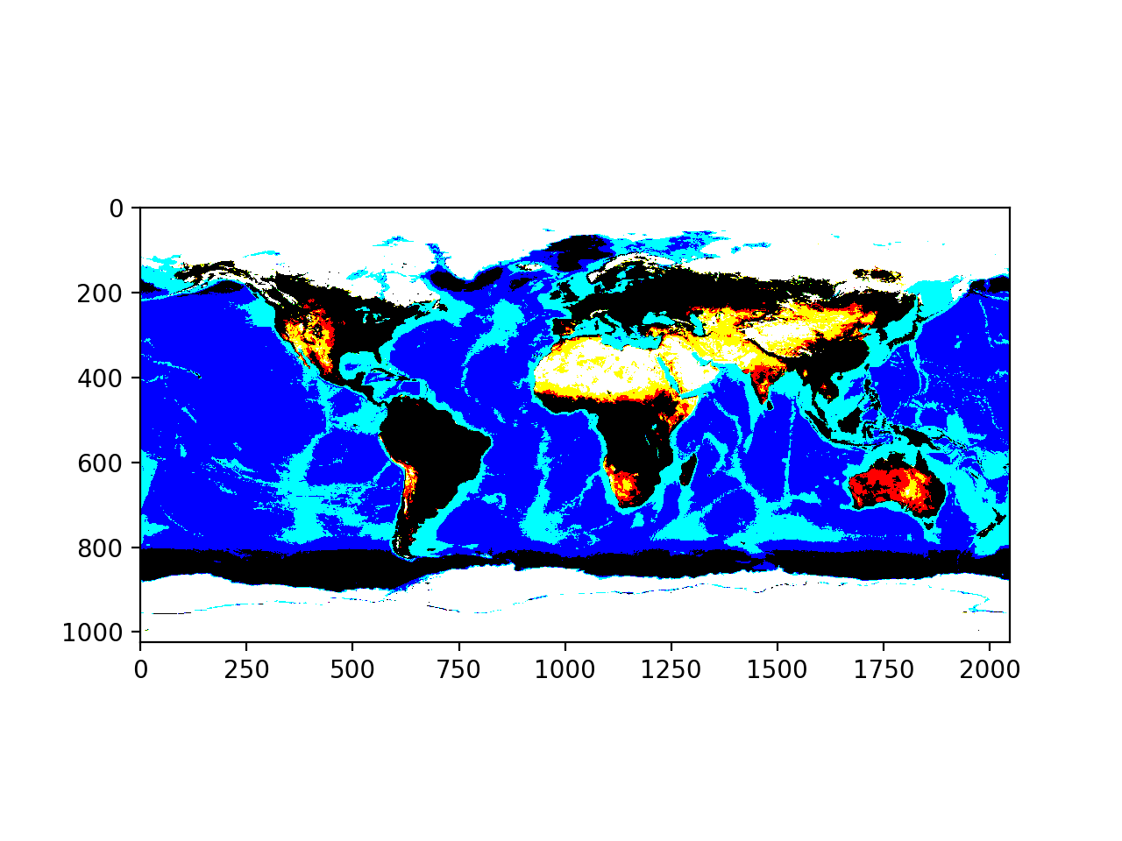
Slicing

Slide 61
Slicing
Can use a sub-image
plt.imshow(im[:,:,0])
plt.show()
plt.imshow(im[:,:,1])
plt.show()
plt.imshow(im[:,:,2])
plt.show()

Slide 62
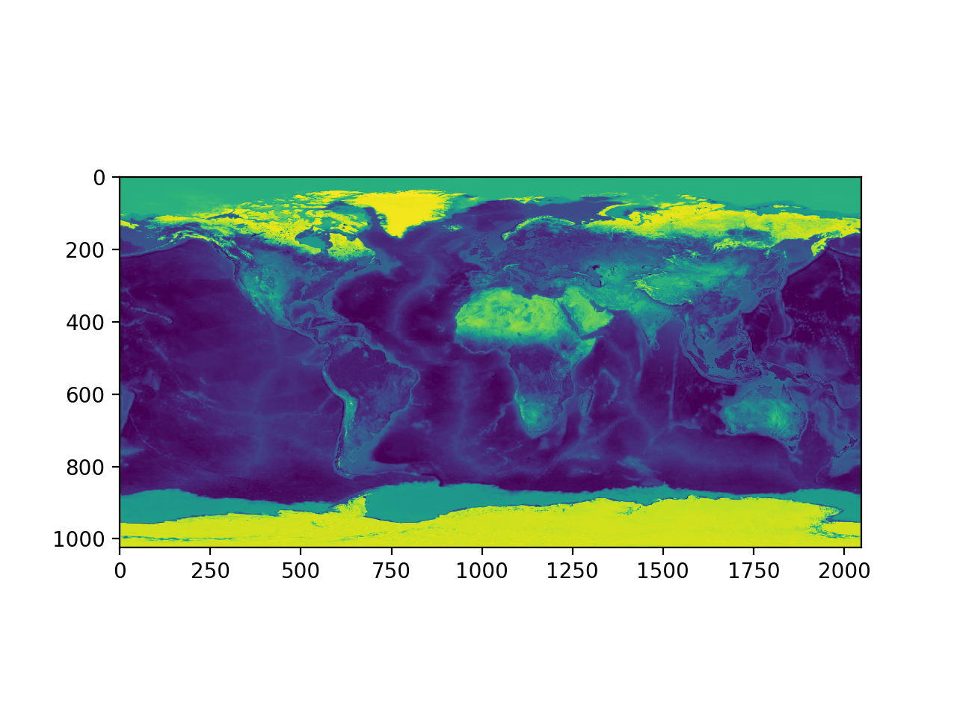
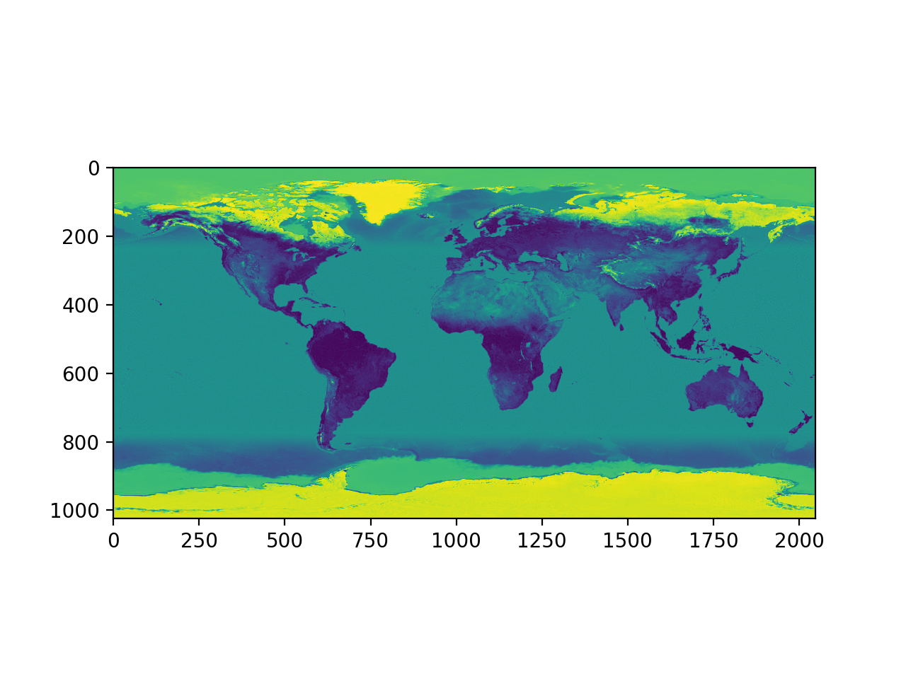
Slicing

Slide 63
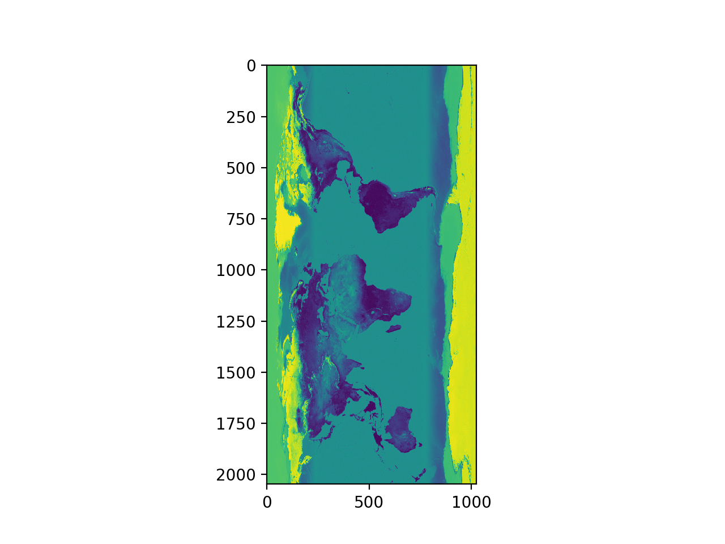
Slicing
Can use the transpose
plt.imshow(im[:,:,2].T)
plt.show()

Slide 64
Slicing
Or just concentrate on the essential
plt.imshow(im[250:500,1350:1600, : ])

Slide 65
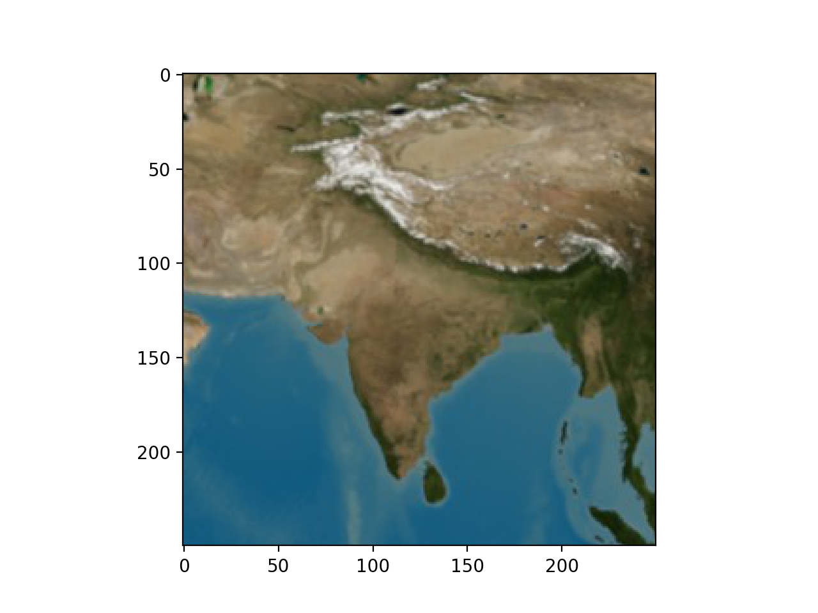
Slicing

Slide 66
NumPy Operations
Numpy allows fast operations on array elements
We can simply add, subtract, multiply or divide by a scalar
>>> vector = np.arange(20).reshape(4,5)
>>> vector
array([[ 0, 1, 2, 3, 4],
[ 5, 6, 7, 8, 9],
[10, 11, 12, 13, 14],
[15, 16, 17, 18, 19]])
>>> vector += 1
>>> vector
array([[ 1, 2, 3, 4, 5],
[ 6, 7, 8, 9, 10],
[11, 12, 13, 14, 15],
[16, 17, 18, 19, 20]])

Slide 67
NumPy Operations
Numpy also allows operations between arrays
>>> mat = np.random.normal(0,1,(4,5))
>>> mat
array([[ 0.04646031, -1.32970787, 1.16764921, -0.48342653, 0.42295389],
[ 0.70547825, 1.51980589, 1.46902433, -0.46742839, 1.42472386],
[ 0.78756679, -0.39975927, 1.24411043, -0.67336526, -0.92416835],
[ 0.4708628 , -0.29419976, -0.58634161, 0.29038393, -0.78814955]])
>>> vector + mat
array([[ 1.04646031, 0.67029213, 4.16764921, 3.51657347, 5.42295389],
[ 6.70547825, 8.51980589, 9.46902433, 8.53257161, 11.42472386],
[11.78756679, 11.60024073, 14.24411043, 13.32663474, 14.07583165],
[16.4708628 , 16.70580024, 17.41365839, 19.29038393, 19.21185045]])

Slide 68
NumPy Operations
What happens if there is an error?
Python would throw an exception, but not so NumPy
Example: Create two vectors, one with a zero
If we divide, we get a warning
But the result exists, with an inf value for infinity
>>> vector = np.arange(5)
>>> vector2 = np.arange(2,7)
>>> vec = vector2/vector
Warning (from warnings module):
File "<pyshell#11>", line 1
RuntimeWarning: divide by zero encountered in true_divide
>>> vec
array([ inf, 3. , 2. , 1.66666667, 1.5 ])

Slide 69
NumPy Operations
If we divide 0 by 0, we get an nan -- not a value
>>> vec=np.arange(4)
>>> vec
array([0, 1, 2, 3])
>>> vec/vec
Warning (from warnings module):
File "<pyshell#15>", line 1
RuntimeWarning: invalid value encountered in true_divide
array([nan, 1., 1., 1.])

Slide 70
NumPy Operations
There are rules for how to define operations with nan and inf, that make intuitive sense
IEEE Standard for Binary Floating-Point Arithmetic (IEEE 754)
We can create inf directly by saying np.inf
Example: Infinity divided by infinity is not defined
>>> np.inf/np.inf
nan

Slide 71
Operations between Vectors and Matrices
Adding two vectors:
>>> v1 = np.array([1,2,3])
>>> v2 = np.array([5,4,3])
>>> v1 + v2
array([6, 6, 6])

Slide 72
Operations between Vectors and Matrices
Adding two matrices
>>> m1 = np.array([[1,2,3],[4,5,6],[9,10,0]])
>>> m1
array([[ 1, 2, 3],
[ 4, 5, 6],
[ 9, 10, 0]])
>>> m2 = np.array([[4,2,0],[7,3,1],[5,1,2]])
>>> m2
array([[4, 2, 0],
[7, 3, 1],
[5, 1, 2]])
>>> m1+m2
array([[ 5, 4, 3],
[11, 8, 7],
[14, 11, 2]])

Slide 73
Operations between Vectors and Matrices
Scalar multiplication
>>> v = np.array([5,3,-2,4])
>>> 5*v
array([ 25, 15, -10, 20])

Slide 74
Operations between Vectors and Matrices
Scalar multiplication
>>> m1
array([[ 1, 2, 3],
[ 4, 5, 6],
[ 9, 10, 0]])
>>> 3*m1
array([[ 3, 6, 9],
[12, 15, 18],
[27, 30, 0]])

Slide 75
Operations between Vectors and Matrices
Element-wise multiplication is not matrix multiplication
>>> m1
array([[ 1, 2, 3],
[ 4, 5, 6],
[ 9, 10, 0]])
>>> m2
array([[4, 2, 0],
[7, 3, 1],
[5, 1, 2]])
>>> m1*m2
array([[ 4, 4, 0],
[28, 15, 6],
[45, 10, 0]])

Slide 76
Operations between Vectors and Matrices
Matrix multiplication uses the (new) @ operator
Python 3.5 and later
>>> m1
array([[ 1, 2, 3],
[ 4, 5, 6],
[ 9, 10, 0]])
>>> m2
array([[4, 2, 0],
[7, 3, 1],
[5, 1, 2]])
>>> m1@m2
array([[ 33, 11, 8],
[ 81, 29, 17],
[106, 48, 10]])

Slide 77
Operations between Vectors and Matrices
Can be used to multiply matrix and vector
Notice that the vectors are in row form
$$\left(\begin{matrix}2 & 3 \\ 1 & -1\end{matrix}\right)⋅\left(\begin{matrix}1, & 2\end{matrix}\right)=\left(\begin{matrix}8, & -1\end{matrix}\right)$$
Follows usage of matlab and Mathematica
>>> m = np.array([[2,3],[1,-1]])
>>> v = np.array([1,2])
>>> m@v
array([ 8, -1])

Slide 78
Operations between Vectors and Matrices
Transpose with np.transpose or the .T operator
>>> m
array([[ 2, 3],
[ 1, -1]])
>>> m.T
array([[ 2, 1],
[ 3, -1]])

Slide 79
Operations between Vectors and Matrices
Thus, could have used
>>> m@ v.T
array([ 8, -1])

Slide 80
Operations between Vectors and Matrices
We can use this to make a linear transform of a data set
def transform(matrix, dataset):
return (matrix@ dataset.T).T
mat = np.array([[.1, .2, .3, .4],
[.2, .2, .3, .4],
[.1, -.1, .2, 3],
[3, 2, 1, -2]
])
print(transform(mat, iris))

Slide 81
Operations between Vectors and Matrices
Dot-product of two vectors:
v = np.array([1, 2, 3, 4, 5])
>>> v@v.T
55
>>> np.vdot(v,v)
55

Slide 82
Operations between Vectors and Matrices
Can use linear algebra package in numpy
numpy.linalg
$${\left(\begin{matrix}1 & 2 \\ 1 & -1\end{matrix}\right)}^{10}=\left(\begin{matrix}243 & 0 \\ 0 & 243\end{matrix}\right)$$
np.linalg.matrix_power(np.array([[1,2],[1,-1]]),10)
array([[243, 0],
[ 0, 243]])

Slide 83
Operations between Vectors and Matrices
Can calculate matrix inverses
Throws LinAlgError if singular
>>> np.linalg.inv( np.array([1,-2],[-2,4]) )
Traceback (most recent call last):
…
numpy.linalg.LinAlgError: Singular matrix

Slide 84
Operations between Vectors and Matrices
Can directly solve linear equations
Solving $x+2y=2,x-y=3$
With solution $x=8/9,y=-1/3$
Gives an error if matrix is not square or singular
>>> np.linalg.solve( np.array([[1,2],[1,-1]]) ,
np.array([2,3]) )
array([ 2.66666667, -0.33333333])

Slide 85
NumPy:
Universal Array Functions
There is a plethora of functions that can be applied to a numpy array.
These are much faster than the corresponding Python functions
You can find a list in the numpy u-function manual
https://docs.scipy.org/doc/numpy/reference/ufuncs.html

Slide 86
NumPy:
Universal Array Functions
There are universal functions around which the operations are wrapped
np.add, np.subtract, np.negative, np.multiply, np.divide, np.floor_divide, np.power, np.mod
The absolute function is
abs
np.absolute

Slide 87
NumPy:
Universal Array Functions
Trigonometric functions
np.sin, np.cos, np.tan, np.arcsin, np.arccos, np.arctan
Exponents and logarithms
np.log, np.log2 (base 2), np.log10 (base 10)
np.expm1 (more exact for small arguments)
np.log1p (more exact for small arguments)

Slide 88
NumPy:
Universal Array Functions
Special u-functions:
In addition, the submodule scipy.special contains many more specialized functions

Slide 89
NumPy:
Universal Array Functions
Avoid creating temporary arrays
If they are large, too much time spent on moving data
Specify the array using the 'out' parameter
>>> y = np.empty(10)
>>> x = np.arange(1,11)
>>> np.exp(x, out = y)
array([2.71828183e+00, 7.38905610e+00, 2.00855369e+01, 5.45981500e+01,
1.48413159e+02, 4.03428793e+02, 1.09663316e+03, 2.98095799e+03,
8.10308393e+03, 2.20264658e+04])
>>> y
array([2.71828183e+00, 7.38905610e+00, 2.00855369e+01, 5.45981500e+01,
1.48413159e+02, 4.03428793e+02, 1.09663316e+03, 2.98095799e+03,
8.10308393e+03, 2.20264658e+04])

Slide 90
NumPy:
Universal Array Functions
Can use np.min, np.max, sum
Use np.argmin, np.argmax to find the index of the maximum / minimum element
Can use np.mean, np.std, np.var, np.median, mp.percentile to get statistics
Not the only way, see the scipy module

Slide 91
NumPy: Broadcasting
Operations can be also made between arrays of different sizes
Example 1: adding a scalar (zero-dimensional) to a vector
>>> x = np.full(5,1)
>>> x+1
array([2, 2, 2, 2, 2])

Slide 92
NumPy: Broadcasting
Adding a vector to a matrix:
Create a matrix
Create a vector
Add them together: The vector has been broadcast to a 2 by 5 matrix by doubling the single row
>>> matrix = np.arange(1,11).reshape((2,5))
>>> matrix
array([[ 1, 2, 3, 4, 5],
[ 6, 7, 8, 9, 10]])
>>> x = np.arange(1,6)
>>> x
array([1, 2, 3, 4, 5])
>>> matrix+x
array([[ 2, 4, 6, 8, 10],
[ 7, 9, 11, 13, 15]])

Slide 93
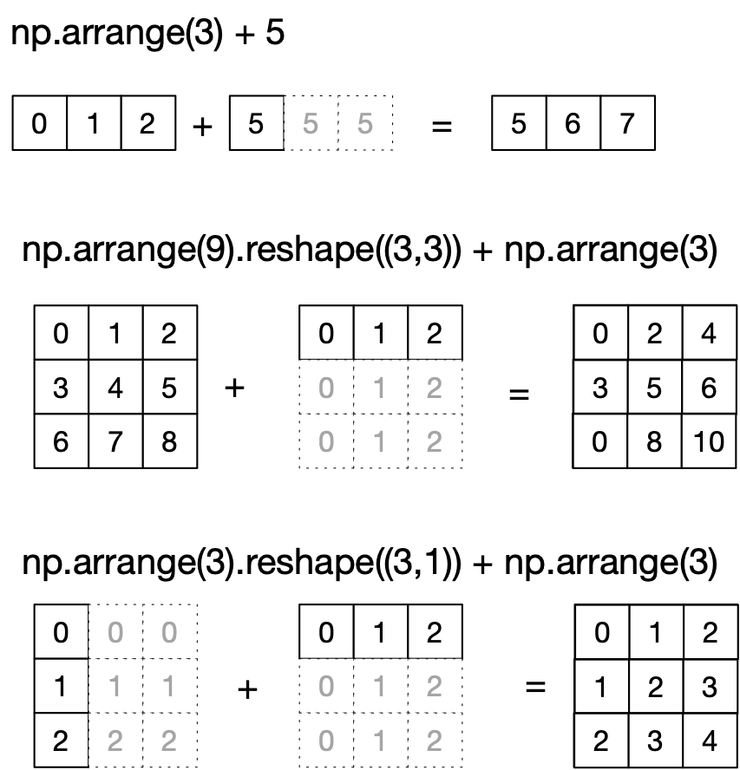
NumPy: Broadcasting
The broadcast rules: Expand a single coordinate in a dimension in one operand to the value in the other

Slide 94
NumPy: Broadcasting
Rule 1: If the two arrays differ in their number of dimensions, the shape of the one with fewer dimensions is padded with ones on its leading site
Rule 2: If the shape of two arrays does not match in any dimension, the array with shape equal to 1 in that dimension is stretched to match the other shape
Rule 3: If in any dimensions the sizes disagree and neither is equal to 1, an error is raised

Slide 95
Neat Example
We combine broadcasting with mathplotlib
Using IDLE, we need to call the show function at the end.

Slide 96
NumPy: Broadcasting
Create a row and a column vector x and y
Then use broadcasting to combine them for something two-dimensional
This will get displayed
import matplotlib.pyplot as plt
def prob7():
x = np.linspace(0,5,51)
y = np.linspace(0,5,51).reshape(51,1)
z = np.sin(x)**5+np.cos(10+x*y)
plt.imshow(z, origin='lower', extent=[0, 5, 0, 5],
cmap='viridis')
plt.colorbar()
plt.show()

Slide 97
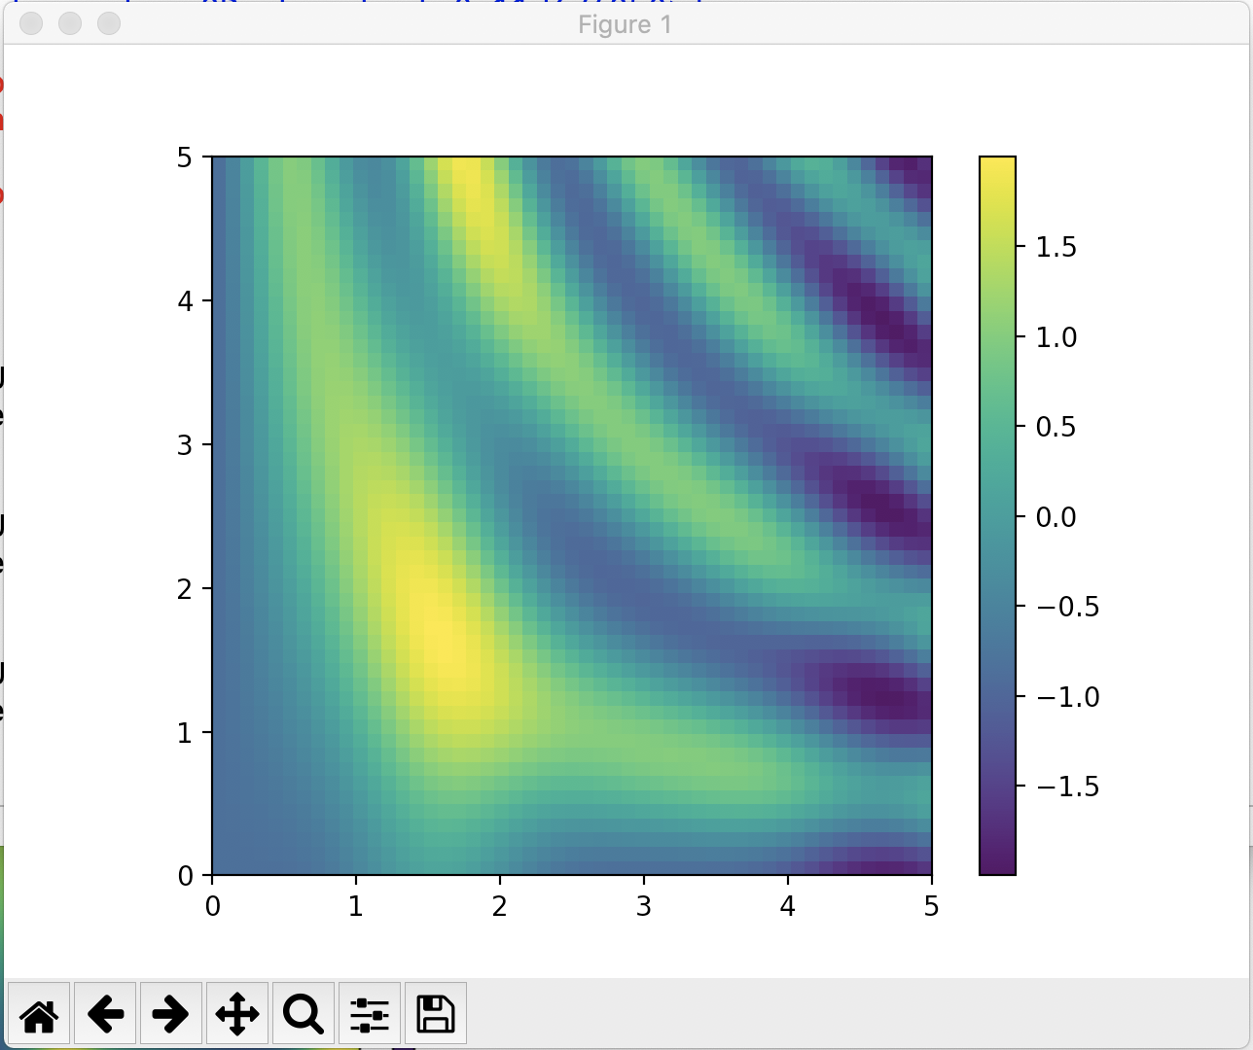
NumPy: Broadcasting

Slide 98
NumPy: Fancy Indexing
Fancy indexing:
Use an array of indices in order to access a number of array elements at once

Slide 99
NumPy: Fancy Indexing
Example:
Create matrix
Fancy Indexing:
>>> mat = np.random.randint(0,10,(3,5))
>>> mat
array([[3, 2, 3, 3, 0],
[9, 5, 8, 3, 4],
[7, 5, 2, 4, 6]])
>>> mat[(1,2),(2,3)]
array([8, 4])

Slide 100
NumPy: Fancy Indexing
Application:
Creating a sample of a number of points
Create a large random array representing data points
Select the x and y coordinates by slicing
>>> mat = np.random.normal(100,20, (200,2))
>>> x=mat[:,0]
>>> y=mat[:,1]

Slide 101
NumPy: Fancy Indexing
Create a matplotlib figure with a plot inside it
>>> fig = plt.figure()
>>> ax = fig.add_subplot(1,1,1)
>>> ax.scatter(x,y)
>>> plt.show()

Slide 102
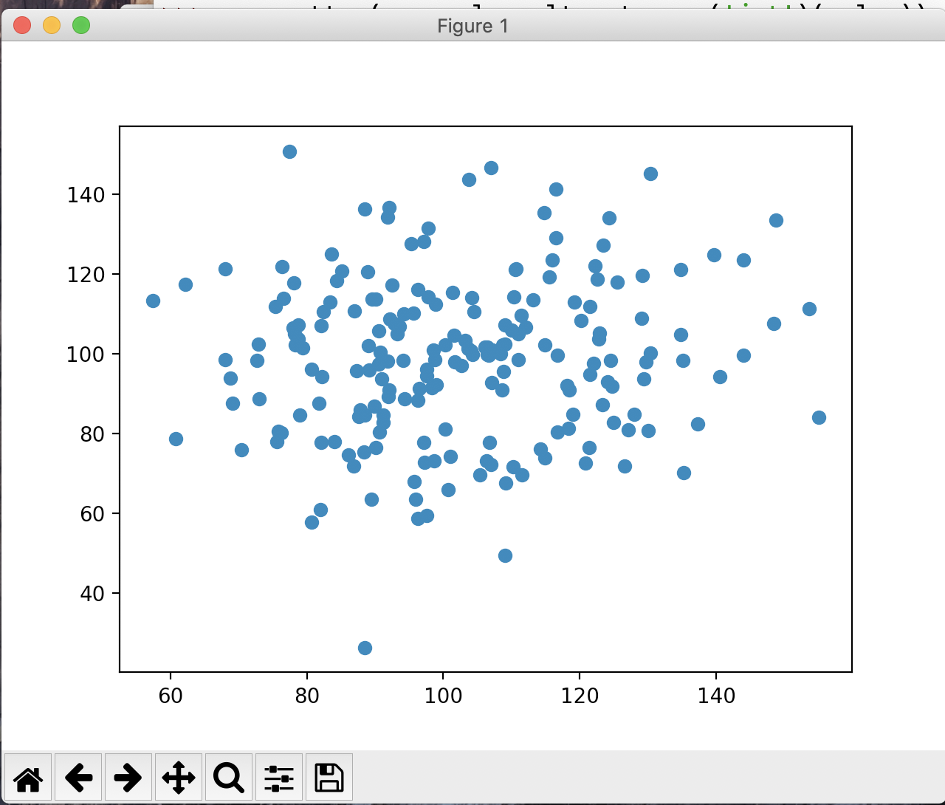
NumPy: Fancy Indexing

Slide 103
NumPy: Fancy Indexing
Create a list of potential indices
Use fancy indexing to create the subset of points
>>> indices = np.random.choice(np.arange(0,200,1),10)
>>> indices
array([ 32, 93, 172, 134, 90, 66, 109, 158, 188, 30])
>>> subset = mat[indices]

Slide 104
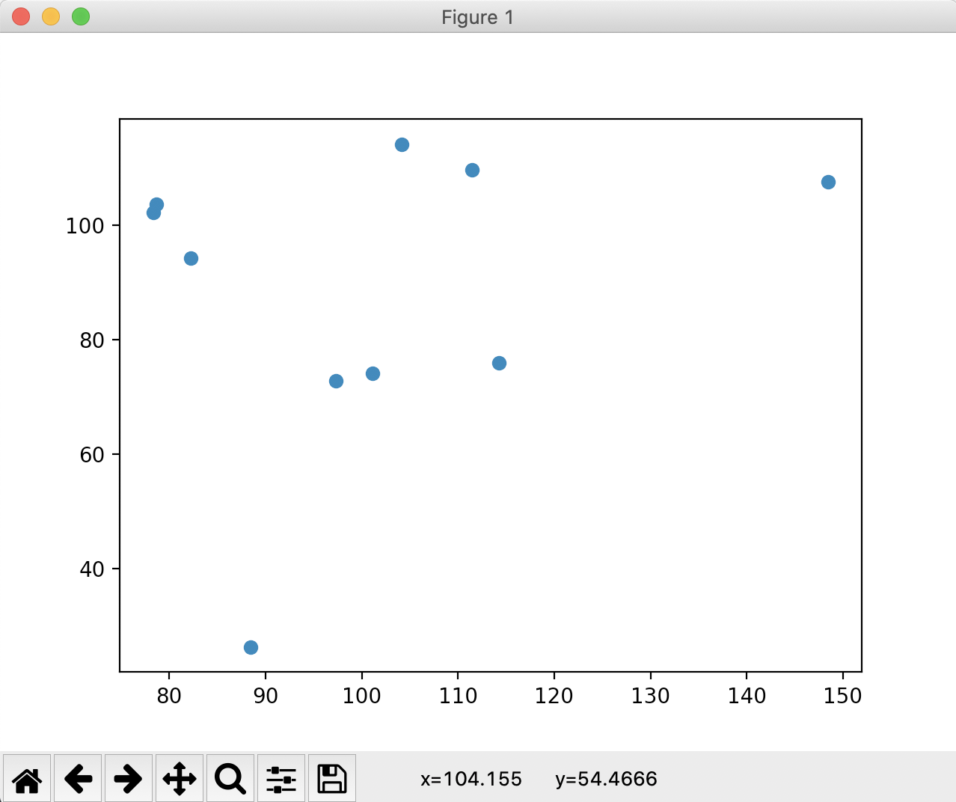
NumPy: Fancy Indexing

Slide 105
Simple Stats
Recall iris data set
After normalization
>>> iris
array([[0.22222222, 0.625 , 0.06779661, 0.04166667],
[0.16666667, 0.41666667, 0.06779661, 0.04166667],
[0.11111111, 0.5 , 0.05084746, 0.04166667],
[0.08333333, 0.45833333, 0.08474576, 0.04166667],
[0.19444444, 0.66666667, 0.06779661, 0.04166667],
[0.30555556, 0.79166667, 0.11864407, 0.125 ],
[0.08333333, 0.58333333, 0.06779661, 0.08333333],
[0.19444444, 0.58333333, 0.08474576, 0.04166667],
[0.02777778, 0.375 , 0.06779661, 0.04166667],

Slide 106
Simple Stats
Calculate average along of all values
Much more important: calculate average along an axis
>>> np.mean(iris)
0.4483046924042686
>>> np.mean(iris, axis=0)
array([0.4287037 , 0.43916667, 0.46757062, 0.45777778])

Slide 107
Simple Stats
Simularly: np.min, np.max, np.median
With version in case nan (not a value) is present
Example: Normalizing the iris data set
def normalize(array):
maxs = np.max(array, axis = 0)
mins = np.min(array, axis = 0)
return (array-mins)/(maxs-mins)

Slide 108
Simple Stats
Or normalize to have mean 0 and standard deviation 1
def normalizeS(array):
means = np.mean(array, axis = 0)
stdevs = np.std(array, axis = 0)
return (array - means)/stdevs

Slide 109
Simple Stats
Can determine percentiles and quantiles
>>> iris[:5,:]
array([[5.1, 3.5, 1.4, 0.2],
[4.9, 3. , 1.4, 0.2],
[4.7, 3.2, 1.3, 0.2],
[4.6, 3.1, 1.5, 0.2],
[5. , 3.6, 1.4, 0.2]])
])
>>> np.percentile(iris, 5, axis=0)
array([4.6 , 2.345, 1.3 , 0.2 ])
np.percentile(iris, 95, axis=0)
array([7.255, 3.8 , 6.1 , 2.3 ])

Slide 110
Broadcast Application
Getting the difference matrix of a vector$\left(\begin{matrix}v_{0}, & v_{1}, & ,…, & v_{n-1}\end{matrix}\right)$
$$\left(\begin{matrix}v_{0}-v_{0} & v_{0}-v_{1} & … & v_{0}-v_{n-1} \\ v_{1}-v_{0} & v_{1}-v_{1} & … & v_{1}-v_{n-1} \\ ⋮ & ⋮ & ⋱ & ⋮ \\ v_{n-1}-v_{0} & v_{n-1}-v_{1} & … & v_{n-1}-v_{n-1}\end{matrix}\right)$$

Slide 111
Broadcast Application
Because of broadcast rules, this will not work
>>> v = np.array([1,2,3,4,5,6,7])
>>> v - v.T
array([0, 0, 0, 0, 0, 0, 0])

Slide 112
Broadcast Application
But we can embed the vector into a two-dimensional vector in two different ways
>>> v[None,:]
array([[1, 2, 3, 4, 5, 6, 7]])
>>> v[:,None]
array([[1],
[2],
[3],
[4],
[5],
[6],
[7]])

Slide 113
Broadcast Application
Now we can use broadcasting
>>> v[:,None]-v[None,:]
array([[ 0, -1, -2, -3, -4, -5, -6],
[ 1, 0, -1, -2, -3, -4, -5],
[ 2, 1, 0, -1, -2, -3, -4],
[ 3, 2, 1, 0, -1, -2, -3],
[ 4, 3, 2, 1, 0, -1, -2],
[ 5, 4, 3, 2, 1, 0, -1],
[ 6, 5, 4, 3, 2, 1, 0]])

Slide 114
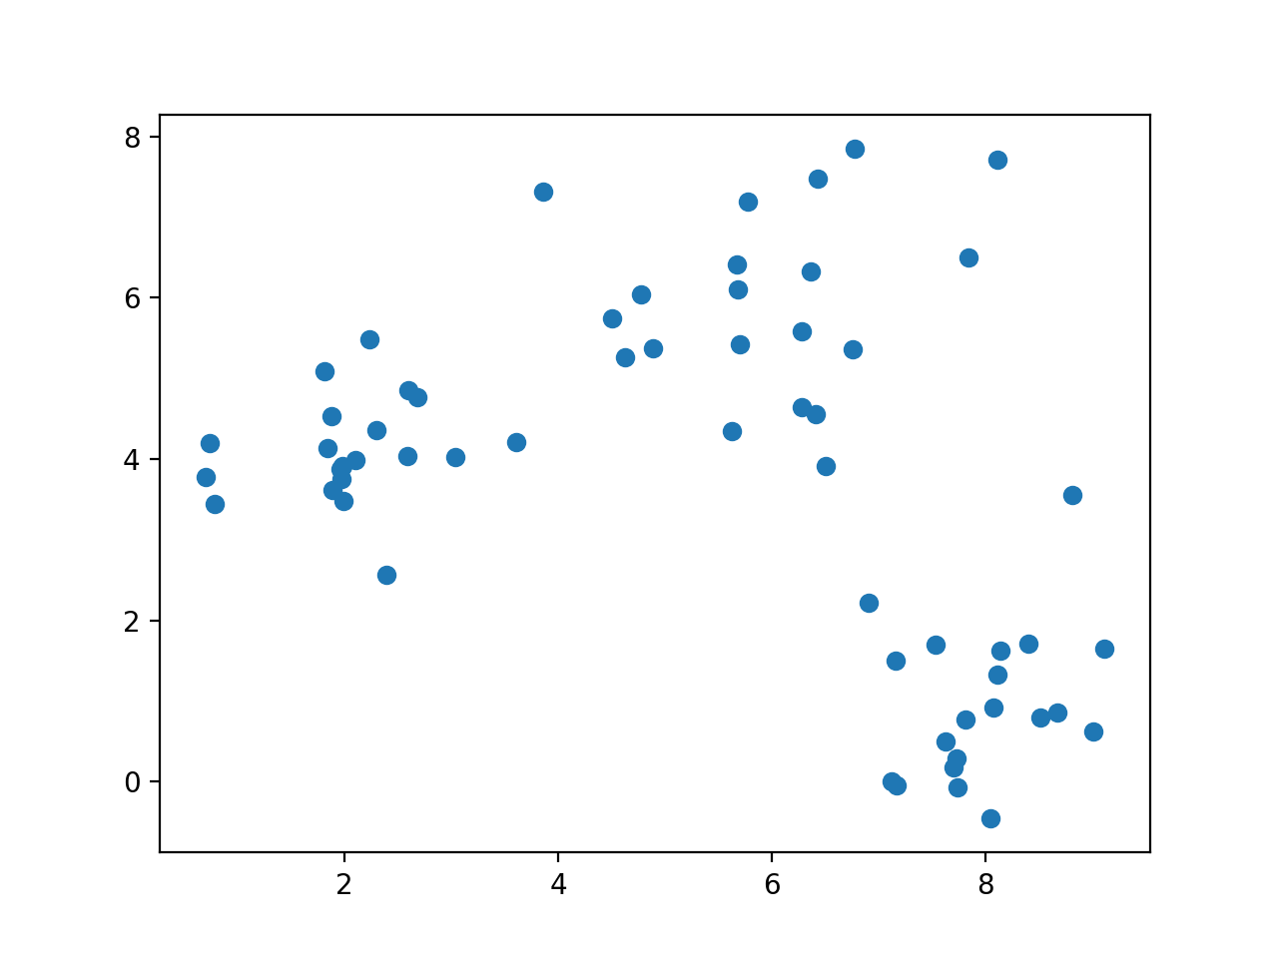
k-means clustering
Given a set of data, can we cluster it even if we do not know its structure?

Slide 115
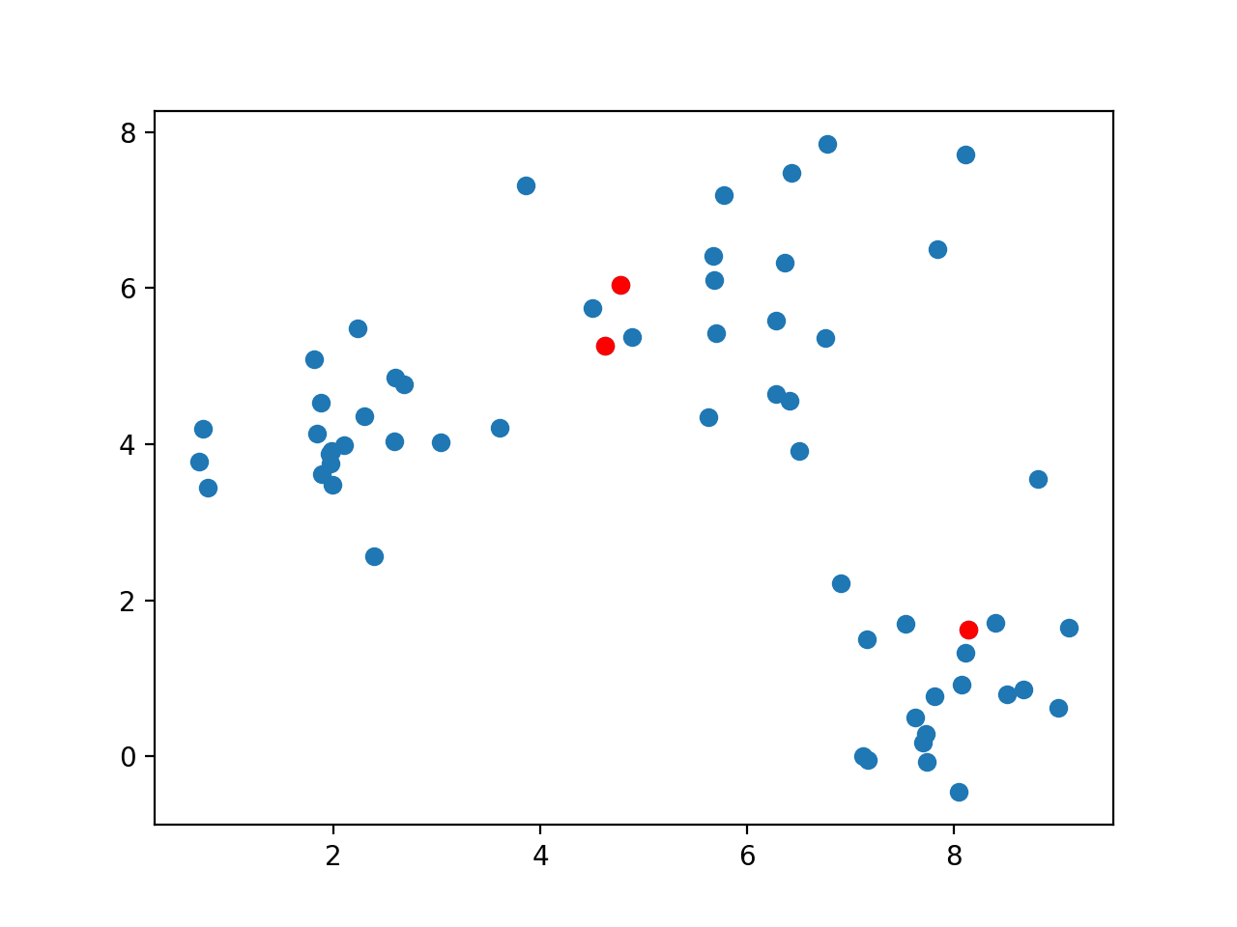
k-means clustering
Guess a number of clusters and pick k arbitrary points

Slide 116
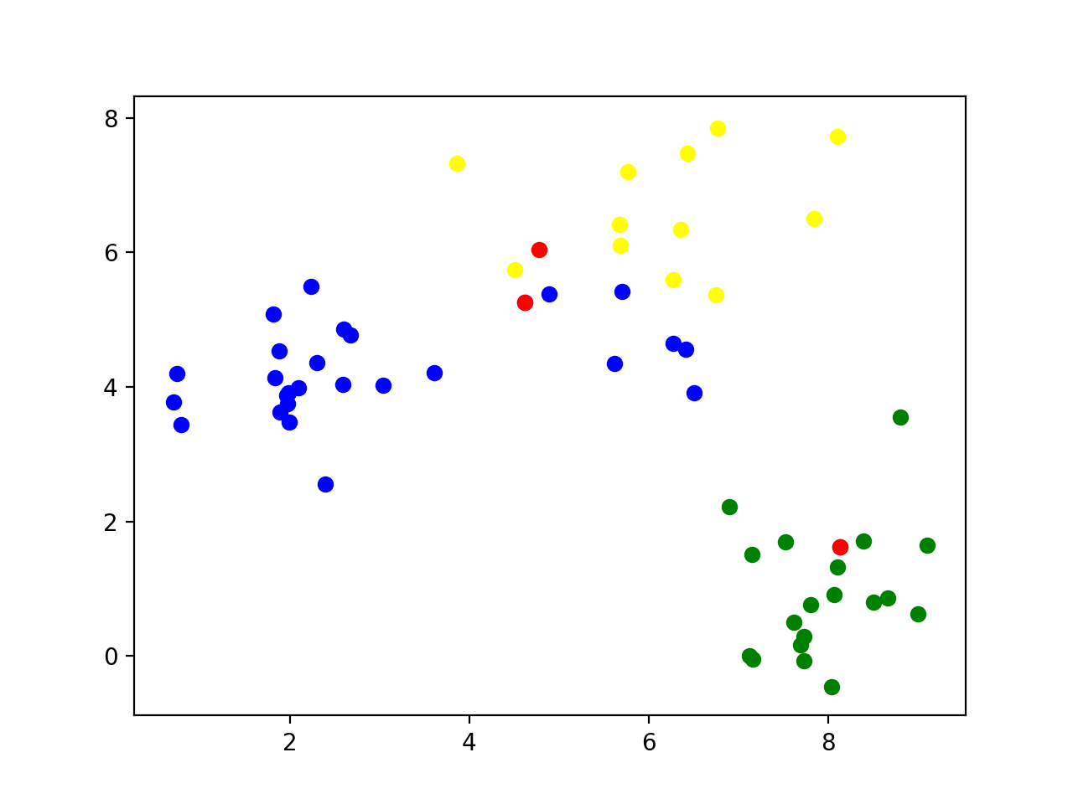
k-means clustering
Classify all points according to which of the points they are closest

Slide 117
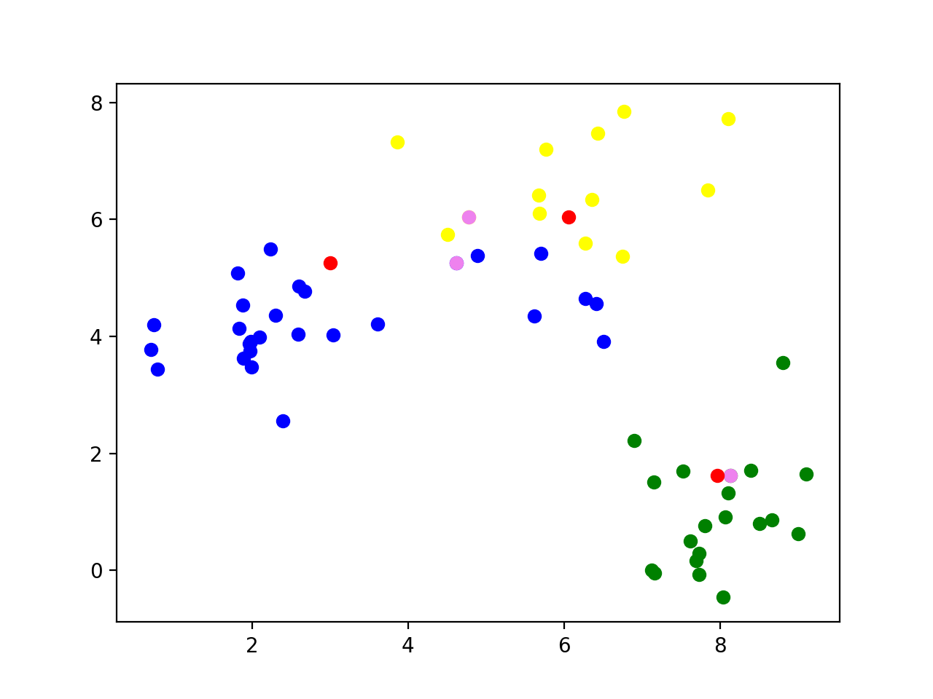
k-means clustering
Calculate the mean of all the data points and set it as the new center

Slide 118
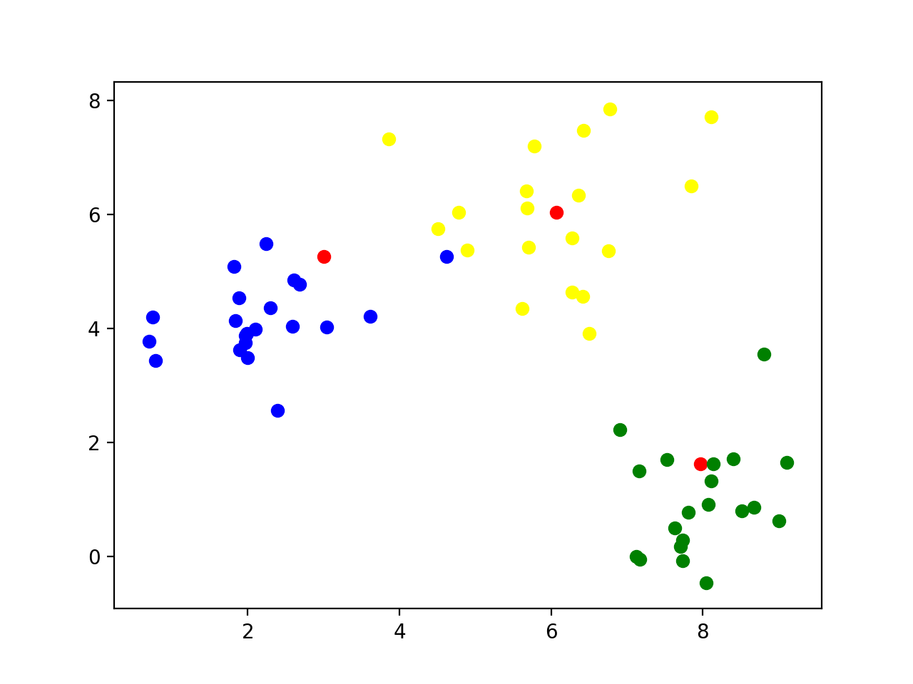
k-means clustering
Reclassify all the points according to their closeness to the new centers

Slide 119
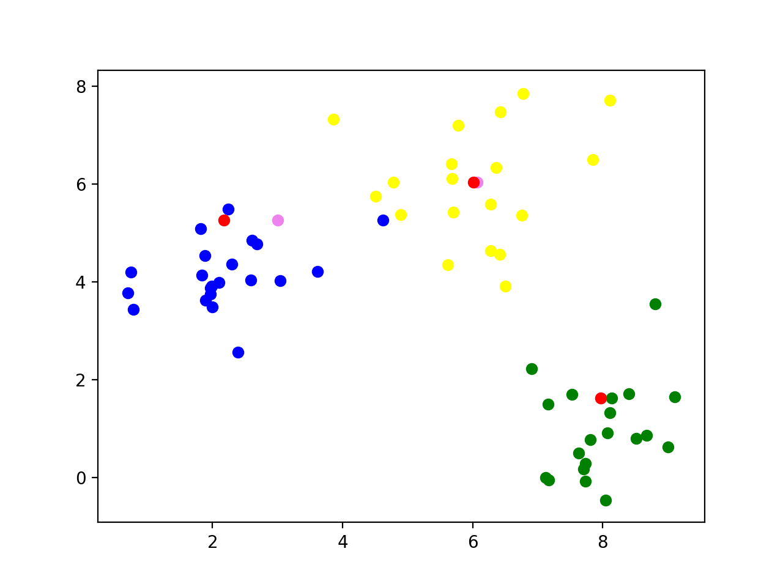
k-means clustering
Now calculate the new centers of the groups

Slide 120
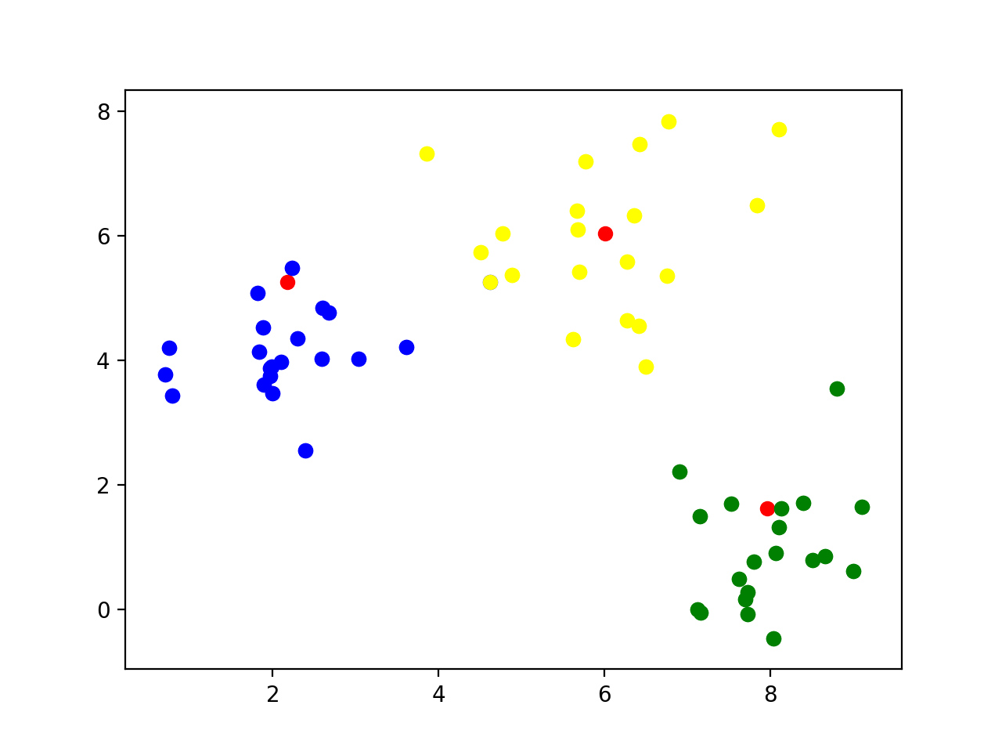
k-means clustering
Repeat: Classify according to closeness to the new centers

Slide 121
k-means clustering
Continue
The centers no longer move when points are no longer moved between different categories

Slide 122
k-means clustering
Implementation
Find starting points by random selection
def cluster(data, k, limit):
centers = data[ np.random.choice(np.arange(data.shape[0]), k, replace=False),: ]
for _ in range(limit):
distances = ((data[:,:,None] - centers.T[None, :, :])**2).sum(axis=1)
classification = np.argmin( distances, axis=1)
new_centers = np.array([data[classification==j,:].mean(axis=0) for j in range(k)])
if np.max(np.abs(new_centers - centers)) < 0.01:
break
else:
centers = new_centers
else: #loop did not end
print('No convergence')
return centers

Slide 123
k-means clustering
Enter a limited loop:
def cluster(data, k, limit):
centers = data[ np.random.choice(np.arange(data.shape[0]), k, replace=False),: ]
for _ in range(limit):
distances = ((data[:,:,None] - centers.T[None, :, :])**2).sum(axis=1)
classification = np.argmin( distances, axis=1)
new_centers = np.array([data[classification==j,:].mean(axis=0) for j in range(k)])
if np.max(np.abs(new_centers - centers)) < 0.01:
break
else:
centers = new_centers
else: #loop did not end
print('No convergence')
return centers

Slide 124
Use the previous trick to calculate the difference between all points and the centers
def cluster(data, k, limit):
centers = data[ np.random.choice(np.arange(data.shape[0]), k, replace=False),: ]
for _ in range(limit):
distances = ((data[:,:,None] - centers.T[None, :, :])**2).sum(axis=1)
classification = np.argmin( distances, axis=1)
new_centers = np.array([data[classification==j,:].mean(axis=0) for j in range(k)])
if np.max(np.abs(new_centers - centers)) < 0.01:
break
else:
centers = new_centers
else: #loop did not end
print('No convergence')
return centers

Slide 125
For each point, find the closest distance
def cluster(data, k, limit):
centers = data[ np.random.choice(np.arange(data.shape[0]), k, replace=False),: ]
for _ in range(limit):
distances = ((data[:,:,None] - centers.T[None, :, :])**2).sum(axis=1)
classification = np.argmin( distances, axis=1)
new_centers = np.array([data[classification==j,:].mean(axis=0) for j in range(k)])
if np.max(np.abs(new_centers - centers)) < 0.01:
break
else:
centers = new_centers
else: #loop did not end
print('No convergence')
return centers

Slide 126
The new centers are obtained by taking the mean of the points with a given classification
def cluster(data, k, limit):
centers = data[ np.random.choice(np.arange(data.shape[0]), k, replace=False),: ]
for _ in range(limit):
distances = ((data[:,:,None] - centers.T[None, :, :])**2).sum(axis=1)
classification = np.argmin( distances, axis=1)
new_centers = np.array([data[classification==j,:].mean(axis=0) for j in range(k)])
if np.max(np.abs(new_centers - centers)) < 0.01:
break
else:
centers = new_centers
else: #loop did not end
print('No convergence')
return centers

Slide 127
If the centers do not move, we are done
def cluster(data, k, limit):
centers = data[ np.random.choice(np.arange(data.shape[0]), k, replace=False),: ]
for _ in range(limit):
distances = ((data[:,:,None] - centers.T[None, :, :])**2).sum(axis=1)
classification = np.argmin( distances, axis=1)
new_centers = np.array([data[classification==j,:].mean(axis=0) for j in range(k)])
if np.max(np.abs(new_centers - centers)) < 0.01:
break
else:
centers = new_centers
else: #loop did not end
print('No convergence')
return centers

Slide 128
Possible to not have convergence
For production quality code: consider raising an exception
def cluster(data, k, limit):
centers = data[ np.random.choice(np.arange(data.shape[0]), k, replace=False),: ]
for _ in range(limit):
distances = ((data[:,:,None] - centers.T[None, :, :])**2).sum(axis=1)
classification = np.argmin( distances, axis=1)
new_centers = np.array([data[classification==j,:].mean(axis=0) for j in range(k)])
if np.max(np.abs(new_centers - centers)) < 0.01:
break
else:
centers = new_centers
else: #loop did not end
print('No convergence')
return centers

Slide 129
The loop stabilized, we are done
def cluster(data, k, limit):
centers = data[ np.random.choice(np.arange(data.shape[0]), k, replace=False),: ]
for _ in range(limit):
distances = ((data[:,:,None] - centers.T[None, :, :])**2).sum(axis=1)
classification = np.argmin( distances, axis=1)
new_centers = np.array([data[classification==j,:].mean(axis=0) for j in range(k)])
if np.max(np.abs(new_centers - centers)) < 0.01:
break
else:
centers = new_centers
else: #loop did not end
print('No convergence')
return centers

Slide 130
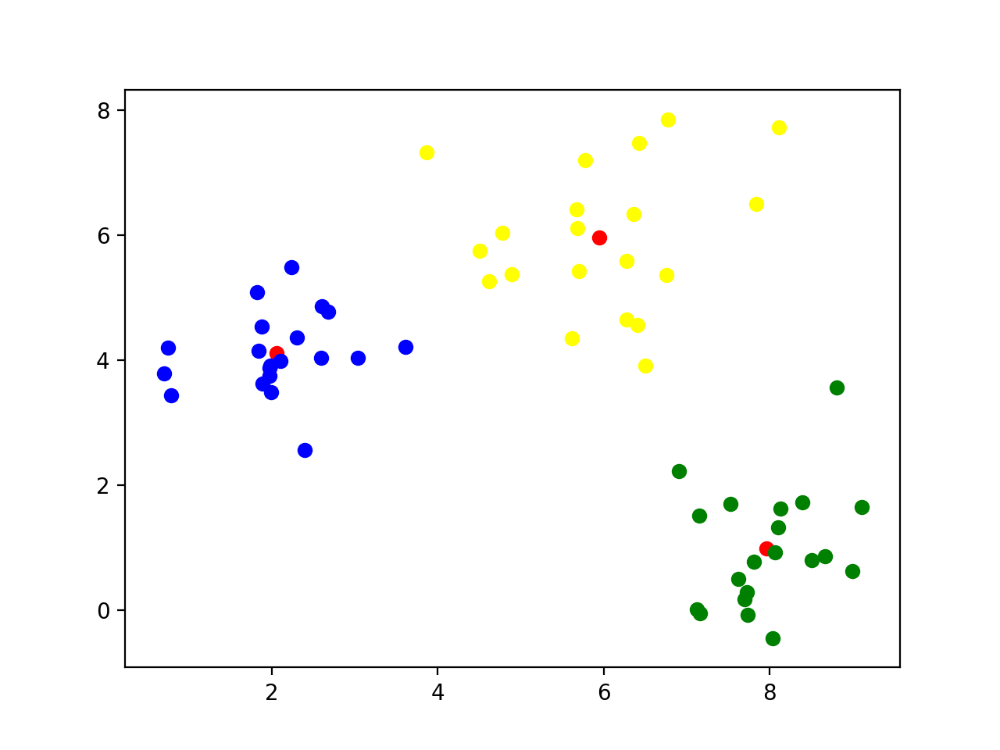
k-means clustering
Final result

Slide 131
k-means clustering
This worked because I used normalvariate to generate points around (2,4), (8,1), and (6,6)

Slide 132
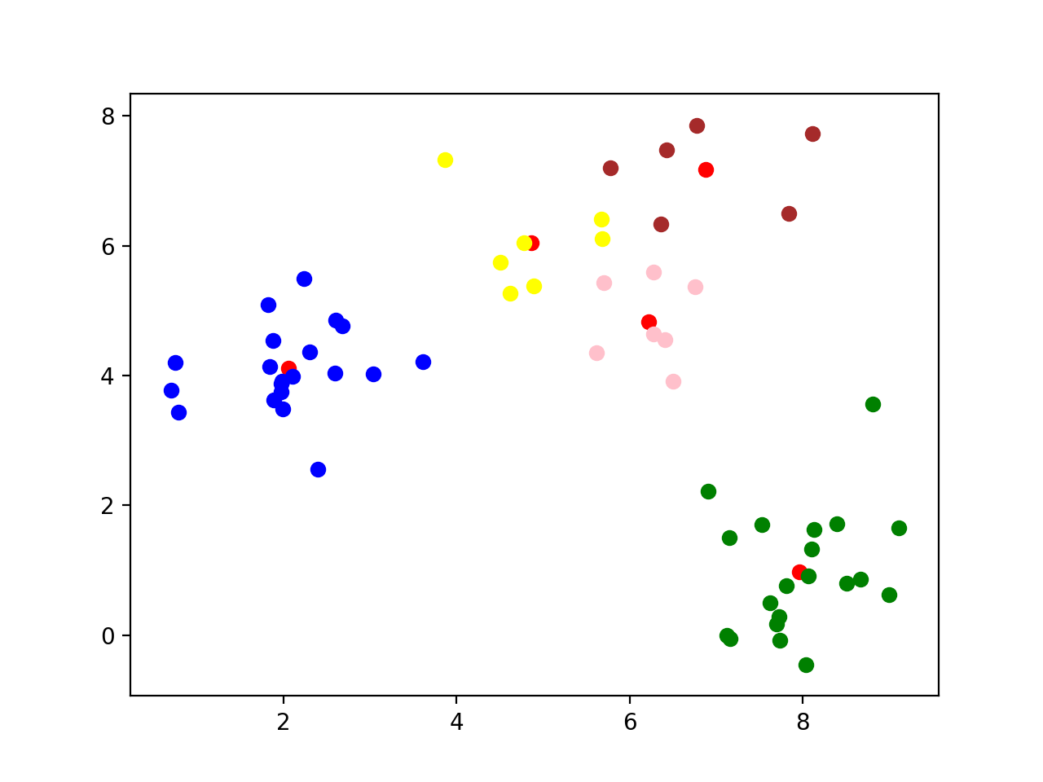
k-means clustering
What happens if we use a different k?
k=5: A cluster gets arbitrarily split

Slide 133
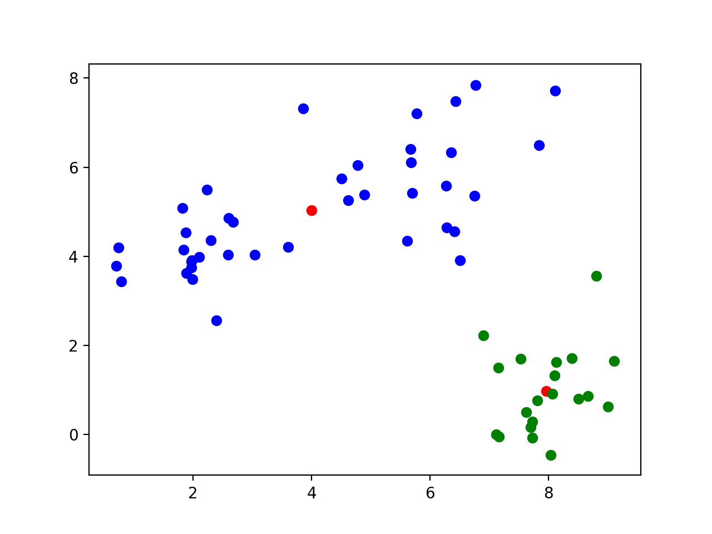
k-means clustering
k=2 Two clusters get merged

Slide 134
k-means clustering
Let's try this out on the Iris data set
We only keep the measurements
We can normalize data using the min-max method
def normalize(array):
maxs = np.max(array, axis = 0)
mins = np.min(array, axis = 0)
return (array-mins)/(maxs-mins)

Slide 135
k-means clustering
Now we try clustering without normalizing
The first 50 are 'Setosa', the next 50 are 'Virginica', then 'Variegata'
Sample with k = 5:
Recognizes 'Setosa' cluster, but not the other two
[1 1 1 1 1 1 1 1 1 1 1 1 1 1 1 1 1 1 1 1 1 1 1 1 1 1 1 1 1 1 1 1 1 1 1 1 1
1 1 1 1 1 1 1 1 1 1 1 1 1 0 0 0 4 0 4 0 2 0 4 2 4 4 0 4 0 4 4 0 4 0 4 0 0
0 0 0 0 0 4 4 4 4 0 4 0 0 0 4 4 4 0 4 2 4 4 4 0 2 4 3 0 3 3 3 3 4 3 3 3 0
0 3 0 0 3 3 3 3 0 3 0 3 0 3 3 0 0 3 3 3 3 3 0 0 3 3 3 0 3 3 3 0 3 3 3 0 0
3 0]

Slide 136
k-means clustering
With k = 3: looks a bit better, but still cannot recognize Virginia and Variegata
[2 2 2 2 2 2 2 2 2 2 2 2 2 2 2 2 2 2 2 2 2 2 2 2 2 2 2 2 2 2 2 2 2 2 2 2 2
2 2 2 2 2 2 2 2 2 2 2 2 2 1 0 1 0 0 0 0 0 0 0 0 0 0 0 0 0 0 0 0 0 0 0 0 0
0 0 0 1 0 0 0 0 0 0 0 0 0 0 0 0 0 0 0 0 0 0 0 0 0 0 1 0 1 1 1 1 0 1 1 1 1
1 1 0 0 1 1 1 1 0 1 0 1 0 1 1 0 0 1 1 1 1 1 0 1 1 1 1 0 1 1 1 0 1 1 1 0 1
1 0]

Slide 137
k-means clustering
Best results with k = 2:
[1 1 1 1 1 1 1 1 1 1 1 1 1 1 1 1 1 1 1 1 1 1 1 1 1 1 1 1 1 1 1 1 1 1 1 1 1
1 1 1 1 1 1 1 1 1 1 1 1 1 0 0 0 0 0 0 0 1 0 0 0 0 0 0 0 0 0 0 0 0 0 0 0 0
0 0 0 0 0 0 0 0 0 0 0 0 0 0 0 0 0 0 0 1 0 0 0 0 1 0 0 0 0 0 0 0 0 0 0 0 0
0 0 0 0 0 0 0 0 0 0 0 0 0 0 0 0 0 0 0 0 0 0 0 0 0 0 0 0 0 0 0 0 0 0 0 0 0
0 0]

Slide 138
k-means clustering
With mean-std normalization, results are more encouraging, but still not satisfactory
[2 2 2 2 2 2 2 2 2 2 2 2 2 2 2 2 2 2 2 2 2 2 2 2 2 2 2 2 2 2 2 2 2 2 2 2 2
2 2 2 2 0 2 2 2 2 2 2 2 2 1 1 1 0 1 0 1 0 1 0 0 0 0 0 0 1 0 0 0 0 1 0 0 0
0 1 1 1 0 0 0 0 0 0 0 1 1 0 0 0 0 0 0 0 0 0 0 0 0 0 1 0 1 1 1 1 0 1 1 1 1
1 1 0 1 1 1 1 1 0 1 0 1 1 1 1 1 1 1 1 1 1 1 1 0 1 1 1 1 1 1 1 0 1 1 1 0 1
1 1]
[1 1 1 1 1 1 1 1 1 1 1 1 1 1 1 1 1 1 1 1 1 1 1 1 1 1 1 1 1 1 1 1 1 1 1 1 1
1 1 1 1 1 1 1 1 1 1 1 1 1 2 2 2 0 0 0 2 0 0 0 0 0 0 0 0 2 0 0 0 0 2 0 0 0
0 2 2 2 0 0 0 0 0 0 0 2 2 0 0 0 0 0 0 0 0 0 0 0 0 0 2 0 2 2 2 2 0 2 0 2 2
0 2 0 0 2 2 2 2 0 2 0 2 0 2 2 0 0 2 2 2 2 2 0 0 2 2 2 0 2 2 2 0 2 2 2 0 2
2 0]
[1 2 2 2 1 1 2 2 2 2 1 2 2 2 1 1 1 1 1 1 2 1 2 2 2 2 2 1 2 2 2 2 1 1 2 2 1
2 2 2 2 2 2 2 1 2 1 2 1 2 0 0 0 0 0 0 0 0 0 0 0 0 0 0 0 0 0 0 0 0 0 0 0 0
0 0 0 0 0 0 0 0 0 0 0 0 0 0 0 0 0 0 0 0 0 0 0 0 0 0 0 0 0 0 0 0 0 0 0 0 0
0 0 0 0 0 0 0 0 0 0 0 0 0 0 0 0 0 0 0 0 0 0 0 0 0 0 0 0 0 0 0 0 0 0 0 0 0
0 0]

Slide 139
k-means clustering
With k = 2, we cluster into Setosa and not-Setosa
[1 1 1 1 1 1 1 1 1 1 1 1 1 1 1 1 1 1 1 1 1 1 1 1 1 1 1 1 1 1 1 1 1 1 1 1 1
1 1 1 1 1 1 1 1 1 1 1 1 1 0 0 0 0 0 0 0 0 0 0 0 0 0 0 0 0 0 0 0 0 0 0 0 0
0 0 0 0 0 0 0 0 0 0 0 0 0 0 0 0 0 0 0 0 0 0 0 0 0 0 0 0 0 0 0 0 0 0 0 0 0
0 0 0 0 0 0 0 0 0 0 0 0 0 0 0 0 0 0 0 0 0 0 0 0 0 0 0 0 0 0 0 0 0 0 0 0 0
0 0]
[1 1 1 1 1 1 1 1 1 1 1 1 1 1 1 1 1 1 1 1 1 1 1 1 1 1 1 1 1 1 1 1 1 1 1 1 1
1 1 1 1 1 1 1 1 1 1 1 1 1 0 0 0 0 0 0 0 0 0 0 0 0 0 0 0 0 0 0 0 0 0 0 0 0
0 0 0 0 0 0 0 0 0 0 0 0 0 0 0 0 0 0 0 0 0 0 0 0 0 0 0 0 0 0 0 0 0 0 0 0 0
0 0 0 0 0 0 0 0 0 0 0 0 0 0 0 0 0 0 0 0 0 0 0 0 0 0 0 0 0 0 0 0 0 0 0 0 0
0 0]
[0 0 0 0 0 0 0 0 0 0 0 0 0 0 0 0 0 0 0 0 0 0 0 0 0 0 0 0 0 0 0 0 0 0 0 0 0
0 0 0 0 0 0 0 0 0 0 0 0 0 1 1 1 1 1 1 1 1 1 1 1 1 1 1 1 1 1 1 1 1 1 1 1 1
1 1 1 1 1 1 1 1 1 1 1 1 1 1 1 1 1 1 1 1 1 1 1 1 1 1 1 1 1 1 1 1 1 1 1 1 1
1 1 1 1 1 1 1 1 1 1 1 1 1 1 1 1 1 1 1 1 1 1 1 1 1 1 1 1 1 1 1 1 1 1 1 1 1
1 1]

Slide 140
k-means clustering
With k=4: still no separation
[0 3 3 3 0 0 3 0 3 3 0 3 3 3 0 0 0 0 0 0 0 0 0 3 3 3 0 0 0 3 3 0 0 0 3 3 0
3 3 0 0 3 3 0 0 3 0 3 0 3 2 2 2 1 1 1 2 1 1 1 1 1 1 1 1 2 1 1 1 1 2 1 1 1
1 2 2 2 1 1 1 1 1 1 1 2 2 1 1 1 1 1 1 1 1 1 1 1 1 1 2 1 2 2 2 2 1 2 2 2 2
2 2 1 1 2 2 2 2 1 2 1 2 1 2 2 1 2 2 2 2 2 2 1 1 2 2 2 1 2 2 2 1 2 2 2 1 2
2 1]
[2 2 2 2 2 2 2 2 2 2 2 2 2 2 2 2 2 2 2 2 2 2 2 2 2 2 2 2 2 2 2 2 2 2 2 2 2
2 2 2 2 2 2 2 2 2 2 2 2 2 0 0 0 1 0 1 0 1 0 1 1 1 1 0 1 0 1 1 1 1 0 1 1 1
0 0 0 0 1 1 1 1 1 1 1 0 0 1 1 1 1 0 1 1 1 1 1 1 1 1 0 1 3 0 0 3 1 3 0 3 0
0 0 1 0 0 0 3 3 1 3 1 3 0 0 3 0 0 0 3 3 3 0 0 1 3 0 0 0 0 0 0 1 3 3 0 1 0
0 0]
[2 1 1 1 2 3 2 2 1 1 2 2 1 1 3 3 3 2 3 2 2 2 2 2 2 1 2 2 2 1 1 2 3 3 1 2 2
1 1 2 2 1 1 2 2 1 2 1 2 2 0 0 0 0 0 0 0 1 0 0 1 0 0 0 0 0 0 0 0 0 0 0 0 0
0 0 0 0 0 0 0 0 0 0 0 0 0 0 0 0 0 0 0 1 0 0 0 0 1 0 0 0 0 0 0 0 0 0 0 0 0
0 0 0 0 0 0 0 0 0 0 0 0 0 0 0 0 0 0 0 0 0 0 0 0 0 0 0 0 0 0 0 0 0 0 0 0 0
0 0]

Slide 141
k-means clustering
Morale:
With k-means clustering
Definitely need to normalize data set
Need to repeat method many times
Pick the one with the lowest sum of Euclidean distances

