Slide 1
Probability & Statistics
Thomas Schwarz, SJ

Slide 2
Overview
Statistics is the lifeblood of data science
You need to learn how to use statistics
But the calculations are implemented in two powerful Python modules
scipy.stats
statsmodels

Slide 3
Probability
We concentrate on categorical data
Categorical data is discrete: e.g. "not infected", "infected, but no symptoms", "sick", "recovered", "dead"
Categorical data can be ordinal :
number of cases in Milwaukee County
Categorical data can be nominal :
Republican, Democrat, Other, Non-affiliated

Slide 4
Probability Distributions for Categorical Data
Binomial distribution:
Given a binary characteristic (yes/no) and a sample / population of $n$ what is the probability that $i$ have the characteristics
If we assume that the presence of the characteristic in one individual is independent of the characteristic of another individual
$p_{binom}(y,n,π)=\frac{n!}{y!(y-n)!}π^{y}(1-π)^{(n-y)}$

Slide 5
In Python
Let's run an experiment:
Select an element of a population with probability p
Count how many population member are selected
Then normalize to get the probability that x members are selected
def run_trials(runs, pop_size, p):
results = np.zeros((pop_size+1))
for _ in range(runs):
seen = len([x for x in
np.random.rand(pop_size) if x < p])
results[seen]+=1
return results/runs

Slide 6
In Python
Then compare with the binomial probability
binom.pmf is the probability mass function $\left({n \atop k}\right)p^{k}(1-p)^{n-k}$
from scipy.stats import binom
results = run_trials(runs, pop_size, p)
xvalues = np.arange(0, len(results))
binom.pmf(xvalues,pop_size, p)

Slide 7
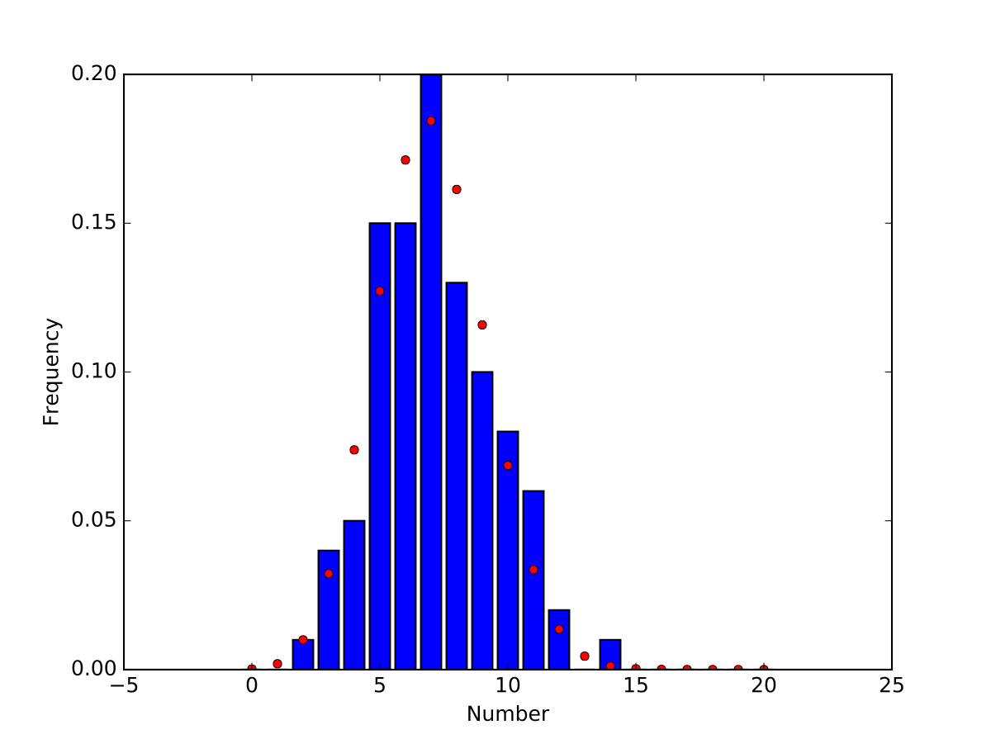
In Python
100 runs : Prediction and experimental results differ

Slide 8
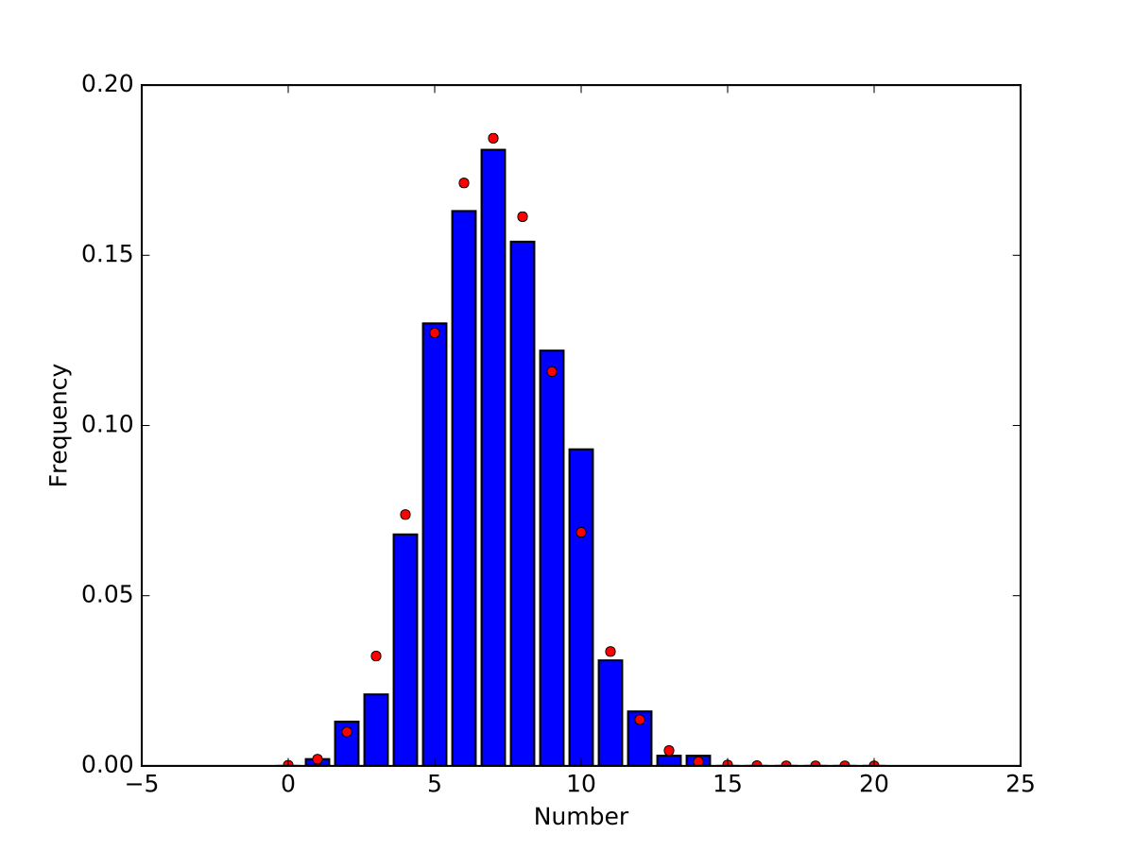
In Python
1000 runs: getting better

Slide 9
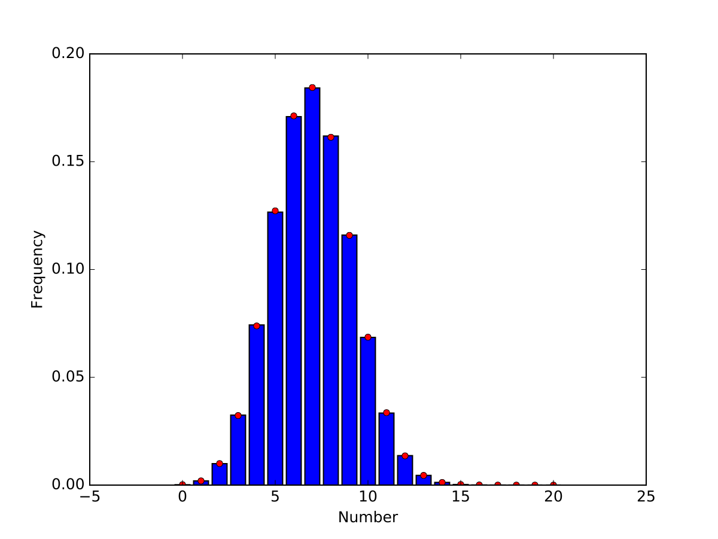
In Python
1,000,000 runs

Slide 10
Morale
Small numbers means large uncertainty
For obtaining probabilities experimentally:
Need to
Estimate confidence
Otherwise, you do not know how significant your results are and cannot distinguish between casuality and causality
Use enough samples

Slide 11
Likelihood Estimation
Problem: Given data, can we say something about the underlying probability distribution
Thought experiment: Throw a fair coin 10 times
H H H H H H H H H H is equally likely than H H T T H T T H H T
Why do we think the first one is fishy and the second one not?
We use a statistics (number of heads) and assume that coin is fair
Observing 10 heads has probability $2^{-10}=0.0009765625$
Observing 5 heads and 5 tails has probability $\left({10 \atop 5}\right)(\frac{1}{2})^{5}(\frac{1}{2})^{5}=0.24609375$

Slide 12
Likelihood Estimation
Reversely
Given a sample and a putative probability $π$
Likelihood:
What is the probability given $π$ to observe a statistics on the sample

Slide 13
Likelihood Estimation
Assume a binominally distributed random variable
How do we estimate $π$ from a sample?
Likelihood: Given $π$, what is the chance to observe what we have seen
Observed: $x$ out of $n$
Probability that this happens is $L(x:π)=\frac{x!(n-x)!}{n!}π^{x}(1-π)^{(n-x)}$

Slide 14
In Python
Example: observed 30 out of 100
def likelihood(x, pop_size):
prob = np.linspace(0,1,1000)
likelihood = binom.pmf(x, pop_size, prob)
fig = plt.figure()
ax = plt.axes()
ax.set_xlabel("Probability")
ax.set_ylabel("Frequency")
ax.plot(prob, likelihood)
fig.savefig("{}{}.pdf".format(x,pop_size))

Slide 15
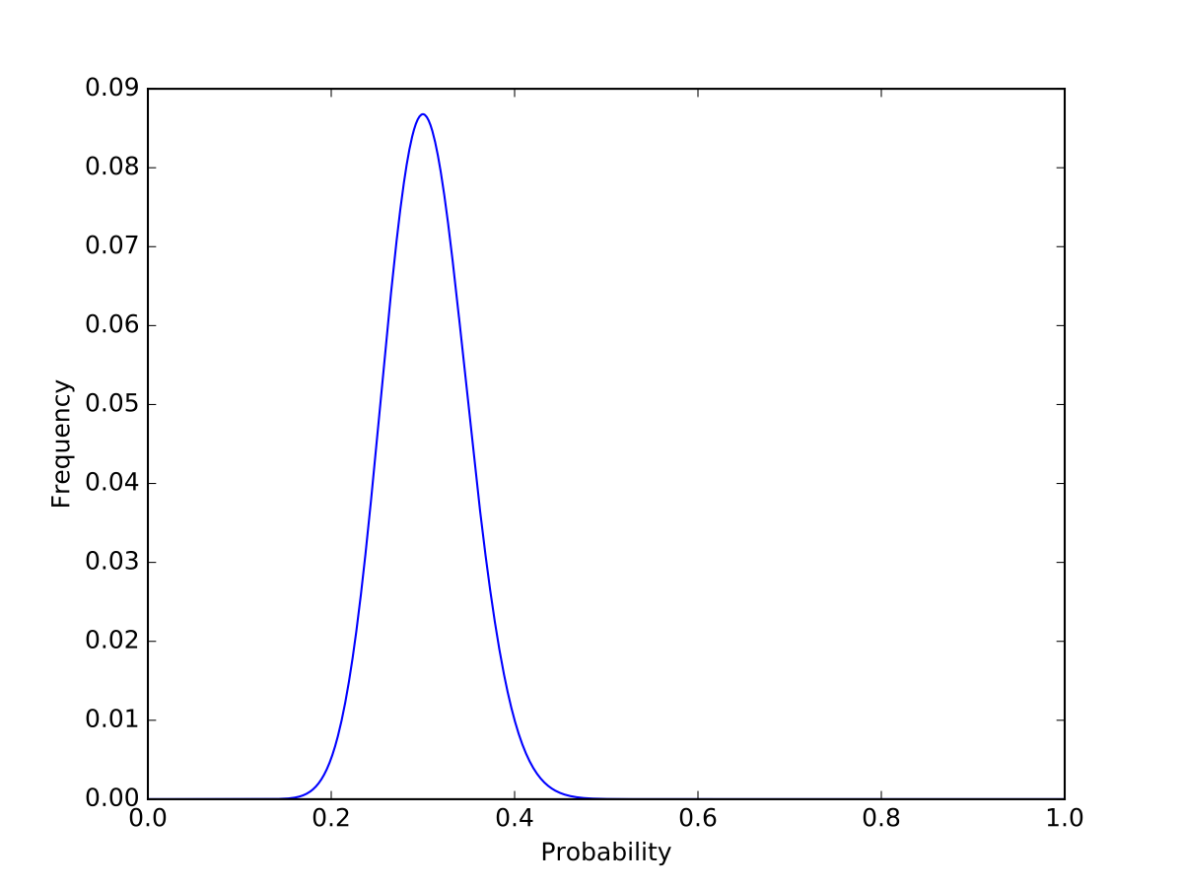
In Python
Example: observed 30 out of 100

Slide 16
Binomial Distribution
Likelihood is maximized for $π=30/100$
Formally:
$$L(x:p)→max$$
$$\text{const}⋅p^{x}(1-p)^{(n-x)}→max$$
which implies by differentiation that
$$xp^{x-1}(1-p)^{n-x}-(n-x)p^{x}(1-p)^{n-x-1}=0$$
$$x(1-p)=(n-x)p$$
$$p=\frac{x}{n}$$

Slide 17
Binomial Distribution
Therefore: Maximum Likelihood estimator for $π$ given $x$ out of $n$ observations is
$$\frac{x}{n}$$

Slide 18
Getting Statistics

Slide 19
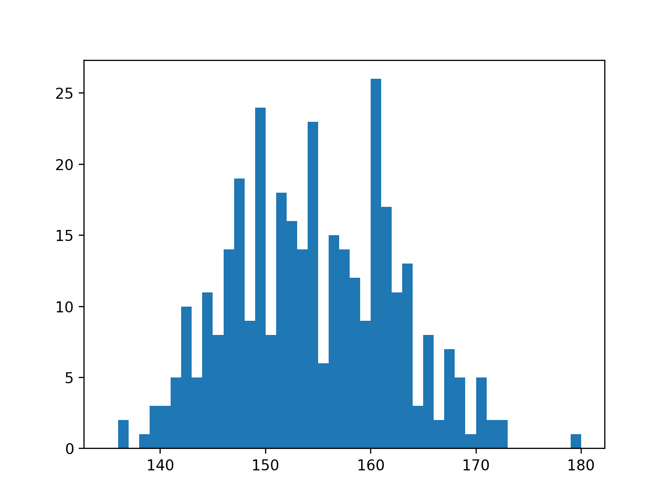
First Step : Visualize
Example: Heights

Slide 20
Second Step: Get Stats
Statistic: any type of measure taken on a sample
Implemented in scipy.stats
Random number generation in np.random

Slide 21
Sample Generation
Use np.random
Returns samples for many different distributions
E.g.
np.random.normal(mean, std, size=1000)
np.random.gamma(shape, scale, size=1000)
Can use numpy.random.seed(12345)to insure same behavior

Slide 22
Getting Statistical Measures
Use scipy.stats
Has many different distributions
scipy.stats.norm is a distribution object
Has a pdf, a cdf, …

Slide 23
Getting Statistic Measures
def stats():
np.random.seed(6072001)
sample1 = create_beta(alpha = 1.5, beta = 2)
fig = plt.figure()
ax = plt.axes()
ax.set_xlabel("Values")
ax.set_ylabel("Frequency")
ax.hist(sample1, bins = 20)
fig.savefig('beta15_2')
print(f'mean is {np.mean(sample1)}')
print(f'median is {np.median(sample1)}')
print(f'25% quantile is {scipy.stats.scoreatpercentile(sample1,25)}')
print(f'75% quantile is {scipy.stats.scoreatpercentile(sample1,75)}')
print(f'st. dev. is {np.std(sample1)}')
print(f'skew is {scipy.stats.skew(sample1)}')
print(f'kurtosis is {scipy.stats.kurtosis(sample1)}')

Slide 24
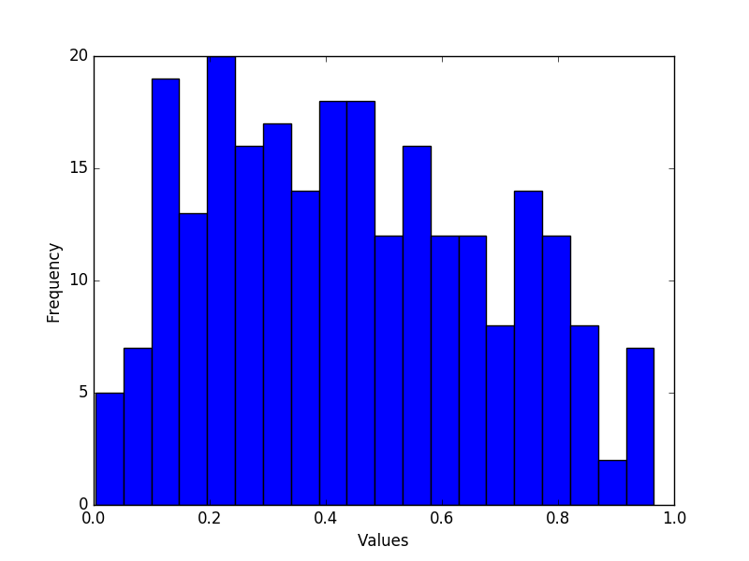
Getting Statistic Measures

Slide 25
Getting Statistic Measures
Many statistical descriptors are available:
mean is 0.44398507464612896
median is 0.42091200120073147
25% quantile is 0.2421793406556383
75% quantile is 0.6277333146506446
st. dev. is 0.24067438845525105
skew is 0.24637036296183917
kurtosis is -0.933113268968349

Slide 26
Getting Statistical Measures
Can also fit to distributions
Example: Height data
Use norm.fit
from scipy.stats import norm
pop1 = np.array([151.765, 156.845, 163.83, 168.91,
165.1, 151.13, 163.195, 157.48, 161.29, 146.4,
147.955, 161.925, 160.655, 151.765, 162.8648,
171.45, 154.305, 146.7, …
loc, std = norm.fit(pop1)

Slide 27
Getting Statistical Measures
To display the data:
Create bins for a histogram
We need the centers later on
Numpy has a function that calculates a histogram
bins = np.linspace(135, 180, 46)
binscenter = np.array([(bins[i]+bins[i+1])/2
for i in range(len(bins)-1)])
dt = np.histogram(pop1, bins)[0]

Slide 28
Getting Statistical Measures
dt contains the number of elements in a bin
[ 0 2 0 1 3 3 5 10 5 11 8 14 19 9 24 8
18 16 14 23 6 15 14 12 9 26 17 11 13 3 8 2
7 5 1 5 2 2 0 0 0 0 0 0 1]

Slide 29
Getting Statistical Measures
We now determine mean and standard deviation using the fit function
We could do the same using np.mean and np.std
loc, std = norm.fit(pop1)
print(loc, std)

Slide 30
Getting Statistical Measures
We now create a normal distribution object with this mean and this standard deviation
pdf = norm(loc, std).pdf

Slide 31
Getting Statistical Measures
Now, we draw both the histogram and the pdf
The pdf has an integral of 1, so we multiply with the number of elements in the population
plt.figure()
plt.bar(binscenter, dt, width = bins[1]-bins[0])
plt.plot(binscenter, len(pop1)*pdf(binscenter),'red')
plt.show()

Slide 32
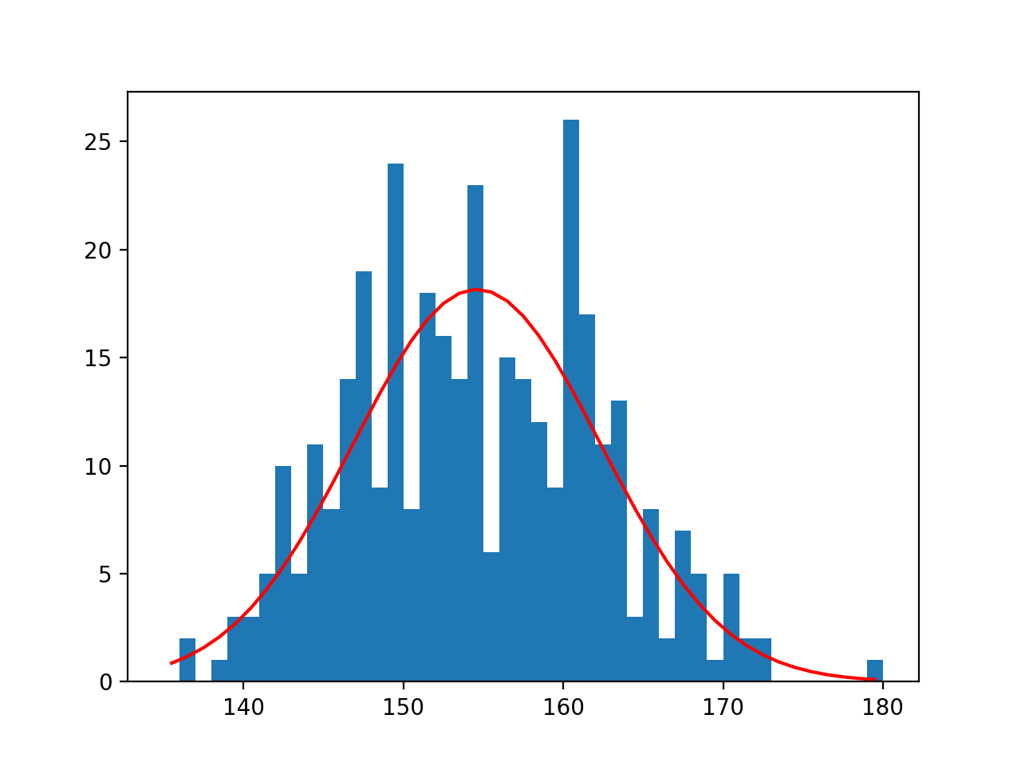
Getting Statistical Measures

Slide 33
Getting Statistical Measures
Question:
Does the red curve fit the blue?
Visual inspection is inconclusive
So, we use statistical tests

Slide 34
Statistical Tests

Slide 35
Statistical Tests
Statistical test calculates a value — the test statistics — from a sample in order to refute or confirm a hypothesis
Formulate a null hypothesis
This is usually the boring stuff: two samples from the same distribution, mean is where it is expected to be, …
Calculate the probability that the observed statistics or a more significant result has occurred given the null hypothesis
If the probability is small: reject the null hypothesis

Slide 36
Statistical Tests
Alpha — measures the confidence as $α=1-\text{confidence}$
Typical are $α=0.05,α=0.01$
Critical value — point at which we start rejecting the null hypothesis
P-value — probability of the observed outcome (or something more significant) under the null hypothesis
We reject if the p-value is below $α$
WARNING: while used, this is somewhat controversial among statisticians

Slide 37
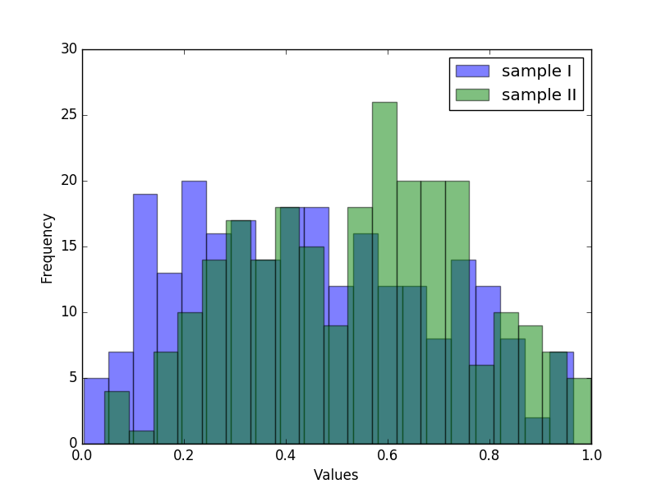
Statistical Tests
Create two samples,
Beta distributed with $α=1.5$ and $β=2$
Normally distributed with $μ=0.5$ and $σ=0.25$

Slide 38
Statistical Tests
To test whether two means are equal:
z-test: Assumes two normally / Gaussian distributions with same standard deviation
Zero Hypothesis: The means are equal
z-score is $z=\frac{x-μ}{σ/{\sqrt{n}}}$
Use statsmodels
WARNING: population should be at least 30

Slide 39
Statistical Tests
Example:
Result:
Again, reject zero hypothesis
print('z-score\n', statsmodels.stats.weightstats.ztest(sample1, x2=None, value = 0.5))
z-score
(-3.672599393379993, 0.00024009571884724942)

Slide 40
Statistical Tests
Compare the two samples
statsmodels.stats.weightstats.ztest(
sample1,
sample2,
value = 0,
alternative='two-sided'
)
z-score
(-4.611040794712781, 4.0065789390516926e-06)

Slide 41
Statistical Tests
Student t-test:
Assumes Gaussian distribution
Works for different variances
Can use for smaller samples

Slide 42
Statistical Tests
Example: One sample t-test
Two sample t-test
print(scipy.stats.ttest_1samp(sample1, 0.5))
Ttest_1sampResult(statistic=-3.672599393379993, pvalue=0.0002938619482386932)
print(scipy.stats.ttest_ind(sample1, sample2))
Ttest_indResult(statistic=-4.611040794712781, pvalue=5.0995747086364474e-06)

Slide 43
Statistical Tests
This is just a sample of important tests

Slide 44
Statistical Tests
It is much safer to talk with a statistician than drawing conclusions yourself
Python makes sure that you make no calculational errors
But it cannot assure that you are using the right test
E.g. you might be making an assumption that is not warranted
Also: interpreting confidence levels is not so simple
$α=0.01$ still means 1% of your results draw the wrong conclusion

Slide 45
Contingency Tables

Slide 46
Contingency tables
Experiments to measure effects of causes on outcomes
Example:
Test two machine learning algorithm on ten data sets
Can we say that classifier 2 is better or could this be chance?
 | Correct | Incorrect | Totals
Classifier 1 | 6 | 4 | 10
Classifier 2 | 5 | 5 | 10
Totals | 11 | 9

Slide 47
Contingency Tables
Other example: treatment versus control
Does Aspirin help against cardiovascular disease (1988)
 | myocardial infarction | none | total
Placebo | 189 | 10845 | 11034
Aspirin | 104 | 10933 | 11037
Total | 293 | 21778

Slide 48
Contingency Tables
Usually have
explanatory variables (Aspirin)
response variables (Disease)

Slide 49
Contingency Tables
Type I error:
We report an effect when there is none
Type II error:
We do not report an effect even though there is one

Slide 50
Contingency Tables
There are many possible statistics
More, if the number of observations is high

Slide 51
Contingency Tables
Number of different statistical tests
Built into statsmodels
 | myocardial infarction | none | total
Placebo | 189 | 10845 | 11034
Aspirin | 104 | 10933 | 11037
Total | 293 | 21778
Estimate SE LCB UCB p-value
-------------------------------------------------
Odds ratio 1.832 1.440 2.331 0.000
Log odds ratio 0.605 0.123 0.365 0.846 0.000
Risk ratio 1.818 1.433 2.306 0.000
Log risk ratio 0.598 0.121 0.360 0.835 0.000
-------------------------------------------------

Slide 52
Contingency Tables
 | myocardial infarction | none | total
Placebo | 189 | 10845 | 11034
Aspirin | 104 | 10933 | 11037
Total | 293 | 21778
Odds:
If we take a placebo, odds are $\frac{189}{10845}$
If we do not take a placebo, odds are $\frac{104}{10933}$
The statistic looks at the ratio of the odds: $θ=\frac{189⋅10933}{104⋅10845}=1.832$
If there would be no influence, then we expect $θ=1$.

Slide 53
Contingency Tables
Log odds
The statistics for odds are heavily skewed
Easier to use $log(θ)$ which can be approximated with a normal distribution

Slide 54
Contingency Tables
Relative risk
$π_{1}$ probability of success for group one
$π_{2}$ probability of success for group two
Relative risk is $\frac{π_{1}}{π_{2}}$
Depends on how we define success because in general$\frac{π_{1}}{π_{2}}≠\frac{1-π}{1-π_{2}}$

Slide 55
Contingency Tables
 | myocardial infarction | none | total
Placebo | 189 | 10845 | 11034
Aspirin | 104 | 10933 | 11037
Total | 293 | 21778
Example:
Estimate relative risk from observations
$$τ=\frac{{189}/{11034}}{{104}/{11037}}=1.817802$$

Slide 56
Contingency Tables
Again, log of risk is easier to approximate

Slide 57
Contingency Tables
statsmodels.Table2x2 gives all four values together with a p-value
The risk and log risk ratio statistics are not symmetric, so by transposing, you get different values

Slide 58
Contingency Table
import numpy as np
import matplotlib.pyplot as plt
from statsmodels.stats.contingency_tables import Table2x2
ct = Table2x2([ [25, 280], [45, 405]])
print(ct.summary())

Slide 59
Contingency Tables
For small samples, we should use Fisher's exact test
If there is no influence of the explanatory variables, then the numbers in the cells are distributed according to a hyper-geometric distribution
With Python, we can apply this even to larger samples
Use fisher_exact in scipy.stats

Slide 60
Contingency Tables
Calling Fisher's exact method
Output is value of the statistics and the p-value
Again, we conclude that the difference between Aspirin and Placebo are unlikely to have happened by chance
scipy.stats.fisher_exact(table))
(1.8320539419087136, 5.032835599791868e-07)

Slide 61
Contingency Tables
 | Lung Cancer Cases | Controls
Smoker | 688 | 650
Non-smoker | 21 | 59

Slide 62
Contingency Tables
 | Lung Cancer Cases | Controls
Smoker | 688 | 650
Non-smoker | 21 | 59
Estimate SE LCB UCB p-value
-------------------------------------------------
Odds ratio 2.974 1.787 4.949 0.000
Log odds ratio 1.090 0.260 0.580 1.599 0.000
Risk ratio 1.959 1.352 2.839 0.000
Log risk ratio 0.672 0.189 0.301 1.043 0.000
-------------------------------------------------

Slide 63
Contingency Tables
 | Right Handed | Left Handed
Male | 43 | 9
Female | 44 | 4
Estimate SE LCB UCB p-value
--------------------------------------------------
Odds ratio 0.434 0.124 1.517 0.191
Log odds ratio -0.834 0.638 -2.084 0.417 0.191
Risk ratio 0.902 0.776 1.049 0.181
Log risk ratio -0.103 0.077 -0.254 0.048 0.181
--------------------------------------------------

Slide 64
Contingency Tables

Slide 65
Contingency Tables

Slide 66
Testing for Normality

Slide 67
Normality Tests
A large number of models assume that data is or close to normally distributed
If data comes from normal distribution:
Lots of statistical tricks available
If data comes from another distribution:
Maybe use "non-parametic" methods
Use tests to determine whether a given set of data is likely to come from a normal distribution
Step 1:
Use a histogram or scatter-plot of the data

Slide 68
Normality Tests
I created two arrays of length 250
With my birth date as the seed for reproducability
First, I create histograms (with default settings)
def show(array, name):
fig = plt.figure()
ax = plt.axes()
ax.set_xlabel("Values")
ax.set_ylabel("Frequency")
ax.hist(array)
fig.savefig(name)

Slide 69
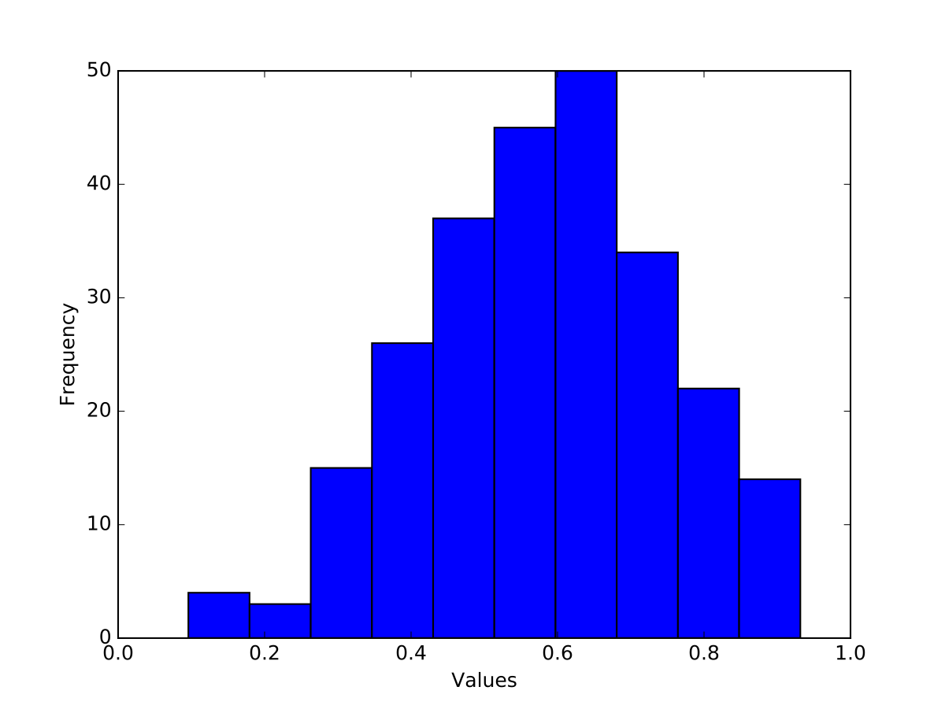
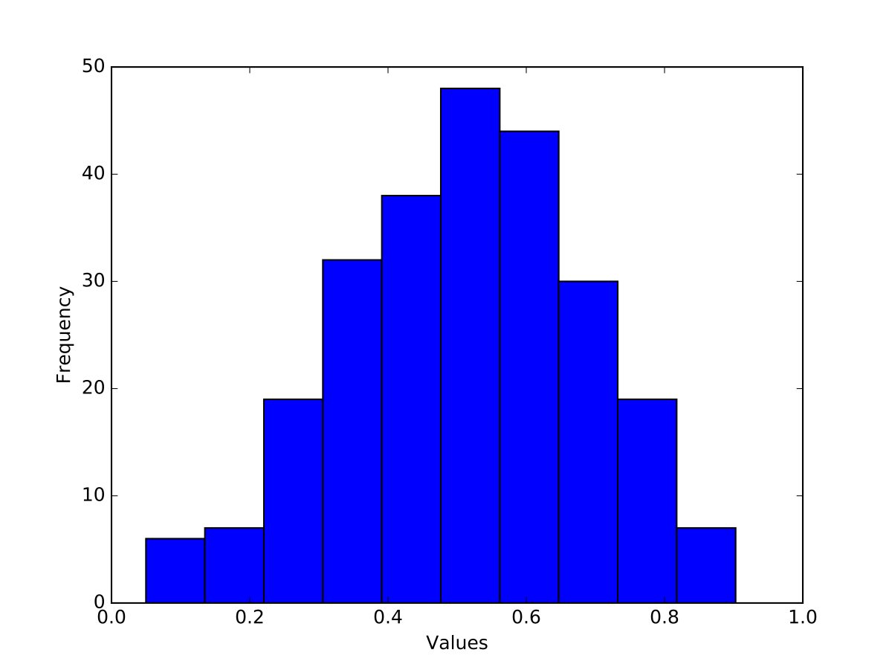
Normality Tests
Results are:
Left: not symmetric (skew is positive)
Right: shape does not look quite right (kurtosis)

Slide 70
Normality Tests
Quantile-Quantile Plot
Quantile q: Proportion q of the data set fall below the point
Example: 30% or 0.3 quantile: 30% of the points are below, 70% of the points are above
Plot two data-sets to compare whether they come from the same distribution
Plot one data-set. If linear: suggests normal distribution

Slide 71
Normality Tests
QQ-Plot part of statsmodels package
Used with numpy, scipy, or pandas and pyplot
line will draw a 45° line to compare with normal distribution
import statsmodels.api as sm
def showqq(array, name):
fig = sm.qqplot(np.array(array), line='s')
fig.savefig(name)

Slide 72
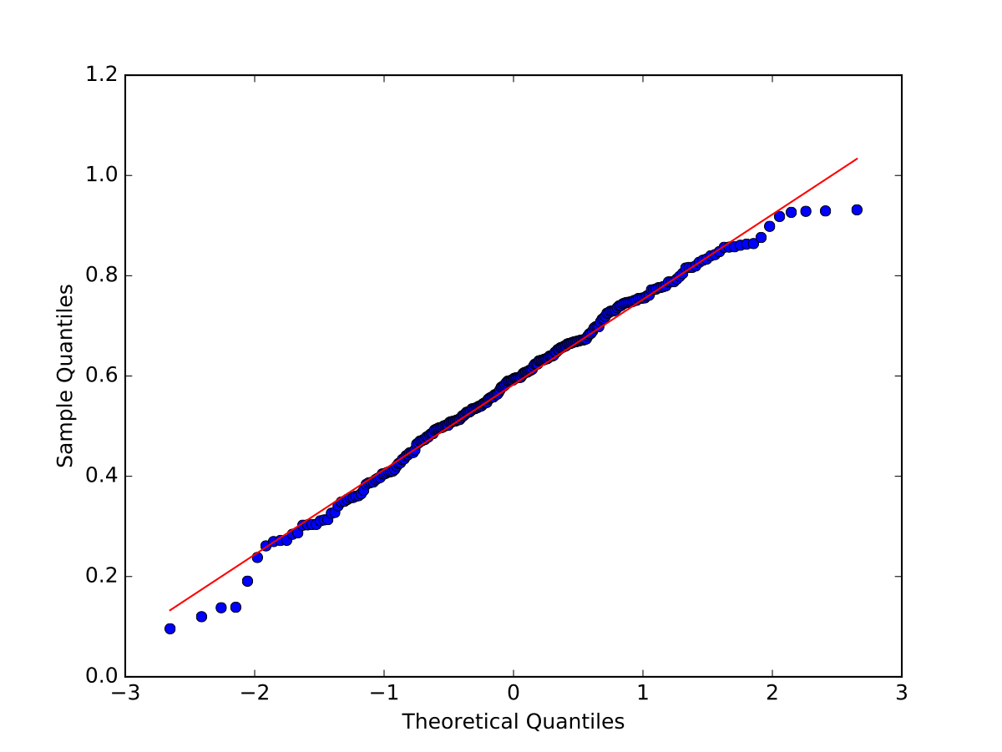
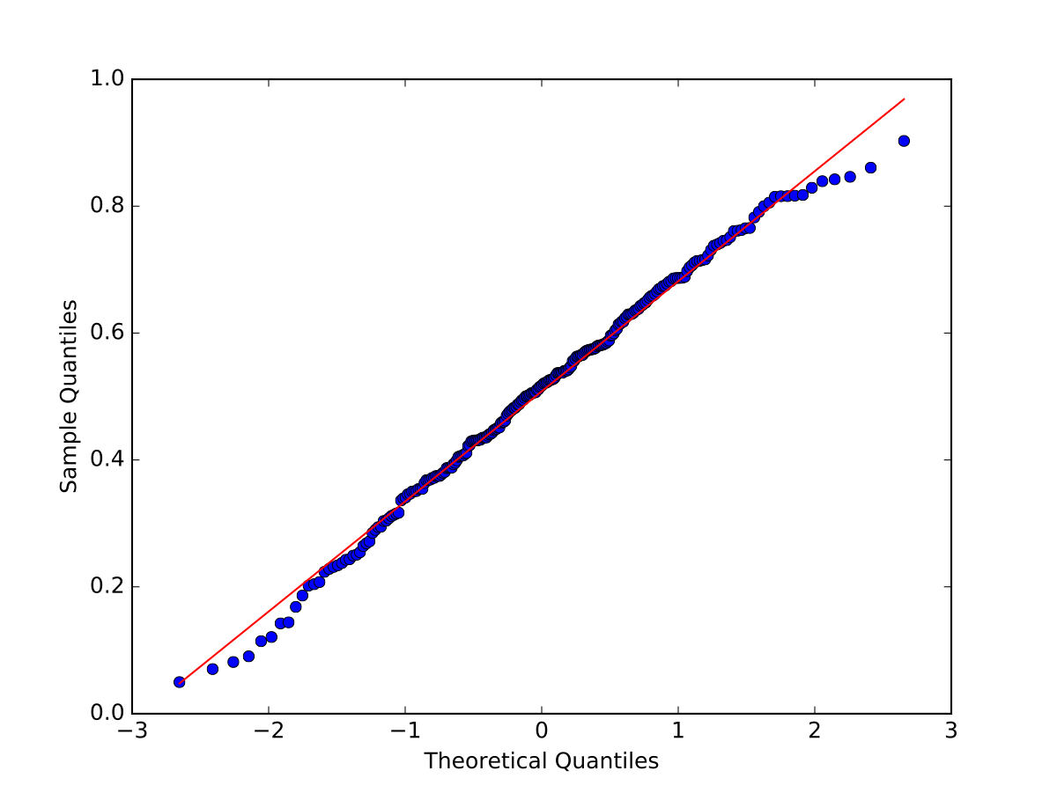
Normality Tests
Results:
Some outliers are normal

Slide 73
Normality Tests
Statistical tests:
Takes data and calculates a test statistics
Calculates the probability of the test value assuming that a null hypothesis is true
If the probability is too small, concludes that the null hypothesis is false
In Scipy:
Null hypothesis: "Distribution is normal"
Returns a p-value
If p-value is smaller than $α$ : reject the Null Hypothesis, otherwise see it supported by data

Slide 74
Normality Tests
Shapiro Wilk Test:
Calculates a test statistics $W=\frac{(∑_{i=1}^{n}a_{i}x_{i})^{2}}{∑_{i=1}^{n}(x_{i}-\overline{x})^{2}}$
where $x_{i}$ ordered sample values
$a_{i}$ constants from covariance, variance, mean of sample
For small samples, not so good
W-distribution is calculated via Monte-Carlo simulation

Slide 75
Normality Tests
Use scipy.stats.shapiro
Input is the data
Output is the W-value and the p-value
import scipy.stats
def getshapiro(array):
return scipy.stats.shapiro(array)

Slide 76
Normality Tests
Results:
Looks valid, normalcy cannot be rejected at the 0.05 level
(0.9899240732192993, 0.08035389333963394)
(0.9923275709152222, 0.22104869782924652)

Slide 77
Normality Tests
D'Agostino's $k^{2}$ test:
Looks at skew and curtosis of the normal distribution
Implemented in scipy.stats as normaltest
Results:
Null hypothesis cannot be rejected
def get_dagostino(array):
return scipy.stats.normaltest(array)
statistic=3.7394424212691764, pvalue=0.15416663584307644
statistic=2.821146323808743, pvalue=0.24400338961897727)

Slide 78
Normality Tests
Anderson Darling
Comes from the Kolmogorov Smirnov test
KS tests for the distance between the cumulative probability of two samples or one sample with a reference distribution

Slide 79
Normality Tests
Anderson-Darling lives in scipy.stats
Prints out statistics with different significance levels
Sample 2: the two statistics are smaller than the critical values and the null hypothesis cannot be rejected
print('Anderson Darling: {}'.format(
scipy.stats.anderson(sample1)))
print('Anderson Darling: {}'.format(
scipy.stats.anderson(sample2)))
Anderson Darling: AndersonResult(statistic=1.998061561955467, critical_values=array([0.567, 0.646, 0.775, 0.904, 1.075]), significance_level=array([15. , 10. , 5. , 2.5, 1. ]))
Anderson Darling: AndersonResult(statistic=1.0717930773325293, critical_values=array([0.567, 0.646, 0.775, 0.904, 1.075]), significance_level=array([15. , 10. , 5. , 2.5, 1. ]))

Slide 80
Normality Tests
Sample 1 was however not normally distributed
Sample 2 was generated with a cut-off normal distribution that prevented samples below 0 and above 1
This is typical, there was insufficient information to reject the thesis of normality

Slide 81
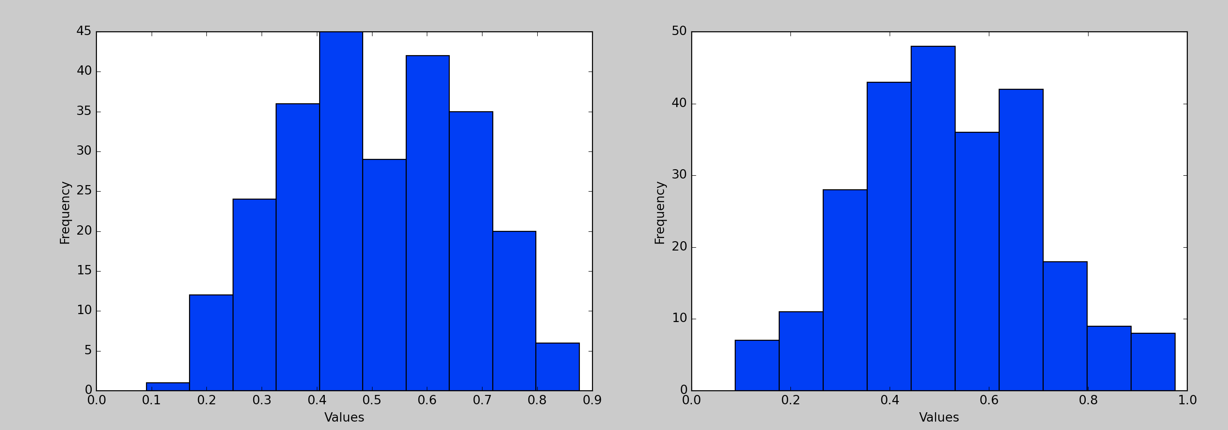
Normality Tests

Slide 82
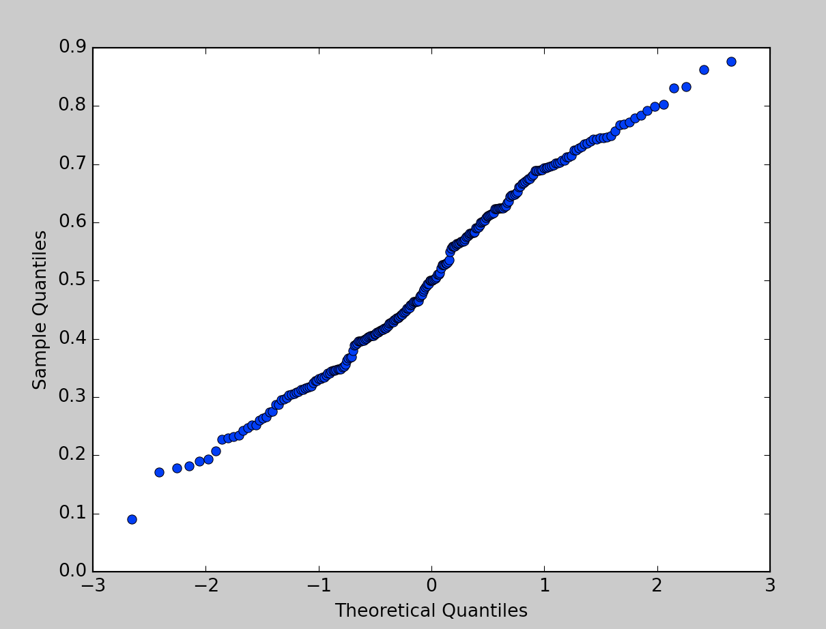
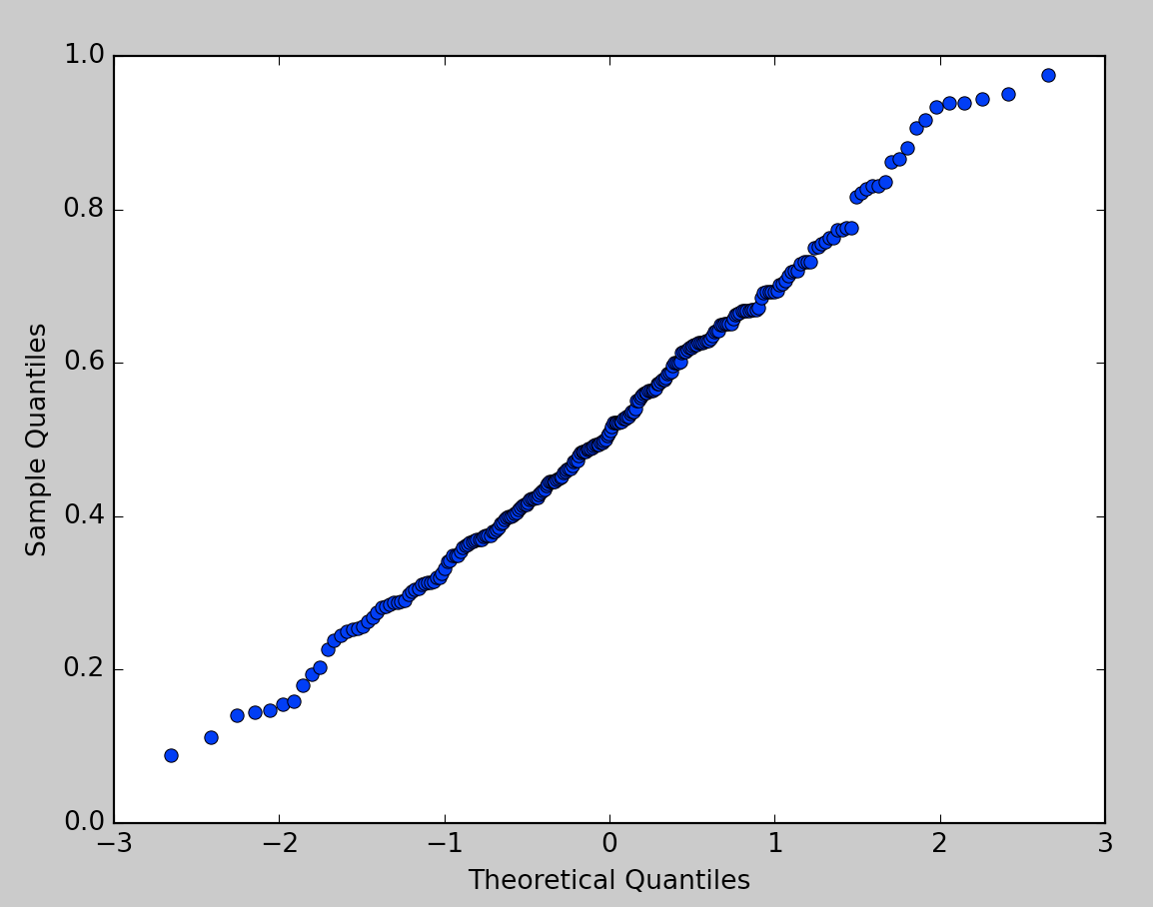
Normality Tests

Slide 83
Normality Tests
Shapiro Wilk
pvalue=0.005319
pvalue=0.2683

Slide 84
Normality Tests
d'Agostino:
p-value 2.944 e -05
p-value 0.346

Slide 85
Normality Tests
Anderson Darling
statistic=1.3877,
statistic=0.3377
critical_values= 1.075,
1% significance

Slide 86
Limitations

Slide 87
Limitations
With a p value of 0.05, one in twenty tests is likely to give us a false positive
Rate of false negatives is also around that

Slide 88
Limitations
Not being able to reject the zero hypothesis does not mean that the hypothesis is wrong

Slide 89
Example
Height data

Slide 90
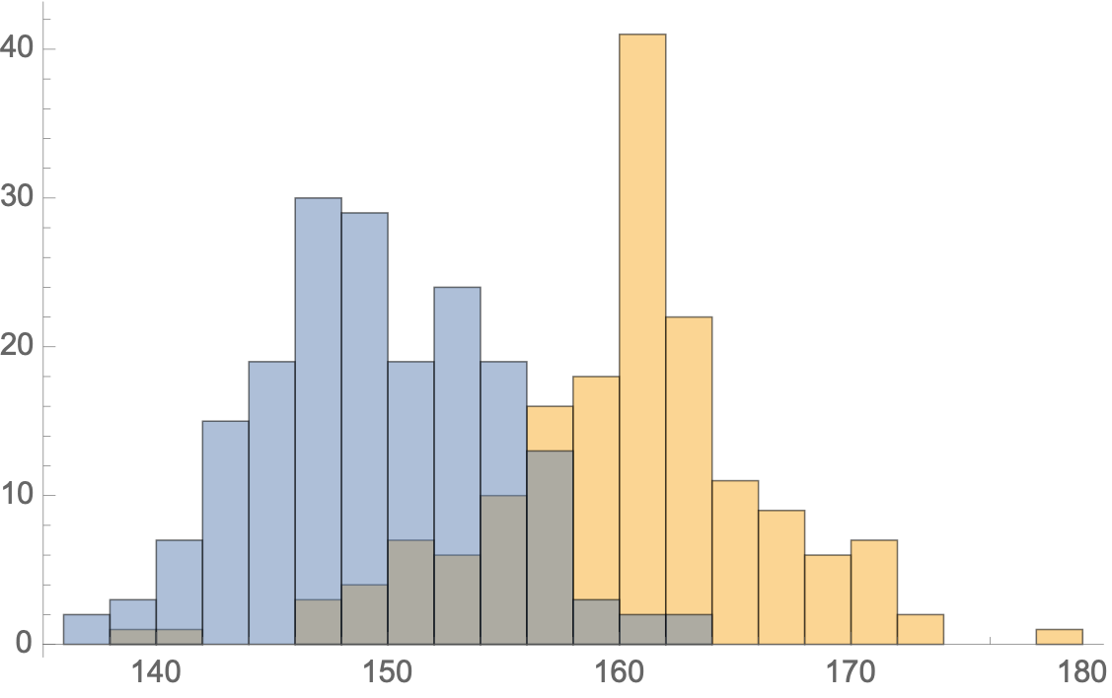
Example
Gender is an important factor for height
If we know the heights, the distribution looks more normal

Slide 91
Example
When we apply normality tests:
Female is normally distributed
Male is not normally distributed according to Anderson
Complete population is normally distributed

Slide 92
Example
Can we recover the two distributions?
Let's try to fit a combination of two normal distributions to the binned data
def func(t, a, b, m1, s1, m2, s2):
return a*norm(m1, s1).pdf(t) + b*norm(m2, s2).pdf(t)
bins = np.linspace(135, 180, 46)
dt = np.histogram(pop1, bins)[0]
binscenter = np.array([(bins[i]+bins[i+1])/2 for i in
range(len(bins)-1)])
params, pcov = curve_fit(func,
xdata = binscenter,
ydata = dt,
p0=[1,1,145,15,160,15]
)

Slide 93
Example
plt.figure()
plt.bar(binscenter, dt, width = bins[1]-bins[0])
plt.plot(binscenter,func(binscenter, *params),'red')
#plt.plot(binscenter, len(pop1)*pdf(binscenter),'red')
plt.show()

Slide 94
Example
Spectacular failure

Slide 95
Conclusions
Numpy has a very broad selection of random number generators
Scipy.stats has a very good set of implementations for many standard statistical tests
Which cannot overcome limitations in the data

Slide 96
Readings
Scipy Lecture notes p.195ff

