Slide 1
Forecasting
and
Time Series
Thomas Schwarz, SJ

Slide 2
Time Series
Study of statistical data that depends on the time
  Examples:
    births in the US on a given day
    names given to children in a certain year
    exchange rates
    …

Slide 3
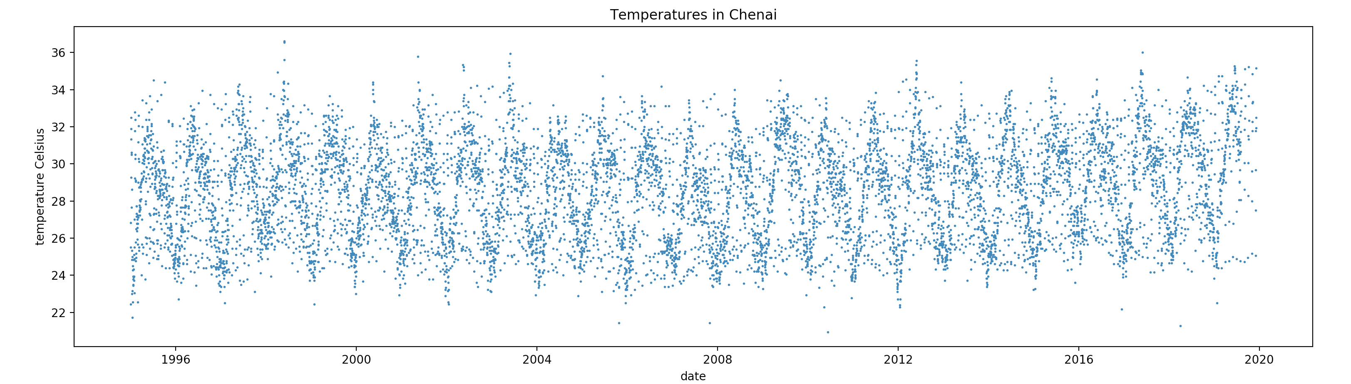
Introduction to Time Series

Slide 4
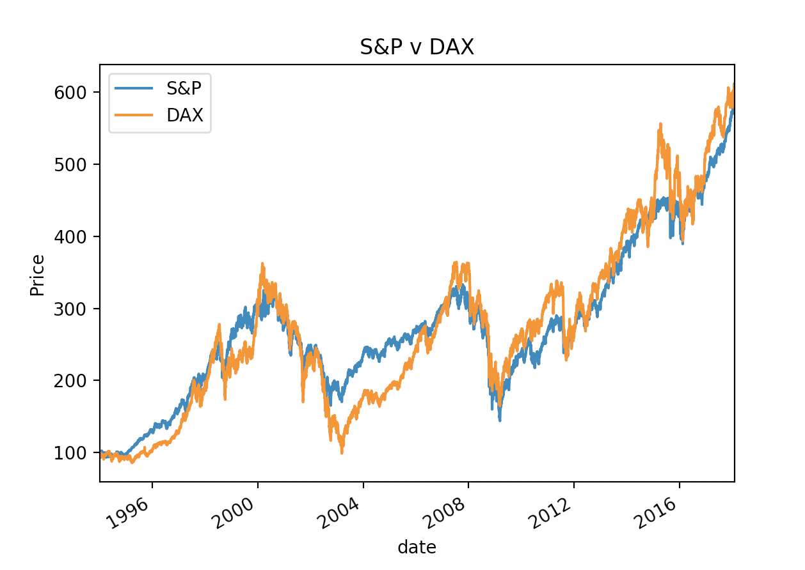
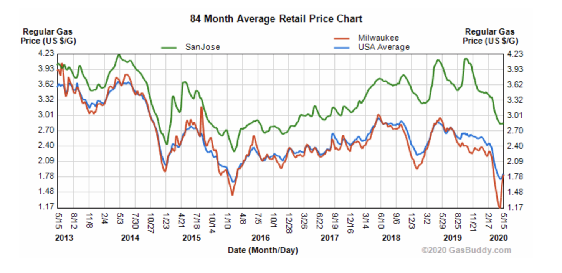
Introduction to Time Series
Time Series Data is highly correlated with itself
  Normal statistical descriptions such as mean are not very useful
  Temperature, stock market, gas prices have long-term trends
  Temperature and gas prices have seasonal trends

Slide 5
Introduction to Time Series
Dealing with time data:
  Generate time plot to see what is happening
    Usually import from csv and transform data
  Determine optically trends, cycles, outliers, undefined or obviously wrong values
  Determine whether there is a need for transformation
    e.g. our stock exchange data is normalized to make DOW and DAX comparable

Slide 6
Introduction to Time Series
Typical transformations:
  Linear normalizations
  Logarithmic, exponential
    E.g. variance grows with mean —> Logarithmic transform
    Make a multiplicative dependence additive
      timevalue = trend * seasonal * random —> Logarithmic: timevalue = trend+seasonal+random

Slide 7
Introduction to Time Series
Filtering: Transform time series $(x_{t})$ into other time series $(y_{t})$
  Smoothing out local variations
    E.g. Linear smoothing with weights $a_{-s},a_{-s+1},…,a_{-1},a_{0},a_{1},…,a_{r-1},a_{r}$
      $$y_{t}=\overset{r}{\underset{ν=-s}{∑}}a_{ν}x_{t+ν}$$
      Eg. Moving average: $y_{t}=\frac{1}{2n+1}\overset{n}{\underset{ν=-n}{∑}}x_{t+ν}$

Slide 8
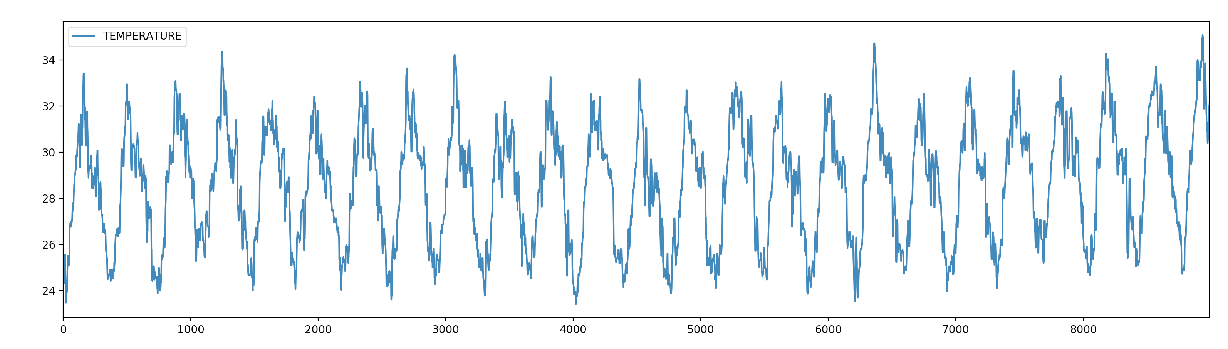
Introduction to Time Series
Median Smoothing with a Window of 10 of the Chenai Temperature Data

Slide 9
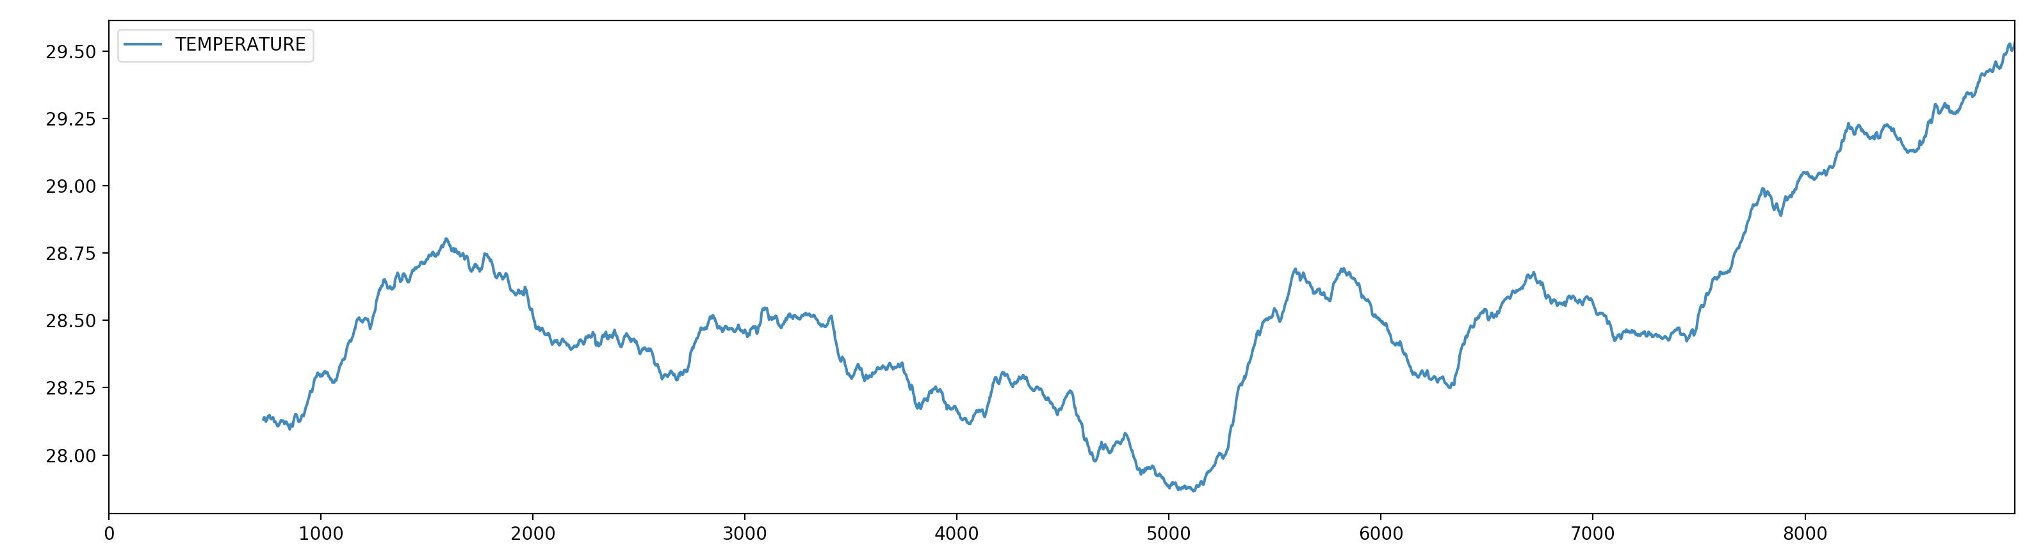
Introduction to Time Series
Smoothing over 2 years with mean

Slide 10
Introduction to Time Series
Seasonal variations:
  Three main models
    $$x_{t}=m_{t}+s_{t}+ϵ_{t}$$
    $$x_{t}=m_{t}⋅s_{t}+ϵ_{t}$$
    $$x_{t}=m_{t}⋅s_{t}⋅ϵ_{t}$$
  Where
    $x_{t}$ time-series value
    $m_{t}$ long-time trend
    $s_{t}$ seasonal component
    $ϵ_{t}$ random noise

Slide 11
Auto-Correlation
Covariance:
  Two random variables $X,Y$ with means $E(X),E(Y)$
  Covariance ${\text{Cov}}_{X,Y}=E\left((X-E(X))⋅(Y-E(Y))\right)$
  If $X$ and $Y$ are independent:
    $${\text{Cov}}_{X,Y}=E(XY-E(X)Y-E(Y)X+E(X)E(Y))=0$$
  If ${\text{Cov}}_{X,Y}>0$:
    High values for $X$ go with high values for $Y$
  If ${\text{Cov}}_{X,Y}<0$:
    High values for $X$ go with low values for $Y$

Slide 12
Auto-Correlation
Covariance depends on the units in which $X$ and $Y$ are given
Therefore, we look at the correlation coefficient
  If $X$ and $Y$ have standard deviations $σ_{X}$ and $σ_{Y}$ respectively:
    $ρ_{X,Y}=\frac{{\text{Cov}}_{X,Y}}{σ_{X}σ_{Y}}∈[-1,1]$

Slide 13
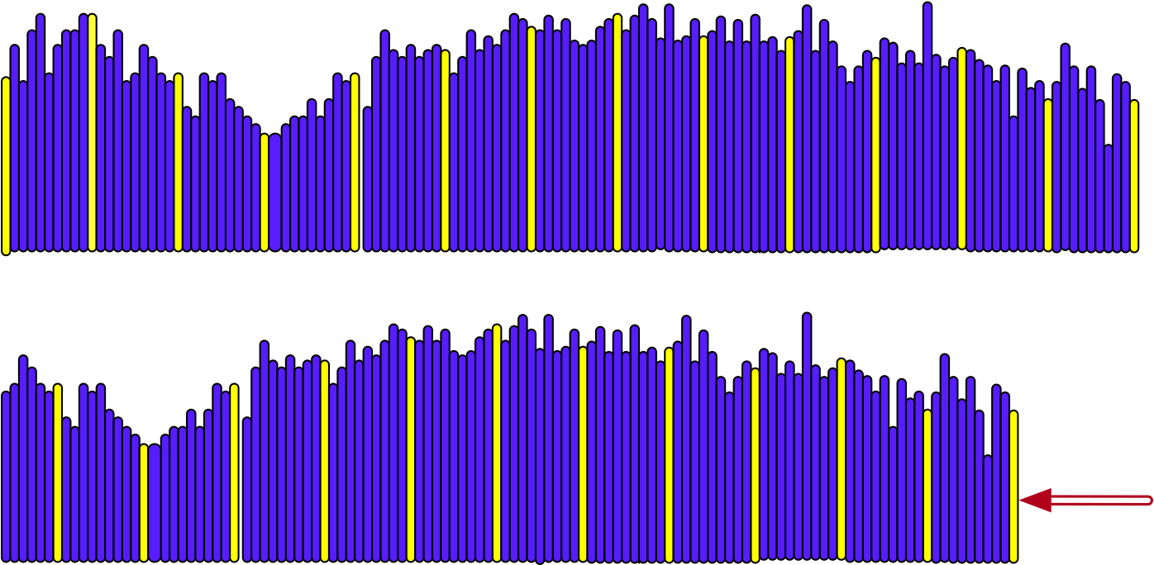
Introduction to Time Series
Auto-correlation: Compare the correlation of a time series with itself moved by $k$ positions

Slide 14
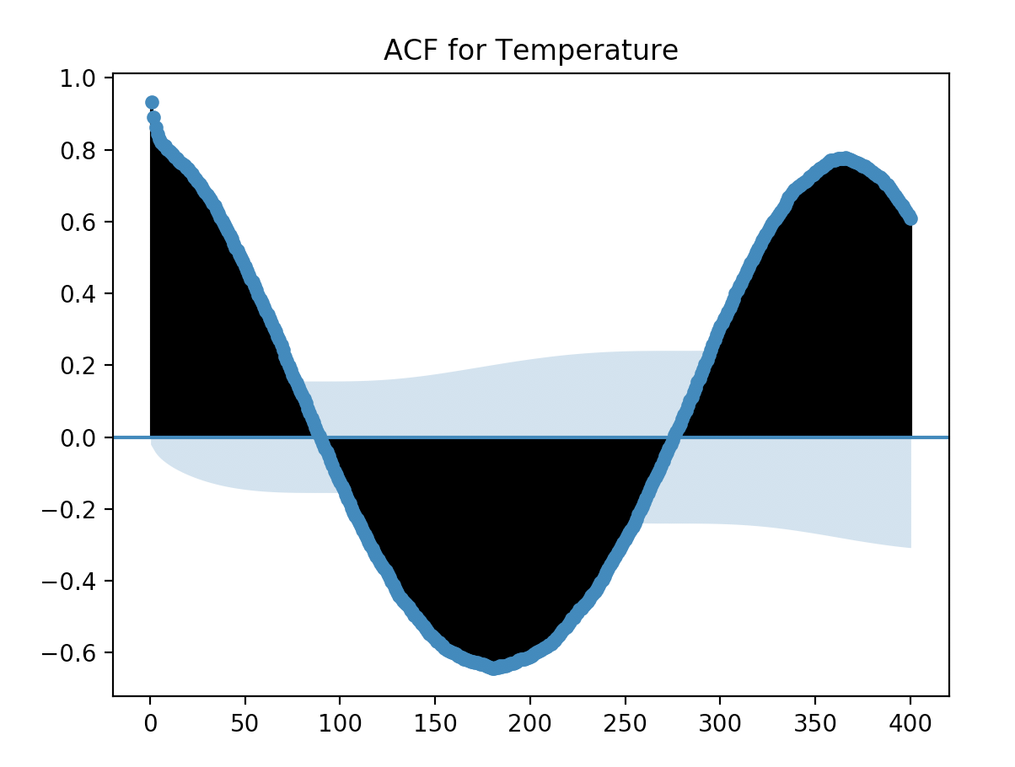
Introduction to Time Series
Autocorrelation for Chenai temperatures
  High auto-correlation for the next day and for a year afterwards
  The light blue denotes significance

Slide 15
Introduction to Time Series
Goal:
  Prediction of future value
Testing:
  Use latest data and predict based on previous data

Slide 16
Time Series in Pandas
Overview
Time series can be
  fixed frequency
    data points occur at regular intervals
  irregular
    no fixed unit of time / offset between data points

Slide 17
Time Series in Pandas
Overview
Time is given in
  Timestamps
  Fixed periods (January 2007)
  Intervals of time such as periods
  Experiment or elapsed time
    Each timestamp measures the difference relative to a particular start time
      For this: use timedelta indices in Pandas

Slide 18
Times in Python
Python time in datetime
  Can take hours, minutes, seconds, microseconds as well
  Also timezone information
Can be combined with timedelta in order to calculate with dates
from datetime import datetime
my_date(year=2020, month = 2, day = 14)

Slide 19
Times in Python
datetime has a μsec resolution
timedelta for the difference between two datetime objects
>>> from datetime import datetime
>>> now = datetime.now()
>>> now
datetime.datetime(2021, 8, 23, 20, 30, 8, 285238)
>>> now.year
2021
>>> now.month
8
>>> now.day
23
>>> delta = now - datetime(1955,12,15)
>>> delta
datetime.timedelta(days=23993, seconds=73808, microseconds=285238)

Slide 20
Times in Python
We can calculate with datetime and timedelta objects
>>> from datetime import datetime, timedelta
>>> timedelta(14)
datetime.timedelta(days=14)
>>> now = datetime.now()
>>> now + 2*timedelta(7)
datetime.datetime(2021, 9, 6, 20, 32, 57, 444108)

Slide 21
Times in Python
We can convert between string and datetime (or date or time)
  strftime takes a format argument
>>> from datetime import date, time, datetime, timedelta
>>> stamp = datetime(1776, 7, 4)
>>> str(stamp)
'1776-07-04 00:00:00'
>>> stamp.strftime('%d-%m-%Y')
'04-07-1776'

Slide 22
Times in Python
Format codes:
  Can also be used to convert from string to date
Type | Description
%Y | 4-digit year
%y | 2-digit year
%m | 2-digit month
%d | 2-digit day
%H | 24 hour clock
%I | 12 hour clock
%M | 2-digit minute
%S | 2-digit seconds
%w | weekday as integer
%U | week number in year
%W | week number (monday)
%z | UTC time zone offset
%F | Shortcut %Y-%m-%d
%D | Shortcut %m/%d/%y

Slide 23
Times in Python
>>> datetime.strptime('7/4/1776', '%m/%d/%Y')
datetime.datetime(1776, 7, 4, 0, 0)

Slide 24
Times in Pandas
Pandas makes this easier
  It comes with dateutil.parser
  Which can guess most formats
>>> from dateutil.parser import parse
>>> parse('2020-06-30')
datetime.datetime(2020, 6, 30, 0, 0)
>>> parse('July 4, 2020')
datetime.datetime(2020, 7, 4, 0, 0)
>>> parse('4th of July, 2020')
datetime.datetime(2020, 7, 4, 0, 0)
>>> parse(1/2/2021, dayfirst=True)

Slide 25
Times in Pandas
For the non-US world, need to use dayfirst=True
>>> parse('1/2/2021', dayfirst=True)
datetime.datetime(2021, 2, 1, 0, 0)

Slide 26
Times in Pandas
A better solution than Python's for us is numpy's datetime
  Called datetime64
    Example:
    For instance, we can create equidistant arrays of timestamps
      Notice the array notation " [Y] "
np.array(['2020-01-01', '2020-01-02'], dtype='datetime64')
np.arange('2000', '2020', dtype = 'datetime64[Y]')

Slide 27
Times in Pandas
In Pandas, there is DatetimeIndex
    Notice the 'ns' as the default for the precision
    Pandas is good at inferring the format of the string
    For reading in data, we can use pd.to_datetime with the format parameter
pd.date_range('2020-01-01', periods=12, freq='M')
DatetimeIndex(['2020-01-31', '2020-02-29', '2020-03-31', '2020-04-30', '2020-05-31', '2020-06-30', '2020-07-31', '2020-08-31','2020-09-30', '2020-10-31', '2020-11-30', '2020-12-31'], dtype='datetime64[ns]', freq='M')

Slide 28
Times in Pandas
Example:
  Let's generate some random data and then add a time index to it.
  Use this function to generate some values
import numpy as np
import pandas as pd
import random
import math
def v(i,j):
return 10+math.floor(
0.3*i+0.1*i**0.4 + random.normalvariate(0,5)
)

Slide 29
Times in Pandas
We create a value array from numpy with the confusing fromfunction function
Then we create a time index, the dates being May 1, 2020 to May 31, 2020
And finally make it into a data-frame
values = np.fromfunction(
np.vectorize(v),
(31,1)
)
idx = pd.date_range('2020-05-01', periods = 31, freq='D')
df = pd.DataFrame(values, index=idx, columns=['values'])
print(df)

Slide 30
Times in Pandas
values
2020-05-01 13
2020-05-02 8
2020-05-03 13
2020-05-04 14
2020-05-05 14
2020-05-06 11
2020-05-07 19
2020-05-08 11
2020-05-09 12
2020-05-10 24
2020-05-11 22
2020-05-12 12
2020-05-13 3
2020-05-14 13
2020-05-15 16
2020-05-16 12
2020-05-17 13
2020-05-18 16
2020-05-19 19
2020-05-20 16
2020-05-21 8
2020-05-22 16
2020-05-23 23
2020-05-24 20
2020-05-25 17
2020-05-26 18
2020-05-27 13
2020-05-28 19
2020-05-29 15
2020-05-30 16
2020-05-31 11
Result:
  (your values will differ)

Slide 31
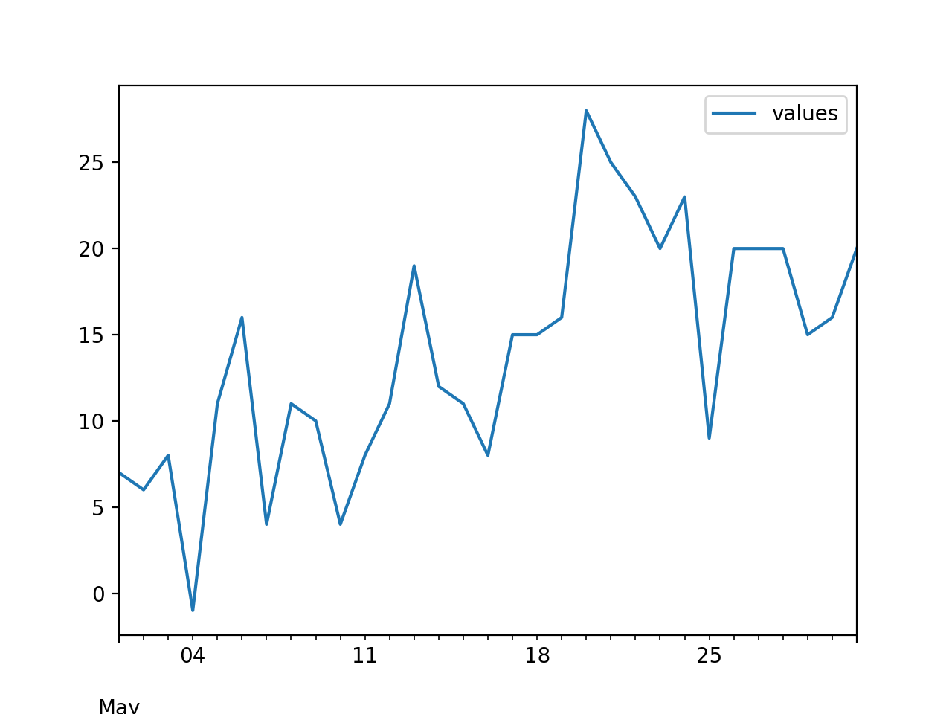
Time Series in Pandas
Overview
df.plot()
plt.show()

Slide 32
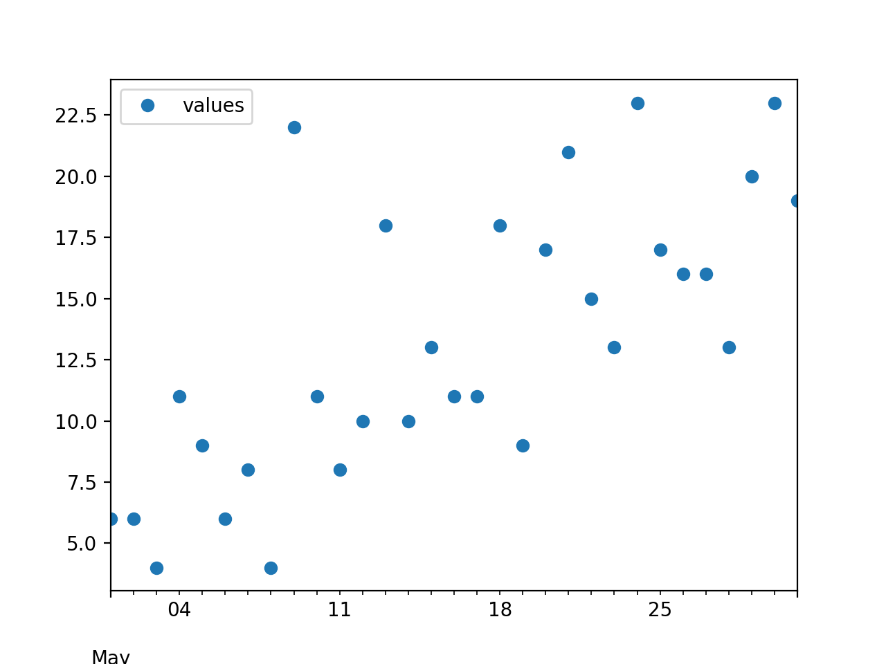
Time Series in Pandas
df.plot(style ='o')
plt.show()
print(df)

Slide 33
Time Series Basics
Usually a series or data frame object indexed by time-stamps
  Often, the time stamps are hidden in the raw data as strings
Arithmetic operations between differently indexed time-series automatically align on the dates

Slide 34
Time Series Basics
Example:
  Take previous times series and do average over three points
  For this, need to create a dataframe with the indices shifted by one day
    For this we use the timedelta
from datetime import timedelta
dfpre = pd.DataFrame(values,
index=(idx-timedelta(1)),
columns=['values']
)

Slide 35
Time Series Basics
Example:
dfpre = pd.DataFrame(values,
index=(idx-timedelta(1)),
columns=['values'])
dfpost = pd.DataFrame(values,
index=(idx+timedelta(1)),
columns=['values'])
dfr = 0.5*df+0.25*dfpre+0.25*dfpost
ax = dfr.plot(style ='r-')
df.plot(style = 'b:', ax = ax)

Slide 36
Time Series Basics
Also: to display to graphs in the same figure:
  df.plot returns an axes object
  Which we can specify in the second plot:
dfpre = pd.DataFrame(values,
index=(idx-timedelta(1)),
columns=['values'])
dfpost = pd.DataFrame(values,
index=(idx+timedelta(1)),
columns=['values'])
dfr = 0.5*df+0.25*dfpre+0.25*dfpost
ax = dfr.plot(style ='r-')
df.plot(style = 'b:', ax = ax)

Slide 37
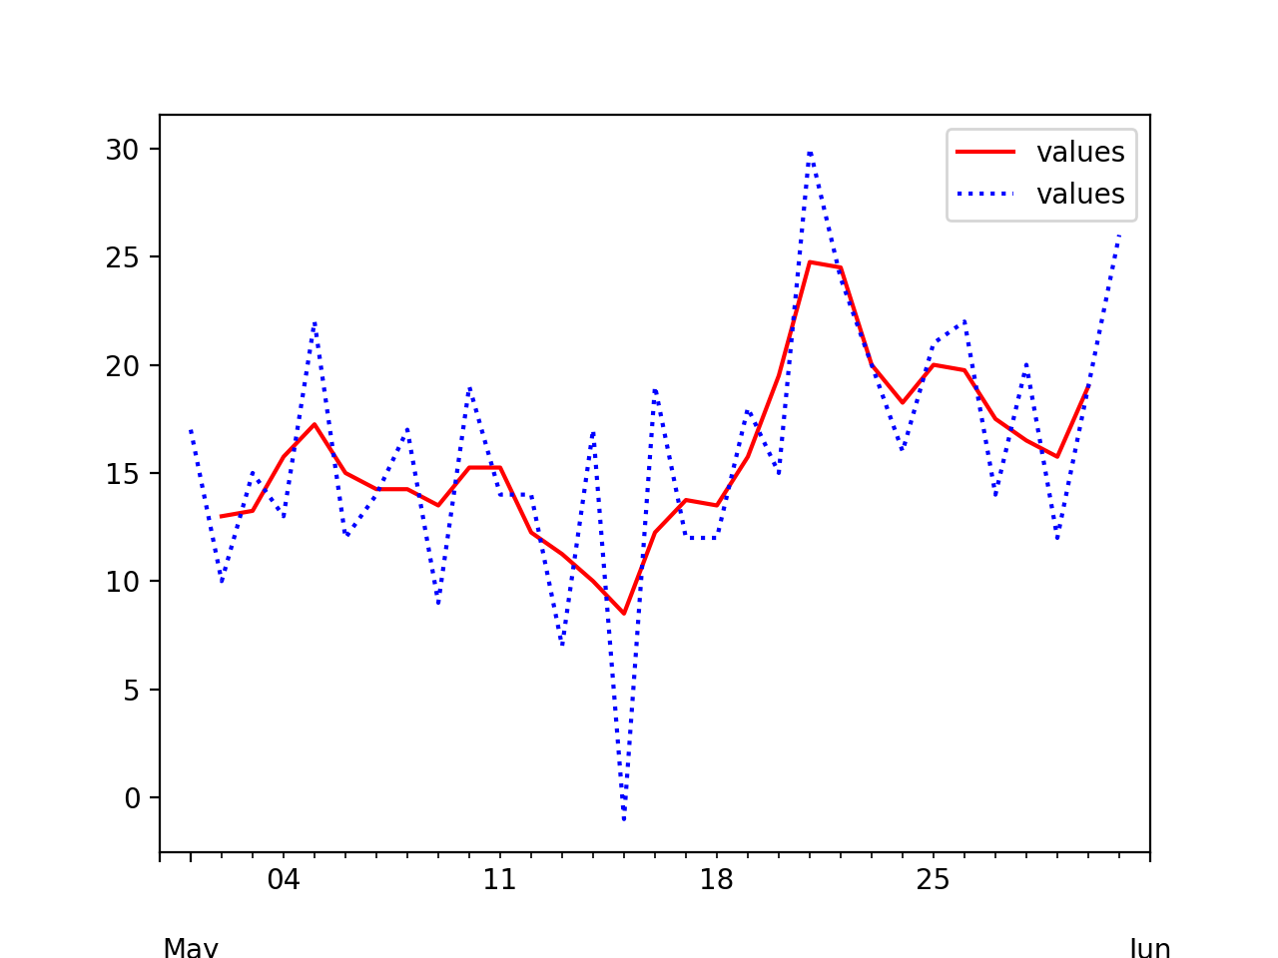
Time Series Basics

Slide 38
Time Series Indexing
Notice that the "smoothed" value has no values for the first and last day of the month

Slide 39
Time Series Indexing
Indexing and selection works as before
  Create a time series with random component and a trend as sqrt.
import numpy as np
import pandas as pd
import matplotlib.pyplot as plt
ts = pd.Series(
3*np.random.randn(1000)
+np.sqrt(np.linspace(100, 1100, 1000)),
index = pd.date_range('1/1/2013', periods=1000))
ts.plot()
plt.show()

Slide 40
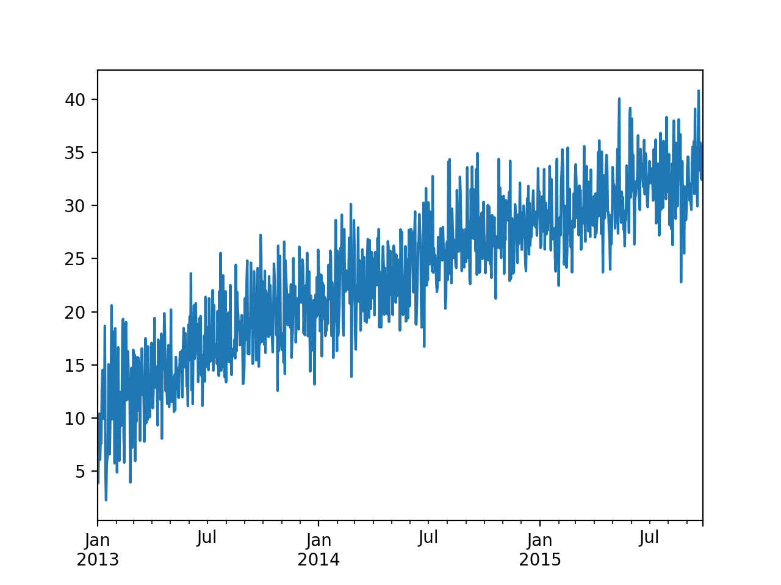
Time Series Indexing

Slide 41
Time Series Indexing
We can access the value of the timeseries using a string
>>> ts['07-01-2014']
30.29958531626109
>>> ts['2014/07/01']
30.29958531626109

Slide 42
Time Series Indexing
We can even slice with a partial date:
>>> ts['2015/01']
2015-01-01 29.018824
2015-01-02 26.018584
2015-01-03 26.322633
2015-01-04 29.884471
2015-01-05 30.861241
2015-01-06 27.578311
…
2015-01-28 31.386897
2015-01-29 34.393147
2015-01-30 24.519918
2015-01-31 28.588378
Freq: D, dtype: float64

Slide 43
Time Series Indexing
We can even slice with a partial date
>>> ts['2013']
2013-01-01 6.579922
2013-01-02 3.886306
2013-01-03 8.624116
2013-01-04 10.406576
2013-01-05 6.078220
...
2013-12-27 21.622836
2013-12-28 19.501775
2013-12-29 23.271005
2013-12-30 19.694463
2013-12-31 25.848146
Freq: D, Length: 365, dtype: float64

Slide 44
Or can do range queries
>>> ts['2013/12/12' : '2014/1/3']
2013-12-12 22.549265
2013-12-13 25.545776
2013-12-14 17.717606
2013-12-15 17.886024
2013-12-16 23.793512
2013-12-17 17.883687
2013-12-18 14.392229
2013-12-19 21.520931
2013-12-20 16.309788
2013-12-21 20.269989
2013-12-22 20.047367
2013-12-23 20.333124
2013-12-24 21.111016
2013-12-25 13.164632
2013-12-26 19.161525
2013-12-27 21.622836
2013-12-28 19.501775
2013-12-29 23.271005
2013-12-30 19.694463
2013-12-31 25.848146
2014-01-01 23.794902
2014-01-02 23.508325
2014-01-03 18.175757

Slide 45
Time Series Indexing
Works for data frames as well, but remember to use loc or iloc
>>> dfr.loc['05-05-2020' : '05-08-2020']
values
2020-05-05 12.75
2020-05-06 12.25
2020-05-07 13.00
2020-05-08 10.50

Slide 46
Time Series Indexing
Duplicate indices
  Time series can have multiple observations per time-stamp
  Use index.is_unique method on data frame to find out
  We would get slices for non-unique indices
  We can aggregate them using groupby

Slide 47
Time Series Date Ranges
Can easily generate data ranges with pd.date_range
  Can specify the frequency and number
>>> pd.date_range('2020-06-01', periods = 30, freq = 'W')
DatetimeIndex(['2020-06-07', '2020-06-14', '2020-06-21', '2020-06-28',
'2020-07-05', '2020-07-12', '2020-07-19', '2020-07-26',
'2020-08-02', '2020-08-09', '2020-08-16', '2020-08-23',
'2020-08-30', '2020-09-06', '2020-09-13', '2020-09-20',
'2020-09-27', '2020-10-04', '2020-10-11', '2020-10-18',
'2020-10-25', '2020-11-01', '2020-11-08', '2020-11-15',
'2020-11-22', '2020-11-29', '2020-12-06', '2020-12-13',
'2020-12-20', '2020-12-27'],
dtype='datetime64[ns]', freq='W-SUN')

Slide 48
Time Series Ranges
Frequencies:
  D — day
  B — business day
  H — hourly
  min T — minute
  M — month end
  MS — month beginning
  …

Slide 49
Time Series Ranges
Can even get third Friday of each month
>>> pd.date_range('2020-06-28', freq = 'WOM-3FRI', periods = 20)
DatetimeIndex(['2020-07-17', '2020-08-21', '2020-09-18', '2020-10-16',
'2020-11-20', '2020-12-18', '2021-01-15', '2021-02-19',
'2021-03-19', '2021-04-16', '2021-05-21', '2021-06-18',
'2021-07-16', '2021-08-20', '2021-09-17', '2021-10-15',
'2021-11-19', '2021-12-17', '2022-01-21', '2022-02-18'],
dtype='datetime64[ns]', freq='WOM-3FRI')

Slide 50
Time Series Shifting
Shifting data — move data backward or forward
  Can do so be ourselves
  Or use shift
>>> smoother = 0.1*ts.shift(-2) + 0.2*ts.shift(-1) + 0.4*ts + 0.2*ts.shift(1)+0.1*ts.shift(2)
>>> smoother.plot()
<matplotlib.axes._subplots.AxesSubplot object at 0x7f9c72f47ee0>
>>> plt.show()

Slide 51
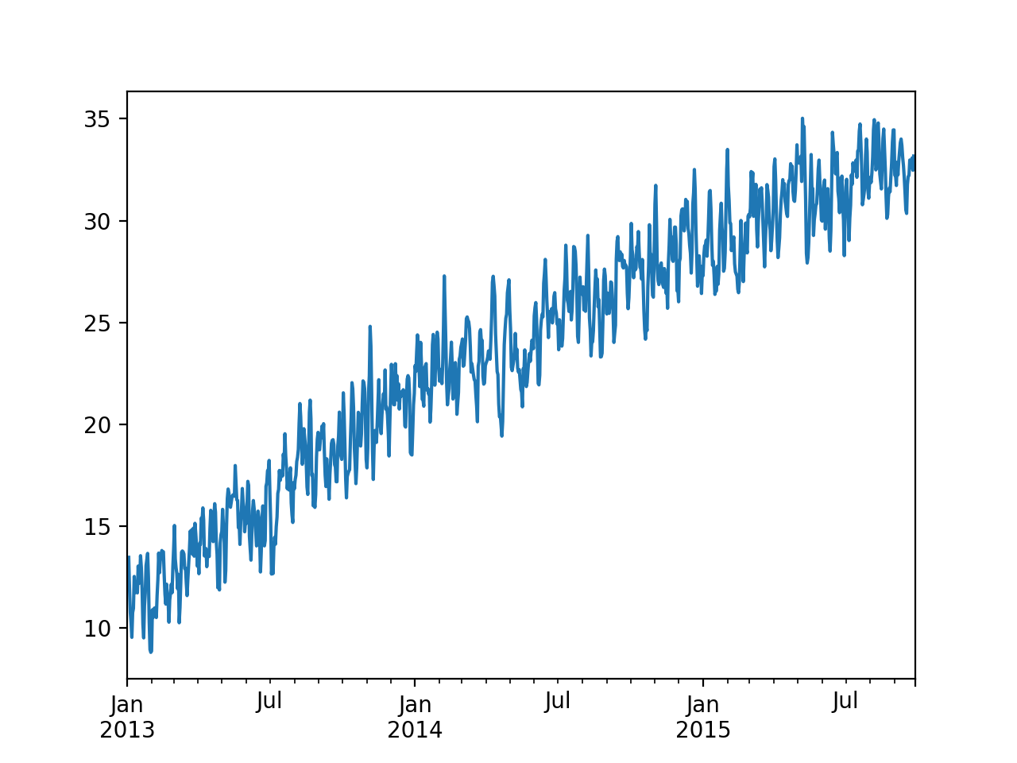
Time Series Shifting

Slide 52
Time Series Shifting
Using percentage changes
>>> plt.show()
>>> pct = (ts/ts.shift(-1)-1)*100
>>> pct.plot()
<matplotlib.axes._subplots.AxesSubplot object at 0x7f9c72f28760>
>>> plt.show()

Slide 53
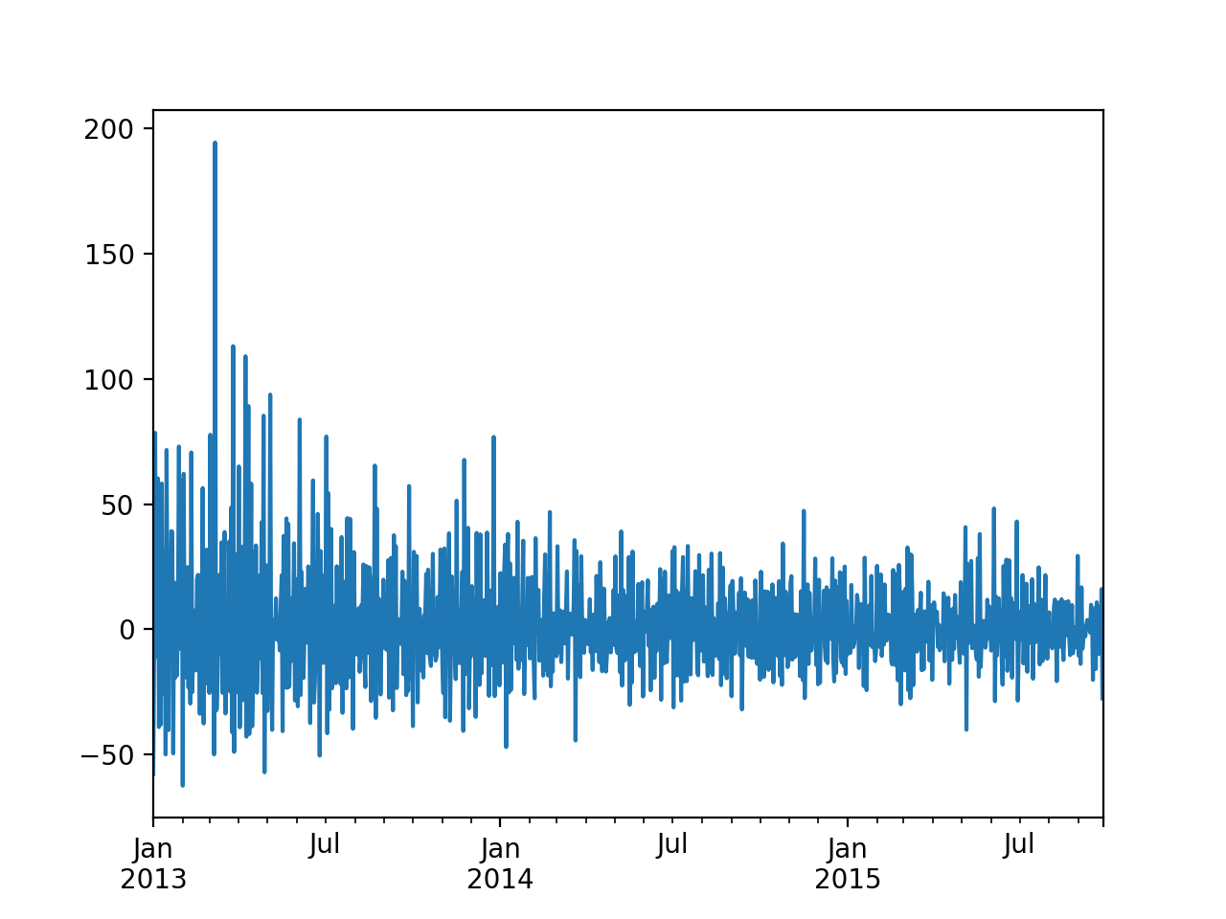
Time Series Shifting

Slide 54
Time Series Shifting
We can use offsets with shifting
  Need to import the timestamp objects:
    Can use arithmetic:
from pandas.tseries.offsets import Day
>>> pd.Timestamp.now()
Timestamp('2020-06-30 16:30:49.660811')
>>> pd.Timestamp.now()+3*Day()
Timestamp('2020-07-03 16:30:51.640833')

Slide 55
Time Zones
Very unpleasant to deal with different time zones
  Easier to use Coordinated Universal Time (UTC)
    Successor to Greenwich Mean Time
  Python: Use Olson database for time zones
    Need to install pytz with pip

Slide 56
Time Zones
>>> kol = pd.date_range('3/9/2020 9:30', periods = 10, freq = 'H', tz=pytz.timezone('Asia/Kolkata'))
>>> kol.tz_convert('America/Chicago')
DatetimeIndex(['2020-03-08 23:00:00-05:00', '2020-03-09 00:00:00-05:00',
'2020-03-09 01:00:00-05:00', '2020-03-09 02:00:00-05:00',
'2020-03-09 03:00:00-05:00', '2020-03-09 04:00:00-05:00',
'2020-03-09 05:00:00-05:00', '2020-03-09 06:00:00-05:00',
'2020-03-09 07:00:00-05:00', '2020-03-09 08:00:00-05:00'],
dtype='datetime64[ns, America/Chicago]', freq='H')

Slide 57
Time Zones
Many countries outside the tropics have daylight savings or summer times
  This year: change on November 7, 2021
  There is a 1:00 am twice on November 7, 2021
>>> pd.date_range('11/06/2021 20:00', periods = 10, freq = 'H', tz=pytz.timezone('America/Chicago'))
DatetimeIndex(['2021-11-06 20:00:00-05:00', '2021-11-06 21:00:00-05:00',
'2021-11-06 22:00:00-05:00', '2021-11-06 23:00:00-05:00',
'2021-11-07 00:00:00-05:00', '2021-11-07 01:00:00-05:00',
'2021-11-07 01:00:00-06:00', '2021-11-07 02:00:00-06:00',
'2021-11-07 03:00:00-06:00', '2021-11-07 04:00:00-06:00'],
dtype='datetime64[ns, America/Chicago]', freq='H')

Slide 58
Time Zones
Many countries outside the tropics have daylight savings or summer times
  This year: change on November 7, 2021
>>> from pandas.tseries.offsets import Hour
>>> pd.Timestamp('2021-11-06 20:00') + 5*Hour()
Timestamp('2021-11-07 01:00:00')

Slide 59
Periods
Periods represents time spans
  Days
  Months
  Quarters (with variously defined business quarters)
    Q-Jan, Q-Feb, Q-MAR, … —> last calendar day of each month
    BQ-Jan, BQ-Feb, …
    QS-Jan, QS-Feb, … —> beginning quarter
    BQS-Jan, BQS-Feb, …
  years: A - calendar year end, BA business year end,

Slide 60
Periods
Examples:
>>> pd.date_range('2021', periods = 5, freq = 'QS')
DatetimeIndex(['2021-01-01', '2021-04-01', '2021-07-01', '2021-10-01',
'2022-01-01'],
dtype='datetime64[ns]', freq='QS-JAN')
>>> pd.date_range('2021', periods = 5,
freq = 'BQS-MAR')
DatetimeIndex(['2021-03-01', '2021-06-01',
'2021-09-01', '2021-12-01',
'2022-03-01'],
dtype='datetime64[ns]', freq='BQS-MAR')

Slide 61
Resampling
Resampling: convert a time series from one frequency to another
  Down-sampling: Aggregating higher frequency data to lower frequency
  Up-sampling: Converting lower frequency to higher frequency

Slide 62
Resampling
Pandas has resample
  Need an aggregation function
  Example:
    Create time series with hourly data
    Down-sample to hours and days
      Down-samples go to the beginning of the period
      Unless we use lshift

Slide 63
Resampling
ts = pd.Series(0.5*np.random.randn(5000)+
np.sqrt(np.linspace(100, 1100, 5000)),
index = pd.date_range('1/1/2013',
periods=5000, freq='H'))
ax = ts.plot(style = 'b-')
ts = ts.resample('D').mean()
ts.plot( style='r-', ax=ax)
ts = ts.resample('M').mean()
ts.plot(style = 'g-.', ax= ax)
plt.show()

Slide 64
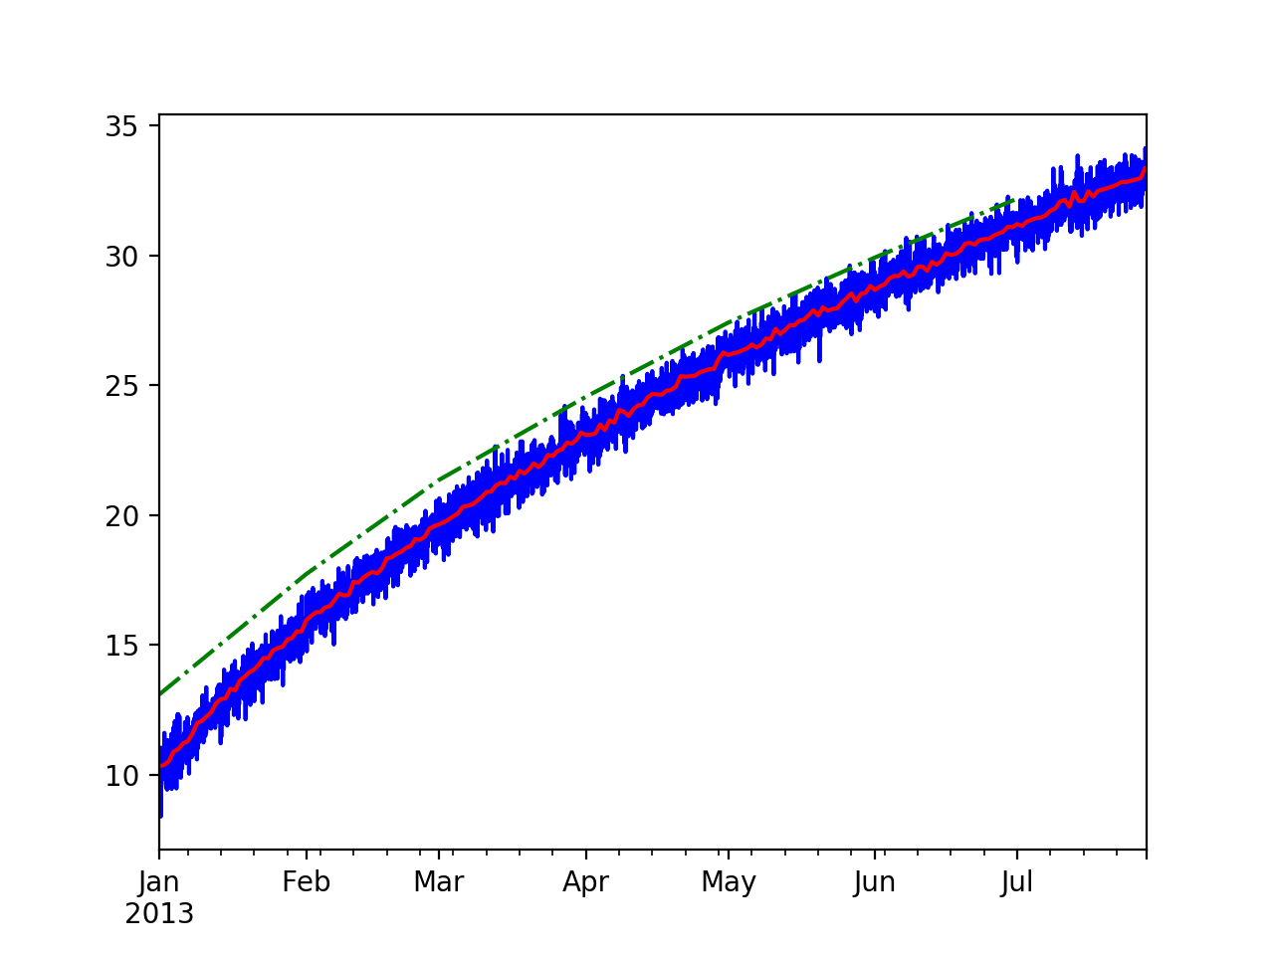
Resampling
The monthly sampling starts January 1

Slide 65
Resampling
We can use scalars for the resample arguments
ts = ts.resample('5D').mean()
ts.plot(style = 'w-.', ax= ax)

Slide 66
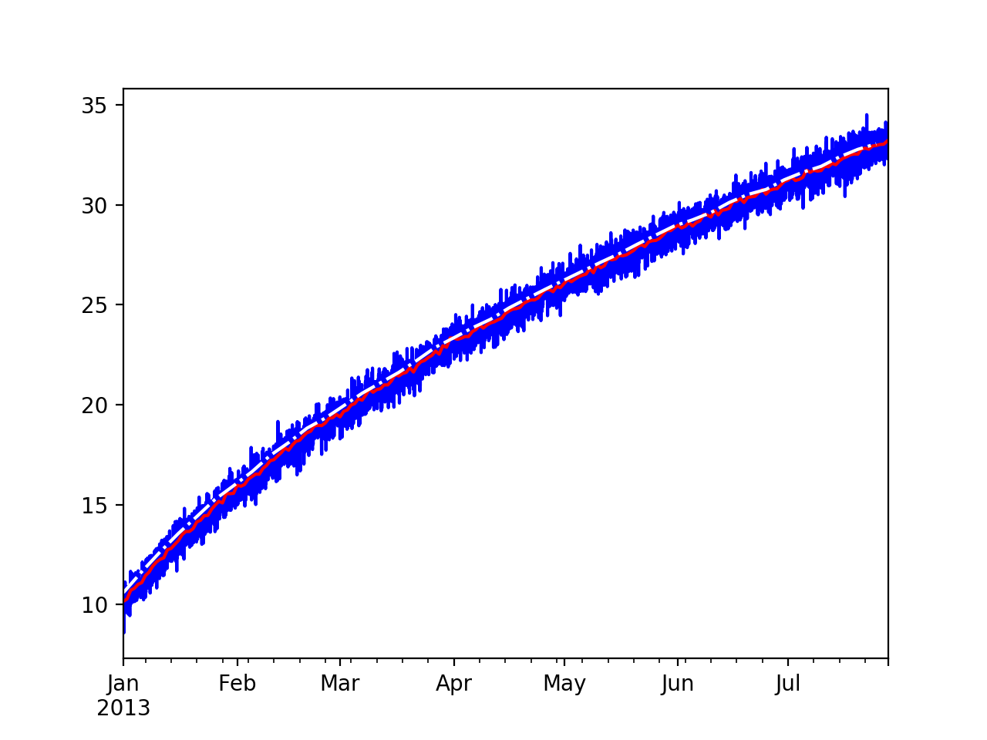
Resampling

Slide 67
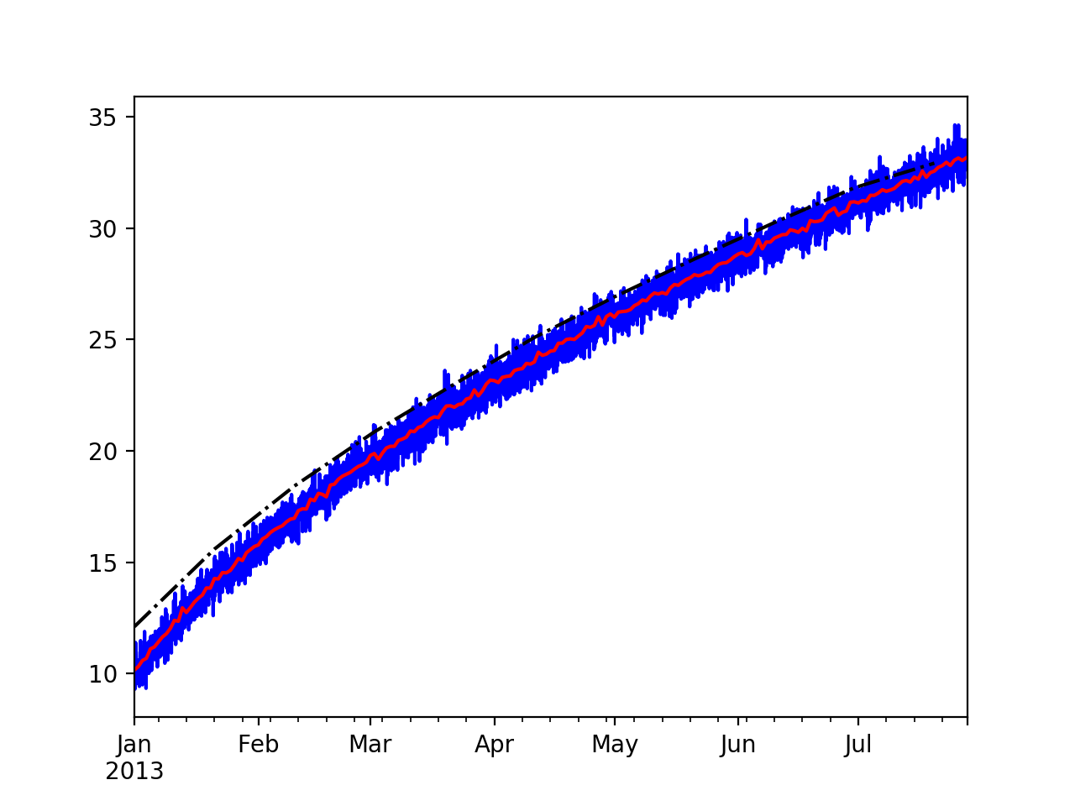
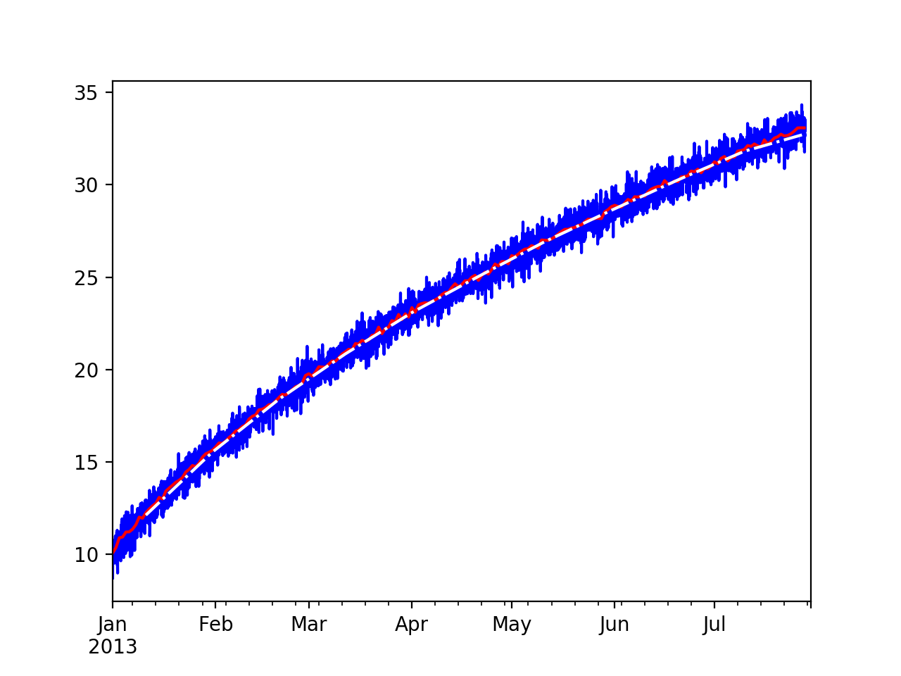
Resampling
Can use loffset to shift the sample
ts = ts.resample('20D', loffset='10D').mean()
ts.plot(style = 'w-.', ax= ax)

Slide 68
Resampling
When up sampling, we do not aggregate but need to interpolate
  ffill - forward fill
  bfill -backward fill
  interpolate
    needs method and sometimes degree

Slide 69
Resampling
Example:
tshourly = ts.resample('H').interpolate(method='linear')
tshourly2 = ts.resample('H').interpolate(method='polynomial',
order=3)
tshourly3 = ts.resample('H').ffill()
ax = tshourly[:5*24].plot()
tshourly2[:5*24].plot(style='k.', ax = ax)
tshourly3[:5*24].plot(style='y:', ax = ax)
ts[:5].plot(style = 'rx', ax = ax)

Slide 70
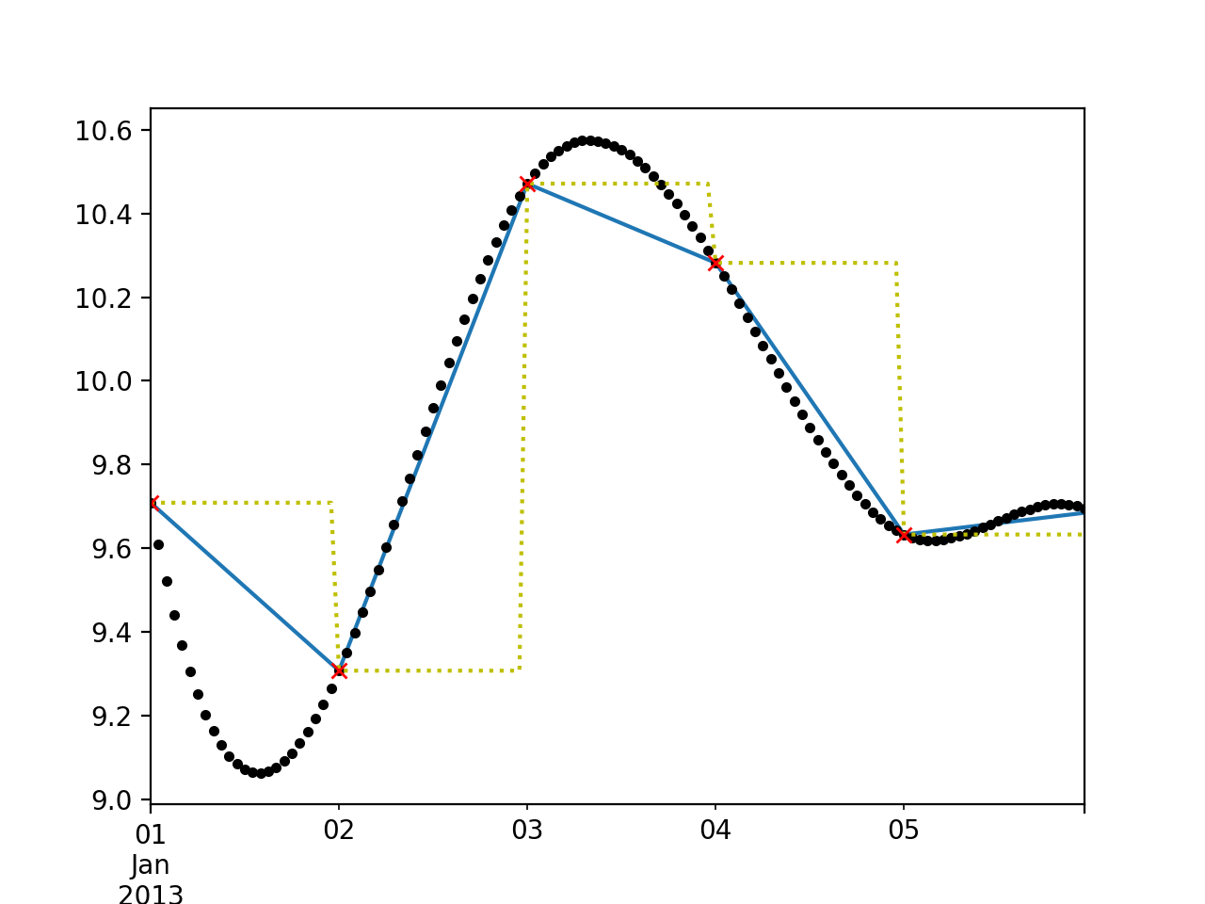
Resampling
y forward fill
b linear
r original data
k third degree polyn

Slide 71
Moving Windows
An important type of resampling is using moving windows
rolling uses a sliding window
Together with mean, this provides a way to see a trend

Slide 72
Moving Windows
Example:
  min_periods=10: start calculating whenever you have 10 values
  center=True: place value in the center of sliding window
rol = ts.rolling(250, min_periods=10).mean()
rol2 = ts.rolling(250, min_periods=10, center=True).mean()
myax = ts.plot(style = 'b-')
rol.plot(style = 'r-', ax = myax)
rol2.plot(style = 'k-.', ax = myax)

Slide 73
Moving Windows
rolling window can also accept a fixed-size time offset
  rolling('20D')

Slide 74
Moving Windows
All data points in a sliding window contribute equally to the aggregator
Can also use exponential decay
Pandas has ewm
  With span parameter for half the size

Slide 75
Moving Windows
Example
rol = ts.ewm(span=250//2, min_periods=10).mean()
myax = ts.plot(style = 'b-')
rol.plot(style = 'r-', ax = myax)

Slide 76
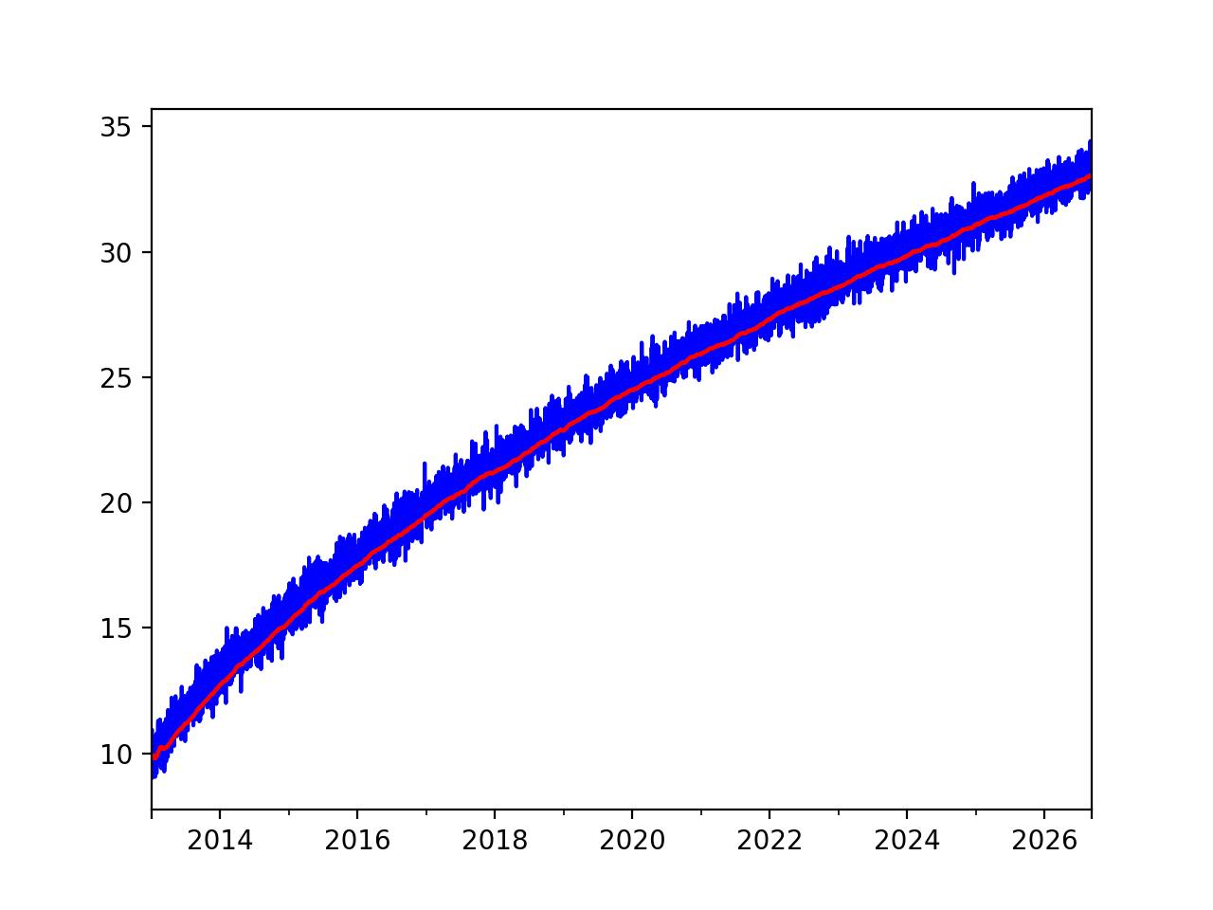
Moving Windows

Slide 77
Pandas Time Series
Time series need and have their own transformation tools
Next steps
  theory of time series
  recognize static time series
  learn how to use auto-correlations

Slide 78
Loading Time Series
Pandas can use parse_dates in order to extract date information
  Example: Airline data
    Has a column called 'date' with month and year
Passengers
date
1949-01-01 112
1949-02-01 118
1949-03-01 132
1949-04-01 129
1949-05-01 121

Slide 79
Loading Time Series
def get_data_1():
df = pd.read_csv('airline-passengers.csv',
parse_dates= {'date' : ["Month"]})
df.set_index('date', inplace=True)
return df

Slide 80
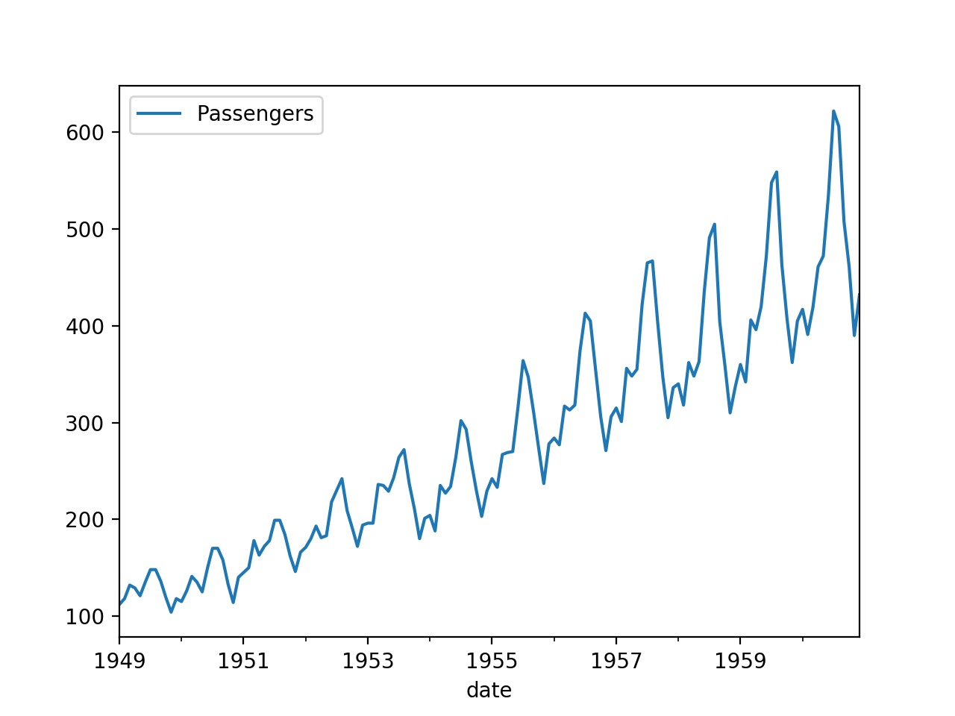
Loading Time Series

Slide 81
Loading Time Series
The date information can also be split over several columns
YEAR,LOCATION,STATE ANSI,ASD CODE,COUNTY ANSI,REFERENCE PERIOD,COMMODITY,"DRY, NONFAT, HUMAN in LB","SKIM, UNSWEETENED, CONDENSED in LB"
2016,CENTRAL, , , ,JAN,MILK,"25,815,000",
2016,CENTRAL, , , ,FEB,MILK,"23,976,000",
2016,CENTRAL, , , ,MAR,MILK,"30,956,000",
2016,CENTRAL, , , ,APR,MILK,"30,393,000",
2016,CENTRAL, , , ,MAY,MILK,"37,183,000",
2016,CENTRAL, , , ,JUN,MILK,"29,760,000",
2016,CENTRAL, , , ,JUL,MILK,"26,698,000",

Slide 82
Loading Time Series
def get_data_2():
df = pd.read_csv('MILK.csv',
parse_dates= {'date' : ["YEAR", "REFERENCE PERIOD"]})
df.set_index('date', inplace=True)
return df

Slide 83
Loading Time Series
df = get_data_2()
df['DRY, NONFAT, HUMAN in LB'] = df['DRY, NONFAT, HUMAN in LB'].str.replace(',','').astype(float)
df['DRY, NONFAT, HUMAN in LB'].plot()

Slide 84
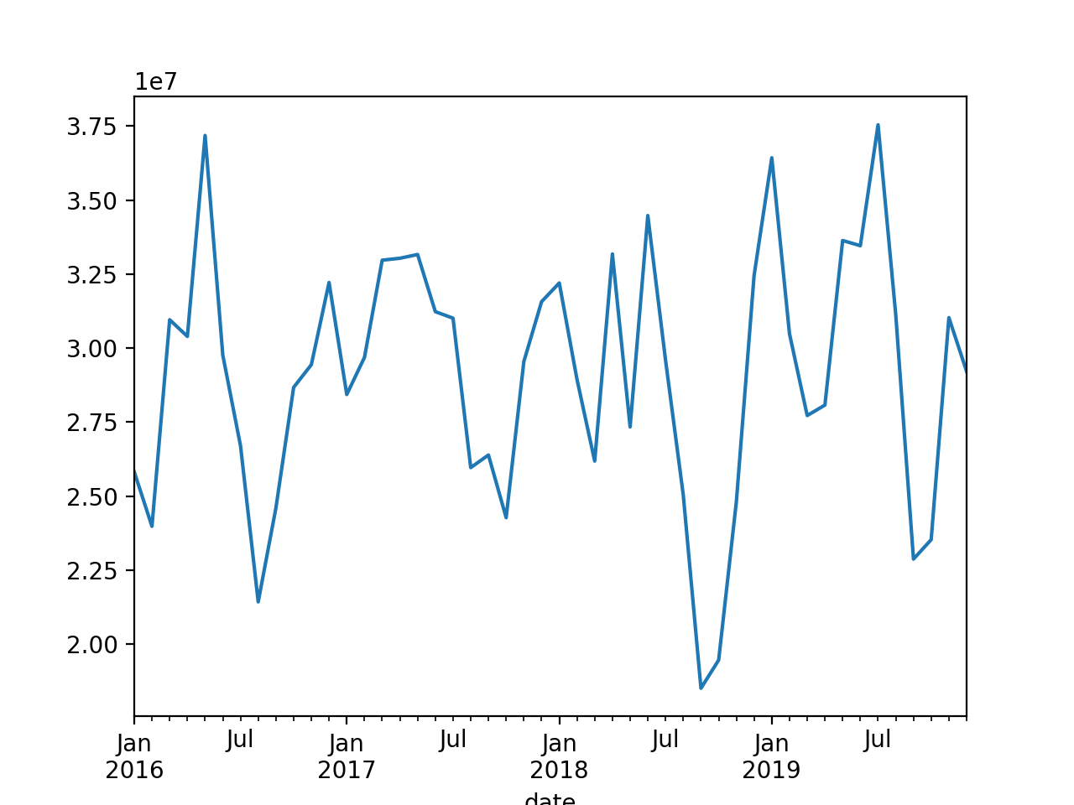
Loading Time Series

Slide 85
Analysis of Time Series

Slide 86
Time Series
General Model of a time series:
  Trend + seasonal(s) + remainder
  Trend $×$ seasonal(s) $×$ remainders
Remainder can be modeled as a random walk

Slide 87
Trends
Example: Disposable Personal Income Massachusetts and Missouri
  from Federal Reserve Bank of St. Louis
  Need to check the raw data: Use separator
df_ma = pd.read_csv('MAPCPI.csv',
sep = ',',
)
df_ma.set_index('DATE', inplace = True)

Slide 88
Trends
Example continued:
  We have two different files that we want to combine
    Pandas has a merge function
      Which needs to have a common column
        Actually, merge implements an SQL-like join
df = pd.merge(df_ma, df_mo, on='DATE')

Slide 89
Trends
We can now use linear recursion
from statsmodels.formula.api import ols
…
model = ols("df.MOPCPI ~ df.MAPCPI", df).fit()
inter, coef = model.params
print(inter, coef)
print(model.summary())
900.173966439816 0.6894112036215065

Slide 90
Trends
OLS Regression Results
==============================================================================
Dep. Variable: df.MOPCPI R-squared: 0.995
Model: OLS Adj. R-squared: 0.995
Method: Least Squares F-statistic: 1.710e+04
Date: Fri, 03 Jul 2020 Prob (F-statistic): 1.60e-103
Time: 16:40:01 Log-Likelihood: -762.99
No. Observations: 91 AIC: 1530.
Df Residuals: 89 BIC: 1535.
Df Model: 1
Covariance Type: nonrobust
==============================================================================
coef std err t P>|t| [0.025 0.975]
------------------------------------------------------------------------------
Intercept 900.1740 147.748 6.093 0.000 606.601 1193.747
df.MAPCPI 0.6894 0.005 130.771 0.000 0.679 0.700
==============================================================================
Omnibus: 0.064 Durbin-Watson: 0.066
Prob(Omnibus): 0.969 Jarque-Bera (JB): 0.069
Skew: 0.051 Prob(JB): 0.966
Kurtosis: 2.911 Cond. No. 3.69e+04
==============================================================================

Slide 91
Trends
We then plot the result:
plt.plot(df.MAPCPI, df.MOPCPI, '.', alpha=0.3)
plt.plot(np.linspace(0,75000),
inter + coef*np.linspace(0,75000),
'r-')
plt.xlabel('MA')
plt.ylabel('MO')
plt.show()

Slide 92
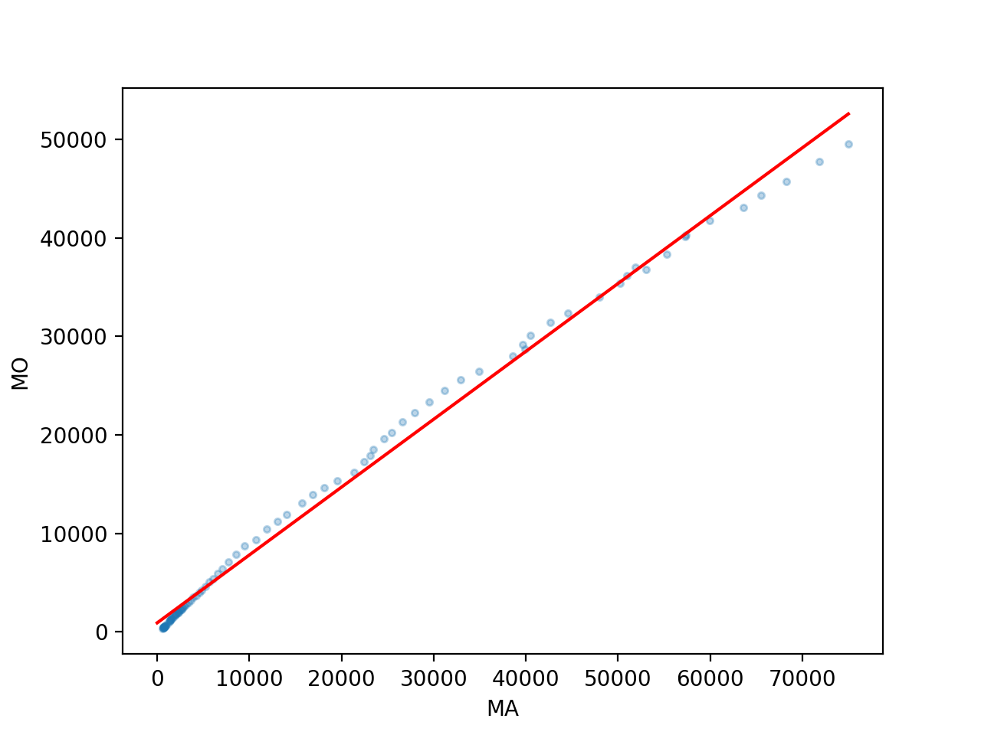
Trends

Slide 93
Trends
We now look at the residual
  We define it as an additional column
df['residual'] = df.MOPCPI - inter-coef*df.MAPCPI

Slide 94
Trends
Showing the residual:
  Use xticks to make the x-axis readable
  And use fill to make the result clearer
plt.plot(df.residual, 'k-')
plt.xticks(['1930-01-01', '1950-01-01', '1970-01-01', '1990-01-01', '2010-01-01'])
plt.fill_between(df.index, 0, df.residual)
plt.show()

Slide 95
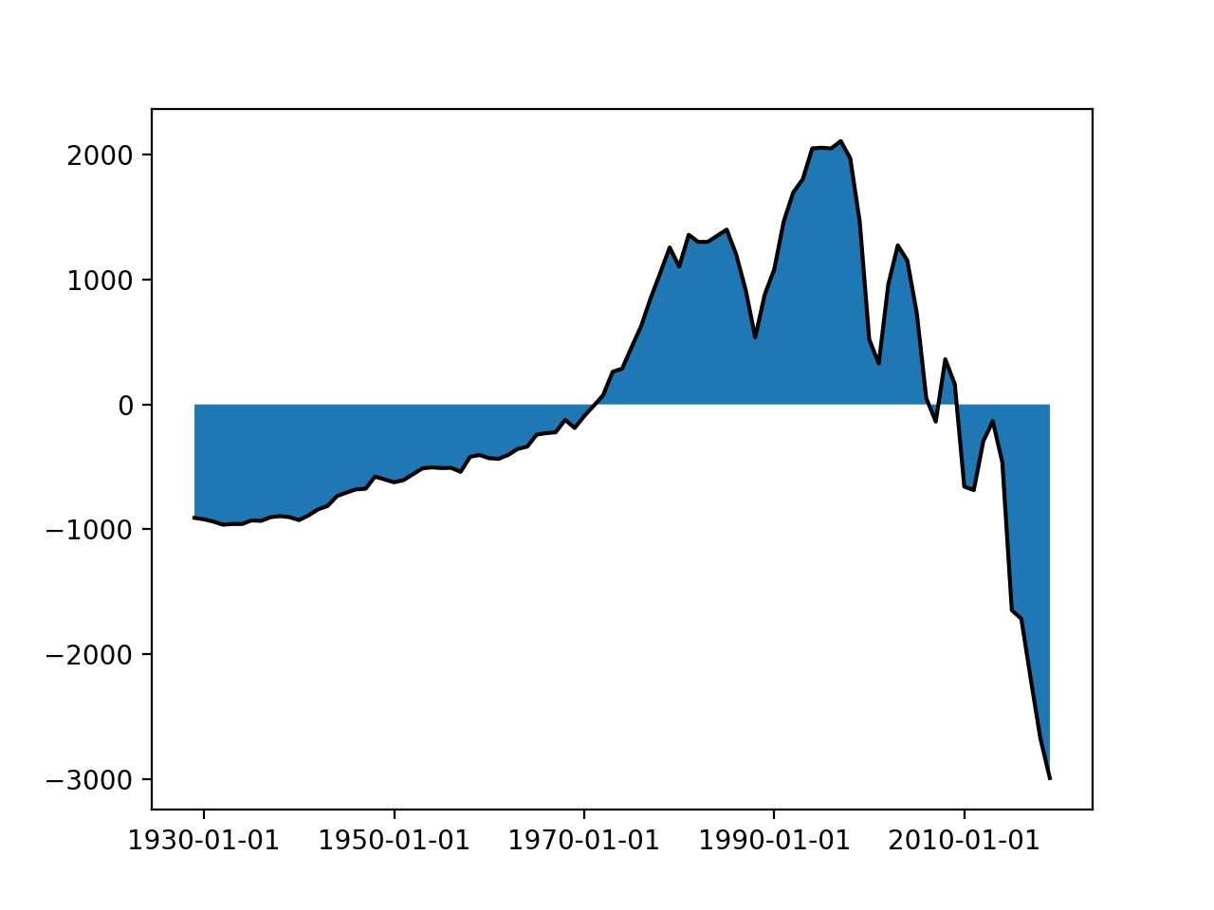
Trends

Slide 96
Trends
This would be a bad regression for prediction!
  We are much lower at the beginning and the end of the time period
  And much higher in the middle
Do not be fooled by spurious prediction

Slide 97

Decomposition:
Dealing with Seasons and Trends

Slide 98
Seasonal Dummy Variables
Suppose you want to use linear regression
Need to account for the effect of week-days
  Introduce dummy variables
 | t13 | t2 | t3 | t4 | t5 | t6 | t7
Mon | 1 | 0 | 0 | 0 | 0 | 0 | 0
Tue | 0 | 1 | 0 | 0 | 0 | 0 | 0
Wed | 0 | 0 | 1 | 0 | 0 | 0 | 0
Thu | 0 | 0 | 0 | 1 | 0 | 0 | 0
Fri | 0 | 0 | 0 | 0 | 1 | 0 | 0
Sat | 0 | 0 | 0 | 0 | 0 | 1 | 0
Sun | 0 | 0 | 0 | 0 | 0 | 0 | 1

Slide 99
Seasonal Dummy Variables
Use linear regression including the dummy variables
  $$y=β_{0}+β_{1}x_{1}+…β_{n}x_{n}+γ_{1}t_{1}+γ_{2}t_{2}+γ_{3}t_{3}+…+γ_{7}t_{7}$$

Slide 100
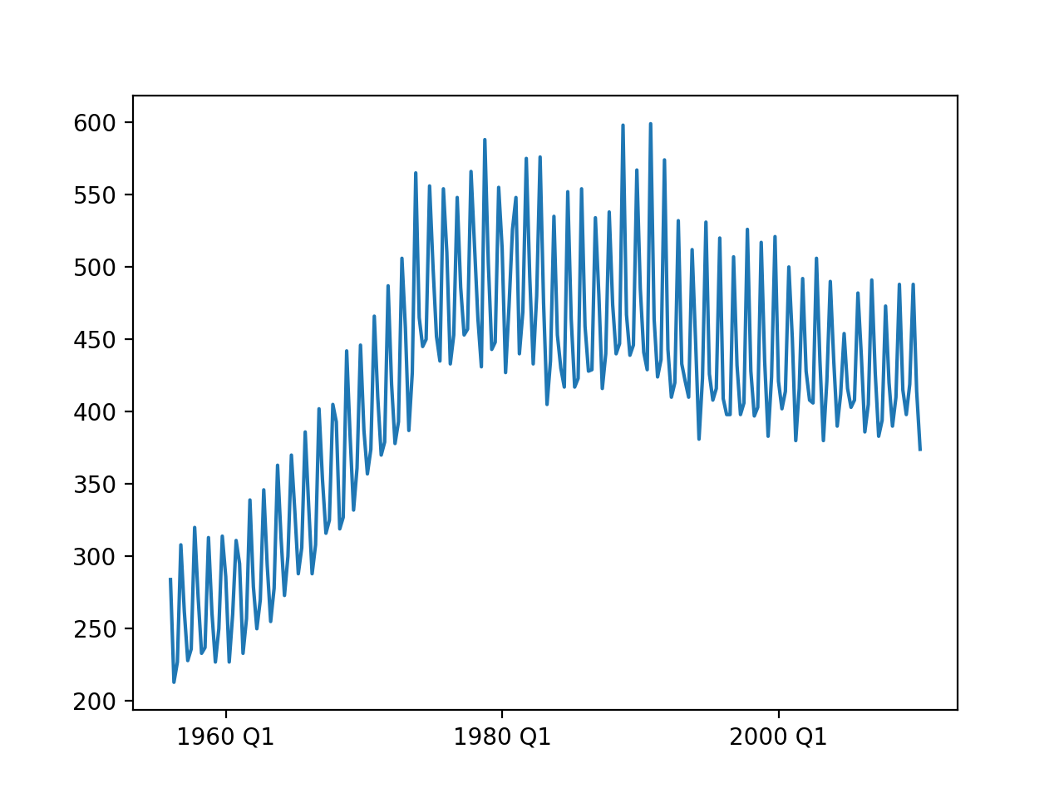
Seasonal Dummy Variables
Example:
  Australian beer production (quarterly)

Slide 101
Seasonal Dummy Variables
Obviously, two different trends, 1955 - 1975 and 1975 -

Slide 102
Seasonal Dummy Variables
Look at the original data:
  Need to parse time stamps from two different columns
  Luckily, parse data is up to it
Time,Year,Quarter,Beer.Production
1,1956,Q1,284
2,1956,Q2,213
3,1956,Q3,227
4,1956,Q4,308
5,1957,Q1,262
6,1957,Q2,228
7,1957,Q3,236
8,1957,Q4,320
9,1958,Q1,272
10,1958,Q2,233
11,1958,Q3,237
12,1958,Q4,313
13,1959,Q1,261
14,1959,Q2,227
15,1959,Q3,250
16,1959,Q4,314
17,1960,Q1,286
def get_data():
df_ab = pd.read_csv('AusBeer.csv',
sep = ',',
parse_dates={'period':['Year', 'Quarter']}
)
df_ab = df_ab.set_index('period')
return df_ab

Slide 103
Seasonal Dummy Variables
Aside:
  When we draw the graph, need to select x-ticks
def show(df_ab):
plt.plot(df_ab['Beer.Production'])
plt.plot(df_ab['pred'])
plt.xticks(['1960 Q1', '1980 Q1', '2000 Q1'])
plt.show()

Slide 104
Seasonal Dummy Variables
First, linear regression just on beer production
  without accounting for the influence of the quarters
df_ab = get_data()
df = df_ab.loc['1979 Q1':]
y = df['Beer.Production']
x = df['Time']
model = ols("y~ x",df).fit()
print(model.summary())

Slide 105
Seasonal Dummy Variables
This gives so-so values (as should be expected)
OLS Regression Results
==============================================================================
Dep. Variable: y R-squared: 0.273
Model: OLS Adj. R-squared: 0.270
Method: Least Squares F-statistic: 81.30
Date: Tue, 24 Aug 2021 Prob (F-statistic): 1.06e-16
Time: 17:22:20 Log-Likelihood: -1244.8
No. Observations: 218 AIC: 2494.
Df Residuals: 216 BIC: 2500.
Df Model: 1
Covariance Type: nonrobust
==============================================================================
coef std err t P>|t| [0.025 0.975]
------------------------------------------------------------------------------
Intercept 337.4062 9.973 33.832 0.000 317.749 357.063
x 0.7120 0.079 9.017 0.000 0.556 0.868
==============================================================================
Omnibus: 11.115 Durbin-Watson: 0.855
Prob(Omnibus): 0.004 Jarque-Bera (JB): 11.202
Skew: 0.516 Prob(JB): 0.00369
Kurtosis: 2.589 Cond. No. 253.
==============================================================================

Slide 106
Seasonal Dummy Variables
But already some nice trend
  Get the model parameters and add a new column with predicted values
  Then display
x = beer['Time']
y = beer['Beer.Production']
model = ols("y~x", beer).fit()
print(model.summary())
intercept, slope = model.params
beer['without'] = intercept+slope*beer.Time
beer.without.plot()
beer['Beer.Production'].plot()
plt.show()

Slide 107
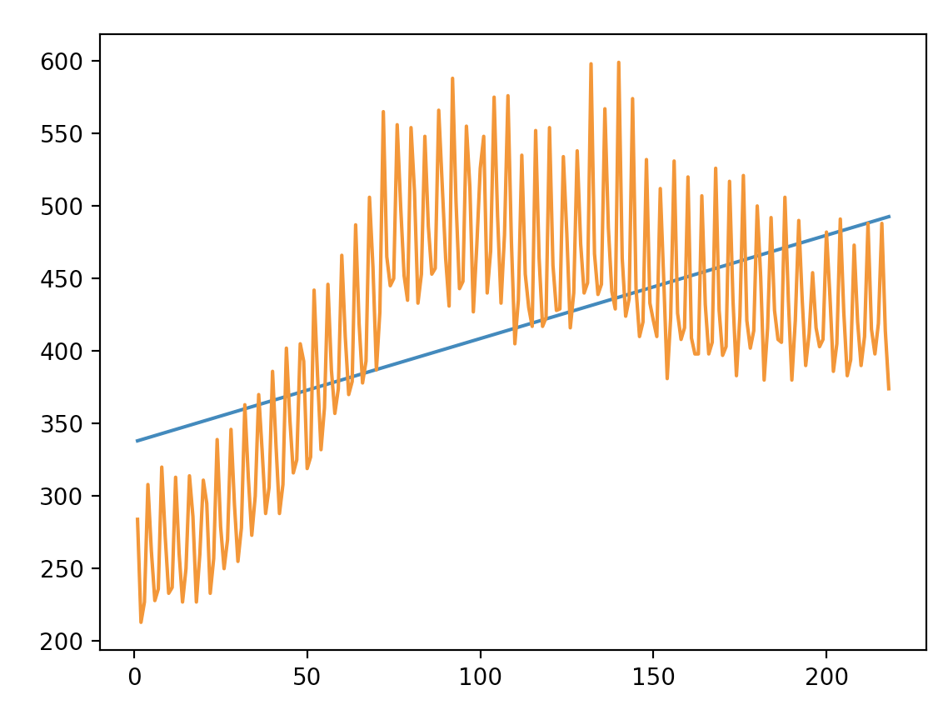
Seasonal Dummy Variables

Slide 108
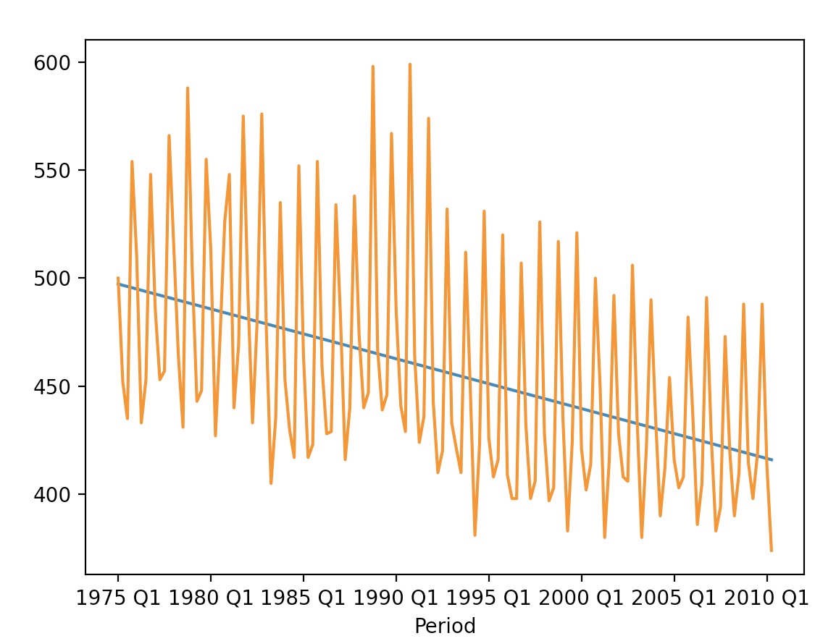
Seasonal Dummy Variable
Restrict to values after 1975:
Lowers $R^{2}$ to 0.191
beer = beer.loc['1975 Q1':]

Slide 109
Seasonal Dummy Variables
Now, let's try using seasonal dummy variables
  Create four new columns
def transform(df_ab):
df_ab['s1'] = [ 1 if 'Q1' in df_ab.index[i]
else 0 for i in range(len(df_ab.index))]
df_ab['s2'] = [ 1 if 'Q2' in df_ab.index[i]
else 0 for i in range(len(df_ab.index))]
df_ab['s3'] = [ 1 if 'Q3' in df_ab.index[i]
else 0 for i in range(len(df_ab.index))]
df_ab['s4'] = [ 1 if 'Q4' in df_ab.index[i]
else 0 for i in range(len(df_ab.index))]

Slide 110
Seasonal Dummy Variables
Set up the model including the seasonal parameters
y = df['Beer.Production']
x = df['Time']
x1 = df['s1']
x2 = df['s2']
x3 = df['s3']
x4 = df['s4']
model = ols("y~ x",df).fit()
print(model.summary())
a, b, b1, b2, b3, b4 = model.params
print(a, b, b1, b2, b3, b4)

Slide 111
Seasonal Dummy Variables
OLS Regression Results
==============================================================================
Dep. Variable: y R-squared: 0.891
Model: OLS Adj. R-squared: 0.888
Method: Least Squares F-statistic: 280.2
Date: Tue, 24 Aug 2021 Prob (F-statistic): 6.77e-65
Time: 17:35:02 Log-Likelihood: -610.68
No. Observations: 142 AIC: 1231.
Df Residuals: 137 BIC: 1246.
Df Model: 4
Covariance Type: nonrobust
==============================================================================
coef std err t P>|t| [0.025 0.975]
------------------------------------------------------------------------------
Intercept 434.1185 4.555 95.303 0.000 425.111 443.126
x -0.5811 0.037 -15.623 0.000 -0.655 -0.508
s1 108.1018 2.855 37.864 0.000 102.456 113.747
s2 65.0717 2.869 22.679 0.000 59.398 70.746
s3 78.5248 2.882 27.243 0.000 72.825 84.225
s4 182.4202 2.897 62.979 0.000 176.692 188.148
==============================================================================
Omnibus: 19.732 Durbin-Watson: 1.947
Prob(Omnibus): 0.000 Jarque-Bera (JB): 32.379
Skew: 0.683 Prob(JB): 9.31e-08
Kurtosis: 4.899 Cond. No. 2.63e+18
==============================================================================

Slide 112
Seasonal Dummy Variables
Add a new column for the prediction
And plot raw data and prediction values
df_ab['pred'] = a + b*df.Time +b1*df.s1+b2*df.s2+b3*df.s3+b4*df.s4
df_ab.dropna(inplace=True)
plt.plot(df_ab['Beer.Production'])
plt.plot(df_ab['pred'], alpha = 0.5)
plt.xticks(['1980 Q1', '1985 Q1','1990 Q1',
'1995 Q1', '2000 Q1', '2005 Q1', '2010 Q1'],
['80', '85', '90', '95', '00', '05', '10'])
plt.show()

Slide 113
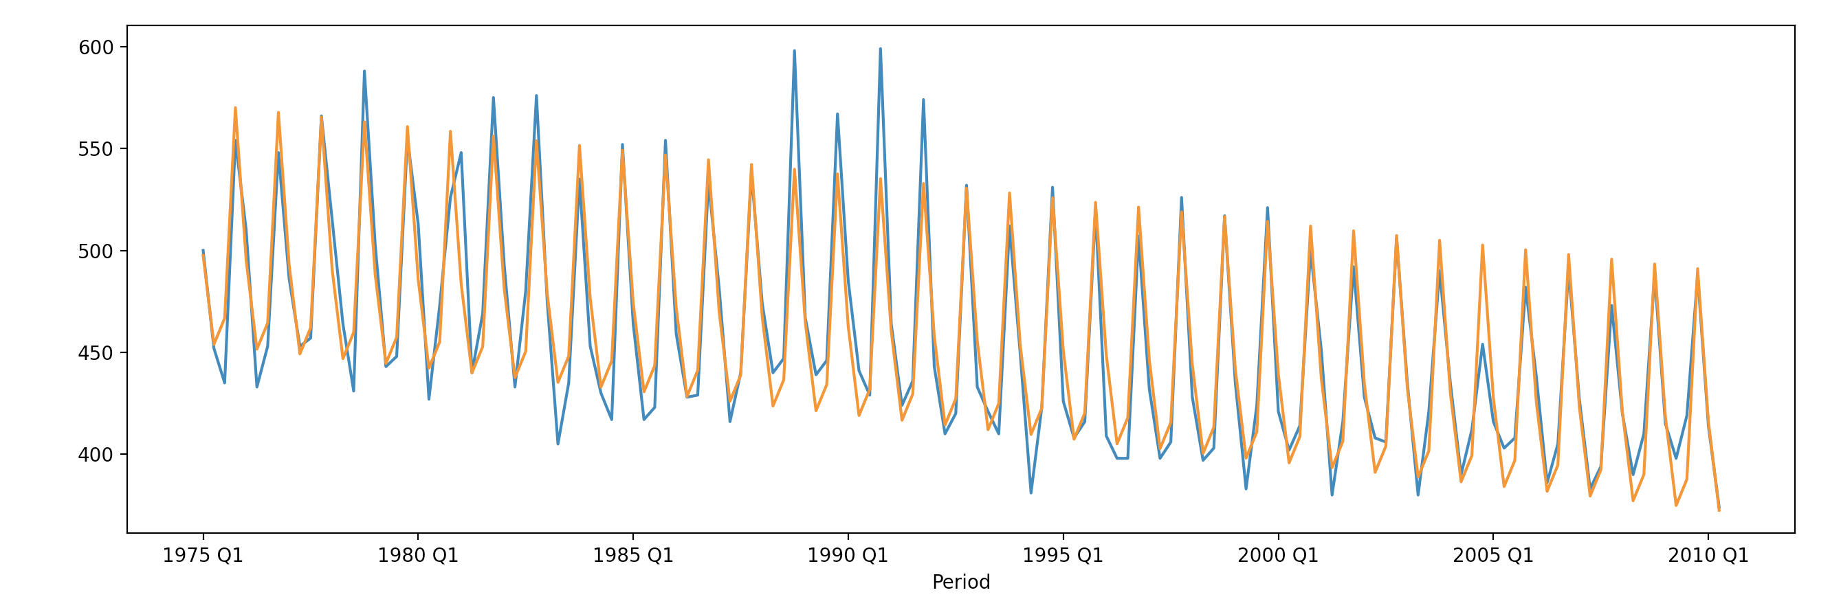
Seasonal Dummy Variables

Slide 114
Seasonal Dummy Variables
Why are we not doing better?
  We only have time and season as explanatory variables
    Temperature and economy could also explain beer consumption
    And maybe exports?

Slide 115
Seasonal Dummy Variables
Let's look at the average error of the prediction
  Add one more column to the data frame
  And display
df_ab['res'] = (df_ab['Beer.Production']-df_ab['pred'])/df_ab['Beer.Production']

Slide 116
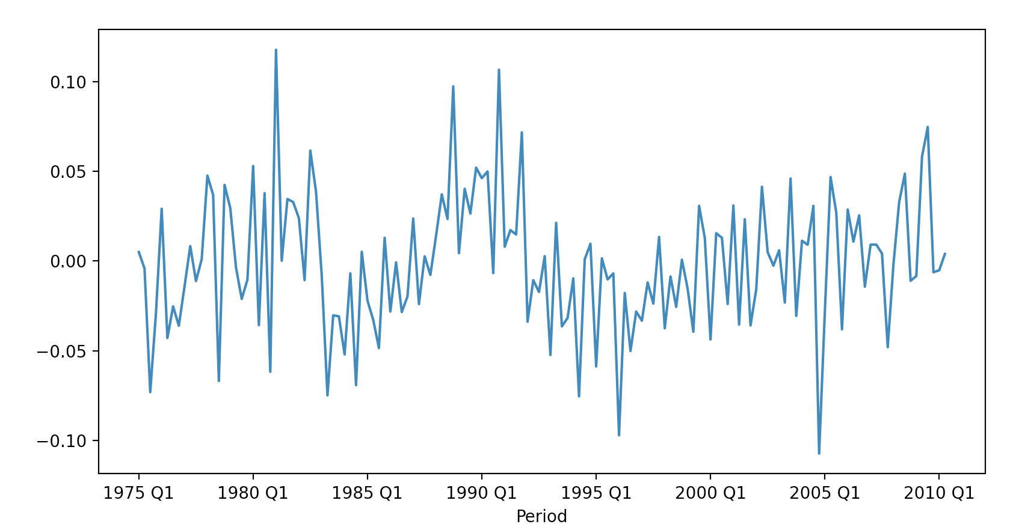
Seasonal Dummy Variables
Shows that we are historically with 10% of the linear regression calculated value

Slide 117
Seasonal Dummy Variables
We can also look at how well the prediction works
plt.scatter(df_ab['Beer.Production'][df_ab['s1']==1],
df_ab['pred'][df_ab['s1']==1],
alpha = 0.5, c = 'red', label='Q1')
plt.scatter(df_ab['Beer.Production'][df_ab['s2']==1],
df_ab['pred'][df_ab['s2']==1],
alpha = 0.5, c = 'green', label='Q2')
plt.scatter(df_ab['Beer.Production'][df_ab['s3']==1],
df_ab['pred'][df_ab['s3']==1],
alpha = 0.5, c = 'blue', label='Q3')
plt.scatter(df_ab['Beer.Production'][df_ab['s4']==1],
df_ab['pred'][df_ab['s4']==1],
alpha = 0.5, c = 'cyan', label='Q4')
plt.legend()
plt.show()

Slide 118
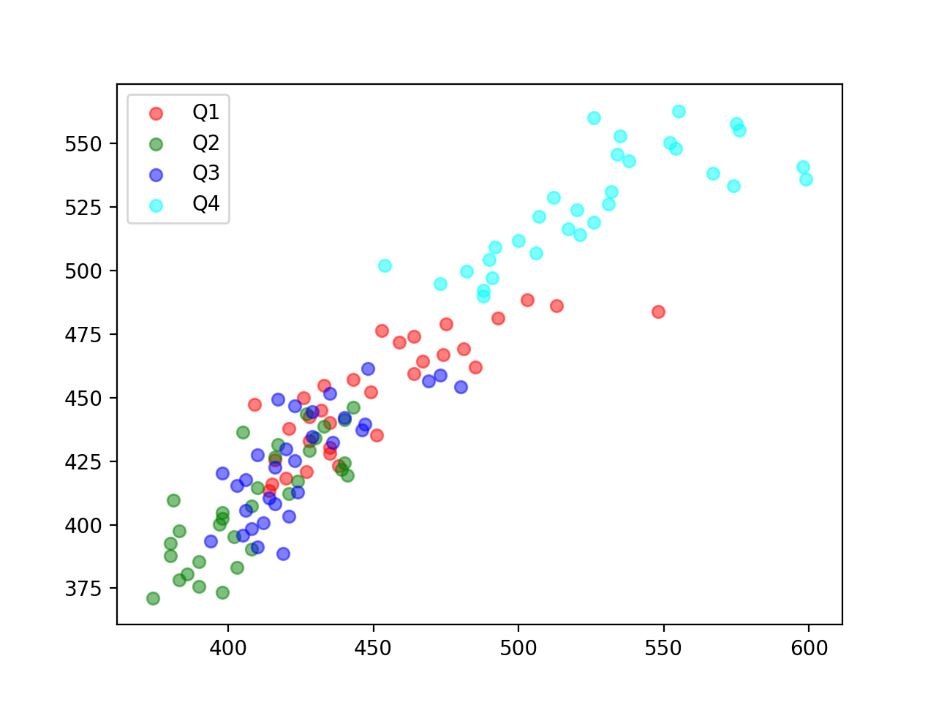
Seasonal Dummy Variables

Slide 119
Classical Decomposition

Slide 120
Classical Decomposition
Simple method with periods of m on $y$
  quarters: m=4, business weeks: m=5, years: m = 365
  Additive decomposition: $y=T+S+R$
    Use moving average of size 2m (or m) to estimate $T$
    Calculate the "detrended" series $d_{t}=y_{t}-T_{t}$
    Seasonal component is the average over all values for that period $S_{t}=\text{Average}\left(\{…,d_{t-2m},d_{t-m},d_{t},d_{t+m},d_{t+2m},…\}\right)$
    Residual is what is left

Slide 121
Classical Decomposition
Problems with classical decomposition:
  Trend cycle not available for the first or last times without extrapolation
  Rapid rises and falls are smoothed out too much
  Assumes seasonal components repeat
    Counter-example:
      Used to be that electricity consumption peaked in the winter (heating)
      Now peaks in the summer (air-conditioning)
  Really difficult to deal with extra-ordinary events (strikes, weather, catastrophes, …)

Slide 122
Classical Decomposition
Implemented in statsmodels
Needs a time series x
Needs a model: "additive" (default), "multiplicative"
Can give filtering weights
Period (if x not Pandas with frequency)
two-sided: method used for filtering
extrapolate_trend: non-zero value or 'freq' to extrapolate
  Otherwise, NaN values
from statsmodels.tsa.seasonal import seasonal_decompose

Slide 123
Classical Decomposition
Call decomposition
  result has components trend, seasonal, resid
result = seasonal_decompose(
df['Beer.Production'],
model = 'additive',
period = 4,
extrapolate_trend = 3)

Slide 124
Classical Decomposition
Show results:
def show(result):
fig, axs = plt.subplots(3, sharex=True, figsize=(5,10))
axs[0].plot(result.trend, 'k-')
axs[1].plot(result.seasonal, 'r:')
axs[2].plot(result.resid, 'b-.')
axs[0].set_title('trend')
axs[1].set_title('seasonal')
axs[2].set_title('residual')
axs[2].set_xticks(['1980 Q1', '1990 Q1', '2000 Q1', '2010 Q1'])
axs[2].set_xticklabels(['80', '90', '00', '10'])
plt.show()

Slide 125
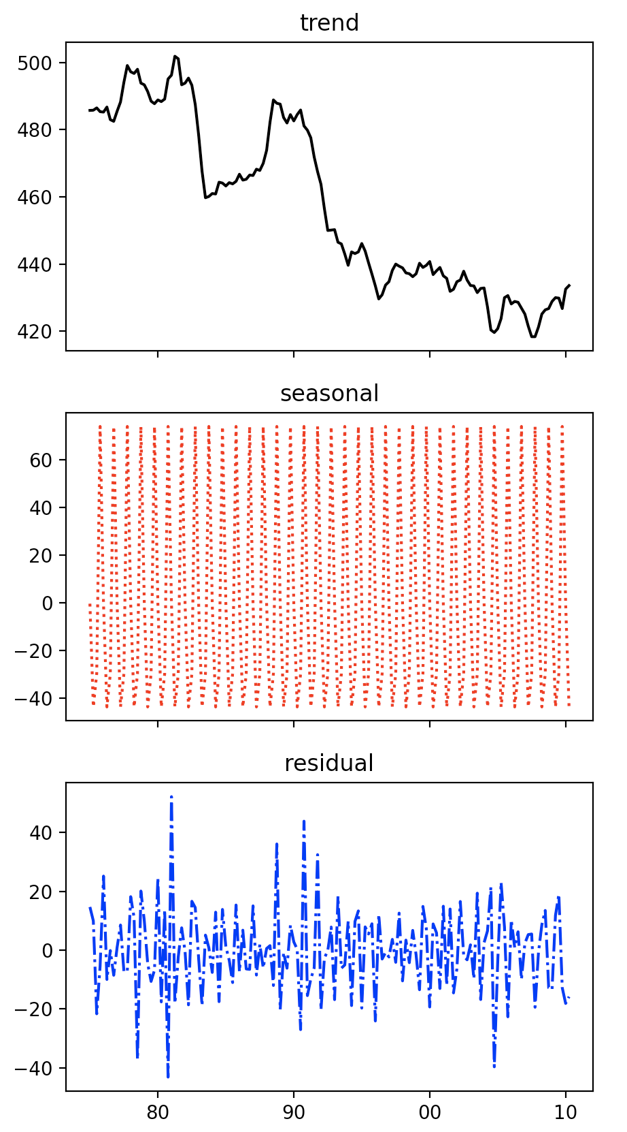
Can extrapolate the trend
Add seasonal
Use residual as a measure of uncertainty

Slide 126
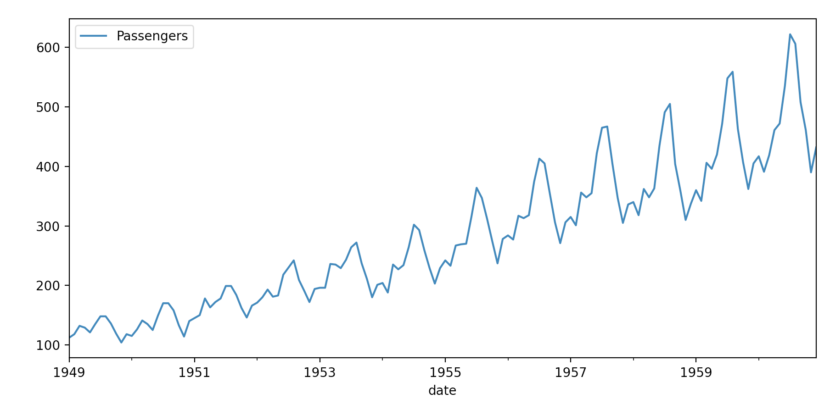
Classical Decomposition
airline passengers
result = seasonal_decompose(df.Passengers,
model = 'additive',
period = 14,
extrapolate_trend = 'freq'
)

Slide 127
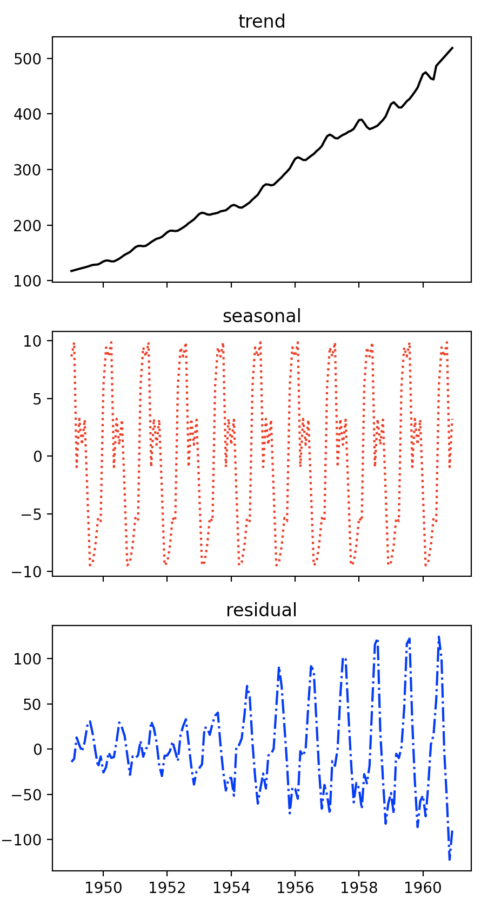
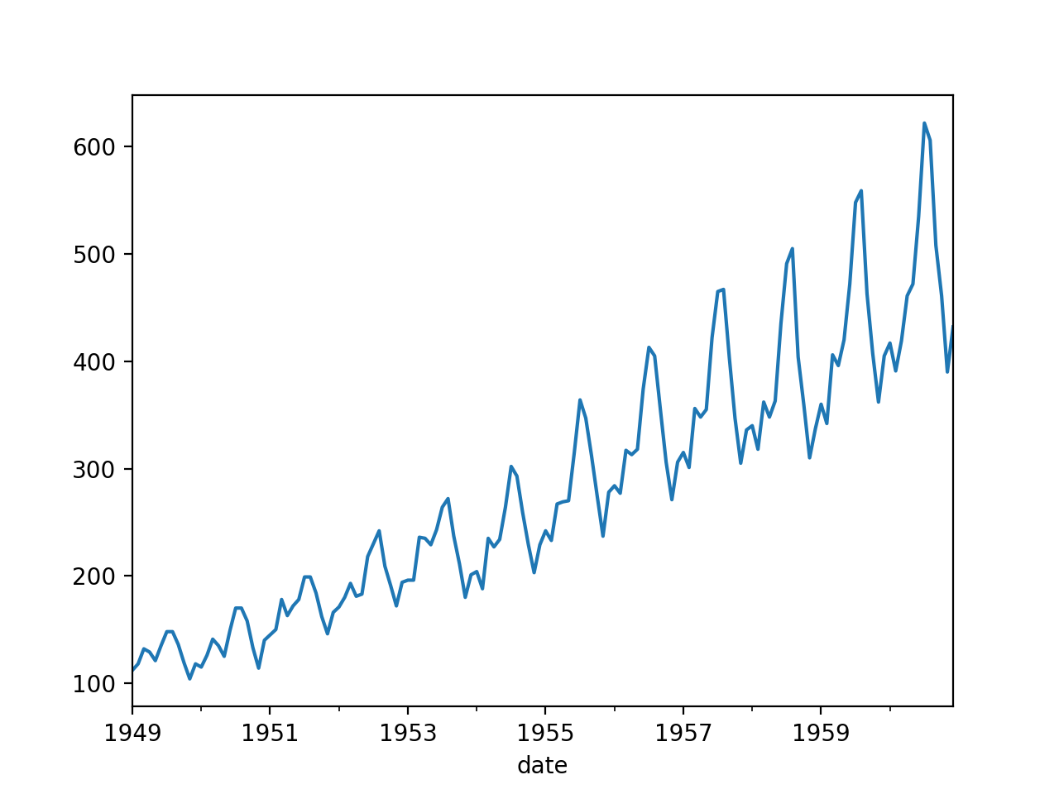

Slide 128
Better Decompositions
Decomposition has had a 100 year history
  Classical decomposition finds seasonal adjustment based on means so that they are constant
  Better decompositions allow seasonal values to vary
  Seasonal Decomposition using LOESS (STL)
    LOESS is based on estimating the trend with a range of functions within a certain window

Slide 129
Better Decompositions
STL is implemented in statsmodels
  Uses the assumed cyclicity as input (periods)
from statsmodels.tsa.seasonal import STL

Slide 130
Better Decompositions
Example: Australian Beer:
  Result is a triple of trend, seasonal, and residual
stl = STL(df['Beer.Production'],
period=4,
robust=False)
result = stl.fit()

Slide 131
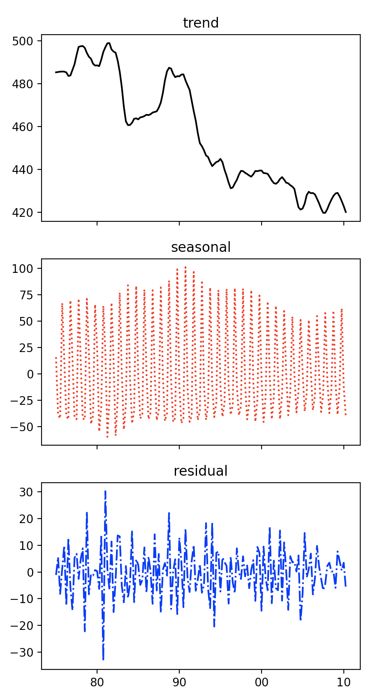
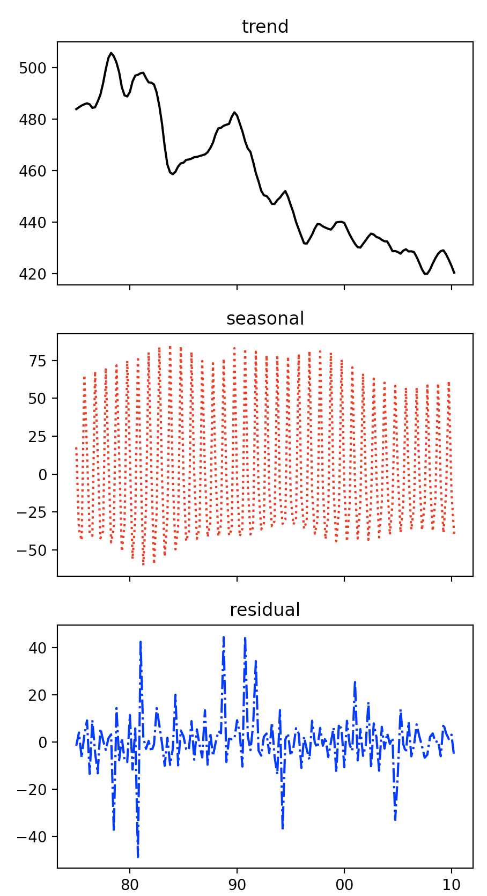
robust
not
robust

Slide 132
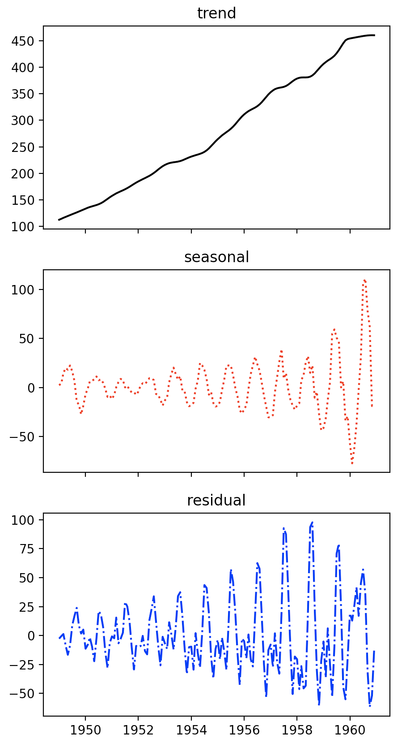
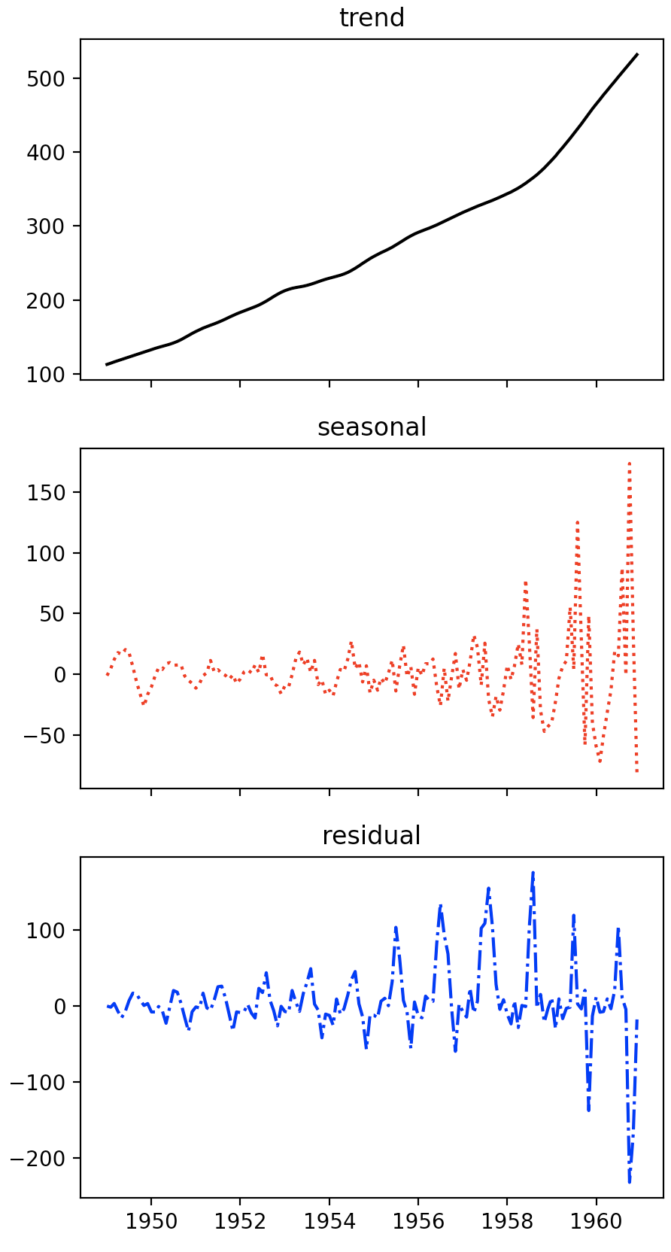
airline
passengers
not
robust
robust

Slide 133
Better Decompositions
Holt's linear trend method:
  Simple exponential smoothing for data with trend
    Estimates series at time t using estimates of the slope obtained as a weighted average
Holt-Winter's Seasonal Method
  Adds a seasonal component

Slide 134
Better Decompositions
Implemented in statsmodels
  Produces a fitted value (fit) and allows predictions
from statsmodels.tsa.holtwinters import ExponentialSmoothing as esm
df = get_data()
esm = esm(df['Passengers'],
seasonal='mul',
seasonal_periods=12
)
result = esm.fit()

Slide 135
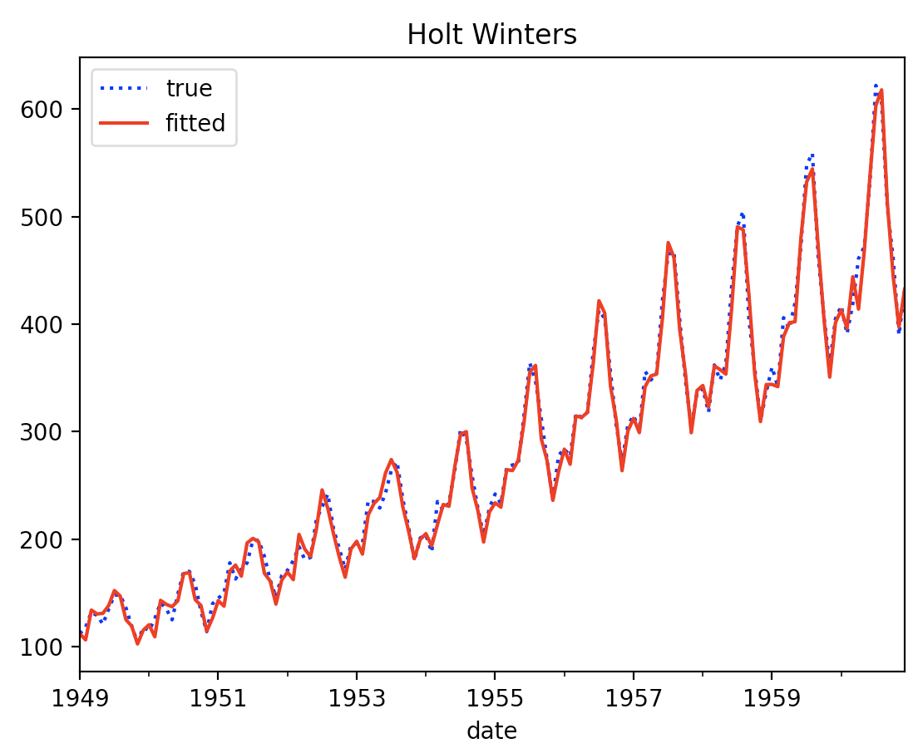
Better Decompositions
Airline Example (multiplicative fit)

Slide 136
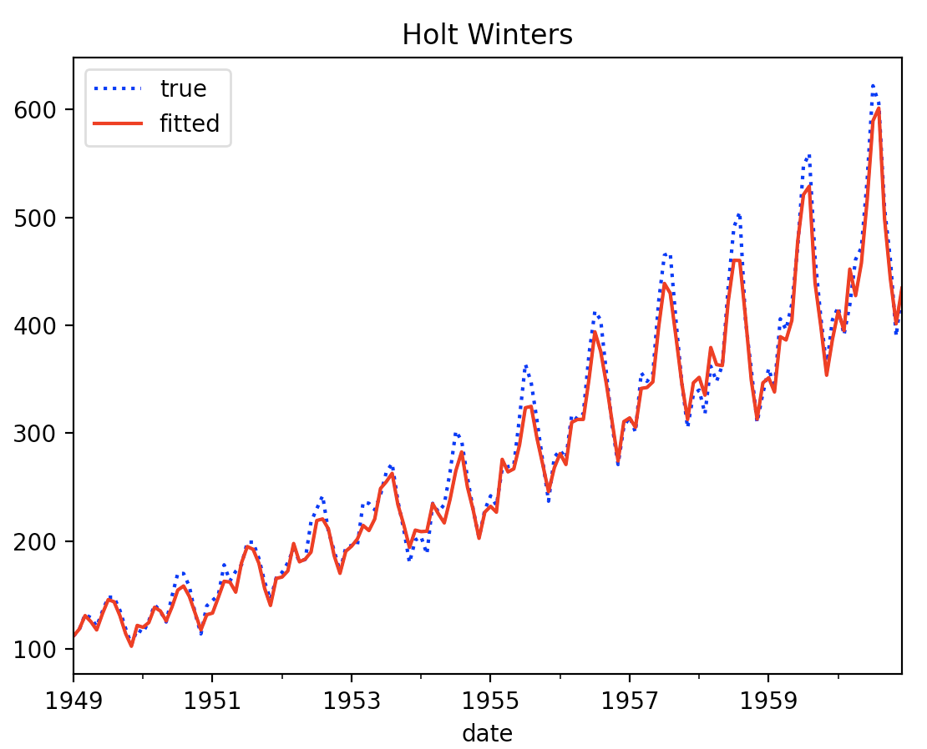
Better Decompositions
Airline Example additive seasonality

Slide 137
Stationary Time Series

Slide 138
Time Series Analysis
After defining and removing
  Seasonal components
  Trends
Residual needs to be analyzed

Slide 139
Stationary Time Series
Properties do not depend on the time at which the series is observed
  No trend, no seasonality
  But could be cyclic if cycles have no fixed length

Slide 140
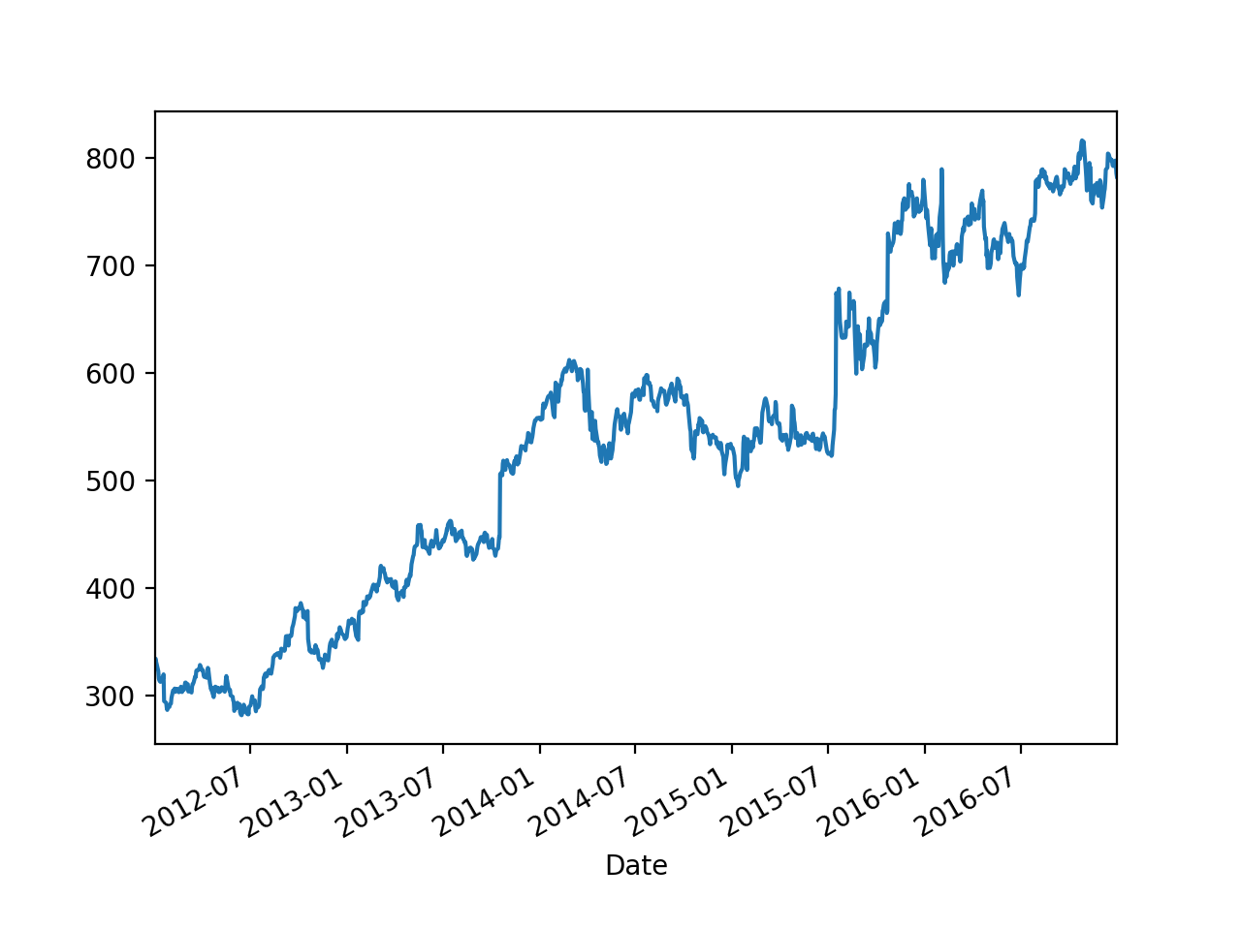
Stationary Time Series
Example:
  Google High stock value is not stationary

Slide 141
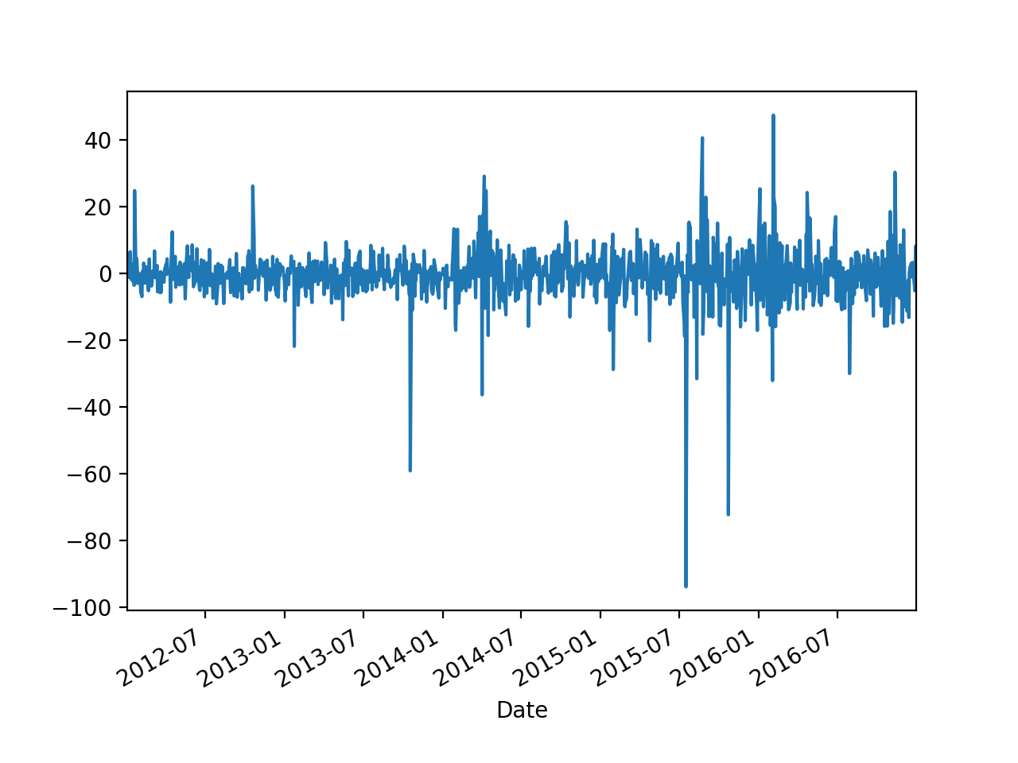
Stationary Time Series
But it's daily change is

Slide 142
Stationary Time Series
Use shift in order to obtain the differences
def get_google_data():
my_df = pd.read_csv('../Pandas/google.csv',
parse_dates=[0],
index_col=0,
converters={
'Close': my_converter,
'Volume': convert_volume}
)
print(my_df.info())
#my_df.High.plot()
(my_df.shift(1).High - my_df.High).plot()
plt.show()
return my_df

Slide 143
Stationary Time Series
This is typical
  Differencing
    Make a non-stationary time series stationary
    Might have to be repeated several times

Slide 144
Stationary Time Series
Can look at the Auto-Correlation Function
  How does the value of a time series relate to the values shifted by m periods
Implemented in Pandas as autocorr(lag = m)

Slide 145
Stationary Time Series
Example: google change
my_df = get_google_data()
for i in range(20):
print(i,
(my_df.shift(1).High - my_df.High).autocorr(lag=i))
0 0.9999999999999999
1 0.12080309541084427
2 -0.035334997385017435
3 -0.048524948019570004
4 -0.05560693878878337
5 -0.0064797046657102605
6 0.011124537759089287
7 -0.03901650231472603
8 -0.012520771888603816

Slide 146
Stationary Time Series
One version in statsmodels
Calculates ACF as a numpy array
from statsmodels.tsa.stattools import acf, pacf
my_df = get_google_data()
google = (my_df.shift(1) - my_df).dropna(axis=0)
my_acf = acf(google.High, fft = False)
fig, ax = plt.subplots(1)
ax.plot(my_acf)

Slide 147
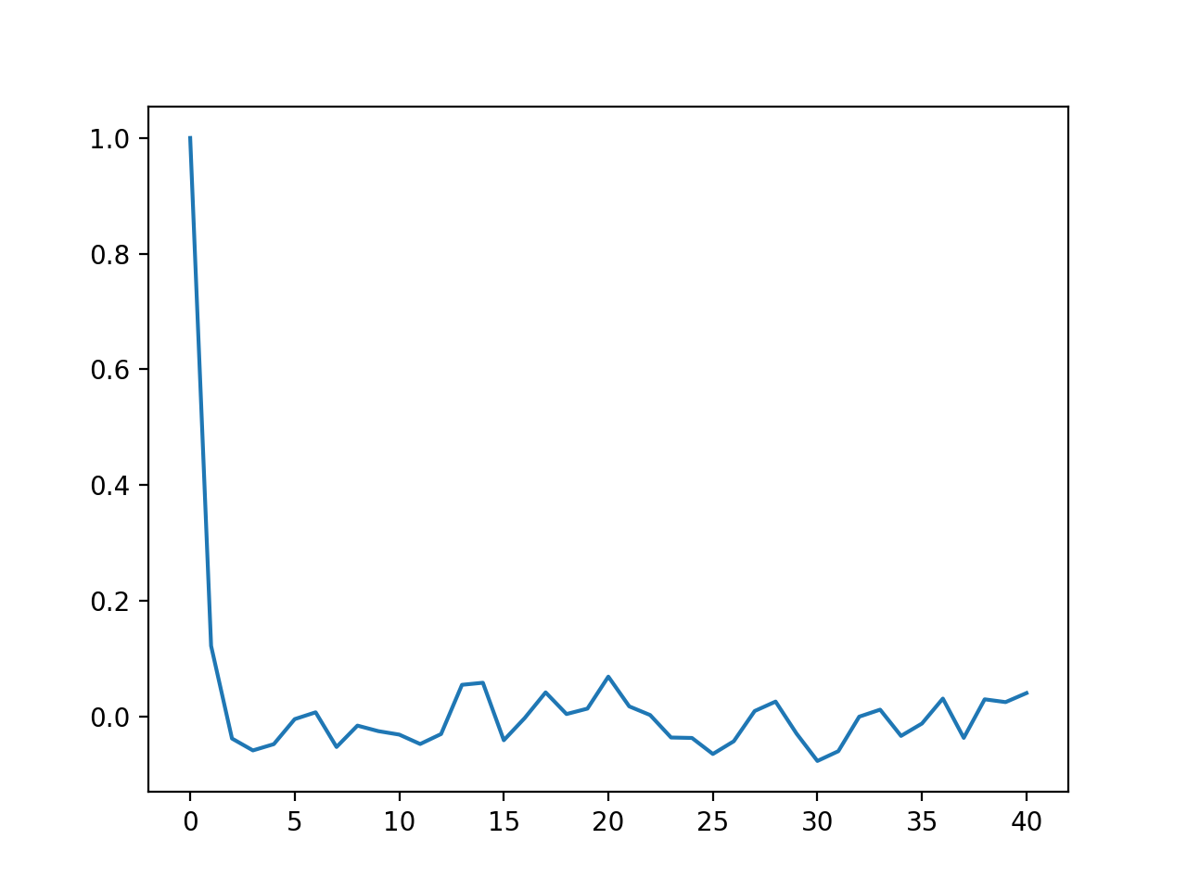
Stationary Time Series

Slide 148
Stationary Time Series
A graphical version is also available:
import statsmodels.graphics.tsaplots as sgt
sgt.plot_acf(google.High, unbiased = True,
zero=False, lags = 40)

Slide 149
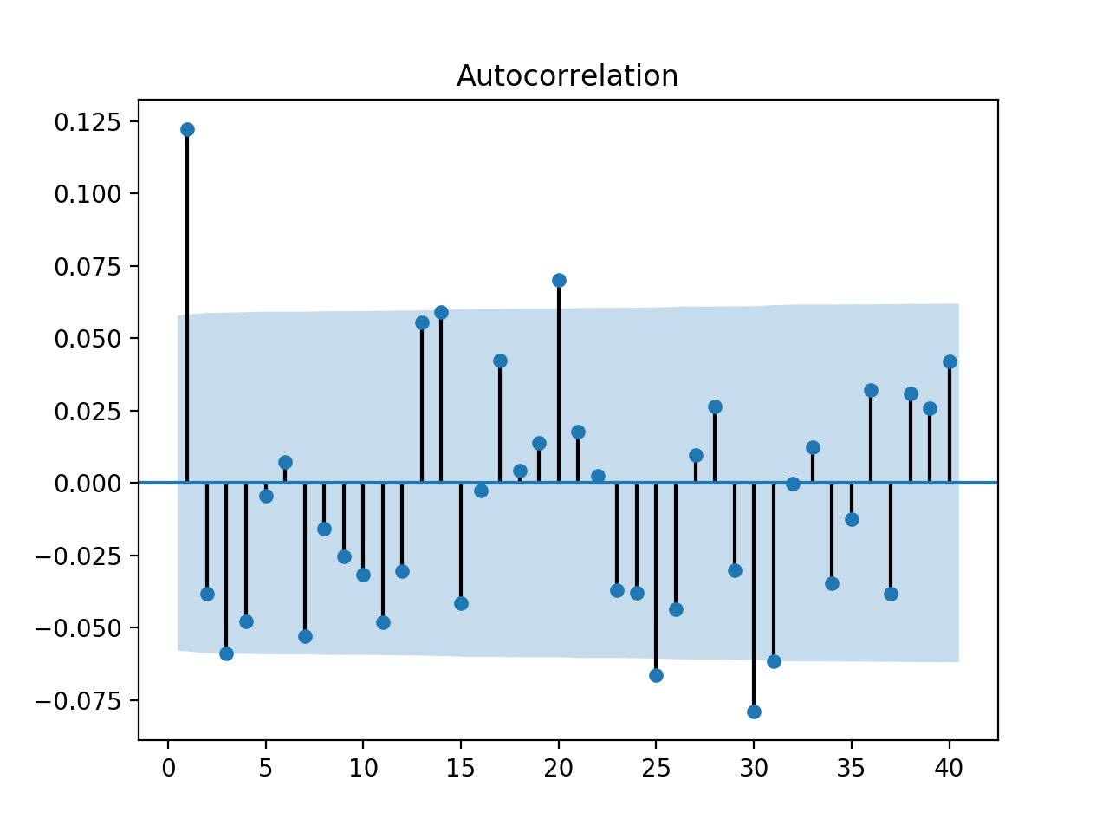
Stationary Time Series

Slide 150
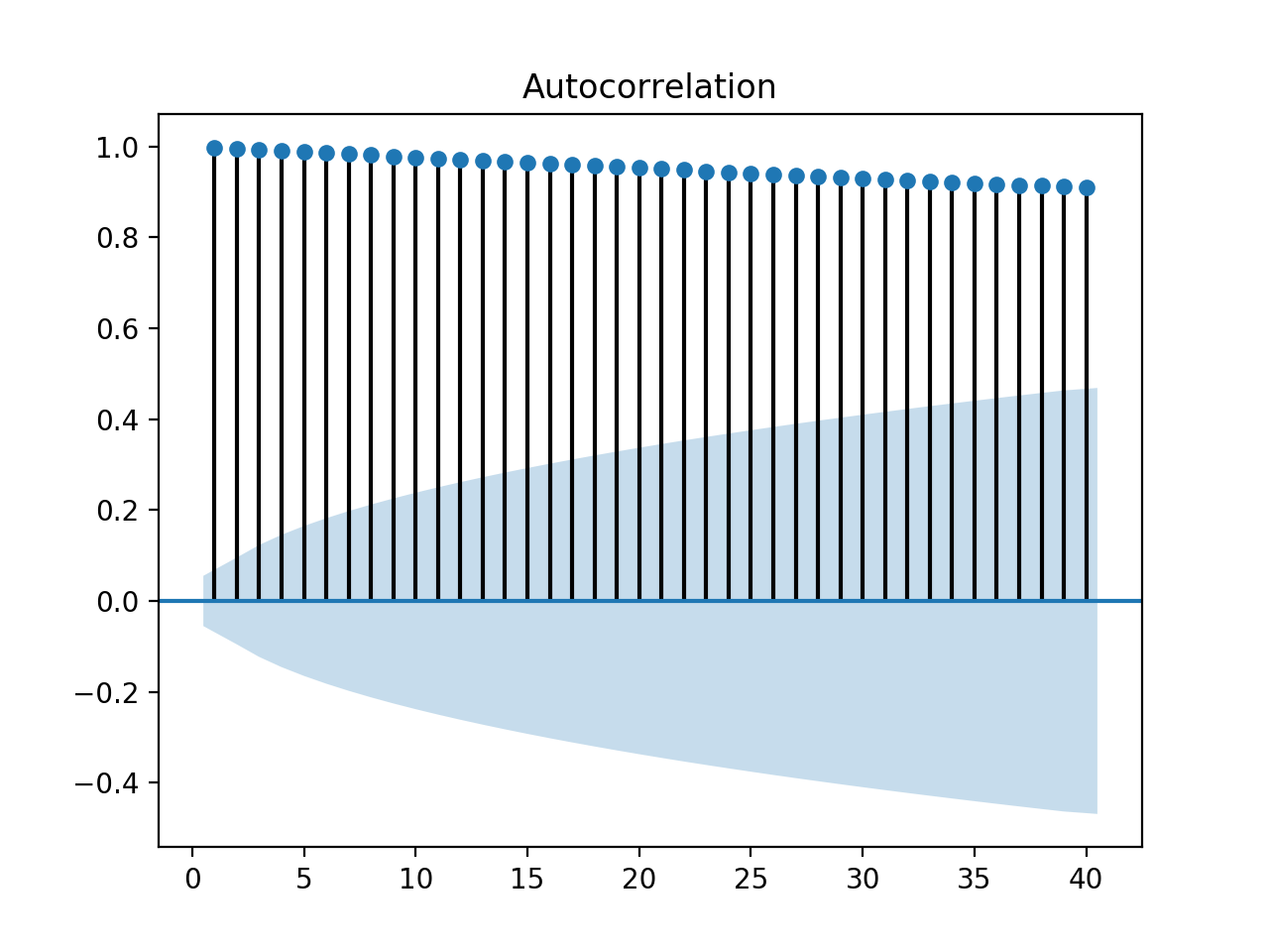
Stationary Time Series
If we apply the same methodology to the original data
  Much more autocorrelation

Slide 151
Stationary Time Series
For lag = 2, the value is mostly because of the correlation between lag = 1
Use pacm instead
  Calculates only the auto-correlation not explained by auto-correlation for smaller lags
sgt.plot_pacf(my_df.High, lags = 40)

Slide 152
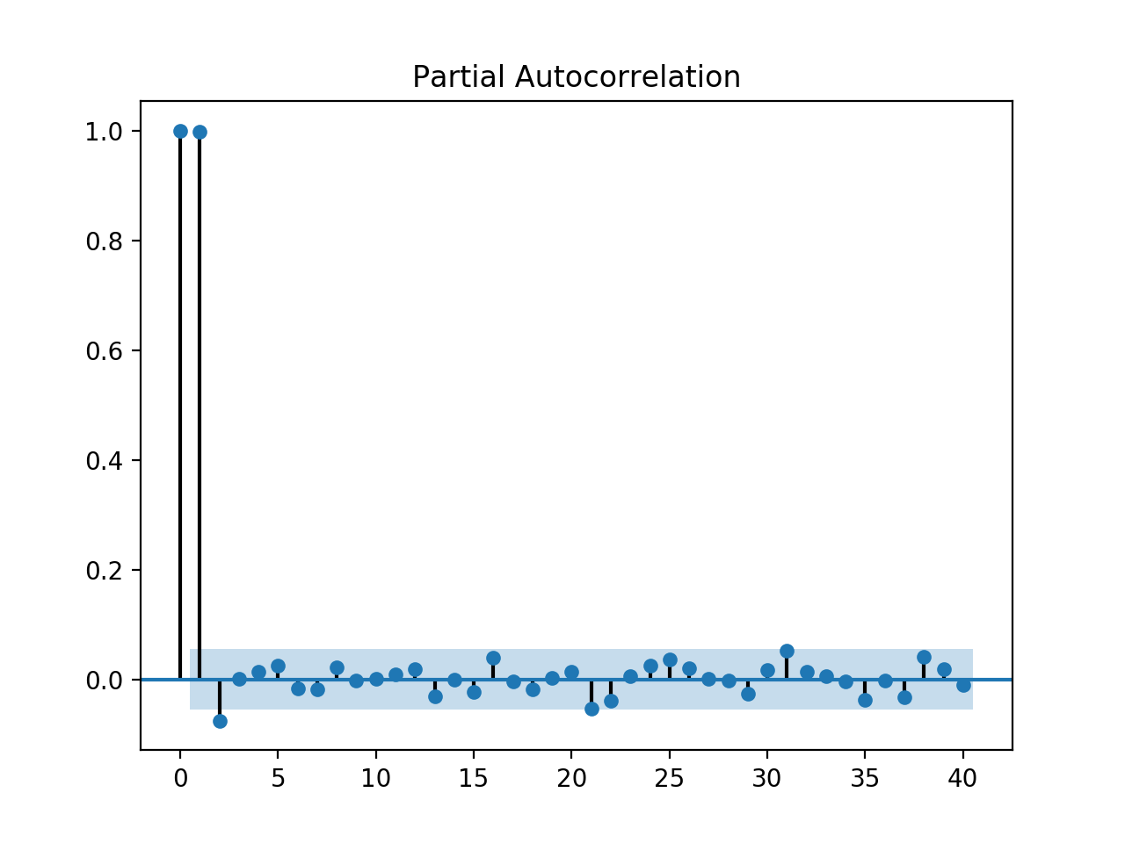
Stationary Time Series

Slide 153
Stationary Time Series
Autoregression Models
  Forecast variable of interest using linear combination of past values of the variable
    $$y_{t}=c+ϕ_{1}y_{t-1}+ϕ_{2}y_{t-2}+…+ϕ_{m}y_{t-m}+ϵ_{t}$$
    With "white error" $ϵ_{t}$
    Autoregressive Model of order $m$

Slide 154
Stationary Time Series
Moving average models
  Uses past forecast errors
    $$y_{t}=c+ϵ_{t}+θ_{1}ϵ_{t-1}+…+θ_{q}ϵ_{t-q}$$
      with white noise $ϵ_{t},ϵ_{t-1},…,ϵ_{t-q}$

Slide 155
Stationary Time Series
ARIMA models
  AutoRegressive Integrated Moving Average
$$y_{t}^{′}=c+ϕ_{1}y_{t-1}^{′}+…+ϕ_{p}y_{t-p}^{′}+θ_{1}ϵ_{t-1}+…+θ_{m}ϵ_{t-q}+ϵ_{t}$$
Differenced value at t is
  autoregressive part of order p
  d times differenciated
  moving average of order q
ARIMA(p,d,q)

Slide 156
Stationary Time Series
Can use statsmodels
Specify degree of ARIMA model and print out its parameters
Display residual
from statsmodels.tsa.arima_model import ARIMA
model = ARIMA(my_df.High, order=(1,1,0))
model_fit = model.fit(disp=0)
print(model_fit.summary())
residuals = pd.DataFrame(model_fit.resid)
residuals.plot(label='residual')
plt.show()

Slide 157
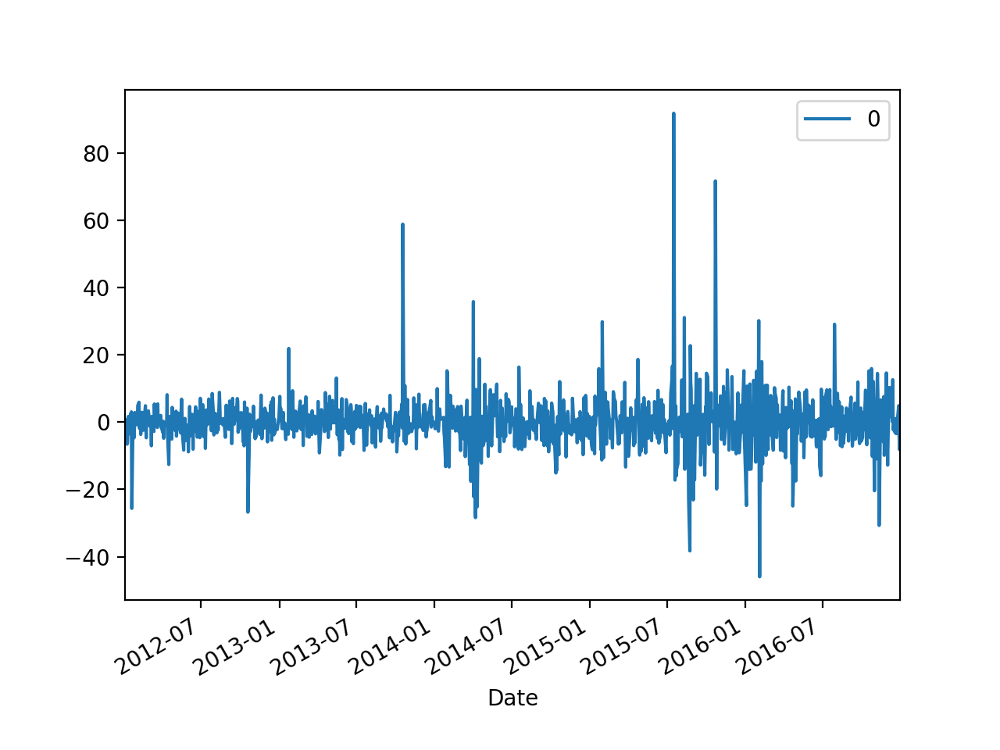
Stationary Time Series

Slide 158
Seasonal Time Series
It is possible to extend ARIMA to include a seasonal component
  In which case we could even put in a trend
from statsmodels.tsa.statespace.sarimax import SARIMAX
df = get_data()
my_order = (1,1,1)
my_seasonal_order=(1,1,1,12)
model = SARIMAX(endog = df.Passengers,
order = my_order,
seasonal_order = my_seasonal_order)
results = model.fit()
print(results.summary())
results.resid.plot()
plt.show()

