Slide 1
Week 1 Exercises
Thomas Schwarz, SJ

Slide 2
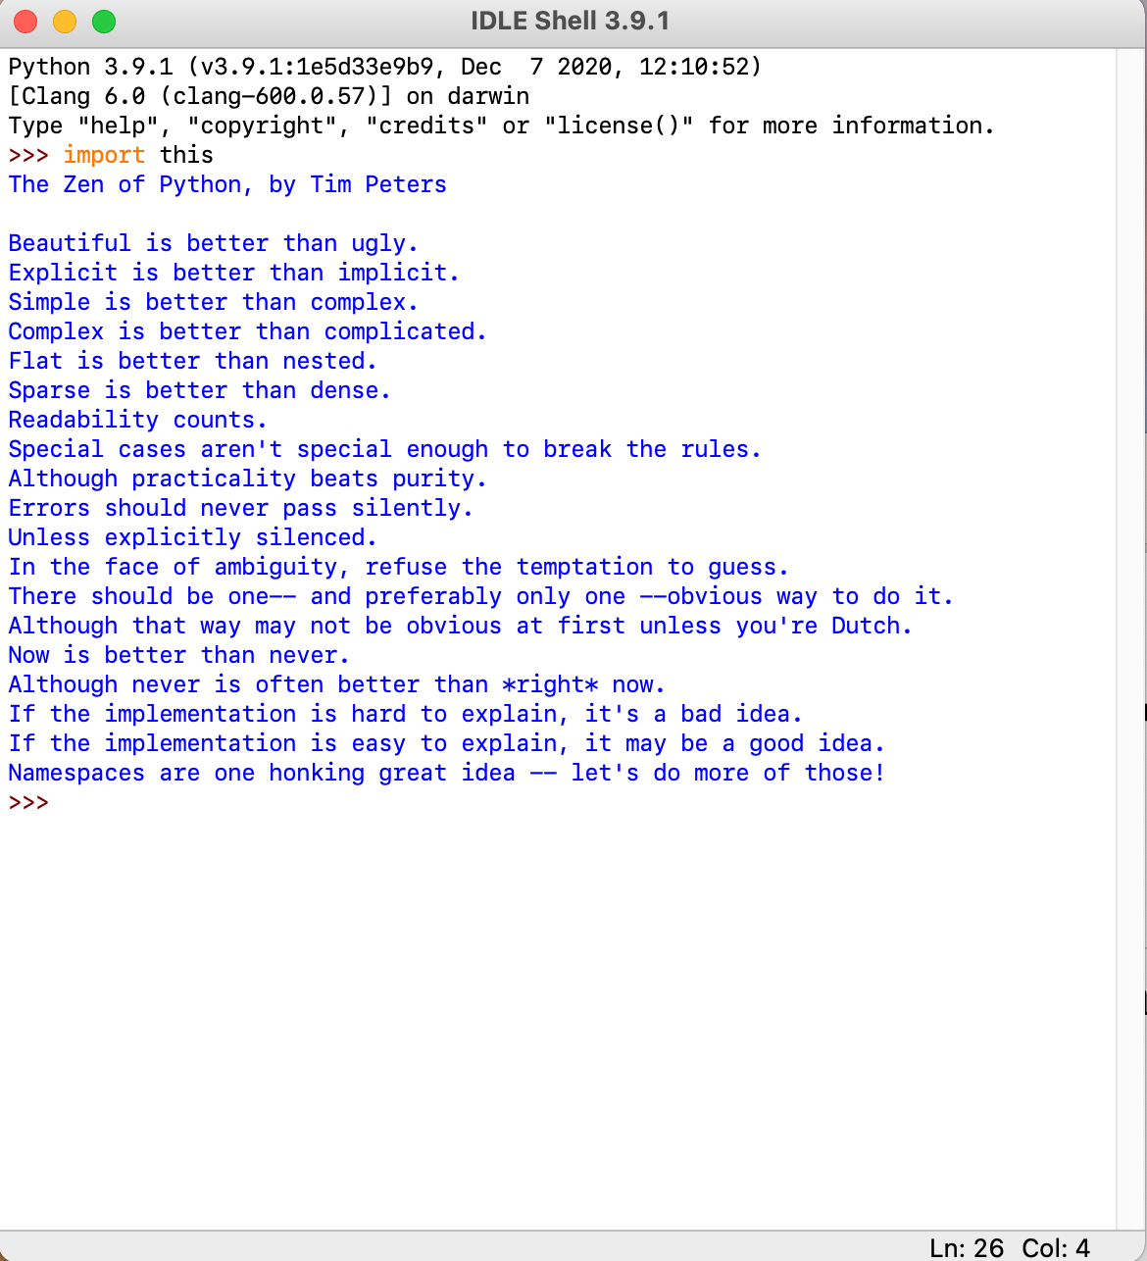
The Zen of Python
Use import this

Slide 3
Refresher: Operations
Write a script with two variables, x and y
Set these variables to 6 and 7, resp.
Print out: sum, difference, product, division, floor division, power, remainder, negatives, absolute values (abs)
Note: There are more operations, the binary operations
x | y (bit-wise or), x^y (bit-wise exclusive or), x&y (bit-wise

Slide 4
Refresher: Booleans
Write a script that prints out Boolean comparisons in terms of x and y
e.g.: print(x+y < 10)

Slide 5
Refresher: Strings
Strings are created by using simple quotation marks or double quotation marks
To include line breaks:
Use triple quotes or the escape sequence \n
Translate the following code to one using \n:
>>> astring = """one line
two lines
three lines
"""
>>> print(astring)
one line
two lines
three lines

Slide 6
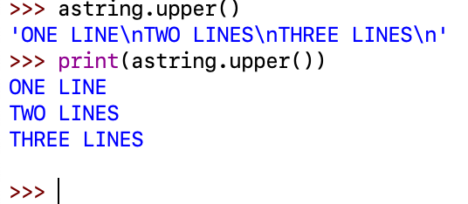
Strings
Python has a lot of methods working on strings
Length — len
Concatenation and repetition with + and *
You can change to lower or to upper case:

Slide 7
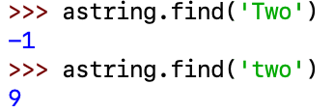
Strings
There are a lot of useful string methods
Finding / matching
Length: len
Replace

Slide 8
Python Survival Rules
Python Error Messages
When you program seriously, you make serious mistakes, seriously
So, you better start understanding error messages

Slide 9
Python Error Messages
Typically, you call functions within functions within functions …
Traceback lists all function calls
Because we are not using functions yet, this is simple:
Traceback is a single line

Slide 10
Python Error Messages
Traceback lists the offending line number
BUT: this is when Python notices the error
Error messages are difficult to read

Slide 11
Python Error Messages
The error has a name: ZeroDivisionError
Can google that with key-word Python
It also has a description, but it is a bit laconic
Here: user input was 3, so we were dividing by zero

Slide 12
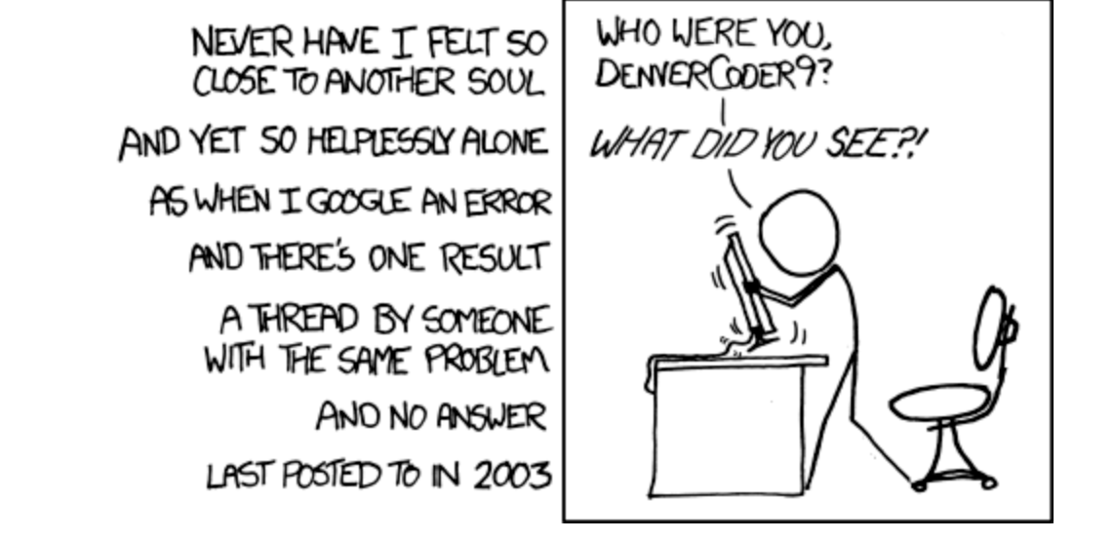
Sources for Help
Internet searches for the problem

Slide 13
Sources for Help
Stackoverflow
Answer quality ranges from acceptable to superb
Asking questions:
First, check that there is no answer for your problem
Second, check the guidelines
https://stackoverflow.com/help/how-to-ask

Slide 14
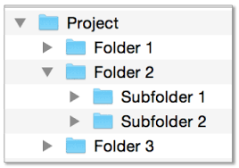
Environment Setup
Sooner or later, you will need to include files
Windows:
Paths start with a drive name
Backslashes separate folders and file names
Sometimes, you need to escape
c:\\Project\\Folder2\\Subfolder1\\my_file

Slide 15
Environment Setup
On Mac and Linux, use a forward slash
There is no drive letter
/Users/thomasschwarz/Documents/Marquette Letterhead/Letterhead/ts.pdf

Slide 16
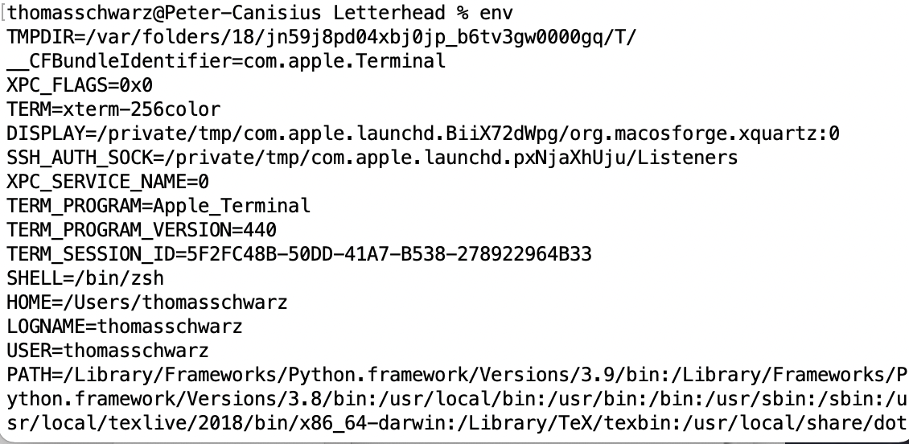
Environment Setup
Whenever you run a program, this program runs in an environment
Characterized by environmental variables
To see them: Use "set" in a command prompt on windows
On Mac/Unix/Linux: use "env"

Slide 17
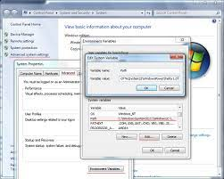
Environment Setup
One of the more important variables is the PATH
This is the set of locations that the OS looks through when it sees a command
On Windows, path variables are separated by semi-colons

Slide 18
Environment Setup
On Mac / Linux, its colons
echo $PATH
/Library/Frameworks/Python.framework/Versions/3.9/bin:/Library/Frameworks/Python.framework/Versions/3.8/bin:/usr/local/bin:/usr/bin:/bin:/usr/sbin:/sbin:/usr/local/texlive/2018/bin/x86_64-darwin:/Library/TeX/texbin:/usr/local/share/dotnet:/opt/X11/bin:~/.dotnet/tools:/Library/Apple/usr/bin:/Library/Frameworks/Mono.framework/Versions/Current/Commands:/Applications/Wireshark.app/Contents/MacOS

Slide 19
Exercises
Hero's algorithm calculates the square-root of a number $S$.
First, estimate the square root $x_{0}$ (or set it to one)
Second, improve on your guess by calculating
$$x_{\text{next}}=\frac{1}{2}\left(x_{\text{old}}+\frac{S}{x_{\text{old}}}\right)$$
Repeat (until approximation is good)

Slide 20
Exercises
ASCII art: Use escape characters to build the following animal
^..^ /
/_/\_____/
/\ /\
/ \ / \

Slide 21
Exercises
Create a Python script that asks a user for a distance in furlongs and prints out the distance in meters
(one furlong is 201.1684 meters)
You can use the Python round function to change the floating point number to

Slide 22
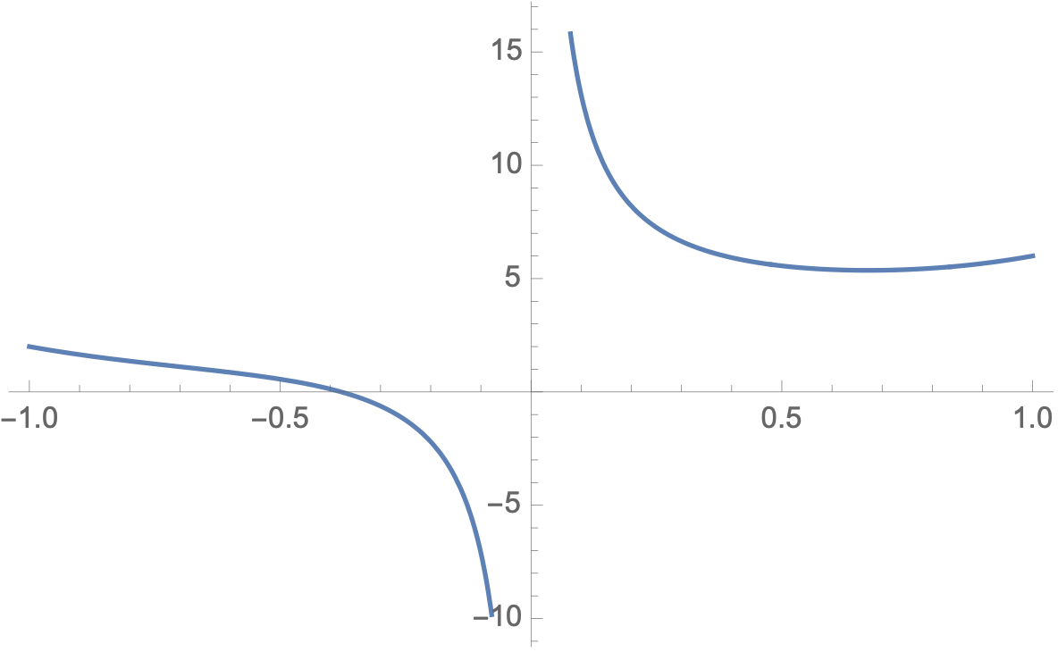
Exercises
Assume that we want to solve an expression such as $x^{4}+x+3+1/x=0$.

Slide 23
Exercises
Assume that we want to solve an expression such as $x^{4}+x+3+1/x=0$.
For $x=-0.1$ the value is negative
For $x=-0.5$, the value is positive
We "bisect" the interval by taking middle
Since with $b=-0.3$, $b^{4}+b+3+1/b≈-0.625233$,
The zero lies between $a=-0.5$ and $b=-0.3$

Slide 24
Exercises
We bisect the interval again:
$$x=-0.4$$
Then $x^{4}+x+3+1/x≈0.1256$
We know the zero is between $a=-0.4$ and $b=-0.3$
We then divide the interval again:
$x=-0.35$.
Then $x^{4}+x+3+1/x≈-0.192137$
Thus, the zero is between $a=-0.4$ and $b=-0.35$

Slide 25
Exercises
And now we continue

Slide 26
Exercises
Calculate the following sums and products
$$\sum_{i=1}^{1000}{i^{4}}$$
$$\sum_{i=0}^{1000}{\frac{1}{1+i^{2}}}$$
$$\sum_{i=1}^{n}{\frac{1}{i^{2}}}$$

Slide 27
Exercises
Calculate the following sums and products
$$\prod_{i=1}^{1000}{\frac{2i+1}{2i}}$$

Slide 28
Exercises
Find the two three digit numbers such that $\frac{a}{b}≈π$
Hint: $π$ is math.pi, but you need to import math
Hint: Generate all three digit numbers a and b
Calculate the absolute difference of a/b and math.pi
If this is better than the previous best value, remember the absolute difference and the best values for a and b.

