Slide 1
List and String Processing
Thomas Schwarz, SJ

Slide 2
Activities 1
Write a program that checks (returns True/False) whether a string ends with .edu
  one solution with endswith
  one solution using a slice and comparing strings
  one solution using indices and comparing characters

Slide 3
Activities 1 Solutions
def check1(a_string):
return a_string.endswith('.edu')
def check2(a_string):
return a_string[-4:] == '.edu'
def check3(a_string):
return (a_string[-4] == '.' and a_string[-3] == 'e' and
a_string[-2] == 'd' and a_string[-1] == 'u')

Slide 4
Activities 2
A function counter that counts the number of consonants in a string

Slide 5
Activities 2 Solutions
def cons(a_string):
count = 0
for letter in a_string:
if letter.lower() in 'bcdfghjklmnpqrstvwxyz':
count += 1
return count

Slide 6
Activities
A function that removes all vowels in a string

Slide 7
Activities 3 Solutions
def rem_vol(a_string):
result = [ ]
for letter in a_string:
if letter not in 'aeiouAEIOU':
result.append(letter)
return ''.join(result)

Slide 8
Formatting method
Python has two type of special strings:
  r-strings for raw strings: no escapes
  f-strings for formatting
  Using f-strings results in more compact and readable code

Slide 9
f-strings
f-strings are defined with a pair of quotation marks preceded immediately by an “f” or “F”
An f-string can contain a variable name surrounded by brackets in its definition
The bracket is then replaced by the value of the variable
fstring = f'hello world'

Slide 10
f-strings
Example:
Variable fstring is then
number = 6.35
astring = “hello"
fstring = f"{astring}, the number is {number}"
'hello, the number is 6.35'

Slide 11
f-strings
The expression in brackets inside an f-string gets evaluated at run time.
For example, we can say
or
      which evaluates to
f"{2+3*4}"
astring = “hello"
string = f"{astring.upper()} World"
'HELLO World'

Slide 12
r-strings
Because of their similarity with f-strings, we mention r-strings
An r-string uses the escape character only as an escape character, so there is no escaping at all
  This is useful for strings containing the backslash such as Windows file names
address = r"c:\Windows\System32\system.ini"

Slide 13
Hangman - Ahorcado
A slightly morbid childrens' game
  Guess a word letter by letter
  For each wrong letter, a part of a hanged man is drawn
Enter a letter j
+------+
| |
| o
| /|\
| / \
|
|
|
|
|
|
you looser you

Slide 14
Hangman — Ahorcado
How to plan a software project?
  Principal idea: divide tasks into simpler components
  Make a diagram of program logic:
    This is apt to change

Slide 15
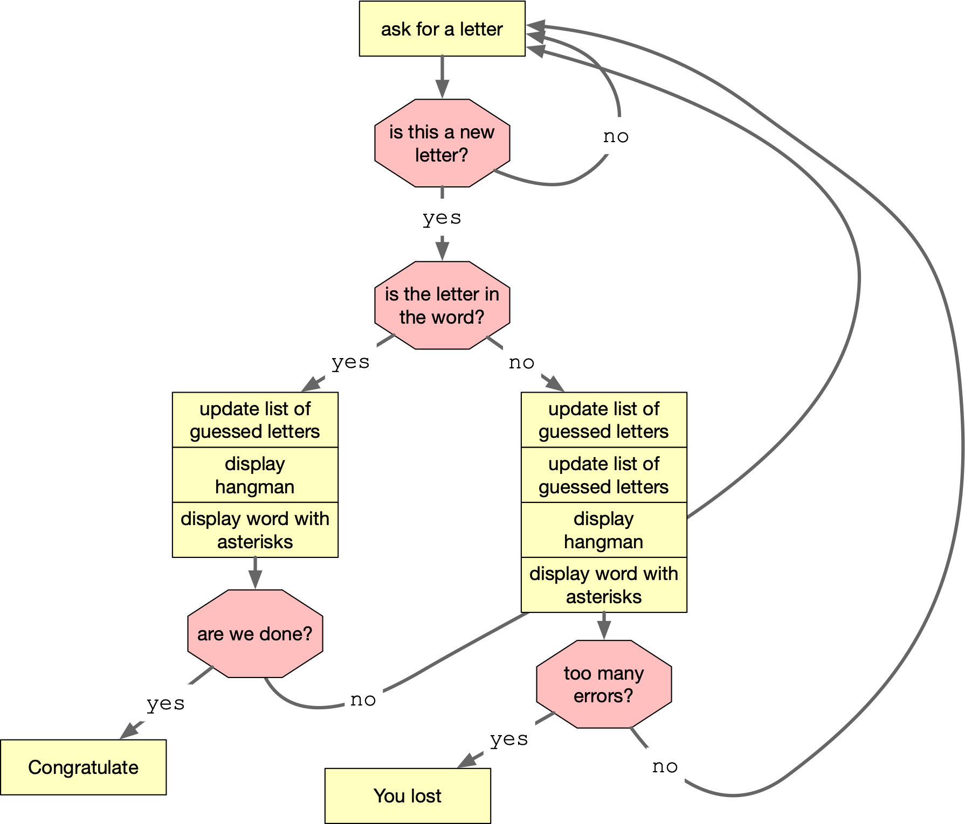
Hangman — Ahorcado

Slide 16
Hangman — Ahorcado
Observation:
  We need a list of guessed letters to decide whether this is a letter
  We need to do more input control
    User enters digit
    user enters capital letters
    …

Slide 17
Hangman — Ahorcado
All of the yellow boxes are candidates for functions
We can see some common data:
  The secret word
  The list of guessed letters
  The number of bad guesses

Slide 18
Hangman — Ahorcado
We can also see that at the heart is a giant loop
Python-style:
  Make the loop an infinite loop
  Break out

Slide 19
Hangman — Ahorcado
A word about diagrams:
  Programming has become a lot easier over the years
    So we program more difficult things
    And focus has shifted
  Some methods are very data-centric
    Useful for big data implementation or graphics, e.g.
  Some methods focus on processing
    As we just did

Slide 20
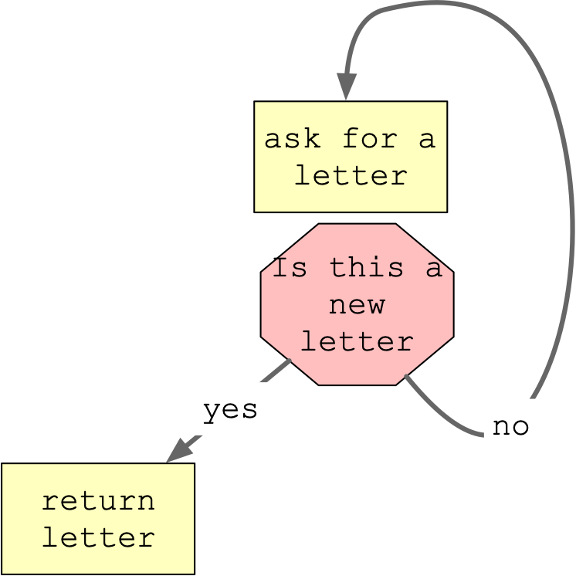
Hangman — Ahorcado
"Enter a letter" function:
  Needs one parameter: list of guessed letters
  Should do error checking (homework / project)
  Returns a letter not previously seen

Slide 21
Hangman — Ahorcado
def get_letter(lol):
while True:
x = input('Enter a letter ')
x = x[0]
if x in lol:
print('This letter is already guessed. Try again.')
else:
return x

Slide 22
Hangman — Ahorcado
Check whether we are done
  All the letters in the secret are in the list of letters already guessed (lol)
def done(lol, secret):
for letter in secret:
if letter not in lol:
return False
return True

Slide 23
Hangman — Ahorcado
Print out the hangman: An exercise in ASCII art
Enter a letter a
+------+
| |
|
|
|
|
|
|
|
|
Good job. The word is *******a

Slide 24
Hangman — Ahorcado
Enter a letter b
+------+
| |
|
|
|
|
|
|
|
|
Good job. The word is *****b*a

Slide 25
Hangman — Ahorcado
Enter a letter d
+------+
| |
| o
|
|
|
|
|
|
|
Not quite. The word is c****b*a

Slide 26
Hangman — Ahorcado
Enter a letter e
+------+
| |
| o
| |
|
|
|
|
|
|
|
Not quite. The word is c****b*a

Slide 27
Hangman — Ahorcado
Enter a letter f
+------+
| |
| o
| /|
|
|
|
|
|
|
|
Not quite. The word is c****b*a

Slide 28
Hangman — Ahorcado
Enter a letter g
+------+
| |
| o
| /|\
|
|
|
|
|
|
|
Not quite. The word is c****b*a

Slide 29
Hangman — Ahorcado
Enter a letter h
+------+
| |
| o
| /|\
| /
|
|
|
|
|
|
Not quite. The word is c****b*a

Slide 30
Hangman — Ahorcado
Enter a letter i
+------+
| |
| o
| /|\
| /
|
|
|
|
|
|
Good job. The word is c****bia

Slide 31
Hangman — Ahorcado
Enter a letter j
+------+
| |
| o
| /|\
| / \
|
|
|
|
|
|
you looser you

Slide 32
Hangman — Ahorcado
"printing the hangman"
  Two possibilities:
    Draw the same string with slight changes for different number of false guesses
    Draw different strings (using copy and paste)
  Can use multi-dimensional strings
    or use string arithmetic (which becomes unreadable)

Slide 33
def print_it(n):
if n <= 0:
print(5*' ' +'+------+\n' + 5*' ' +'| |\n' + 8*(5*' '+'|\n'))
elif n == 1:
print(5*' ' +'+------+\n' + 5*' ' +'| |\n'
+5*' '+'| o\n' +7*(5*' '+'|\n'))
elif n == 2:
print(5*' ' +'+------+\n' + 5*' ' +'| |\n'
+5*' '+'| o\n' ++5*' '+'| |\n'
+7*(5*' '+'|\n'))
elif n == 3:
print(5*' ' +'+------+\n' + 5*' ' +'| |\n'
+5*' '+'| o\n' + 5*' '+'| /|\n'
+7*(5*' '+'|\n'))
elif n == 4:
print(5*' ' +'+------+\n' + 5*' ' +'| |\n'
+5*' '+'| o\n' + 5*' '+'| /|\\ \n'
+7*(5*' '+'|\n'))
elif n == 5:
print(5*' ' +'+------+\n' + 5*' ' +'| |\n'
+5*' '+'| o\n' + 5*' '+'| /|\\ \n'
+5*' '+'| / \n'
+6*(5*' '+'|\n'))
elif n == 6:
print(5*' ' +'+------+\n' + 5*' ' +'| |\n'
+5*' '+'| o\n' + 5*' '+'| /|\\ \n'
+5*' '+'| / \ \n'
+6*(5*' '+'|\n'))

Slide 34
Hangman — Ahorcado
Now we are ready for the game:
  First, define the data structures
def game():
secret = 'colombia'
lol = []
false_guesses = 0
…

Slide 35
Hangman — Ahorcado
Then start the while loop:
def game():
secret = 'colombia'
lol = []
false_guesses = 0
while True:
…

Slide 36
Hangman — Ahorcado
First, get the letter and do not forget to update your list of guessed letters (lol)
We have hidden some logic in get_letter
while True:
x = get_letter(lol)
lol.append(x)

Slide 37
Hangman — Ahorcado
If the letter is a good guess:
  Print hangman and word, then check whether we are done
if x in secret:
print_it(false_guesses)
if done(lol, secret):
print('You won')
break
else:
print('Good job. The word is', display(secret, lol))

Slide 38
Hangman — Ahorcado
If the letter is bad:
  update false guesses
  print hangman
  decide on whether we lost
if x not in secret:
false_guesses += 1
print_it(false_guesses)
if false_guesses >= 6:
print("you looser you")
break
else:
print('Not quite. The word is', display(secret, lol))

Slide 39
Hangman — Ahorcado
Notice: We could have used return in order to get out of the loop

Slide 40
def game():
secret = 'colombia'
lol = []
false_guesses = 0
while True:
x = get_letter(lol)
lol.append(x)
if x in secret:
print_it(false_guesses)
if done(lol, secret):
print('You won')
break
else:
print('Good job. The word is', display(secret, lol))
if x not in secret:
false_guesses += 1
print_it(false_guesses)
if false_guesses >= 6:
print("you looser you")
break
else:
print('Not quite. The word is', display(secret, lol))

