Slide 1
Practice Week 3
Encryptions

Slide 2
How to Process Files
We open a file for reading
We open a file for writing
We read the file line by line and process all the data
Then we write the processed data to another file
Alternatively, we print out the results

Slide 3
Today: Some simple cryptography
Cryptography has been around for more than 2000 years
Computers have had a big impact on cryptography and vice versa
Here: Use two simple codes and break them
  Take a text
  Convert the text to only upper letters and suppress punctuation marks
  Use the substitution code on the result

Slide 4
How to Process a String
Task:
  Given a string, remove all punctuation marks and white spaces and make the text upper only
  Hint: instead of typing the alphabet, you can use ascii_letters and digits

Slide 5
How to Process a String
We can import directly from string
We use the standard pattern: Create a result array and add to it selectively
from string import ascii_letters, digits

Slide 6
How to Process a String
from string import ascii_letters, digits
def process(string):
result = [ ]
for letter in string:
if letter in ascii_letters or letter in digits:
result.append(letter.upper())
return ''.join(result)

Slide 7
How to Process a String
This has an error. Can you spot it?
from string import ascii_letters, digits
def process(string):
result = [ ]
for letter in string:
if letter in ascii_letters or digits:
result.append(letter.upper())
return ''.join(result)

Slide 8
How to Process a String
This has an error. Can you spot it?
digits is not zero and always true
All letters are added to result
from string import ascii_letters, digits
def process(string):
result = [ ]
for letter in string:
if letter in ascii_letters or digits:
result.append(letter.upper())
return ''.join(result)

Slide 9
How to Process a String
This concatenates the letters and digits string and works
from string import ascii_letters, digits
def process(string):
result = [ ]
for letter in string:
if letter in ascii_letters+digits:
result.append(letter.upper())
return ''.join(result)

Slide 10
Substitution Cipher
Replace every letter with another letter
Classic use case for a dictionary
  Generate a random dictionary that uses random.shuffle to shuffle a list
  The upper letters are in strings.ascii_uppercase
  Then create the translation dictionary

Slide 11
Substitution Cipher
To permute the list of letters:
let = list(ascii_uppercase)
random.shuffle(let)

Slide 12
Substitution Cipher
How to make a dictionary out of it?
  Comprehension
substitution = { ascii_uppercase[i]:let[i] for i in range(len(let))}

Slide 13
Substitution Cipher
How to make a dictionary out of it?
  comprehension and zipping
substitution2 = { x[0]:x[1] for x in zip(list(ascii_uppercase), let) }

Slide 14
Substitution Cipher
How to make a dictionary out of it?
  Comprehension and enumerate
substitution3 = { letter:let[i] for i, letter in enumerate(ascii_uppercase) }

Slide 15
Substitution Cipher
How to make a dictionary out of it?
  Comprehension and using dict
substitution4 = dict(zip(ascii_uppercase, let))

Slide 16
Substitution Cipher
Using a key to generate the dictionary
  Idea: take a string "LOYOLA COLLEGE"
  Then A->L, B->O, C->Y, D->?
    Skip O and L
  D->A, E->E, F->G, and then?
  H -> next free letter:
  H->B, I->D, J->F, K->I, L->J, M->K, N->M, …
ABCDEFGHIJKLMNOPQRSTUVWXYZ

Slide 17
Substitution Cipher
How to solve this:
  Make a list of possible choices by concatenating the list of letters in the key and all letters
  Assign the first letter to 'A'
['L', 'O', 'Y', 'O', 'L', 'A', 'C', 'O', 'L', 'L', 'E', 'G', 'E', 'A', 'B', 'C', 'D', 'E', 'F', 'G', 'H', 'I', 'J', 'K', 'L', 'M', 'N', 'O', 'P', 'Q', 'R', 'S', 'T', 'U', 'V', 'W', 'X', 'Y', 'Z']

Slide 18
Substitution Cipher
How to solve this:
  Then remove this letter from the list:
[ele for ele in choices if ele != retval[letter]]
['O', 'Y', 'O', 'A', 'C', 'O', 'E', 'G', 'E', 'A', 'B', 'C', 'D', 'E', 'F', 'G', 'H', 'I', 'J', 'K', 'M', 'N', 'O', 'P', 'Q', 'R', 'S', 'T', 'U', 'V', 'W', 'X', 'Y', 'Z']

Slide 19
Substitution Cipher
Complete code:
def make_dict(key):
retval = { }
choices = list(key)+list(ascii_uppercase)
for letter in ascii_uppercase:
print(choices)
retval[letter] = choices[0]
choices = [ele for ele in choices if ele != retval[letter]]
return retval

Slide 20
Substitution Cipher
How to encode a whole book:
  Write a function that takes a line and applies the dictionary to it
  Write a function that opens the book for reading and an output-file for writing
    Take all lines
    Translate the lines
    Print the translated line to the file

Slide 21
Substitution Cipher
def translate(line, dictionary):
result = [ ]
for letter in line:
if letter in digits:
result.append(letter)
else:
result.append(dictionary[letter])
return ''.join(result)

Slide 22
Substitution Cipher
def encode(infile, key):
mydict = make_dict(key)
with open(infile) as infile, open('output.txt','w') as outfile:
for line in infile:
line = process(line)
new_line = translate(line, mydict)
print(new_line, file = outfile)

Slide 23
Substitution Cipher
How to decode?
  Use the same procedure, but with the reversed dictionary

Slide 24
Substitution Cipher
revdict = { mydict[letter]:letter for letter in mydict }

Slide 25
Substitution Cipher
def decode(infile, outfile, key):
mydict = make_dict(key)
revdict = { mydict[letter]:letter for letter in mydict }
with open(infile) as inputfile, open(outfile, 'w') as outputfile:
for line in inputfile:
line = line.strip()
new_line = translate(line, revdict)
print(new_line, file = outputfile)

Slide 26
Substitution Cipher
How to break a substitution cipher?
  Just do a frequency analysis
    Open the encoded file and use a dictionary to count the letters

Slide 27
Substitution Cipher
def get_frequencies(filename):
count = {letter:0 for letter in ascii_uppercase}
with open(filename) as infile:
for line in infile:
for letter in line:
if letter in count:
count[letter]+=1
total = sum(list(count.values()))
for letter in ascii_uppercase:
print(letter, ' : ', count[letter]/total*100)

Slide 28
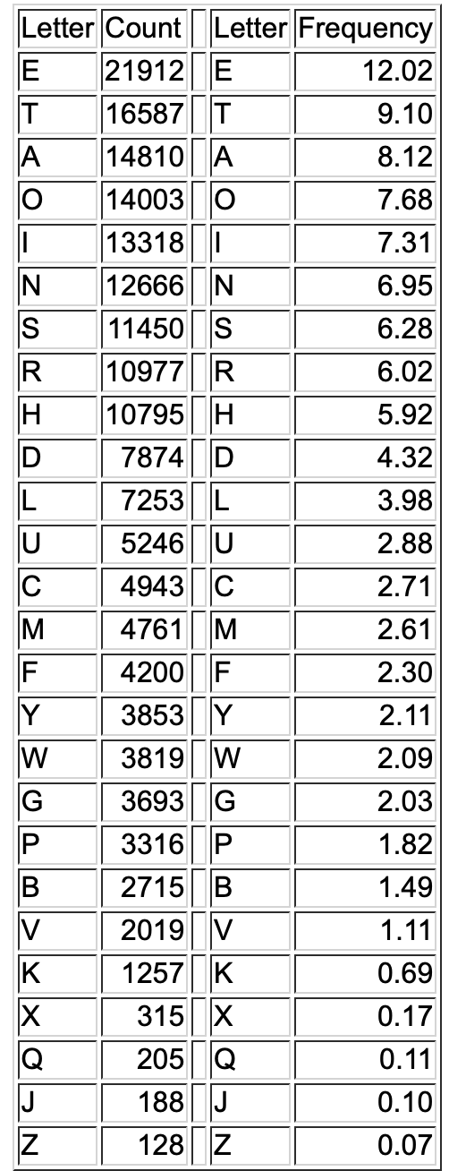
Substitution Cipher
The frequency of letters is reasonably constant over texts in the same language

Slide 29
Substitution Cipher
A : 1.3285085277595021
B : 6.941140745989169
C : 0.134116098992864
D : 4.458727668404271
E : 1.973784098385546
F : 6.518548509539956
G : 7.5408674528063155
H : 1.3538134520977783
I : 4.605496229566273
J : 0.21509185687534796
K : 5.159674072574523
L : 1.9408876967457867
M : 6.1415051368996405
N : 8.522698517131435
O : 12.725846449719116
P : 2.3660104256288275
Q : 9.671542082089173
R : 1.0552153449061188
S : 2.917657776203249
T : 2.3584189483273446
U : 6.807024646996306
V : 0.751556252846804
W : 2.495065539754036
X : 0.11640265195607066
Y : 1.8194240599220608
Z : 0.08097575788248393

Slide 30
Caesar Cipher
A simple form of a substitution cipher
  Each letter is moved to the letter x spots away
    Example: x=5
    A->F, B->G, C->H, D->I, …
      When you reach 'Z', start with 'A' again:
    U->Z, V->A, W->B, X->C, Y->D, Z->E

Slide 31
Caesar Cipher
We can use two built in functions that associate a letter with its encoding
>>> ord('य')
2351
>>> chr(2351)
'य'

Slide 32
Caesar Cipher
The encoding reflects the ordering of the alphabet.
  To get the letter 5 steps afterwards:
>>> def trans(character):
return chr(ord(character)+5)
>>> trans('g')
'l'
>>> trans('य')
'ऴ'
>>>

Slide 33
Caesar Cipher
The uppercase letters in the English alphabet are between ord('A') and ord('Z'), i.e. between 65 and 90
  Implement the Caesar Cipher

Slide 34
Caesar Cipher
def translate(letter, offset):
number = ord(letter)-65
new_number = number+offset
if new_number > 25:
new_number -=26
return chr(new_number+65)

