Slide 1
Week 4 Practice

Slide 2
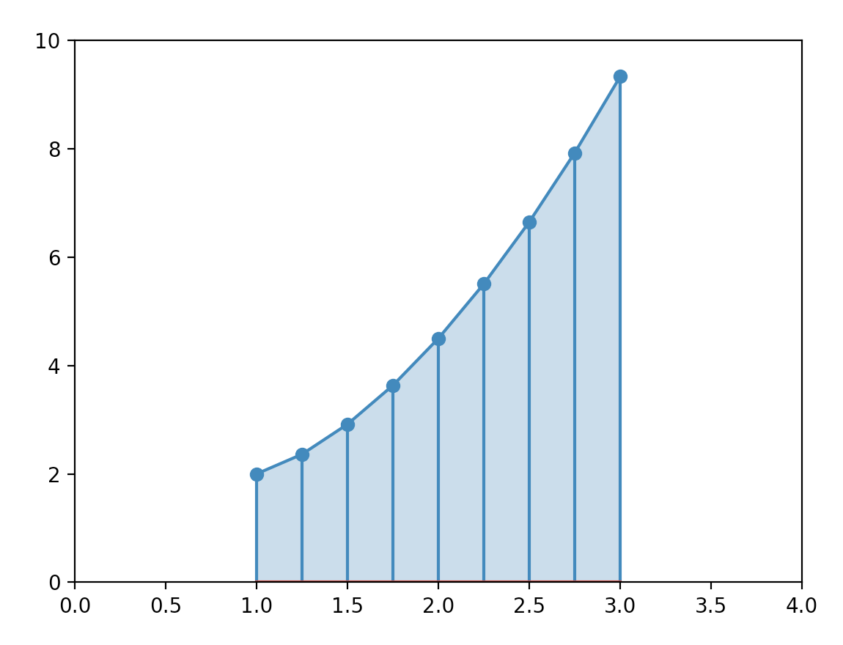
Numerical Integration
How to calculate a one-dimensional integral?

Slide 3
Numerical Integration
How to calculate a one-dimensional integral?
  $$∫_{a}^{b}f(x)dx$$
    Approximate with trapezoids

Slide 4
Numerical Integration
We calculate the weighted average (first and last point get half weight) of $n+1$ points at distance $\frac{b-a}{n}$
And multiply by $(b-a)$

Slide 5
Numerical Integration
def integral(function, low, up, nr_pts):
delta = (up-low)/(nr_pts-1)
func_vals = [function(low + i*delta) for i in range(nr_pts)]
return (sum(func_vals)+sum(func_vals[1:-1]))/2*delta

Slide 6
Scrabble Values

Slide 7
Scrabble Values
Players place tiles with letters on a board to form a word
The word is scored by letter value
  1 Point - A, E, I, L, N, O, R, S, T and U.
  2 Points - D and G.
  3 Points - B, C, M and P.
  4 Points - F, H, V, W and Y.
  5 Points - K.
  8 Points - J and X.
  10 Points - Q and Z.

Slide 8
Curse of Dimensionality

Slide 9
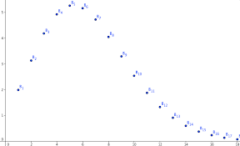
Curse of Dimensionality
As the dimensions increase, our intuition will leave us
  As the dimension increase, the volume of a unit-sphere goes down

Slide 10
Simple Case Study
Thomas Schwarz, SJ

Slide 11
Data Analytics Process
Discovery phase: what data do we need
Data preparation phase: Cleaning
Modeling planning phase: how to go about dealing with the data
Model building phase: build the models
Communication phase
Operationalization: build process into production

Slide 12
Data Gathering
Use Kaggle as a source of data
  https://www.kaggle.com/paultimothymooney/denver-crime-data/
  This is a huge file.

Slide 13
Understanding the Data
Read supporting information
Look at the first lines of the file
  There is a heading and examples
def head():
with open('crime.csv') as infile:
for _ in range(10):
print(infile.readline())

Slide 14
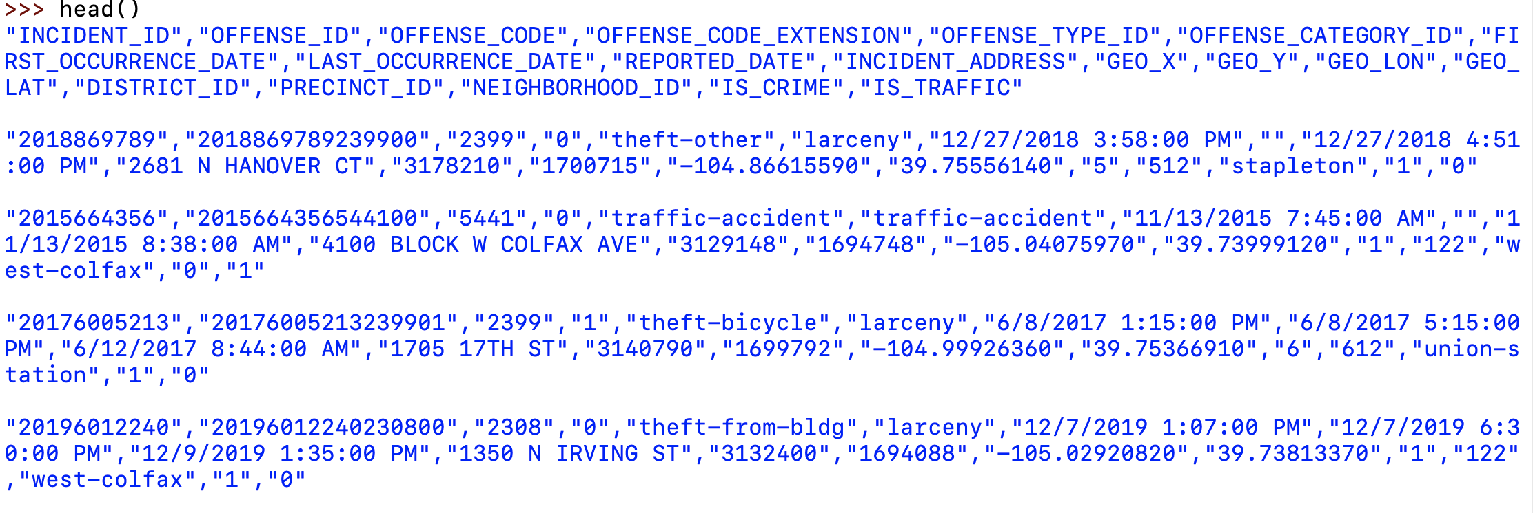
Understanding the Data

Slide 15
Transforming the data
We can look at the headers
  "INCIDENT_ID","OFFENSE_ID","OFFENSE_CODE","OFFENSE_CODE_EXTENSION","OFFENSE_TYPE_ID","OFFENSE_CATEGORY_ID","FIRST_OCCURRENCE_DATE","LAST_OCCURRENCE_DATE","REPORTED_DATE","INCIDENT_ADDRESS","GEO_X","GEO_Y","GEO_LON","GEO_LAT","DISTRICT_ID","PRECINCT_ID","NEIGHBORHOOD_ID","IS_CRIME","IS_TRAFFIC"

Slide 16
Transforming the data
Notice what we could do:
  The incidents are geo-coded
    We can use this to overlay data points on a map of Denver
    We can determine influence of neighborhood on crimes
    We will wait with this until we understand matplotlib better
  The incidents are time-stamped
    We can look at the relationship between time and incidents

Slide 17
Transforming the data
Dealing with time stamps
  Core Python has a datetime module that allows us to create and calculate with dates and times
  Comes with a strptime( ) methods that needs a description of the format
    This is because there are lot of different time formats
      The am/pm format is one of the worst

Slide 18
Transforming the data
In our case:
  The relevant time is the first time stamp in column 6
    This took quite a while to get right
dati = datetime.strptime(contents[6], "\"%m/%d/%Y %I:%M:%S %p\"")

Slide 19
Transforming the data
We can also do so 'manually':
def translate(hour, ampm):
hour = int(hour)
if hour == 12 and ampm == 'AM':
return 0
if hour == 12 and ampm == 'PM':
return 12
if ampm == 'PM':
return hour
else:
return hour+12

Slide 20
Transforming the data
def getdate(astring):
astring = astring.strip('"')
date, time, ap = astring.split()
month, day, year = date.split('/')
hour, minute, second = time.split(':')
#print(year, month, day, hour, minute, second)
return datetime(int(year),
int(month),
int(day),
translate(hour, ap),

Slide 21
Selecting the Data
Assume we only want to look at traffic problems in Denver
  First question: When do traffic accidents happen?
    Notice: Presumably winter weather (snow & ice) are important, so we should distinguish between winter month and the rest of the year
  We look up the offense code and find that all traffic related incidents have codes between 15

Slide 22
Selecting the Data
Write down all time stamps of traffic related incidents
def select_vehicular():
traffic = []
with open('crime.csv') as infile:
infile.readline()
for line in infile:
contents = line.split(',')
dati = getdate(contents[6])
code = int(contents[2].strip('"'))
if 5400 <= code <= 5499:
traffic.append(dati)
return traffic

Slide 23
Selecting the Data
Determine number of accidents during a given hour at a given week-day
A datetime object allows us access to the week-day and the hour
    One is a method, the other a field
Can use the Counter object in collections
  Because there is no need to initialize a dictionary
item.weekday()
item.hour

Slide 24
Selecting the Data
Create seven counters
  For each item (a datetime) in the traffic incident list:
    Update the counter
def process_traffic(traffic):
weekdays = [Counter() for i in range(7)]
for item in traffic:
weekdays[item.weekday()][item.hour]+=1
return weekdays

Slide 25
Displaying the Data
From within Pyhton, use matplotlib
  Developed from matlab interface with many add-ons
  If you use IDLE, need to say plt.show( ) at the end
    This will show all plot elements that you created
import matplotlib.pyplot as plt

Slide 26
Displaying the Data
Pyplot supports many different types of graphs
  We use mostly scatter and plot
  There is even support for three-dimensions

Slide 27
Displaying the Data
Create a figure with plt.figure( )
Create several line-plot elements using
  plt.plot(x-data, y-data)
  Can add a legend as a named parameter
  But we need to place the legend then
    plt.legend(loc='upper left')

Slide 28
Displaying the Data
def show(counters):
weekday = ['Monday', 'Tuesday', 'Wednesday', 'Thursday',
'Friday', 'Saturday', 'Sunday']
f = plt.figure()
for i, counter in enumerate(counters):
hours = [i for i in range(24)]
numbers = [counter[i] for i in range(24)]
s = plt.plot(hours, numbers, label=weekday[i])
plt.legend(loc='upper left')
plt.show()

