Slide 1
6th Week
Review
Thomas Schwarz, SJ

Slide 2
Topics
Babynames homework
Numpy arrays
Loading from text
Indexing
Extracting Information
Application: Simple recursion

Slide 3
Babynames
Tasks:
Find / open files, extract year from the file name
Find the data in each file and add to a data structure
Use the data structure in order to display result
Note:
You could add more files to the directory, so we cannot assume that the years are fixed

Slide 4
Babynames
Finding all files
We are interested in html files in a directory
Use os
>>> import os
>>> os.listdir('/Users/thomasschwarz/Documents/My website/Classes/PDS2021/Babynames')
['baby2004.html', 'baby2012.html', 'baby2008.html', 'baby1998.html', 'baby1982.html', 'baby1994.html', 'baby2002.html', 'baby2014.html', 'baby1984.html', 'baby1992.html', 'baby1988.html', 'baby2016.html', 'baby2000.html', 'baby1990.html', 'baby1986.html', 'baby2010.html', 'baby2006.html', 'baby1996.html', 'baby1980.html']

Slide 5
Babynames
We can also filter for the extension
Please get used to comprehension:
It is used in many data science scripts
def get_files(directory_name):
file_names = [file for file in
os.listdir(directory_name)
if file.endswith('.html')]
return file_names

Slide 6
Babynames
We need to extract the year from the file name
A typical file name
We are looking at:
the last four letters before the dot
or: letters 4-8
def get_year(filename):
return int(filename.split('.')[0][-4:])

Slide 7
Babynames
Deciding on a data structure
We want to answer queries on popularity of a name
Or even draw it
>>> display(dd, yy, 'thomas')
1980 25
1982 23
1984 25
1986 26
1988 23
1990 26
1992 27
1994 27
1996 28
1998 31
2000 33
2002 36
2004 37
2006 51
2008 52
2010 62
2012 63
2014 54
2016 48
>>> display(dd, yy, 'emil')
1980 955
1982 995
1984 969
1986 not ranked
1988 not ranked
1990 not ranked
1992 not ranked
1994 not ranked
1996 not ranked
1998 not ranked
2000 not ranked
2002 not ranked
2004 not ranked
2006 not ranked

Slide 8
Babynames
My answer:
Get a list of years
Get a dictionary that associates a name with a dictionary year —> ranking

Slide 9
Babynames
Extracting Information from the file
Need to look at a file
All information is in an html table
<tr align="right">
<td>1</td> <td>Michael</td> <td>Jessica</td>
</tr>
<tr align="right">
<td>2</td> <td>Christopher</td> <td>Ashley</td>
</tr>
<tr align="right">
<td>3</td> <td>Matthew</td> <td>Emily</td>
</tr>
<tr align="right">
<td>4</td> <td>Joshua</td> <td>Samantha</td>

Slide 10
Babynames
Relevant pattern:
<td>rank</td> <td>male_name</td> <td>female_name</td>
Split on the empty space!
Check that this gives a list of three instances
<tr align="right">
<td>1</td> <td>Michael</td> <td>Jessica</td>
</tr>
<tr align="right">
<td>2</td> <td>Christopher</td> <td>Ashley</td>
</tr>
<tr align="right">

Slide 11
Babynames
for line in infile:
if line.strip().startswith("<td>"):
items = line.split()
if len(items)==3:
We extract based on the items
And add / create to the dictionary
rank = items[0][4:-5]
male = items[1][4:-5].lower()
female = items[2][4:-5].lower()
if male not in result:
result[male] = {year: rank}
else:
result[male][year] = rank

Slide 12
Babynames
Display:
Notice: get allows to specify a default value
def display(dictionary, years, name):
if name not in dictionary:
print('never ranked')
else:
for year in years:
print(year, dictionary[name].get(year,'not ranked'))

Slide 13
Babynames
How to make a plot:
Create a figure and an axis object
import matplotlib.pyplot as plt
import numpy as np
dd, yy = create_dictionary('Babynames')
fig = plt.figure()
axes = fig.add_subplot()
axes.set_ylim(1000, 0)

Slide 14
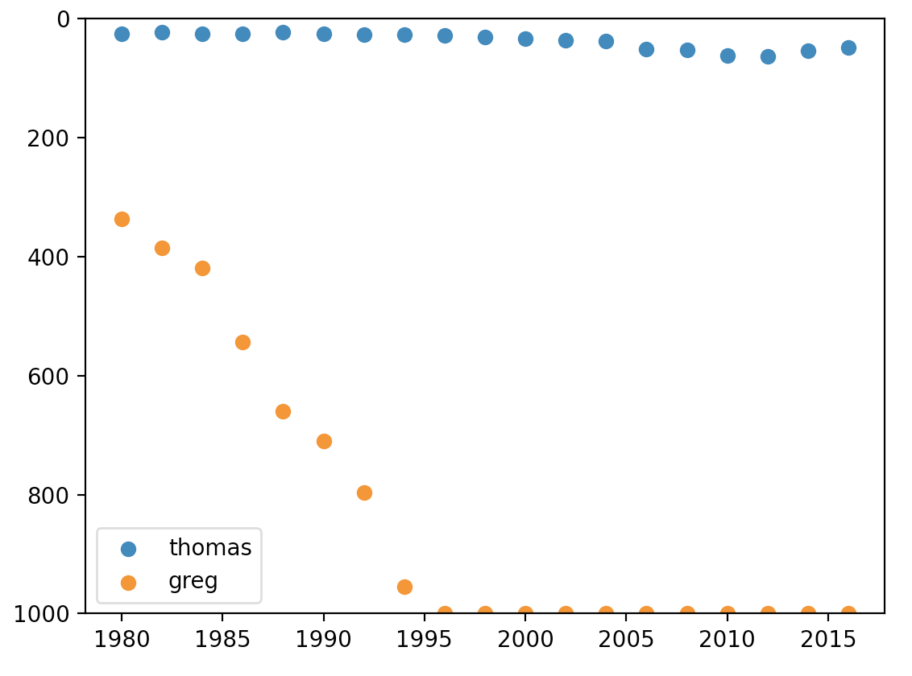
Babynames
Provide a scatter plot by calling the dictionary
And plot the values
axes.scatter(yy, [int(dd['thomas'].get(year, 1000))
for year in yy], label='thomas')
axes.scatter(yy, [int(dd['greg'].get(year, 1000))
for year in yy], label='greg')

Slide 15
Penguins
The Iris data set has been over-analyzed
and published in a Eugenics journal
So, there is an alternative:
Allison Horst collected penguin data from
Gorman, Williams, and Fraser (2014)
Palmer Island Station
https://allisonhorst.github.io/palmerpenguins/

Slide 16
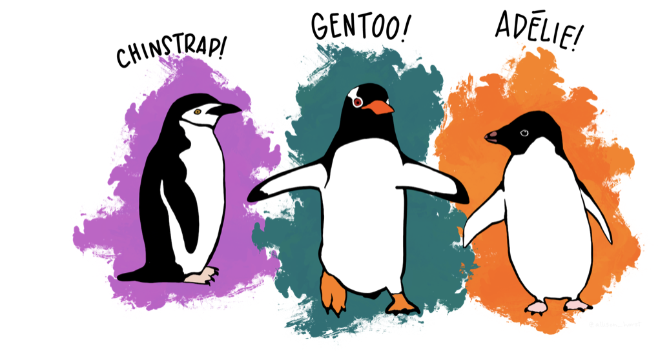
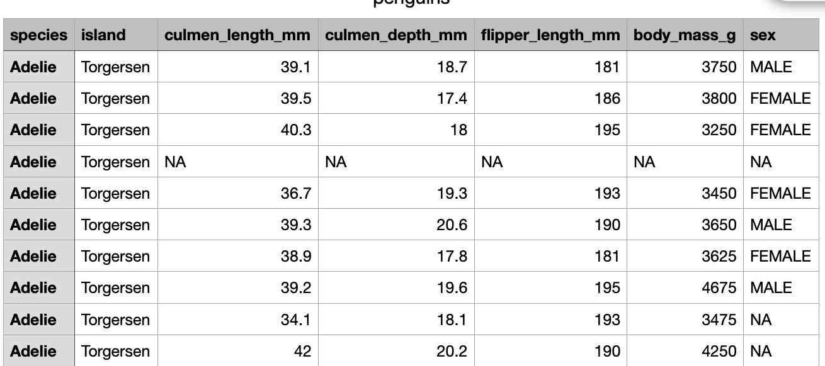
Penguins
I publish the data set as a csv file
Need to import it with loadtext
Which is not easy
Artwork by @allison_horst.

Slide 17
Penguins
We skip over the island (column 1)
We code species and sex using converters
converters={
0: lambda astring: (0 if astring == 'Adelie' else 1 if
astring == 'Chinstrap' else 2),
6: lambda astring: (0 if astring == 'MALE' else 1 if astring == 'FEMALE' else 2)
}

Slide 18
Penguins
This means column 0 and 6 are integers, the rest is float
np.genfromtxt(
'penguins.csv',
usecols=(0,2,3,4,5,6),
dtype = [('type','>i4'), ('cl',float), ('cd', float),
('fl',float), ('bm', float), ('sex', '>i4')],
encoding = None,
delimiter = ',',
converters = converters,
skip_header=1))

Slide 19
Penguins
Now we get rid of rows with a NAN value in them
isnan is the numpy function
We can use .any / .all to specify whether one or more or all are NAs
This is our boolean condition
The tilde indicates negation, because these are the value we want
~np.isnan(penguins).any(axis=1)
peng = penguins[~np.isnan(penguins).any(axis=1),]

Slide 20
Penguins
Now let's use only Adelie penguins
First column has a 0 in it
Boolean condition is
We select:
And throw away column 0 (axis = 1 because column)
peng[:,0]==0
peng[peng[:,0]==0]
adelie = np.delete(peng[peng[:,0]==0], 0,
axis = 1)

Slide 21
Penguins
Now we can calculate things:
Mean values by hand
Recall that shape[0] is the number of rows
def get_mean(array):
return [np.sum(array[:,i])/array.shape[0] for
i in range(array.shape[1])]

Slide 22
Penguins
We can also use the np.mean function
Where we need to specify the axis, depending on whether we want to get the mean of columns or of rows
>>> get_mean(adelie)
[38.79139072847682, 18.34635761589404, 189.95364238410596, 3700.662251655629, 0.5496688741721855]
>>> np.mean(adelie, axis=0)
array([3.87913907e+01, 1.83463576e+01, 1.89953642e+02, 3.70066225e+03, 5.49668874e-01])

Slide 23
Penguins
Calculate the variance $(\overset{n}{\underset{i=1}{∑}}(x_{i}-\overline{x})^{2})/n$
Or better: the sample variance $(\overset{n}{\underset{i=1}{∑}}(x_{i}-\overline{x})^{2})/(n-1)$
def get_var(array):
result = []
for i in range(array.shape[1]):
mu = np.sum(array[:,i])/array.shape[0]
var = (np.sum( (array[:,i]-mu)**2 )
/ (array.shape[0]-1))
result.append(var)
return result

Slide 24
Penguins
Sample variance: ddof (degrees of freedom) = 1
>>> np.var(adelie, axis=0, ddof=1)
array([7.09372539e+00, 1.48023664e+00, 4.27645033e+01,
2.10282892e+05, 3.15849890e-01])

Slide 25
Penguins
Correlation between two columns x and y
$$\frac{∑_{i=1}^{n}(x_{i}-\overline{x})(y_{i}-\overline{y})}{\sqrt{(∑_{i=1}^{n}(x_{i}-\overline{x})^{2}∑_{i=1}^{n}(y_{i}-\overline{y})^{2}}}$$
def cov(array, i, j):
means = np.mean(array, axis=0)
numerator = np.sum( (array[:,i]-means[i])*
(array[:,j]-means[j]) )
var1 = np.sum( (array[:,i]-means[i])**2 )
var2 = np.sum( (array[:,j]-means[j])**2 )
return numerator/sqrt(var1*var2)

Slide 26
Penguins
Simple regression:
Two data sets X, Y
Assume $Y=βX+α+ϵ$
$α$ — intercept
$β$ — slope
$ϵ$ — error
Minimize the expectation of $ϵ^{2}$

Slide 27
Penguins
Turns out:
$$β=\frac{∑_{i=1}^{n}(X_{i}-\overline{X})⋅(Y_{i}-\overline{Y})}{∑_{i=1}^{n}(X_{i}-\overline{X})^{2}}$$
$$α=\overline{Y}-β\overline{X}$$

Slide 28
Penguins
Thus:
def slope(array, i, j):
means = np.mean(array, axis=0)
numerator = np.sum( (array[:,i]-means[i])*
(array[:,j]-means[j]) )
denominator = np.sum( (array[:,i]-means[i])**2 )
return numerator / denominator

Slide 29
Penguins
And:
def intercept(array, i, j):
beta = slope(array, i, j)
means = np.mean(array, axis=0)
return means[j]-beta*means[i]

Slide 30
Penguins
To visualize:
Create a prediction function:
And a lin-space
def prediction(x):
return alpha + beta*x
plt.scatter(adelie[:,3], adelie[:,0])
X = np.linspace(np.min(adelie, axis=0)[3],
np.max(adelie, axis=0)[3],101)
plt.plot(X, prediction(X))
plt.show()

Slide 31
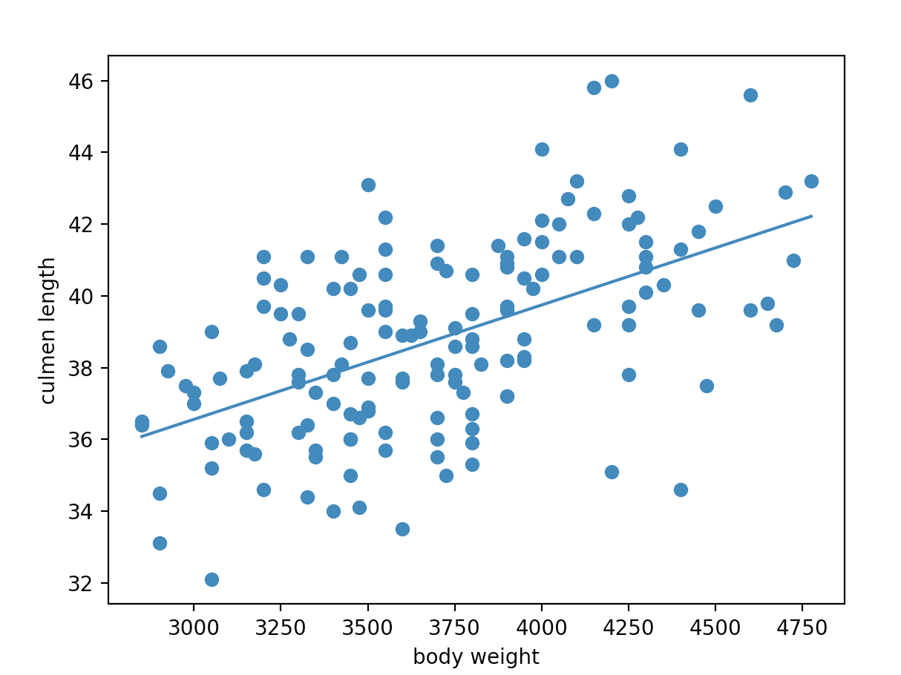
Penguins

