Slide 1
Practice

Slide 2
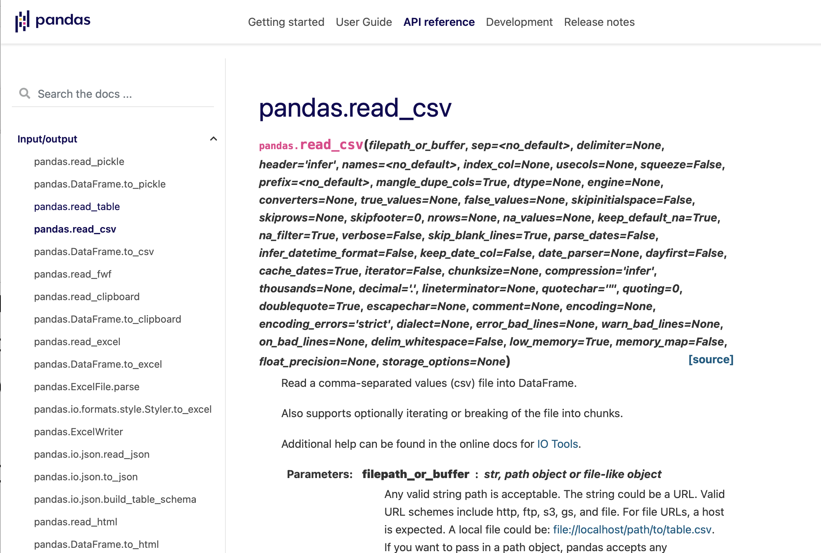
Penguins
Let's explore the penguins data set again
We now load in Pandas
How do we read a csv file?
Go to Pandas documentation

Slide 3
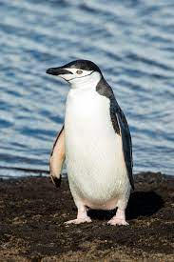
Penguins
Result:
Pandas does most of it
But there are bad values
Drop rows that have a single na in them
Chinstrap Penguin
penguins = pd.read_csv('../Week6Exercises/penguins.csv')
penguins.dropna(inplace=True)

Slide 4
Penguins
An inspection reveals a bad value
Can remove the row from the original file
Can remove rows with bad values
Adelie Penguin

Slide 5
Penguins
Need to get index of the offending row
Recall: Use a boolean inside a selection
Then remove the row with drop
Gentoo Penguin
bad_index = penguins[ penguins.sex == '.' ].index
penguins = penguins.drop(bad_index)

Slide 6
Penguins
Grouping: We want to group penguins by species
This is done with groupby
We can group by more than one column name
We can aggregate over the group:
penguins_by_species = penguins.groupby('species')
>>> penguins_by_species.mean()
culmen_length_mm culmen_depth_mm flipper_length_mm body_mass_g
species
Adelie 38.823973 18.347260 190.102740 3706.164384
Chinstrap 48.833824 18.420588 195.823529 3733.088235
Gentoo 47.568067 14.996639 217.235294 5092.436975

Slide 7
Penguins
We can plot using scatter
Import matplotlib.pyplot as plt
Can use color based on species
colors = {'Adelie':'red', 'Gentoo': 'blue', 'Chinstrap': 'green'}

Slide 8
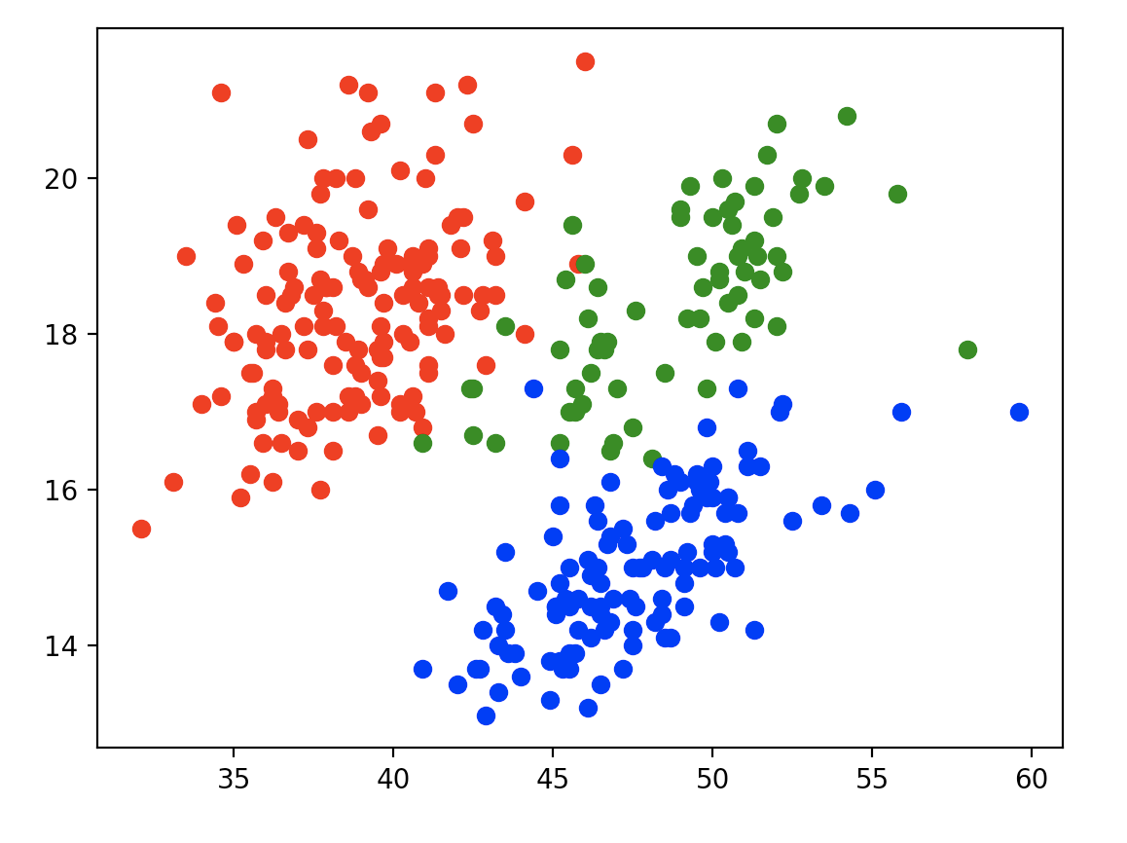
Penguins
for key, group in penguins_by_species:
plt.scatter(group.culmen_length_mm,
group.culmen_depth_mm,
color = colors[key])

Slide 9
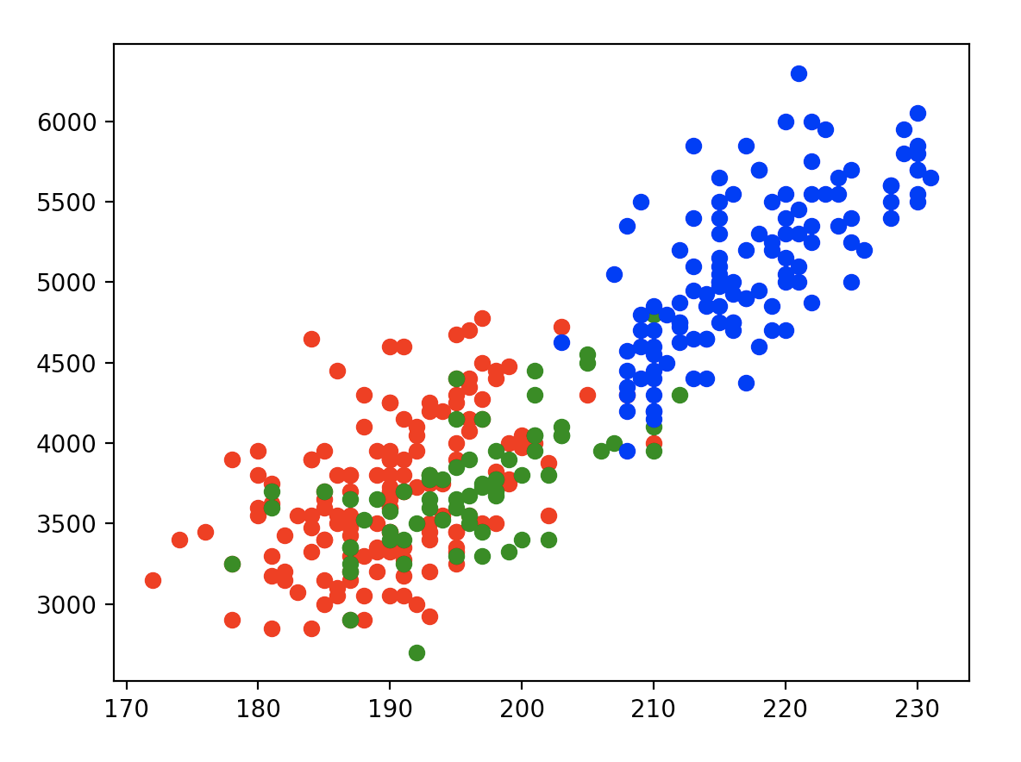
Penguins
for key, group in penguins_by_species:
plt.scatter(group.flipper_length_mm,
group.body_mass_g,
color = colors[key])
plt.show()

Slide 10
Penguins
We can group by more than one column
penguins_by_species_sex = penguins.groupby(['species', 'sex'])
print(penguins_by_species_sex.mean())
print(penguins_by_species_sex.std())

Slide 11
Penguins
culmen_length_mm culmen_depth_mm flipper_length_mm \
species sex
Adelie FEMALE 37.257534 17.621918 187.794521
MALE 40.390411 19.072603 192.410959
Chinstrap FEMALE 46.573529 17.588235 191.735294
MALE 51.094118 19.252941 199.911765
Gentoo FEMALE 45.563793 14.237931 212.706897
MALE 49.473770 15.718033 221.540984
body_mass_g
species sex
Adelie FEMALE 3368.835616
MALE 4043.493151
Chinstrap FEMALE 3527.205882
MALE 3938.970588
Gentoo FEMALE 4679.741379
MALE 5484.836066

Slide 12
Penguins
We can also do scatter diagrams
But now we need to look up a few more color names
colors = {('Adelie','MALE'): 'red',
('Adelie','FEMALE'):'tab:pink',
('Gentoo', 'MALE'): 'tab:blue',
('Gentoo', 'FEMALE'): 'blue',
('Chinstrap','MALE'): 'tab:green',
('Chinstrap','FEMALE'): 'green'}
for key, group in penguins_by_species_sex:
plt.scatter(group.flipper_length_mm, group.body_mass_g, color = colors[key])
plt.show()

Slide 13
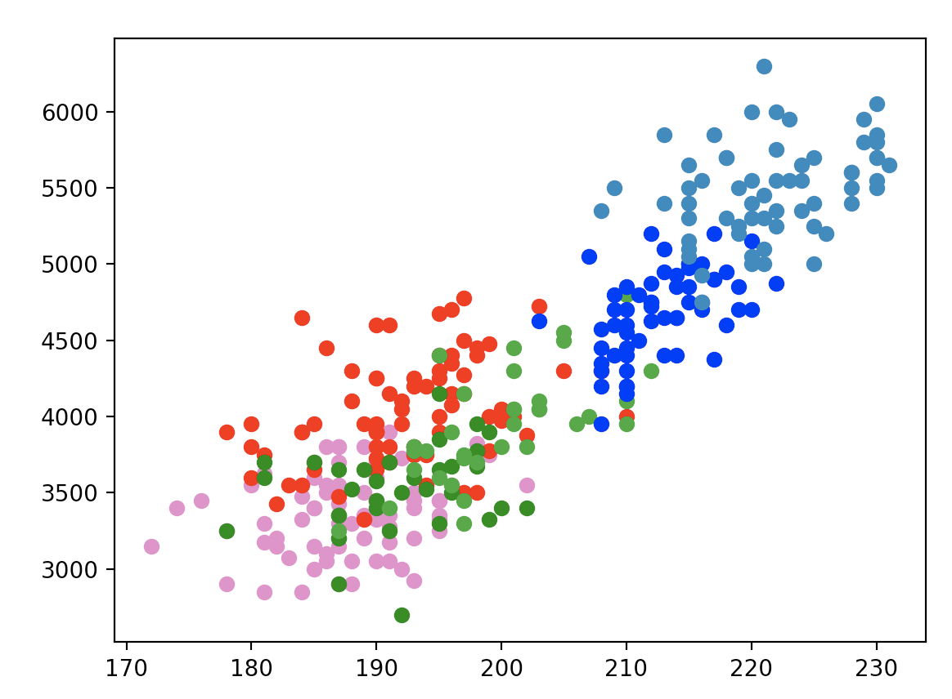
Penguins

Slide 14
Sunspots
Observed systematically with telescope in 16th century
Activity varies over history

Slide 15
Sunspots
Not the easy to make into a pandas data frame via read_csv
I found it easier to just build the frame via vanilla python
with open('sunspots.csv') as infile:
line = infile.readline()
headers = line.split()
data = []
for line in infile:
contents = line.split()
contents[2] = float(contents[2])
data.append(contents)

Slide 16
Sunspots
Import from a column name -> data array dictionary
Create a new column date
Drop existing columns Mon and Year
Reset the index
sunspots = pd.DataFrame({headers[i]:
[data[l][i] for l in range(len(data))] for i in range(3)})
sunspots['Date'] = pd.to_datetime(sunspots.Year+"/"+sunspots.Mon)
sunspots.drop(columns=['Mon', 'Year'], inplace = True)
sunspots.reset_index()
sunspots.set_index('Date', inplace=True)

Slide 17
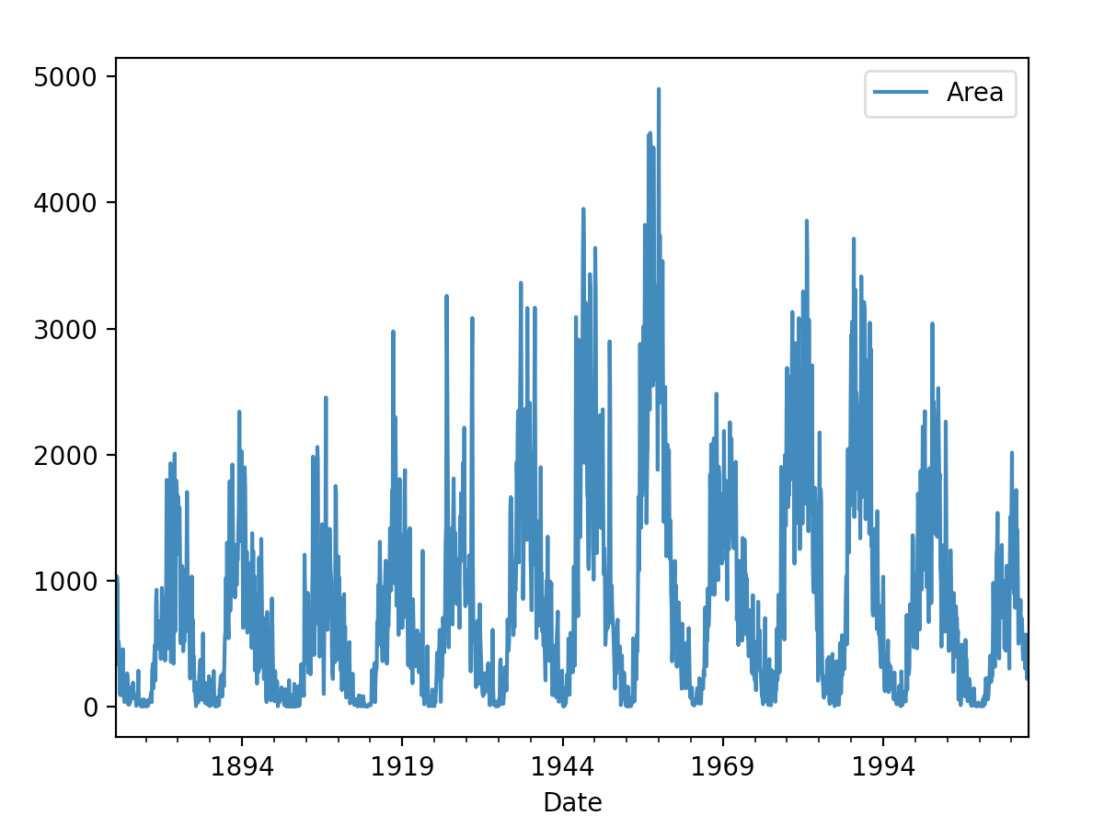
Sunspots
Pandas has very nice automatic graphing
sunspots.plot()
plt.show()

Slide 18
Sunspots
Make the area into an np.array
Use two models and try to fit
X = sunspots['Area'].values
def model1(t, alpha, beta, gamma, delta, epsilon, eta):
return alpha*beta*t+gamma*t**2+delta*t**3+epsilon*t**4+eta*t**5
def model2(t, alpha, beta, gamma, delta, epsilon, eta, phi):
return alpha+beta*np.sin(gamma*t+epsilon)+eta*t+phi*t**2

Slide 19
Sunspots
But the results of curve-fitting are not good
xs = np.arange(0, len(X))
par1, cov1 = opt.curve_fit(model1, xs, X)
par2, cov2 = opt.curve_fit(model2, xs, X)
plt.scatter(xs, X, s=1)
plt.plot(xs, model1(xs, *par1))
plt.plot(xs, model2(xs, *par2))
plt.show()

Slide 20
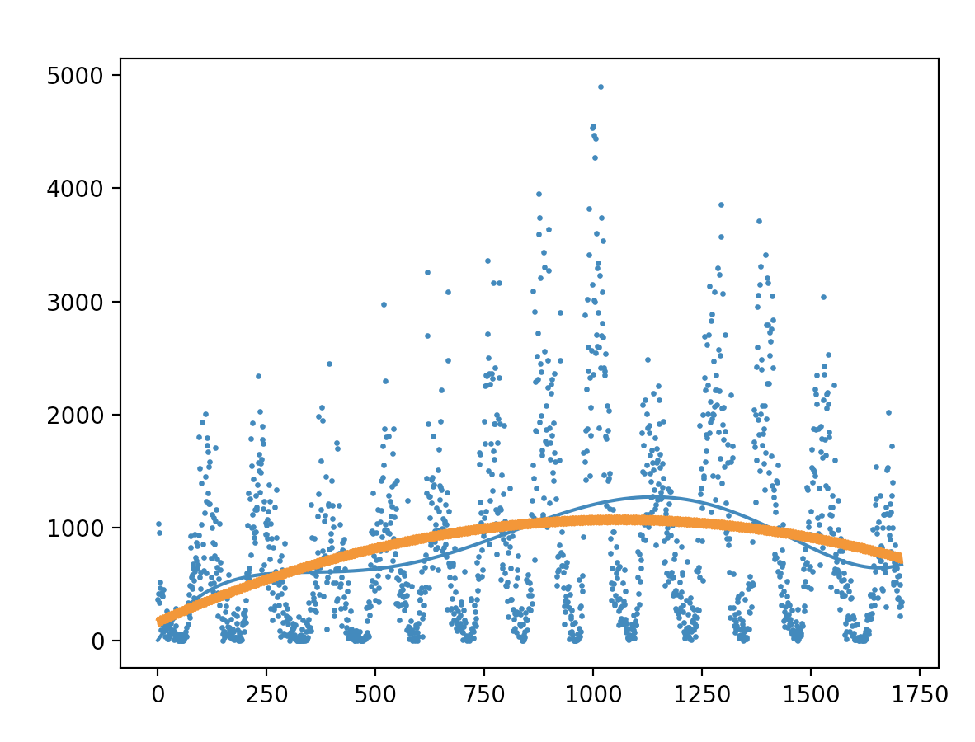
Sunspots

Slide 21
Crop Production in India
Import as usual
Get the column names
crop = pd.read_csv('crop_production.csv')
crop.dropna(inplace=True)
print(crop.columns)

Slide 22
Crop Production in India
Pandas has a nice aggregate: describe
Gives statistics on what it things are numeric
Even if they do not make sense
print(crop.describe())
Crop_Year Area Production
count 242361.000000 2.423610e+05 2.423610e+05
mean 2005.625773 1.216741e+04 5.825034e+05
std 4.958285 5.085744e+04 1.706581e+07
min 1997.000000 1.000000e-01 0.000000e+00
25% 2002.000000 8.700000e+01 8.800000e+01
50% 2006.000000 6.030000e+02 7.290000e+02
75% 2010.000000 4.545000e+03 7.023000e+03
max 2015.000000 8.580100e+06 1.250800e+09

Slide 23
Crop Production in India
We can get the crop production file into a pandas dataframe
import numpy as np
import pandas as pd
import matplotlib.pyplot as plt
from math import sin
import scipy.optimize as opt
crop = pd.read_csv('crop_production.csv')
crop.dropna(inplace=True)

Slide 24
Crop Production in India
What are the Indian states according to this data set?
Use the unique method
print(crop.State_Name.unique())

Slide 25
Crop Production in India
How much rice is produced in Maharashtra?
mah = crop[ (crop['State_Name'] == 'Maharashtra') &
(crop['Crop'] == 'Rice')]
print(mah)
State_Name District_Name Crop_Year ... Crop Area Production
125200 Maharashtra AHMEDNAGAR 1997 ... Rice 5900.0 7200.0
125222 Maharashtra AHMEDNAGAR 1998 ... Rice 5600.0 7400.0
125253 Maharashtra AHMEDNAGAR 1999 ... Rice 5700.0 8000.0
125285 Maharashtra AHMEDNAGAR 2000 ... Rice 5500.0 3800.0
125315 Maharashtra AHMEDNAGAR 2001 ... Rice 7300.0 4100.0
... ... ... ... ... ... ... ...
137704 Maharashtra YAVATMAL 2007 ... Rice 6.0 4.0
137721 Maharashtra YAVATMAL 2008 ... Rice 500.0 200.0
137737 Maharashtra YAVATMAL 2009 ... Rice 200.0 300.0
137766 Maharashtra YAVATMAL 2011 ... Rice 100.0 100.0
137782 Maharashtra YAVATMAL 2012 ... Rice 100.0 40.0

Slide 26
Crop Production in India
Group by year
mah_vals = mah.groupby('Crop_Year').sum()
print(mah_vals)
Area Production
Crop_Year
1997 1339329.0 2330646.0
1998 1483100.0 2467600.0
1999 1498500.0 2549300.0
2000 1511500.0 1929700.0
2001 1514000.0 2651200.0
2002 1523300.0 1854100.0
2003 1529900.0 2834100.0
2004 1508700.0 2147200.0
2005 1503000.0 2665900.0
2006 1529300.0 2571700.0
2007 36836.0 29128.0
2008 1499500.0 2234210.0
2009 1450000.0 2137114.0
2010 1486200.0 2624900.0
2011 1544200.0 2848900.0
2012 1559000.0 3078040.0
2013 1604800.0 3108290.0
2014 1550900.0 2946600.0

Slide 27
Crop Production in India
Create a new column yield
Production over area
mah_vals['Yield'] = mah_vals.Area / mah_vals.Production
print(mah_vals)

Slide 28
Crop Production in India
Let's approximate yield in dependence on year linearly and quadratically
def model1(t, alpha, beta, gamma):
return alpha + beta*t + gamma*t**2
def model2(t, alpha, beta):
return alpha + beta*t
values = mah_vals.Yield
args = np.arange(1997, 2015)
par1, cov1 = opt.curve_fit(model1, args, values)
par2, cov2 = opt.curve_fit(model2, args, values)

Slide 29
Crop Production in India
And visualize
Parameter s stands for size
plt.scatter(args, values, s=5)
plt.plot(args, model1(args, *par1))
plt.plot(args, model2(args, *par2))
plt.show()

Slide 30
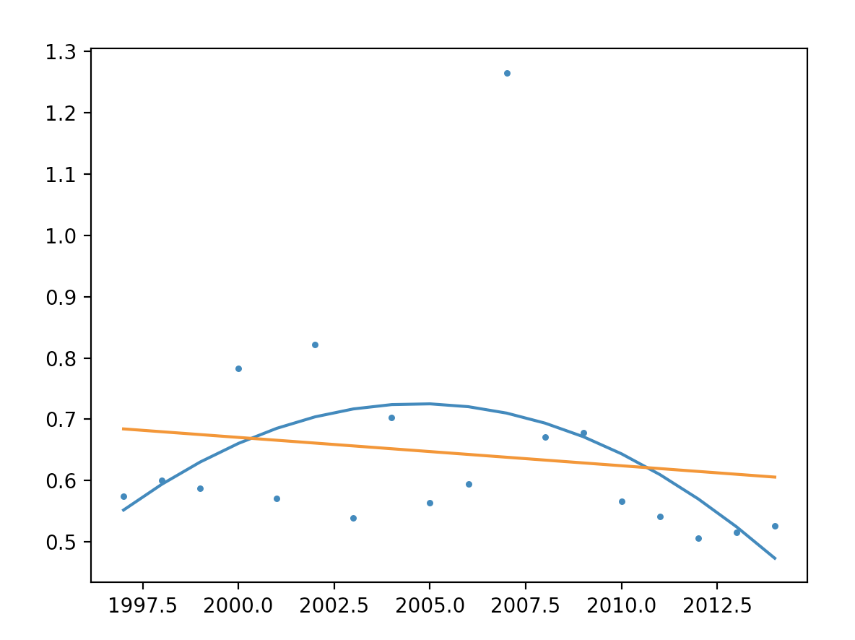
Crop Production in India

Slide 31
Crop Production in India
There is one outlier for 2007
Let's get the years without 2007
Need to use np.concatenate with a tuple as parameter
args = np.concatenate((np.arange(1997, 2007),
np.arange(2008,2015)))

Slide 32
Crop Production in India
We also need to get rid of the corresponding entrance in the data frame
bad_index = mah_vals[mah_vals.Area<1000000].index
mah_vals.drop(bad_index, inplace=True)
print(mah_vals)
Area Production Yield
Crop_Year
1997 1339329.0 2330646.0 0.574660
1998 1483100.0 2467600.0 0.601029
1999 1498500.0 2549300.0 0.587808
2000 1511500.0 1929700.0 0.783282
2001 1514000.0 2651200.0 0.571062
2002 1523300.0 1854100.0 0.821585
2003 1529900.0 2834100.0 0.539819
2004 1508700.0 2147200.0 0.702636
2005 1503000.0 2665900.0 0.563787
2006 1529300.0 2571700.0 0.594665
2008 1499500.0 2234210.0 0.671154
2009 1450000.0 2137114.0 0.678485
2010 1486200.0 2624900.0 0.566193
2011 1544200.0 2848900.0 0.542034
2012 1559000.0 3078040.0 0.506491
2013 1604800.0 3108290.0 0.516297
2014 1550900.0 2946600.0 0.526335

Slide 33
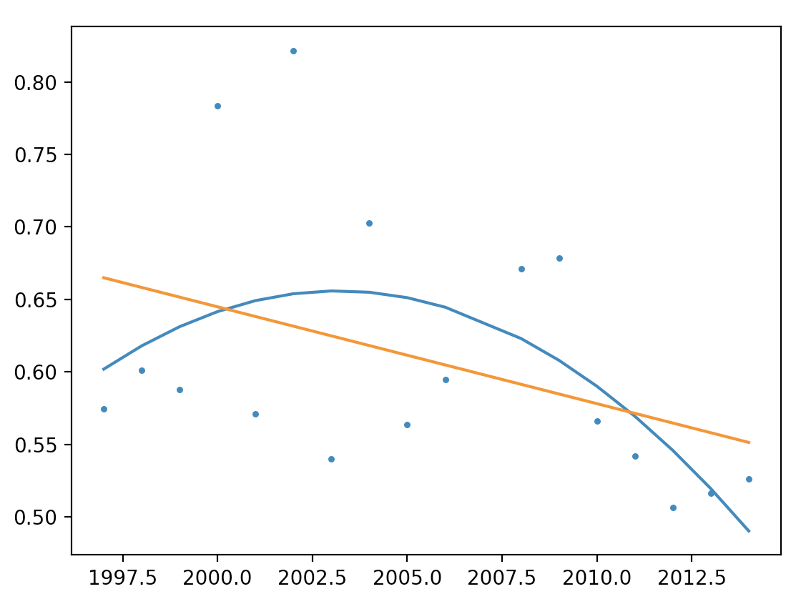
Crop Production in India
Now we can repeat the fitting:

