Slide 1
Visualization 3
Thomas Schwarz, SJ

Slide 2
Review
Create figures in matplotlib.pyplot imported as plt
  Use pandas, i.e. df.column.plot( )
    Limited functionality, but easiest to use
  Use plt.plot
    Matplotlib style
  Use the OO interface
    fig, ax = plt.subplots(8,8, figsize=(6,6) )

Slide 3
Review
Scripts:
  Need to call plt.show( ) but only once
IPython
  Use the %matplotlib magic command
    plt commands now run in place to update a plot
    Might need to force updates with plt.draw( )
IPython notebook
  %matplotlib notebook
    Interactive plots embedded in notebook
  % matplotlib inline
    Static images embedded in notebook

Slide 4
Review
plot for line plots: give x- and y-values
scatter plot with setting marker as third argument
  color codes and line codes
    color, linestyle, or abbreviation
control with
plt | ax
plt.xlabel( ) | ax.set_xlabel( )
plt.xlim( ) | ax.set_xlim( )
plt.title( ) | ax.set_title( )

Slide 5
Multiple Subplots
Can use fig.add_axes( ) to manually create subplots.
  Create a figure
  Add axes:
    First argument is a list with x-offset, y-offset, x-height, y-height out of 0 … 1
      Remember to leave space for ticks
fig = plt.figure()
ax1 = fig.add_axes([0.1,0.1,0.88,0.88],
…

Slide 6
Multiple Subplots
We can then add limits, ticks and labels
    This is an axes with origin at 0.1, 0.1 going to 0.98, 0.98
ax1 = fig.add_axes([0.1,0.1,0.88,0.88],
xlim = (0, np.pi),
ylim = (-1.1, 1.1),
xticks=[0, np.pi/2, np.pi],
xticklabels=['0', 'pi/2', 'pi'])

Slide 7
Multiple Subplots
Can add another axes in the right upper corner
ax2 = fig.add_axes([0.7, 0.7, 0.25, 0.2],
xlim = (0, np.pi),
ylim = (-1.1, 1.1),
xticks=[0, np.pi/2, np.pi],
xticklabels=['0', 'pi/2', 'pi'])

Slide 8
Multiple Subplots
Finally, plot random (trig) functions
x = np.linspace(0, np.pi, 30)
ax1.plot(x, np.sin(x))
ax2.plot(x, np.cos(x))
plt.show()

Slide 9
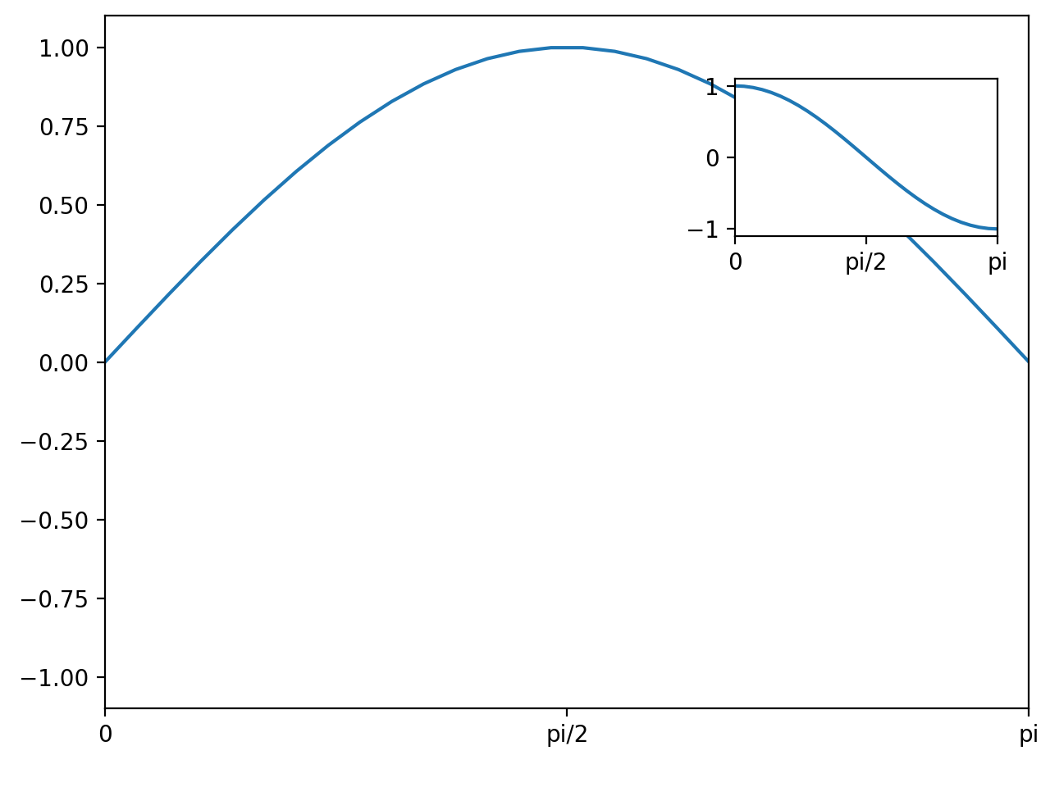
Multiple Subplots

Slide 10
Multiple Subplots
Can create figure with a subplot
Adjust layout
  hspace - space between rows of subplots (height)
  wspace - space between columns of subplots (width)
fig = plt.figure()
fig.subplots_adjust(hspace=0.4,
wspace = 0.6)

Slide 11
Multiple Subplots
Create 6 axes in two rows and three columns
Write an interior text
  The position is relative to the grid in the subplot
  Then plot x**i
for i in range(1, 7):
ax = fig.add_subplot(2,3,i, ylim = (-1,1))
ax.text(0, 0.5, str(i),
fontsize = 15,
ha='center')
x = np.linspace(-1,1,21)
ax.plot(x, np.power(x,i))

Slide 12
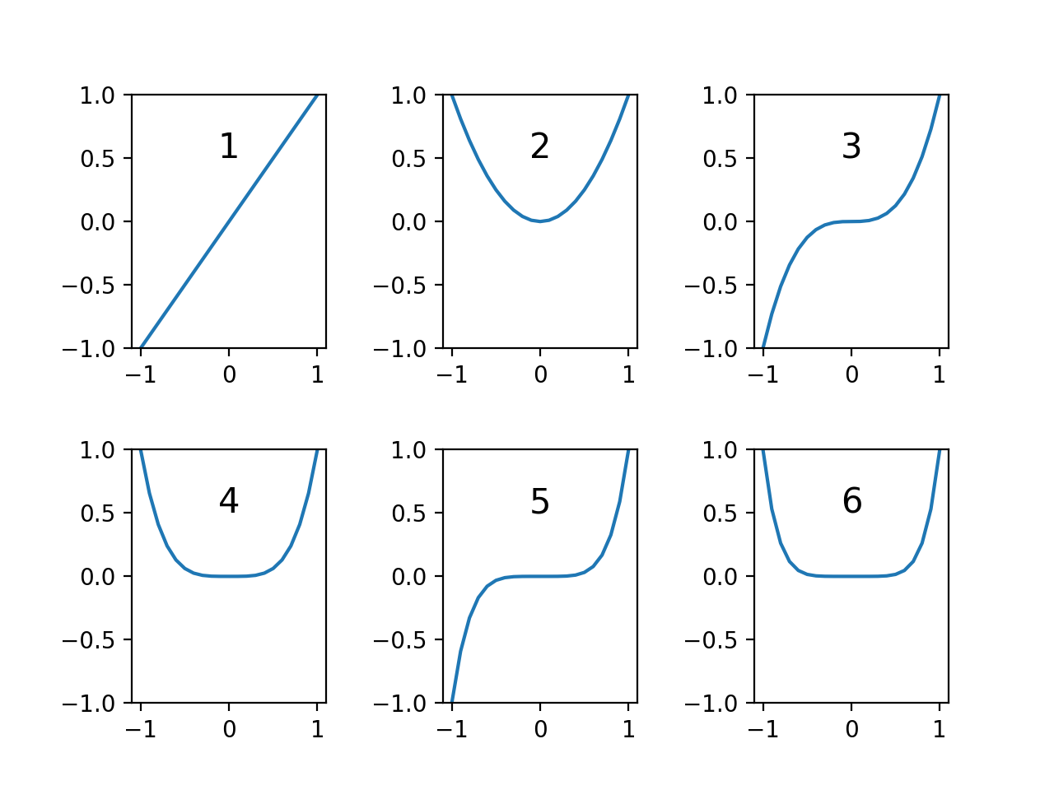
Multiple Subplots

Slide 13
Multiple Subplots
Can use subplots (with a plural-s) to create a number of plots
  Can make share coordinate layout
fig, axes = plt.subplots(3,4,
sharex='col',
sharey='row')

Slide 14
Multiple Subplots
The axes is a 3 by 4 matrix
  Notice the way we are accessing them by a single bracket
for i in range(3):
for j in range(4):
degree = 4*i+j+2
axes[i,j].text(0, 0.5, str(degree), ha='center')
axes[i,j].plot(x, np.power(x,degree))

Slide 15
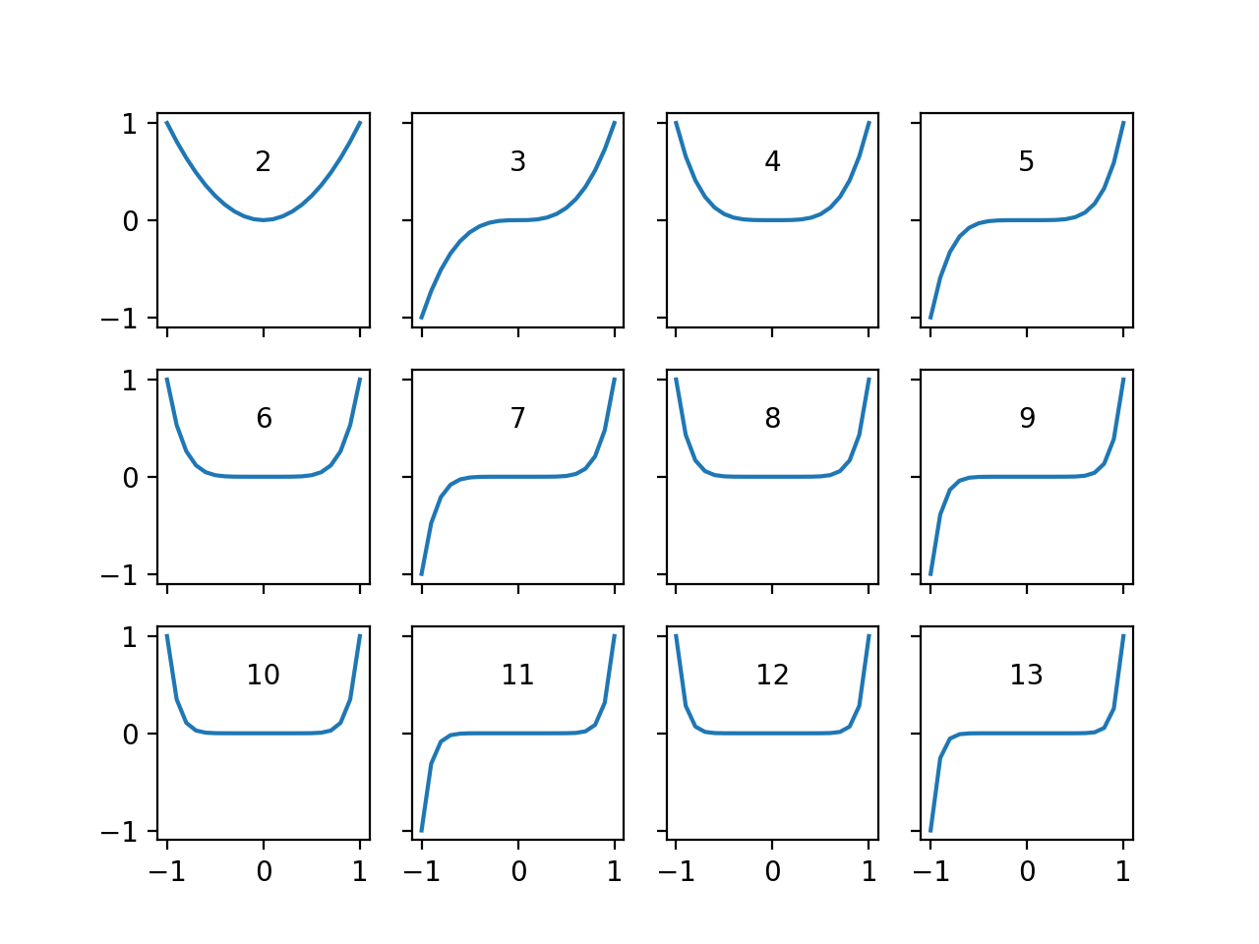
Multiple Subplots

Slide 16
Multiple Subplots
For more complicates arrangements, look at plt.GridSpec

Slide 17
Controlling Ticks
Figure: bounding box, contains
  Axes objects, which contain
    A variety of other objects representing plot contents
    Such as xaxis, yaxis
      contains properties of lines, ticks, and labels
      Has major and minor locator object
      Has major and minor formatter object

Slide 18
Controlling Ticks
No ticks at all:
ax = plt.axes(yscale='log')
ax.xaxis.set_major_locator(plt.NullLocator())

Slide 19
Controlling Ticks
Example: Handwriting recognition set
  In sklear.datasets
  Create a figure and pack it densely
from sklearn.datasets import load_digits
fig = plt.figure(figsize=(6,6)) #in inches
fig.subplots_adjust(left=0, right=1, bottom=0,
top=1, hspace=0.05,
wspace = 0.05)

Slide 20
Controlling Ticks
Create 64 axes
No ticks
Show images
Show target text
for i in range(64):
ax = fig.add_subplot(8,8, i+1)
ax.xaxis.set_major_locator(plt.NullLocator())
ax.yaxis.set_major_locator(plt.NullLocator())
ax.imshow(digits.images[i],
cmap=plt.cm.binary,
interpolation='nearest')
ax.text(0,7, str(digits.target[i]))

Slide 21
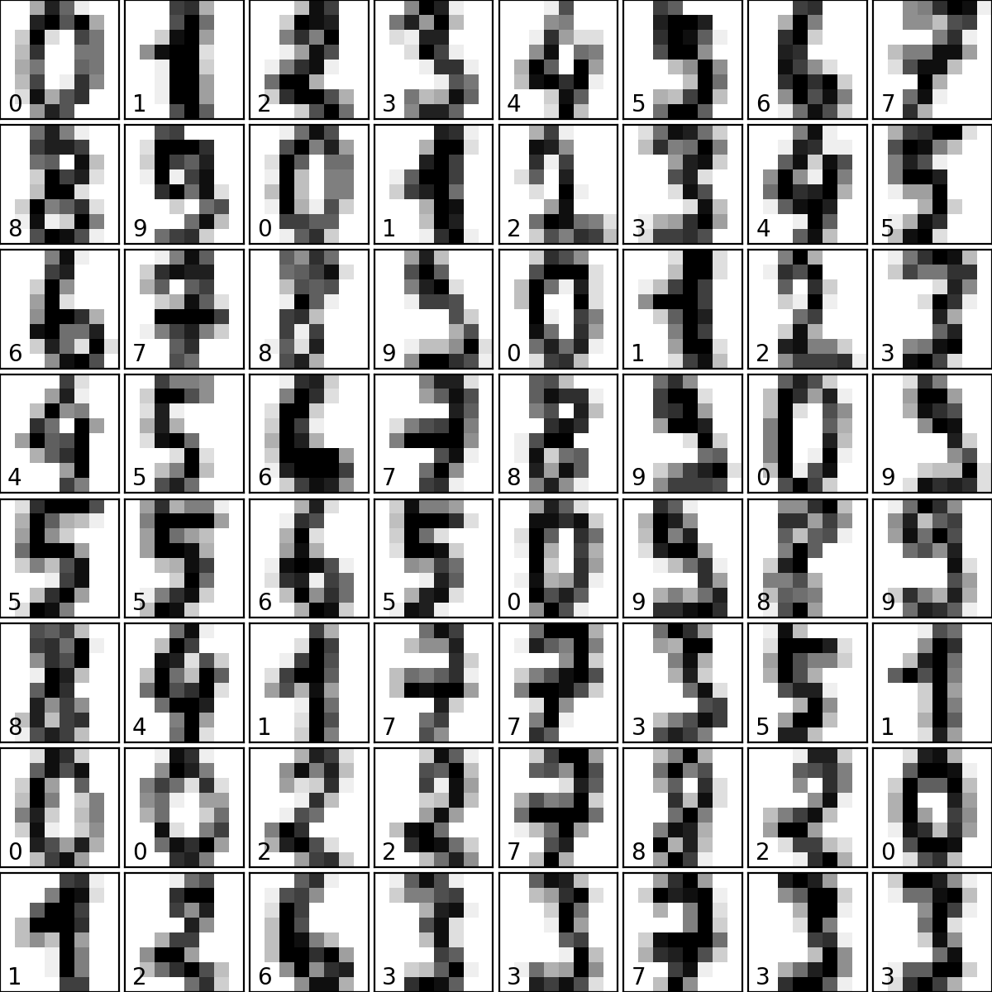
Controlling Ticks

Slide 22

Controlling Ticks
Without suppressing ticks

Slide 23
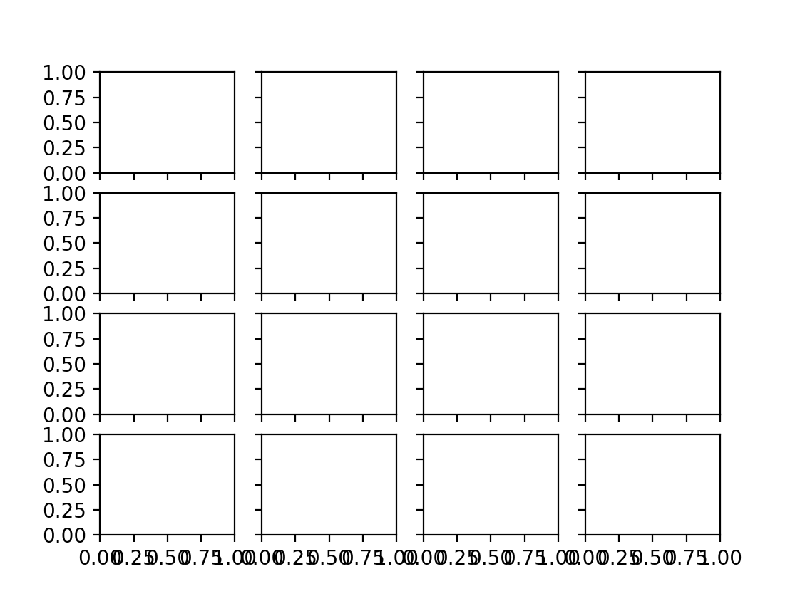
Controlling Ticks
Sometimes, ticks can be too close together

Slide 24
Controlling Ticks
Use the locator to determine the number of ticks
fig, axes = plt.subplots(4,4, sharex=True, sharey=True)
for ax in axes.flat:
ax.xaxis.set_major_locator(plt.MaxNLocator(4))
ax.yaxis.set_major_locator(plt.MaxNLocator(4))

Slide 25
Controlling Ticks
Sometimes, need more control
x= np.linspace(-np.pi, np.pi, 51)
fig, axes = plt.subplots(2,2, sharex=True, sharey=True)
axes[0,0].plot(x, np.sin(x))
axes[0,1].plot(x, np.cos(x))
axes[1,0].plot(x, np.sinh(x))
axes[1,1].plot(x, np.cosh(x))
axes[0,0].text(0,2, 'sin', ha='center')
axes[0,1].text(0,2, 'cos', ha='center')
axes[1,0].text(0,2, 'sinh', ha='center')
axes[1,1].text(0,2, 'cosh', ha='center')

Slide 26
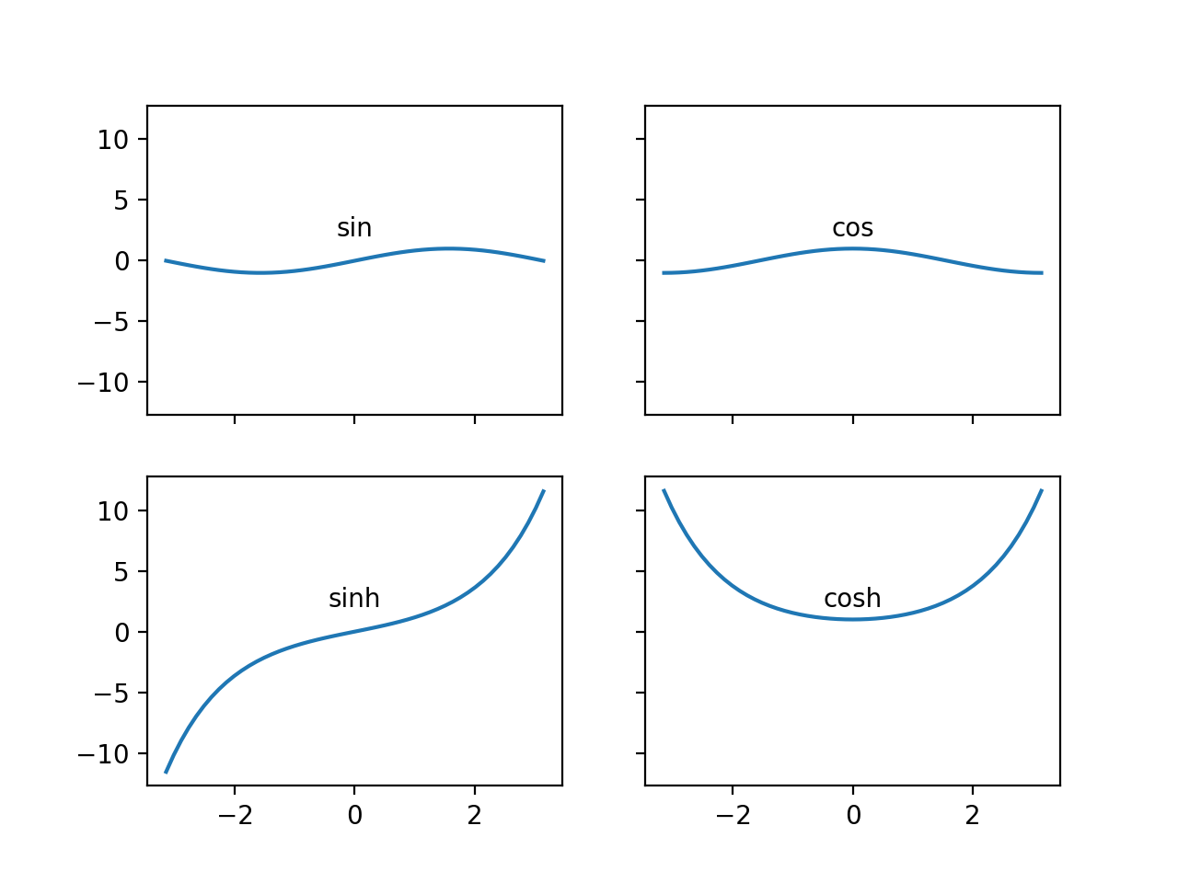
Controlling Ticks
More natural to have the x-axis use multiple of $π$

Slide 27
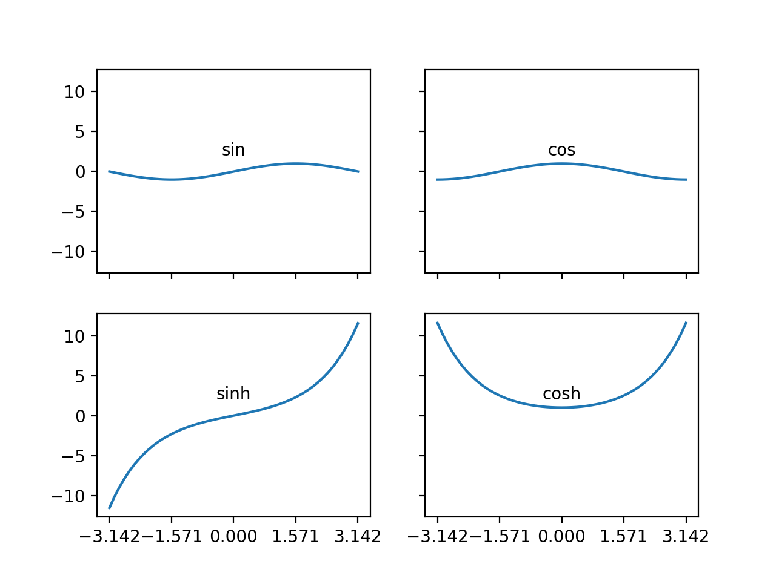
Controlling Ticks
Set the multiplelocator object
axes[0,0].xaxis.set_major_locator(
plt.MultipleLocator(np.pi/2))

Slide 28
Controlling Ticks
The ticks are fine, but need to write in terms of multiples of $π$
Create our own format function using TeX
def my_format_func(value, tick_number):
nn = int(np.round(2*value / np.pi))
if nn == 0:
return '0'
elif nn == 1:
return r'$\pi/2$'
elif nn%2:
return r'${0}\pi/2$'.format(nn)
else:
return r'${0}\pi$'.format(nn//2)

Slide 29
Controlling Ticks
Now it works:
x= np.linspace(-2*np.pi, 2*np.pi, 51)
fig, axes = plt.subplots(2,1, sharex=True, sharey=True)
axes[0].plot(x, np.sin(x))
axes[1].plot(x, np.cos(x))
axes[0].text(0,0.6, 'sin', ha='center')
axes[1].text(0,0.6, 'cos', ha='center')
axes[0].xaxis.set_major_locator(plt.MultipleLocator
(np.pi/2))
axes[0].xaxis.set_major_formatter(plt.FuncFormatter
(my_format_func))

Slide 30
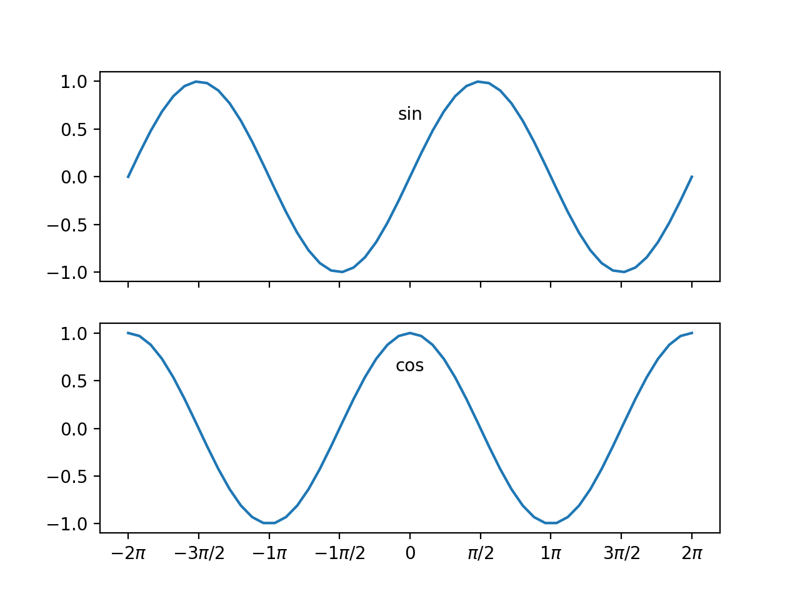

Slide 31
Seaborn
Matplotlib is based on an old version of matlab
  Defaults are not all that pretty
    Calculate random walk
x = np.linspace(0,20,51)
y = np.cumsum(np.random.normal(0, 5,51))
plt.plot(x,y)
plt.show()

Slide 32
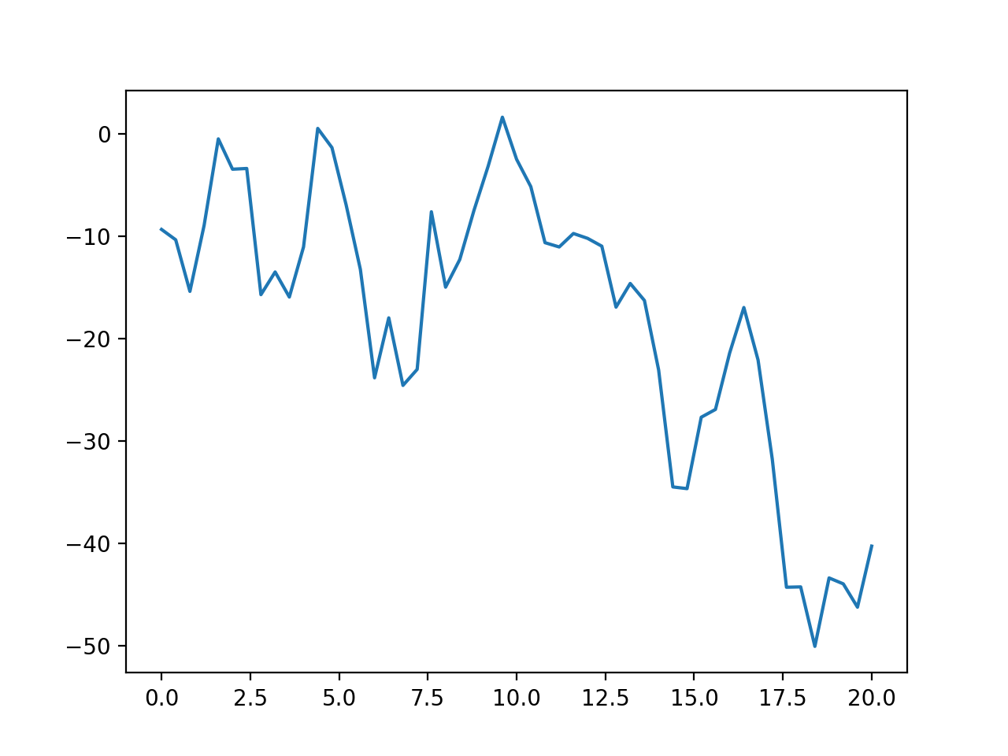
Seaborn
Without seaborn

Slide 33
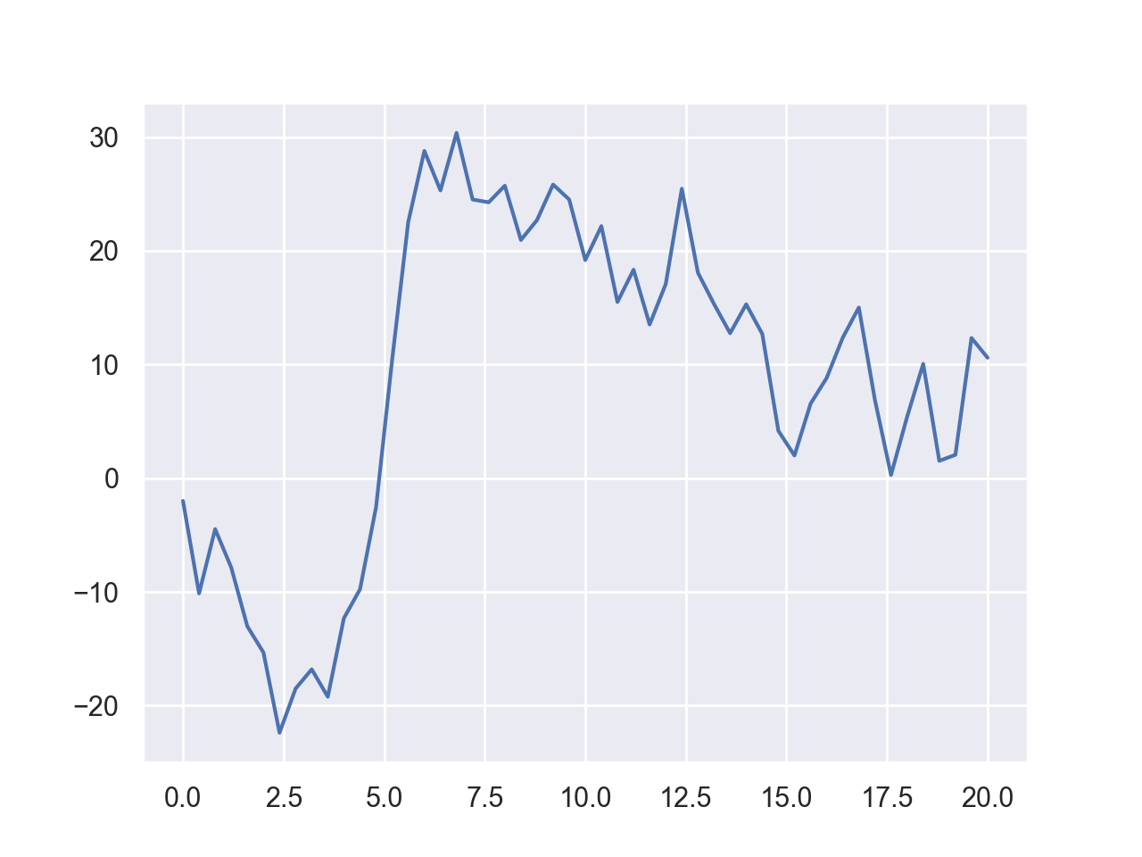
Seaborn
With Seaborn
import seaborn as sns
sns.set()

Slide 34
Seaborn
The difference extends to labeling
sns.set()
x = np.linspace(0,20,51)
label = 'ABCDEF'
for letter in label:
y = np.cumsum(np.random.normal(0, 5,51))
plt.plot(x,y, label=letter)
plt.legend()

Slide 35
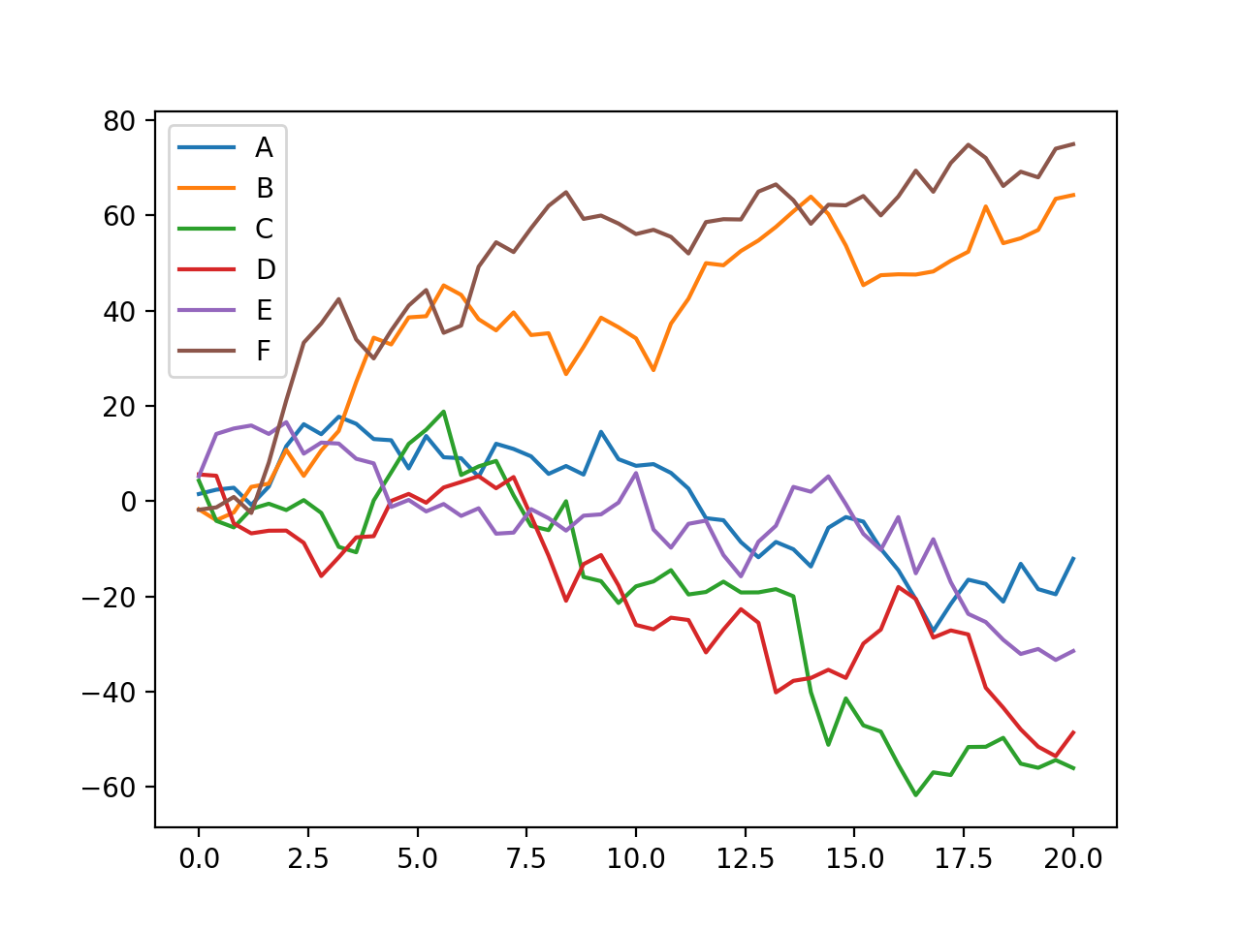
Seaborn
without Seaborn

Slide 36
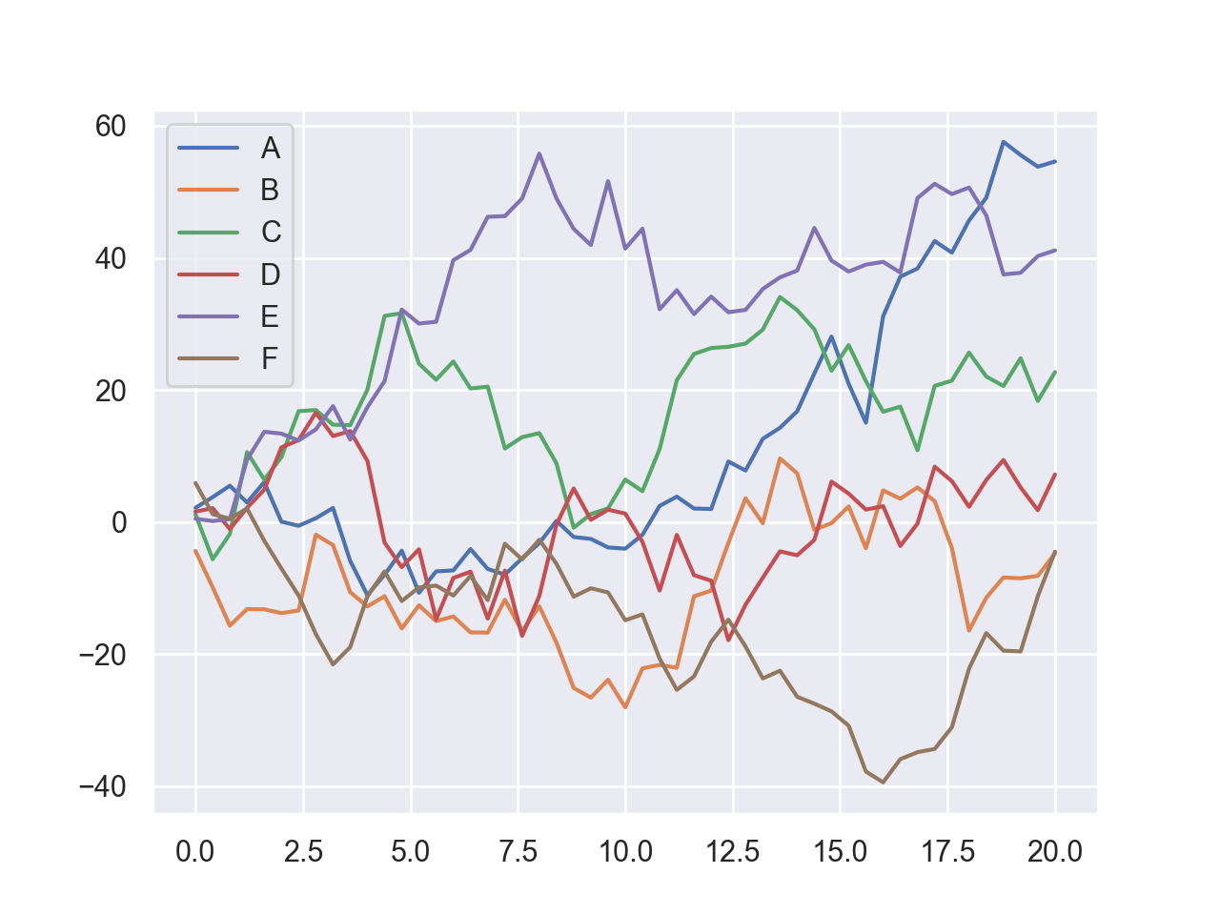
Seaborn
With Seaborn

Slide 37
Seaborn
Seaborn provides many statistical visualization tools
  Example: Generate a multinomial distribution with covariance matrix $\left(\begin{matrix}5 & 2 \\ 2 & 2\end{matrix}\right)$ around the origin
data=np.random.multivariate_normal(
[0,0],
[[5,2],[2,2]],
size = 5000)

Slide 38
Seaborn
With plt, easy to generate histogram
df = pd.DataFrame(data, columns=['x', 'y'])
for col in ['x', 'y']:
plt.hist(df[col], normed=True, alpha = 0.5)

Slide 39
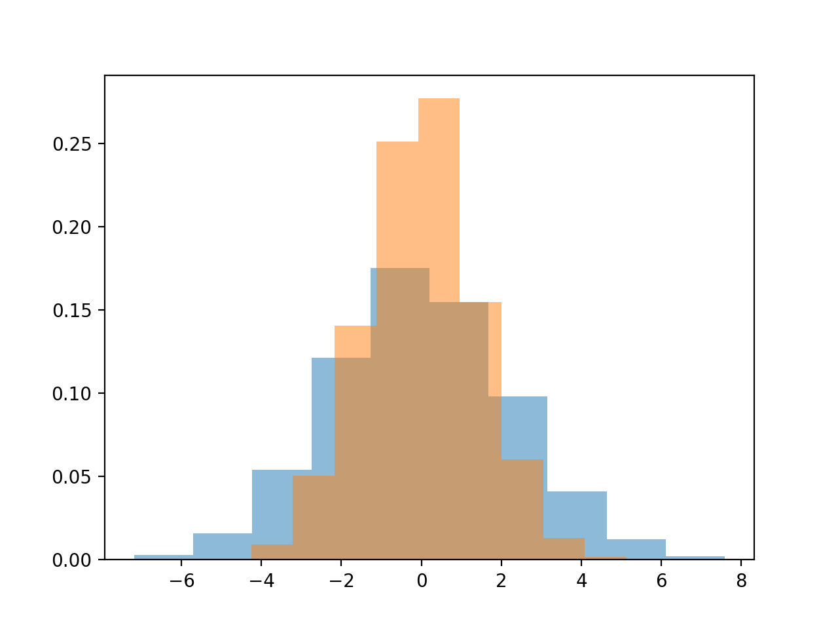
Seaborn

Slide 40
Seaborn
With Seaborn, we can use a "kernel density estimation"
for col in ['x', 'y']:
sns.kdeplot(df[col], shade=True)

Slide 41
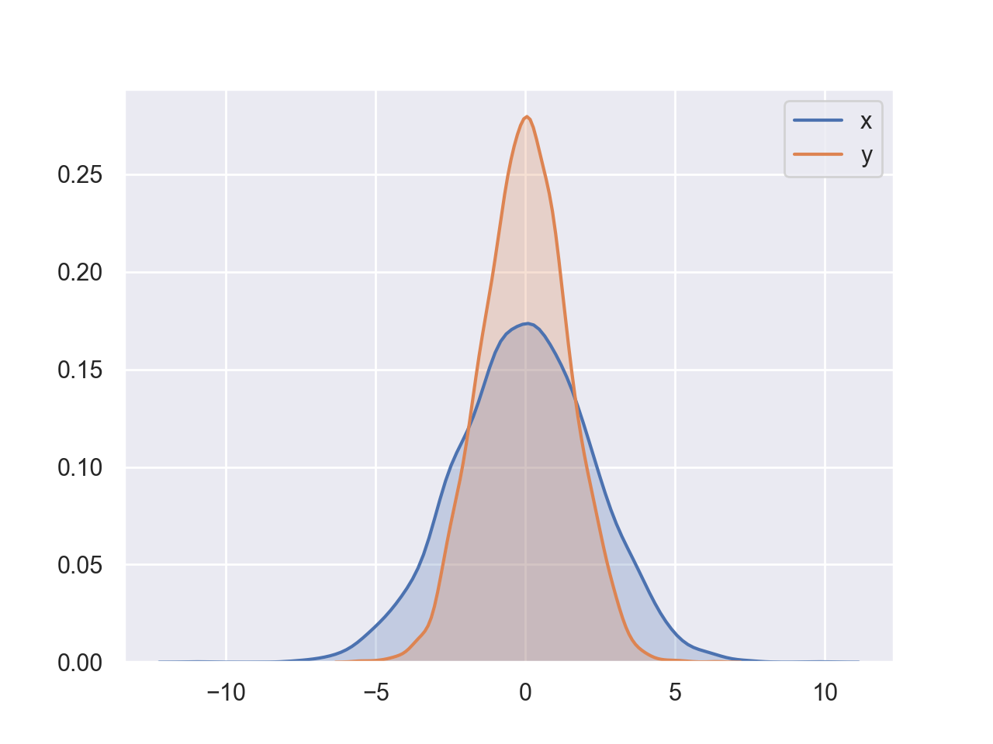
Seaborn

Slide 42
Seaborn
Can combine with distplot
for col in ['x', 'y']:
sns.distplot(df[col])

Slide 43
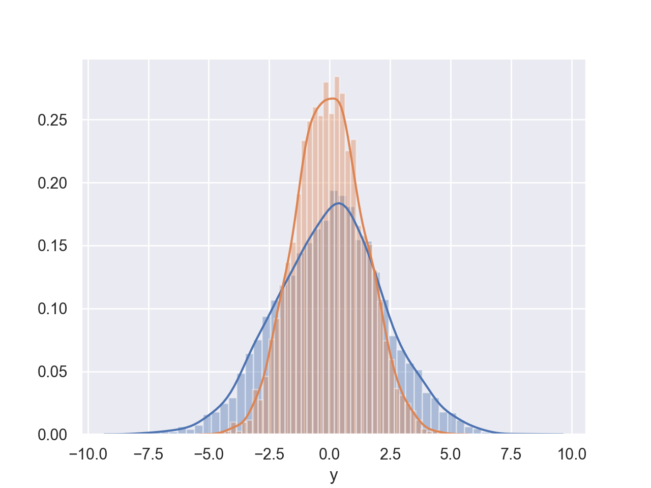
Seaborn

Slide 44
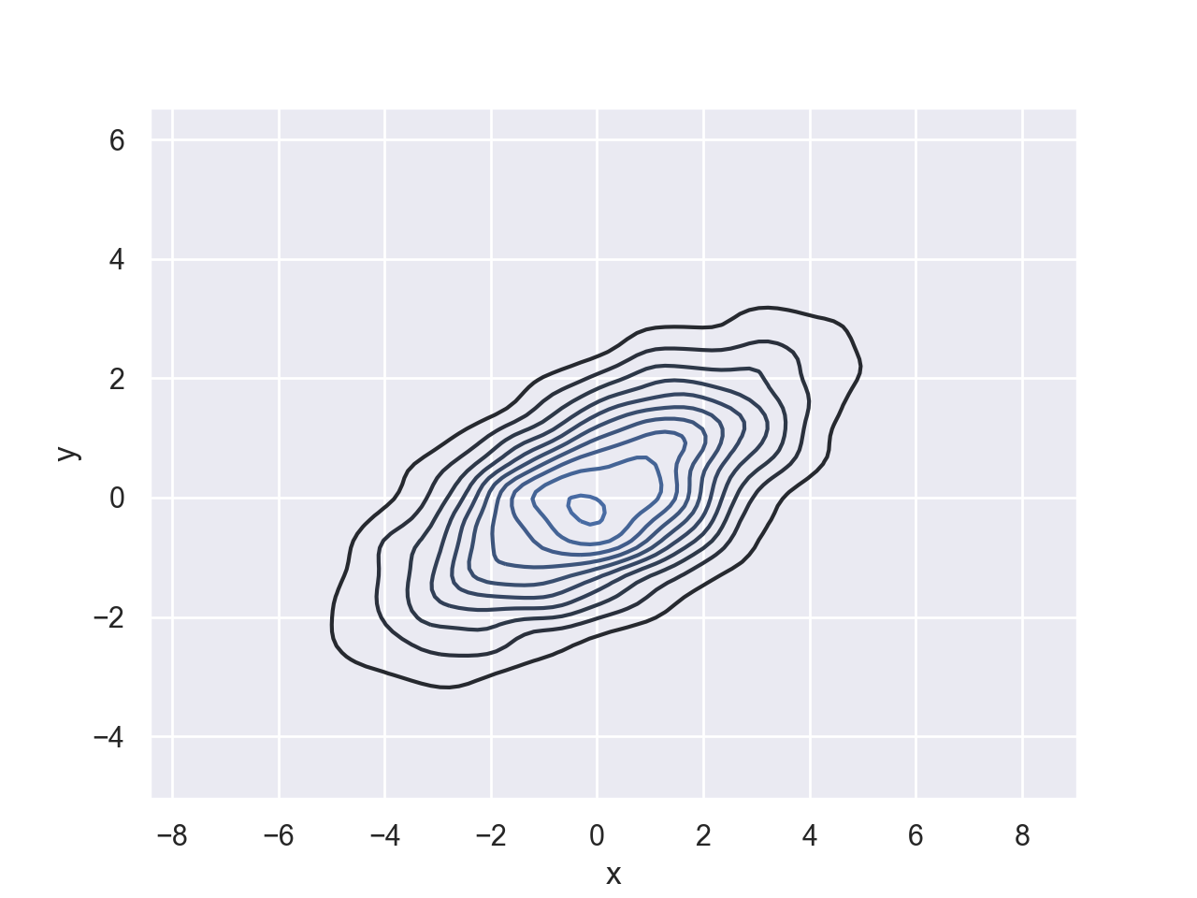
Seaborn
Can also use a two dimensional kernel density estimation plot
sns.kdeplot(df.x, df.y)

Slide 45
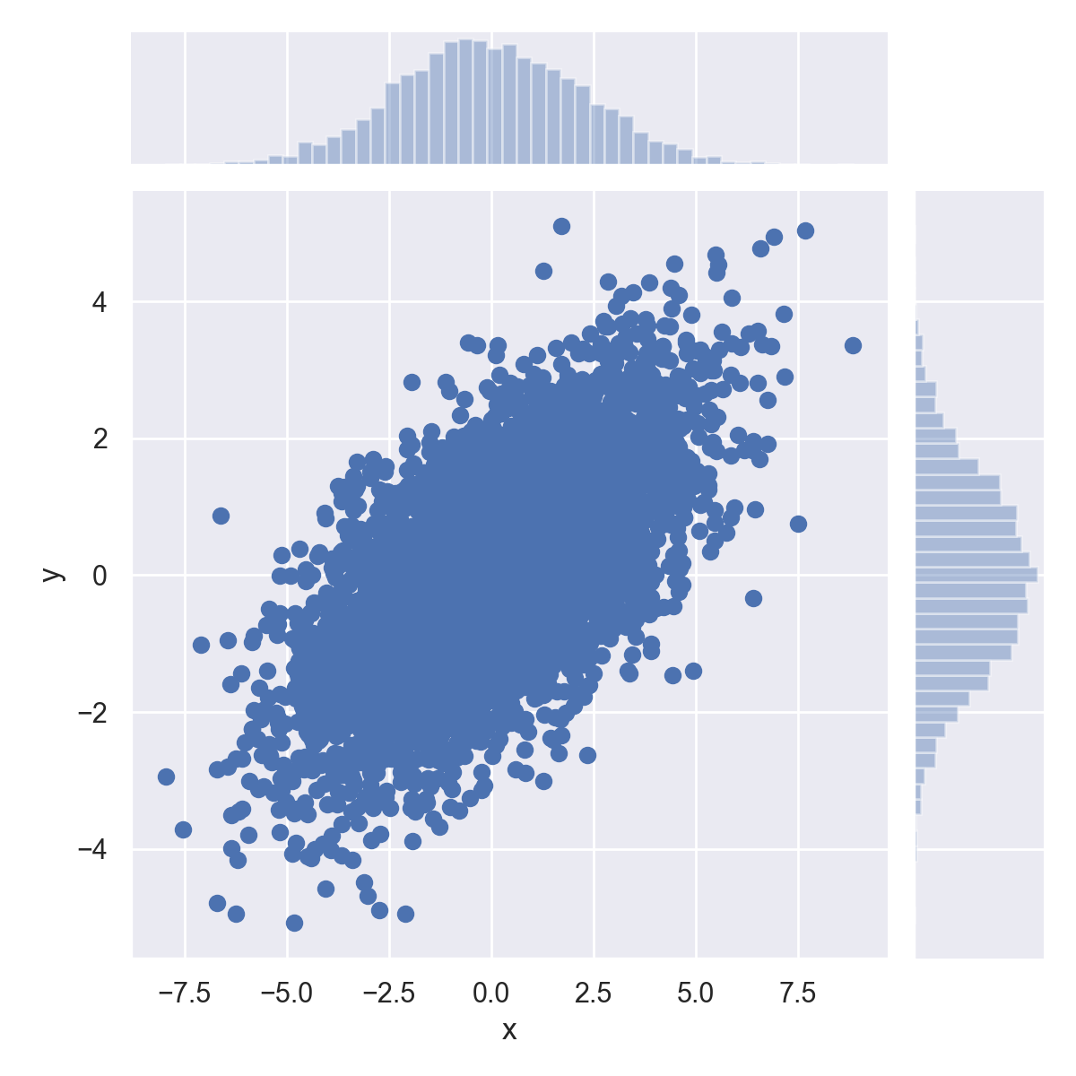
Seaborn
Or use sns.jointplot

Slide 46
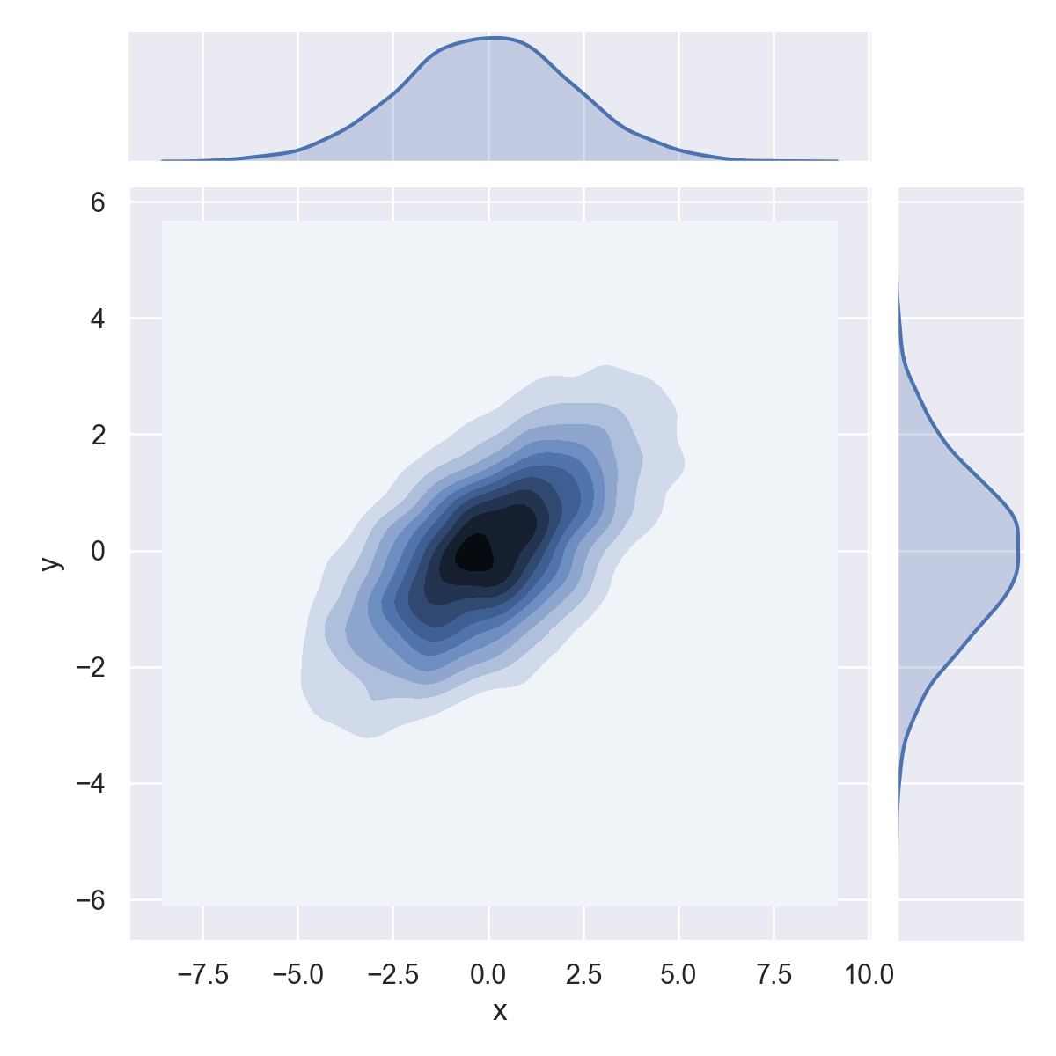
Seaborn
sns.jointplot(df.x, df.y, kind='kde')

Slide 47
Seaborn
Seaborn's jointplot even works for higher dimensions
  When it is called pairplot
iris = sns.load_dataset('iris')
sns.pairplot(iris, hue='species',height=2.5)

Slide 48
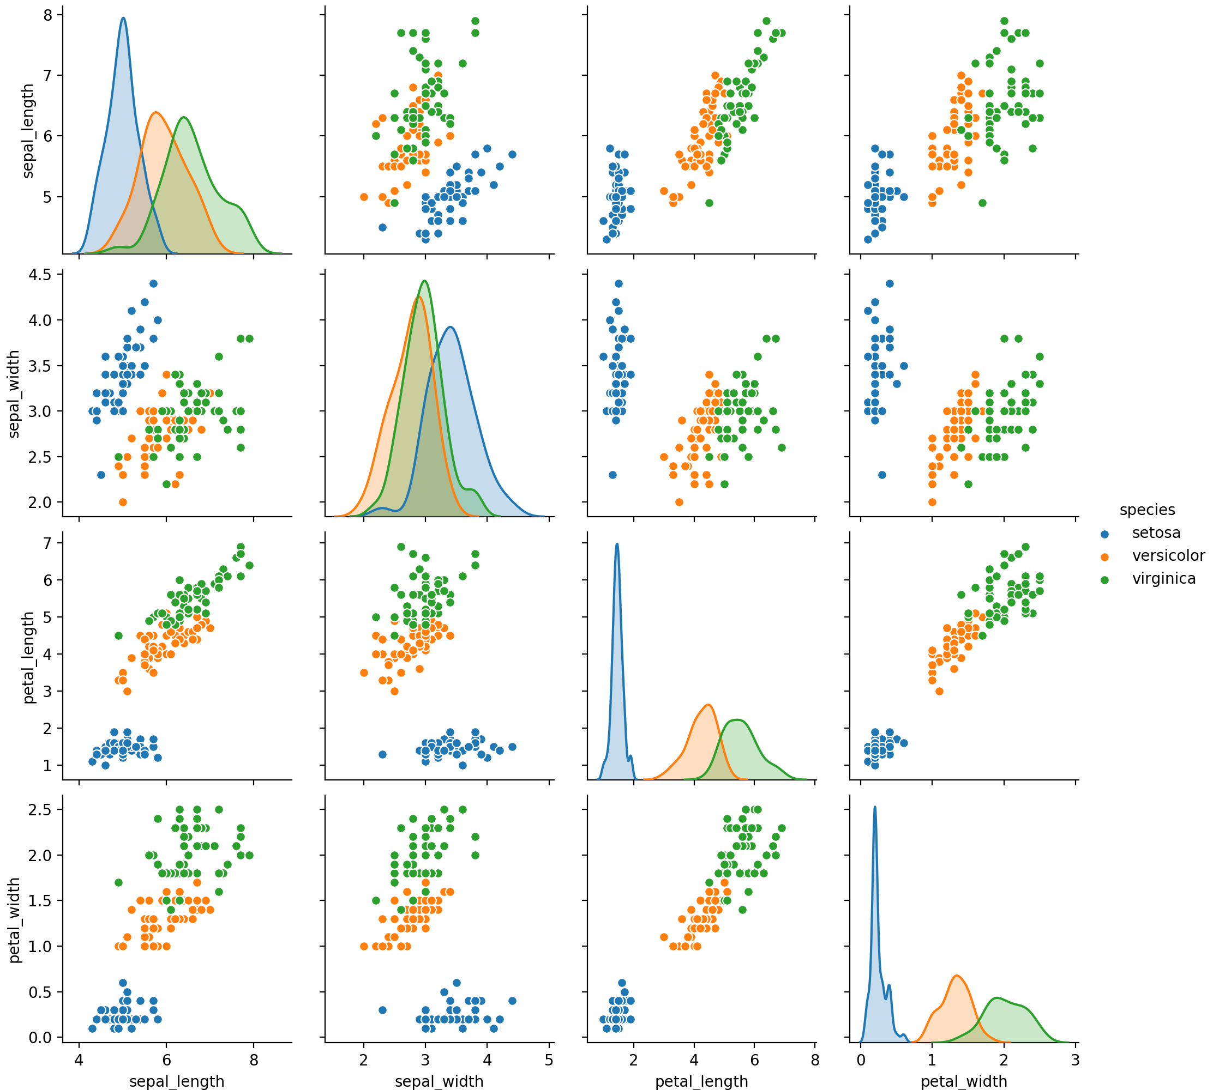

Slide 49
Seaborn
Seaborn allows us to show various factors
tips = sns.load_dataset('tips')
tips['tip_percent'] = 100*tips.tip/tips.total_bill
grid = sns.FacetGrid(tips,
row='sex',
col='time',
margin_titles=True)
grid.map(plt.hist, 'tip_percent', bins=np.linspace(0,40,15))

Slide 50
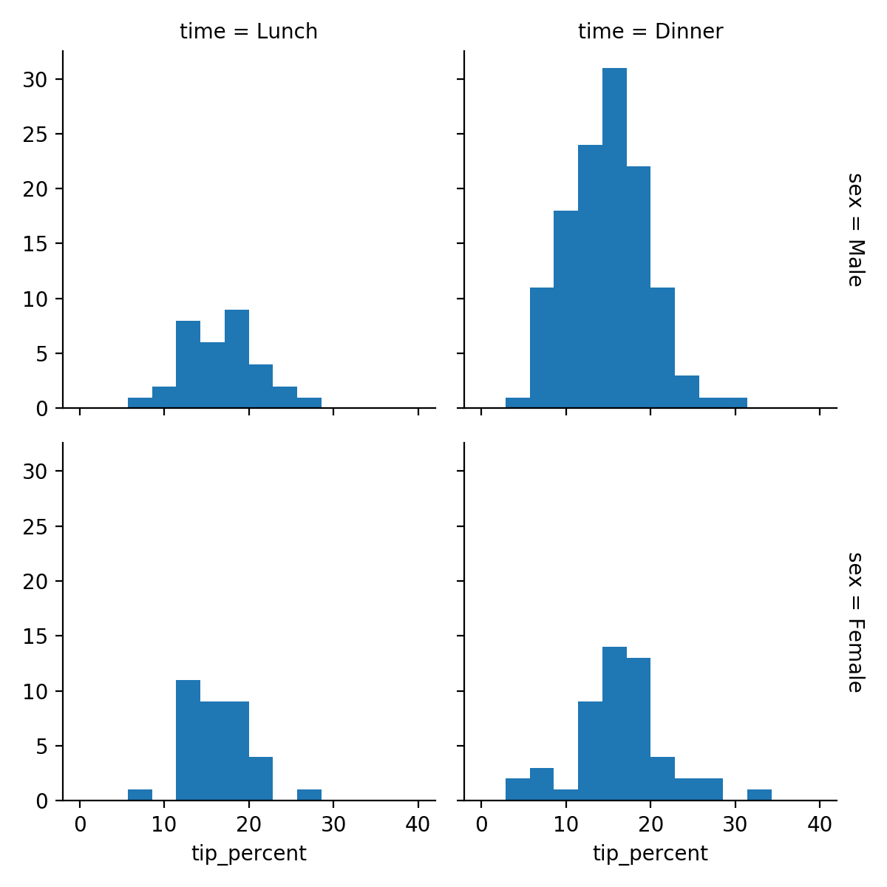
Seaborn

Slide 51
Seaborn
Can use category plot to show dependencies
tips['tip_percent'] = 100*tips.tip/tips.total_bill
g = sns.catplot('day', 'total_bill', 'sex', data=tips, kind='box')

Slide 52
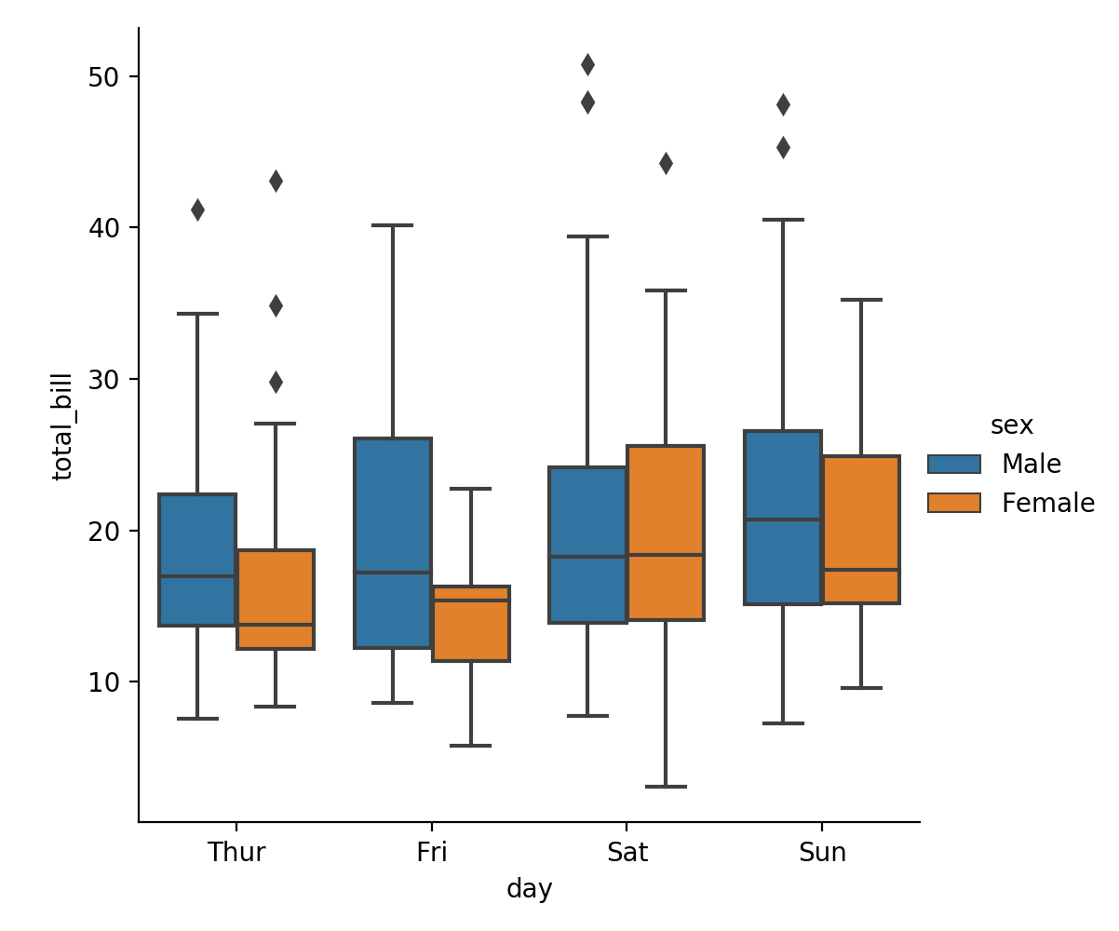
Seaborn

Slide 53
Tasks
Import the penguin data set
  Get rid of:
    Rows with NA values
    The row with the bad sex
Use seaborn
Plot body mass versus culmen-length for all penguins

Slide 54
Tasks
Use the seaborn pairplot on the penguins

Slide 55
Tasks
Use the seaborn category plot for body-mass based on sex and species

Slide 56
Tasks
Test whether the body mass for the penguins in dependence on sex and species are normally distributed

Slide 57
Tasks
Use scipy stats to check whether the means are different based on sex and species.

Slide 58
Tasks
 | Electric | Mechanical | Other
Line 1 | 13 | 33 | 15
Line 2 | 7 | 4 | 11
Line 3 | 18 | 10 | 14
Can we say that failure behavior differs between lines.

