Slide 1
Week 9

Slide 2
Regression Example
Get internet usage data from kaggle
inter = pd.read_csv('internet.csv')
inter.dropna(inplace=True)
seaborn.pairplot(inter)
plt.show()

Slide 3
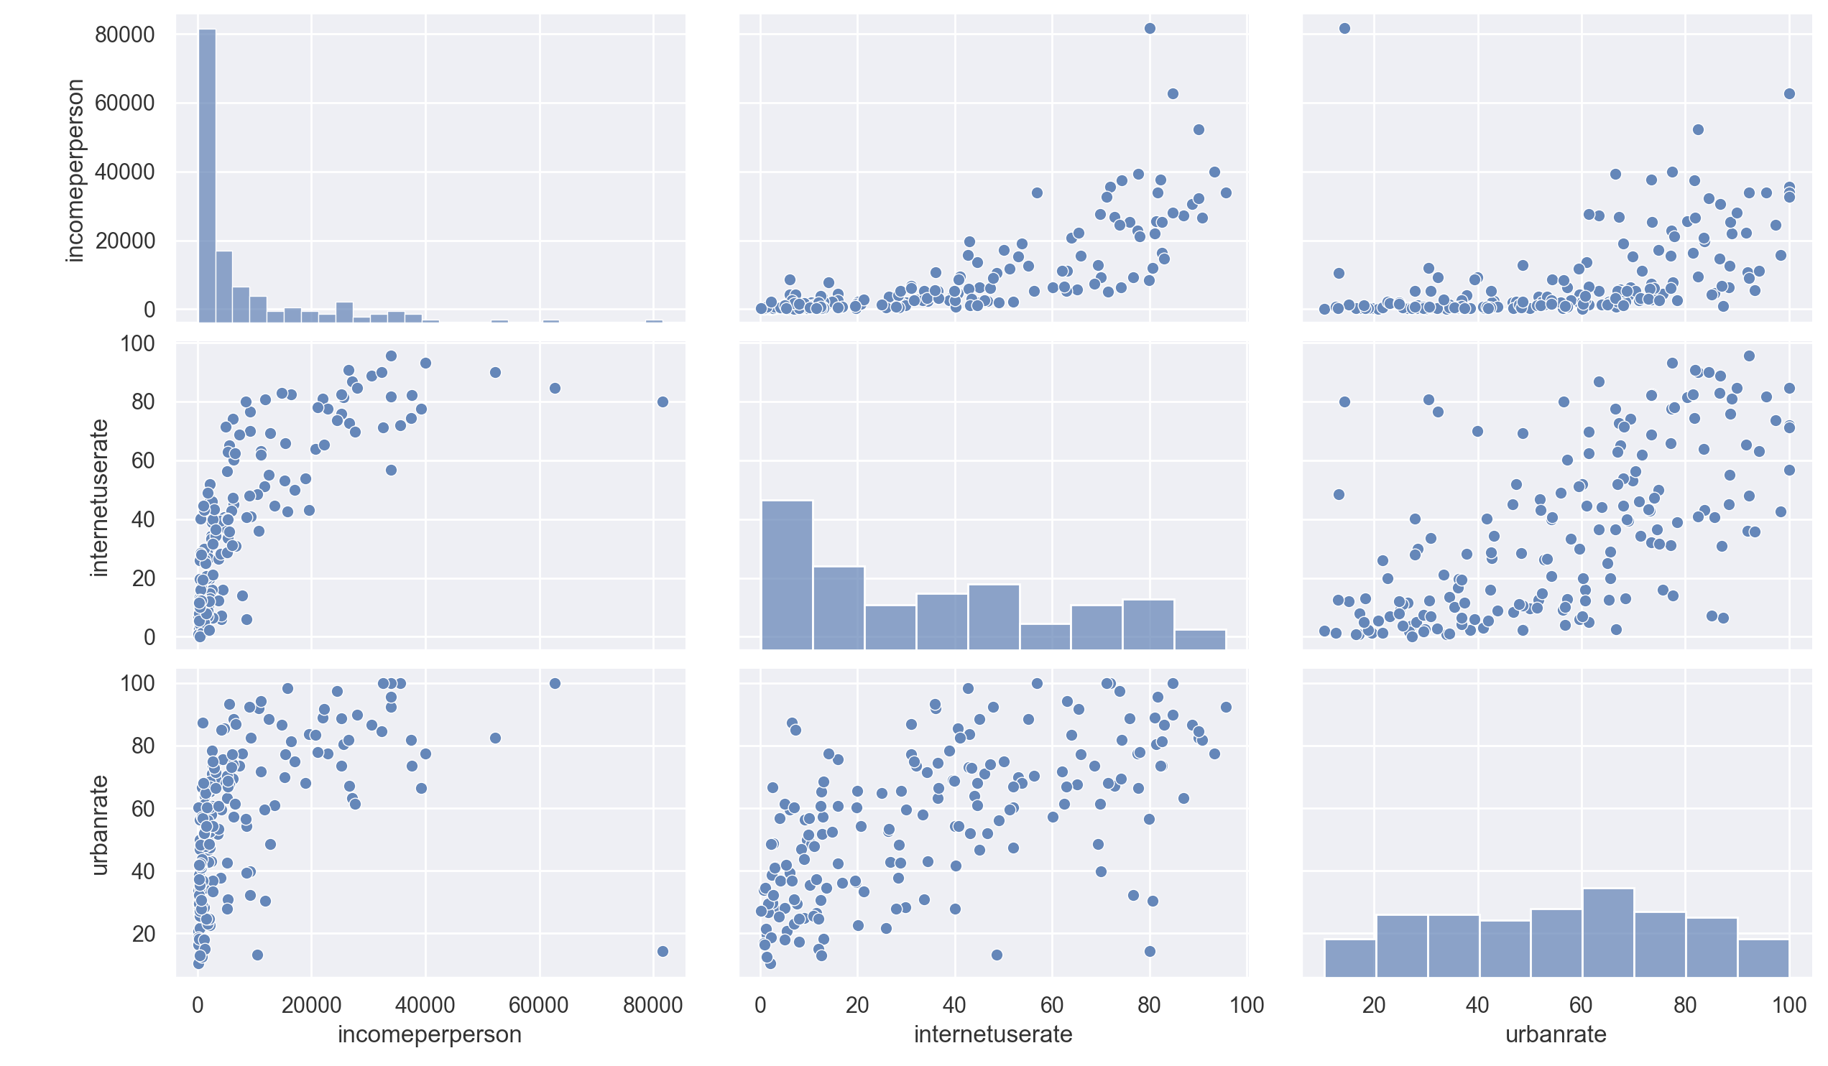
Regression Example

Slide 4
Regression Example
Most prominent is the relation income —> internet use
  But this is definitely not linear
    Try out square-root and cubic-root
inter['sqr'] = inter.incomeperperson**0.5
inter['cr'] = inter.incomeperperson**(1/3)

Slide 5
Regression Example
We try out different models
model = ols('internetuserate ~ incomeperperson + sqr + cr ', inter).fit()
print(model.summary())
a, b1, b2, b3 = (model.params)

Slide 6
Regression Example
With all data
model = ols('internetuserate ~ incomeperperson + sqr + cr + urbanrate', inter).fit()
print(model.summary())
print(model.params)
a, b1, b2, b3, c = (model.params)
print('b1', b1, b1*inter.incomeperperson.std()/inter.internetuserate.std())
print('b2', b2, b2*inter.sqr.std()/inter.internetuserate.std())
print('b3', b3, b3*inter.cr.std()/inter.internetuserate.std())
print('c', c, c*inter.urbanrate.std()/inter.internetuserate.std())

Slide 7
Regression Example
We look at the change of $R^{2}$ and the relative slopes to decide that
  only first and second variable (income and square-root of income) are important
b1 -0.0014352058731803116 -0.6401231587766388
b2 0.7060138860595546 1.4177729717900212
b3 0.07024055095535309 0.021435848641083485
c 0.04632491019563843 0.03902714038562757

Slide 8
Regression Example
We fit the model and obtain the parameters
We create an interval and add a prediction column to the data frame
a -5.853396168966507
b1 -0.001557898847916358 -0.6948460497676745
b2 0.7546950130884635 1.5155313693239216
x = np.linspace(0, np.max(inter.incomeperperson),101)
pred =a+b1*x+b2*x**(1/2)

Slide 9
Regression Example
And then display the result
plt.plot(inter.incomeperperson, inter.internetuserate, '.r')
plt.plot(x, pred , 'b-')
plt.xlabel('Income Per Person ($ p.a.)')
plt.ylabel('Internet Use Rate (%)')
plt.title=('Internet Usage')
plt.show()

Slide 10
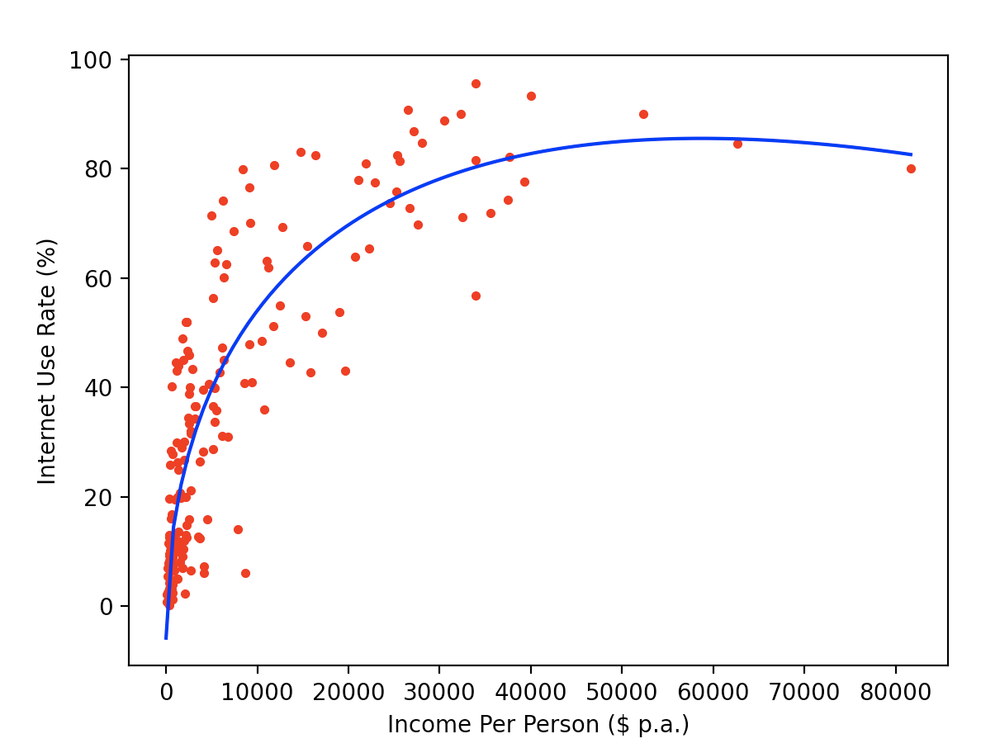
Regression Examples

Slide 11
Regression Example
Criticizing the model:
  We predict for high income countries, that internet usage goes down
    This is somewhat counterintuitive and based on a couple of outliers.

Slide 12
Regular Expression and Web Scraping

Slide 13
Important Preliminaries
On your own machine:
  Install pip3 (the python 3 version)
    You can invoke pip3 also by python3 -m pip
  Then install a number of packages:
    beautifulsoup4
      sudo python3 -m pip install beautifulsoup4
    requests

Slide 14
Scraping and Crawling
Both involve automatic ('bot') access to a web-site
Crawling tries to find and process all the information on all pages of the website
  Typically used by search engines
Scraping
  Used to obtain data contained in certain web-pages

Slide 15
Legal and Ethical Issues
Web-scrapping is sometimes considered a threat
  Because it creates real problems
  Because it accesses data for use against the business interests of the web service provider

Slide 16
Legal and Ethical Issues
Web-scraping can run afoul of:
  Existing and future laws
    In the US:
      Computer Fraud and Abuse Act, Digital Millennium Copyright Act,
  Terms of Use / Breach of Contract e.g. those in robots.txt
  Copyright
  ...

Slide 17
Legal and Ethical Issues
robots.txt gives conditions for automatic crawling
  No crawling:
  All crawling allowed:
  Block twitbot from crawling the indicated directory
User-agent: *
Disallow: /
User-agent: *
Disallow:
User-agent: twitbot
Disallow: /mysecrets/

Slide 18
Legal and Ethical Issues
robots.txt
  Needs to be called that (not Robots.txt)
  Needs to be placed in the top-level of the hierarchy
  needs to be publicly available
  subdomains will have to use separate robots files
  Can be used to provide a sitemap for crawlers (so that search engines will show your content)
    Sitemap: https://www.mysite.com/sitemap.xml

Slide 19
Legal and Ethical Issues
Aggressive scraping (and crawling) can become a Denial of Service Attack
  Server busy to answer scraping demands and cannot serve other traffic
  robots.txt can specify a desired back-off interval
    In general: do not access web-pages on a site without an interval of at least 10 seconds

Slide 20
Legal and Ethical Issues
Many sites provide APIs in order to allow users to make bulk-downloads of data
  This usually means they do not want to have their site scraped, so they offer a simpler alternative

Slide 21
Legal and Ethical Issues
Raw data is not protected by copy-right
Exceptions can arise when scraping is used to obtain the same functionality as the original site
Scraping needs to be done at a low level of intensity
Using an agent that sends identifying information with each request is useful
  Security pouring over logs can be put at ease with an explanation

Slide 22
Legal and Ethical Issues
Websites are free to ban robots by using a black-list for IP addresses
  Commercial crawling solutions exists that circumvent banning
    Imitate human user behavior
    Use many different IP addresses
    Automatic throttling of requests
The need and the existence of these automated crawlers show that:
  Scraping is in a legal and ethical gray-zone

Slide 23
Techniques
To download data from a website and prepare it for processing
  We need to access the website
  We need to find the data on the website and put it into a structure we can use
Before we code, we need to first understand the source of the website
After we obtained the data, we need to store it in a reasonable format

Slide 24
Understanding Web Sites
Access the target website
Use the developer tools or view the source
  Browser dependent

Slide 25
Understanding Web Sites
Milwaukee police maintains a website with current call data
  https://itmdapps.milwaukee.gov/MPDCallData/
  Goal is to download this data
  Use the "Show Source Functionality" of your browser on the website

Slide 26
Understanding Web Sites
<!DOCTYPE HTML>
<html>
<head>
<title>Milwaukee Police Department: Call for Service</title>
<meta http-equiv='X-UA-Compatible' content='IE=edge'>
<meta name='viewport' content='width=device-width, initial-scale=1'>
<link rel='stylesheet' href='/ItmdScripts/css/redesign.css' type='text/css'/>
<link rel='stylesheet' href='/ItmdScripts/css/city-various.css' type='text/css'/>
<script src='/ItmdScripts/js/jquery.min.js'></script>
<script src='/ItmdScripts/js/message.js'></script>
<script src='/ItmdScripts/js/mil-default.js'></script>
</head>
<body>
<div id='bg-div'>
<div data-role='page' class='main'>
<div data-role='header' class='redesign-header'>
<a id='lnk-citylogo' href='http://city.milwaukee.gov'>
<img alt='City of Milwaukee' src='//itmdapps.milwaukee.gov/templates/2014/city2013_logo.png'/>
</a>
<div class='city-title'>Official Website of the City of Milwaukee</div>
<div id='city-navbar-div'>
<div style='position: relative'>

Slide 27
Understanding Web Sites
Identify the data that we would like to extract
  In this case, data in a table
<tr style='border-style: none; border-collapse: collapse;'>
<td style='border: 1px solid black; border-collapse: collapse;'>201731019</td>
<td style='border: 1px solid black; border-collapse: collapse;'>06/21/2020 11:54:25 AM</td>
<td style='border: 1px solid black; border-collapse: collapse;'>6000 W SILVER SPRING DR,MKE</td>
<td style='border: 1px solid black; border-collapse: collapse; text-align: center;'>4</td>
<td style='border: 1px solid black; border-collapse: collapse;'>PATROL</td>
<td style='border: 1px solid black; border-collapse: collapse;'>Assignment Completed</td>
</tr>

Slide 28
Understanding Websites
Before we start downloading websites, let's first understand them
  Each web browser has a way to view the source of a website
  On Chrome, use Developer -> View Source
    Easiest tool for web development

Slide 29
Accessing Web Sites
Selenium: Module for automatic web application tests
  Automatically click links, pretend to be a certain browser, etc
  Useful when data is accessed after ajax requests
  Needs some downloads

Slide 30
Accessing a Web Site
Scrapy:
  Framework to run scraping and web crawling
  Developed by web-aggregation and e-commerce company Mydeco
  Maintained by Scrapinghub
  Interlaced with a commercial offering

Slide 31
Accessing websites
Requests
  Simple and basic translator for making url requests
    r = requests.get(address)
    Variable r.content now contains the contents of the web page (as a binary string)
    Variable r.text contains the contents as a string
      Requests will guess the encoding
      But you can set the encoding with
        response.encoding = 'utf-8'

Slide 32
Accessing websites
Requests
  Can use r.headers to obtain a dictionary-like object with various header values
  Can use query string in requests:
    Example:
requests.get('https://api.github.com/search/rep',
params=[('q', 'requests+language:python')])
requests.put('https://httpbin.org/put', data={'key':'value'})

Slide 33
Accessing Websites
Use regular expression (just a little bit)
Use beautiful soup (html parser)
Use requests

Slide 34
Regular Expressions
Python

Slide 35
Why
A frequent programming task is “filtering”
  Retain only those records that fit a certain pattern
  Typical part of big data and analytics applications
Example for text processing

Slide 36
Why
Whenever you deal with text processing
  Think about whether you want to use regular expressions

Slide 37
Why
Regular Expressions are a theoretical concept that is well understood
Many programming languages have a module for regular expressions
  Usually, very similar syntax and semantics
We can use ad hoc solutions, but regular expressions are almost always faster

Slide 38
How
Usually, we want to compile a regular expression
  This allows for faster scanning
    Compilation cost time
      But usually amortized very quickly
Python regular expressions are in module re
  Use p=re.compile('?')
    Where the question mark is the search string

Slide 39
How
A Python regular expression is a string that defines the search
The string is compiled
After compilation, a match, search, or findall is performed on all strings
  The output is None if the regular expression is not matched
  Otherwise, depending on the function, it provides the parts of the string that match

Slide 40
A first example
In a regular expression, most characters match themselves
  Unless they are “meta-characters” such as *, \, ^
E.G.: Find all lines in “alice.txt” with a double hyphen
Regular expression is '--'
Read in all lines of the text file, find the ones that match
  Need to use search, because match only matches at the beginning of a string

Slide 41
A first example
import re
p = re.compile('--')
def match1():
with open("alice.txt") as infile:
line_count = 0
for line in infile:
line_count+=1
line = line.strip()
if p.search(line):
print(line_count, line)
Import re
Compile the regular expression
Match lines with .search()

Slide 42
Using raw strings
A raw string is a string preceeded with a letter r:
  print(r'Hello World')
The difference to a normal string is that the escape character always means the escape character itself.
  print(r'\tHello') prints out \tHello
  print('\tHello') prints out Hello after a tab.
This can be very useful because we might on occasion have to escape the escape character several times.

Slide 43
Matching
Characters are the easiest to match
  Find all words in lawler.txt (a large list of English words) with a double “oo”
    Just change the expression
import re
p = re.compile('oo')
def match1():
with open("lawler.txt") as infile:
line_count = 0
for line in infile:
line_count+=1
line = line.strip()
if p.search(line):
print(line_count, line)

Slide 44
Matching
Letters and numbers match themselves
But are case sensitive
Punctuation marks often mean something else.

Slide 45
Matching
Square brackets [ ] mean that any of the enclosed characters will do
  Example: [ab] means either 'a' or 'b'
Square brackets can contain a range
  Example: [0-5] means either 0, 1, 2, 3, 4, or 5
A caret ^ means negation
  Example: [^a-d] means neither 'a', 'b', 'c', nor 'd'

Slide 46
Self Test
Find all lines in a file that have a double 'e'

Slide 47
Self Test Solution
import re
p = re.compile(r'ee')
def match_ee(filename):
with open(filename) as infile:
for line in infile:
if p.search(line):
print(line.strip())

Slide 48
Self Test 2
Find all lines in a file that have a double-'ee' followed by a letter between 'l' (el) and 'n'

Slide 49
Self Test 2 Solution
The only difference is in the regular expressions where
we have now a range of letters.
import re
p = re.compile(r'ee[l-m]')
def match_ee(filename):
with open(filename) as infile:
for line in infile:
if p.search(line):
print(line.strip())

Slide 50
Matching: Wild Cards
Wild Card Characters
  The simplest wild card character is the period / dot: “.”
  It matches any single character, but not a new line
  Example: Find all English words using Lawler.txt that have a patterns of an “a” followed by another letter followed by “a”
  Solution: Use p = re.compile('a.a')

Slide 51
Matching: Wild Cards
If you want to use the literal dot '.' you need to escape it with a backslash
Example: To match “temp.txt” you can use 't...\.txt'
  This matches any file name that starts with a t, has three characters afterwards, then a period, and then txt.

Slide 52
Matching: Repetitions
The asterisks repeats the previous character zero or more times
  Example: '\.[a-z]*' looks for a period, followed by any number of small letters, but will also match the simple string '.'
The plus sign repeats the previous character one or more times.
  Example: 'uni[a-z]+y' matches a string that starts with 'uni' followed by at least one small letter and terminating with 'y'
    This is difficult to read, as the + looks like an operation

Slide 53
Matching: Repetitions
Braces (curly brackets) can be used to specify the exact number of repetitions
  'a{1:4}' means one, two, three, or four letters 'a'
  'a{4:4}' means exactly four letters 'a'

Slide 54
Self Test
Print all file names in a directory that look like a Python file.
  Notice that ".py" is not a valid Python file. There must be something before the dot.

Slide 55
Self Test Solution
def get_python(dir_name):
python = re.compile('.+\\.py')
lista = os.listdir(dir_name)
for name in lista:
if python.match(name):
print(name)

Slide 56
Matching
\w stands for any letter (small or capital) or any digit
\W stands for anything that is not a letter or a digit
Example: Matching “n”+non-letter/digit+”t”
  p = re.compile(’n\\Wt')
    We need to double escape the backslash using normal Python strings
  p = re.compile(r’n\Wt')
    Or use a “raw string” (with an “r” before the string)
    In a raw string, the backslash is always a backslash
"Speak English!" said the Eaglet. "I don't know the meaning of half
They were indeed a queer-looking party that assembled on the bank

Slide 57
Matching
\s means a white space, newline, tab
\S means anything but a white space, newline, or tab
\d matches a digit
\t matches a tab
\r matches a return

Slide 58
Regular Expression Functions
Once compiled a regular expression can be used with
  match() matches at the beginning of the string and returns a match object or None
  search() matches anywhere in the string and returns a match object or None
  findall() matches anywhere in the string and does not return a match object

Slide 59
Match Objects
A match object has its own set of methods
  group() returns the string matched by the regular expression
  start()returns the starting position of the matched string
  end()returns the ending position
  span()returns a tuple containing the (start, end) positions of a match

Slide 60
Regular Expression Gotcha
Regular expression matching is greedy
  Prefers to match as much of the string as it possibly can
Example:
  Prints out
p3 = re.compile(r'.+\.py')
print( p3.search("This file, hello.py and this file world.py are python files"))
<re.Match object; span=(0, 42), match='This file, hello.py and this file world.py'>

Slide 61
Non-Greedy Matching
We can use the question mark qualifier to obtain a non-greedy match.
  p = re.compile('o.+?o')
Finds all non-overlapping, minimal instances

Slide 62
Advanced Topics
In this module we only scratched the surface.
There is excellent online documentation if you need more information
But this should be sufficient to do simple tasks such as data cleaning and web scraping

Slide 63
Webscraping with BeautifulSoup
Thomas Schwarz, SJ

Slide 64
Beautiful Soup
Module developed for parsing web-pages
  Current version is called bs4
  from bs4 import BeautifulSoup

Slide 65
Beautiful Soup Installation
Easy installation with pip
  Just remember that you need to install it for the correct Python version

Slide 66
HTML in Five Minutes
HTML is a markup language
  Tags < > are used to delimit elements
HTML documents start out and end with an <html> </html> tag
HTML documents consists of two parts:
  Head: <head> </head>
  Body: <body> </body>
    Head: Information on the page
    Body: The page itself

Slide 67
HTML in Five Minutes
Basic html elements:
  Text header <h1></h1>, ... <h6></h6>
  Paragraphs <p></p>
  Links <a> </a> anchors
  Images <im> </im>
  Lists <ul> <ol>
  Dividers <div>
  Spans <span>

Slide 68
HTML in Five Minutes
Often, tags have metadata embedded.
  Example:
  <a href="https://tschwarz.mscs.mu.edu">Schwarz </a>
    A link with a property href set
  An ordered list using capital letters as numbers
    <ol type = "A">

Slide 69
Beautiful Soup Parser
Start out by creating a Beautiful Soup object
  Need to have a parser attached
    Standard is the html parser
import requests
from bs4 import BeautifulSoup
r = requests.get(url)
soup = BeautifulSoup(r.content, 'html.parser')

Slide 70
Beautiful Soup Parser
We can use prettify( ) in order to find print out the contents of the beautiful soup obejct.
  Step 1: Import the modules
  Step 2: Scrape
  Step 3: Display the contents
from bs4 import BeautifulSoup
from requests import get
def scrape():
return get('https://tschwarz.mscs.mu.edu')
def display():
soup = BeautifulSoup(scrape().content,
features = 'html.parser')
print(soup.prettify())

Slide 71
Beautiful Soup Parser
The 'html.parser' comes with Python
There are a number of other parsers that can be installed
See the BeautifulSoup/bs4 documentation

Slide 72
BeautifulSoup Objects
An html tag defines an html element
  We can access tag elements from within BeautifulSoup
  The first tag element can be accessed just by using the tag
    Example: Getting the first li tag on my website:
import requests
from bs4 import BeautifulSoup
soup = BeautifulSoup(ts.content, 'html.parser')
print(soup.li)

Slide 73
Beautiful Soup Objects
HTML tags have names
  <a> (anchor) tag has name a
  <p> (paragraph) tag has name p
HTML tags have attributes
  class, id, style, ...

Slide 74
Beautiful Soup Objects
Getting the name of a tag:
We could actually change the name of a tag and thereby beautiful soup parse tree
import requests
from bs4 import BeautifulSoup
soup = BeautifulSoup(ts.content, 'html.parser')
li_tag = soup.li
print(li_tag.name) # prints out li

Slide 75
Beautiful Soup Objects
Getting attributes of a tag
  In the example, the li - tag has an anchor inside.
    We can get to the anchor
      The attributes are in a dictionary

Slide 76
Beautiful Soup Objects
Example
Prints out
Attributes are in a dictionary:
and accessible directly
print(li_tag.a)
<a class="tab_active" href="index.html" target="_self">Home</a>
>>> print(li_tag.a.attrs)
{'class': ['tab_active'], 'href': 'index.html',
'target': '_self'}
>>> print(li_tag.a['class'])
['tab_active']

Slide 77
Beautiful Soup Objects
To get to the text in a tag, use .string
>>> print(li_tag.a.string)
Home

Slide 78
Searches in Beautiful Soup
To search within a BeatifulSoup object, we can use
  find
    Only finds first occurrence
  find_all
    Returns a list of occurrences

Slide 79
Searches in Beautiful Soup
Find can use
  a tag , e.g. an anchor
  a text string or a regular expression
    Careful: You are looking for the exact string.
soup.find('a')
soup.find(name = 'a')
>>> mke = soup.find(text = re.compile('Milwaukee'))
>>> mke
'Milwaukee Police Department: Call for Service'
>>> mke = soup.find(text = 'Milwaukee')
>>> print(mke)
None

Slide 80
Searches in Beautiful Soup
Find can use attributes of tags
  Generic: Use attrs parameter with a dictionary
>>> footer = soup.find(attrs={'class' : "footer"})
>>> footer
<div class="footer" data-role="footer"><ul><li><a href="http://city.milwaukee.gov/Mayor">Mayor Tom Barrett</a></li><li><a href="http://city.milwaukee.gov/CommonCouncil">Common Council</a></li></ul><ul><li><a ...

Slide 81
Searches in Beautiful Soup
Can use find with a function
  Function is boolean, i.e. returns True or False

Slide 82
Searches in Beautiful Soup
find_all works like find, but returns a list of results
In addition, limit=n limits the list to the first results

Slide 83
Case Study: MPD
Go to https://itmdapps.milwaukee.gov/MPDCallData/ and save the file
  We do not want to upset the police

Slide 84
Case Study: MPD
First, we use beautiful soup to show us the file:
This is just a nicer version of the html file
  The call data is in a single table
def prob3():
with open('mpd.html') as mpd:
soup = BeautifulSoup(mpd, 'html.parser')
print(soup.prettify())

Slide 85
Case Study: MPD
Now let's find all tables: Look for tr
def prob4():
with open('mpd.html') as mpd:
soup = BeautifulSoup(mpd, 'html.parser')
results = soup.find_all('tr')
for item in results:
print('an item:')
print(item)
print()

Slide 86
Case Study: MPD
This gives us lots of tables, some belonging to navigation and some belonging to what we are looking for
The good stuff is the third item in the list
an item:
<tr style="border-style: none; border-collapse: collapse;">
<td style="border: 1px solid black; border-collapse: collapse;">201731676</td>
<td style="border: 1px solid black; border-collapse: collapse;">06/21/2020 04:56:37 PM</td>
<td style="border: 1px solid black; border-collapse: collapse;">2423 S 6TH ST,MKE</td>
<td style="border: 1px solid black; border-collapse: collapse; text-align: center;">2</td>
<td style="border: 1px solid black; border-collapse: collapse;">TRBL W/SUBJ</td>
<td style="border: 1px solid black; border-collapse: collapse;">Advised</td>
</tr>

Slide 87
Case Study: MPD
First, let's restrict ourselves to the good stuff
def prob5():
with open('mpd.html') as mpd:
soup = BeautifulSoup(mpd, 'html.parser')
results = soup.find_all('tr')[2:] #use slicing
return results

Slide 88
Case Study: MPD
Then inside these results, let's look for the columns (td)
def prob6():
with open('mpd.html') as mpd:
soup = BeautifulSoup(mpd, 'html.parser')
results = soup.find_all('tr')[1:]
for r in results:
print('\n')
for e in r.find_all('td'):
print(e)

Slide 89
Case Study: MPD
Now we can take out the contents
  Strategy:
    For each row create a dictionary
    Use
      to parse the date time
from dateutil.parser import parse

Slide 90
Case Study: MPD
def prob7():
findall = [ ]
with open('mpd.html') as mpd:
soup = BeautifulSoup(mpd, 'html.parser')
results = soup.find_all('tr')[2:]
for r in results:
entries = [e.contents[0] for e in r.find_all('td')]
datetime = parse(entries[1])
dicti = { 'id': entries[0],
'datetime': datetime,
'address': entries[2],
'district': entries[3],
'descr': entries[4],
'status': entries[5]}
findall.append(dicti)
return findall

Slide 91
Case Study: MPD
Finally, can create a data frame
data = pd.DataFrame(prob7())
>>> data.head()
id datetime ... descr status
0 201731692 2020-06-21 17:04:39 ... TRAFFIC HAZARD Assignment Completed
1 201731630 2020-06-21 17:03:42 ... ACC PDO Service in Progress
2 201731573 2020-06-21 17:03:09 ... FAMILY TROUBLE Advised
3 201731601 2020-06-21 17:02:26 ... THREAT Service in Progress
4 201731683 2020-06-21 17:02:05 ... ACC PI Service in Progress

Slide 92
Case Study: Finding Links
Let's use request in order to do some web-navigation
  Target is my web-site:
    https://tschwarz.mscs.mu.edu/Classes/
  We just beat up on this one

Slide 93
Case Study: Finding Links
First step:
  Store addresses in global constant
    Use the class Gl trick
class Gl:
site = 'https://tschwarz.mscs.mu.edu/Classes'
file = 'classes.html'
regex_headers = re.compile(r'<h.>.*?</h.>')
regex_links = re.compile(r'href=".*?"')
regex_div = re.compile(r'<div.*?>')

Slide 94
Case Study: Finding Links
Second step:
  Download the page
def get_links(site=Gl.site, file=Gl.file):
webpage = requests.get('/'.join([site, file])).text

Slide 95
Case Study: Finding Links
Third step:
  Find all links
    Links use the <a href = … > construct
class Gl:
regex_links = re.compile(r'href=".*?"')

Slide 96
Case Study: Finding Links
Third step:
  This will give us exactly the links as a list
['href="../style.css"', 'href="../style_extra.css"', 'href="../index.html"', 'href="../cv.html"', 'href="publications.html"', 'href="classes.html"', 'href="PDS/index.html"', 'href="Algo2020/index.html"', 'href="AlgoF2020/index.html"', 'href="PDS/index.html"', 'href="Ahmedabad2019/Python.html"', 'href="Ahmedabad2019/index.html"', 'href="Mumbai2019/index.html"', 'href="Mumbai2020/index.html"', 'href="AhmedabadDataAtScale/index.html"', 'href="COSC1010F2019/index.html"', 'href="COSC1010/index.html"', 'href="Algorithms/index.html"', 'href="DataAtScale/index.html"']

Slide 97
Case Study: Finding Links
We cut out the beginning 'html="' and the ending '"'
def get_links(site=Gl.site, file=Gl.file):
webpage = requests.get('/'.join([site, file])).text
lista = Gl.regex_links.findall(webpage)
for element in lista:
element = element[6:-1]
print(site+'/'+element)

Slide 98
Case Study: Finding Links
We could now add all of the resulting websites into a list
  Which we then could crawl, if we wanted to
def get_links(site=Gl.site, file=Gl.file):
webpage = requests.get('/'.join([site, file])).text
lista = Gl.regex_links.findall(webpage)
result = [ ]
for element in lista:
element = element[6:-1]
result.append(site+'/'+element)
return result

Slide 99
Case Study:
Downloading images from a web-site
Google has an API googlesearch that allows you to find addresses of pages with a query
Used this to obtain a random target
  Please be nice and find a different target because they might be paying per access to page

Slide 100
Case Study:
Downloading images from a web-site
Import the tools of the trade and set the target url
from bs4 import BeautifulSoup
import requests
import urllib.request
url = "http://thehibbitts.net/troy/photo/birds/sandhill_crane.htm"

Slide 101
Case Study:
Downloading images from a web-site
Use beautiful soup in order to find all instances of an img tag:
url = "http://thehibbitts.net/troy/photo/birds/sandhill_crane.htm"
response = requests.get(url)
soup = BeautifulSoup(response.text, "html.parser")
aas = soup.find_all("img")

Slide 102
Case Study:
Downloading images from a web-site
>>> aas
[<img height="600" src="sandhill.cranes.tx.archer.17.1.3956.jpg" width="900"/>, <img height="600" src="sandhill.cranes.tx.archer.17.1.3986.jpg" width="900"/>, <img height="600" src="sandhill.cranes.tx.archer.17.1.3997.jpg" width="900"/>, <img height="558" src="sandhill.crane.mi.delta.16.1.0145.jpg" width="834"/>, <img height="558" src="sandhill.crane.mi.delta.16.1.0139.jpg" width="834"/>, <img height="600" src="sandhill.cranes.wi.jackson.13.1.0095.jpg" width="900"/>, <img height="600" src="sandhill.cranes.wi.jackson.13.1.0086.jpg" width="900"/>, <img border="0" height="555" src="sandhill.cranes.tx.uvalde.10.1a.jpg" width="835"/>, <img border="0" height="554" src="sandhill.cranes.tx.uvalde.10.1b.jpg" width="834"/>, <img border="0" height="554" src="sandhill.cranes.tx.uvalde.10.1c.jpg" width="834"/>, <img border="0" height="602" src="sandhill.cranes.tx.uvalde.07.1a1.jpg" width="837"/>, <img border="0" height="577" src="sandhill.cranes.tx.uvalde.07.1a.jpg" width="838"/>]

Slide 103
Case Study:
Downloading images from a web-site
Convert them to strings and divide them into components
Then extract the url
for line in aas:
line = str(line)
components = line.split()
for component in components:
if component.startswith('src'):
image_url = component[5:-1]

Slide 104
Case Study:
Downloading images from a web-site
Then get the image and save it as a file under the same name
imurl = "http://thehibbitts.net/troy/photo/birds/"+image_url
image = requests.get(imurl).content
with open(image_url, 'wb') as file:
file.write(image)

Slide 105
Case Study:
Downloading images from a web-site
Result:
  You downloaded all the images

Slide 106
Summary
If data is published on the web:
  First, see whether the data is available through an API
    Administrators get annoyed if people scrape unnecessarily
  If data is available only as html data:
    Be careful in making large number of requests.
      This can get you banned / blacklisted
    You might get a complaint from the legal department
      Which is usually not valid unless you exploit for commercial nature

