Slide 1
Classes 3
Thomas Schwarz, SJ

Slide 2
Classes through Special Methods
Python:
  Many mechanisms use specialized (= dunder) methods

Slide 3
Classes through Special Methods
Example: Playing cards (again)
class Card:
def __init__(self, suite, rank):
self.suite = suite
self.rank = rank
def __str__(self):
return "({:2s},{:2s})".format(
self.suite[:2],
self.rank[:2])
def __retr__(self):
return '[Card' + str(self)+']'

Slide 4
Classes through Special Methods
Can find all attributes of an instance defined using __dict__ or dir :
>>> c=Card('heart', 'king')
>>> c.__dict__
{'suite': 'heart', 'rank': 'king'}
>>> dir(c)
['__class__', '__delattr__', '__dict__', '__dir__', '__doc__', '__eq__', '__format__', '__ge__', '__getattribute__', '__gt__', '__hash__', '__init__', '__init_subclass__', '__le__', '__lt__', '__module__', '__ne__', '__new__', '__reduce__', '__reduce_ex__', '__repr__', '__retr__', '__setattr__', '__sizeof__', '__str__', '__subclasshook__', '__weakref__', 'rank', 'suite']

Slide 5
Classes through Special Methods
Equality versus Identity
  Default evaluation for == looks at location of storage
    Can get storage location with object.__repr__( )
    Or in most Python implementation, with id
>>> id(d)
140299613922544
>>> object.__repr__(d)
'<__main__.Card object at 0x7f9a0ca664f0>'
>>> hex(id(d))
'0x7f9a0ca664f0'

Slide 6
Classes through Special Methods
Equality versus Identity
  This is usually not the behavior we want
    Equality means all attributes are equal
    Need to define __eq__ in your class
class Card:
def __eq__(self, other):
return self.suite==other.suite and self.rank==other.rank
>>> d=Card('heart', 'king')
>>> c=Card('heart', 'king')
>>> d==c
True

Slide 7
Classes through Special Methods
Equality versus Identity
  We can still compare for identity with is
>>> d is c
False

Slide 8
Classes through Special Methods
‘You are sad,’ the Knight said in an anxious tone: ‘let me sing you a song to comfort you.’
‘Is it very long?’ Alice asked, for she had heard a good deal of poetry that day.
‘It’s long,’ said the Knight, ‘but very, very beautiful. Everybody that hears me sing it—either it brings the tears into their eyes, or else—’
‘Or else what?’ said Alice, for the Knight had made a sudden pause.
‘Or else it doesn’t, you know. The name of the song is called “Haddocks’ Eyes.”’
‘Oh, that’s the name of the song, is it?’ Alice said, trying to feel interested.
‘No, you don’t understand,’ the Knight said, looking a little vexed. ‘That’s what the name is called. The name really is “The Aged Aged Man.”’
‘Then I ought to have said “That’s what the song is called”?’ Alice corrected herself.
‘No, you oughtn’t: that’s quite another thing! The song is called “Ways and Means”: but that’s only what it’s called, you know!’
‘Well, what is the song, then?’ said Alice, who was by this time completely bewildered.
‘I was coming to that,’ the Knight said. ‘The song really is “A-sitting On A Gate”: and the tune’s my own invention.’

Slide 9
Classes through Special Methods
We cannot make cards into elements of sets without making them hashable
>>> seta = {c}
Traceback (most recent call last):
File "<pyshell#36>", line 1, in <module>
seta = {c}
TypeError: unhashable type: 'Card'

Slide 10
Classes through Special Methods
Need to declare a method __hash__ and a method __eq__
  Now it works
class Card:
def __hash__(self):
return hash(self.suite)*hash(self.rank)
>>> c = Card('heart', 'king')
>>> seta = {c}
>>> c in seta
True

Slide 11
Classes through Special Methods
But to do this, we should make cards immutable
  Right now, we can just say
Strategy: declare the components private
Create a getter function
  Which we do by using a property generator
c.rank = 'ace'

Slide 12
Classes through Special Methods
Implementation
class Card:
def __init__(self, suite, rank):
self._suite = suite
self._rank = rank
@property
def suite(self):
return self._suite
@property
def rank(self):
return self._rank
private attributes

Slide 13
Classes through Special Methods
Implementation
class Card:
def __init__(self, suite, rank):
self._suite = suite
self._rank = rank
@property
def suite(self):
return self._suite
@property
def rank(self):
return self._rank
made to behave like attributes

Slide 14
Classes through Special Methods
"Perl does not have an infatuation with enforced privacy. It would prefer that you stayed out of its living room because you weren't invited, not because it has a shot-gun."
- -Larry Wall, Creator of Perl

Slide 15
Classes through Special Methods
Containers:
  Example: a deck of cards
class Deck:
def __init__(self, suites, ranks):
self.cards = [Card(s,r) for s in suites for r in ranks]
def __str__(self):
retVal = [ ]
for card in self.cards:
retVal.append(str(card))
return '\n'.join(retVal)

Slide 16
Classes through Special Methods
We want:
  Sequences: length and [ ]
  Slicing

Slide 17
Classes through Special Methods
Implementing sequencing
  Define __len__ and __getitem__
class Deck:
def __len__(self):
return len(self.cards)
def __getitem__(self, i):
return self.cards[i]

Slide 18
Classes through Special Methods
Now we can do the following:
  Get an element
  Randomly select
  Use slices
>>> import random
>>> deck = Deck(suites, rank)
>>> random.choice(deck)
>>> print(deck[5:10])
>>> print(deck[3])

Slide 19
Classes through Special Methods
But we cannot shuffle a deck of cards
>>> random.shuffle(deck)
Traceback (most recent call last):
File "<pyshell#66>", line 1, in <module>
random.shuffle(deck)
File "/Library/Frameworks/Python.framework/Versions/3.8/lib/python3.8/random.py", line 307, in shuffle
x[i], x[j] = x[j], x[i]
TypeError: 'Deck' object does not support item assignment

Slide 20
Classes through Special Methods
We need to implement a __setitem__ method
def __setitem__(self, position, card):
self.cards[position] = card

Slide 21
Classes through Special Methods
>>> deck = Deck(suites, ranks)
>>> import random
>>> random.shuffle(deck)
>>> print(deck)
(cl,ki)
(di,ja)
(cl,4 )
(he,3 )
(cl,9 )

Slide 22
Classes through Special Methods
We could even use monkey-patching
  Define a function that takes deck, position, and card as arguments
  Dynamically create a Deck.__setitem__ method
Deck.__setitem__ = setcard

Slide 23
Inheritance
"We started to push on the inheritance idea as a way to let novices build on frameworks that could only be assigned by experts"
- -Alan Kay: The Early History of Smalltalk

Slide 24
Inheritance
To inherit from a class, just add the name of the base class in parenthesis
class BlackjackCard(Card):

Slide 25
Inheritance
To initialize a derived class, usually want to call the initializer of the base class
values = {'ace':11, '2':2, '3':3, '4':4, '5':5, '6':6, '7':7, '8':8,
'9':9, '10':10, 'jack':10, 'queen':10, 'king':10}
class BlackjackCard(Card):
def __init__(self, suite, rank):
super().__init__(suite, rank)
self.value = values[rank]
self.softvalue = 1 if rank=='ace' else self.value
def __str__(self):
return "{} of {} with value {}({})".format(
self.rank,
self.suite,
self.value,
self.softvalue
)

Slide 26
Inheritance
Notice:
  All methods in the base class are still available and attributes
  But we can also override them
def __hash__(self):
return super().__hash__()^self.softvalue
Calling base class function

Slide 27
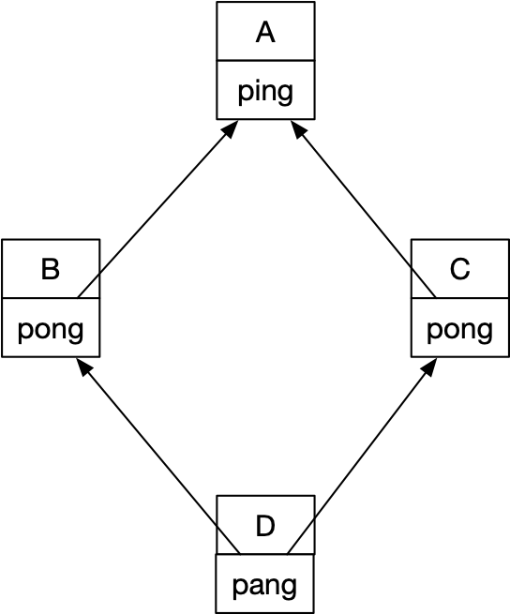
Inheritance
Multiple inheritance
  Allowed but tricky
  Diamond Problem
class A:
def ping(self):
print('ping')
class B:
def pong(self):
print('pong')
class C:
def pong(self):
print('PONG')
class D(B,C):
def ping(self):
super().ping()
def pang(self):
super().ping()
super().pong()
    C.pong(self)

Slide 28
Inheritance
class D(B,C):
def ping(self):
super().ping()
def pang(self):
super().ping()
super().pong()
    C.pong(self)
Method Resolution for d.pong( ):
  First look in the current class
  Then look into B
  Then look into C
  Then look into A
Implemented via __mro__, which lists the classes in a certain order
Can avoid ambiguity by giving explicit class names in the invocation

Slide 29
Inheritance
Multiple inheritance can be used
  Can use inheritance to define an interface:
    A base class that requires that certain methods are implemented
  Then multiple inheritance is fine

Slide 30
Operator Overloading
Fundamental Rule:
  Do not overload operators that do not make sense
    E.g. Addition for cards makes no sense
    Addition for complex numbers makes sense

Slide 31
Operator Overloading
Unary Operations:
  - __neg__
    Negative
  + __pos__
    +x is not always the same as x
  ~ __inv__
    Bitwise inverse of an integer

Slide 32
Operator Overloading
Binary Operations
  When confronted with an expression
    a ^ b
  Python looks into the class of a for a method __xor__(self, other)
  If not found, then Python looks into the class of b for a method __rxor__(self, other)

Slide 33
Operator Overloading
Binary Operations
  When Python sees a ^= b
  Then Python looks into the class of a for a method __ixor__(a,b)
    a = ixor(a,b) is equivalent to a^=b

Slide 34
Operator Overloading
Implementation:
  All methods need to return an object
  Operands do not have to be from the same class

Slide 35
Operator Overloading
class Complex:
def __init__(self, re, im):
self.re = re
self.im = im
def __str__(self):
return "({},{})".format(self.re, self.im)
def __add__(self, other):
return Complex(self.re+other.re, self.im+other.im)
def __iadd__(self, other):
self.re += other.re
self.im += other.im
return self
def __radd__(self, other):
return self+other

Slide 36
Interfaces
Interfaces encapsulate how a user can use a certain set of classes
Python does not need interfaces and only implemented them as Abstract Base Classes (ABC) in 3.4

Slide 37
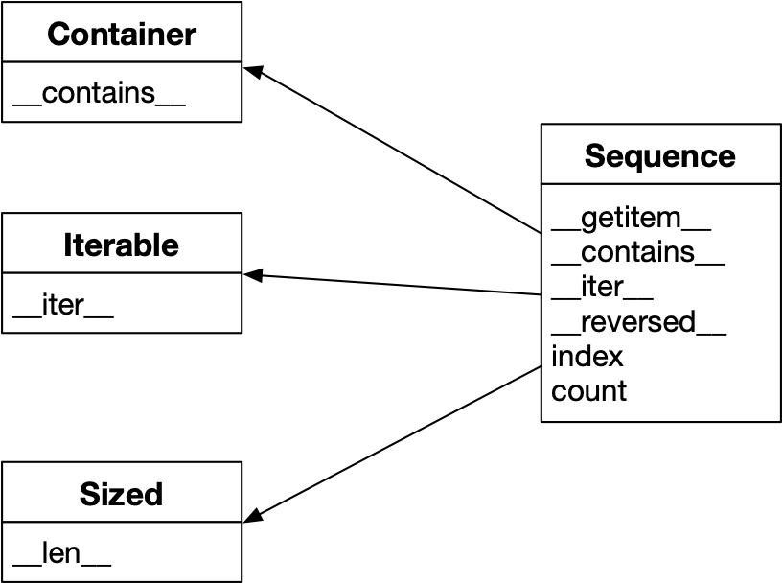
Interfaces
Example: Sequences
An interface describes what can be invoked

Slide 38
Interfaces
Example: Sequences
  Some missing methods can be implemented via other methods
    in still works even without __contains__ and __iter__

Slide 39
Interfaces
ABC: Abstract Base Class
  A class that does not have any methods implemented
If you derive a class from an ABC:
  You have to implement these methods
  You make a public declaration that these methods are in your class

Slide 40
Interfaces
class FrenchDeck(collections.MutableSequence):
ranks = [str(n) for n in range(2, 11)] + list('JQKA')
suits = 'spades diamonds clubs hearts'.split()
def __init__(self):
self._cards = [Card(rank, suit) for suit in self.suits
for rank in self.ranks]
def __len__(self):
return len(self._cards)
def __getitem__(self, position):
return self._cards[position]
def __setitem__(self, position, value):
self._cards[position] = value
def __delitem__(self, position):
del self._cards[position]
def insert(self, position, value):
self._cards.insert(position, value)

Slide 41
Interfaces
Here we have to implement methods that do not make sense for a deck of cards because MutableSequence demands them
But now we get a whole lot of other methods that are implemented in terms of these methods

