Slide 1
Dictionaries
Thomas Schwarz, SJ

Slide 2
Opening and Reading Text Files
Python follows the posix conventions:
  You can open a file
  You can interact with a file
  You then close the file
Easiest done with a Python context
  The context automatically closes the file after use
with open(filename) as infile:
|— statement block —|

Slide 3
Opening and Reading Text Files
To read from a file, we can use a for loop
    Within the for loop, we can use strip( ) in order to break the line apart at white spaces
with open(filename) as infile:
for line in infile:
|— do something with each line
with open(filename) as infile:
for line in infile:
for words in line.split( )

Slide 4
Dictionaries
Python has a efficient association data structure — the dictionary
  Dictionary pairs keys with values
    Useful for: indices
    Useful for: translations
    Useful for: quick lookups
      E.g.: first letters —> full email address
      E.g.: human-readable URL —> IP address
      …

Slide 5
Dictionaries
Dictionaries are key-value stores
  Keys — anything, but needs to be immutable
    Remember: Lists are mutable, strings are immutable
  Value — anything

Slide 6
Dictionaries
Dictionaries are created by using curly brackets
  Can use lists
          dicc = {1: ‘uno’, 2: ‘dos’, 3: ‘tres’}
  Or can use assignment
      dicc = {}
          dicc[1] = “uno”
            dicc[2] = “dos”
            dicc[3] = “tres”
Values are assigned / retrieved using the bracket notation

Slide 7
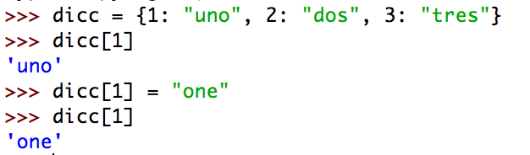
Dictionary
Dictionary dicc={}
Accessing values:
            dicc['key']
  With default value
            dicc.get(key, default_value)
  Or with if - else
            if key in dicc:
Creating / changing values
        dicc['key'] = value

Slide 8
Dictionary
Deleting from a dictionary
        dicc = {}
  Use the del keyword
    Raises a key error if the key is not in the dictionary
      if key in dicc:
      del dicc[key]
  Use the pop method, which returns the value
                value = dicc.pop(key)
                value = dicc.pop(key, default)

Slide 9
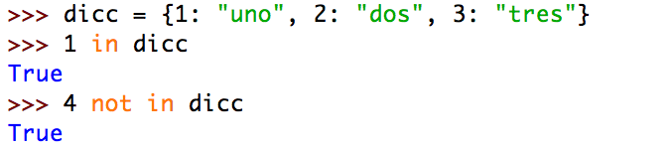
Dictionary
Checking for existence
  Use the “in” keyword

Slide 10
Dictionaries
A simple program that “learns” Spanish words
def test():
dicc = {}
while True:
astr = input("Enter an English word: ")
if astr == "Stop it":
return
elif astr in dicc:
print(dicc[astr])
else:
print("I have not yet learned this word")
val = input("Please enter the Spanish word: ")
dicc[astr] = val

Slide 11
Dictionaries
Dictionaries have an internal structure
  You will learn in Data Structures how to build dictionaries yourselves
  For the moment, enjoy their power
You can print dictionaries
  You will notice that they change structure after inserts and not reflect the order in which you inserted elements
  This is because they optimize access

Slide 12
Dictionaries
Deleting all entries in a dictionary
  use the clear() method
Deleting an entry without fear of creating a key error
  Use an if statement
  Use pop with a second argument None
    dicc.pop(1, None)

Slide 13
Dictionaries
Looping over keys
  Simplest:
    for number in dicc:
  iterkeys( ) or iter works the same way
    for number in dicc.iterkeys():
    for number in iter(dicc):

Slide 14
Some Uses of Dictionaries
Dictionaries can be used to count things.
  Example: Count the number of letters in a file.
    We open the file with encoding latin-1 so that there are no encoding errors
alphabet = "abcdefghijklmnopqrstuvwxyz"
with open("alice.txt", encoding = "latin-1") as infile:
dicc = {}
for letter in alphabet:
dicc[letter]=0

Slide 15
Some Uses of Dictionaries
Create and initialize a dictionary
  We are only interested in letters
alphabet = "abcdefghijklmnopqrstuvwxyz"
with open("alice.txt", encoding = "latin-1") as infile:
dicc = {}
for letter in alphabet:
dicc[letter]=0

Slide 16
Some Uses of Dictionaries
Read the file line by line.
  Read each letter in the line
    After changing to lower case, update dictionary
alphabet = "abcdefghijklmnopqrstuvwxyz"
with open("alice.txt", encoding = "latin-1") as infile:
dicc = {}
for letter in alphabet:
dicc[letter]=0
for line in infile:
for letter in line:
letter=letter.lower()
if letter in alphabet:
dicc[letter]+=1

Slide 17
Some Uses of Dictionaries
Now process the dictionary
  Calculate the sum of values (i.e. the counts)
  Pretty-print the results
for letter in alphabet:
cum += dicc[letter]
for letter in alphabet:
print("{:1s} {:5d} {:5.2f}%”.format(
letter, dicc[letter], dicc[letter]/cum*100))

Slide 18
Some Uses of Dictionaries
Using lists as dictionary values
  in order to create an index of words in a file

Slide 19
Some Uses of Dictionaries
Open file with encoding “latin-1”
  Read file line by line
    Break line into words
    Normalize words by stripping and lowering
with open("alice.txt", encoding = "latin-1") as infile:
index = {}
word_count = 0
for line in infile:
for word in line.split():
word_count += 1
word = word.lower().strip(",.;:?![]-'\"")

Slide 20
Some Uses of Dictionaries
Add word to dictionary if long enough
with open("alice.txt", encoding = "latin-1") as infile:
index = {}
word_count = 0
for line in infile:
for word in line.split():
word_count += 1
word = word.lower().strip(",.;:?![]-'\"")
if len(word)>7:
if word in index:
index[word].append(word_count)
else:
index[word] = [word_count]

Slide 21
Some Uses of Dictionaries
Print out results if word is frequent enough
for word in index:
if len(index[word])>2:
print(word, index[word])

Slide 22
A Teaser on Iterators
Iterators are the hidden engine of many Python features
  Iterators are almost like lists
    You always can get the next element
      Unless you are at the end of a list
  But they are not lists:
    All the elements in the list have to be there before the list can be used
      They need to be stored in memory
      Which uses up space
      And can be disastrous if there are just too many

Slide 23
A Teaser on Iterators
Iterators are only created when there is a need
Iterators are often hidden from view
But we will have to use them
  For our purposes:
    We can make them explicitly into lists because we are just not working with millions of data items
    But hopefully, once we get to play with the grown-ups …
Seriously, we get back to iterators

Slide 24
Multi-Dictionaries
Problem:
  Instead of associating one value with a key, we want to associate several values:
    a “multi-dictionary”
Solution:
  The values of the dictionaries should be lists (or sets — coming week)

Slide 25
Multi-Dictionaries
Example:
  We want to pass through a file and create an index of important words with their occurrences
with open("alice.txt", encoding = "latin-1") as infile:
dicc = {}
word_number = 0
for line in infile:
for word in line.split():
word = word.strip(":,.?![]'")
word = word.lower()
                word_number +=1
if len(word)>8:
if word in dicc:
dicc[word].append(word_number)
else:
dicc[word]=[word_number]

Slide 26
Calculating on Values
Assume you have a dictionary with numerical values
  For example: a dictionary with the prices of stocks on September 15, 2018
  You want the average, the maximum, the minimum … price
dstocks = {“tata”: 2063.30,
            “hdfc”: 2029.20,
            “hiul”: 1630.15,
            …
                }

Slide 27
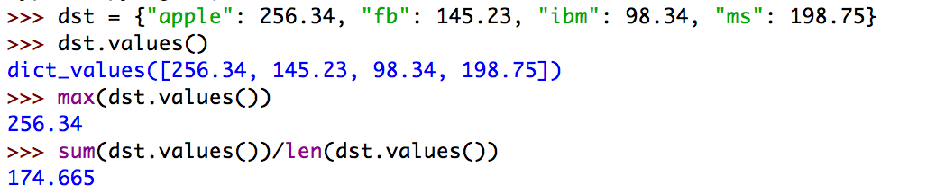
Solution
You can access the values of a dictionary through the values method.
  values( ) returns an iterator of all the values in the dictionary

Slide 28
Calculating with keys
Problem:
  You want to calculate on the keys of a dictionary
Solution:
  The keys( ) method returns an iterator of the keys of a dictionary

Slide 29
Finding the most common item in a list
We use a dictionary as a counter.
  First way: We can do so by ourselves.
    Create a dictionary
      Pass through the list
get specifies a default value,
it is otherwise equivalent to counter[x]
def most_frequent(lista):
counter = {}
for x in lista:
counter[x]=counter.get(x, 0)+1

Slide 30
Finding the most common item in a list
If we do not want to use get, we can just check whether the list-item is already in the dictionary
def most_frequent(lista):
counter = {}
for x in lista:
if x in counter:
counter[x]+=1
else:
counter[x]=1

Slide 31
Finding the most common item in a list
After counting, we pass through the dictionary to find the maximum element.
  Notice that we are interested in the key, not the value
highest_seen contains the highest encountered value
def most_frequent(lista):
counter = {}
for x in lista:
counter[x]=counter.get(x, 0)+1
highest_seen = 0
for x in counter:
if counter[x]>highest_seen:
best_key = x
highest_seen = counter[x]
return best_key

Slide 32
Finding the most common item in a list
After counting, we pass through the dictionary to find the maximum element.
  Notice that we are interested in the key, not the value
highest_seen is adjusted whenever we see a higher value in the counter
def most_frequent(lista):
counter = {}
for x in lista:
counter[x]=counter.get(x, 0)+1
highest_seen = 0
for x in counter:
if counter[x]>highest_seen:
best_key = x
highest_seen = counter[x]
return best_key

Slide 33
Finding the most common item in a list
After counting, we pass through the dictionary to find the maximum element.
  Notice that we are interested in the key, not the value
but we also need to remember the key,
which we record in best_key
def most_frequent(lista):
counter = {}
for x in lista:
counter[x]=counter.get(x, 0)+1
highest_seen = 0
for x in counter:
if counter[x]>highest_seen:
best_key = x
highest_seen = counter[x]
return best_key

Slide 34
Finding the most common item in a list
After counting, we pass through the dictionary to find the maximum element.
  Notice that we are interested in the key, not the value
because the key with the highest counter value is the result that we return
def most_frequent(lista):
counter = {}
for x in lista:
counter[x]=counter.get(x, 0)+1
highest_seen = 0
for x in counter:
if counter[x]>highest_seen:
best_key = x
highest_seen = counter[x]
return best_key

Slide 35
Finding the most common item in a list
But we can also use the work of others
  The Counter in the collections module
    You create a new object of type Counter
from collections import Counter
def most_frequent(lista):
ctr = Counter()
Defines a new object called ctr
ctr is an object of type Counter

Slide 36
Finding the most common item in a list
Counters are (updated) like dictionaries
  But they have a default value of 0
from collections import Counter
def most_frequent(lista):
ctr = Counter()
for item in lista:
ctr[item] += 1
Here we add 1 to the value of ctr[item]
No need to initialize!

Slide 37
Finding the most common item in a list
Counters have a method called most_common
  Argument is the number of most common items
  Returns a list of pairs
Get a list of one elements.
Get the first (and only) element of the list
Get the first coordinate of that element
from collections import Counter
def most_frequent(lista):
ctr = Counter()
for item in lista:
ctr[item] += 1
return ctr.most_common(1)[0][0]

Slide 38
Memoization
(Some) Computer Scientists love recursion
  A function calls itself
    This is super-elegant and the more mathematically inclined pine for this elegance
  But it is not necessarily very fast
    The more engineeringly inclined think its a waste

Slide 39
Recursion
When it works
  Factorials
    The factorial of n is n (n-1) (n-2) (n-3) … (4) (3) (2) (1)
    Define it to be one for negative or zero n

Slide 40
Recursion
This implementation has the function factorial call itself
def factorial(number):
if number<1:
return 1
else:
return number*factorial(number-1)
Here we are calling on the function itself
Will call factorial(number-1), which will call factorial(number-2), which will call factorial(number -3) … until we call factorial on 1, in which case the recursion stops.

Slide 41
Recursion
This implementation has the function factorial call itself
def factorial(number):
if number<1:
return 1
else:
return number*factorial(number-1)
The base case:
  We cannot call recursion infinitely often, so we need one.

Slide 42
Recursion
The Fibonacci numbers
  The Fibonacci numbers are defined recursively
$$f_{0}=0,f_{1}=1,f_{n}=f_{n-1}+f_{n-2}$$
def fibonacci(number):
if number <= 0:
return 0
if number == 1:
return 1
return fibonacci(number-1)+fibonacci(number-2)

Slide 43
Recursion
But this implementation is inane!
  Takes too long even for small numbers.
    We can use the time-module in order to obtain the cpu-time
      We do so once before and after execution of the function
    This yields approximately the time it takes to execute the function

Slide 44
Recursion
We just write a function that measures the time
def measure(function, number):
start = time.time()
function(number)
print(number, time.time()-start)

Slide 45
Recursion
Now we try it out with factorial and fibonacci
  Not a problem with factorial
27 1.52587890625e-05
28 1.5974044799804688e-05
29 1.52587890625e-05
30 1.5735626220703125e-05
31 1.811981201171875e-05
32 1.71661376953125e-05
33 1.7881393432617188e-05
34 1.7881393432617188e-05
35 1.9073486328125e-05
36 1.9788742065429688e-05
37 1.8835067749023438e-05
38 2.09808349609375e-05
39 2.193450927734375e-05

Slide 46
Recursion
But disastrous for Fibonacci
It takes 34 seconds in order to calculate fibonacci(39).
28 0.17530512809753418
29 0.27112603187561035
30 0.43769311904907227
31 0.7113552093505859
32 1.1374599933624268
33 1.846013069152832
34 2.9945621490478516
35 4.856478929519653
36 7.85633397102356
37 12.681456804275513
38 20.59703803062439
39 33.98105502128601

Slide 47
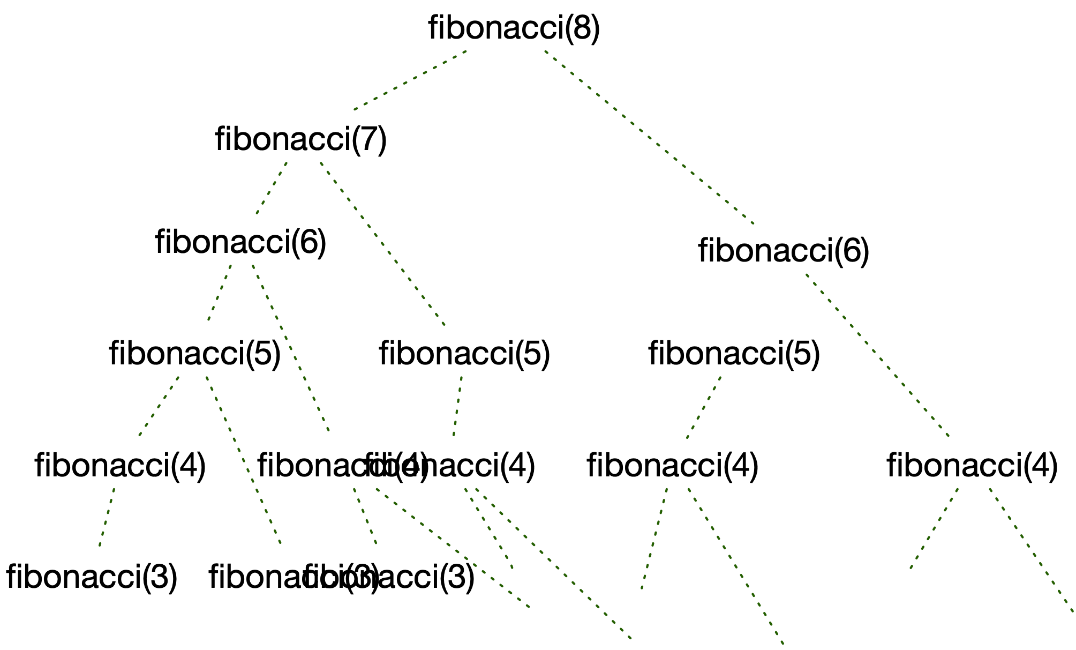
Recursion
What is the problem?
  Look at what happens if we calculate fibonacci(9).
  We calculate fibonacci(8) and fibonacci(7)
    Since the first one also calculates fibonacci(7), we calculate fibonacci(7) twice.
    And it gets worse for fibonacci(6), fibonacci(5), …

Slide 48
Memoization
A simple trick to speed up recursive functions is to remember values that we have already calculated.
Create a dictionary (possibly global) that stores values already calculated
  Before any calculation check whether the desired value is in the dictionary
  If we calculate something, we put the value into the dictionary

Slide 49
Memoization
fdic={0: 0, 1:1}
def fibonacci2(number):
if number in fdic:
return fdic[number]
else:
retval = fibonacci2(number-1)+fibonacci2(number-2)
fdic[number] = retval
return retval
for i in range(41):
measure(fibonacci2, i*50)

Slide 50
Memoization
fdic={0: 0, 1:1}
def fibonacci2(number):
if number in fdic:
return fdic[number]
else:
retval = fibonacci2(number-1)+fibonacci2(number-2)
fdic[number] = retval
return retval
for i in range(41):
measure(fibonacci2, i*50)
Defining the dictionary

Slide 51
Memoization
fdic={0: 0, 1:1}
def fibonacci2(number):
if number in fdic:
return fdic[number]
else:
retval = fibonacci2(number-1)+fibonacci2(number-2)
fdic[number] = retval
return retval
for i in range(41):
measure(fibonacci2, i*50)
Check whether value is in the dictionary

Slide 52
Memoization
fdic={0: 0, 1:1}
def fibonacci2(number):
if number in fdic:
return fdic[number]
else:
retval = fibonacci2(number-1)+fibonacci2(number-2)
fdic[number] = retval
return retval
for i in range(41):
measure(fibonacci2, i*50)
Calculation is necessary

Slide 53
Memoization
fdic={0: 0, 1:1}
def fibonacci2(number):
if number in fdic:
return fdic[number]
else:
retval = fibonacci2(number-1)+fibonacci2(number-2)
fdic[number] = retval
return retval
for i in range(41):
measure(fibonacci2, i*50)
But we store the result in the dictionary in case we use it in the future

Slide 54
Memoization
fdic={0: 0, 1:1}
def fibonacci2(number):
if number in fdic:
return fdic[number]
else:
retval = fibonacci2(number-1)+fibonacci2(number-2)
fdic[number] = retval
return retval
for i in range(41):
measure(fibonacci2, i*50)
And now we measure

Slide 55
Decorators
Python uses decorators to allow changing functions
A decorator is implemented by:
  Creating a function of a function that returns the amended function

Slide 56
Decorators
def timeit(function):
def clocked(*args):
start_time = time.perf_counter()
result = function(*args)
duration = (time.perf_counter() - start_time)
name = function.__name__
arg_string = ', '.join(repr(arg) for arg in args)
print('Function {} with arguments {} ran
in {} seconds'.format(
name, arg_string, duration))
return result
return clocked

Slide 57
Decorators
Decorator takes a function with positional arguments as function
Decorator defines a new version of the argument function
And returns it.

Slide 58
Decorators
def timeit(function):
def clocked(*args):
start_time = time.perf_counter()
result = function(*args)
duration = (time.perf_counter() - start_time)
name = function.__name__
arg_string = ', '.join(repr(arg) for arg in args)
print('Function {} with arguments {} ran
in {} seconds'.format(
name, arg_string, duration))
return result
return clocked

Slide 59
Decorators
To use a decorator, just put its name on top of the function definition
  Decorator generator is executed when module is imported (or generator is defined)
  When decorated function is defined, the modified version is created

Slide 60
Decorators
@timeit
def fibonacci(n):
if n == 0:
return 0
if n == 1:
return 1
else:
return fibonacci(n-1)+fibonacci(n-2)

Slide 61
Decorators
If we execute this function, we get to see how often fibonacci is called on arguments already executed
>>> fibonacci(10)
Function fibonacci with arguments 1 ran in 5.140000070014139e-07 seconds
Function fibonacci with arguments 0 ran in 1.0870000011209413e-06 seconds
Function fibonacci with arguments 2 ran in 0.1692790839999958 seconds
Function fibonacci with arguments 1 ran in 1.2330000060956081e-06 seconds
Function fibonacci with arguments 3 ran in 0.2676633440000131 seconds
Function fibonacci with arguments 1 ran in 9.8000001003129e-07 seconds
Function fibonacci with arguments 0 ran in 1.0470000120221812e-06 seconds
Function fibonacci with arguments 2 ran in 0.09880945999999824 seconds
Function fibonacci with arguments 4 ran in 0.4692909440000079 seconds
Function fibonacci with arguments 1 ran in 6.51999997103303e-07 seconds
Function fibonacci with arguments 0 ran in 1.0500000087176886e-06 seconds
Function fibonacci with arguments 2 ran in 0.11281222700000626 seconds
Function fibonacci with arguments 1 ran in 1.958000012791672e-06 seconds
Function fibonacci with arguments 3 ran in 0.21685028000000273 seconds
Function fibonacci with arguments 5 ran in 0.7868284680000102 seconds
Function fibonacci with arguments 1 ran in 5.6999999742402e-07 seconds
Function fibonacci with arguments 0 ran in 1.0729999928571488e-06 seconds
Function fibonacci with arguments 2 ran in 0.11366798399998856 seconds
Function fibonacci with arguments 1 ran in 1.2930000110600304e-06 seconds
Function fibonacci with arguments 3 ran in 0.2176230820000029 seconds
Function fibonacci with arguments 1 ran in 5.839999914769578e-07 seconds

Slide 62
Memoization with lru_cache
We can define our own memoization decorator
  But Python has one that uses an LRU cache
    Memoization is LRU cache with an infinite cache size
    Import from functools lru_cache
@functools.lru_cache
def fib(n):
if n <= 1:
return n
else:
return fib(n-1)+fib(n-2)

Slide 63
Simple Cryptography
Substitution code:
  Substitute every letter with a different letter.
  Easiest do with a dictionary.
  Read string letter for letter
  Look up the letter in a dictionary
  Then replace the letter with the value of the dictionary.

Slide 64
Simple Cryptography
Example Dictionary:
  Caesar’s code:
    Move all letters by 5 to the left
  This is tricky, but we have
    ord ASCII code of a letter
    chr Letter with that code

Slide 65
Simple Cryptography
Example
for letter in string.ascii_letters:
print(letter, ord(letter), chr(ord(letter)))
a 97 a
b 98 b
c 99 c
d 100 d
e 101 e
f 102 f
g 103 g
h 104 h
i 105 i
j 106 j
…
U 85 U
V 86 V
W 87 W
X 88 X
Y 89 Y
Small letters between 97-122
Capital letters between 65 - 90

Slide 66
Simple Cryptography
Create the dictionary:
  Distinguish between lower and capital letters
  Add 5 to the integer equivalent of the code
  If too big, reduce by 26

Slide 67
Simple Cryptography
create an empty dictionary
def make_dictionary():
dicc = { }
for x in string.ascii_letters:
if 97 <= ord(x) <= 122: #small letter
y = ord(x)+5
if y > 122:
y = y - 26
else: #capital letter
y = ord(x)+5
if y > 90:
y = y - 26
dicc[x] = chr(y)
return dicc

Slide 68
Simple Cryptography
def make_dictionary():
dicc = { }
for x in string.ascii_letters:
if 97 <= ord(x) <= 122: #small letter
y = ord(x)+5
if y > 122:
y = y - 26
else: #capital letter
y = ord(x)+5
if y > 90:
y = y - 26
dicc[x] = chr(y)
return dicc
walk through all letters

Slide 69
Simple Cryptography
def make_dictionary():
dicc = { }
for x in string.ascii_letters:
if 97 <= ord(x) <= 122: #small letter
y = ord(x)+5
if y > 122:
y = y - 26
else: #capital letter
y = ord(x)+5
if y > 90:
y = y - 26
dicc[x] = chr(y)
return dicc
use ord to find out whether this is a small letter

Slide 70
Simple Cryptography
def make_dictionary():
dicc = { }
for x in string.ascii_letters:
if 97 <= ord(x) <= 122: #small letter
y = ord(x)+5
if y > 122:
y = y - 26
else: #capital letter
y = ord(x)+5
if y > 90:
y = y - 26
dicc[x] = chr(y)
return dicc
add 5 to the ord

Slide 71
Simple Cryptography
def make_dictionary():
dicc = { }
for x in string.ascii_letters:
if 97 <= ord(x) <= 122: #small letter
y = ord(x)+5
if y > 122:
y = y - 26
else: #capital letter
y = ord(x)+5
if y > 90:
y = y - 26
dicc[x] = chr(y)
return dicc
and deal with overshoot

Slide 72
Simple Cryptography
def make_dictionary():
dicc = { }
for x in string.ascii_letters:
if 97 <= ord(x) <= 122: #small letter
y = ord(x)+5
if y > 122:
y = y - 26
else: #capital letter
y = ord(x)+5
if y > 90:
y = y - 26
dicc[x] = chr(y)
return dicc
Same for capital letters

Slide 73
Simple Cryptography
Result (You really need to test these guys)
>>> dicc = make_dictionary()
>>> dicc
{'a': 'f', 'b': 'g', 'c': 'h', 'd': 'i', 'e': 'j', 'f': 'k', 'g': 'l', 'h': 'm', 'i': 'n', 'j': 'o', 'k': 'p', 'l': 'q', 'm': 'r', 'n': 's', 'o': 't', 'p': 'u', 'q': 'v', 'r': 'w', 's': 'x', 't': 'y', 'u': 'z', 'v': 'a', 'w': 'b', 'x': 'c', 'y': 'd', 'z': 'e', 'A': 'F', 'B': 'G', 'C': 'H', 'D': 'I', 'E': 'J', 'F': 'K', 'G': 'L', 'H': 'M', 'I': 'N', 'J': 'O', 'K': 'P', 'L': 'Q', 'M': 'R', 'N': 'S', 'O': 'T', 'P': 'U', 'Q': 'V', 'R': 'W', 'S': 'X', 'T': 'Y', 'U': 'Z', 'V': 'A', 'W': 'B', 'X': 'C', 'Y': 'D', 'Z': 'E'}

Slide 74
Simple Cryptography
Encoding is simple:
def encoding(a_string, dictionary):
result = [ ]
for letter in a_string:
if letter in dictionary:
result.append(dictionary[letter])
else:
result.append(letter)
return ''.join(result)

Slide 75
Simple Cryptography
Example:
>>> encoding('Britishers on the left. Nena Sahib: Move back the elephants by 100 yards and prepare artillery firing', dicc)
'Gwnynxmjwx ts ymj qjky. Sjsf Xfmng: Rtaj gfhp ymj jqjumfsyx gd 100 dfwix fsi uwjufwj fwynqqjwd knwnsl'

Slide 76
Simple Cryptography
To decode:
  Can use the same method, but need to revert the dictionary
{'f': 'a', 'g': 'b', 'h': 'c', 'i': 'd', 'j': 'e', 'k': 'f', 'l': 'g', 'm': 'h', 'n': 'i', 'o': 'j', 'p': 'k', 'q': 'l', 'r': 'm', 's': 'n', 't': 'o', 'u': 'p', 'v': 'q', 'w': 'r', 'x': 's', 'y': 't', 'z': 'u', 'a': 'v', 'b': 'w', 'c': 'x', 'd': 'y', 'e': 'z', 'F': 'A', 'G': 'B', 'H': 'C', 'I': 'D', 'J': 'E', 'K': 'F', 'L': 'G', 'M': 'H', 'N': 'I', 'O': 'J', 'P': 'K', 'Q': 'L', 'R': 'M', 'S': 'N', 'T': 'O', 'U': 'P', 'V': 'Q', 'W': 'R', 'X': 'S', 'Y': 'T', 'Z': 'U', 'A': 'V', 'B': 'W', 'C': 'X', 'D': 'Y', 'E': 'Z'}

Slide 77
Simple Cryptography
To revert the dictionary:
  Create a new dictionary
  Walk through the dictionary
  Add to the new dictionary:
    The value of the old dictionary as key
    The key of the old dictionary as value

Slide 78
Simple Cryptography
def revert_dictionary(dictionary):
dicc = {}
for key in dictionary:
dicc[dictionary[key]] = key
return dicc

Slide 79
Simple Cryptography
Example:
>>> encoding('Gwnynxmjwx ts ymj qjky. Sjsf Xfmng: Rtaj gfhp ymj jqjumfsyx gd 100 dfwix fsi uwjufwj fwynqqjwd knwnsl',dic2)
'Britishers on the left. Nena Sahib: Move back the elephants by 100 yards and prepare artillery firing'

Slide 80
Simple Cryptography
How to beat this encryption
  Count frequencies
    Total frequencies of letters
    If you can, frequencies of beginning letters
    Frequencies of bigrams (two consecutive letters) …

Slide 81
Simple Cryptography
Here is how we count letters in a dictionary
def total_frequ(a_string):
dicc = { }
for letter in string.ascii_letters:
dicc[letter] = 0
for letter in a_string:
letter = letter.lower()
if letter in dicc:
dicc[letter]=dicc[letter]+1
return dicc

Slide 82
Simple Cryptography
When we apply it:
Most frequent letter in English is ‘e’:
Possible substitutions: ‘e’ -> ‘f’, ‘e’ -> ‘j’, ‘w’ -> ‘e’
>>> total_frequ('Gwnynxmjwx ts ymj qjky. Sjsf Xfmng: Rtaj gfhp ymj jqjumfsyx gd 100 dfwix fsi uwjufwj fwynqqjwd knwnsl')
{'a': 1, 'b': 0, 'c': 0, 'd': 3, 'e': 0, 'f': 8, 'g': 4, 'h': 1, 'i': 2, 'j': 11, 'k': 2, 'l': 1, 'm': 5, 'n': 6, 'o': 0, 'p': 1, 'q': 4, 'r': 1, 's': 6, 't': 2, 'u': 3, 'v': 0, 'w': 8, 'x': 5, 'y': 6, 'z': 0, 'A': 0, 'B': 0, 'C': 0, 'D': 0, 'E': 0, 'F': 0, 'G': 0, 'H': 0, 'I': 0, 'J': 0, 'K': 0, 'L': 0, 'M': 0, 'N': 0, 'O': 0, 'P': 0, 'Q': 0, 'R': 0, 'S': 0, 'T': 0, 'U': 0, 'V': 0, 'W': 0, 'X': 0, 'Y': 0, 'Z': 0}

Slide 83
Simple Cryptography
Works better with longer text, but in this one we would already guess ‘e’.
Now look at bigrams, beginning letters, etc.
You can find frequency distributions of letters in different languages or you can download files (e.g. Project Gutenberg) and count yourself

Slide 84
Simple Cryptography

Slide 85
Simple Cryptography

