Slide 1
Exceptions

Slide 2
Exceptions
There are two approaches to living life as a religious:
  Before you do anything, you ask for permission
    Strengthens humility and denial of self
  Do something and then ask for pardon
    Strengthens your Ego too much, but makes it easier on the superior
Similarly: There are two approaches to the risks of live:
  Make sure you are prepared for anything
  Just live your life and deal with the consequences of your errors.
In programming, Python tends to fall squarely into the second category
  But it makes more sense than in real life

Slide 3
Exceptions
RAISING AN EXCEPTION interrupts the flow of the program
HANDLING AN EXCEPTION puts the program flow back on track or deals with an error situation
  Such as out of memory, file cannot be found, CPU illegal instruction error, division by zero, overflow, …

Slide 4
Python Philosophy
Philosopher’s Football
Handle the common case.
  And deal with the exceptions.

Slide 5
C, Java, C++ Philosophy
C: check before you assume
Java, C++: Use exceptions to handle bad situations
Python: Use exceptions for the not so ordinary

Slide 6
Python
If an instruction or block of instruction can cause an error, put it in a try block.
try:
  int(string)
Converts the string into an integer
Notice that we are not using the result of the conversion,
we just attempt the conversion

Slide 7
Python Exceptions
Then afterwards, handle the exception.
  You should, but are not required to specify the possible offending exception
try:
  int(string)
  except ValueError:
    print(“Conversion error”)
If the conversion fails, a ValueError is thrown
This block handles the exception

Slide 8
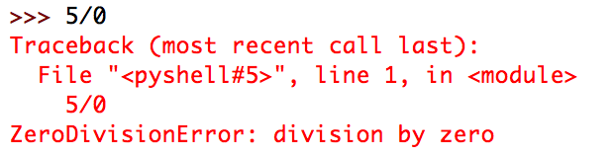
Python Exceptions
How do you find which error is thrown:
  You can cause the error and see what type of error it is
  You can look it up
Division by zero creates a ZeroDivisionError

Slide 9
Python Exceptions
Putting things together: Testing whether a string represents an integer
def is_int(string):
try:
int(string)
return True
except:
return False
Try out the conversion

Slide 10
Python Exceptions
Putting things together: Testing whether a string represents an integer
def is_int(string):
try:
int(string)
return True
except:
return False
Try out the conversion
It worked:
We return True

Slide 11
Python Exceptions
Putting things together: Testing whether a string represents an integer
def is_int(string):
try:
int(string)
return True
except:
return False
Try out the conversion
It did NOT work:
An exception is thrown
We return FALSE

Slide 12
Python Exceptions
As you can see from this example, the moment an exception is thrown, we jump to the exception handler.

Slide 13
Python Exceptions
When to use exceptions and when to use if
  Recall: Using if is defensive programming
  Recall: Using exceptions amounts to the same degree of safety, but is offensive
Rule of thumb:
  If exceptions are raised infrequently, then use them

Slide 14
Python Exceptions
Let’s make some timing experiments
  Define two functions that square all elements in a list, if the elements are integers.
def square_list(lista):
result = []
for element in lista:
if element.isdigit():
result.append(int(element)**2)
def square_list2(lista):
result = []
for element in lista:
try:
result.append(int(element)**2)
except:
pass

Slide 15
Python Exceptions
The pass instruction:
  When Python expects a statement, but we don’t have one:
    Just use pass
      The No-Operation instruction

Slide 16
Python Exceptions
Recall how to use the time-module to obtain the CPU (wall-clock) time
We use this to measure execution time
  First a list that only contains integers
def timeit(function, trials):
lista = [str(i) for i in range(1000000)]
count = 0
for _ in range(trials):
start = time.time()
lista2 = function(lista)
count += time.time()-start
return count/trials

Slide 17
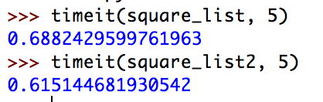
Python Exceptions
Result: Exceptions are somewhat faster

Slide 18
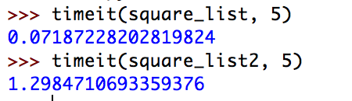
Python Exceptions
What if none of the list elements are integers:
def timeit(function, trials):
lista = ["a"+str(i) for i in range(1000000)]
count = 0
for _ in range(trials):
start = time.time()
lista2 = function(lista)
count += time.time()-start
return count/trials
Exceptions are much slower

Slide 19
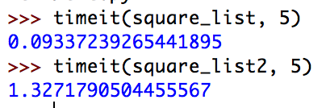
Python Exceptions
What about if the letter is at the end
def timeit(function, trials):
lista = [str(i)+"a" for i in range(1000000)]
count = 0
for _ in range(trials):
start = time.time()
lista2 = function(lista)
count += time.time()-start
return count/trials
Exceptions are still much slower

Slide 20
Self Test
Define a function that calculates the geometric mean of two numbers.
Use an exception to deal with a ValueError, arisen by taking the square-root of a negative number
  Here is the if-version. We return None if there is no mean.
def geo(x, y):
if x*y > 0:
return math.sqrt(x*y)
return None

Slide 21
Self Test Solution
def geoe(x,y):
try:
return math.sqrt(x*y)
except ValueError:
return None

Slide 22
Multiple Exceptions
We can write an exception handler that handles all the exceptions
  This is discouraged since there are just too many exceptions that can occur
    such as out-of-memory, system-error, keyboard-interrupt …
  In this case, the except clause specifies no exception
try:
accum += 1/n
except:
      print(“something bad happened”)
No exception specified
Handler handles everything

Slide 23
Multiple Exceptions
Normally, you want to specify which exceptions you are handling
You can specify several exception handles by repeating the exception clause
Or you can handle a list of exceptions
The parentheses are necessary
def test():
try:
f = open("none.txt")
block = f.read(256)
except IOError:
print("something happened when reading the file")
except EOFError:
print("ran out of file")
except (KeyboardInterrupt, ValueError):
print("something strange happened")

Slide 24
Cleaning Up
Sometimes you need to make sure that failure-prone code cleans up
Use the finally clause
  Guaranteed to be executed
    Even with return statements
    Even when exceptions are raised

Slide 25
Example for finally clause
If we open a file without the if-clause, we are morally obliged to close it
  Let’s say, if you have a long-running process that only needs a file for a little time, you should not hog the file and prevent others from accessing it.

Slide 26
Example for finally clause
def harmonic(filename):
"""
Assumes that the elements in the file are numbers.
We return the harmonic mean of the numbers.
"""
count = 0
accumulator = 0
try:
infile = open(filename, encoding="utf-8")
for line in infile:
for words in line.split():
accumulator += 1/int(words)
count += 1
return count/accumulator
except ZeroDivisionError:
print("saw a zero")
return 1000000000
except ValueError:
print("saw a non-integer")
return 0
finally:
print("I am done and closing the file")
infile.close()
Return in the try block
Return in the handler
But finally is guaranteed to run before any of the returns

Slide 27
Raising exceptions
You can also raise your own exception
  You can even define your own exceptions when you have understood classes
  Just say: raise ValueError
  or whatever the exception is that you want to raise.

Slide 28
Self Test
Recall that the finally clause is always executed.
What is the output of the following code
def raising():
try:
raise ValueError
except ValueError:
return 0
finally:
return 1

Slide 29
Answer
The functions returns 1
  The exception is raised and control passes to the exception handler
  Before the exception handler can return, the finally clause is executed
  And that one returns 1

Slide 30
Multiple Exceptions
It is common that Python code throws multiple exceptions
  Can list different exceptions using a tuple and handle them all
  Or write different exception handlers
try:
client_obj.get_url(url)
except (URLError, ValueError, SocketTimeout):
client_obj.remove_url(url)
try:
client_obj.get_url(url)
except (URLError, ValueError):
client_obj.remove_url(url)
except SocketTimeout:
client_obj.handle_url_timeout(url)

Slide 31
Handles to Exceptions
Exceptions are classes that have methods
To gain access use the as keyword
try:
f = open(filename)
except OSError as e:
if e.errno == errno.ENOENT:
print('file not found')
elif e.errno == errno.EACCES:
print('permission denied')
else:
print('unexpected error')

Slide 32
Multiple Exceptions
More than one exception can be triggered
  The first matching exception handler will handle, even if a more specific exception handler is available
    prints out 'it failed'
try:
f = open(a_missing_file)
execpt OSError:
print('it failed')
except FileNotFoundError:
print('File not found')

Slide 33
Multiple Exceptions
Exceptions are in a hierarchy
    catches all exceptions except SystemExit, KeyboardInterrupt, GeneratorExit
    If you want to catch those, change Exception to BaseException
try:
…
except Exception as e:
…
print(e)

Slide 34
Creating Custom Exceptions
To create a new exception, just define a class that derives from Exception
class NetworkError(Exception):
pass
class TimeoutError(NetworkError):
pass

Slide 35
Creating Custom Exceptions
If your custom exception overrides the constructor
  Make sure you call the exception class constructor
  Parts of Python and libraries except all exceptions to have an .args attribute, that will be provided by calling the super
class CustomError(Exception):
def __init__(self, message, status):
self.message = message
self.status = status

Slide 36
Chaining Exceptions
Raise an exception in response to catching a different exception, but include information about both exceptions in the traceback
def example():
try:
int('N/A')
except ValueError as e:
raise RuntimeError('A parsing error occured') from e

Slide 37
Assertions
To prevent error conditions, can use assertions
  E.g.: your code only runs on a linux machine
  If the condition is violated, throws an AssertionError
  But the assert statements are optimized away when
import sys
assert ('linux' in sys.platform),
'this code runs on linus only')

Slide 38
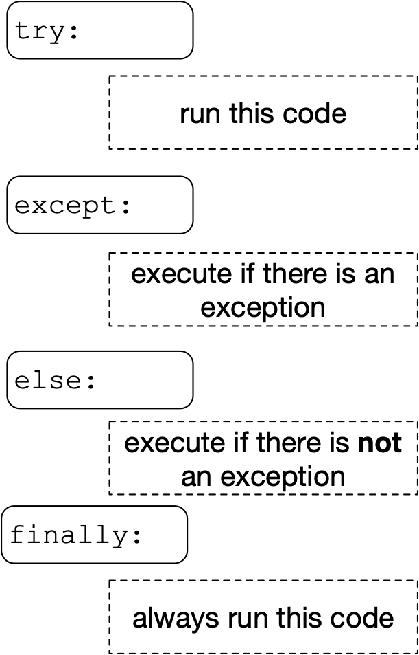
Else Statement
Else block after a try block is executed only if no exception was raised

Slide 39
Else Statement
Exceptions in the else block would not be caught by the current try block
for arg in sys.argv[1:]:
try:
f = open(arg, 'r')
except OSError:
print('cannot open', arg)
else:
print(arg, 'has', len(f.readlines()), 'lines')
f.close()

Slide 40
Exercises
The following code is potentially buggy.
info = [{'score': 3, 'confidence': 2},
{'score': -1, 'confidence': 4},
{'score': 1, 'confidence': 4},
{'confidence': 0}]
def get_total_score(info):
total = 0
for item in info:
  total += item['score']
  return total
get_total_score(info)

Slide 41
Solutions
def get_total_score(info):
total = 0
number_of_items = 0
for item in info:
try:
total += item['score']
except KeyError:
pass
else:
number_of_items += 1
return total/number_of_items
print(get_total_score(info))

Slide 42
Exercises
The following code is potentially buggy.
import os
def check(directory):
for file_name in os.listdir(directory):
with open(file_name) as infile:
nr = len(infile.readlines())
print(file_name, nr)

Slide 43
Solutions
import os
def check(directory):
for file_name in os.listdir(directory):
try:
with open(file_name) as infile:
nr = len(infile.readlines())
print(file_name, nr)
except UnicodeDecodeError:
print('unicode decode error in', file_name)
except IsADirectoryError:
print(f'{file_name} is a directory')

