Slide 1
Linear Regression
Thomas Schwarz, SJ

Slide 2
Linear Regression
Sir Francis Galton : 16 Feb 1822 — Jan 17 1911
  Cousin of Charles Darwin
    Discovered "Regression towards Mediocrity":
      Individuals with exceptional measurable traits have more normal progreny
    If parent's trait is at $xσ$ from $μ$, then progeny has traits at $ρxσ$ from $μ$
      $ρ$ is the coefficient of correlation between trait of parent and of progeny

Slide 3
Linear Regression

Slide 4
Statistical Aside
Regression towards mediocrity does not mean
  Differences in future generations are smoothed out
It reflects a selection biases
  Trait of parent is mean + inherited trait + error
    The parents we look at have both inherited trait and error >>0
  Progeny also has mean + inherited trait + error
    But the error is now random, and on average ~ 0.

Slide 5
Statistical Aside
Example:
  You do exceptionally well in a chess tournament
    Result is Skill + Luck
    You probably will not do so well in the next one
      Your skill might have increased, but you cannot expect your luck to stay the same
        It might, and you might be even luckier, but the odds are against it

Slide 6
Review of Statistics
We have a population with traits
  We are interested in only one trait
    We need to make predictions based on a sample, a (random) collection of population members
  We estimate the population mean by the sample mean
      $m=\frac{1}{N}\overset{N}{\underset{i=1}{∑}}x_{i}$
  We estimate the population standard deviations by the (unbiased) sample standard deviation
      $s^{2}=\frac{1}{N-1}\overset{N}{\underset{i=1}{∑}}(x_{i}-μ)^{2}$

Slide 7
Unbiased ?
Normally distributed variable with mean $μ$ and st. dev. $σ$
    Take sample $\{x_{1},…,x_{N}\}$
    Calculate $s^{2}=\frac{1}{N}\overset{N}{\underset{i=1}{∑}}(x_{i}-μ)^{2}$
Turns out: expected value for $s$ is less than $σ$
Call $N-1$ the degree of freedom

Slide 8
Forecasting
Mean model
  We have a sample
    We predict the value of the next population member to be the sample mean
  What is the risk?
    Measure the risk by the standard deviation

Slide 9
Forecasting
Normally distributed variable with mean $μ$ and st. dev. $σ$
    Take sample $\{x_{1},…,x_{N}\}$
  What is the expected squared difference of $m$ and $μ$: $E((m-μ)^{2})$
  "Standard error of the mean"
      $E((m-μ)^{2})=\frac{s}{\sqrt{N}}$

Slide 10
Forecasting
Forecasting Error of : $x_{N+1}←\frac{1}{N}\overset{N}{\underset{i=1}{∑}}X_{i}$
Two sources of error:
  We estimate the standard deviation wrongly
  $x_{N+1}$ is on average one standard deviation away from the mean
Expected error
  $$=\sqrt{s^{2}+(\frac{s}{\sqrt{N}})^{2}}=s\sqrt{1+\frac{1}{N}}$$
model
error
parameter
error

Slide 11
Forecasting
There is still a model risk
  We just might not have the right model
    The underlying distribution is not normal

Slide 12
Confidence Intervals
Assume that the model is correct
  Simulate the model run times
  The x-confidence interval then
    contains x% of the runs contain the true value

Slide 13
Confidence Intervals
Confidence intervals usually are $±t×(\text{standard error of forecast}$
    Contained in t-tables and depend on sample size

Slide 14
Student t-distribution
Gossett (writing as "Student")
    Distribution of
  $\frac{(m-μ)}{s/{\sqrt{N}}}$
  With increasing $N$ comes close to normal distribution

Slide 15
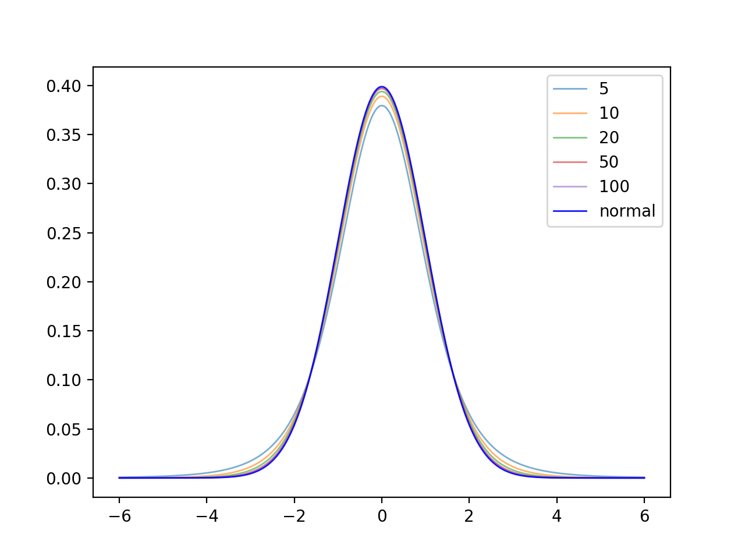
Student-t distribution

Slide 16
Simple Linear Regression
Linear regression uses straight lines for prediction
  Model:
    "Causal variable" $x$, "observed variable" $y$
    Connection is linear (with or without a constant)
    There is an additive "error" component
      Subsuming "unknown" causes
      With expected value of 0
      Usually assumed to be normally distributed

Slide 17
Simple Linear Regression
Model:
  $$y=b_{0}+b_{1}x+ϵ$$

Slide 18
Simple Linear Regression
Assume $y=b_{0}+b_{1}x$
  Minimize $S=\overset{n}{\underset{i=1}{∑}}(y_{i}-\left(b_{0}+b_{1}x_{i}\right))^{2}$
  Take the derivative with respect to $b_{0}$ and set it to zero:
  $$\frac{δS}{δb_{0}}=\overset{n}{\underset{i=1}{∑}}-2(y_{i}-b_{0}-b_{1}x_{i})=0$$
  $$⇒\overset{n}{\underset{i=1}{∑}}y_{i}=b_{0}n+b_{1}\overset{n}{\underset{i=1}{∑}}x_{i}⇒b_{0}=\frac{1}{n}\overset{n}{\underset{i=1}{∑}}y_{i}-b_{1}\frac{1}{n}\overset{n}{\underset{i=1}{∑}}x_{i}$$
  $$⇒b_{0}=\overline{y}-b_{1}\overline{x}$$

Slide 19
Simple Linear Regression
Assume $y=b_{0}+b_{1}x$
  Minimize $S=\overset{n}{\underset{i=1}{∑}}(y_{i}-\left(b_{0}+b_{1}x_{i}\right))^{2}$
  Take the derivative with respect to $b_{1}$ and set it to zero:
  $$\frac{δS}{δb_{1}}=\overset{n}{\underset{i=1}{∑}}-2x_{i}(y_{i}-b_{0}-b_{1}x_{i})=0$$
  $$⇒\overset{n}{\underset{i=1}{∑}}x_{i}(y_{i}-b_{0}-b_{1}x_{i})=\overset{n}{\underset{i=1}{∑}}(x_{i}y_{i}-b_{0}x_{i}-b_{1}x_{i}^{2})=0$$

Slide 20
Simple Linear Regression
From previous, we know $b_{0}=\overline{y}-b_{1}\overline{x}$
Our formula $\overset{n}{\underset{i=1}{∑}}(x_{i}y_{i}-b_{0}x_{i}-b_{1}x_{i}^{2})=0$ becomes
$$\overset{n}{\underset{i=1}{∑}}\left(x_{i}y_{i}-(\overline{y}-b_{1}\overline{x})x_{i}-b_{1}x_{i}^{2}\right)=0$$
$$\overset{n}{\underset{i=1}{∑}}\left(x_{i}y_{i}-\overline{y}x_{i}\right)+b_{1}\overset{n}{\underset{i=1}{∑}}\left(\overline{x}x_{i}-x_{i}^{2}\right)=0$$

Slide 21
Simple Linear Regression
This finally gives us a solution:
$b_{1}=\frac{∑_{i=1}^{n}(x_{i}y_{i}-\overline{y}x_{i})}{∑_{i=1}^{n}(x_{i}^{2}-\overline{x}x_{i})}$
$b_{0}=\overline{y}-b_{1}\overline{x}$

Slide 22
Simple Linear Regression
Measuring fit:
  Calculate the sum of squares $SS_{\text{tot}}=\overset{n}{\underset{i=1}{∑}}(y_{i}-\overline{y})^{2}$
  Residual sum of squares $SS_{\text{res}}=\overset{n}{\underset{i=1}{∑}}(b_{0}+b_{1}x_{i}-y_{i})^{2}$
  Coefficient of determination $R^{2}=1-\frac{SS_{\text{res}}}{SS_{\text{tot}}}$

Slide 23
Simple Linear Regression
$R^{2}$ can be used as a goodness of fit
  Value of 1: perfect fit
  Value of 0: no fit
  Negative values: wrong model was chosen

Slide 24
Simple Linear Regression
  Look at residuals:
    Determine statistics on the residuals
    Question: do they look normally distributed?

Slide 25
Simple Linear Regression
Example 1: brain sizes versus IQ
  A number of female students were given an IQ test
  They were also given an MRI to measure the size of their brain
Is there a relationship between brains size and IQ?
VerbalIQ Brain Size
132 816.932
132 951.545
90 928.799
136 991.305
90 854.258
129 833.868
120 856.472
100 878.897
71 865.363
132 852.244
112 808.02
129 790.619
86 831.772
90 798.612
83 793.549
126 866.662
126 857.782
90 834.344
129 948.066
86 893.983

Slide 26
Simple Linear Regression
Can use statsmodels
import statsmodels.api as sm
df = pd.read_csv('brain-size.txt', sep = '\t')
Y = df['VerbalIQ']
X = df['Brain Size']
X = sm.add_constant(X)
model = sm.OLS(Y,X).fit()
predictions = model.predict(X)
print(model.summary())

Slide 27
Simple Linear Regression
Gives a very detailed feed-back
OLS Regression Results
==============================================================================
Dep. Variable: VerbalIQ R-squared: 0.065
Model: OLS Adj. R-squared: 0.013
Method: Least Squares F-statistic: 1.251
Date: Thu, 02 Jul 2020 Prob (F-statistic): 0.278
Time: 16:22:00 Log-Likelihood: -88.713
No. Observations: 20 AIC: 181.4
Df Residuals: 18 BIC: 183.4
Df Model: 1
Covariance Type: nonrobust
==============================================================================
coef std err t P>|t| [0.025 0.975]
------------------------------------------------------------------------------
const 24.1835 76.382 0.317 0.755 -136.288 184.655
Brain Size 0.0988 0.088 1.119 0.278 -0.087 0.284
==============================================================================
Omnibus: 5.812 Durbin-Watson: 2.260
Prob(Omnibus): 0.055 Jarque-Bera (JB): 1.819
Skew: -0.259 Prob(JB): 0.403
Kurtosis: 1.616 Cond. No. 1.37e+04
==============================================================================

Slide 28
Simple Linear Regression
Interpreting the outcome:
    Are the residuals normally distributed?
    Omnibus: test for skew and kurtosis
      Should be zero
    In this case: Probability of this or worse is 0.055
Omnibus: 5.812 Durbin-Watson: 2.260
Prob(Omnibus): 0.055 Jarque-Bera (JB): 1.819
Skew: -0.259 Prob(JB): 0.403
Kurtosis: 1.616 Cond. No. 1.37e+04

Slide 29
Simple Linear Regression
Interpreting the outcome:
    Are the residuals normally distributed?
    Durbin-Watson: tests homoscedasticity
      Is the Variance of the errors consistent
Omnibus: 5.812 Durbin-Watson: 2.260
Prob(Omnibus): 0.055 Jarque-Bera (JB): 1.819
Skew: -0.259 Prob(JB): 0.403
Kurtosis: 1.616 Cond. No. 1.37e+04

Slide 30
Simple Linear Regression
Homoscedasticity
  Observe that variance increases

Slide 31
Simple Linear Regression
Interpreting the outcome:
    Jarque-Bera:
      Tests skew and kurtosis of residuals
      Here acceptable probability
Omnibus: 5.812 Durbin-Watson: 2.260
Prob(Omnibus): 0.055 Jarque-Bera (JB): 1.819
Skew: -0.259 Prob(JB): 0.403
Kurtosis: 1.616 Cond. No. 1.37e+04

Slide 32
Simple Linear Regression
Interpreting the outcome:
      Condition number
        Indicates either multicollinearity or numerical problems
Omnibus: 5.812 Durbin-Watson: 2.260
Prob(Omnibus): 0.055 Jarque-Bera (JB): 1.819
Skew: -0.259 Prob(JB): 0.403
Kurtosis: 1.616 Cond. No. 1.37e+04

Slide 33
Simple Linear Regression
Plotting
my_ax = df.plot.scatter(x='Brain Size', y='VerbalIQ')
x=np.linspace(start=800,stop=1000)
my_ax.plot(x,24.1835+0.0988*x)

Slide 34
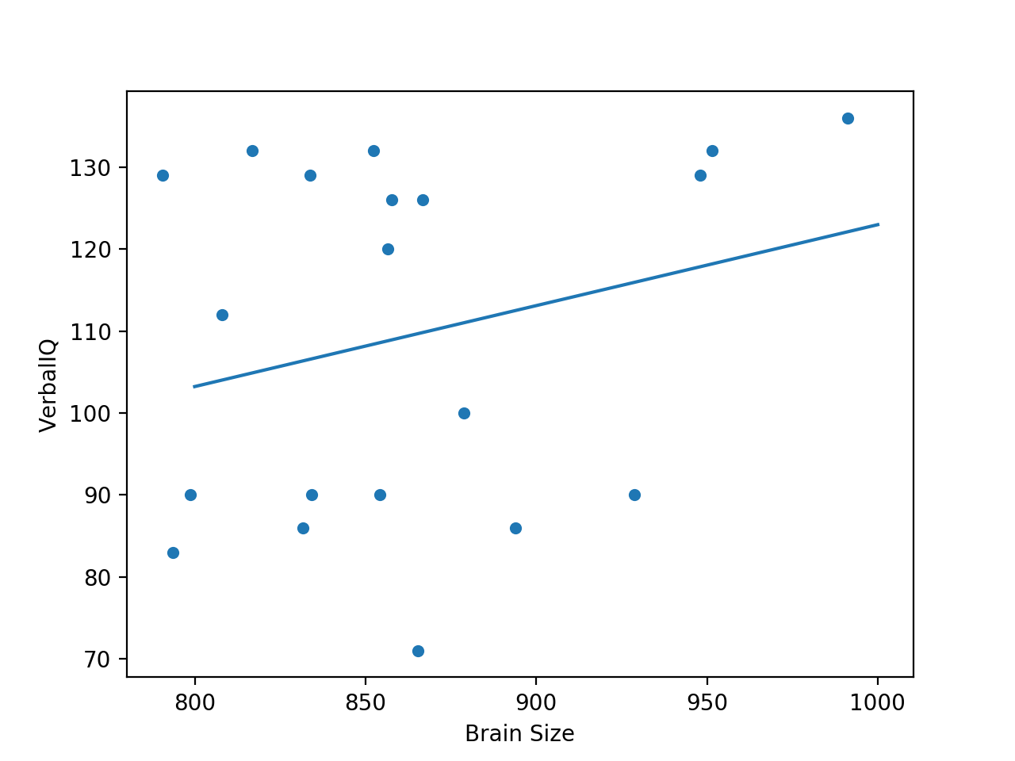
Simple Linear Regression

Slide 35
Simple Linear Regression
scipy has a stats package
from scipy import stats
df = pd.read_csv('brain-size.txt', sep = '\t')
Y = df['VerbalIQ']
X = df['Brain Size']
x = np.linspace(800,1000)
slope, intercept, r_value, p_value, std_err = stats.linregress(X, Y)

Slide 36
Simple Linear Regression
plotting using plt
plt.plot(X, Y, 'o', label='measurements')
plt.plot(x, intercept+slope*x, 'r:', label='fitted')
plt.legend(loc='lower right')
print(slope, intercept, r_value, p_value)
plt.show()

Slide 37
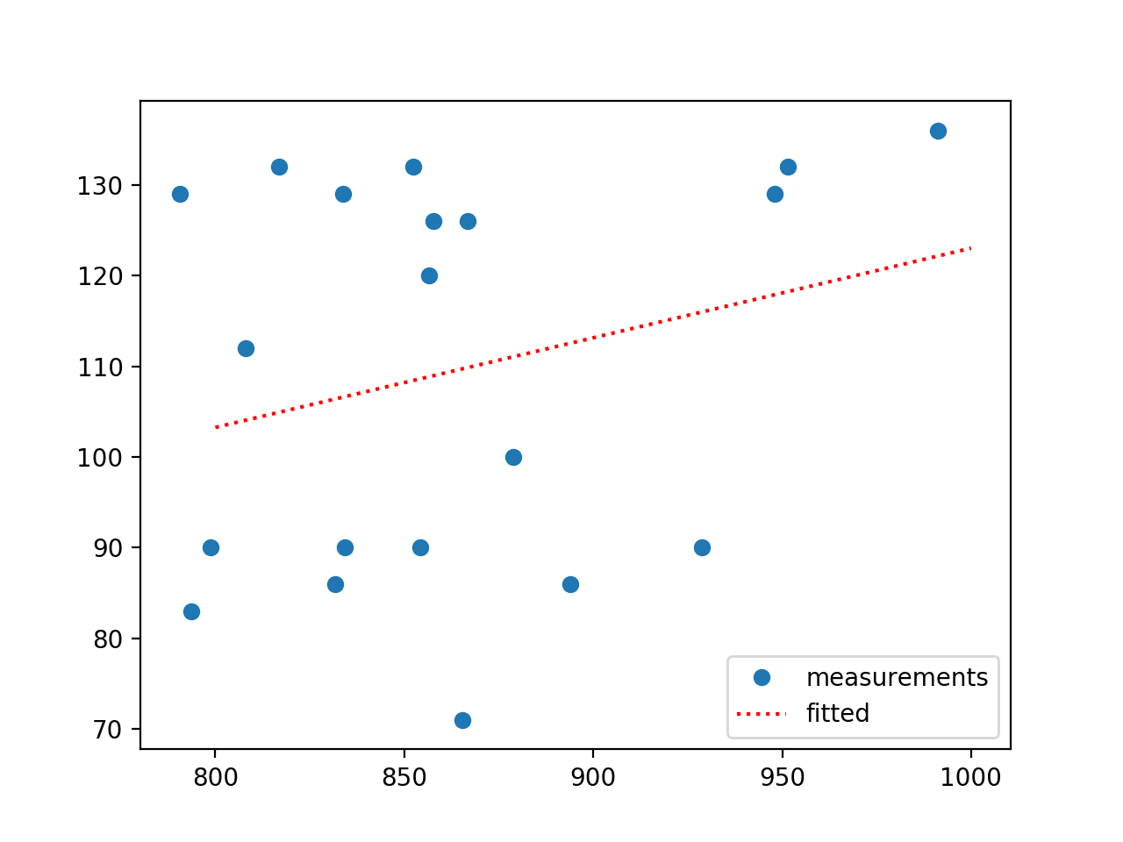
Simple Linear Regression

Slide 38
Multiple Regression
Assume now more explanatory variables
$$y=b_{0}+b_{1}x_{1}+b_{2}x_{2}+…+b_{r}x_{r}$$

Slide 39
Multiple Regression
Seattle Housing Market
  Data from Kaggle
df = pd.read_csv('kc_house_data.csv')
df.dropna( inplace=True)

Slide 40
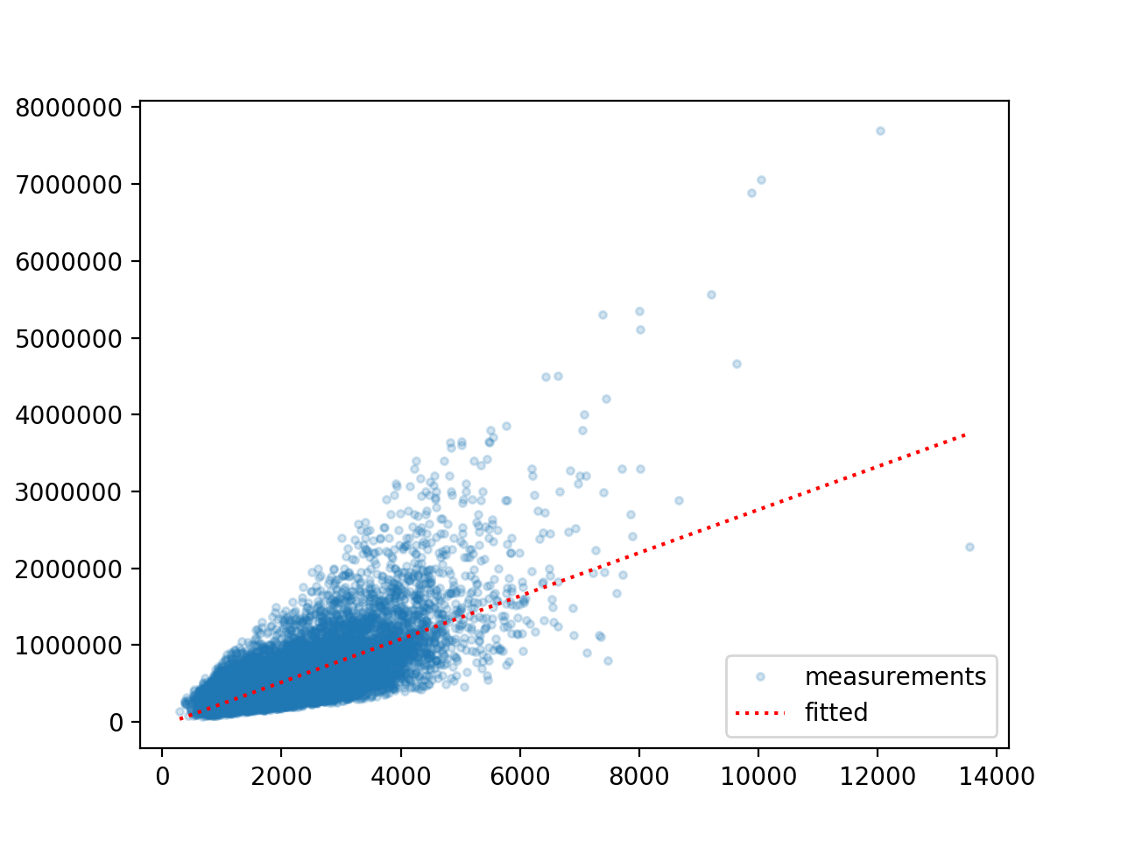
Multiple Regression
Linear regression: price — grade

Slide 41
Multiple Regression
Can use the same Pandas recipes
df = pd.read_csv('kc_house_data.csv')
df.dropna( inplace=True)
Y = df['price']
X = df[ ['sqft_living', 'bedrooms', 'condition', 'waterfront'] ]
model = sm.OLS(Y,X).fit()
predictions = model.predict(X)
print(model.summary())

Slide 42
Multiple Regression
OLS Regression Results
=======================================================================================
Dep. Variable: price R-squared (uncentered): 0.857
Model: OLS Adj. R-squared (uncentered): 0.857
Method: Least Squares F-statistic: 3.231e+04
Date: Thu, 02 Jul 2020 Prob (F-statistic): 0.00
Time: 20:47:11 Log-Likelihood: -2.9905e+05
No. Observations: 21613 AIC: 5.981e+05
Df Residuals: 21609 BIC: 5.981e+05
Df Model: 4
Covariance Type: nonrobust
===============================================================================
coef std err t P>|t| [0.025 0.975]
-------------------------------------------------------------------------------
sqft_living 303.8804 2.258 134.598 0.000 299.455 308.306
bedrooms -5.919e+04 2062.324 -28.703 0.000 -6.32e+04 -5.52e+04
condition 3.04e+04 1527.531 19.901 0.000 2.74e+04 3.34e+04
waterfront 7.854e+05 1.96e+04 40.043 0.000 7.47e+05 8.24e+05
==============================================================================
Omnibus: 13438.261 Durbin-Watson: 1.985
Prob(Omnibus): 0.000 Jarque-Bera (JB): 437567.612
Skew: 2.471 Prob(JB): 0.00
Kurtosis: 24.482 Cond. No. 2.65e+04
==============================================================================
Warnings:
[1] Standard Errors assume that the covariance matrix of the errors is correctly specified.
[2] The condition number is large, 2.65e+04. This might indicate that there are
strong multicollinearity or other numerical problems.

Slide 43
Multiple Regression
sklearn
from sklearn import linear_model
df = pd.read_csv('kc_house_data.csv')
df.dropna( inplace=True)
Y = df['price']
X = df[ ['sqft_living', 'bedrooms', 'condition', 'waterfront'] ]
regr = linear_model.LinearRegression()
regr.fit(X, Y)
print('Intercept: \n', regr.intercept_)
print('Coefficients: \n', regr.coef_)

Slide 44
Polynomial Regression
What if the explanatory variables enter as powers?
Can still apply multi-linear regression
$$y=b_{0}+b_{1}x_{1}+b_{2}x_{2}+b_{3}x_{1}^{2}+b_{4}x_{1}x_{2}+b_{5}x_{2}^{2}$$

