Slide 1
Logistic Regression
Thomas Schwarz

Slide 2
Categorical Data
Outcomes can be categorical
  Often, outcome is binary:
    President gets re-elected or not
    Customer is satisfied or not
  Often, explanatory variables are categorical as well
    Person comes from an under-performing school
    Order was made on a week-end
    …

Slide 3










Prediction Models for Binary Outcomes
Famous example:
  Taken an image of a pet, predict whether this is a cat or a dog

Slide 4
Prediction Models for Binary Outcomes
Bayes: generative classifier
    Predicts indirectly $P(c|d)$
  $$\overset{̂}{c}={\text{arg max}}_{c∈C}P(d|c)P(c)$$
    Evaluates product of likelihood and prior
      Prior: Probability of a category $c$ without looking at data
      Likelihood: Probability of observing data if from a category $c$
Likelihood
Prior

Slide 5
Prediction Models for Binary Outcomes
Regression is a discriminative classifier
  Tries to learn directly the classification from data
    E.g.: All dog pictures have a collar
      Collar present —> predict dog
      Collar not present —> predict cat
  Computes directly $P(c|d)$

Slide 6
Prediction Models for Binary Outcomes
Regression:
  Supervised learning: Have a training set with classification provided
  Input is given as vectors of numerical features
    $$x^{(i)}=(x_{1,i},x_{2,i},…,x_{n,i})$$
  Classification function that calculates the predicted class $\overset{̂}{y}(x)$
  An objective function for learning: Measures the goodness of fit between true outcome and predicted outcome
  An algorithm to optimize the objective function

Slide 7
Prediction Models for Binary Outcomes
Linear Regression:
  Classification function of type
    $$\overset{̂}{y}\left((x_{1},x_{2},…,x_{n})\right)=a_{1}x_{1}+a_{2}x_{2}+…a_{n}x_{n}+b$$
  Objective function (a.k.a cost function)
    Sum of squared differences between predicted and observed outcomes
      E.g. Test Set $T=\{x^{(1)},x^{(2)},…x^{(m)}\}$
      Minimize cost function $\overset{m}{\underset{i=1}{∑}}(y^{(i)}-{\overset{̂}{y}}^{(i)})^{2}$

Slide 8
Prediction Models for Binary Outcomes
Linear regression can predict a numerical value
  It can be made to predict a binary value
    If the predictor is higher than a cut-off value: predict yes
    Else predict no
But there are better ways to generate a binary classifier

Slide 9
Prediction Models for Binary Outcomes
Good binary classifier:
  Since we want to predict the probability of a category based on the features:
    Should look like a probability
  Since we want to optimize:
    Should be easy to differentiate
  Best candidate classifier that has emerged:
    Sigmoid classifier

Slide 10
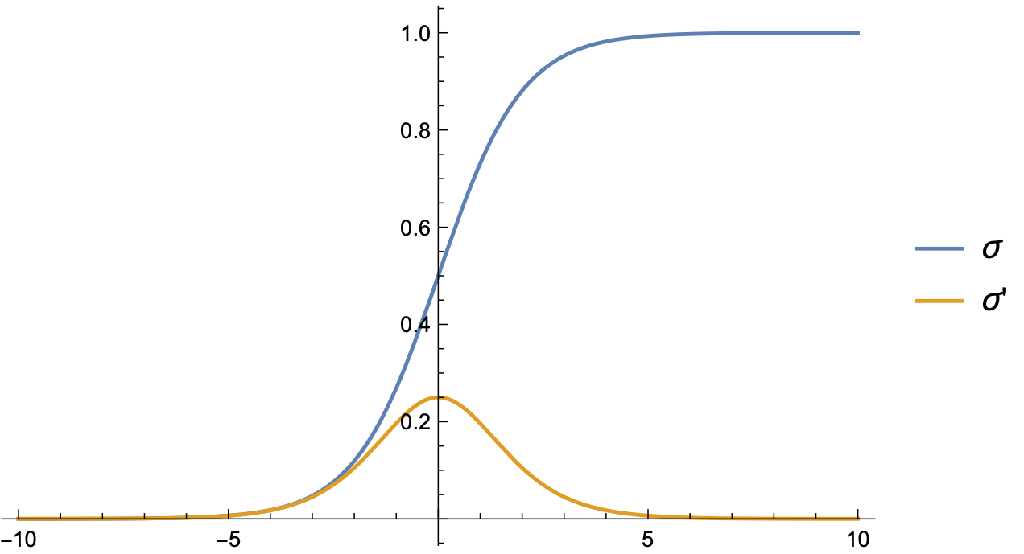
Logistic Regression
Use logistic function
    $σ(z)=\frac{1}{1+exp(-z)}$

Slide 11
Logistic Regression
Combine with linear regression to obtain logistic regression approach:
  Learn best weights in
    $$\overset{̂}{y}\left((x_{1},x_{2},…,x_{n})\right)=σ(b+w_{1}x_{1}+w_{2}x_{2}+…w_{n}x_{n})$$
  We know interpret this as a probability for the positive outcome '+'
  Set a decision boundary at 0.5
    This is no restriction since we can adjust $b$ and the weights

Slide 12
Logistic Regression
We need to measure how far a prediction is from the true value
  Our predictions $\overset{̂}{y}$ and the true value $y$ can only be 0 or 1
    If $y=1$: Want to support $\overset{̂}{y}=1$ and penalize $\overset{̂}{y}=0$.
    If $y=0$: Want to support $\overset{̂}{y}=0$ and penalize $\overset{̂}{y}=1$.
  One successful approach:
    $$\text{Loss}(\overset{̂}{y},y)={\overset{̂}{y}}^{y}(1-\overset{̂}{y})^{(1-y)}$$

Slide 13
Logistic Regression
Easier: Take the negative logarithm of the loss function
  Cross Entropy Loss
  $${\text{L}}_{\text{CE}}=-ylog(\overset{̂}{y})-(1-y)log(1-\overset{̂}{y})$$

Slide 14
Logistic Regression
This approach is successful, because we can use Gradient Descent
  Training set of size $m$
    Minimize $\overset{m}{\underset{i=1}{∑}}{\text{L}}_{\text{CE}}(y^{(i)},{\overset{̂}{y}}^{(i)})$
  Turns out to be a convex function, so minimization is simple! (As far as those things go)
  Recall:
      $$\overset{̂}{y}\left((x_{1},x_{2},…,x_{n})\right)=σ(b+w_{1}x_{1}+w_{2}x_{2}+…w_{n}x_{n})$$
  We minimize with respect to the weights and $b$

Slide 15
Logistic Regression
Calculus:
      $\frac{δ{\text{L}}_{\text{CE}}(w,b)}{δw_{j}}=\left(σ(w_{1}x_{1}+…w_{n}x_{n}+b)-y\right)x_{j}$
  $=(\overset{̂}{y}-y)x_{j}$
  Difference between true $y$ and estimated outcome $\overset{̂}{y}$, multiplied by input coordinate

Slide 16
Logistic Regression
Stochastic Gradient Descent
  Until gradient is almost zero:
    For each training point $x^{(i)},y^{(i)}$:
      Compute prediction ${\overset{̂}{y}}^{(i)}$
      Compute loss
      Compute gradient
      Nudge weights in the opposite direction using a learning weight $η$
        $$(w_{1},…,w_{n})←(w_{1},…,w_{n})-η∇{\text{L}}_{\text{CE}}$$
      Adjust $η$

Slide 17
Logistic Regression
Stochastic gradient descent uses a single data point
  Better results with random batches of points at the same time

Slide 18
Lasso and Ridge Regression
If the feature vector is long, danger of overfitting is high
  We learn the details of the training set
    Want to limit the number of features with positive weight
  Dealt with by adding a regularization term to the cost function
    Regularization term depends on the weights
      Penalizes large weights

Slide 19
Lasso and Ridge Regression
L2 regularization:
  Use a quadratic function of the weights
    Such as the euclidean norm of the weights
  Called Ridge Regression
    Easier to optimize

Slide 20
Lasso and Ridge Regression
L1 regularization
  Regularization term is the sum of the absolute values of weights
  Not differentiable, so optimization is more difficult
  BUT: effective at lowering the number of non-zero weights
Feature selection:
  Restrict the number of features in a model
  Usually gives better predictions

Slide 21
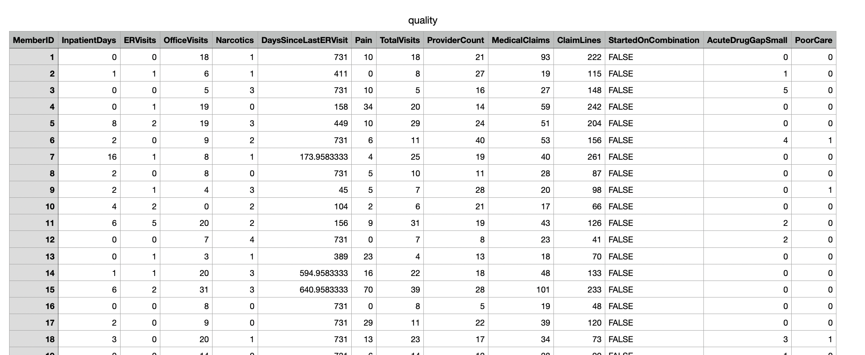
Examples
Example: quality.csv
  Try to predict whether patient labeled care they received as poor or good

Slide 22
Examples
First column is an arbitrary patient ID
  we make this the index
One column is a Boolean, when imported into Python
  so we change it to a numeric value
df = pd.read_csv('quality.csv', sep=',', index_col=0)
df.replace({False:0, True:1}, inplace=True)

Slide 23
Examples
Farmington Heart Data Project:
  https://framinghamheartstudy.org
  Monitoring health data since 1948
  2002 enrolled grandchildren of first study

Slide 24
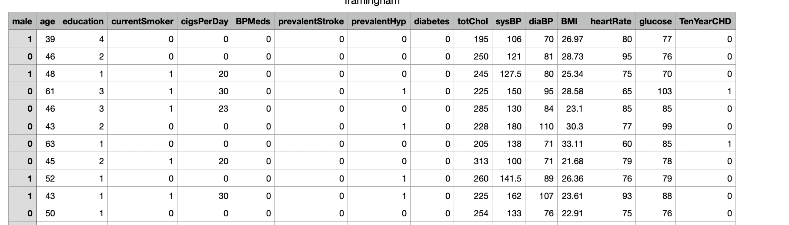
Examples

Slide 25
Examples
Contains a few NaN data
  We just drop them
df = pd.read_csv('framingham.csv', sep=',')
df.dropna(inplace=True)

Slide 26
Logistic Regression
in Stats-Models
Import statsmodels.api
Interactively select the columns that gives us high p-values
import statsmodels.api as sm
cols = [ 'Pain', 'TotalVisits',
'ProviderCount',
'MedicalClaims', 'ClaimLines',
'StartedOnCombination',
'AcuteDrugGapSmall',]

Slide 27
Logistic Regression
in Stats-Models
Create a logit model
  Can do as we did for linear regression with a string
  Can do using a dataframe syntax
  Print the summary pages
logit_model=sm.Logit(df.PoorCare,df[cols])
result=logit_model.fit()
print(result.summary2())

Slide 28
Logistic Regression
in Stats-Models
Print the results
This gives the "confusion matrix"
  Coefficient [i,j] gives:
    predicted i values
    actual j values
print(result.pred_table())

Slide 29
Logistic Regression
in Stats-Models
Quality prediction:
7 False negative and 18 false positives
[[91. 7.]
[18. 15.]]

Slide 30
Logistic Regression
in Stats-Models
Heart Event Prediction:
26 false negatives
523 false positives
[[3075. 26.]
[ 523. 34.]]

Slide 31
Logistic Regression
in Stats-Models
Can try to improve using Lasso
result=logit_model.fit_regularized()

Slide 32
Logistic Regression
in Stats-Models
Can try to improve selecting only columns with high P-values
Optimization terminated successfully.
Current function value: 0.423769
Iterations 6
Results: Logit
================================================================
Model: Logit Pseudo R-squared: 0.007
Dependent Variable: TenYearCHD AIC: 3114.2927
Date: 2020-07-12 18:18 BIC: 3157.7254
No. Observations: 3658 Log-Likelihood: -1550.1
Df Model: 6 LL-Null: -1560.6
Df Residuals: 3651 LLR p-value: 0.0019166
Converged: 1.0000 Scale: 1.0000
No. Iterations: 6.0000
----------------------------------------------------------------
Coef. Std.Err. z P>|z| [0.025 0.975]
----------------------------------------------------------------
currentSmoker 0.0390 0.0908 0.4291 0.6679 -0.1391 0.2170
BPMeds 0.5145 0.2200 2.3388 0.0193 0.0833 0.9457
prevalentStroke 0.7716 0.4708 1.6390 0.1012 -0.1511 1.6944
prevalentHyp 0.8892 0.0983 9.0439 0.0000 0.6965 1.0818
diabetes 1.4746 0.2696 5.4688 0.0000 0.9461 2.0030
totChol -0.0067 0.0007 -9.7668 0.0000 -0.0081 -0.0054
glucose -0.0061 0.0019 -3.2113 0.0013 -0.0098 -0.0024
================================================================

Slide 33
Logistic Regression
in Stats-Models
Select the columns
Get a better (?) confusion matrix:
  False negatives has gone down
  False positives has gone up
cols = ['currentSmoker', 'BPMeds',
'prevalentStroke', 'prevalentHyp',
'diabetes', 'totChol','glucose']
[[3086. 15.]
[ 549. 8.]]

Slide 34
Logistic Regression
in Scikit-learn
Import from sklearn
from sklearn.linear_model import LogisticRegression
from sklearn import metrics
from sklearn.metrics import confusion_matrix
from sklearn.model_selection import train_test_split
from sklearn.metrics import classification_report

Slide 35
Logistic Regression
in Scikit-learn
Create a logistic regression object and fit it on the data
logreg = LogisticRegression()
logreg.fit(X=df[cols], y = df.TenYearCHD)
y_pred = logreg.predict(df[cols])
confusion_matrix = confusion_matrix(df.TenYearCHD, y_pred)
print(confusion_matrix)

Slide 36
Logistic Regression
in Scikit-learn
Scikit-learn uses a different algorithm
  Confusion matrix on the whole set is
[[3087 14]
[ 535 22]]

Slide 37
Logistic Regression
in Scikit-learn
Can also divide the set in training and test set
X_train, X_test, y_train, y_test =
train_test_split(df[cols],
df.TenYearCHD,
test_size=0.3,
random_state=0)
logreg.fit(X_train, y_train)
y_pred = logreg.predict(X_test)
confusion_matrix = confusion_matrix(y_test, y_pred)
print(confusion_matrix)

Slide 38
Logistic Regression
in Scikit-learn
Confusion matrix
[[915 1]
[176 6]]

Slide 39
Measuring Success
precision recall f1-score support
0 0.84 1.00 0.91 916
1 0.86 0.03 0.06 182
accuracy 0.84 1098
macro avg 0.85 0.52 0.49 1098
weighted avg 0.84 0.84 0.77 1098

Slide 40
Measuring Success
How can we measure accuracy?
  accuracy = (fp+fn)/(tp+tn+fp+fn)
    Unfortunately, because of skewed data sets, often very high
  precision = tp/(tp+fp)
  recall = tp/(tp+fn)
  F measure = harmonic mean of precision and recall

Slide 41
Probit Regression
Instead of using the logistic function $σ$, can also use the cumulative distribution function of the normal distribution
    $$\text{erf}(z)=\frac{2}{\sqrt{π}}∫_{0}^{z}exp(-t^{2})dt$$
Predictor is then
            $$\frac{1}{2}\left(1+\text{erf}(b+w_{1}x_{1}+w_{2}x_{2}+…+w_{n}x_{n})\right)$$

Slide 42
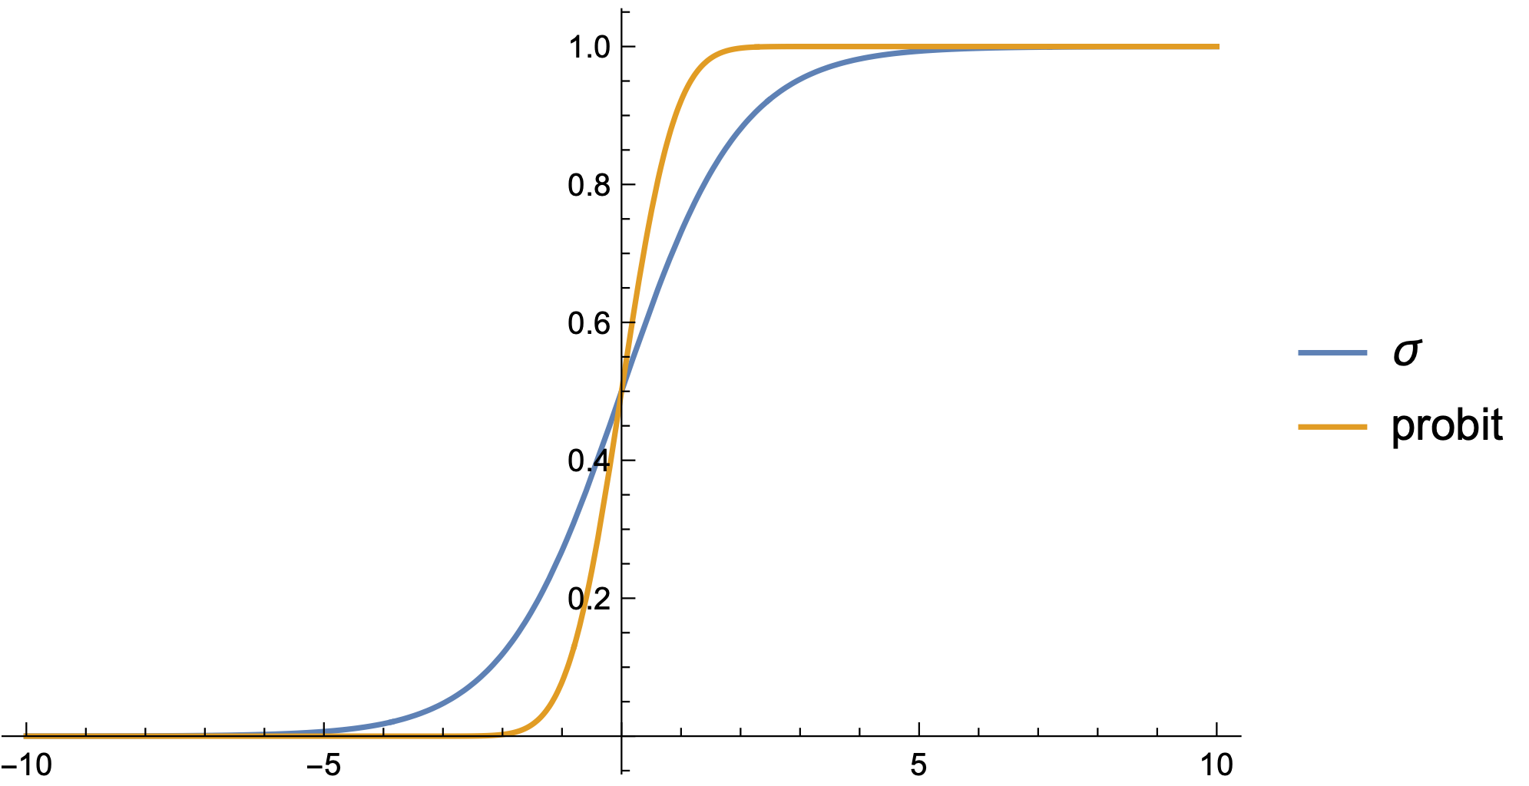
Probit Regression

Slide 43
Probit Regression
Calculations with probit are more involved
  Statsmodels implements it
  Fit the probit model
from statsmodels.discrete.discrete_model import Probit
probit_model=Probit(df.TenYearCHD,df[cols])
result=probit_model.fit()
print(result.summary())
print(result.pred_table())
for i in range(20):
print(df.TenYearCHD.iloc[i], result.predict(df[cols]).iloc[i])

Slide 44
Probit Regression
Confusion matrix is now
  More false positives but less false negatives
[[3085. 16.]
[ 547. 10.]]

Slide 45
Multinomial Logistic Regression
Want to predict one of several categories based on feature vector
Use the softmax function $\text{softmax}\left(z_{1},z_{2},…,z_{m}\right)=\left(\frac{e^{z_{1}}}{\sum_{i=1}^{m}{e^{z_{i}}}},\frac{e^{z_{2}}}{\sum_{i=1}^{m}{e^{z_{i}}}},…,\frac{e^{z_{m}}}{\sum_{i=1}^{m}{e^{z_{i}}}}\right)$

Slide 46
Multinomial Logistic Regression
Learning is still possible, but more complicated

Slide 47
Multinomial Logistic Regression
model1 = LogisticRegression(random_state=0,
multi_class='multinomial',
penalty='none',
solver='newton-cg').fit(X_train, y_train)
preds = model1.predict(X_test)

Slide 48
Final Example
Spine data
Use explanations to give column names
Remove last column
Col1 Col2 Col3 Col4 Col5 Col6 Col7 Col8 Col9 Col10 Col11 Col12 Class_att
63.0278175 22.55258597 39.60911701 40.47523153 98.67291675 -0.254399986 0.744503464 12.5661 14.5386 15.30468 -28.658501 43.5123 Abnormal
39.05695098 10.06099147 25.01537822 28.99595951 114.4054254 4.564258645 0.415185678 12.8874 17.5323 16.78486 -25.530607 16.1102 Abnormal
68.83202098 22.21848205 50.09219357 46.61353893 105.9851355 -3.530317314 0.474889164 26.8343 17.4861 16.65897 -29.031888 19.2221 Abnormal Prediction is done by using binary classification.
69.29700807 24.65287791 44.31123813 44.64413017 101.8684951 11.21152344 0.369345264 23.5603 12.7074 11.42447 -30.470246 18.8329 Abnormal
49.71285934 9.652074879 28.317406 40.06078446 108.1687249 7.918500615 0.543360472 35.494 15.9546 8.87237 -16.378376 24.9171 Abnormal
40.25019968 13.92190658 25.1249496 26.32829311 130.3278713 2.230651729 0.789992856 29.323 12.0036 10.40462 -1.512209 9.6548 Abnormal Attribute1 = pelvic_incidence (numeric)

Slide 49
Final Example
back_data = pd.read_csv("spine.csv")
del back_data['Unnamed: 13']
back_data.columns = ['pelvic_incidence','pelvic tilt',
'lumbar_lordosis_angle','sacral_slope',
'pelvic_radius','degree_spondylolisthesis',
'pelvic_slope','Direct_tilt','thoracic_slope',
‘cervical_tilt','sacrum_angle','scoliosis_slope',
‘Status']
print(back_data.Status.describe())

Slide 50
Final Example
Can also change the values of Status Column to 0 or 1
back_data.loc[back_data.Status=='Abnormal','Status'] = 1
back_data.loc[back_data.Status=='Normal','Status'] = 0
X = back_data.iloc[:, :12]
y = back_data.iloc[:, 12]

Slide 51
Final Example
First task:
  Are any of the columns strongly correlated?
    Otherwise, model would have difficulties
    Create a seaborn heatmap of the correlation
corr_back = back_data.corr()
sns.heatmap(corr_back, center=0, square=True, linewidths=.5)

Slide 52
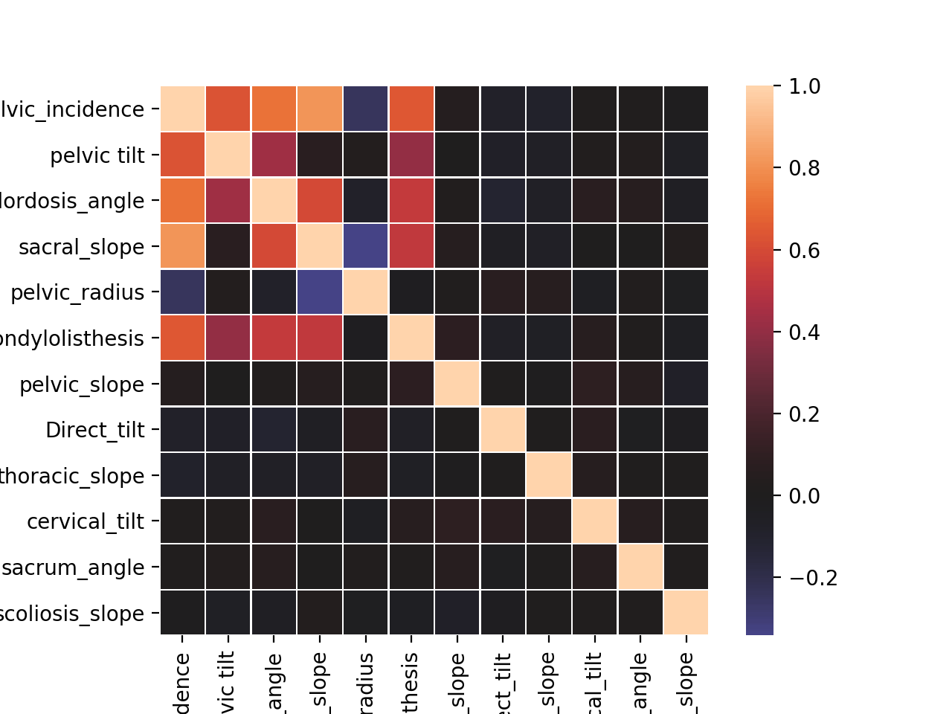
Final Example

Slide 53
Final Example
We now see whether the values differ between normal and abnormal spines:
for x in back_data.columns[:-1]:
print(x, back_data.groupby(‘Status').mean()[x])
for x in back_data.columns[:-1]:
print(x, back_data.groupby(‘Status').median()[x])

Slide 54
Final Example
Can also use a box plot to see the difference
fig, axes = plt.subplots(3, 4, figsize = (15,15))
axes = axes.flatten()
for i in range(0,len(back_data.columns)-1):
sns.boxplot(x="Status", y=back_data.iloc[:,i],
data=back_data, orient='v', ax=axes[i])
plt.tight_layout()
plt.show()

Slide 55
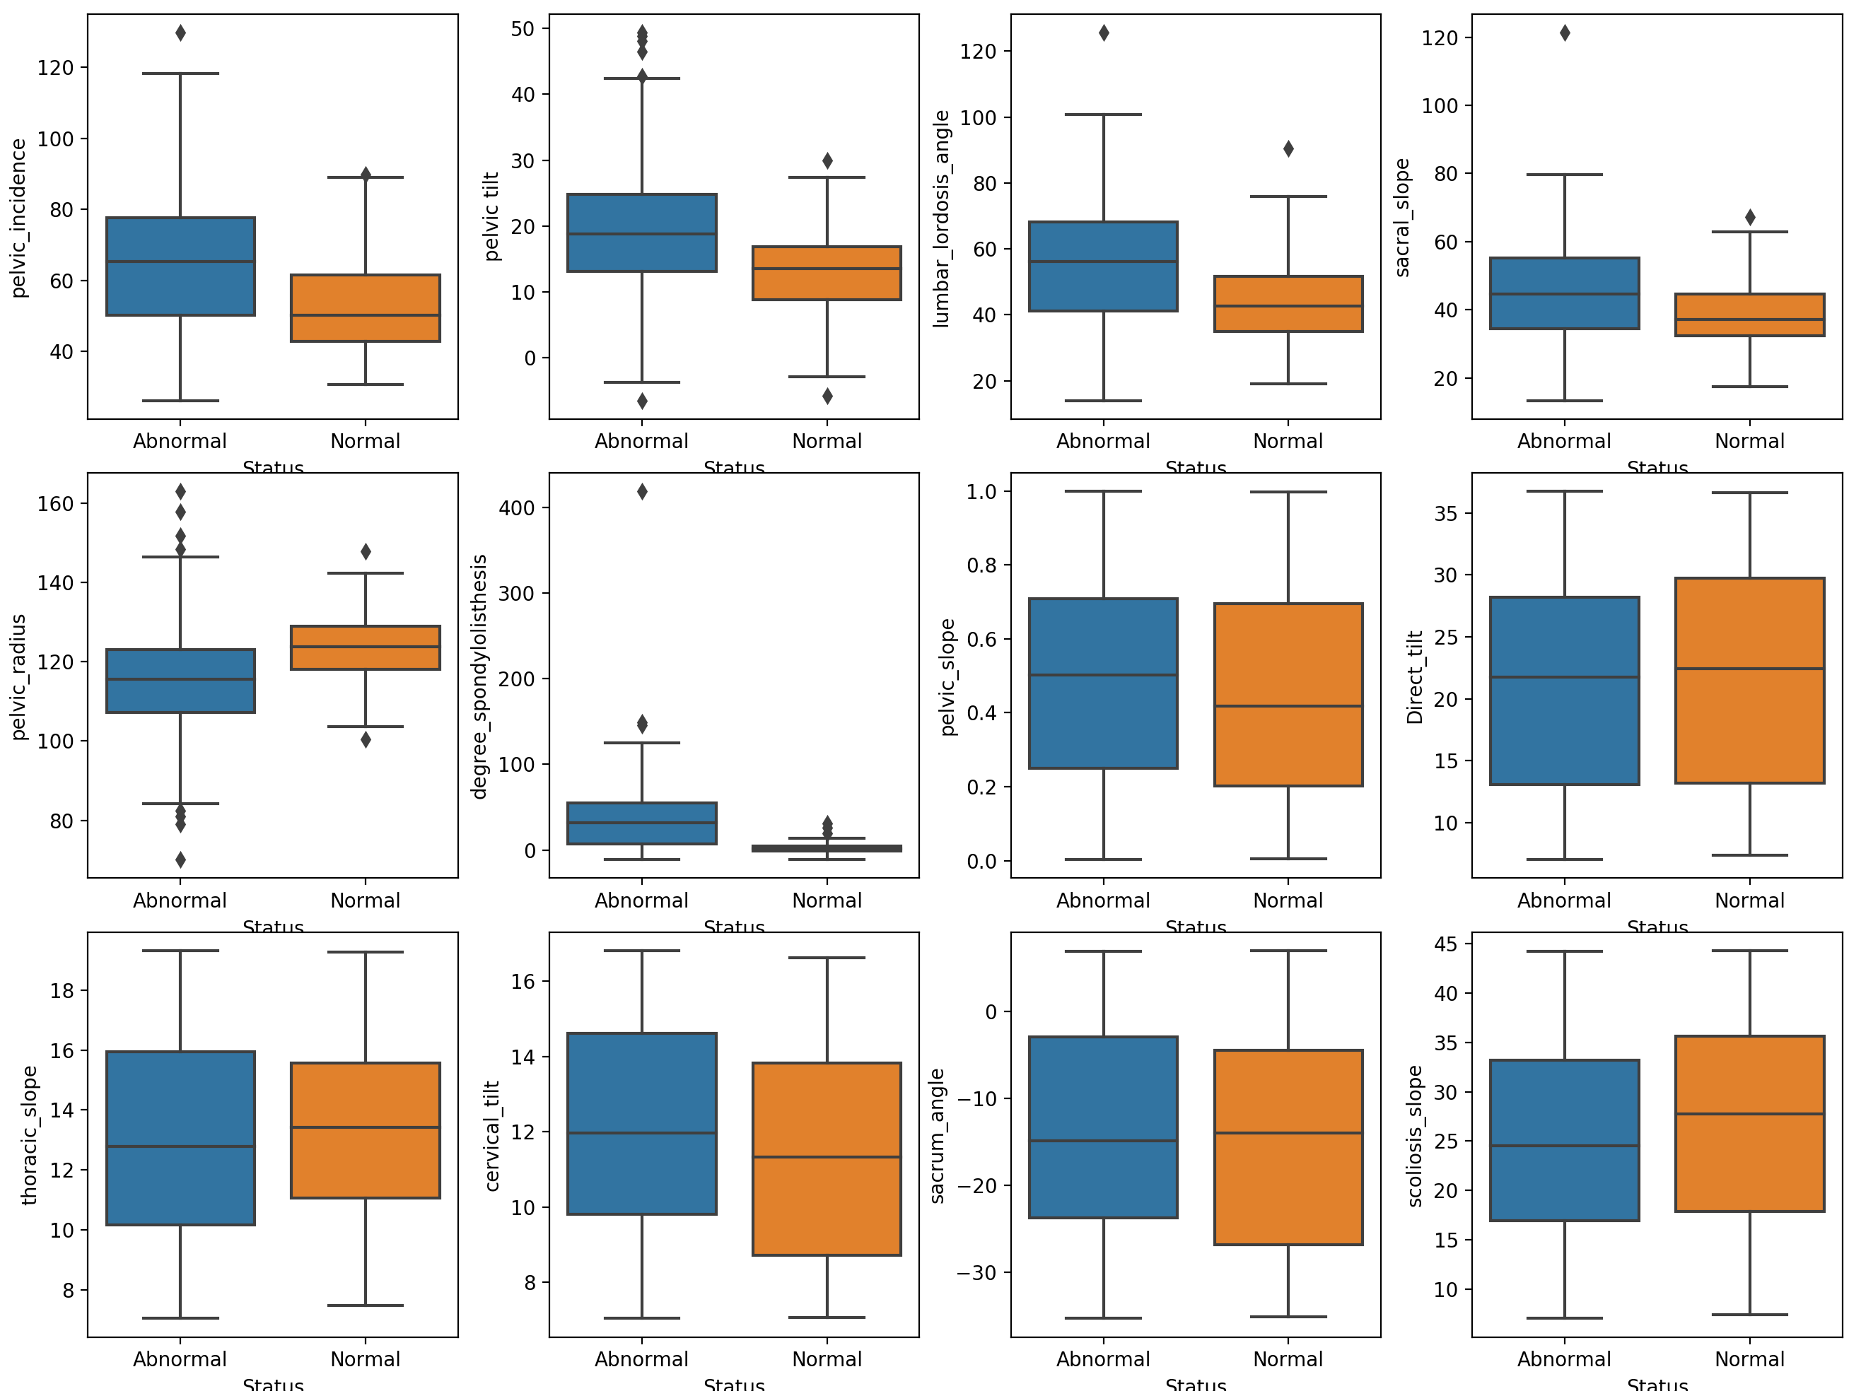
Final Example

Slide 56
Final Example
Need to create training set and test set
Need to scale:
  Mean is set to 0
  StDev is set to 1
  Can be done with
    sklearn.preprocessing.StandardScaler

Slide 57
Final Example
def data_preprocess(X,y):
X_train, X_test, y_train,
y_test = train_test_split(X, y.values.ravel(),
test_size=0.3,
random_state=0)
from sklearn.preprocessing import StandardScaler
scaler = StandardScaler(copy=True,
with_mean=True,
with_std=True)
scaler.fit(X_train)
train_scaled = scaler.transform(X_train)
test_scaled = scaler.transform(X_test)
return(train_scaled, test_scaled, y_train, y_test)

Slide 58
Final Example
We use the logistic regression model from sklearn
from sklearn.linear_model import LogisticRegression
X_train_scaled, X_test_scaled, y_train, y_test = data_preprocess(X,y)
logreg = LogisticRegression().fit(X_train_scaled, y_train)
logreg_result = logistic_regression(X_train_scaled, y_train)
logreg = LogisticRegression().fit(x, y)

Slide 59
Final Example
We can now read the results:
logreg_result.score(X_train_scaled,y_train)
Training set score: 0.876
logreg_result.score(X_test_scaled,y_test)
Test set score: 0.817

Slide 60
Final Example
To see what influence variables have, we use statsmodels
X_train_scaled, X_test_scaled, y_train, y_test = data_preprocess(X,y)
logit_model = sm.Logit(y_train, X_train_scaled)
result = logit_model.fit()
print(result.summary2())

Slide 61
Final Example
Results: Logit
=====================================================================
Model: Logit Pseudo R-squared: 0.248
Dependent Variable: y AIC: 229.3058
Date: 2020-11-19 18:19 BIC: 269.8646
No. Observations: 217 Log-Likelihood: -102.65
Df Model: 11 LL-Null: -136.45
Df Residuals: 205 LLR p-value: 3.4943e-10
Converged: 0.0000 Scale: 1.0000
No. Iterations: 35.0000
---------------------------------------------------------------------
Coef. Std.Err. z P>|z| [0.025 0.975]
---------------------------------------------------------------------
x1 0.0814 11580039.8359 0.0000 1.0000 -22696460.9366 22696461.0993
x2 0.0765 6600560.9760 0.0000 1.0000 -12936861.7142 12936861.8673
x3 -0.2797 0.3142 -0.8904 0.3733 -0.8955 0.3361
x4 -0.5412 9111339.5243 -0.0000 1.0000 -17857897.8597 17857896.7773
x5 -1.1234 0.2351 -4.7773 0.0000 -1.5842 -0.6625
x6 2.3250 0.4401 5.2832 0.0000 1.4625 3.1875
x7 0.1711 0.1790 0.9561 0.3390 -0.1797 0.5220
x8 -0.2115 0.1770 -1.1950 0.2321 -0.5583 0.1354
x9 0.0724 0.1738 0.4166 0.6770 -0.2683 0.4131
x10 0.2003 0.1772 1.1301 0.2584 -0.1471 0.5476
x11 -0.1042 0.1804 -0.5778 0.5634 -0.4578 0.2493
x12 -0.2749 0.1764 -1.5579 0.1193 -0.6207 0.0709
=====================================================================

Slide 62
Final Example
There was no convergence, meaning that there was some high correlation between variables
Pelvic Incidence column is sum of Pelvic Tilt and Sacral Slope
Let’s remove these
And run again
cols_to_include = [cols for cols in X.columns
if cols not in
['pelvic_incidence', 'pelvic tilt','sacral_slope']]
X = back_data[cols_to_include]

Slide 63
Final Example
Optimization terminated successfully.
Current function value: 0.481933
Iterations 7
Results: Logit
=================================================================
Model: Logit Pseudo R-squared: 0.234
Dependent Variable: y AIC: 227.1591
Date: 2020-11-19 18:23 BIC: 257.5781
No. Observations: 217 Log-Likelihood: -104.58
Df Model: 8 LL-Null: -136.45
Df Residuals: 208 LLR p-value: 8.5613e-11
Converged: 1.0000 Scale: 1.0000
No. Iterations: 7.0000
--------------------------------------------------------------------
Coef. Std.Err. z P>|z| [0.025 0.975]
--------------------------------------------------------------------
x1 -0.5434 0.2568 -2.1158 0.0344 -1.0468 -0.0400
x2 -0.9642 0.2080 -4.6364 0.0000 -1.3719 -0.5566
x3 2.2963 0.4142 5.5443 0.0000 1.4846 3.1081
x4 0.1499 0.1771 0.8464 0.3974 -0.1972 0.4971
x5 -0.2442 0.1738 -1.4047 0.1601 -0.5849 0.0965
x6 0.0640 0.1732 0.3694 0.7118 -0.2754 0.4034
x7 0.2068 0.1747 1.1841 0.2364 -0.1355 0.5491
x8 -0.1183 0.1777 -0.6660 0.5054 -0.4666 0.2299
x9 -0.2872 0.1736 -1.6547 0.0980 -0.6274 0.0530
=================================================================

Slide 64
Final Example
We concentrate on those variables with a low P-value:
--------------------------------------------------------------------
Coef. Std.Err. z P>|z| [0.025 0.975]
--------------------------------------------------------------------
x1 -0.5434 0.2568 -2.1158 0.0344 -1.0468 -0.0400
x2 -0.9642 0.2080 -4.6364 0.0000 -1.3719 -0.5566
x3 2.2963 0.4142 5.5443 0.0000 1.4846 3.1081
x4 0.1499 0.1771 0.8464 0.3974 -0.1972 0.4971
x5 -0.2442 0.1738 -1.4047 0.1601 -0.5849 0.0965
x6 0.0640 0.1732 0.3694 0.7118 -0.2754 0.4034
x7 0.2068 0.1747 1.1841 0.2364 -0.1355 0.5491
x8 -0.1183 0.1777 -0.6660 0.5054 -0.4666 0.2299
x9 -0.2872 0.1736 -1.6547 0.0980 -0.6274 0.0530
=================================================================

Slide 65
Final Example
X_trim_1 = X.loc[:,['lumbar_lordosis_angle’,
'pelvic_radius',
'degree_spondylolisthesis']]
X_train_scaled, X_test_scaled, y_train, y_test = data_preprocess(X_trim_1,y)
logit_model = sm.Logit(y_train, X_train_scaled)
result = logit_model.fit()
print(result.summary2())

Slide 66
Final Example
=====================================
Optimization terminated successfully.
Current function value: 0.498420
Iterations 7
Results: Logit
=================================================================
Model: Logit Pseudo R-squared: 0.207
Dependent Variable: y AIC: 222.3145
Date: 2020-11-19 18:30 BIC: 232.4542
No. Observations: 217 Log-Likelihood: -108.16
Df Model: 2 LL-Null: -136.45
Df Residuals: 214 LLR p-value: 5.1622e-13
Converged: 1.0000 Scale: 1.0000
No. Iterations: 7.0000
--------------------------------------------------------------------
Coef. Std.Err. z P>|z| [0.025 0.975]
--------------------------------------------------------------------
x1 -0.4688 0.2426 -1.9325 0.0533 -0.9443 0.0067
x2 -0.9188 0.2037 -4.5100 0.0000 -1.3181 -0.5195
x3 2.1897 0.3937 5.5626 0.0000 1.4182 2.9613
=================================================================

Slide 67
Final Example
Some improvement in scores:
Training set score: 0.857
Test set score: 0.774

