Slide 1
Minimization and Curve Fitting with SciPy
Thomas Schwarz, SJ

Slide 2
Curve Fitting
Want to construct a curve (mathematical function) that best fits a series of data points
  First, need to select a model: what type of curve?
  Then, need to determine how we measure fit
    Examples:
      y-values: $L(y,\overset{̂}{y})=\overset{n}{\underset{ν=1}{∑}}(y_{i}-\overset{̂}{y}(i))^{2}→min$
      orthogonal least squares

Slide 3
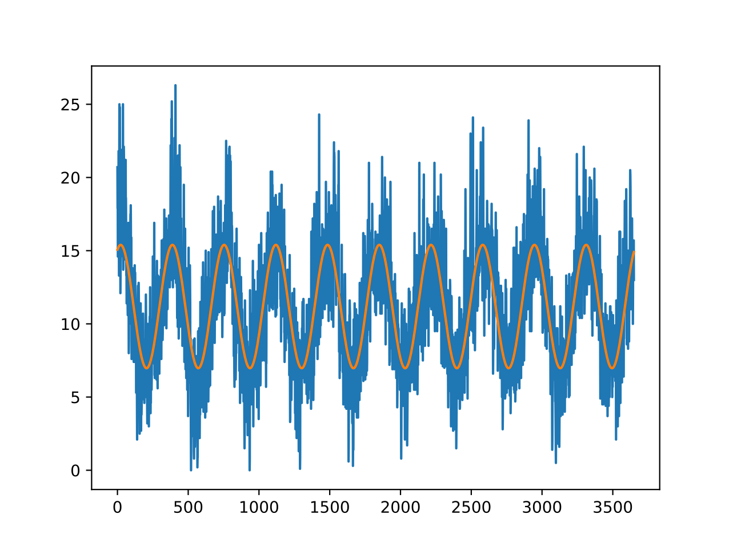
Curve Fitting
Example: Fit a sine curve to meteorological data
  Minimum daily temperatures in Melbourne
$$f_{α,β,γ,δ}(t)=α+βsin(γt+δ)$$

Slide 4
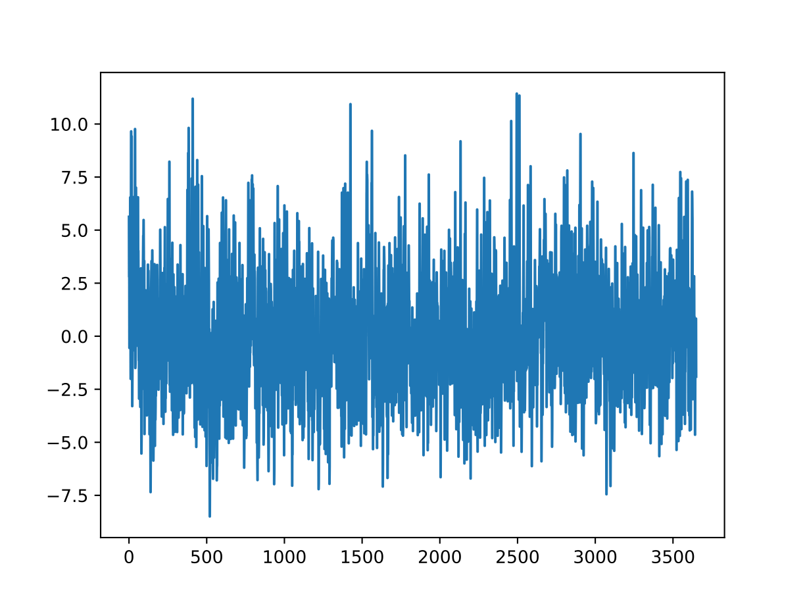
Curve Fitting
The data after removing the sine curve shows a seemingly random time series with just a little bit of seasonality

Slide 5

Curve Fitting
We can do better by including a cos
$$f_{α,β,γ,δ,ϵ}(t)=α+βsin(γt+δ)+ϵcos(γt+δ)$$

Slide 6

Curve Fitting
Residual:
  Looks slightly better?

Slide 7
Curve Fitting
Find the parameters that minimize the squared difference between function and model
  This is a minimization problem
Too general a model:
  Optimization can be very difficult and lengthy
  Overfit: The result matches the test set, but not the future
Not general a model
  Fit is not good, therefore no strong predictions either

Slide 8
Program
Need to learn about minimization
  One dimensional methods: Minimization along a line
  Gradient Descent Methods
  Minimization for Sums of Squares
  Curve-fitting

Slide 9
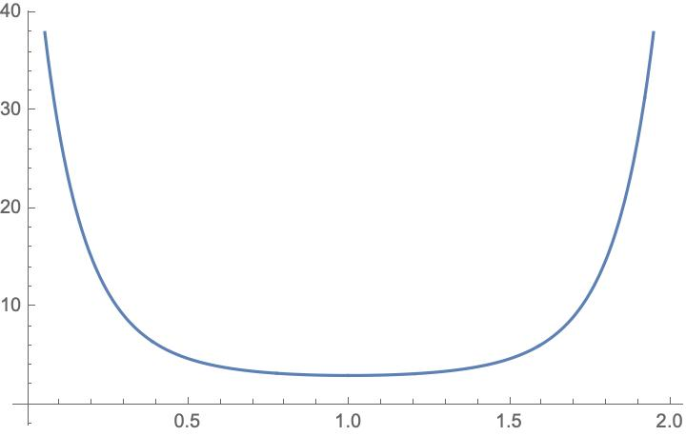
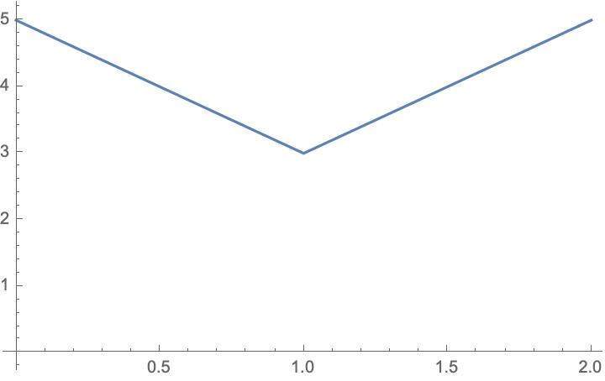
Minimization
Functions can be smooth and non-smooth

Slide 10
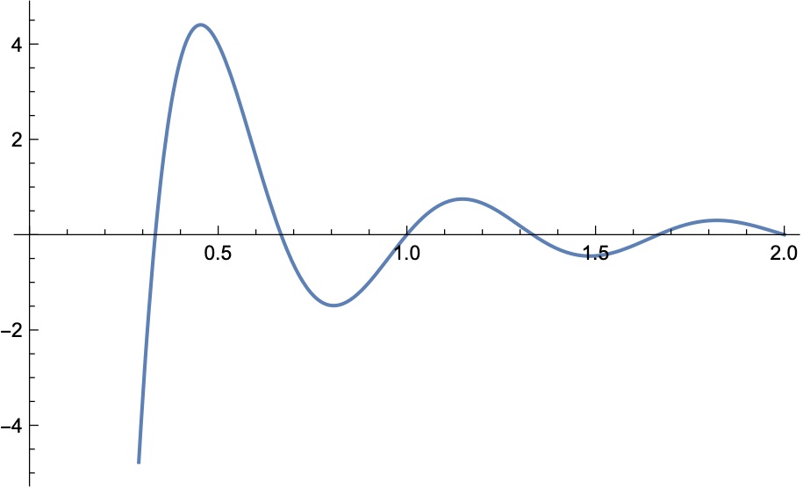
Minimization
Given a function $R^{n}→R$
  Find a minimum
Potential problems:
  Minimum might not exist
  Minimum might be local

Slide 11
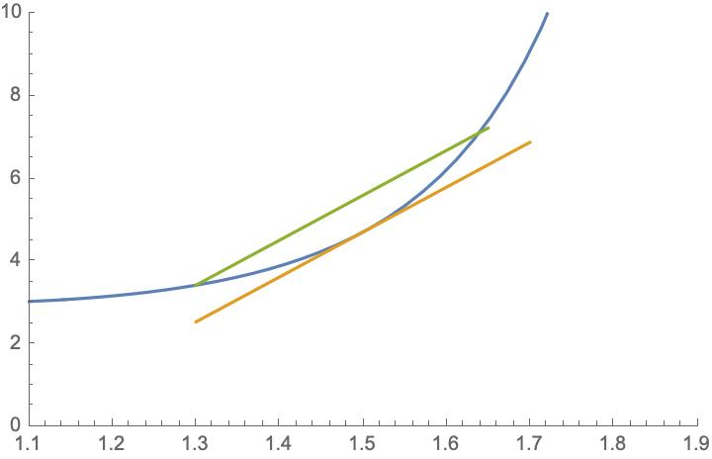
Minimization
Convex functions: For $t∈[0,1]:$
  $f(\overset{⃗}{a}+t(\overset{⃗}{b}-\overset{⃗}{a}))≤f(\overset{⃗}{a})+t(f(\overset{⃗}{b})-f(\overset{⃗}{a})$
  Tends to be easy
  Relative minimum is unique

Slide 12
Scalar Minimization
Can be done without using derivatives:
  Brent’s method
  Standard method for scipy.optimize.minimize_scalar

Slide 13
Scalar Minimization
Example:
  A curvy function
from scipy import optimize
import numpy as np
from matplotlib import pyplot as plt
def f2(x):
return -np.exp(-(x-.9)**2+0.1*x+np.cos(10*x))

Slide 14
Scalar Minimization
Show:
def show(f):
x = np.linspace(0,2,251)
y = f(x)
plt.plot(x,y)
plt.show()

Slide 15
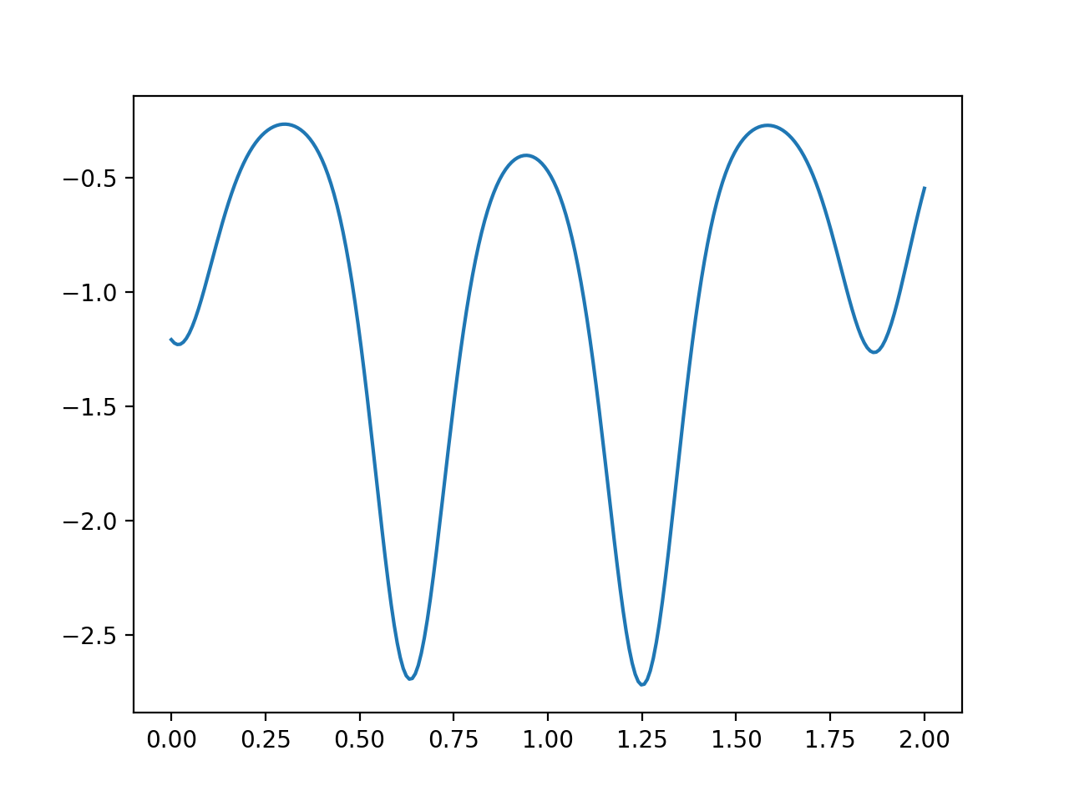
Scalar Minimization

Slide 16
Scalar Minimization
Brent’s method is the default
result = optimize.minimize_scalar(f2)
>>> result>>> result
fun: -2.7191461357325406
message: 'Solution found.'
nfev: 12
status: 0
success: True
x: 1.2506211193351628

Slide 17
Scalar Minimization
Bounded Brent method
result = optimize.minimize_scalar(f2, bounds=(0,2), method='bounded')
>>> result
fun: -2.7191461357325406
message: 'Solution found.'
nfev: 12
status: 0
success: True
x: 1.2506211193351628

Slide 18
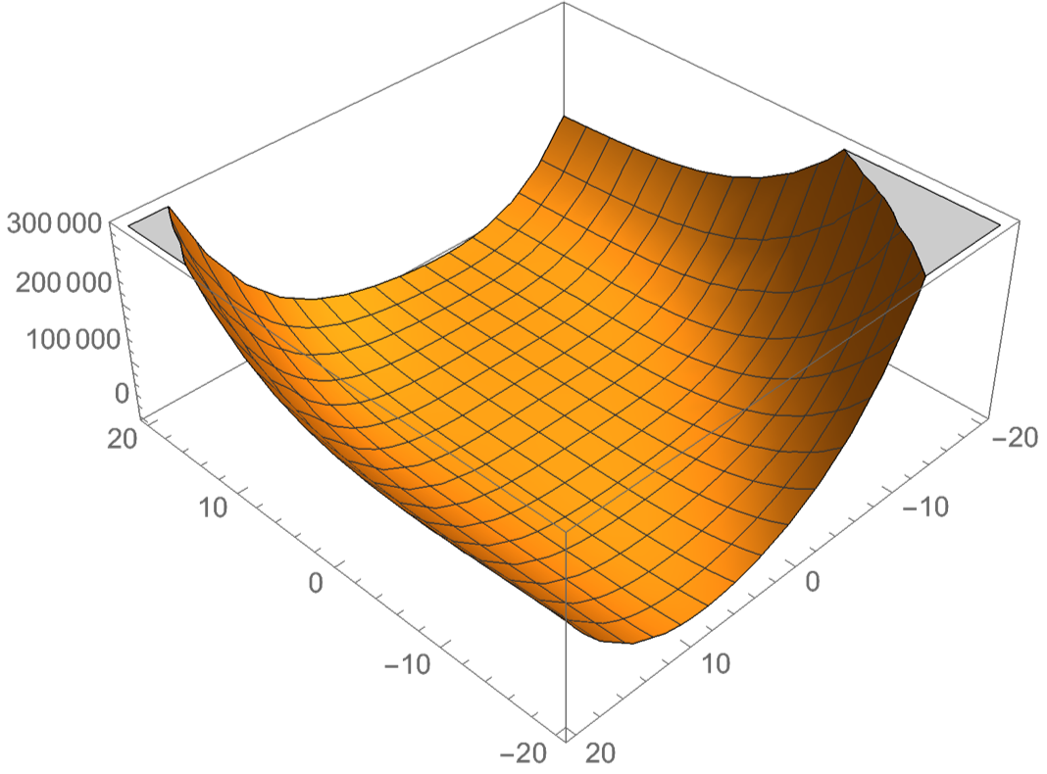
Minimization
Minimization is easier for convex functions

Slide 19
Minimization
Smooth functions are (usually) easier than non-smooth functions
  Exception: Linear systems with constraints —> Linear Programming

Slide 20
Minimization
Gradient $∇f=(\frac{df}{dx_{1}},\frac{df}{dx_{2}},\frac{df}{dx_{3}},…,\frac{df}{dx_{n}})$ is always in the direction of greatest increase of a function

Slide 21
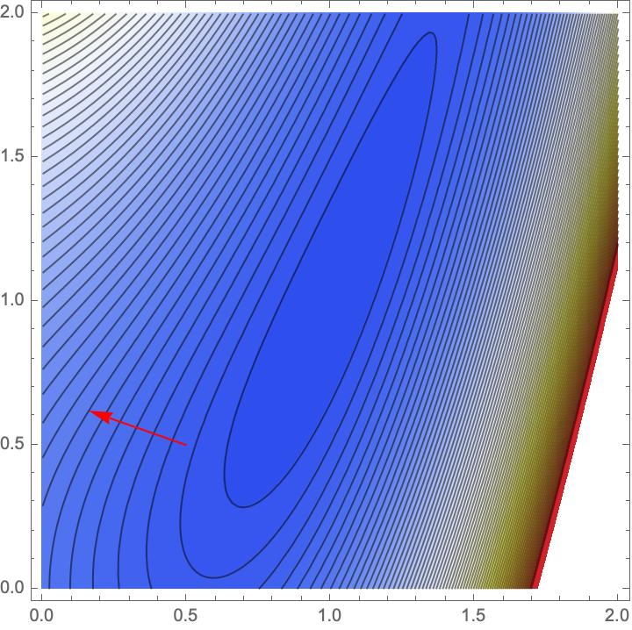
Minimization
Example: Rosenbrock Function
  $$f(x,y)=1.2(y-x^{2})^{2}+1.1(1-x)^{2}$$
  Gradient is $(-2.2(1-x)-4.8x(-x^{2}+y),2.4(-x^{2}+y)$
  Contour graph is

Slide 22
Minimization
Descent Methods:
  Choose a starting point $x_{0}∈R^{n}$
  If $∥∇f(x_{k})∥<ϵ$ declare victory and return $x_{k}$
  Pick a search direction $d_{k}∈R^{n}$ s.t. $∇f(x_{k})⋅d_{k}<0$
  Choose a step size $α_{k}>0$ s.t. $f(x_{k}+α_{k}d_{k})<f(x_{k})$
  Set $x_{k+1}=x_{k}+α_{k}d_{k}$. Go to 2

Slide 23
Minimization
This algorithm leaves two things open:
  Selecting the step length $α_{k}$
  Selecting the search direction $d_{k}$

Slide 24
Minimization
Finding minimum along line:
  Finding minimum of function $t↦f(x_{k}+td_{k})$
  Use derivative is usually dangerous:
    Often function too flat
    Better bracketing

Slide 25
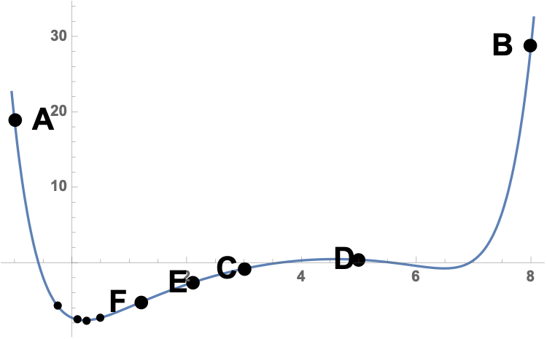
Minimization
Can use bracketing
  Three points A < C < B such that $f(A)>f(C)<f(B)$
    Thus, minimum guaranteed to exist
    Now find another point D between A and C or C and B
    Get a new bracket

Slide 26
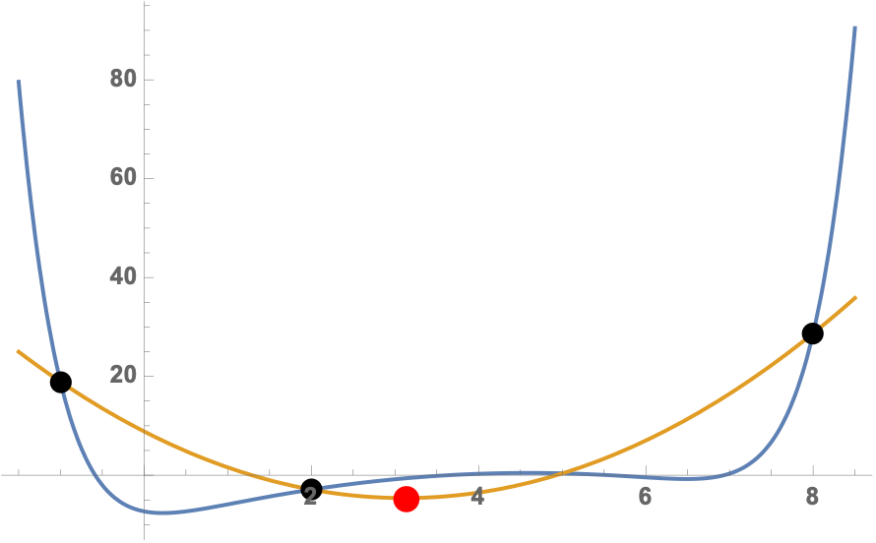
Minimization
One possibility: golden ratio: $\frac{|A-C|}{|A-B|}=\frac{|B-C|}{|A-C|}$
Other possibility: parabolic approximation
Or a combination of both

Slide 27
Minimization
Determining direction:
  Can use coordinates

Slide 28
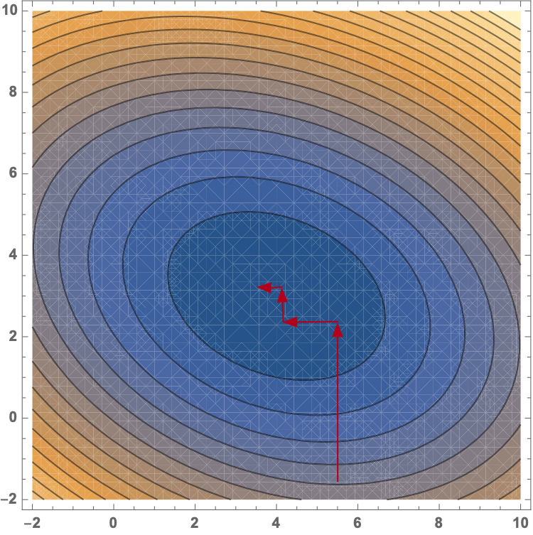
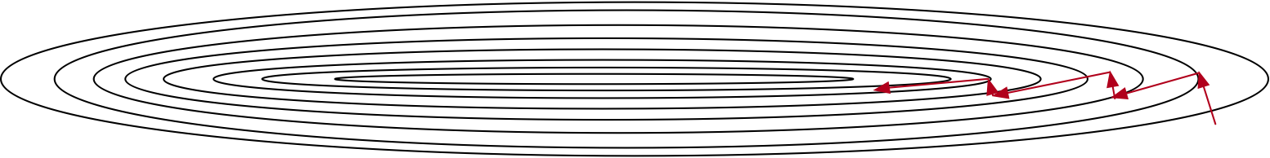
Minimization

Slide 29
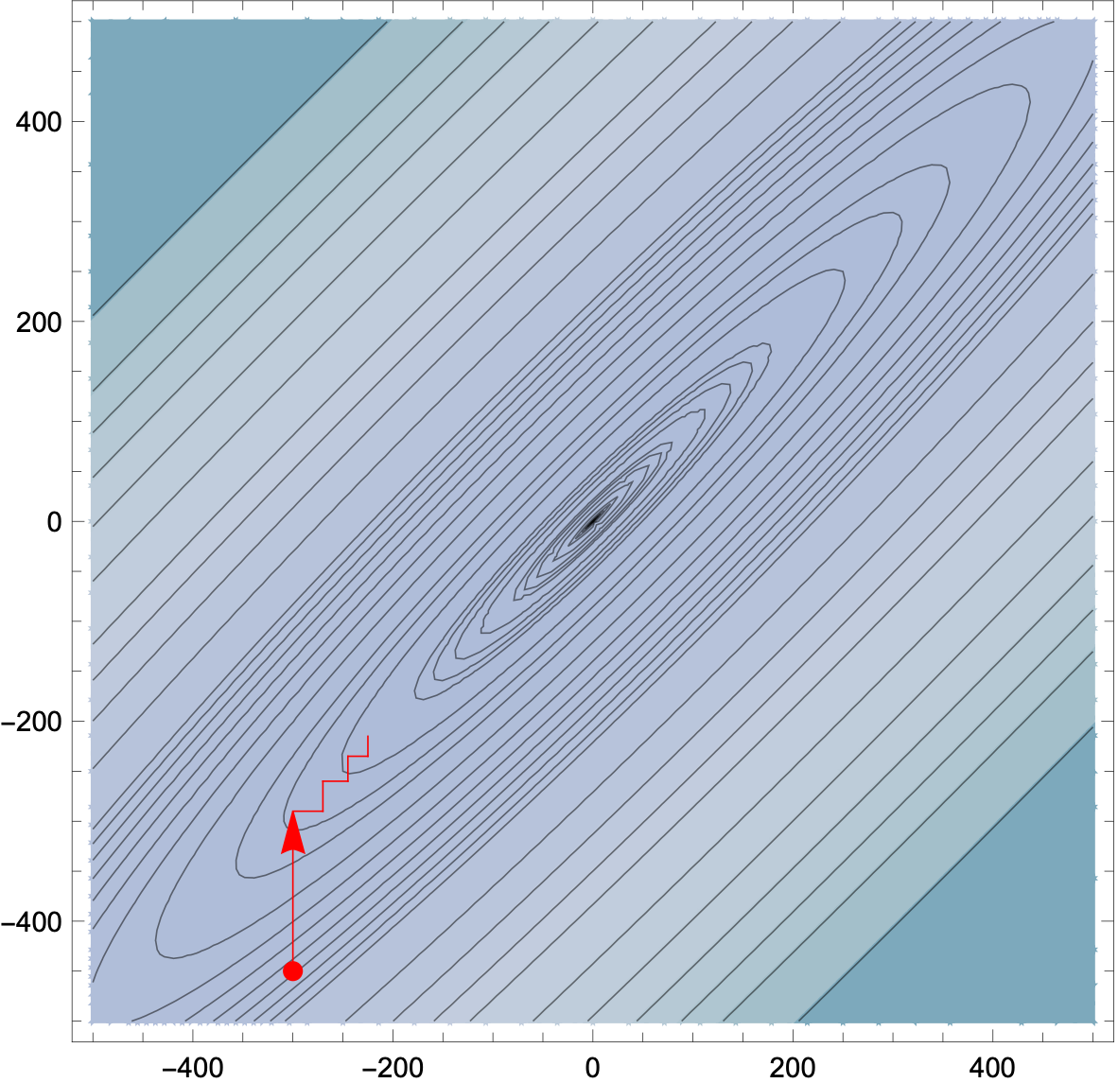
Minimization
Using coordinates
  Make little progress per iteration

Slide 30
Minimization
Better use orthogonal directions:
  otherwise we partially undo the previous steps
Possibilities
  Canonical Directions
  Steepest Descent (Cauchy)
    badly affected by round-off errors and subject to zigzagging
  Powell: Change set of directions every so often

Slide 31
Minimization
Selecting the step length
  Finding the best step length is laborious
  Often do better by guessing
  Many machine learning algorithms use a steadily declining $α$
    Trying out several guesses

Slide 32
Minimization
Newton Methods:
  Repeatedly replace condition$∇f(x)=0$ by a sequence of linear problems
  Newton-Raphson:
    apply exact Newton steps
possibly does not converge
works best for convex functions
  Use linear-search descent, then switch to Newton

Slide 33
Minimization
Numerical minimization of a cost function of the parameters
  Various minimization methods
    Line methods
      Minimize along a particular line

Slide 34
Minimization
Instead of line searches: Trust Region Methods
  Idea: for each iteration: replace $f$ with a quadratic model function
    Quadratic model function approximates $f$ in the "trust region"
    And quadratic model functions are easy to minimize!
    The proposed solution can or cannot have a smaller value for $f$
    Many different ways of defining the model

Slide 35
Minimization with SciPy
Can use a number of method for finding a local minimum
  Some need the Jacobian and some need in addition the Hessian
  Can be calculated numerically but results are better with exact functions
  Jacobian $J(f)=\frac{df}{dx}=(\frac{δf}{δx_{1}},\frac{δf}{δx_{2}},…,\frac{δf}{δx_{n}})$
  Hessian $H(f)={\left(\begin{aligned}\frac{δ^{2}f}{δx_{i}δx_{j}}\end{aligned}\right)}_{i,j}$

Slide 36
Minimization with SciPy
Use scipy.optimize.minimize
  Needs a function that is a one-dimensional np.array
  Specify a starting point, options, and method

Slide 37
Minimization with SciPy
Importing the optimizer:
import numpy as np
from scipy.optimize import minimize

Slide 38
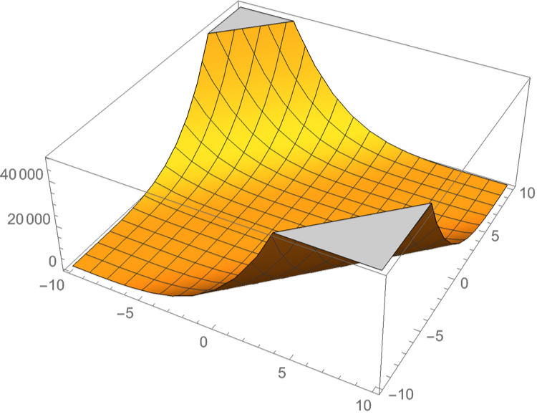
Minimization with SciPy
Defining a function to be minimized
  Needs to be in "standard form", i.e. numpy array of one dimension
def func(x):
return np.sin(x[0]*x[1])+(x[0]+x[1]-1)**2+(x[0]-x[1]+1)**4

Slide 39
Minimization with SciPy
Sometimes need to give Jacobian
def jacob(x):
return np.array(
(4*(1+x[0]-x[1])**3 +
2*(x[0]+x[1]-1)+
x[1]*np.cos(x[0]*x[1]),
-4*(1+x[0]-x[1])**3 +
2*(x[0]+x[1]-1)+
x[0]*np.cos(x[0]*x[1])) )

Slide 40
Minimization with SciPy
We pick (5,5) as the starting point
res = minimize(func,
[5,5],
method = 'nelder-mead',
options = {'xatol': 1e-9, 'disp':True}
)
print(res.x)

Slide 41
Minimization with SciPy
Success: (but with lots of function evaluations)
Optimization terminated successfully.
Current function value: -0.295490
Iterations: 84
Function evaluations: 164
[-0.37249737 1.18821832]

Slide 42
Minimization with SciPy
res = minimize(func,
[5,5],
method = 'Newton-CG',
jac = jacob,
options = {'disp':True}
)
print(res.x)

Slide 43
Minimization with SciPy
Optimization terminated successfully.
Current function value: -0.295490
Iterations: 10
Function evaluations: 12
Gradient evaluations: 47
Hessian evaluations: 0
[-0.37249737 1.18821832]

Slide 44
Minimization with SciPy
res = minimize(func,
[5,5],
method = 'Powell',
options = {'disp':True}
)
print(res.x)

Slide 45
Minimization with SciPy
Optimization terminated successfully.
Current function value: -0.295490
Iterations: 5
Function evaluations: 139
[-0.37249969 1.18821518]

Slide 46
Minimization with SciPy
res = minimize(func,
[5,5],
method = 'BFGS',
options = {'disp':True}
)
print(res.x)

Slide 47
Minimization with SciPy
Optimization terminated successfully.
Current function value: -0.295490
Iterations: 15
Function evaluations: 84
Gradient evaluations: 21
[-0.37249848 1.18821848]

Slide 48
Least Square Optimization
Want to minimize a sum of squares
  $$f:R^{n}→R^{m}$$
      $f(\overset{⃗}{x})=\frac{1}{2}\overset{m}{\underset{j=1}{∑}}r_{j}^{2}(\overset{⃗}{x})$
  (Factor of 1/2 to make derivatives look nicer)

Slide 49
Least Square Optimization
With this special form, we can calculate the Jacobian of $(r_{1}(\overset{⃗}{x}),r_{2}(\overset{⃗}{x}),…,r_{m}(\overset{⃗}{x}))^{T}$ more easily
$J^{T}=\left(\begin{matrix}\frac{δr_{1}}{δx_{1}} & \frac{δr_{2}}{δx_{1}} & … & \frac{δr_{m}}{δx_{1}} \\ \frac{δr_{1}}{δx_{2}} & \frac{δr_{2}}{δx_{2}} & … & \frac{δr_{m}}{δx_{2}} \\ ⋮ & ⋮ & ⋱ & ⋮ \\ \frac{δr_{1}}{δx_{n}} & \frac{δr_{2}}{δx_{n}} & … & \frac{δr_{m}}{δx_{n}}\end{matrix}\right)=\left(\begin{aligned}\frac{δr_{j}}{δx_{i}}\end{aligned}\right)$

Slide 50
Least Square Optimization
Then
$$∇f(\overset{⃗}{x})=J(\overset{⃗}{x})^{T}r(x)$$
$$∇^{2}f(\overset{⃗}{x})=J(\overset{⃗}{x})^{T}J(\overset{⃗}{x})+\overset{m}{\underset{j=1}{∑}}r_{j}(\overset{⃗}{x})∇^{2}r_{j}(\overset{⃗}{x})$$

Slide 51
Least Square Optimization
Now we assume that $||r(\overset{⃗}{x})||$ is linear
  Then $J$ is a constant
  $$∇^{2}(r_{j})(\overset{⃗}{x})=0$$
  Taylor expansion is
$$f(\overset{⃗}{x})=f(x_{0})+J(f(x))|_{{\overset{⃗}{x}}_{0}}(\overset{⃗}{x}-{\overset{⃗}{x}}_{0})+\frac{1}{2}(\overset{⃗}{x}-{\overset{⃗}{x}}_{0})^{T}H(f(\overset{⃗}{x})|_{{\overset{⃗}{x}}_{0}}(\overset{⃗}{x}-{\overset{⃗}{x}}_{0})+…$$
Taking derivatives gives
$$∇f(\overset{⃗}{x})=J^{T}(J\overset{⃗}{x}+\overset{⃗}{r})=0$$
at a minimum

Slide 52
Least Square Optimization
  This means we can solve for the minimum since then$J^{T}J\overset{⃗}{x}=-J^{T}r(\overset{⃗}{x})$
and so we could solve $\overset{⃗}{x}=(J^{T}J)^{-1}J^{T}r$

Slide 53
Least Square Optimization
However, calculating the inverse is
  computationally expensive
  numerically unstable

Slide 54
Least Square Optimization
Can use
  Cholesky factorization
  QR factorisation
  Singular value decomposition of
      $$J^{T}J$$
  which are all implemented in np.linalg

Slide 55
Least Square Optimization
Levenberg Marquardt algorithm
  Even if $r$ is not linear:
    Assume that it is approximately
    Use the above method as an approximator
    Get results

Slide 56
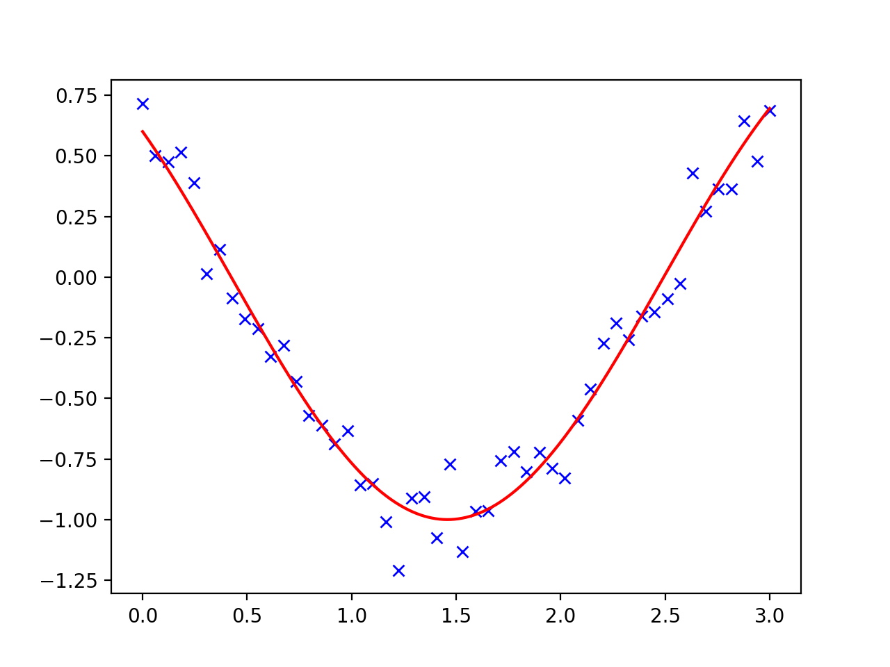
Curve Fitting
Number of numerical methods for minimization problems
Curve fitting:
  Given a number of points, find a smooth curve going through it

Slide 57
Curve Fitting
Use a cosine as the test function
def f(t, omega, phi):
return np.cos(omega * t + phi)

Slide 58
Fitting with scipy
Create sample data
x = np.linspace(0, 3, 50)
y = f(x, 1.5, 1) + .1*np.random.normal(size=50)

Slide 59
Fitting with scipy
Now fit using scipy.optimize
params, params_cov = optimize.curve_fit(f, x, y)
print(params)

Slide 60
Fitting with scipy
Can almost recover parameters
y = f(x, 1.5, 1) + .1*np.random.normal(size=50)
[1.51854577 0.92665541]

Slide 61
Fitting with scipy

Slide 62
Fitting with scipy
Could also fit with a quadratic
def g(t, a, b, c):
return a*t**2+b*t+c
params, params_cov = optimize.curve_fit(g, x, y)

Slide 63
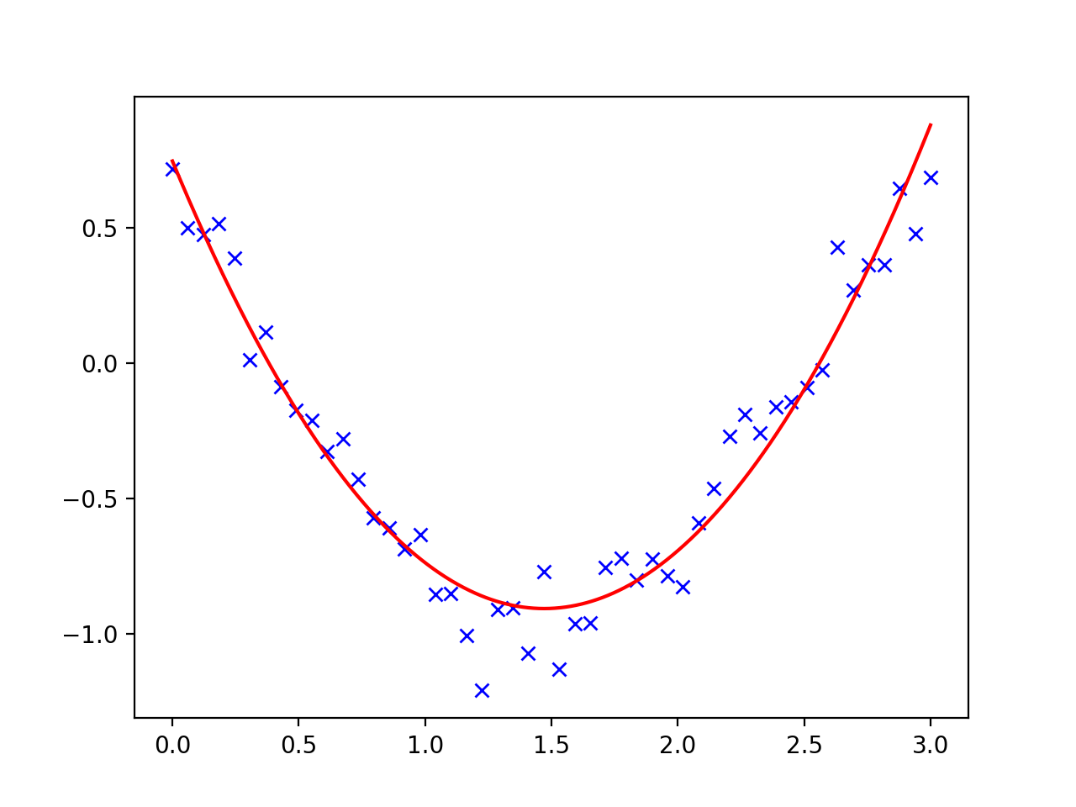
Fitting with scipy

Slide 64
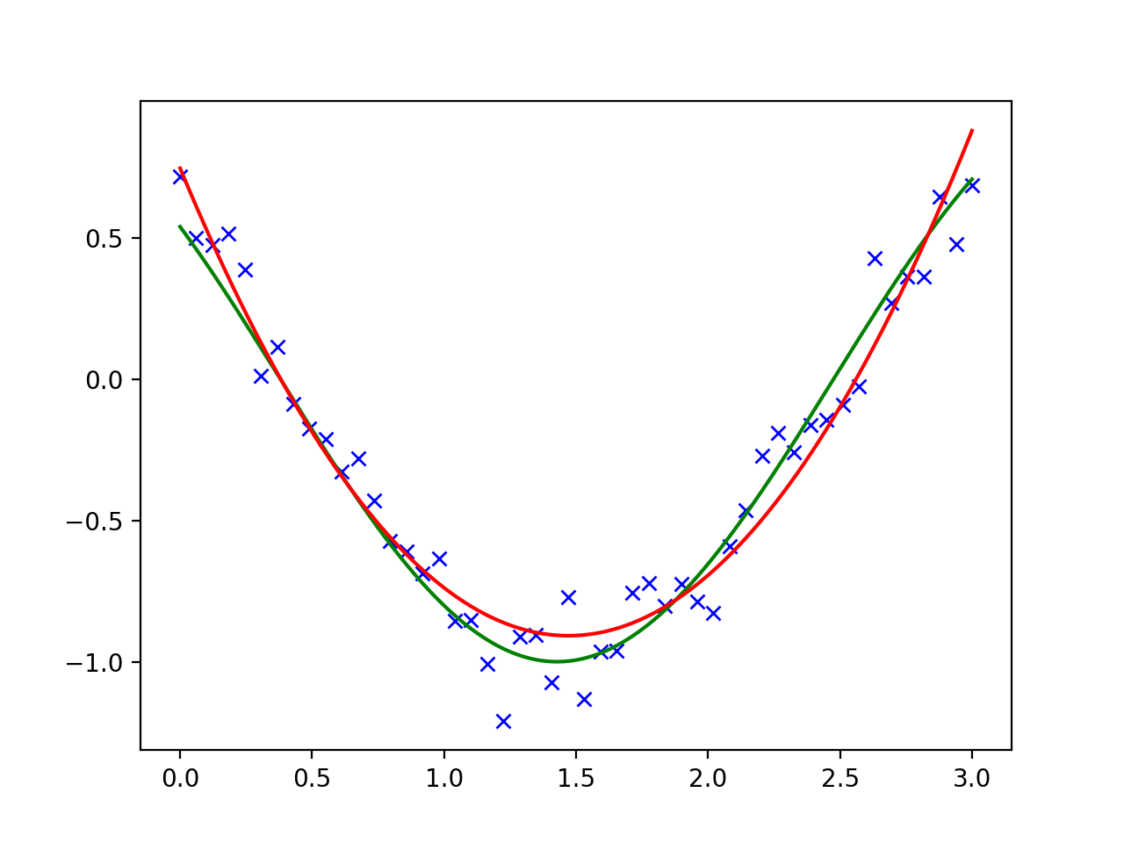
Fitting with scipy

Slide 65
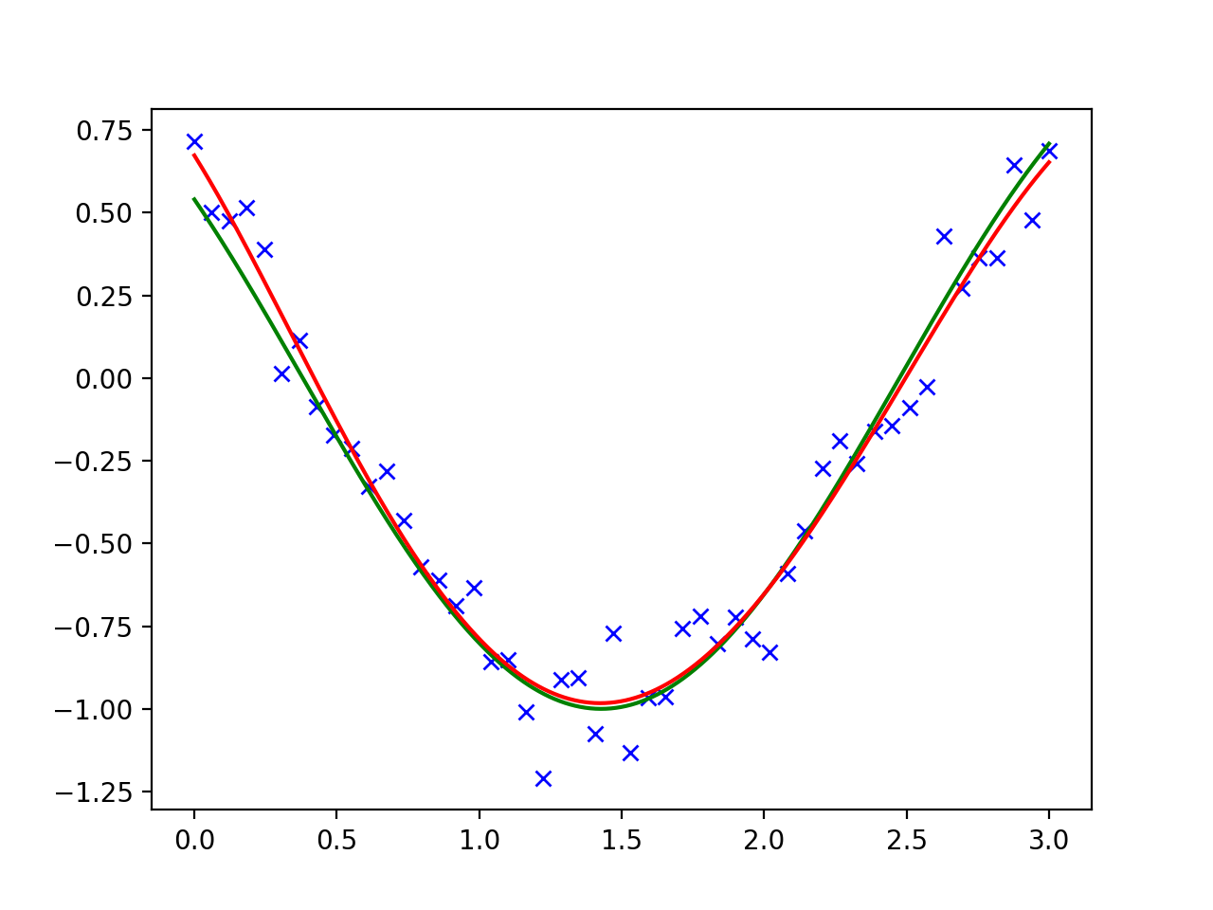
Fitting with scipy
Could also try a higher level polynomial

Slide 66
Fitting with scipy
And if we try with a polynomial with as many degrees as there are points, we would get perfect fit
  And absolutely no insights!

Slide 67
Optimization
Global optimizers:
  Grid search: Start out at a large number of starting positions
  Try out several methods
    If possible, calculate the gradient and the Hessian yourself
    Can use scipy.optimize.check_grad( ) to see whether you calculated correctly

Slide 68
Curve Fitting
Need to have a good model:
  Avoids under- and over-fitting
  Find a way to measure success
    E.g. time series: You want to remove trends and have white noise left over

Slide 69
Constraints
Often need to optimize under constraints
  Easiest constraints are for box bounds:
    Variables need to be within a certain range

Slide 70
Constraints
Function:
def f(x):
return np.sqrt((x[0]-3)**2 + (x[1]-2)**2)

Slide 71
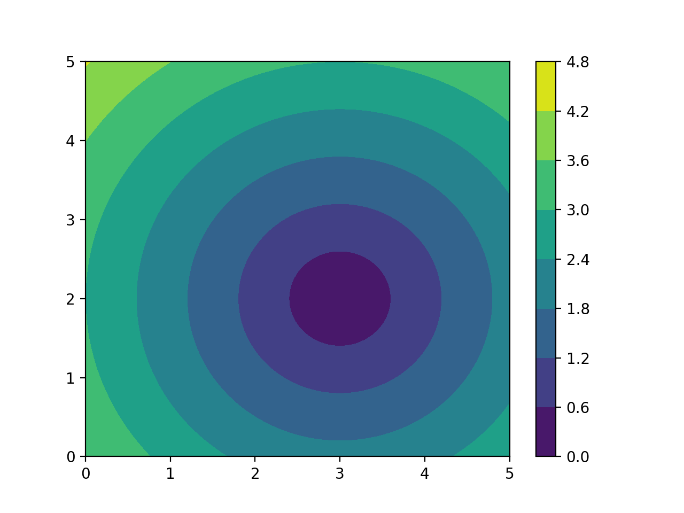
Constraints

Slide 72
Constraints
Optimization:
result = optimize.minimize(f, np.array([0, 0]), bounds=((-1.5, 1.5), (-1.5, 1.5)))

Slide 73
Constraints
Result:
>>> result
fun: 1.5811388300841898
hess_inv: <2x2 LbfgsInvHessProduct with dtype=float64>
jac: array([-0.94868331, -0.31622778])
message: b'CONVERGENCE: NORM_OF_PROJECTED_GRADIENT_<=_PGTOL'
nfev: 9
nit: 2
status: 0
success: True
x: array([1.5, 1.5])

Slide 74
HELP!!!!
Get Scipy Lecture notes (for free)
  www.scipy-lectures.org

