Slide 1
Functions in Python

Slide 2
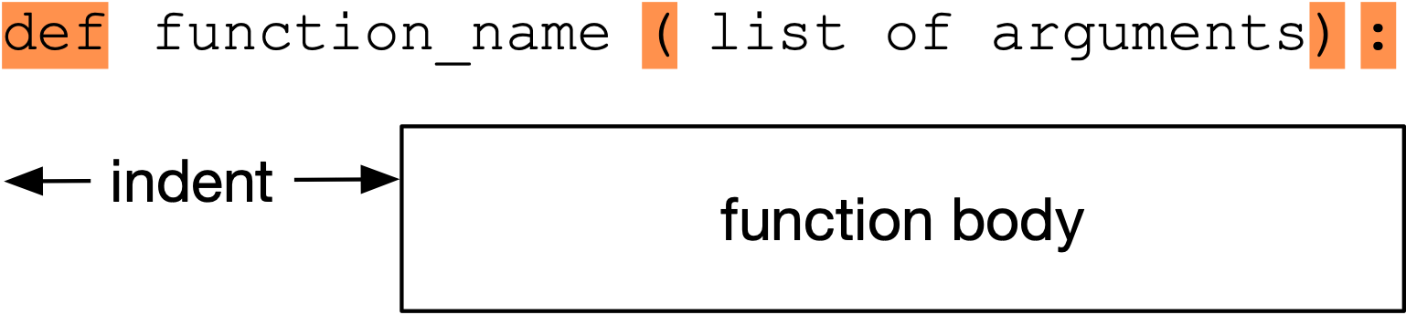
Python Functions
Functions defined by keyword def
Can return value with keyword return

Slide 3
Python Functions
Without return:
  Function returns when code is exhausted
Peculiarities:
  Neither argument nor return types are specified

Slide 4
Python Functions
This is weird, but legal
  Returns a None value for x = 4
  Returns int for x=1, string for x=2, float for x=3
def example(x):
if x == 1:
return 1
if x == 2:
return "two"
if x == 3:
return 3.0

Slide 5
Functions of Functions
Functions are full-fledged objects in Python
  This means you can pass functions as parameters
  Example: Calculate the average of the values of a function at -n, -n+1, -n+2, …, -2, -1, 0, 1, 2, … , n-2, n-1, n
    The function needs to be a function of one integer variable
  Example:
    n = 2, function is squaring
    Return value is
$$((-2)^{2}+(-1)^{2}+0^{2}+1^{2}+2^{2})/5=2$$

Slide 6
Functions of Functions
We first define the averaging function with two arguments
  The number n
  The function over which we average, called func
def averaging(n, func):

Slide 7
Functions of Functions
Inside the function, we create an accumulator and a loop index, running from -n to n.
def averaging(n, func):
  accu = 0
  for i in range(-n, n+1):

Slide 8
Functions of Functions
Inside the loop, we modify the accumulator accu by adding the value of the function at the loop variable.
def averaging(n, func):
  accu = 0
  for i in range(-n, n+1):
  accu += func(i)

Slide 9
Functions of Functions
There are 2n+1 points at which we evaluate the function.
We then return the average as the accumulator over the number of points
def averaging(n, func):
  accu = 0
  for i in range(-n, n+1):
  accu += func(i)
        return accu/(2*n+1)

Slide 10
Functions of Functions
In order to try this out, we need to use a function
We can just define one in order to try out our averaging function
def square(number):
return number*number
def averaging(n, func):
  accu = 0
  for i in range(-n, n+1):
  accu += func(i)
return accu/(2*n+1)
print(averaging(2, square))

Slide 11
Local Functions
Can have a function definition inside a function
  Not many use cases
def factorial(number):
if not isinstance(number, int):
raise TypeError("sorry", number, "must be an integer")
if not number >= 0:
raise ValueError("sorry", number, "must be positive")
def inner_factorial(number):
if number <= 1:
return 1
return number * inner_factorial(number-1)
return inner_factorial

Slide 12
Local and Global Variables
A Python function is an independent part of a program
  It has its own set of variables
    Called local variables
  It can also access variables of the environment in which the function is called.
    These are global variables
  The space where variables live is called their scope
  We will revisit this issue in the future

Slide 13
Examples
a=3
b=2
def foo(x):
return a+x
def bar(x):
b=1
return b+x
print(foo(3), bar(3))
a and b are two global variables
In function foo:
  a is global, its value remains 3
In function bar:
  b is local, since it is redefined to be 1

Slide 14
The global keyword
In the previous example, we generated a local variable b by just assigning a value to it.
There are now two variables with name b
In bar, the global variable is hidden
If we want to assign to the global variable, then we can use the keyword global to make b refer to the global variable. An assignment then does not create a new local variable, but rather changes the value of the old one.

Slide 15
Example
In foo:
  A local variable b
  A global variable a
  The value of a changes by executing foo( )
a = 1
b = 2
def foo():
global a
a = 2
b = 3
print("In foo:" , "a=", a, " b=", b)
print("Outside foo: " ,"a=", a, " b=", b)
foo()
print("Outside foo: " ,"a=", a, " b=", b)
##Outside foo: a= 1 b= 2
##In foo: a= 2 b= 3
##Outside foo: a= 2 b= 2

Slide 16
Scoping
Global scope:
  Names that we define are visible to all our code
Local scope:
  Names that we define are only visible to the current function

Slide 17
Scoping
LEGB — rule to resolve names
  Local
  Enclosed (e.g. enclosing function)
  Global
  Built-in

Slide 18
Functions with Default Arguments
We have created functions that have positional arguments
  Example:
    When we invoke this function, the first argument (2) gets plugged into variable foo and the second argument (3) get plugged into variable bar
def fun(foo, bar):
print(2*foo+bar)
fun(2, 3)

Slide 19
Keyword (Named) Arguments
We can also use the names of the variables in the function definition.
Example: (we soon learn how to deal better with errors)
def quadratic(a, b, c):
if b**2-4*a*c >= 0:
return -b/(2*a) + math.sqrt(b**2-4*a*c)/(2*a)
else:
print("Error: no solution")
print(quadratic(1, -4, 4)) #CALL BY POSITION
print(quadratic(c=4, a=1, b=-4) #CALL BY KEYWORD

Slide 20
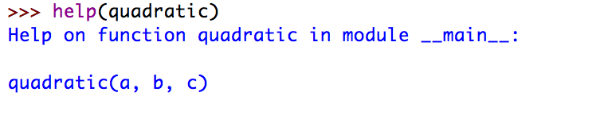
Keyword (Named) Arguments
Keyword arguments have advantages
  If you have a function with many positional arguments, then you need to carefully match them up
  At least, you can use the help function in order to figure out what each argument does, if you named them well in the function definition

Slide 21
Keyword (Named) Arguments
You can force the user of a function to use keywords by introducing an asterisk into the definition of the function:
  All arguments after the asterisk need to be passed by keyword
  The arguments before the asterisk can be positional
def fun(a, b, *, c):
…
print(fun(2, 3, c=5)

Slide 22
Pythonic Tip
If you want to write understandable code:
  Use keyword arguments

Slide 23
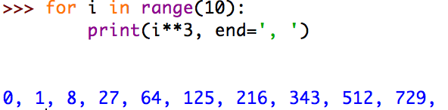
Default arguments
You have already interacted with built-in functions that use default arguments
  Print:
    end: How the string is terminated (default is new-line character)
    sep: What comes between different outputs (default is space)
    file: Location of output (default is “standard output”)

Slide 24
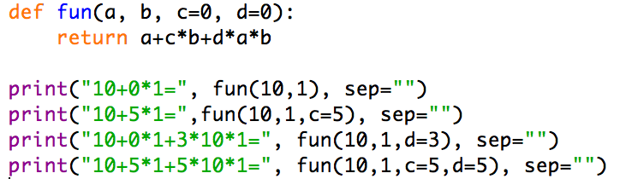
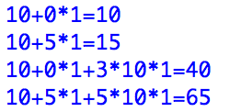
Default Arguments
Defining default arguments is easy
  Just use the arguments with default arguments last and assign default values in the function definition

Slide 25
Default Arguments
How to write readable code:
  Named arguments and default arguments with well-chosen names make code more readable
  Most effort in software engineering goes towards maintaining code

Slide 26
Anonymous Functions
Up till now, we used the def-construct in order to define functions
Sometimes it is necessary to pass functions to another function, but not necessary to define the argument for future uses

Slide 27
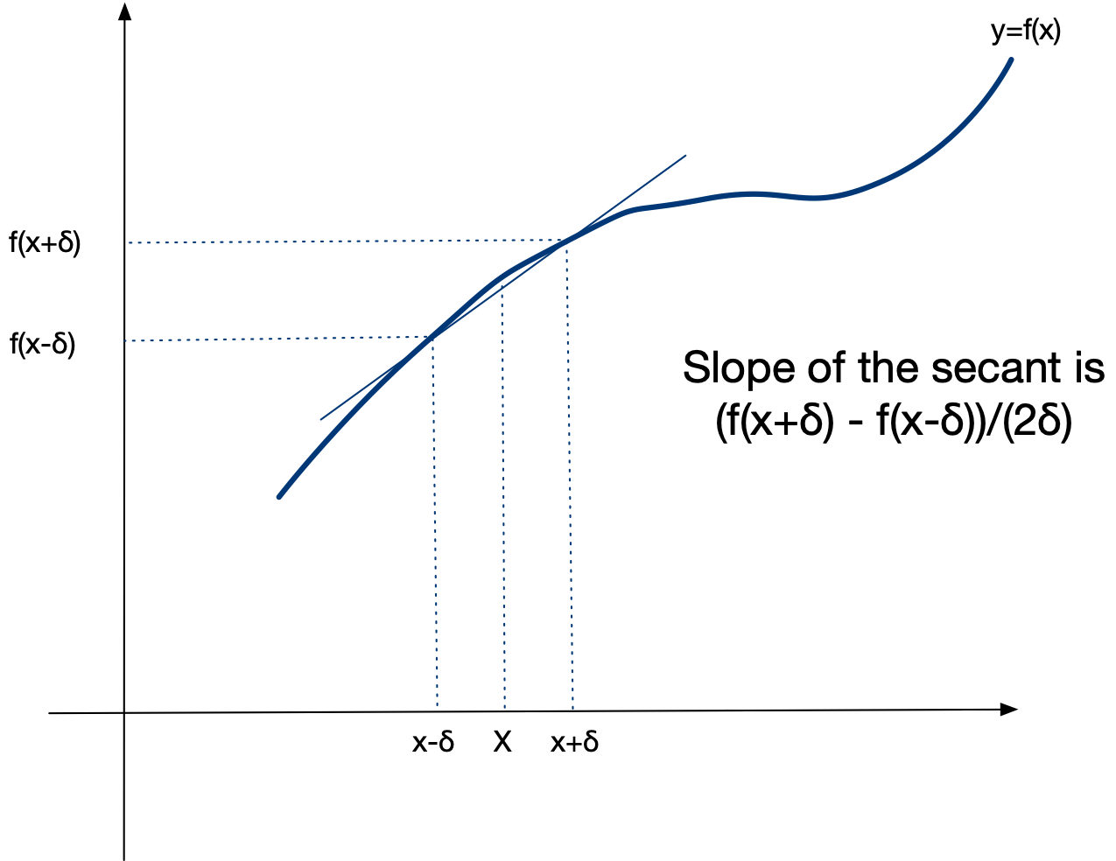
Anonymous Function
Example:
  Numerical Differentiation
    Derivative of a function f at a point is the slope of the tangent
    Approximated by a secant

Slide 28
Anonymous Functions
The slope of the secant is the difference of values over the difference of arguments:
If δ is small, then this is a good approximation of the derivative
$$\frac{f(x+δ)-f(x-δ)}{x+δ-(x-δ)}=\frac{f(x+δ)-f(x-δ)}{2δ}$$

Slide 29
Anonymous Functions
A simple method for derivation uses a fixed, but small value for δ.
To test this, we try it out with sine, whose derivative is cosine
def derivative(function, x):
delta = 0.000001
return (function(x+delta)-function(x-delta))/(2*delta)
for i in range(20):
x = i/20
print(x, math.cos(x), derivative(math.sin, x))

Slide 30
Anonymous Functions
It turns out that the numerical derivative is quite close in this test
0.0 1.0 0.9999999999998334
0.05 0.9987502603949663 0.9987502603940601
0.1 0.9950041652780257 0.9950041652759256
0.15 0.9887710779360422 0.9887710779310499
0.2 0.9800665778412416 0.9800665778519901
0.25 0.9689124217106447 0.9689124216977207
0.3 0.955336489125606 0.9553364891112803
0.35 0.9393727128473789 0.9393727128381713
0.4 0.9210609940028851 0.9210609939747094
0.45 0.9004471023526769 0.9004471023255078
0.5 0.8775825618903728 0.8775825618978494
0.55 0.8525245220595057 0.8525245220880606
0.6 0.8253356149096783 0.8253356149623414
0.65 0.7960837985490559 0.7960837985487856
0.7 0.7648421872844885 0.7648421873063249
0.75 0.7316888688738209 0.7316888688824186
0.8 0.6967067093471655 0.6967067094354462
0.85 0.6599831458849822 0.6599831459119798
0.9 0.6216099682706645 0.6216099682765375
0.95 0.5816830894638836 0.5816830894733727

Slide 31
Anonymous Functions
Notice that in the test, we specified math.sin and not math.sin(x),
The former is a function (which we want)
The latter is a value (which we do not want)
for i in range(20):
x = i/20
print(x, math.cos(x), derivative(math.sin, x))

Slide 32
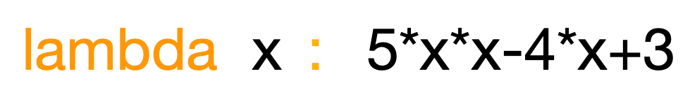
Anonymous Functions
To specify a function argument, I can use a lambda-expression
  Lambda-expressions were used in Mathematical Logic to investigate the potential of formal calculations
  Lambda expression consists of a keyword lambda
    followed by one or more variables
    followed by a colon
    followed by an expression for the function
  This example implements the function
$$x→5x^{2}-4x+3$$

Slide 33
Anonymous Functions
To test our numerical differentiation function, we pass it the function , which has derivative
$$x→x^{2}$$
$$2x$$
for i in range(20):
x = i/20
print("{:5.3f} {:5.3f} {:5.3f}”.format(
          x,
          derivative(lambda x: x*x, x),
          2*x))

Slide 34
Anonymous Functions
Since we are rounding to only three digits after the decimal point, we get perfect results
0.000 0.000 0.000
0.050 0.100 0.100
0.100 0.200 0.200
0.150 0.300 0.300
0.200 0.400 0.400
0.250 0.500 0.500
0.300 0.600 0.600
0.350 0.700 0.700
0.400 0.800 0.800
0.450 0.900 0.900
0.500 1.000 1.000
0.550 1.100 1.100
0.600 1.200 1.200
0.650 1.300 1.300
0.700 1.400 1.400
0.750 1.500 1.500
0.800 1.600 1.600
0.850 1.700 1.700
0.900 1.800 1.800
0.950 1.900 1.900

Slide 35
Anonymous Functions
I can even use lambda expressions as an alternative way of defining functions:
Since there are two variables, norm is a function of two arguments:
norm = lambda x, y: math.sqrt(x*x+y*y)
print(norm(2.3, 1.7))

Slide 36
Annotations
Completely optional way to make function definitions easier to read
  Uses swift language convention
    for arguments: name colon type
      where type is either a Python type or a string
    for return value: use ->
def quadratic(a: 'number', b: 'number', c: 'number') -> float :
disc = (b**2-4*a*c)**0.5
return (-b+disc)/(2*a)

Slide 37
Decorators
Functions are also return values
  One way to use this are decorators (for the future)
    A decorator is put on top of a function
    The decorator then takes the function and replaces it with another function

Slide 38
Decorators
This is an example of a function factory!
We can automatically apply the decorator
def my_decorator(func):
def wrapper():
print("Something is happening before the function is called.")
func()
print("Something is happening after the function is called.")
return wrapper
def say_namaste():
print("Namaste!")
say_when = my_decorator(say_whee)
@my_decorator
def say_namaste():
print("Namaste!")

Slide 39
Decorators
Some decorators are provided in modules
  lru_cache in functools
    stores the result of functions in an lru cache

Slide 40
Future topics on functions
Memoization
Decorators

