Slide 1
Numpy Arrays
Thomas Schwarz, SJ

Slide 2
NumPy Fundamentals
Numpy is a module for faster vector processing with numerous other routines
Scipy is a more extensive module that also includes many other functionalities such as machine learning and statistics

Slide 3
NumPy Fundamentals
Why Numpy?
  Remember that Python does not limit lists to just elements of a single class
  If we have a large list $[a_{1},a_{2},a_{3},…,a_{n}]$ and we want to add a number to all of the elements, then Python will asks for each element:
    What is the type of the element
    Does the type support the + operation
    Look up the code for the + and execute
  This is slow

Slide 4
NumPy Fundamentals
Why Numpy?
  Primary feature of Numpy are arrays:
    List like structure where all the elements have the same type
      Usually a floating point type
    Can calculate with arrays much faster than with list
    Implemented in C / Java for Cython or Jython

Slide 5
NumPy Arrays
NumPy Arrays are containers for numerical values
Numpy arrays have dimensions
  Vectors: one-dimensional
  Matrices: two-dimensional
  Tensors: more dimensions, but much more rarely used
Nota bene: A matrix can have a single row and a single column, but has still two dimensions

Slide 6
NumPy Arrays
After installing, try out import numpy as np
Making arrays:
  Can use lists, though they better be of the same type
import numpy as np
my_list = [1,5,4,2]
my_vec = np.array(my_list)
my_list = [[1,2],[4,3]]
my_mat = np.array(my_list)

Slide 7
Array Creation
Numpy can generate arrays:
  From disks or the net,
    using various libraries
    using loadtxt and similar functions
  From lists and similar data structures
  Generate them natively

Slide 8
Array Creation
Numpy has a number of ways to create an array
  Import numpy as np
  np.zeroes((2,3))
    array([[ 0., 0., 0.], [ 0., 0., 0.]])
  np.ones(5)
    array([1., 1., 1., 1. , 1.])
  np.eye(3) generates the identity matrix
    array([[1., 0., 0.], [0., 1., 0.],[0., 0., 1.]])])

Slide 9
Array Creation
Numpy has a number of ways to create arrays
  np.linspace(1., 4., 6) creates an array of 6 elements between 1.0 and 4.0 evenly spaced out
    array([ 1. , 1.6, 2.2, 2.8, 3.4, 4. ])
  np.arange(2, 3, 0.1) a more generalized version of Python's range function (with float step)
    array([ 2. , 2.1, 2.2, 2.3, 2.4, 2.5, 2.6, 2.7, 2.8, 2.9])
  np.arange(2,5)
    array([2, 3, 4])

Slide 10
Array Creation
Can generate using lists, tuples, etc. even with a mix of types
  np.array([[1,2,3], (1,0,0.5)])
    array([[1. , 2. , 3. ], [1. , 0. , 0.5]])

Slide 11
Array Creation
Creating arrays:
  np.full to fill in with a given value
np.full(5, 3.141)
array([3.141, 3.141, 3.141, 3.141, 3.141])

Slide 12
Array Creation
Can also use random values.
  Uniform distribution between 0 and 1
>>> np.random.random((3,2))
array([[0.39211415, 0.50264835],
[0.95824337, 0.58949256],
[0.59318281, 0.05752833]])

Slide 13
Array Creation
Or random integers
>>> np.random.randint(0,20,(2,4))
array([[ 5, 7, 2, 10],
[19, 7, 1, 10]])

Slide 14
Array Creation
Or other distributions, e.g. normal distribution with mean 2 and standard deviation 0.5
>>> np.random.normal(2,0.5, (2,3))
array([[1.34857621, 1.34419178, 1.977698 ],
[1.31054068, 2.35126538, 3.25903903]])

Slide 15
Array Creation
fromfunction
>>> x = np.fromfunction(lambda i,j: (i**2+j**2)//2, (4,5) )
>>> x.astype(int)
array([[ 0, 0, 2, 4, 8],
[ 0, 1, 2, 5, 8],
[ 2, 2, 4, 6, 10],
[ 4, 5, 6, 9, 12]])
>>> x.shape
(4,5)

Slide 16
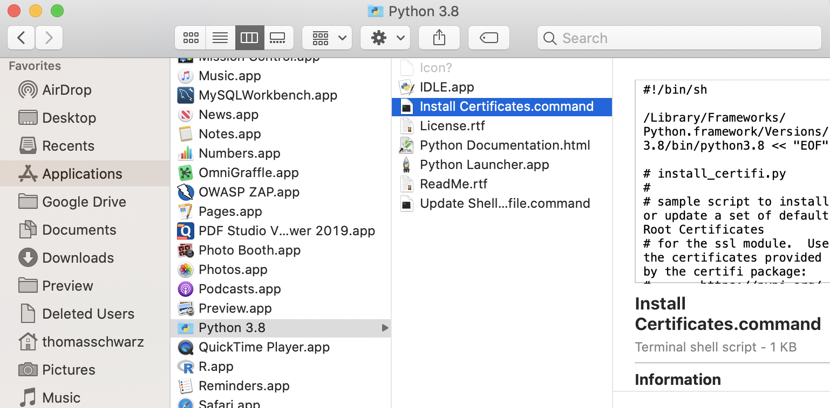
Array Creation
Creating from download / file
  We use urllib.request module
    If you are on Mac, you need to have Python certificates installed
      Go to your Python installation in Applications and click on "Install Certificates command"

Slide 17
Array Creation
Use urllib.request.urlretrieve with website and file name
  Remember: A file will be created, but the directory needs to exist
  This is a text file, with one numerical value per line
  Then create the numpy array using
urllib.request.urlretrieve(
url = "https://ndownloader.figshare.com/files/12565616",
filename = "avg-monthly-precip.txt"
)
avgmp = np.loadtxt(fname = 'avg-monthly-precip.txt')
print(avgmp)

Slide 18
Array Creation
Example: Get an account at openweathermap.org/appid
Install requests and import json
  Use the openweathermap.org api to request data on a certain town
  Result is send as a JSON dictionary

Slide 19
Array Creation
import numpy as np
import requests
import json
mumbai=json.loads(requests.get('http://api.openweathermap.org/data/2.5/weather?q=mumbai,india&APPID=4561e0cd15ec2ee307bdcfe19ec22ab9').text)
vasai = json.loads(requests.get('http://api.openweathermap.org/data/2.5/weather?q=vasai,india&APPID=4561e0cd15ec2ee307bdcfe19ec22ab9').text)
navi_mumbai = json.loads(requests.get('http://api.openweathermap.org/data/2.5/weather?q=navi%20mumbai,india&APPID=4561e0cd15ec2ee307bdcfe19ec22ab9').text)

Slide 20
Array Creation
Can use np.genfromtext
  Very powerful and complicated function with many different options

Slide 21
Array Creation
Example
  Need a source (the iris file)
  Can specify the columns we need
  Give the dtype U20-unicode string, S20-byte string
  Delimiter
  Skipheader, skipfooter
  converters to deal with encoding
converters = {5: lambda x: int(0 if 'Iris-setosa' else 1 if 'Iris-virginica' else 2) }
my_array = np.genfromtxt('../Classes2/Iris.csv',
usecols=(1,2,3,4,5),
dtype =[float, float, float, float, float],
delimiter = ',',
converters = converters,
skip_header=1)

Slide 22
Array Creation
This is an array of 150 tuples
Use comprehension to convert to a two-dimensional array
m = np.array( [ [row[0], row[1], row[2], row[3], row[4]]
for row in my_array ])

Slide 23
NumPy Array Attributes
The number of dimensions: ndim
The values of the dimensions as a tuple: shape
The size (number of elements)
>>> tensor
array([[[2.11208424, 2.01510638, 2.03126777, 1.89670846],
[1.94359036, 2.02299445, 2.08515919, 2.05402626],
[1.8853457 , 2.01236192, 2.07019962, 1.93713157]],
[[1.84275427, 1.99537922, 1.96060154, 1.90020305],
[2.00270166, 2.11286224, 2.03144254, 2.06924855],
[1.95375653, 2.0612986 , 1.82571628, 1.86067971]]])
>>> tensor.ndim
3
>>> tensor.shape
(2, 3, 4)
>>> tensor.size
24

Slide 24
NumPy Array Attributes
The data type: dtype
  can be bool, int, int64, uint, uint64, float, float64, complex ...
The size of a single element in bytes: itemsize
The size of the total array: nbytes

Slide 25
NumPy Array Indexing
Single elements
  Use the bracket notation [ ]
    Single array: Same as in standard python
>>> vector = np.random.normal(10,1,(5))
>>> print(vector)
[10.25056641 11.37079651 10.44719557 10.54447875 10.43634562]
>>> vector[4]
10.436345621654919
>>> vector[-2]
10.544478746079845

Slide 26
NumPy Arrays Indexing
Matrix and tensor elements: Use a single bracket and a comma separated tuple
>>> tensor
array([[[2.11208424, 2.01510638, 2.03126777, 1.89670846],
[1.94359036, 2.02299445, 2.08515919, 2.05402626],
[1.8853457 , 2.01236192, 2.07019962, 1.93713157]],
[[1.84275427, 1.99537922, 1.96060154, 1.90020305],
[2.00270166, 2.11286224, 2.03144254, 2.06924855],
[1.95375653, 2.0612986 , 1.82571628, 1.86067971]]])
>>> tensor[0,0,1]
2.015106376191313

Slide 27
NumPy Arrays Indexing
Multiple bracket notation
  We can also use the Python indexing of multi-dimensional lists using several brackets
    It is more writing and more error prone than the single bracket version
>>> tensor[0][1][2]
2.085159191502853

Slide 28
NumPy Arrays Indexing
We can also define slices
>>> vector = np.random.normal(10,1,(3))
>>> vector
array([10.61948855, 7.99635252, 9.05538706])
>>> vector[1:3]
array([7.99635252, 9.05538706])

Slide 29
NumPy Arrays Indexing
In Python, slices are new lists
In NumPy, slices are not copies
  Changing a slice changes the original

Slide 30
NumPy Arrays Indexing
Example:
  Create an array
  Define a slice
>>> vector = np.random.normal(10,1,(3))
>>> vector
array([10.61948855, 7.99635252, 9.05538706])
>>> x = vector[1:3]

Slide 31
NumPy Arrays Indexing
Example (cont.)
  Change the first element in the slice
  Verify that the change has happened
  But the original has also changed:
>>> x[0] = 5.0
>>> x
array([5. , 9.05538706])
>>> vector
array([10.61948855, 5. , 9.05538706])

Slide 32
NumPy Arrays Indexing
Slicing does not makes copies
  This is done in order to be efficient
    Numerical calculations with a large amount of data get slowed down by unnecessary copies

Slide 33
NumPy Arrays Indexing
If we want a copy, we need to make one with the copy method
Example:
  Make an array
  Make a copy of the array
>>> vector = np.random.randint(0,10,5)
>>> vector
array([0, 9, 5, 7, 8])
>>> my_vector_copy = vector.copy()

Slide 34
NumPy Arrays Indexing
  Example (continued)
    Change the middle elements in the copy
    Check the change
    Check the original
    No change!
>>> my_vector_copy[1:-2]=100
>>> my_vector_copy
array([ 0, 100, 100, 7, 8])
>>> vector
array([0, 9, 5, 7, 8])

Slide 35
NumPy Arrays Indexing
Multi-dimensional slicing
  Combines the slicing operation for each dimension
>>> slice = tensor[1:, :2, :1]
>>> slice
array([[[1.84275427],
[2.00270166]]])

Slide 36
NumPy Arrays
Conditional Selection
We can create an array of Boolean values using comparisons on the array
>>> array = np.random.randint(0,10,8)
>>> array
array([2, 4, 4, 0, 0, 4, 8, 4])
>>> bool_array = array > 5
>>> bool_array
array([False, False, False, False, False,
False, True, False])

Slide 37
NumPy Arrays
Conditional Selection
We can then use the Boolean array to create a selection from the original array
The new array only has one element!
>>> selection=array[bool_array]
>>> selection
array([8])

Slide 38
Selftest
Can you do this in one step?
  Create a random array of 10 elements between 0 and 10
  Then select the ones larger than 5

Slide 39
Selftest Solution
Solution:
  Looks a bit cryptic
    First, we create an array
    Then we select in a single step
>>> arr = np.random.randint(0,10,10)
>>> arr
array([3, 2, 7, 8, 7, 2, 1, 0, 4, 8])
>>> sel = arr[arr>5]
>>> sel
array([7, 8, 7, 8])

Slide 40
NumPy Arrays
Conditional Selection
Let's try this out with a matrix
  We create a vector, then use reshape to make the array into a vector
    Recall: the number of elements needs to be the same
>>> mat = np.arange(1,13).reshape(3,4)
>>> mat
array([[ 1, 2, 3, 4],
[ 5, 6, 7, 8],
[ 9, 10, 11, 12]])

Slide 41
NumPy Arrays
Conditional Selection
Now let's select:
This is no longer a matrix, which makes sense
>>> mat1 = mat[mat>6]
>>> mat1
array([ 7, 8, 9, 10, 11, 12])

Slide 42
Slicing
Photo Manipulation
  Need to install imageio and matplotlib
  Get a photo as a 3-dimensional array
import imageio
import matplotlib.pyplot as plt
import matplotlib.image as mpimg
im = mpimg.imread('earth.jpg')
print(im.shape)

Slide 43
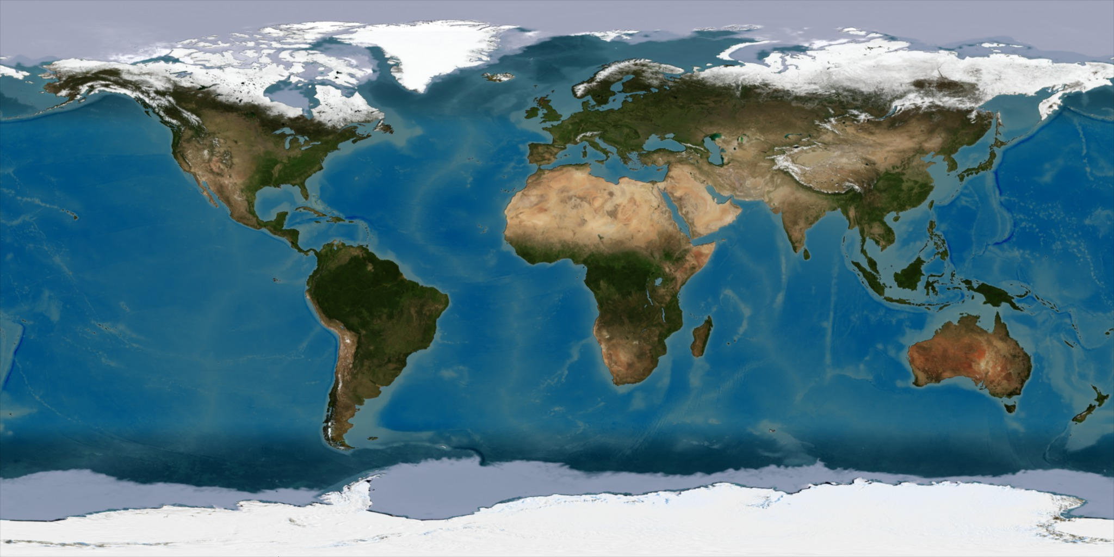
Slicing
Display the photo
plt.imshow(im)
plt.show()

Slide 44
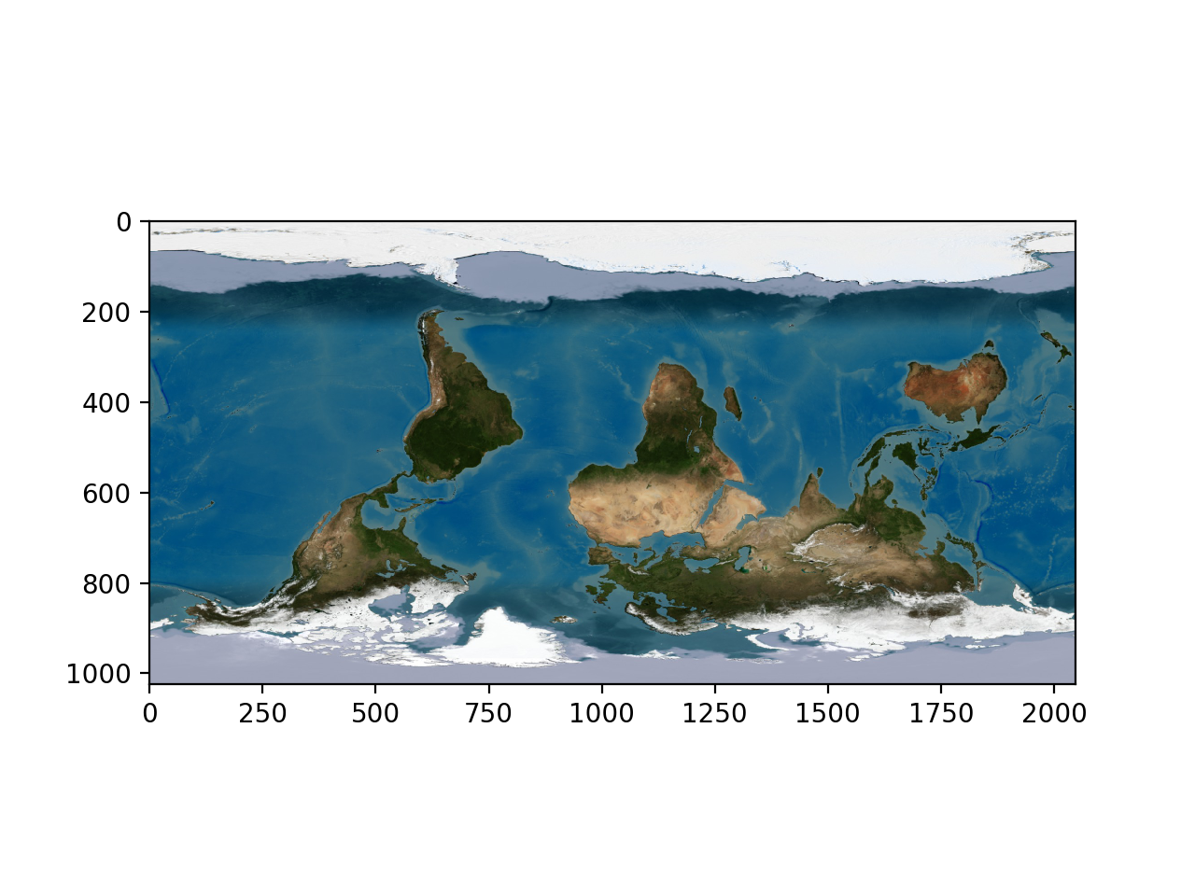
Slicing
Swap first coordinate
plt.imshow(im[::-1,])
plt.show()

Slide 45
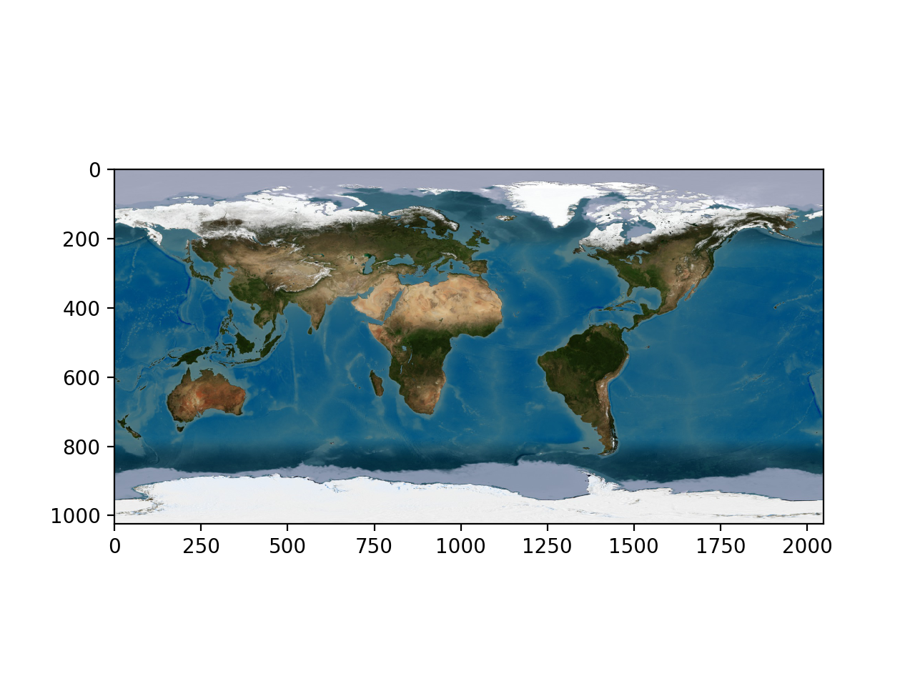
Slicing
Swap second coordinate
plt.imshow(im[:,::-1,])
plt.show()

Slide 46
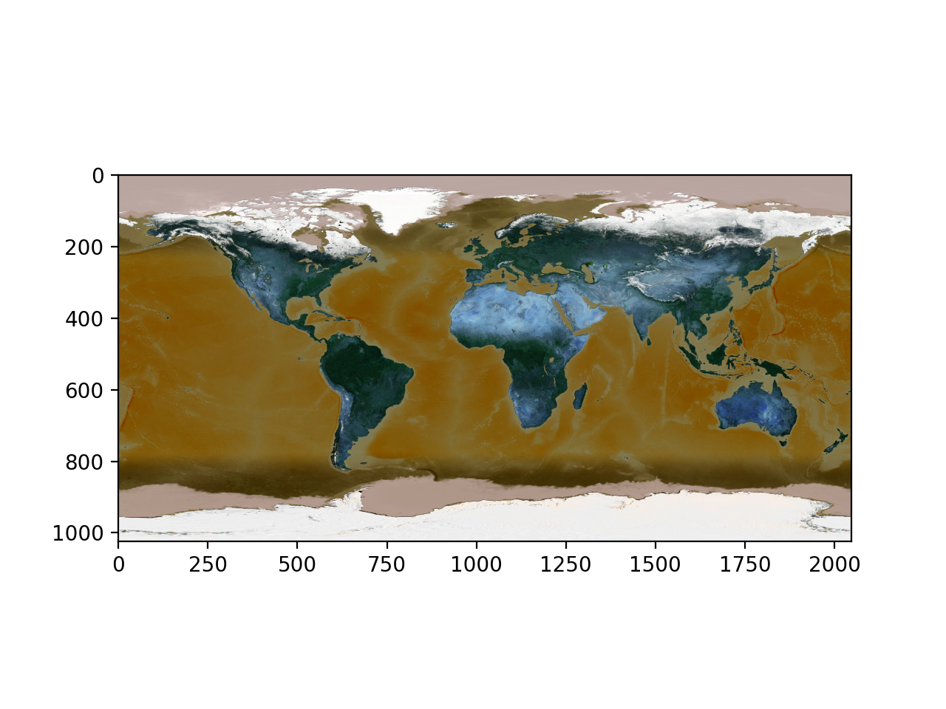
Slicing
Swap third coordinate (color coordinate)
plt.imshow(im[:,:,::-1])
plt.show()

Slide 47
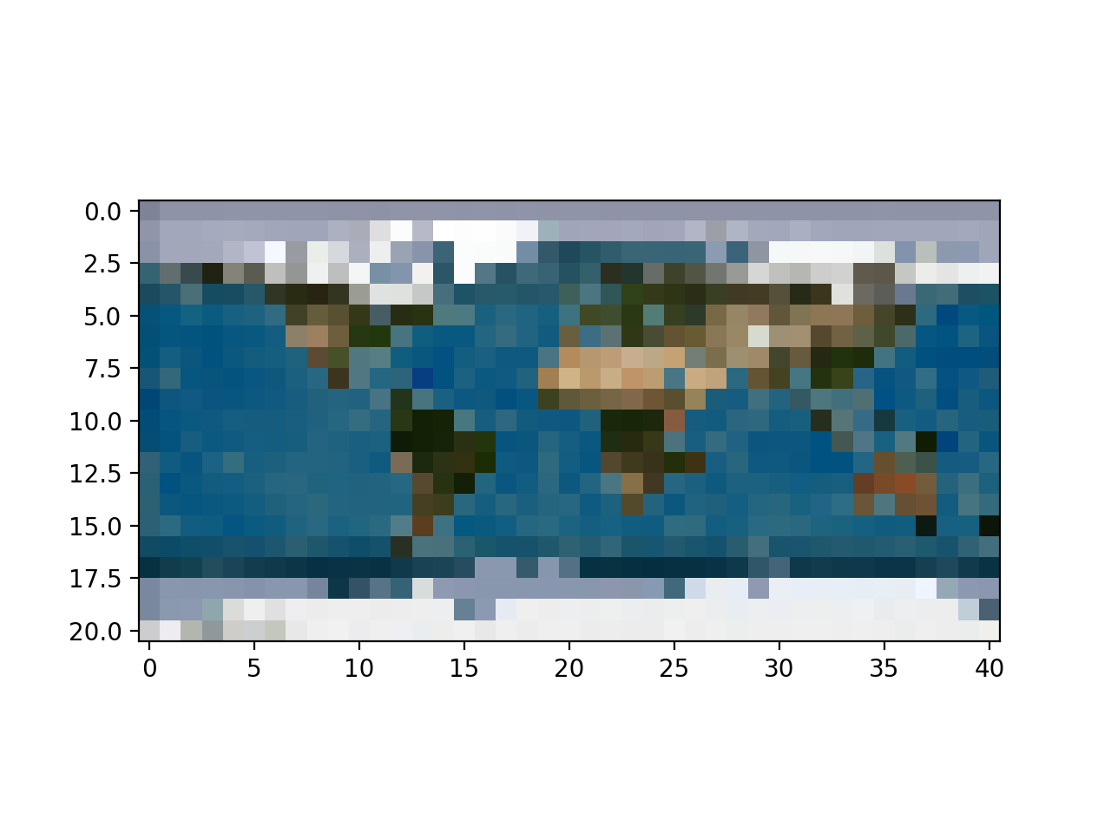
Slicing
Take every 50th line and column
plt.imshow(im[::50, ::50,])
plt.show()

Slide 48
Slicing
We can also apply functions
  np.where allows us to replace values
      Where-ever the value of the image is less than 100, replace it with 0
      Otherwise, replace it with 255
image = np.where(im>100, 255, 0)

Slide 49
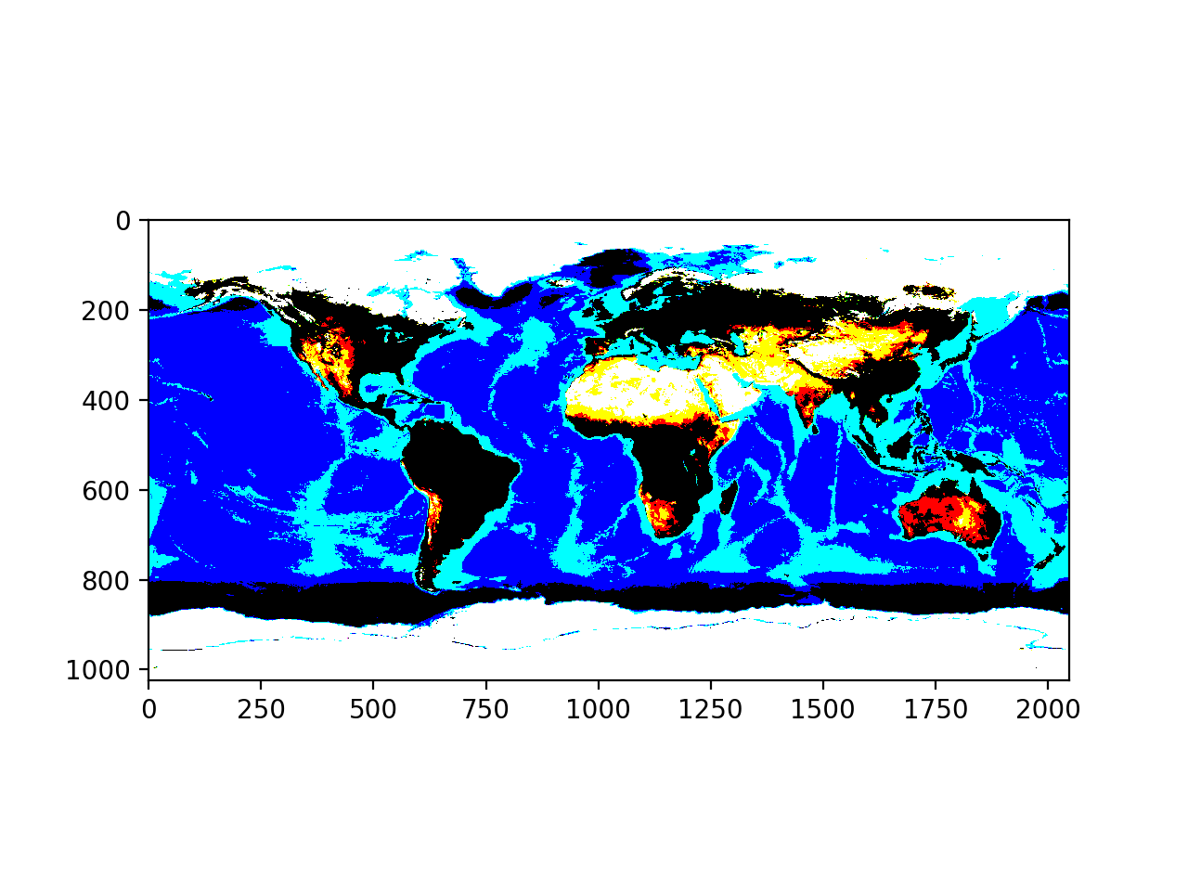
Slicing

Slide 50
Slicing
Can use a sub-image
plt.imshow(im[:,:,0])
plt.show()
plt.imshow(im[:,:,1])
plt.show()
plt.imshow(im[:,:,2])
plt.show()

Slide 51
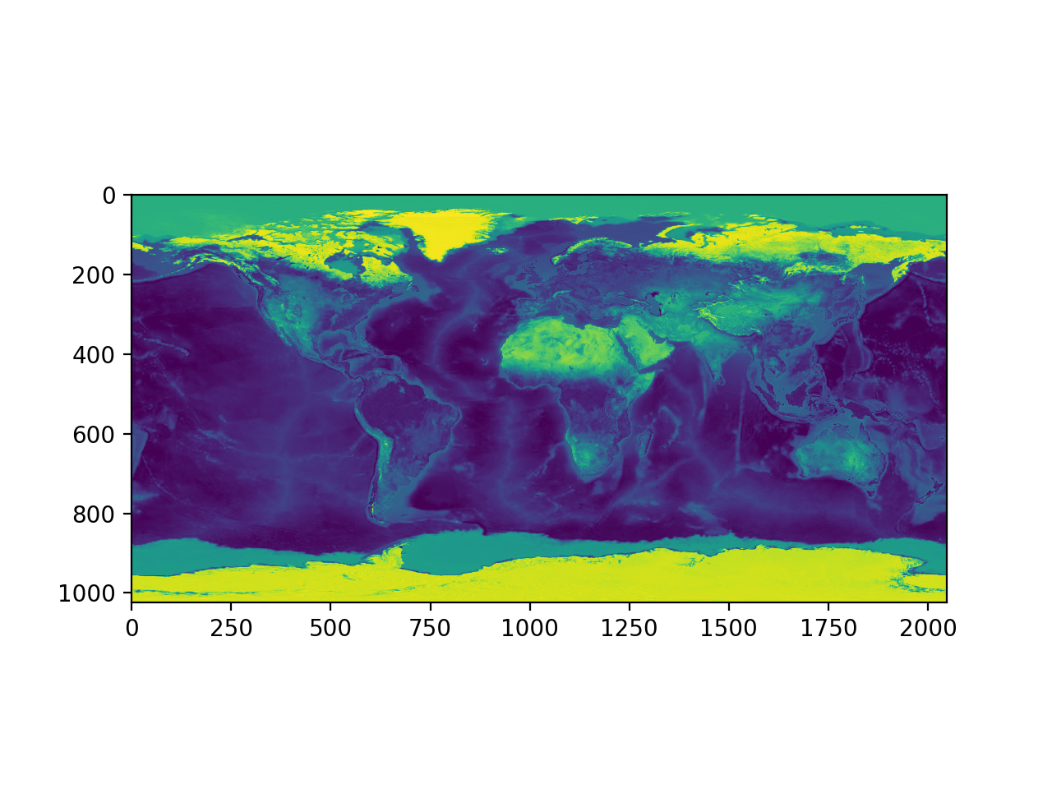
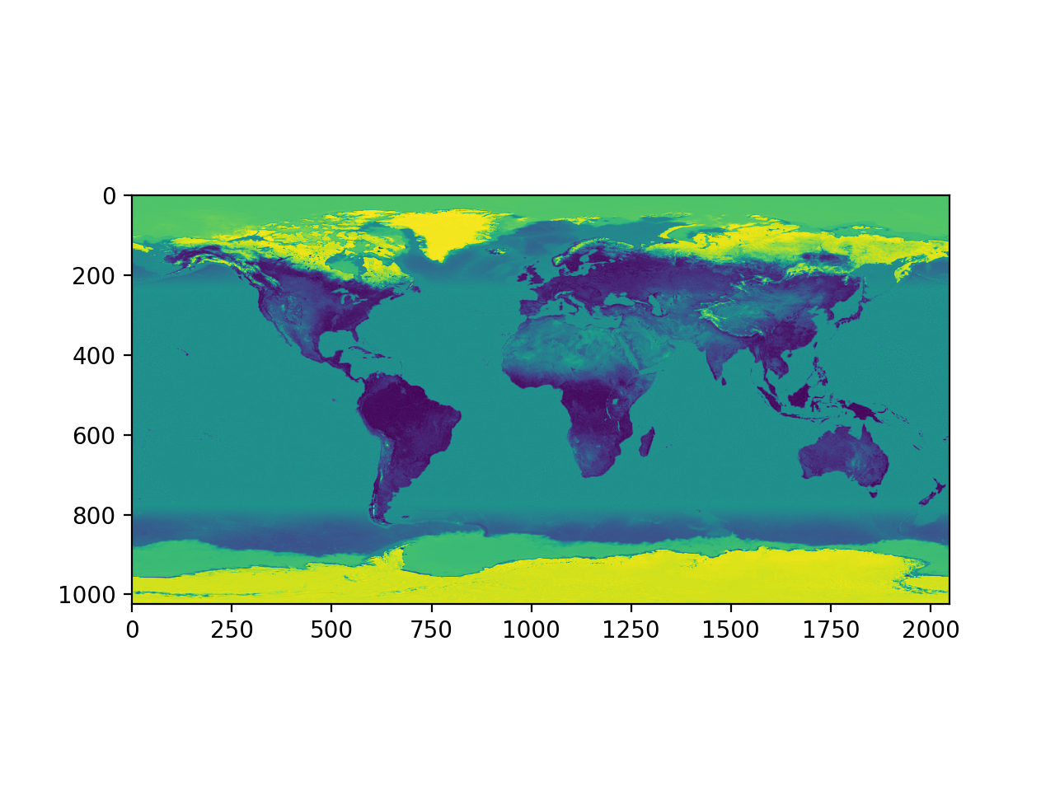
Slicing

Slide 52
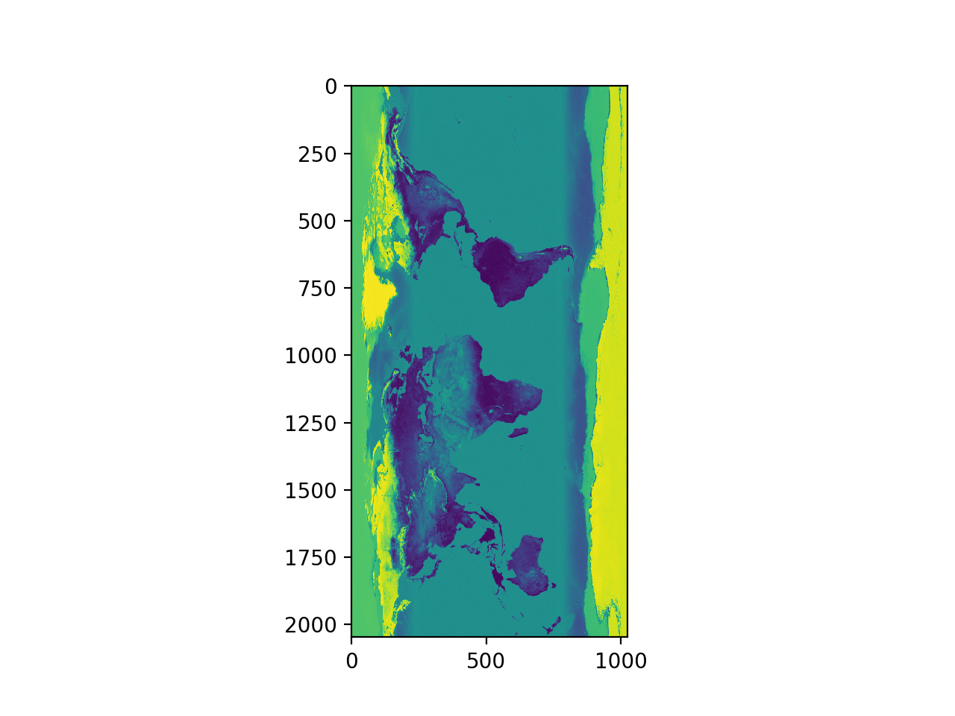
Slicing
Can use the transpose
plt.imshow(im[:,:,2].T)
plt.show()

Slide 53
Slicing
Or just concentrate on the essential
plt.imshow(im[250:500,1350:1600, : ])

Slide 54
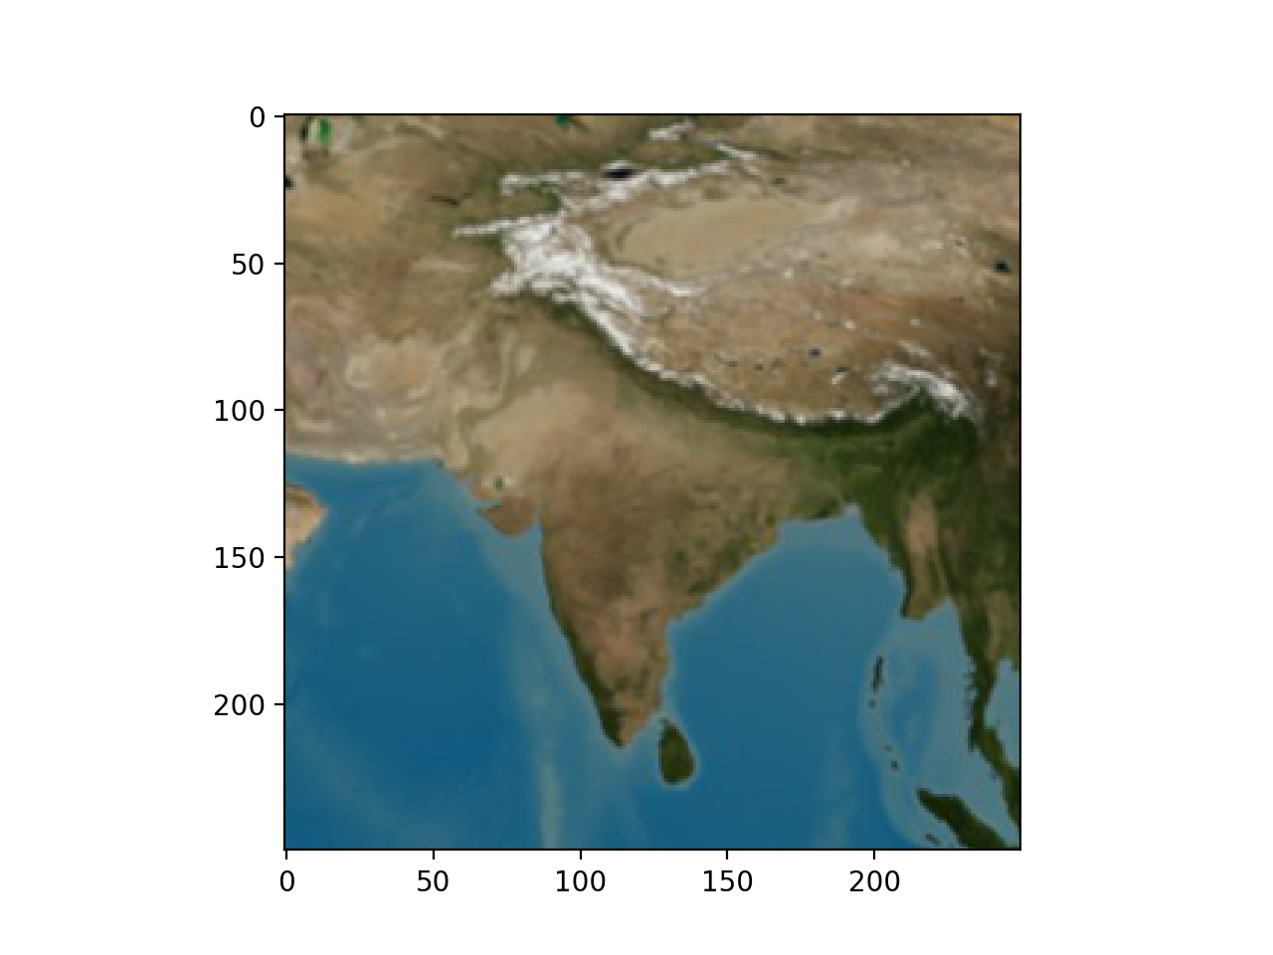
Slicing

