Slide 1
Strings in Python
Thomas Schwarz, SJ

Slide 2
Strings
Basic data type in Python
  Strings are immutable, meaning they cannot be shared
    Why?
      It’s complicated, but string literals are very frequent. If strings cannot be changed, then multiple occurrences of the same string in a program can be placed in a single memory location.
      More importantly, strings can serve keys in key-value pairs.

Slide 3
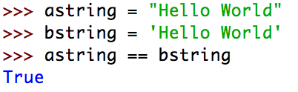
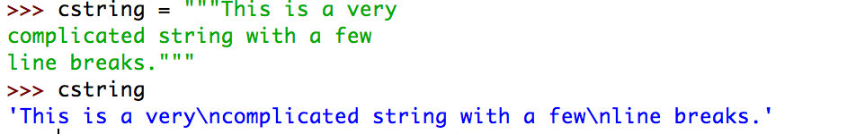
String Literals
String literals are defined by using quotation marks
  Example:
  To create strings that span newlines, use the triple quotation mark

Slide 4
Escapes
Python is very good at detecting your intentions when processing string literals
  E.g.: "It's mine"
  Still sometimes need to use the escape character
    \t, \n, \", \', \\, \r
    \xhh —> character with hex value 0xhh
  Python 3 uses machine conventions for endings
Python 3 uses utf-8 natively
  greetings = ("शुभ प्रभात", "સુપ્રભાત", "शुभ प्रभात")

Slide 5
Docstrings
Doc strings
  String literals that appear as the first line of a module, function, class, method definition
  All these items should have a docstring
  The docstring replaces the help string in Idle and IPython/Jupyter
  Indent them under the indentation of the object they describe

Slide 6
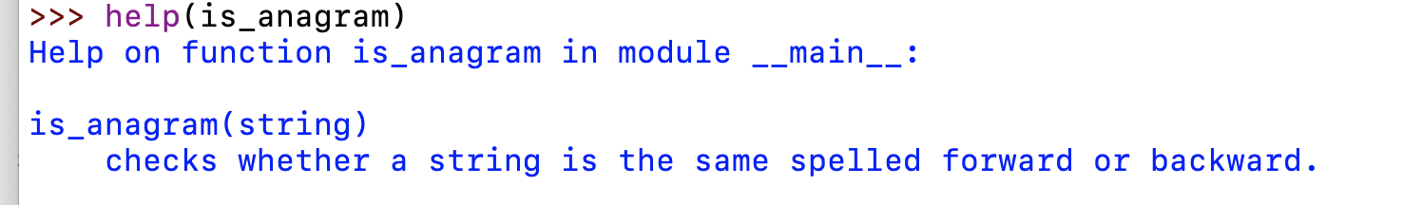
Docstrings
Always use triple quotation marks
  Even for one-liners

Slide 7
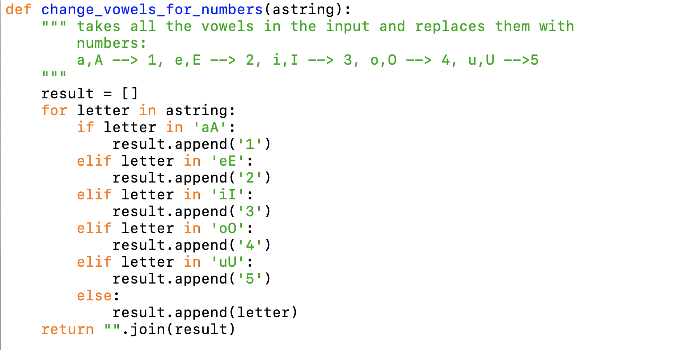
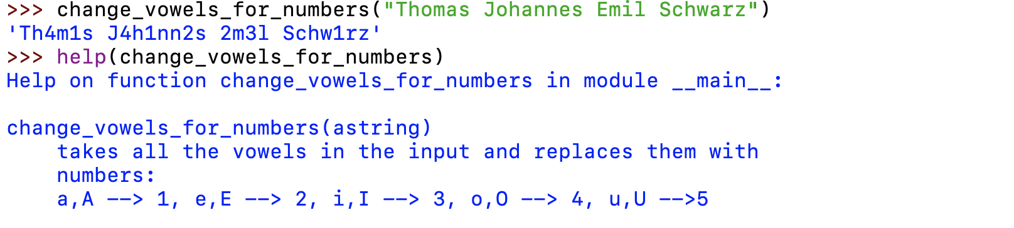
Docstrings
Example

Slide 8
String Methods
Strings are classes and have many built in methods
s.lower(), s.upper() : returns the lowercase or uppercase version of the string
s.strip(): returns a string with whitespace removed from the start and end
s.isalpha() / s.isdigit() / s.isspace() tests if all the string chars are in the various character classes
s.startswith('other'), s.endswith('other') tests if the string starts or ends with the given other string

Slide 9
String Methods
There are a number of methods for strings. Most of them are self-explaining
s.find('other') : searches for the given other string (not a regular expression) within s, and returns the first index where it begins or -1 if not found
s.replace('old', ‘new'): returns a string where all occurrences of 'old' have been replaced by 'new'
len(s) returns the length of a string

Slide 10
Strings and Characters
Python does not have a special type for characters
  Characters are just strings of length 1.

Slide 11
Accessing Elements of Strings
We use the bracket notation to gain access to the characters in a string
  a_string[3] is character number 3, i.e. the fourth character in the string

Slide 12
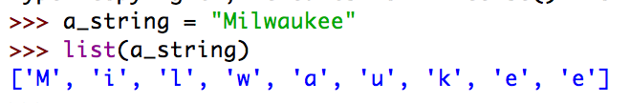
String Processing
Since strings are immutable, we process strings by turning them into lists, then processing the list, then making the list into a string.
  String to list: Just use the list-command

Slide 13
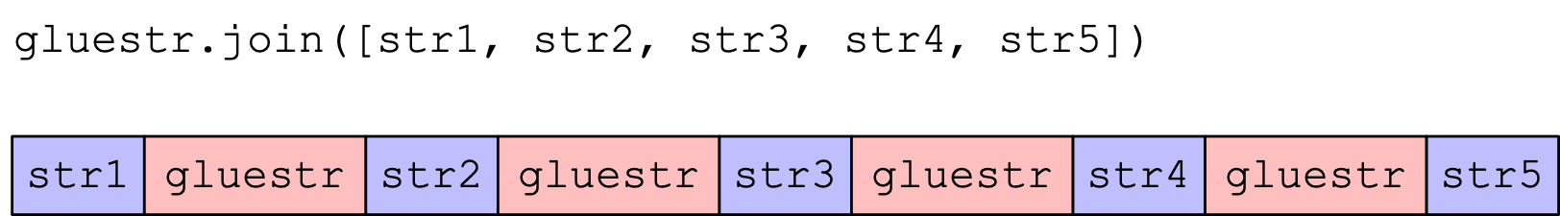
String Processing
Turn lists into strings with the join-method
  The join-method has weird syntax
    a_string = "".join(a_list)
      The method is called on the empty string ""
      The sole parameter is a list of characters or strings
    You can use another string on which to call join
      This string then becomes the glue

Slide 14
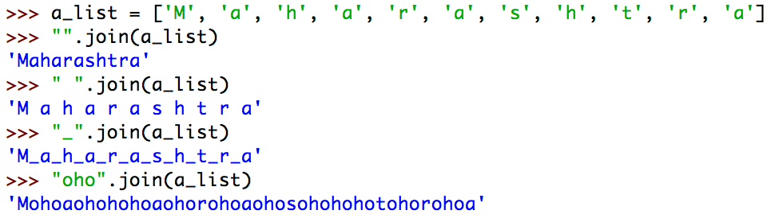
String Processing
Examples

Slide 15
String Processing
Procedure:
  Take a string and convert to a list
  Change the list or create a new list
  Use join to recreate a new string
Alternative Procedure:
  Build a string one by one, using concatenation ( + -operator)
  Creates lots of temporary strings cluttering up memory
    Which is bad if you are dealing with large strings.

Slide 16
String Processing
Example: Given a string, change all vowels to increasing digits.
  This is used as a (not very secure) password generator
    Examples:
      Wisconsin —> W1sc2ns3n
      AhmedabadGujaratIndia —> 1hm2d3b4dG5j6r7t8nd90

Slide 17
String Processing
Implementation:
  Define an empty list for the result
  We return the result by changing from list to string
def pwd1(string):
result = [ ]
return "".join(result)

Slide 18
String Processing
Need to keep a counter for the digits
def pwd1(string):
result = [ ]
number = 1

Slide 19
String Processing
Now go through the string with a for statement
Create the list that will be returned converted into a string
def pwd1(string):
result = [ ]
number = 1
for character in string:
        #append to result here
return "".join(result)

Slide 20
String Processing
We either append the letter from the string or we append the current integer, of course cast into a string
def pwd1(string):
result = [ ]
number = 1
for character in string:
if character not in "aeiouAEIOU":
result.append(character)
else:
result.append(str(number))
number = (number+1)%10
return "".join(result)

Slide 21
String Processing
Argot
  A variation of a language that is not understandable to others
    E.g. Lufardo — an argot from Buenos Aires that uses words from Italian dialects
      Invented originally to prevent guards from understanding the inmates
      Some words are just based on changing words
        vesre - al reves (backwards)
        chochamu - vesre for muchacho (chap)
        lorca - vesre for calor (heat)

Slide 22
String Processing
Argot
  Pig Latin
    Children’s language that uses a scheme to change English words
    Understandable to practitioners, but not to those untrained

Slide 23
String Processing
Argot:
  Efe-speech
    A simple argot from Northern Argentina no longer in use
    Take a word: “muchacho”
    Replace each vowel with a vowel-f-vowel combination
    “Muchacho” becomes Mufuchafachofo
    “Aires” becomes “Afaifirefes”

Slide 24
String Processing
Implementing efe-speech
  Walk through the string, modifying the result list
def efe(string):
result = [ ]
for character in string:
result.append(SOMETHING)
return "".join(result)

Slide 25
String Processing
We need to be careful about capital letters
  We can use the string method lower
    Which you find with a www-search
def efe(string):
result = [ ]
for character in string:
elif character in "AEIOU":
result.append(character+'f'+character.lower())
return "".join(result)

Slide 26
String Processing
def efe(string):
result = [ ]
for character in string:
if character in "aeiou":
result.append(character+'f'+character)
elif character in "AEIOU":
result.append(character+'f'+character.lower())
else:
result.append(character)
return "".join(result)

Slide 27

String Processing

Slide 28
Try it out:
Implement pig latin
  Use wikipedia
  Use testing

Slide 29
Slices
We already know two sequence types: lists and strings
  Sequences can be sliced: A slice is a new object of the same type, consisting of a subsequence
  Use a bracket cum colon notation to define slices.
  sequence[a:b] are all elements starting with index a and stoping before index b.

Slide 30
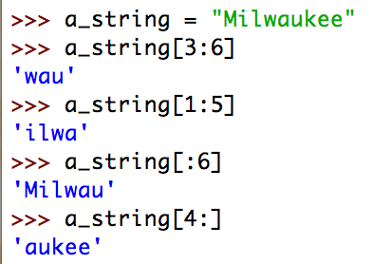
Slices
String slices
  Number before colon:
    Start
  Number after colon:
    Stop
  Default value before colon:
    Start with first character
  Default value after colon
    End with the string

Slide 31

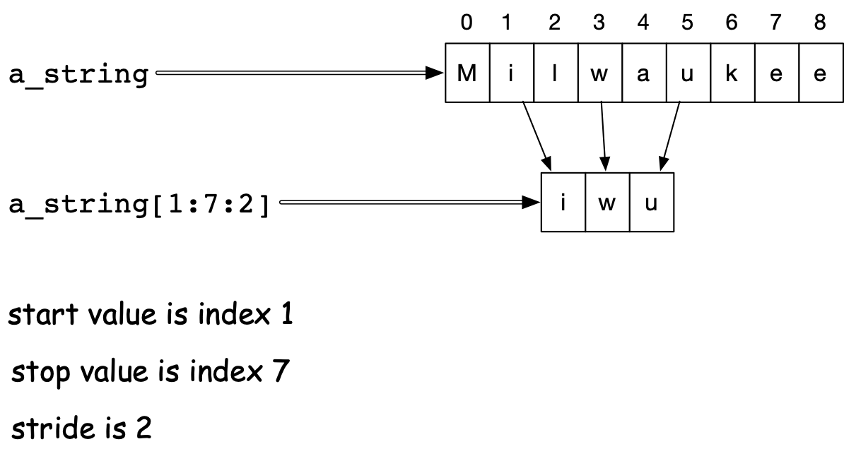
Slices
String slices:
  Optional third parameter is Stride
    First character is character 1
    Next one is character 1+2
    Next one is character 1+2+2
    Next one would be character 1+2+2+2, but that one is >= the stop value.

Slide 32
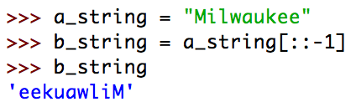
Slices
Negative strides are allowed.
  Create a new string that is reversed using default values

Slide 33
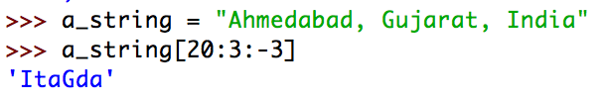

Slices
Negative strides are allowed
Character 20 is “I” of India
Next character is 17, the “t” in Gujarat
Stop before character 3 (the fourth character)

Slide 34
Lists and Strings
Both lists and strings are sequences
  Length: len(a_string), len(a_list)
  Concatenation: a_string + b_string, a_list + b_list
  Repetition: 3*a_string, 3*a_list
  Membership: if ‘x’ in a_string, if a in a_list
  Iteration: for ele in a_string, for ele in a_list

Slide 35
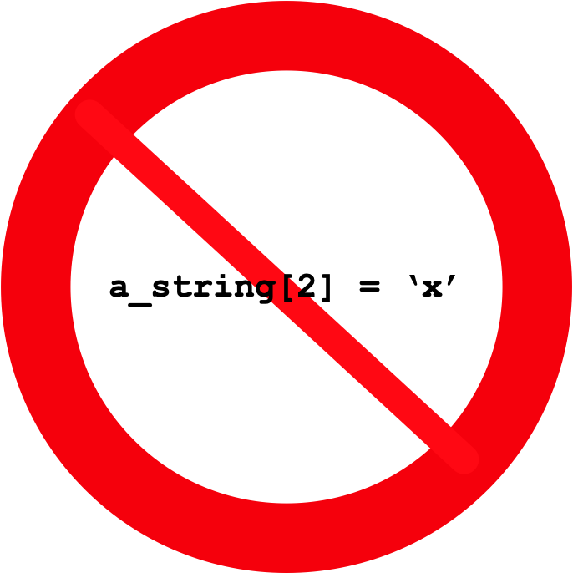
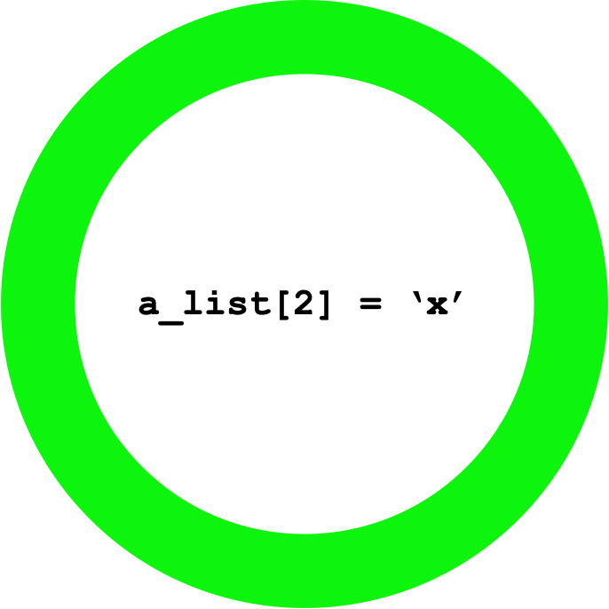
Lists and Strings
Strings are immutable
Lists are mutable

Slide 36
Try it out
Write a function that determines whether a word is a palindrome (spelled forward the same as backward)
Write a function that checks whether two words are anagrams (have exactly the same letters).
  Hint: Without counting letters, you just create an ordered list of the letters in each word
    For extra credit: remove all non-letters
      Use string.ascii_letters

Slide 37
Formatting Strings
We really need to learn how to format strings
  Python has made several attempts before settling on an efficient syntax.
    You can find information on the previous solutions on the net.
  Use the format function
    Distinguish between the blueprint
    and the string to be formatted
    Result is the formatted string.

Slide 38
Formatting Strings
Blueprint string
  Uses {} to denote places for variables
  Simple example
    "{} {}".format('one', ‘two')
    Result
String to be
formatted
Calling
format
Blueprint
‘one two’

Slide 39
Formatting Strings
Inside the brackets, we can put indices to select variables
  0 means first variable, 1 second, …
  Can reuse variables

Slide 40
Formatting Strings
Additional formatting inside the bracket after a colon
Can assign the number of characters to print out
  Default alignment is to the left

Slide 41
Formatting Strings
Use ^ to center
Use < to left-align
Use > to right-align

Slide 42
Formatting Strings
Numbers are handled without specifying format instructions.
Or we can insist on special types
  Use s for string
  Use d for decimal
  Use f for floating point
  Use e for floating point in exponential notation

Slide 43

Formatting Strings
By specifying “f” we ask for floating point format
By specifying “e” we ask for scientific format

Slide 44
Formatting Strings
Padding
  If the variable needs more space to print out, it will be provided automatically
  This is actually the longest officially recognized word in English

Slide 45
Formatting Strings
Padding:
  On the reverse, we can give the number of significant digits after a period
  We only want to keep two decimal digits after the period
  But use a total of 8 spaces for the number.

Slide 46

Formatting Strings
Escaping curly brackets:
  If we want to write strings with format containing the curly brackets “{“ and “}”, we just have to write “{{“ and “}}”
    A single bracket is a placeholder, a double curly bracket is a single one in the resulting string.

Slide 47
Application: Pretty Printing
Develop a mortgage payment plan
  Accountants have formulae for that, but it is fun to do it directly
  Assume you take out a loan of L$ dollars
    The loan is financed at a rate of r% annually
    Interest is paid monthly, i.e. at a rate of r/12%
  Each month you make a repayment
    Part of the repayment is to pay the interest
    The remainder pays down the debt

Slide 48
Mortgage Payments
Use a while-loop
  Condition is that there is still an outstanding debt
  Adjust outstanding debt
  Count the number of payments
Need to initialize values

Slide 49
Mortgage Payments
We need values for:
  Monthly Rate (interest in percent)/1200
  Principal
  Repayment
Get those from the user
  A true application would contain code that checks whether these numbers make sense.

Slide 50
Mortgage Payments
Initialization
princ = float(input("What is the prinipal “))
rate = float(input("What is the interest rate (in percents)? "))/1200
print("Your minimum rate is ", rate*princ)
paym = float(input("What is the monthly payment? “))
month = 0

Slide 51
Mortgage Payments
We continue until we paid down the principal to zero
while princ > 0:

Slide 52
Mortgage Payments
Update the situation in the while loop
Last payment does not need to be full, so we calculate it
intpaid = princ*rate
princ = princ + princ*rate - paym
if princ < 0:
lastpayment = paym + princ
princ = 0
month += 1

Slide 53
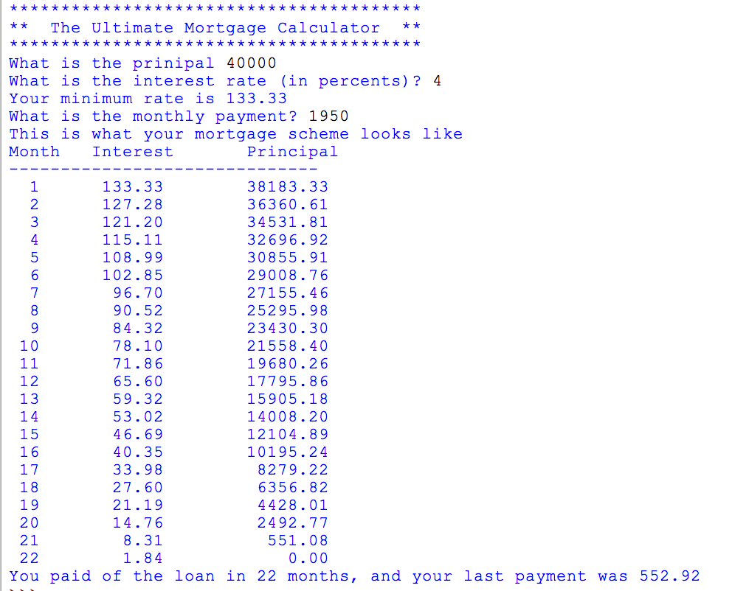
Put things together

Slide 54
Pretty-Printing Tables
Format Strings revisited:
  Format string — blueprint
  Uses { } to denote spots where variables get inserted

Slide 55
Pretty-Printing Tables
Syntax
  {a:^10.3f}
    a — the number of the variable
      Can be left out
    : — what follows is the formatting instruction
    10 — number of spaces for the variable
    . — what follows is the precision
    3 — precision
    f — print in floating point format

Slide 56
Pretty-Printing Tables
If the variable is larger than the space given:
  Full value is printed out
  Alignment by default is
    left (<) for strings
    right (>) for numbers

Slide 57
Pretty-Printing Tables
Task:
  A program that gives a table for the log and the exponential function between 1 and 10
  Hint: x=1+i/10
x | exp(x) | log(x)
-------------------------------
1.00 | 2.71828 | 0.00000
1.10 | 3.00417 | 0.09531
1.20 | 3.32012 | 0.18232
1.30 | 3.66930 | 0.26236
1.40 | 4.05520 | 0.33647
1.50 | 4.48169 | 0.40547
1.60 | 4.95303 | 0.47000
1.70 | 5.47395 | 0.53063

Slide 58
Why another formatting method
The format method allows very fine-grained control
But it is verbose
Python has two type of special strings:
  r-strings for raw strings: no escapes
  f-strings for formatting
  Using f-strings results in more compact and readable code

Slide 59
f-strings
f-strings are defined with a pair of quotation marks preceded immediately by an “f” or “F”
An f-string can contain a variable name surrounded by brackets in its definition
The bracket is then replaced by the value of the variable
fstring = f'hello world'

Slide 60
f-strings
Example:
Variable fstring is then
number = 6.35
astring = “hello"
fstring = f"{astring}, the number is {number}"
'hello, the number is 6.35'

Slide 61
f-strings
The expression in brackets inside an f-string gets evaluated at run time.
For example, we can say
or
      which evaluates to
f"{2+3*4}"
astring = “hello"
string = f"{astring.upper()} World"
'HELLO World'

Slide 62
r-strings
Because of their similarity with f-strings, we mention r-strings
An r-string uses the escape character only as an escape character, so there is no escaping at all
  This is useful for strings containing the backslash such as Windows file names
address = r"c:\Windows\System32\system.ini"

Slide 63
Hangman - Ahorcado
A slightly morbid childrens' game
  Guess a word letter by letter
  For each wrong letter, a part of a hanged man is drawn
Enter a letter j
+------+
| |
| o
| /|\
| / \
|
|
|
|
|
|
you looser you

Slide 64
Hangman — Ahorcado
How to plan a software project?
  Principal idea: divide tasks into simpler components
  Make a diagram of program logic:
    This is apt to change

Slide 65
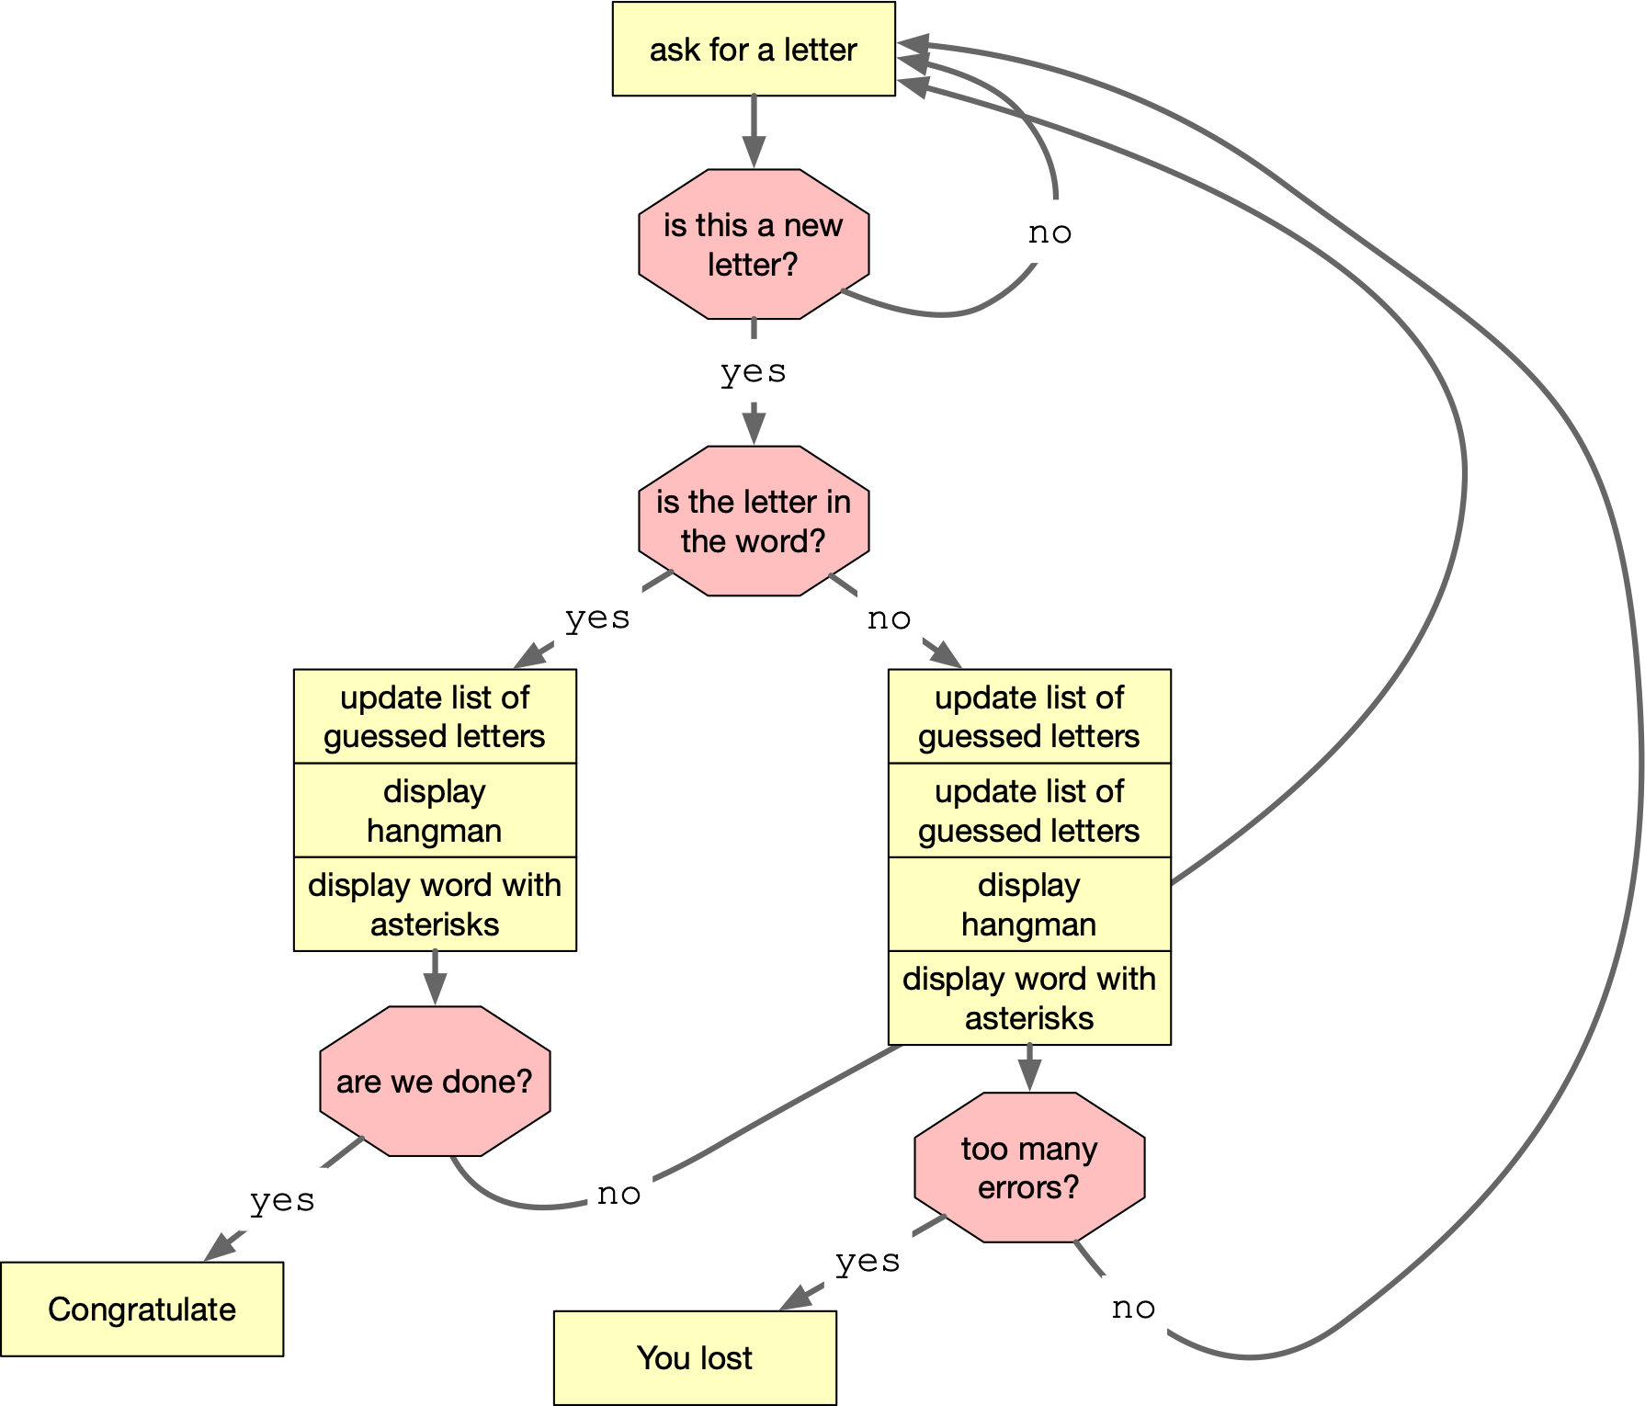
Hangman — Ahorcado

Slide 66
Hangman — Ahorcado
Observation:
  We need a list of guessed letters to decide whether this is a letter
  We need to do more input control
    User enters digit
    user enters capital letters
    …

Slide 67
Hangman — Ahorcado
All of the yellow boxes are candidates for functions
We can see some common data:
  The secret word
  The list of guessed letters
  The number of bad guesses

Slide 68
Hangman — Ahorcado
We can also see that at the heart is a giant loop
Python-style:
  Make the loop an infinite loop
  Break out

Slide 69
Hangman — Ahorcado
A word about diagrams:
  Programming has become a lot easier over the years
    So we program more difficult things
    And focus has shifted
  Some methods are very data-centric
    Useful for big data implementation or graphics, e.g.
  Some methods focus on processing
    As we just did

Slide 70
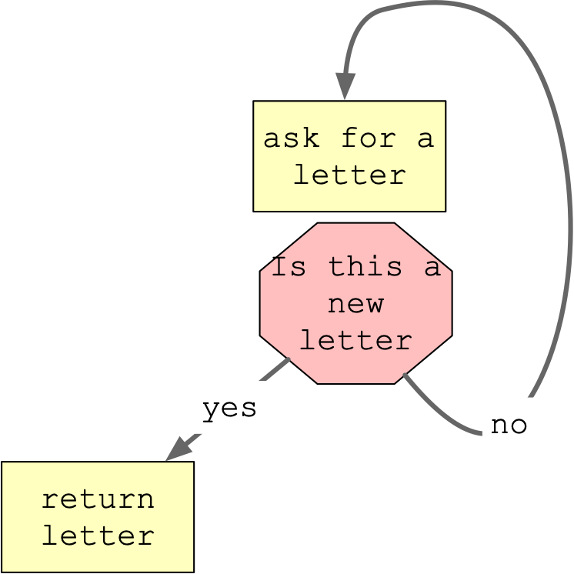
Hangman — Ahorcado
"Enter a letter" function:
  Needs one parameter: list of guessed letters
  Should do error checking (homework / project)
  Returns a letter not previously seen

Slide 71
Hangman — Ahorcado
def get_letter(lol):
while True:
x = input('Enter a letter ')
x = x[0]
if x in lol:
print('This letter is already guessed. Try again.')
else:
return x

Slide 72
Hangman — Ahorcado
Check whether we are done
  All the letters in the secret are in the list of letters already guessed (lol)
def done(lol, secret):
for letter in secret:
if letter not in lol:
return False
return True

Slide 73
Hangman — Ahorcado
Print out the hangman: An exercise in ASCII art
Enter a letter a
+------+
| |
|
|
|
|
|
|
|
|
Good job. The word is *******a

Slide 74
Hangman — Ahorcado
Enter a letter b
+------+
| |
|
|
|
|
|
|
|
|
Good job. The word is *****b*a

Slide 75
Hangman — Ahorcado
Enter a letter d
+------+
| |
| o
|
|
|
|
|
|
|
Not quite. The word is c****b*a

Slide 76
Hangman — Ahorcado
Enter a letter e
+------+
| |
| o
| |
|
|
|
|
|
|
|
Not quite. The word is c****b*a

Slide 77
Hangman — Ahorcado
Enter a letter f
+------+
| |
| o
| /|
|
|
|
|
|
|
|
Not quite. The word is c****b*a

Slide 78
Hangman — Ahorcado
Enter a letter g
+------+
| |
| o
| /|\
|
|
|
|
|
|
|
Not quite. The word is c****b*a

Slide 79
Hangman — Ahorcado
Enter a letter h
+------+
| |
| o
| /|\
| /
|
|
|
|
|
|
Not quite. The word is c****b*a

Slide 80
Hangman — Ahorcado
Enter a letter i
+------+
| |
| o
| /|\
| /
|
|
|
|
|
|
Good job. The word is c****bia

Slide 81
Hangman — Ahorcado
Enter a letter j
+------+
| |
| o
| /|\
| / \
|
|
|
|
|
|
you looser you

Slide 82
Hangman — Ahorcado
"printing the hangman"
  Two possibilities:
    Draw the same string with slight changes for different number of false guesses
    Draw different strings (using copy and paste)
  Can use multi-dimensional strings
    or use string arithmetic (which becomes unreadable)

Slide 83
def print_it(n):
if n <= 0:
print(5*' ' +'+------+\n' + 5*' ' +'| |\n' + 8*(5*' '+'|\n'))
elif n == 1:
print(5*' ' +'+------+\n' + 5*' ' +'| |\n'
+5*' '+'| o\n' +7*(5*' '+'|\n'))
elif n == 2:
print(5*' ' +'+------+\n' + 5*' ' +'| |\n'
+5*' '+'| o\n' ++5*' '+'| |\n'
+7*(5*' '+'|\n'))
elif n == 3:
print(5*' ' +'+------+\n' + 5*' ' +'| |\n'
+5*' '+'| o\n' + 5*' '+'| /|\n'
+7*(5*' '+'|\n'))
elif n == 4:
print(5*' ' +'+------+\n' + 5*' ' +'| |\n'
+5*' '+'| o\n' + 5*' '+'| /|\\ \n'
+7*(5*' '+'|\n'))
elif n == 5:
print(5*' ' +'+------+\n' + 5*' ' +'| |\n'
+5*' '+'| o\n' + 5*' '+'| /|\\ \n'
+5*' '+'| / \n'
+6*(5*' '+'|\n'))
elif n == 6:
print(5*' ' +'+------+\n' + 5*' ' +'| |\n'
+5*' '+'| o\n' + 5*' '+'| /|\\ \n'
+5*' '+'| / \ \n'
+6*(5*' '+'|\n'))

Slide 84
Hangman — Ahorcado
Now we are ready for the game:
  First, define the data structures
def game():
secret = 'colombia'
lol = []
false_guesses = 0
…

Slide 85
Hangman — Ahorcado
Then start the while loop:
def game():
secret = 'colombia'
lol = []
false_guesses = 0
while True:
…

Slide 86
Hangman — Ahorcado
First, get the letter and do not forget to update your list of guessed letters (lol)
We have hidden some logic in get_letter
while True:
x = get_letter(lol)
lol.append(x)

Slide 87
Hangman — Ahorcado
If the letter is a good guess:
  Print hangman and word, then check whether we are done
if x in secret:
print_it(false_guesses)
if done(lol, secret):
print('You won')
break
else:
print('Good job. The word is', display(secret, lol))

Slide 88
Hangman — Ahorcado
If the letter is bad:
  update false guesses
  print hangman
  decide on whether we lost
if x not in secret:
false_guesses += 1
print_it(false_guesses)
if false_guesses >= 6:
print("you looser you")
break
else:
print('Not quite. The word is', display(secret, lol))

Slide 89
Hangman — Ahorcado
Notice: We could have used return in order to get out of the loop

Slide 90
def game():
secret = 'colombia'
lol = []
false_guesses = 0
while True:
x = get_letter(lol)
lol.append(x)
if x in secret:
print_it(false_guesses)
if done(lol, secret):
print('You won')
break
else:
print('Good job. The word is', display(secret, lol))
if x not in secret:
false_guesses += 1
print_it(false_guesses)
if false_guesses >= 6:
print("you looser you")
break
else:
print('Not quite. The word is', display(secret, lol))

