Slide 1
Time Series Analysis
with Pandas
Thomas Schwarz, SJ

Slide 2
Time Series
Study of statistical data that depends on the time
  Examples:
    births in the US on a given day
    names given to children in a certain year
    exchange rates
    …

Slide 3
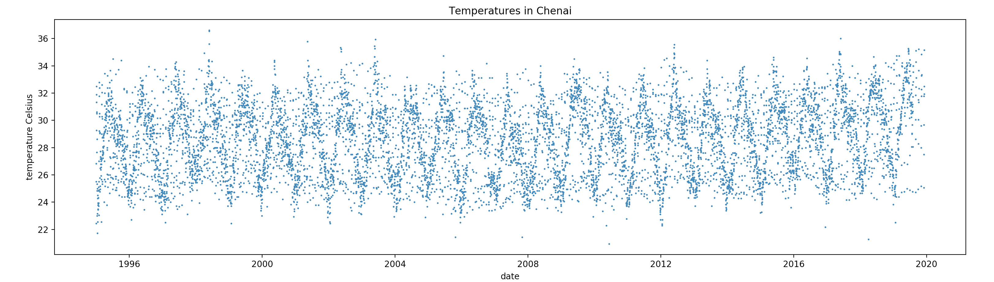
Introduction to Time Series

Slide 4
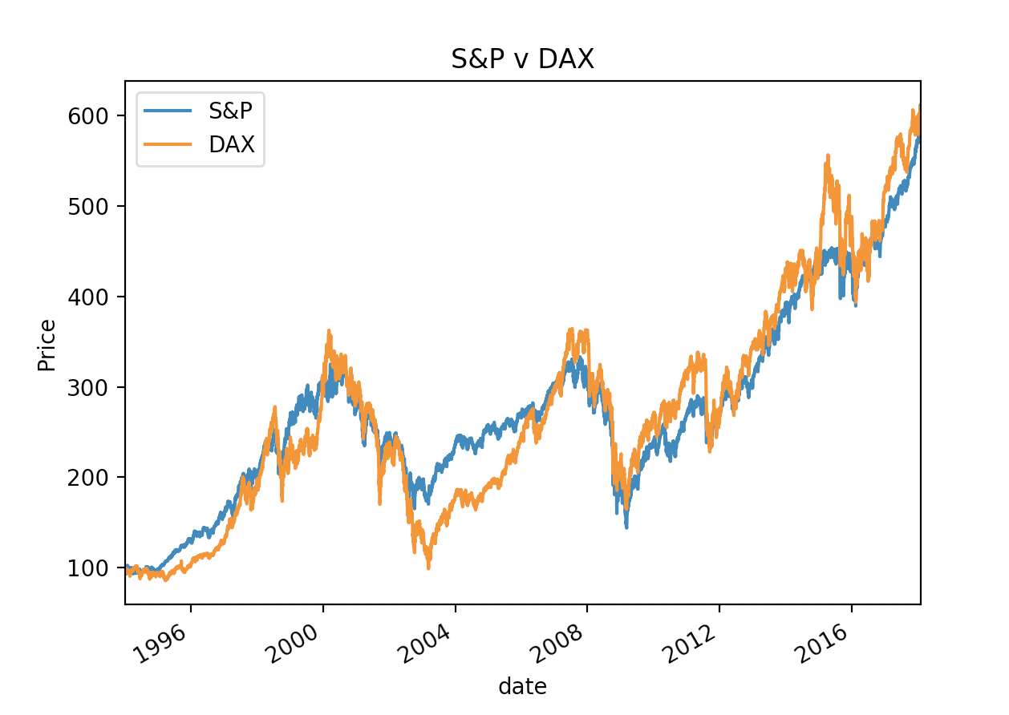
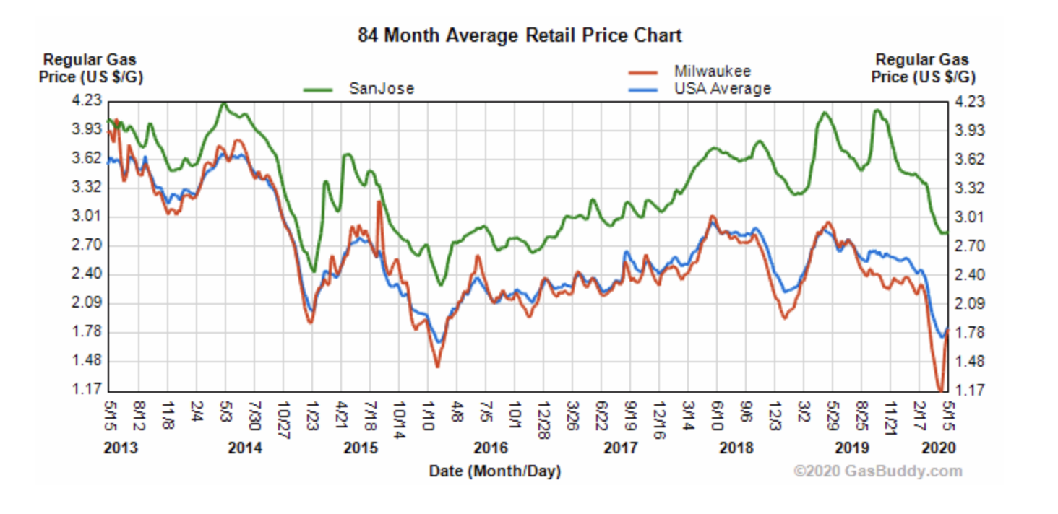
Introduction to Time Series
Time Series Data is highly correlated with itself
  Normal statistical descriptions such as mean are not very useful
  Temperature, stock market, gas prices have long-term trends
  Temperature and gas prices have seasonal trends

Slide 5
Introduction to Time Series
Dealing with time data:
  Generate time plot to see what is happening
    Usually import from csv and transform data
  Determine optically trends, cycles, outliers, undefined or obviously wrong values
  Determine whether there is a need for transformation
    e.g. our stock exchange data is normalized to make DOW and DAX comparable

Slide 6
Introduction to Time Series
Typical transformations:
  Linear normalizations
  Logarithmic, exponential
    E.g. variance grows with mean —> Logarithmic transform
    Make a multiplicative dependence additive
      timevalue = trend * seasonal * random —> Logarithmic: timevalue = trend+seasonal+random

Slide 7
Introduction to Time Series
Filtering: Transform time series $(x_{t})$ into other time series $(y_{t})$
  Smoothing out local variations
    E.g. Linear smoothing with weights $a_{-s},a_{-s+1},…,a_{-1},a_{0},a_{1},…,a_{r-1},a_{r}$
      $$y_{t}=\overset{r}{\underset{ν=-s}{∑}}a_{ν}x_{t+ν}$$
      Eg. Moving average: $y_{t}=\frac{1}{2n+1}\overset{n}{\underset{ν=-n}{∑}}x_{t+ν}$

Slide 8
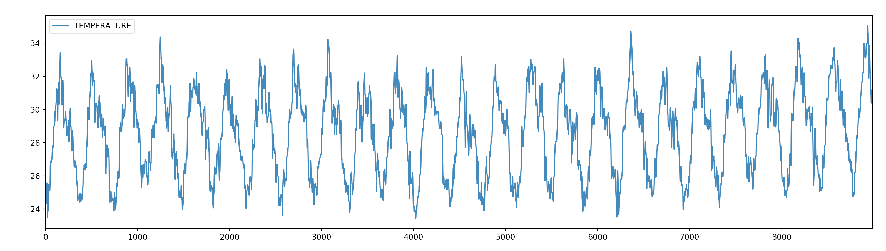
Introduction to Time Series
Median Smoothing with a Window of 10 of the Chenai Temperature Data

Slide 9
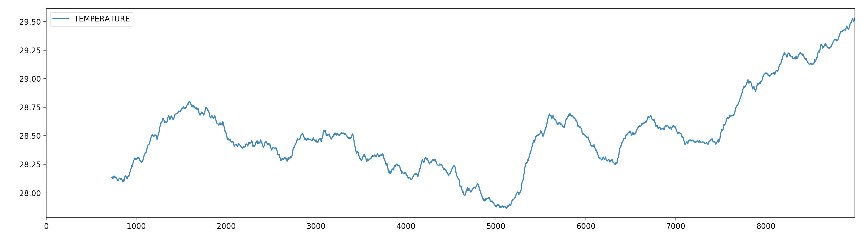
Introduction to Time Series
Smoothing over 2 years with mean

Slide 10
Introduction to Time Series
Seasonal variations:
  Three main models
    $$x_{t}=m_{t}+s_{t}+ϵ_{t}$$
    $$x_{t}=m_{t}⋅s_{t}+ϵ_{t}$$
    $$x_{t}=m_{t}⋅s_{t}⋅ϵ_{t}$$
  Where
    $x_{t}$ time-series value
    $m_{t}$ long-time trend
    $s_{t}$ seasonal component
    $ϵ_{t}$ random noise

Slide 11
Auto-Correlation
Covariance:
  Two random variables $X,Y$ with means $E(X),E(Y)$
  Covariance ${\text{Cov}}_{X,Y}=E\left((X-E(X))⋅(Y-E(Y))\right)$
  If $X$ and $Y$ are independent:
    $${\text{Cov}}_{X,Y}=E(XY-E(X)Y-E(Y)X+E(X)E(Y))=0$$
  If ${\text{Cov}}_{X,Y}>0$:
    High values for $X$ go with high values for $Y$
  If ${\text{Cov}}_{X,Y}<0$:
    High values for $X$ go with low values for $Y$

Slide 12
Auto-Correlation
Covariance depends on the units in which $X$ and $Y$ are given
Therefore, we look at the correlation coefficient
  If $X$ and $Y$ have standard deviations $σ_{X}$ and $σ_{Y}$ respectively:
    $ρ_{X,Y}=\frac{{\text{Cov}}_{X,Y}}{σ_{X}σ_{Y}}∈[-1,1]$

Slide 13
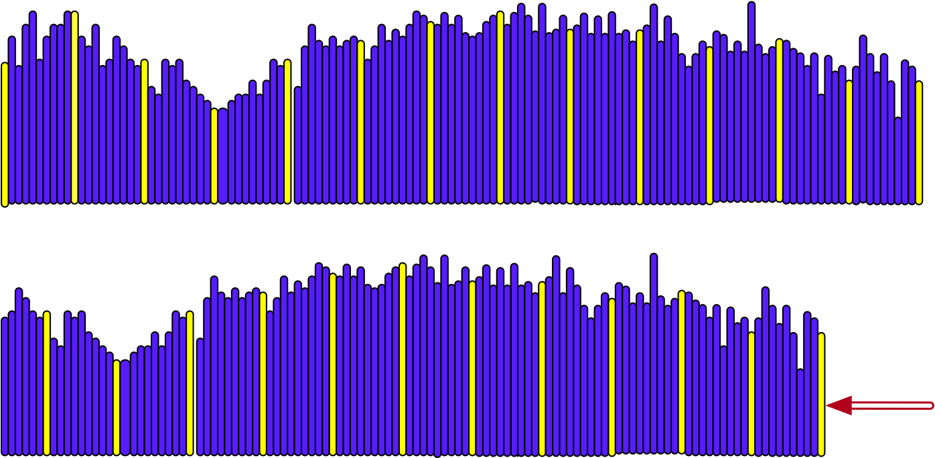
Introduction to Time Series
Auto-correlation: Compare the correlation of a time series with itself moved by $k$ positions

Slide 14
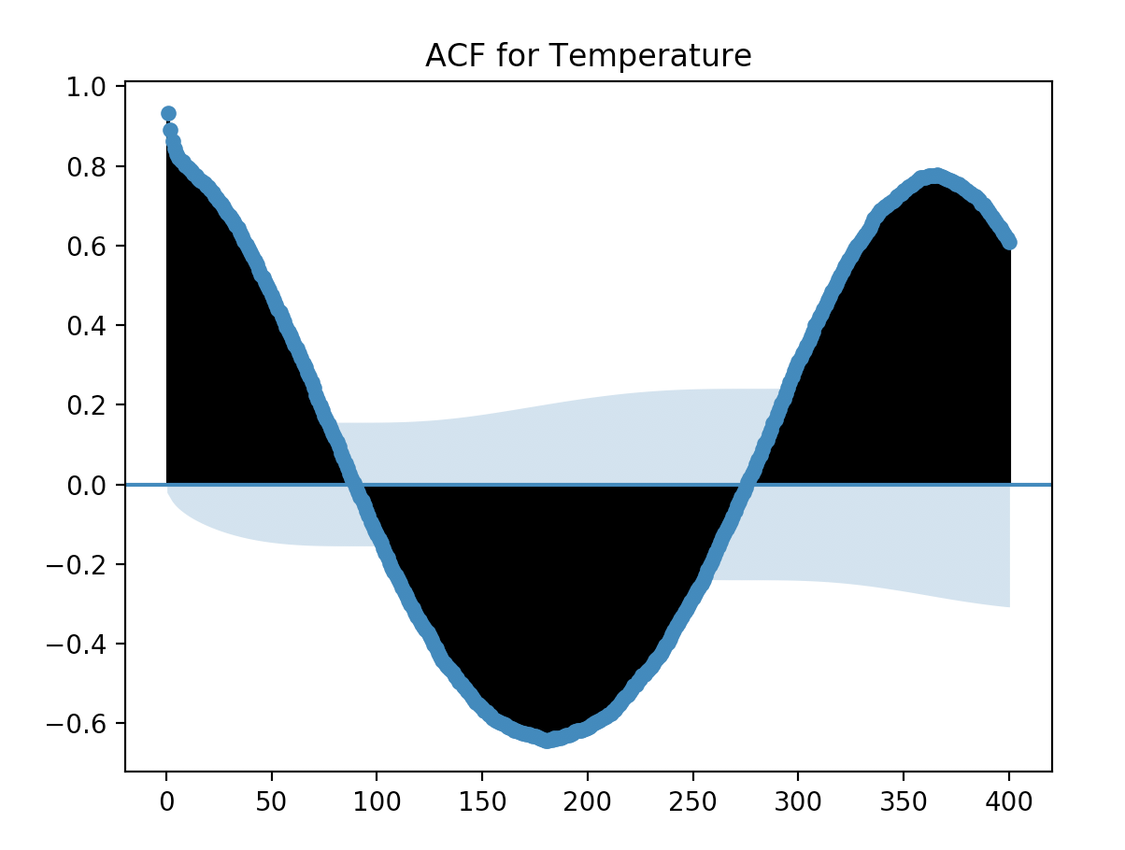
Introduction to Time Series
Autocorrelation for Chenai temperatures
  High auto-correlation for the next day and for a year afterwards
  The light blue denotes significance

Slide 15
Introduction to Time Series
Goal:
  Prediction of future value
Testing:
  Use latest data and predict based on previous data

Slide 16
Time Series in Pandas
Overview
Time series can be
  fixed frequency
    data points occur at regular intervals
  irregular
    no fixed unit of time / offset between data points

Slide 17
Time Series in Pandas
Overview
Time is given in
  Timestamps
  Fixed periods (January 2007)
  Intervals of time such as periods
  Experiment or elapsed time
    Each timestamp measures the difference relative to a particular start time
      For this: use timedelta indices in Pandas

Slide 18
Times in Python
Python time in datetime
  Can take hours, minutes, seconds, microseconds as well
  Also timezone information
Can be combined with timedelta in order to calculate with dates
from datetime import datetime
my_date(year=2020, month = 2, day = 14)

Slide 19
Times in Python
datetime has a μsec resolution
timedelta for the difference between two datetime objects
>>> from datetime import datetime
>>> now = datetime.now()
>>> now
datetime.datetime(2020, 6, 30, 14, 11, 29, 82191)
>>> now.year, now.month, now.day
(2020, 6, 30)
>>> delta = now - datetime(2001,6,16,11)
>>> delta
datetime.timedelta(days=6954, seconds=11489, microseconds=82191)

Slide 20
Times in Python
We can calculate with datetime and timedelta objects
>>> from datetime import datetime, timedelta
>>> timedelta(12)
datetime.timedelta(days=12)
>>> now = datetime.now()
>>> now + 3.5*timedelta(10)
datetime.datetime(2020, 8, 4, 14, 17, 1, 562436)

Slide 21
Times in Python
We can convert between string and datetime (or date or time)
  strftime takes a format argument
>>> from datetime import date, time, datetime, timedelta
>>> stamp = datetime(1776, 7, 4)
>>> str(stamp)
'1776-07-04 00:00:00'
>>> stamp.strftime('%d-%m-%Y')
'04-07-1776'

Slide 22
Times in Python
Format codes:
  Can also be used to convert from string to date
Type | Description
%Y | 4-digit year
%y | 2-digit year
%m | 2-digit month
%d | 2-digit day
%H | 24 hour clock
%I | 12 hour clock
%M | 2-digit minute
%S | 2-digit seconds
%w | weekday as integer
%U | week number in year
%W | week number (monday)
%z | UTC time zone offset
%F | Shortcut %Y-%m-%d
%D | Shortcut %m/%d/%y

Slide 23
Times in Python
>>> datetime.strptime('7/4/1776', '%m/%d/%Y')
datetime.datetime(1776, 7, 4, 0, 0)

Slide 24
Times in Pandas
Pandas makes this easier
  It comes with dateutil.parser
  Which can guess most formats
>>> from dateutil.parser import parse
>>> parse('2020-06-30')
datetime.datetime(2020, 6, 30, 0, 0)
>>> parse('July 4, 2020')
datetime.datetime(2020, 7, 4, 0, 0)
>>> parse('4th of July, 2020')
datetime.datetime(2020, 7, 4, 0, 0)
>>> parse(1/2/2021, dayfirst=True)

Slide 25
Times in Pandas
For the non-us world, need to use dayfirst=True
>>> parse('1/2/2021', dayfirst=True)
datetime.datetime(2021, 2, 1, 0, 0)

Slide 26
Times in Pandas
A better solution than Python's for us is numpy's datetime
  Called datetime64
    Example:
    For instance, we can create equidistant arrays of timestamps
      Notice the array notation " [Y] "
np.array(['2020-01-01', '2020-01-02'], dtype='datetime64')
np.arange('2000', '2020', dtype = 'datetime64[Y]')

Slide 27
Times in Pandas
In Pandas, there is DatetimeIndex
    Notice the 'ns' as the default for the precision
    Pandas is good at inferring the format of the string
    For reading in data, we can use pd.to_datetime with the format parameter
pd.date_range('2020-01-01', periods=12, freq='M')
DatetimeIndex(['2020-01-31', '2020-02-29', '2020-03-31', '2020-04-30', '2020-05-31', '2020-06-30', '2020-07-31', '2020-08-31','2020-09-30', '2020-10-31', '2020-11-30', '2020-12-31'], dtype='datetime64[ns]', freq='M')

Slide 28
Times in Pandas
Example:
  Let's generate some random data and then add a time index to it.
  Use this function to generate some values
import numpy as np
import pandas as pd
import random
import math
def v(i,j):
return 10+math.floor(
0.3*i+0.1*i**0.4 + random.normalvariate(0,5)
)

Slide 29
Times in Pandas
We create a value array from numpy with the confusing fromfunction function
Then we create a time index, the dates being May 1, 2020 to May 31, 2020
And finally make it into a data-frame
values = np.fromfunction(
np.vectorize(v),
(31,1)
)
idx = pd.date_range('2020-05-01', periods = 31, freq='D')
df = pd.DataFrame(values, index=idx, columns=['values'])
print(df)

Slide 30
Times in Pandas
values
2020-05-01 13
2020-05-02 8
2020-05-03 13
2020-05-04 14
2020-05-05 14
2020-05-06 11
2020-05-07 19
2020-05-08 11
2020-05-09 12
2020-05-10 24
2020-05-11 22
2020-05-12 12
2020-05-13 3
2020-05-14 13
2020-05-15 16
2020-05-16 12
2020-05-17 13
2020-05-18 16
2020-05-19 19
2020-05-20 16
2020-05-21 8
2020-05-22 16
2020-05-23 23
2020-05-24 20
2020-05-25 17
2020-05-26 18
2020-05-27 13
2020-05-28 19
2020-05-29 15
2020-05-30 16
2020-05-31 11
Result:
  (your values will differ)

Slide 31
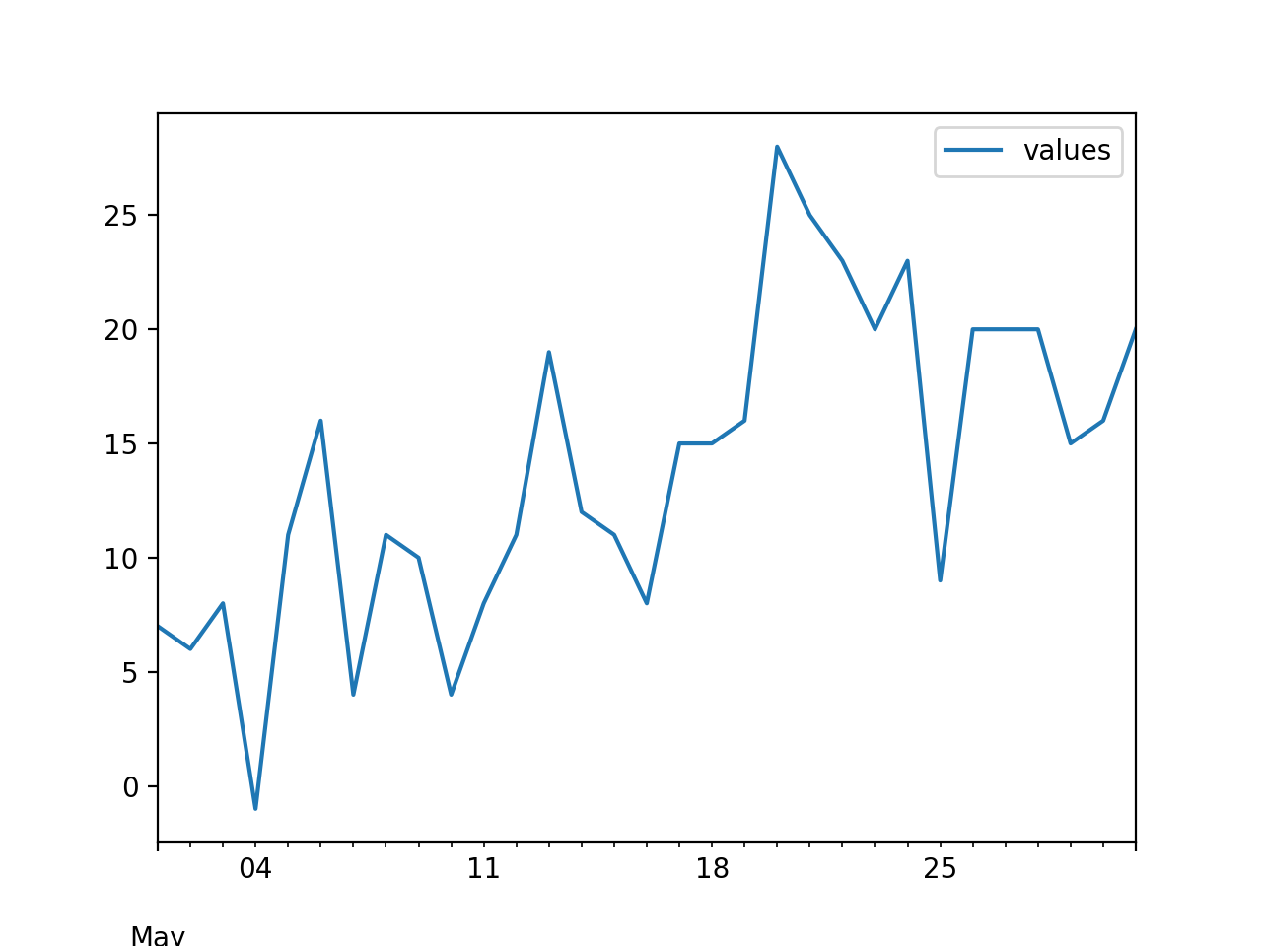
Time Series in Pandas
Overview
df.plot()
plt.show()

Slide 32
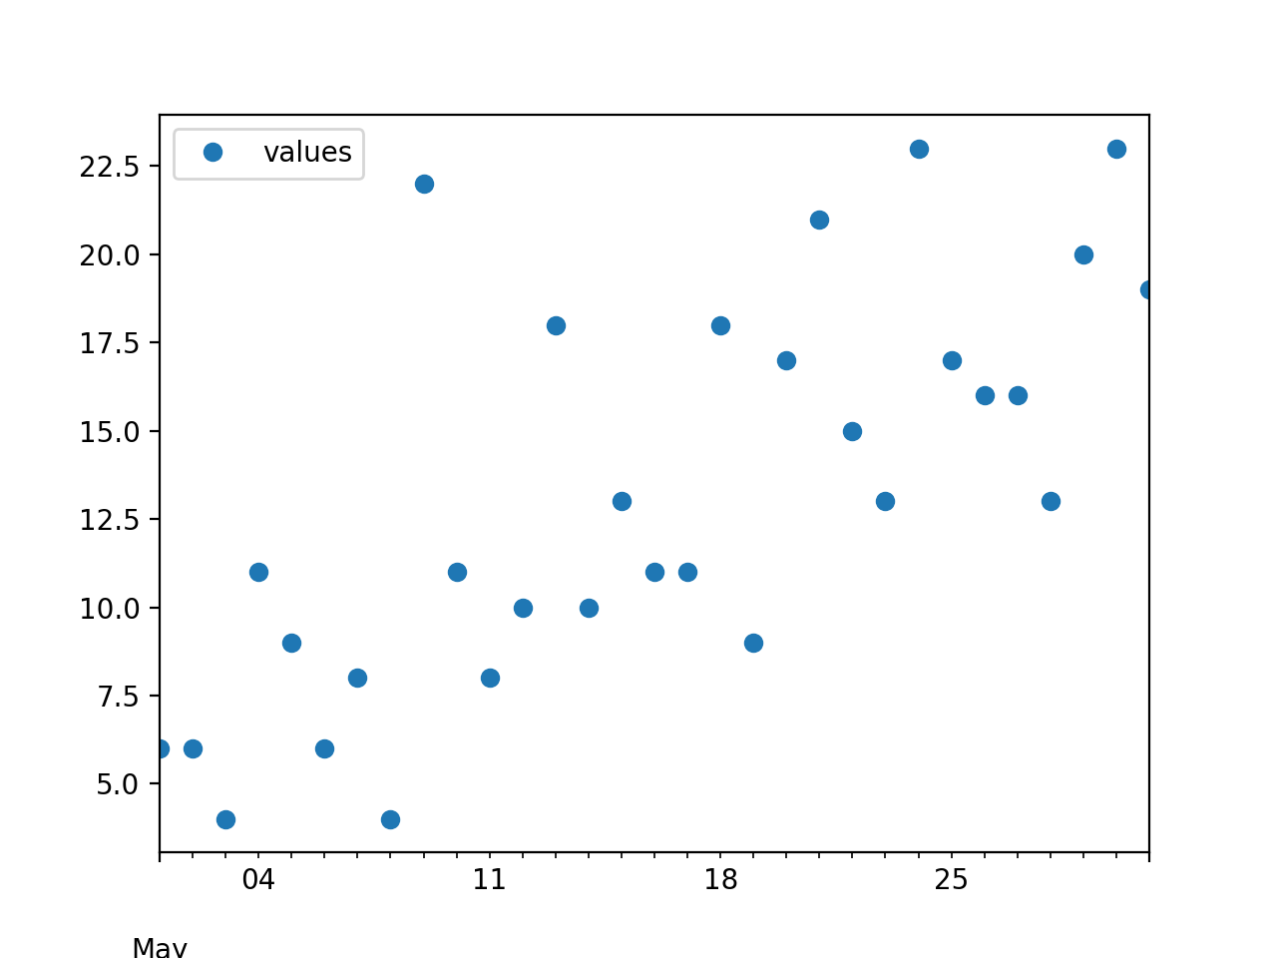
Time Series in Pandas
df.plot(style ='o')
plt.show()
print(df)

Slide 33
Time Series Basics
Usually a series or data frame object indexed by time-stamps
  Often, the time stamps are hidden in the raw data as strings
Arithmetic operations between differently indexed time-series automatically align on the dates

Slide 34
Time Series Basics
Example:
  Take previous times series and do average over three points
  For this, need to create a dataframe with the indices shifted by one day
    For this we use the timedelta
from datetime import timedelta
dfpre = pd.DataFrame(values,
index=(idx-timedelta(1)),
columns=['values']
)

Slide 35
Time Series Basics
Example:
dfpre = pd.DataFrame(values,
index=(idx-timedelta(1)),
columns=['values'])
dfpost = pd.DataFrame(values,
index=(idx+timedelta(1)),
columns=['values'])
dfr = 0.5*df+0.25*dfpre+0.25*dfpost
ax = dfr.plot(style ='r-')
df.plot(style = 'b:', ax = ax)

Slide 36
Time Series Basics
Also: two display to graphs in the same figure:
  df.plot returns an axes object
  Which we can specify in the second plot:
dfpre = pd.DataFrame(values,
index=(idx-timedelta(1)),
columns=['values'])
dfpost = pd.DataFrame(values,
index=(idx+timedelta(1)),
columns=['values'])
dfr = 0.5*df+0.25*dfpre+0.25*dfpost
ax = dfr.plot(style ='r-')
df.plot(style = 'b:', ax = ax)

Slide 37
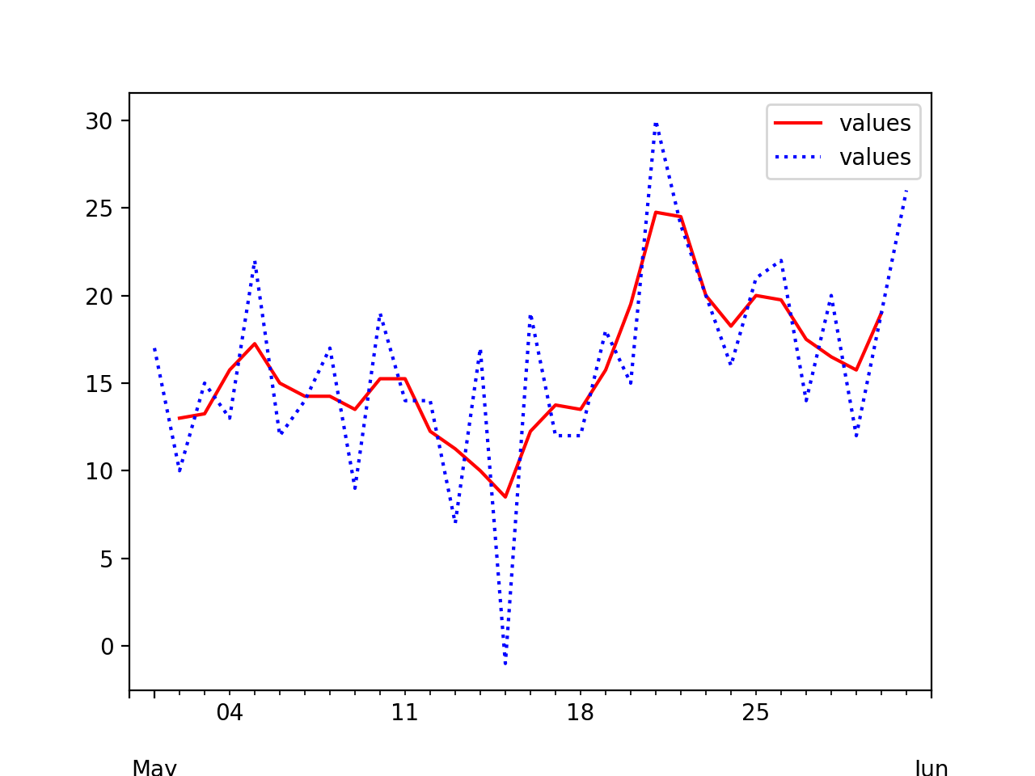
Time Series Basics

Slide 38
Time Series Indexing
Notice that the "smoothed" value has no values for the first and last of the month

Slide 39
Time Series Indexing
Indexing and selection works as before
  Create a time series with random component and a trend as sqrt.
import numpy as np
import pandas as pd
import matplotlib.pyplot as plt
ts = pd.Series(
3*np.random.randn(1000)
+np.sqrt(np.linspace(100, 1100, 1000)),
index = pd.date_range('1/1/2013', periods=1000))
ts.plot()
plt.show()

Slide 40
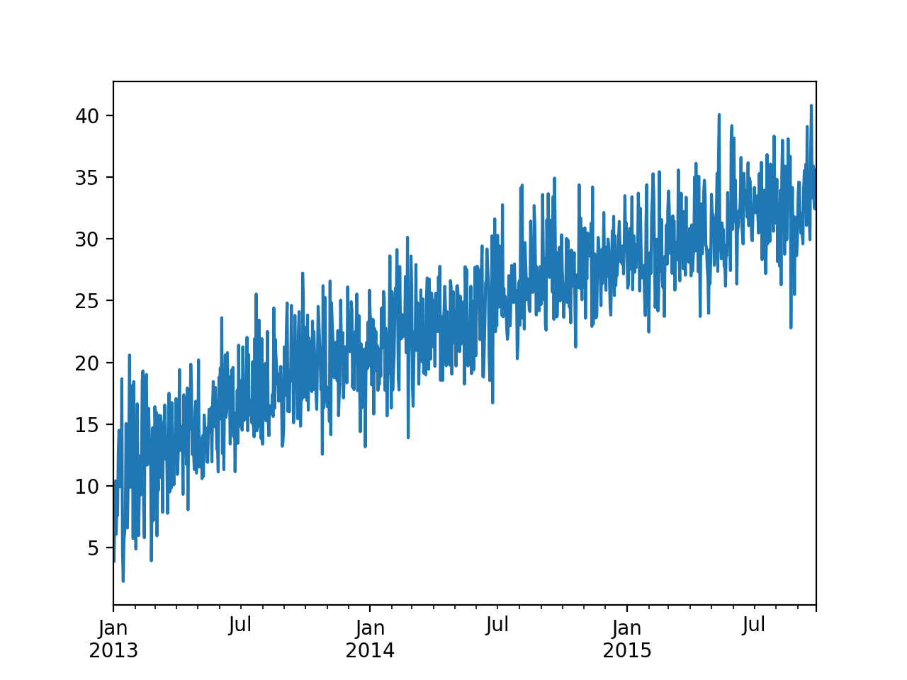
Time Series Indexing

Slide 41
Time Series Indexing
We can access the value of the timeseries using a string
>>> ts['07-01-2014']
30.29958531626109
>>> ts['2014/07/01']
30.29958531626109

Slide 42
Time Series Indexing
We can even slice with a partial date:
>>> ts['2015/01']
2015-01-01 29.018824
2015-01-02 26.018584
2015-01-03 26.322633
2015-01-04 29.884471
2015-01-05 30.861241
2015-01-06 27.578311
…
2015-01-28 31.386897
2015-01-29 34.393147
2015-01-30 24.519918
2015-01-31 28.588378
Freq: D, dtype: float64

Slide 43
Time Series Indexing
We can even slice with a partial date
>>> ts['2013']
2013-01-01 6.579922
2013-01-02 3.886306
2013-01-03 8.624116
2013-01-04 10.406576
2013-01-05 6.078220
...
2013-12-27 21.622836
2013-12-28 19.501775
2013-12-29 23.271005
2013-12-30 19.694463
2013-12-31 25.848146
Freq: D, Length: 365, dtype: float64

Slide 44
Or can do range queries
>>> ts['2013/12/12' : '2014/1/3']
2013-12-12 22.549265
2013-12-13 25.545776
2013-12-14 17.717606
2013-12-15 17.886024
2013-12-16 23.793512
2013-12-17 17.883687
2013-12-18 14.392229
2013-12-19 21.520931
2013-12-20 16.309788
2013-12-21 20.269989
2013-12-22 20.047367
2013-12-23 20.333124
2013-12-24 21.111016
2013-12-25 13.164632
2013-12-26 19.161525
2013-12-27 21.622836
2013-12-28 19.501775
2013-12-29 23.271005
2013-12-30 19.694463
2013-12-31 25.848146
2014-01-01 23.794902
2014-01-02 23.508325
2014-01-03 18.175757

Slide 45
Time Series Indexing
Works for data frames as well, but remember to use loc or iloc
>>> dfr.loc['05-05-2020' : '05-08-2020']
values
2020-05-05 12.75
2020-05-06 12.25
2020-05-07 13.00
2020-05-08 10.50

Slide 46
Time Series Indexing
Duplicate indices
  Time series can have multiple observations per time-stamp
  Use index.is_unique method on data frame to find out
  We would get slices for non-unique indices
  We can aggregate them using groupby

Slide 47
Time Series Date Ranges
Can easily generate data ranges with pd.date_range
  Can specify the frequency and number
>>> pd.date_range('2020-06-01', periods = 30, freq = 'W')
DatetimeIndex(['2020-06-07', '2020-06-14', '2020-06-21', '2020-06-28',
'2020-07-05', '2020-07-12', '2020-07-19', '2020-07-26',
'2020-08-02', '2020-08-09', '2020-08-16', '2020-08-23',
'2020-08-30', '2020-09-06', '2020-09-13', '2020-09-20',
'2020-09-27', '2020-10-04', '2020-10-11', '2020-10-18',
'2020-10-25', '2020-11-01', '2020-11-08', '2020-11-15',
'2020-11-22', '2020-11-29', '2020-12-06', '2020-12-13',
'2020-12-20', '2020-12-27'],
dtype='datetime64[ns]', freq='W-SUN')

Slide 48
Time Series Ranges
Frequencies:
  D — day
  B — business day
  H — hourly
  min T — minute
  M — month end
  MS — month beginning
  …

Slide 49
Time Series Ranges
Can even get third Friday of each month
>>> pd.date_range('2020-06-28', freq = 'WOM-3FRI', periods = 20)
DatetimeIndex(['2020-07-17', '2020-08-21', '2020-09-18', '2020-10-16',
'2020-11-20', '2020-12-18', '2021-01-15', '2021-02-19',
'2021-03-19', '2021-04-16', '2021-05-21', '2021-06-18',
'2021-07-16', '2021-08-20', '2021-09-17', '2021-10-15',
'2021-11-19', '2021-12-17', '2022-01-21', '2022-02-18'],
dtype='datetime64[ns]', freq='WOM-3FRI')

Slide 50
Time Series Shifting
Shifting data — move data backward or forward
  Can do so be ourselves
  Or use shift
>>> smoother = 0.1*ts.shift(-2) + 0.2*ts.shift(-1) + 0.4*ts + 0.2*ts.shift(1)+0.1*ts.shift(2)
>>> smoother.plot()
<matplotlib.axes._subplots.AxesSubplot object at 0x7f9c72f47ee0>
>>> plt.show()

Slide 51
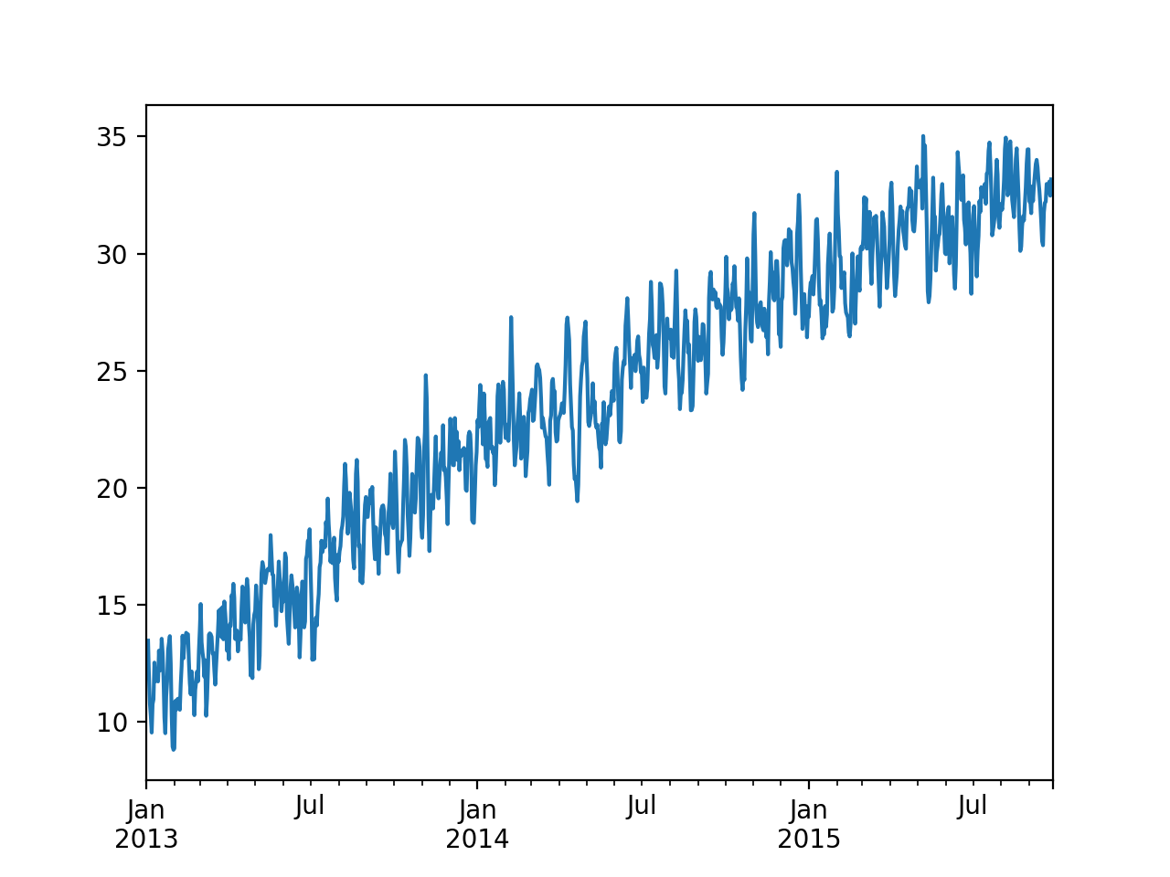
Time Series Shifting

Slide 52
Time Series Shifting
Using percentage changes
>>> plt.show()
>>> pct = (ts/ts.shift(-1)-1)*100
>>> pct.plot()
<matplotlib.axes._subplots.AxesSubplot object at 0x7f9c72f28760>
>>> plt.show()

Slide 53
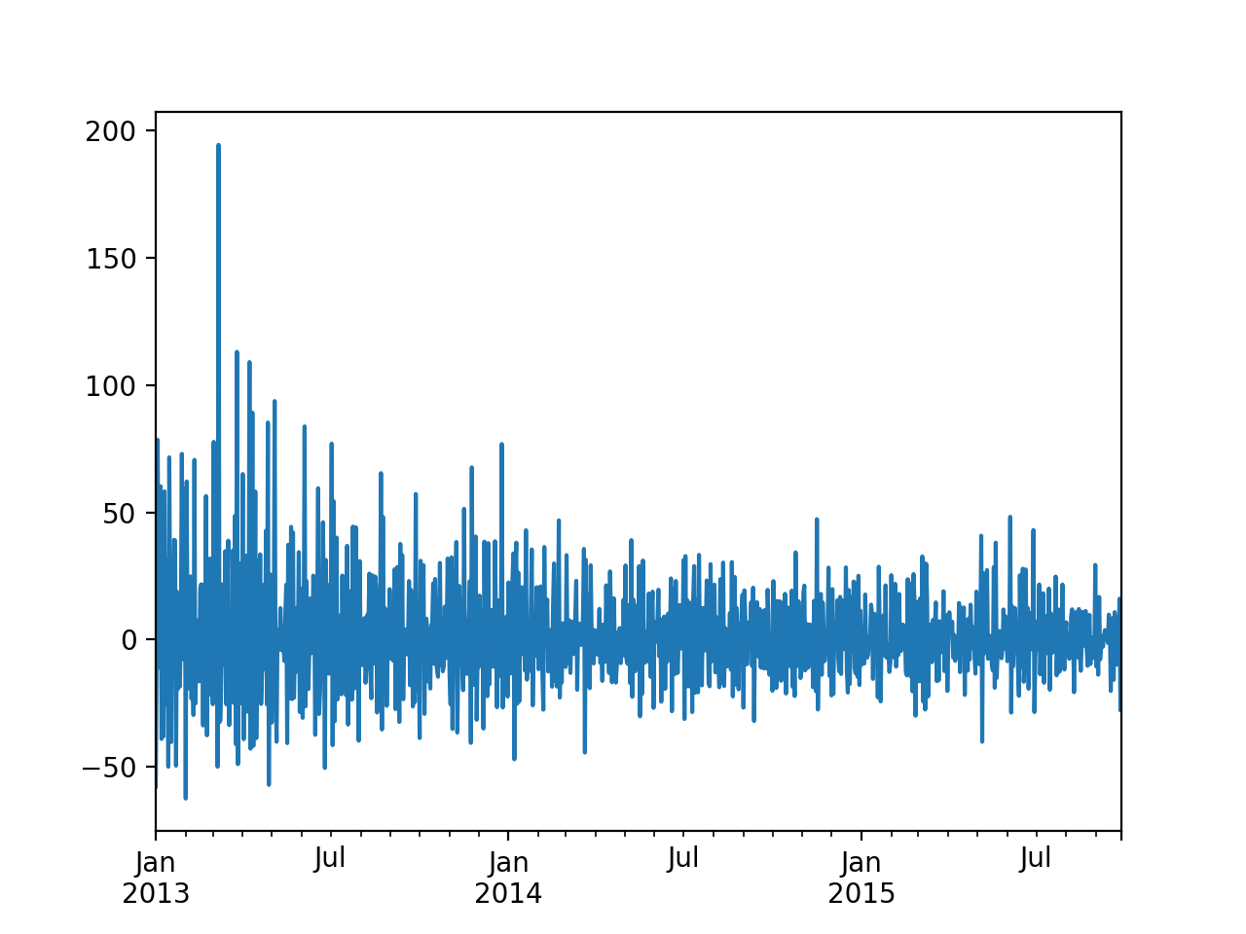
Time Series Shifting

Slide 54
Time Series Shifting
We can use offsets with shifting
  Need to import the timestamp objects:
    Can use arithmetic:
from pandas.tseries.offsets import Day
>>> pd.Timestamp.now()
Timestamp('2020-06-30 16:30:49.660811')
>>> pd.Timestamp.now()+3*Day()
Timestamp('2020-07-03 16:30:51.640833')

Slide 55
Time Zones
Very unpleasant to deal with different time zones
  Easier to use Coordinated Universal Time (UTC)
    Successor to Greenwich Mean Time
  Python: Use Olson database
    Need to install pytz with pip

Slide 56
Time Zones
>>> kol = pd.date_range('3/9/2020 9:30', periods = 10, freq = 'H', tz=pytz.timezone('Asia/Kolkata'))
>>> kol.tz_convert('America/Chicago')
DatetimeIndex(['2020-03-08 23:00:00-05:00', '2020-03-09 00:00:00-05:00',
'2020-03-09 01:00:00-05:00', '2020-03-09 02:00:00-05:00',
'2020-03-09 03:00:00-05:00', '2020-03-09 04:00:00-05:00',
'2020-03-09 05:00:00-05:00', '2020-03-09 06:00:00-05:00',
'2020-03-09 07:00:00-05:00', '2020-03-09 08:00:00-05:00'],
dtype='datetime64[ns, America/Chicago]', freq='H')

Slide 57
Time Zones
Many countries outside the tropics have daylight savings or summer times
  This year: change on November 1, 2020
pd.date_range('10/31/2020 20:00', periods = 10, freq = 'H', tz=pytz.timezone('America/Chicago'))
DatetimeIndex(['2020-10-31 20:00:00-05:00', '2020-10-31 21:00:00-05:00',
'2020-10-31 22:00:00-05:00', '2020-10-31 23:00:00-05:00',
'2020-11-01 00:00:00-05:00', '2020-11-01 01:00:00-05:00',
'2020-11-01 01:00:00-06:00', '2020-11-01 02:00:00-06:00',
'2020-11-01 03:00:00-06:00', '2020-11-01 04:00:00-06:00'],
dtype='datetime64[ns, America/Chicago]', freq='H')

Slide 58
Time Zones
Many countries outside the tropics have daylight savings or summer times
  This year: change on November 1, 2020
>>> from pandas.tseries.offsets import Hour
>>> pd.Timestamp('10/31/2020 20:00') + 5*Hour()
Timestamp('2020-11-01 01:00:00')

Slide 59
Periods
Periods represents time spans
  Days
  Months
  Quarters (with variously defined business quarters)
    Q-Jan, Q-Feb, Q-MAR, … —> last calendar day of each month
    BQ-Jan, BQ-Feb, …
    QS-Jan, QS-Feb, … —> beginning quarter
    BQS-Jan, BQS-Feb, …
  years: A - calendar year end, BA business year end,

Slide 60
Periods
Examples:
>>> pd.date_range('2020', periods = 5, freq = 'QS')
DatetimeIndex(['2020-01-01', '2020-04-01',
'2020-07-01', '2020-10-01', '2021-01-01'],
dtype='datetime64[ns]', freq='QS-JAN')
>>> pd.date_range('2020', periods = 5,
freq = 'BQS-MAR')
DatetimeIndex(['2020-03-02', '2020-06-01',
'2020-09-01', '2020-12-01', '2021-03-01'],
dtype='datetime64[ns]', freq='BQS-MAR')

Slide 61
Resampling
Resampling: convert a time series from one frequency to another
  Down-sampling: Aggregating higher frequency data to lower frequency
  Up-sampling: Converting lower frequency to higher frequency

Slide 62
Resampling
Pandas has resample
  Need an aggregation function
  Example:
    Create time series with hourly data
    Down-sample to hours and days
      Down-samples go to the beginning

Slide 63
Resampling
ts = pd.Series(0.5*np.random.randn(5000)+
np.sqrt(np.linspace(100, 1100, 5000)),
index = pd.date_range('1/1/2013',
periods=5000, freq='H'))
ax = ts.plot(style = 'b-')
ts = ts.resample('D').mean()
ts.plot( style='r-', ax=ax)
ts = ts.resample('M').mean()
ts.plot(style = 'g-.', ax= ax)
plt.show()

Slide 64
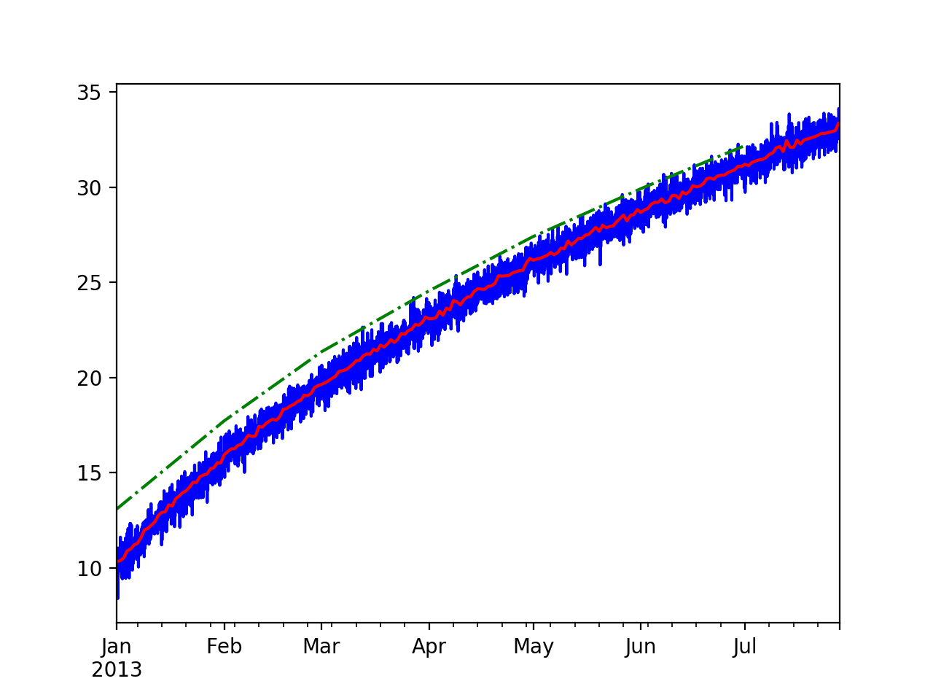
Resampling
The monthly sampling starts January 1

Slide 65
Resampling
We can use scalars for the resample arguments
ts = ts.resample('5D').mean()
ts.plot(style = 'w-.', ax= ax)

Slide 66
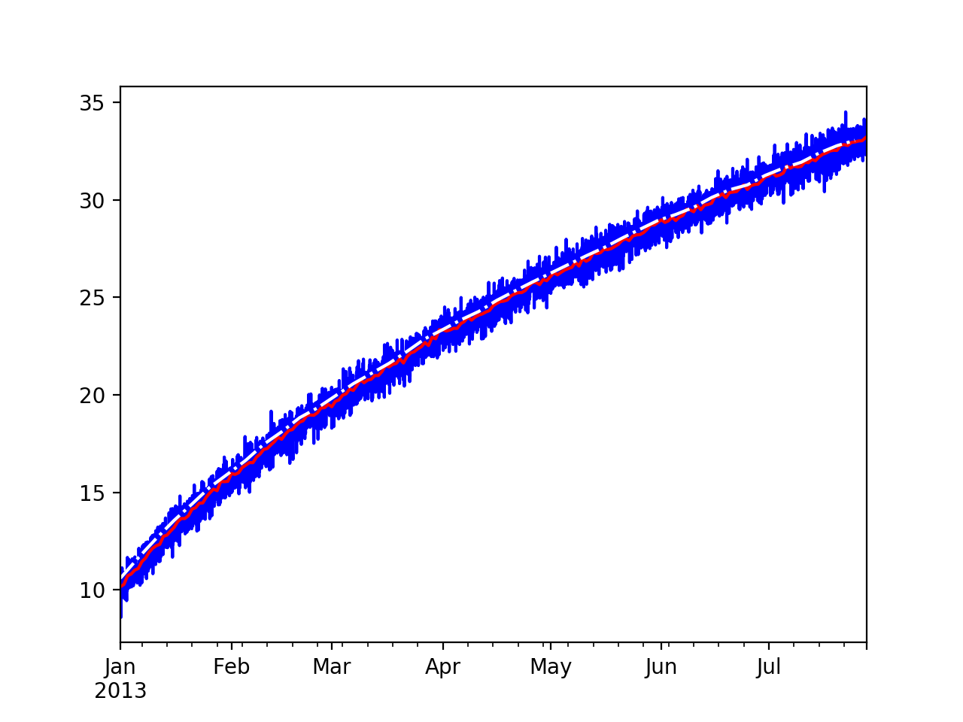
Resampling

Slide 67
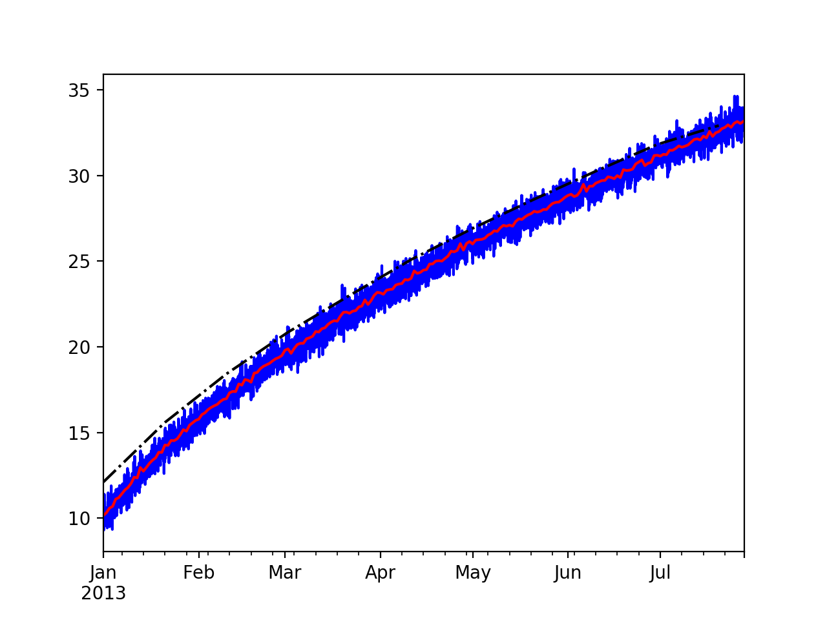
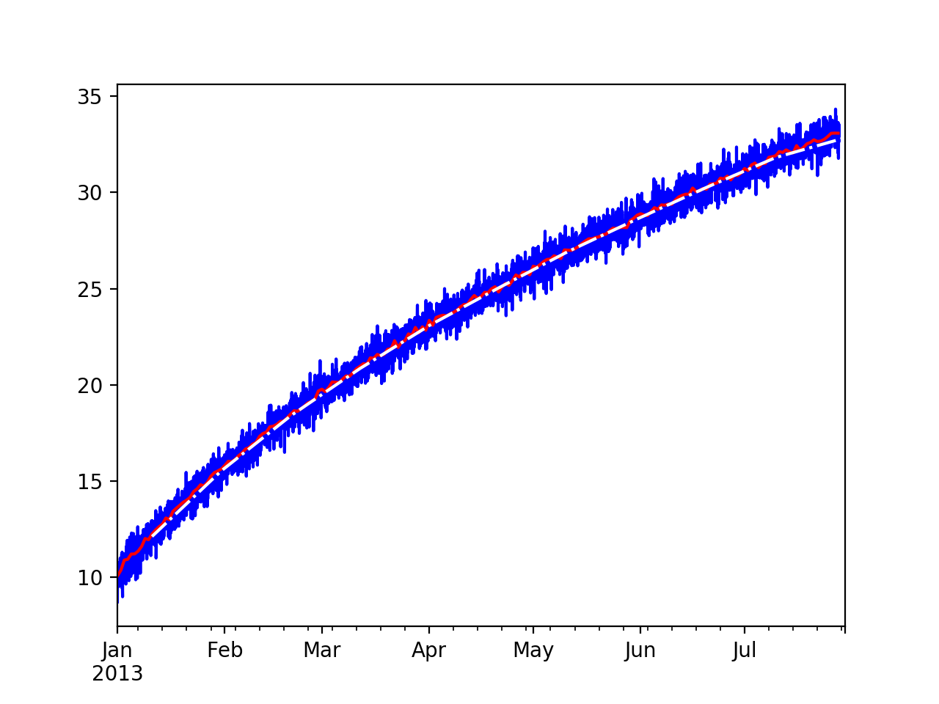
Resampling
Can use loffset to shift the sample
ts = ts.resample('20D', loffset='10D').mean()
ts.plot(style = 'w-.', ax= ax)

Slide 68
Resampling
When up sampling, we do not aggregate but need to interpolate
  ffill - forward fill
  bfill -backward fill
  interpolate
    needs method and sometimes degree

Slide 69
Resampling
Example:
tshourly = ts.resample('H').interpolate(method='linear')
tshourly2 = ts.resample('H').interpolate(method='polynomial',
order=3)
tshourly3 = ts.resample('H').ffill()
ax = tshourly[:5*24].plot()
tshourly2[:5*24].plot(style='k.', ax = ax)
tshourly3[:5*24].plot(style='y:', ax = ax)
ts[:5].plot(style = 'rx', ax = ax)

Slide 70
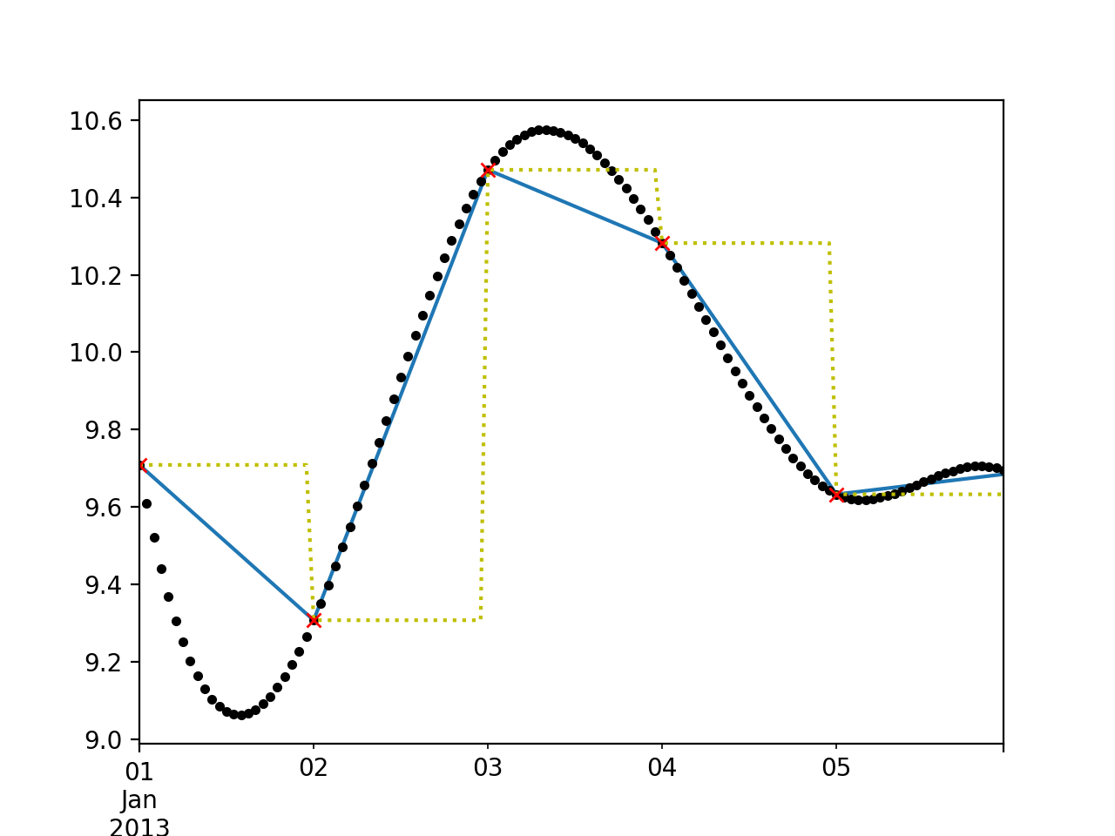
Resampling
y forward fill
b linear
r original data
k third degree polyn

Slide 71
Moving Windows
An important type of resampling is using moving windows
rolling uses a sliding window
Together with mean, this provides a way to see a trend

Slide 72
Moving Windows
Example:
  min_periods=10: start calculating whenever you have 10 values
  center=True: place value in the center of sliding window
rol = ts.rolling(250, min_periods=10).mean()
rol2 = ts.rolling(250, min_periods=10, center=True).mean()
myax = ts.plot(style = 'b-')
rol.plot(style = 'r-', ax = myax)
rol2.plot(style = 'k-.', ax = myax)

Slide 73
Moving Windows
rolling window can also accept a fixed-size time offset
  rolling('20D')

Slide 74
Moving Windows
All data points in a sliding window contribute equally to the aggregator
Can also use exponential decay
Pandas has ewm
  With span parameter for half the size

Slide 75
Moving Windows
Example
rol = ts.ewm(span=250//2, min_periods=10).mean()
myax = ts.plot(style = 'b-')
rol.plot(style = 'r-', ax = myax)

Slide 76
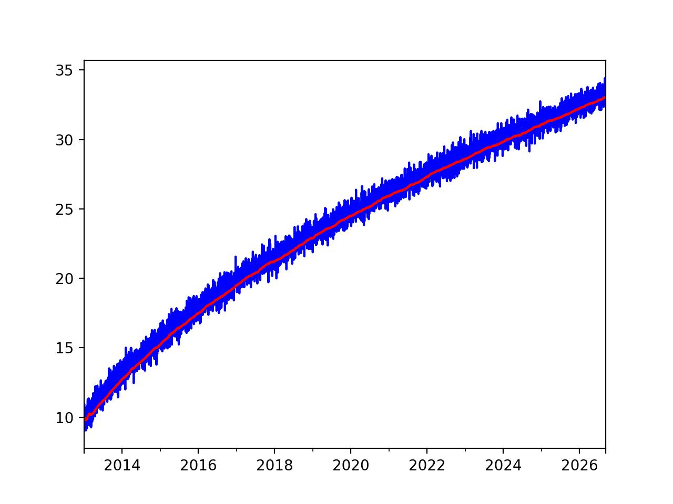
Moving Windows

Slide 77
Pandas Time Series
Time series need and have their own transformation tools
Next steps
  theory of time series
  recognize static time series
  learn how to use auto-correlations

Slide 78
Loading Time Series
Pandas can use parse_dates in order to extract date information
  Example: Airline data
    Has a column called 'date' with month and year
Passengers
date
1949-01-01 112
1949-02-01 118
1949-03-01 132
1949-04-01 129
1949-05-01 121

Slide 79
Loading Time Series
def get_data_1():
df = pd.read_csv('airline-passengers.csv',
parse_dates= {'date' : ["Month"]})
df.set_index('date', inplace=True)
return df

Slide 80
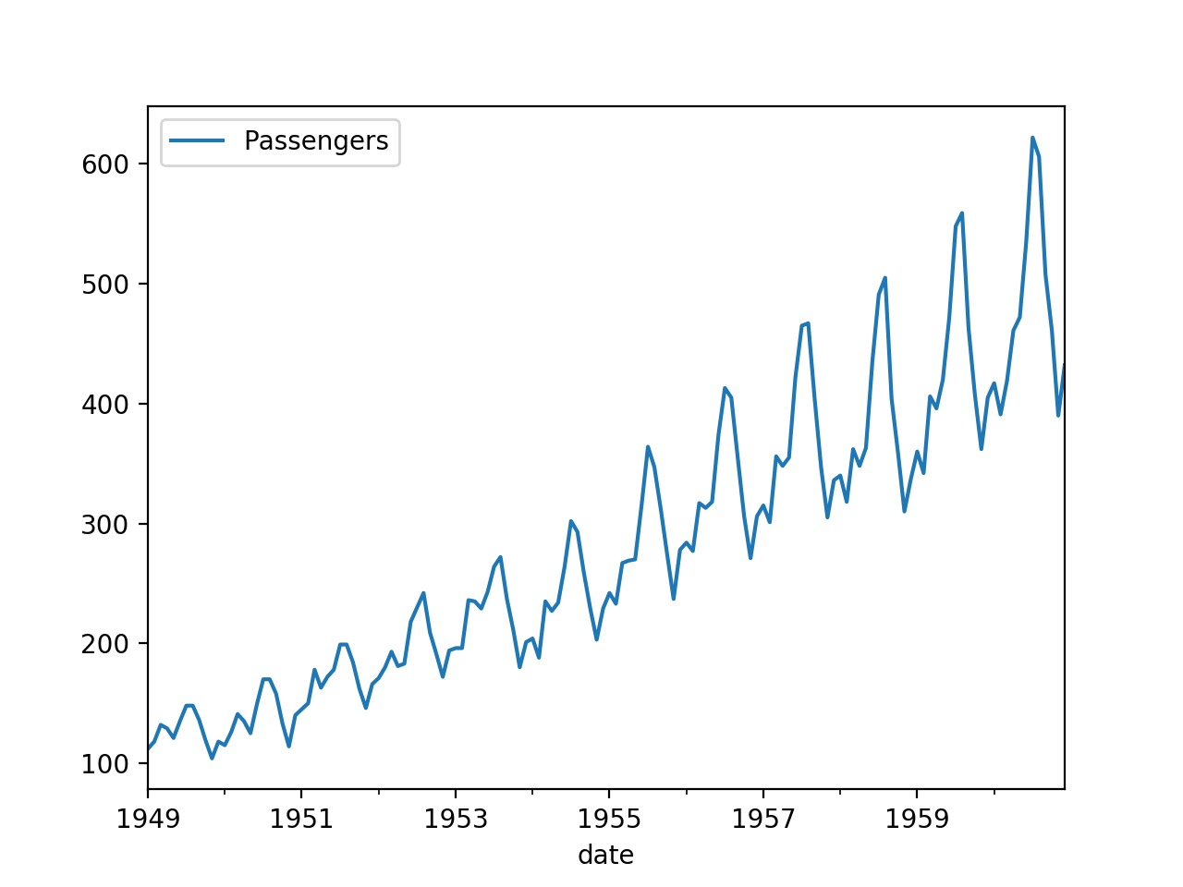
Loading Time Series

Slide 81
Loading Time Series
The date information can also be split over several columns
YEAR,LOCATION,STATE ANSI,ASD CODE,COUNTY ANSI,REFERENCE PERIOD,COMMODITY,"DRY, NONFAT, HUMAN in LB","SKIM, UNSWEETENED, CONDENSED in LB"
2016,CENTRAL, , , ,JAN,MILK,"25,815,000",
2016,CENTRAL, , , ,FEB,MILK,"23,976,000",
2016,CENTRAL, , , ,MAR,MILK,"30,956,000",
2016,CENTRAL, , , ,APR,MILK,"30,393,000",
2016,CENTRAL, , , ,MAY,MILK,"37,183,000",
2016,CENTRAL, , , ,JUN,MILK,"29,760,000",
2016,CENTRAL, , , ,JUL,MILK,"26,698,000",

Slide 82
Loading Time Series
def get_data_2():
df = pd.read_csv('MILK.csv',
parse_dates= {'date' : ["YEAR", "REFERENCE PERIOD"]})
df.set_index('date', inplace=True)
return df

Slide 83
Loading Time Series
df = get_data_2()
df['DRY, NONFAT, HUMAN in LB'] = df['DRY, NONFAT, HUMAN in LB'].str.replace(',','').astype(float)
df['DRY, NONFAT, HUMAN in LB'].plot()

Slide 84
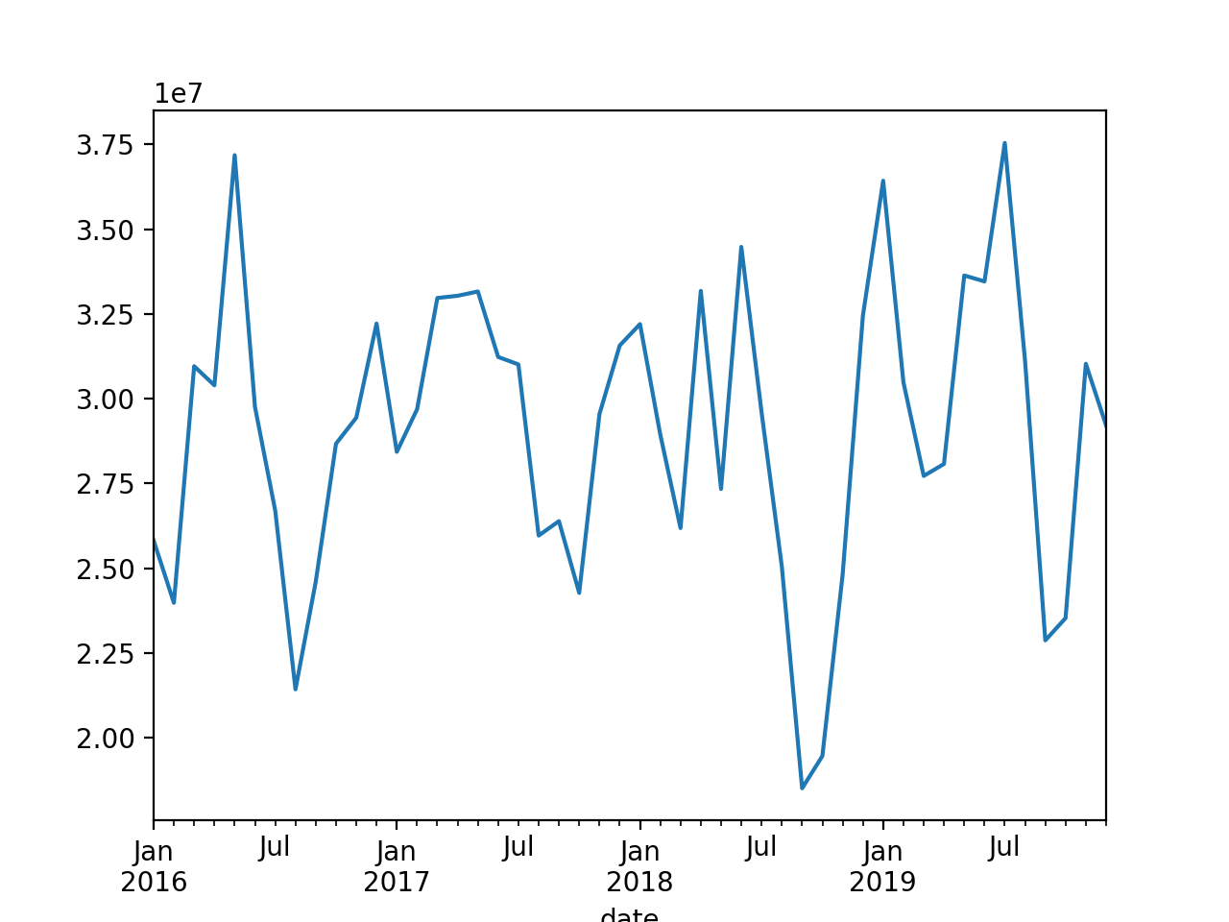
Loading Time Series

