Slide 1
Visualization 3
Thomas Schwarz, SJ

Slide 2
Review
Create figures in matplotlib.pyplot imported as plt
Use pandas, i.e. df.column.plot( )
Limited functionality, but easiest to use
Use plt.plot
Matplotlib style
Use the OO interface
fig, ax = plt.subplots(8,8, figsize=(6,6) )

Slide 3
Review
Scripts:
Need to call plt.show( ) but only once
IPython
Use the %matplotlib magic command
plt commands now run in place to update a plot
Might need to force updates with plt.draw( )
IPython notebook
%matplotlib notebook
Interactive plots embedded in notebook
% matplotlib inline
Static images embedded in notebook

Slide 4
Review
plot for line plots: give x- and y-values
scatter plot with setting marker as third argument
color codes and line codes
color, linestyle, or abbreviation
control with
plt | ax
plt.xlabel( ) | ax.set_xlabel( )
plt.xlim( ) | ax.set_xlim( )
plt.title( ) | ax.set_title( )

Slide 5
Error Bars
errorbar: Add a third numpy array to create error bars
Can use ecolor, elinewidth, …
fill_between: Give two different functions

Slide 6
Error Bars
Example:
Generate some fake experimental data for $0≤i<30$
Normally distributed with mean $\sqrt{2⋅i+3}$
Std. Dev. of $0.5+2⋅i$
Then calculate sample mean and sample standard deviation

Slide 7
Error Bars
def create_numbers():
lista = [np.random.normal(
loc = np.sqrt(2*i)+3,
scale= 0.5+.2*i,
size = 50)
for i in range(30)]
means = np.mean(lista, axis=1)
conf = np.std(lista, axis=1)/np.sqrt(29)
return means, conf

Slide 8
Error Bars
Display results
a, b = create_numbers()
x = np.linspace(0,29,30)
fig, ax = plt.subplots(1, figsize = (5,4) )
ax.errorbar(x, a, yerr= b,
color='black', fmt='.k',
ecolor = 'green')

Slide 9
Error Bars
About 2/3 of all values should be within the true value
Display the sample mean and the true population mean
Draw upper and lower limits at $σ$ and $2σ$ in green

Slide 10
Error Bars
ax.plot(x, np.sqrt(2*x)+3, 'r-')
ax.fill_between(x,
np.sqrt(2*x)+3+(0.5+.2*x)/np.sqrt(30),
np.sqrt(2*x)+3-(0.5+.2*x)/np.sqrt(30),
color = 'green',
alpha= 0.2)
ax.fill_between(x,
np.sqrt(2*x)+3+2*(0.5+.2*x)/np.sqrt(30),
np.sqrt(2*x)+3-2*(0.5+.2*x)/np.sqrt(30),
color = 'green',
alpha= 0.1)
plt.show()

Slide 11
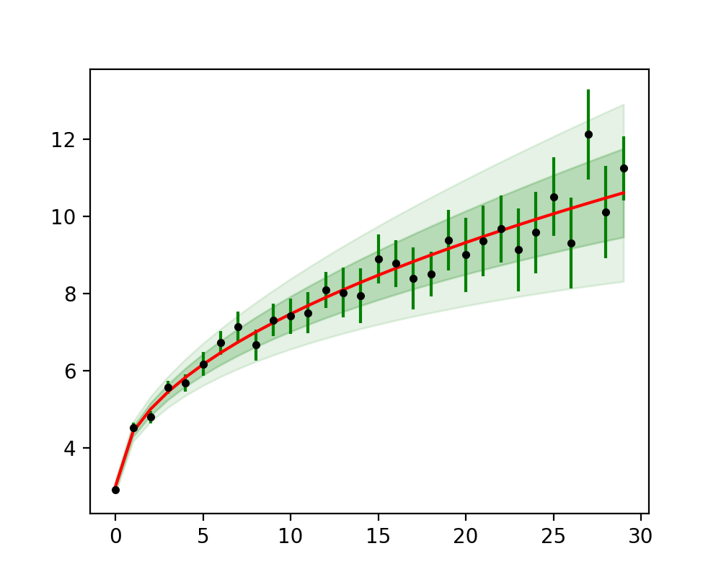
Error Bars

Slide 12
Multiple Subplots
Can use fig.add_axes( ) to manually create subplots.
Create a figure
Add axes:
First argument is a list with x-offset, y-offset, x-height, y-height out of 0 … 1
Remember to leave space for ticks
fig = plt.figure()
ax1 = fig.add_axes([0.1,0.1,0.88,0.88],
…

Slide 13
Multiple Subplots
We can then add limits, ticks and labels
This is an axes with origin at 0.1, 0.1 going to 0.98, 0.98
ax1 = fig.add_axes([0.1,0.1,0.88,0.88],
xlim = (0, np.pi),
ylim = (-1.1, 1.1),
xticks=[0, np.pi/2, np.pi],
xticklabels=['0', 'pi/2', 'pi'])

Slide 14
Multiple Subplots
Can add another axes in the right upper corner
ax2 = fig.add_axes([0.7, 0.7, 0.25, 0.2],
xlim = (0, np.pi),
ylim = (-1.1, 1.1),
xticks=[0, np.pi/2, np.pi],
xticklabels=['0', 'pi/2', 'pi'])

Slide 15
Multiple Subplots
Finally, plot random (trig) functions
x = np.linspace(0, np.pi, 30)
ax1.plot(x, np.sin(x))
ax2.plot(x, np.cos(x))
plt.show()

Slide 16
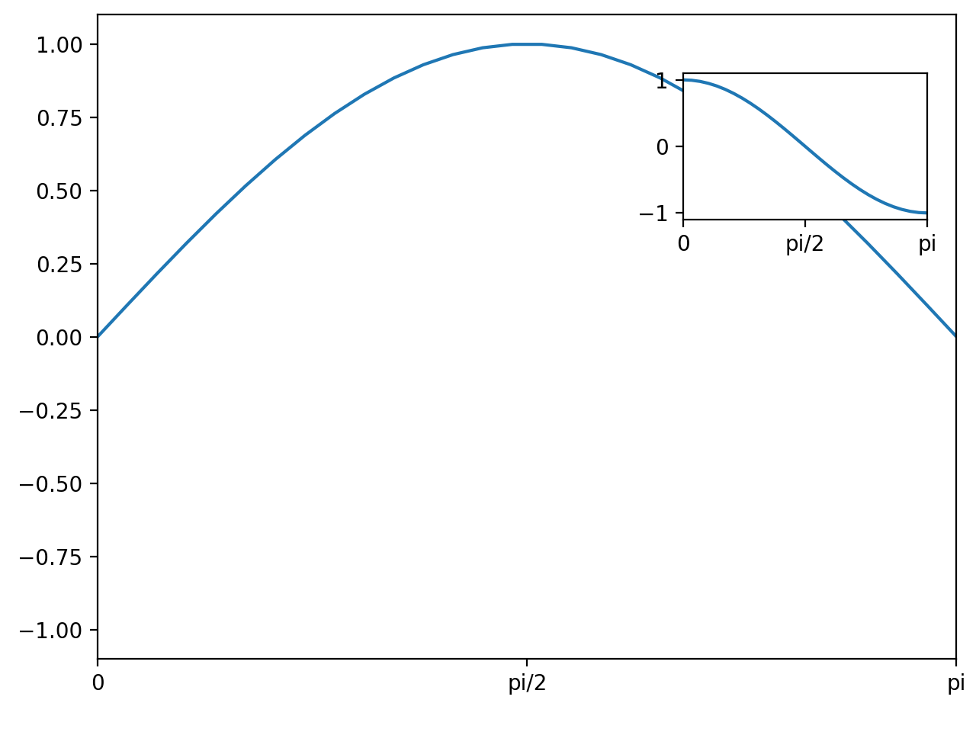
Multiple Subplots

Slide 17
Multiple Subplots
Can create figure with a subplot
Adjust layout
hspace - space between rows of subplots (height)
wspace - space between columns of subplots (width)
fig = plt.figure()
fig.subplots_adjust(hspace=0.4,
wspace = 0.6)

Slide 18
Multiple Subplots
Create 6 axes in two rows and three columns
Write an interior text
The position is relative to the grid in the subplot
Then plot x**i
for i in range(1, 7):
ax = fig.add_subplot(2,3,i, ylim = (-1,1))
ax.text(0, 0.5, str(i),
fontsize = 15,
ha='center')
x = np.linspace(-1,1,21)
ax.plot(x, np.power(x,i))

Slide 19
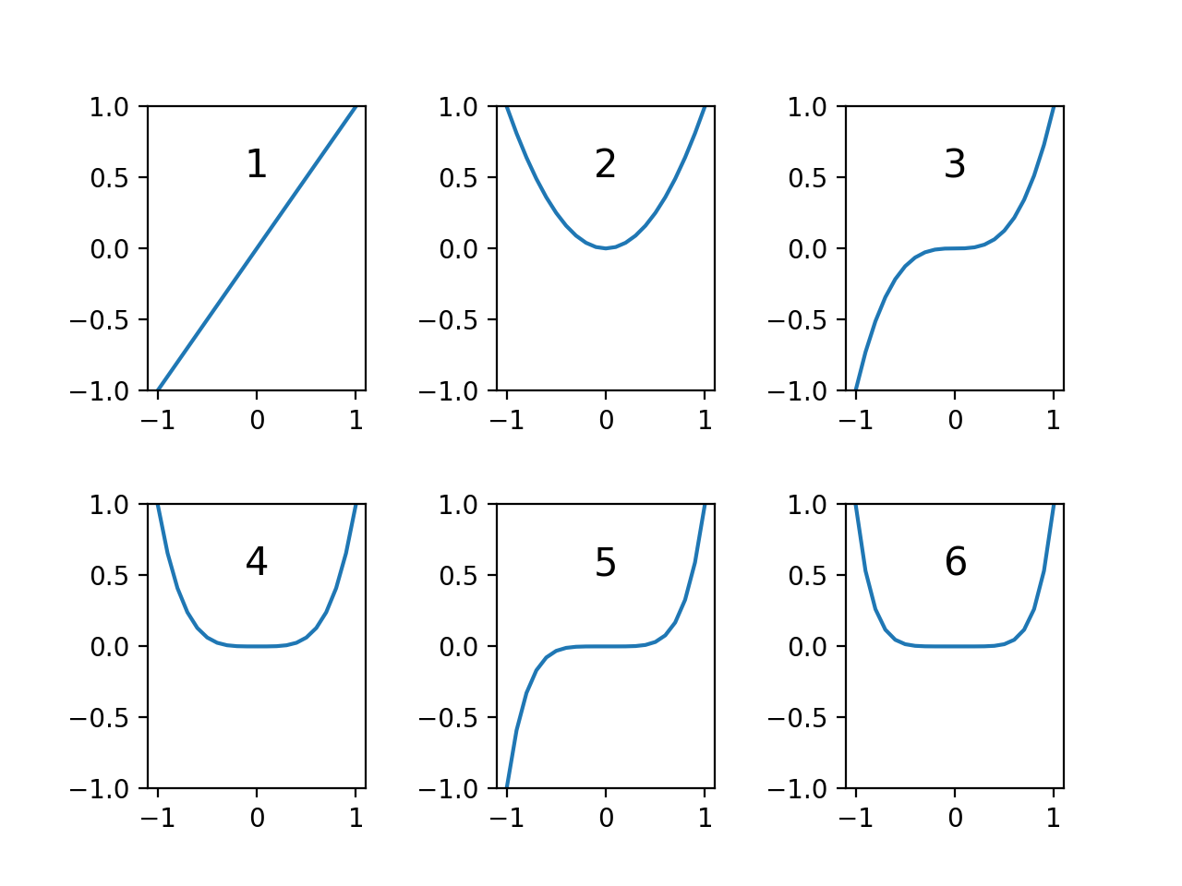
Multiple Subplots

Slide 20
Multiple Subplots
Can use subplots (with a plural-s) to create a number of plots
Can make share coordinate layout
fig, axes = plt.subplots(3,4,
sharex='col',
sharey='row')

Slide 21
Multiple Subplots
The axes is a 3 by 4 matrix
Notice the way we are accessing them by a single bracket
for i in range(3):
for j in range(4):
degree = 4*i+j+2
axes[i,j].text(0, 0.5, str(degree), ha='center')
axes[i,j].plot(x, np.power(x,degree))

Slide 22
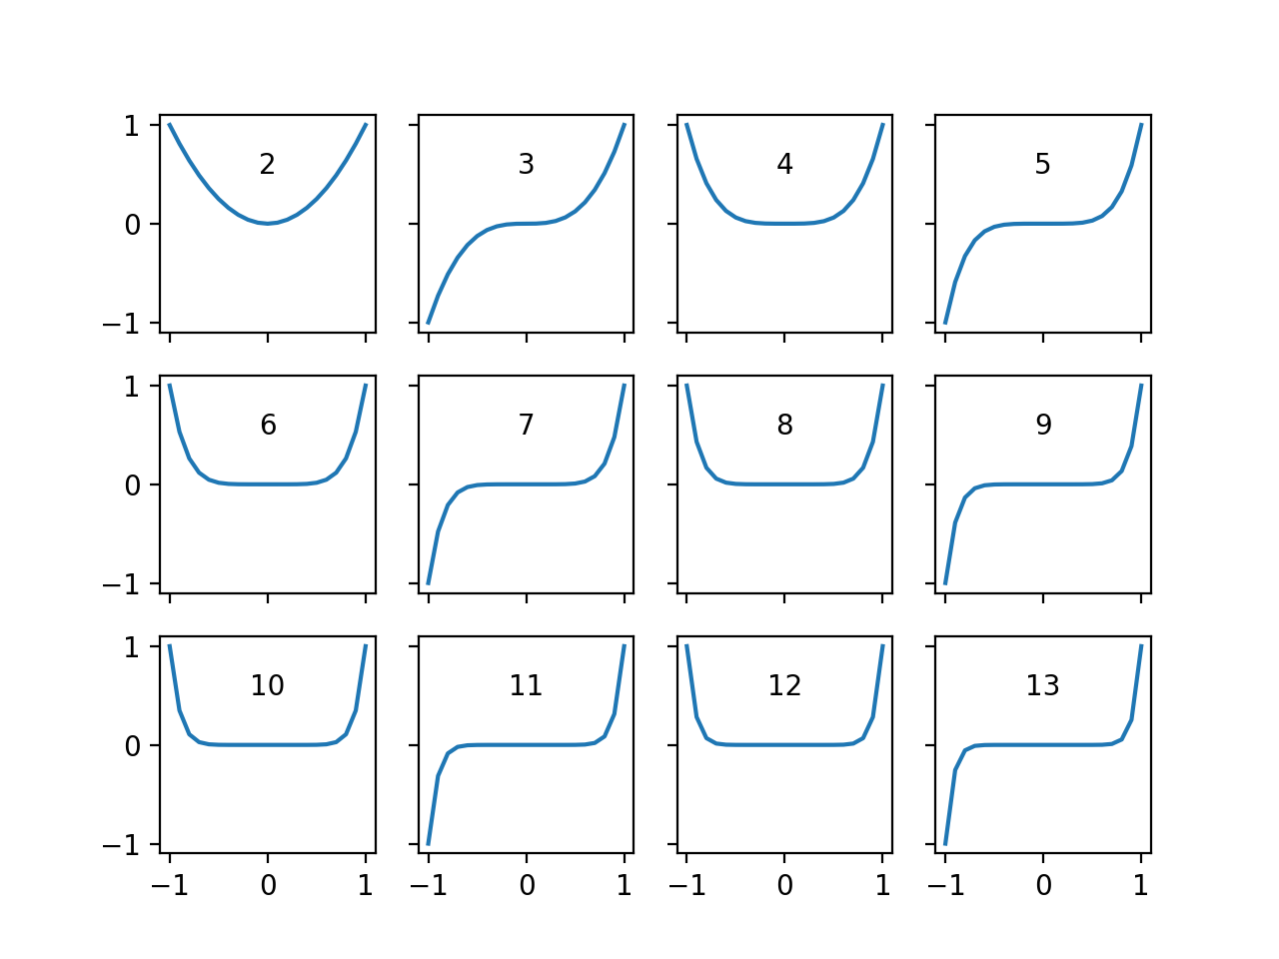
Multiple Subplots

Slide 23
Multiple Subplots
For more complicates arrangements, look at plt.GridSpec

Slide 24
Controlling Ticks
Figure: bounding box, contains
Axes objects, which contain
A variety of other objects representing plot contents
Such as xaxis, yaxis
contains properties of lines, ticks, and labels
Has major and minor locator object
Has major and minor formatter object

Slide 25
Controlling Ticks
No ticks at all:
ax = plt.axes(yscale='log')
ax.xaxis.set_major_locator(plt.NullLocator())

Slide 26
Controlling Ticks
Example: Handwriting recognition set
In sklear.datasets
Create a figure and pack it densely
from sklearn.datasets import load_digits
fig = plt.figure(figsize=(6,6)) #in inches
fig.subplots_adjust(left=0, right=1, bottom=0,
top=1, hspace=0.05,
wspace = 0.05)

Slide 27
Controlling Ticks
Create 64 axes
No ticks
Show images
Show target text
for i in range(64):
ax = fig.add_subplot(8,8, i+1)
ax.xaxis.set_major_locator(plt.NullLocator())
ax.yaxis.set_major_locator(plt.NullLocator())
ax.imshow(digits.images[i],
cmap=plt.cm.binary,
interpolation='nearest')
ax.text(0,7, str(digits.target[i]))

Slide 28
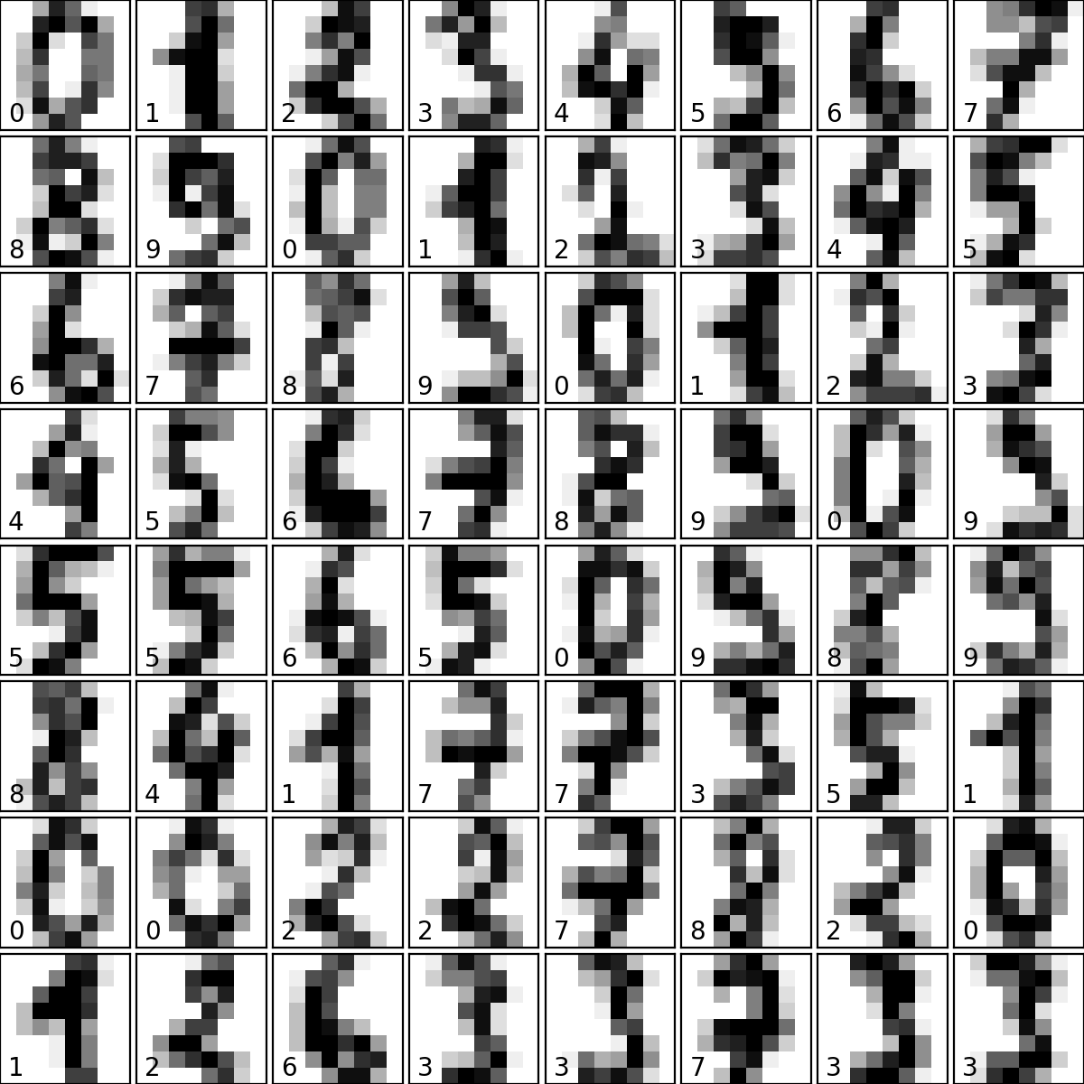
Controlling Ticks

Slide 29
Controlling Ticks
Without suppressing ticks

Slide 30
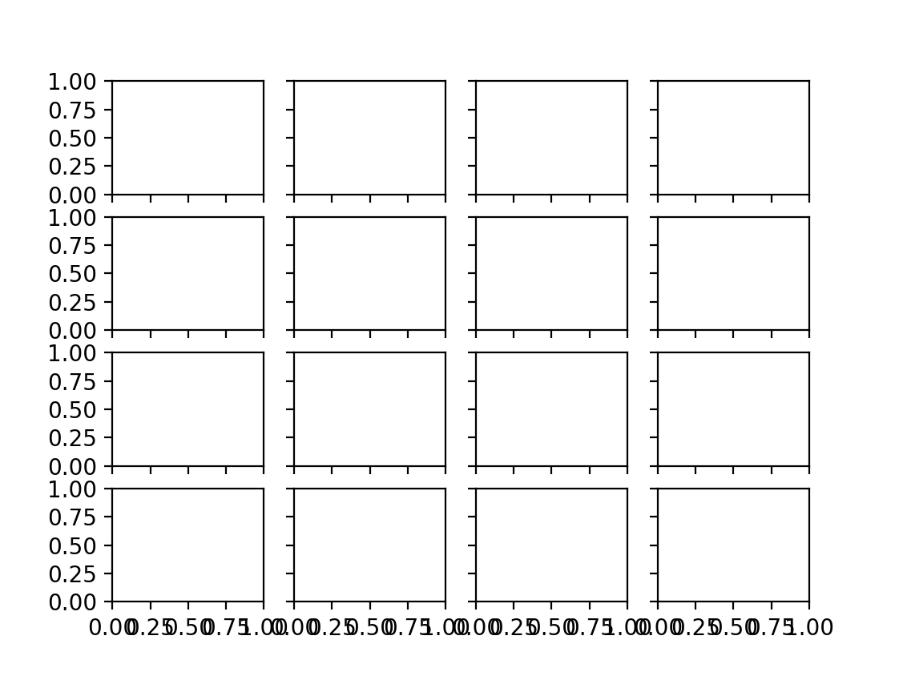
Controlling Ticks
Sometimes, ticks can be too close together

Slide 31
Controlling Ticks
Use the locator to determine the number of ticks
fig, axes = plt.subplots(4,4, sharex=True, sharey=True)
for ax in axes.flat:
ax.xaxis.set_major_locator(plt.MaxNLocator(4))
ax.yaxis.set_major_locator(plt.MaxNLocator(4))

Slide 32
Controlling Ticks
Sometimes, need more control
x= np.linspace(-np.pi, np.pi, 51)
fig, axes = plt.subplots(2,2, sharex=True, sharey=True)
axes[0,0].plot(x, np.sin(x))
axes[0,1].plot(x, np.cos(x))
axes[1,0].plot(x, np.sinh(x))
axes[1,1].plot(x, np.cosh(x))
axes[0,0].text(0,2, 'sin', ha='center')
axes[0,1].text(0,2, 'cos', ha='center')
axes[1,0].text(0,2, 'sinh', ha='center')
axes[1,1].text(0,2, 'cosh', ha='center')

Slide 33
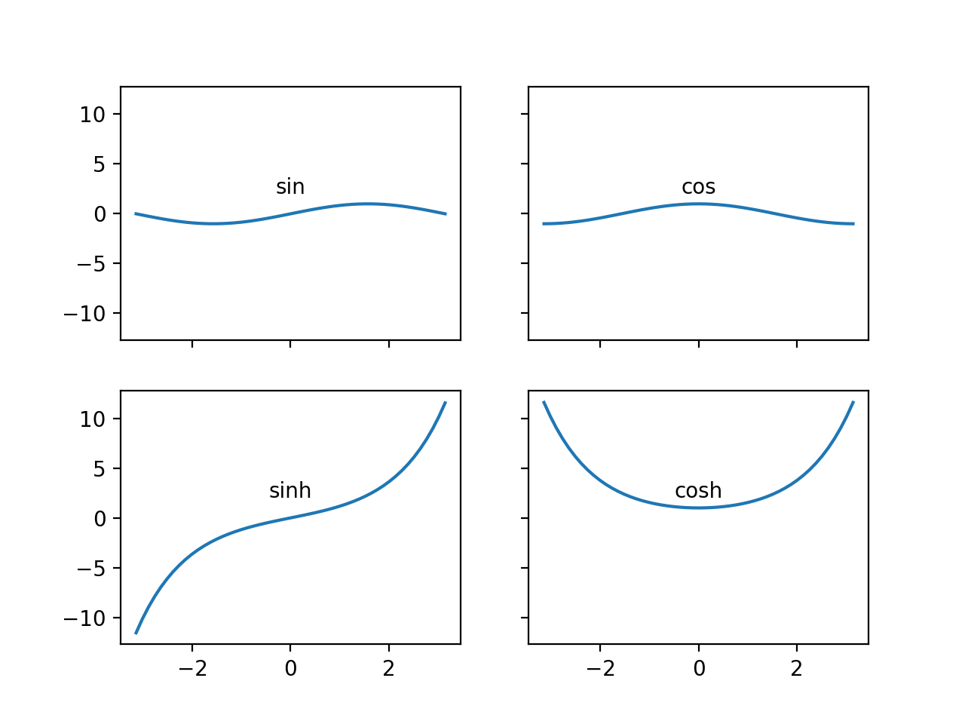
Controlling Ticks
More natural to have the x-axis use multiple of $π$

Slide 34
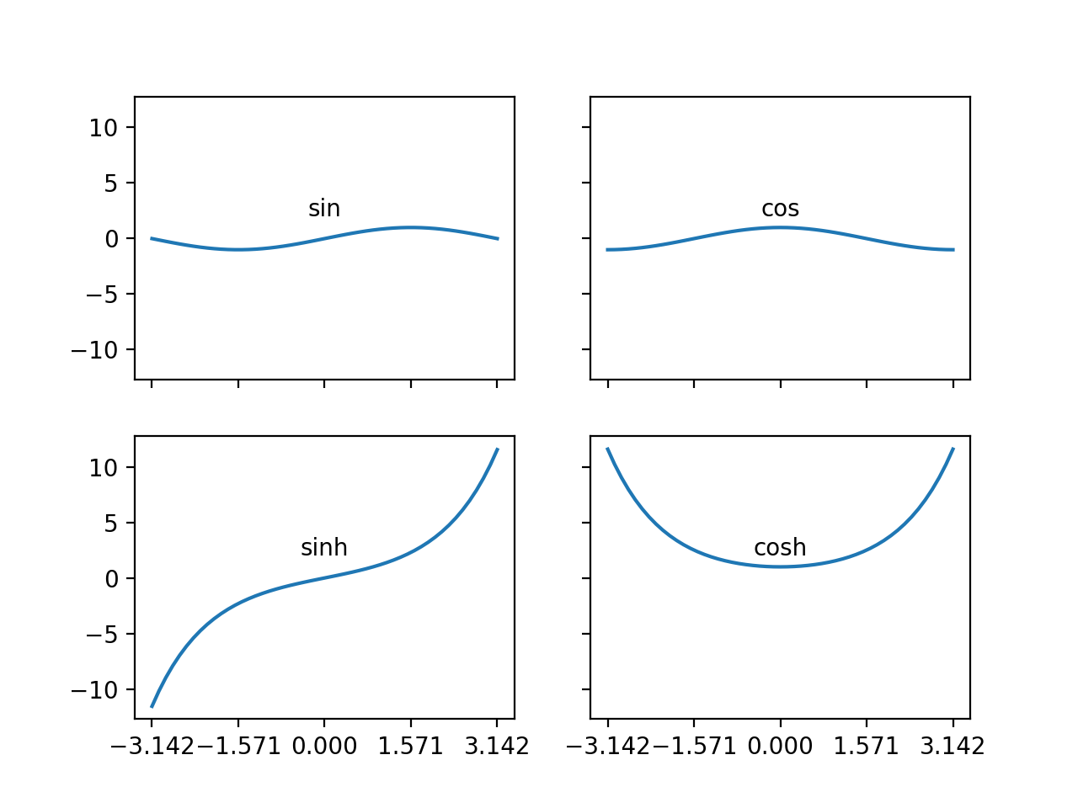
Controlling Ticks
Set the multiplelocator object
axes[0,0].xaxis.set_major_locator(
plt.MultipleLocator(np.pi/2))

Slide 35
Controlling Ticks
The ticks are fine, but need to write in terms of multiples of $π$
Create our own format function using TeX
def my_format_func(value, tick_number):
nn = int(np.round(2*value / np.pi))
if nn == 0:
return '0'
elif nn == 1:
return r'$\pi/2$'
elif nn%2:
return r'${0}\pi/2$'.format(nn)
else:
return r'${0}\pi$'.format(nn//2)

Slide 36
Controlling Ticks
Now it works:
x= np.linspace(-2*np.pi, 2*np.pi, 51)
fig, axes = plt.subplots(2,1, sharex=True, sharey=True)
axes[0].plot(x, np.sin(x))
axes[1].plot(x, np.cos(x))
axes[0].text(0,0.6, 'sin', ha='center')
axes[1].text(0,0.6, 'cos', ha='center')
axes[0].xaxis.set_major_locator(plt.MultipleLocator
(np.pi/2))
axes[0].xaxis.set_major_formatter(plt.FuncFormatter
(my_format_func))

Slide 37
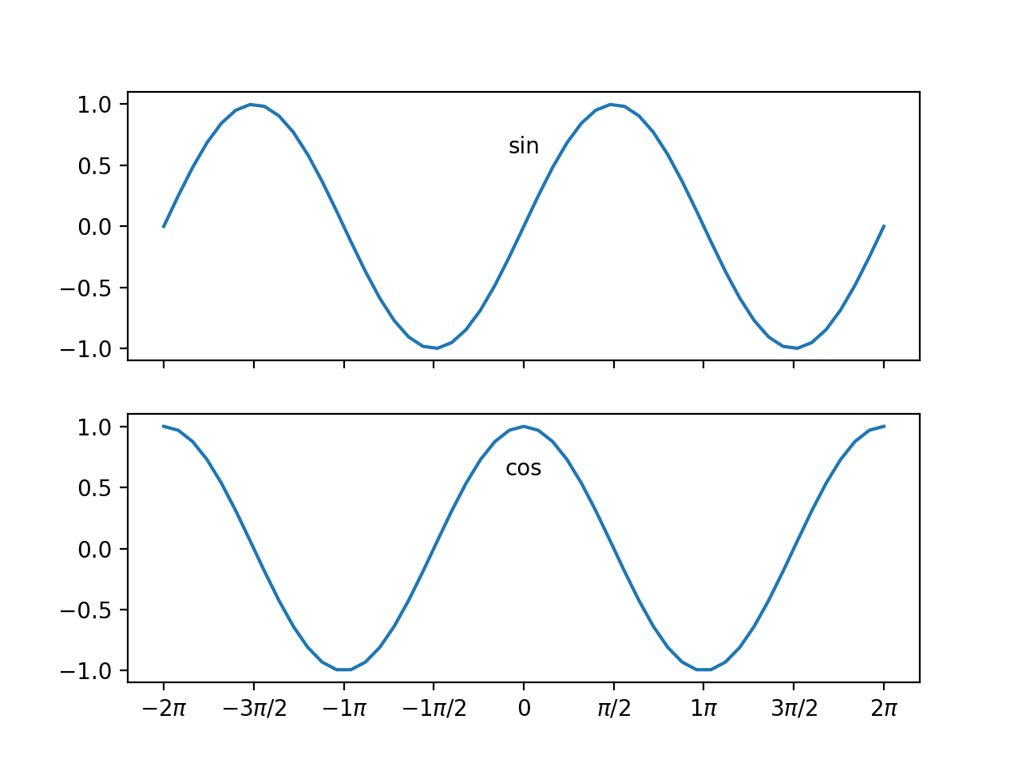

Slide 38
Seaborn
Matplotlib is based on an old version of matlab
Defaults are not all that pretty
Calculate random walk
x = np.linspace(0,20,51)
y = np.cumsum(np.random.normal(0, 5,51))
plt.plot(x,y)
plt.show()

Slide 39
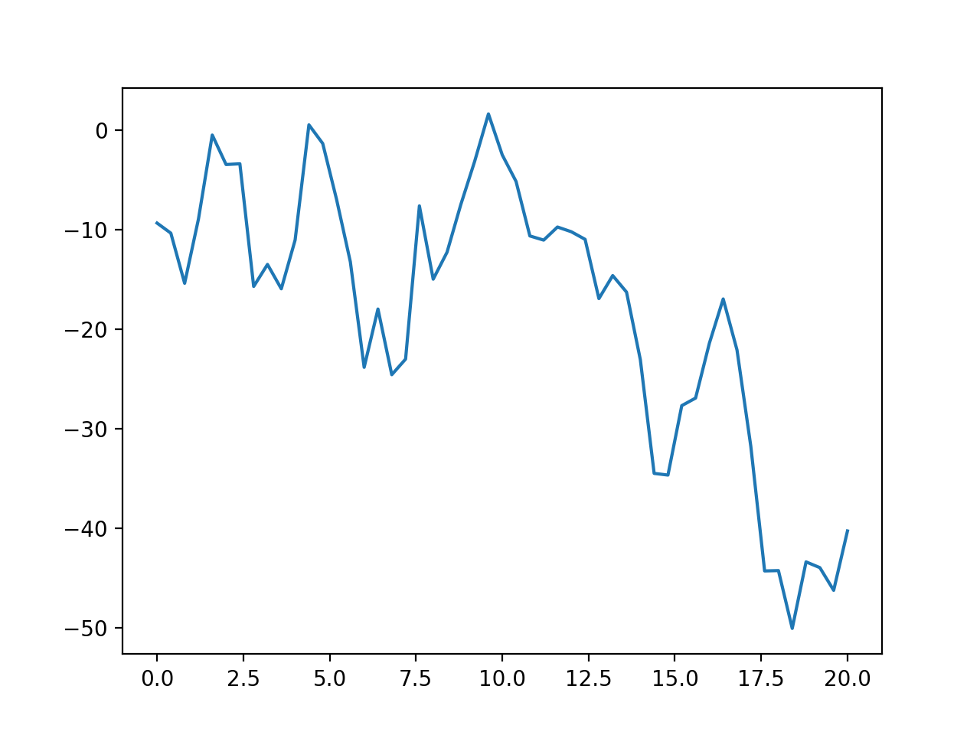
Seaborn
Without seaborn

Slide 40
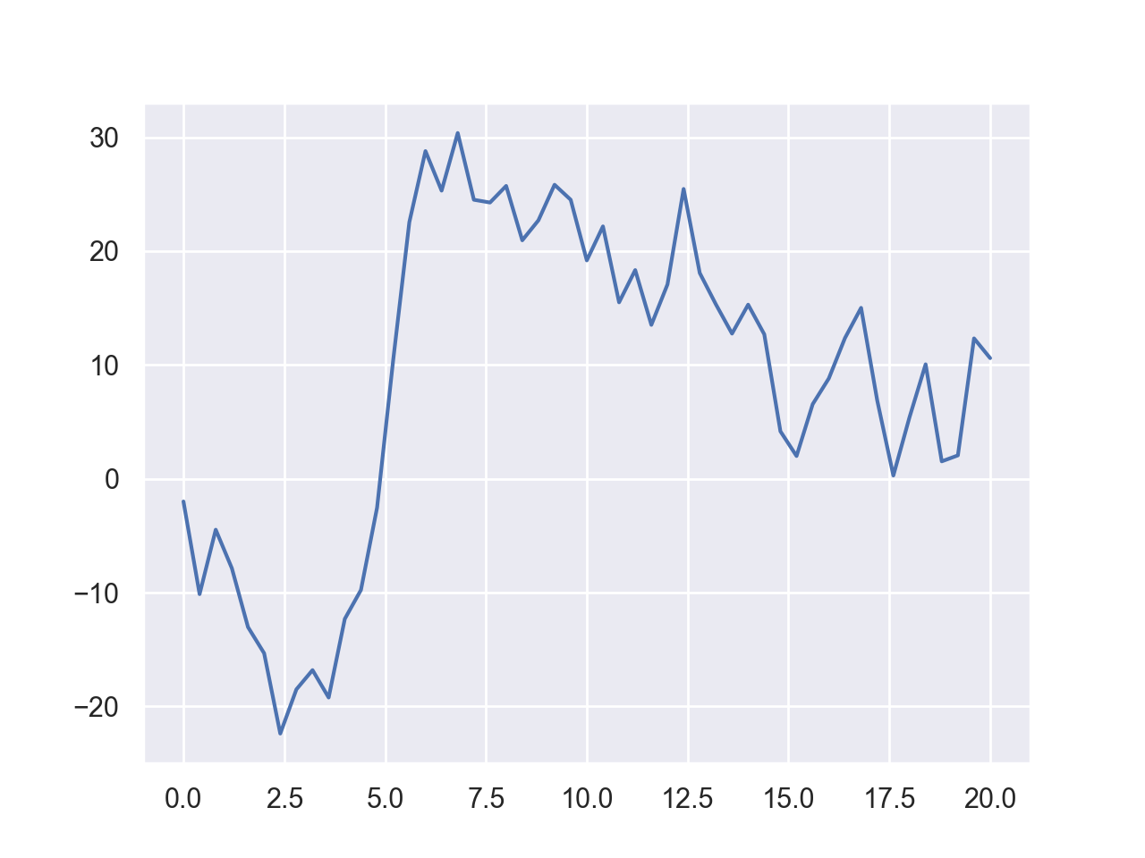
Seaborn
With Seaborn
import seaborn as sns
sns.set()

Slide 41
Seaborn
The difference extends to labeling
sns.set()
x = np.linspace(0,20,51)
label = 'ABCDEF'
for letter in label:
y = np.cumsum(np.random.normal(0, 5,51))
plt.plot(x,y, label=letter)
plt.legend()

Slide 42
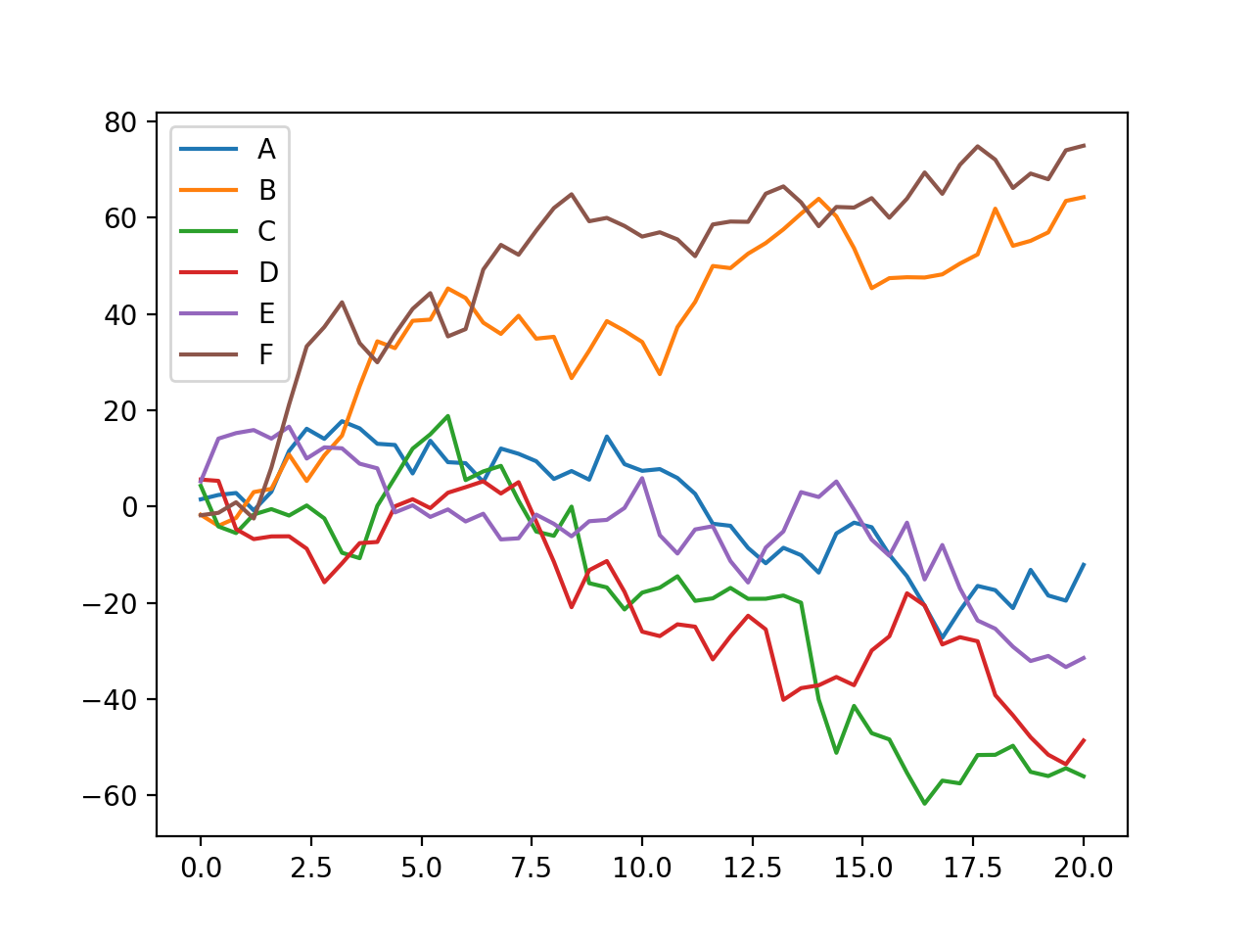
Seaborn
without Seaborn

Slide 43
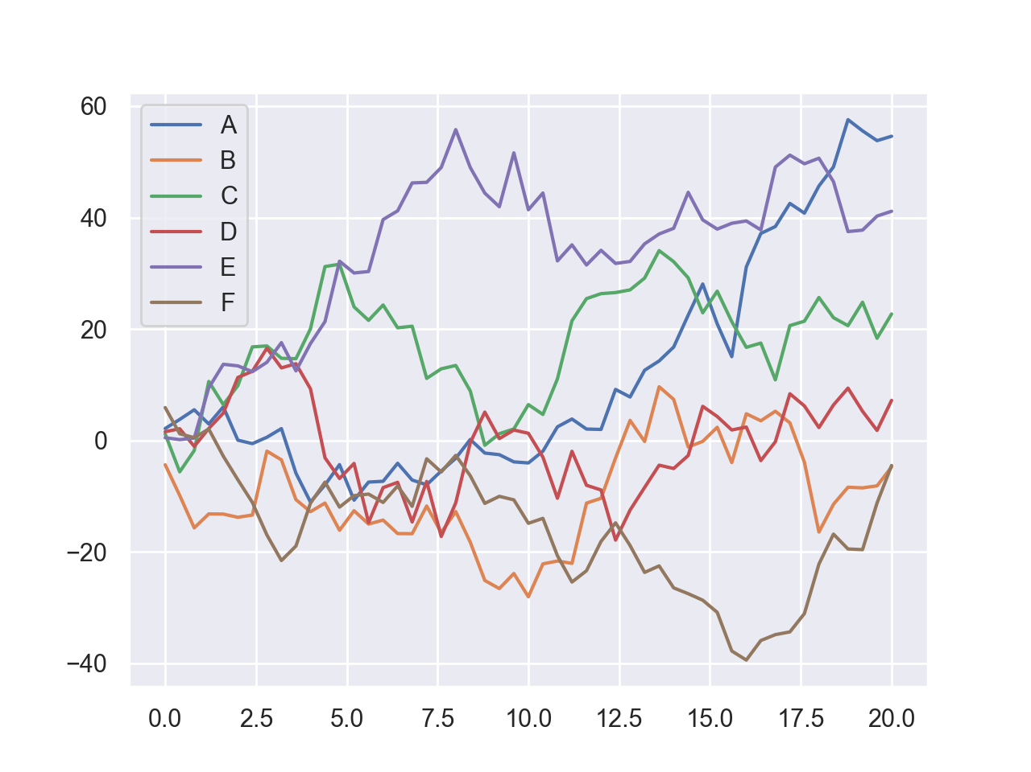
Seaborn
With Seaborn

Slide 44
Seaborn
Seaborn provides many statistical visualization tools
Example: Generate a multinomial distribution with covariance matrix $\left(\begin{matrix}5 & 2 \\ 2 & 2\end{matrix}\right)$ around the origin
data=np.random.multivariate_normal(
[0,0],
[[5,2],[2,2]],
size = 5000)

Slide 45
Seaborn
With plt, easy to generate histogram
df = pd.DataFrame(data, columns=['x', 'y'])
for col in ['x', 'y']:
plt.hist(df[col], normed=True, alpha = 0.5)

Slide 46
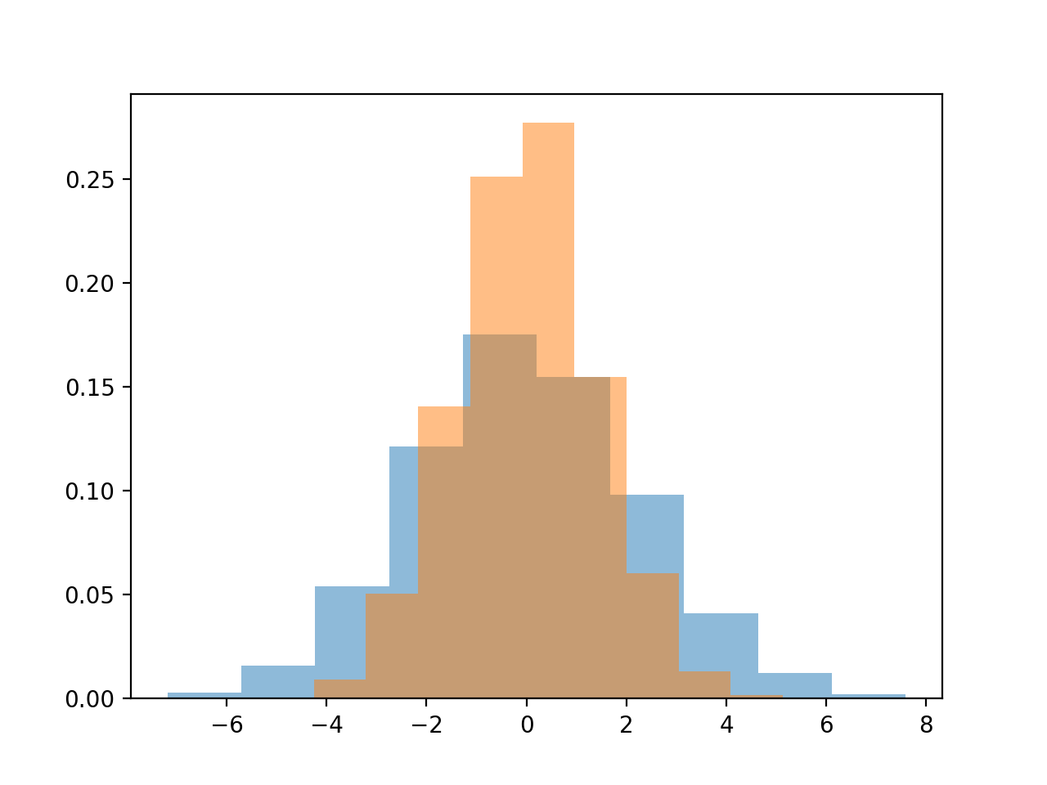
Seaborn

Slide 47
Seaborn
With Seaborn, we can use a "kernel density estimation"
for col in ['x', 'y']:
sns.kdeplot(df[col], shade=True)

Slide 48
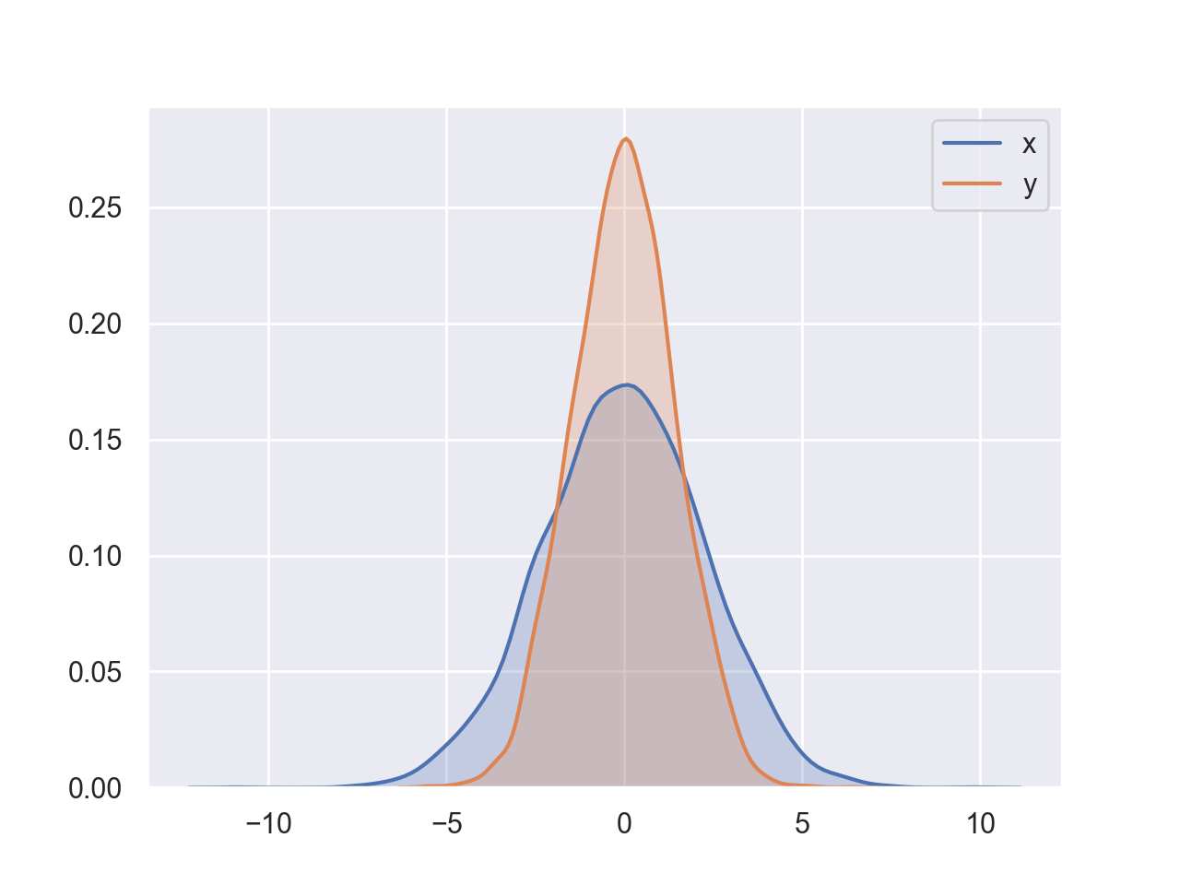
Seaborn

Slide 49
Seaborn
Can combine with distplot
for col in ['x', 'y']:
sns.distplot(df[col])

Slide 50
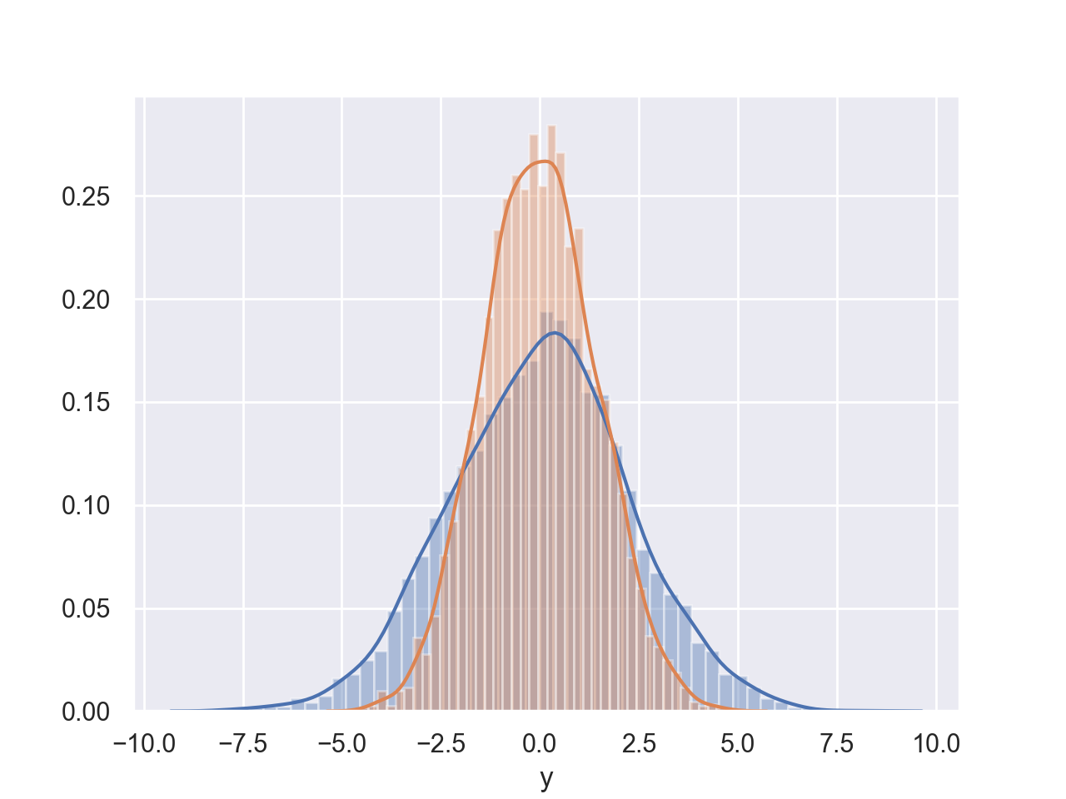
Seaborn

Slide 51
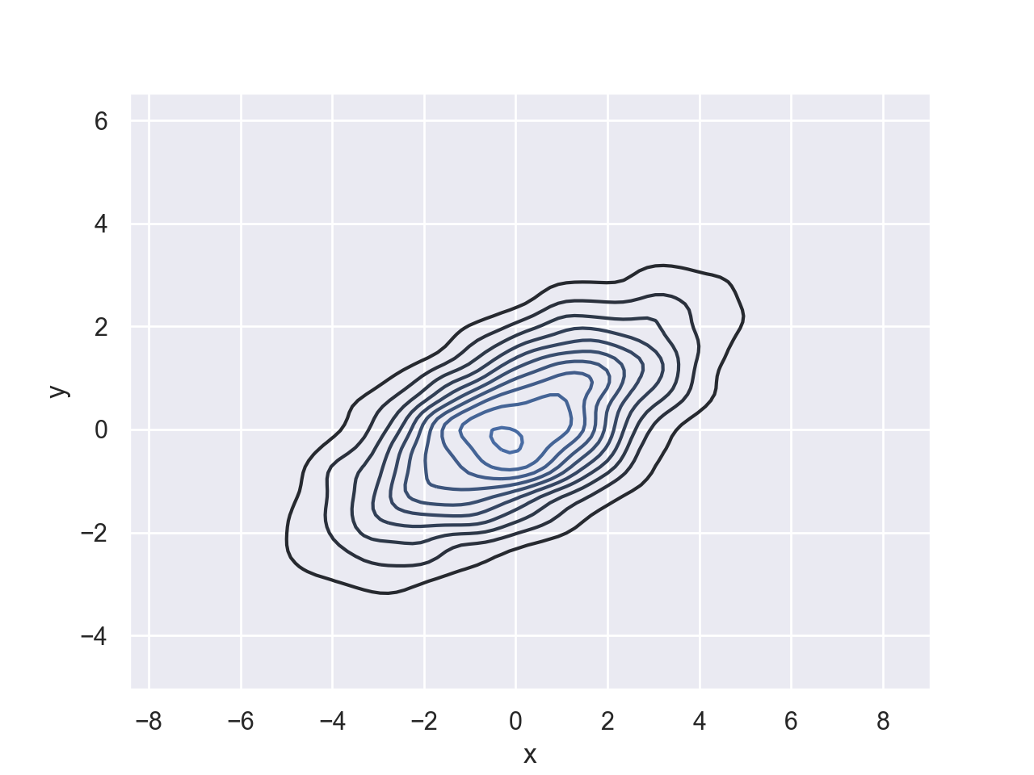
Seaborn
Can also use a two dimensional kernel density estimation plot
sns.kdeplot(df.x, df.y)

Slide 52
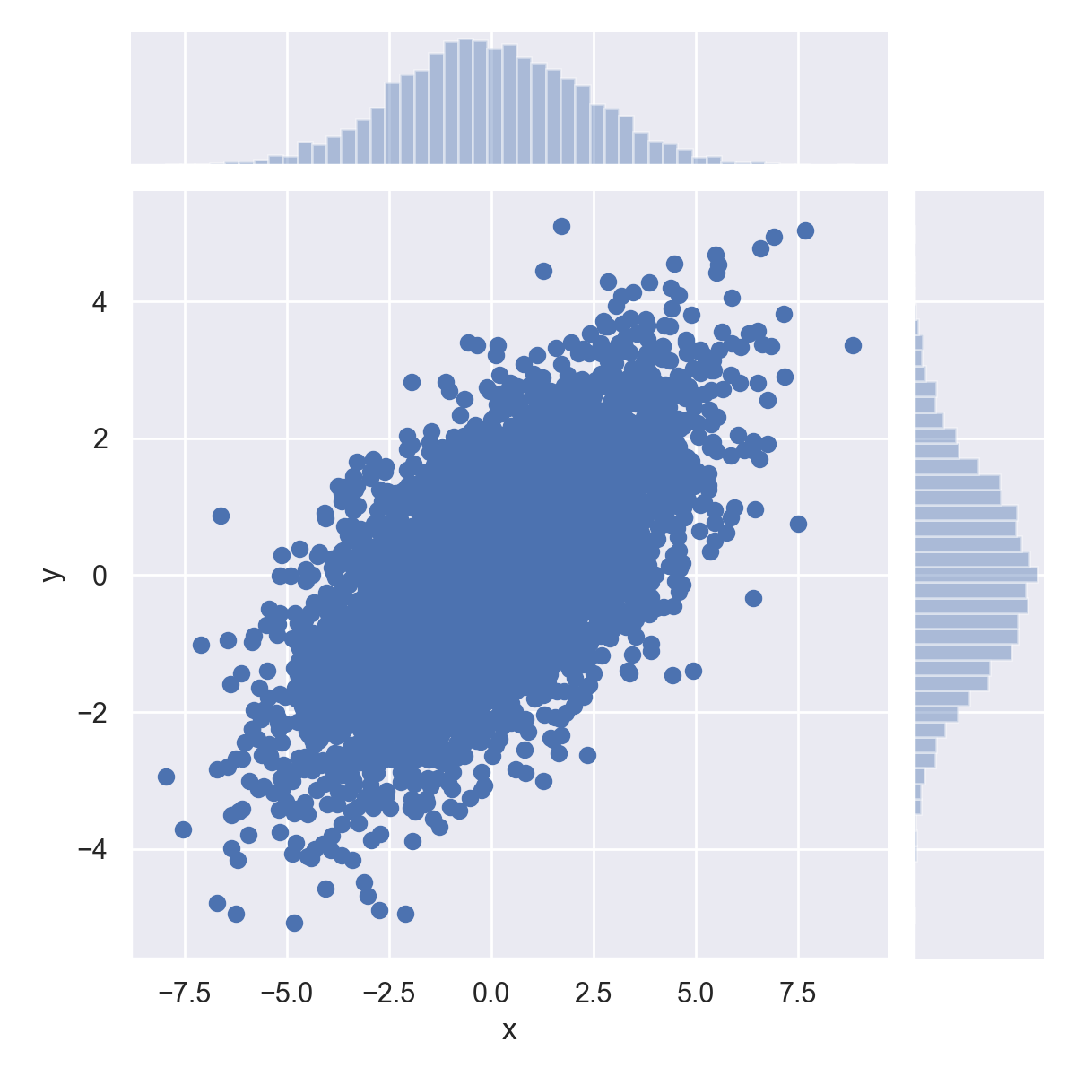
Seaborn
Or use sns.jointplot

Slide 53
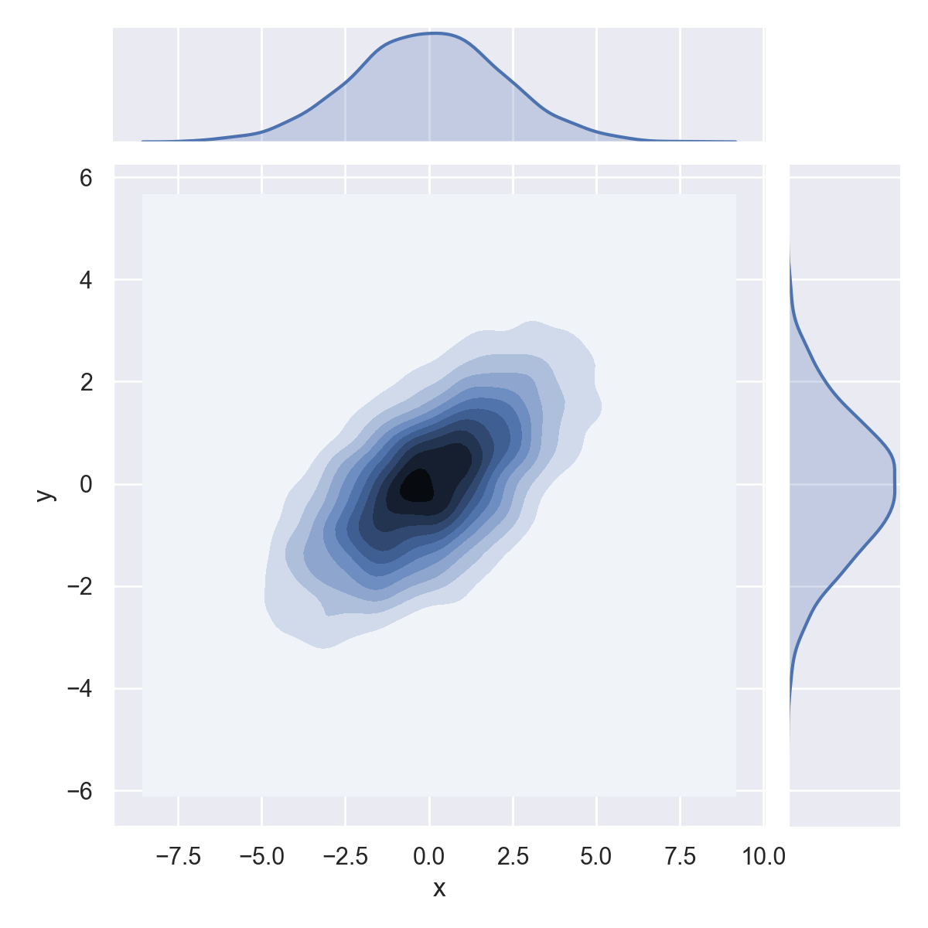
Seaborn
sns.jointplot(df.x, df.y, kind='kde')

Slide 54
Seaborn
Seaborn's jointplot even works for higher dimensions
When it is called pairplot
iris = sns.load_dataset('iris')
sns.pairplot(iris, hue='species',height=2.5)

Slide 55
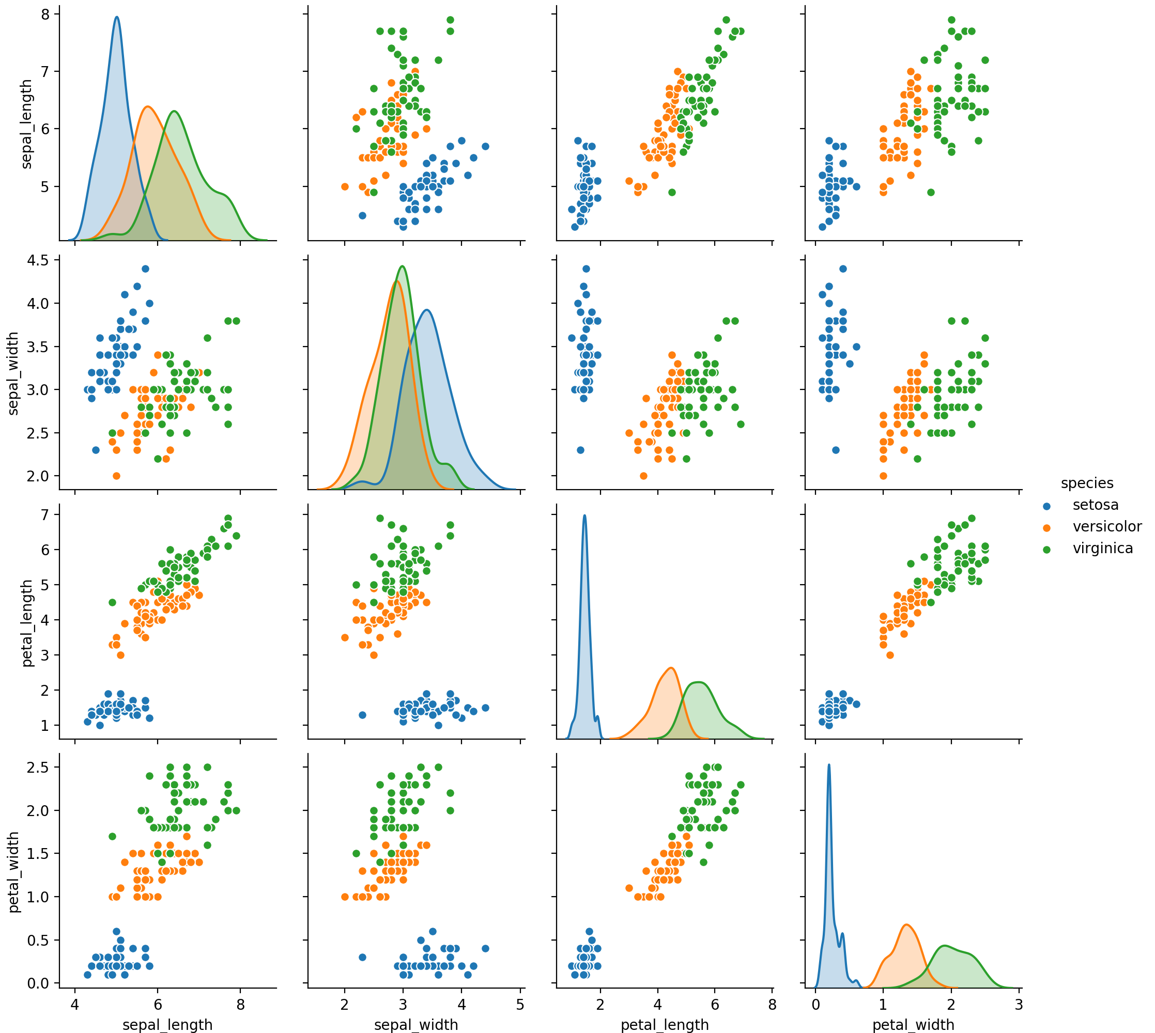

Slide 56
Seaborn
Seaborn allows us to show various factors
tips = sns.load_dataset('tips')
tips['tip_percent'] = 100*tips.tip/tips.total_bill
grid = sns.FacetGrid(tips,
row='sex',
col='time',
margin_titles=True)
grid.map(plt.hist, 'tip_percent', bins=np.linspace(0,40,15))

Slide 57
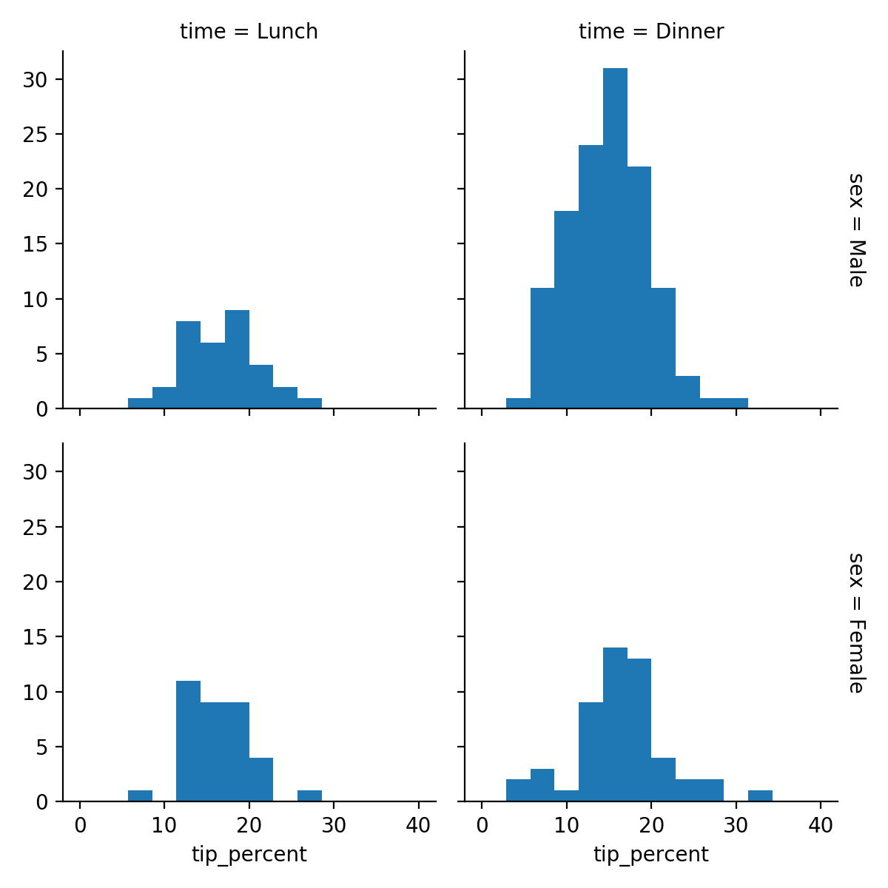
Seaborn

Slide 58
Seaborn
Can use category plot to show dependencies
tips['tip_percent'] = 100*tips.tip/tips.total_bill
g = sns.catplot('day', 'total_bill', 'sex', data=tips, kind='box')

Slide 59
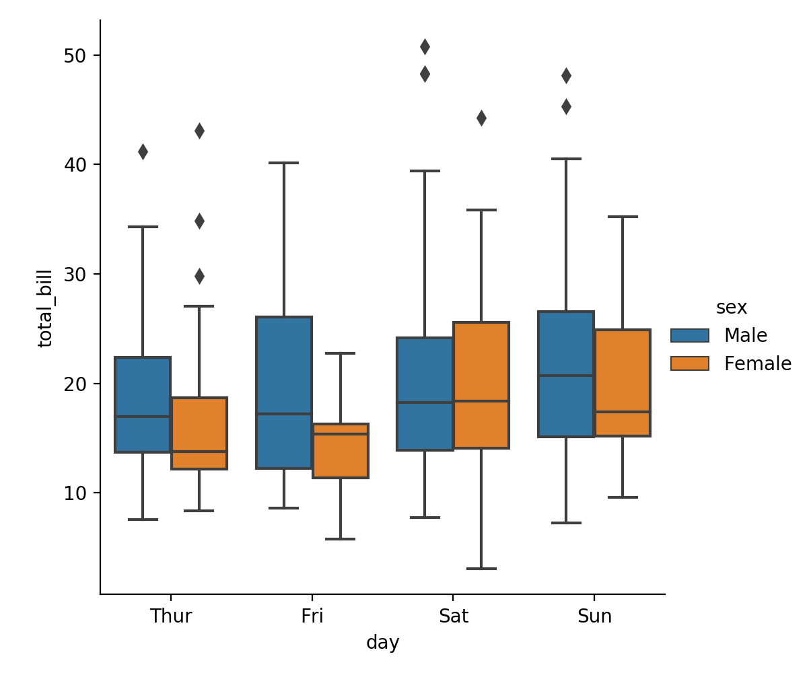
Seaborn

