Slide 1
Data Visualization with Pandas

Slide 2
Basics
Use matplotlib
Based on matlab
Allows
histograms
line plots
box-plots
scatter plots
hex-density plots

Slide 3
Basics
Import numpy as np
Import pandas as pd
Import matplotlib.pyplot as plt

Slide 4
Basic Example
Import an artificial time series
Show it:
>>> ts1 = pd.read_csv('../Data/ts1.csv')
>>> ts1.info()
<class 'pandas.core.frame.DataFrame'>
RangeIndex: 5000 entries, 0 to 4999
Data columns (total 2 columns):
time 5000 non-null int64
TS 5000 non-null float64
dtypes: float64(1), int64(1)
memory usage: 78.2 KB

Slide 5
Basic Example
Use head and tail
To make it more realistic, we need to make the index into one with actual dates
Drop the column 'time'
We want to change the data frame, so we need to set inplace to True
ts1.head()
ts1.tail()

Slide 6
Basic Example
>>> ts1.drop(columns=['time'], inplace=True)
>>> ts1.head()
TS
0 1027.096129
1 1041.701344
2 1046.905793
3 1038.360279
4 1033.118933
Create a new column with dates starting at January 1, 2001.
Use Bing to Google the name of the function:
>>> ts1['time'] = pd.date_range(start='1/1/2001', periods = 5000)

Slide 7
Basic Example
We still have an index, but now a new column
>>> ts1['time'] = pd.date_range(start='1/1/2001', periods=5000)
>>> ts1.head()
TS time
0 1027.096129 2001-01-01
1 1041.701344 2001-01-02
2 1046.905793 2001-01-03
3 1038.360279 2001-01-04
4 1033.118933 2001-01-05

Slide 8
Basic Example
Now we can re-index by setting the index
>>> ts1.set_index('time', inplace = True)
>>> ts1.info()
<class 'pandas.core.frame.DataFrame'>
DatetimeIndex: 5000 entries, 2001-01-01 to 2014-09-09
Data columns (total 1 columns):
TS 5000 non-null float64
dtypes: float64(1)
memory usage: 78.1 KB
>>> ts1.head()
TS
time
2001-01-01 1027.096129
2001-01-02 1041.701344

Slide 9
Basic Example
If we try to only access the TS data, we run into a problem
>>> ts1.TS
Traceback (most recent call last):
File "<pyshell#73>", line 1, in <module>
ts1.TS
File "/Library/Frameworks/Python.framework/Versions/3.8/lib/python3.8/site-packages/pandas/core/generic.py", line 5179, in __getattr__
return object.__getattribute__(self, name)
AttributeError: 'DataFrame' object has no attribute 'TS'

Slide 10
Basic Example
We can look at the columns of the data frame
And now we see the problem (cost me about an hour of my life)
The csv file has an additional white space after the comma
>>> ts1.columns
Index([' TS'], dtype='object')
>>> ts1.columns
Index([' TS'], dtype='object')

Slide 11
Basic Example
We better rename that column
>>> ts1.rename(columns={' TS': 'TS'}, inplace = True)
>>> ts1.TS
time
2001-01-01 1027.096129
2001-01-02 1041.701344
2001-01-03 1046.905793
2001-01-04 1038.360279
2001-01-05 1033.118933
...
2014-09-05 1019.451193
2014-09-06 1017.043391
2014-09-07 1046.658204
2014-09-08 1030.316278
2014-09-09 1044.078304
Name: TS, Length: 5000, dtype: float64
[5000 rows x 1 columns]

Slide 12
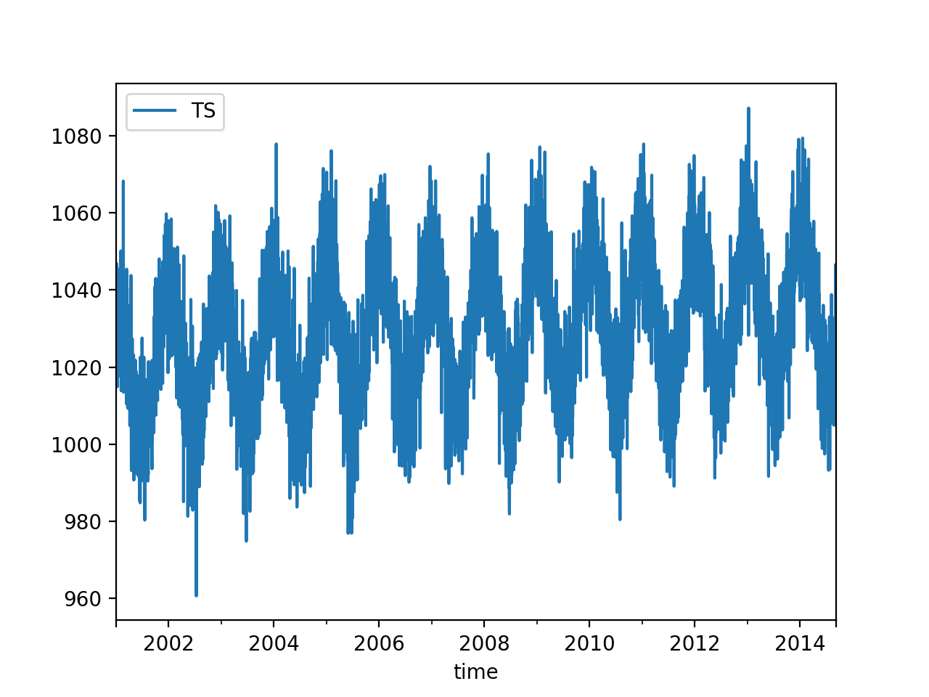
Basic Example
We can now use the plotting component of Pandas
ts1.plot()
plt.show()

Slide 13
Basic Example
We can also do a scatter graph
But this needs to be specialized because scatter graphs usually need two numeric values
plt.plot_date(ts1.index, ts1.TS)

Slide 14
Basic Example
Let's see whether we can make the line plot clearer
Use curve smoothing
Can use rolling, then mean, then plot
>>> ts1.rolling(10).mean().plot()
<matplotlib.axes._subplots.AxesSubplot object at 0x7fbb221e1be0>
>>> plt.show()

Slide 15
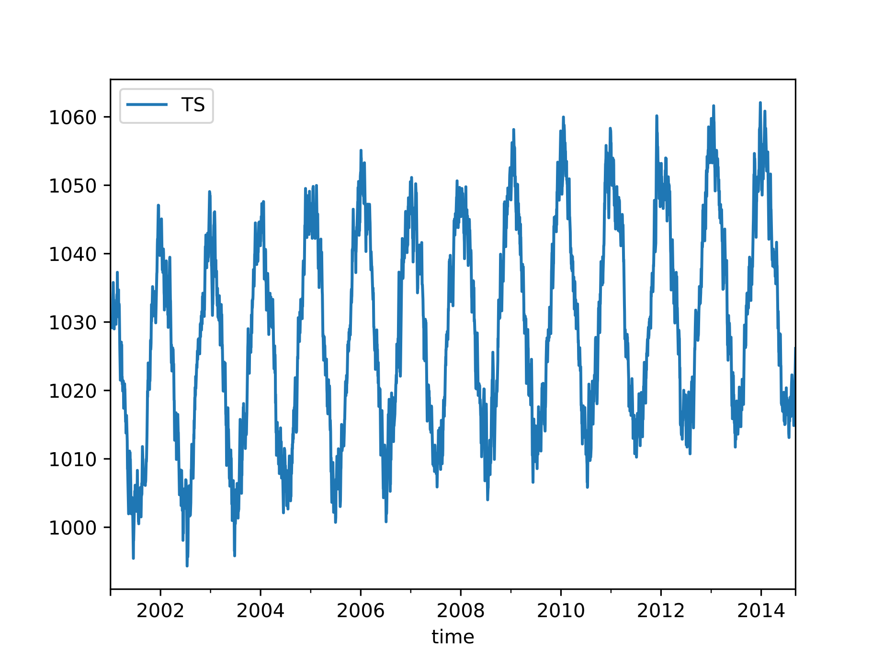
Basic Example
rolling window 10

Slide 16
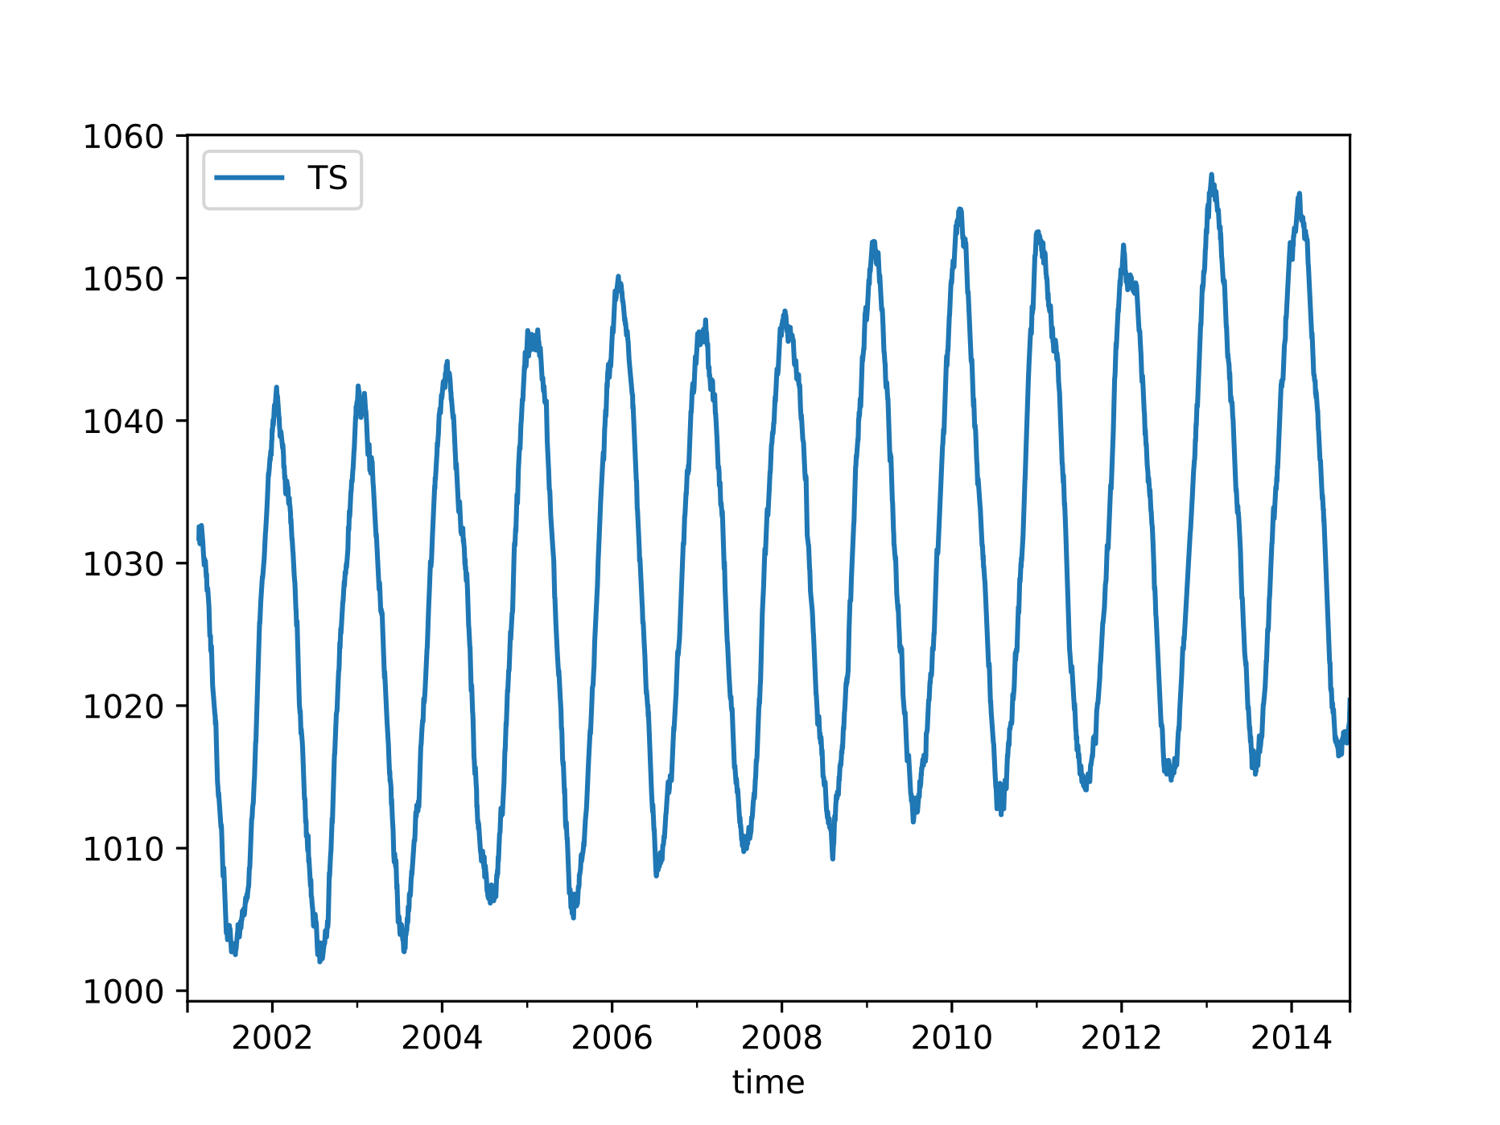
Basic Example
rolling window 50

Slide 17
Basic Example
While rolling takes all observations in the window at the same value, we can also use exponential weighted windows
ts1.ewm(span=10).mean().plot()

Slide 18
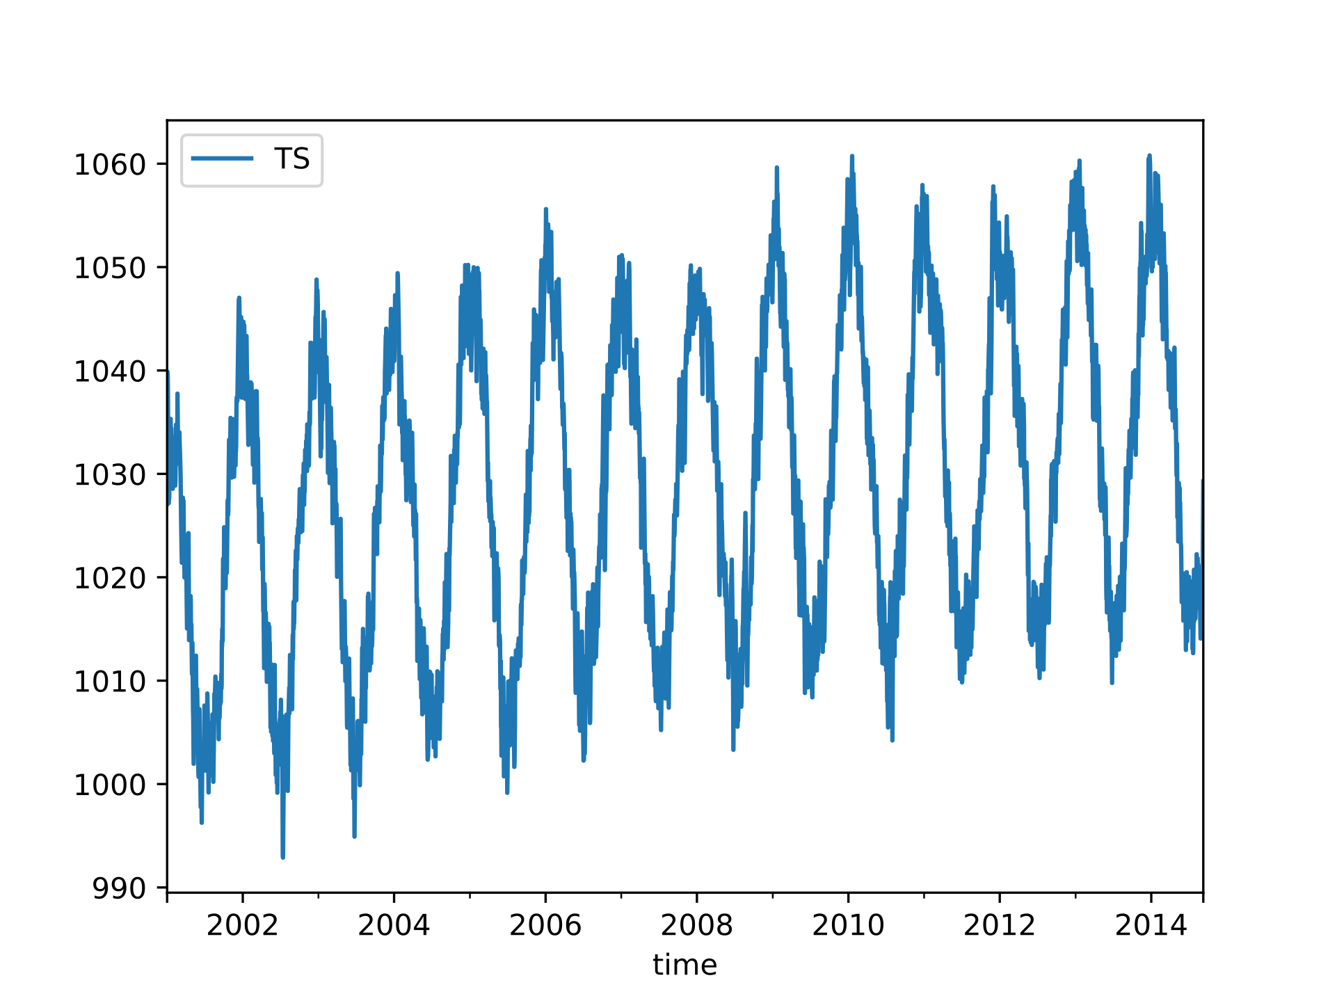
Basic Example
window size 10

Slide 19
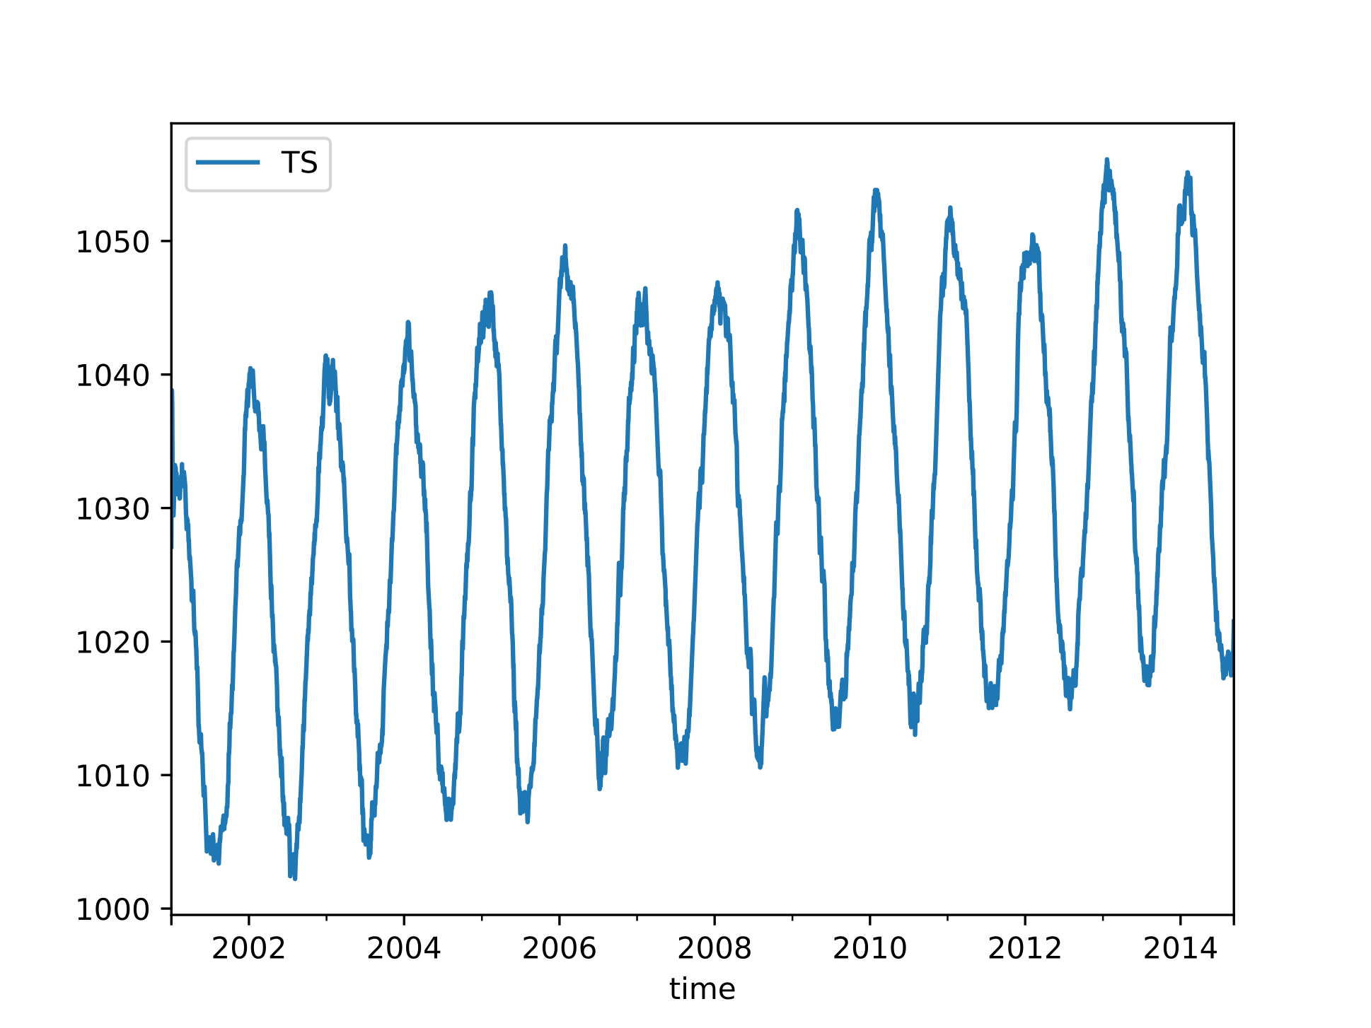
Basic Example
window size 50

Slide 20
Fundamentals
The basic plotting tool is still matplotlib
It can be wrapped by
Pandas
Seaborn (future lecture)
ggplot
Holoview

Slide 21
Fundamentals
Importing
Just as np from numpy and pd for pandas, we use traditional shortcuts
Usually only need the latter
import matplotlib as mpl
import matplotlib.pyplot as plt

Slide 22
Fundamentals
We can pick style
We can find styles with
plt.style.use('classic')
plt.style.available
['seaborn-dark', 'seaborn-darkgrid', 'seaborn-ticks', 'fivethirtyeight', 'seaborn-whitegrid', 'classic', '_classic_test', 'fast', 'seaborn-talk', 'seaborn-dark-palette', 'seaborn-bright', 'seaborn-pastel', 'grayscale', 'seaborn-notebook', 'ggplot', 'seaborn-colorblind', 'seaborn-muted', 'seaborn', 'Solarize_Light2', 'seaborn-paper', 'bmh', 'tableau-colorblind10', 'seaborn-white', 'dark_background', 'seaborn-poster', 'seaborn-deep']

Slide 23
Fundamentals
Plotting from a script
Use plt.show( )
Interacts with the system
Results are system dependent
plt.show( ) does a lot in the background
should only be run once in a script

Slide 24
Fundamentals
Plotting from a notebook
Use matplotlib inline
Creates a new cell to embed any png created with plt.plot()

Slide 25
Fundamentals
Saving figures to files
Use fig.savefig(address )
File format is inferred from file extension

Slide 26
Fundamentals
Two interfaces:
MATLAB style interface
Best for relatively simple plots
Keeps track of all figure elements
Object oriented interface
Create figures and "axes"
Use method calls

Slide 27
Fundamentals
Example:
MATLAB interface
x = np.linspace(-1,10)
plt.figure( ) #create figure
plt.subplot(1,2,1) #rows columns panel number
plt.plot(x, np.sin(x))
plt.subplot(1,2,2)
plt.plot(x, np.cos(x))

Slide 28
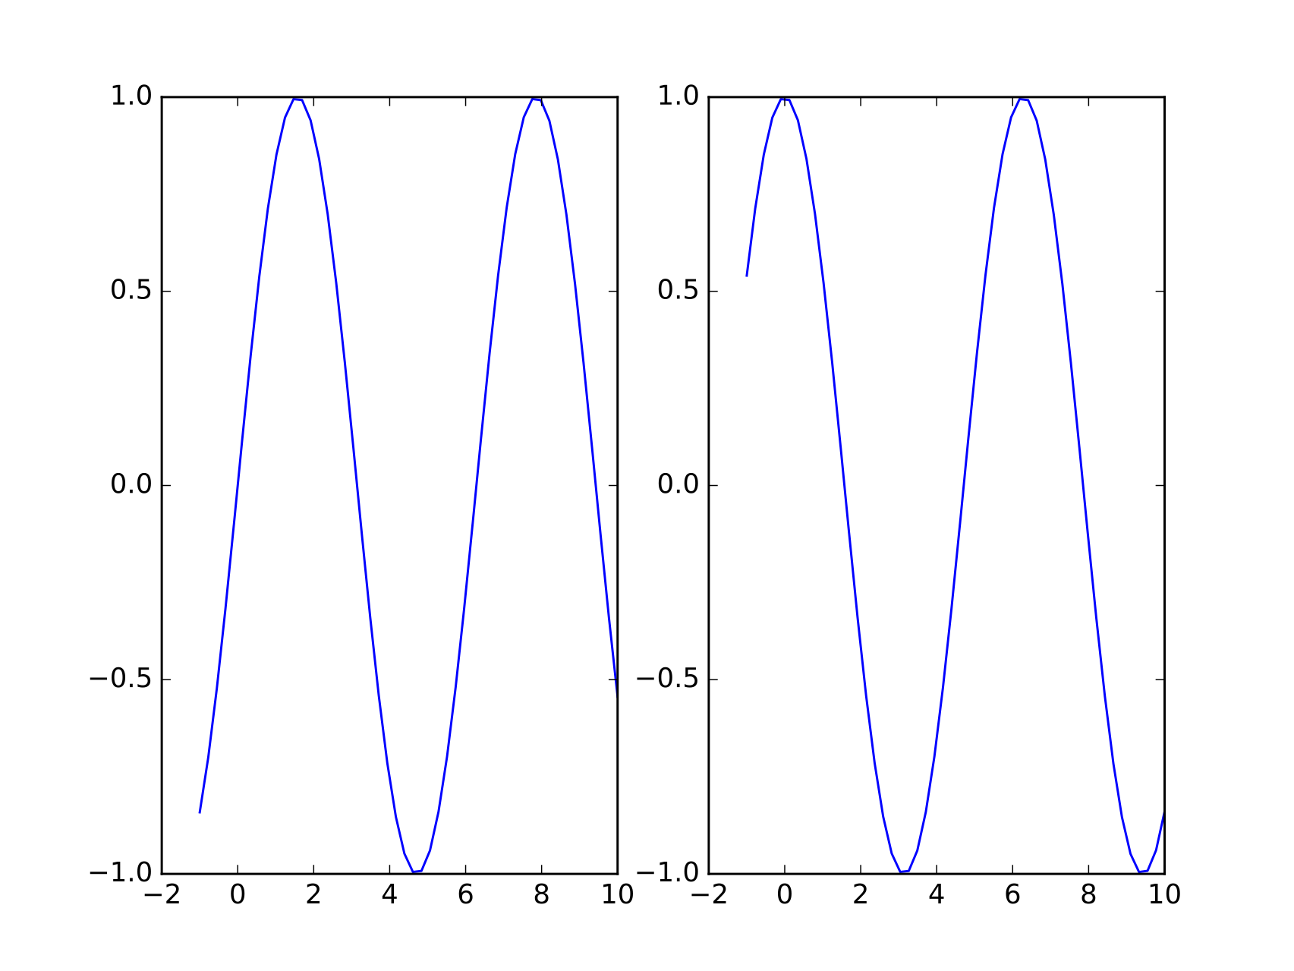
Fundamentals

Slide 29
Fundamentals
OO interface
Figure : single container with potentially many axes
Axes : bounding box with many elements
Axis, Tick, Line2D, Text, Polygon
fig, ax = plt.subplots(ncols=2)
ax[0].plot(x, np.sin(x))
ax[1].plot(x, np.cos(x))

Slide 30
Simple Line Plots
Define a Figure and an Axes object
Create an array of x values [0., 0.01, 0.02, 0.03, 0.04, … ]
Create an array of y values
plt.style.use('seaborn-whitegrid')
fig = plt.figure
ax = plt.axes()
x = np.linspace(0,10, 1000)
ax.plot(x, (x**2+1)/(x**2+x+1))

Slide 31
Simple Line Plots
Line colors
colors have
names,
abbreviations (rgbcmyk),
Grayscales between 0 and 1
Hexcodes (RRGGBB) between 00 and FF
RGB tuples with values between 0 and 1
HTML color names

Slide 32
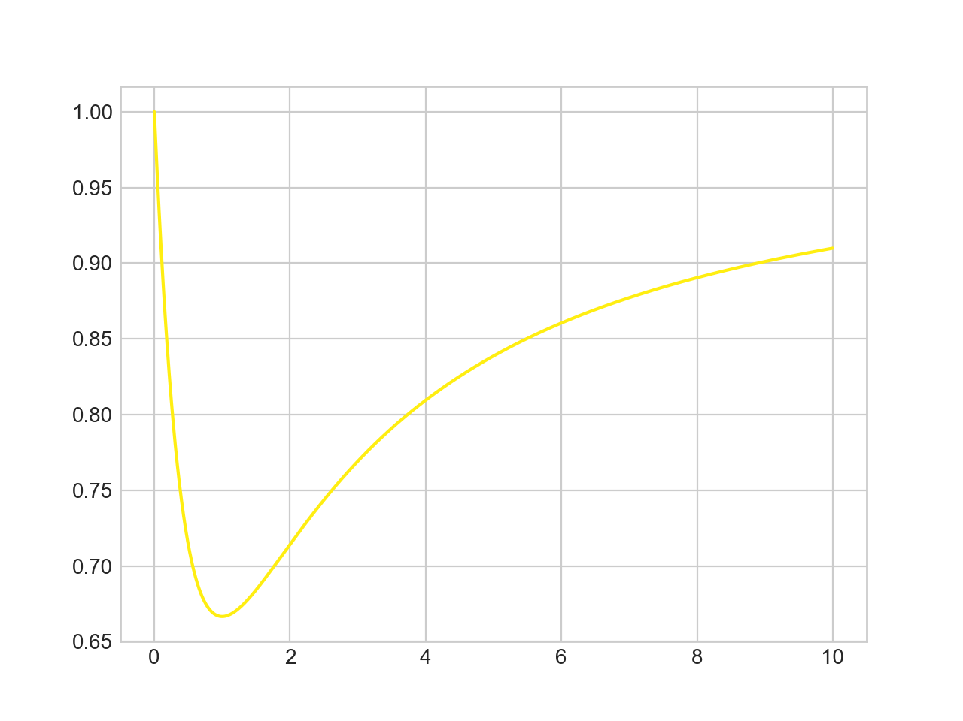
Simple Line Plots
x = np.linspace(0,10, 1001)
ax.plot(x, (x**2+1)/(x**2+x+1), color = '#FFEE11')

Slide 33
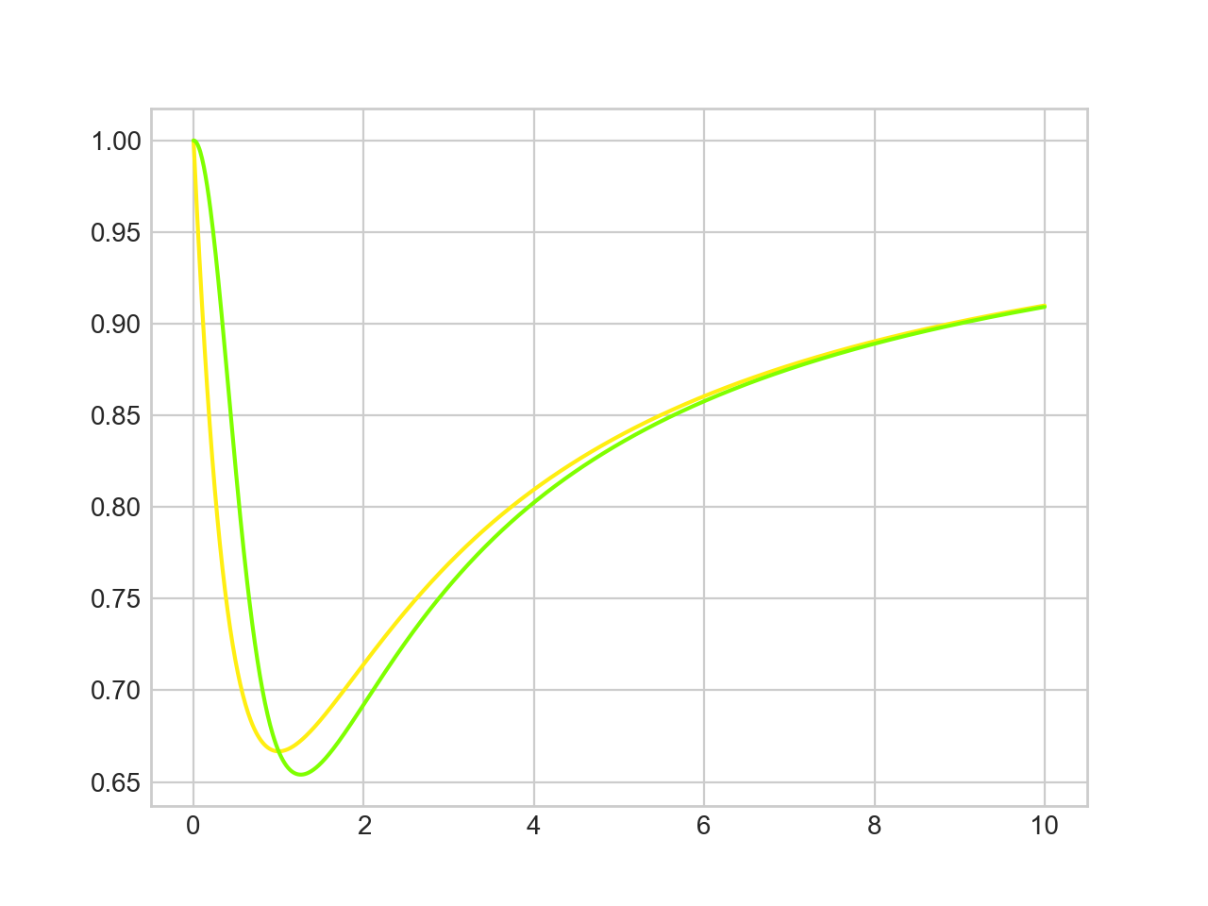
Simple Line Plots
x = np.linspace(0,10, 1001)
ax.plot(x, (x**2+1)/(x**2+x+1), color = '#FFEE11')
ax.plot(x, (x**3+1)/(x**3+x**2+1), color = 'chartreuse')

Slide 34
Simple Line Plots
Line Styles
'solid', 'dashed', 'dashdot' 'dotted'
Abbreviated as
'-', '- -', '-.', ':'

Slide 35
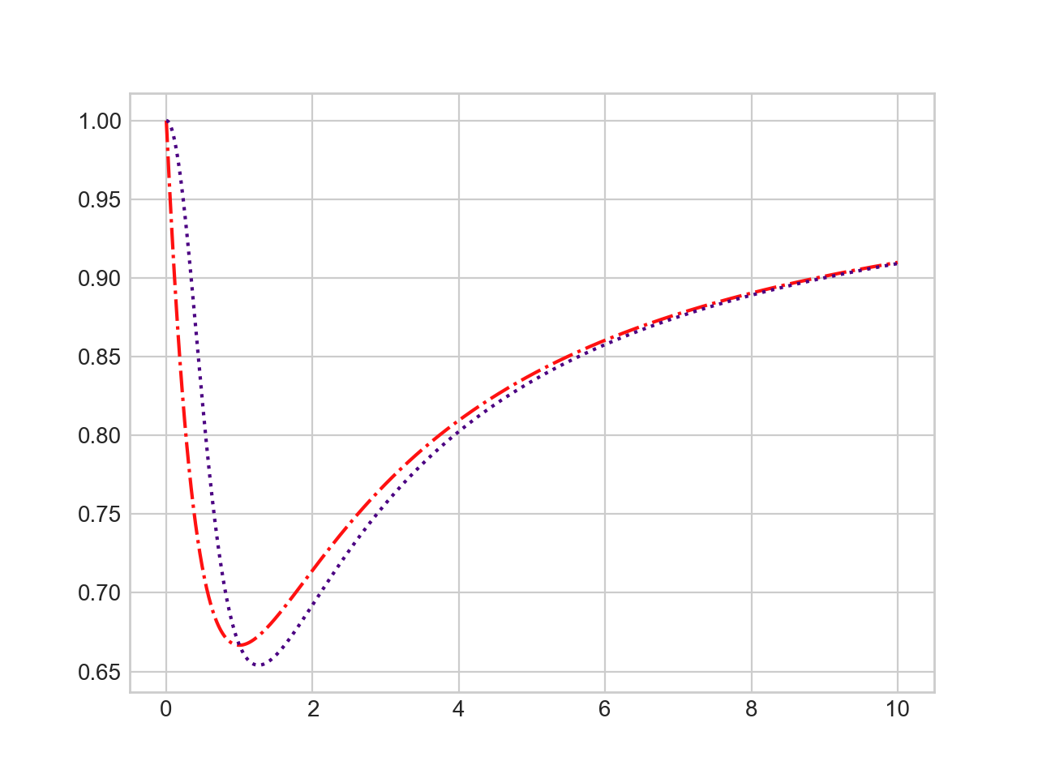
Simple Line Plots
ax.plot(x, (x**2+1)/(x**2+x+1), color = '#FF1111', linestyle='dashdot')
ax.plot(x, (x**3+1)/(x**3+x**2+1), color = 'indigo', linestyle = ':')

Slide 36
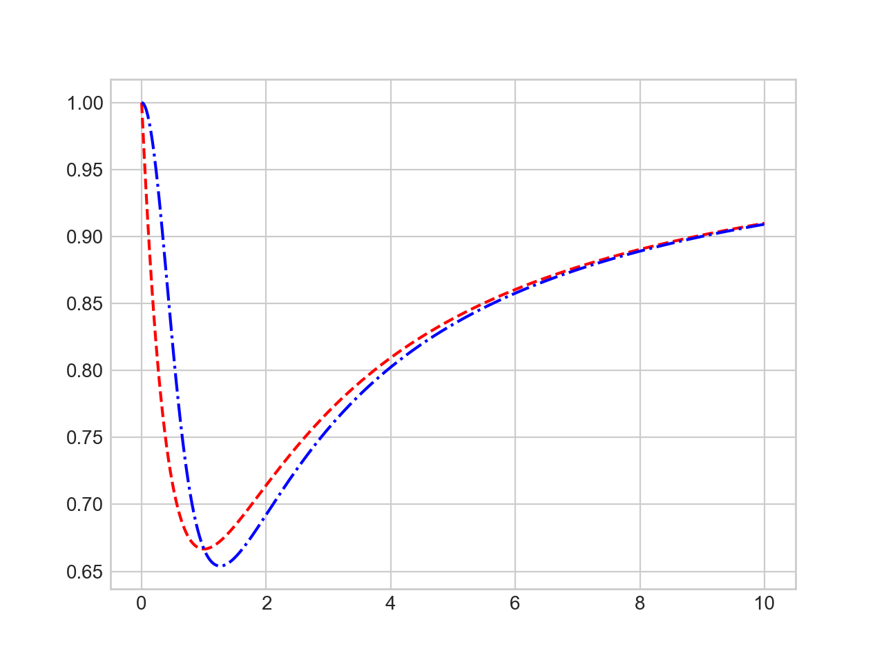
Simple Line Plots
These can also be combined
ax.plot(x, (x**2+1)/(x**2+x+1), 'r--')
ax.plot(x, (x**3+1)/(x**3+x**2+1), 'b-.')

Slide 37
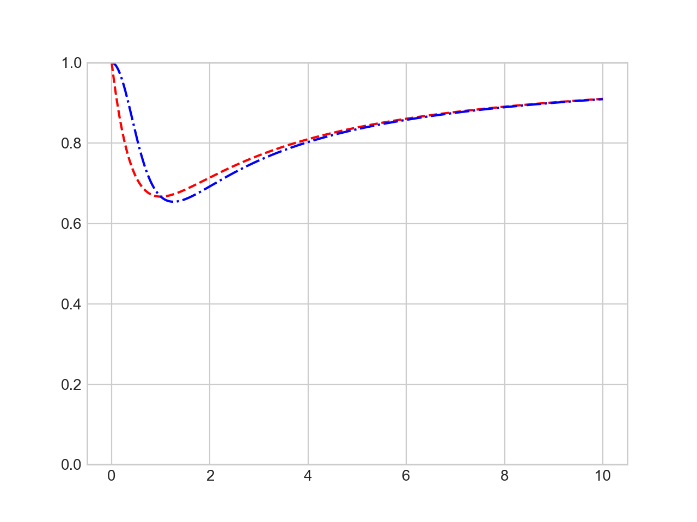
Simple Line Plots
Axes Limits for finer control
set xlim, ylim
plt.ylim(0,1)
ax.plot(x, (x**2+1)/(x**2+x+1), 'r--')
ax.plot(x, (x**3+1)/(x**3+x**2+1), 'b-.')

Slide 38
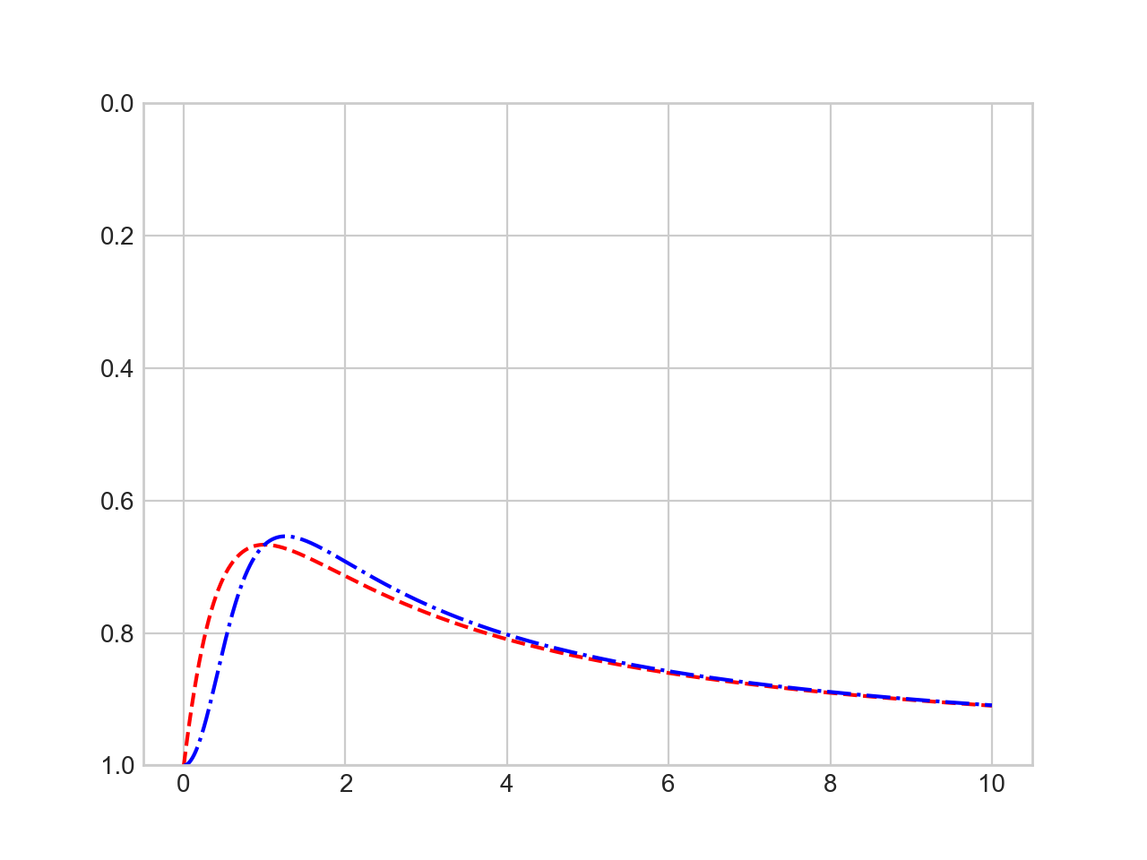
Simple Line Plots
You can even revert an axis
plt.ylim(1,0)
ax.plot(x, (x**2+1)/(x**2+x+1), 'r--')
ax.plot(x, (x**3+1)/(x**3+x**2+1), 'b-.')

Slide 39
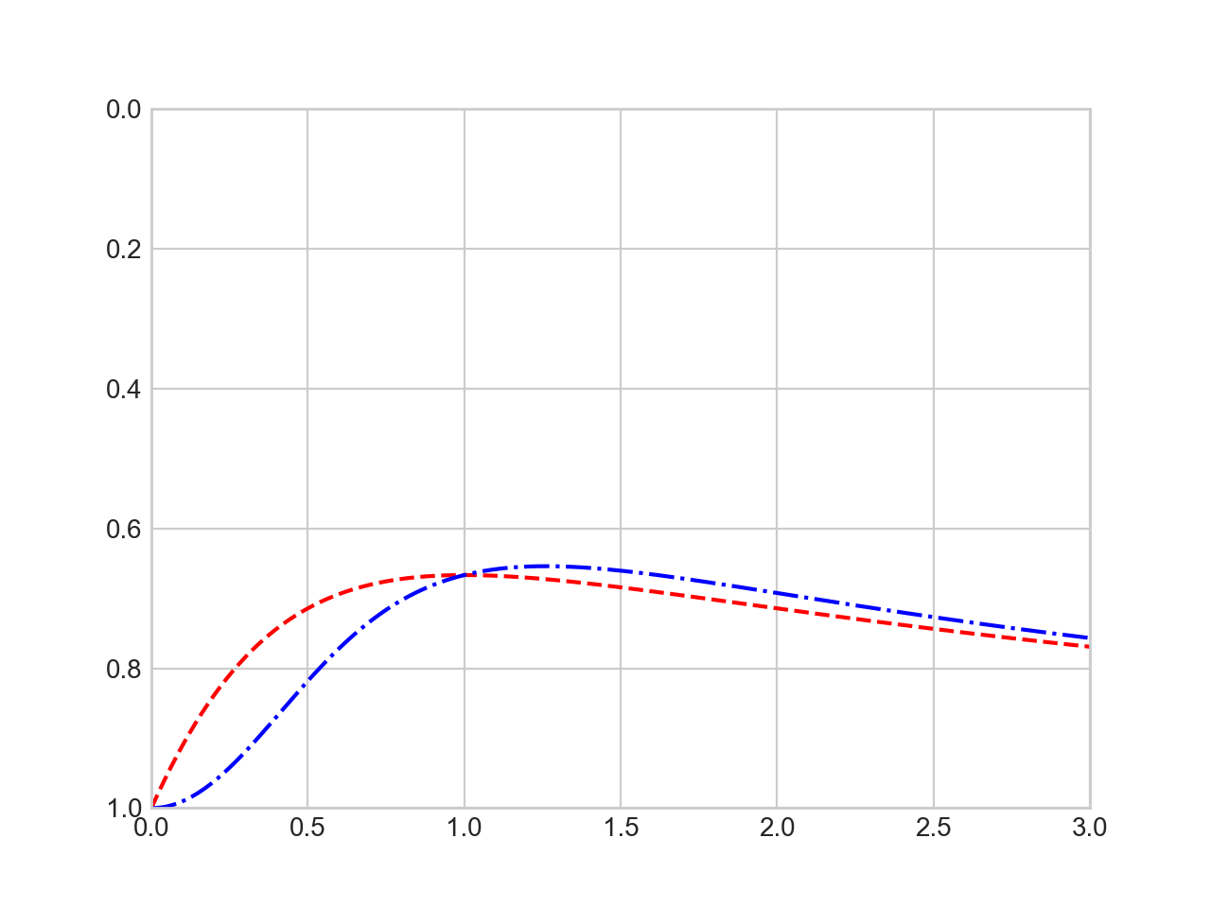
Simple Line Plots
You can set all axes with the confusingly named axis method
plt.axis([0,3,1,0])

Slide 40
Simple Line Plots
plt.axis actually allow even more plot control
'tight' to tighten bounds around current plot
''equal' for equal aspect ratio

Slide 41
Simple Line Plots
Plot axes can be labeled
fig = plt.figure
ax = plt.axes()
x = np.linspace(0,10, 1001)
plt.axis([0,3,0.5,1], 'tight')
plt.xlabel('t')
plt.ylabel('f(t)')
ax.plot(x, (x**2+1)/(x**2+x+1), 'r--')
ax.plot(x, (x**3+1)/(x**3+x**2+1), 'b-.')

Slide 42
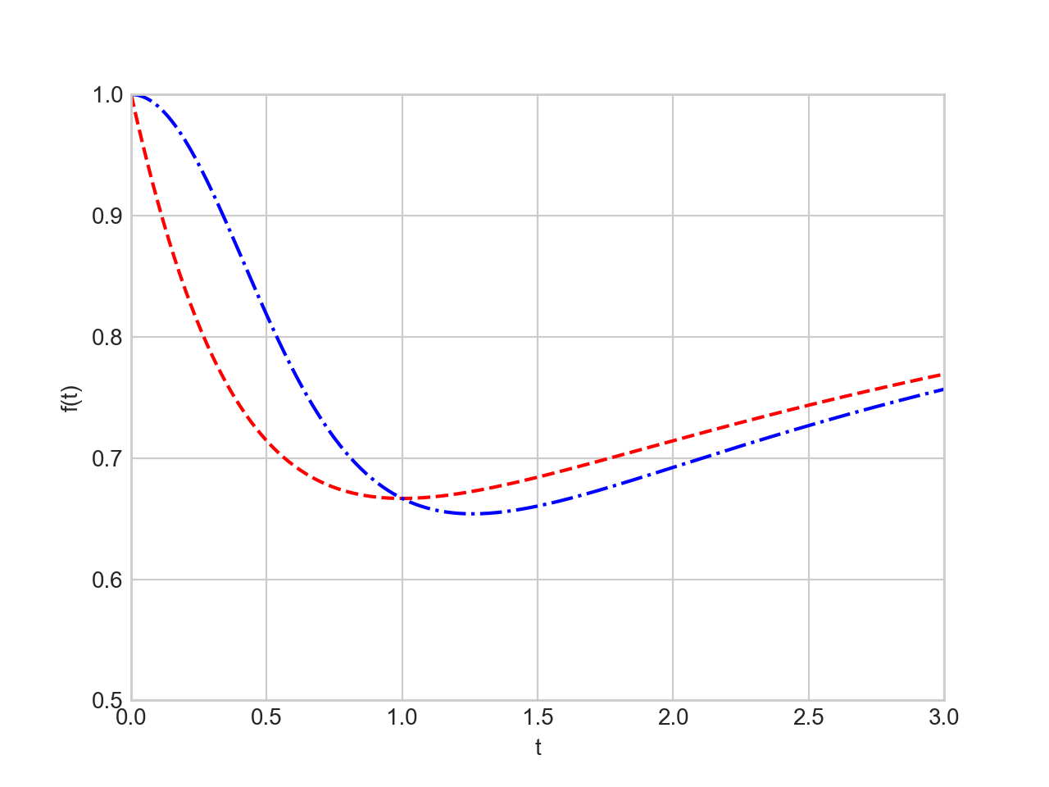
Simple Line Plots

Slide 43
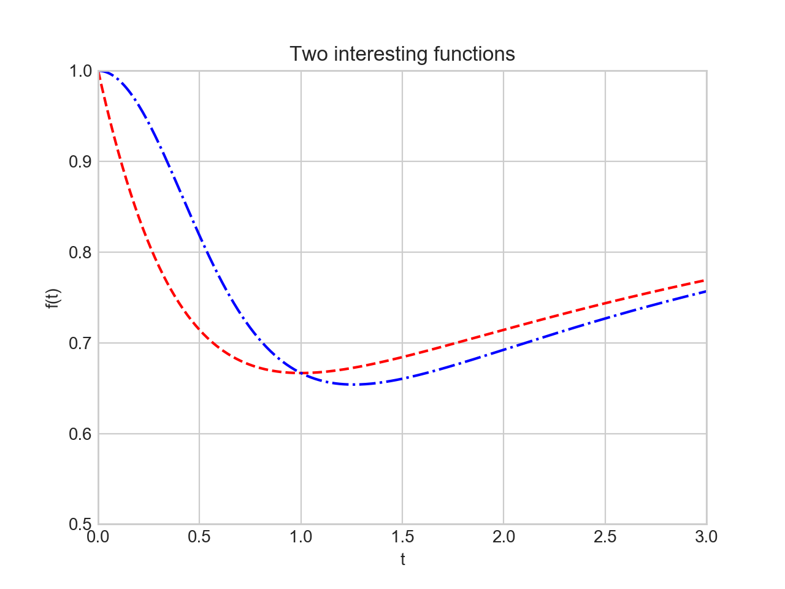
Simple Line Plots
We label a plot with plt.title

Slide 44
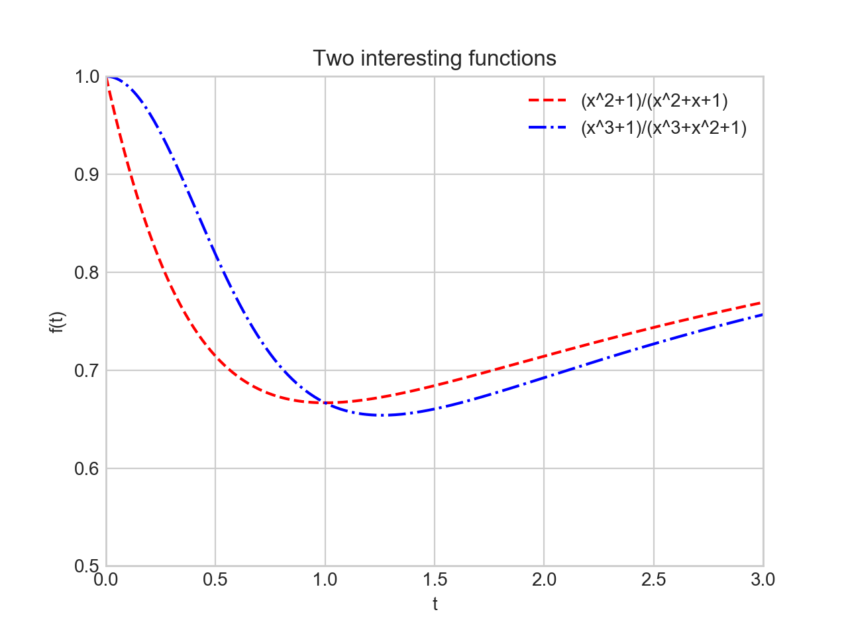
Simple Line Plots
And we can provide a legend
ax.plot(x, (x**2+1)/(x**2+x+1), 'r--', label='(x^2+1)/(x^2+x+1)')
ax.plot(x, (x**3+1)/(x**3+x**2+1), 'b-.', label='(x^3+1)/(x^3+x^2+1)')
plt.legend()

Slide 45
Simple Line Plots
OO translation:
plt.xlabel( ) —> ax.set_xlabel( )
plt.ylabel( ) —> ax.set_ylabel( )
plt.xlim( ) —> ax.set_xlim( )
plt.ylim( ) —> ax.set_ylim( )
plt.title( ) —> ax.set_title( )
or just use ax.set

Slide 46
Simple Line Plots
ax.plot(x, (x**2+1)/(x**2+x+1), 'r--', label='(x^2+1)/(x^2+x+1)')
ax.plot(x, (x**3+1)/(x**3+x**2+1), 'b-.', label='(x^3+1)/(x^3+x^2+1)')
ax.set(xlim=(0,1.5), ylim=(0.6, 1), xlabel='x', ylabel='f(y)',
title = 'Two functions')

Slide 47
Simple Line Plots

Slide 48
Simple Scatter Plots
plt.plot / ax.plot can also produce scatter plots
Just give it a marker
ax.plot(x, (x**2+1)/(x**2+x+1), 'o', color = 'black', label='(x^2+1)/(x^2+x+1)')
ax.plot(x, (x**3+1)/(x**3+x**2+1), 'x', color = 'red', label='(x^3+1)/(x^3+x^2+1)')
ax.set(xlim=(0,1.5), ylim=(0.6, 1), xlabel='x', ylabel='f(y)', title = 'Two functions')
ax.legend()

Slide 49
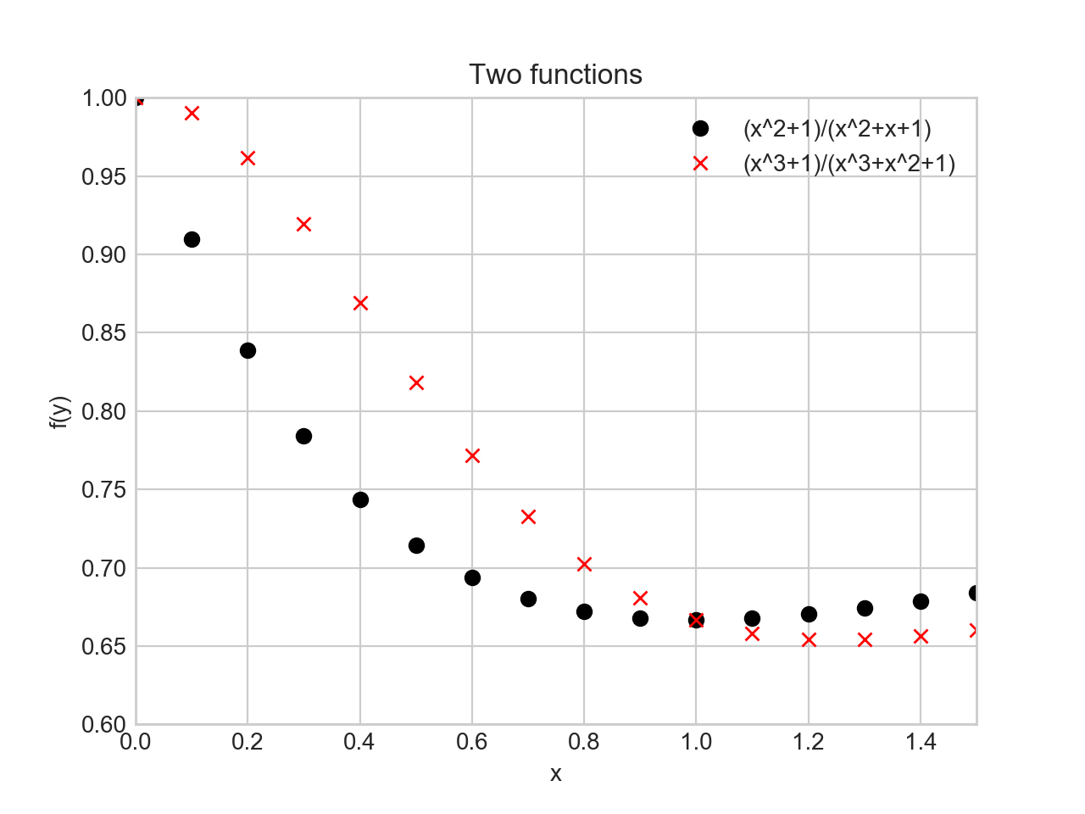
Simple Scatter Plots

Slide 50
Simple Scatter Plots
Additional argument represent the symbol
'o', '.', 'x', '+', 'v', '^', '<', '>',
's' square
'd' diamond

Slide 51
Simple Scatter Plots
More powerful: Use plt.scatter
Can control many more aspects
Example:
Create 100 random pairs of x, y
Create random colors (between 0 and 1)
Create random sizes (between 0 and 1000)
Set alpha = 0.3 in order to make things transparent

Slide 52
Simple Scatter Plots
np.random.seed(250620)
x = np.random.randn(100)
y = np.random.randn(100)
colors = np.random.rand(100)
sizes = 1000 * np.random.rand(100)
plt.scatter(x, y, c=colors, s=sizes, alpha = 0.3,
cmap = 'viridis')
plt.colorbar() # show color scale
plt.show()

Slide 53
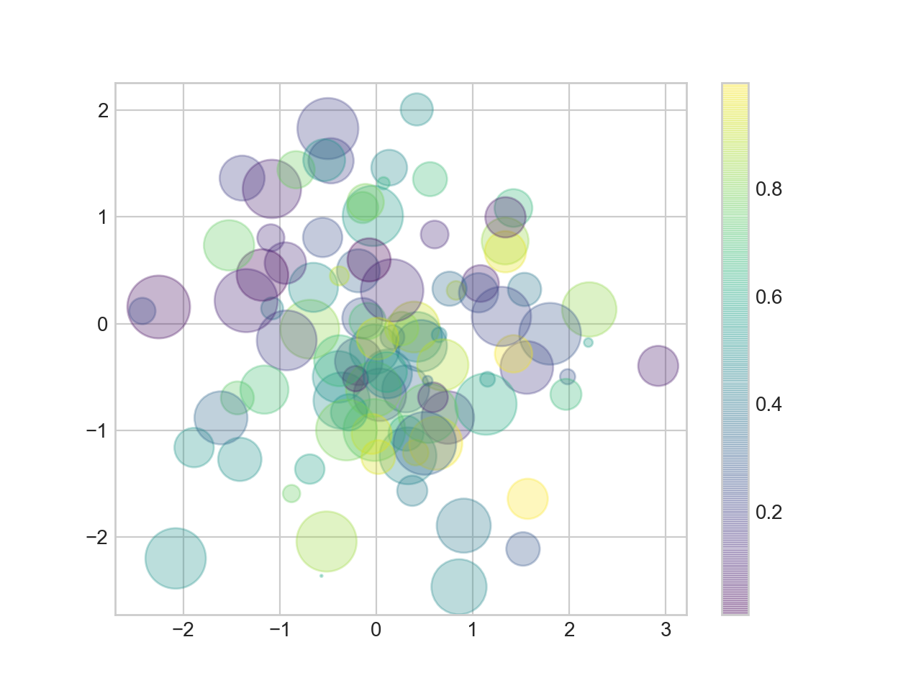
Simple Scatter Plots

Slide 54
Simple Scatter Plots
Example: Iris data set (from sklearn.datasets)
from sklearn.datasets import load_iris
iris = load_iris()
features = iris.data.T #need to transpose
plt.scatter(features[2], features[3], alpha = 0.6,
c=iris.target, cmap = 'prism')
plt.xlabel(iris.feature_names[2])
plt.ylabel(iris.feature_names[3])
plt.show()

Slide 55
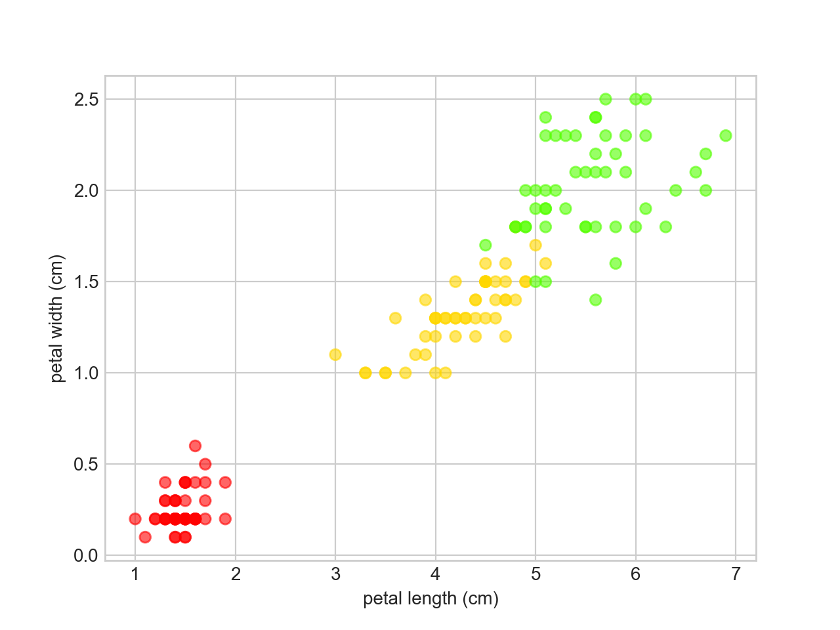
Simple Scatter Plots

Slide 56
Simple Scatter Plots
As datasets get larger, plot becomes more efficient than scatter

Slide 57
Error Bars
it's not science if there is no statistics
it's not statistics if there are no errorbars
When you have a data set, you should also have a confidence interval
This is displayed by an error bar
Use plt.errorbar with
x-values
y-values
confidence interval size
format code to control appearances (same as for lines and colors)

Slide 58
Error Bars
Example:
Use a simple function
Use random.normal in order to generate y-values centered around the random function
Then draw error bars with $2σ±y$

Slide 59
Error Bars
x = np.linspace(0,10,51)
y = np.random.normal(loc = x**2/10+x-1 , scale = 2+x/10)
plt.errorbar(x,y, yerr=2*(2+x/10), fmt='.k')
plt.plot(x, x**2/10+x-1, 'r-')
plt.show()

Slide 60
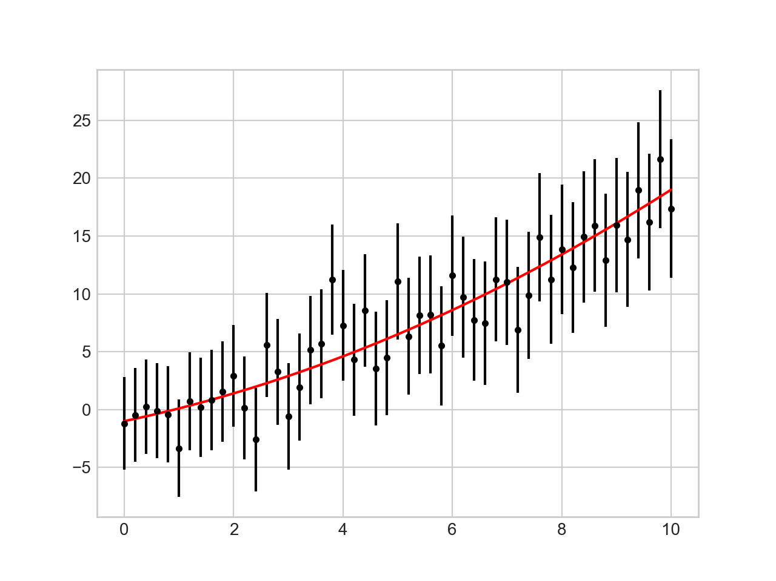
Error Bars

Slide 61
Error Bars
Continuous errors
No real support in matplotlib
Can make it ourselves with filling between curves
x = np.linspace(0,10,101)
y = np.random.normal(loc = x**2/10+x-1 , scale = 2+x/10)
plt.plot(x,y, 'x')
plt.plot(x, x**2/10+x-1, 'r-')
plt.fill_between(x, x**2/10+x-1-2*(2+x/10), x**2/10+2*(x-1+2+x/10), color = 'gray', alpha=0.2)
plt.show()

Slide 62
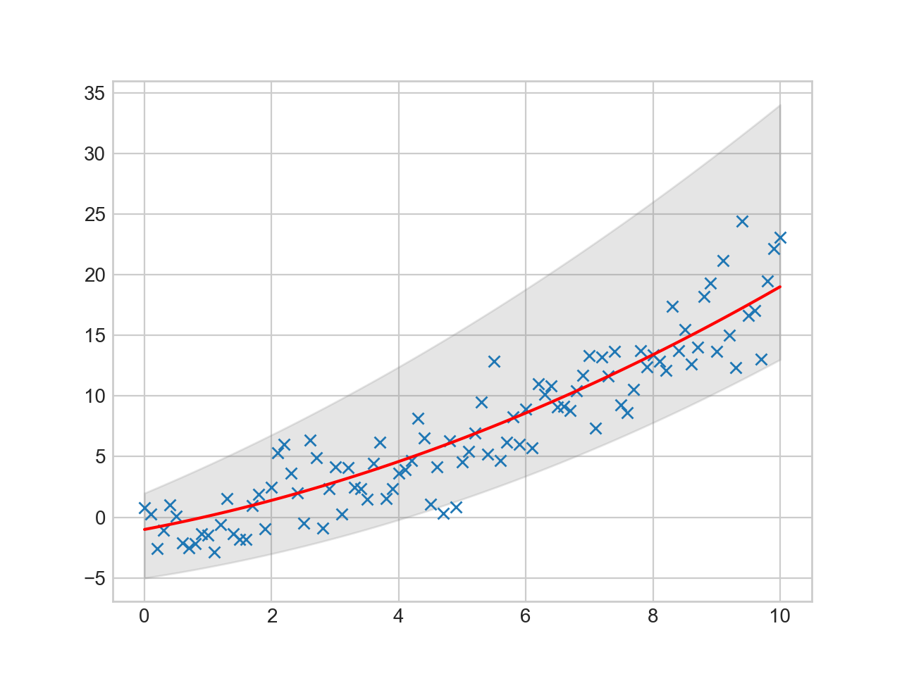
Error Bars

Slide 63
Contour / Density Plots
As an example, use the following function
def f(x,y):
return np.sin(x)**10+np.cos(10+y*x)*np.cos(x)

Slide 64
Contour / Density Plots
Contour plot
Need to create a grid
Easiest with meshgrid
x = np.linspace(-5,5,101)
y = np.linspace(-5,5,101)
X,Y = np.meshgrid(x,y)
Z = f(X,Y)

Slide 65
Contour / Density Plots
>>> X
array([[-5. , -4.9, -4.8, ..., 4.8, 4.9, 5. ],
[-5. , -4.9, -4.8, ..., 4.8, 4.9, 5. ],
[-5. , -4.9, -4.8, ..., 4.8, 4.9, 5. ],
...,
[-5. , -4.9, -4.8, ..., 4.8, 4.9, 5. ],
[-5. , -4.9, -4.8, ..., 4.8, 4.9, 5. ],
[-5. , -4.9, -4.8, ..., 4.8, 4.9, 5. ]])
>>> Y
array([[-5. , -5. , -5. , ..., -5. , -5. , -5. ],
[-4.9, -4.9, -4.9, ..., -4.9, -4.9, -4.9],
[-4.8, -4.8, -4.8, ..., -4.8, -4.8, -4.8],
...,
[ 4.8, 4.8, 4.8, ..., 4.8, 4.8, 4.8],
[ 4.9, 4.9, 4.9, ..., 4.9, 4.9, 4.9],
[ 5. , 5. , 5. , ..., 5. , 5. , 5. ]])

Slide 66
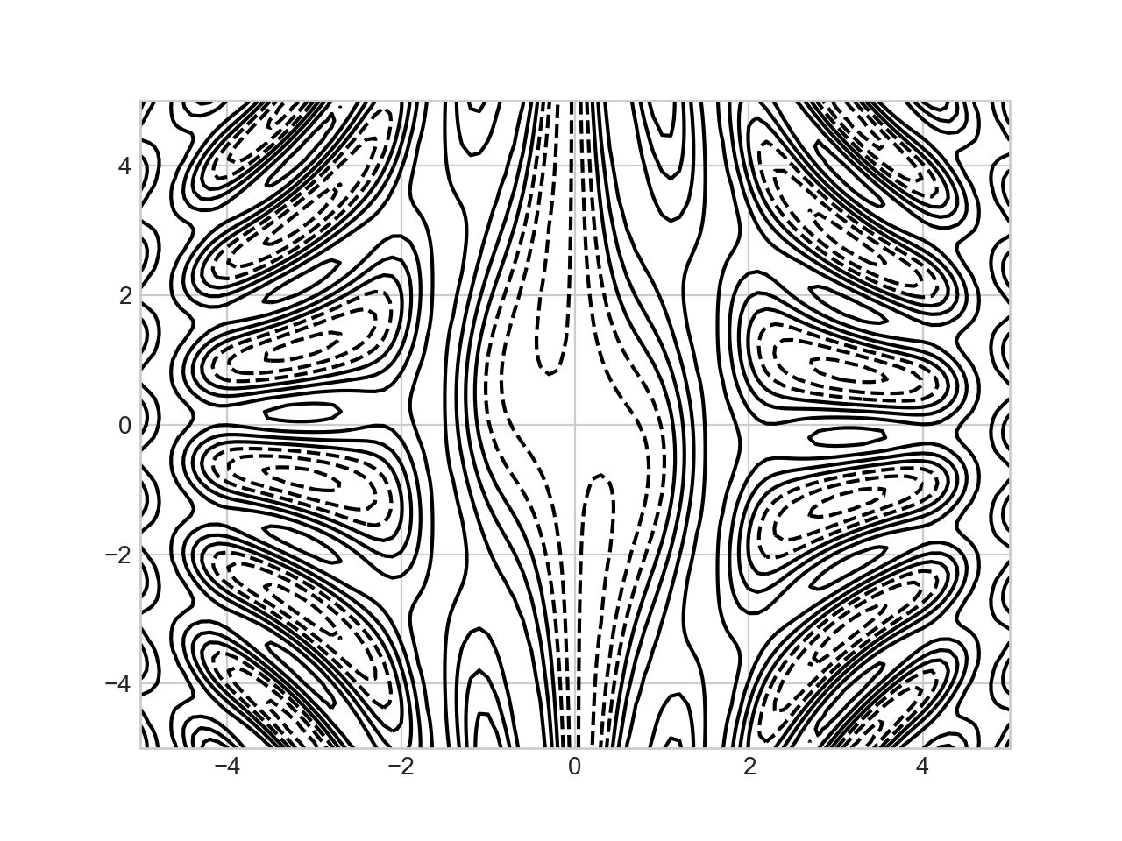
Contour / Density Plots
Simple contour plot: dashed lines stand for neg. values
plt.contour(X,Y,Z, colors='black')

Slide 67
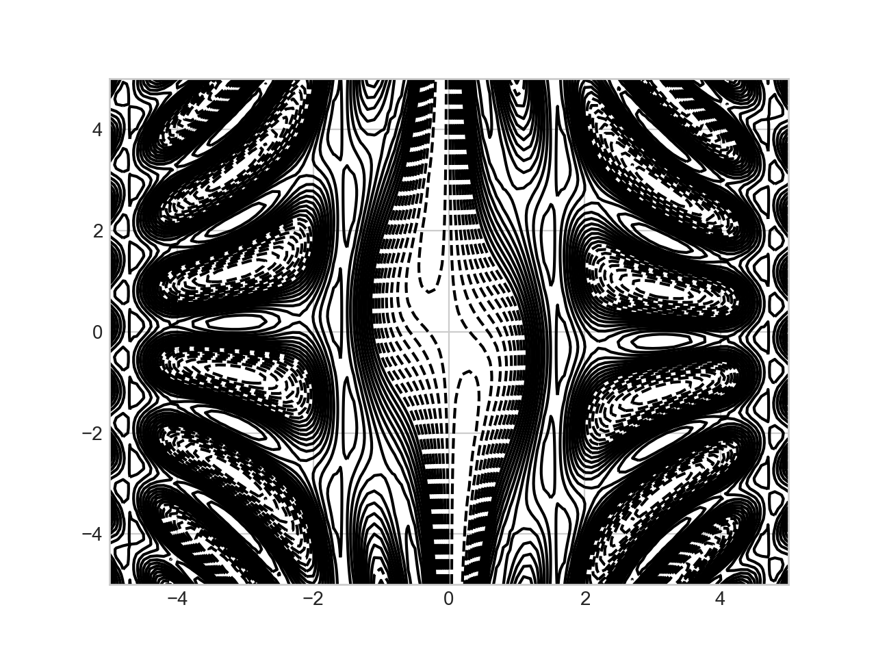
Contour / Density Plots
Can specify the number of contour lines
plt.contour(X,Y,Z, 20, colors='black')

Slide 68
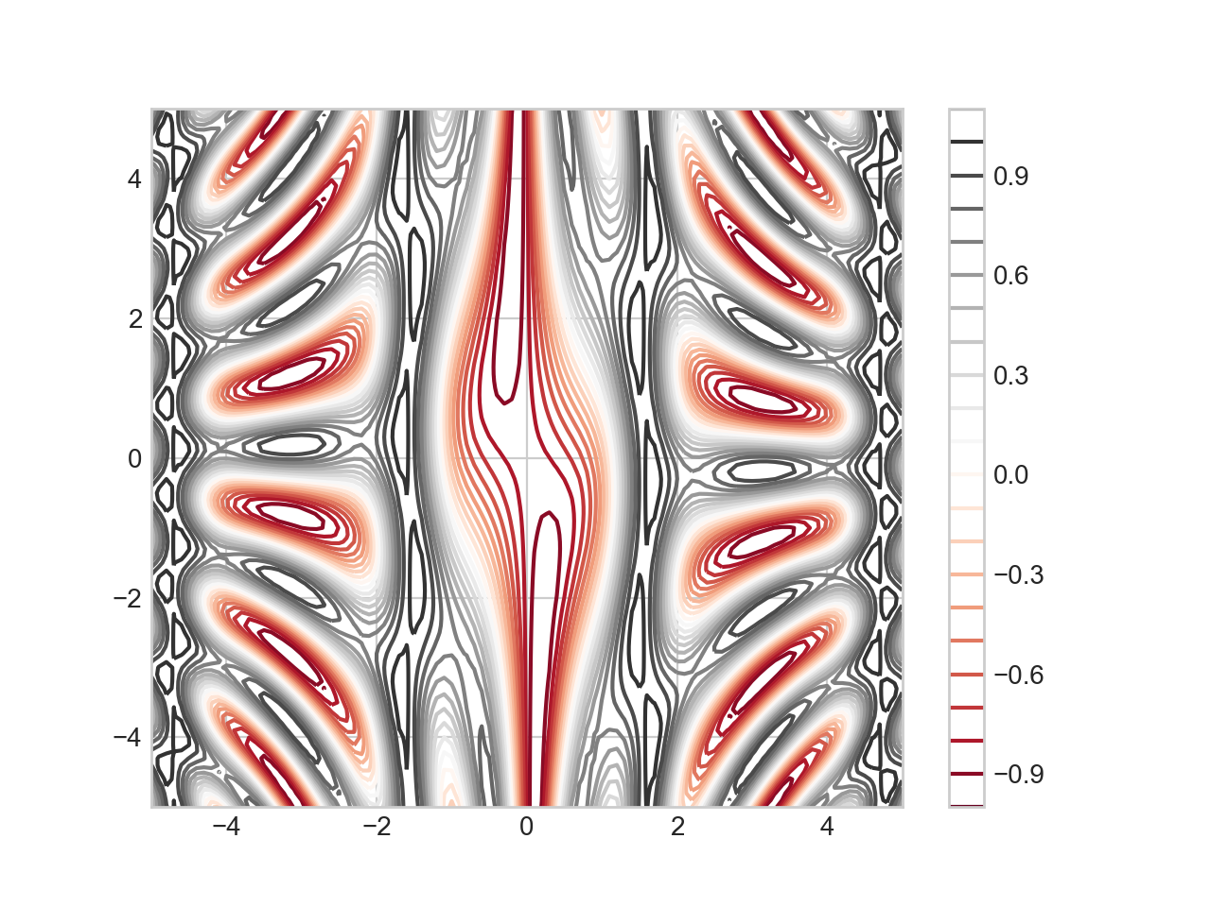
Contour / Density Plots
Can use a color map
plt.contour(X,Y,Z, 20, cmap = 'RdGy')
plt.colorbar()

