Slide 1
Sudoku Problem
Thomas Schwarz, SJ

Slide 2
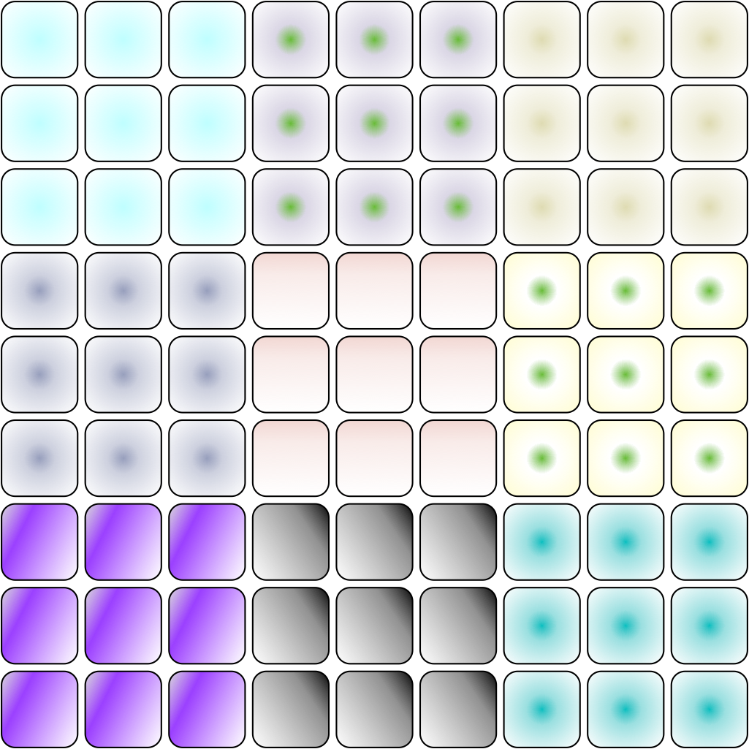
Sudoku
$81=9×9$ squares
Filled with numbers from 1 to 9
All numbers from 1 to 9 need to make up:
Each of nine rows
Each of nine columns
Each of nine "houses"
A $3×3$ sub-block

Slide 3
Sudoku
Task:
Write a valid Sudoku test for a $9×9$ integer array in numpy

Slide 4
Checking for Equality
We want to check whether a row has exactly the same elements as np.arange(1,10)

Slide 5
Checking for Equality
To check whether two arrays are equal
Use np.array_equal to check whether two arrays are equal
Checks whether shape is the same and whether all elements in the same position are equal
np.array_equal(np.array([1,2,3,4]), np.array([3,2,1,4])) is False
Because they are different as array but not as sets

Slide 6
Checking for Equality
This type of equality is of arrays,
but not of sets
To check whether one array is a permutation of another:
Use numpy operations
Build something ourselves

Slide 7
Checking for Equality
Can use set operations in numpy
in1d(array1, array2) tests whether each element in the first array is also in the second
intersect1d(array1, array2): intersection of the arrays
setdiff1d(array1, array2): find the set difference
Those in array1 that are not in array2
setxor1d(array1, array2): symmetric difference of the arrays
union1d(array1, array2): union, not concatenation of the two arrays

Slide 8
Checking for Equality
isin(element, array):
Checks whether element is in the array
This is useful
But be careful about broadcasting and flattening
np.isin(np.arange(1,6), test)
just returns [True, True, True, True, True] as the test array gets flattened and the function is applied on the first parameter
test=np.array([
[1,2,4,5,3],
[4,4,3,1,5],
[1,4,3,2,5],
[1,2,5,0,2],
[1,1,2,3,5]
])

Slide 9
Checking for Equality
isin(element, array):
We can combine the results of isin by using np.all or np.any
np.all(array) returns True if all elements of the array are true
np.any(array) returns True if at least one element of the array is true

Slide 10
Checking for Equality
We now can test whether an array of nine numbers is a permutation of {1,2,3,4,5,6,7,8,9}
Assume that we know beforehand that the array has nine members
Then if all of 1, 2, 3, …, 9 are in the array, the array is a permuation

Slide 11
Checking for Equality
We need to combine
Cardinality
IsIn
All
def check_perm(array):
return np.all(np.isin(np.arange(1,10), array)) and len(array)==9

Slide 12
Numpy Array Indexing
Repetition
Array indexing is vital, but the many possibilities in numpy are confusing
So, let's look at them again

Slide 13
Numpy Indexing
First, generate a simple array made into a $3×3$ matrix
>>> mat = np.arange(1,10)
>>> mat = np.reshape(mat,(3,3))
>>> print(mat)
array([[1, 2, 3],
[4, 5, 6],
[7, 8, 9]])

Slide 14
Numpy Indexing
The simplest indexing is direct, python-style
We can also address with tuples
In fact, mat[0,2] is internally converted into mat.__getitem__((0,2))
>>> mat[0,2]
3
>>> mat[(0,2)]
3

Slide 15
Numpy Indexing
Tuple addressing is in fact more "natural"
>>> for i in np.ndindex(mat.shape):
print (i, mat[i])
(0, 0) 1
(0, 1) 2
(0, 2) 3
(1, 0) 4
(1, 1) 5
(1, 2) 6
(2, 0) 7
(2, 1) 8
(2, 2) 9

Slide 16
Numpy Indexing
Remember zip(*iterable) to aggregate a tuple?
We can use np.where with a single argument, a condition, to find the elements in an array that satisfy the condition
np.where returns a list of indices where the condition is true
We then convert the list into tuples
>>> list(zip(*np.where(mat%2==0)))
[(0, 1), (1, 0), (1, 2), (2, 1)]

Slide 17
Numpy Slicing
Normal slicing works as in Python
With the important difference
Slices are not copies
If you need copies, then use the copy( ) method
>>> A = mat.copy()
>>> print(A)
[[1 2 3]
[4 5 6]
[7 8 9]]

Slide 18
Numpy Slicing
Slice actually constructs slice objects
You can apply them to all arrays (of the correct shape)
>>> s = slice(1,None, 2)
>>> print(s)
slice(1, None, 2)
>>> arr = np.arange(1,10)
>>> arr
array([1, 2, 3, 4, 5, 6, 7, 8, 9])
>>> arr[s]
array([2, 4, 6, 8])

Slide 19
Numpy Slicing
Slices have up to three components:
Start (default 0 or -1)
Stop (default 0 or -1)
Step (default 1)
For multidimensional arrays, can slice in each dimension
First part is rows
Second part is columns
etc

Slide 20
Numpy Slicing
Examples:
Inverting rows: use first dimension
>>> A
array([[1, 2, 3],
[4, 5, 6],
[7, 8, 9]])
>>> A[::-1,:]
array([[7, 8, 9],
[4, 5, 6],
[1, 2, 3]])

Slide 21
Numpy Slicing
Examples:
Invert columns: Use second dimension
>>> A[:,::-1]
array([[3, 2, 1],
[6, 5, 4],
[9, 8, 7]])

Slide 22
Numpy Slicing
Examples: Get the first three rows of the first two columns
>>> B = np.arange(1,21)
>>> B = np.reshape(B,(4,5))
>>> print(B)
[[ 1 2 3 4 5]
[ 6 7 8 9 10]
[11 12 13 14 15]
[16 17 18 19 20]]
>>> B[0:3,0:2]
array([[ 1, 2],
[ 6, 7],
[11, 12]])

Slide 23
Numpy Slicing
If you specify a slice that has only one element, the dimension does not vanish
The slice is still a two-dimensional array
Count the brackets
It just happens to have one row and one column
>>> B[1:2,3:4]
array([[9]])

Slide 24
Numpy Slicing
Ellipsis
As a short-cut, we can use the ellipsis, consisting of three dots
…
Consists of as many colons as needed : :
But usually, we can only use one to avoid ambiguity
>>> B[...,2:4]
array([[ 3, 4],
[ 8, 9],
[13, 14],
[18, 19]])

Slide 25
Numpy Slicing
If you do not provide enough information for each dimension, an ellipsis will be provided

Slide 26
Fancy Indexing
Sometimes, slices are not enough
Then we can use fancy indexing
Example: Create a random two-dimensional array
>>> X = 10*numpy.random.rand(5,4)-5
>>> X
array([[ 1.23489451, 1.22443527, 3.35876328, 2.72987117],
[-1.32420494, 4.14354623, -3.09531196, 4.97524407],
[-4.43644932, 4.7533215 , -1.14004859, -4.32039428],
[ 2.05397116, -1.05290493, -3.20528586, -4.5549263 ],
[ 3.62748115, 0.53619237, 2.48564965, 1.34442926]])

Slide 27
Fancy Indexing
Let's square the negative entries
Need to change X
>>> X[X<0] **= 2
>>> X
array([[ 1.23489451, 1.22443527, 3.35876328, 2.72987117],
[ 1.75351872, 4.14354623, 9.58095613, 4.97524407],
[19.68208255, 4.7533215 , 1.29971079, 18.66580675],
[ 2.05397116, 1.1086088 , 10.27385742, 20.74735363],
[ 3.62748115, 0.53619237, 2.48564965, 1.34442926]])

Slide 28
Numpy Slicing
You can always use slices to assign to numpy arrays
This is different then for Python
QUIZ:
Create an array from 1 to 20.
Change this to a 5 by 4 array
Change the second row to negatives

Slide 29
Numpy Slicing
Answer:
>>> import numpy as np
>>> x = np.reshape(np.arange(1,21),(5,4))
>>> x
array([[ 1, 2, 3, 4],
[ 5, 6, 7, 8],
[ 9, 10, 11, 12],
[13, 14, 15, 16],
[17, 18, 19, 20]])
>>> x[1]
array([5, 6, 7, 8])
>>> x[1,...]=-x[1,...]
>>> x
array([[ 1, 2, 3, 4],
[-5, -6, -7, -8],
[ 9, 10, 11, 12],
[13, 14, 15, 16],
[17, 18, 19, 20]])

Slide 30
Numpy Slicing
QUIZ:
No change the second row by squaring
>>> x[...,1]=x[...,1]**2
>>> x
array([[ 1, 4, 3, 4],
[ -5, 36, -7, -8],
[ 9, 100, 11, 12],
[ 13, 196, 15, 16],
[ 17, 324, 19, 20]])

Slide 31
Sudoku Task
Now we have all the ingredients for you to write a program that checks the Sudoku:
You can check whether an array is a permutation of 1 … 9
You can extract rows
You can extract columns
You can extract houses (sub-squares)
And you can combine checks with np.all

